Slide 1
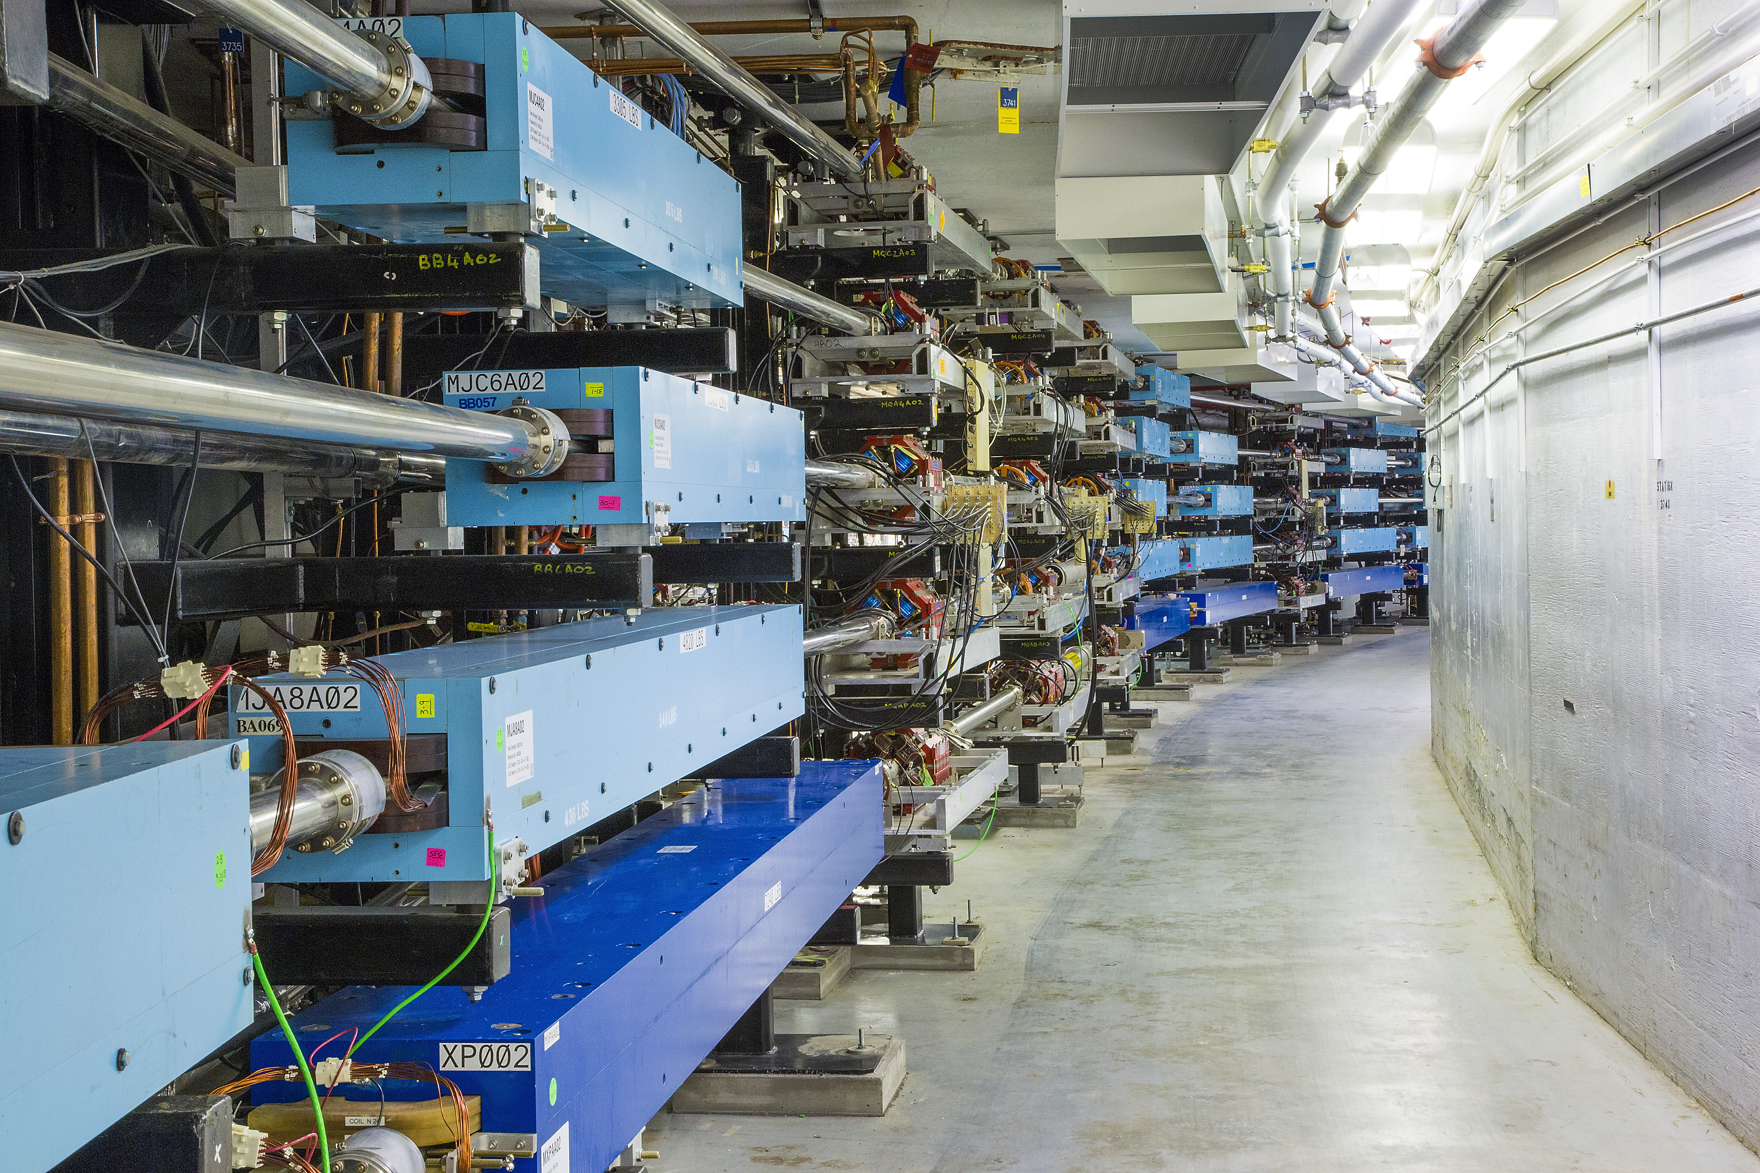
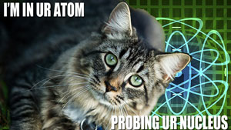
Nuclear Partons at Large x: The EMC Effect
Light Ion Physics in the EIC Era
Dave Gaskell
Jefferson Lab
June 26-27, 2025

Slide 2
Describing the Strong Force
1935 – Hideki Yukawa proposed a theory of the strong force between nucleons involving exchange of (as yet) unknown particles → pions
N
π
N
Modern descriptions of interactions between nucleons are still based on this fundamental idea, but with many refinements
Multiple pion exchange
Include other exchange particles
3-body forces

Slide 3
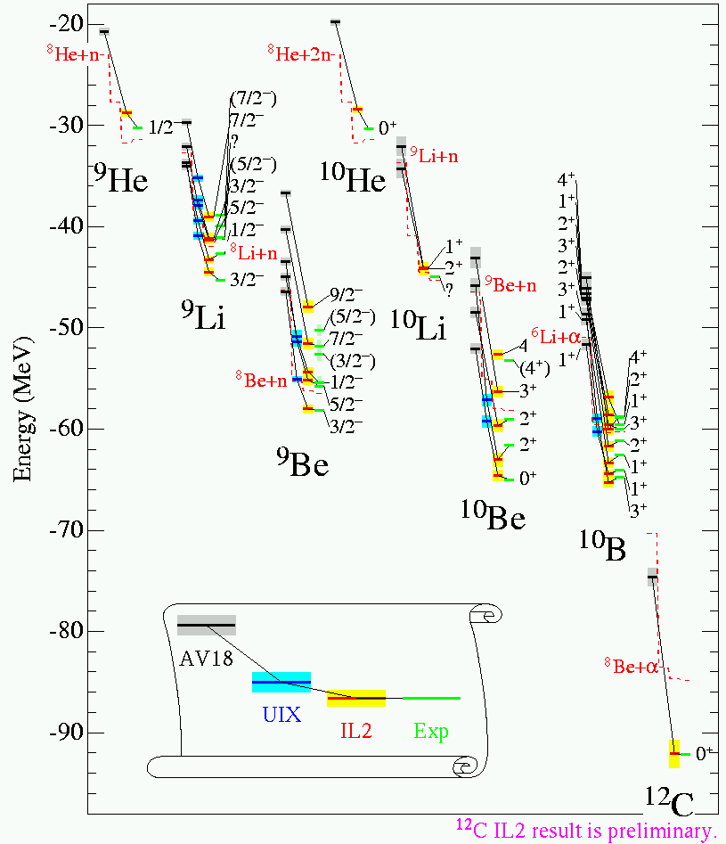
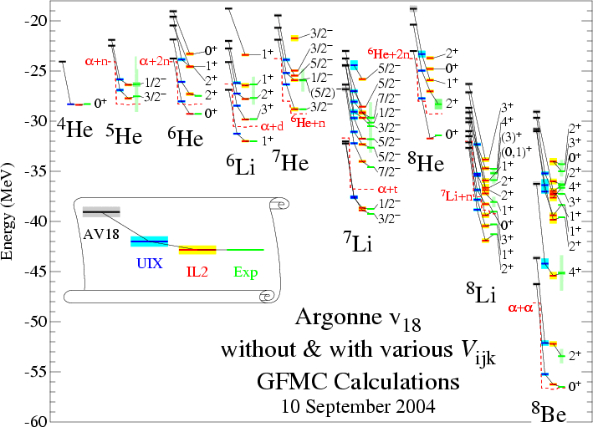
Example: Argonne v18 Potential
Starting from this “effective” model of interactions between protons and neutrons – one can build up any nucleus we want → (only limited by computing power)

Slide 4
Strong Interactions – QCD
These days, we know the fundamental degrees of freedom are quarks and gluons
Interactions between quarks and gluons, are governed by Quantum Chromodynamics
Nucleon-nucleon interactions governed by the part of the quark-gluon interactions that “spill over outside the nucleon
Unlike gravity and electromagnetism, interactions get stronger as particles get further apart → confinement
3 important points about QCD
  It cannot be solved “exactly”
  It can be solved approximately but only at very large energies (small distances)
  It can also be solved numerically with a lot of computing power (Lattice QCD)

Slide 5
Meson exchange vs. QCD
Why is the effective theory of the interactions between nucleons (meson exchange) so successful?
→ Likely related to fundamental quantum mechanics → physics phenomena can be described by multiple, complete basis states
Σ_{hadrons}
Σ_{quarks+gluons}
=
In many situations one basis is more convenient than the other
→ Is there such a situation for quarks in nuclei?

Slide 6
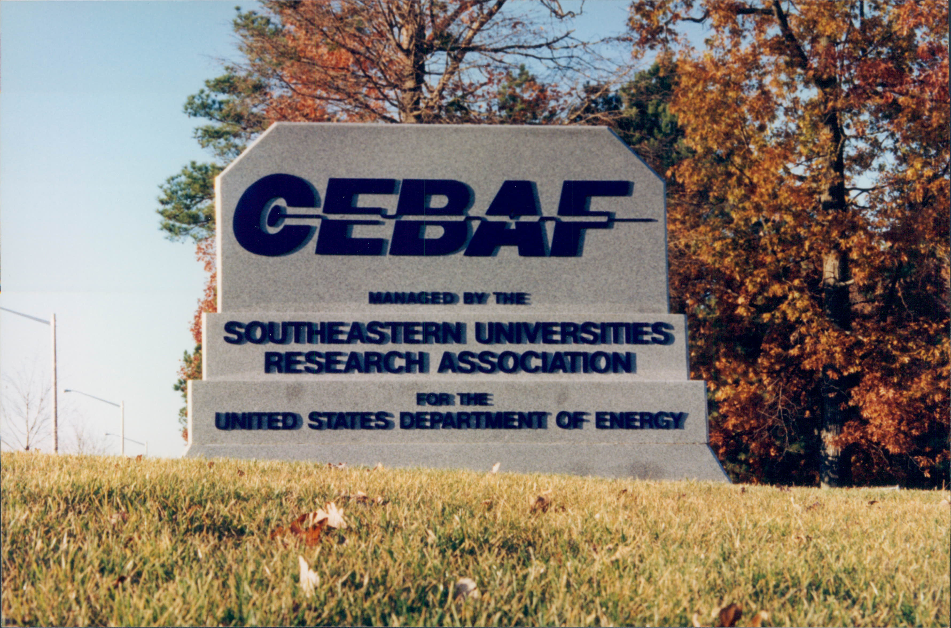
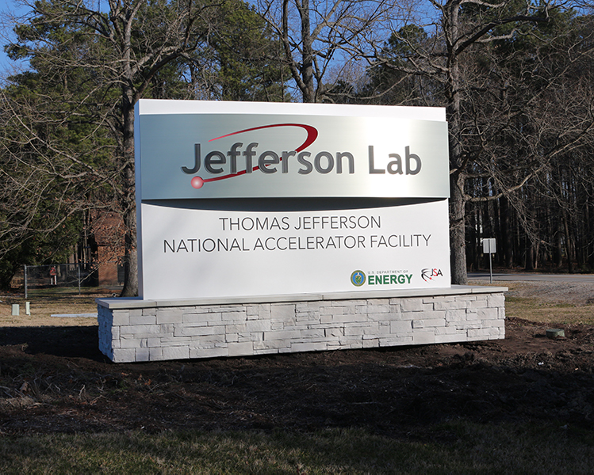
CEBAF’s Original Mission Statement
Key Mission and Principal Focus (1987):
  The study of the largely unexplored transition between the nucleon-meson and the quark-gluon descriptions of nuclear matter.
The Role of Quarks in Nuclear Physics
We can describe nuclei, for the most part, just using protons, neutrons, and other exchange particles: does there come a point at which we must describe in terms of quarks and gluons?
  If not, why not?

Slide 7
Related Topics
Do individual nucleons change their size, shape, and quark structure in the nuclear medium?
How do quarks and gluons come together to determine the structure of the proton?
  What is the distribution of charge and magnetism in the nucleon?
  How is the spin of the proton built up from quarks and gluons?
What are the properties of the strong force (“QCD”) in the regime where quarks are confined?

Slide 8
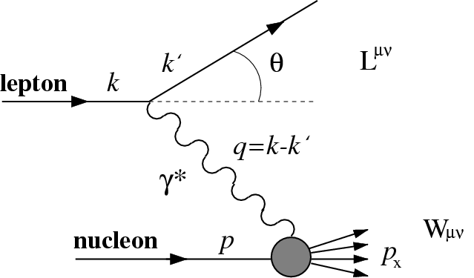
Deep Inelastic Scattering
Cross section for inclusive lepton (electron) scattering:
Q² = -q²
ν=E-E’
In the limit of large Q², structure functions scale

Slide 9
F₂ and Parton Distributions
F₂ interpreted in the quark-parton model as the charge-weighted sum over quark distributions
At finite Q², F₂ not Q² independent → scaling violations can be predicted in pQCD
At fixed x, scaling can be tested via logarithmic derivative of F₂ w.r.t. to Q²
In addition, corrections due to the finite mass of the nucleon lead to further scaling violations → these can be partially accounted for by examining data in terms of Nachtmann variable, ξ

Slide 10
F₂ and Parton Distributions
F₂ interpreted in the quark-parton model as the charge-weighted sum over quark distributions
Quark structure of nucleon inferred from DIS on proton and neutron (deuteron) + complementary reactions
q_{i}(x) = u(x), d(x), s(x) …
x
From Particle Data Group – 2023 Review of Particle Physics

Slide 11
Nuclear Structure Functions
Since nuclear binding energies are small (~MeV) compared to typical DIS energies (~GeV), the naïve expectation was that nuclear effects in DIS would be small
No nuclear effects
From the beginning the above expression was known to be too simple → difference in the “Fermi momentum” for heavy nuclei leads to rise at large x
Figure from Bickerstaff and Thomas, J. Phys. G 15, 1523 (1989)
Calculation: Bodek and Ritchie PRD 23, 1070 (1981)

Slide 12
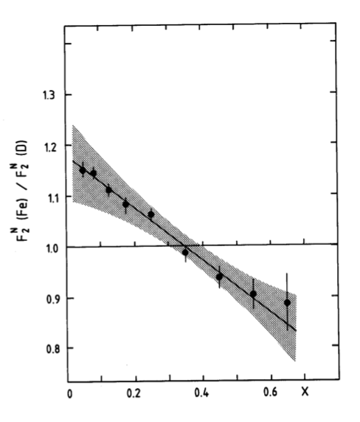
Discovery of the EMC Effect
First published measurement of nuclear dependence of F₂ by the European Muon Collaboration in 1983
Observed 2 mysterious effects
  Significant enhancement at small x → Nuclear Pions! (my thesis)
  Depletion at large x → the “EMC Effect”
Enhancement at x<0.1 later went away
EMC Collaboration
Aubert et al, Phys. Lett. B123, 275 (1983)

Slide 13
Confirmation of the EMC Effect
SLAC re-analysis of old solid target data used for measurements of cryotarget wall backgrounds
Effect for x>0.3 confirmed
No large excess at very low x
Bodek et al, PRL 50, 1431 (1983) and PRL 51, 534 (1983)

Slide 14
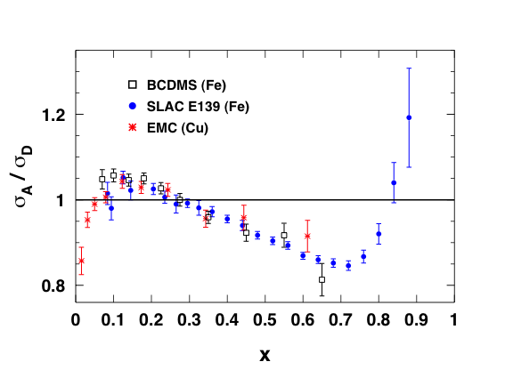
Subsequent Measurements
A program of dedicated measurements quickly followed
The resulting data is remarkably consistent over a large range of beam energies and measurement techniques

Slide 15
EMC Effect Measurements
Laboratory/collaboration | Beam | Energy (GeV) | Targets | Year
SLAC E139 | e | 8-24.5 | D,⁴He, Be, C, Ca, Fe, Ag, Au | 1994,1984
SLAC E140 | e | 3.75-19.5 | D, Fe, Au | 1992,1990
CERN NMC | μ | 90 | ⁶Li, ¹²C, ⁴⁰Ca | 1992
 | μ | 200 | D, ⁴He, C, Ca | 1991, 1995
 | μ | 200 | Be, C, Al, Ca, Fe, Sn, Pb | 1996
CERN BCDMS | μ | 200 | D, Fe | 1987
 | μ | 280 | D, N, Fe | 1985
CERN EMC | μ | 100-280 | D, Cu | 1993
 | μ | 280 | D, C, Ca | 1988
 | μ | 100-280 | D, C, Cu, Sn | 1988
 | μ | 280 | H, D, Fe | 1987
 | μ | 100-280 | D, Fe | 1983
FNAL E665 | μ | 490 | D, Xe | 1992
 | μ | 490 | D, Xe | 1992
DESY HERMES | e | 27 | D, ³He, N, Kr | 2000, 2003
Jefferson Lab | e | 6 | D, ³He, ⁴He, Be, C, Cu, Au | 2009, 2021
 | e | 6 | D, C, Cu, Au | 2004 (thesis)
 | e | 5 | D, C, Al, Fe, Pb | 2019
 | e | 11 | D, Be, ¹⁰B, ¹¹B, C | 2022
Since the original discovery in 1983, numerous measurements to explore properties of EMC Effect
→ Wide range of beam energies: 5 GeV electrons to 490 GeV muons

Slide 16
Measuring the EMC Effect: Muons vs. Electrons
Muon beam experiments (EMC, NMC, BCDMS, FNAL E665)
  →Energy scale ~ 100-500 GeV
  Secondary beams, relatively low intensity
  Beam energy determined event by event
  Large acceptance devices required
Electron beam experiments (SLAC, HERMES, JLAB)
  Energy scale 6-25 GeV
  Well defined beam energy, narrow dE
  Intense beams → higher statistics
  Small acceptance devices often (but not always) used

Slide 17
New Muon Collaboration
NMC: next generation experiment at CERN, building on EMC
Large acceptance spectrometer with large array of tracking chambers
P. Amaudruz et al: Nucl Phys. B 371 (1992) 3-31

Slide 18
New Muon Collaboration
Target designed to minimize systematic uncertainties → excellent vertex resolution so several targets could be in beam simultaneously
M. Arneodo et al: Nucl. Phys. B 441 (1995) 12-30
Order 10⁷ muons/s: 3 m long cryotargets → Luminosity~ 10³² cm⁻² s⁻¹
Normalization uncertainties for σ(A)/σ(D) → 0.4%
σ(A)/σ(C) → 0.2%

Slide 19
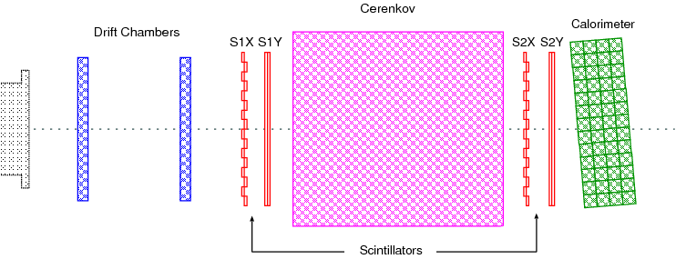
Jefferson Lab – Hall C
Moderate acceptance (6 msr) magnetic focusing spectrometer
Excellent understanding
of acceptance and kinematics

Slide 20
Jefferson Lab – Hall C
High current electron beam requires high power cryogenic targets
→ Knowledge of the absolute target density sometimes challenging due to target boiling effects
Yield from ³He target vs. beam current
Order 5 10¹⁴ electrons/s: 4-10 cm long cryotargets → Luminosity~ 10³⁸ cm⁻² s⁻¹
Normalization uncertainties for σ(A)/σ(D) → 1-2%

Slide 21
Nuclear dependence of structure functions
Experimentally, we measure cross sections (and the ratios of cross sections)
In the limit R_{A} = R_{D} or ε=1
σ_{A}/σ_{D} = F₂^{A}/F₂^{D}
Experiments almost always display cross section ratios, σ_{A}/σ_{D}
Often these ratios are labeled or called F₂^{A}/F₂^{D}
Sometimes there is an additional uncertainty estimated to account for the σ→F₂ translation. Sometimes there is not.

Slide 22
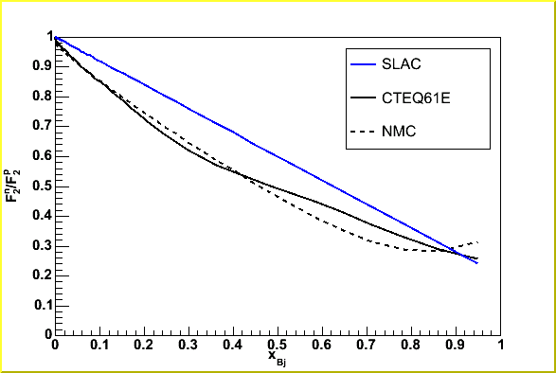
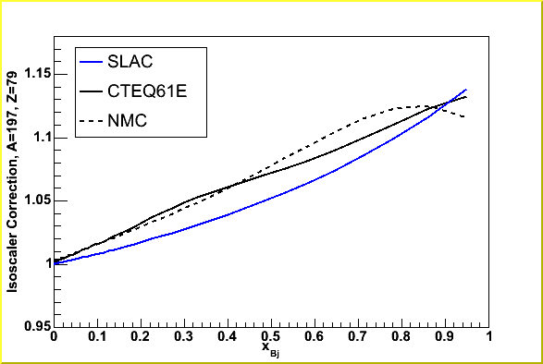
Isoscalar Corrections
In the case of nuclei where N≠Z, need to remove the “trivial” change in nuclear cross section due to σ_{n}≠σ_{p}
→ Different experiments often use slightly different parameterizations/estimates for this correction
SLAC param. (1-0.8x)
CTEQ
NMC fit
Isoscalar correction applied to data
Au

Slide 23
Properties of the EMC Effect
Antishadowing
1. Universal x-dependence
Fermi motion
Shadowing
EMC region

Slide 24
x Dependence
A=3
A=4
A=9
A=12 (14)

Slide 25
x Dependence
A=27
A=40
A=108/119
A=197/208

Slide 26
Properties of the EMC Effect
Antishadowing
1. Universal x-dependence
2. Little Q² dependence*
Fermi motion
Shadowing
EMC region

Slide 27
Q² Dependence of the EMC Effect
EMC
Q²=10-200 GeV²
SLAC E139
Q²=1-10 GeV²
x=0.05
x=0.65
Gomez et al, Phys. Rev. D 49, 4348 (1994)
Aubert et al, Nucl. Phys. B293, 740 (1987)

Slide 28
Q² Dependence of the EMC Effect
Carbon
Copper/Iron
Very little Q² dependence – even in the resonance region! (W²>2 GeV², Q²>3 GeV²)
Arrington et al, Phys.Rev.C 104 (2021) 6, 065203

Slide 29
(*) Q² Dependence of Sn/C
NMC measured non-zero Q² dependence in Sn/C ratio at small x
→ This result is in some tension with other NMC C/D and HERMES Kr/D results
Arneodo et al, Nucl. Phys. B 481, 23 (1996)

Slide 30
Properties of the EMC Effect
Antishadowing
1. Universal x-dependence
2. Little Q² dependence*
3. EMC effect increases with A
→ Anti-shadowing region shows little nuclear dependence
Fermi motion
Shadowing
EMC region

Slide 31
A-Dependence of EMC Effect
NMC: Arneodo et al, Nucl. Phys. B 481, 3 (1996)

Slide 32
A-Dependence of EMC Effect
ρ=3A/4πR_{e}³
R_{e}²=5⟨r²⟩/3
<r²>=RMS electron scattering radius
SLAC E139: Gomez et al, PRD 49, 4348 (1992)

Slide 33
Explaining the EMC Effect
Plethora of models attempting to explain the EMC Effect
“Conventional” nuclear physics not sufficient
  Fermi motion dominates at large x, but minimal impact elsewhere
  Binding effects small, nuclear pions ruled out by other measurements (Drell-Yan)
Other models require more “exotic” effects
  Dynamical rescaling
  Multiquark clusters → 6, 9, 12 .. quark configurations
Newer models involve direct coupling of meson fields to quarks
More recently, models connecting the EMC Effect to “Short Range Correlations” under investigation

Slide 34
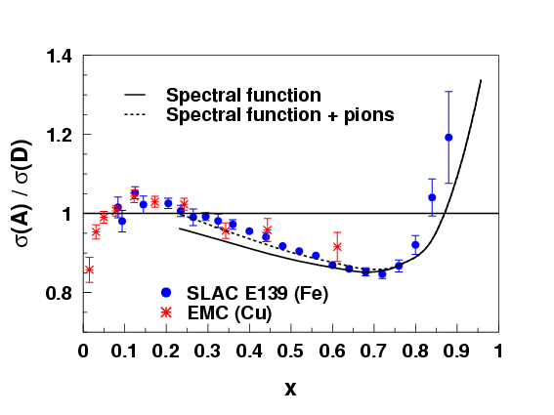
Binding and Nuclear Pions
Start with a “realistic” description of nucleons in the nucleus
  → Use a spectral function rather than simple Fermi gas
Start with convolution picture
  Allow virtual photon to scatter from quarks in pions in the nucleus
Requires ad-hoc prescription for off-shell behavior of structure functions
Benhar, Pandharipande, and Sick Phys. Lett. B410, 79 (1997)
Fair agreement is achieved at large x – including nuclear pions improves agreement at lower x

Slide 35
Multiquark Clusters
Multiquark cluster model assumes that, in nuclei, quarks may combine into clusters that include more than 3 quarks
Nuclear structure function is a convolution over contribution from nucleons (F₂^{N}) and contribution from 6 quark clusters (F₂⁶)
Requires F₂^{N} ≠ F₂⁶ to get EMC effect
K.E. Lassila and U.P. Sakhatme
Phys. Lett. B209, 343 (1988)

Slide 36
Quark-Meson Coupling Model
Quark-meson coupling model describes nuclei in terms of quark interactions with (scalar and vector) meson fields
Guichon, Stone, Thomas, PPNP 100, 262-297, 2018
Calculations using NJL model (similar properties as QMC) give good description of unpolarized EMC Effect
→ Also predict EMC effect for polarized nucleons
Cloët, Bentz, and Thomas, PRL 95, 052302 (2005)

Slide 37
Isolating the Physics of Interest
“Conventional” nuclear effects play non-trivial role in DIS target ratios
Kulagin and Petti performed calculations including these effects to attempt to isolate the interesting effects
Calculations included:
Fermi motion and binding w/realistic nucleon distributions (FMB) → large x
Nuclear pion excess (PI) → antishadowing
Coherent nuclear processes (NS) → low x
Off-shell correction to structure function (OS)
Nucl.Phys.A 765 (2006) 126-187

Slide 38
Isolating the Physics of Interest
The interesting physics is encoded in the off-shell correction to the F₂ structure function
C_{N} = normalization parameter
0<x₁<x₀<1
h>1
Surprisingly, a single set of parameters works pretty well for most nuclei
Successful parametrization and interesting approach, but this does not provide fundamental information about the origins of the EMC effect

Slide 39
40+ Years of the EMC Effect
No clear consensus on origin of EMC Effect
  Conventional nuclear physics contributions can be handled with more precision, but still cannot explain whole effect
  Testing models challenging – only a few observables (Inclusive DIS and Drell-Yan)
Settling the question of the origin of the EMC effect requires new information
  New ways of looking at existing data
  Explore effect for wider range of nuclei (different A, n/p ratios..)
  New experimental avenues beyond inclusive DIS cross sections are likely required
Information from JLab has helped provide some direction, but more information needed!

Slide 40
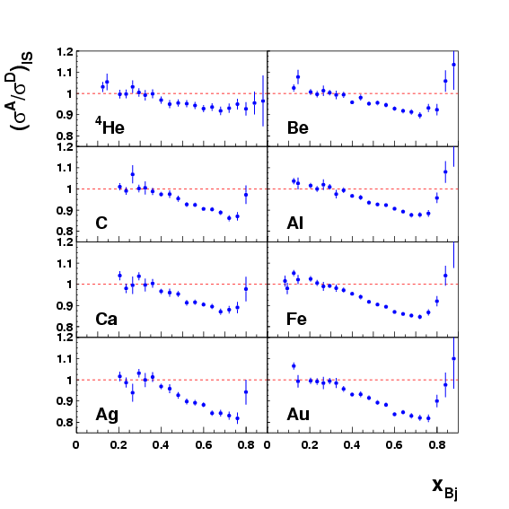
EMC Effect Measurements at Large x
SLAC E139
SLAC E139 provided the most extensive and precise data set for x>0.2
Measured σ_{A}/σ_{D} for A=4 to 197
  → ⁴He, ⁹Be, C, ²⁷Al, ⁴⁰Ca, ⁵⁶Fe, ¹⁰⁸Ag, and ¹⁹⁷Au
  → Best determination of the A dependence
  Verified that the x dependence was roughly constant
  Building on the SLAC data
  Higher precision data for ⁴He
  Addition of ³He
  Precision data at large x

Slide 41
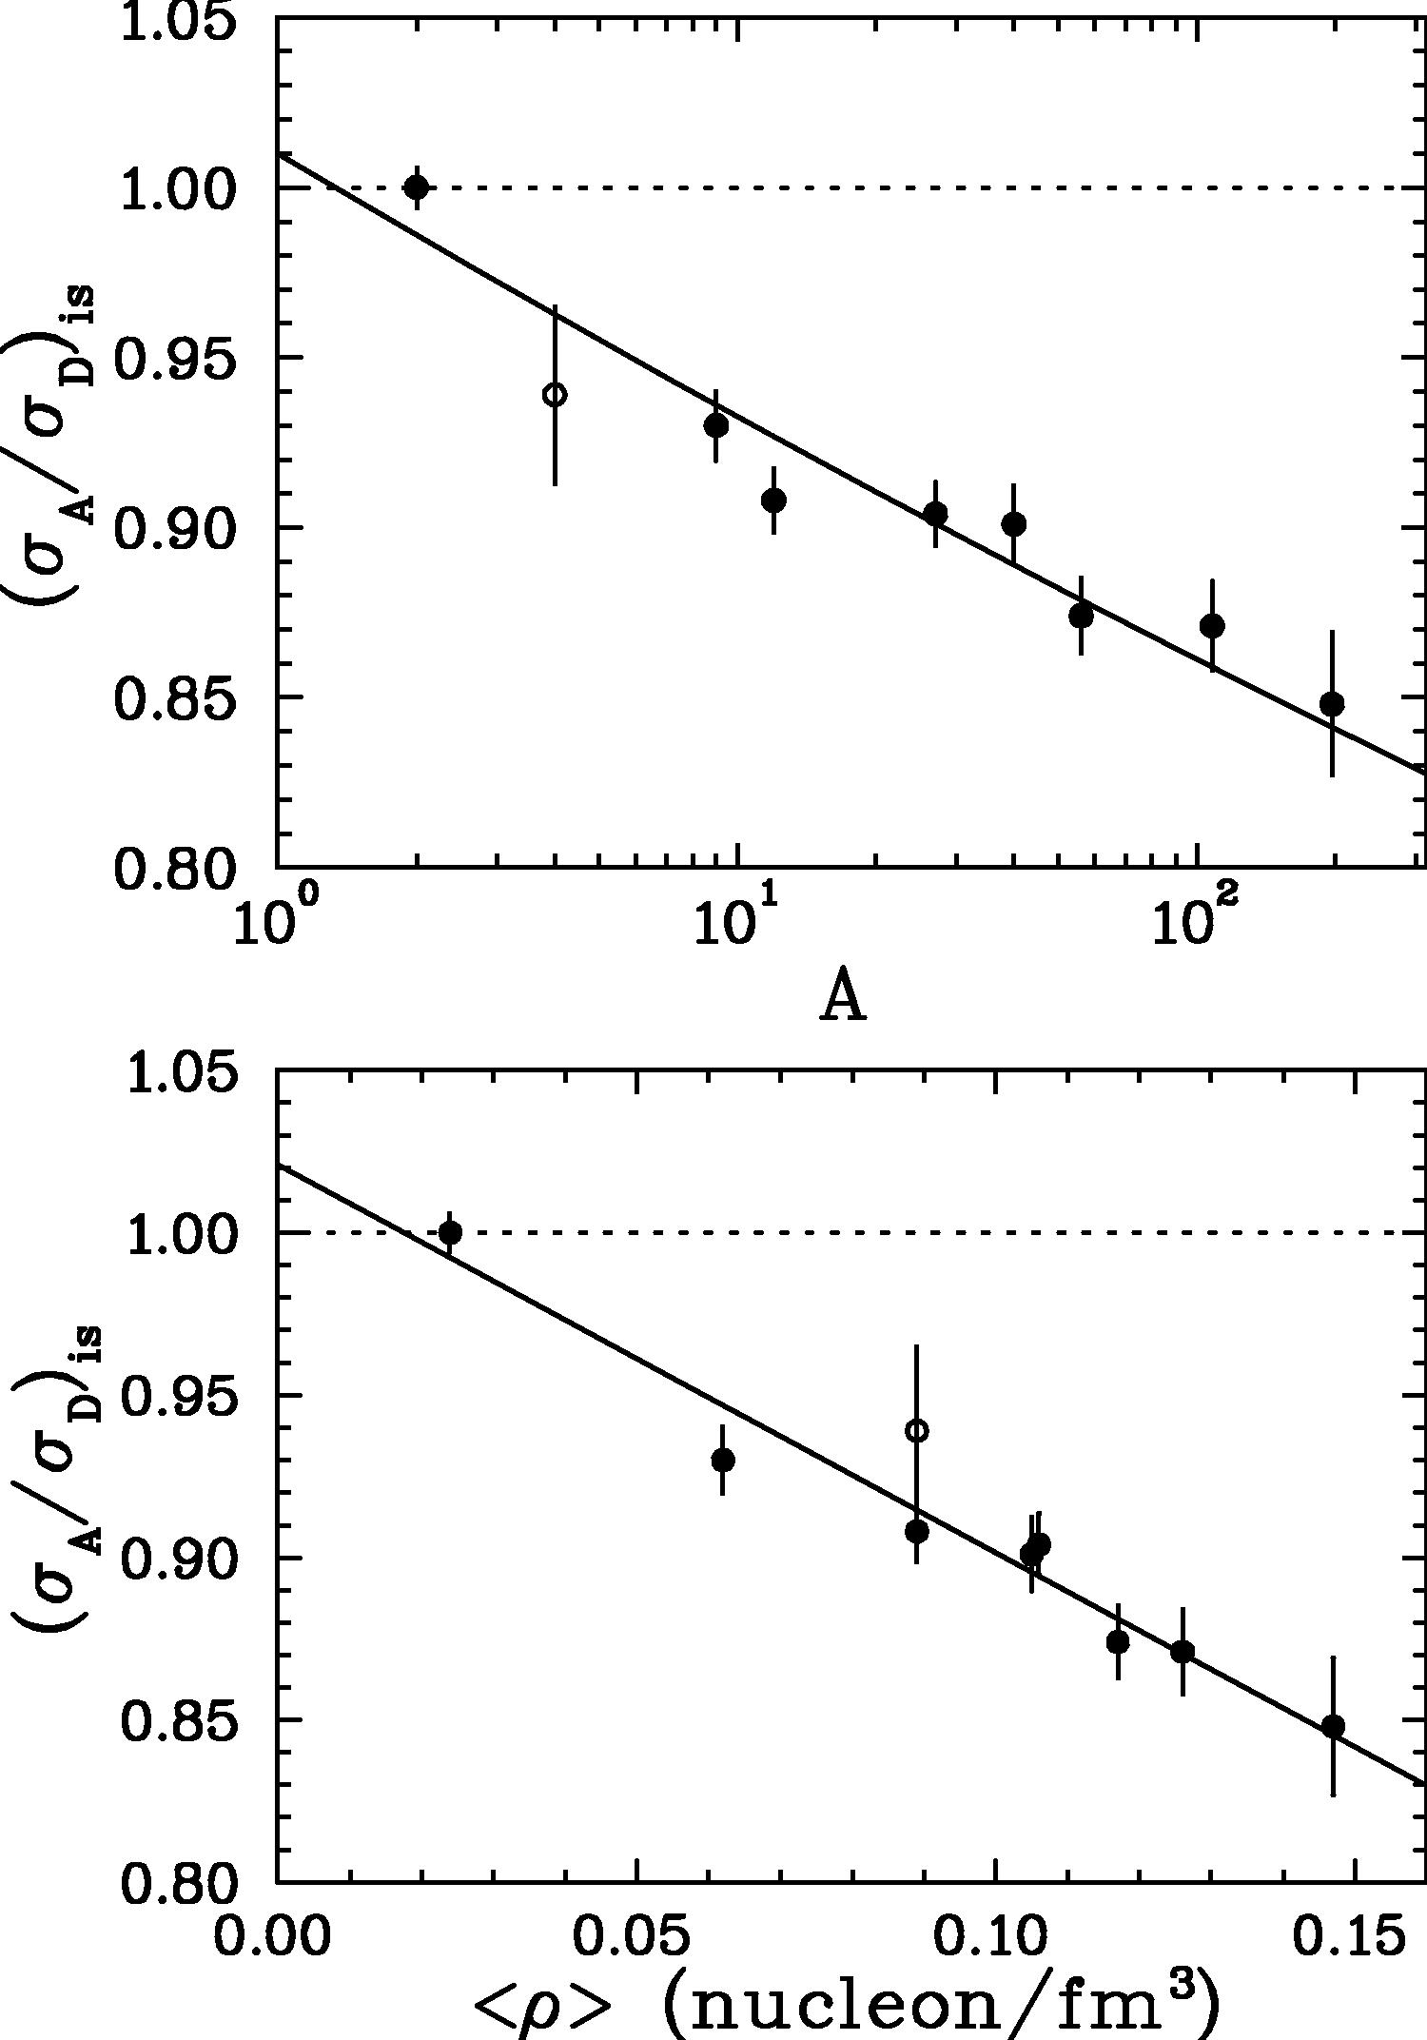
Nuclear Dependence of the EMC Effect
SLAC E139 studied the nuclear dependence of the EMC Effect at
fixed x
Results consistent with
Simple logarithmic A dependence
Average nuclear density*
*uniform sphere with radius R_{e},
R_{e}² = 5/3 <r²> → charge radius of nucleus
Many models of the EMC effect either implicitly or explicitly assume the size of the EMC effect scales with average nuclear density
→ Constraining form of nuclear dependence can confirm or rule out this assumption
A-dependence
⁴He
Density-dependence
x=0.6
Gomez et al, PRD 49, 4348 (1994)

Slide 42
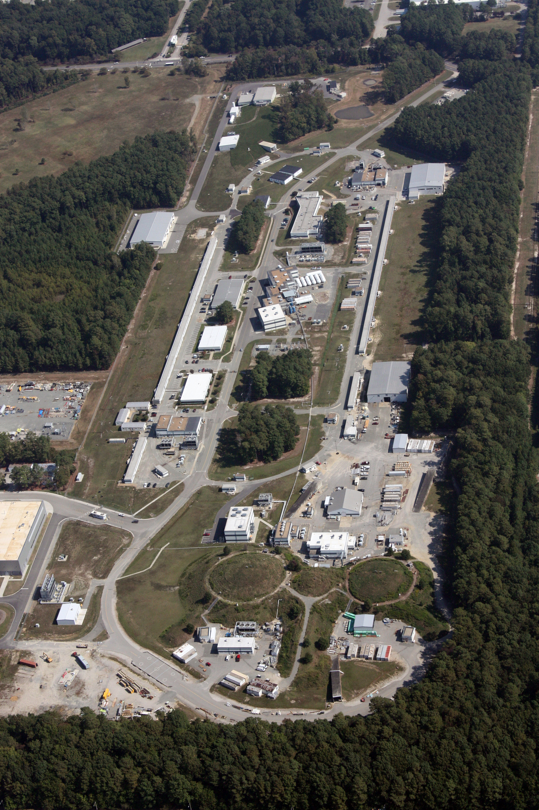
Exploring the EMC Effect at Jefferson Lab
D
High intensity electron beam and improved target technology provides excellent opportunity for studying EMC Effect
Originally, max beam energy = 6 GeV, limited kinematic reach
Upgrade to 12 GeV provided wider access to the DIS region
Unexpected results from the 6 GeV program have motivated a significant number of experiments at 12 GeV
A
B
C

Slide 43
JLab E03103 and the Nuclear Dependence of the EMC Effect
Carbon
New definition of “size” of the EMC effect
Slope of line fit from x=0.35 to 0.7
Assumes shape is universal for all nuclei
→Normalization uncertainties a much smaller relative contribution
Notes:
Critical improvement – define size of EMC effect as slope between 0.4-0.7: fractional normalization error less important

Slide 44
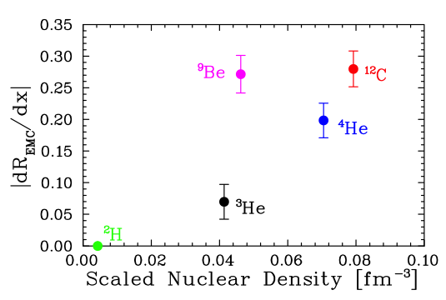
JLab (Hall C) Measurements on Light Nuclei (6 GeV)
J. Seely, et al., PRL103, 202301 (2009)
JLab E03103 goal:
More information on nuclear dependence → emphasis on light nuclei:
³He, ⁴He, Be, C
→ New definition of size of EMC effect:
|dR/dx| for 0.35<x<0.7
→ ³He, ⁴He, C, EMC effect scales well with density
Scaled nuclear density = (A-1)/A <ρ>
→ remove contribution from struck nucleon
<ρ> from ab initio few-body calculations
→ [S.C. Pieper and R.B. Wiringa, Ann. Rev. Nucl. Part. Sci 51, 53 (2001)]

Slide 45
JLab (Hall C) Measurements on Light Nuclei (6 GeV)
J. Seely, et al., PRL103, 202301 (2009)
JLab E03103 goal:
More information on nuclear dependence → emphasis on light nuclei:
³He, ⁴He, Be, C
→ New definition of size of EMC effect:
|dR/dx| for 0.35<x<0.7
→ ³He, ⁴He, C, EMC effect scales well with density – Be does not!
Scaled nuclear density = (A-1)/A <ρ>
→ remove contribution from struck nucleon
<ρ> from ab initio few-body calculations
→ [S.C. Pieper and R.B. Wiringa, Ann. Rev. Nucl. Part. Sci 51, 53 (2001)]

Slide 46
Improved Precision via New Observable
Key to observation of “local density” dependence is modified definition of size of EMC Effect*
Nuclear dependence of EMC effect typically examined at fixed x
Use of dR/dx greatly reduced sensitivity to normalization uncertainties
EMC effect ~ 10% deviation from 1.0
Normalization uncertainties ~ 1-2%
¹²C
⁹Be
²H
³He
⁴He
*Full disclosure: I was initially skeptical of this approach

Slide 47
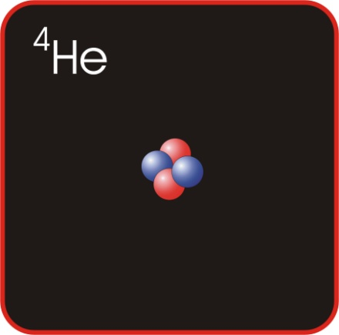
EMC Effect and Local Nuclear Density
⁹Be has low average density
Large component of structure is 2α+n
Most nucleons in tight, α-like configurations
EMC effect driven by local rather than average nuclear density
Can this “local density” picture be tied to other observables?

Slide 48
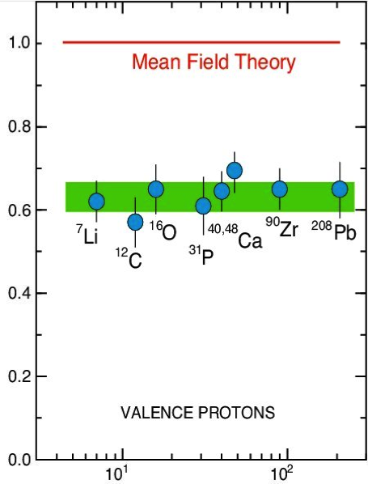
Local Density → Short Range Correlations
What drives high “local” density in the nucleus?
In simple models of the nucleus (Fermi gas), all nucleons experience basically the same local environment
Fermi gas, or other mean field models incomplete
(e,e’p) data for knockout of protons with momenta lower than “Fermi” momentum indicates significant missing strength
L. Lapikas, Nucl. Phys. A553 (1993) 297
Notes:
EMC effect correlated with local density – what is the source of this higher local density?
Mean field models do not lead to high local densities – but they are incomplete.

Slide 49
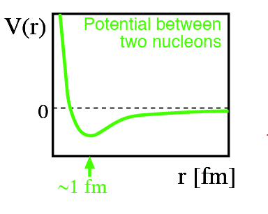
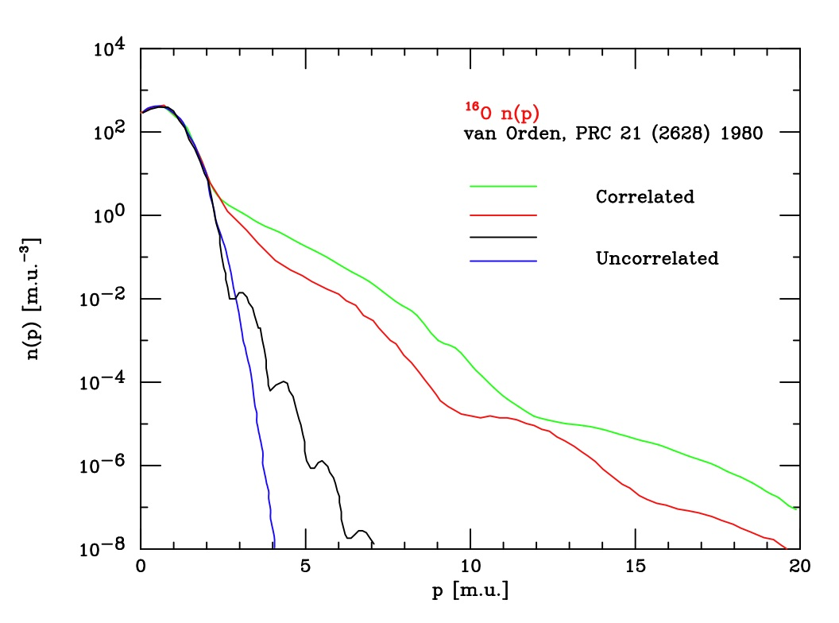
Local Density → Short-Range Correlations
What drives high “local” density in the nucleus?
Tensor interaction and short-range repulsive core lead to high momentum tail in nuclear wave function → correlated nucleons

Slide 50
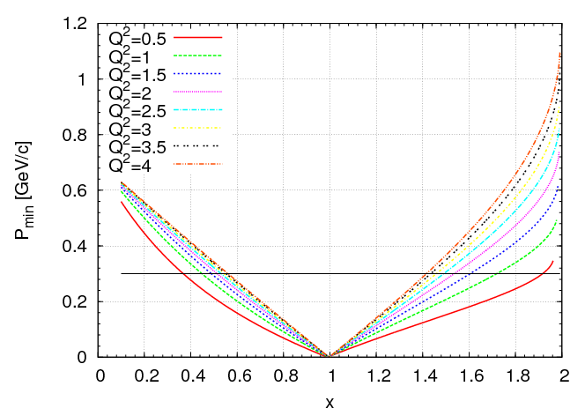
Measuring Short Range Correlations
High momentum nucleons in the nucleus can be accessed using quasi-elastic scattering
→ At quasi-elastic peak (x=1), all parts of the nucleon momentum distribution contribute
e⁻
e⁻
QES
W²=M_{n}²
M*_{A-1}
M_{A}
→ At x>1, we can access higher momentum components, if we go to large enough Q²
Figure courtesy N. Fomin, after Frankfurt, Sargsian,
and Strikman, Int.J.Mod.Phys. A23 (2008) 2991-3055

Slide 51
Measuring Short-Range Correlations
High momentum nucleons in the nucleus can be accessed using quasi-elastic scattering
To measure the (relative) probability of finding a correlated pair, ratios of heavy to light nuclei are taken at x>1 → QE scattering
If high momentum nucleons in nuclei come from correlated pairs, ratio of A/D should show a plateau
3N SRC
2N SRC
1.4<x<2 => 2 nucleon correlation
2.4<x<3 => 3 nucleon correlation

Slide 52
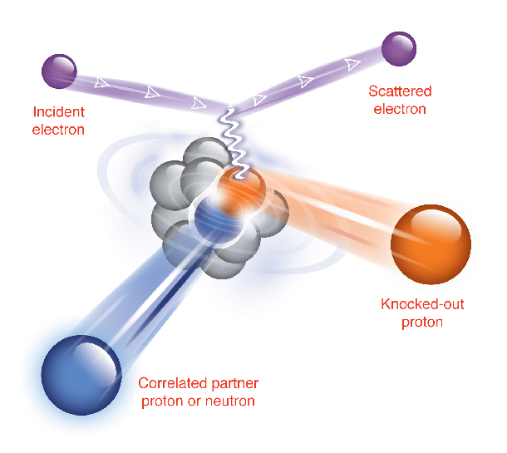
Short Range Correlations – np Dominance
SRCs can be studied in more detail via triple-coincidence reactions
→ Electron knocks out high momentum proton from carbon nucleus
→ “Partner” backward-going proton or neutron also detected
96 +/- 22%
Subedi, et al, Science 320, 1476 (2008)
Conclusion: High momentum nucleons are dominated by np pairs
9.5 +/- 2%
Shneor, et al, PRL 99, 072501 (2007)

Slide 53
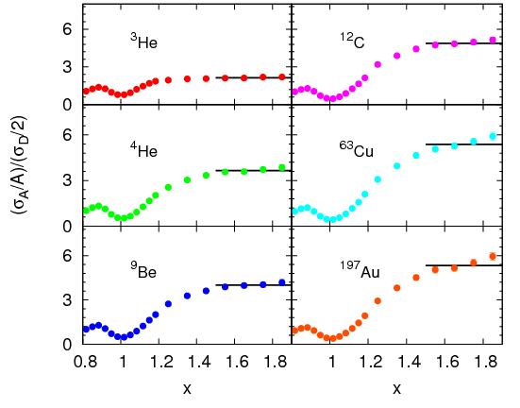
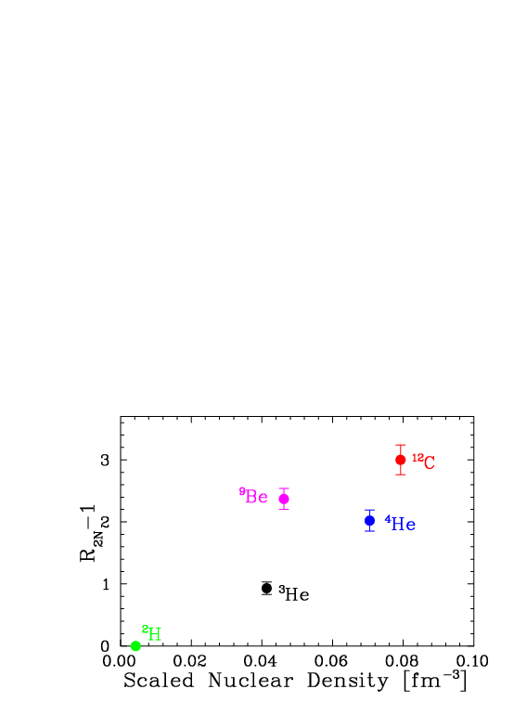
Nuclear Dependence of SRCs
N. Fomin et al, Phys.Rev.Lett. 108 (2012) 092502
JLab also data on A/D ratios at x>1 at 6 GeV
a₂ ratios for:
Additional nuclei (Cu, Be, Au)
Higher precision for targets with already existing ratios
→ Relative probability to find SRC shows similar dependence on nuclear density as EMC effect

Slide 54
Nuclear Dependence of SRCs and the EMC Effect
EMC
SRC
→ Relative probability to find SRC shows similar dependence on nuclear density as EMC effect!

Slide 55
EMC Effect and Short-Range Correlations
Weinstein et al first observed linear correlation between size of EMC effect and Short-Range Correlation “plateau” using EMC and older SRC data
Correlation strengthened with addition of JLab 6 GeV SRC (beryllium) data
O. Hen et al, Phys.Rev. C85 (2012) 047301
This result provides a quantitative test of level of correlation between the two effects, but does not provide a microscopic explanation for EMC Effect

Slide 56
Summary: Part 1
Discovery of the EMC Effect was perhaps the first indication of the relevance of quark degrees of freedom in the nucleus
Significant experimental and theoretical effort over the last 40+ years
  Still so consensus on origin!
“Conventional” nuclear effects (Fermi motion, binding, nuclear pions) are insufficient to explain the EMC Effect
Observation of correlation with SRCs has generated a lot of excitement
  Are there testable predictions/observables in this picture?

