Slide 1
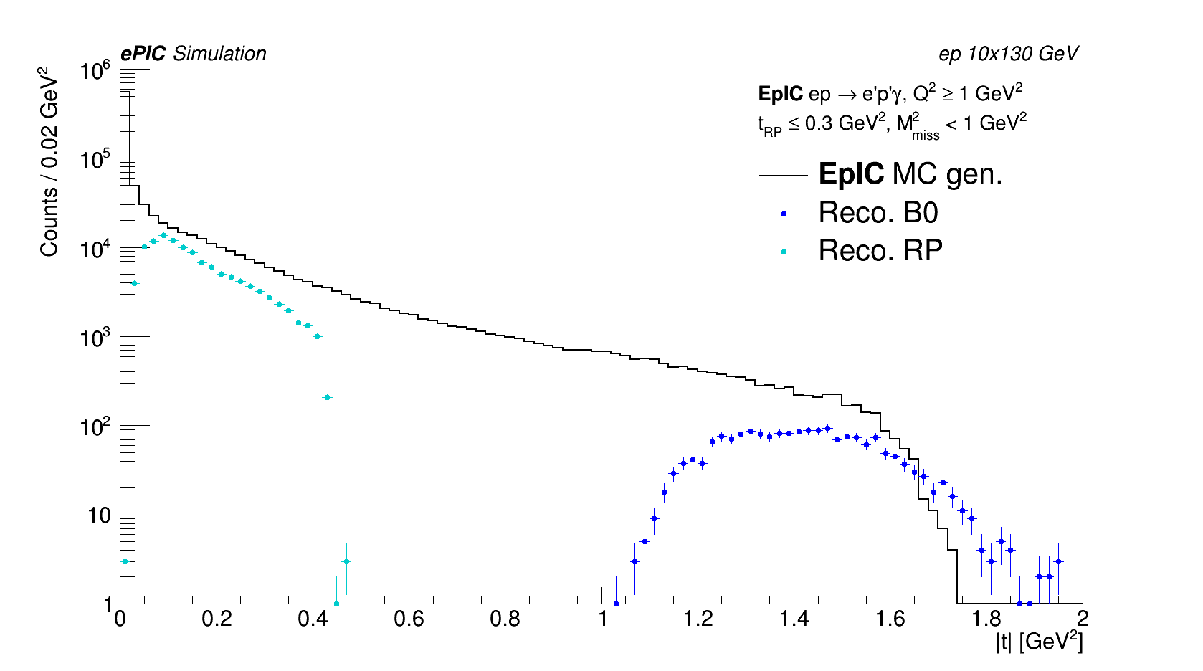
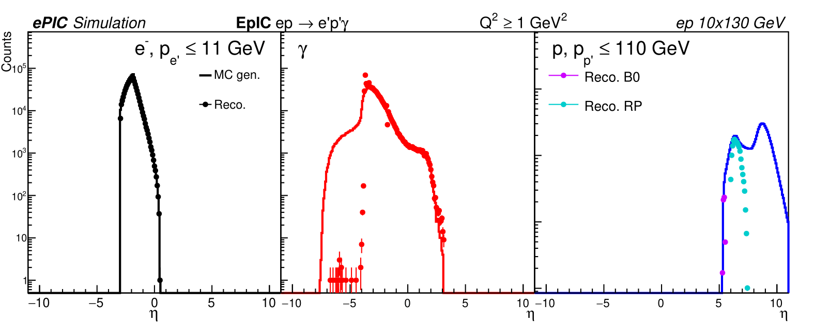
DVCS in ep – Early science updates
O. Jevons, University of Glasgow
Using 1M events from EpIC generator.
Beam energies: 10x130
Full DVCS + Bethe-Heitler + interference
Only negative e⁻ beam helicity
No proton polarisation
Still have work to do on corrections.
Previous issue with generator file only fixed for most recent simulation campaign
|t| (uncorrected)
η
Coverage of RP detector removes most BH background for free!
(For this energy config.)

Slide 2
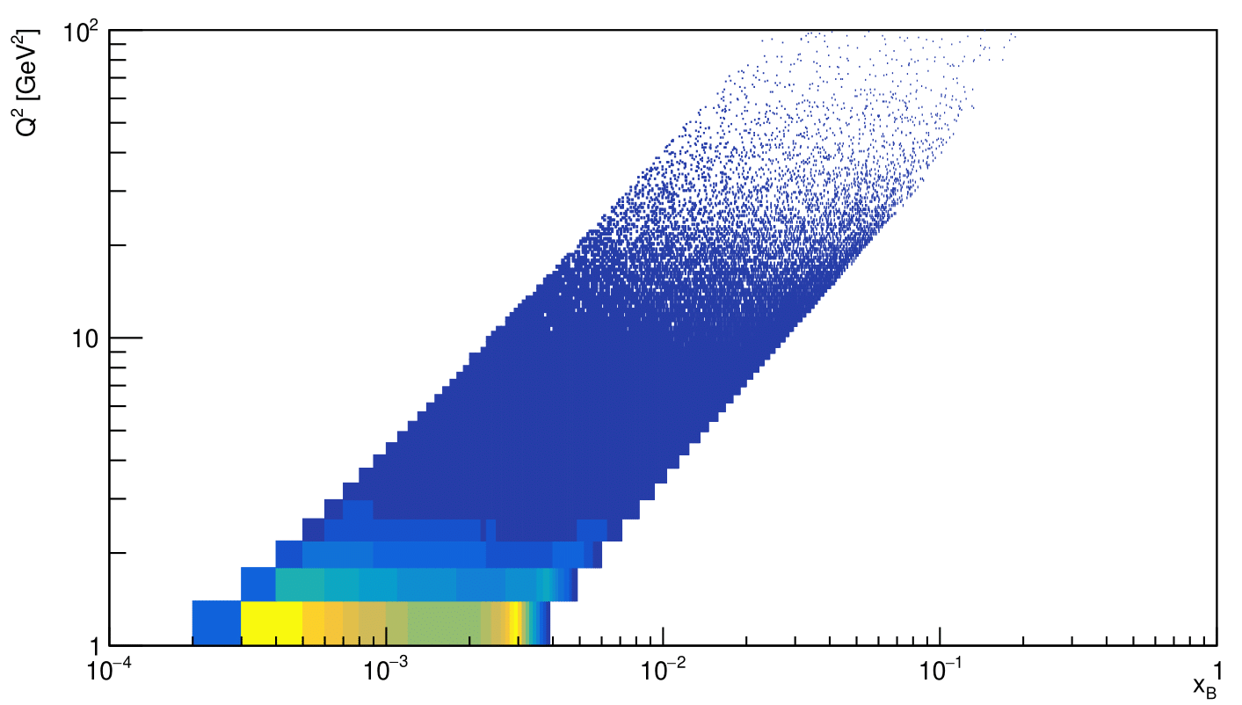
DVCS in ep – next steps
O. Jevons, University of Glasgow
Currently generating more events.
EpIC generator
2.6M events (~3 months’ worth of EIC running, using given early science parameters)
No proton polarisation
Split electron beam helicities
Will allow for asymmetries to be simulated.
Q² vs x_{B} coverage

