Slide 1
fTOF Assembly workfest
July 16th 2025, EIC ePIC collaboration meeting
Mathieu Benoit
ORNL

Slide 2
fTOF assembly sequence
Sensors
ASIC
support structure
Assembly
Module Flex
ROB
Module
3
PWRB
Support
“Super” Module

Slide 3
fTOF assembly sequence
“Super” Module
800
Cabling and Fibers
PP0
Cooling services
fTOF

Slide 4
Assembly
Sensors
Fabrication (sensor + UBM) handled by manufacturer (HPK)
Testing will need to be handled by us after dicing
Diced + QA’ed sensor ready for flip-chipping
ASIC
ASIC fabrication handled by TSMC via CERN/IMEC
Wafer level testing with probe card need to be performed by us
ASIC Wafer then goes to bump-bonding manufacturer for bumping (EU)
BB Manufacturer will handle bumping + dicing
Flip-Chipping could be done in-house (ORNL) or at manufacturer
Sensors
ASIC

Slide 5
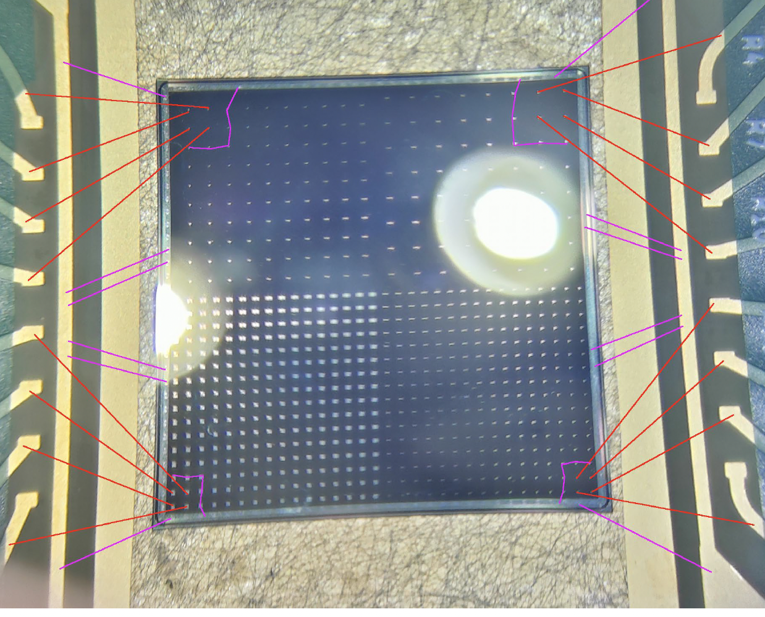
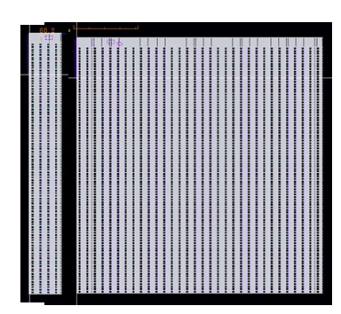
EIC fTOF modules
The EICROC will be the readout for the fTOF
EICROC1A(4x32)/1B(32x32) currently in design for submission this summer
EICROC0/A/B design completed (Frontend optimisation)
EICROC2 should be the final design for fTOF and far-forward, planned for tapeout in ~Q3 2026
HPK Sensor production for pixel in UCSC, first trials with EICROC1 when available (Q4 2025)
We are following closely CMS ETL efforts in developing their bump-bonding process. ORNL actively involved in developing flip-chip process.

Slide 7
Module
Assembly
Assembly from manufacturer/ORNL will need to be tested for functionality either before (probe station) or after module construction (table)
Good assemblies are sent to production site for module assembly
support structure
Support structure
Support structure (AlN) can be purchased and machined by manufacturer
Support cleaned and prepared at production site for receiving the assemblies and flex
Assembly
Module Flex
Module Flex
Flex produced and populated by manufacturer
Cleaning of flex done at production site

Slide 8
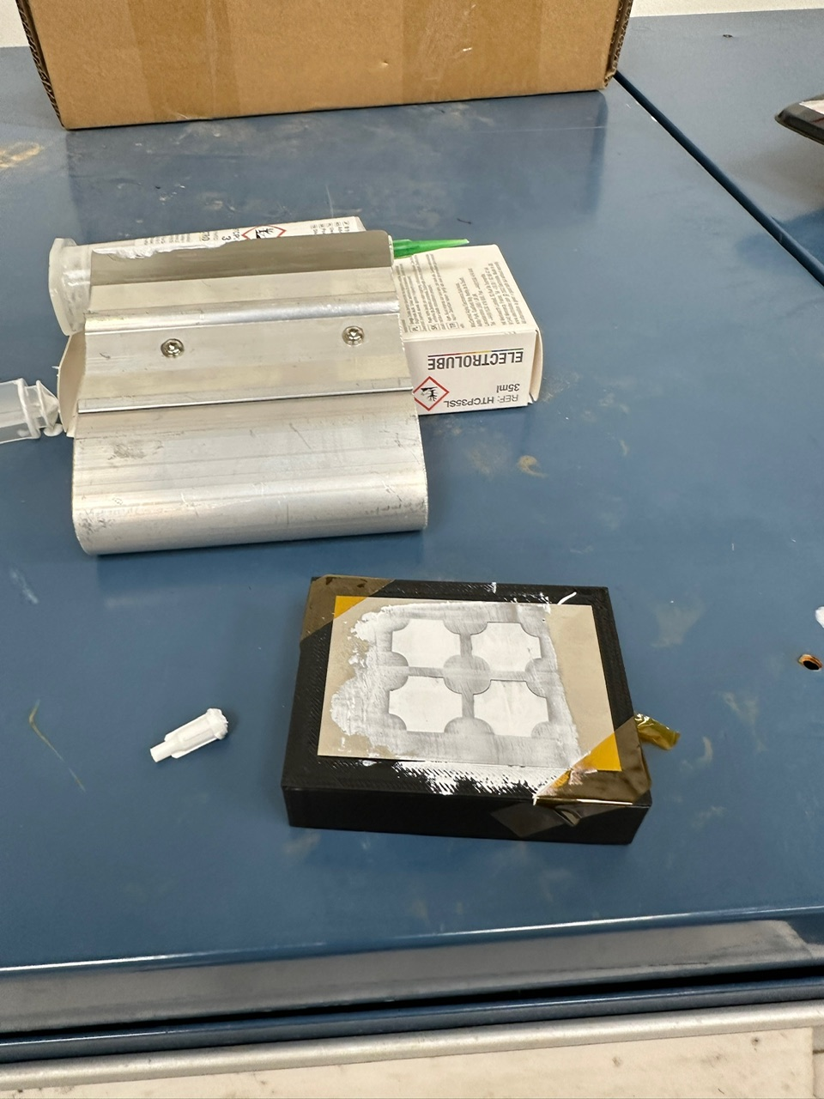

Slide 9
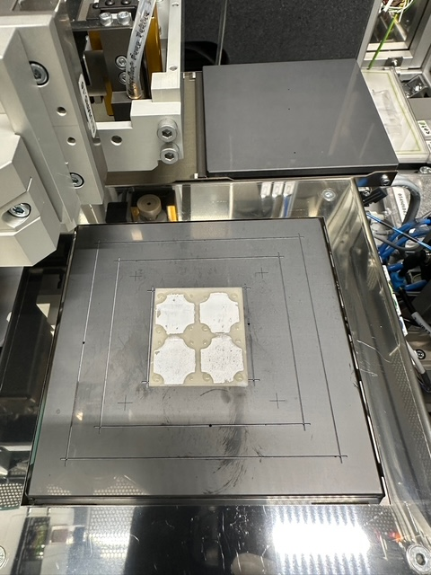
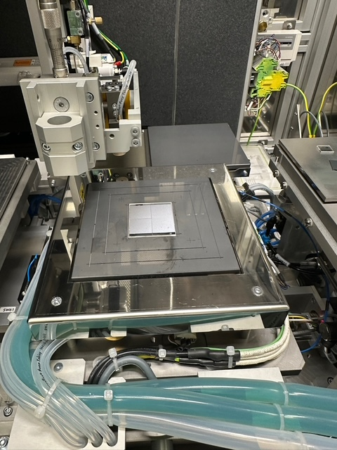

Slide 10
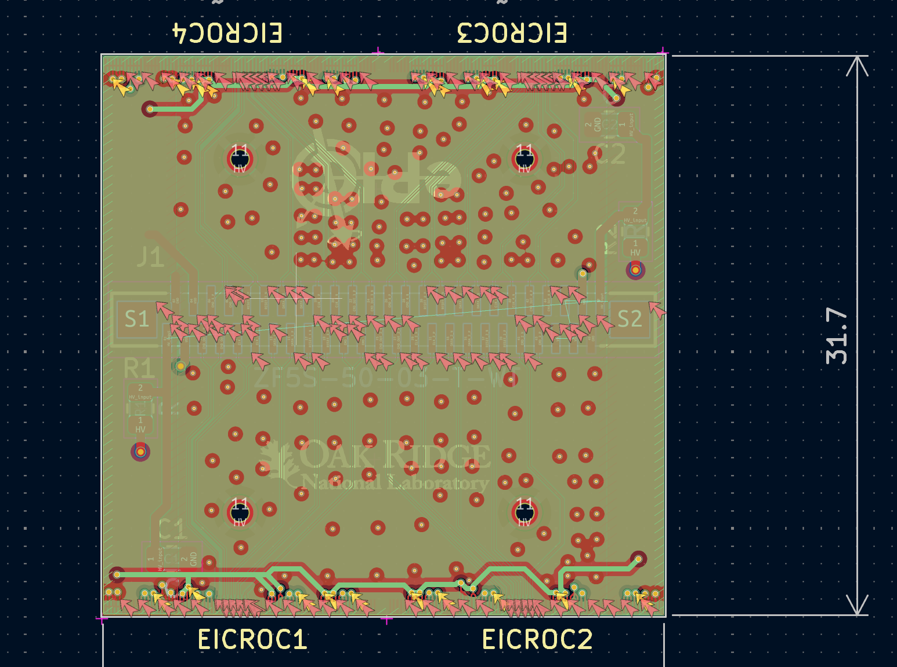
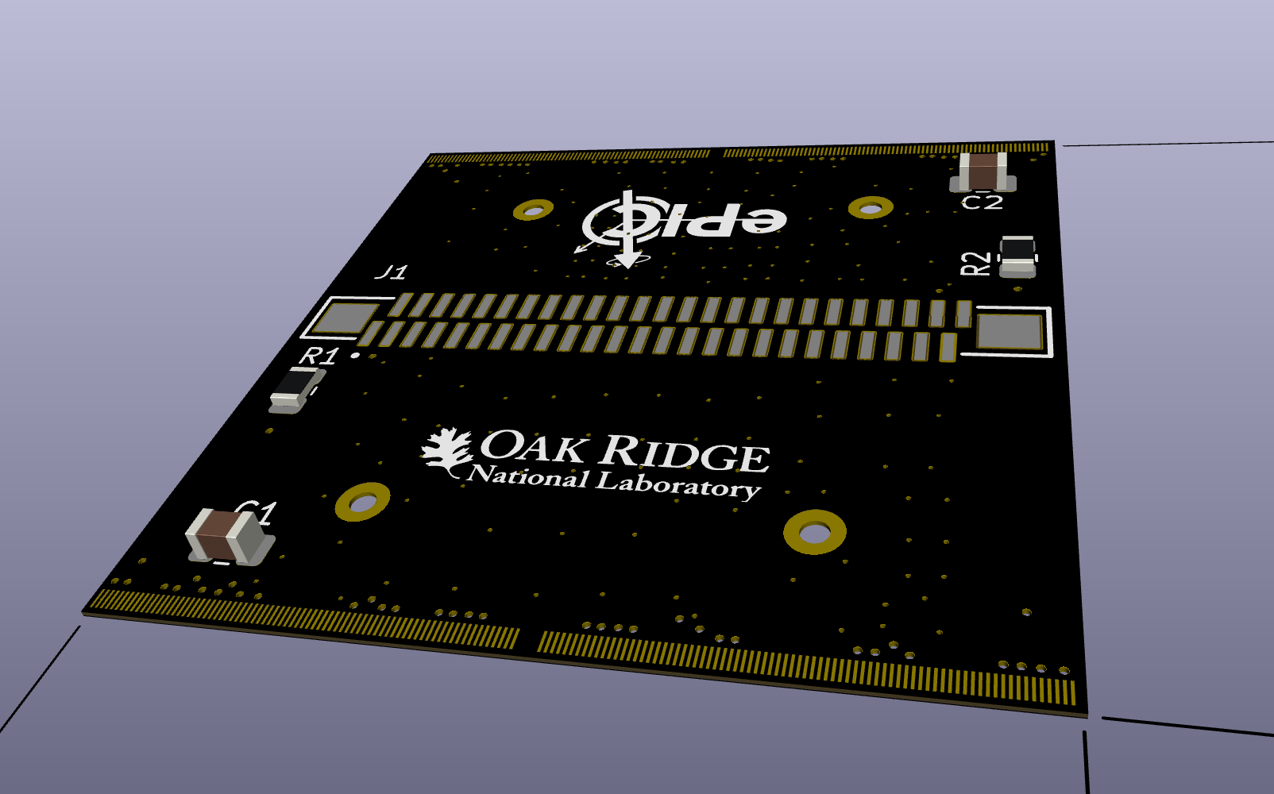

Slide 11
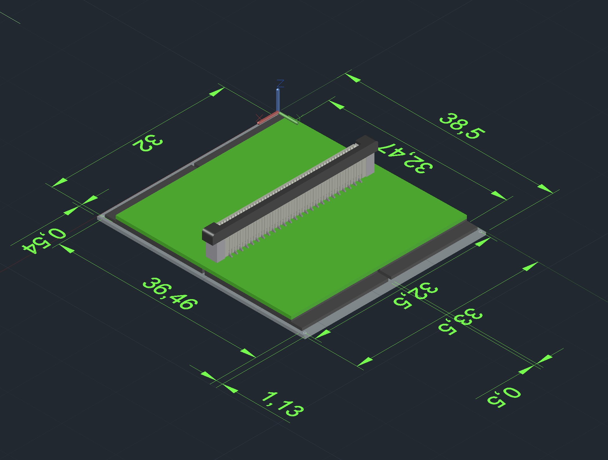

Slide 12
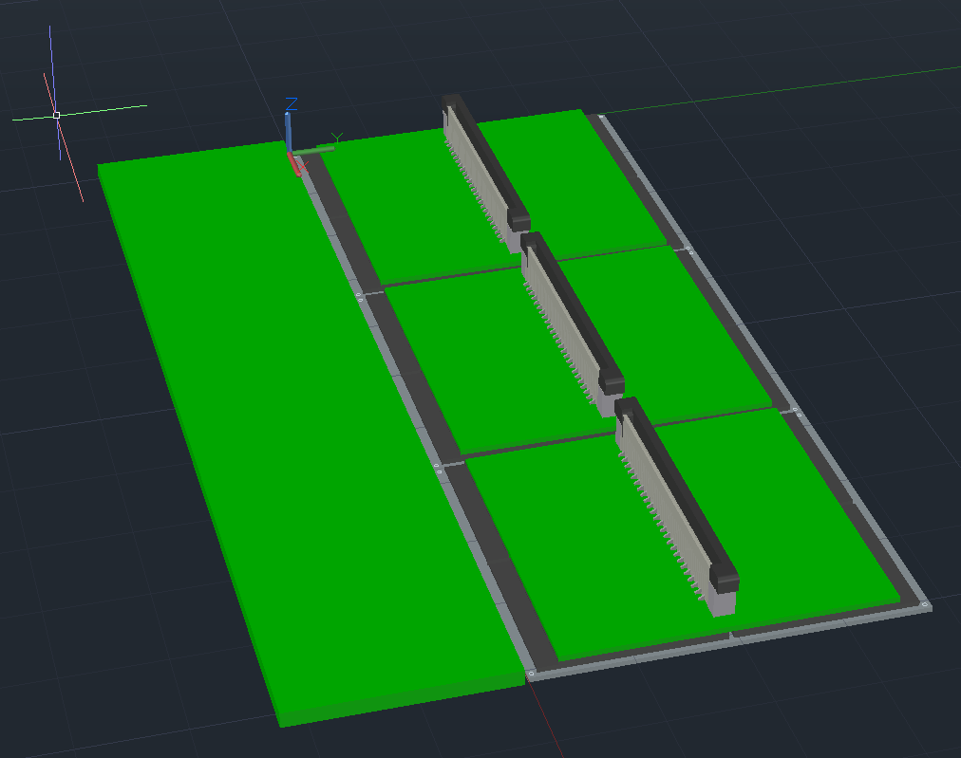
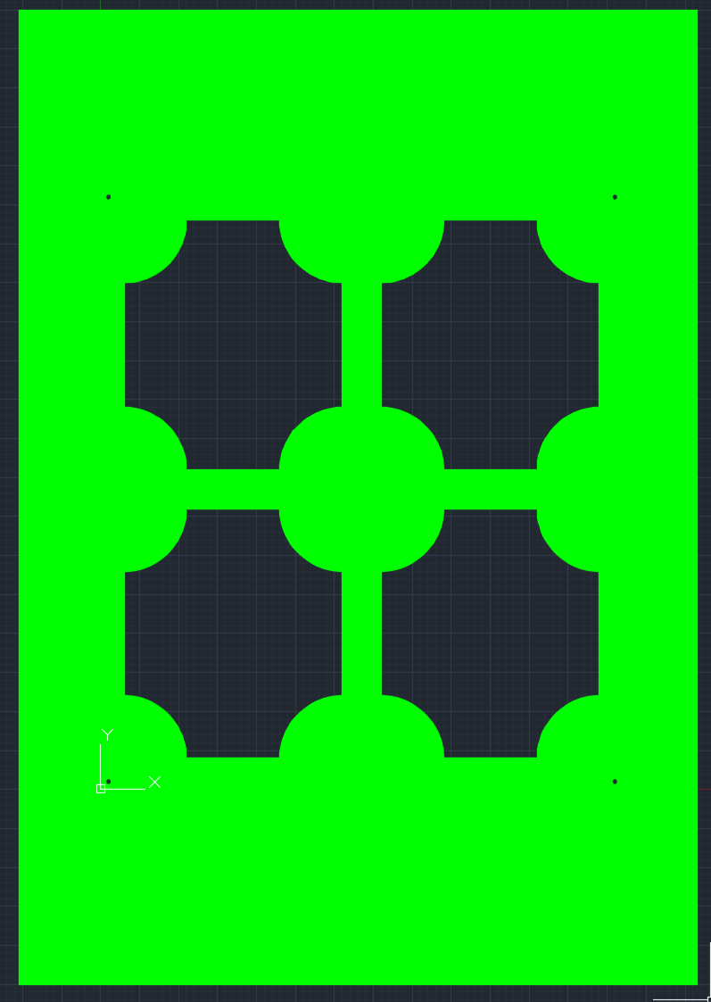
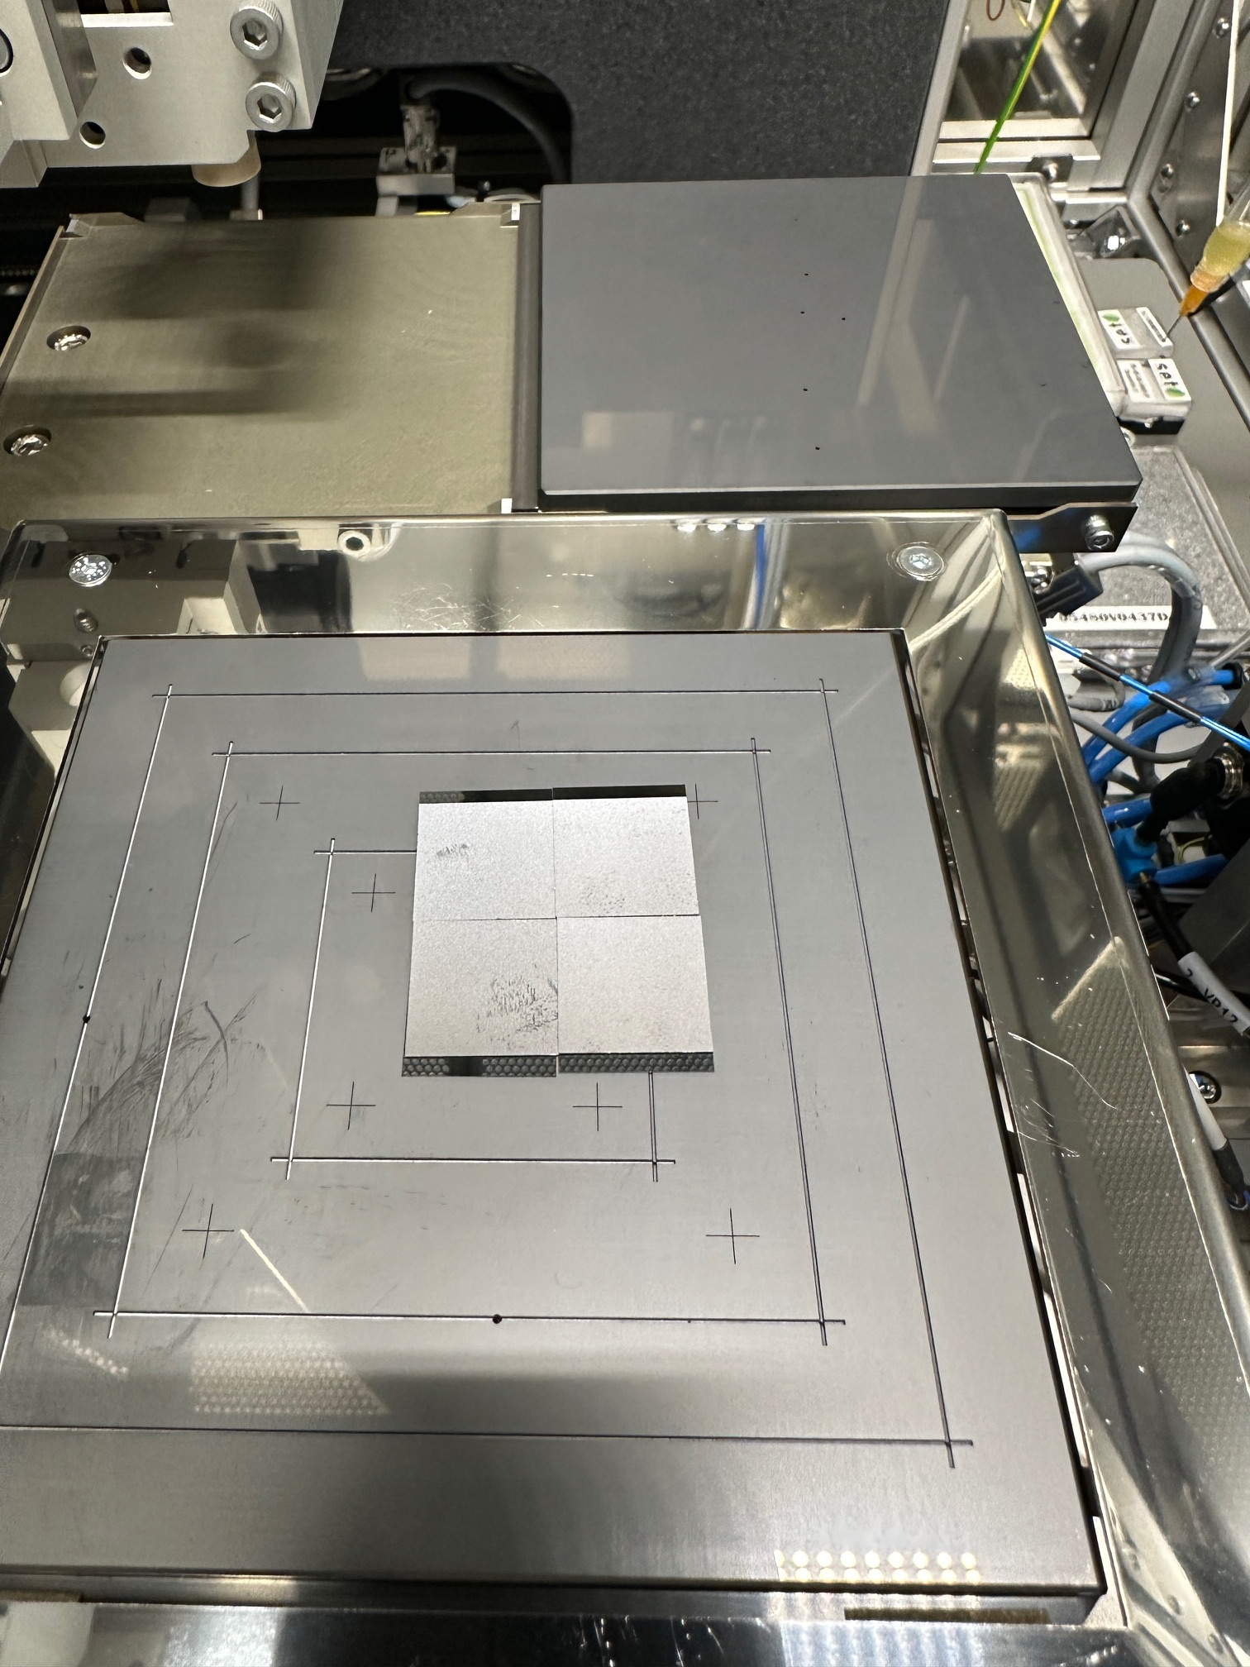
Module Assembly
Prototype 0 (Show and tell) Summer 2025
We are assembling mechanical prototypes of assemblies at ORNL (1.6x1.6cm Sensor, 1.6x1.8cm ASIC)
Rather quick to make , can make enough of a few modules
Purchased AlN plates (0.3,0.5mm) that we will laser dice to hold assemblies
Mounted with dummy PB&RB
Prototype 1 (Thermo-mecanical) Q4 2025
We plan on doing lithography in-house to make ASIC and Sensor heaters that can be WB to flex/PCB
Assemble following prototype 0 geometry for thermal testing on stave etc .
Prototype 2 (Functional EICROC1 + Dummy LGAD) Q2-3 2026
Demonstrate power distribution, readout (even if not final scheme)
Can be used for more realistic thermal testing

Slide 13
Super Modules
Readout board and Power Board
The boards will be produced and populated at manufacturer and delivered to integration site
Board will be tested with Modules at integration site
Board get mounted on support board for integration to support structure
Connection between module and board done via flex/cable to allow alignment mismatch and thermal expansion and contraction
Module
3
ROB
PWRB
Support

Slide 14
Final assembly of fTOF
“Super” Module
800
Support structure
Support structure will be produced by manufacturer/University and delivered to integration site
Manifolds for cooling and patch panels integrated to structure
Super modules are mounted on structure and cabled to patch panel for final integration tests
Attachement is reworkable to allow to remove bad modules during that step
Cabling and Fibers
PP0
Cooling services

Slide 15
Disscussion

