Slide 1
Status report ToF Simulations and Software Kentaro Kawade Shinshu Univ. on behalf of the ePIC ToF simulation team

Slide 2
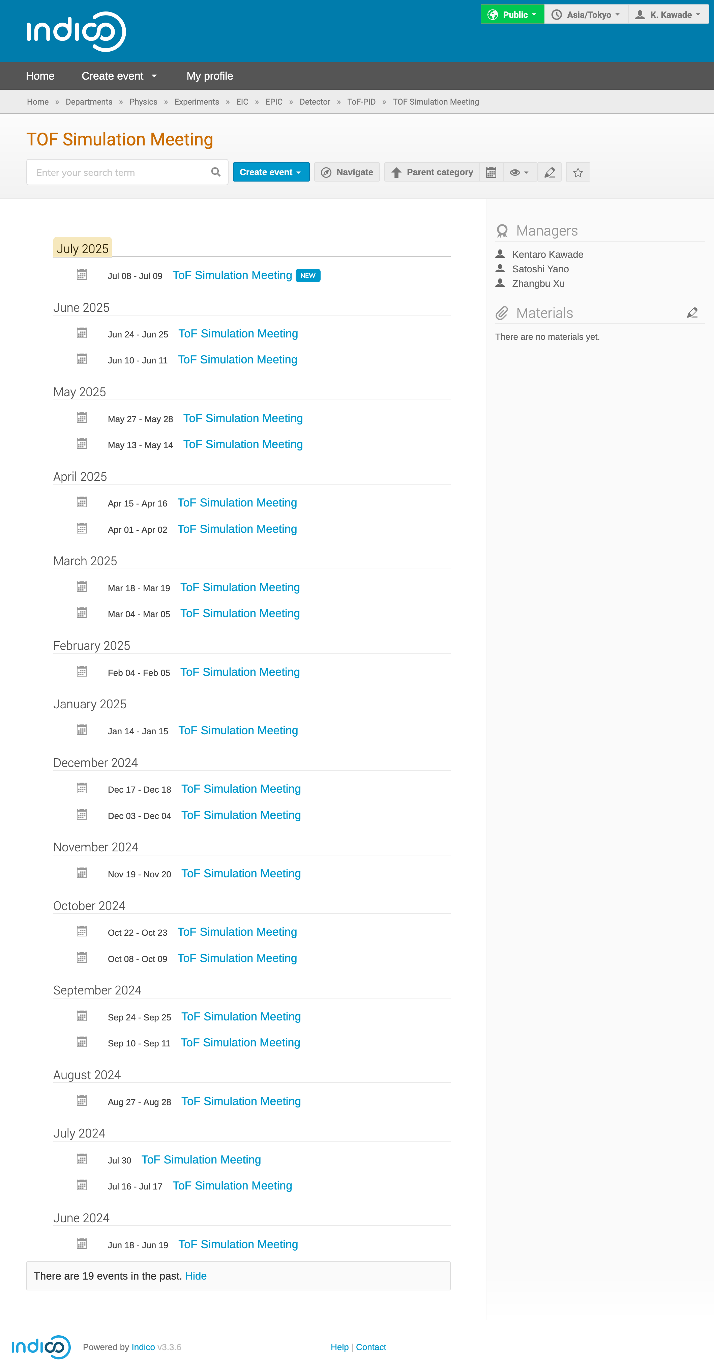
ToF Simulation Working Group
https://indico.bnl.gov/category/569
Coordinators
Kentaro Kawade, Tommy Tsang Chun Yuen
Holding biweekly meeting since June 2024
Current Activities
Tommy (KSU)
Digitization for BToF
Implement new ToF geometry/design
Honey Khindri (IIT Madras)
Digitization for EToF
Kyohei Ono
Impact of ToF material budgets on hpDIRC resolution
Kentaro Kawade
Evaluate PID performance

Slide 3
ToF Digitization Tommy and Honey
ToF (AC-LGAD) brief software status on PID session

Slide 4
BToF; Digitization work-flow design
Already pushed to main branch
Start
Geant4 hit
Edep & time in cells
Charge sharing
Pulse Generation
Pulse Combiner
ADC and TDC
in sensor
Hit Association
Pulse Digitization
Pulse Discretization
Calibration
Trying to push in [PR]
Clustering
Tracking
Coupling of clusters and tracking is a next step
Tracking

Slide 5
Calibration, clustering and Hit association
Calibration of TDC to time is just a linear transformation
Same for ADC
No time walk (slewing) correction
Clustering is just weighted average of neighbors
Group connected neighbors together
Hits are neighbors if Δt < 1ns
Weighted by E_{dep}
Time of a cluster = time of the earliest hit
No Edge correction
Association of reconstructed hit with true hits
They come from the same sensor
Time difference between the two hits < 1 ns
If there are multiple hits within 1 ns → choose the one with the smallest t difference
Time axis not shown
Cluster 1
Cluster 2
Cluster 3

Slide 6
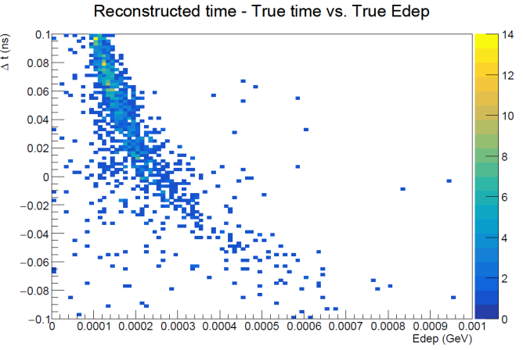
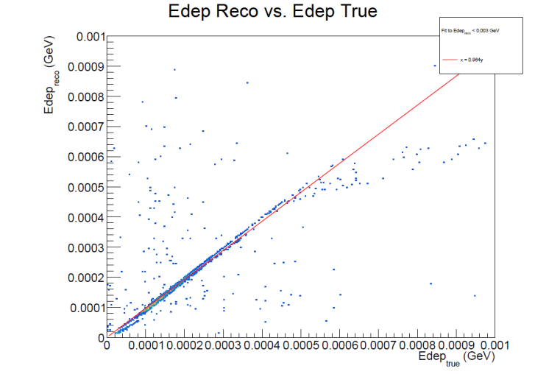
Clustering performance
Checking digitized ADC and TDC
Time walk as expected
Need to introduce time walk correction or CFD for BToF
Need to introduce noise on the pulse
Clustering worked fine
better ADC linearity
better phi resolution thanks to the charge sharing

Slide 7
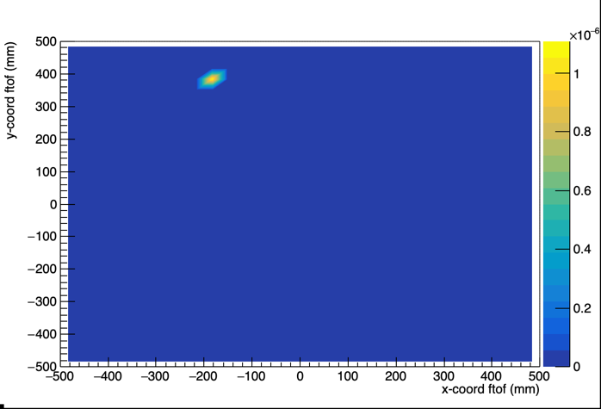
EToF; Current digitization work-flow design
Ongoing development based on BToF WF
Energy distribution of a single Hit in EToF
Distributed as expected
Tentative: 2D gaussian 1 mm width

Slide 8
Geometry updates in EPIC simulation

Slide 9
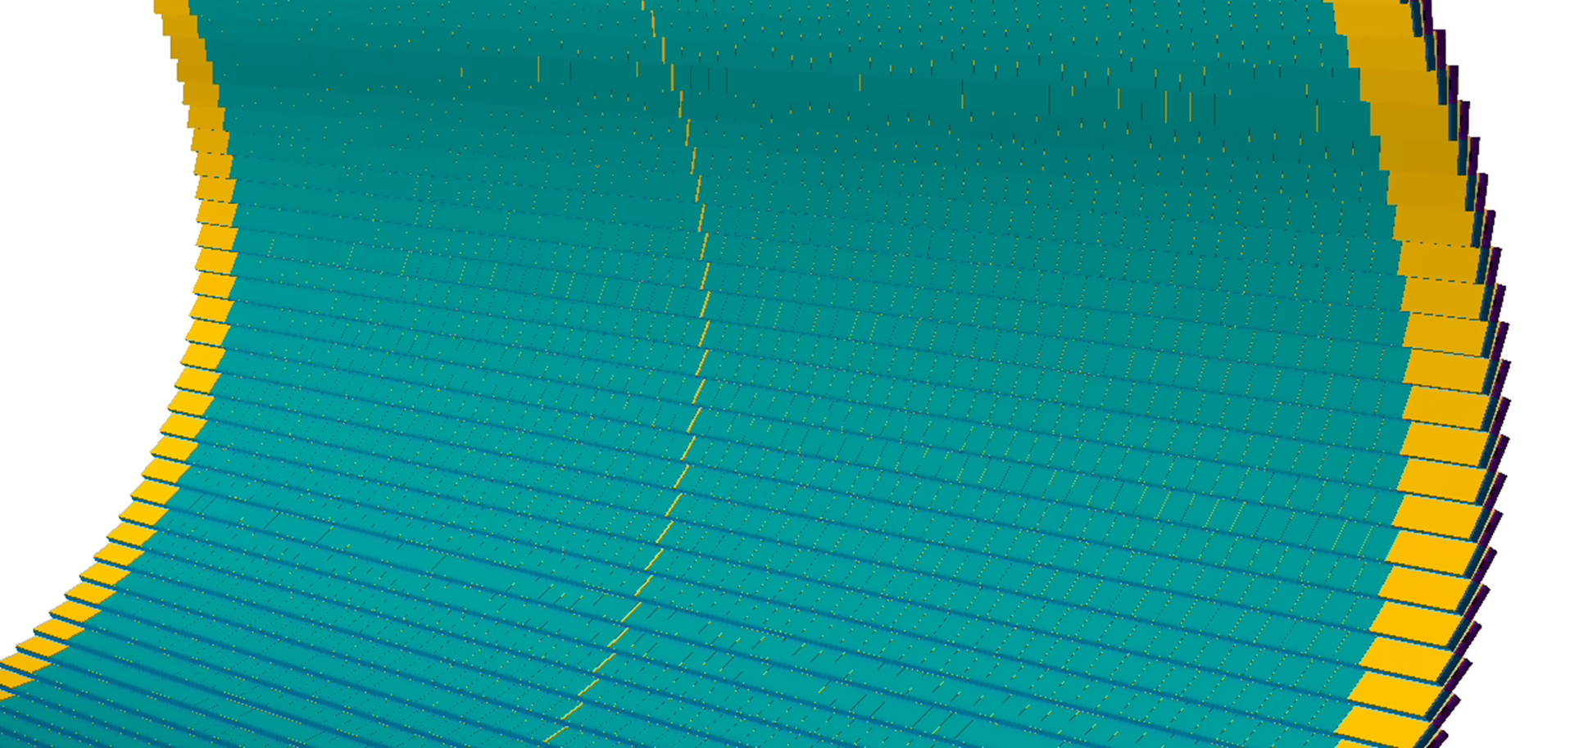
update: BTOF geometry
Before: Sensor on one side → New: Sensors on both sides
Cooling tubes in carbon form
Updated to match proposed drawing [Link]
Updated on May 2025

Slide 10
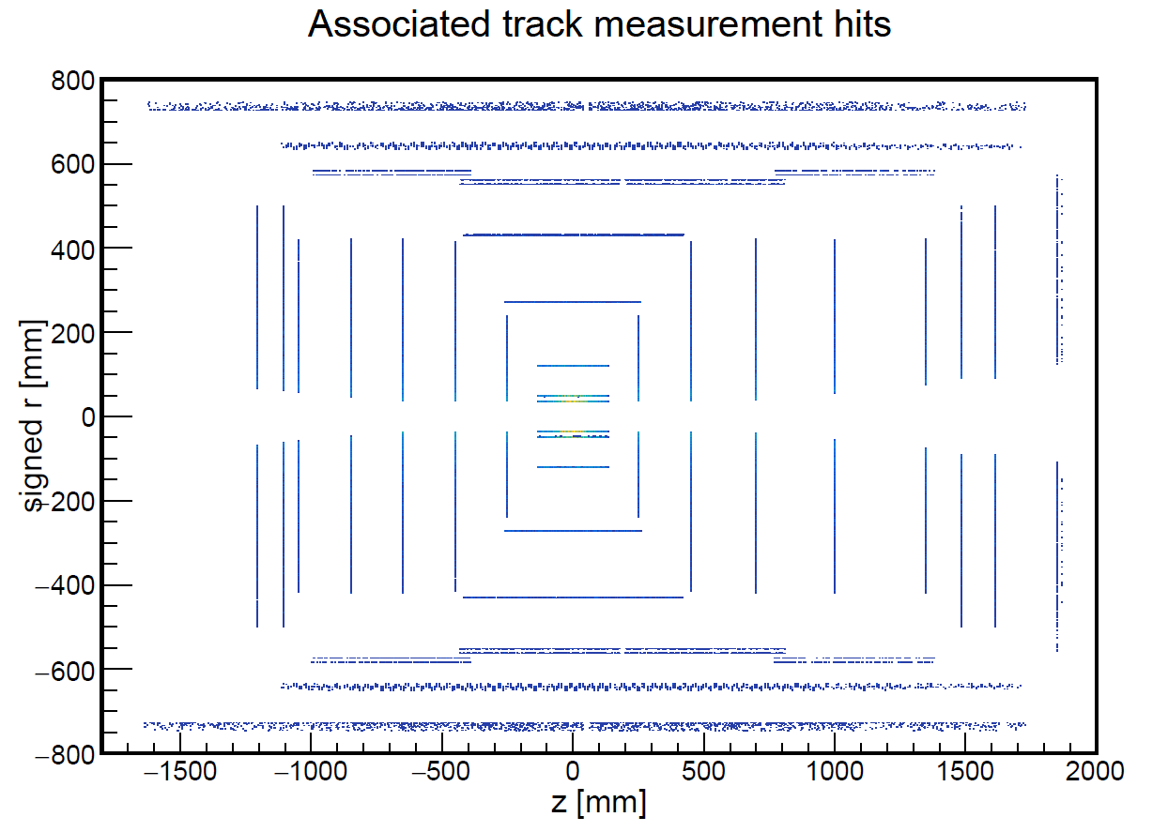
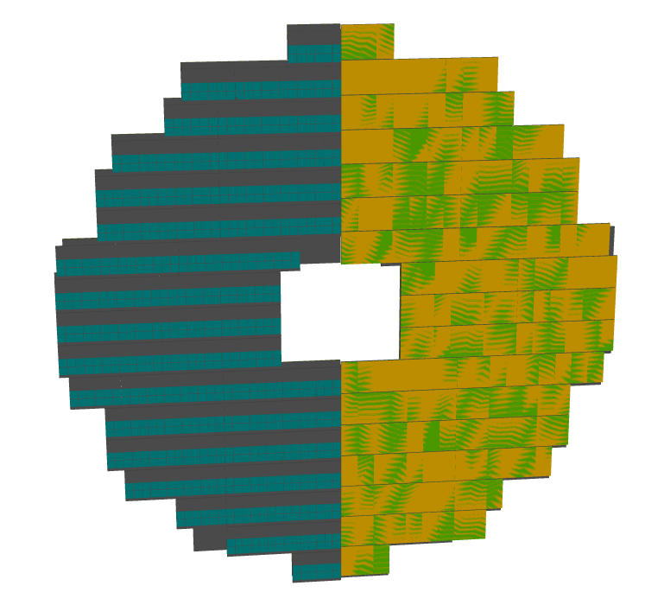
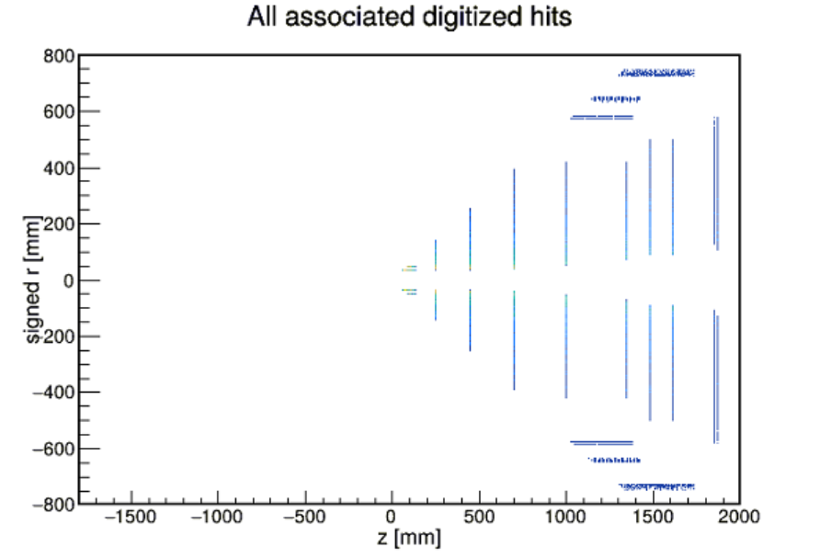
update: ETOF geometry
Issue: ACTS is unable to use tracking information on the back side of ETOF [Report]
Error with ETOF geometry implementation
Fixed in [PR]
Cover on the left removed to show sensors

Slide 11
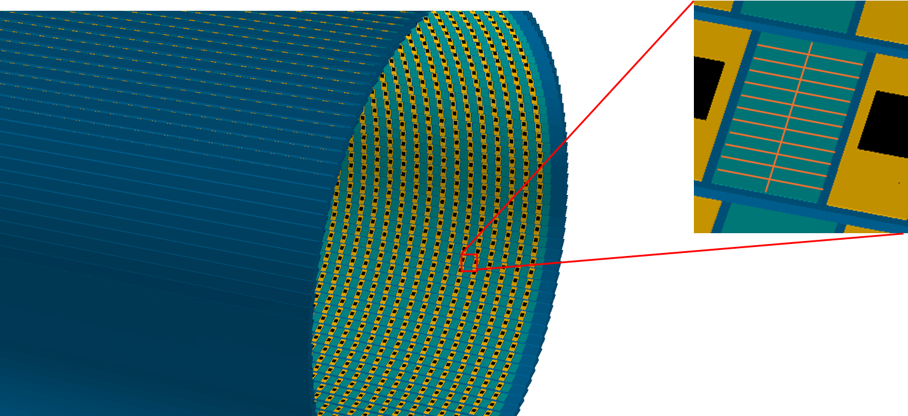
update: strip size
Realistic BTOF grid size: 0.5 cm * 0.5 mm
Realistic ETOF grid size: 0.5 mm * 0.5 mm
However, position better than 0.5 mm because of charge sharing (not yet implemented).
Reduced BTOF grid size to 0.5 cm * 0.1 mm
Reduced ETOF grid size to 0.1 mm * 0.1 mm
Grid size

Slide 12
Plans: Geometry and digitization
Time walk/edge correction
Use CFD instead of EICROC for BTOF
EICROC uses constant threshold, not constant fraction
Add noise to pulses
Add cooling tubes to ETOF
Realistic charge sharing parameters
Communicate with sensor R&D experts

Slide 13
Material effect Study Kyohei

Slide 14
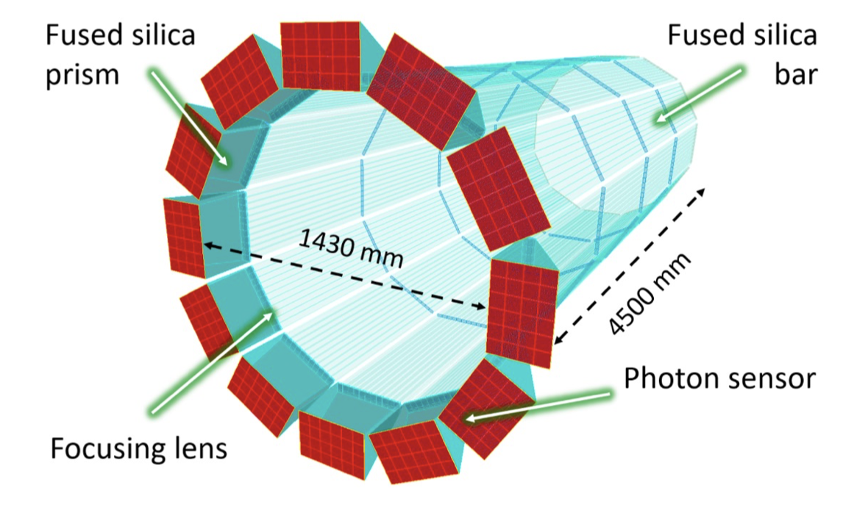
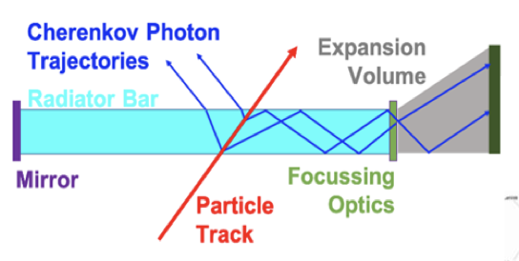
Motivation: Material budget
TOF (64cm) Outer MPGD (72.5cm) DIRC (75.5cm)
Estimate the impact of BTOF material budgets on the outer hpDIRC angular resolution
To optimize the BTOF design and performance
Crucial inputs for sensors, structures and readout PCBs to relax the tight requirement (1% X₀)
hpDIRC is a Cherenkov particle identification detector
→ Angular resolution at the surface is important
Target@6 GeV/c: Δθ = 0.5 [mrad]
Material budget of BTOF → Affects on angular resolution due to multiple scattering effects Determine the upper limit of the BToF material budget
hpDIRC: high performance Detection of Internally Reflected Cherenkov light

Slide 15
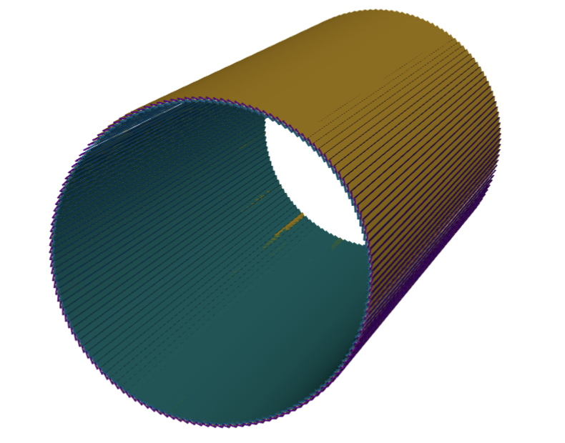
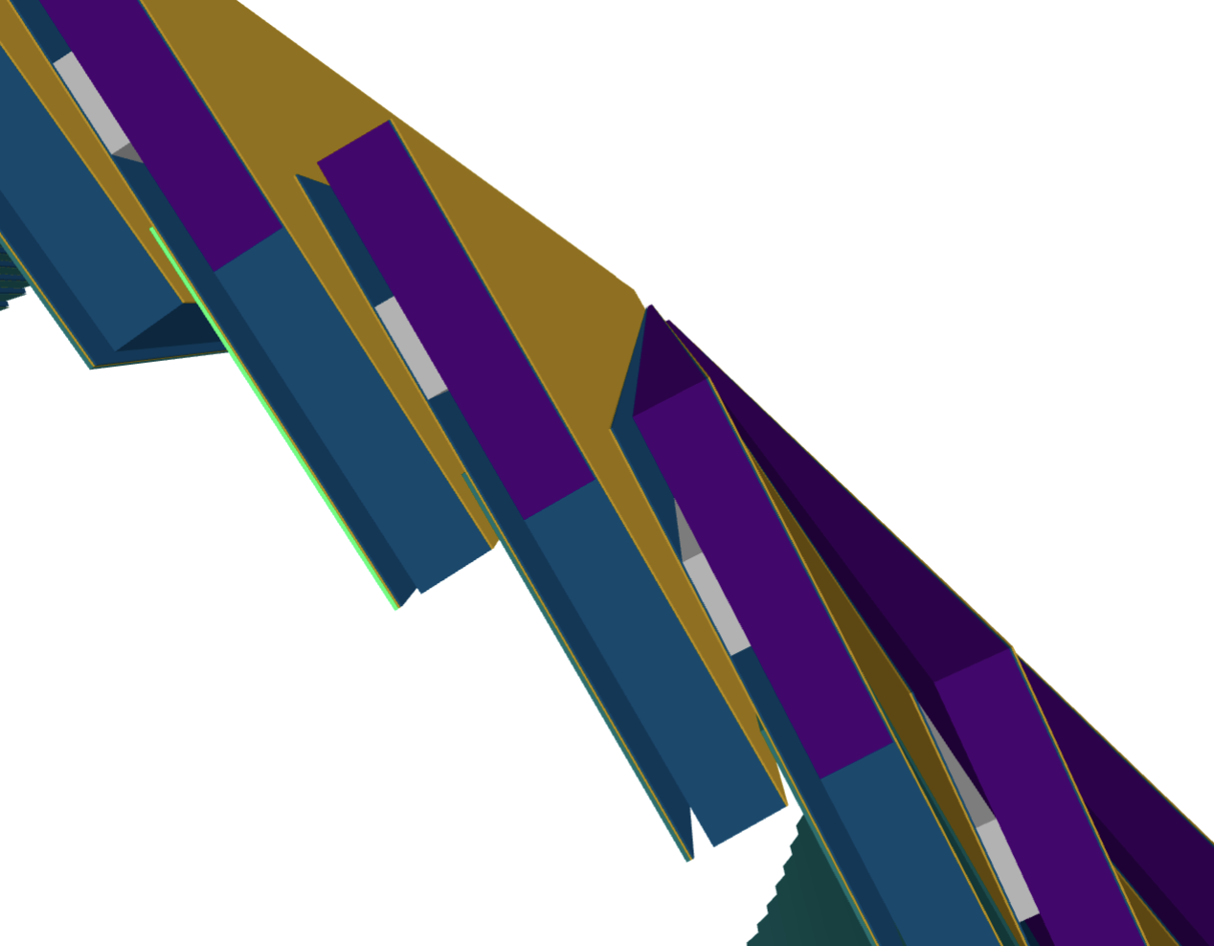
Simulation setup: Angle & Material Study
Original sensor position
Added sensitive layer at the hpDIRC surface
To take truth hit position at the surface
Different BToF Support structure materials
Carbon foam (default)：0.09 g/cm³ (0.12% X/X₀)
Carbon fiber : 1.5 g/cm³ (2.64% X/X₀)
Aluminum：2.65 g/cm³ (6.52% X/X₀)
Single particle full Detector simulation in DD4hep
Particle: $π^{−}$
Fixed Momentum: $1, 1.5, 2, 4, 6, 8, 10 GeV$
Direction
$φ$: $0^{°}≤φ≤{360}^{°}$
$θ$: $58°−62°, 68°−72°…$
EICrecon to perform tracking and calculate angular resolution
Take angular resolution using the “Residual method”
Dummy sensitive layer
BTOF Support structure

Slide 16
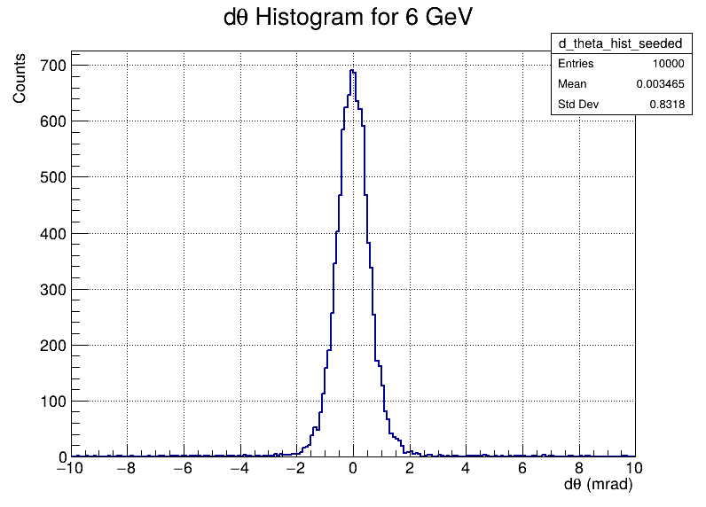
Calculate Angular Resolution -Residual method
Reconstruct tracks using all tracker hits with a Kalman filter
Propagate the fitted tracks to the hpDIRC surface → Use the intersection as a reconstructed hit position
Take difference of propagated track angles and truth hit angles
Resolution is given by Gaussian sigma Ex) $σ_{θ}=0.55 [mrad]$ $@ 6 GeV$
$$θ_{prop}=arctan2\left(\sqrt{{p_{x}}^{2}+{p_{y}}^{2}},p_{z}\right) \\ φ_{prop}=arctan2(p_{x},p_{y})$$
$∆θ$ @6GeV
$$∆θ=θ_{prop} −θ_{truth}$$
$$∆φ=φ_{prop} −φ_{truth}$$
epic 25.06.0
EICrecon 1.26.0
$0.55 [mrad]$
$$θ_{prop} −θ_{truth}[mrad]$$

Slide 17
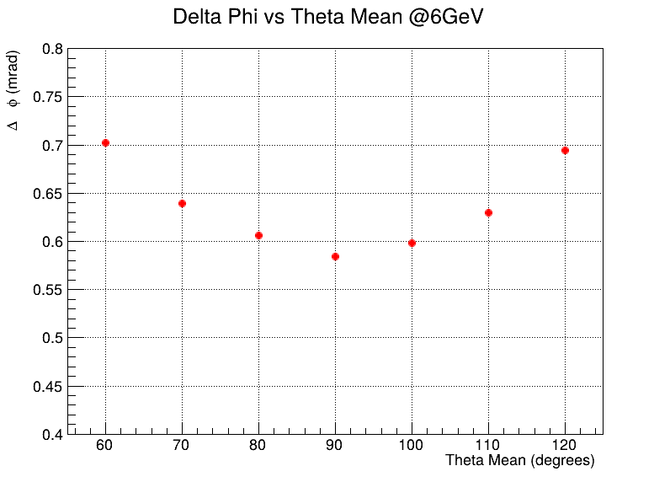
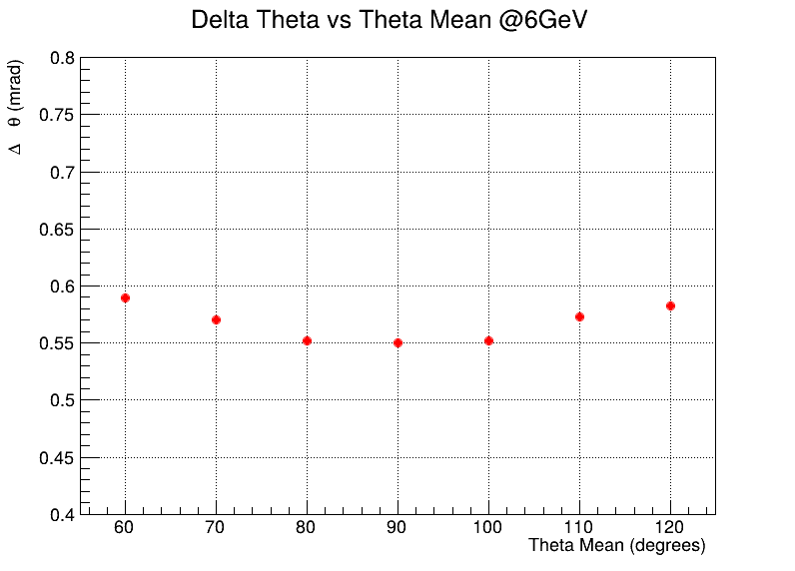
Angular Resolution vs. angle
Best resolution achieved at θ ≈ 90° (as expected)
But; Still does not match the requirement “0.5 mrad @ 6 GeV”
$$σ_{φ} vs direction angle θ mean @6GeV$$
$$σ_{θ} vs direction angle θ mean @6GeV$$
epic 25.06.0
EICrecon 1.26.0
epic 25.06.0
EICrecon 1.26.0
$$σ_{φ}[mrad]$$
$$σ_{φ} =0.58[mrad]$$
$$σ_{θ}[mrad]$$
$$σ_{θ}=0.55[mrad]$$
Detector Requirements 0.5mrad @ 6GeV

Slide 18
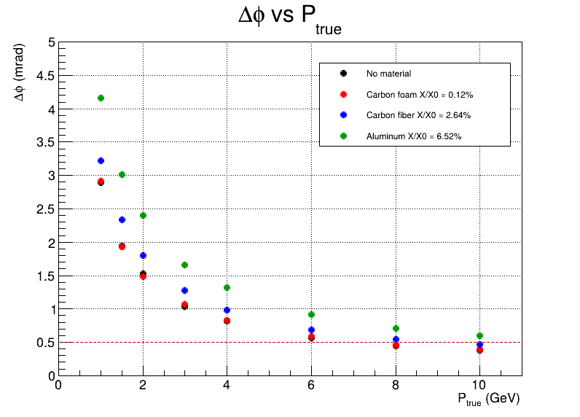
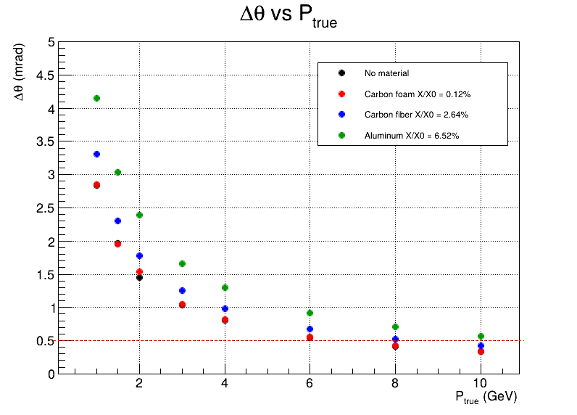
Angular Resolution for different Materials
Slight performance degradation observed with increasing material budget
Carbon foam keep the resolution close to requirement
But, not very sensitive to material budget → Can ToF be more dense?
$$σ_{φ} vs Momentum[GeV]$$
$$σ_{θ} vs Momentum[GeV]$$
$$σ_{φ}[mrad]$$
$$σ_{θ}[mrad]$$
epic 25.06.0
EICrecon 1.26.0
epic 25.06.0
EICrecon 1.26.0
Detector Requirements 0.5mrad @ 6GeV

Slide 19
Sensor Position Study Kyohei

Slide 20
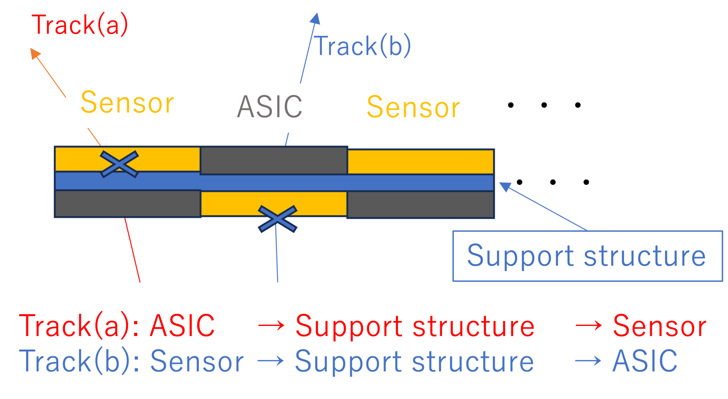
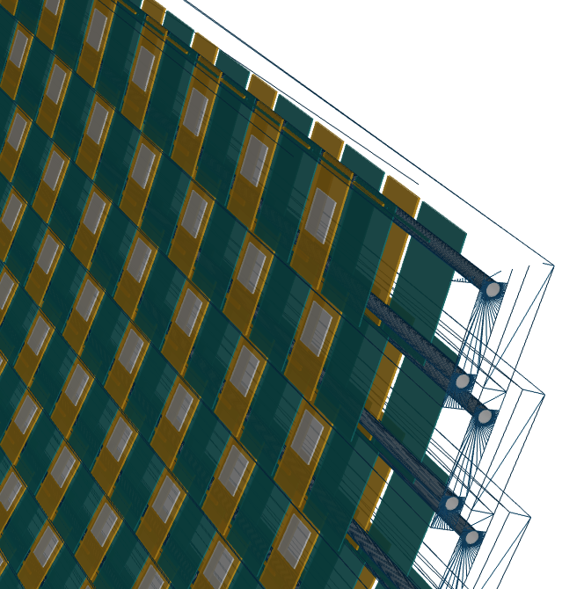
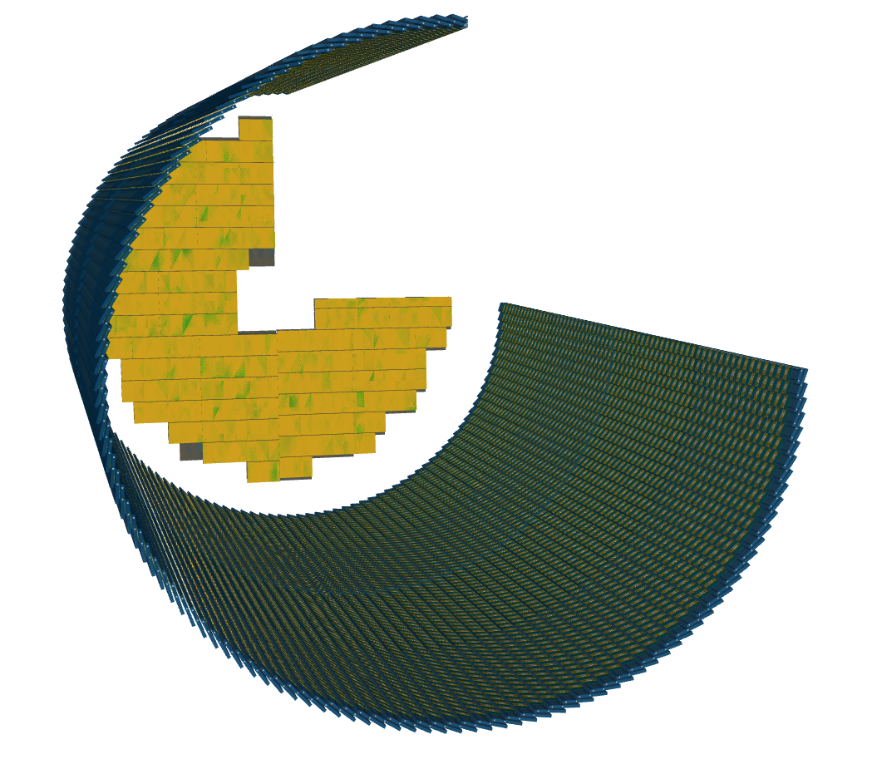
Sensor Position Study: Motivation
Barrel TOF layout:
Si sensor → ASIC → Si → ASIC → ...
Both sided structure
The total material amount varies depending on the sensor position
Inner sensor hit: Sensor → Support structure → ASIC
Outer sensor hit: ASIC → Support structure → Sensor
Insensitive to scattering?

Slide 21
Simulation setup: Sensor Position Study
Particle gun：$π^{−}$
Events：10,000
Particle direction：
① Inner sensor only hits: $269°≤φ≤271°$, $87.97°≤θ≤88.03°$
② Outer sensor only hits: $269°≤φ≤271°$, $85.97°≤θ≤86.03°$
③ Both sensors hits: $269°≤φ≤271°$, $85°≤θ≤89°$
Fixed Momentum：$1, 2, 3, 4, 6, 8, 10 GeV$
Recent simulation versions
epic version：25.06.0
EICrecon version: 1.26.0
Take angular resolution with Residual method

Slide 22
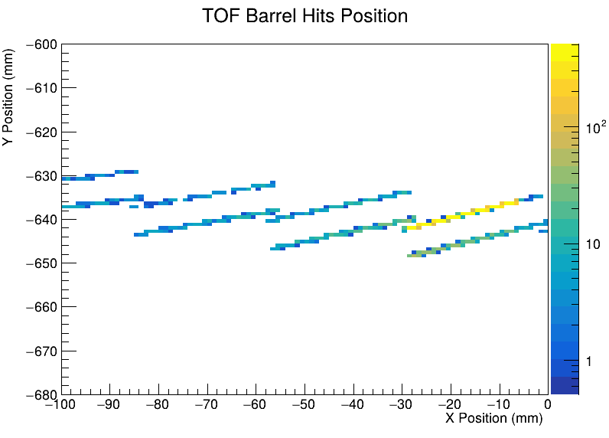
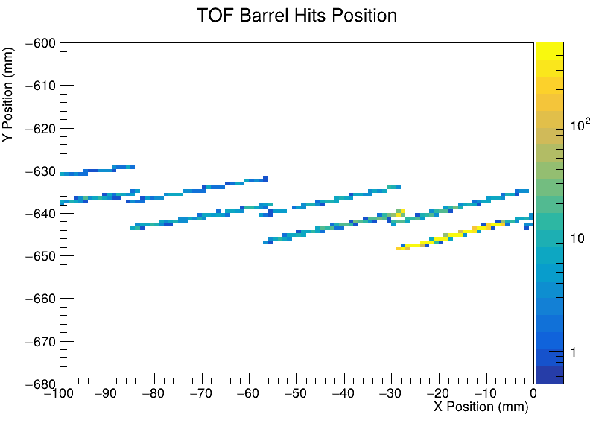
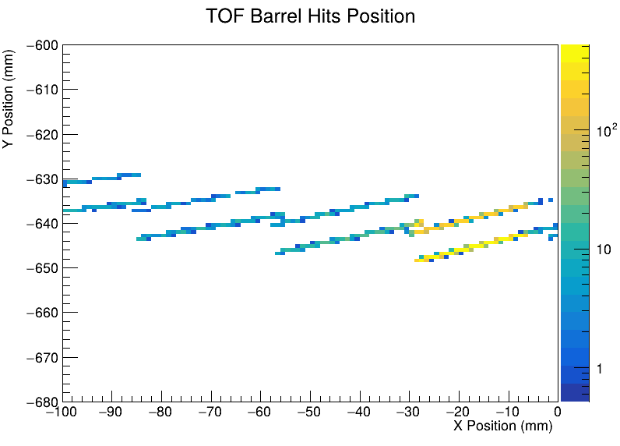
Sanity Check: BTOF Sensor Hit Distribution
Looks OK for X-Y hit distribution
Note: Maps integrate over Z-axis
Inner Only | Outer Only | Both side

Slide 23
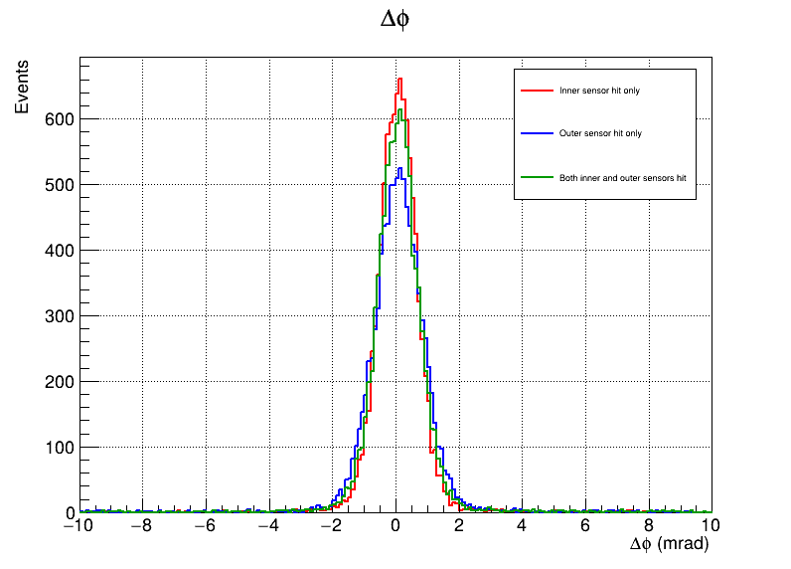
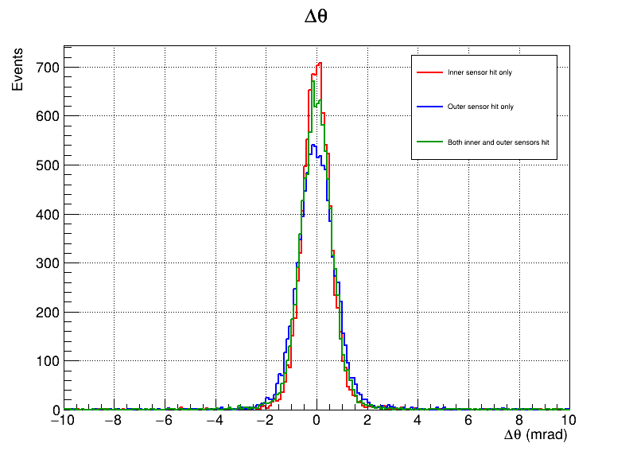
$∆φ$, $∆θ$ by Sensor Position @ 6GeV
The inner sensor has better angular resolution than the outer sensor
$∆φ$ $@6GeV$
$∆θ$ $@6GeV$
$$Entries$$
$$Entries$$

Slide 24
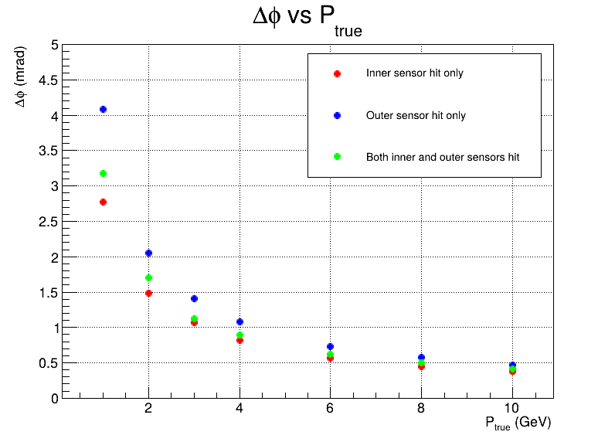
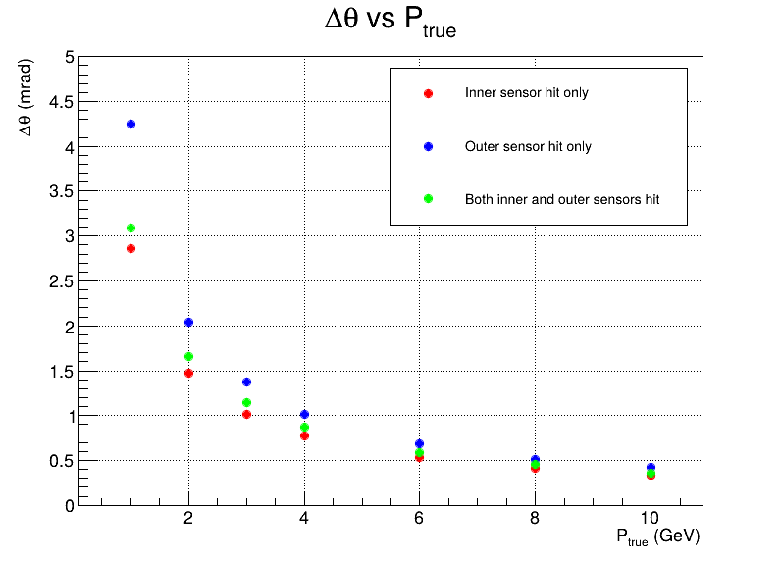
Angular Resolution vs Momentum by Sensor Position
Angular resolution varies significantly with hit location.
→ Certain structural layouts may achieve even better resolution than current designs.
$$σ_{φ} vs Momentum$$
$$σ_{θ} vs Momentum$$
$$σ_{φ}[mrad]$$
$$σ_{θ}[mrad]$$
Inner: 0.56 mrad
Outer: 0.72 mrad
Both: 0.63 mrad
Inner: 0.53 mrad
Outer: 0.68 mrad
Both: 0.59 mrad

Slide 25
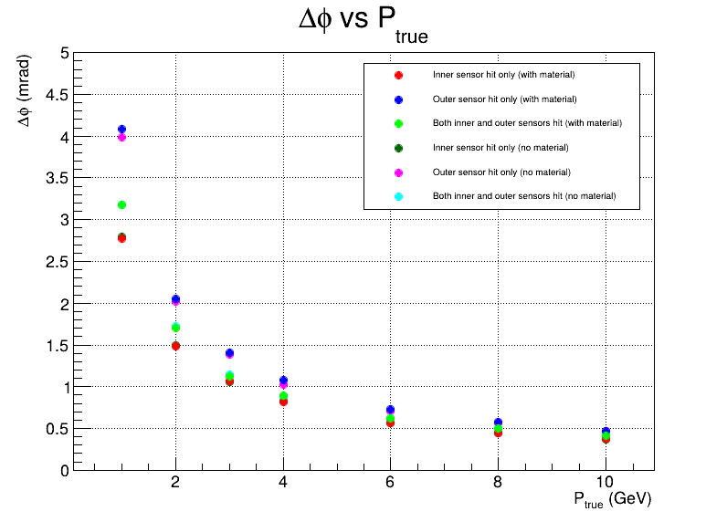
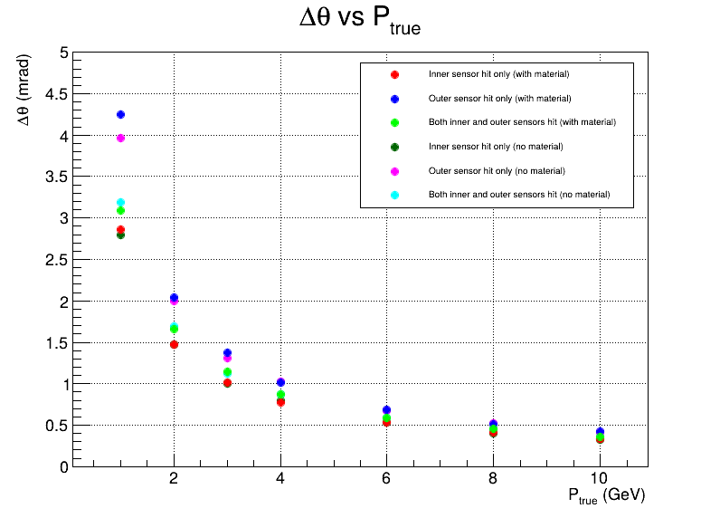
Angular Resolution vs. Momentum by Sensor Position
Position dependent angular resolution gap remains even in the no material baseline.
→ Difference is not driven by support structure material.
The cause of the effect of the position is still under investigation.
$$σ_{φ} vs Momentum$$
$$σ_{θ} vs Momentum$$
$$σ_{φ}[mrad]$$
$$σ_{θ}[mrad]$$

Slide 26
Tentative summary
This study is ongoing to determine the upper limit of the material budget for BTOF and to optimize the detector design.
Angle & Material Study
Best θ and φ resolution at θ≈90°, but slightly less than the detector requirement of 0.5 mrad at 6 GeV
The TOF support material of the barrel can also be a decisive factor.
→ Lighter options (carbon foam) keep hpDIRC resolution close to spec, but heavier options can cause PID performance to decline
Sensor position study
Angular resolution varies significantly with hit location.
→ Certain structural layouts may achieve even better resolution than current designs.
Origin of the position effect is still under investigation.

Slide 27
TOF PID performance in recent ToF software and geometry Kentaro Kawade & Kyohei Ono
ToF digitization is fully ready yet, we are using artificial smearing for hit timing

Slide 28
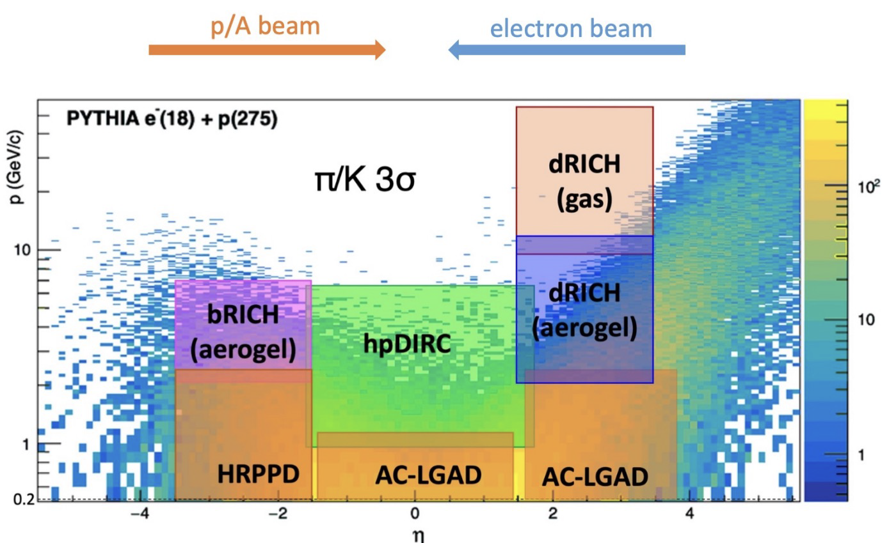
Intro: PID
Generators
Pythia NCDIS
N_{events}: 200k
Energy: 18x275 GeV
Particle Gun: pi/K/proton
N_{events}: 100k for each
$0.1 ≤p ≤5.0 GeV$
Eta&Phi: Flat
epic ver 25.04.1
Reconstruction framework
EIC Recon Version 1.24.2
Own developed offline analysis code
PID performance when considering finite timing resolution will be shown
This report focus on this only
ePIC PID requirement

Slide 29
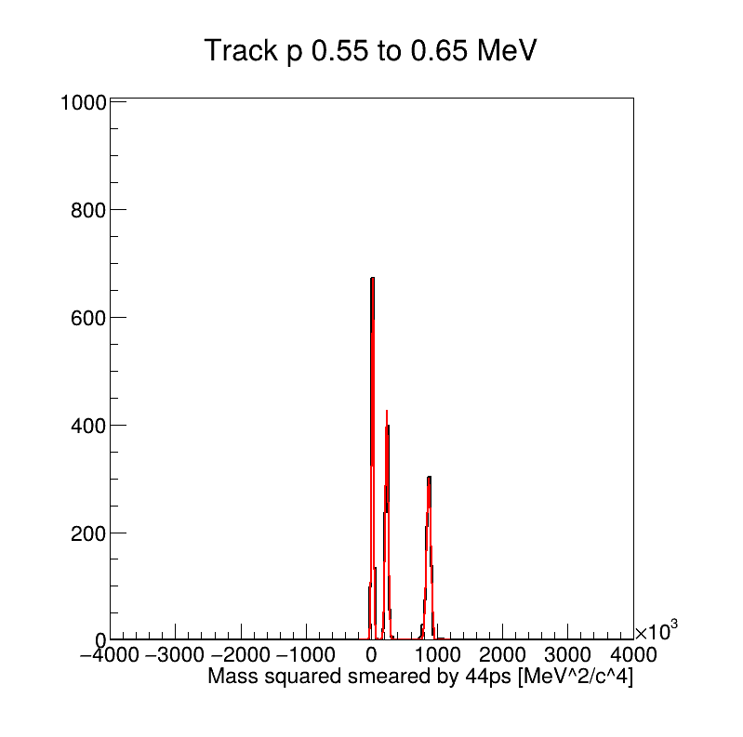
PID performance evaluation: Gaussian fit
Obtain each mass peak and its width
inclusive 3 gaussian fitting
Introduce Figure of Merit (FoM), to assess the PID performance quantitatively
μ: mass² peak position
σ: gaussian width
pion Kaon Proton

Slide 30
Results: 0. No smearing
FoM
3σ separation
pi/K Enough GeV
K/p Enough GeV

Slide 31
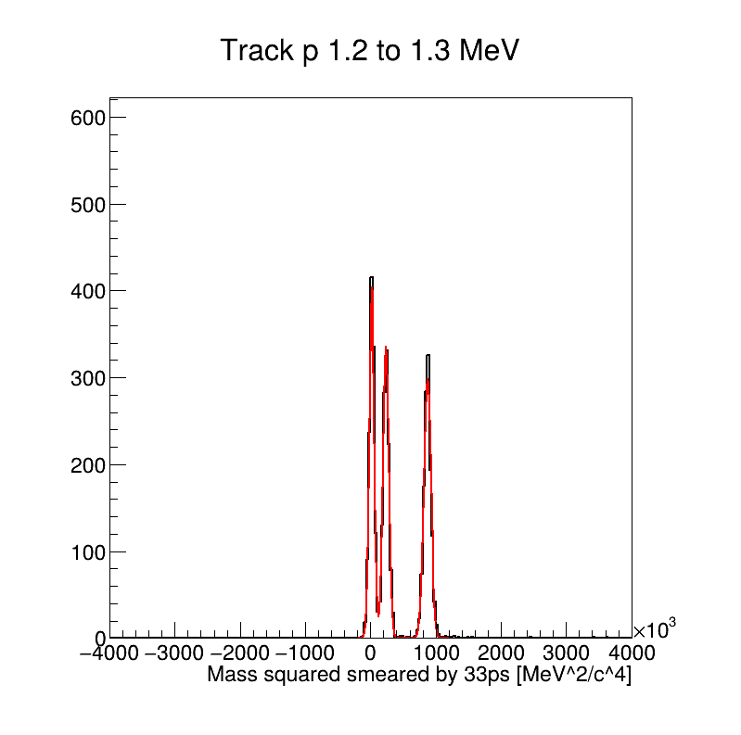
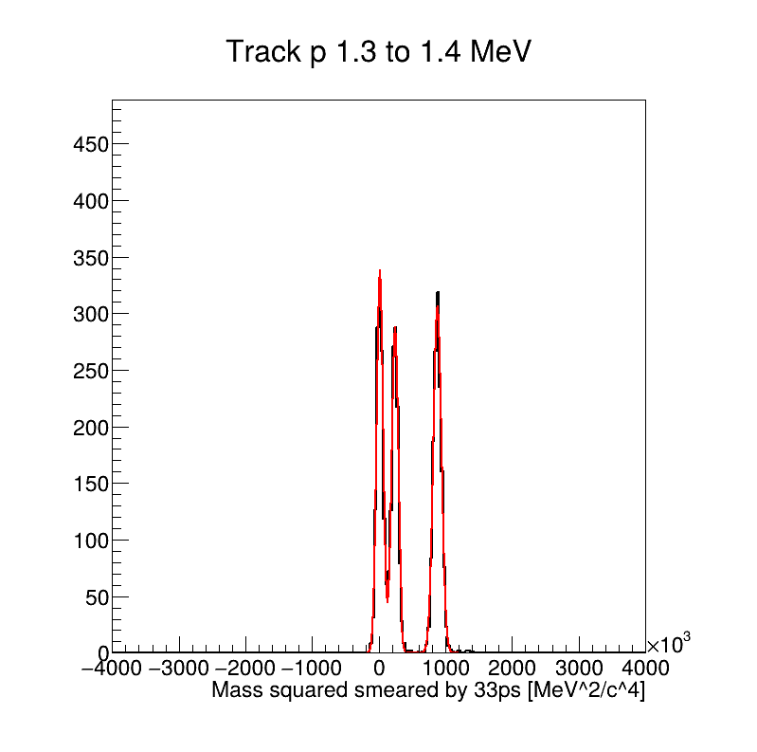
Results: 1. 33 ps smearing
FoM
3σ separation
pi/K 1.4 GeV
K/p 2.3 GeV

Slide 32
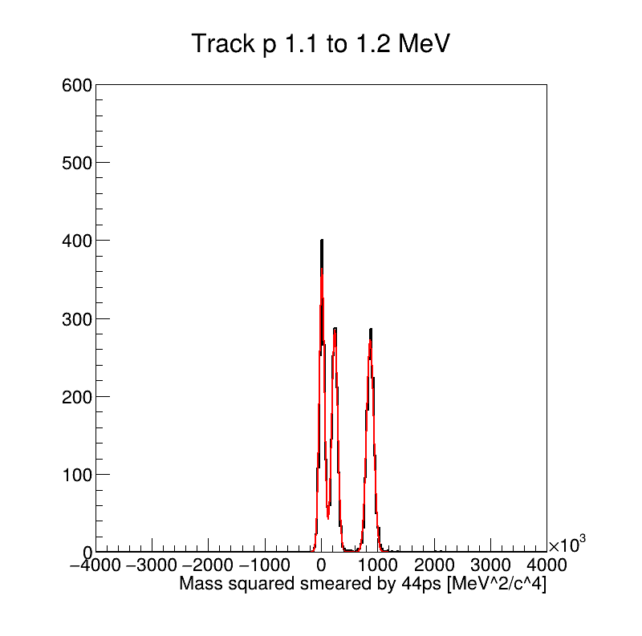
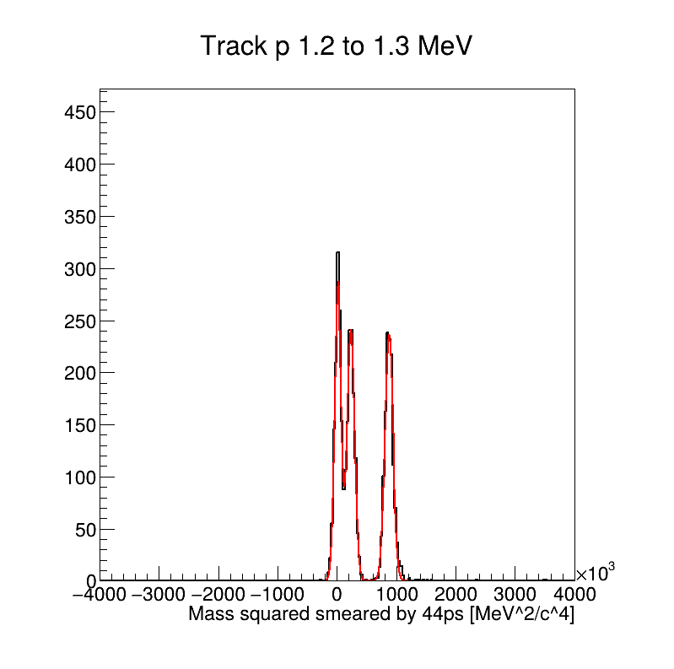
Results: 2. 44 ps smearing
This (44ps total timing resolution) is a realistic option
FoM
3σ separation
pi/K 1.2 GeV
K/p 2.1 GeV

Slide 33
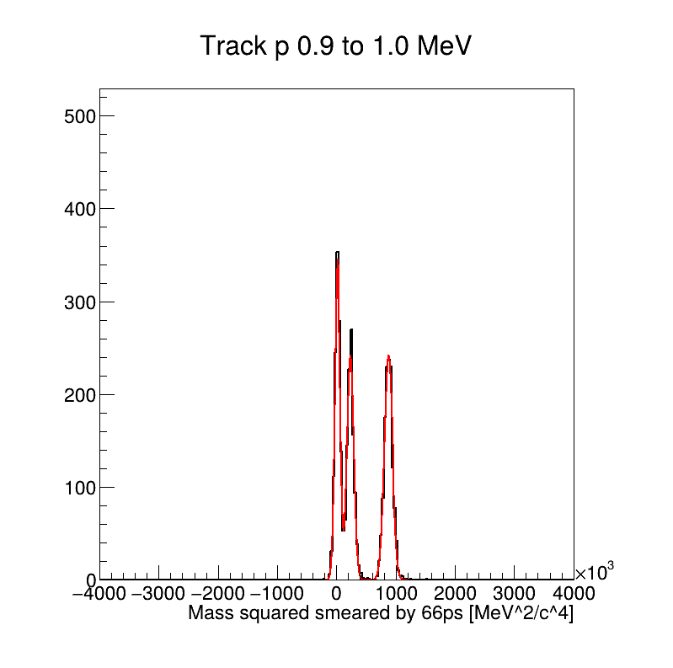
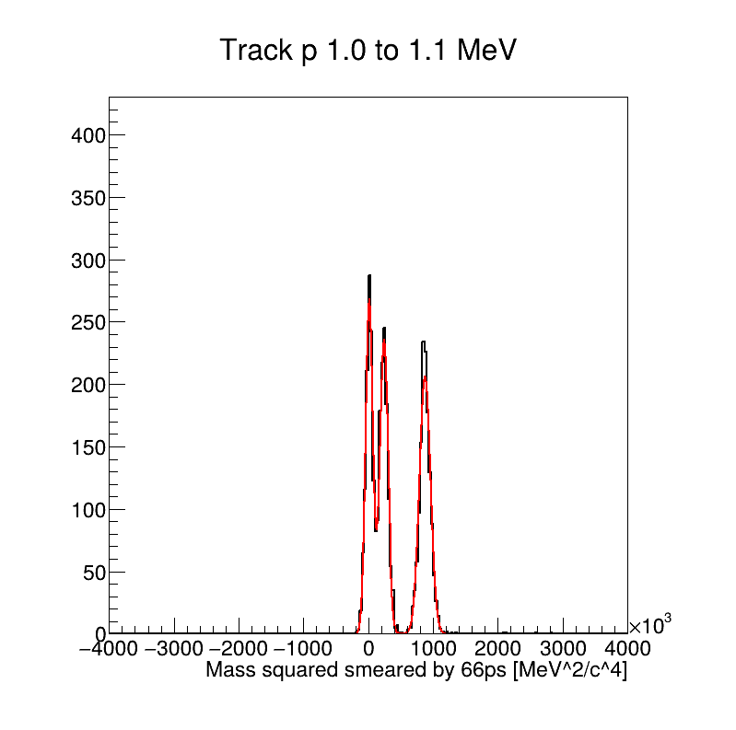
Results: 3. 66 ps smearing
FoM
3σ separation
pi/K 1.0 GeV
K/p 1.6 GeV

Slide 34
3σ separation power vs eta
Perform same analysis differentially

Slide 35
PID: Summary
PID performance study was performed based on single particle gun generator
Generate uniform pion/kaon/proton
Checked impact from finite timing and tracking pathlength resolution
Timing resolution is crucial for PID performance
Ex) 44ps timing resolution
3σ pi/K separation up to 1.2 GeV
3σ K/p separation up to 2.1 GeV
Todo
Study with PYTHIA eP collision
Basically consistent, no different beyond stat error
Perform same analysis for the EToF region (MC is ready)
Signal + Background sample

Slide 36
Summary and prospects
Digitization
Many progress on BToF/EToF digitization but there are still a lot of Todo items
Time walk/edge correction & Introduce CFD for BTOF
Add noise to pulses and etc.
Impact of BTOF material budgets on the outer hpDIRC angular resolution
Closed to the 0.5 mrad requirement for tracking
However, not very sensitive to the BToF material budget
How tracking resolution affects the overall PID performance at the hpDIRC? → Need input from hpDIRC
PID performance
Estimating PID performance with recent software & geometry
Looks fine for BToF, need to do for EToF as well
Plan; PID performance with signal + background samples

