Slide 1
fTOF Status
July 16th 2025, ePIC Collaboration meeting
Mathieu Benoit
ORNL

Slide 2
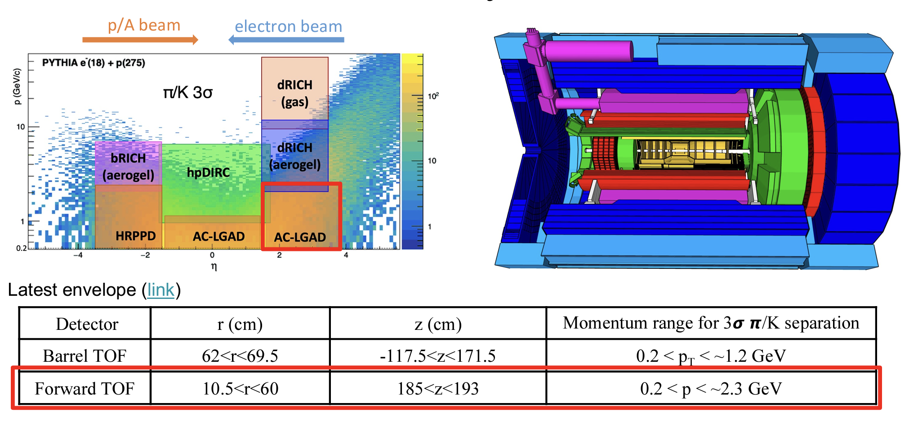
AC-LGADs TOF system for PID
185<z<193cm
Total fTOF Area ~ 1m²

Slide 3
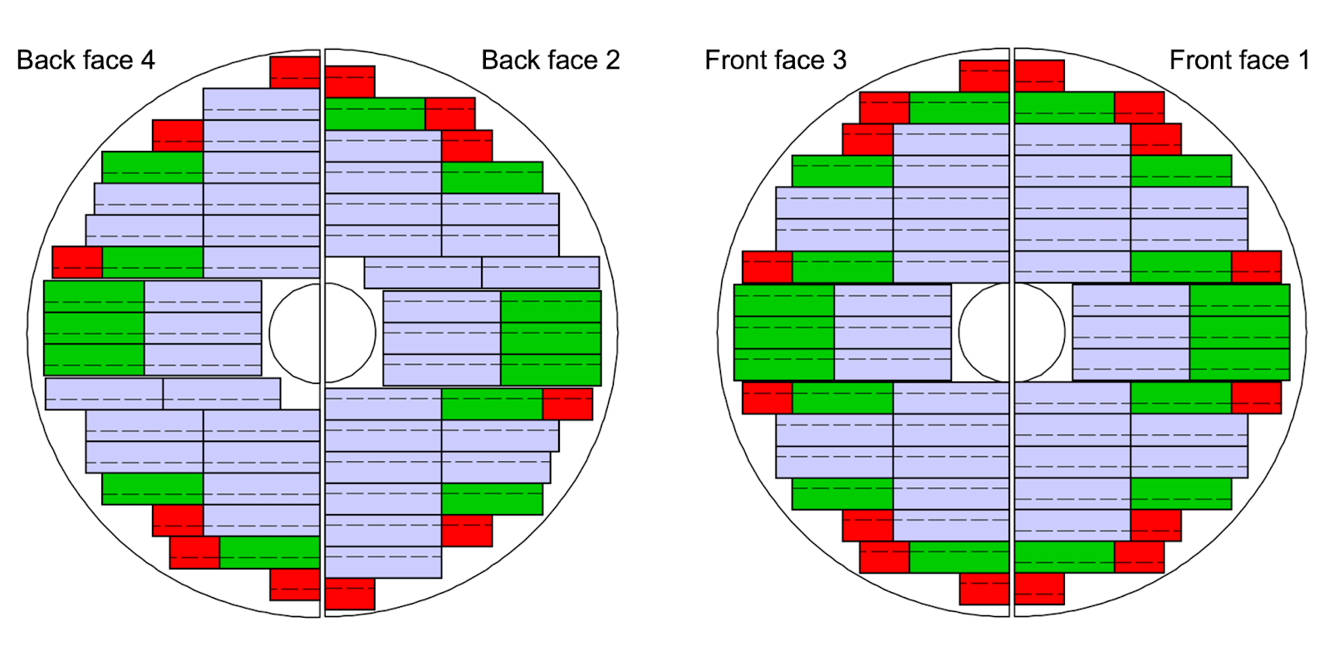
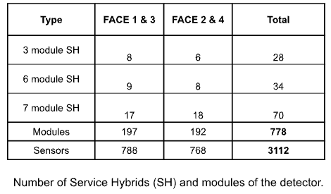
Forward TOF Detector Layout
To estimate the material budget, we consider the follow composition:
Sensor: 300 microns (0.3%X0)
ASICs: 400 microns (0.4%X0)
RB and PB PCB board: 2 mm kapton (0.7%X0)
Module PCB board: 0.6 mm kapton (0.2%X0)
Aluminium nitride (AIN) base plate: 0.5mm (1.1%X0)
Cooling and support: 5%X0 (Detailed design ongoing)
Total material budget is currently estimated to be: 7.7% X0

Slide 4
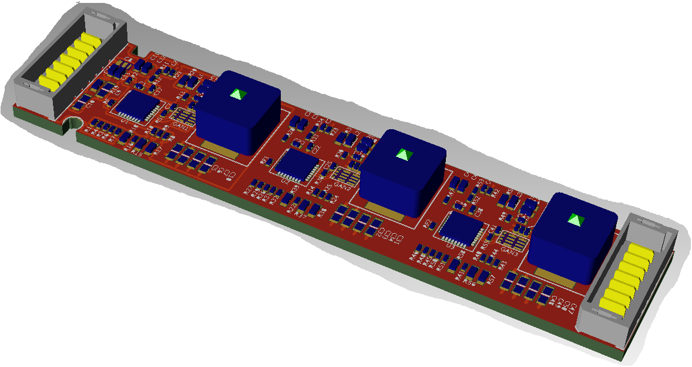
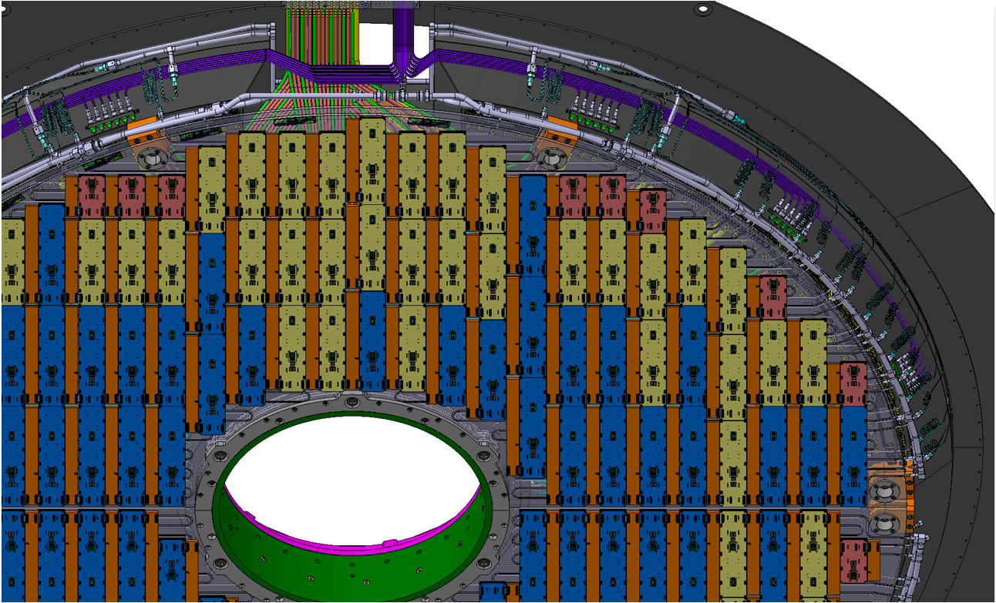
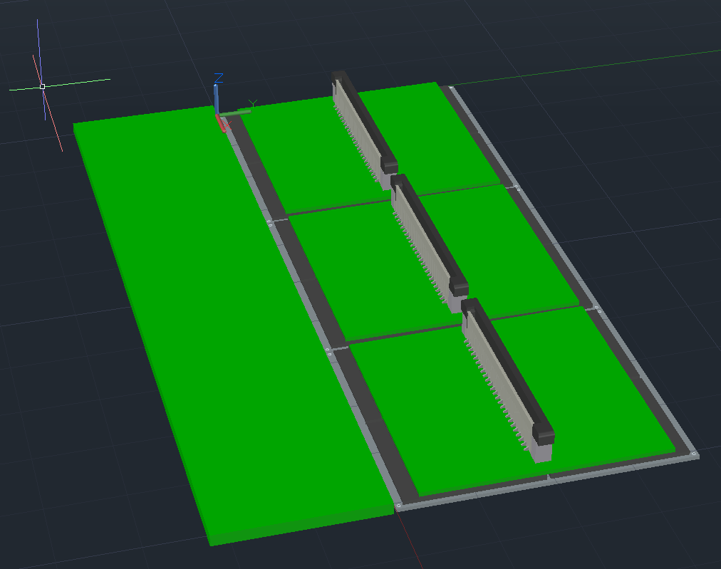
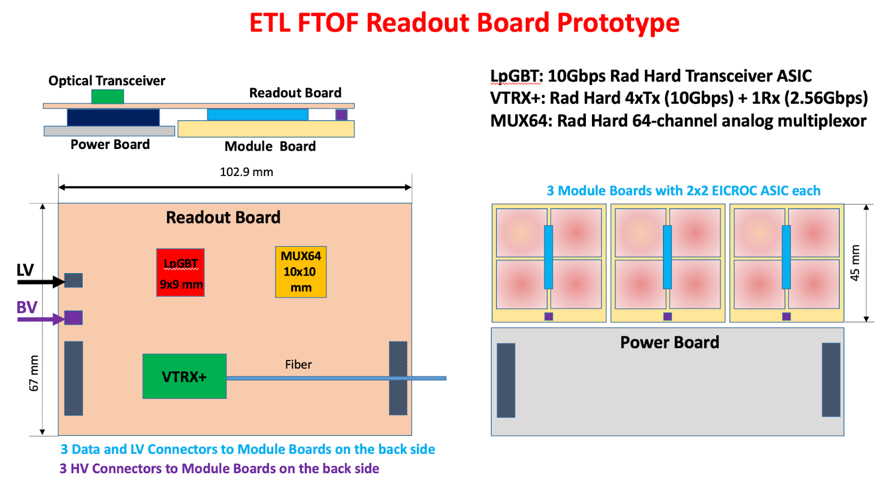
EIC fTOF Building Blocks
Modules
Service hybrids
Cooling and mechanical support

Slide 5
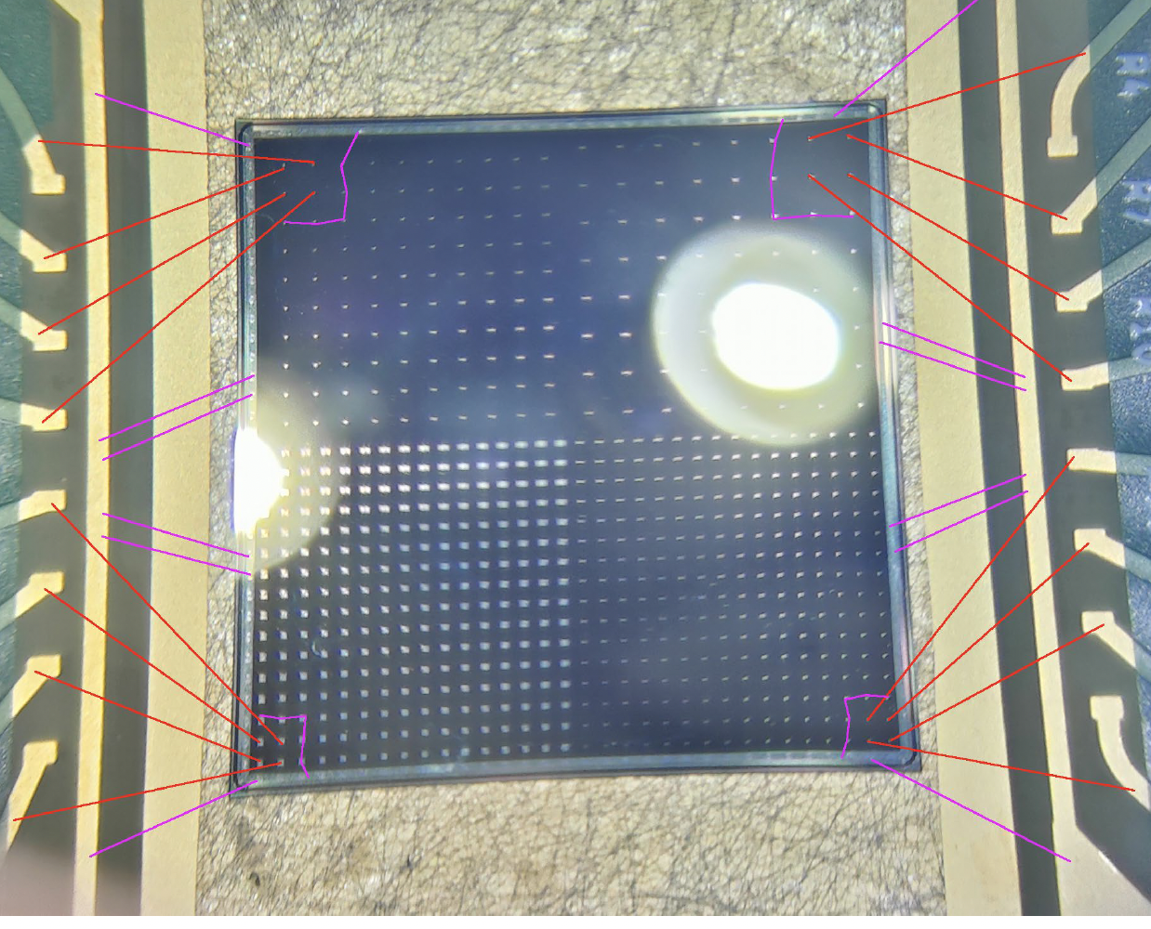
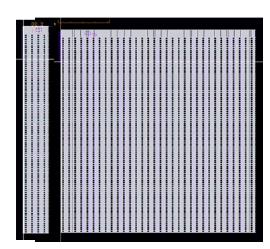
EIC fTOF modules
The EICROC will be the readout for the fTOF
EICROC1A(4x32)/1B(32x32) currently in design for submission this summer
EICROC0/A/B design completed (Frontend optimisation)
EICROC2 should be the final design for fTOF and far-forward, planned for tapeout in ~Q3 2026
HPK Sensor production for pixel in UCSC, first trials with EICROC1 when available (Q4 2025)
We are following closely CMS ETL efforts in developing their bump-bonding process. ORNL actively involved in developing flip-chip process.

Slide 6
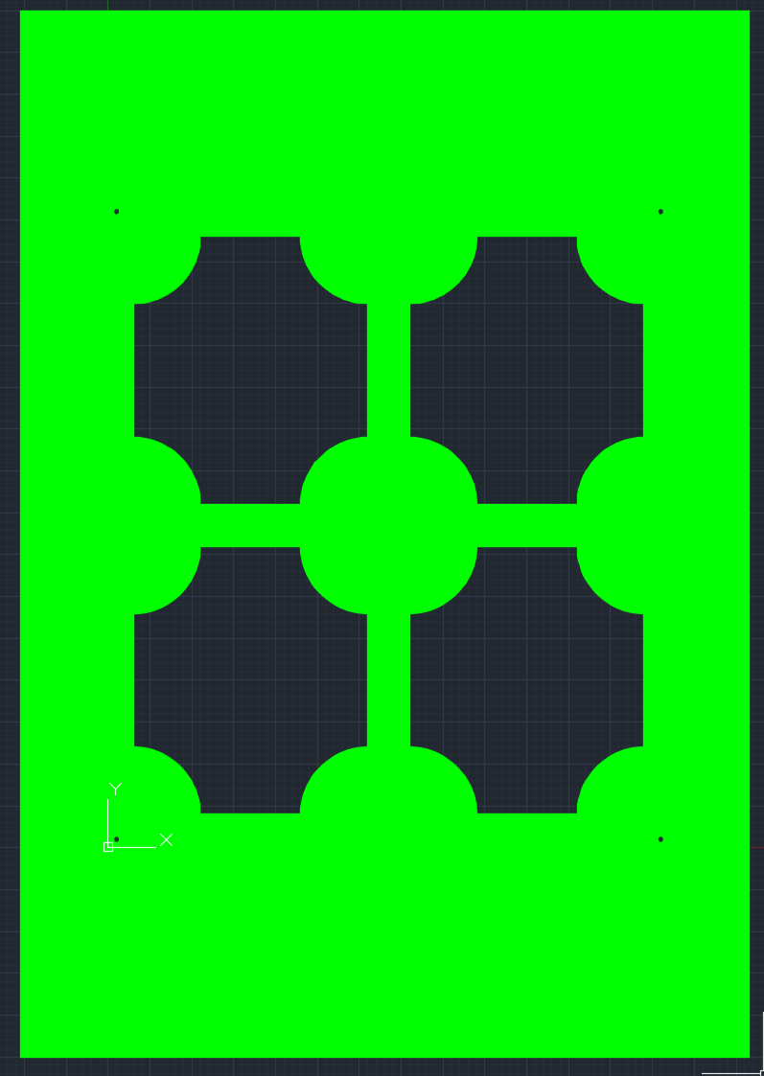
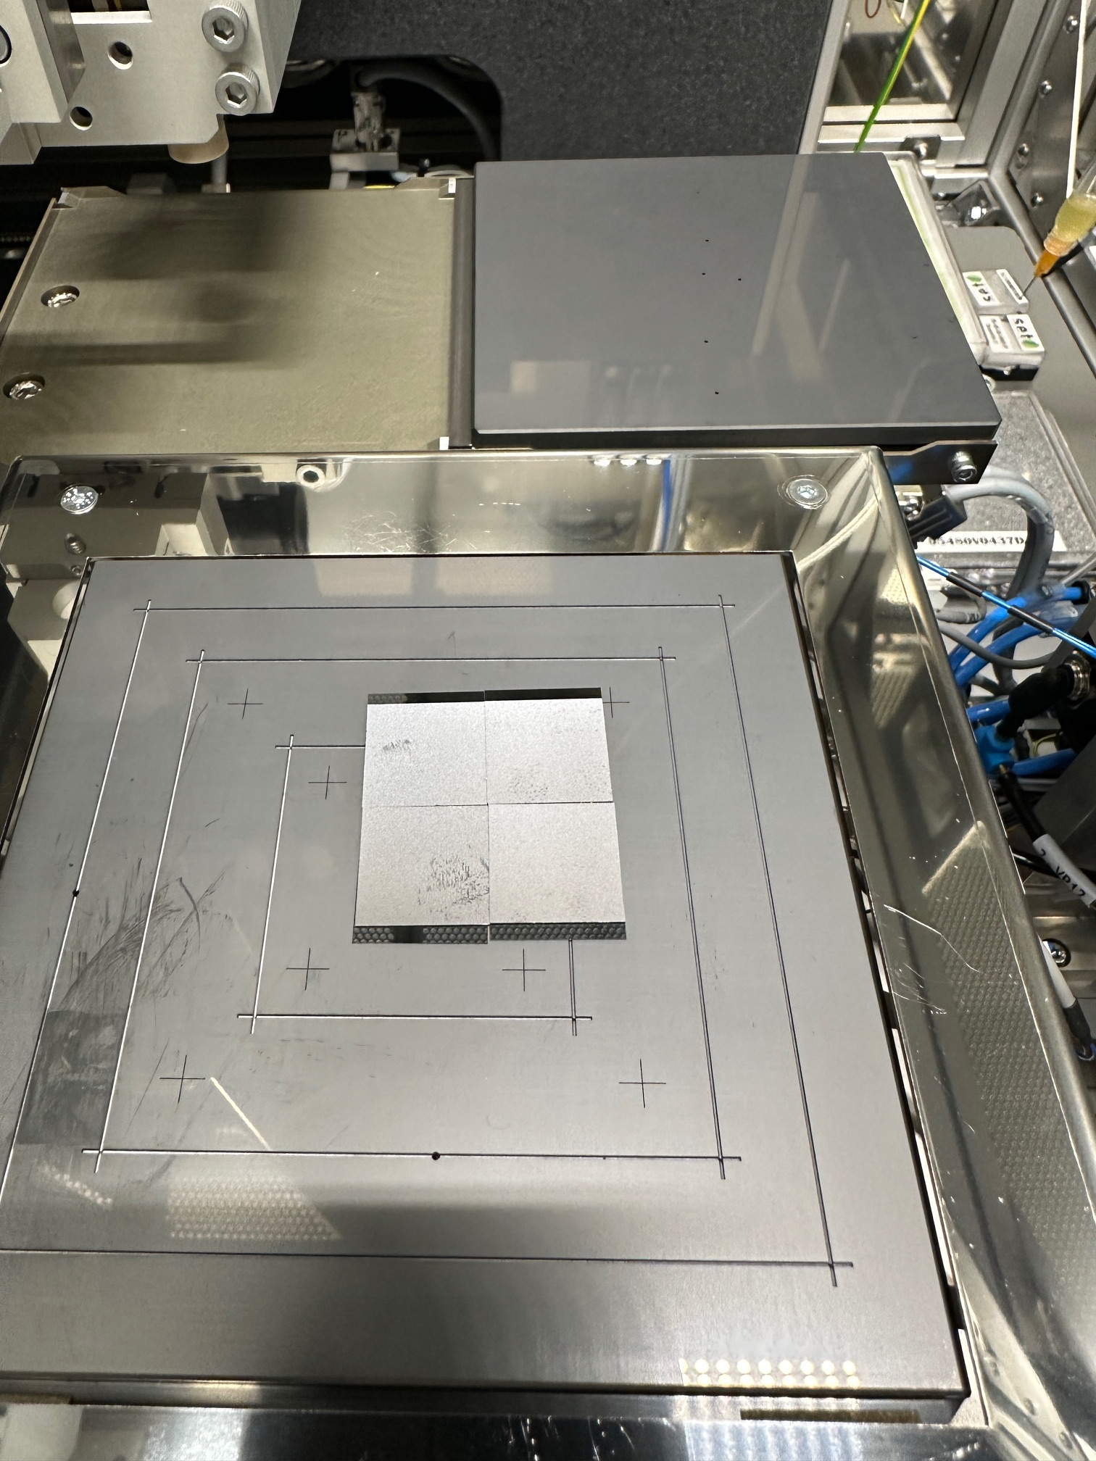
Module Assembly
Prototype 0 (Show and tell) Summer 2025
We are assembling mechanical prototypes of assemblies at ORNL (1.6x1.6cm Sensor, 1.6x1.8cm ASIC)
Rather quick to make , can make enough of a few modules
Purchased AlN plates (0.3,0.5mm) that we will laser dice to hold assemblies
Mounted with dummy PB&RB
Prototype 1 (Thermo-mecanical) Q4 2025
We plan on doing lithography in-house to make ASIC and Sensor heaters that can be WB to flex/PCB
Assemble following prototype 0 geometry for thermal testing on stave etc .
Prototype 2 (Functional EICROC1 + Dummy LGAD) Q2-3 2026
Demonstrate power distribution, readout (even if not final scheme)
Can be used for more realistic thermal testing

Slide 7
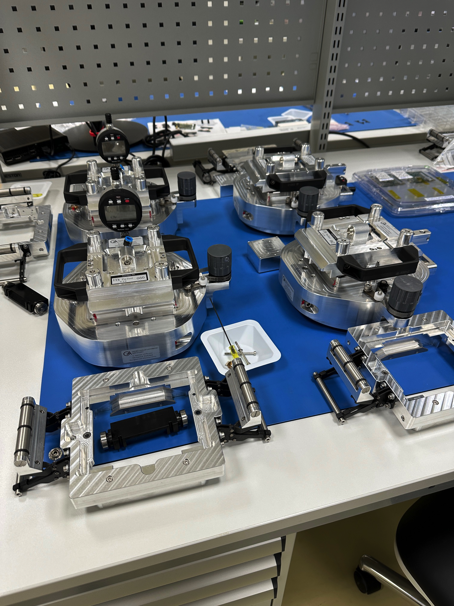
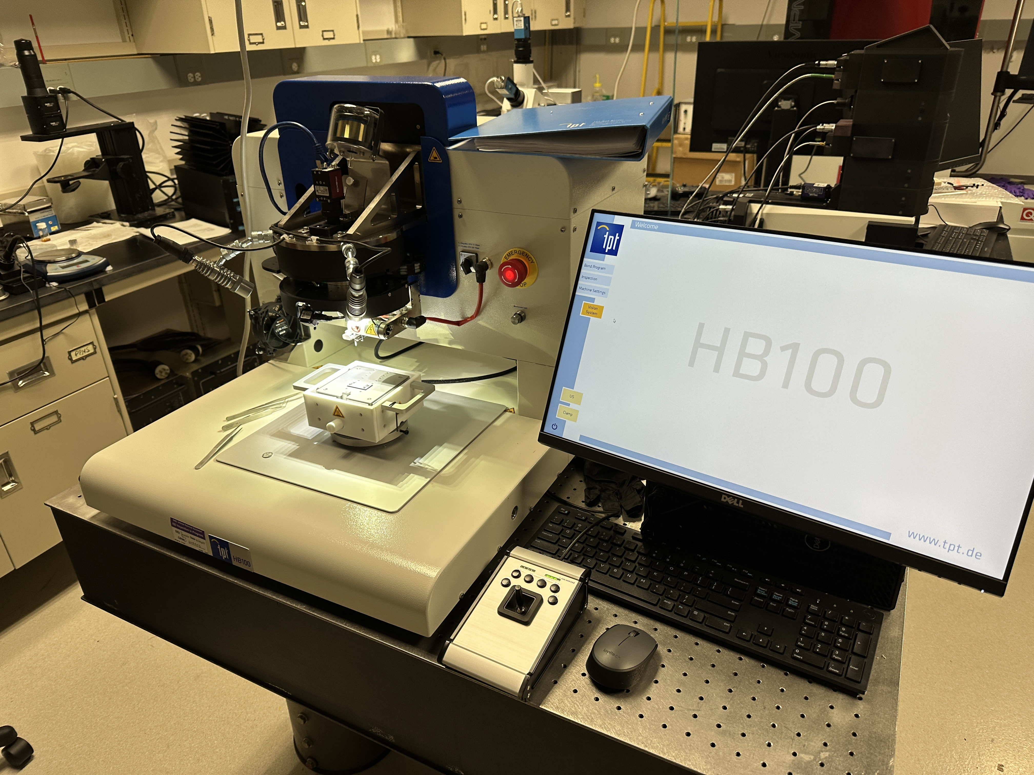
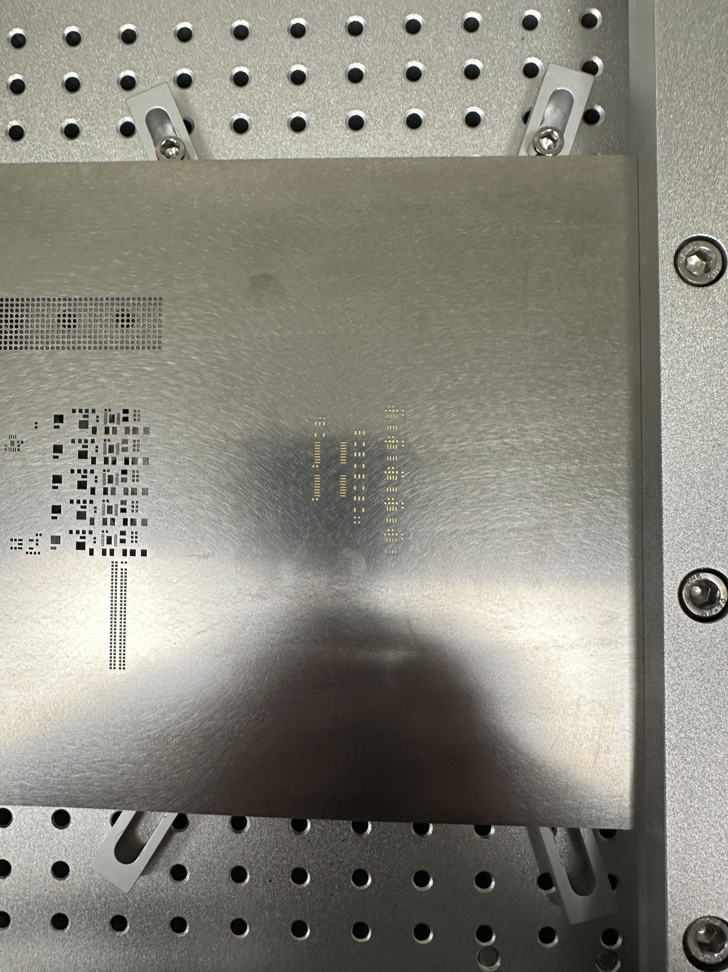
Module Assembly plans
We are investigating two module assembly path:
Jig-based assembly
More labor intensive
Lower cost of entry
Robotic Gantry-based assembly
Less labor intensive and faster
Higher cost of entry (gantry available with some collaborators)
Module production : 778 + 10% spare = 856 modules
2h per modules (Jig), 20 Modules a week -> 43-week production (for 1 site)
Jig method could speed this up by factor 2-4x

Slide 8
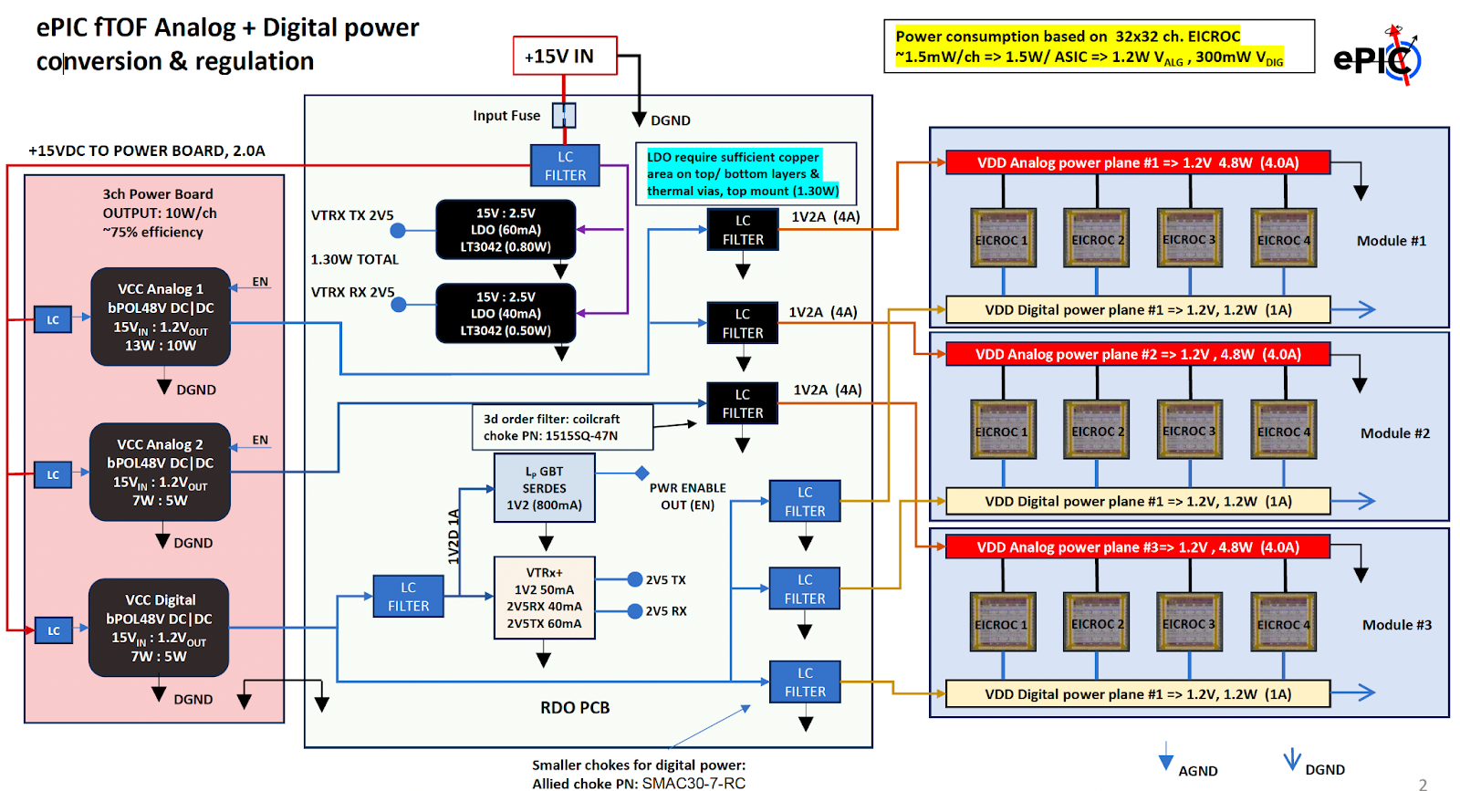
Service Hybrids
Power Board (PB):
Each PB consists of three CERN bPOL48V DC-DC converters to provide the necessary voltages for powering the RB and EICROC chips. The PB connects to the RB through board-to-board connectors.
First prototype in production
First test to be carried with dummy loads
Readout Board (RB):
Each RB includes:
lpGBT for high-speed data transmission.
VTRx+ optical transceiver.
MUX64 multiplexer for monitoring
Design completed; PED request ongoing for production of first demonstrator

Slide 9
Mechanical integration and cooling
The mechanical supports for the fTOF will follow closely the CMS ETL design (ongoing). A double-sided disk base structure (Carbon) will support cooling tubes
SH + modules to be mechanically mounted on disk with thermal coupling and interconnected.
Service cabling from SH is routed to the outer radius for fanout to Patch Panel at the rim of the structure
Detailed design ongoing (Purdue)

Slide 10
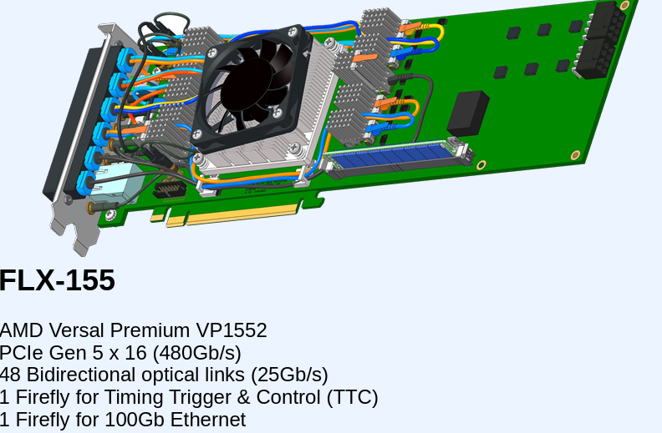
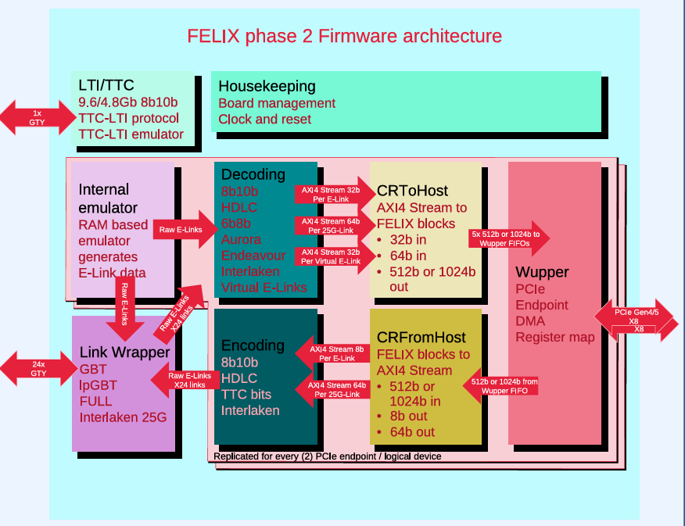
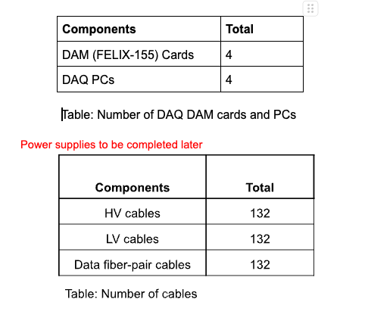
Readout architecture
The connection the to readout board optical links will be done using ATLAS Phase-II FELIX Card
4 DAM (FELIX-155) boards will each service a quarter of the disk’s sensors (left/right, front/back)
4 DAQ PCs needed for readout

Slide 11
Schedule and baselining
Modules
Service Hybrids and readout
Power board demonstrator in production
Will allow to measure power consumption and heat dissipation
Readout board demonstrator designed, waiting for PED fund for production
Will allow to test interface to FELIX, clock distribution etc.
EICROC2 digital interface specification will be required for the final design of the boards.
FLX-155 board identified for readout
Mechanical Integration
The module concept defines the granularity for integration to mechanical support
Design ramping up for disk support , first model expected Q4 2025
Assembly and integration kinematics to be established along the design of the support and refined in 2026.
A series of 3 demonstrators planned for module assembly. The demonstrator will allow to baseline module concept and assembly procedure
Show-and-tell (summer 25)
Thermo-mechanical (Q4 25)
Functional (Q2-3 2026)
EICROC1A/B submission waiting for final EICROC1B design, we expect availability Q4 25. EICROC2 is baseline.
Sensor production with HPK ongoing to validate EICROC0B performance , next production aimed at final design baseline.

