Slide 1

Overview
Barrel Time-of-Flight
Satoshi YANO
Hiroshima University
The ePIC Collaboration Meeting AC-LGAD detector workfest
07/16/2025

Slide 2
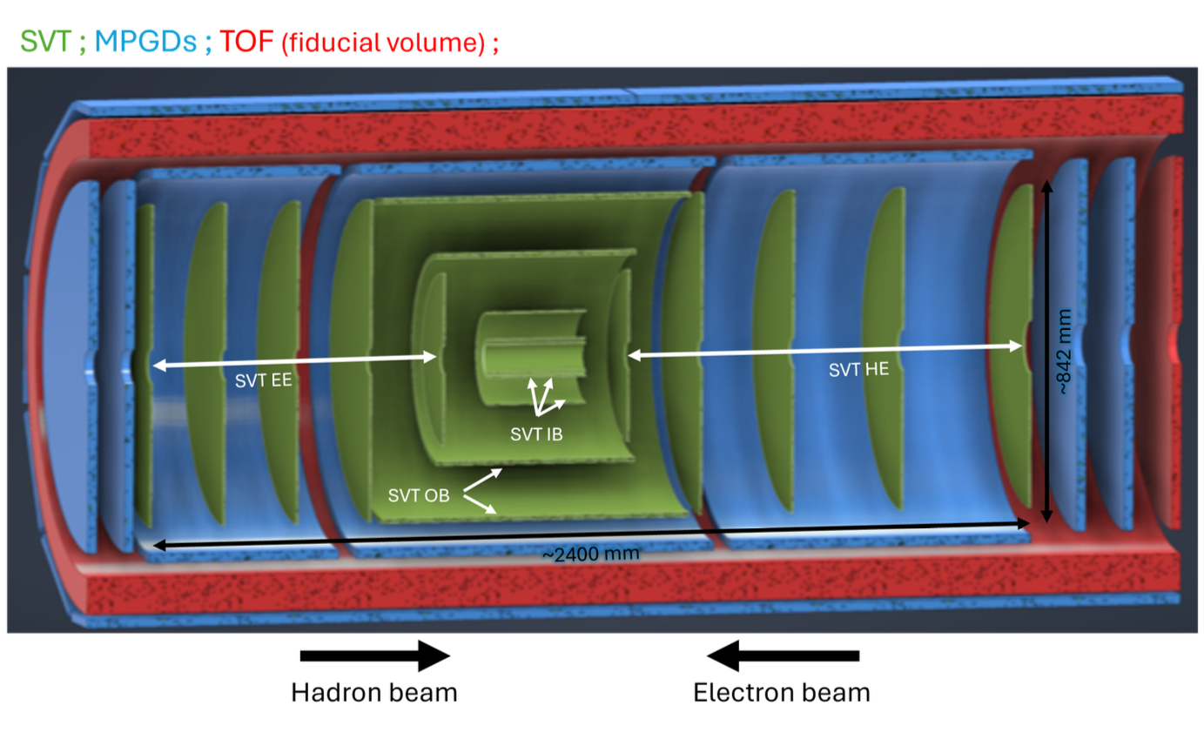
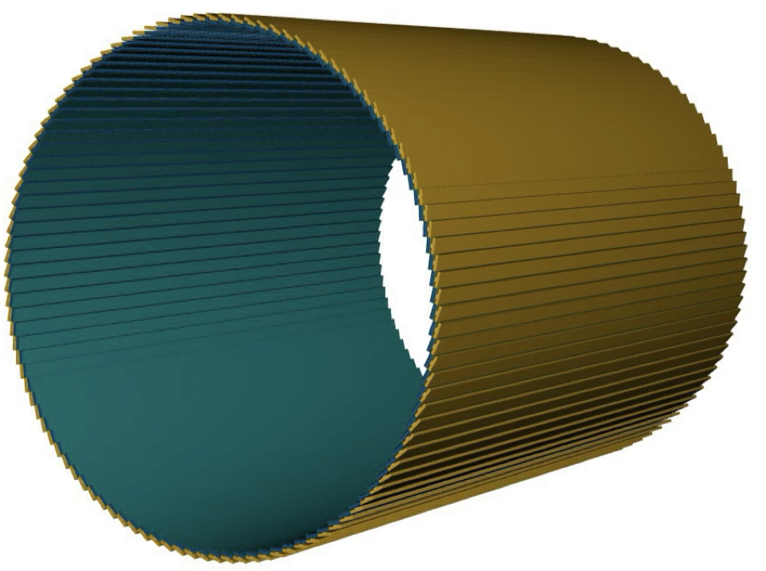
Recap of Barrel-TOF
Barrel-TOF (BTOF)
0.64 m
~2.8 m
-1.33<η<1.74
The ePIC AC-LGAD TOF is PID, tracking and background rejection detector for mid-rapidity (BTOF: -1.33<η<1.74)
Cylindrical shape is composed of 144 tilted staves (288 half-staves)
Strip-type AC-LGAD sensor is used to meet the requirement of ~35 ps and ~30 um timing and spatial resolution respectively

Slide 3
Recap of Barrel-TOF
Barrel-TOF (BTOF)
144 x Staves
0.64 m
~2.8 m
-1.33<η<1.74
The ePIC AC-LGAD TOF is PID, tracking and background rejection detector for mid-rapidity (BTOF: -1.33<η<1.74)
Cylindrical shape is composed of 144 tilted staves (288 half-staves)
Strip-type AC-LGAD sensor is used to meet the requirement of ~35 ps and ~30 um timing and spatial resolution respectively

Slide 4
Recap of Barrel-TOF
Barrel-TOF (BTOF)
144 x Staves
0.64 m
~2.8 m
-1.33<η<1.74
The ePIC AC-LGAD TOF is PID, tracking and background rejection detector for mid-rapidity (BTOF: -1.33<η<1.74)
Cylindrical shape is composed of 144 tilted staves (288 half-staves)
Strip-type AC-LGAD sensor is used to meet the requirement of ~35 ps and ~30 um timing and spatial resolution respectively

Slide 5
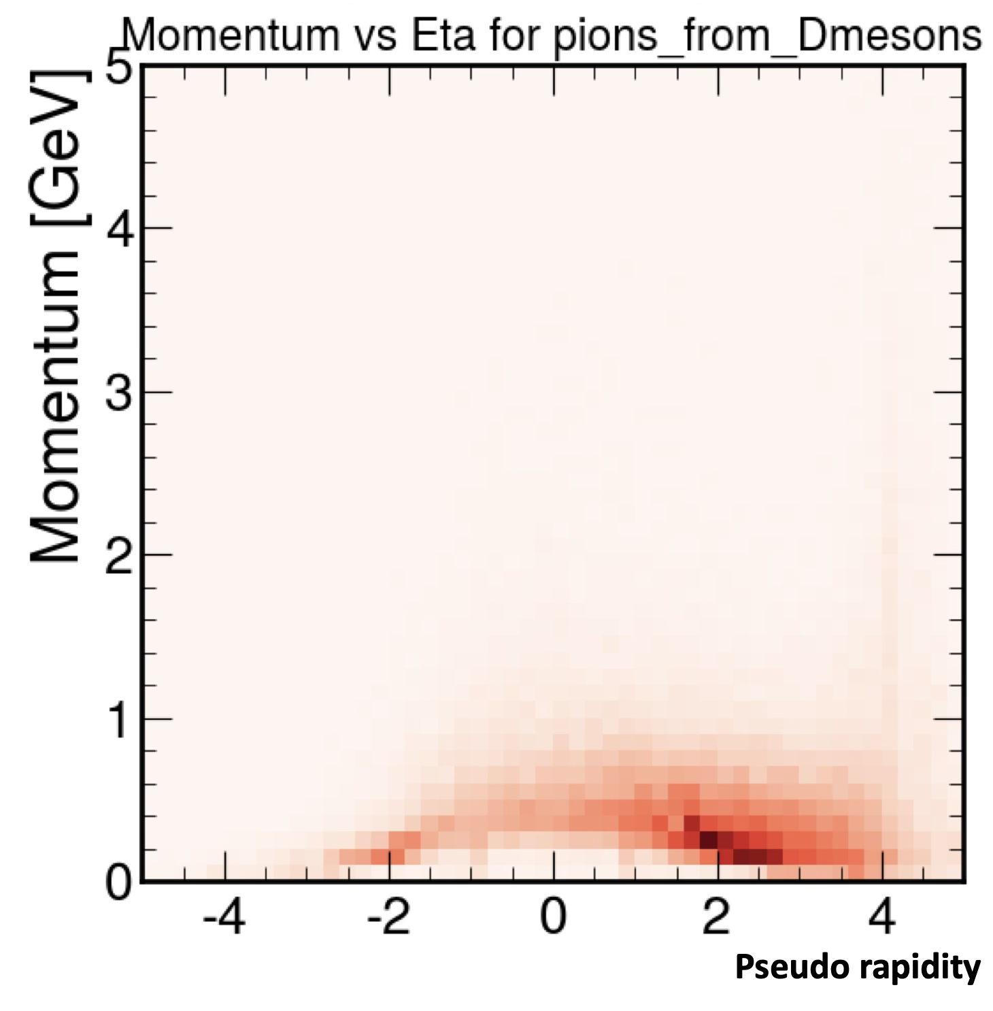
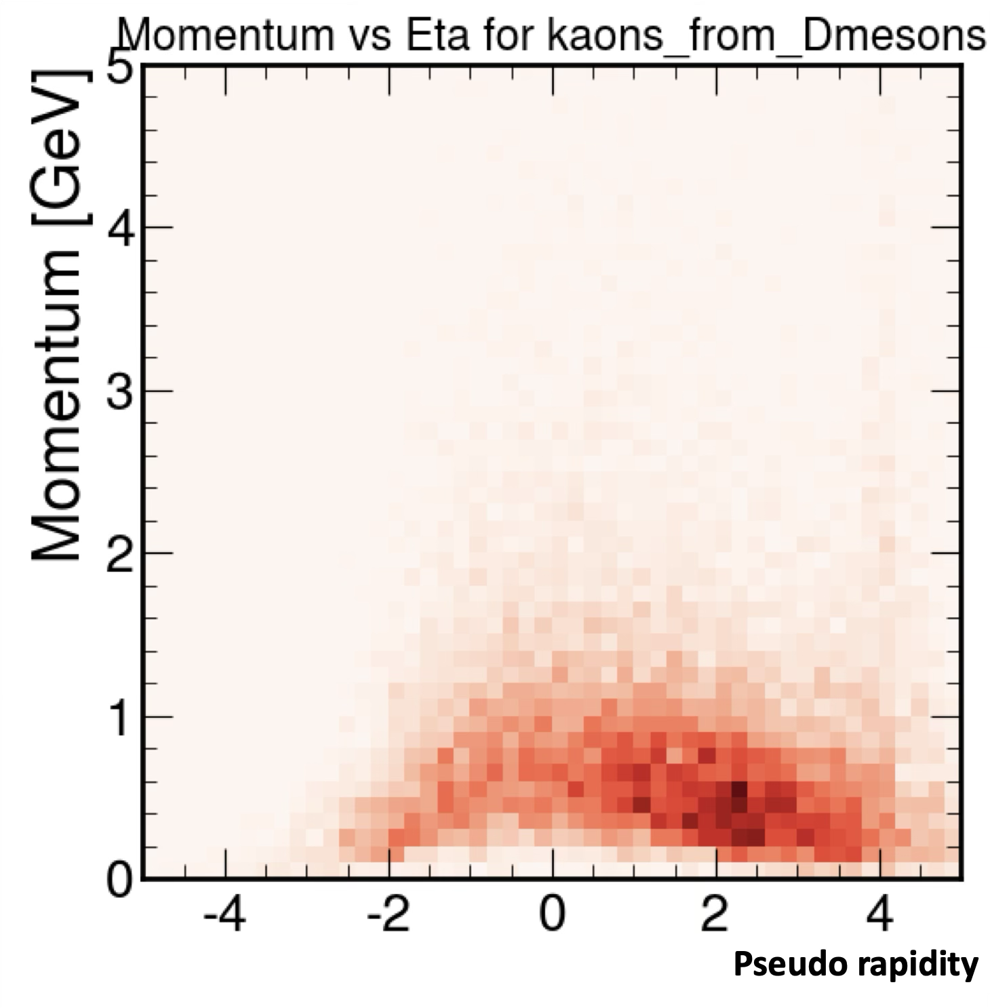
Impact on the ePIC PID performance
Focus of TOF is below p = 1 GeV/c
Particle-Identification at low momentum region is the primary task
Used in conjunction with Cherenkov light detectors to eliminate PID gaps and to cross-calibrate each other in overlapping regions
π from D
K from D
Decay products from D-meson in ep DIS @ √s = 141 GeV

Slide 6
Impact on the ePIC PID performance
Focus of TOF is below p = 1 GeV/c
Particle-Identification at low momentum region is the primary task
Used in conjunction with Cherenkov light detectors to eliminate PID gaps and to cross-calibrate each other in overlapping regions
K/p 3σ
π/K 3σ
BTOF
FTOF
BTOF
Assuming
BTOF σ_{tot} = 35 ps
FTOF σ_{tot} = 25 ps
FTOF
π from D
K from D
Decay products from D-meson in ep DIS @ √s = 141 GeV

Slide 7
Impact on the ePIC PID performance
Focus of TOF is below p = 1 GeV/c
Particle-Identification at low momentum region is the primary task
Used in conjunction with Cherenkov light detectors to eliminate PID gaps and to cross-calibrate each other in overlapping regions
hpDIRC
dRICH
hpDIRC
dRICH
K/p 3σ
π/K 3σ
BTOF
FTOF
BTOF
Assuming
BTOF σ_{tot} = 35 ps
FTOF σ_{tot} = 25 ps
FTOF
π from D
K from D
Decay products from D-meson in ep DIS @ √s = 141 GeV

Slide 8
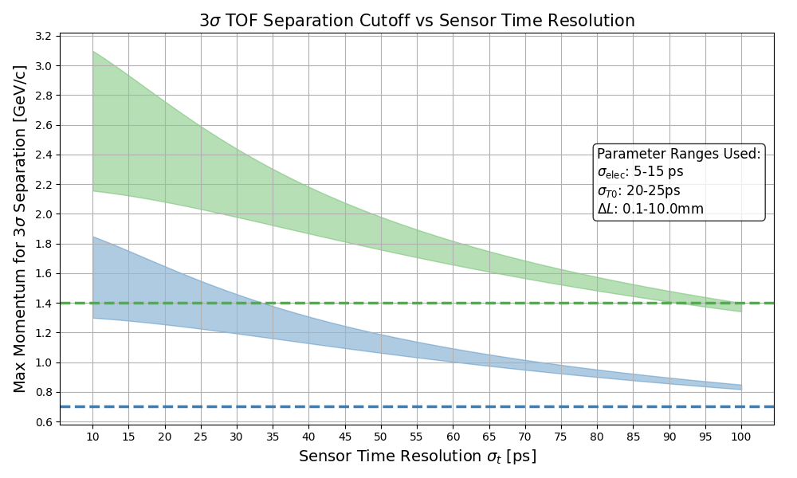
Sensor Timing Resolution v.s.
Overlap with hpDIRC
hpDIRC limit for K/p sep.
hpDIRC limit for π/K sep.
Even in the worst case scenario, with current sensor performance (σ_{sensor}~35 ps), there is an overlap area with hpDIRC → Already no PID hole!
σ_{sensor}> 90 ps doesn’t have overlapping region with hpDIRC in K/p separation any more

Slide 9
Sensor Timing Resolution v.s.
Overlap with hpDIRC
Current best performance
σ_{sensor} ~ 35 ps
Δp ~ 0.5 GeV/c
hpDIRC limit for K/p sep.
Δp ~ 0.45 GeV/c
hpDIRC limit for π/K sep.
Even in the worst case scenario, with current sensor performance (σ_{sensor}~35 ps), there is an overlap area with hpDIRC → Already no PID hole!
σ_{sensor}> 90 ps doesn’t have overlapping region with hpDIRC in K/p separation any more

Slide 10
Sensor Timing Resolution v.s.
Overlap with hpDIRC
Current best performance
σ_{sensor} ~ 35 ps
Δp ~ 0.5 GeV/c
hpDIRC limit for K/p sep.
Δp ~ 0.45 GeV/c
hpDIRC limit for π/K sep.
Even in the worst case scenario, with current sensor performance (σ_{sensor}~35 ps), there is an overlap area with hpDIRC → Already no PID hole!
σ_{sensor}> 90 ps doesn’t have overlapping region with hpDIRC in K/p separation any more

Slide 11
Data Transmission
Half-Stave = 8 x Modules = ~ 1320 [mm]
Front-side
Back-side
Module (Stavelet) ~ 160 [mm]
3 x 8 x 2 x 288
=13824
8 x 2 x 288 =4608
2 x 8 x 2 x 288
=4608

Slide 12
Stave Assembling Steps (Opt1)
Sensor + ASIC
Module Assembly Site
Glue dispenser
Wire bonding
Interposer
FPC
Module-to-Module bonding machine
Support structure
Final Construction Site
Glue dispenser

Slide 13
Detector Assembling Workflow
Interposer
Production
Company C
Sensor Production
HAMAMATSU
ASIC Production
TSMC
FPC Production
Company D
RB Assembling
Company E
PB Assembling
Company E
Interposer QA
Hiroshima
Interposer QA
RIKEN
Interposer QA
UCSC
Sensor QA/QC
Hiroshima
Sensor QA/QC
RIKEN
Sensor QA/QC
UCSC
ASIC QA
Institute A
ASIC QA
Institute B
FPC QA
Hiroshima
FPC QA
RIKEN
FPC QA
UCSC
RB QA
Rice
PB QA
Rice
SH Assembling
Rice
SH QA
Rice
Module assembling
Hiroshima
Module assembling
RIKEN
Module assembling
UCSC
Mechanical
Production
Purdue/Academia Sinica
Module QA
Hiroshima
Module QA
RIKEN
Module QA
UCSC
Mechanical QA
Purdue/Academia Sinica
Module
Check
Purdue /BNL
Stave assembling
Purdue/BNL
Stave QA
Purdue/BNL
BTOF construction
BNL
BTOF QA
BNL
Install to ePIC
BNL

Slide 14
Assembly Site in Japan
Hiroshima University and RIKEN will be one of the main assembly site
The site, 100 m² Class 10,000 (partially Class 1,000), are under construction
  Construction will be completed at the end of JFY25 (March 2026).

Slide 15
Assembly Site in Japan
Hiroshima University and RIKEN will be one of the main assembly site
The site, 100 m² Class 10,000 (partially Class 1,000), are under construction
  Construction will be completed at the end of JFY25 (March 2026).

Slide 16
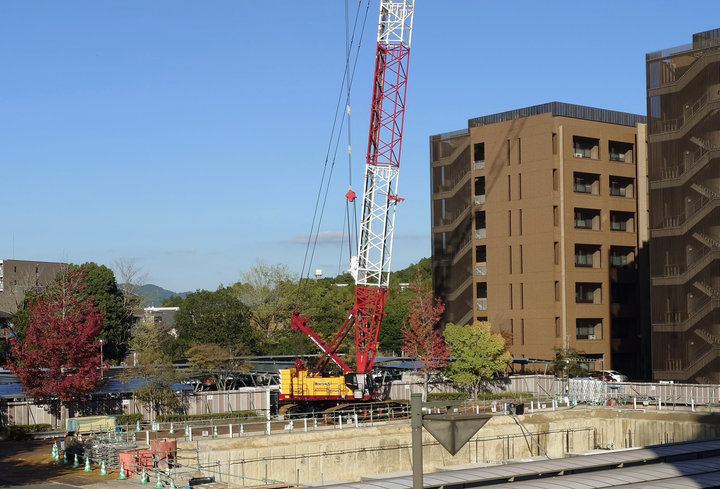
Assembly Site in Japan
Hiroshima University and RIKEN will be one of the main assembly site
The site, 100 m² Class 10,000 (partially Class 1,000), are under construction
  Construction will be completed at the end of JFY25 (March 2026).
Autumn 2024

Slide 17
Assembly Site in Japan
Hiroshima University and RIKEN will be one of the main assembly site
The site, 100 m² Class 10,000 (partially Class 1,000), are under construction
  Construction will be completed at the end of JFY25 (March 2026).
Reference object
Autumn 2024

Slide 18
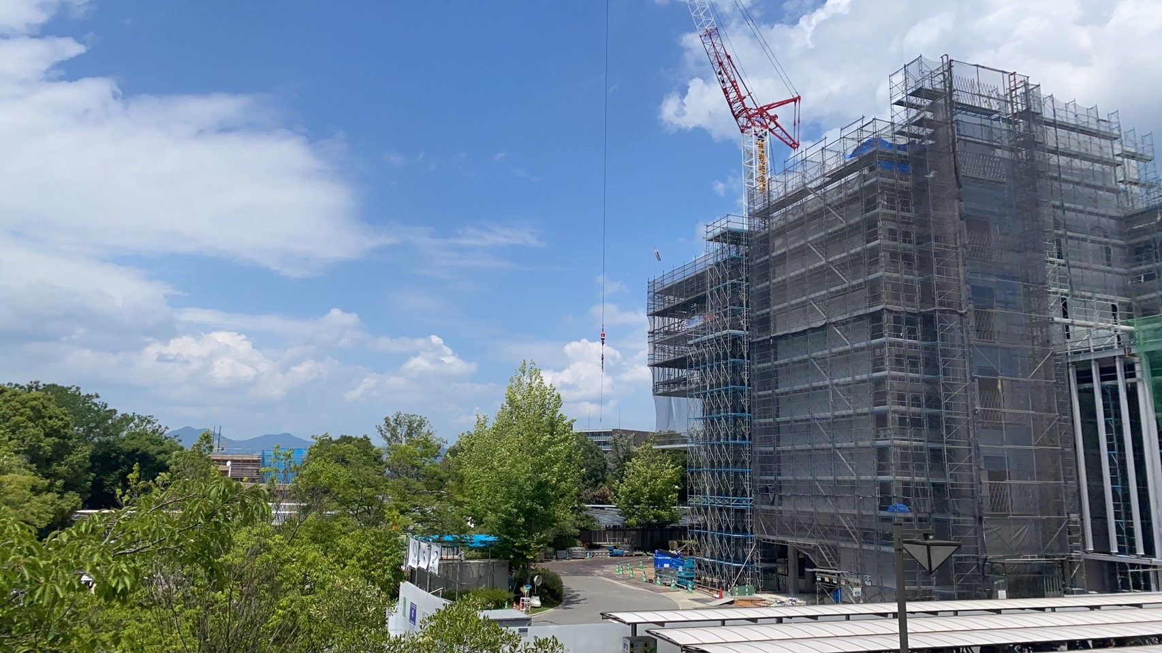
Assembly Site in Japan
Hiroshima University and RIKEN will be one of the main assembly site
The site, 100 m² Class 10,000 (partially Class 1,000), are under construction
  Construction will be completed at the end of JFY25 (March 2026).
Reference object
Autumn 2024
8 months later
Summer 2025

Slide 19
Assembly Site in Japan
Hiroshima University and RIKEN will be one of the main assembly site
The site, 100 m² Class 10,000 (partially Class 1,000), are under construction
  Construction will be completed at the end of JFY25 (March 2026).
Reference object
Autumn 2024
8 months later
Summer 2025

Slide 20
What should be discussed with the other working groups
Impact on other detectors and entire ePIC system
  Acceptable maximum material budget for tracking and PID
  Required spatial resolution for tracking
Best design for the integration, services and maintenance keeping best performance
Service Hybrid (SH) design and location
  Currently, the design of FTOF is mainly ongoing
  The space available for the BTOF is limited due to material budget constraints and service requirements, so deeper exploration is required.
Today

Slide 21
What should be discussed with the other working groups
Impact on other detectors and entire ePIC system
  Acceptable maximum material budget for tracking and PID
  Required spatial resolution for tracking
Best design for the integration, services and maintenance keeping best performance
Service Hybrid (SH) design and location
  Currently, the design of FTOF is mainly ongoing
  The space available for the BTOF is limited due to material budget constraints and service requirements, so deeper exploration is required.
Today
Beyond today

Slide 22
Backup

Slide 23
Stave Assembling Process (Opt2)
Assembling sites
Sensor + ASIC (packaged)
Wire bonding
Glue dispenser
Interposer
FPC
Glue dispenser
Support structure
Wire bonding
BNL/Purdue
FPC

