Slide 1
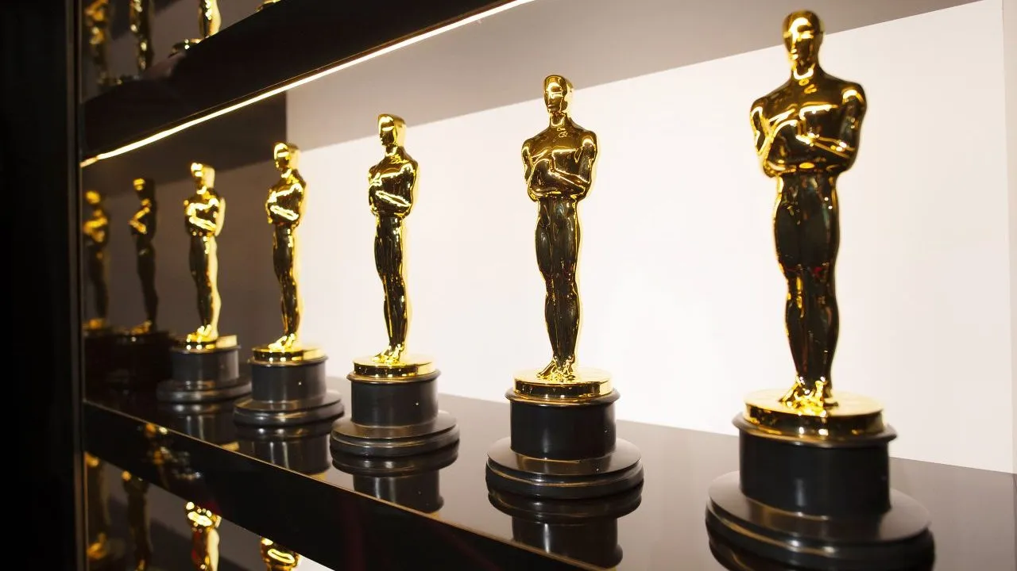
Thank you everybody for voting
We had 107 votes for the poster contest
We had 106 votes for the photo contest
And the Winners are

Slide 2
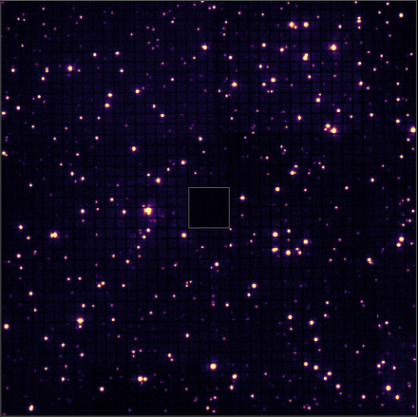

Slide 3
2nd ePIC Photo Contest
1st Place
Roberto Perghenella
July 14 - 18, 2025

Slide 4
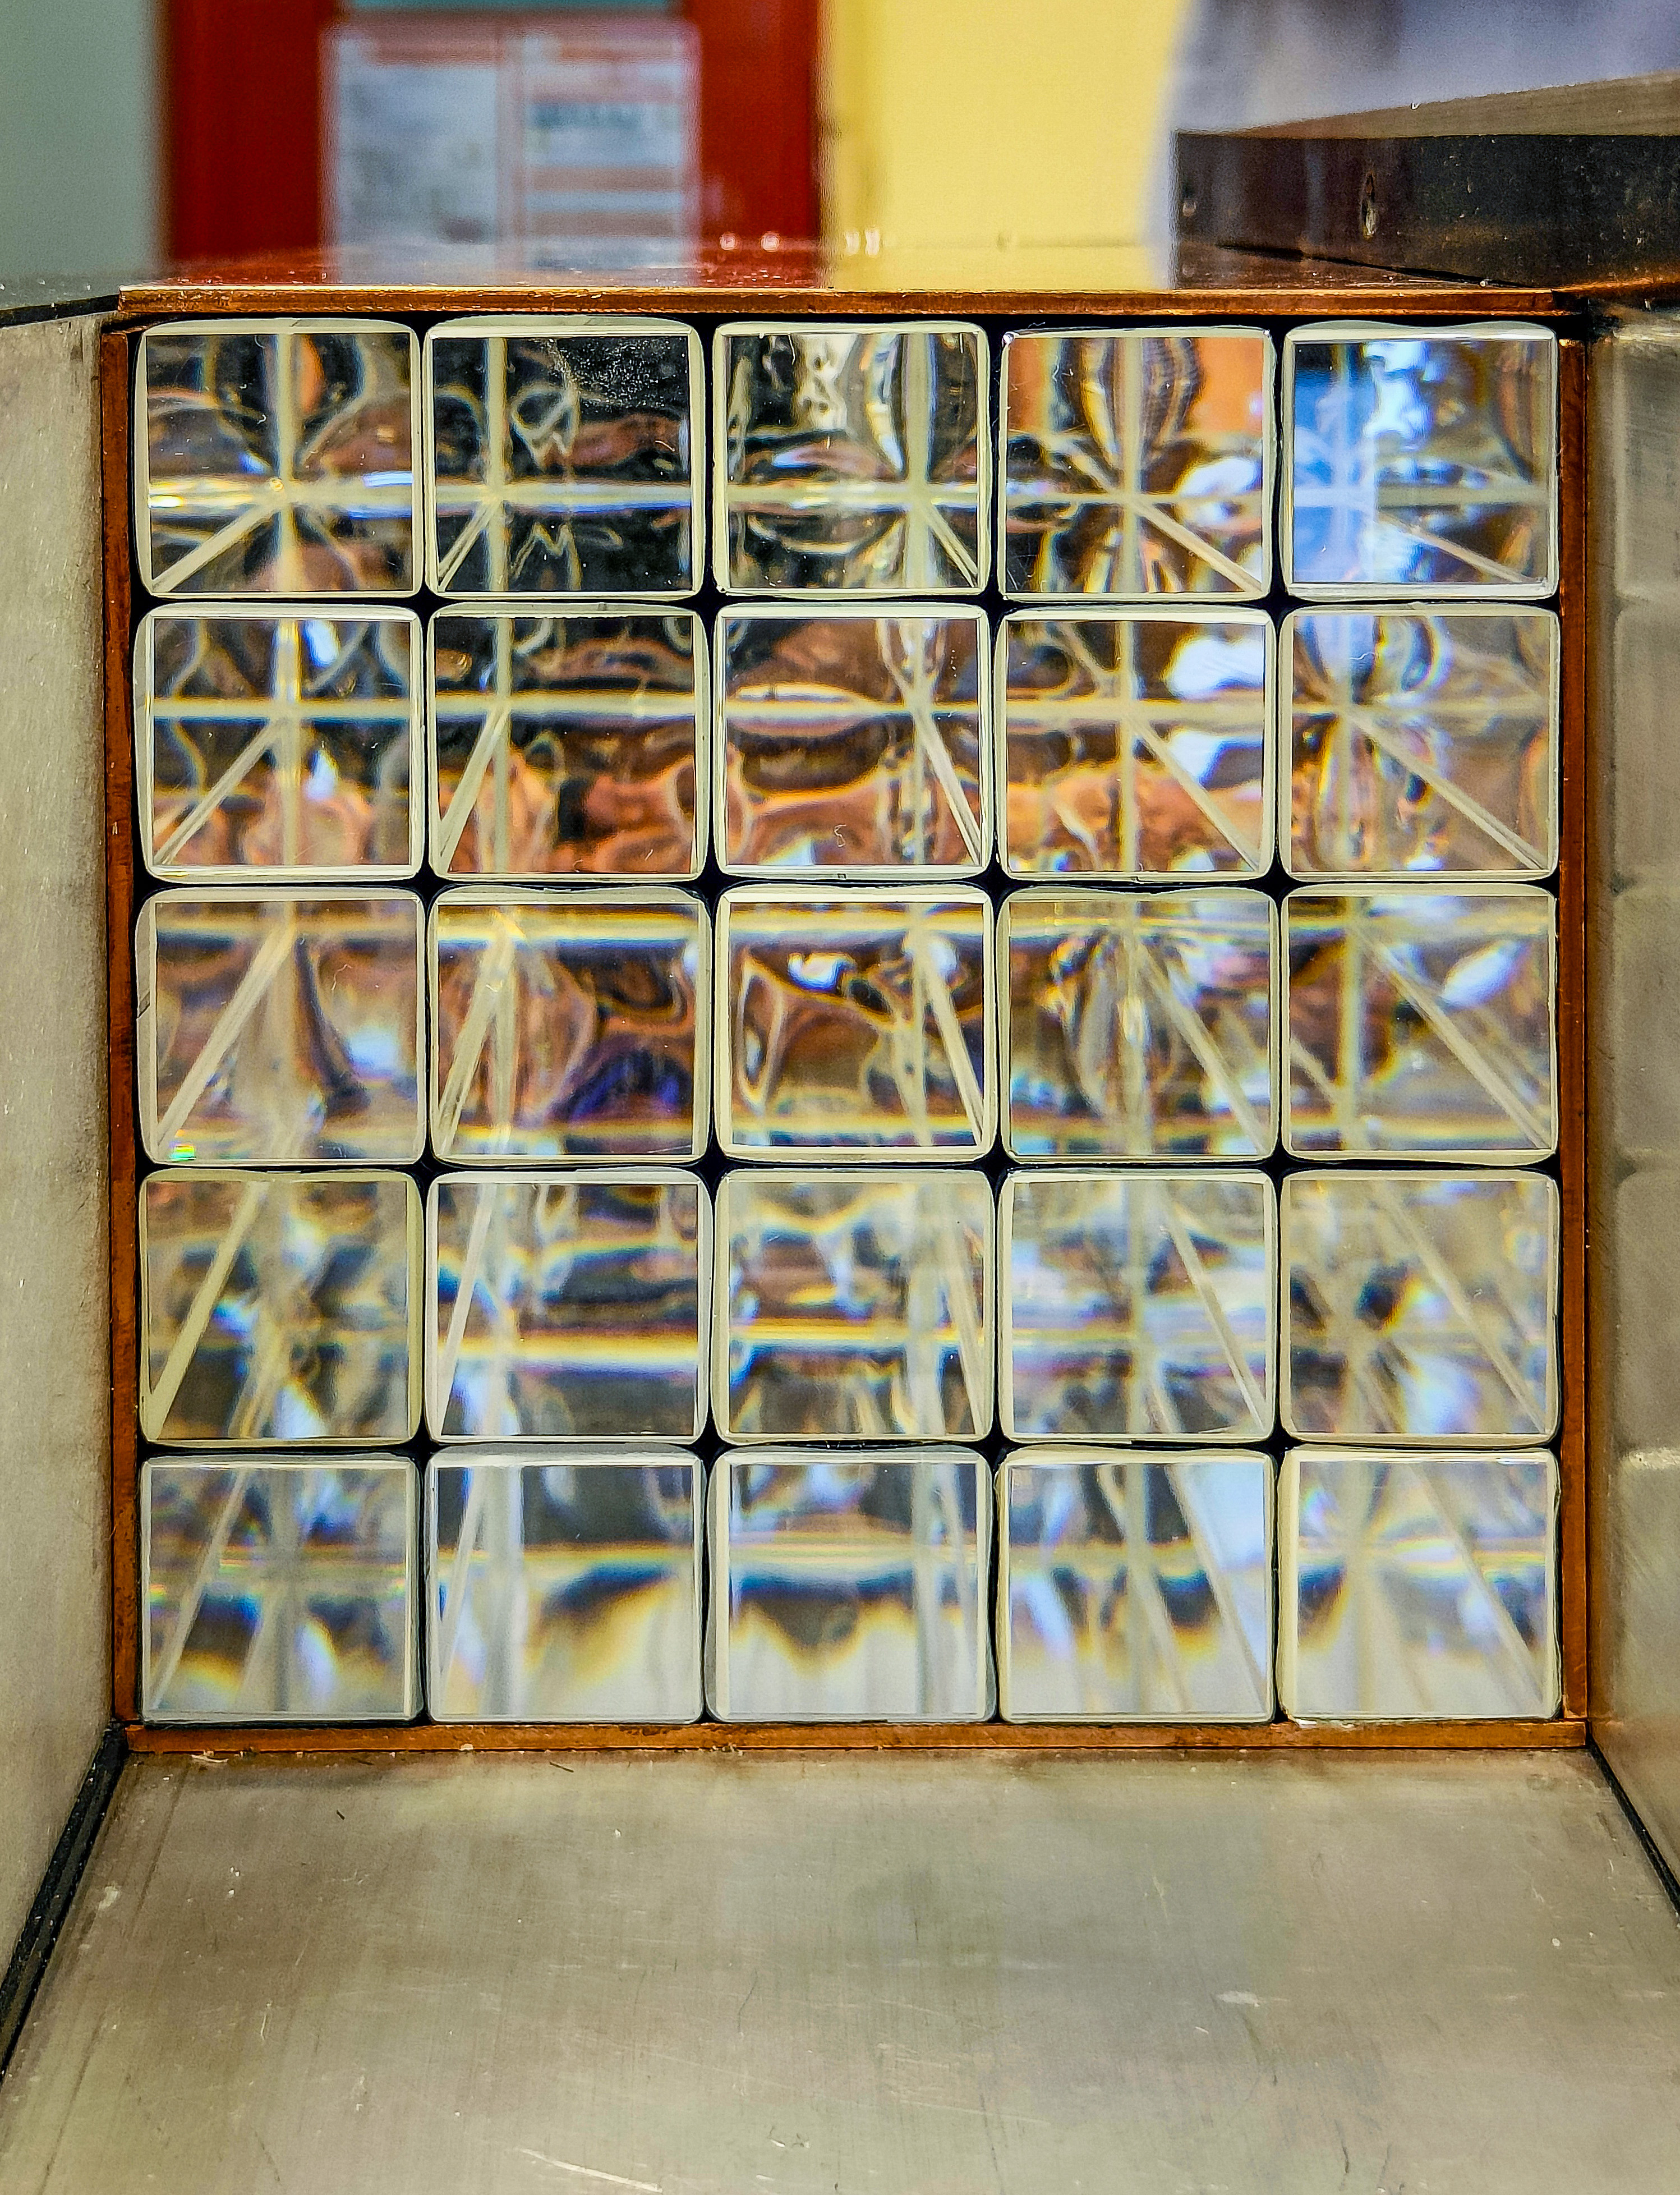

Slide 5
2nd ePIC Photo Contest
1st Place
Julien Bettane
July 14 - 18, 2025

Slide 6
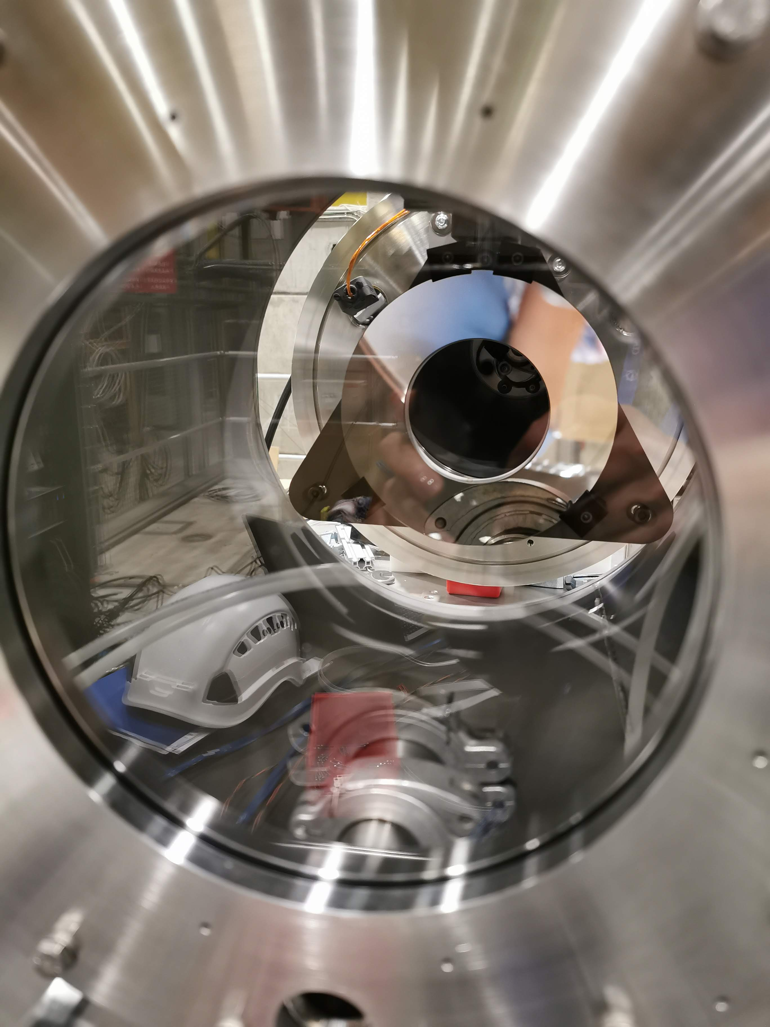

Slide 7
2nd ePIC Photo Contest
3rd Place
Christina Tuve
July 14 - 18, 2025

Slide 8
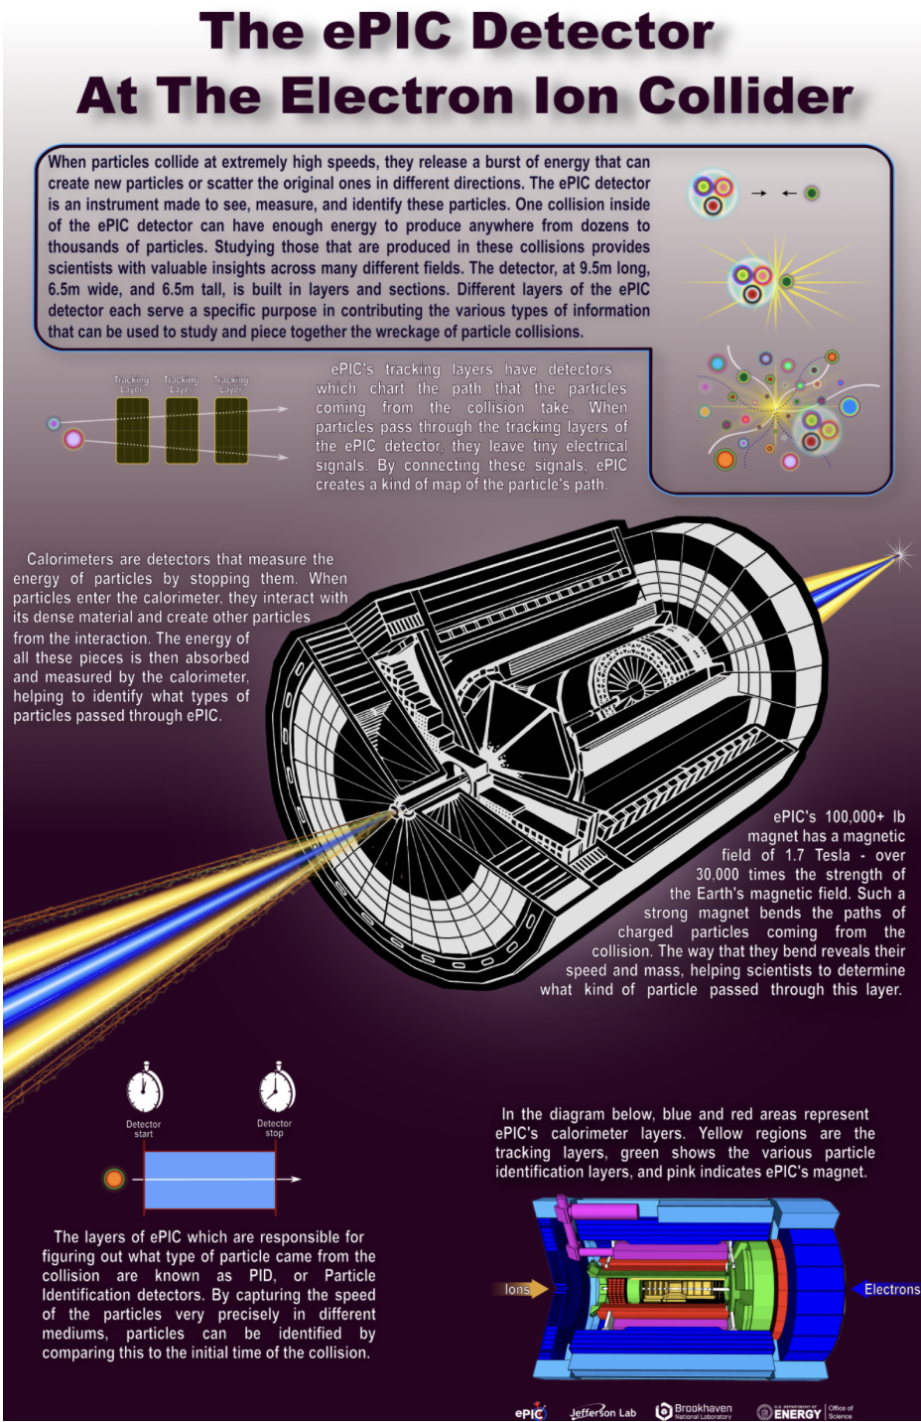

Slide 9
ePIC –EICUG Poster Contest
Best in Category 1
A poster on EIC Science or the ePIC Detector, designed for high school students
Lauren Kasper
July 14 - 18, 2025

Slide 10
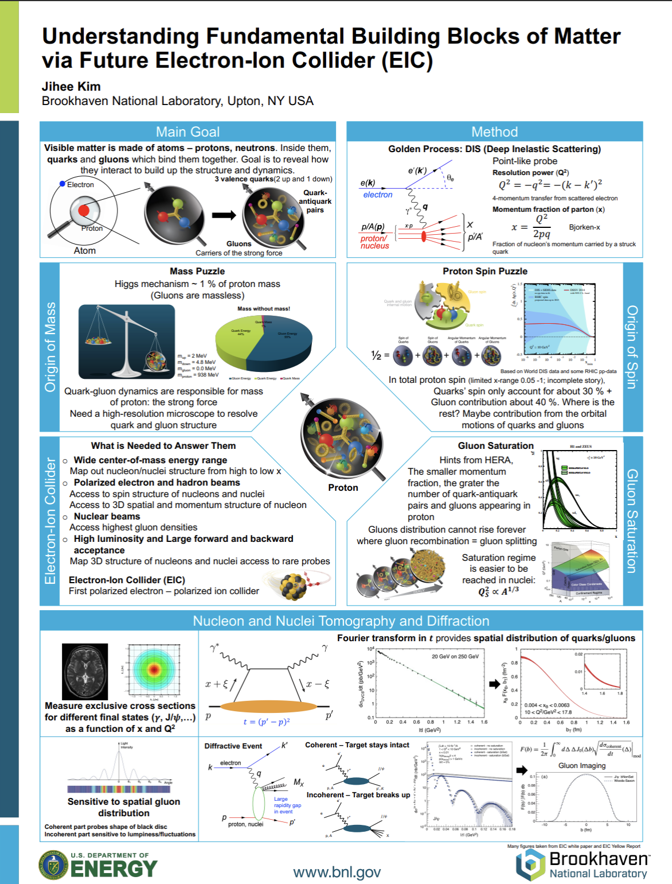

Slide 11
ePIC –EICUG Poster Contest
Best in Category 2
A poster on EIC Science or the ePIC Detector, intended for scientists who are not experts in ePIC, EIC, or DIS
Jihee Kim
July 14 - 18, 2025

Slide 12
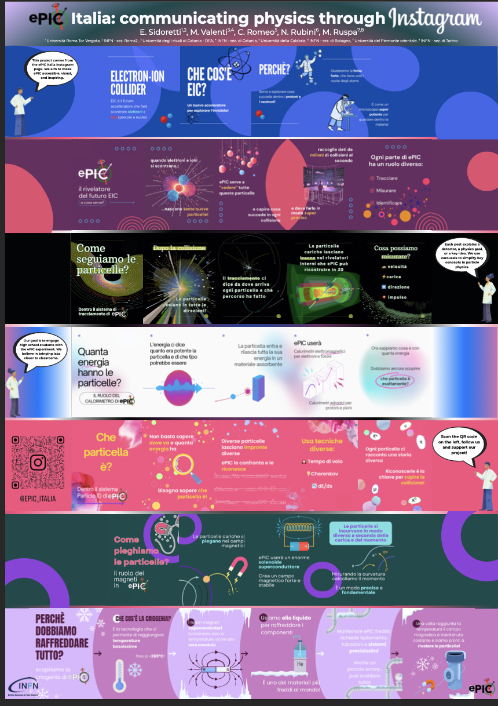

Slide 13
ePIC –EICUG Poster Contest
Best Overall
The single most outstanding poster across all categories
E. Sidoretti, M. Valenti,
C. Romeo, N. Rubini, M. Ruspa
July 14 - 18, 2025

Slide 14

A big Thank You to Jihee Kim
and Antonio Paladino
for all the help

