Slide 1
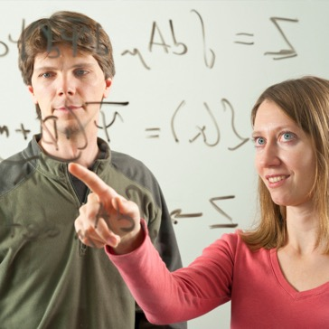
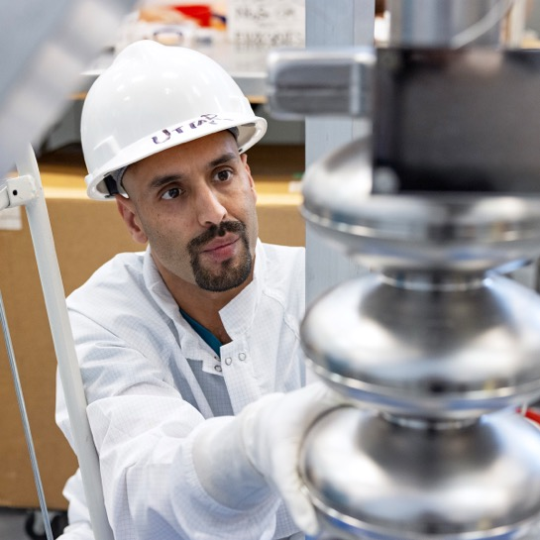
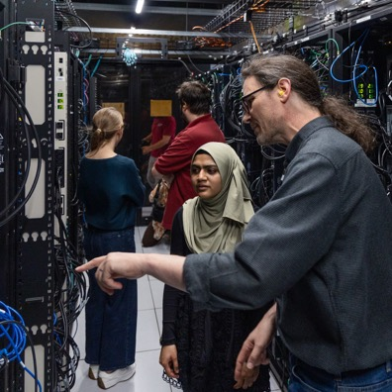
Welcome
EIC User Group &
ePIC Joint Collaboration Meeting
Jens Dilling, Lab Director
July 14, 2025

