Slide 1
RCDAQ as a picoDAQ
Martin Purschke, BNL
Reading the H2GROC3
What else RCDAQ can do for you
Online monitoring and other amenities
Automated scans/measurement campaigns

Slide 2
Let me first put this into context a bit
This here shows the front-end part of the sPHENIX data acquisition system that is taking data as I speak… we are getting some 34GB/s, or 270GBit/s, at peak luminosities
It uses a synchronized “cohort” of about 80 (84 to be precise) individual RCDAQ instances, each reading a particular part of the detector
FEM
FEE
FEE
~20 RCDAQs are reading our calorimeters via a particular readout card
~62 RCDAQs are reading out the tracking system (MVTX, INNT, TPC, TPOT) with FELIX cards. The tracking system reads out in Streaming Mode
What I will be talking about here is just one element of this cohort that we set up to read out the H2GCROC3:
DCM
DCM2
DCM
DCM
DCM
DCM
DCM
FELIX
EBDC
DCM
DCM
DCM
DCM
DCM
FELIX
EBDC
FEM
DCM
SEB
FEE
FEE
DCM
DCM
DCM
DCM
DCM2
DCM
FELIX
EBDC
DCM
FELIX
EBDC
DCM
DCM
DCM
DCM
DCM
FEM
DCM
SEB
FEE
DCM
DCM
FEE
DCM
DCM
FELIX
EBDC
DCM
DCM
DCM2
DCM
DCM
FELIX
EBDC
DCM
SEB
DCM
DCM
DCM
FEE
FEE
DCM
DCM
DCM
FELIX
EBDC
DCM
FEM
DCM
DCM
FELIX
EBDC
DCM
DCM2
DCM
DCM
FEE
FEE
DCM
DCM
DCM
DCM
DCM
SEB
DCM
FELIX
EBDC
DCM
FELIX
EBDC
FEM
DCM
DCM
DCM
DCM
DCM2
FEE
DCM
DCM
DCM
FEE
DCM
DCM
FELIX
EBDC
DCM
FEM
DCM
SEB
DCM
DCM
FELIX
EBDC
DCM
DCM
DCM
DCM
DCM2
FEE
FEE
DCM
SEB
DCM
DCM
DCM
DCM
FELIX
EBDC
DCM
DCM
DCM
FELIX
EBDC
FEE
DCM
FEM
DCM
FEE
DCM
DCM
FELIX
EBDC
DCM
DCM
DCM2
DCM
DCM
FELIX
EBDC
DCM
DCM
DCM
DCM
DCM
SEB
FEE
FEE
FEM
DCM
FELIX
EBDC
DCM
DCM
DCM
DCM
FELIX
EBDC
DCM
DCM2
DCM
DCM
DCM
DCM
DCM
FEM
DCM
SEB
FEE
FEE
DCM
DCM
DCM
DCM
DCM
FELIX
EBDC
DCM
DCM
DCM2
DCM
DCM
FELIX
EBDC
DCM
SEB
DCM
DCM
FEE
FEE
DCM
DCM
DCM
FELIX
EBDC
DCM
FELIX
EBDC
FEM
DCM
DCM
DCM
DCM2
FEE
FEE
DCM
DCM
DCM
DCM
DCM
DCM
DCM
FELIX
EBDC
DCM
FELIX
EBDC
FEM
DCM
SEB
DCM
DCM
DCM
DCM
DCM2
FEE
DCM
DCM
DCM
FEE
DCM
DCM
FELIX
EBDC
DCM
FEM
DCM
SEB
DCM
DCM
FELIX
EBDC
DCM
DCM
DCM
FEE
DCM
DCM2
DCM
FEE
DCM
SEB
DCM
FELIX
EBDC
DCM
DCM
DCM
DCM
FELIX
EBDC
DCM
FEE
DCM
DCM
FEE
FEM
DCM
FELIX
EBDC
DCM
FELIX
EBDC
DCM
DCM
DCM
DCM
DCM2
DCM
DCM
DCM
DCM
DCM
SEB
FEE
FEE
PC
FEM
DCM
DCM
FEE
DCM
DCM
FELIX
EBDC
DCM
DCM
DCM2
DCM
DCM
FELIX
EBDC
DCM
DCM
DCM
FEE
FEM
DCM
SEB
DCM
FEE
DCM
DCM
FELIX
EBDC
DCM
DCM
DCM
DCM
FELIX
EBDC
DCM
DCM2
DCM
DCM
SEB
FEE
DCM
DCM
FEE
DCM
DCM
FELIX
EBDC
DCM
FELIX
EBDC
DCM
DCM
FEM
FEE
DCM
DCM
DCM2
DCM
FEE
DCM
DCM
DCM
DCM
DCM
DCM
DCM
FELIX
EBDC
DCM
FELIX
EBDC
FEM
DCM
SEB
DCM
DCM
FEE
DCM
DCM2
DCM
FEE
DCM
DCM
DCM
FELIX
EBDC
DCM
DCM
DCM
DCM
FELIX
EBDC
FEM
DCM
SEB
DCM
DCM
FEE
DCM
DCM
FEE
DCM
DCM2
DCM
FELIX
EBDC
DCM
FELIX
EBDC
(Here: KCU105 + H2GCROC3)
DCM
DCM
DCM
DCM
SEB
DCM
DCM
FEE
FEE
DCM
DCM
DCM
FELIX
EBDC
DCM
FEM
DCM
DCM
FELIX
EBDC
DCM
DCM2
DCM
DCM
DCM
DCM
FEE
FEE
DCM
SEB
DCM
DCM
FEM
DCM
FELIX
EBDC
DCM
FELIX
EBDC
DCM
DCM
DCM
DCM
DCM2
DCM
DCM
FEE
DCM
DCM
FEE
FEM
DCM
SEB
DCM
FELIX
EBDC
DCM
FELIX
EBDC
DCM
DCM
DCM
DCM
DCM
DCM
DCM2
DCM
SEB
DCM
DCM

Slide 3
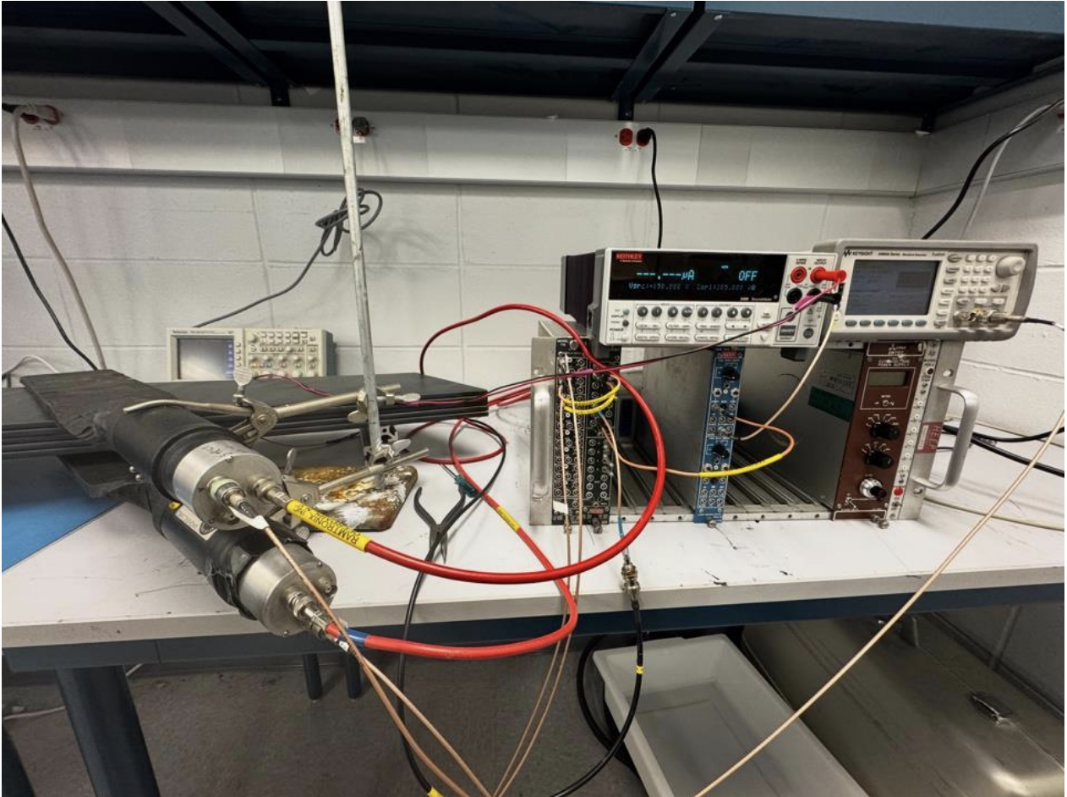
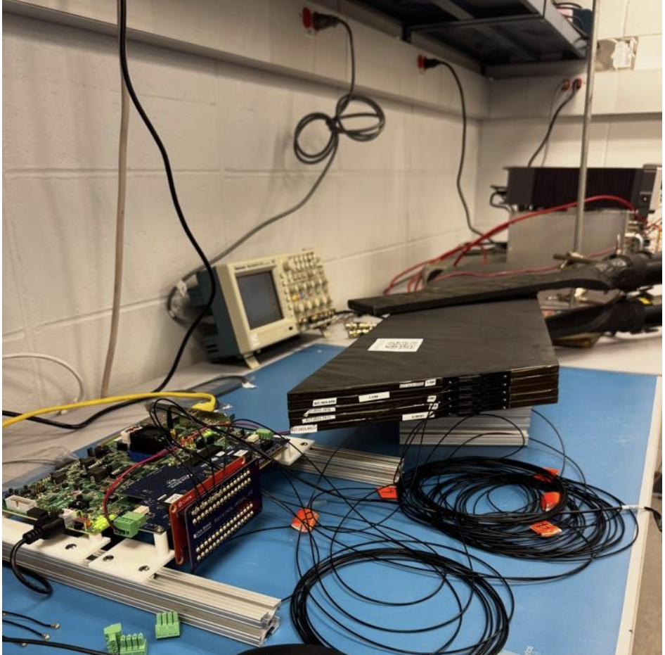
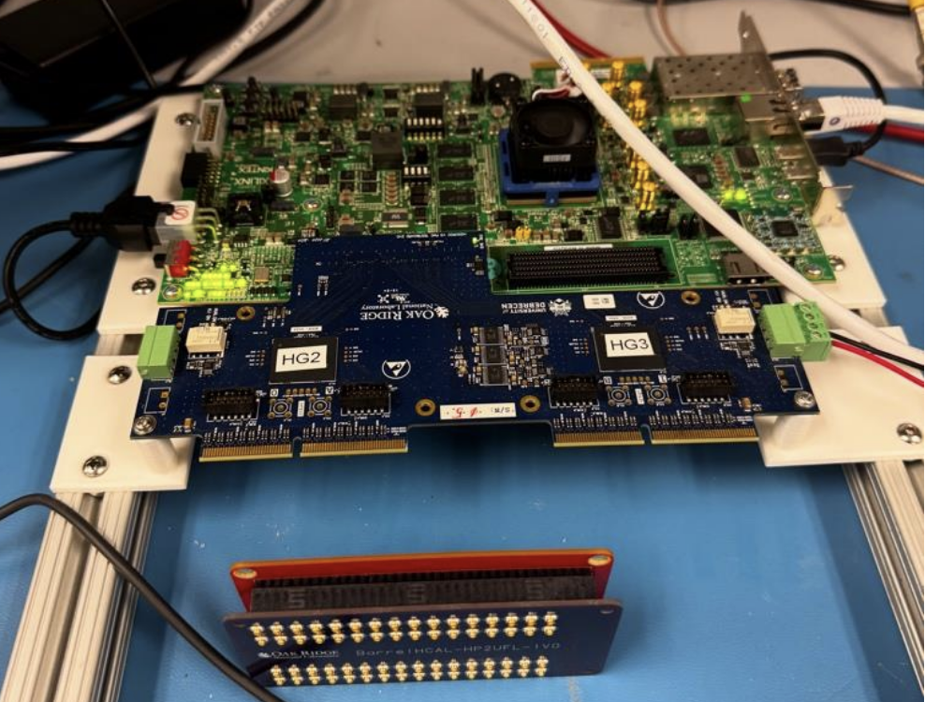
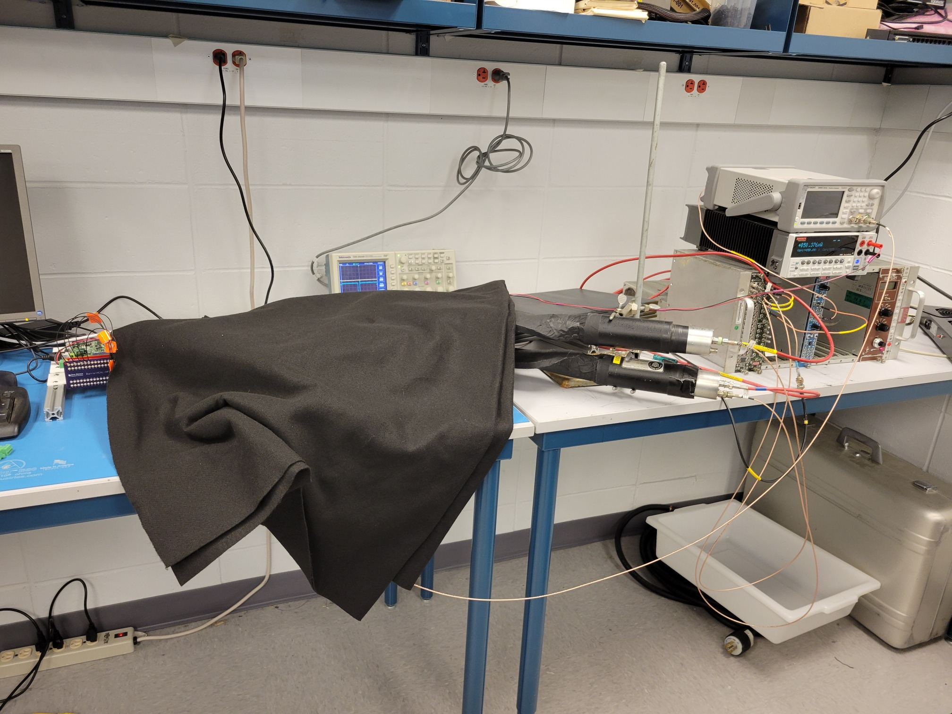
ROC readout in our Hcal Lab @BNL
5 BHcal tiles with the ePIC SiPMs connected to the H2GCROC3 card
Read out via the KCU105 FPGA board
Readout fully implemented in RCDAQ

Slide 4
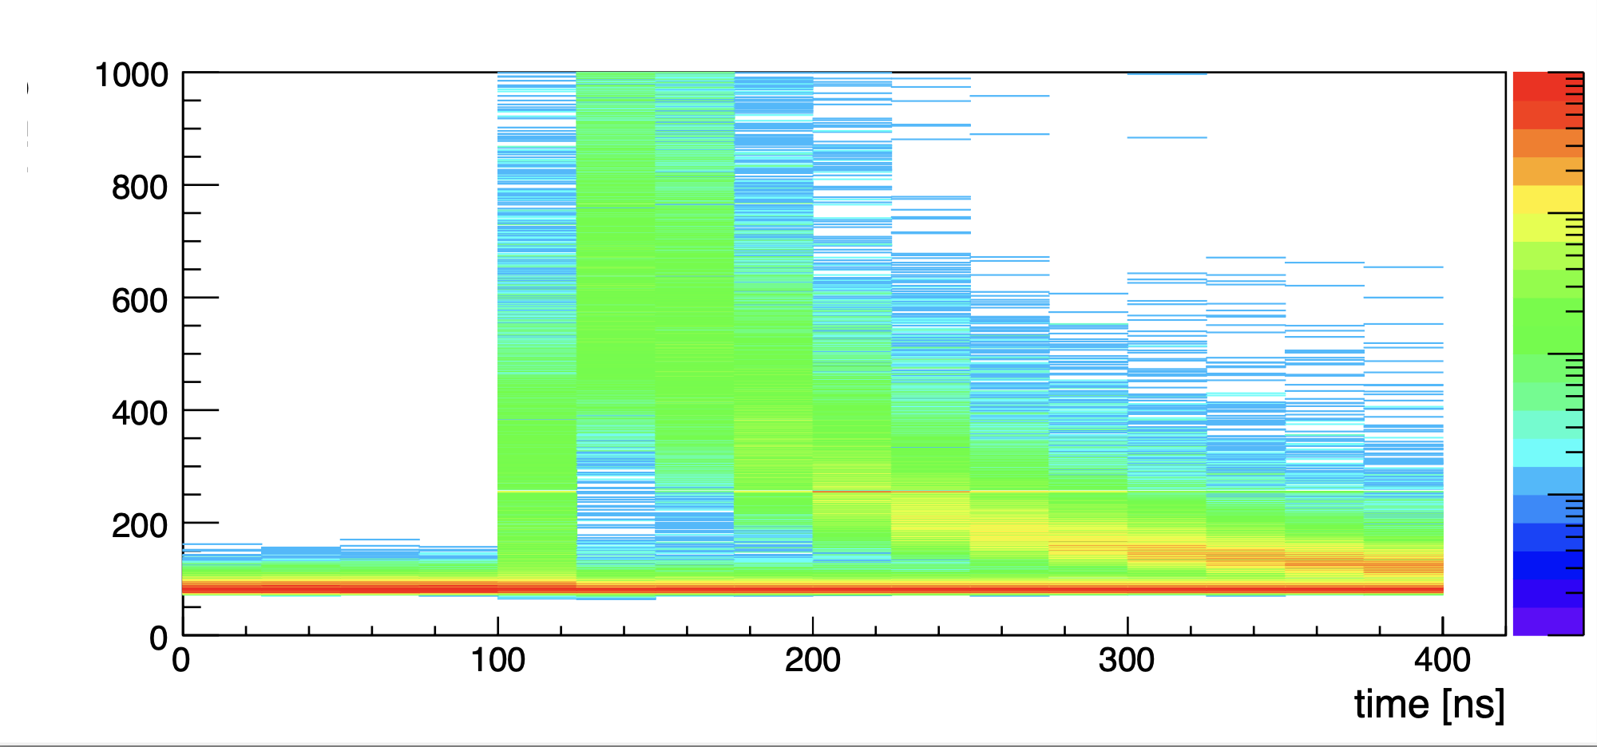
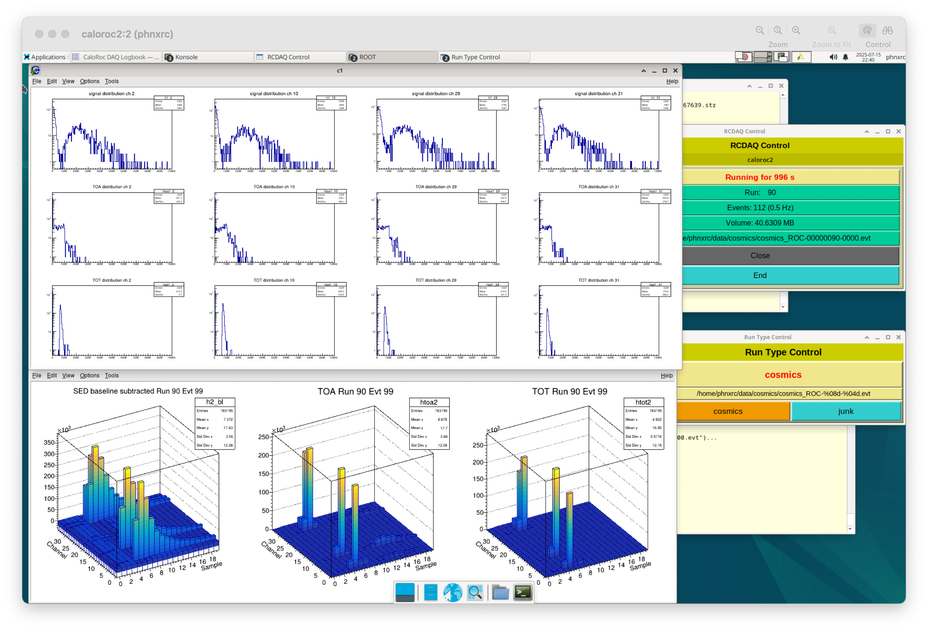
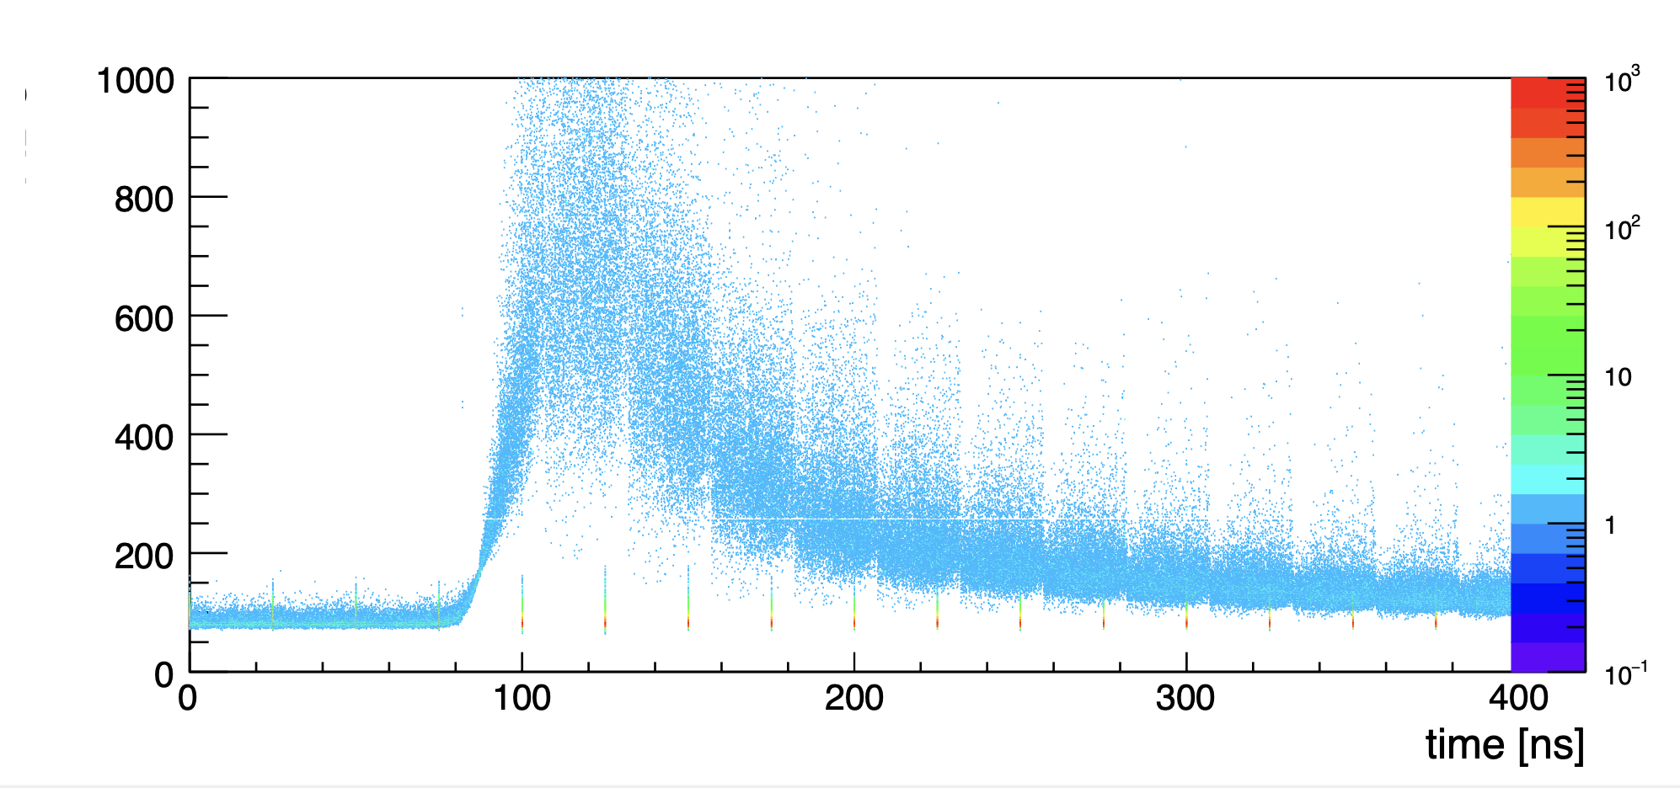
Taking data in the BNL “HCal” lab
This is of course a screen shot, but I can give you a live demo – find me
uncorrected
Norbert asked me to weave in this plot – the current state-of-the-art of the waveform analysis
corrected

Slide 5
RCDAQ - The High Points
Each interaction with RCDAQ is a shell command. There is no “starting an application and issuing internal commands” (think of your interaction with, say, root)
You still have a rich set of GUIs. But it is guaranteed that any GUI isn’t doing anything that you cannot also do with a command
This makes everything inherently scriptable (which you really need for many bench tests or test beams – thing of bias voltage scans, position scans in a test beam, etc)
RCDAQ out of the box doesn’t know about any particular hardware. All knowledge how to read out something, say, a FELIX card, comes by way of a plugin that teaches RCDAQ how to do that.
Built-in support for standard online monitoring
Built-in support for electronic logbooks (Stefan Ritt’s Elog)
Network-transparent control interfaces

Slide 6
The H2GCROC3 RCDAQ plugin
“All knowledge how to read out a device comes by way of a plugin that teaches RCDAQ how to do that.”
This shows the relevant portions of the RCDAQ setup file
It loads that plugin that teaches RCDAQ how to read the H2GCROC3 front-end
And then we create the device itself
rcdaq_client load librcdaqplugin_h2gcroc3.so
rcdaq_client create_device device_h2gcroc3 1 12001 10.1.2.208 1 128
This is all that the plugin needs to know
$ daq_status -ll
caloroc2 - Stopped
Filerule: /home/phnxrc/data/junk/junk_ROC-%08d-%04d.evt
Logging enabled
. . . Lines deleted
List of loaded Plugins:
- H2GCROC3 Plugin, provides -
- device_h2gcroc3 (evttype, subid, IP addr, trigger, nr_packets) - readout an H2GCROC3

Slide 7
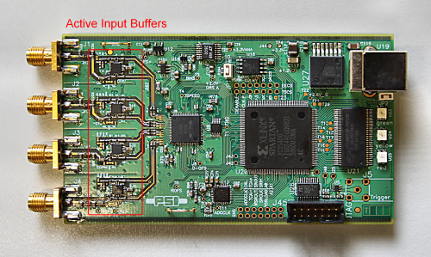
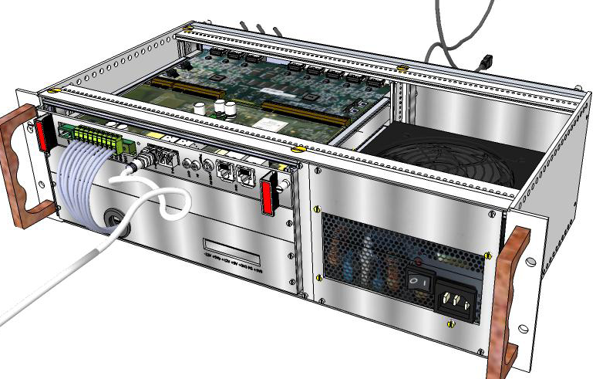
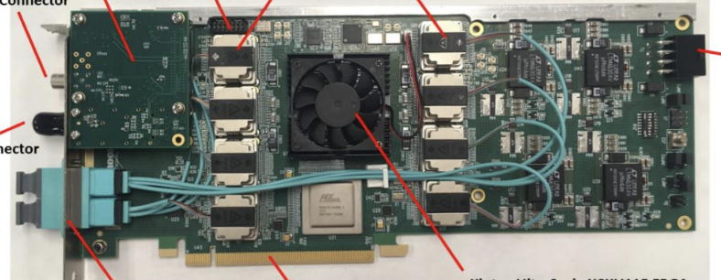
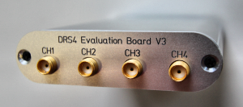
We have plugins for many common devices
RCDAQ
PCIe
PCIe
H2GCROC3
The CERN RD51 SRS System
DRS4 Eval board
“USB Oscilloscope”
The CAEN V1742 waveform digitizer
FELIX Cards
All of those are or have been used for EIC-themed R&D
And many more! I know of about 35 or so

Slide 8
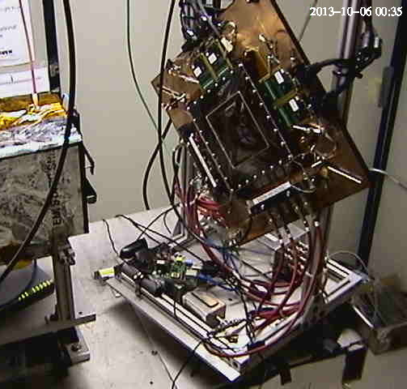
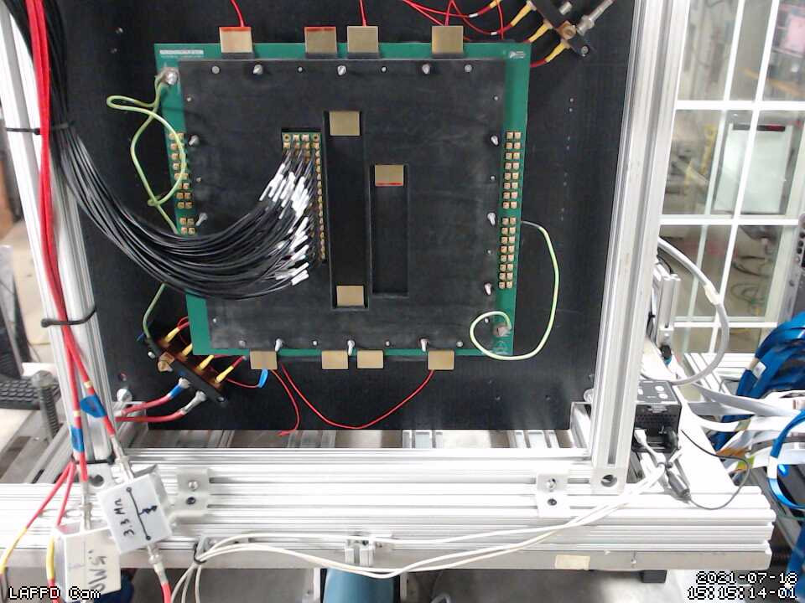
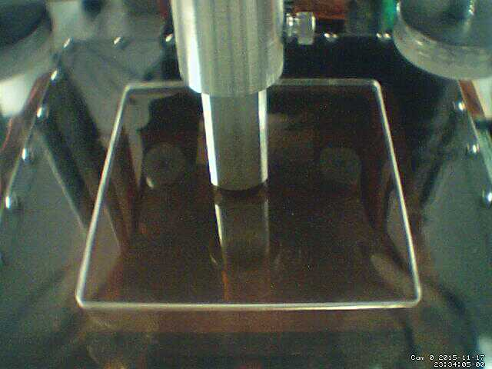
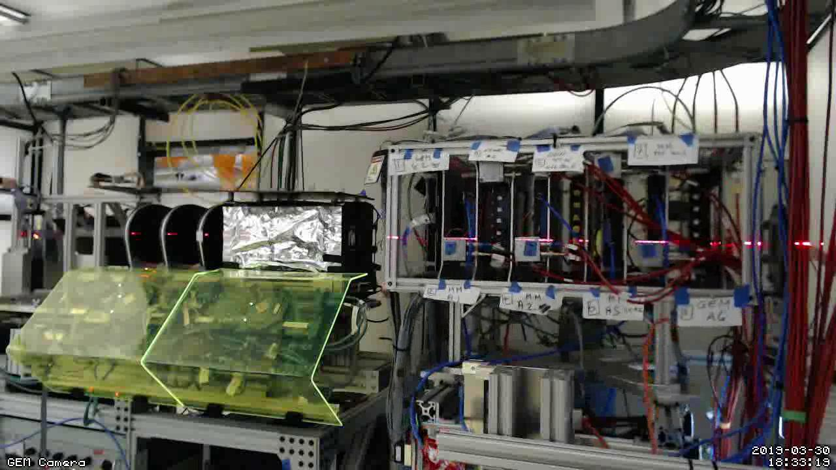
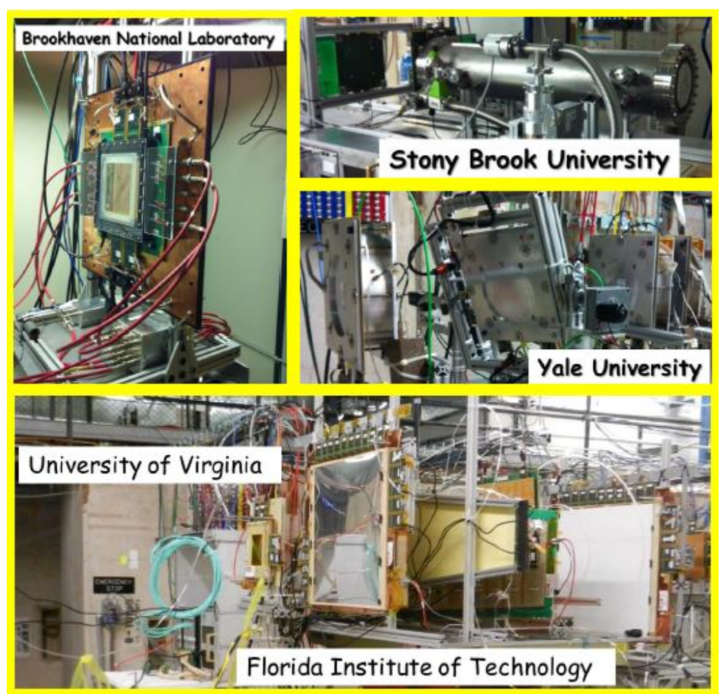
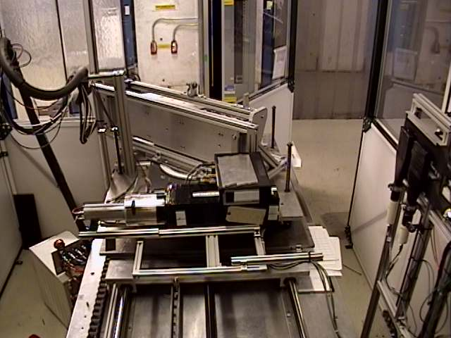
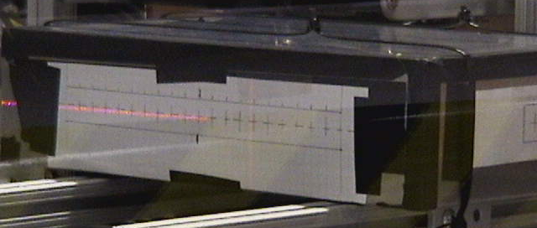
Long History of EIC-themed test beams with RCDAQ
The RCDAQ system has been a pillar of EIC-themed data taking for R&D, test beams etc since 2013 – eRD1, eRD6, LDRDs, …
Many active RCDAQ installations in the ePIC orbit + ~30 elsewhere
Usual entry by ease-of-use for standard devices (DRS, SRS, CAEN, …) and support for fully automated measurement campaigns
Manuals and “application notes” at https://www.phenix.bnl.gov/~purschke/rcdaq
MPGD-LDRD (2019)
LAPPD / Kiselev
(2022)
Minidrift TPC (2013)
ZigZag Readout (2016)
PWO prototype (2018)
Dual-sided PWO readout (2017)
FLYSUB consortium (2014)
Thanks to Jin Huang for this collection

Slide 9
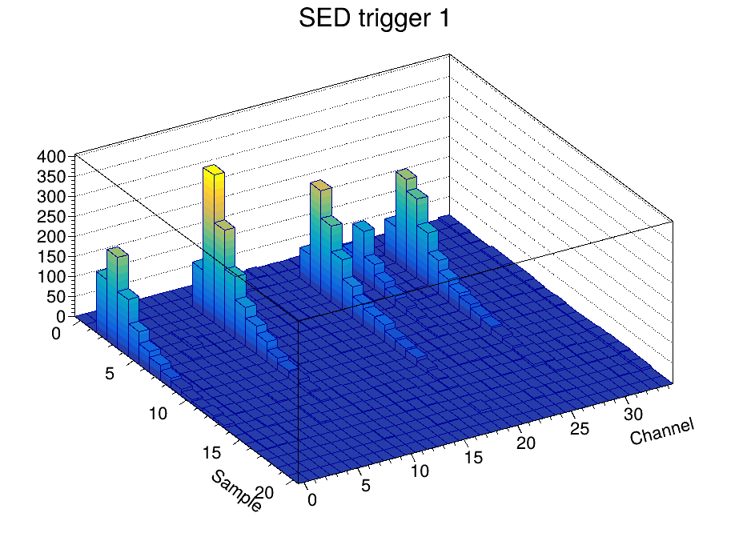
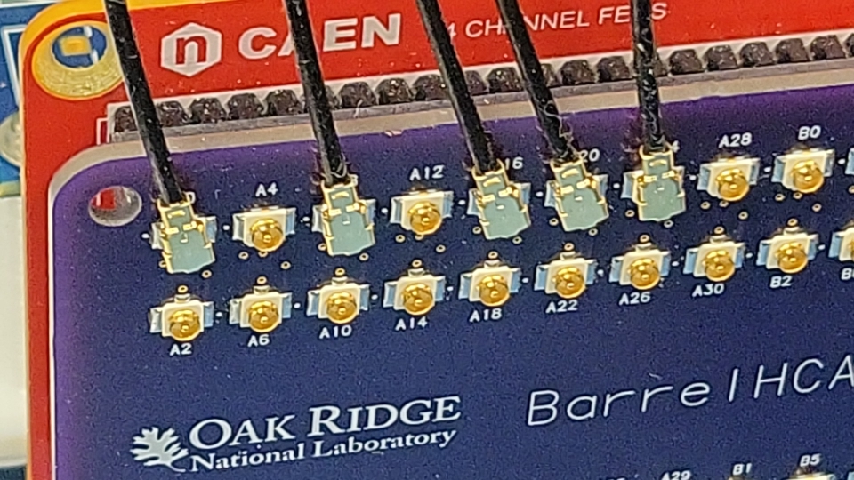
Online monitoring
RCDAQ comes with a package (“pmonitor”) that allows you view and in general interact with histograms etc while they are being filled from an RCDAQ online event stream
(of course you can replay existing data files etc)
There is a wealth of re-usable existing monitoring code for the general types of readout
Conversely, the operational experience gained here typically feeds into the offline analysis
Case in point: The H2GCROC3 is a Waveform Sampler at heart
Waveform Sampler = many readout channels, each of which provides a waveform with a number of samples (72 ch x <30 samples for H2GCROC2)
Just like the CAEN V1742 (32 ch x 1024 samples), or our SAMPA (what you know as the SALSA) with 32ch x a variable number of samples – all the same in the end)
When Norbert and I set up what I showed before, I took some existing monitoring code. I simply adjusted the channel/sample boundaries in some histograms
and…
Signals from 5 scintillators

Slide 10
Analysis API
The data from each device gets a “house number” (packet id) that uniquely identifies what is being read out
If p is a pointer to the data object from that device:
Here is the relevant code snippet:
rcdaq_client create_device device_h2gcroc3 1 12001 10.1.2.208 1 128
p->iValue(0,"SAMPLES") tells you how many samples are present
p->iValue(0,”CHANNELS") tells you how many channels that device has (here:144)
p->iValue(c,s) gives you sample s from channel c (there are faster interfaces available)
Packet *p = e->getPacket(12001);
if (p)
{
for ( int s = 0; s < p->iValue(0,"SAMPLES"); s++)
{
for (int c = 1; c < 35; c++) // we can ask iValue(0,”CHANNELS”) but we only want 35
{
h2->Fill(c,s, p->iValue(c,s));
}
}
delete p;
}
This API will not change when we switch to different hardware (universal for all waveform samplers)
Different APIs suitable for other detectors (say, pixel-based devices)

Slide 11
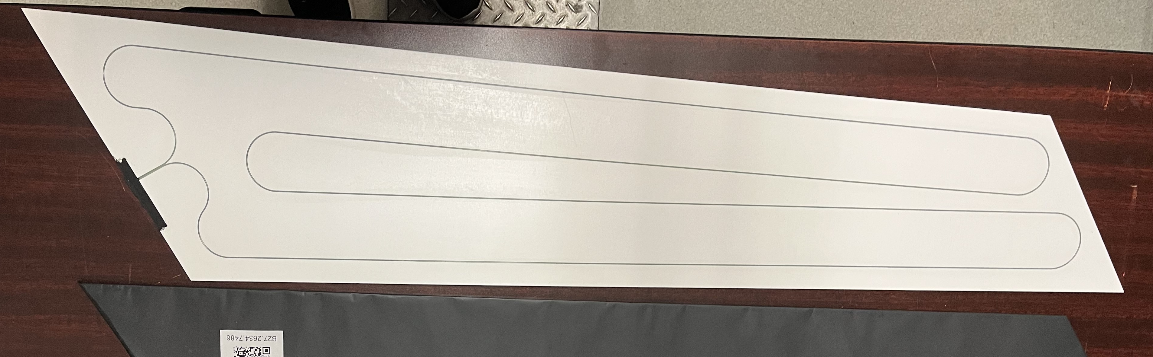
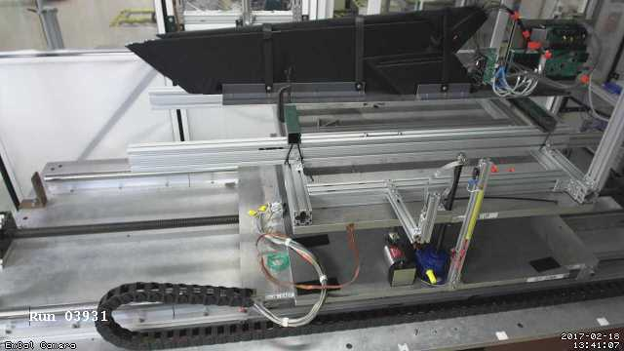
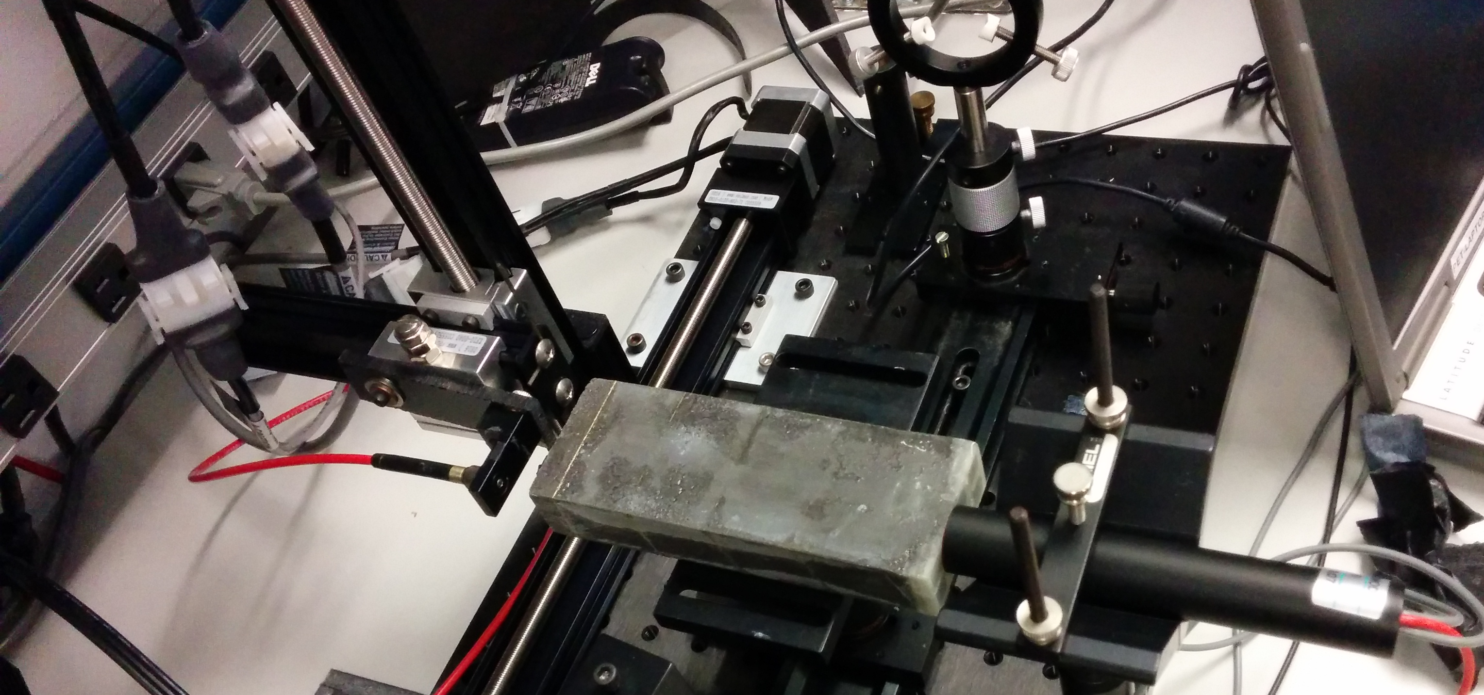
Scans and automated measurements
The next thing you want to do right after you manage to read out your detector prototype are scans of various things
Bias scans, position scans (typical at test beams), temperature scans, and so on and so on
RCDAQ is all about automation, scripting, and also support for the easy analysis of the so-taken data
Here are some position-scan examples:
The key to capturing meta data are different event types that read out different things at different times, in particular the begin-run and end-run events that make it easy to store meta-data
WLS Fiber in the scintillator panel
EmCal Module shower position gain uniformity scan
BHCal scintillator “tile mapping” with beam (FTBF)
(there is a cool movie in the backup slides..)
GEM Gain uniformity scan

Slide 12
Measurements on autopilot through scripting
Simulate shower incidence positions by moving a light fiber in x and y
take a run for each position w/ 4000 events
50 x 25 = 1250 positions (later we had 70x70 =4900, you really want to automate that)
I have shown the data-taking script before, let me go quickly to the analysis
X-Y step motor
Calorimeter Module
Light Fiber
PMT
(later SiPM)

Slide 13
The “4900 positions” Script
#! /bin/sh
STARTPOSX=0
STARTPOSY=-5200
INCREMENTX=200
INCREMENTY=200
CURRENTPOSY=$STARTPOSY
for posy in $(seq 70) ; do
quickmove.sh $CURRENTPOSY 2
sleep 5
CURRENTPOSY=$( expr $CURRENTPOSY + $INCREMENTY)
CURRENTPOSX=$STARTPOSX
for posx in $(seq 70) ; do
echo "moving to $CURRENTPOSX"
quickmove.sh $CURRENTPOSX 1
sleep 5
CURRENTPOSX=$( expr $CURRENTPOSX + $INCREMENTX)
done
done
The DAQ operation becomes an integral part of your shell environment
70 positions in y
move the Y motor
70 positions in x
move the x motor
next x
next y
Automatic end after 4000 events
start the DAQ
rcdaq_client daq_set_maxevents 4000
rcdaq_client daq_begin
wait_for_run_end.sh

Slide 14
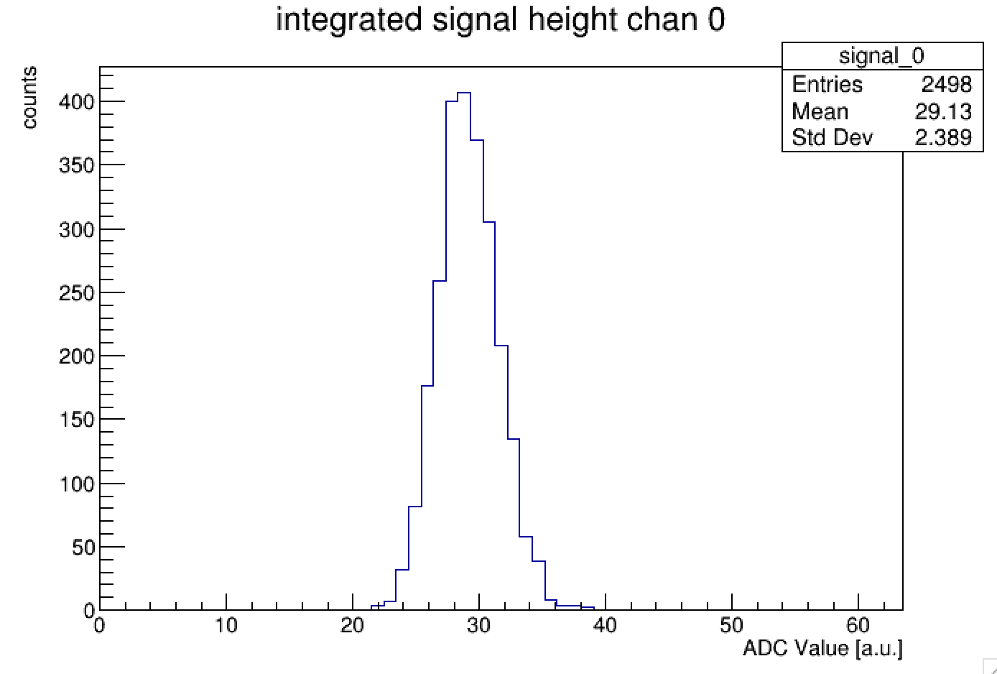
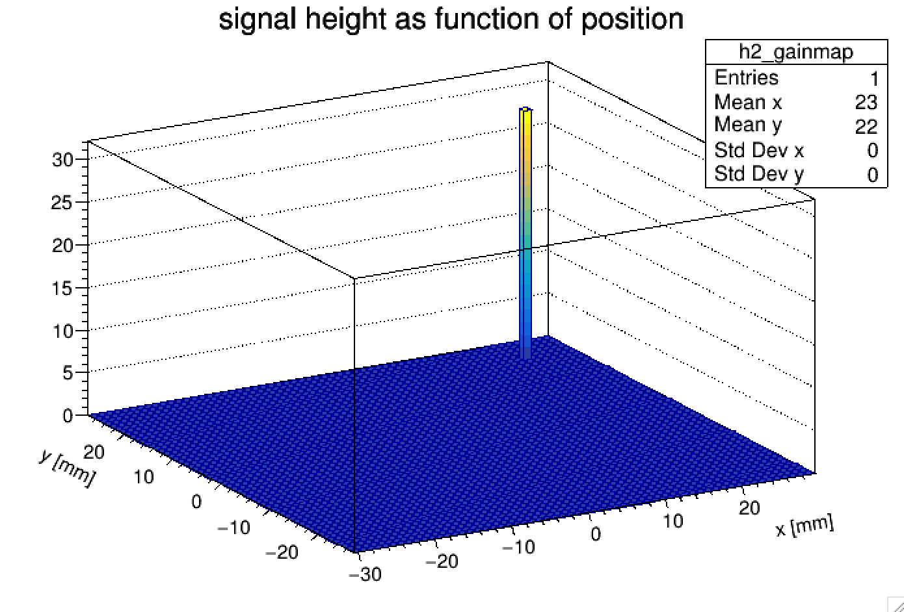
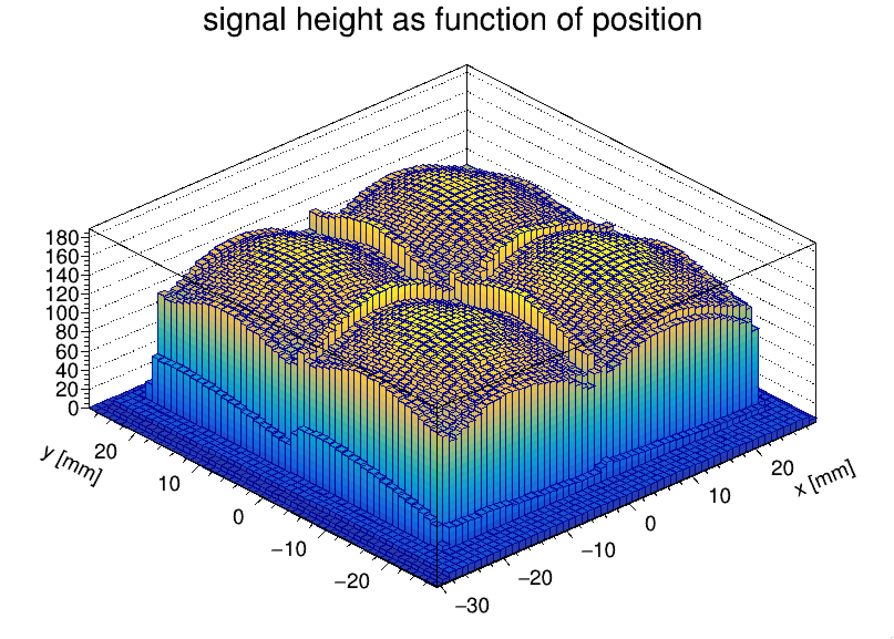
Now we want to analyze those 4900 data files
In each data file in the begin-run event we capture additional information, especially the x/y position where this data point is from
Now you go through all 4900 files. Each file knows its position from its “metadata”
We then histogram the signal, get the mean value at the end of the file, and put the value into the right x/y position
Run through all files in the set, have a coffee, and see the results:
In this way you can run the analysis without burdensome additional bookkeeping
All you need to analyze the data in one fell swoop is contained in the data themselves
$ ddump -i -t 9 -p 920 data_0000050000-0000.evt
-- Event 1 Run: 50000 length: 3238 type: 9 (Begin Run Event) 1491849916
300
-5300
$ ddump -i -t 9 -p 920 data_0000050001-0000.evt
-- Event 1 Run: 50001 length: 3264 type: 9 (Begin Run Event) 1491849930
500
-5300
$ ddump -i -t 9 -p 920 data_0000050002-0000.evt
-- Event 1 Run: 50002 length: 3242 type: 9 (Begin Run Event) 1491849944
700
-5300

Slide 15
RCDAQ support for ePIC
All software is available on github
Since all readout support lives in plugins to begin with, there is no need for an ePIC version of RCDAQ (in the same sense that there is no special ePIC ROOT version)
I forked the “Event Libraries” that interfaces the RCDAQ format to other packages, such as ROOT, or EICRecon
I added the ROC support to the ePIC fork, am weeding out the non-ePIC things
What I intend to keep:
The commercial devices – CAEN V1742 and siblings, DRS4, SRS, the FELIX card support, and some FNAL/FTBF-specific beamline devices for the day when we might have test beams there again
Future support:
I personally intend to stick around for the foreseeable future
There are many RCDAQ power users in our orbit - I have long handed over the plugin support for the sPHENIX-specific plugins (such as FELIX) to others
I also find that completely unrelated groups are using RCDAQ, without any hand-holding, going just by the manuals – a while ago I was contacted by a group in LA that had already been using RCDAQ for years, and finally had a question

Slide 16
Summary
RCDAQ is a mature DAQ framework that is in use in many places, not just in our immediate orbit
Has all amenities that you would expect, GUIs, but also scripting and automation
Support for metadata for automatic “environment” capturing and analysis streamlining
Support for online monitoring
Support for automated logbook entries
The picoDAQ aspect: the first ROC support plugin has reached maturity, Astropix is next in line, likely
RCDAQ already supports the readout of the sPHENIX-flavored FELIX (172) cards
The same framework supports the commercial readout devices you may have started out with (Alexander’s pfRICH/HRPPD efforts are a good example, progressing from CAEN units to dedicated electronics)
Maturity: At some point during the next days sPHENIX will reach 80PB of physics data recorded with RCDAC. We are writing 34GB/s (270Gbit/s) to disk at peak luminosities.
I alluded to the possibility of a live demo – stick around for the “Hackathon” tonight, or find me in the breaks, or at the hotel bar…

Slide 17
Backup

Slide 18
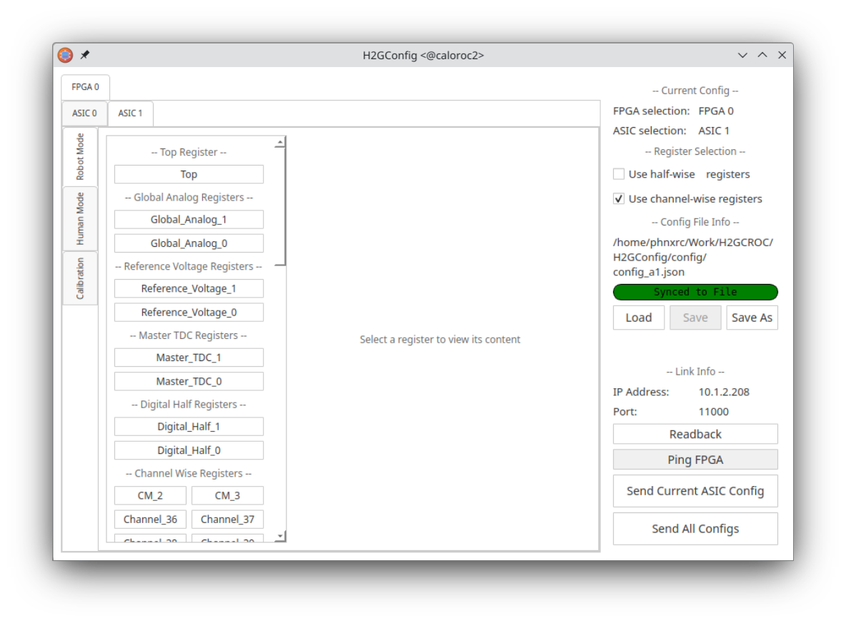
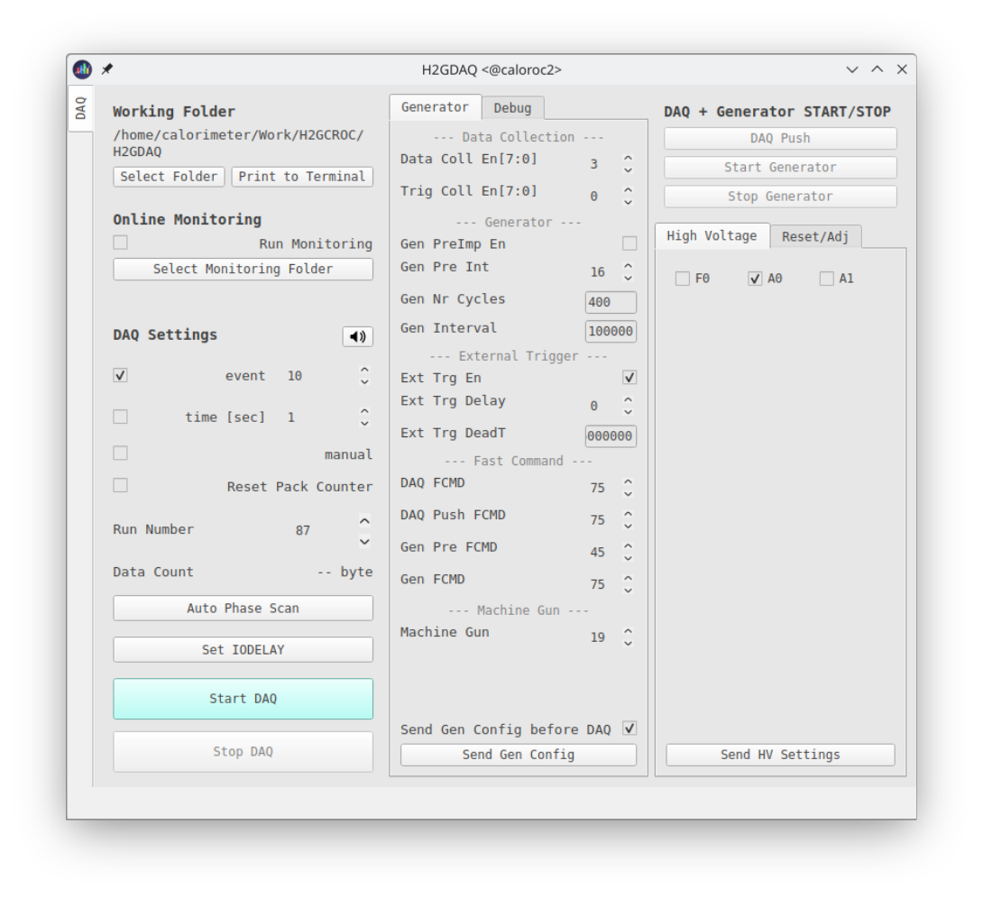
Front-end configuration vs RCDAQ configuration
Like many other devices with a vast configuration space (here: some 3000 parameters, most with reasonable defaults), the configuration of the front-end and the readout are two distinct tasks
The front-end is getting configured with two GUI-based processes (H2GConfig for the ASICs, H2GDAQ for the FPGA portion), and set up just the way we want it
RCDAQ is almost fully oblivious to the particulars of the front-end configuration, it reads whatever comes its way
It really only needs to know the IP address from which the data are coming; it also issues “start” and “stop” commands to the front-end to start or stop the flow of data – that’s all.
The standalone configuration process
We also support command based “canned” configs – GUIs are nice but can also be tedious.

Slide 19
Meta Data Capturing
In the “real” experiment that’s running for a few years (think sPHENIX, ATLAS, what have you) you are embedded in an environment that supports all sorts of record keeping
At a test beam or you in your lab needs a different kind of “record keeping support”
What was the temperature? Was the light on? What was the HV? What was the position of that X-Y positioning table?
We capture this information in the raw data file itself and the data cannot get lost
I often add a webcam picture to the data so we have a visual confirmation that the detector is in the right place, or something
A picture captures everything…
Let me show you how we always capture the RCDAQ setup itself

Slide 20
Reading different things with different Event Types
You would think of the DAQ as “reading out your detector”
Very often, it is necessary to read out different things at different times.
Let’s go to the CERN-SPS (or the Fermilab Test Beam facility) for an example
One needs to read out “meta-info” about each spill for spill-by-spill corrections
acceleration
SPS or AGS
extraction
“spill”
Begin-run event
End-run event
Spill-On event
Read and clear scalers
Flush buffers
Data Events
Read your detector channels, ADCs, TDCs...
Spill-Off event
Read and clear scalers
(allows spill intensity-based corrections)
20
Two more events that are always there – the begin-run and end-run events

Slide 21
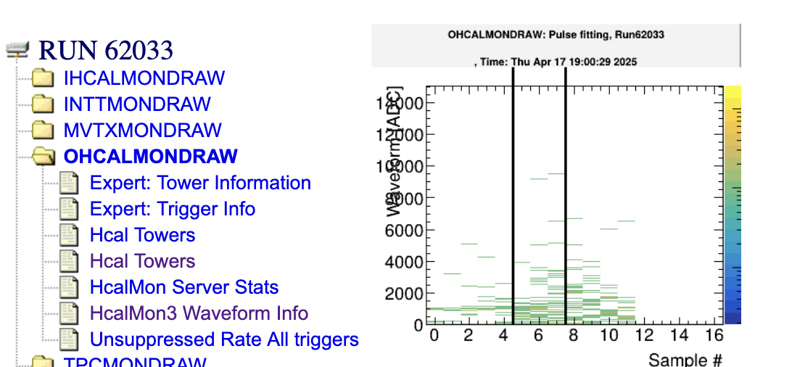
Why are begin- and endrun events so important?
In each run, they are generated exactly once
This is the place where you can keep information that is needed/valid for the entire run
Like the position information of the x/y motors that you saw before - they would get stored in the begin run.
Ditto for configuration information – we always make it so that we store it in the begin-run.
RCDAQ guarantees that the begin-run is the first, and the end-run is the last event in that run
If nothing else, if you treat your data as a stream (think online monitoring – doesn’t stop, sees many runs), these serve as convenient markers that a new run has begun, or a run has ended.
On receipt of the begin-run event, you typically clear all your monitoring histograms
On receipt of the end-run event, you save your histograms to a file
This is actually how all this online monitoring history is generated!

Slide 22
More about capturing your environment
Many times you capture things only “just in case”
You don’t routinely look at them in your analysis (such as cam pictures shown before)
But if you have some inexplicable feature, you can use the data to do “forensics”
Find out what, if anything, went wrong
The more data you capture, the better this gets
Think of it as “black box” on a plane…

Slide 23
Forensics
“It appears that the distributions change for Cherenkov1 at 1,8,12,and 16 GeV compared to the other energies. It seems that the Cherenkov pressures are changed. […] Any help on understanding this would be appreciated.”
Martin: “Look at the info in the data files:”
$ ddump -t 9 -p 923 beam_00002298-0000.prdf
S:MTNRG = -1 GeV
F:MT6SC1 = 5790 Cnts
F:MT6SC2 = 3533 Cnts
F:MT6SC3 = 1780 Cnts
F:MT6SC4 = 0 Cnts
F:MT6SC5 = 73316 Cnts
E:2CH = 1058 mm
E:2CV = 133.1 mm
E:2CMT6T = 73.84 F
E:2CMT6H = 32.86 %Hum
F:MT5CP2 = .4589 Psia
F:MT6CP2 = .6794 Psia
$ ddump -t 9 -p 923 beam_00002268-0000.prdf
S:MTNRG = -2 GeV
F:MT6SC1 = 11846 Cnts
F:MT6SC2 = 7069 Cnts
F:MT6SC3 = 3883 Cnts
F:MT6SC4 = 0 Cnts
F:MT6SC5 = 283048 Cnts
E:2CH = 1058 mm
E:2CV = 133 mm
E:2CMT6T = 74.13 F
E:2CMT6H = 37.26 %Hum
F:MT5CP2 = 12.95 Psia
F:MT6CP2 = 14.03 Psia

Slide 24
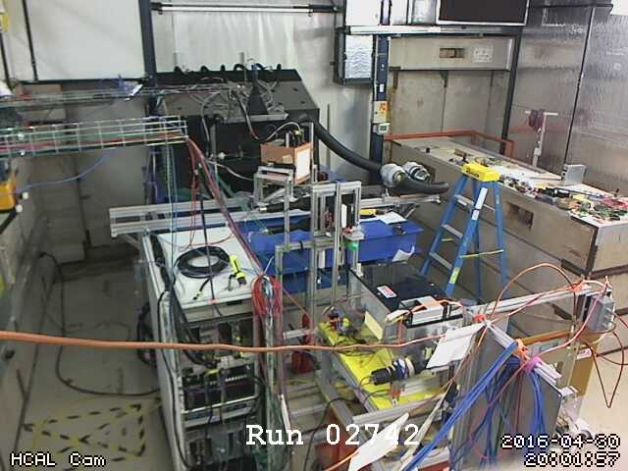
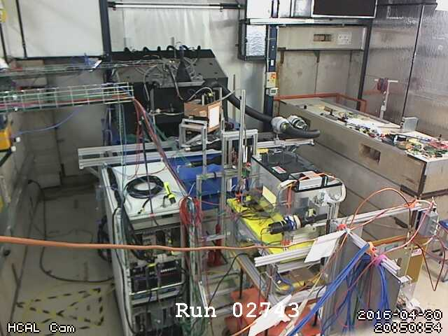
More Forensics (my poster child why this is so useful…)
“There is a strange effect starting in run 2743. There is a higher fraction of showering than before. I cannot see anything changed in the elog.”
Look at the cam pictures we automatically captured for each run:
$ ddump -t 9 -p 940 beam_00002742-0000.prdf > 2742.jpg
$ ddump -t 9 -p 940 beam_00002743-0000.prdf > 2743.jpg

Slide 25
Moving Detector Example: “HCal Tile Mapping” at the Fermi Test Beam Facility
“Tile mapping” refers to mapping the position-dependent response of a hadronic calorimeter tile. We were moving a stack of Hcal tiles so the beam hits particular positions (In the picture, beam is coming at you)
About 200 individual positions of the tile relative to the beam – you’d go nuts doing all that manually, and you are bound to make mistakes
And all on camera for ach run for feel-good value – does that thing move right when we think it should?
This setup exercises many of the aforementioned features: scripting and reacting to the FTBF spill, network transparency (we cannot access the table positioning from our DAQ machine, but a FTBF-owned machine can control our DAQ)

Slide 26
A typical RCDAQ Setup Script
#! /bin/sh
# this sets up the DRS4 readout with 5GS/s, a negative
# slope trigger in channel 1 with a delay of 140
if ! rcdaq_client daq_status > /dev/null 2>&1 ; then
echo "No rcdaq_server running, starting..."
rcdaq_server > $HOME/rcdaq.log 2>&1 &
sleep 2
fi
MYSELF=$(readlink -f $0)
rcdaq_client daq_clear_readlist
rcdaq_client create_device device_file 9 900 "$MYSELF”
rcdaq_client load librcdaqplugin_drs.so
rcdaq_client create_device device_drs -- 1 1001 0x21 -150 negative 140 3
We comment a lot as a way of documentation
If no server is running, we start one here.
We convert the script filename into a full path
We clear all existing definitions
We load the plugin(s) and define the device(s)

Slide 27
Here is the actual setup script for our FELIX readout
Abridged version, just the essentials
#!/bin/bash
RunType=beam
H=$RCDAQHOST
[ -z "$H" ] && H=$(hostname)
MYSELF=$(readlink -f $0)
rcdaq_client daq_clear_readlist
rcdaq_client create_device device_file 9 900 "$MYSELF"
rcdaq_client load librcdaqplugin_dam.so
rcdaq_client create_device device_dam 1 4${H:4:2}1 1 128
rcdaq_client daq_set_runcontrolmode 1

Slide 28
Just for completeness, the full H2GCROC2 setup (1 )
#! /bin/sh
# we need the $0 as absolute path b/c we pass it on to a "file" device further down
MYSELF=$(readlink -f $0)
# we figure out if a server is already running
if ! rcdaq_client daq_status > /dev/null 2>&1 ; then
echo "No rcdaq_server running, starting... log goes to $HOME/rcdaq.log"
rcdaq_server > $HOME/rcdaq.log 2>&1 &
sleep 2
# see if we have an elog command (ok, this is a weak test but
# at least it tells us that elog is installed.)
ELOG=$(which elog 2>/dev/null)
[ -n "$ELOG" ] && rcdaq_client elog localhost 666 RCDAQLog
fi
rcdaq_client daq_setrunnumberfile $HOME/.rcdaq_run
STEM=$HOME/data
rcdaq_client daq_define_runtype junk $STEM/junk/junk_ROC-%08d-%04d.evt
rcdaq_client daq_define_runtype cosmics $STEM/cosmics/cosmics_ROC-%08d-%04d.evt

Slide 29
Just for completeness, the full H2GCROC2 setup (2)
rcdaq_client daq_set_runtype junk
rcdaq_client daq_clear_readlist
# Since we have plenty of CPUs muscle, we enable the highest compression with 35 threads
rcdaq_client daq_set_nr_threads 35
rcdaq_client daq_set_compression 4
# and we roll over the files at 3GB
rcdaq_client daq_set_rolloverlimit 3
# we add this script itself to the begin-run event
rcdaq_client create_device device_file 9 900 "$MYSELF"
rcdaq_client create_device device_command 9 0 "RequestScript.py > /tmp/roc_setup.json"
rcdaq_client create_device device_file_delete 9 910 /tmp/roc_setup.json
rcdaq_client load librcdaqplugin_h2gcroc3.so
rcdaq_client create_device device_h2gcroc3 1 12001 10.1.2.208 1 1024
rcdaq_client daq_open

Slide 30
PacketID assignment Example (BHCal)
In sPHENIX we assign each detector system a “Detector Number” – our Hcal happens to be #8
Each detector then can assign packet IDs in the d_nr * 1000 +1 …. d_nr * 1000 +999 range
8001… 8999 for the Hcal (the “even 1000” is reserved). Much more than we need
So we have 8001, 8002, 8007 and 8008 on the west side.
8003, 8004, 8005, 8006 on the east side
All 8 together constitute the data of the entire HCal
8003
8002
E
8004
8001
W
8005
8008
8006
8007
$ dlist /bbox/bbox6/W/HCal/cosmics/cosmics_seb16-064906-0000.prdf
Packet 8001 788 0 (Unformatted) 172 (IDDIGITIZERV3_12S)
Packet 8002 676 0 (Unformatted) 172 (IDDIGITIZERV3_12S)
Packet 8007 753 0 (Unformatted) 172 (IDDIGITIZERV3_12S)
Packet 8008 753 0 (Unformatted) 172 (IDDIGITIZERV3_12S)
The channel mapping for one device /packet repeats for each packet – super-easy to deal with
$ dlist /bbox/bbox7/W/HCal/cosmics/cosmics_seb17-064906-0000.prdf
Packet 8003 746 0 (Unformatted) 172 (IDDIGITIZERV3_12S)
Packet 8004 732 0 (Unformatted) 172 (IDDIGITIZERV3_12S)
Packet 8005 662 0 (Unformatted) 172 (IDDIGITIZERV3_12S)
Packet 8006 690 0 (Unformatted) 172 (IDDIGITIZERV3_12S))

