Slide 1
ePIC DAQ Plans and picoDAQ Overview
David Abbott (Jefferson Lab)
L3 Project Manager for ePIC DAQ/Computing
EIC User Group and ePIC Joint Collaboration Meeting
July 14th – 18th, 2025
Jefferson Lab, Newport News, VA

Slide 2
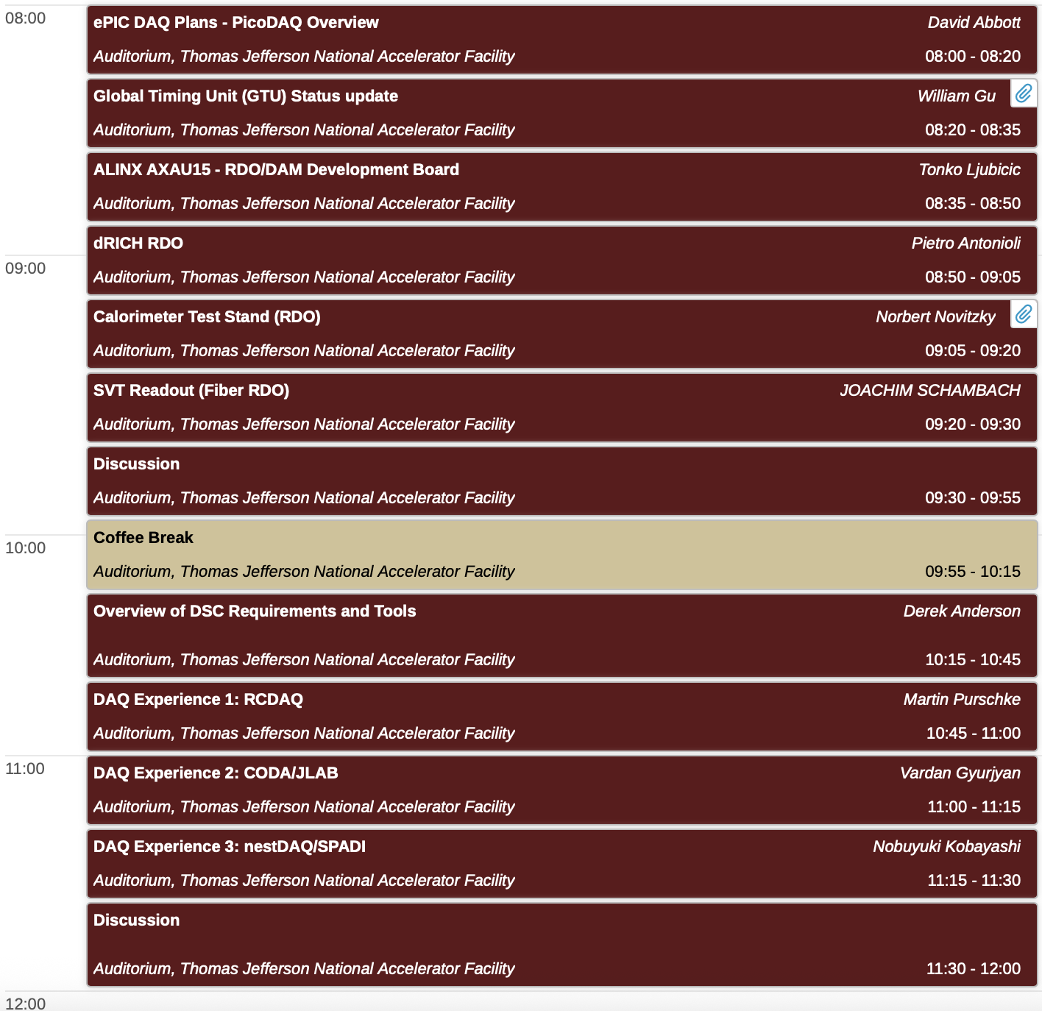
Breakout Overview
Joint session discussions this morning
ePIC DAQ plans (picoDAQ) and RDO development status
Software interfaces for test benches and beams.
ePIC DAQ Status
picoDAQ plans
ePIC sub-detectors – upcoming testing
GTU Status
RDO Overviews
ALINX AXAU15 RDO/DAM Development Board
dRICH RDO
Calorimeter test stand
SVT readout development

Slide 3
ePIC DAQ Schedule
A functional DAQ will be necessary for small scale detector testing as well as commissioning and pre-ops.
Computing resources are staged to make purchases when the hardware is needed, taking advantage of price savings and performance improvements in time.
Hardware and software development early in the construction phase will involve a series of releases with increasing functionality.
Detector Install: FY29Q2 - FY31Q2
Cosmics: FY31Q3
Early CD-4: FY32Q4
DAQ Releases:
PicoDAQ FY26Q1
Readout test setups
MicroDAQ: FY26Q4
Readout detector data in test stand using engineering articles
MiniDAQ: FY28Q1
Readout detector data using full hardware and timing chain
Full DAQ-v1: FY29Q2
Full functionality DAQ ready for full system integration & testing
Production DAQ: FY31Q3
Ready for cosmics
PDR1
PicoDAQ
MiniDAQ
Production
DAQ
PDR2
MicroDAQ
Full DAQ-V1
PDR3
Non-LLP pre-baseline schedule is in progress

Slide 4
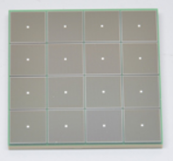
ePIC Readout Chain
Global Timing
Unit (GTU)
- Interfaces to Collider
- Run Control & DAM
- Config & Control
- Clock & Timing
On Detector
SMT BGA
Front End
Board
(FEB)
Detector Specific
Readout
Board
(RDO)
Few Variants
Data Aggregation Module (DAM)
Common
Echelon 0
Computing
Common
To Echelon 1
(ethernet)
Sensor
Detector Specific
Adapter
Detector Specific
ASIC Protocols
(I2C, lpGBT)
Copper/Fiber
RDO/DAM
Protocol
(fiber-pair)
PCIe/
Ethernet
FEB
Off Detector (Platform)
DAQ Room
On Detector RDO
(98.5 or 39.4 MHz)
ASICs
RDO
DAM
dRICH, TimePix, AstroPix, Calorimeters
VTRX+/SFP+
39.4 MHz
ASICs
lpGBT
VTRX+/SFP+
DAM
pfRICH, hpDIRC, TOF
RDO
39.4 MHz
ASICs
lpGBT
VTRX+
RDO/
Aggregator
DAM
SVT/MAPS

Slide 5
ePIC DAQ Support
While many detector groups may have test stands that they are using for development work, it is important at this stage to begin to have common solutions available for all ePIC sub-systems (even if they choose not to use them).
In near term, as we are developing engineering articles for all the DAQ components (FEB,RDO,DAM,GTU), we want to have two “releases” of firmware/software that will support a subset of hardware that is generally available – both commercially and from new and existing hardware designs.
PicoDAQ
Focused around RDO/ASIC configuration and readout.
This is for simple test systems supporting a single RDO (FPGA) connected to one or multiple FEBs (ASICS/Digitizers).
Ethernet-based configuration, control and readout support from a Linux PC or server.
MicroDAQ
Build on PicoDAQ by adding DAM and GTU hardware support
Implementation of GTU<->DAM<->RDO clock distribution and communication protocol.
Support via DAM for time frame building of data from multiple RDOs.
PCIe and Ethernet readout options from the DAM.

Slide 6
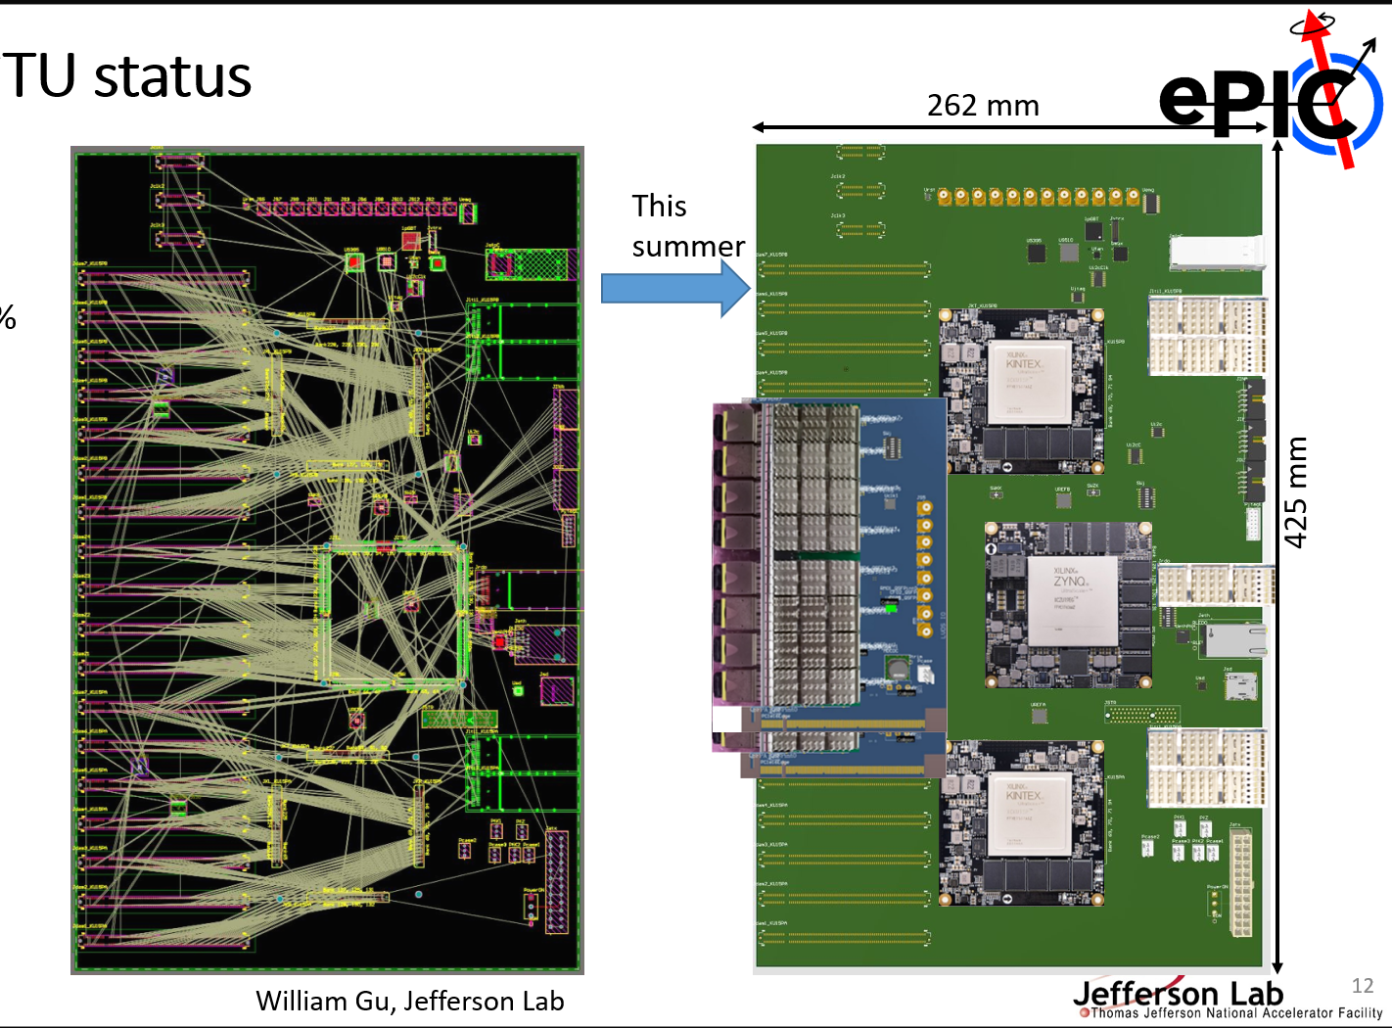
GTU Updates
GTU specifications and schematic design has been under development this year.
Thanks to William Gu for all his work on this. He will provide an overview and status in this session.
The current timeline is to produce an engineering article by the end of 2025 (or early 2026).
For early detector test setups we still need to provide some GTU functionality, in particular the appropriate clocks (98.5 MHz and 39.4 MHz).
In additional to the final DAM design, we are supporting GTU functionality for some commercial hardware as well.

Slide 7
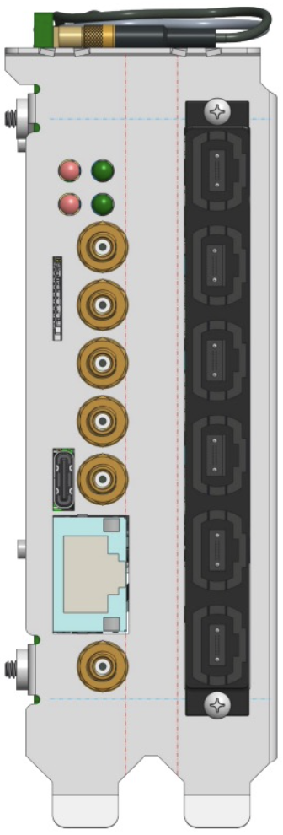
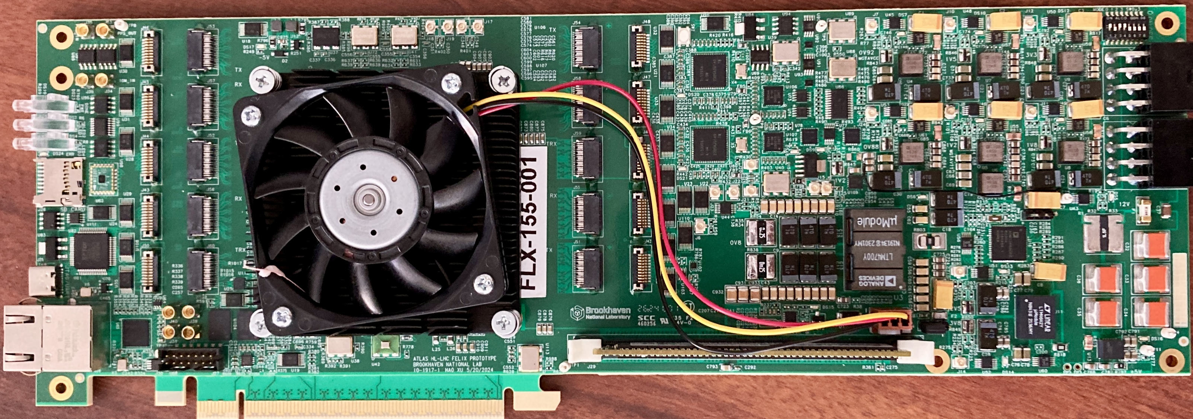
FELIX Updates – FLX-155
Front-End Link eXchange
Versal Ultrascale+ FPGA
Linux OS, Clock Distribution
Stream Frame Builder, Optional fixed latency processing
(output via Ethernet and/or PCIe)
GTU interface
100Gb
Ethernet
RDO
Detector
RDO
Up to 48 fiber links
RDO
RDO
FELIX hardware for future ATLAS experiments at HL-LHC is being developed at BNL (Omega Group)
ePIC is collaborating with Omega to use this design as our DAM board.
Initial engineering articles were tested in early 2025. Updated PCB design sent out for fabrication/population
Final design board will be tested this Fall (2025).
We expect to produce at least 4 boards for ePIC use after testing. Availability anticipated in Jan/Feb 2026

Slide 8
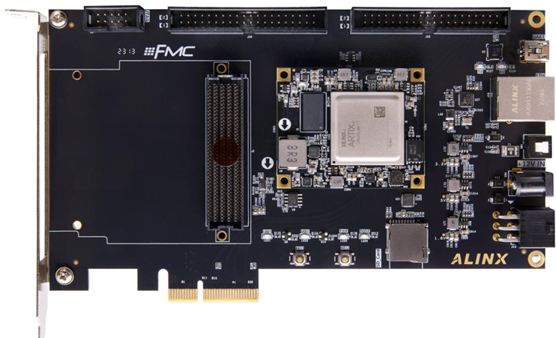
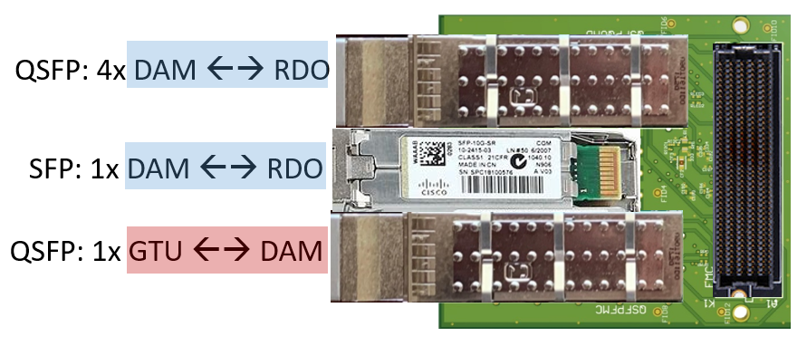
Mini-DAM/GTU Support
Inexpensive FPGA development board can be used as an RDO interface to ASIC FEBs via the FMC connector.
With the addition of an FMC adaptor board developed at JLAB it can be used as a “mini” DAM with readout/control support for up to 5 RDO boards.
In addition, a clock chip on the adapter card will provide GTU services for distribution of 98.5 MHz or 39.4MHz clocks
Alinx AXAU15
(Artix Ultrascale+ FPGA)
~$800
FMC DAM adapter board (JLAB Design)

Slide 9
JLab DAQ Support for ePIC
At JLab all 4 experimental halls use common hardware and software designs and applications to implement their DAQ systems (CODA).
Our long-term goal is to integrate ePIC DAQ developments into our existing designs.
We also work with researchers wanting to bring in new equipment to try and integrate with existing systems. This is not always easy.
There are a number of groups now working on ePIC related sub-detectors whom we need to support at some level.

Slide 10
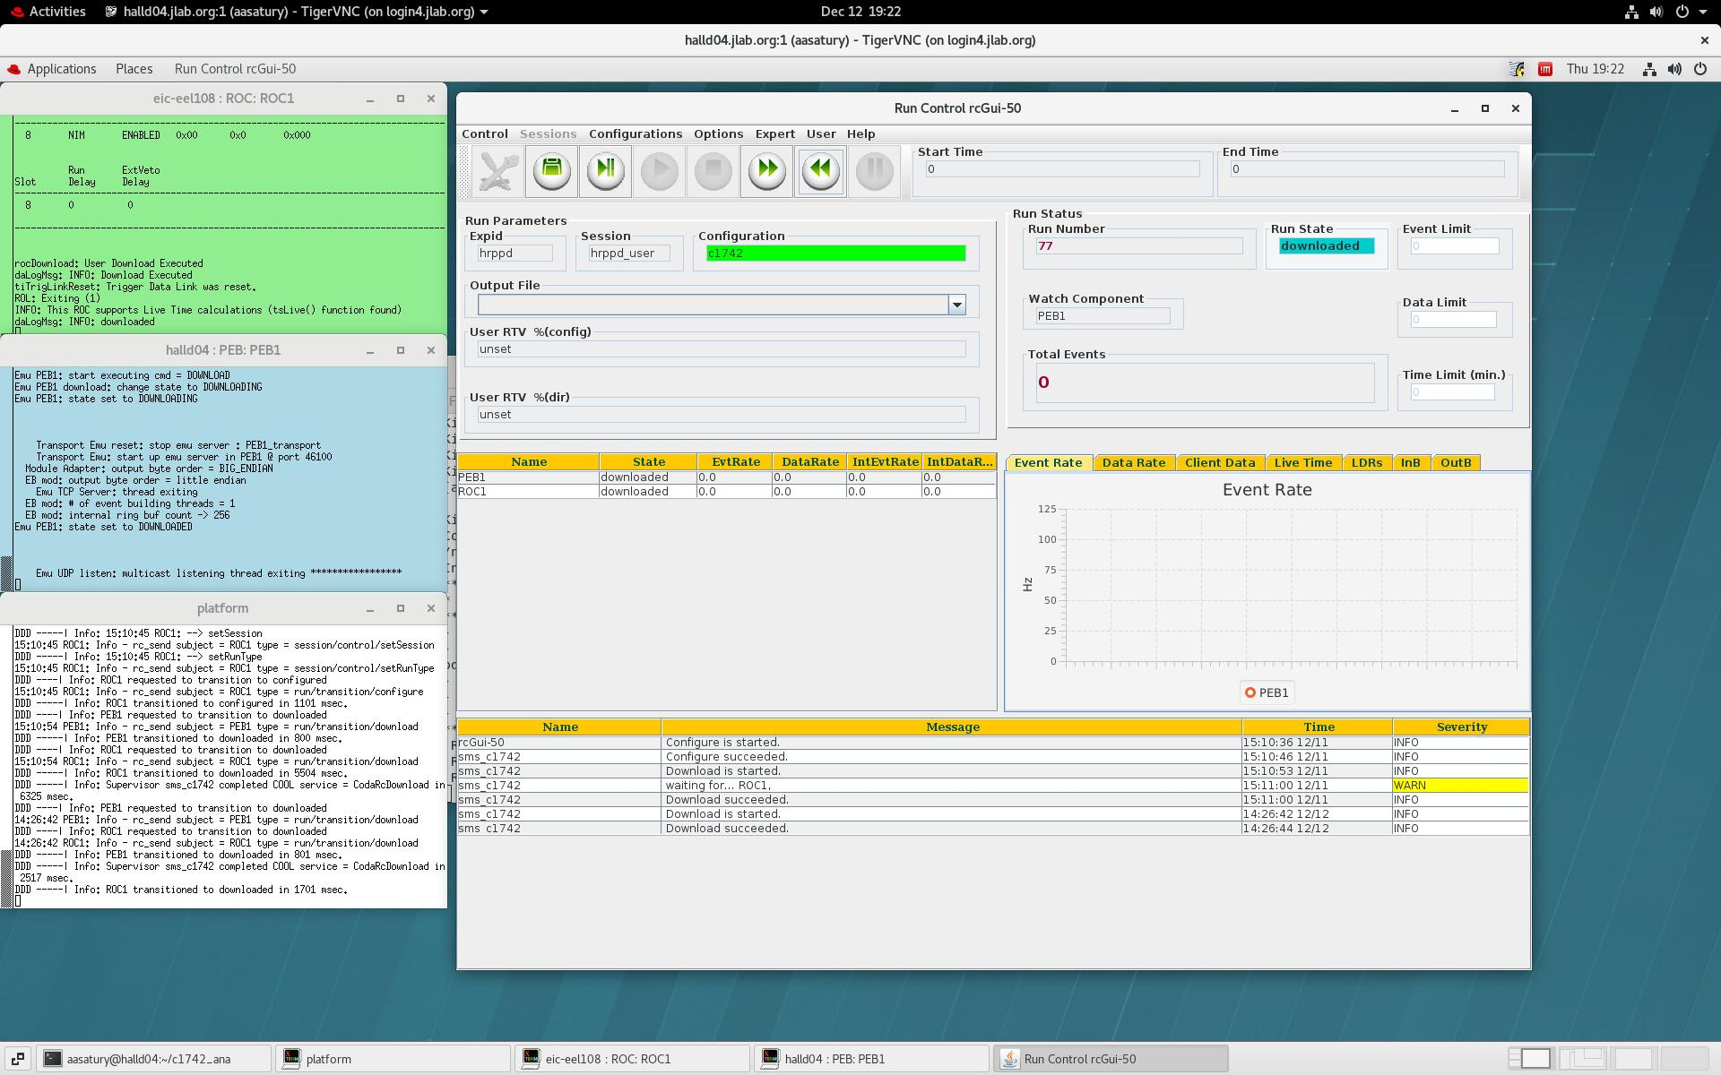
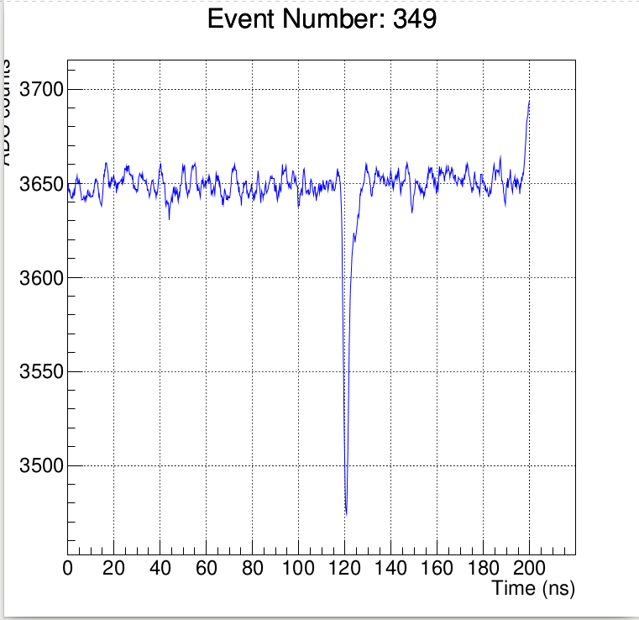
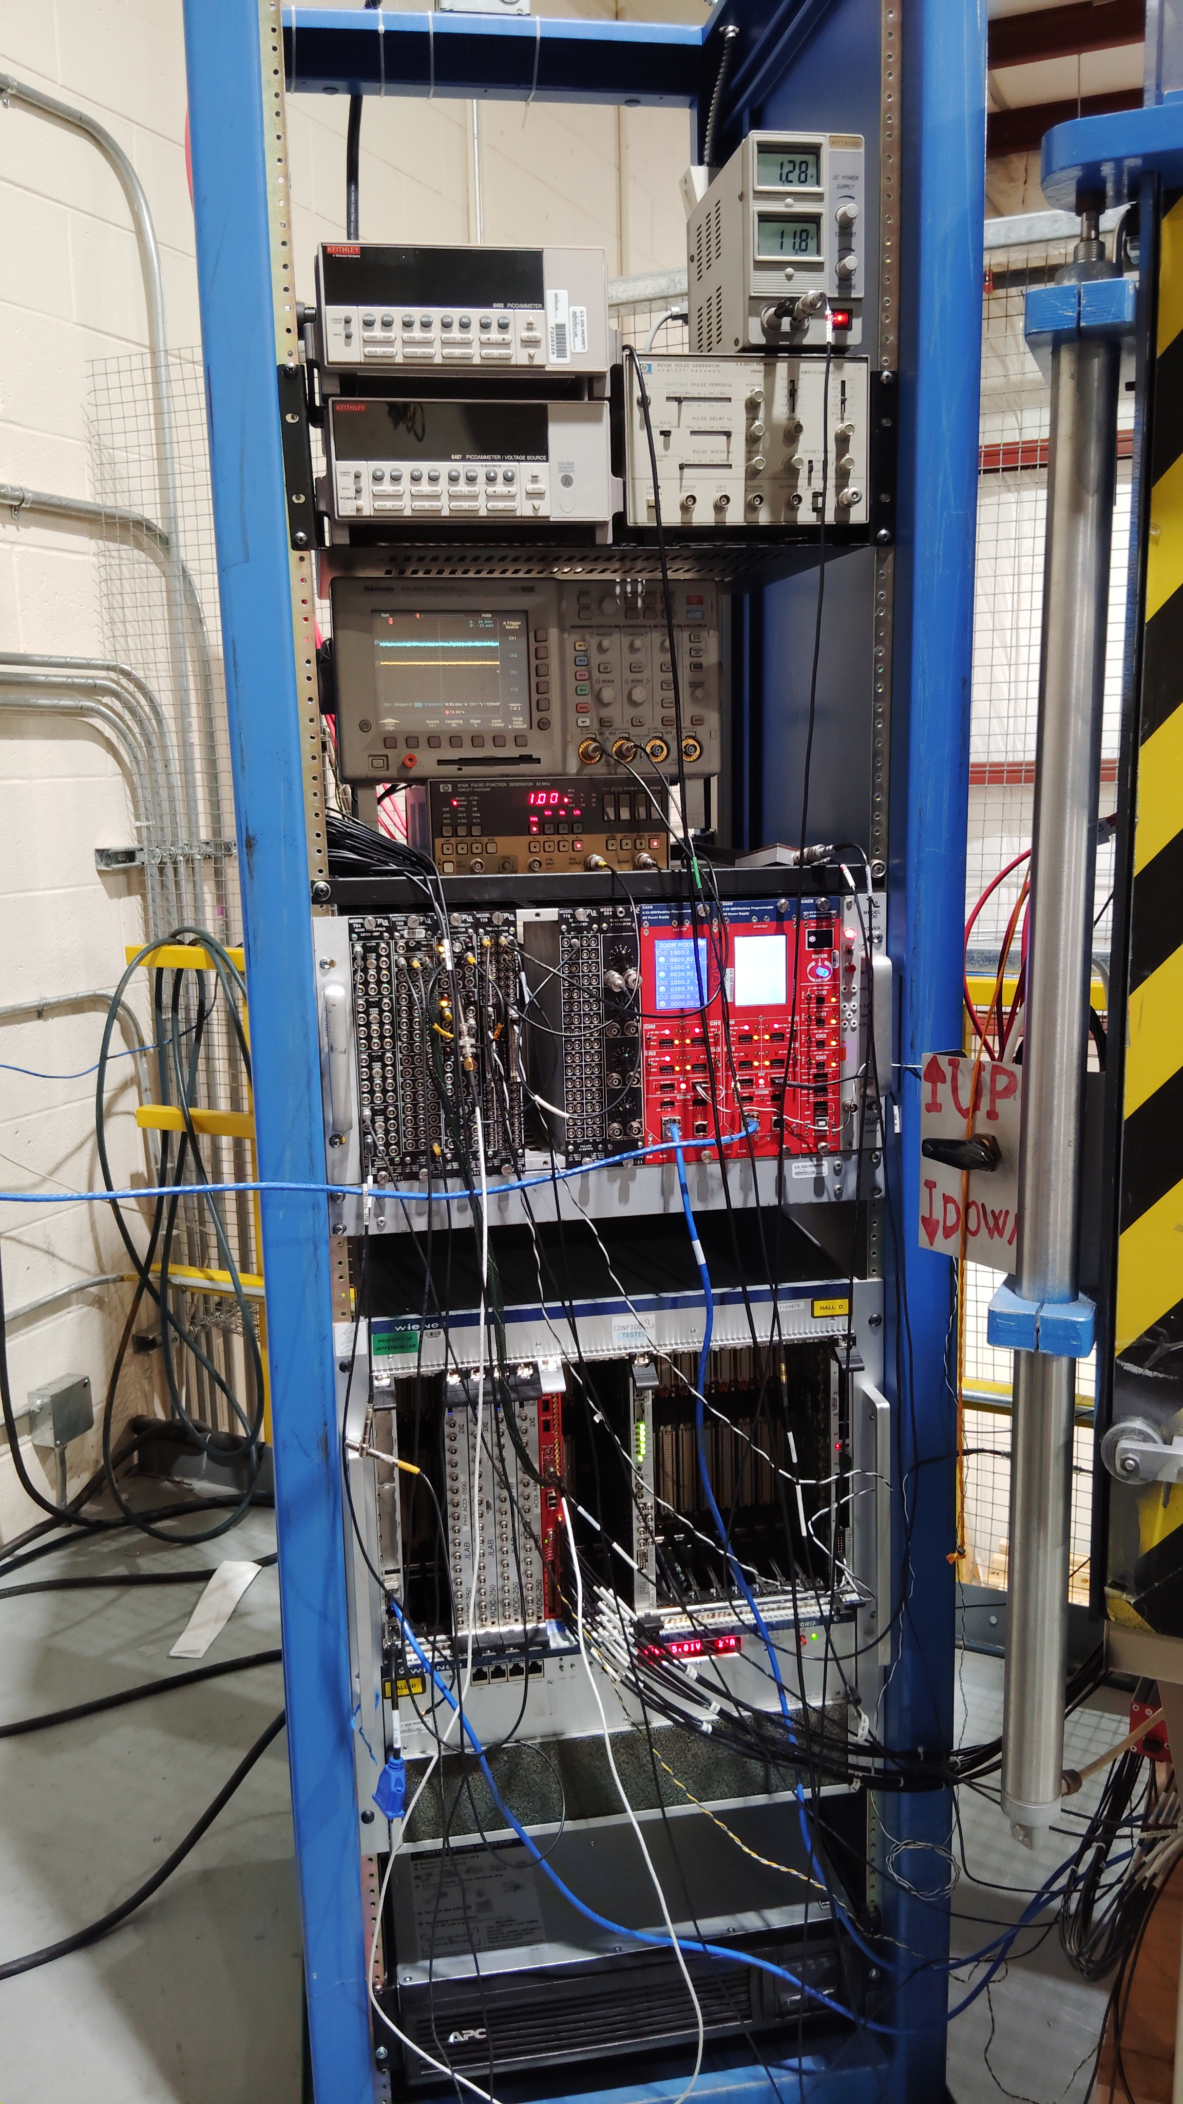
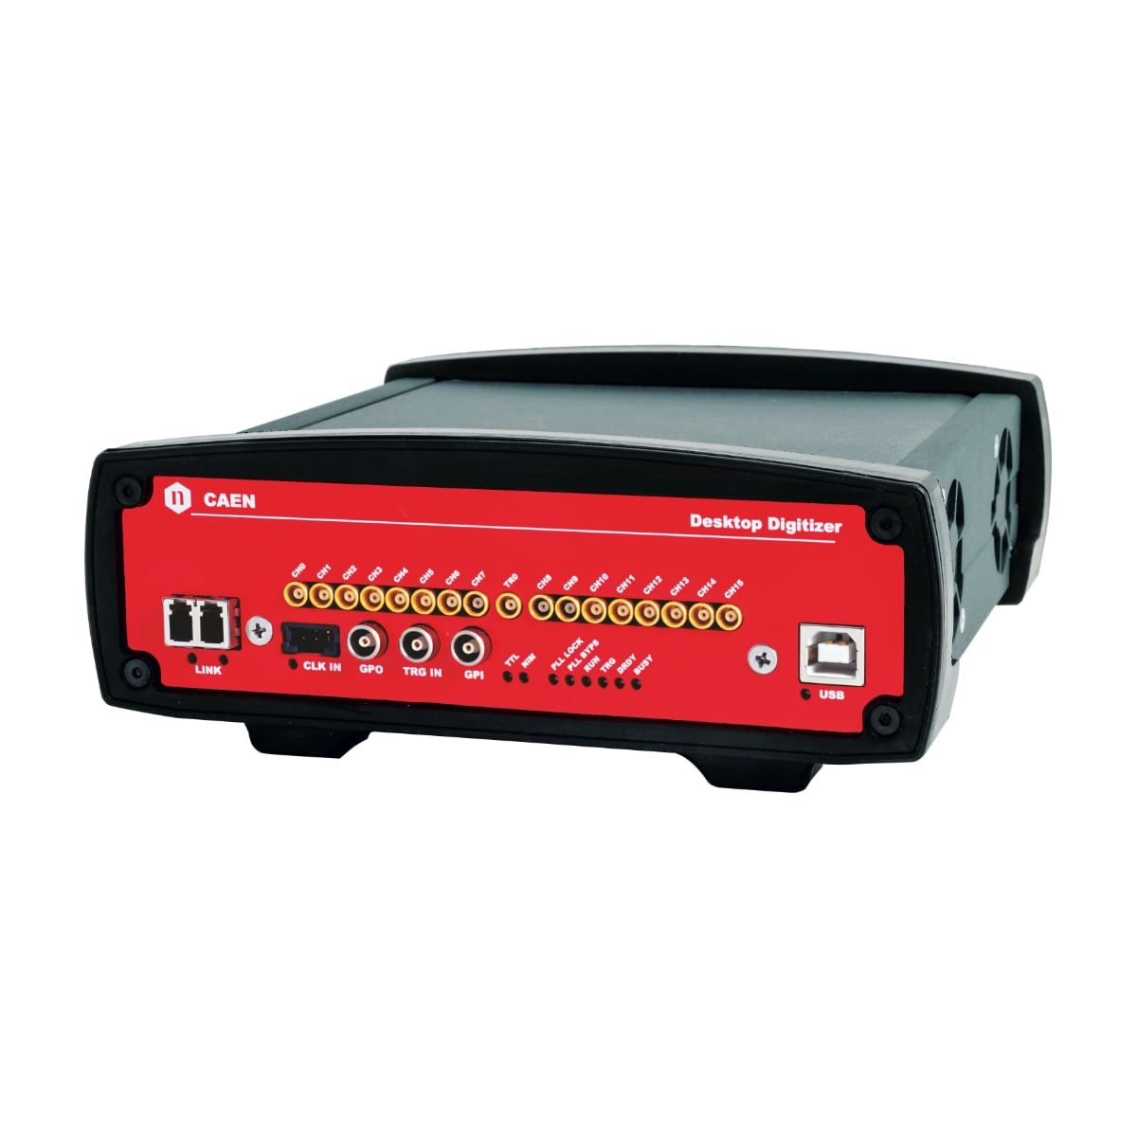
HRPPD Readout Test Stand
Waveform from CAEN *742 digitizer
CAEN DT5742B digitizer
CAEN V1742 Digitizer with CODA DAQ and electronics
CAEN N1470 HV source for HRPPD
Light source pulsed 405nm laser
Calibrated Hamamatsu S2281 photodiode
XYZ motion stage Velmex
Electronics Rack
CAEN DT5742B Digitizer
CAEN 1742 Digitizer​

Slide 11
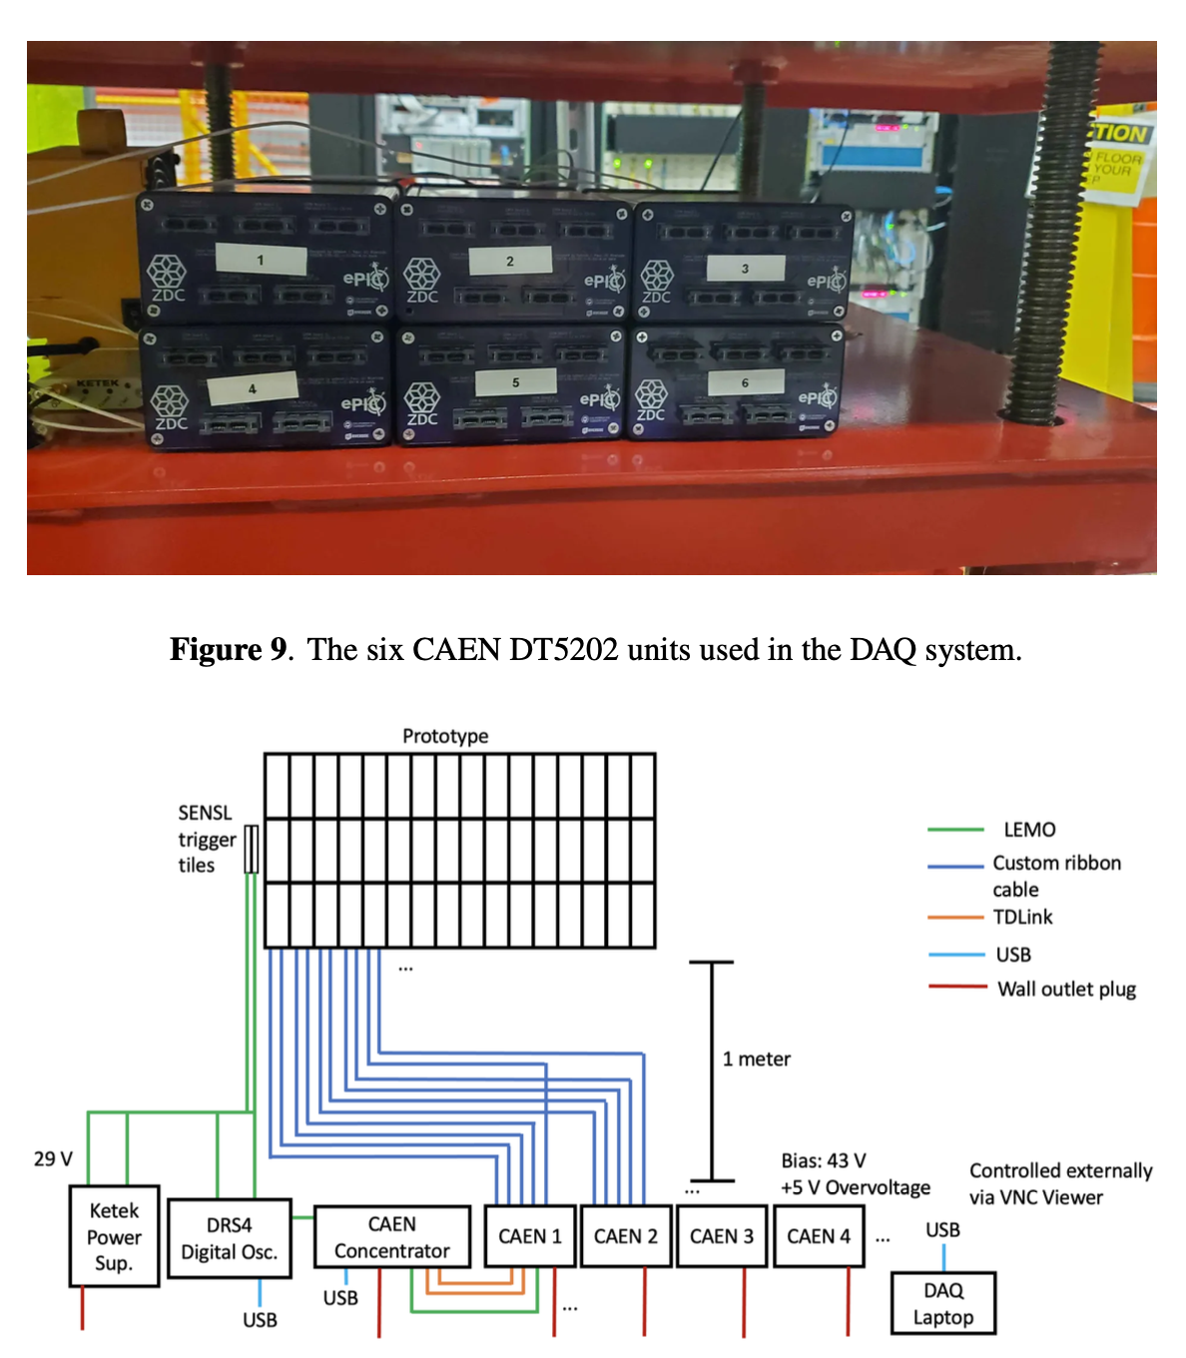
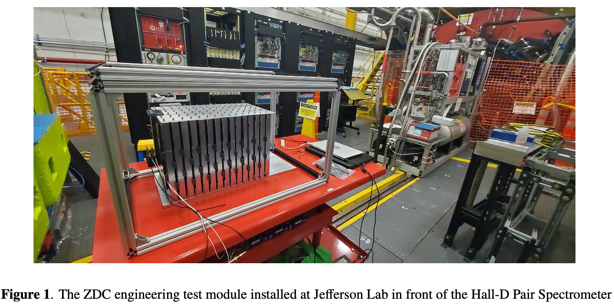
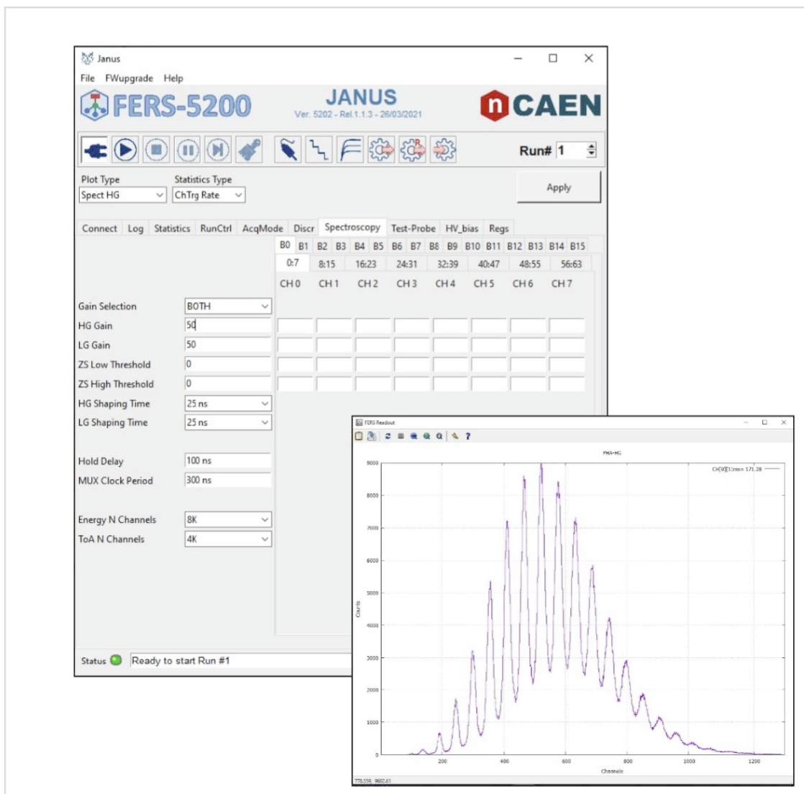
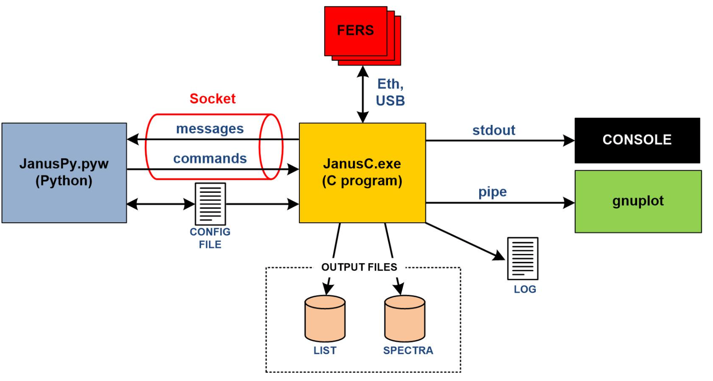
ZDC testing – CAEN Commercial System
Janus is open-source software developed by CAEN for the control and readout of FERS‐5200 boards

Slide 12
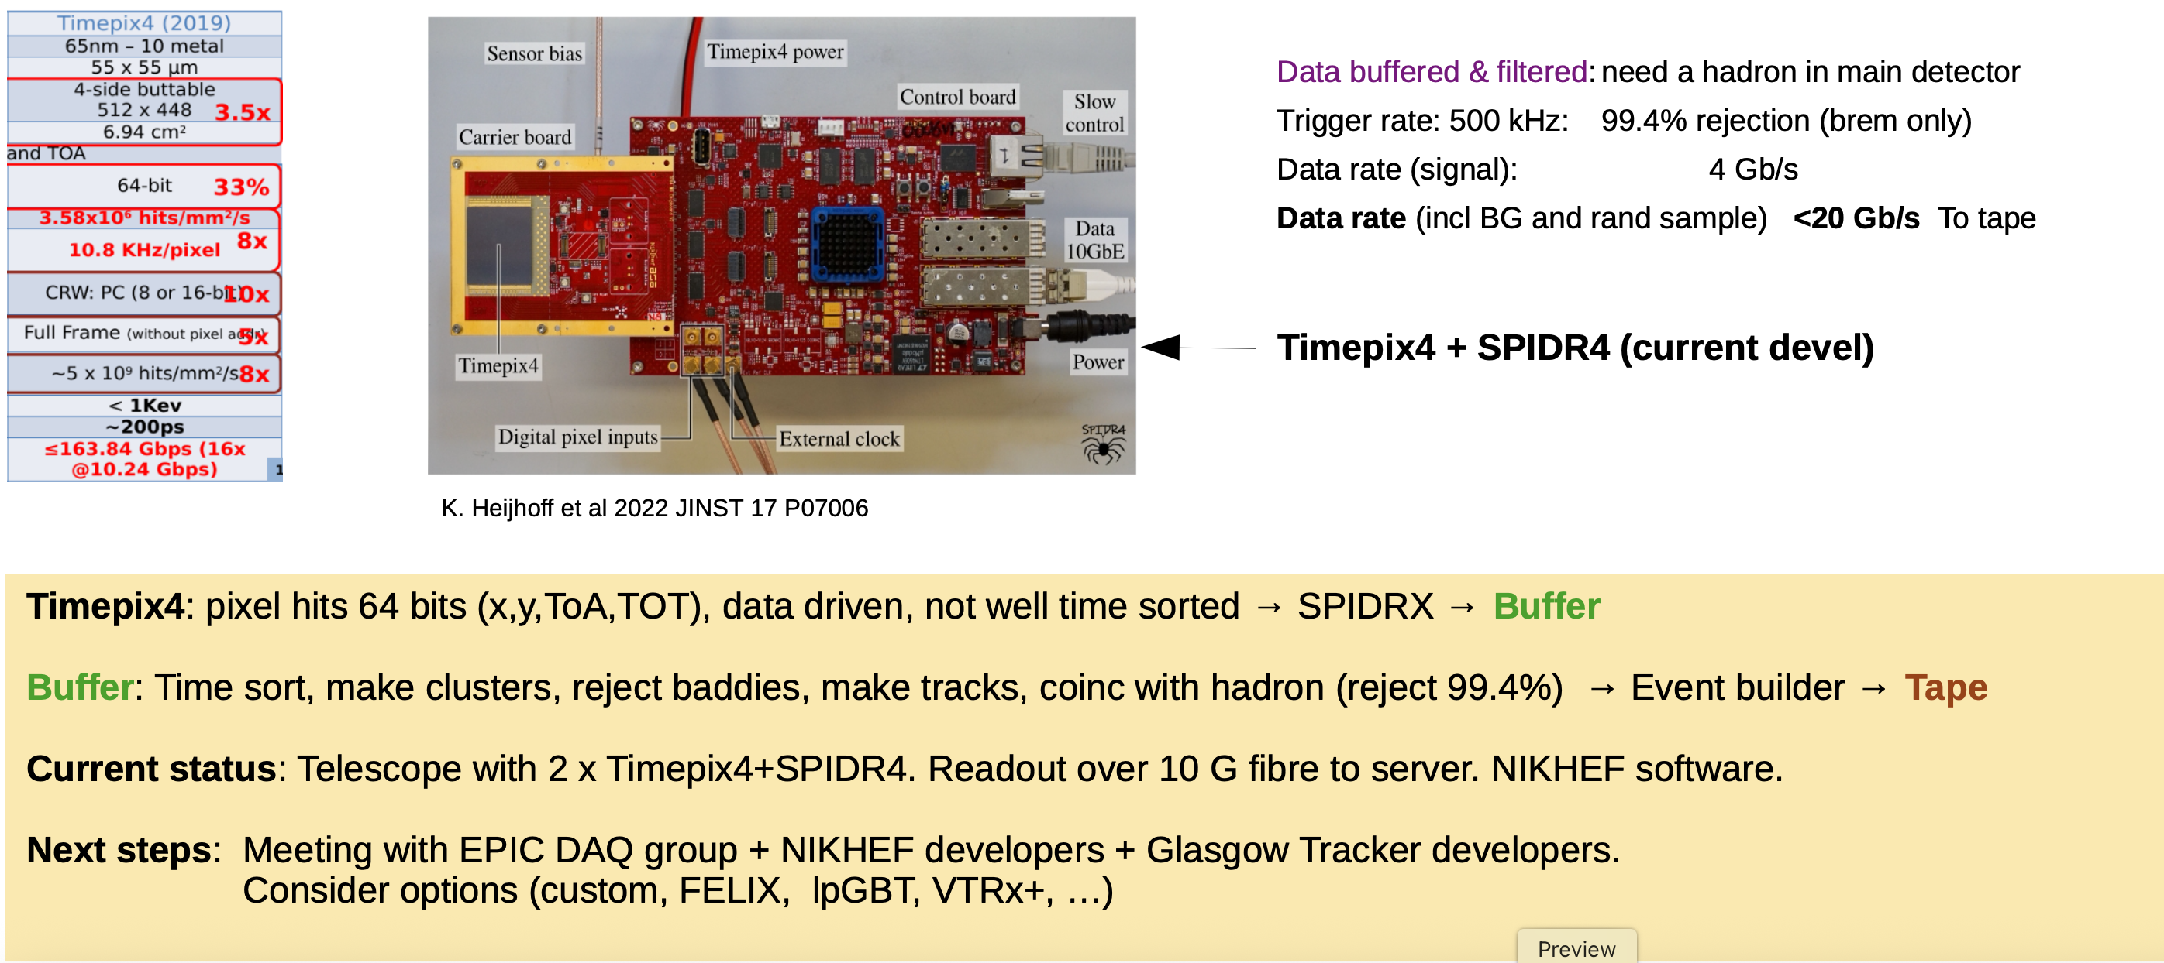
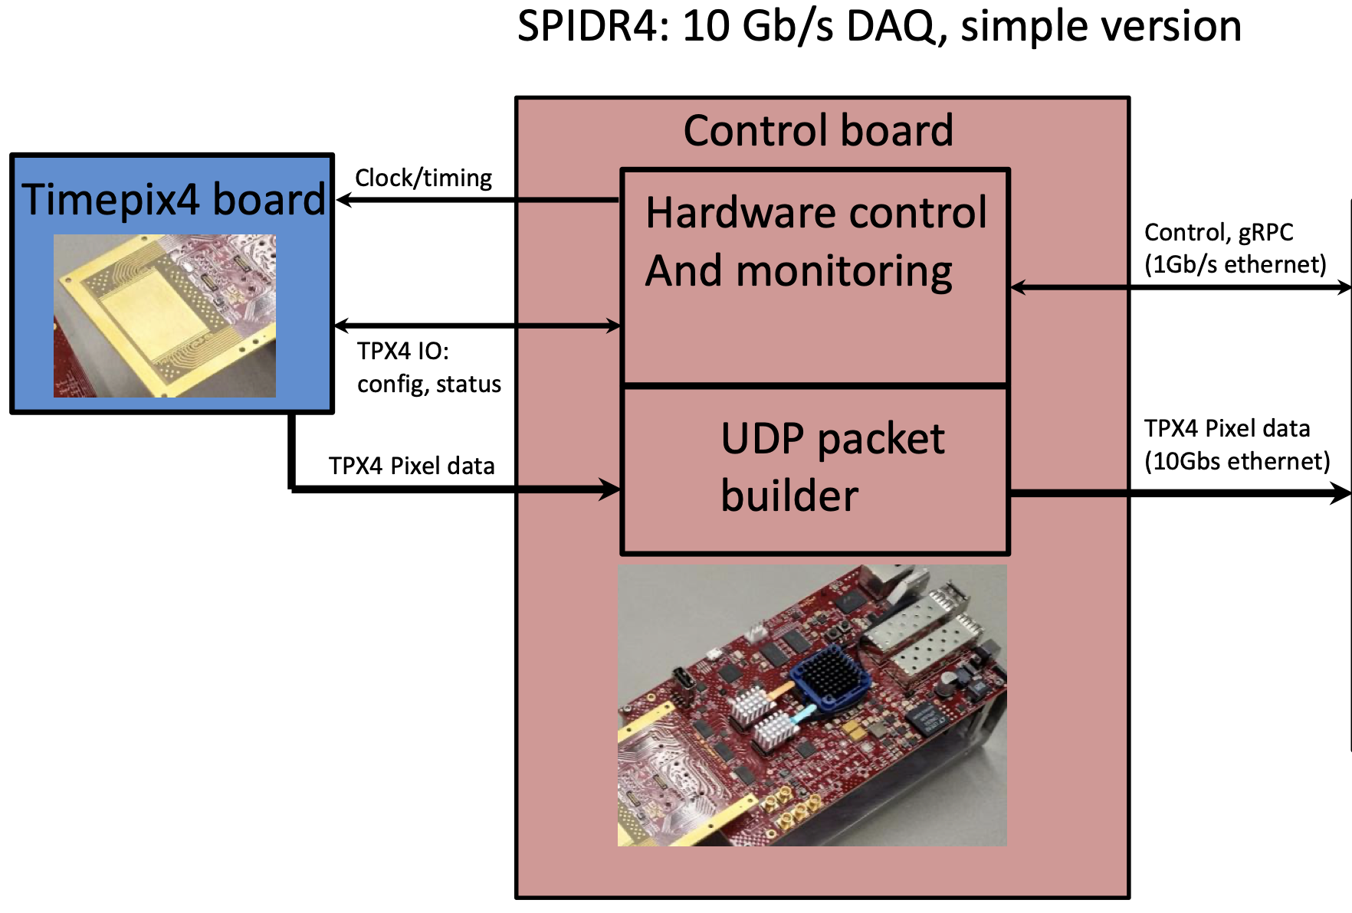
TimePix – Readout testing
SPIDR4 Control board using a Zync 7000 series SoC
Petalinux OS, Developed at NIKEF

Slide 13
Lumi Pair Spectrometer DAQ/Readout Overview
Stephen JD Kay, Nicholas Zachariou, University of York
Pair Spectrometer
Two WSciFi calorimeters
Max #readout channels - 3360
By grouping SiPMs in first 4 + last 6 layers, can reduce significantly
3360 -> 2100
Expected rates - At peak lumi setting, 0.1 pair production event per 10ns
Expect ~80 SiPMs to fire from an event
~50 NPE per SiPM
Expected signal
Readout, no final decision but don’t want to reinvent the wheel
HGCROC
Some initial beam tests of modules
Would love to use real readout system
Caen desktop digitisers so far -> Very limited (~2 seconds of data!)

Slide 14
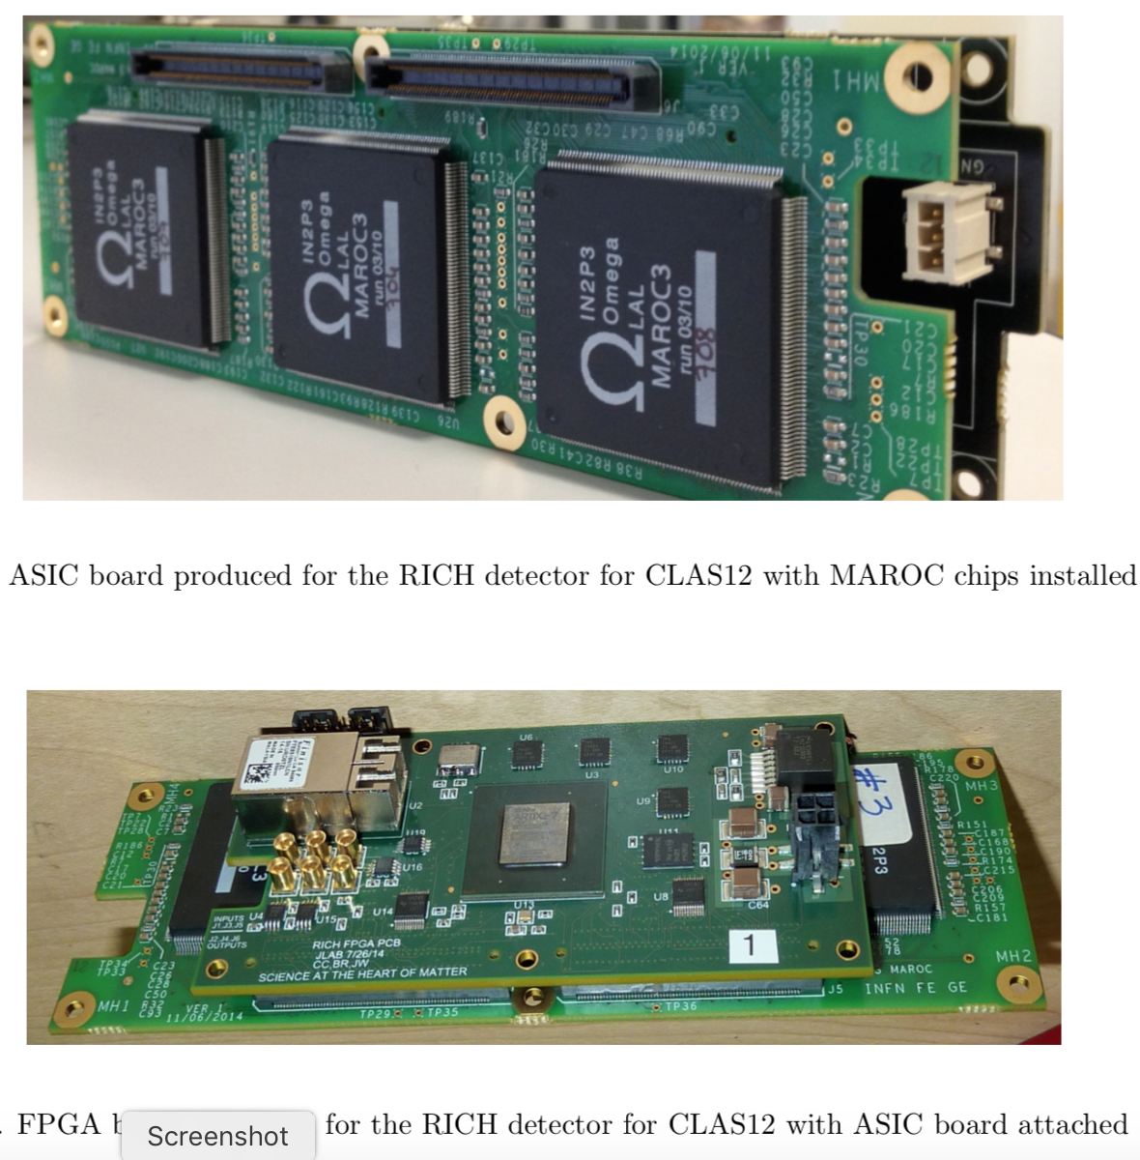
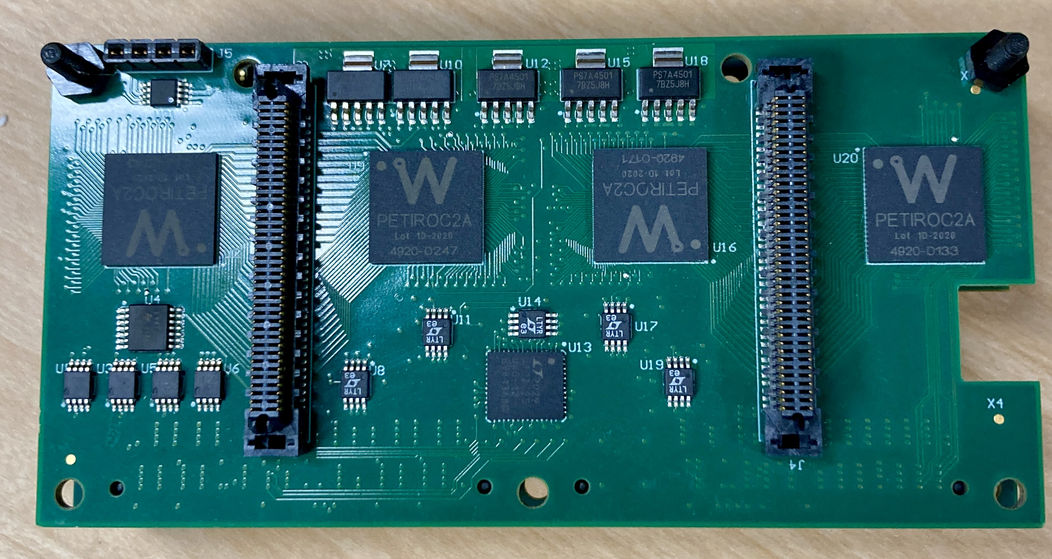
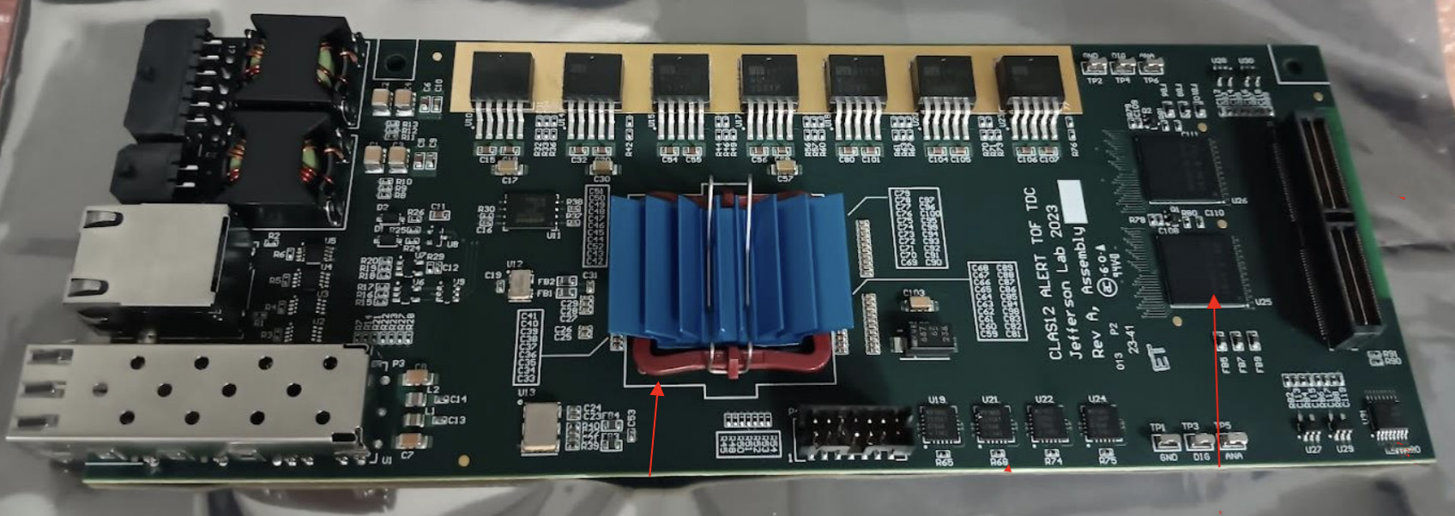
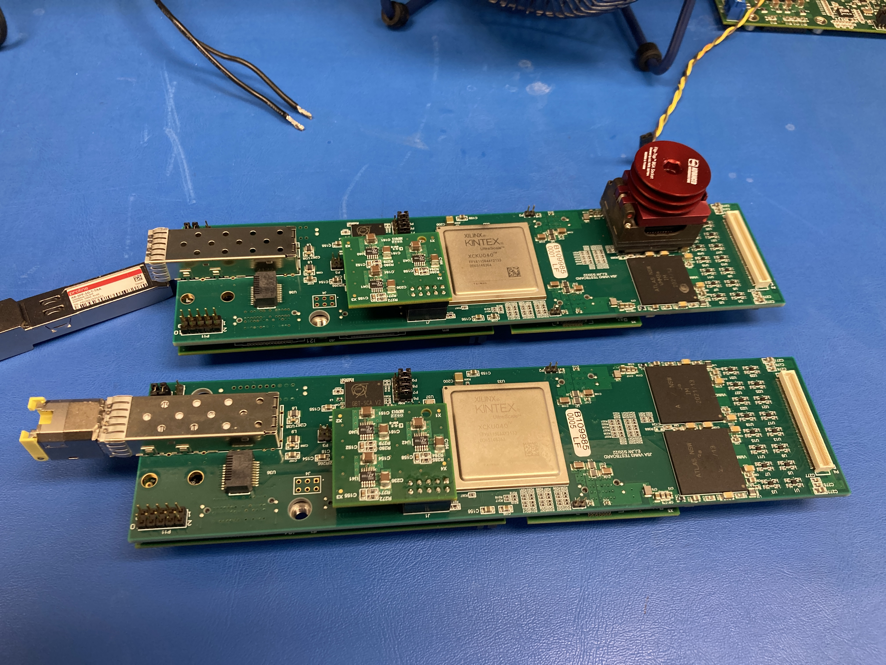
JLAB Front-End Readout Electronics
Clock/Sync
(RJ45)
1Gb
Ethernet
ALERT experiment in
Hall B (TOF detector).
Artix 7 FPGA
(firmware TDC)
Petiroc
ASICs
MAROC3 ASIC Daughter Card
Petiroc ASIC Daughter Card
Used with the RICH Detector in Hall B and the DIRC detector in Hall D
VMM3 ASICs
Artix FPGA card with 1Gb Ethernet
At JLAB we have developed a common firmware and software framework for simple readout of these types of electronics.
KINTEX
FPGA

Slide 15
Front-End readout support at JLab
TCP Socket based slow control protocol from a Linux-based PC using a 1/10Gb ethernet port
32bit registers map to ASIC configuration bus.
FPGA based block RAM used to aggregate data and build frames/events
Up to 32 input streams to create one ~1GB/s output stream
Low cost commercial TCP/IP block supporting 1 or 10Gb ethernet links (Client and Server)
Low resource utilization
License will allow JLAB to distribute downloadable firmware using this IP for ePIC associated projects
We plan to continue and expand support for this firmware/software for both existing and future projects.
FPGA
PC
ASIC
Slow Control
Bridge
ASIC
Network
IP
ASIC
Frame
Builder
TCP/UDP
Client/Server
Linux OS
c library
0
0
0
Stream 0
Framebuilder
Stream 1
0
1
2
0
1
2
0
1
2
1
1
1
TCP Even Builder socket
Stream N
2
2
2

Slide 16
Thank you! Questions?

Slide 17
Backup

Slide 18
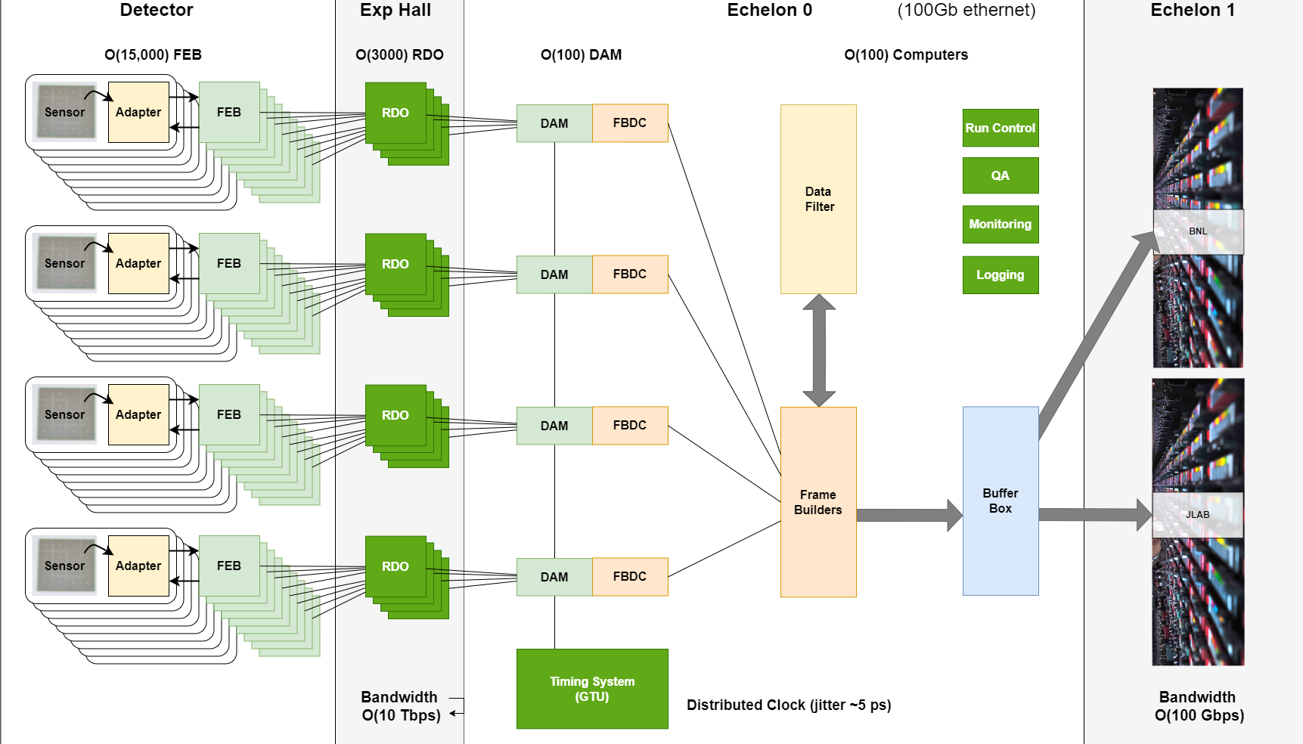
EIC Streaming DAQ/Computing Architecture
Bunch Crossing
10.2 ns/98.5 MHz
Interaction Rate
~ 2 us/500 kHz
Low occupancy
(for Physics signal)

Slide 19
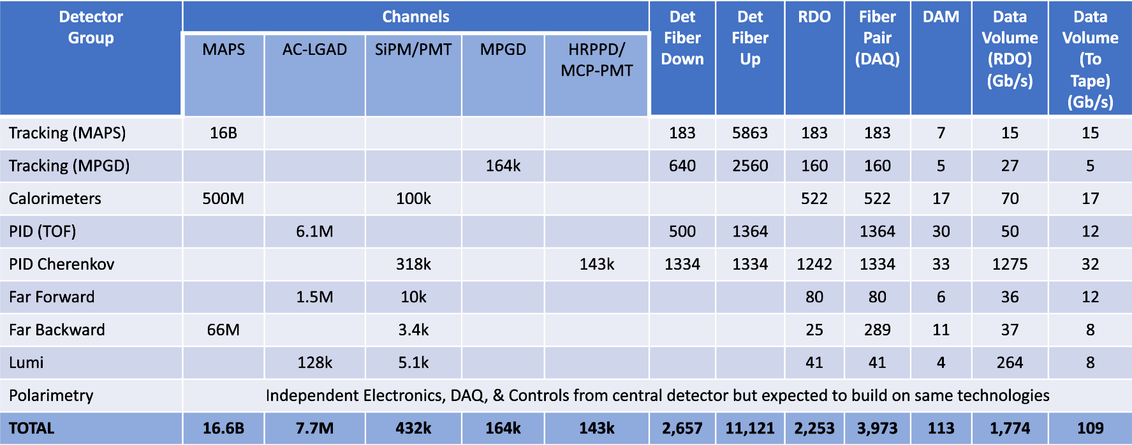
Summary of Channel Counts and Data Flow
Scale of the system:
Electronics
~ 24 detectors
~ 5 Readout Technologies
~ 3000 RDOs (on detector/in racks)
~ 100 DAM boards (DAQ room)
GTU (with interface boards)
Maximum Data Volume
~ 2 Tb/sec digitized
~ 115 Gb/sec recorded
Online Computing
~200 nodes (DAQ Room/SDCC)
Summary of Data Flow
PCI/Eth
Eth
Detector
FEB
Copper
RDO
Fiber
DAM
Readout Computer
Aggregate | 2.0 Tb/sec
Noise | 1.6 Tb /sec
Signal from Physics + Background | 400 Gb / sec
Aggregate | 115 Gb/sec
Collision Signal | 62 Gb/sec
Synchrotron Rad | 6 Gb/sec*
Electron Beam | 4.5 Gb/sec
Hadron Beam | 1.0 Gb/sec
Noise | 41 Gb/sec
Synchrotron radiation caveats:
Rates are based upon hit rate for all ePIC detectors. In fact, data volumes depend upon specific detector hit (64 bits/hit assumed)
Highest Synchrotron radiation / electron beam gas will correspond to lower values for collision signal
Plan to analyze by component soon
*
Aggregate | 2.0 Tb/sec
Per RDO (Avg) | 0.7 Gb/sec

Slide 20
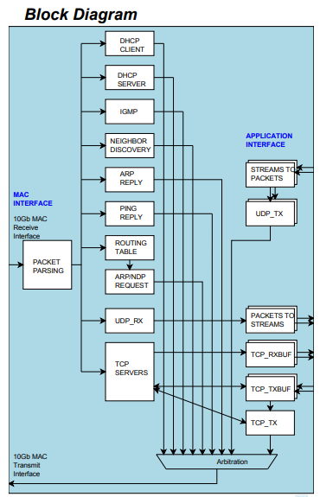
TCP/IP IP Blocks for FPGA
Low cost 10Gbps TCP/IP IP blocks from COMBLOCK (also 1Gbps version are available)
Very flexible license
Low resource utilization
TCP <-> Peripheral bus bridge used, but this bridge can be replaced by many other bus types if needed without changing the register map of the front-end unit
JLAB can distribute downloadable firmware using this IP for ePIC associated projects
10G TCP/IP Server
10G TCP/IP Client
https://www.comblock.com/com5502soft.html
https://comblock.com/download/com5503soft.pdf

Slide 21
Timing Resolution with Reconstructed Clock

Slide 22
Timing Resolution with Reconstructed Clock

