Slide 1
EICUG & ePIC Joint Collaboration Meeting
ASICs & FEBs
Fernando Barbosa (JLab)
14 – 18 July 2025

Slide 2
Agenda
  Recent Developments
  Status Summary
  ASIC Fabrication Overview, Scope of the Effort, Path to Completion
  ASIC-to-FEB
  FEB Development
  Resources
  Summary

Slide 3
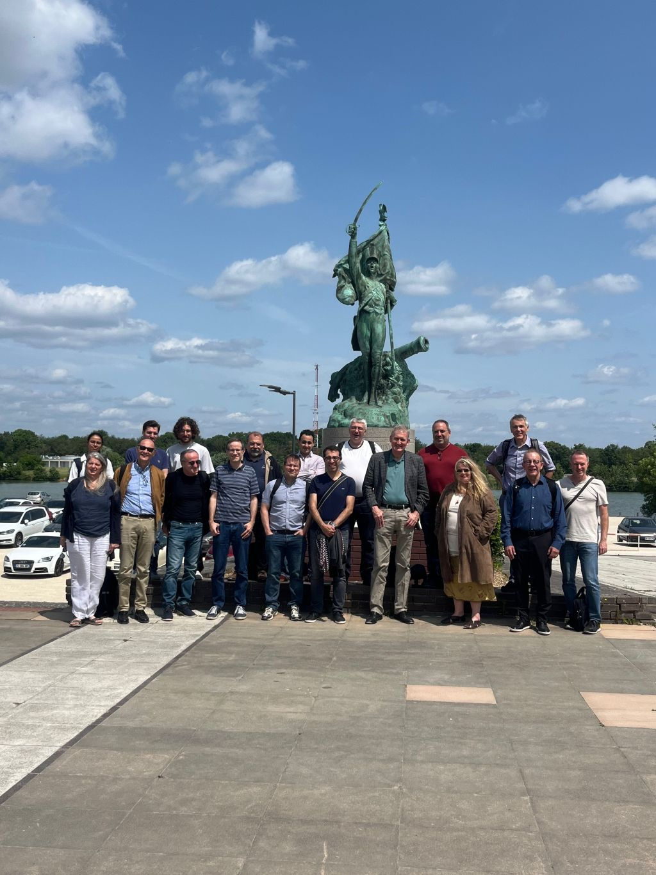
Recent Developments - ASIC Meeting in France
Where: Ecole Polytechnique (+ Omega) and Saclay
When: 2-3 June 2025
Topics & Goals: Full assessment of ASICs’ developments through production
Reference: https://indico.bnl.gov/event/28161/
A very big thank you to Dominique Marchand, Christophe De La Taille, Damien Neyret and everyone at Ecole Polytechnique and Saclay for the great organization and tours.

Slide 4
ASIC Meeting in France – Topics & Goals
  EICROC
  CALOROC
  FCFD – AC-LGAD Strips
  FCFD Variant – HRPPD/MCP-PMT for pfRICH & hpDIRC
  SALSA
  ALCOR (via Zoom)
  Status
  Review of specifications, requirements, nice-to-have requests. Includes frontend and backend with interfaces and packaging
  Steps to completion with anticipated schedule, including testing
  Production outlook, including QA/QC and testing
  Synergies. Possibly sharing of designs, architectures and infrastructure (e.g. power implementation, distribution)
  Documentation. Functionality (e.g. User’s Manual/Spec sheets) and approvals needed (e.g. CERN, import/export, etc.)
  Digital Interfaces & Calibration

Slide 5
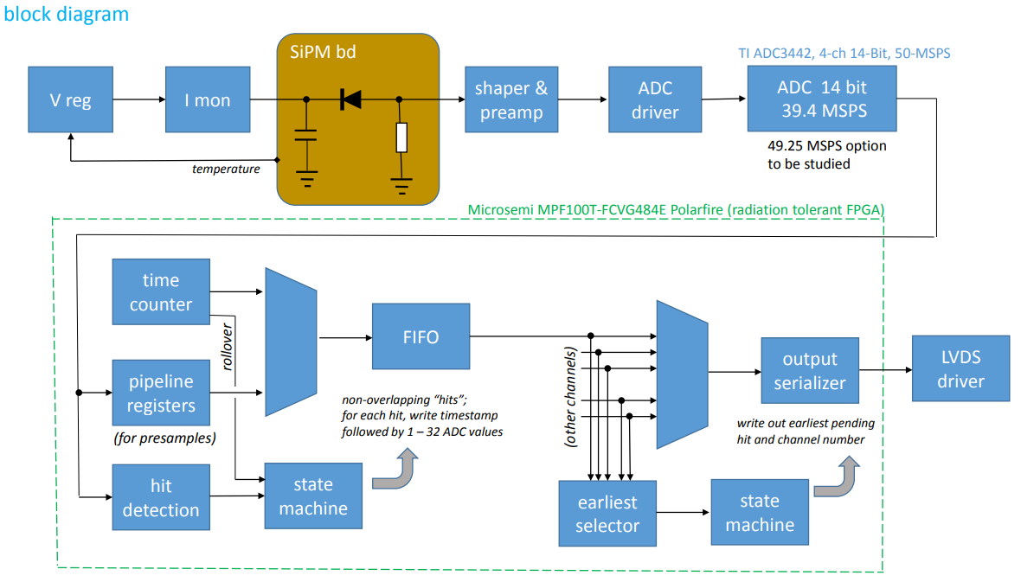
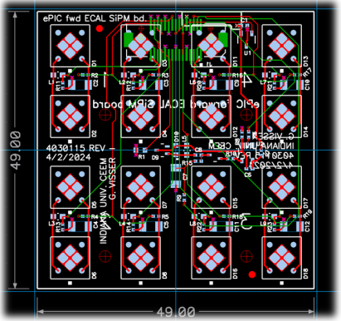
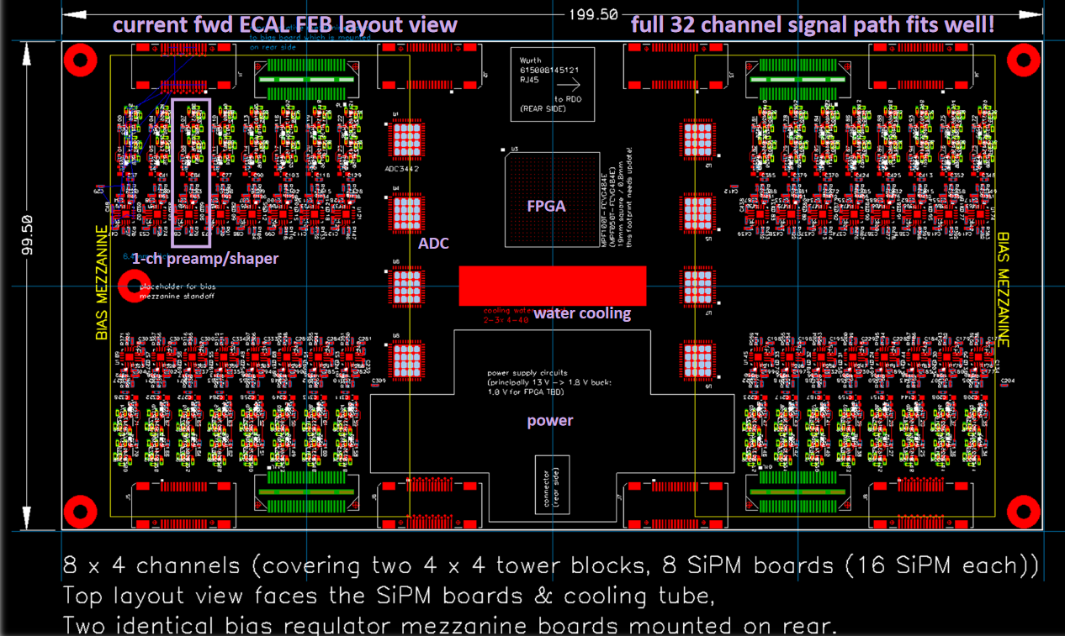
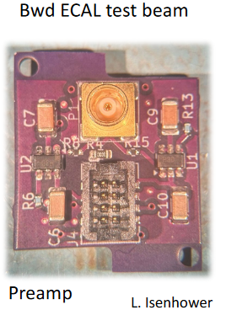
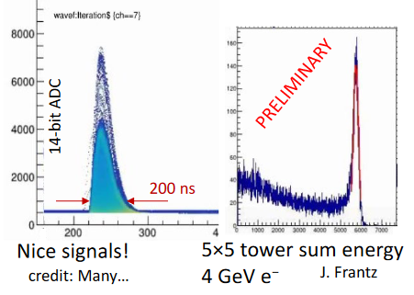
FY25 Status & Progress
Calorimeters, SiPMs – Discrete/COTS/ASIC (IU)
Adapter PCBs
Adapter PCB (Fwd ECAL)
FEB PCBs
FEB PCBs
32 ch Waveform Digitizer
12/14-bit TI ADC3422
Microsemi MPF100T-FCVG484E Polarfire (radiation hard FPGA)
CERN DC/DC converter bPOL12V/bPOL48V or LTC3601
Cabling (CAT6), Power (DC-DC), Cooling (liquid), Packaging (rack).
Progress Summary:
  Developments on fwd, bwd ECALs – DESY tests Feb 2025
  COTS DC/DC converters radiation tested in May 2024.
  Shaping (80 ns peaking time), 12 mW/ch PA
  2 ch full readout prototype PCB Aug 2025.
Design, Fab: FY23 –FY24
Tests + Beam: FY24 – FY25
Engineering Article: FY26
Production: FY27

Slide 6
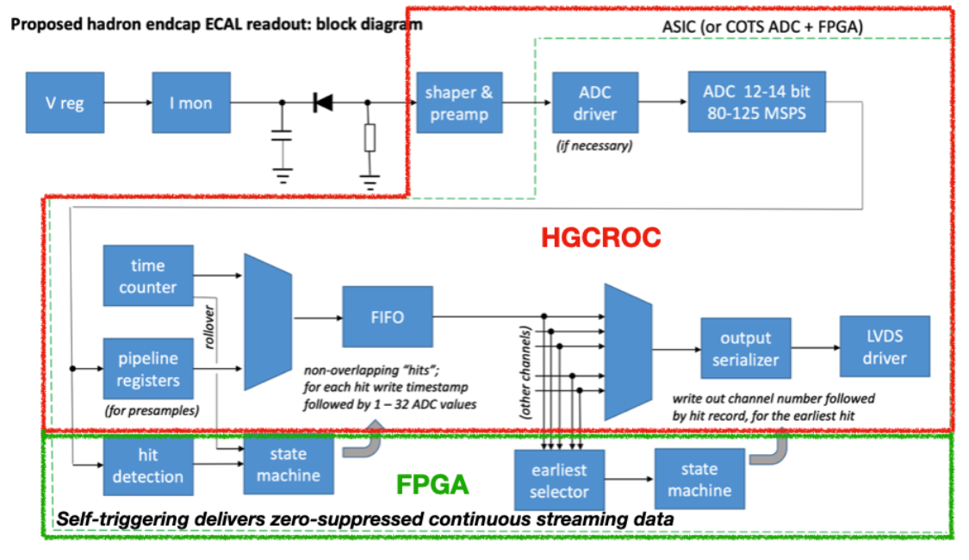
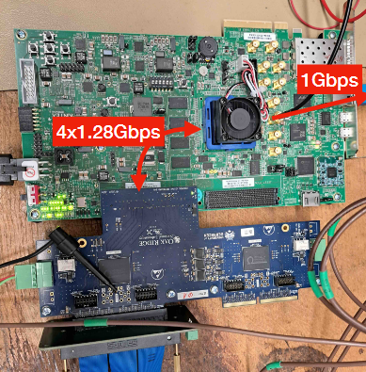
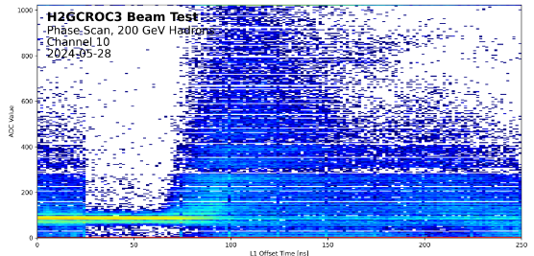
FY25 Status & Progress – cont.
Calorimeters, SiPMs – H2GCROCv3 (ORNL)
Develop a readout solution for the calorimeters with SiPMs by:
  Employing existing H2GCROCv3 ASIC
  Developing PCBs for full readout chain
  Developing cabling infrastructure
  Input to CALOROC design.
Adapter PCBs
FEB PCBs
Beam Tests, Waveforms
RDO PCBs
H2GCROCv3
Progress Summary:
  H2GCROCv3 PCBs (6) from OMEGA with KCU105 FPGA eval kit – Beam tests validating streaming readout operation algorithms.
  I2C and DAQ GUI interfaces done.
  Cabling studies for interconnects from FEBs to RDOs are progressing (SAMTEC connectors).
  LED tests using H2GCROC pulser.
  Testing SiPM summing PCBs for full characterization with multiple sensors under way.
  RCDAQ integration, EEEMCAL beam tests very successful.

Slide 7
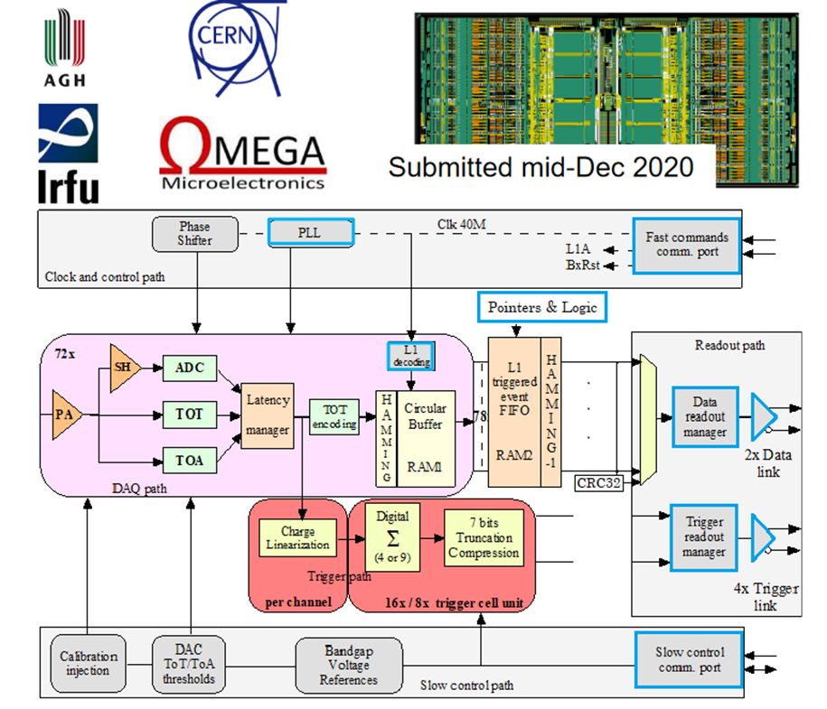
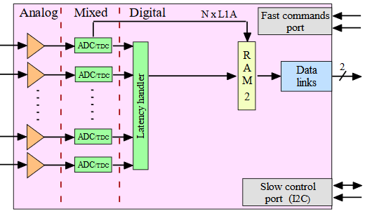
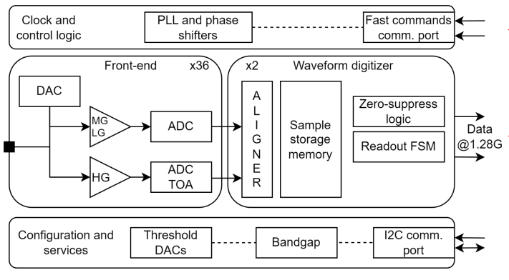
FY25 Status & Progress – cont.
Calorimeters, SiPMs – CALOROC (OMEGA/IN2P3/IJCL)
CALOROV1A
H2GCROCv3
No Change
Modify trig, mem, CLK dist.
1D, 64 ch.
130 nm CMOS
Charge (ADC+TOT) + Time (TOA)
Cdin: 500 pF-10 nF
Dynamic Range: up to 12 nC
Timing: <500 ps (1 MIP)
ADC: 10b; TOT: 15b
39.4 MHz operation from BX 98.5 MHz
Links: 1260.8 Mbps @ 39.4 MHz, multiple
Power: 10 mW/ch
Radiation tolerant.
Progress Summary:
  CALOROC1A and 1B – different FE (TOT or switched gain), same backend.
  Ready for submission – February 2025 – Pending funding.
  Available in June 2025, depending on funding.
  Backend designed and simulated:
    Streaming Readout logic
    Memory
    Clock pre-scaling & distribution.
Design Backend: FY23 - FY24
CALOROC1A/B: FY24 – FY25
CALOROC2: FY25 – FY26
CALOROC3: FY27 Production

Slide 8
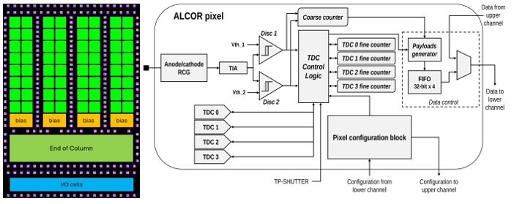
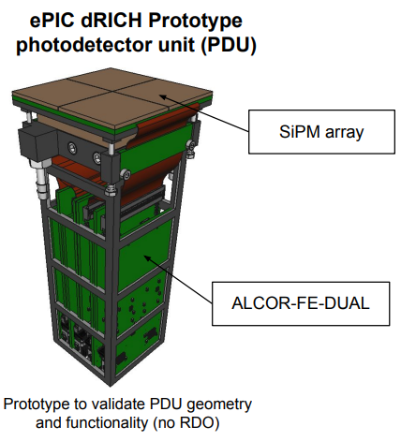
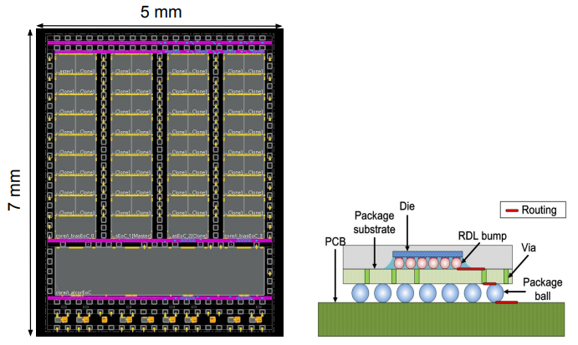
FY25 Status & Progress – cont. dRICH – SiPMs – ALCOR (INFN)
Originally developed by INFN for DARKSIDE.
Progress Summary:
  ALCOR v2: 32-pixel,
  ALCOR v2.1 delivered in Jan 2024 and currently in beam tests.
  Two 32 ch ALCOR on PCB (FE-DUAL) for PDU tests.
  ALCOR 64 ch fabricated.
  ALCOR v3 characterization – September 2025.
  FEB v1 – May 2025.
  RDO v1 – July 2025.
2D 8x8 pixel readout
110 nm CMOS
Dual polarity, RCG Amplification, conditioning, inhibit , digitization.
Modes of operation: single-photon tagging or time and charge.
Triggerless and triggered operation; Digital Shutter; Timing: <150 ps
20-40 ps TDCs, TOA+TOT
5 MHz input
788 Mbps LVDS links.
SPI Configuration.
Power: 12 mW/Ch
Radiation tolerant.
ALCOR v2.1 (32 pixel): FY24
ALCOR v3: FY24 – FY26
ALCOR: FY26 – FY27 Production

Slide 9
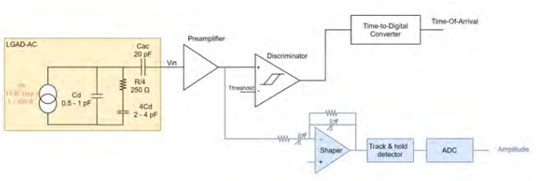
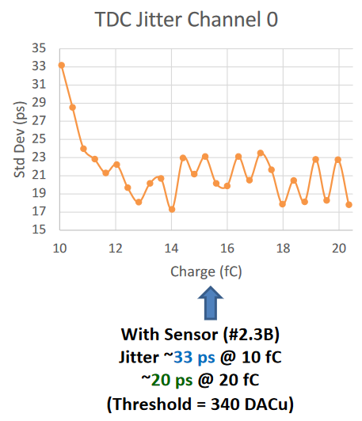
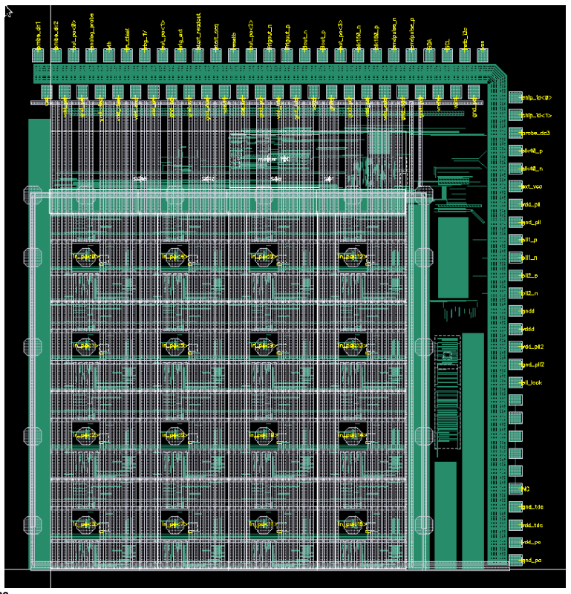
FY25 Status & Progress – Cont.
AC-LGAD pixel – EICROC (OMEGA/IN2P3/IJCLab/CEA-IRFU/AGH)
One pixel – EICROC0
2D, 32x32 pixel readout
130 nm CMOS
Preamp, Discriminator, TOA, ADC, TDC
Cdin: 1-5 pF; Dynamic Range: 1-50 fC
Timing: 30 ps; ADC: 8b; TDC: 10b
39.4 MHz operation from BX 98.5 MHz
Links: 1260.8 Mbps @ 39.4 MHz, multiple
Power: <2 mW/ch
Packaging: Bump+Wire bonds
Radiation tolerant.
Sensor
Plus backend as CALOROC
Progress Summary:
  EICROC0 (4x4) full characterization complete.
  EICROC0,A,B – intermediate iteration for low power complete.
  EICROC1A 8x32, EICROC1 32x32 - complete.
  Ready for submission – February 2025 – Pending funding.
  Available in June 2025, depending on funding.
Wire
EICROC0 (4x4): FY23 – FY24
EICROC0A (4x4): FY24 – FY25
EICROC1A (8x32), EICROC1 (32x32): FY25
EICROC2 (32x32): FY27 – FY28 Production
Wire
Bump
4x4 500 um pixels

Slide 10
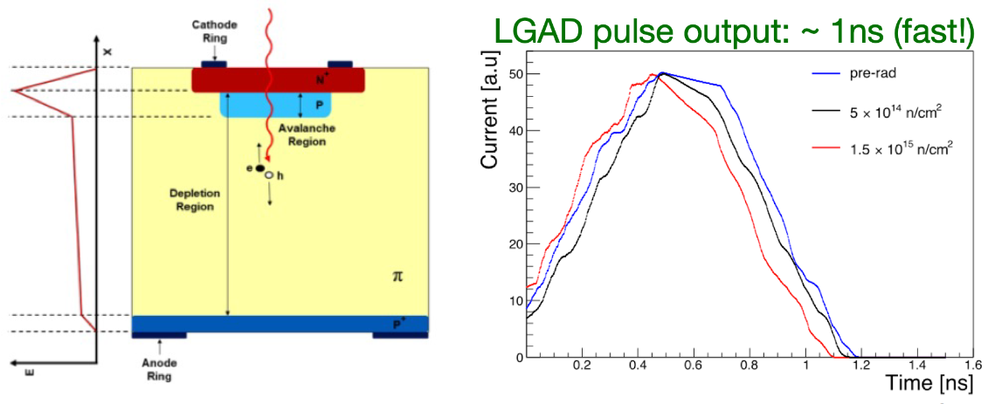
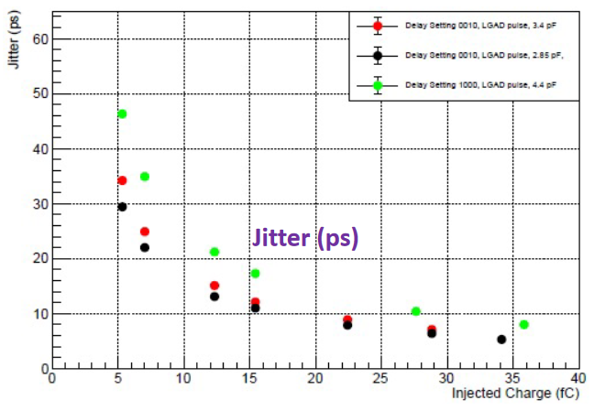
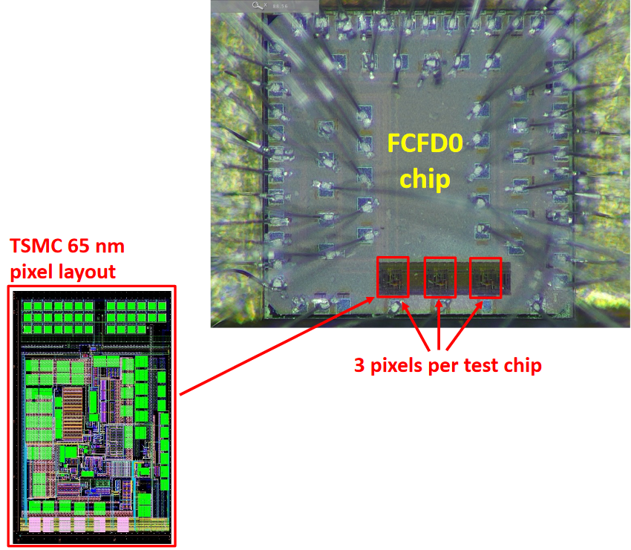
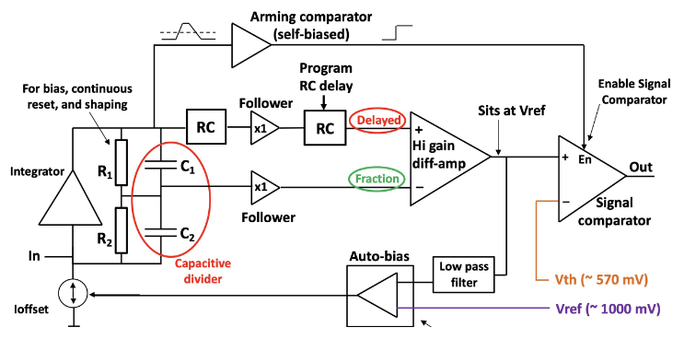
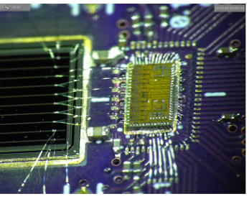
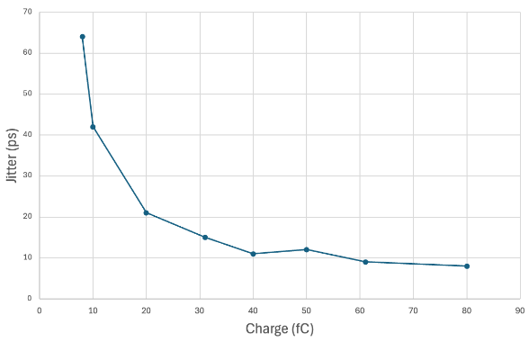
FY25 Status & Progress – Cont.
AC-LGAD strip – FCFD (FNAL)
Progress Summary:
  FCFDv1 – 6 channel received Jan 2024.
  Tested at FNAL in May & June 2024, AC & DC-LGAD (1 mm):
    DC-LGAD @ 50 ps; AC-LGAD @ 52 ps
    AC-LGAD should get ~35 ps with improved comparator.
  FCFDv1.1 – First results are good, current beam tests at DESY.
128 ch strip readout
65 nm CMOS
Constant Fraction Discriminator
Plus TDC, ADC, interfaces
Cdin: <15 pF
Dynamic Range: 5-40 fC
Timing: 10-30 ps
Links: ~Gbps, multiple
Radiation tolerant.
FCFDv1 (6 ch): FY23 – FY24
FCFDv1.1 (6ch): May 2025
FCFDv2: FY25 – FY26
FCFDv3: FY27 Production

Slide 11
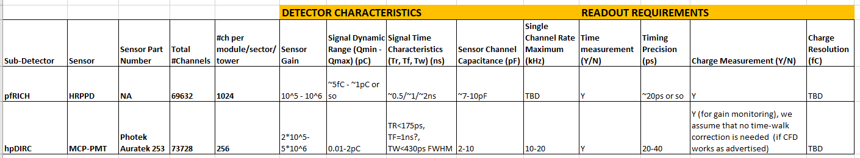
FY25 Status & Progress – Cont.
FCFD Variant for pfRICH, hpDIRC
Specifications & Requirements - Preliminary
FCFD Variant - project schedule to be input into P6:
  Detectors operational characteristics and requirements
  ASIC preliminary specifications and requirements
  Packaging (64 ch?)
  Additional resources from FNAL.
Dynamic range requirements for pfRICH possibly narrower and agreeable with FCFD design for the bTOF AC-LGADs and wrt timing precision and signal charge envelope
Priority is to finalize specifications and requirements with pfRICH & hpDIRC groups.

Slide 12
FY25 Status & Progress – Cont.
FCFD Variant for pfRICH, hpDIRC
Development Plan
Priority is to finalize specifications and requirements with pfRICH & hpDIRC groups.
Evaluate performance of FCFD v1.1 (AC-LGAD strip version) w/ prototype:
  PCB Plug-in w/ multiple wire-bonded chips (6 ch each, e.g. 60 ch total) - Design & Fab – Jlab
  Evaluate performance w/ HRPPD – terminations, attenuators/scaling for dynamic range matching on PCB – Fall 2025.
Convergence into P6.
Design of FCDROC Variant:
  Effort of re-design to be determined after evaluation tests
    A priori, trimming present design within a factor of 10 in DR is viable, a factor of 100 is not
  Adding digital/interface blocks (from AC-LGAD strip version)
    Needed for readout of large number of channels
    Preliminary design – FNAL – Summer 2026

Slide 13
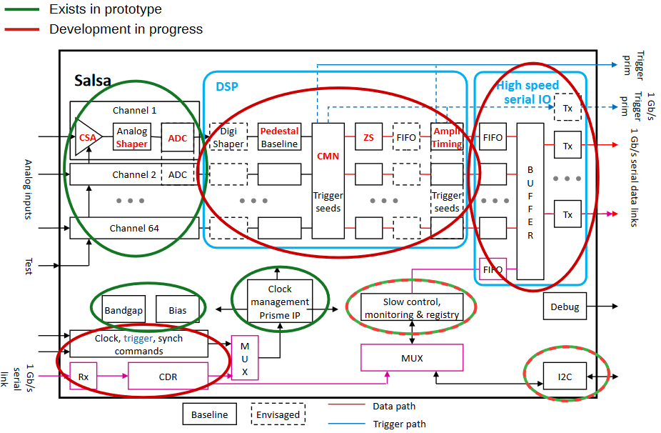
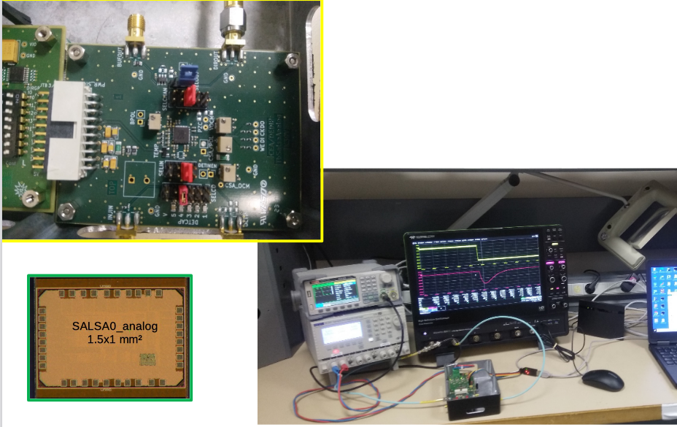
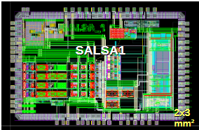
FY25 Status & Progress – Cont.
MPGD – SALSA (CEA-Saclay, U. Sao Paulo)
Progress Summary:
  SALSA0_analog and SALSA0_digital blocks fully characterized.
  PLL block + services prototyped under PRISME. PRISMEv1 – April 2025.
  SALSA1 (full frontend and ADC chain) – under tests.
  SALSA2 (32 ch fully featured with DSP) design in progress for submission in October 2025.
  Tests in 2026, available to users.
64 Ch
65 nm CMOS
Peaking time: 50 – 500 ns;
Inputs: Cdin<200 pF; Dual polarity; Q: 3 – 250 fC
ADC: 12 bits, 5 – 50 MSPS.
Extensive data processing capabilities
I2C configuration.
Triggerless and triggered operation;
Several 1 Gbps links.
Power: 15 mW/Ch
Radiation tolerant.
SALSA0 (IP blocks): FY23
SALSA1: FY23 – FY24
SALSA2: FY23 – FY25
SALSA3: FY25 – FY26
SALSA: FY27 – FY28 Production

Slide 14
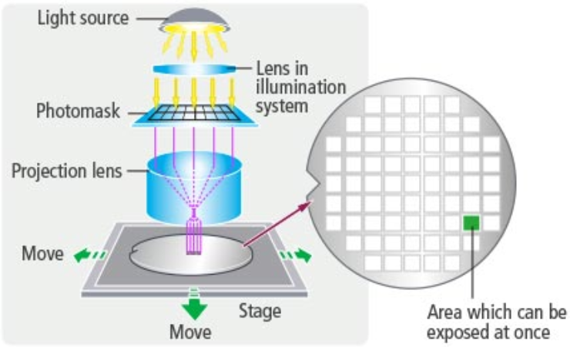
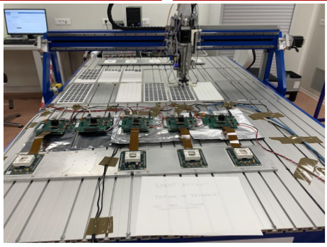
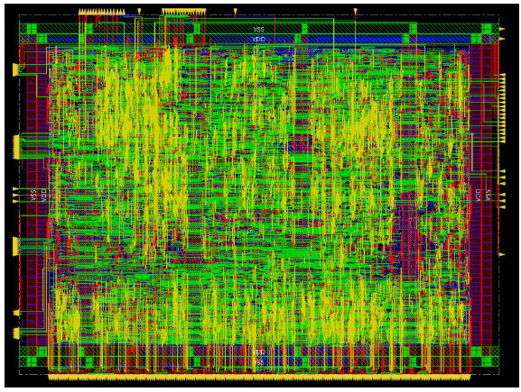
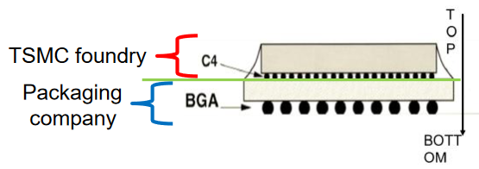
ASIC Fabrication Overview
Circuit design > Photomask fabrication >
Dicing or singulation
CALOROC
+ multiple chem. steps
Testing
Testing @ Omega (~100/hour).
Packaging
Stepper – Very high precision
Reticle - may include multiple ASICs (e.g. set by TSMC)
Functional Tests
ASIC to fit within Reticle, or port design to a different technology node (e.g. 130 nm to 65 nm) - EICROC?
A mask set may consist of 40 – 50 masks ( to build layers of metal, oxide, implantation, etc.) to make an ASIC
Wafer tests for process QA/QC

Slide 15




ASICs & Electronics - Scope of the Effort
Approximate quantities and costs.
Costs include mask sets, fabrication and packaging, wrt quantities needed.
 | #Ch | #Ch/Unit | #ASICs/Wafer | #Wafers | Node (nm) | Packaging | Cost/ch ($) | Institution
Discrete/COTS | 24 k | 32 | NA | 740 Digitizers | COTS | NA | 91 (Includes FE Adapter) | Indiana University
CALOROC | 97 k | 64 | 480 | 5 | 130 | BGA | 3.2 | OMEGA/IN2P3/IJCL, ORNL
EICROC | 5.2 M | 1,024 | 160 | 42 | 130 | Wafer Bump | 0.1 | OMEGA/IN2P3/IJCL/CEA-Saclay, AGH
FCFD strip FCFD Variant | 2.6 M 144 k | 128 64 | 180 | 149 13 | 65 | Wire Bond BGA | 0.5 | FNAL
ALCOR | 318 k | 64 | 800 | 8 | 110 | BGA | 0.9 | INFN
SALSA | 202 k | 64 | 500 | 9 | 65 | BGA | 4.1 | CEA-Saclay, U Sao Paulo
Production
      65 nm: $750 k masks + $3.5 k per wafer
      110 nm: $190 k masks + $4 k per wafer
      130 nm: $250 k masks + $4 k per wafer
Packaging BGA: $3-$7.5 per chip.
ASIC Costs Total: ~$3.3 M
  Masks: ~$2.2 M; Chips: ~$1.1 M

Slide 16
ASICs – Path to Completion
 | Status & Development Summary | Next Steps | Production | Institution
CALOROC | Interface design FY23- FY24, CALOROC1A/B designed FY24-FY25 CALOROC1A: ADC/TOT + TOA, full SRO interface CALOROC1B: Switched gain (4) + ADC + TDC, full SRO interface Tests: Oct 2025 | CALOROC2 (64 ch) – FY25-FY26 Select version and increase (?) channels from 32 ch to 64 ch. | FY27 | OMEGA/IN2P3/IJCL, ORNL
EICROC (32x32) | EICROC0A (4x4) designed FY24-FY25, EICROC1 (32x32) FY25 EICROC0A: ADC + TOA, improved testability EICROC0B: Replaced ADC with peak sensing, Wilkinson ADC, lower power EICROC1: added full SRO interface | EICROC2 (32x32) FY26 Add Derandomizer and ZS. Digital on Top design for lower power (~1 mW/ch). | FY27 | OMEGA/IN2P3/IJCL/CEA-Saclay, AGH
FCFD (128) | Front end characterized, FCFDv1 (6 ch) FY23-FY24 characterized, FCFDv1.1 FY25 Optimized for HPK sensor characteristics | FCFDv2 (32 ch) FY25-FY26 Add ADC, TDC, interfaces from ETROC, ECON CERN. FCFDv3 (128 ch) FY26 | FY27 | FNAL
FCFD Variant (64) | FCFDv1.1 FY25 Preliminary tests with sensors | Harmonize sensor/ASIC specifications, adapt FCFD for 64 ch. | TBD | FNAL
ALCOR | ALCORv2.1 (32 ch) beam tests FY24, ALCOR v3 (64 ch) FY24-FY26 Full specification, SRO interface, BGA | ALCOR-64 – FY26 Final iteration for production | FY26 – FY27 | INFN
SALSA | SALSA0/1 FY24, SALSA2 (32 ch) designed FY23-FY25 Full SRO interface, most DSP features, Submission October 2025 | SALSA3 (64 ch) FY25-FY27 full DSP, 64 ch | FY27 – FY28 | CEA-Saclay, U Sao Paulo
ASIC production is ~1 Year: Fab, Packaging, Test. Additional information in the following slides. PED is expected to be completed in FY26.
Complete.
Fab submission is imminent.

Slide 17
ASIC-to-FEB – Most of ASIC Development – Up to Current Stage
Specifications & Requirements
Detector group <> Designers
  Critical: Design-to-spec
Incrementally from limited to full features
May not include interface links
Likely not final pinout nor package
Multi-Project Wafer (MPW)
  Limited quantities
Verify performance against specs
A few channels
Develop PCB-for-test
  May re-use for tests with detector prototypes
Design
Fabrication & Packaging
Tests
Internal
Review
Next development step

Slide 18
ASIC-to-FEB – Pre-Production – Next stage – ~FY26 for all ASICs
Specifications & Requirements
Detector group <> Designers
  Critical: Design-to-spec
Full featured
Include interface links
Final pinout and package
Engineering Run
  Large quantities
Verify performance against specs
Final channel density
Develop pre-production FEB (may not be final)
  A few boards
  Include links (lpGBT, VTRX+, etc.), power DC-DC
  Tests with detector prototypes
Design
Fabrication & Packaging
Tests
FDR
Ready for Production

Slide 19
FEB Development
Pre-production FEB
  Can start without final ASIC pinout (pre-production ASIC)
  PCB geometry and envelope, cooling, services constraints (from detector & mechanical groups)
  CAD setup
  Architecture/block diagram/schematics (synergies among detectors)
    Components (connectors, links, lpGBT, VTRX+, power/DC-DC/LDO, etc.)
    Transmission line simulations - input to PCB
  PCB floor planning
    Layout, layer stack-up
    Grounding and shielding provisions
  Necessary and Sufficient design
    Include some flexibility but realize that this will be obsolete someday
  A few boards
  Tests with detector prototypes & DAQ

Slide 20
FEB Development – cont.
FEB Engineering Article (intended to be installed onto the detector)
  Finalize FEB design from pre-production version
  Uses production ASIC
  Limited quantities
  Full tests with detectors and DAQ
  FDR
    OK production.

Slide 21
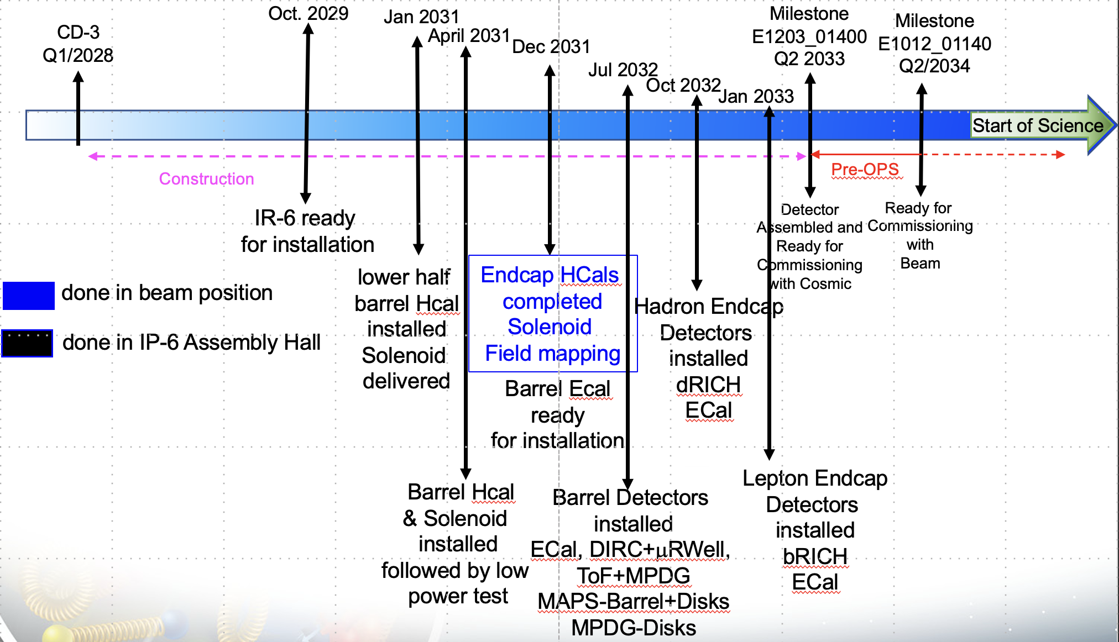
FEB Development – cont.
Jan 2031 – Jan 2033
Project Schedule

Slide 22
FEB Development – cont.
NOTE: FEB designs are contingent upon final ASIC pinout/package design.
Final Design ASIC Submission
Construction
FY23 through FY26
ASIC Development
FY26 – FY28 – 1 Year each ASIC
Final Pinout
ASIC Fab Production & Testing
6 Months
ASIC Testing
pFEB
FEB Eng. Article Development
Eng. Article Tests
Installation
<1 Year
PCB Production
First Production ASICs
<1 Year
Production Tests
<3 Months
Integration Tests
<3 Months
R&D FY23 - FY24
PED FY25 - FY26
System Tests
ASIC Fab & Eng. Article
FEB Production & Tests

Slide 23
FEB Development – cont.
NOTE: FEB designs are contingent upon final ASIC pinout/package design.
Example: Final Design FY27 ASIC Submission
Oct 2026
Jan 2027
Jun 2027
Jan 2028
Mar 2029
Installation
1 Year each ASIC
Jan 2031 – Jan 2033
Final Pinout
ASIC Fab Production & Testing
Target QC Complete
6 Months
ASIC Testing
Jun 2030 – Jun 2032
FEB Development
FEB Eng. Article Development
Eng. Article Tests
Installation
<1 Year
PCB Production
First Production ASICs
<1 Year
Production Tests
<3 Months
Integration Tests
<3 Months
System Tests
ASIC Fab & Eng. Article
FEB Production & Tests

Slide 24
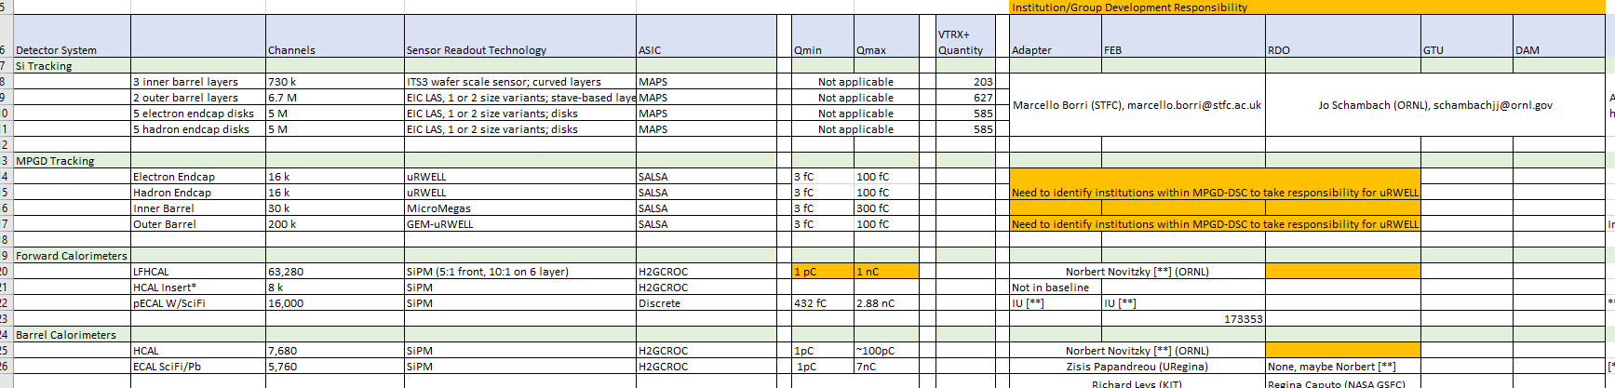
Resources
In early 2024, we collected information on resources, responsibilities and expressions of interest for the electronics and DAQ efforts under ePIC Detector Information Request.xlsx.
Over the next few months, we will need your help in updating this information and as we proceed to mature designs of Adapters, FEBs, RDOs, GTU, DAM.
This information, with schedules, will inform the resource profile for deliverables of the various components to their respective detectors.

Slide 25
Summary
Internal reviews to start soon
  First review likely to be on Discrete ~September 2025
Considerable progress on the readout ASIC/Discrete
  Pre-production versions nominally in FY26
  EICROC: 130 nm to 65 nm?
  CALOROC: 1A or 1B? 32ch or 64 ch?
  FCFD Variant: evaluation tests w/ FCFDv1.1 a very important step in development
Designs of the pre-production FEBs to start within the next year
Resources & funding are critical
Administrative steps take longer than anticipated (approvals, institutes, contracts, etc.)
Europractice/IMEC/TSMC – agreements are with CERN and ePIC recognized experiment is not enough
  We have ~2 years to production – need to clarify need for agreements and when (CERN/ePIC/EIC/BNL/JLAB/institutions, …)

