Slide 1
Integration Issues Related to DAQ * Timing Requirements * TOF Requirements, T0, Calibrations – Satoshi Yano * Data volumes, Event Rates, Noise Jeff Landgraf

Slide 2
Data Volumes, Why?
ASIC meeting in Paris June 2-3
Lots of new information regarding data formats (and therefore data volumes / hit)
Additional information regarding readout rate
New data
Synchrotron Radiation
Electron Touschek, Coulomb, & Bremstrahlung
Noise has never been properly handled
There is an exercise going on in the Calorimeter groups to properly characterize the thresholds needed, noise rates, and effect of radiation on these
This work is going on, but they are not yet ready to present
I wanted to give the Electronics & DAQ perspective, as we have constraints that need to be considered
Noise (and backgrounds if large) are the points that can destroy the usefulness of the streaming concept. We depend upon having quiet detectors, and the special plans for the dRICH illustrate this.
In a triggered system the noise (per bunch crossing) is multiplied by the trigger rate
In a streaming system the noise (per bunch crossing) is multiplied by the bunch crossing rate.

Slide 3
Data Formats – General
Originally the DAQ Assumption for data hit rates was e.g.:
Hit Size = number of bits readout per channel per digitization cycle
Charge Sharing = average number of nearby channels readout by an average track
#ADCs = number of bunch crossings of ADC data readout
T=0
T=1
T=2
T=3
T=4
Bits = HitSize * Charge Sharing * #ADCs
The assumption was always
Hitsize ~ 64 bits
20 bits for time (20 bits is a million)
20 bits for channel ID
20 bits for deposited charge
Better Information Now!
ADC[1]
ADC[2]
ADC[3]
ADC[4]
ADC[5]

Slide 4
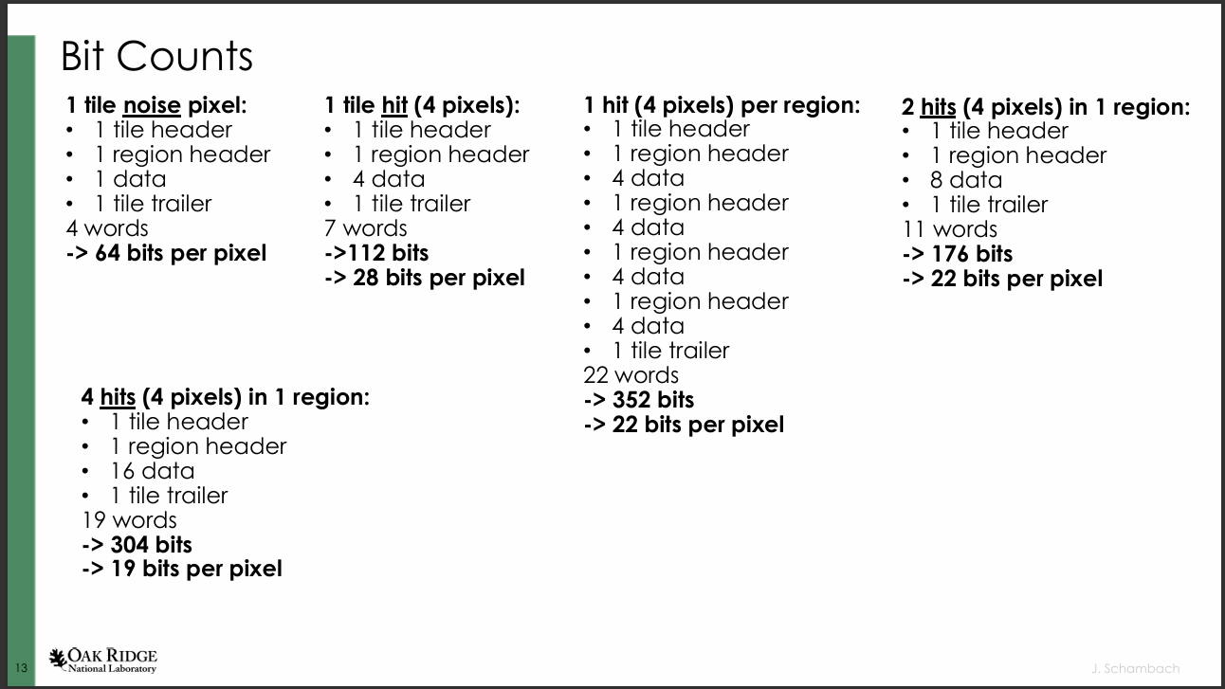
Data Formats – ITS3
Assume 1 Region hit per track
Assume 4 pixels hit per track
Assume 1 pixel hit for noise
Hits → 112 bits per hit
Noise → 64 bits per hit

Slide 5
Data Sizes
ASIC | Charge Share | Times Readout | Formula | Bits / Hit FEB | Old HitSize | Bits / Noise FEB | Bits / DAQ Output | Max Rate
ITS-3 | 4 | 1 | 16 x (C+3) | 112 | 128 | 64 | 128 | Not simple
Discrete (FECAL) | 4 | 5 | 12 x C x (5 x T + 7) | 576 | 144 | 144 | 128 | 50 kHz / ch
CALOROC | 4 | 5 | 32 x T x (4 + C) | 1280 | 480 | 800 | 128 | 50 kHz / ch
EcalBarrelScFi | 4 | 5 | 2 x ( 32 x T x (4 x C) ) | 2560 | 960 | 800 | 128 | 50 kHz / ch
EICROC1 | 128 | 8 | (T x 24 + 8) x C | 25600 | 576 |  |  | 12 hz / ch
EICROC2 | 9 | 5 | (60 + T x 8) x C | 900 | 576 | 900 | 128 | 350 hz / ch
FCFD | 4 | 5 | 32 x T x (4 + C) | 1280 | 192 | 800 | 128 | 50 kHz / ch
ALCOR | 1 | 1 |  | 64 | 64 | 64 | 64 | 300 kHz / ch
SALSA | 4 | 5 | C * (T + 4) * 32 | 1152 | 320 | 288 | 128 | 25 kHz / ch
Actual ASIC sizes are typically 2-4 times larger than previous assumption
Maximum supported rates are also lower
The rates are bandwidth limited

Slide 6
Data Sizes
ASIC | Charge Share | Times Readout | Formula | Bits / Hit FEB | Old HitSize | Bits / Noise FEB | Bits / DAQ Output | Max Rate
ITS-3 | 4 | 1 | 16 x (C+3) | 112 | 128 | 64 | 128 | Not simple
Discrete (FECAL) | 4 | 5 | 12 x C x (5 x T + 7) | 576 | 144 | 144 | 128 | 50 kHz / ch
CALOROC | 4 | 5 | 32 x T x (4 + C) | 1280 | 480 | 800 | 128 | 50 kHz / ch
EcalBarrelScFi | 4 | 5 | 2 x ( 32 x T x (4 x C) ) | 2560 | 960 | 800 | 128 | 50 kHz / ch
EICROC1 | 128 | 8 | (T x 24 + 8) x C | 25600 | 576 |  |  | 12 hz / ch
EICROC2 | 9 | 5 | (60 + T x 8) x C | 900 | 576 | 900 | 128 | 350 hz / ch
FCFD | 4 | 5 | 32 x T x (4 + C) | 1280 | 192 | 800 | 128 | 50 kHz / ch
ALCOR | 1 | 1 |  | 64 | 64 | 64 | 64 | 300 kHz / ch
SALSA | 4 | 5 | C * (T + 4) * 32 | 1152 | 320 | 288 | 128 | 25 kHz / ch
What does rate / ch mean here?
This table is for use with the ePIC simulations. The rate is the number particles readout by the ASIC / number of channels. Actual hits activate more than one channel as specified as Charge Share, but these don’t count as individual hits.

Slide 7
Synchrotron Radiation Issues
Andrii Natochii’s Presentation on SR:
https://indico.bnl.gov/event/26268/contributions/101528/attachments/59475/102194/ePIC_Tracking_Group_Meeting_Jan16_2025_NATOCHII.pdf
The hepmc3 files:
/gpfs/mnt/gpfs02/eic/anatochii/SynradG4_HepMC_Files_SR_on_IP6/
These files are designed to be run in release 25.01.0. The distribution of photons doesn’t match the beamline in recent releases, leading to incorrect and very high rates.
The XrootD files:
/volatile/eic/EPIC/RECO/25.05.0/epic_craterlake/BACKGROUNDS/SYNRAD/dataprod_rel_1.0.0/18x275
Readme:

Slide 8
Synchrotron Radiation Issues
Andrii Natochii’s Presentation on SR:
https://indico.bnl.gov/event/26268/contributions/101528/attachments/59475/102194/ePIC_Tracking_Group_Meeting_Jan16_2025_NATOCHII.pdf
The hepmc3 files:
/gpfs/mnt/gpfs02/eic/anatochii/SynradG4_HepMC_Files_SR_on_IP6/
These files are designed to be run in release 25.01.0. The distribution of photons doesn’t match the beamline in recent releases, leading to incorrect and very high rates.
The XrootD files:
/volatile/eic/EPIC/RECO/25.05.0/epic_craterlake/BACKGROUNDS/SYNRAD/dataprod_rel_1.0.0/18x275
Readme:

Slide 9
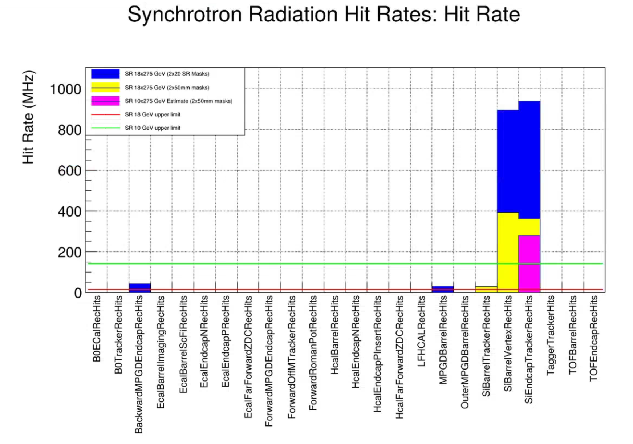
Synchrotron Radiation Issues
There is no reason to expect that the 2x50mm masks work better than the 2x20mm masks. (The 2x50mm point is invalid)
There is a question as to the worst data point for SR. The SR is highest at 18 GeV, but the Beam current is a factor of 10 higher at 10GeV
I tried to scale this to 10x275. At Andrii’s advice I divided the energy entire distribution of hepmc3 events by ${\left(\frac{18}{10}\right)}^{3}$and then reran npsim/eicrecon. Only 2 events made it through despite the higher beam current.
Andrii claims that the current goal / expectation is another reduction of 50-100.

Slide 10
Synchrotron Radiation Issues
There is no reason to expect that the 2x50mm masks work better than the 2x20mm masks. (The 2x50mm point is invalid)
There is a question as to the worst data point for SR. The SR is highest at 18 GeV, but the Beam current is a factor of 10 higher at 10GeV
I tried to scale this to 10x275. At Andrii’s advice I divided the energy entire distribution of hepmc3 events by ${\left(\frac{18}{10}\right)}^{3}$and then reran npsim/eicrecon. Only 2 events made it through despite the higher beam current.
Andrii claims that the current goal / expectation is another reduction of 50-100.
I’m taking 4 things from the synchrotron radiation study (thus far)
There has been quite some progress already. The original estimates would have been impossible to consider reading out.
The current hit rates are very high ~1 GHz in the barrel vertex, and endcap tracker. We could likely readout the MAPS detectors, but would need to rethink the maximum data rates. The very high rates are limited to a few detectors
10 GeV likely has lower synchrotron radiation than 18 GeV, the SR power wins over the higher beam current
We still need patience before including SR estimates in projections

Slide 11
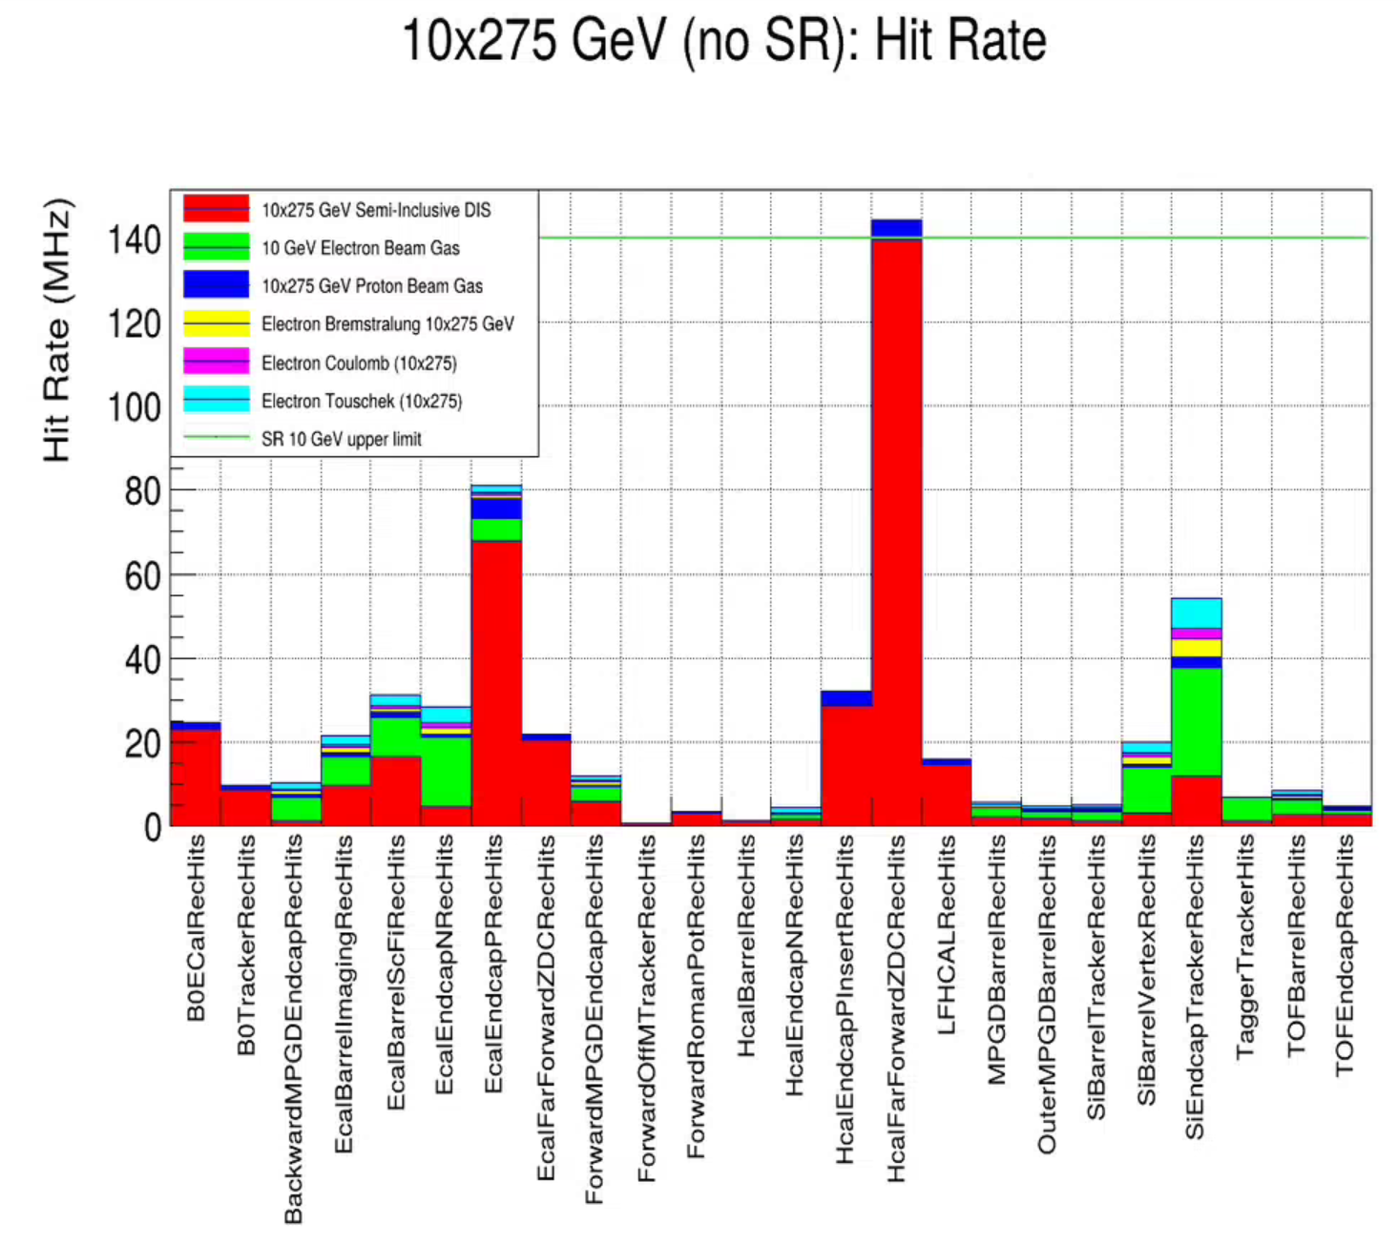
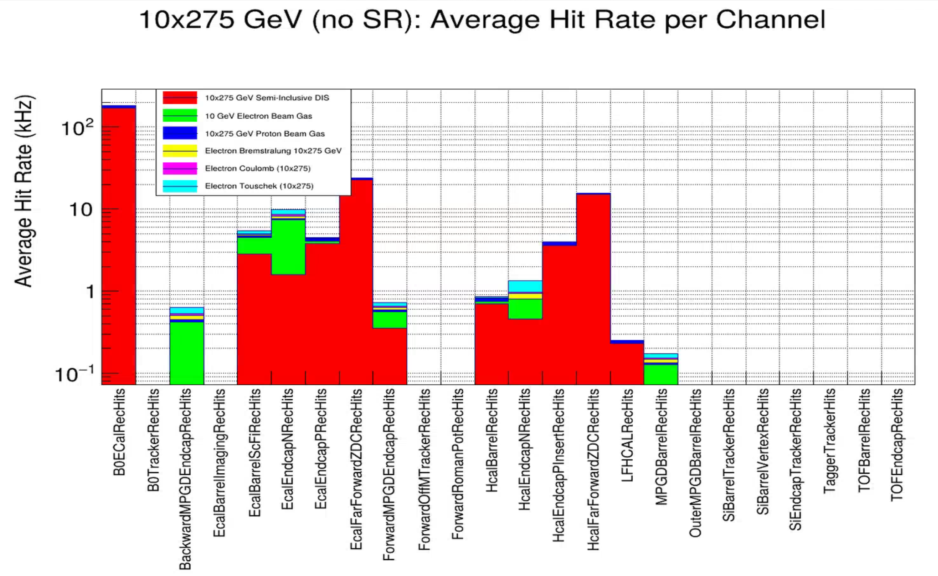
Hit Rates
CALOROC (50 kHz)
SALSA (25 kHz)
EICROC (350 Hz)

Slide 12
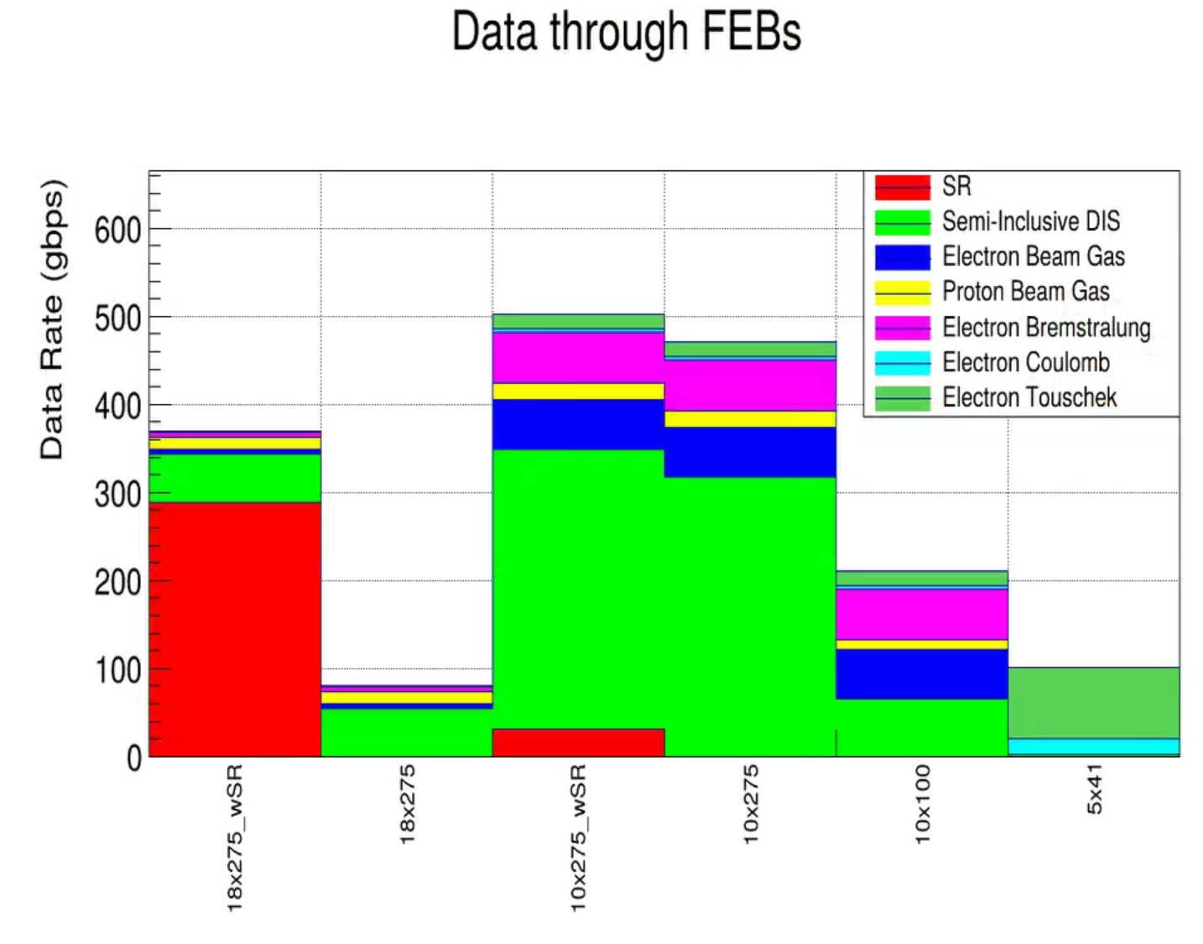
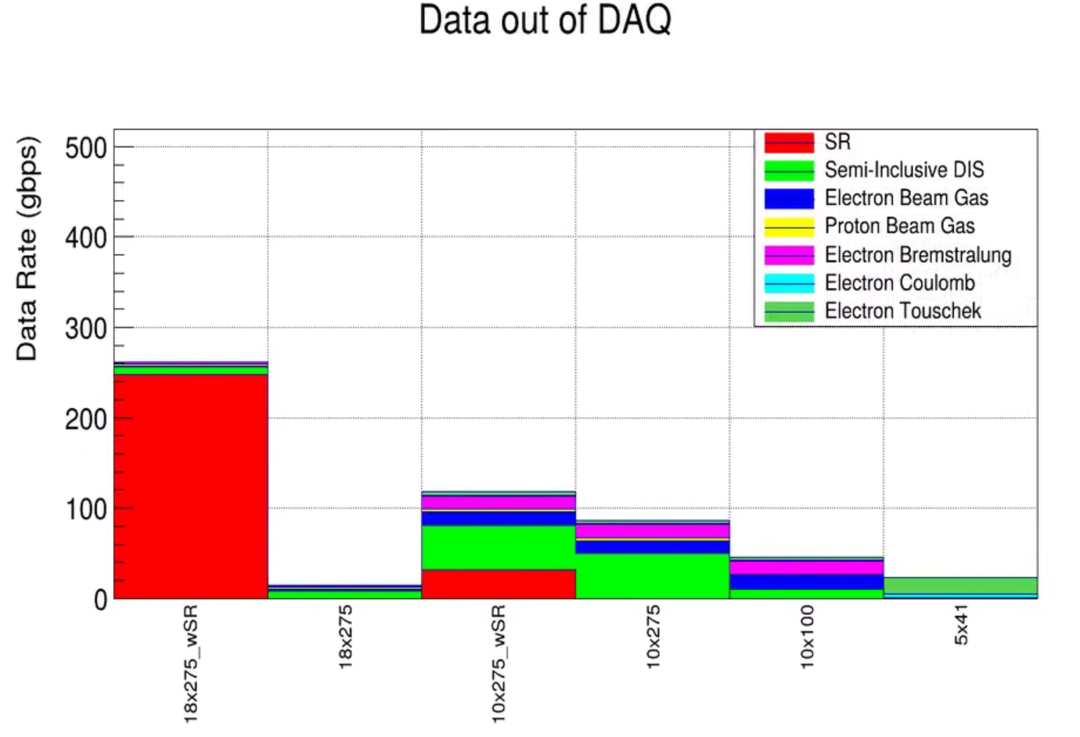
Data Rates for Different Energies (eP)
These are well within our capabilities (ignoring for now the SR)
The goal of not touching the data at all in DAQ is not likely to be possible at moderate luminosities, however the ASIC formats are not very compressed, we can likely get to 100 gbps target via lossless repacking and/or simple analysis such as clustering
We need to evaluate the maximum rate regions of each detector to ensure the ASICs can keep up with the data volume.

Slide 13
Noise
For detectors where we expect charge sharing: random noise is an issue in the ASIC / FEB / RDO, not in the final data
We can eliminate significant noise by requiring adjacent hits (After RDO)
Coherent noise needs to be addressed externally, and can not exceed ASIC capabilities
If too much noise is present:
Raise thresholds
Lower ASIC controls (number of timebins readout)
Disable (or don’t connect) channels – this could be a solution in very high-rate areas, although it is not simple given the fact that such areas are already have constrained space.
Apply deadtime to detector
Join ASIC internal-mini-reviews and push for more efficient data packing
Algorithm for finding maximum noise
Find hit rate in worst-case physics --- careful, full understanding of simulation and ASIC required!
Subtract hit rate from MAX-RATE from table on page 5.
Apply safety margin you think is appropriate!

Slide 14
Discussion?
???

