Slide 1
TOF requirements, T0 determination, Timing calibrations
Satoshi YANO
Hiroshima University
The ePIC Collaboration Meeting
Electronics and DAQ II: DAQ Integration / ASIC status and plans
07/17/2025

Slide 2
Message from Jeff
Is there anyone who could give a summary from the TOF side? Specifically, I'd want some idea about:
The requirement/impact of timing resolution for the physics analysis
The timing impact of the T0 determination
Whether it is (or might be) possible to track slow phase drifts of the clock (due to temperature) using calibrations

Slide 3
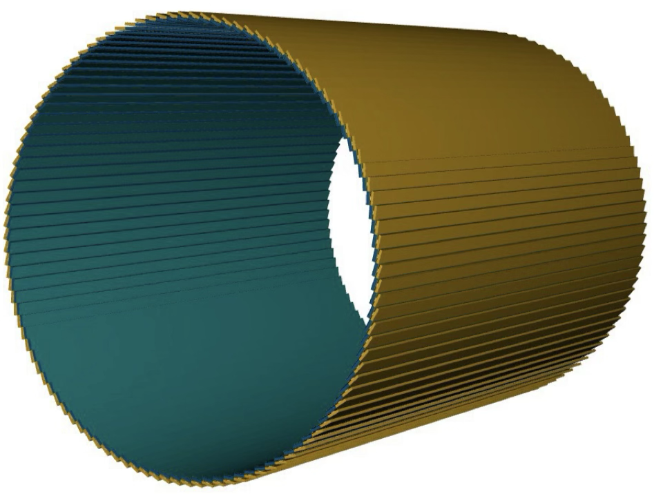
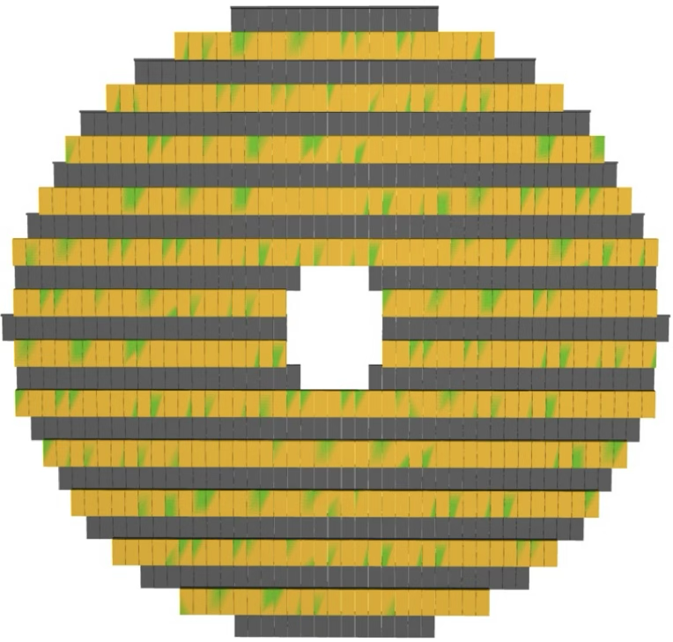
Recap of AC-LGAD TOF
Barrel-TOF (BTOF)
Forward-TOF (FTOF)
-1.33<η<1.74
1.84<η<3.61
0.64 m
10.5 cm
60 cm
~2.8 m
The ePIC AC-LGAD TOF system is used for particle identification (PID), tracking, and background rejection in both mid-rapidity (BTOF) and forward-rapidity (FTOF) regions.
A position resolution of ~30 um and a timing resolution of 35 ps for PID and tracking within a space of less than 10 cm in thickness are required

Slide 4
Recap of AC-LGAD TOF
Barrel-TOF (BTOF)
Forward-TOF (FTOF)
-1.33<η<1.74
1.84<η<3.61
0.64 m
10.5 cm
60 cm
~2.8 m
The ePIC AC-LGAD TOF system is used for particle identification (PID), tracking, and background rejection in both mid-rapidity (BTOF) and forward-rapidity (FTOF) regions.
A position resolution of ~30 um and a timing resolution of 35 ps for PID and tracking within a space of less than 10 cm in thickness are required

Slide 5
Message from Jeff
Is there anyone who could give a summary from the TOF side? Specifically, I'd want some idea about:
The requirement/impact of timing resolution for the physics analysis
The timing impact of the T0 determination
Whether it is (or might be) possible to track slow phase drifts of the clock (due to temperature) using calibrations

Slide 6
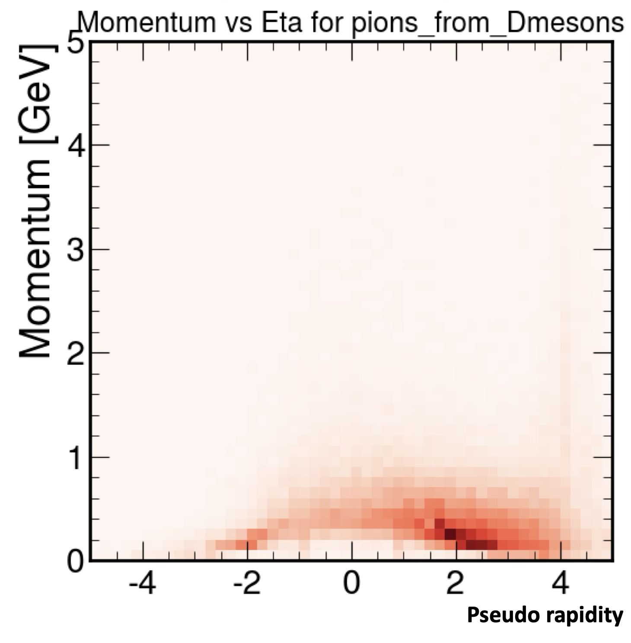
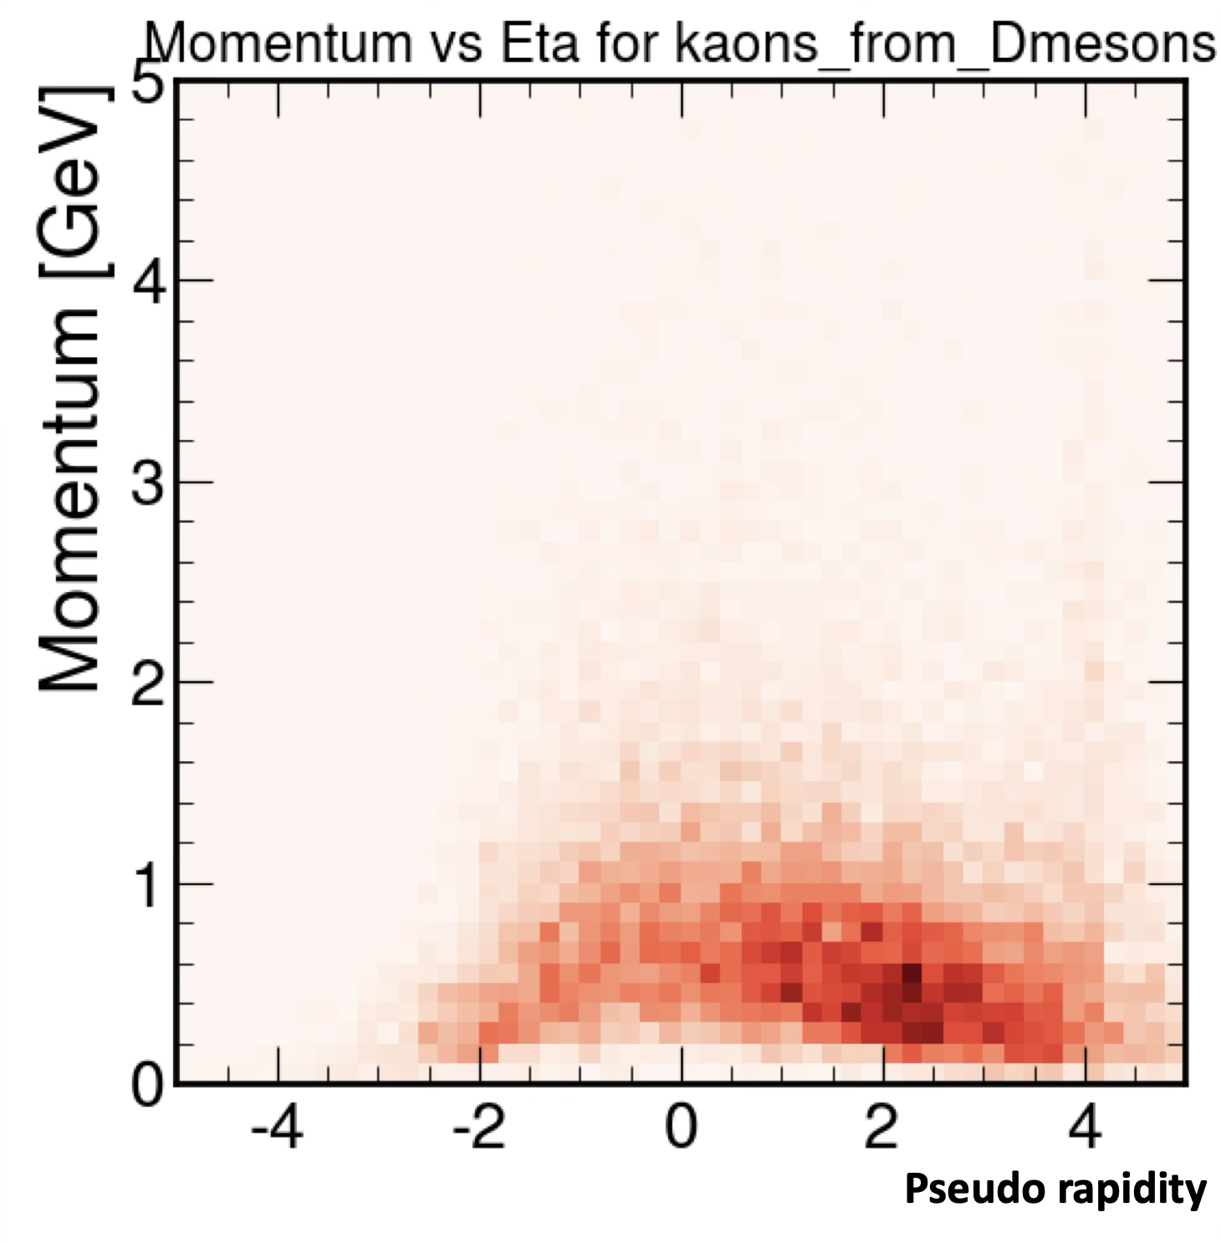
Impact on the ePIC PID performance
Focus of TOF is below p = 1 GeV/c
Particle-Identification at low momentum region is the primary task
Used in conjunction with Cherenkov light detectors to eliminate PID gaps and to cross-calibrate each other in overlapping regions
π from D
K from D
Decay products from D-meson in ep DIS @ √s = 141 GeV

Slide 7
Impact on the ePIC PID performance
Focus of TOF is below p = 1 GeV/c
Particle-Identification at low momentum region is the primary task
Used in conjunction with Cherenkov light detectors to eliminate PID gaps and to cross-calibrate each other in overlapping regions
K/p 3σ
π/K 3σ
BTOF
FTOF
BTOF
Assuming
BTOF σ_{tot} = 35 ps
FTOF σ_{tot} = 25 ps
FTOF
π from D
K from D
Decay products from D-meson in ep DIS @ √s = 141 GeV

Slide 8
Impact on the ePIC PID performance
Focus of TOF is below p = 1 GeV/c
Particle-Identification at low momentum region is the primary task
Used in conjunction with Cherenkov light detectors to eliminate PID gaps and to cross-calibrate each other in overlapping regions
hpDIRC
dRICH
hpDIRC
dRICH
K/p 3σ
π/K 3σ
BTOF
FTOF
BTOF
Assuming
BTOF σ_{tot} = 35 ps
FTOF σ_{tot} = 25 ps
FTOF
π from D
K from D
Decay products from D-meson in ep DIS @ √s = 141 GeV

Slide 9
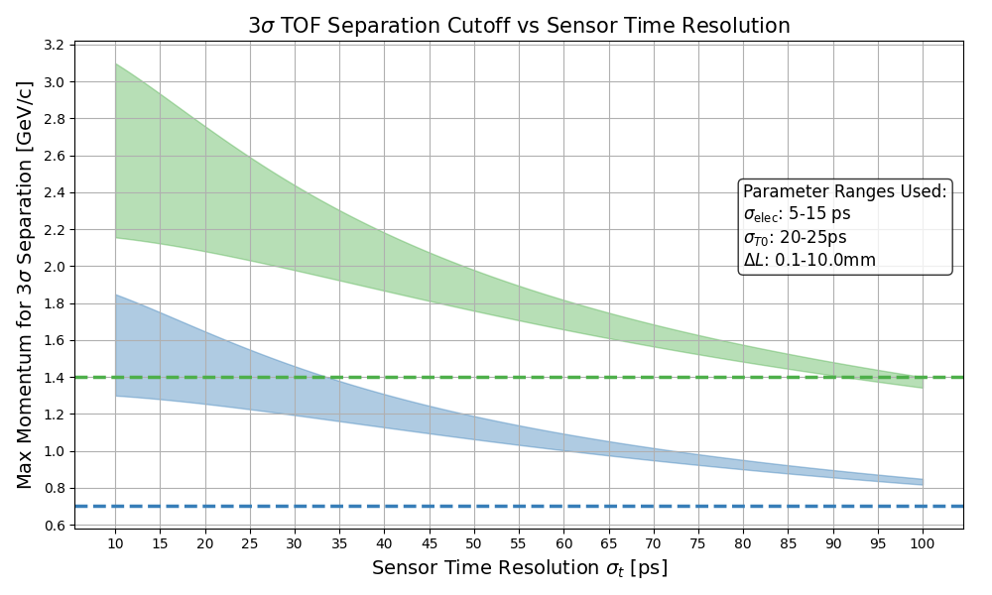
Sensor Timing Resolution v.s. Overlap with hpDIRC
y = 0
hpDIRC limit for K/p sep.
hpDIRC limit for π/K sep.
Even in the worst case scenario, with current sensor performance (σ_{sensor}~35 ps), there is an overlap area with hpDIRC → Already no PID hole!
σ_{sensor}> 90 ps doesn’t have overlapping region with hpDIRC in K/p separation any more

Slide 10
Sensor Timing Resolution v.s. Overlap with hpDIRC
y = 0
Current best performance
σ_{sensor} ~ 35 ps
Δp ~ 0.5 GeV/c
hpDIRC limit for K/p sep.
Δp ~ 0.45 GeV/c
hpDIRC limit for π/K sep.
Even in the worst case scenario, with current sensor performance (σ_{sensor}~35 ps), there is an overlap area with hpDIRC → Already no PID hole!
σ_{sensor}> 90 ps doesn’t have overlapping region with hpDIRC in K/p separation any more

Slide 11
Sensor Timing Resolution v.s. Overlap with hpDIRC
y = 0
Current best performance
σ_{sensor} ~ 35 ps
Δp ~ 0.5 GeV/c
hpDIRC limit for K/p sep.
Δp ~ 0.45 GeV/c
hpDIRC limit for π/K sep.
Even in the worst case scenario, with current sensor performance (σ_{sensor}~35 ps), there is an overlap area with hpDIRC → Already no PID hole!
σ_{sensor}> 90 ps doesn’t have overlapping region with hpDIRC in K/p separation any more

Slide 12
Message from Jeff
Is there anyone who could give a summary from the TOF side? Specifically, I'd want some idea about:
The requirement/impact of timing resolution for the physics analysis
The timing impact of the T0 determination
Whether it is (or might be) possible to track slow phase drifts of the clock (due to temperature) using calibrations

Slide 13
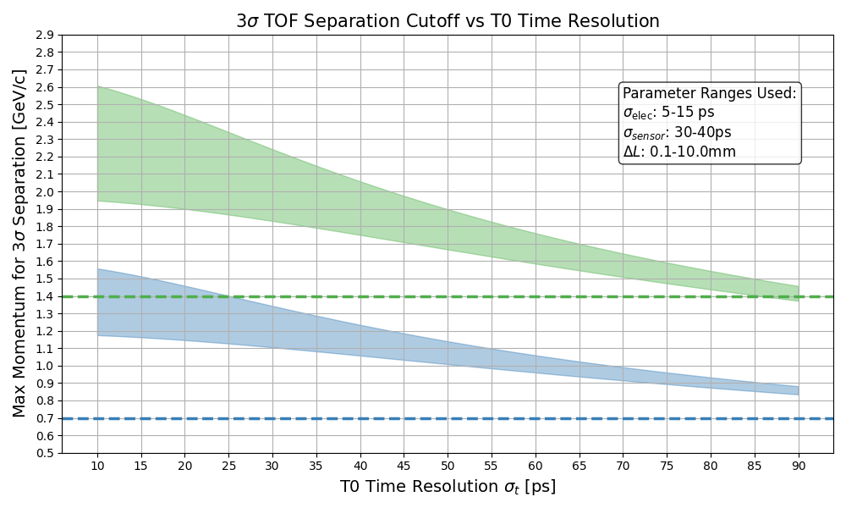
T0 Timing Resolution v.s. PID performance (BTOF case)
y = 0

Slide 14
T0 Timing Resolution v.s. PID performance (BTOF case)
y = 0
Reference T0 jitter = 25 ps

Slide 15
T0 Timing Resolution v.s. PID performance (BTOF case)
y = 0
Reference T0 jitter = 25 ps
+10 ps

Slide 16
T0 Timing Resolution v.s. PID performance (BTOF case)
y = 0
Reference T0 jitter = 25 ps
+10 ps
+20 ps

Slide 17
T0 Timing Resolution v.s. PID performance (BTOF case)
y = 0
Reference T0 jitter = 25 ps
Δp ~ 0.1 GeV/c per additional 10ps jitter
for K/p sep.
+10 ps
+20 ps
Δp ~ 0.05 GeV/c per additional 10ps jitter
for π/p sep.
In σ_{T0} = 25 ps case, the overlap region is shifted by ~0.05 GeV/c for π/K sep. and ~ 0.1 GeV/c for K/p sep. when the additional jitter is 10 ps

Slide 18
Message from Jeff
Is there anyone who could give a summary from the TOF side? Specifically, I'd want some idea about:
The requirement/impact of timing resolution for the physics analysis
The timing impact of the T0 determination
Whether it is (or might be) possible to track slow phase drifts of the clock (due to temperature) using calibrations

Slide 19
T0 Monitoring and Calibration
T0 can be estimated by “Track-Based Average” method
t_{hit}: Measured hit time
t_{exp}: Expected hit time w/ particle assumption (pion mass is assumed)
Combining hpDIRC PID, the precision can be improved
Precision of the Track-Based T0 depends on # tracks
Hit rate of one sensor is about 1 Hz (BTOF)
E.g. time interval is set to be 1min, σ_{T0} = 43 ps / √60 ~ 5 ps
σ_{sensor} = 40 ps and σ_{elec.} = 15 ps is assumed
(I think), even in considering various additional effects, the shift can be monitored < 10ps / min
1 min is enough?
$$T_{0}=\left\langle t_{hit }−t_{exp}\right\rangle$$

Slide 20
T0 Monitoring and Calibration
T0 can be estimated by “Track-Based Average” method
t_{hit}: Measured hit time
t_{exp}: Expected hit time w/ particle assumption (pion mass is assumed)
Combining hpDIRC PID, the precision can be improved
Precision of the Track-Based T0 depends on # tracks
Hit
rate of one sensor is about 1 Hz (BTOF)
E.g. time interval is set to be 1min, σ_{T0} = 43 ps / √60 ~ 5 ps
σ_{sensor} = 40 ps and σ_{elec.} = 15 ps is assumed
(I think), even in considering various additional effects, the shift can be monitored < 10ps / min
1 min is enough?
$$T_{0}=\left\langle t_{hit }−t_{exp}\right\rangle$$
$$σ_{T0}=\frac{T0}{\sqrt{N_{track}}}$$

Slide 21
T0 Monitoring and Calibration
T0 can be estimated by “Track-Based Average” method
t_{hit}: Measured hit time
t_{exp}: Expected hit time w/ particle assumption (pion mass is assumed)
Combining hpDIRC PID, the precision can be improved
Precision of the Track-Based T0 depends on # tracks
Hit rate of one sensor is about 1 Hz (BTOF)
E.g. time interval is set to be 1min, σ_{T0} = 43 ps / √60 ~ 5 ps
σ_{sensor} = 40 ps and σ_{elec.} = 15 ps is assumed
(I think), even in considering various additional effects, the shift can be monitored < 10ps / min
1 min is enough?
$$T_{0}=\left\langle t_{hit }−t_{exp}\right\rangle$$
$$σ_{T0}=\frac{T0}{\sqrt{N_{track}}}$$

Slide 22
Summary
TOF is one of the important PID detector, especially in low-momentum region
T0 is one of the main source of the timing jitter
Under realistic assumption (σ_{T0} =20-25 ps), there is already no PIC acceptance hole
Additional T0 jitter effect is expected to worse PID coverage momentum range by 0.05 GeV/c and 0.1 GeV/c per 10ps for π/K and K/p separation, respectively
The T0 shift is possibly monitored by “Track-Based Average” method
The shift to each sensor may be able to be monitored by 10 ps precision each 1 min

Slide 23
Summary
TOF is one of the important PID detector, especially in low-momentum region
T0 is one of the main source of the timing jitter
Under realistic assumption (σ_{T0} =20-25 ps), there is already no PID acceptance hole
Additional T0 jitter effect is expected to worse PID coverage momentum range by 0.05 GeV/c and 0.1 GeV/c per 10ps for π/K and K/p separation, respectively
The T0 shift is possibly monitored by “Track-Based Average” method
The shift to each sensor may be able to be monitored by 10 ps precision each 1 min

Slide 24
Summary
TOF is one of the important PID detector, especially in low-momentum region
T0 is one of the main source of the timing jitter
Under realistic assumption (σ_{T0} =20-25 ps), there is already no PID acceptance hole
Additional T0 jitter effect is expected to worse PID coverage momentum range by 0.05 GeV/c and 0.1 GeV/c per 10ps for π/K and K/p separation, respectively
The T0 shift is possibly monitored by “Track-Based Average” method
The shift to each sensor may be able to be monitored by 10 ps precision each 1 min

Slide 25
Summary
TOF is one of the important PID detector, especially in low-momentum region
T0 is one of the main source of the timing jitter
Under realistic assumption (σ_{T0} =20-25 ps), there is already no PID acceptance hole
Additional T0 jitter effect is expected to worse PID coverage momentum range by 0.05 GeV/c and 0.1 GeV/c per 10ps for π/K and K/p separation, respectively
The T0 shift is possibly monitored by “Track-Based Average” method
The shift to each sensor may be able to be monitored by 10 ps precision each 1 min

