Slide 1
Integration Issues Related to DAQ * Timing Requirements * TOF Requirements, T0, Calibrations – Satoshi Yano * Data volumes, Event Rates, Noise Jeff Landgraf

Slide 2
Timing from RHIC (STAR) to ePIC
At STAR each trigger detector produces a result every bunch crossing that is used for constructing the trigger:
Time windows are important
They cut away backgrounds
They define the live time of the trigger detectors
They define the determination of hit times, e.g. for vertexing detectors
Fast detectors are “timed in” each year. Using beam we move the time windows to bracket detector hits. Effectively we change the clock to explicitly subtract |z|/c from the time, so that all (prompt) hits occur at T=0
The delay needed for trigger determination defines front-end electronics buffer depths. In STAR, the trigger is issued 17 bunch crossings after the collision has occurred
All detectors use the RF clock to drive their electronics, so they automatically operate in phase with the beam. In ePIC multiple digitization clocks are used 39.4 MHz, 98.5 MHz, 197 MHz. Each is synchronized to the RF clock but not equal to it.
TOF detector has a start detector (VPD) to provide timing reference
At RHIC the finest granularity for time (in trigger/daq) is 0.5 ns

Slide 3
Timing in ePIC
No trigger implies that online timing is less critical (in most cases) because hit position in time is not used for any activity inside the electronics or DAQ.
To first order:
Each hit has a time in the streaming system, whereas in a triggered system hits are assumed to have the event time
The time value is for each channel arbitrary – as long as it stays constant relative to beam and other detectors, the final corrections can be applied offline, in software, before reconstruction.
ePIC Does have special needs regarding timing:
dRICH Shutter
Synchronize detectors, and verify synchronization
Time frame coherency
Bunch crossing determination for events
TOF has no start detector so provide reference relative to beam

Slide 4
What are these needs?
Detector Synchronization
→ Each hit, (or at least each track), eventually needs to be assigned to a source bunch crossing to know the proper spin state of the colliding beam
DAQ Must ensure that this bunch crossing is accurate and consistent for each detector
Note that bunch crossing value of specific hits will not be the same, as we expect to report times without subtracting |z|/c, so the hit times will span up to 12 bunch crossings.
dRICH Shutter
The dRICH will cut noise/background by about 2/3 by requiring hits during expected periods
Requires online calibration to ~0.5 - 1 ns
Time Frame Coherency
The bunch crossing alone defines which time frame a hit is in
Events span up to 12 BX, so some events might be stored in two time frames (far forward/back in later frame)
In fullness of time, the overlap region of two frames can still be analyzed
In the short term, time frame borders are not synchronized to the initial bunch crossing of a revolution, which should eliminate the issue of always loosing border hits from particular bunches.
TOF Has no start detector
→ O(25) ps timing needs to be delivered. This is the topic of the ideas to follow.

Slide 5
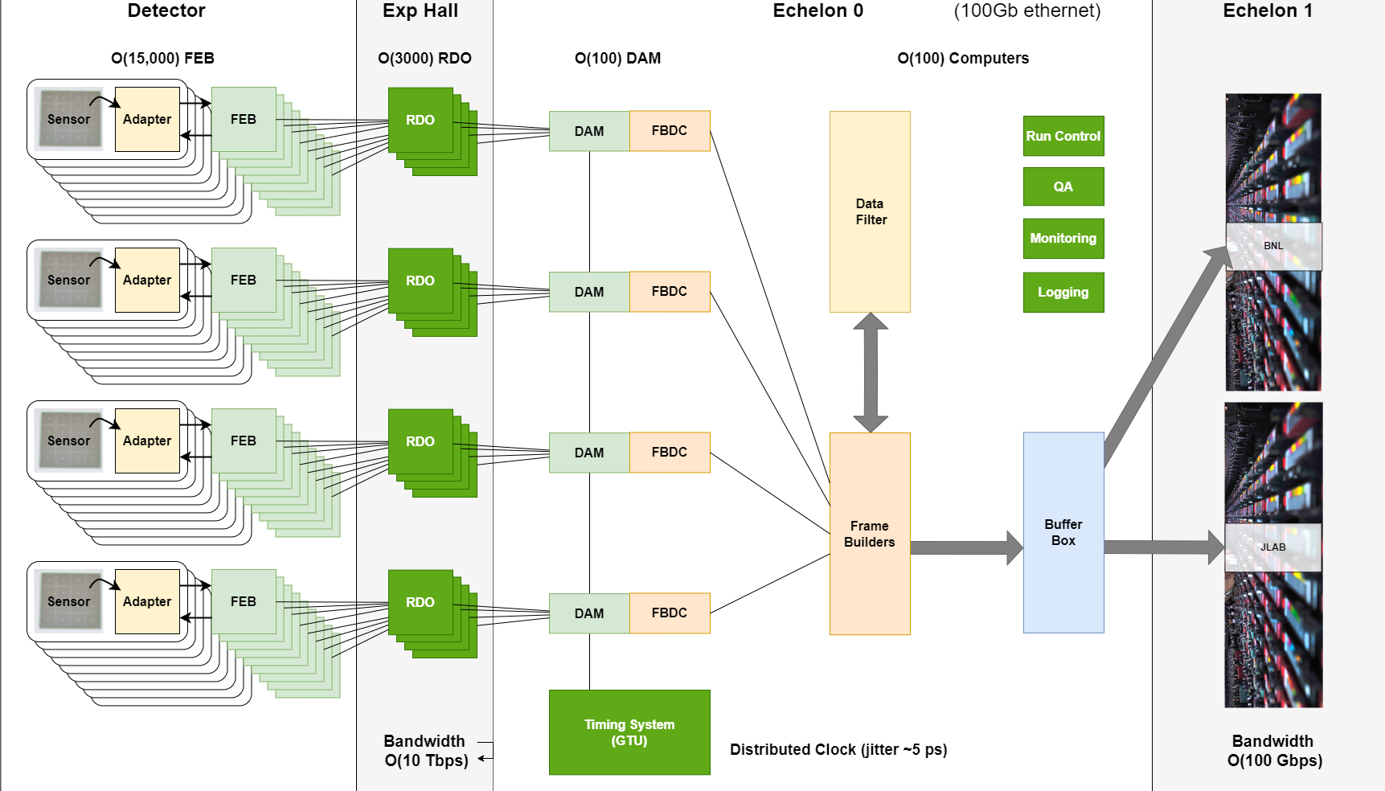
EIC Streaming DAQ/Computing Architecture
Bunch Crossing
~10.2 ns/98.5 MHz
Interaction Rate
~ 2 us/500 kHz
Low occupancy

Slide 6
Timing System Connections
DAQ ROOM
70 - 130 m
DET
DAM
IP10
DAM
DET
RF
(Electron)
Common Platform
5 m
1300 m
DAM
DET
DAM
DET
DAM
DET
(…)
GTU
75 m
25 m
DAM
RDO
DET
DAM
RDO
DET
DAM
RDO
DET
IP4
DAM
RDO
DET
RF
(Hadron)
650 m
Common Platform
DAM
RDO
DET
DAM
RDO
DET
Clock pulse on fiber (parallel fiber to data)
Reconstructed Clock on fiber (shared with data)

Slide 7
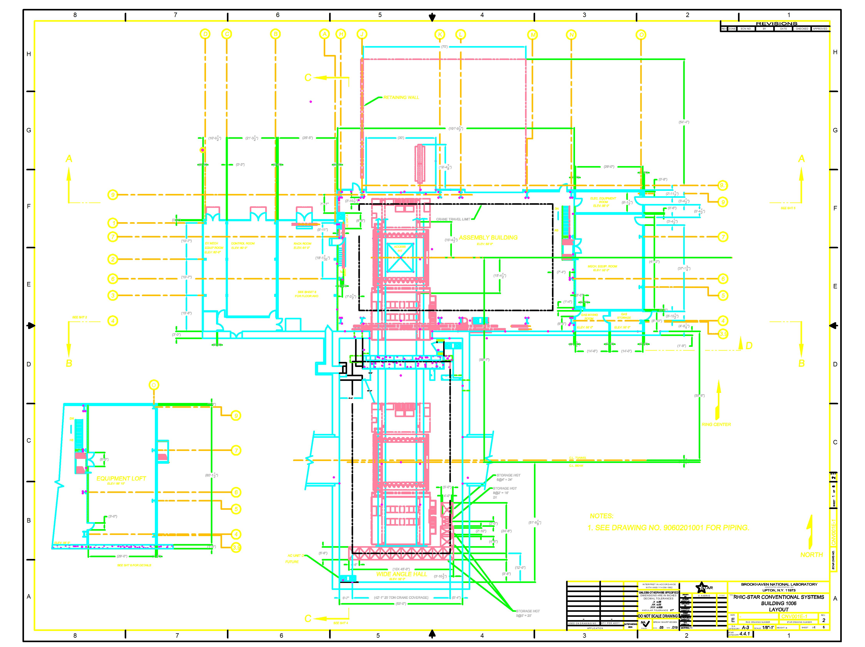
Physical Layout
Fiber Layouts:
ABC ~ 100 m
AD ~ 70 m
AE ~ 130 m
AF/AG ~ 100 m
FB / CB ~ 25 m
FC ~ 12 m
DAQ room Patch Panel
WAH Patch Panel
FEB Connections
- 40 m
+ 40 m
BPM positions
(A)
(D)
(F)
(C)
(F)
(E)
(B)

Slide 8
PID is the most sensitive to timing resolution
DET | Timing Resolution
pfRICH | 30-40 ps
DIRC | N/A ?
Barrel TOF | 35 ps
Forward TOF | 20 ps
dRICH | N/A* Real time requirement < O(1 ns) for noise shutter
Not 100% clear if these time resolutions are meant as descriptions of the technology, or as requirements for the success of the physics programs

Slide 9
Timing Requirements DAQ
F-DET-COMP.11: Global Timing Unit (GTU) will provide common timing information to all DET sub systems
P-DET-COMP.18: The GTU will deliver a stable high-resolution clock at the level of 100ps jitter to DET subsystems, with an option to deliver up to a 5ps jitter clock to DET subsystems requiring very high-resolution timing measurements.
P-DET-COMP.19: The DAQ system will require interfaces to the accelerator which provide timing and data exchange, and allow the accelerator to read the state and condition of detector systems.
P-DET-COMP.18: The GTU will deliver a high-resolution clock to the RDO boards. The clock measured at the RDO will have <= 8ps Jitter. The clock phase between the output of the GTU and the output of the RDO will have a constant offset stable to <= 50 ps. The DAQ will measure phase drift within 10 ps.
P-DET-COMP.19: The DAQ system will require interfaces to the accelerator which provide timing data exchange. The clock delivered to DAQ will have jitter <= 8ps. The clock delivered to DAQ will have a constant offset to the RF clock stable to <= 8 ps.

Slide 10
If 20-40 ps is requirement, then integration challenge:
Issue | Significance
Need clear definition of time reference requirement | Not all factors in control of DAQ
Jitter through GTU/DAM/RDO chain | <5 ps
Phase reproducibility on electronics restart | <5 ps
Temperature fluctuations along fiber path | IP6 historical measurements variations estimated to produce in the worst case O(40 ps) variations
Temperature fluctuations within ePIC Detector | lpGBT ~5ps / K variation
RF Signal delivery | Basis for ePIC clock
Bunch length / T0 measurement | ESR $σ_{z}=23 −30$ps HSR $σ_{z}=200−250$ ps
ASIC Analog Jitter | O(10 ps) for large pulses
ASIC time precision | 12 bit @ 40 MHz = 6 ps
Sensor time resolution | 20 ps, 25 ps, 30-40 ps
→ O(25 ps)

Slide 11
Definition of Time Requirements
The time that matters: (Time particles hit detector) – (collision time)
DAQ will never provide this directly:
Provide a clock with low jitter (5 ps is demonstrated)
Provide with a constant phase relative to the clock (O(100 ps) should be delivered by chosen technology)
Calibration must provide the offset to the actual collision time
If we need to define a more stringent time-resolution we need attainable and measurable requirements by component:
Sensor
ASIC analog
ASIC digital precision
Fiber delays
lpGBT (for the AC-LGAD based detectors)
Effect of RDO
Effect of DAM
Effect of GTU
Delivered clock from collider
Collision T0
Calibration Methods

Slide 12
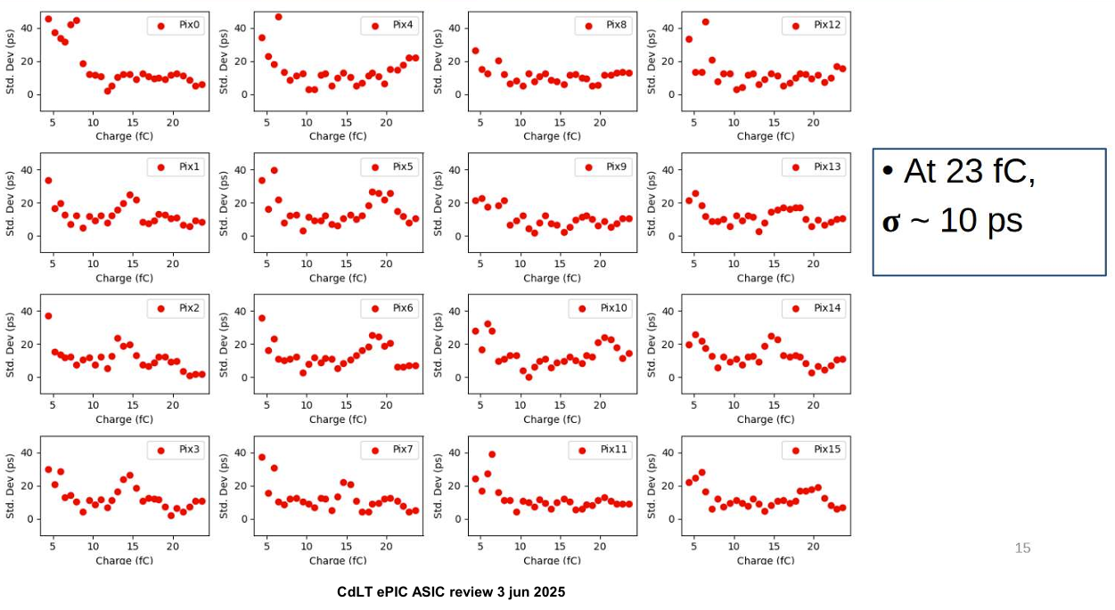
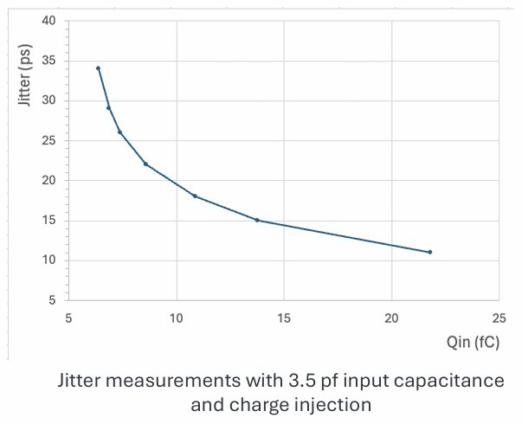
Parameters for TOF ASICS
EICROC
FCFD
At 20 fC,
$σ\sim 11$ps
Digital Precision: 12b / 25ns = 6 ps
Digital Precision: 10b / 25ns = 25 ps

Slide 13
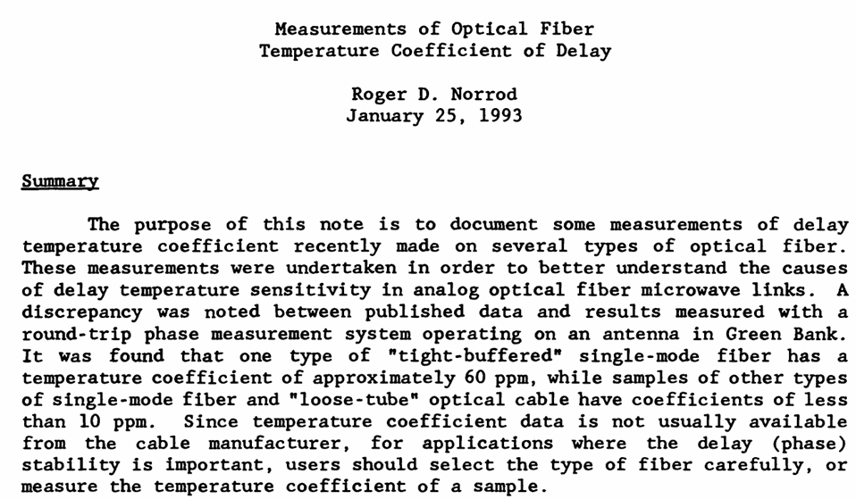
Fiber speed of light depends upon temperature
C_fiber = $\frac{2}{3}c+.04$ ps / (m degree C)
Delay for 100 m = -4 ps / degree C
Also need to test actual fiber chosen in Q/A plan

Slide 14
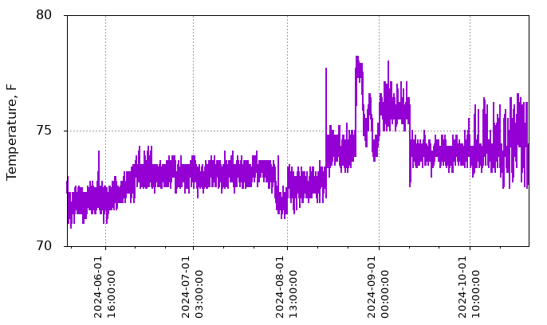
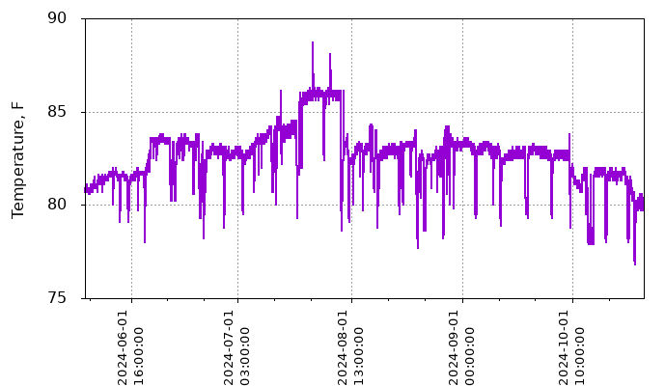
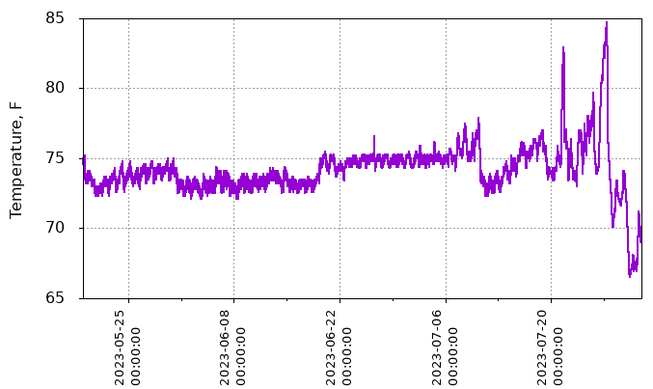
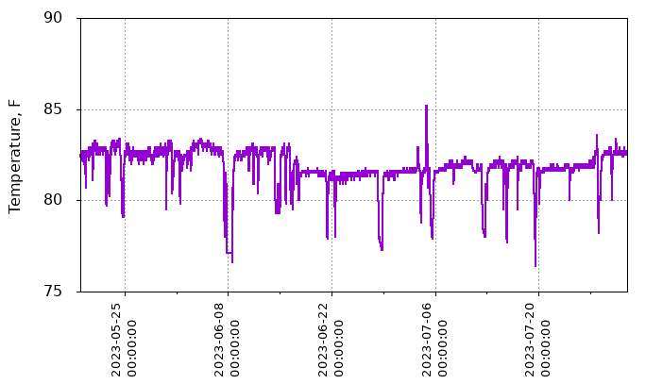
Historical Temperatures In IP-6
DAQ Room
Platform
2024
4 deg C
6 deg C
2023
10 deg C
4 deg C
16-40 ps fiber drift

Slide 15
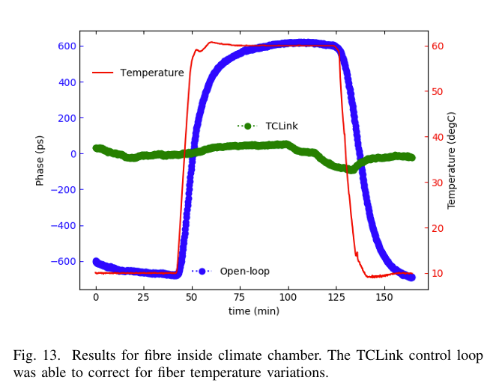
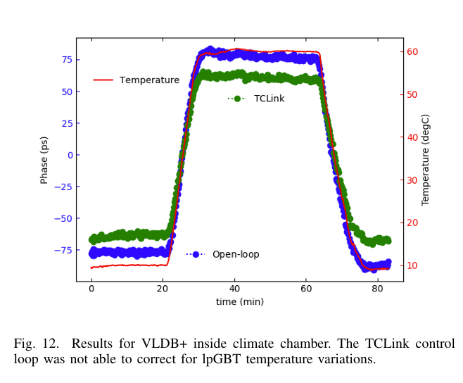
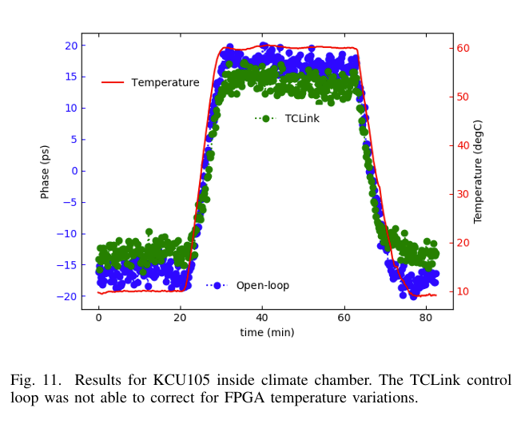
TcLink – Temperature Compensated Link
Compensate temperature using DDMTD (Digital Dual Mixer Time Difference) Algorithm
Uses Auxiliary Clock generated with MMCM (Mixed Mode Clock Manager)
Uses Phase shifter available in Xilinx Ultra-scale / Ultra-scale + FPGA
Fiber In Environmental Chamber
lpGBT in Environmental Chamber
FPGA in Environmental Chamber

Slide 16
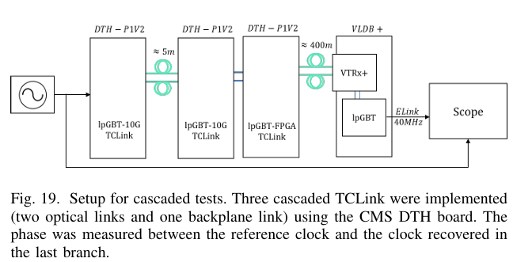
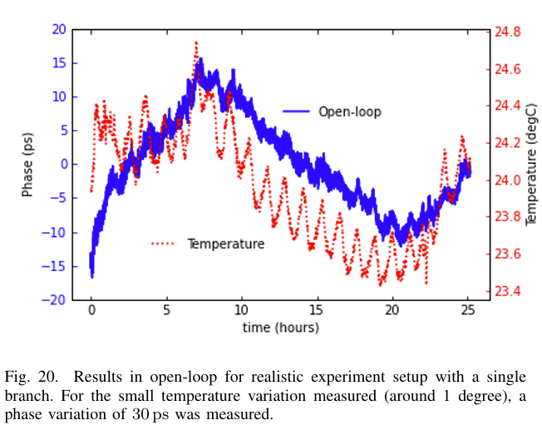
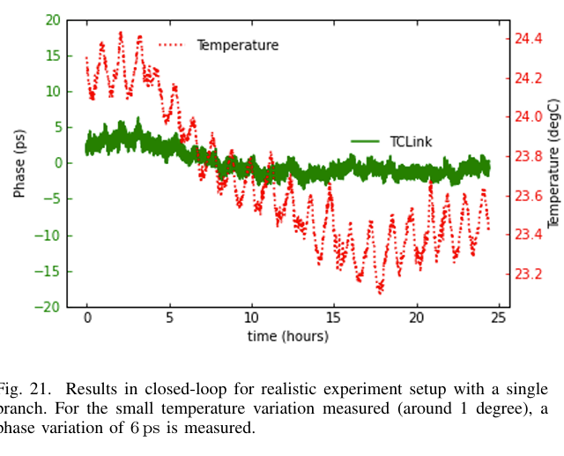
TcLink #2
Combining Last few Slides -
Reasonable assumptions about timing variations
lpGBT → 5 ps / degree C
FPGA → 1 ps / degree C
Fiber → 4 ps / (100 m degree C)
Fiber part can be reduced by x6-10 by implementing TcLink

Slide 17
Delivered clock from collider
P-DET-COMP.19: The DAQ system will require interfaces to the accelerator which provide timing data exchange. The clock delivered to DAQ will have jitter <= 8ps. The clock delivered to DAQ will have a constant offset to the RF clock stable to <= 8 ps.
The controls group is in at a similar point regarding the RF clock delivery. They are also considering a temperature compensation scheme to reduce the temperature variations.
The problem there is complicated by the longer fibers
Electron RF in IP10 – fiber length ~ 1300 m
Hadron RF in IP4 – fiber length ~ 650 m
One potential resource is the BPM’s which get induced charge from the beam passing through the beam pipe. These are located on either side of the detector (mounted in the B0 magnet structure on the east, and near the bellows on the west.)
How we might use these signals is less clear – devise a T0 detector interacting with the TOF detectors? Measure the times and assume the fiber is following similar paths? There is no scope/P6 activities currently associated with making use of this information.

Slide 18
T0 variations of the collision relative to RF clock
T. Satogata, 2022
Brian Page, 2022
If you measure the z-vertex you can constrain the T0. T0 resolution ~ 20-30 ps

Slide 19
“Reasonable Estimates of full time resolution”
Feature | pfRICH (ps) | Barrel TOF (ps) | Forward TOF (ps) | Notes
Sensor | 40 | 35 | 20
ASIC Analog | 11 | 11 | 10 | Large Hits
ASIC Digital Precision | 25 | 25 | 6 | Modifiable?
Fiber Delay | 24 | 24 | 24 | Assume 6 deg C
lpGBT | 30 | 30 | 30 | Assume 6 deg C
RDO | 6 | 6 | 6 | FPGA
DAM | 6 | 6 | 6 | FPGA
GTU | 6 | 6 | 6 | FPGA
Delivered Clock | 24 | 24 | 24* | Assume partial Tc
Collision T0 | 25 | 25 | 25 | 20-30 ps
Total | 71 | 69 | 58 | Dumb Quadrature

Slide 20
Summary
The DAQ should provide a high quality clock to all detectors with jitter < 8ps.
If the delivered clock must also be depended on to deliver phase with long term stability then temperature effects must be included. In this case, time resolution of the TOF detectors is significantly higher than the sensor resolution.
Further mitigations are possible including:
Temperature compensation on fiber links
Verification of interface requirement of Common Platform phase delivery
Strong requirements on temperature ranges for detector & and surrounding areas
The gains here are limited because of features that have no direct mitigation
If better resolutions are necessary need additional plans to define T0 offsets
Design method to make use of induced signal from the BPMs
Calibration of phase drift from measured detector data

