Slide 1
Overview of Jefferson Laboratory S&T
David J. Dean, Deputy Director for Science and Technology
Presented To:
ePIC and EIC UG meeting
July 14, 2025

Slide 2
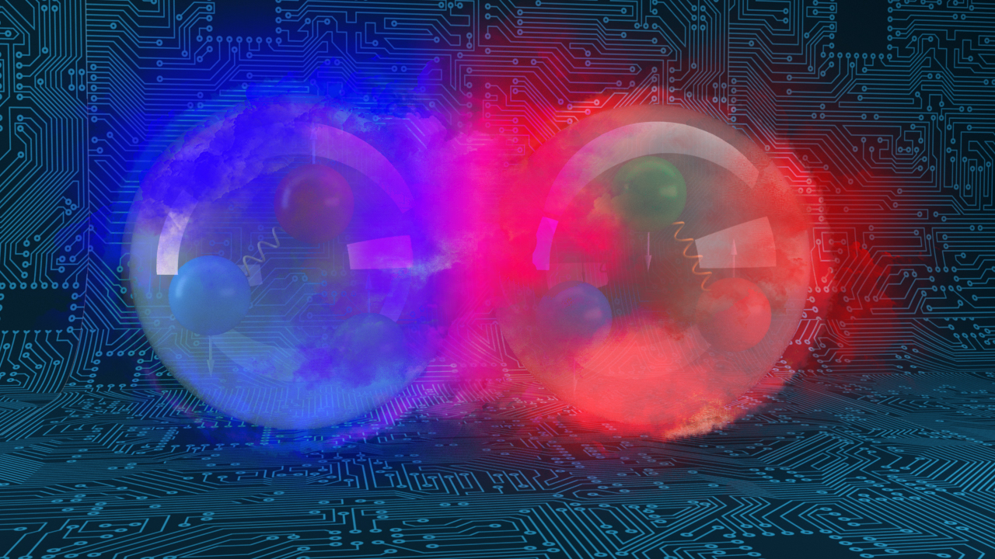
Outline…
The Vision and high-level science
CEBAF now and into the future
HPDF and EIC

Slide 3
Jefferson Lab’s Science and Technology Vision The future S&T Vision builds upon our present strengths, founded on four pillars:
Nuclear Physics at CEBAF
Electron-Ion Collider Partnership
Data and Computational Science, and HPDF
Innovative Accelerator Science and Technology
User Community
Partnerships and collaborations are imperative to achieve our vision​

Slide 4
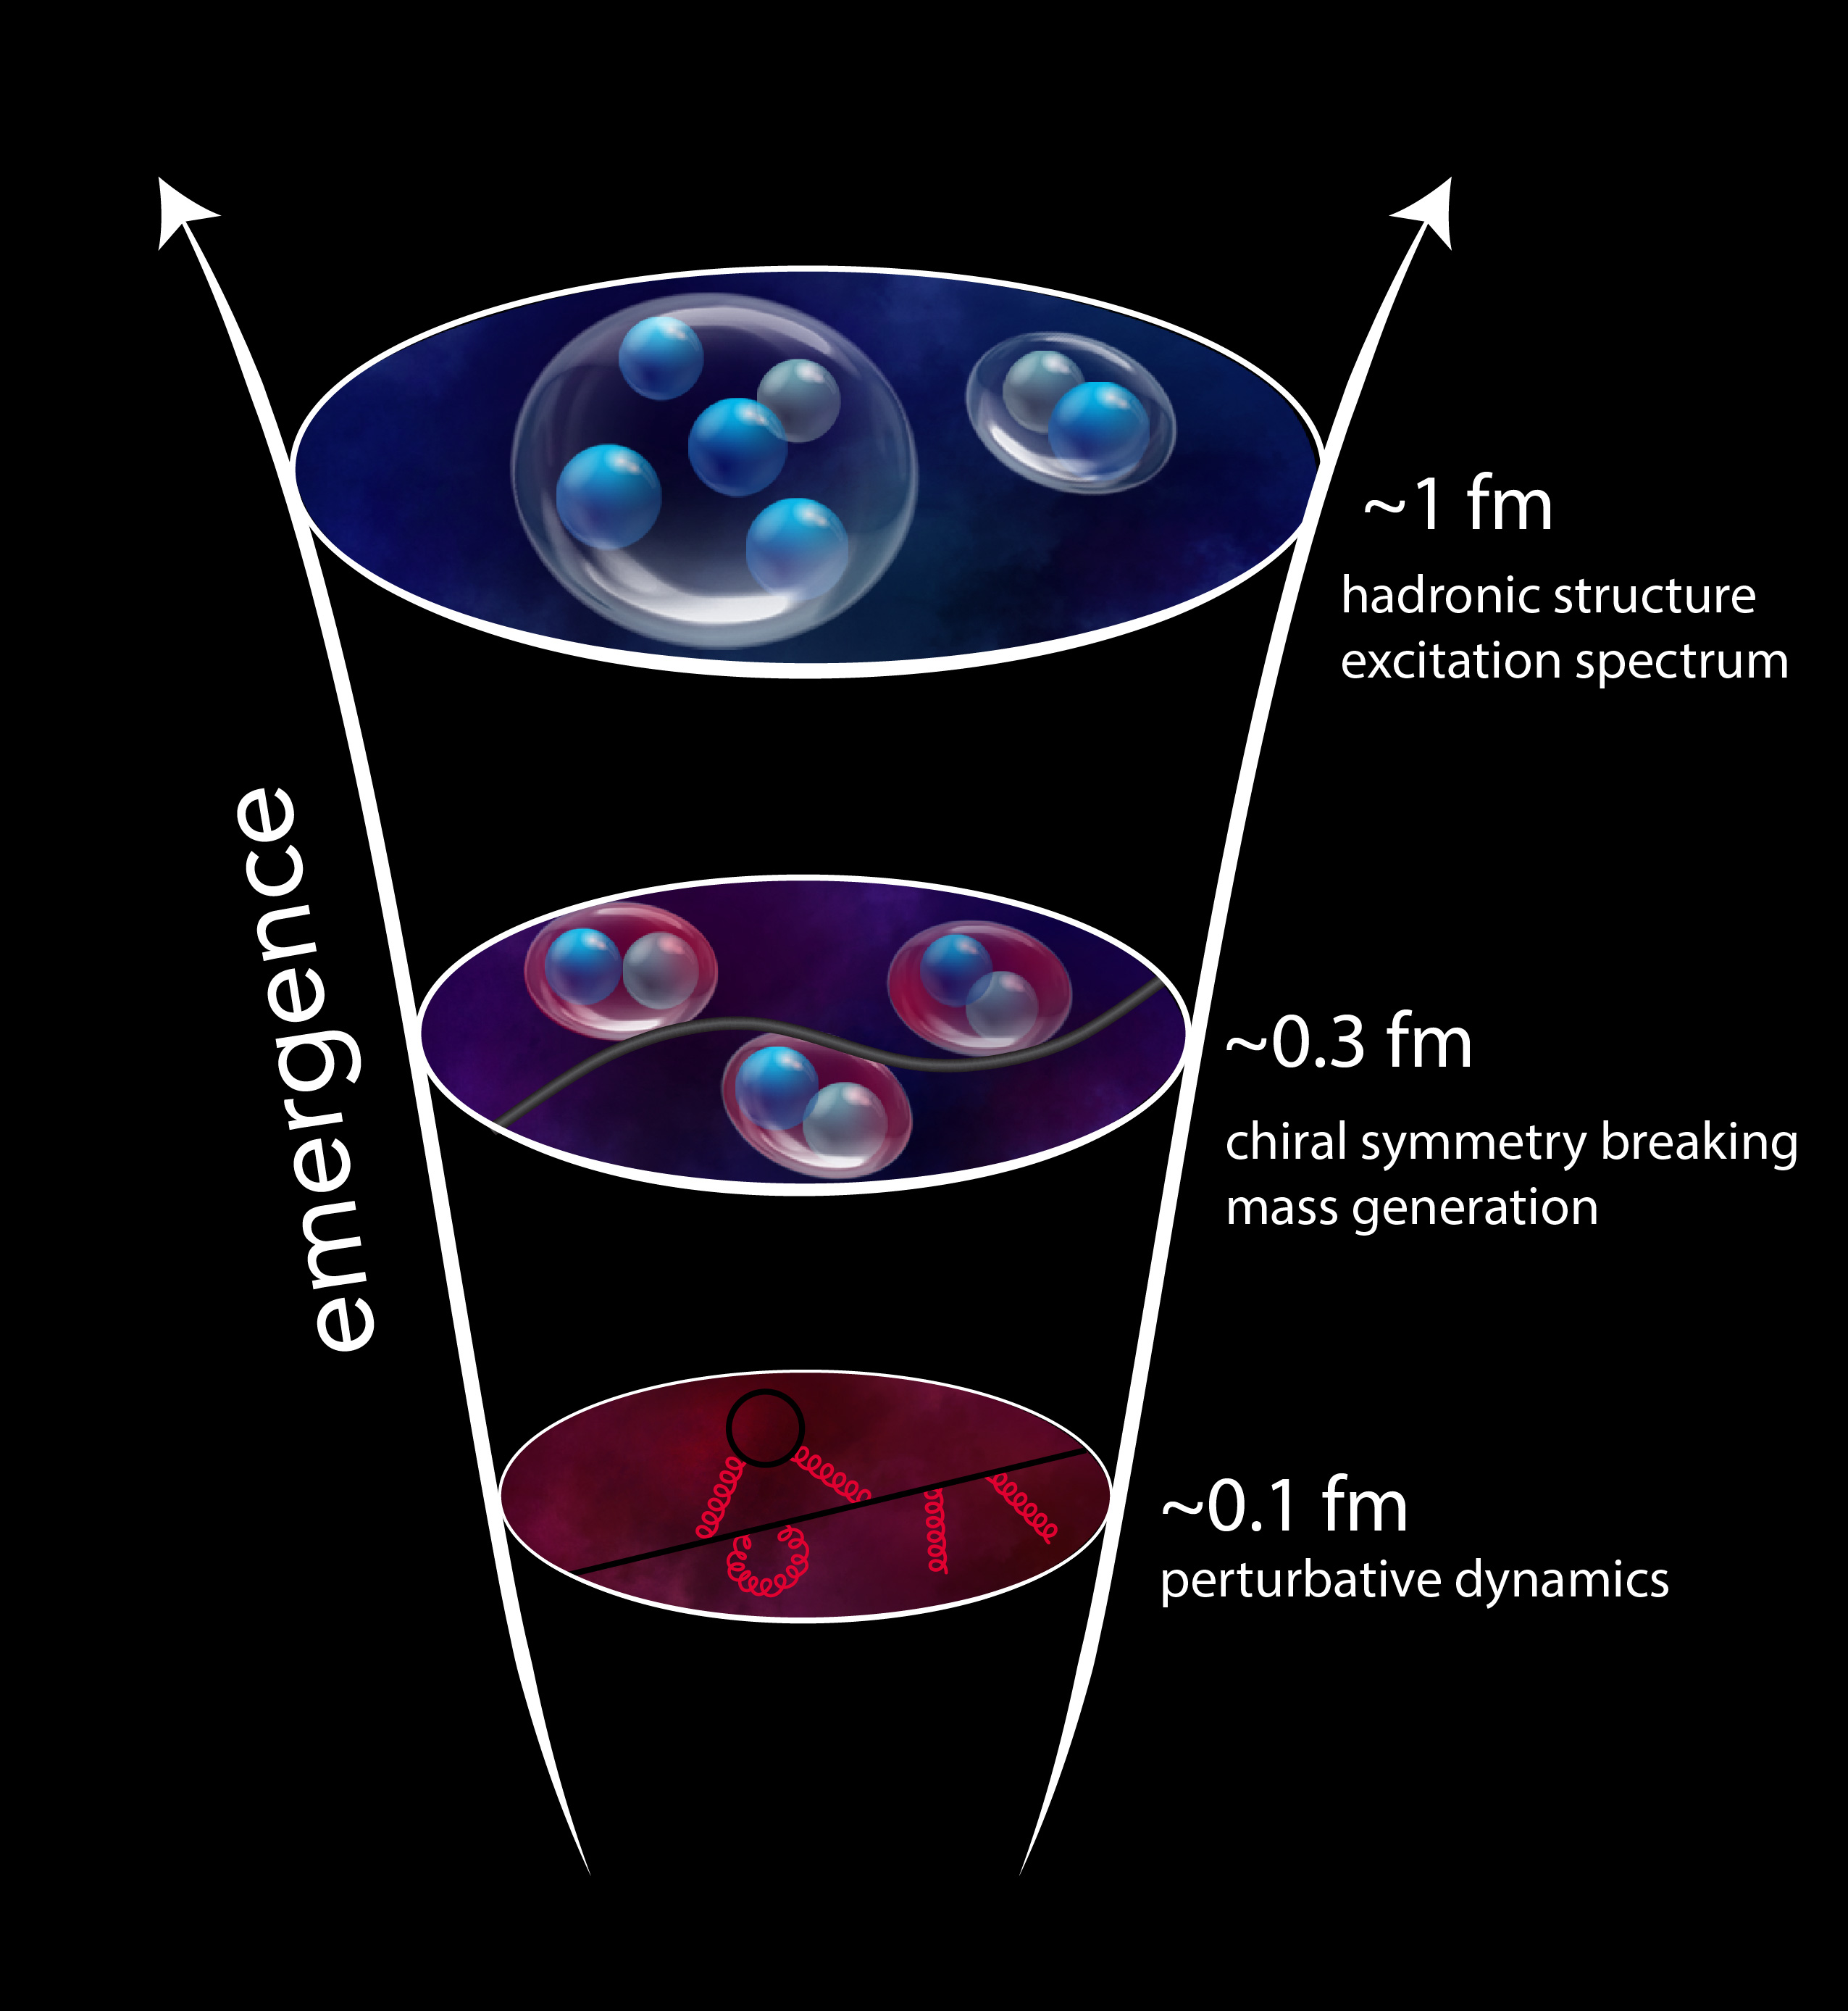
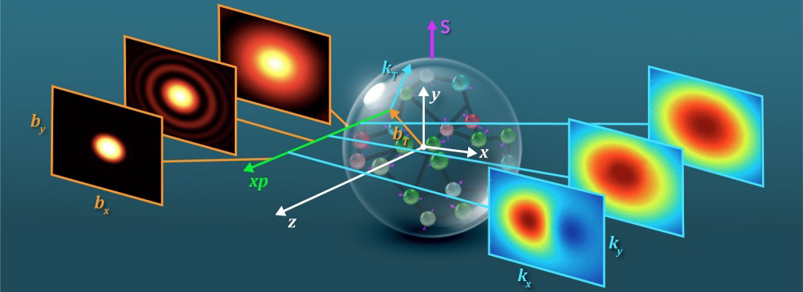
QCD Describes Quark Gluon Interactions
Position
Momentum
Direction of Proton
How do quarks and gluons make up protons, neutrons, and, ultimately, atomic nuclei?
The ability to reduce everything to simple fundamental laws does not imply the ability to start from those laws and reconstruct the universe. -- More is different, P. W. Anderson [Sci 177, 393 (1972)]

Slide 5
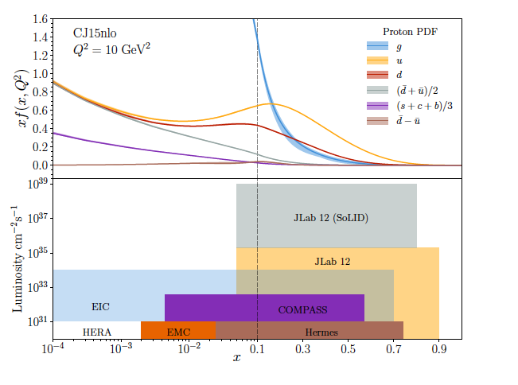
CEBAF probes nucleon valence structure at unparalleled luminosity
Electrons are a ‘pure’ probe
Partonic structure in the valence region defines the hadron baryon number, charge, flavor content, total spin,…
How does this happen? What is the mechanism? Are there thresholds?
At CEBAF energies, we probe nucleon structure in the non-perturbative regime
Large x, low Q2 evolves to low x, high Q2 via pQCD, extract PDF shape and strength from data
Precision measurements (2D,3D) in the valence regime require high luminosity, and are the unique purview of JLab, providing overlap with EIC into the low x region
Fraction of nucleon momentum
Physics with CEBAF at 12 GeV and Future Opportunities
Prog. Part. Nucl. Phys. 127 (2022) 103985

Slide 6
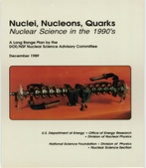
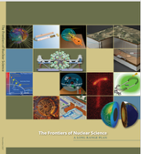
DOE/NSF Long Range Plans set the NP community direction
Since 1979 the Department of Energy Office of Science and the National Science Foundation periodically have charged the Nuclear Science Advisory Committee, NSAC, to provide a framework for coordinated advancement of the Nation’s nuclear science research program
A consistent strategic plan for investments was developed
NSAC engaged the community though town meetings organized by the Division of Nuclear Physics of the American Physical Society
The future CEBAF shows up in the very first plan. EIC appears first in at least 2002.
1979
1983
1989
1996
2002
2007
2015
2023

Slide 7
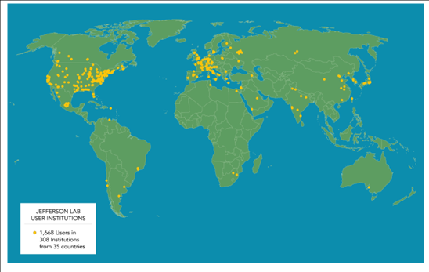
A Vibrant international community performs R&D at CEBAF
Examples:
CLAS12 incorporates substantial equipment from Italian (RICH), and French (ALERT) and other institutions
Moller: CFI funds for detector systems
RIKEN Hall C hypernuclear experiments (building 2 spectrometers next year) that can be done only at JLab
BDX (dark matter experiment) being pursued by members of INFN
With respect to Accelerator S&T, JLAB’s expertise in SRF will be in demand for any future large project in CERN (such as Higgs Factory, e.g. FCC-ee) and of course EIC

Slide 8
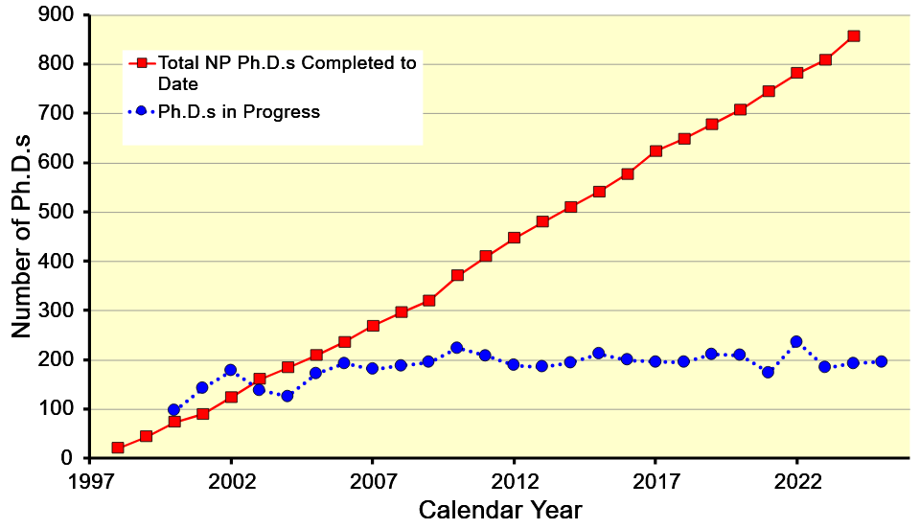
CEBAF consistently contributes to 1/3 of all Nuclear Physics PhDs in the US

Slide 9
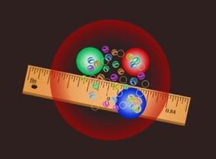
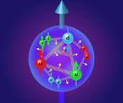
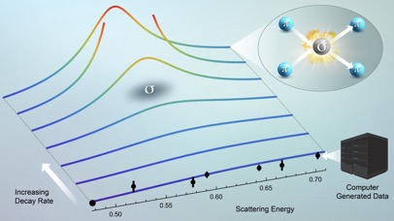
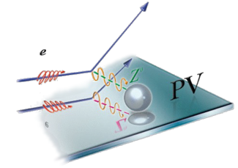
We investigate nuclear forces to answer questions
How big is the proton?
How are quarks distributed in the proton?
What is the spectrum of excited hadrons?
What is the evidence for physics beyond the standard model?

Slide 10
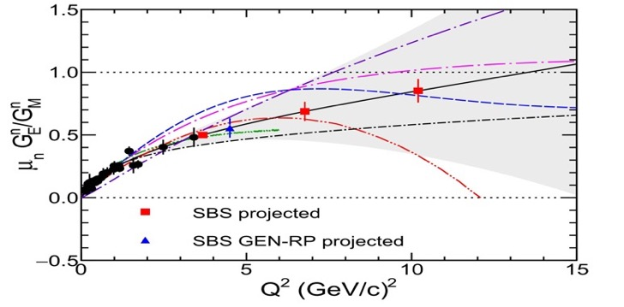
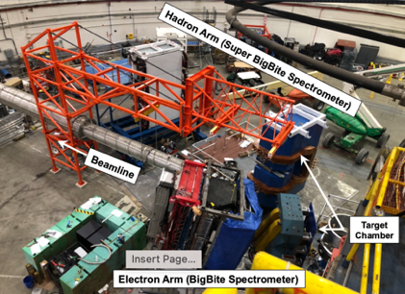
Nuclear Physics Questions: ‘How big is the proton?’
Electric and magnetic form factor measurements give distribution of charges and currents inside the proton.
Differing approaches to QCD inspired calculations predict different behavior at high momentum transfer Q
Form factors at highest Q² measured to date
Years of effort to build the spectrometer and targets
Largest GEMs in the world running at 10 MHz/cm2
Highest figure-of-merit optically pumped 3He target ever deployed
The SBS form factor program is high priority and is the last one in Hall A before MOLLER Installation

Slide 11
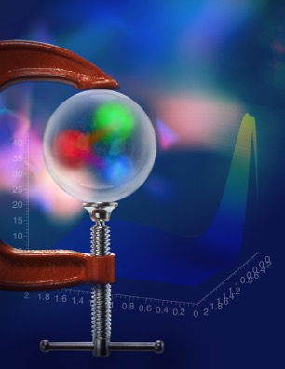
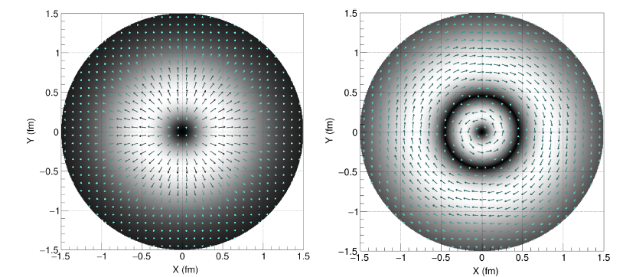
Nuclear Physics Questions: What are the mechanical properties of the proton?
Burkert, et al., Colloquium: Gravitational form factors of the proton. Reviews of Modern Physics 95, 041002 (2023)
Similar gluonic force distributions, obtained from J/ψ → μ+μ− photo production,
and comparisons to L-QCD nearly ready for submission to PRL (Joosten et al., J/ψ-007 Collaboration)

Slide 12
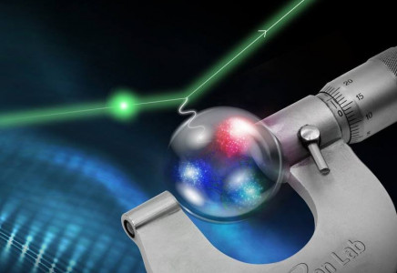
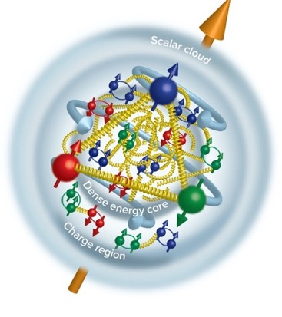
Nuclear Physics Questions: ‘How big is the proton?’
Proton Radius Measurements: 0.831+/-0.014 fm, Xiong et al.,Nature 575, 147 (2019)
Duran et al “Determining the gluonic gravitational form factors of the proton," Duran et al, Nature 615, 813 (2023)
‘Inner gluon Rms’: 0.52 +/-0.03 fm
Future ‘PRad-II’ experiment will yield a 2.5x more precision: confirm the smaller radius

Slide 13
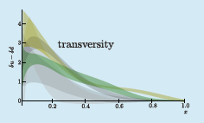
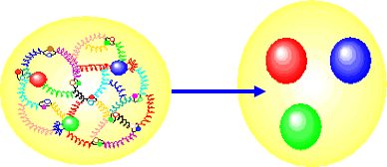
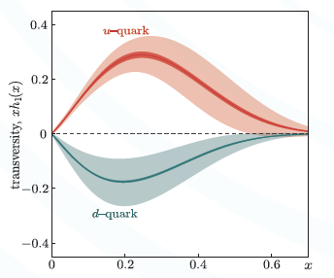
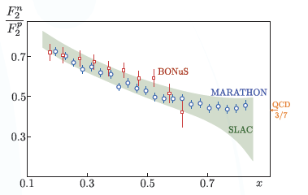
Nuclear Physics Questions: ‘How are quarks distributed in the proton?’
3D
2D
Example of a SoLID SIDIS measurement: huge error improvement (TMD)
High luminosity is critical to measure the typically small cross sections at large x (2D), and to isolate individual kinematic dependencies (3D)
Phys. Rev. Lett. 128, 132003 (2022)

Slide 14
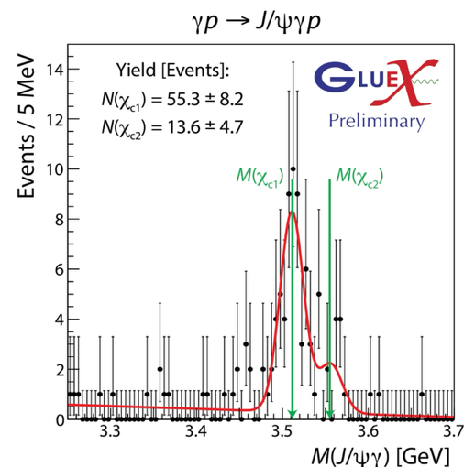
Nuclear Physics Questions: What is the Spectrum of excited hadrons? Charmonium production in Hall D
Foundation for the future GlueX-III program.
Production of $J/ψ$ has implications on proton structure and existence of pentaquarks
Two GlueX publications with $≈300$ total citations
Next publications – analysis in progress
First measurement of the photoproduction cross section of $χ_{c1}$ and $χ_{c2}$ (based on existing data through 2020)
Upper limit on production of open charm $\overline{D^{(∗)}}Λ_{c}$ to constrain production models and validate proton structure interpretation
The plan for GlueX-III
200 days approved by PAC 52 with “A” scientific rating
Large sample of polarized $J/ψ$ to understand production mechanisms and validate data interpretations

Slide 15
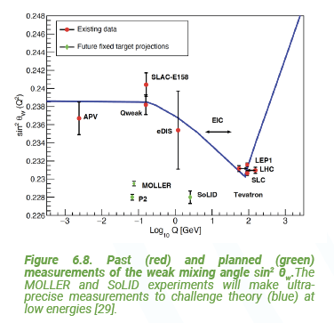
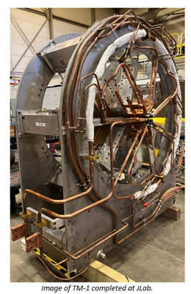
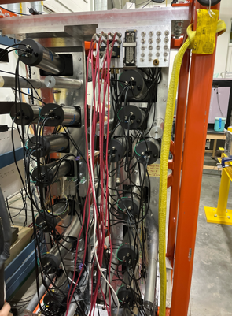
Nuclear Physics Questions: What is the evidence for physics beyond the Standard Model?
MOLLER probes BSM in the multi TeV range through Parity Violation
Construction and assembly continues

Slide 16
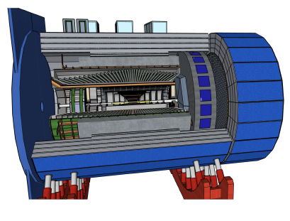
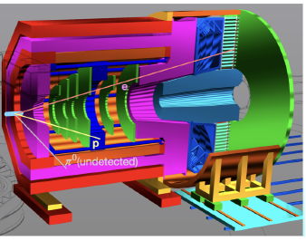
SoLID and ePIC
~8 m
9.5 m
SoLID: A large acceptance device which can handle very high luminosity to allow full exploitation of JLab12 potential. Rich science program and great training opportunity as ePIC develops.
ePIC – comprehensive measurement of particles produced in ep or eA collisions. Advanced planning, significant international involvement, exciting times.

Slide 18
The High Performance Data Facility will support data lifecycle management
Refine
User Facilities
Science Gateways
Raw & Derived Data
Publish
Fulfill FAIR principles for scientific data
Share
Hub
Release
Acquire and Prepare
Ingest experimental, observational and reprocessed data using standard APIs
ESnet
Preserve
Long-term data curation and archiving
Tiered Storage
Analyze
Transfer
Move and manage data and dynamic data streams
Part of SC’s Integrated Research Infrastructure
Clean and Process
Scalable scientific and AI/ML workflows
Compute
The HPDF Hub is a cutting-edge high-performance data platform that provides advanced storage, processing, and analytical services, empowering data-intensive research and AI-driven discoveries.

Slide 19
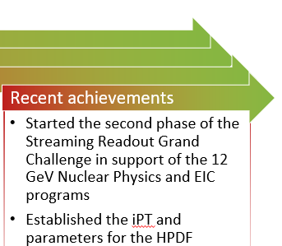
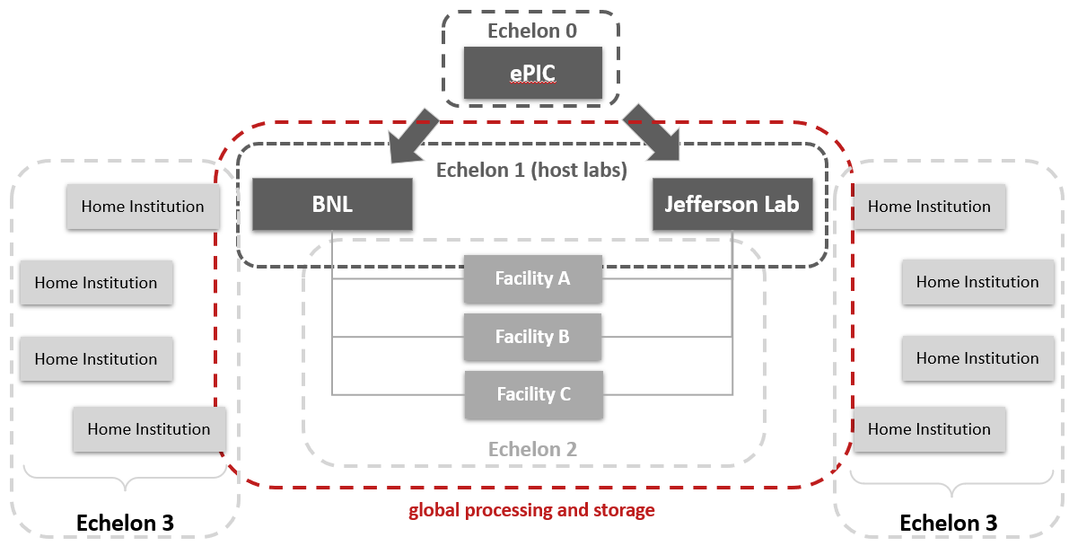
Advancing Scientific Analysis Group – Computing Synergy
JLab will pursue AI-empowered near-real time analysis of EIC science with an emphasis on 3D imaging and understanding emergent mass and structure.
The Jefferson Lab 12-GeV science is the place to start.
Jefferson Lab leads the computing and software efforts in EIC.
Natural synergy with streaming readout grand challenge, SciDAC project on 3D imaging, and HPDF.
From Annual Lab Plan slide on “Deploy HPDF and Develop an Associated R&D Program”
Adapted from the “The ePIC Streaming Computing Model” and the 3rd ePIC computing & software review
From QUAntum chromodynamics Nuclear TOMography (QuantOm) Collaboration web pages at ANL
The EIC Computing and Software are unique in a number of important respects: globally distributed computing, streaming computing model, two host Labs are symmetric peers for post-echelon-0 processing.
Notes:
Guidelines: 6-8 bullets per slide; Use sentence fragments for bullets

Slide 20
Discussion

