Slide 1
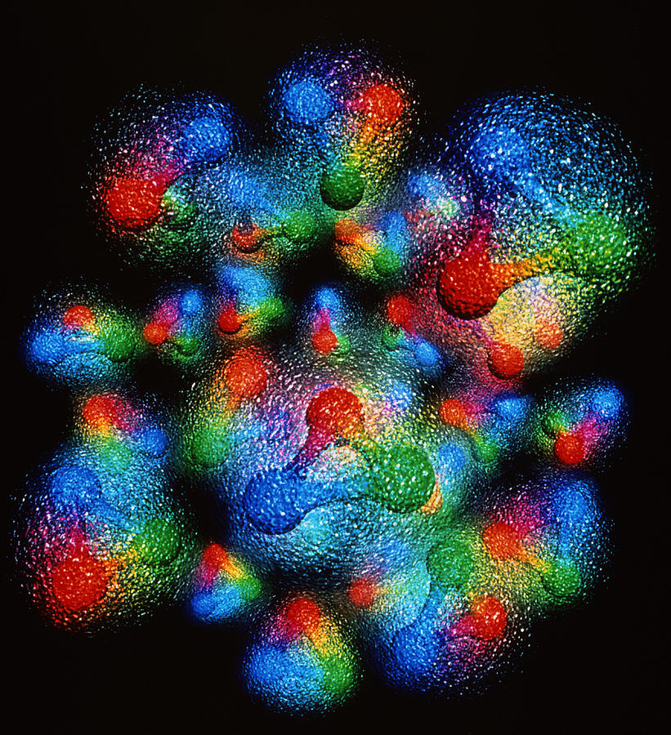




What physical information is in deeply virtual exclusive experiments and how do we take a snapshot of the proton?
Simonetta Liuti
Notes:
EIC have templates for that
UQ pointing at where to measure at EIC
Digital twins and lattice
Example: molecular dynamics, diffusion model, build the whole dynamics in ns, surrogate of very costly project. GiaWei: accuracy issue? For both stages: lattice configurations and correlators
Prasanna: when to use surrogate models, build cheaper yet accurate
Self-learning MC and non-abelian theory, like surrogate model
Kyle Cranmer P. Shanahan et al., Nature review paper,
Pseudo data + data based anaysis
Put in lattice component on digital twins at the observable level not gauge configurations, End-to-End: big survey of all GPD calculations from parameters to observables
Ensemble based analysis

Slide 2



UVA sub-group
Douglas Q. Adams
Saraswati Pandey
Zaki Panjsheeri
Adil Khawaja

Slide 3
Outline
Introduction
    theoretical background and physics information
    can GPDs be observed?
Maximum Likelihood Analysis and Bayesian Analysis
Quantitative extraction Compton Form Factors from DVCS
Outlook: what data should be added to reliably extract CFFs?
π⁰ electroproduction analysis
Conclusions

Slide 4
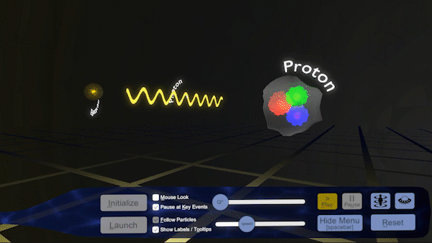
“The EIC will be a particle accelerator that collides electrons with protons and nuclei to produce snapshots of those particles’ internal structure—like a CT scanner for atoms. The electron beam will reveal the arrangement of the quarks and gluons that make up the protons and neutrons of nuclei.”
https://www.bnl.gov/eic/
But what is the science that goes into imaging the proton, observing its spatial structure at 10⁻¹⁵ m?

Slide 5

Physicists Loop
Experimental data
Suggest interpretation
Prediction/Analysis
Test
AI Model Learning and interpretation
From Standard Computational Paradigm ↓
Explainable AI-based Paradigm

Slide 6
Our Physics Case: Extracting information from exclusive deeply virtual scattering
Notes:
On the LHS is the Feynman diagram for the DVCS scattering process. The virtual photon q (along z in previous page) scatters off a quark coming out of the proton. The quark probability/QCD matrix element for finding a quark with given momentum and spin is represented by the “blob”.
On the RHS we integrate over the quark (loop) momentum, which by Fourier transformation corresponds to taking the two photon-quark scattering vertices at the same point in the conjugate space coordinate. This is represents the QCD matrix element for a local operator. It measures a moment in the momentum fraction x. Particularly interesting are the second moments, x \times GPD, because they coincide with the Eneregy Momentum tensor (EMT) form factors

Slide 7
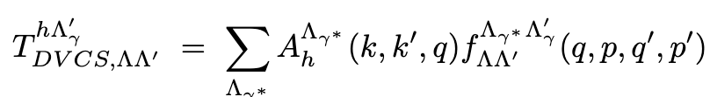
Deeply virtual Exclusive Scattering Experiments
At least one photon is hard
q, Λ_{γ∗}
q’, Λ_{γ’}
helicity amplitude
GPD
e γ∗ -> e’
γ∗ p -> γ’ p’
p, Λ
p’, Λ’
Jacob and Wick (1959)
Notes:
On the LHS is the Feynman diagram for the DVCS scattering process. The virtual photon q (along z in previous page) scatters off a quark coming out of the proton. The quark probability/QCD matrix element for finding a quark with given momentum and spin is represented by the “blob”.
On the RHS we integrate over the quark (loop) momentum, which by Fourier transformation corresponds to taking the two photon-quark scattering vertices at the same point in the conjugate space coordinate. This is represents the QCD matrix element for a local operator. It measures a moment in the momentum fraction x. Particularly interesting are the second moments, x \times GPD, because they coincide with the Eneregy Momentum tensor (EMT) form factors

Slide 8
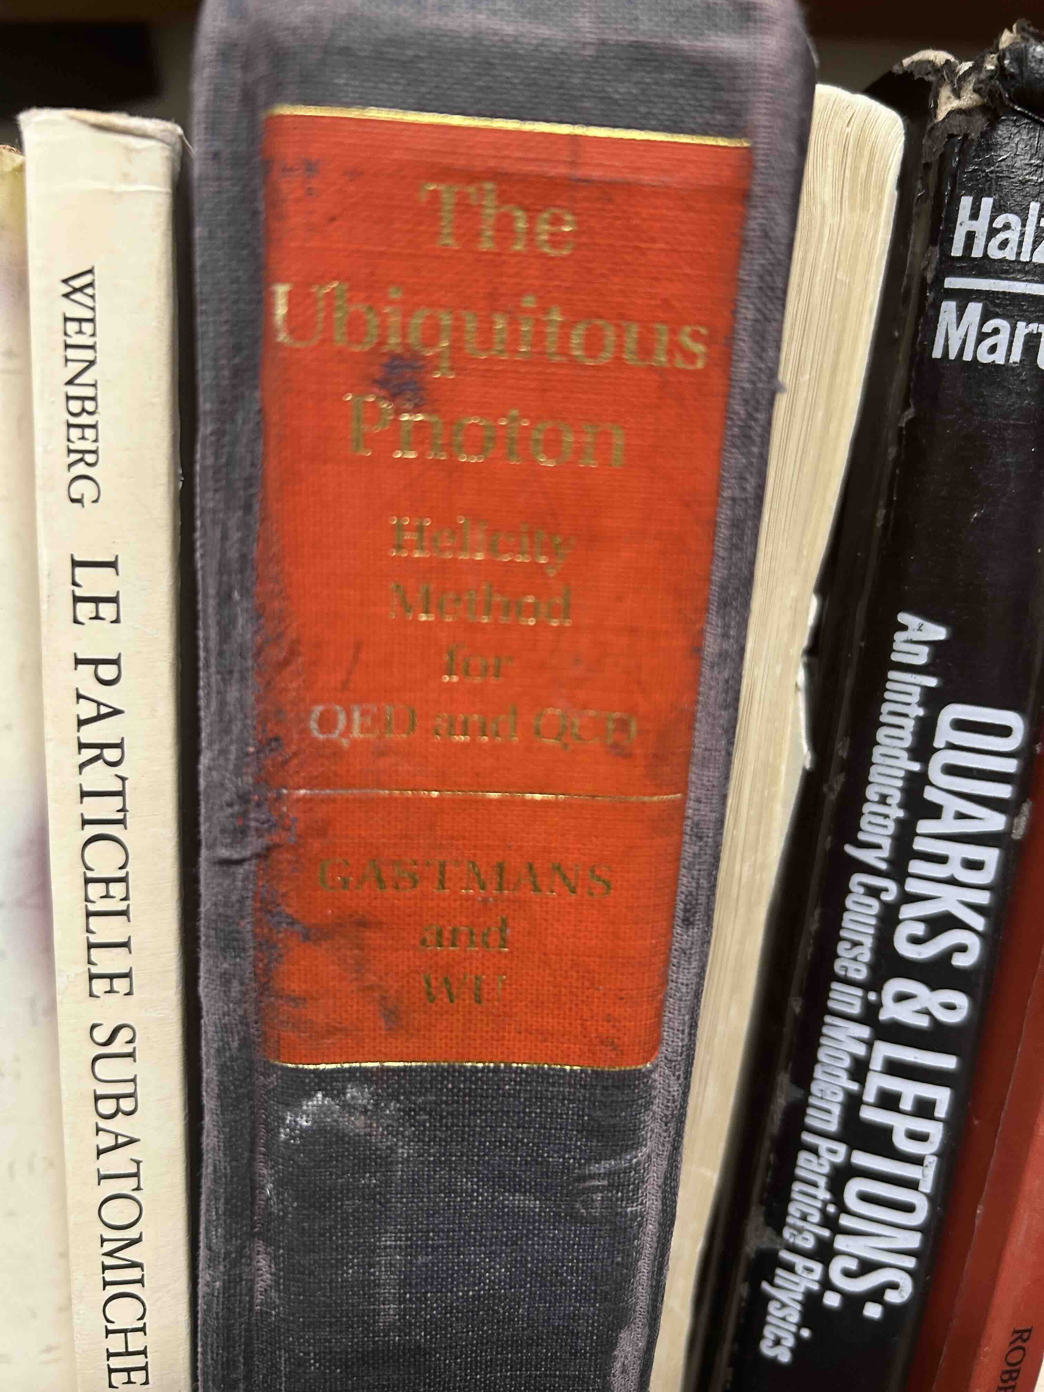
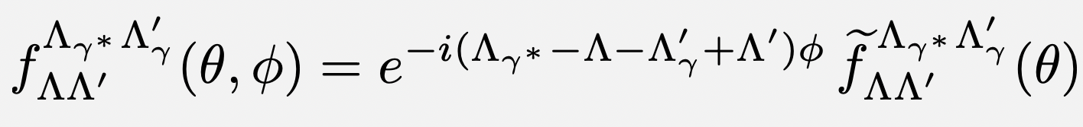
Role of phase ϕ
hadron plane
ϕ
two-body scattering in hadron plane
p’
q
p
q
γ∗
lepton plane
q’
Virtual photon phase not measured: this ambiguity generates the x-sec. phase dependence!
Gastmans and Wu (1982)

Slide 9
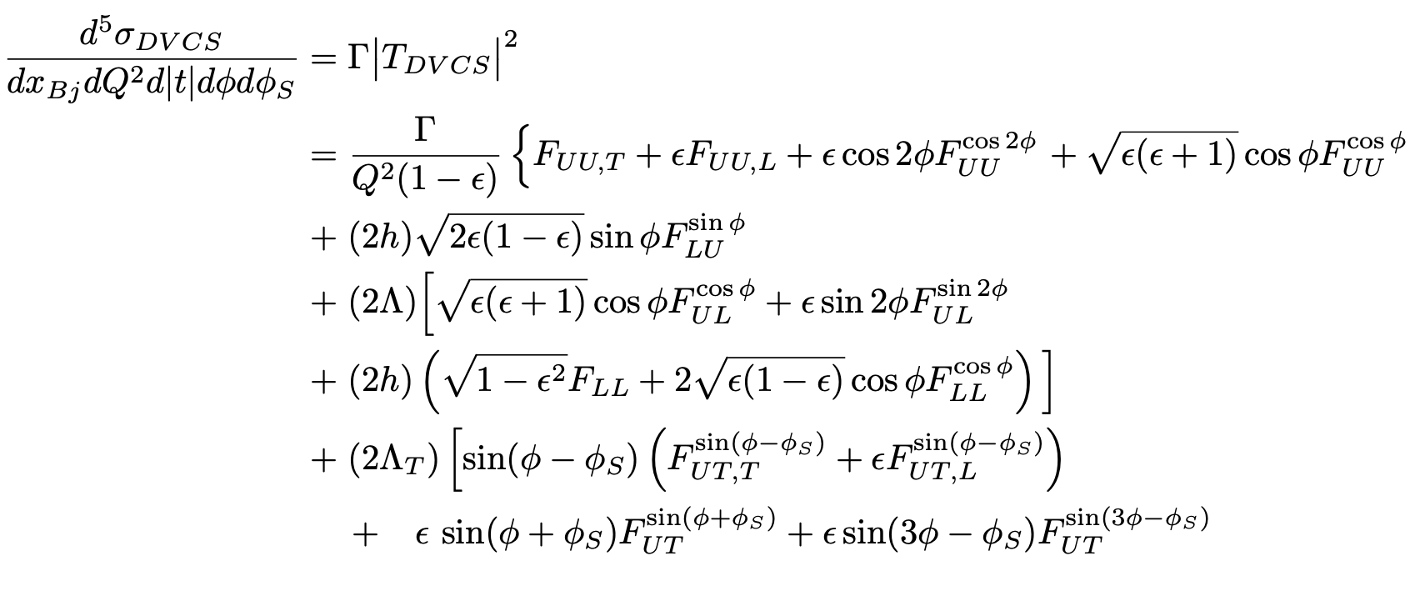
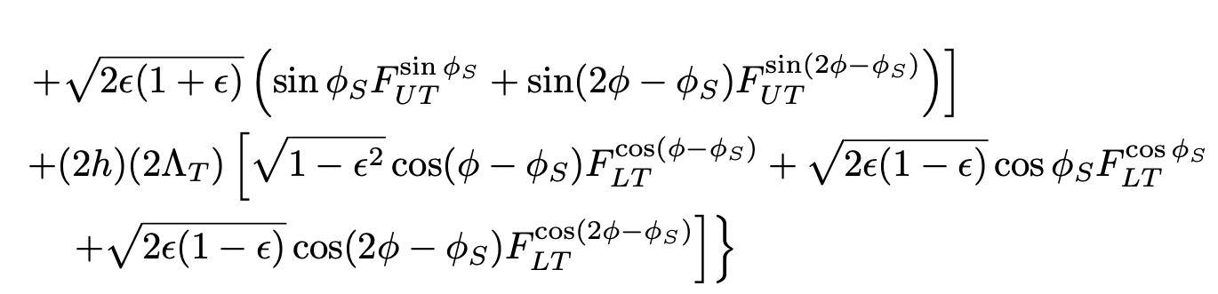
From Helicity Amplitudes to DVCS Cross Section
unpolarized
long. polarized
transv. polarized
B. Kriesten et al, Phys.Rev. D 101 (2020)
B. Kriesten and SL, Phys.Rev. D105 (2022), arXiv 2004.08890
B. Kriesten and SL, Phys. Lett. B829 (2022), arXiv:2011.04484
First inverse problem!

Slide 10

Assuming a QCD factorized scenario → CFFs → GPDs
Assume known from PQCD
Second Inverse Problem!

Slide 11
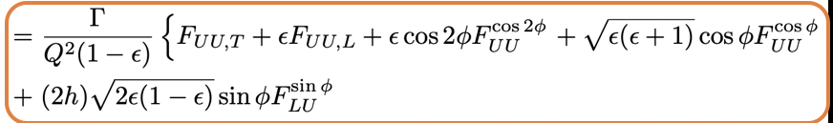
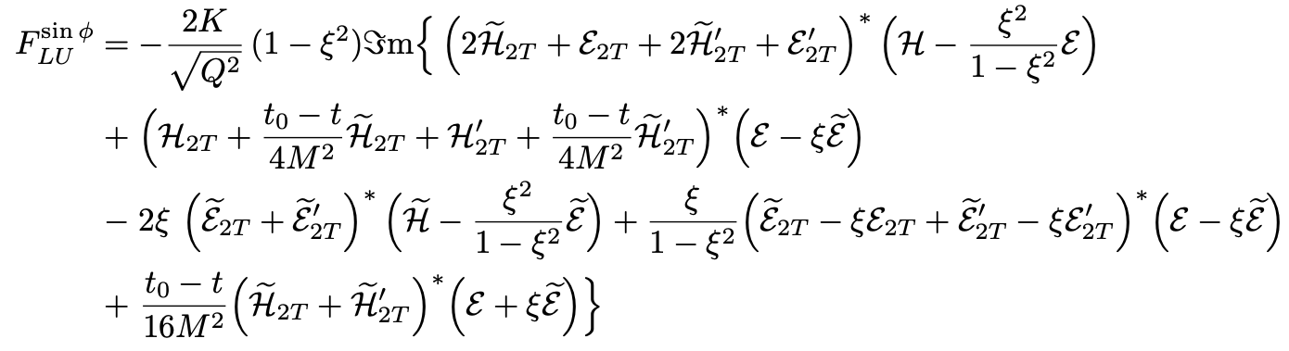
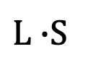
Example
Twist 3
Twist 2
Twist 3 GPDs
B. Kriesten and S. Liuti, Phys.Rev. D105 (2022)
GPD (Old)
“Cahn CFF”
OAM
$L∙$S
Transverse OAM
Transverse Spin
(*) T-odd

Slide 12
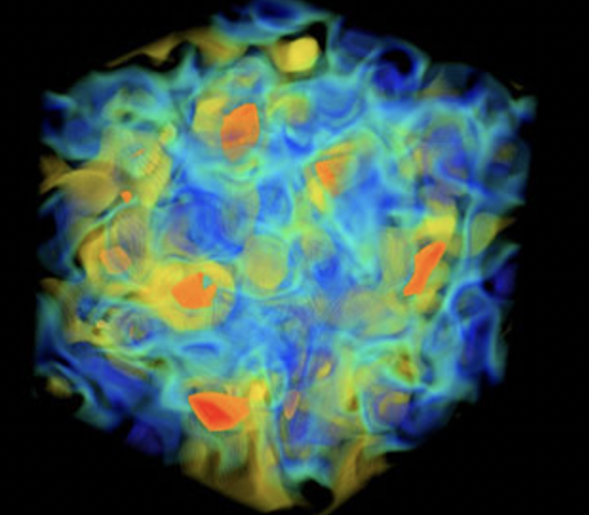
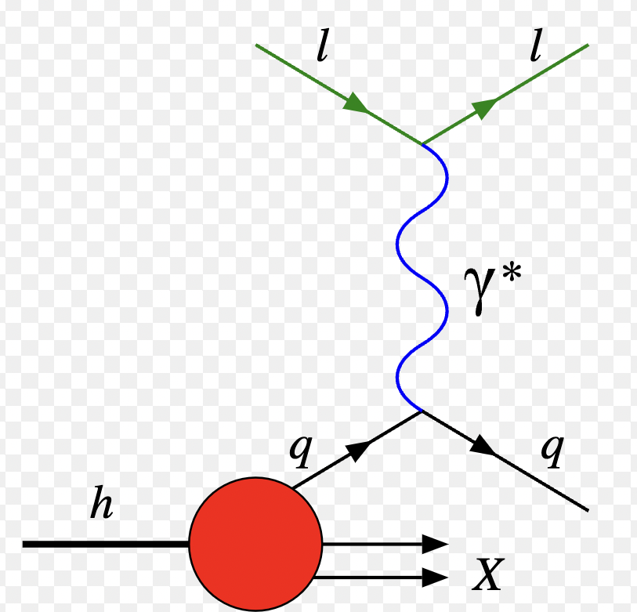
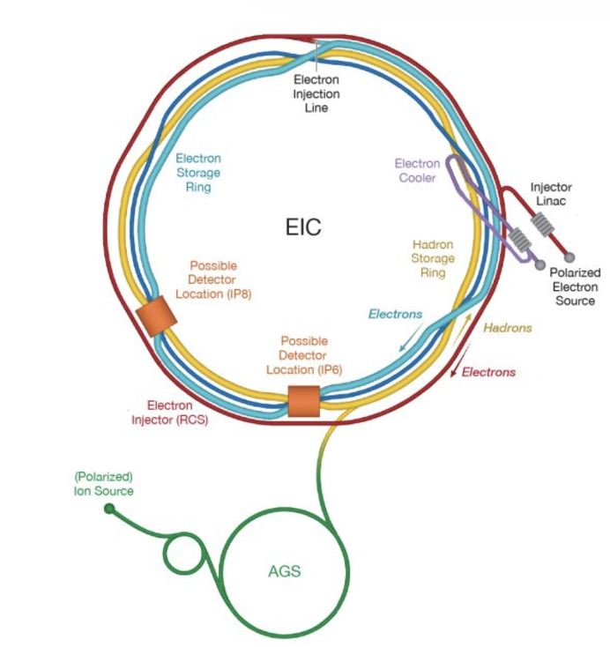
Forward Problem
QCD
  quark field
  gluon field
  correlation functions
Observables
  Form Factors
  Structure Functions
  Compton Form Factors
  Fragmentation functions
  …
Data/Measurements
Inverse Problem
Notes:
We want to merge ML and physics to use machines to generate interpretable understandable models which humans can understand, while solving inverse problems

Slide 13
Twist three GPD Physical interpretation at the core of spin puzzle
A. Rajan, M. Engelhardt and S. Liuti, Phys. Rev. D98, 074022 (2018)
A. Rajan, A. Courtoy, M. Engelhardt and S. Liuti, Phys. Rev. D94, 034041 (2016)
M. Rodekamp, M. Engelhardt, J.R. Green, S. Krieg, S. Liuti, S. Meinel, J.W. Negele, A. Pochinsky and S. Syritsyn, Phys. Rev. D 109, 074508 (2024)
*Twist 3 GPD notation from Meissner, Metz and Schlegel, JHEP(2009)

Slide 14
Transverse Angular Momentum Sum Rule
O. Alkassasbeh, M. Engelhardt, SL and A. Rajan,
https://arxiv.org/abs/2410.21604
Will we ever be able to test these relations?

Slide 15
Introducing Maximum Likelihood Analysis of deeply virtual exclusive scattering data
Douglas Adams et al., arXiv:2410.23469

Slide 16
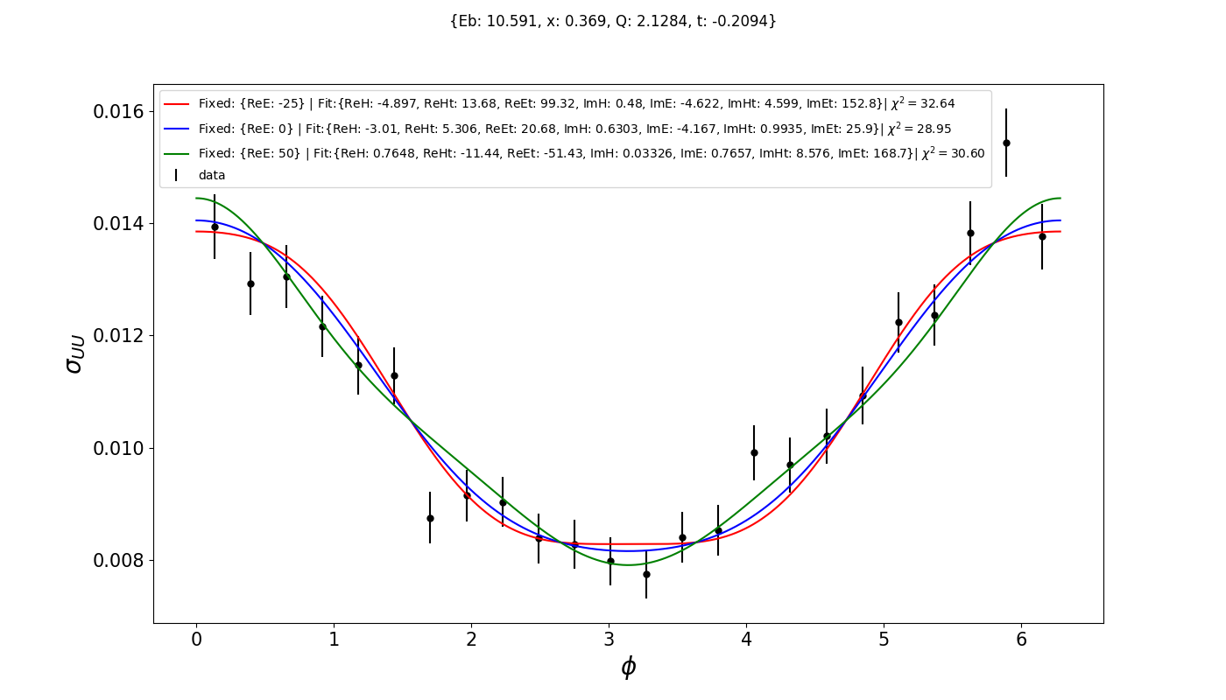
Performing CURVE FIT with “standard methods” results in degeneracy
The extracted CFFs are significantly sensitive to the way the fit is done!

Slide 17
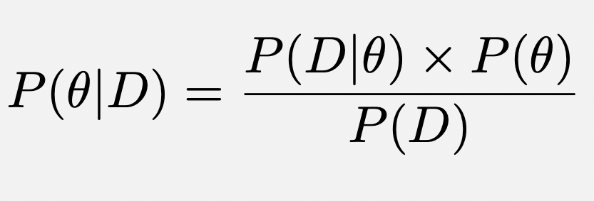
Working Framework: Bayesian statistical inference
parameters are determined from probability distribution functions (PDFs) that quantify the degree of uncertainty of our knowledge of those parameters
PDFs quantify the randomness inherent in a random variable and are in principle unknown but related to one another in a measurement process through Bayes theorem
Bayes theorem
Likelihood : PDF of Data given Model (parameters θ)
Prior: PDF of Model
Posterior : PDF of Model (parameters θ) given Data (D)
Evidence/Normalization: PDF of Data

Slide 18
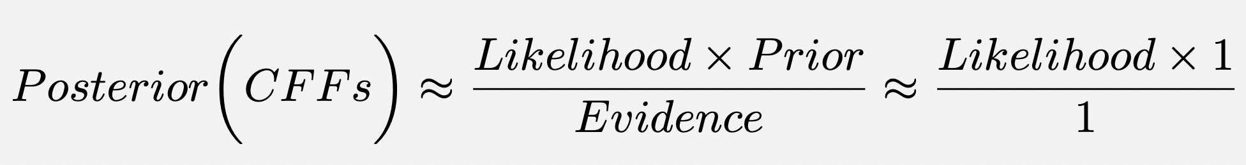
Uninformative prior

Slide 19


Evaluating Likelihood: MCMC/Metropolis Hasting Algorithm
To obtain the parameters=marginalize one needs a method to evaluate complicated integrals of PDFs
If the number of data is large then we can generate samples of the variable θ even if the probability function is unknown
For multi-dimensional problems this is best accomplished with Markov Chain MonteCarlo (MCMC) algorithm: allows to single out high probability regions by exploring the PDF through random walk, forming a Markov chain
Notes:
the values of the parameters only depend on the parameter that came before

Slide 20
Unpolarized DVCS Results: only three CFFs are not degenerate
DVCS-BH Interference term

Slide 21
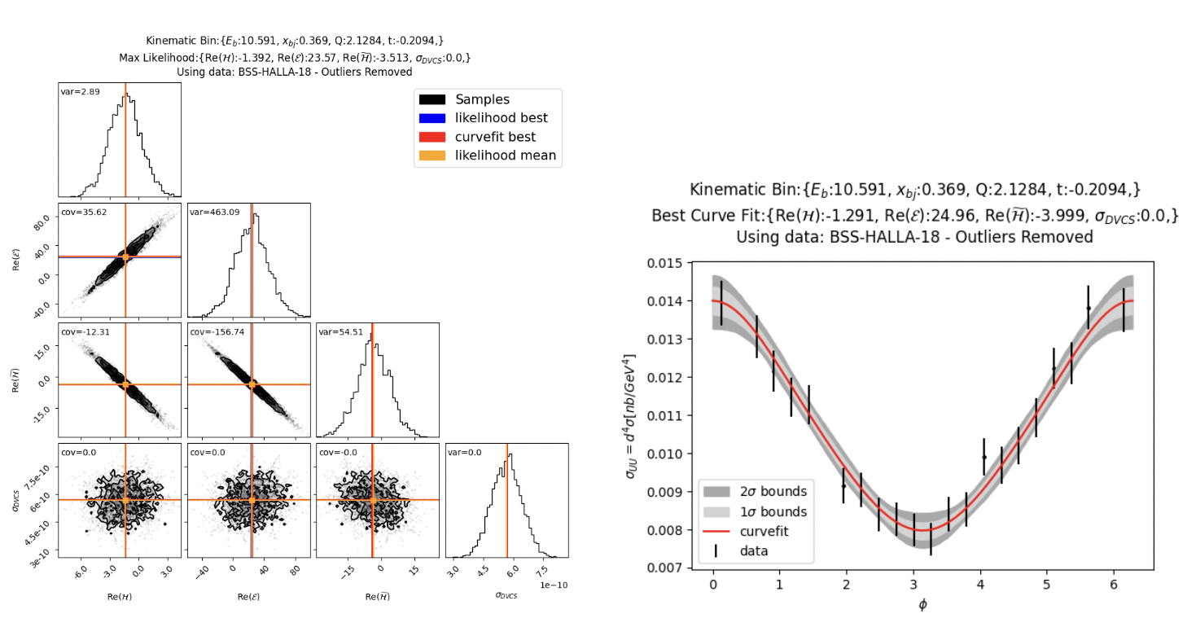
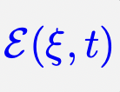
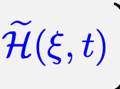
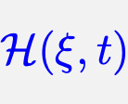
DVCS Results

Slide 22
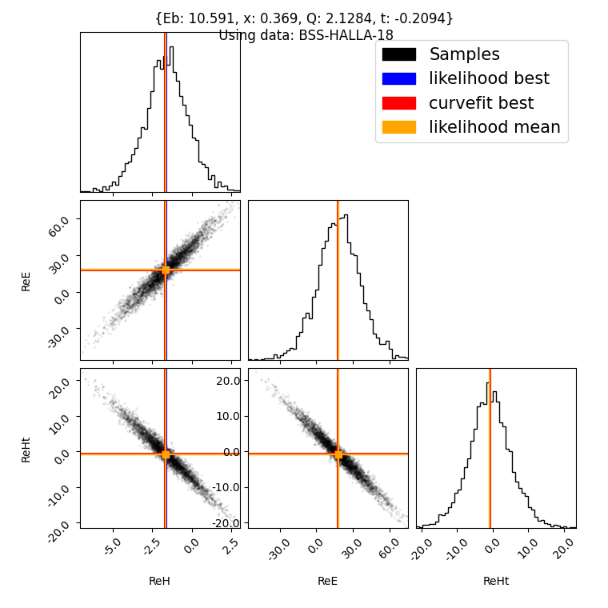
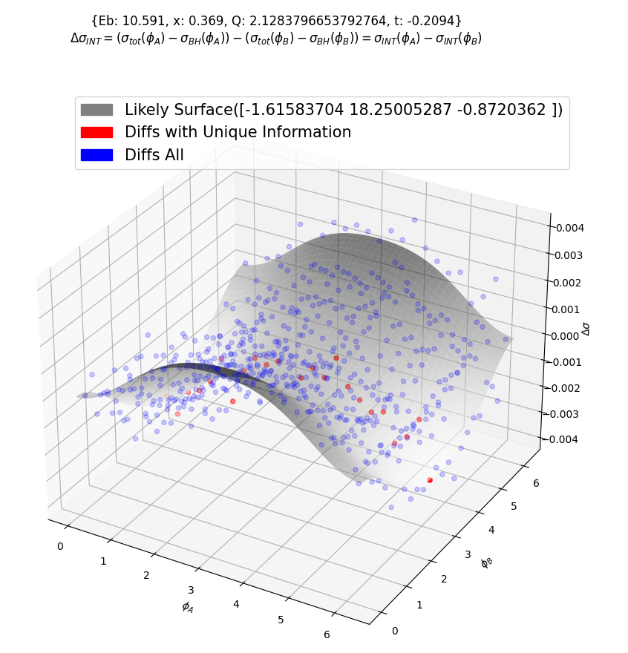
Covariance of CFF Results
Here the maximum likelihood is achieved allowing 3 CFFs to vary.
Only 23 combinations of 2 angles are used.
Notes:
Define Bayesian Likelihood

Slide 23
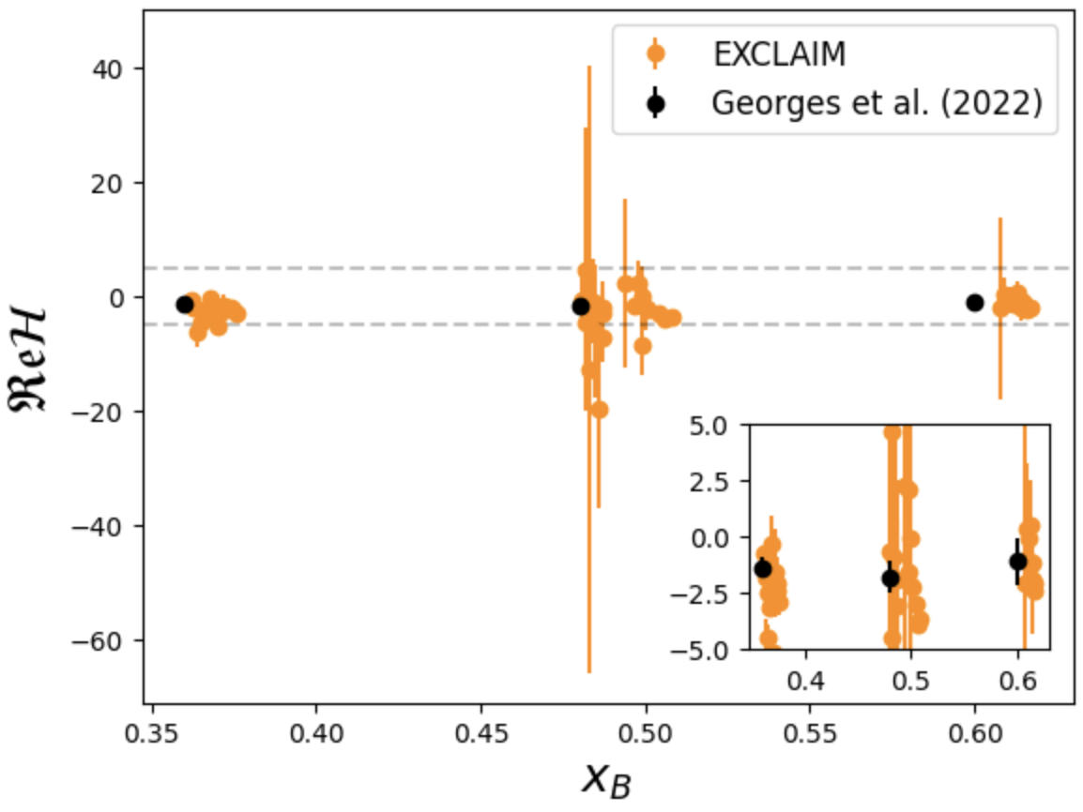
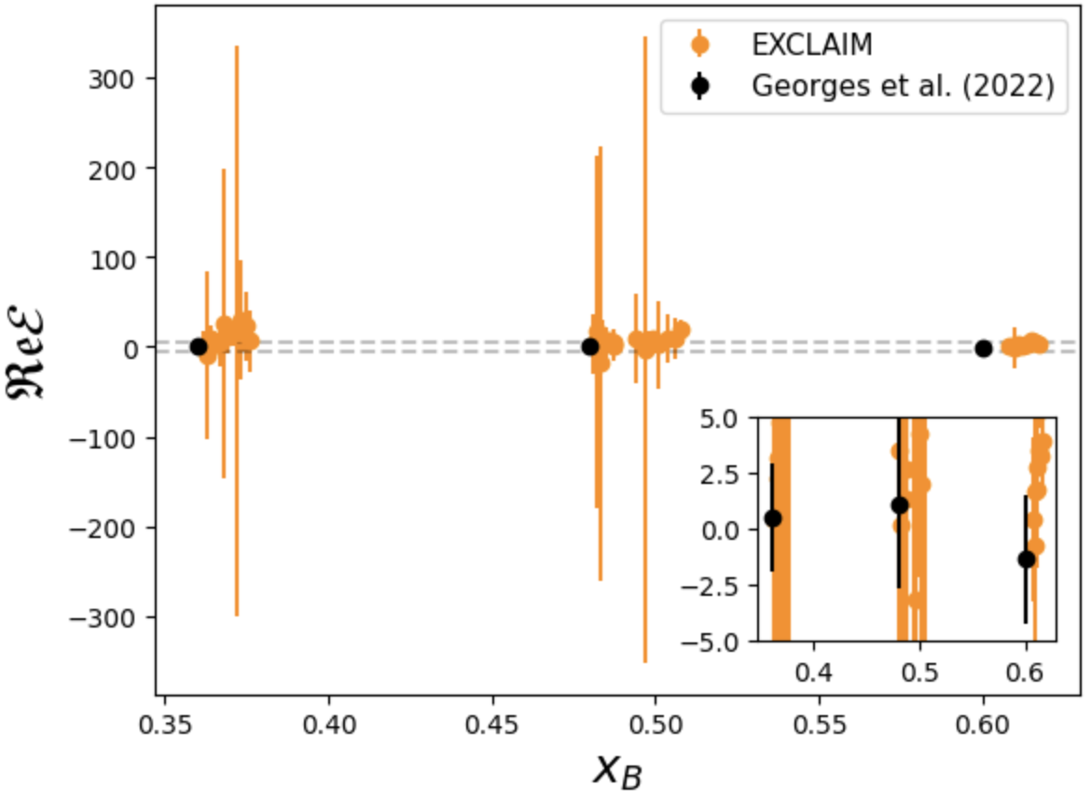
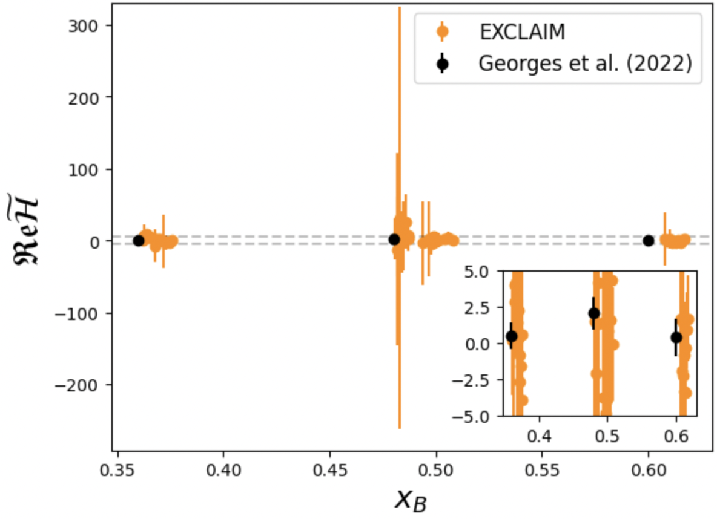
Marginal Posterior CFF Results
H
E
~
H

Slide 24
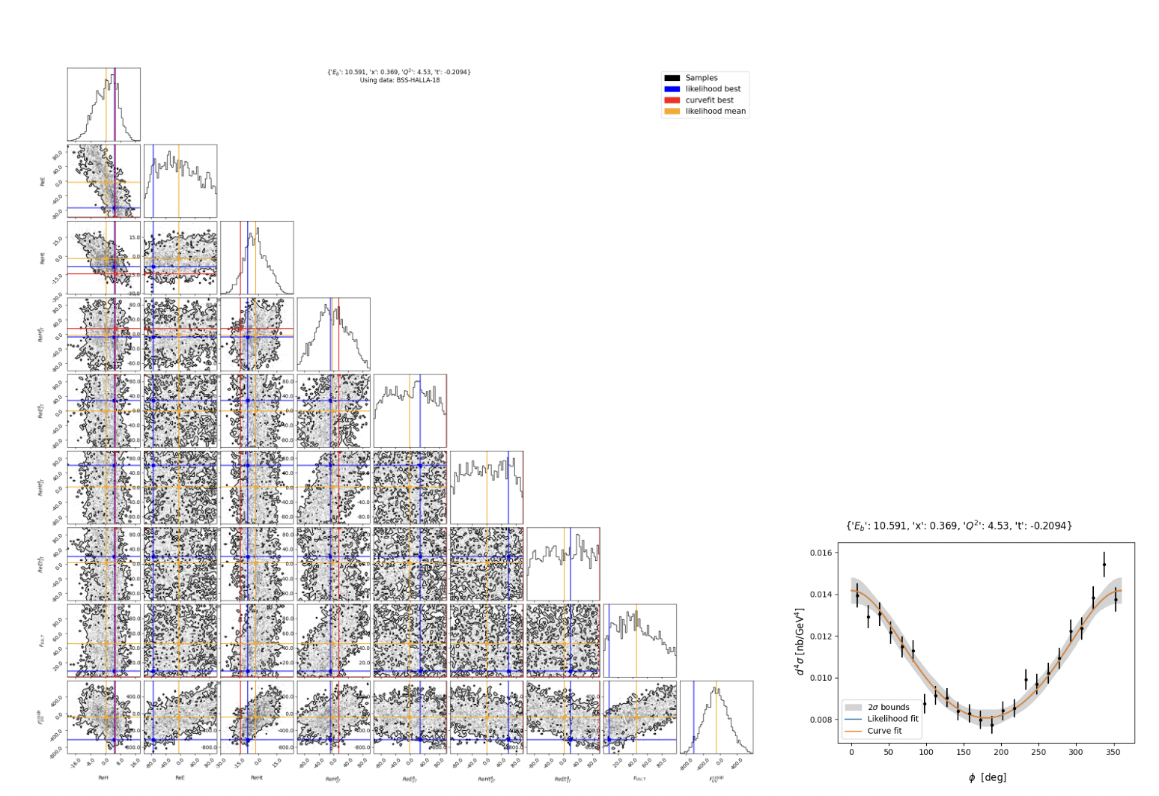
Twist 3

Slide 25
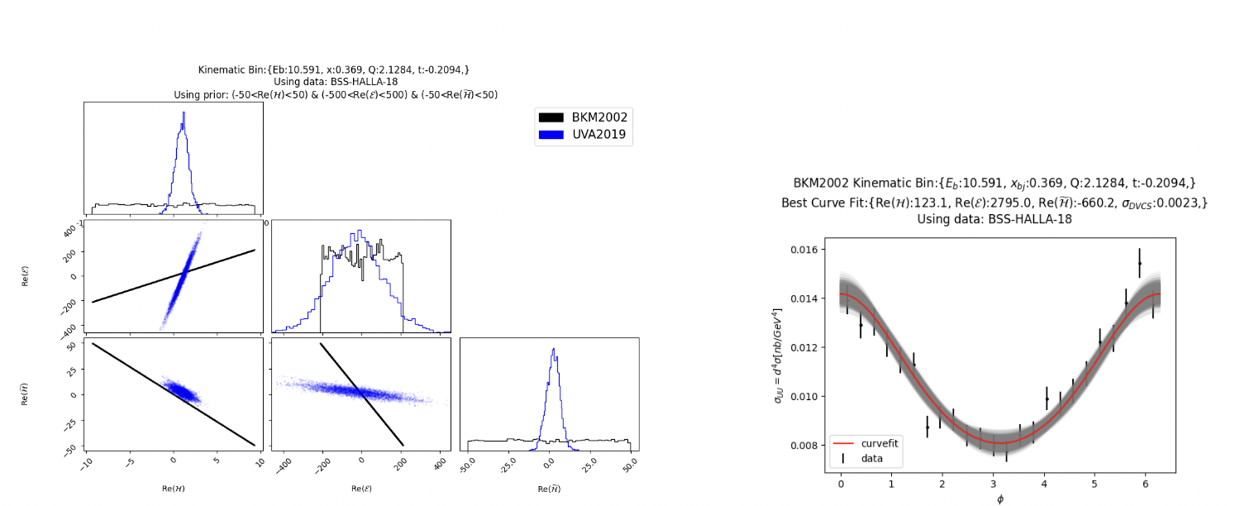
Comparison with harmonics formalism (BKM, Braun et al.)

Slide 26
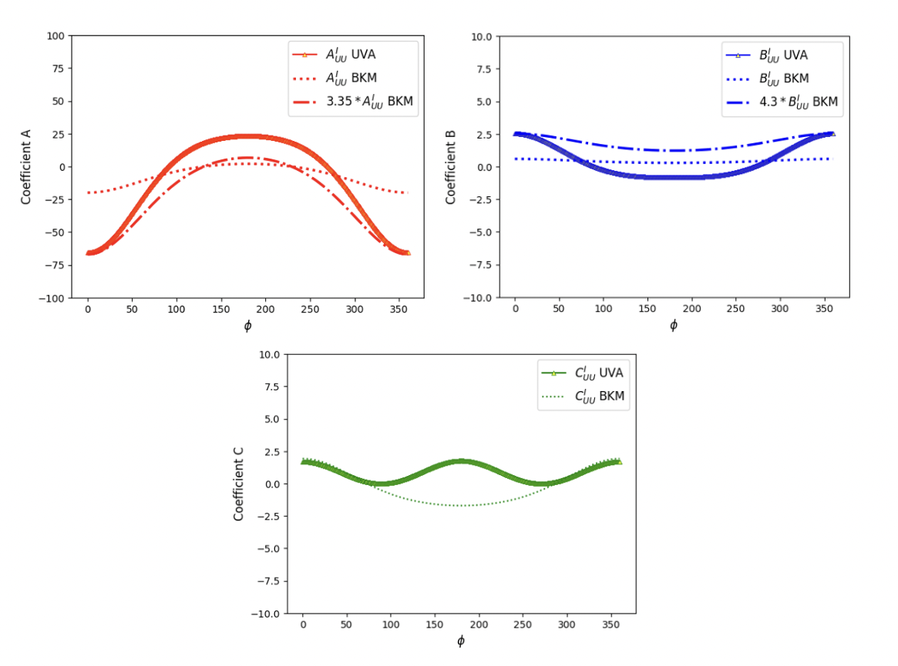
Understanding the origin of degeneracy of BKM results

Slide 27
What’s next?
LL type data: E.Seder et al. [CLAS], PRL114 (2015)

Slide 28
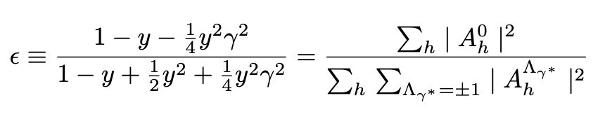
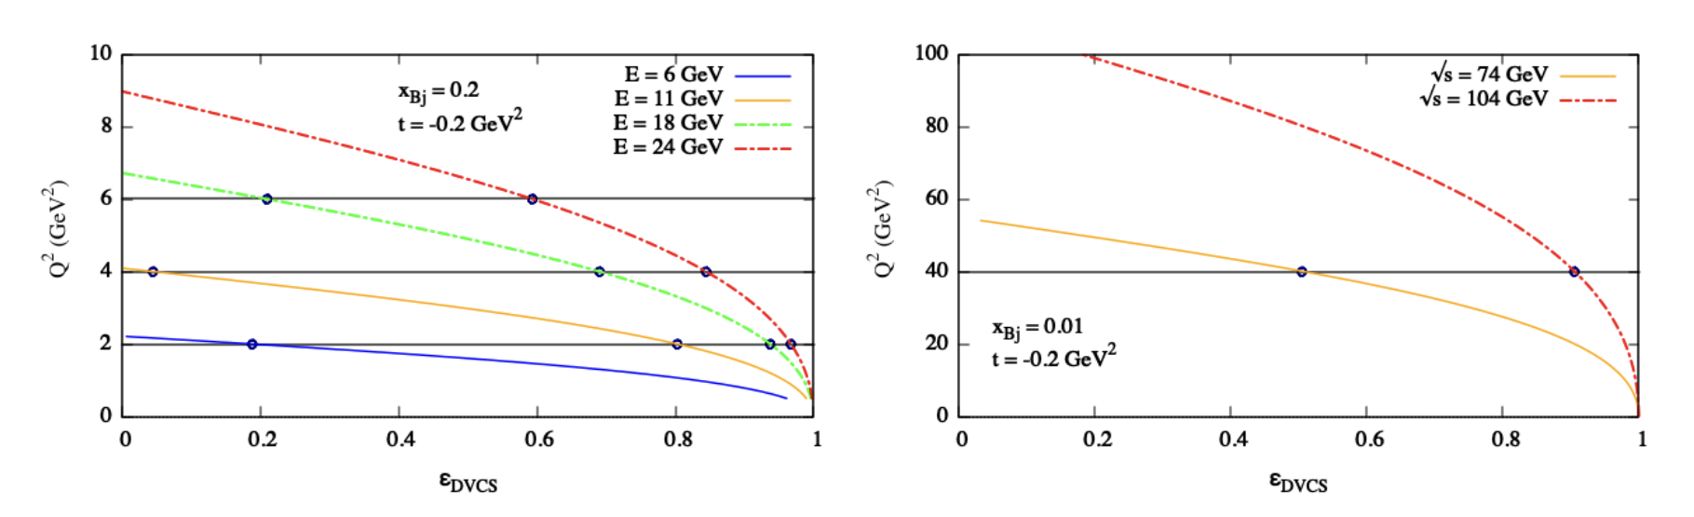
The analysis variables at a given kinematics are ε and ϕ
L
T
Fixed target (Jlab)
Collider (EIC)

Slide 29
Conclusions
A successful reconstruction of the spatial structure of the proton (and all of its mechanical properties) relies on our ability to understand the cross section for all the various DVES processes
This implies solving multiple inverse problems
We have defined a path to extract the observables from experiment that allows us to fully take into account UQ from data using likelihood analysis and MCMC
Our path to AI&theoretical physics brings interpretability features in the computation and benchmarking of AI tools
We have detected inconsistencies leading to degeneracy in the harmonics formalism of deeply virtual exclusive processes
Notes:
UQ is a necessary and currently incomplete step in forming the 3D structure of the proton

