Slide 1

Farewell
J. Lajoie, S. Dalla Torre
July 18, 2025

Slide 2

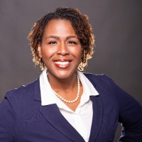
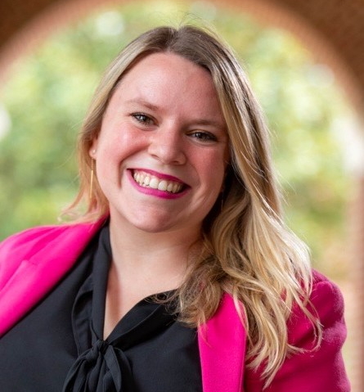
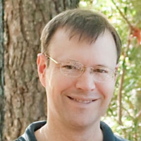

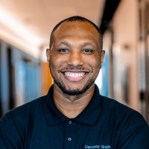
A huge “THANK YOU” to the local organizers:
Alyssa Butler
Sadie Cherry
Sarah Crouse
Doug Higinbotham
Nina Ullrich
Davonte Smith

Slide 3



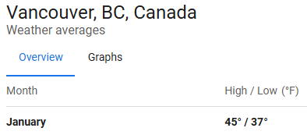
Next ePIC Collaboration Meeting
(logo shamelessly stolen from Estudiar en Canada)
The next ePIC Collaboration meeting will be January 2026 in Vancouver BC, hosted by EIC Canada and TRIUMF.
Stay tuned for more details coming soon!

Slide 4

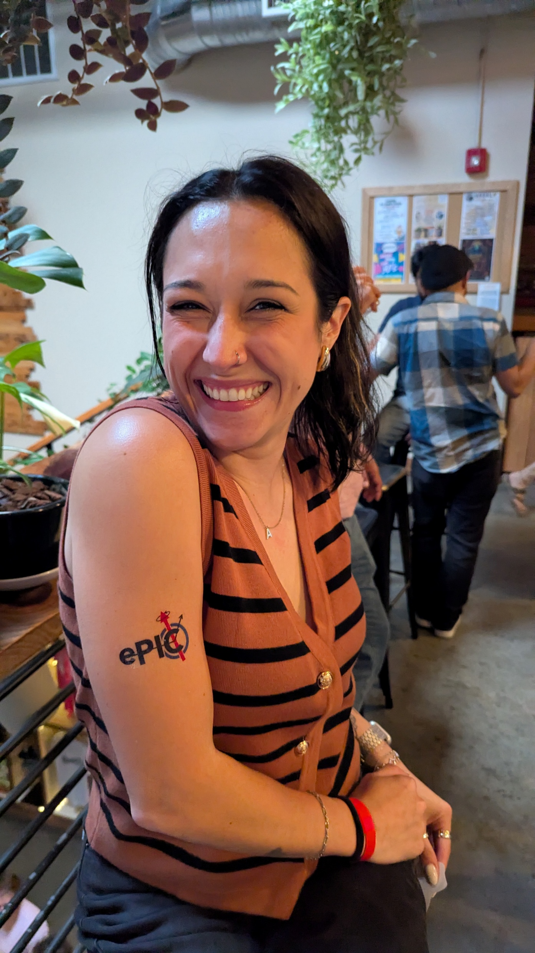
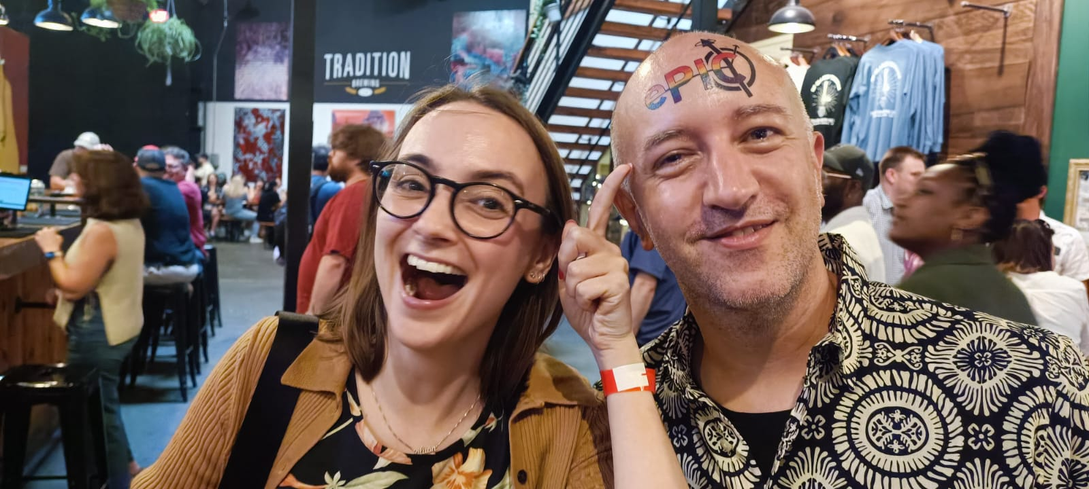
Farewell!
Safe travels back home!
Keep that “ePIC spirit” going!

Slide 5


Slide 6

ePIC Resources
Public Website - https://www.bnl.gov/eic/epic.php
Mailing Lists – https://lists.bnl.gov/mailman/listinfo
Indico Agenda - https://indico.bnl.gov/category/402/
  ePIC Software and Computing: https://indico.bnl.gov/category/435/
Wiki - https://wiki.bnl.gov/EPIC
ePIC Software Training:
  Landing Page: https://eic.github.io/documentation/landingpage.html
  Tutorials: https://eic.github.io/documentation/tutorials.html
Mattermost: https://chat.epic-eic.org
ePIC Zenodo Community: https://zenodo.org/communities/epic

Slide 7


EICUG Membership
The EICUG is a vital organization to promote the interests of the EIC community!
  Without the EICUG we would never have gotten far enough to form ePIC!
Please register your institution!
Check with your EICUG IB representative to get registered as a member
https://www.eicug.org/content/join.html

