Slide 1
Discussion: Current Status of the Project, International Perspectives
Rolf Ent
Co-Associate Director of the EIC Experimental Program
EIC Group Leader
EIC User Group & ePIC Collaboration Joint Meeting
July 15, 2025

Slide 2
ePIC Detector – Current Status
Detector is in good shape, but…
My experience: CD-2 approvals are the toughest gates to pass.
Detector R&D projected completion September 2025
Cost-weighted design maturity at 60%, projected > 80% at July 1, 2026
Jun. 11-13: Comprehensive Design Review by DAC on technical design maturity:
The DAC believes the detector will be ready for baselining late 2025, and to start construction in the 2026/2027 timeframe.
In general, “the DAC has been impressed by the very substantial progress across many areas of the ePIC Detector.”
ePIC Collaboration plans for complete pre-TDR (== preliminary design report for CD-2) by late 2025.
The In-Kind-Contribution (IKC) target for the EIC detector (~30% or approx. $100M) is within reach.
Need to finalize some ICRADAs once we have final resolution of DOE on approved ICRADA template
Need to have draft Project Planning Documents by CD-2 review
Required documentation for CD-2 baselining review well underway
Requirements documents are signed and posted (eic.jlab.org/Detector)
We have a few requirements that are “orphans” as not backed up by science need or simulations → see Friday discussion
Interface requirements are signed and posted → We need to complete all Interface Control Documents
Detector quality control plan is complete, signed and posted. Individual quality control plans are in progress.
Many quality control setups exist, but we need what we do documented in Inspection and Test Plans (see template)
We need to update Basis-of-Estimates for costs to ensure they are robustly documented
Installation plan has been documented
Nov. 12-14, 2025: Baseline Readiness Assessment review for Detector Subproject.
Co-Chairs: A. White, UTA, DAC Chair & S. Nahn, FNAL, USCMS PM.
The charge for these reviews includes technical, cost, schedule, and management.
The charge will also evaluate plans to design to cost.
June 2026: Assumed Independent Project Review for Detector CD-2 Approval

Slide 3
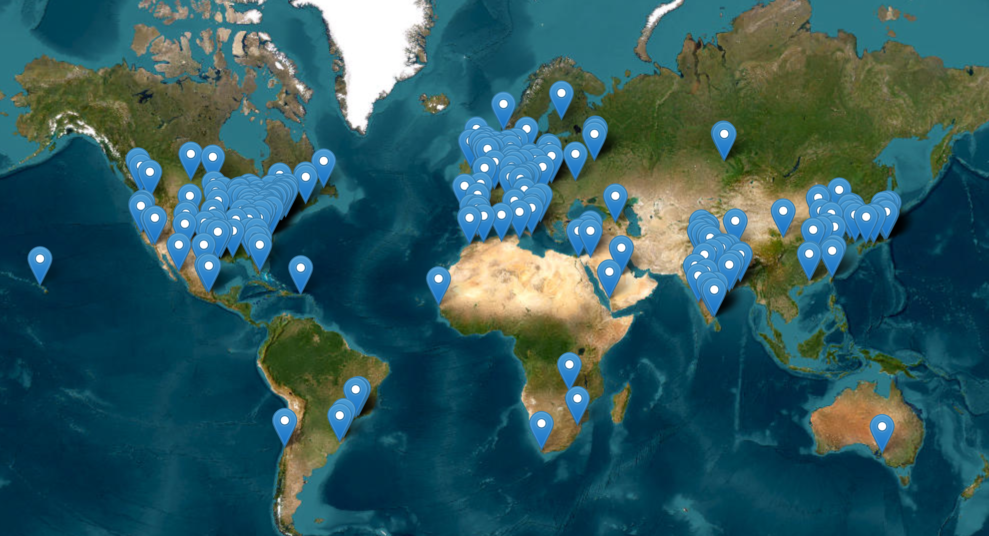
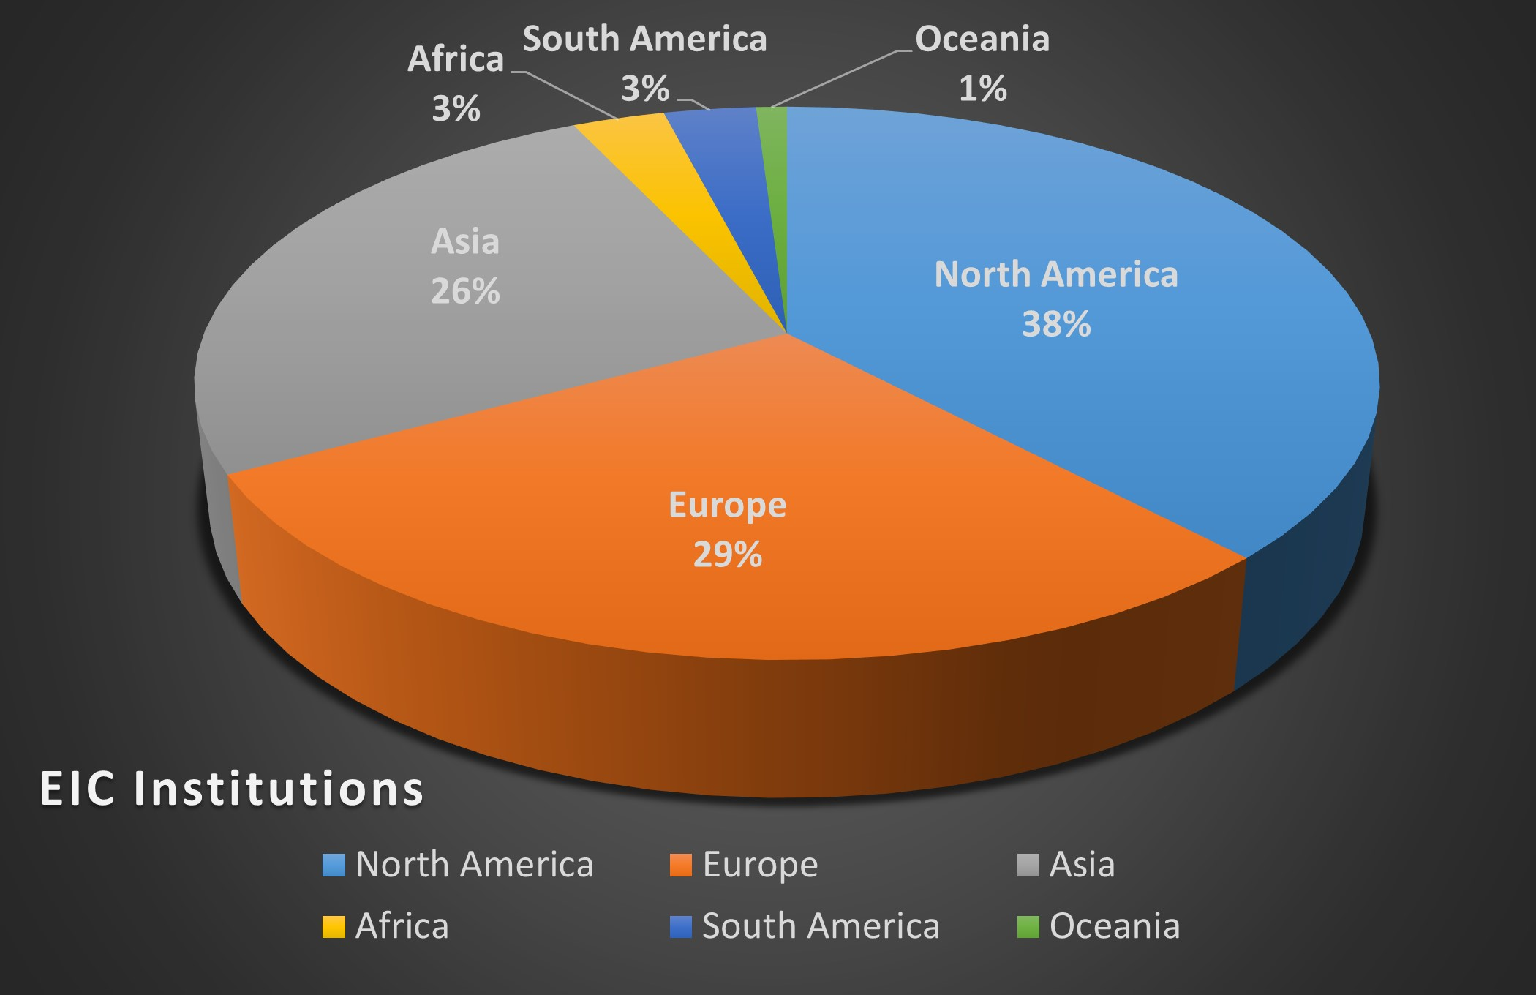
EIC User Group (& ePIC) – Current Status
The EIC Users Group: https://eicug.github.io/
Formed 2016: 400 Users → Now
1557 users, 41 countries, 307 institutions
Experiment 1032
Theory 383
Accelerator Scientists 125
Computer Scientists & Other 17
Location of Institutions in EICUG
Cross-references:
ePIC Collaboration, see https://www.epic-eic.org/
EIC Accelerator Collaboration, see https://eicac.org/

Slide 4
EIC User Group (& ePIC) – Current Status, Opportunities
EIC User Group (& ePIC) – Current Status, Opportunities, Risks
Opportunities are linked to:
Promising science future of EIC
Promise of detector technologies
Promise of accelerator S&T
Continuation of strong and growing interest
International perspectives
Risks are linked to:
Uncertainties in Budget or Project
Timeline of EIC completion
Perceptions
User community erosion by strong delayed timelines or support
International competition

Slide 5
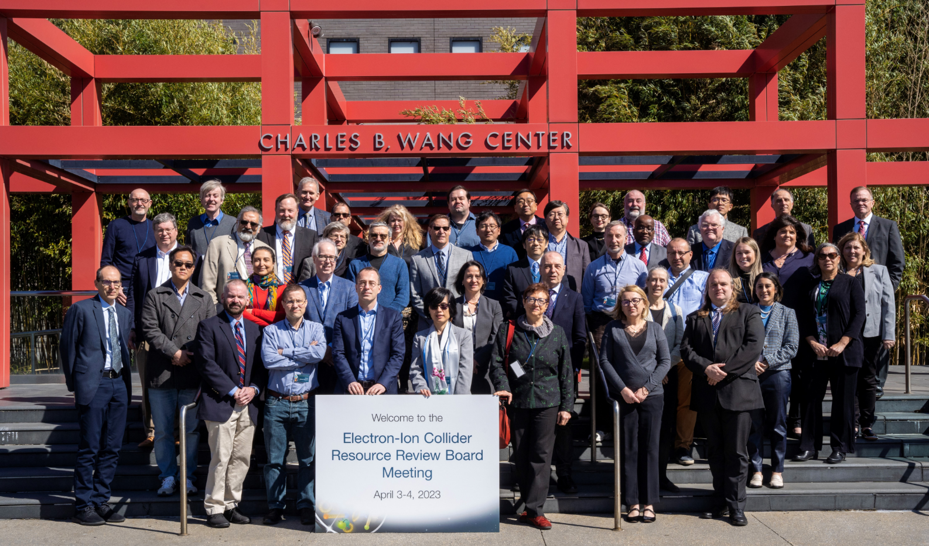
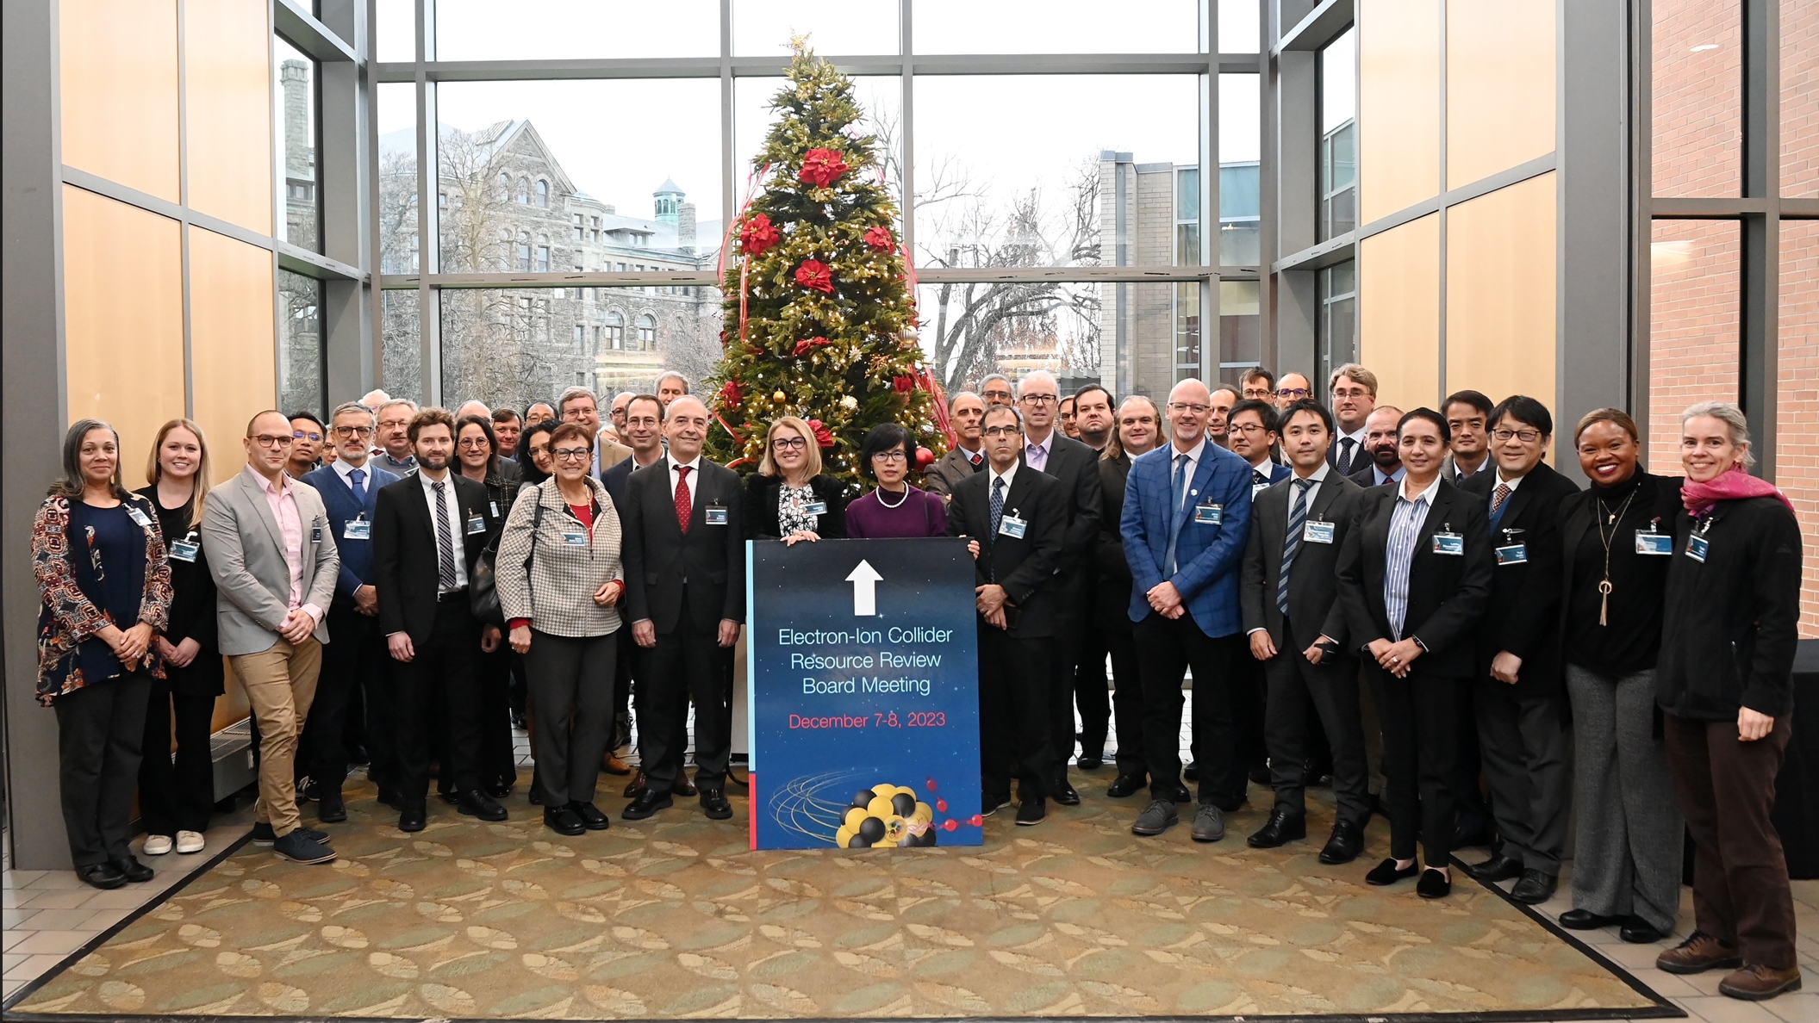
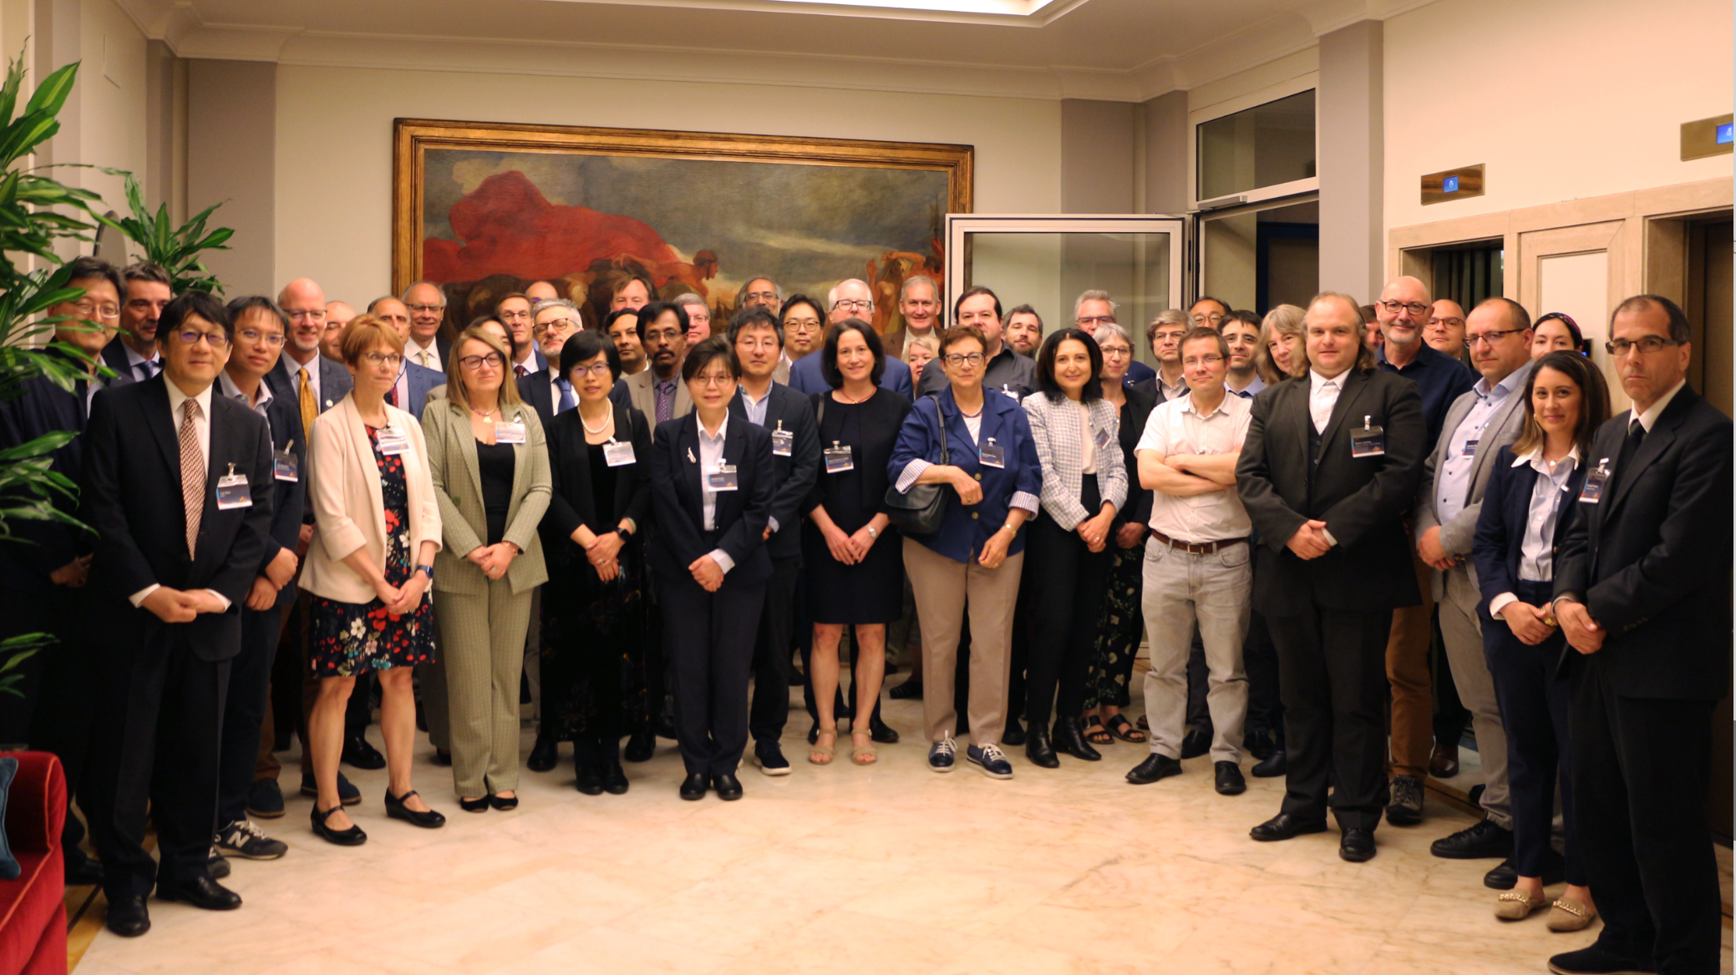
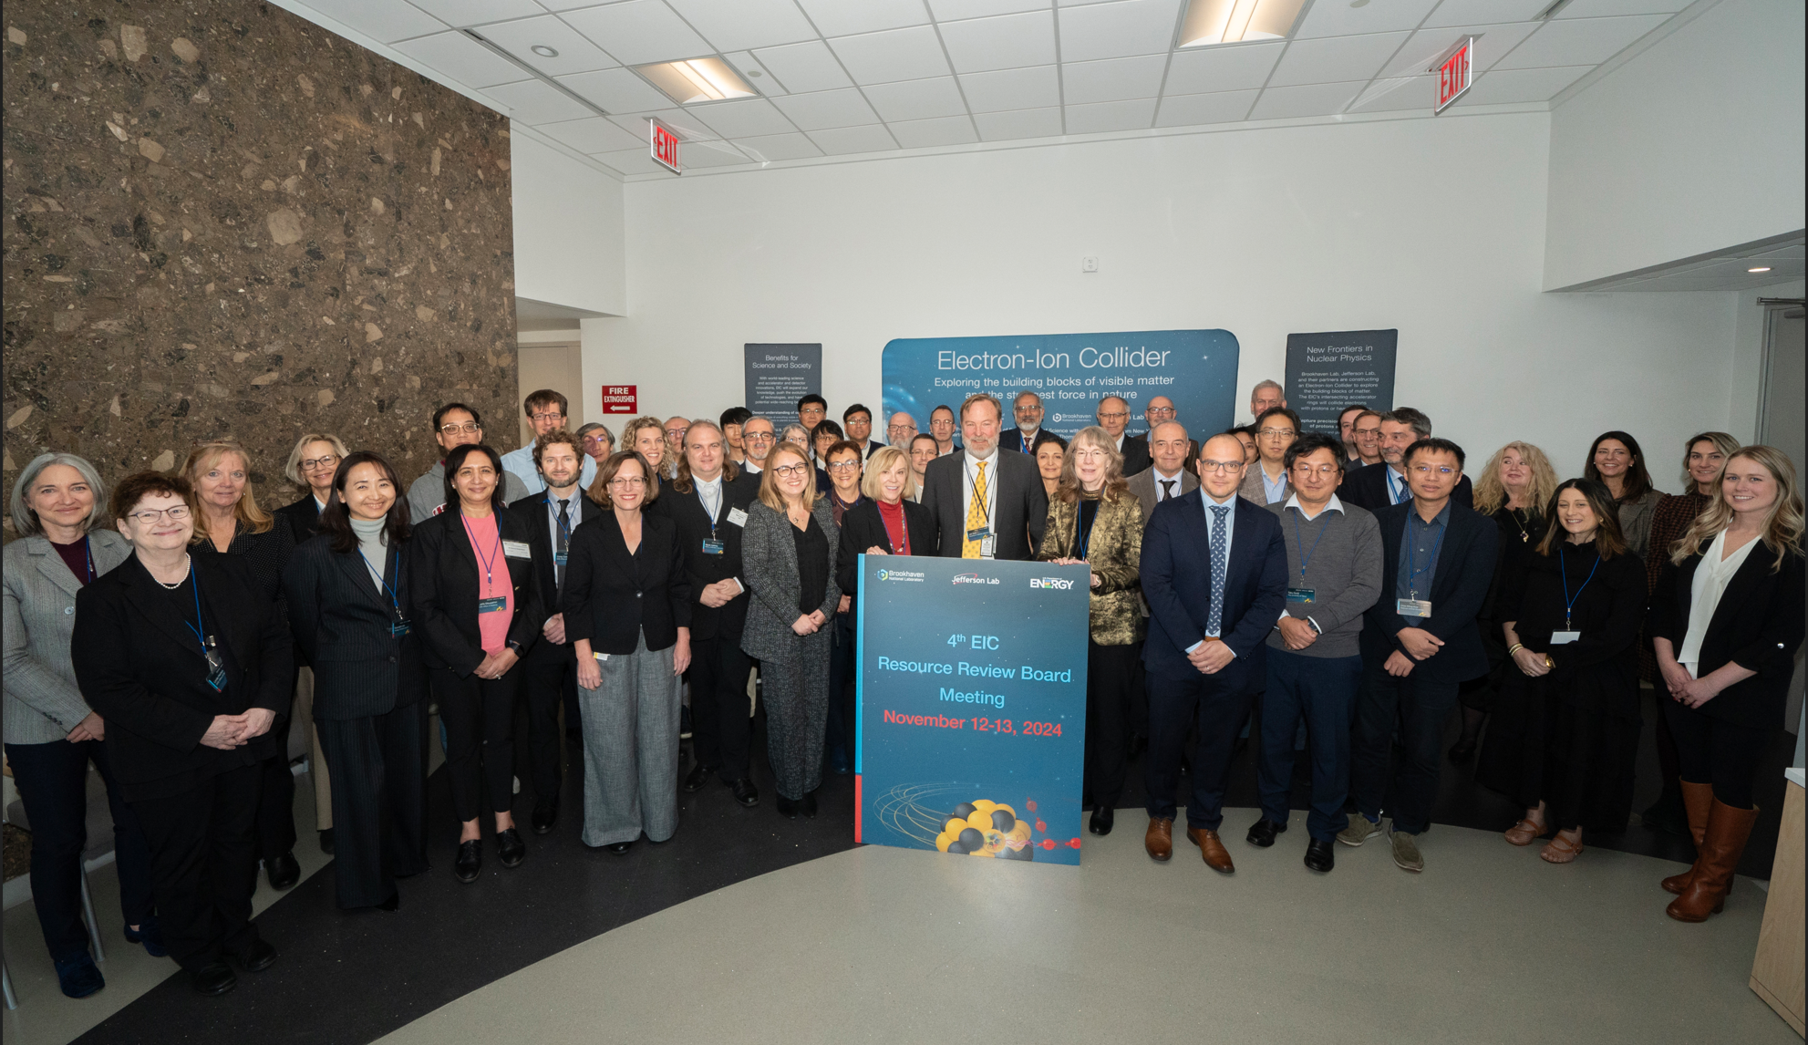
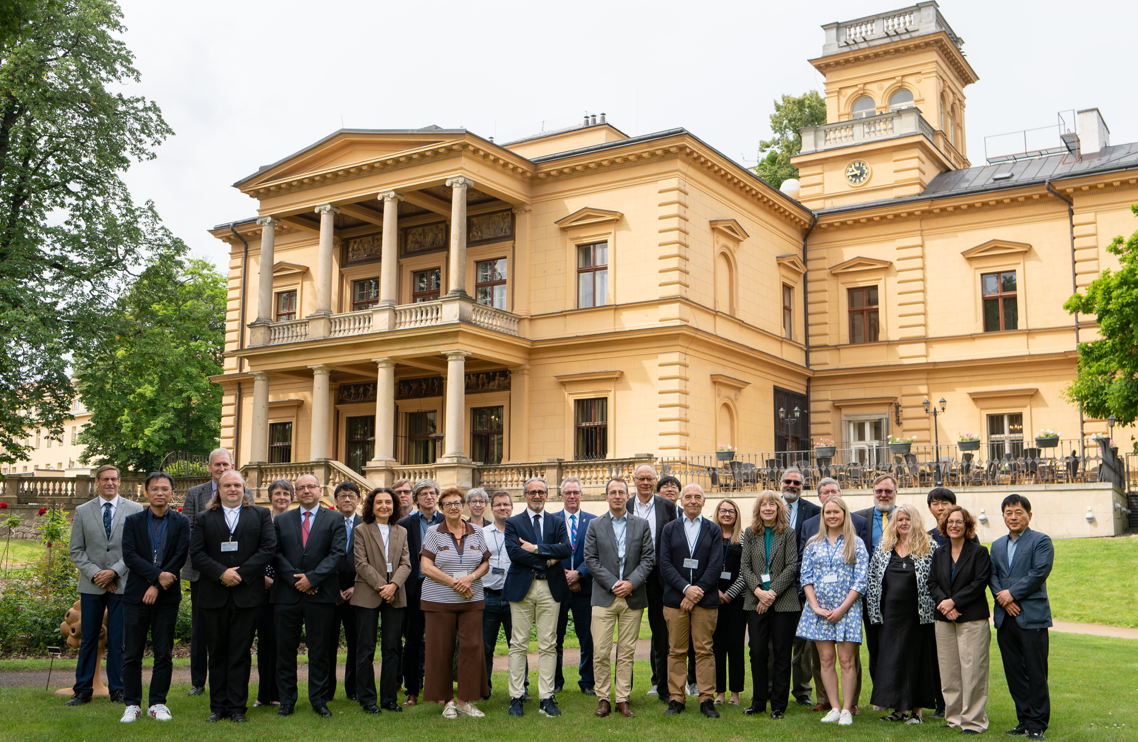
Resource Review Board (RRB) Meetings
DOE and the host labs promote the EIC as a facility “fully international in character.”
Strong international participation included: Armenia, Brazil, Canada, CERN, Czech Rep., France, India, Israel, Italy, Morocco, Japan, Poland, South Korea, Senegal, South Africa, Taiwan, UK
April 3rd-4th, 2023 - Stony Brook University, New York, U.S.A
December 7th- 8th,2023 - Catholic University of America, Washington, D.C, U.S.A
May 6th-7th, 2024 – INFN, Rome, Italy
November 12th-13th,2024 – BNL, New York, U.S.A
June 5th-6th,2025 – Czech Ministry, Prague, Czech
Future:
November 4-5, 2025 – BNL Science & User Support Center
June 2026 – Proposal from Japan
November 2026 – U.S.
June 2027 - Interest from Taiwan & France

Slide 6
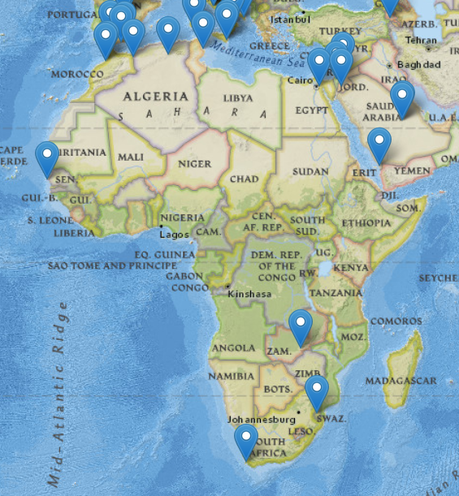
Africa Engagement in EIC
The International Conference on Physics Opportunities at an ElecTron-Ion-Collider (POETIC) workshop series started in Africa!
POETIC-1 organized by U Cape Town in Stellenbosch, South Africa in 2010
Subsequently in Bloomington (2011), Valparaiso (2012), Jyvaskyla (2013), Yale (2014), Palaiseau (2015), Philadelphia (2016), Regensburg (2018), Berkeley (2019), Sao Paulo (2023), Miami (2025)
Eight African countries are a member of the Electron-Ion Collider User Group (EICUG.ORG)
Algeria
Egypt
Eswatini
Morocco
Senegal
South Africa
Tunisia
Zambia
11/307 institutions (3%) & 33/1557 members (2%)
Opportunities: 1) pursue joint visible role as EIC-Africa; 2) “regulars” in Resource Review Board meetings

Slide 7
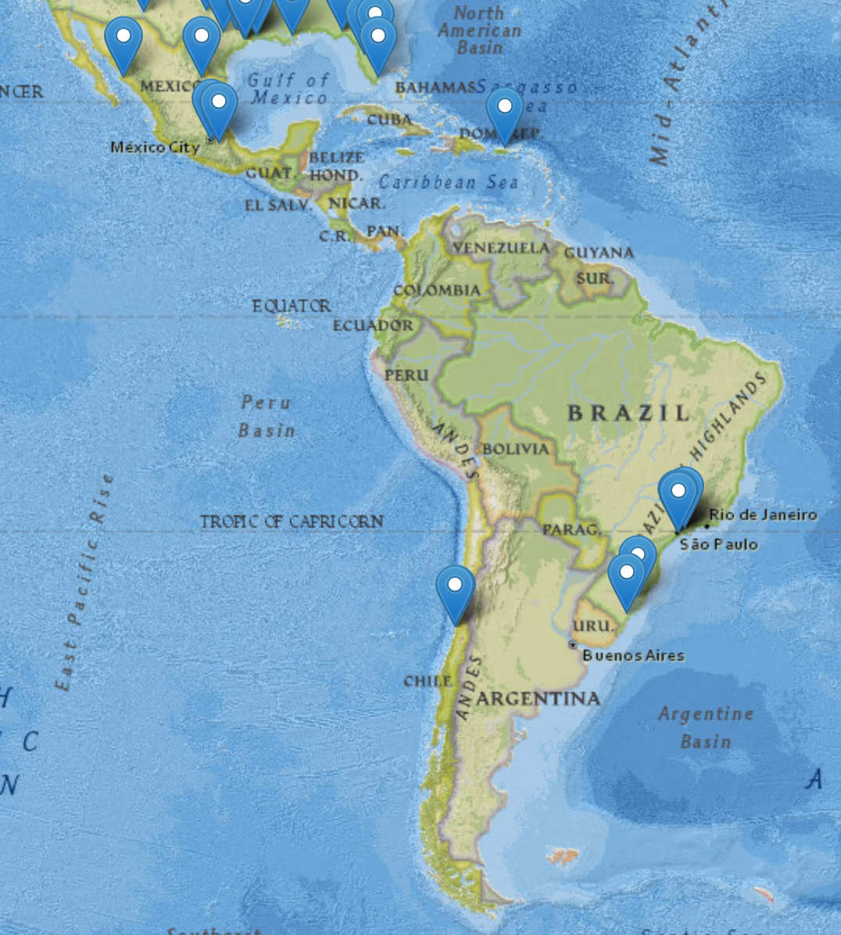
Latin America Engagement in EIC
Strong interest exists in EIC science in Latin America
POETIC-3 in Chile (2012) and POETIC-10 in Brazil (2023)
Multiple workshops organized related to EIC science: Non-Perburbative QCD (Brazil and Mexico), HADRON, Light-Cone, QCD4EIC, …
Active participation in EIC community-wide efforts (EIC White Paper, Yellow Report, meson structure WG, CFNS workshops, …)
Inter-American Network of Networks of QCD challenges (I.ANN-QCD)
Up to now:
Limited experimental participation of Latin American physicists to the EIC
Substantial contributions from Brazil to vacuum in Interaction Region and development of SALSA, interest from Mexico to EIC Accelerator scope
Three Latin American countries are a member of the Electron-Ion Collider User Group (EICUG.ORG)
Brazil
Chile
Mexico
15/307 institutions (5%) & 47/1557 members (3%)
Opportunities: 1) Collective applications and building a LA EIC network; 2) Formalize LA contributions; 3) Enhance experimental participation

Slide 8
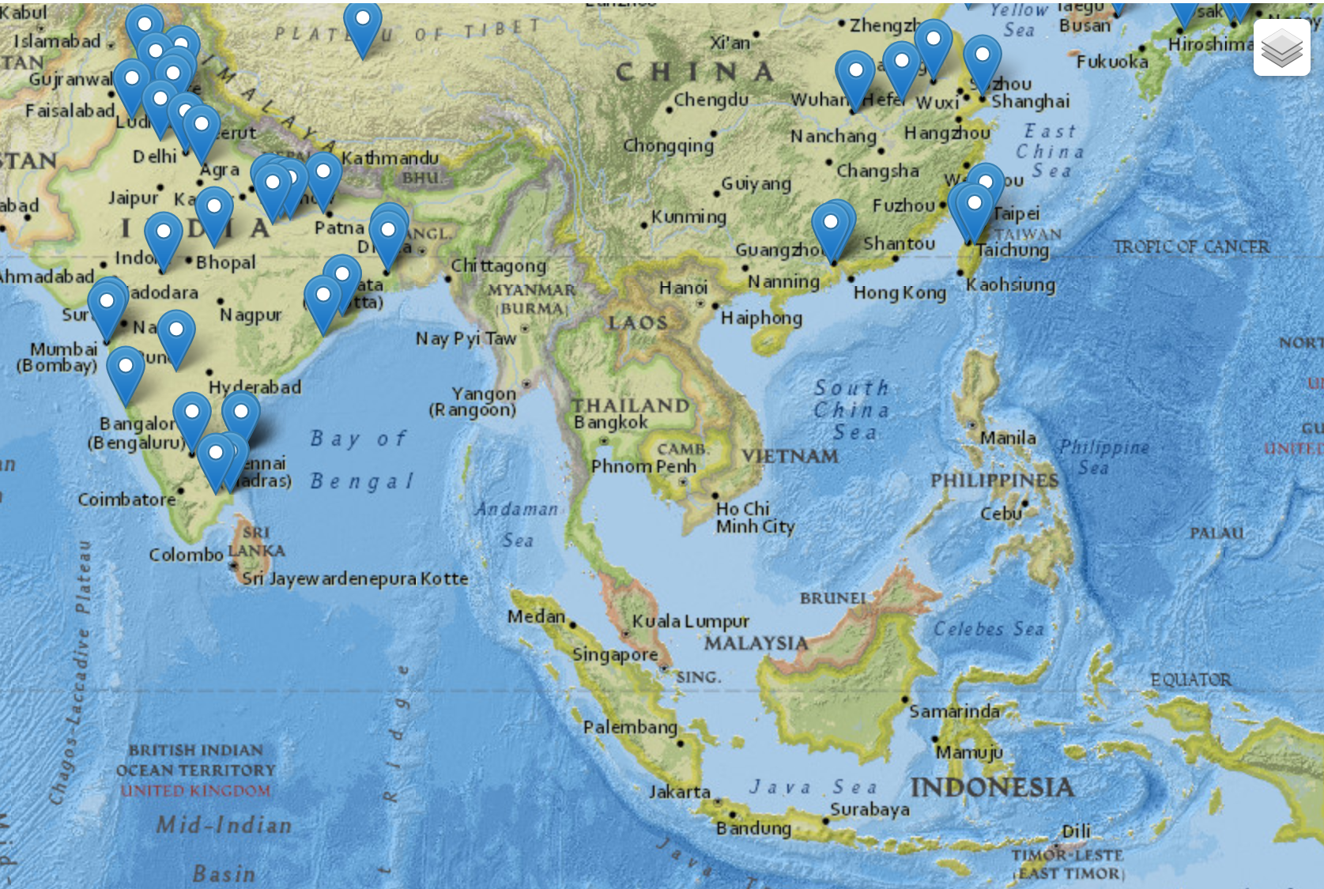
South-East Asia Engagement in EIC
Interest in EIC science in South-East Asia is in India
Strong links with QCD Theory community in India and with Heavy-Ion experimental program at RHIC and CERN
QCD with Electron-Ion Collider (QEIC) Workshops in 2020, 2022, 2024.
Hosted EIC Summer School in Bangalore in 2024
Next EIC Summer School in February 2026
Large involvement in simulation working group during Yellow Report activity concentrating on validation
Revived this for ePIC with large involvement of early career scientists at various institutions in India → ePIC simulations
NHSF-India / ePIC Computing Workshop at IIT Bombay in 2025
EIC mention included in India’s Mega Science Vision 2035 document
Experimental effort on EIC-India took strong organizational efforts to coordinate – bottleneck has been limited institutions in India interested in hardware development, and they already have ongoing commitments.
Hardware activities:
One of two production lines for the forward EM calorimeter
Characterization of Aerogel and SiPM for dRICH
Under discussion: Forward Time-of-Flight (FTOF) detector development; Data Acquisition system design and integration
One South-East Asia country is a member of the Electron-Ion Collider User Group (EICUG.ORG)
India
35/307 institutions (11%) & 66/1557 members (4%)
Opportunities: 1) make EIC Detector Project Contribution in India real: RRB participation only possible after EIC project exists; 2) reach out to more South-East Asia nuclear scientists; 3) engage in EIC-Asia or EIC-South-East Asia consortium

Slide 9
Discussion
Topics:
Current Status
International Perspectives
Note there is also the EIC Global Outreach efforts and session on EIC Outreach:
Wednesday morning from 10:00 am to noon, see https://indico.jlab.org/event/934/timetable/#20250716.detailed

Slide 10
Backup
Three slides provided by EIC-India

Slide 11
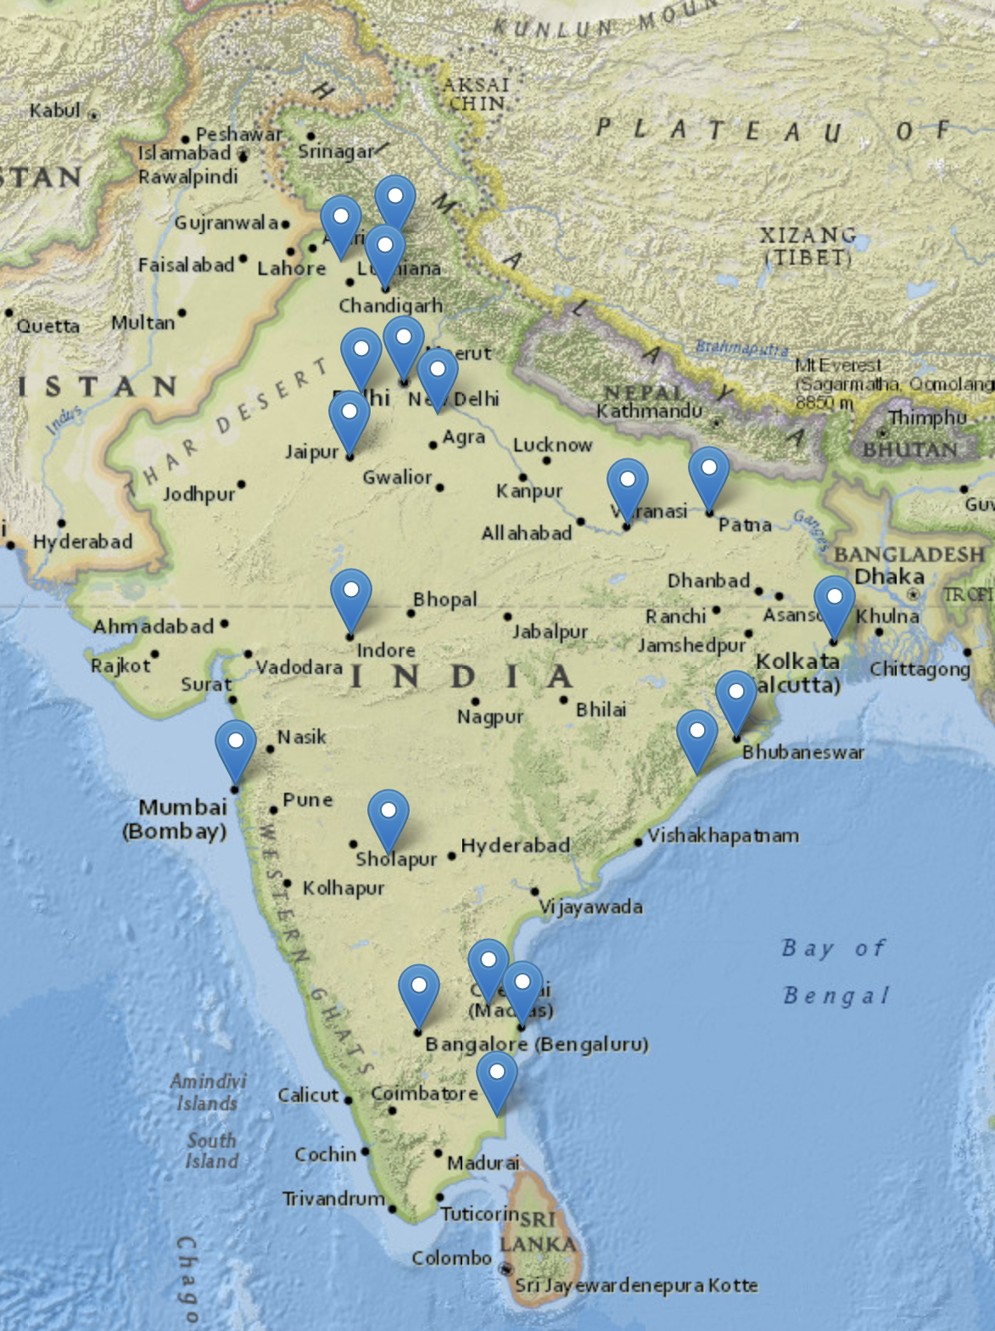
Indian Participation in the EIC: ePIC & EICUG
19 Indian Institutions participating in ePIC experiment
Actively contributing to simulations and hardware
activities
Representation in key committees at ePIC
Currently serving in the ePIC Membership and Publication Committee
Hardware Activities:
Production of the Forward EMCAL blocks – NISER
Most materials and components have already been procured
Design work ongoing Mold forms and light guides
Characterization of Aerogel and SiPM for dRICH – NISER
Development of characterization setup is ongoing
Discussions ongoing for participation in:
Forward Time-of-Flight (FTOF) detector development
Data Acquisition (DAQ) system design and integration
A strong high-energy and hadronic physics THEORY community
Actively pursuing theoretical developments in physics related to the EIC.
Leading topical and general workshops and regional summer & winter schools

Slide 12
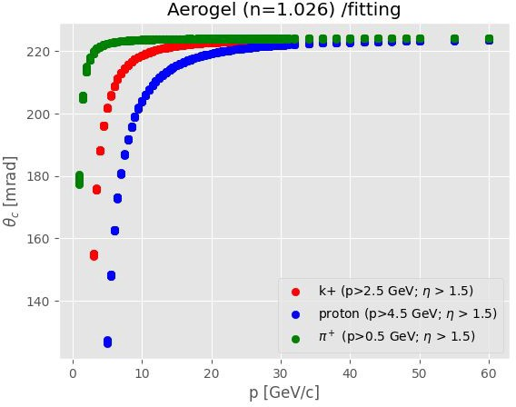
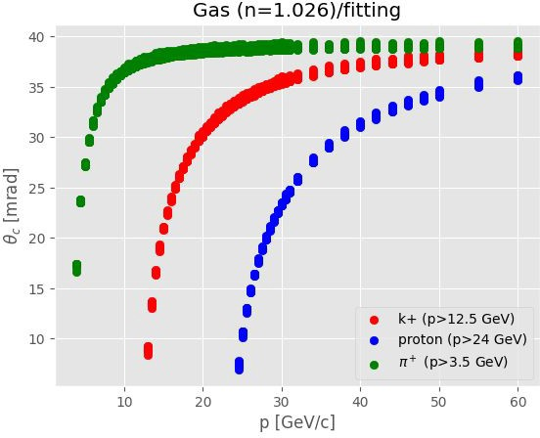
Indian Participation in the ePIC Simulations
Simulation Activities:
PID studies for dRICH - CUK and CUH
Estimation of separation powers for pions, kaons and protons in aerogel and gas
Submitted for pre-TDR draft
Implementation of Quartz Window in Geant4 for dRICH - CUK and CUH
Simulation for FTOF - IIT Madras
Extracting hit and neighboring cell information
Implementing 2D Gaussian smearing of energy across neighboring cells
Performance Evaluation of Vertexing Algorithms for ePIC - Panjab Univ.

Slide 13
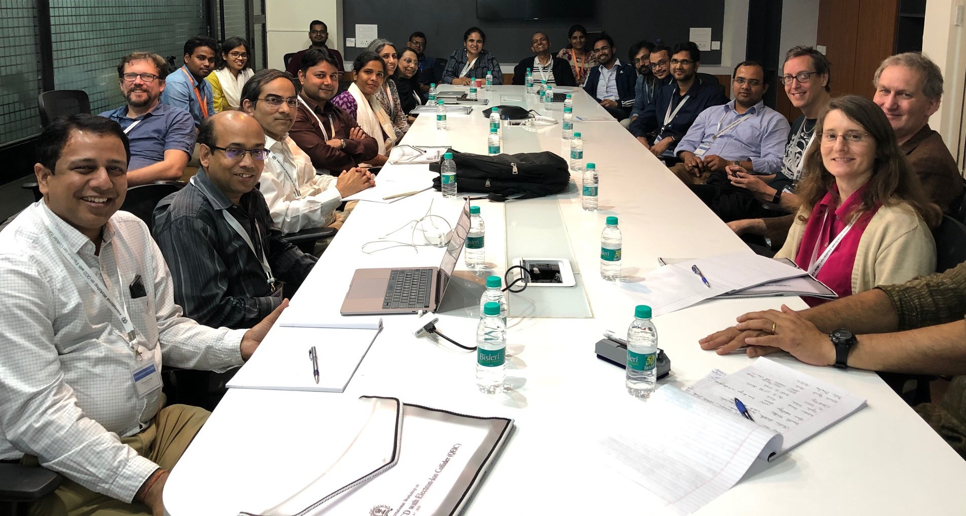
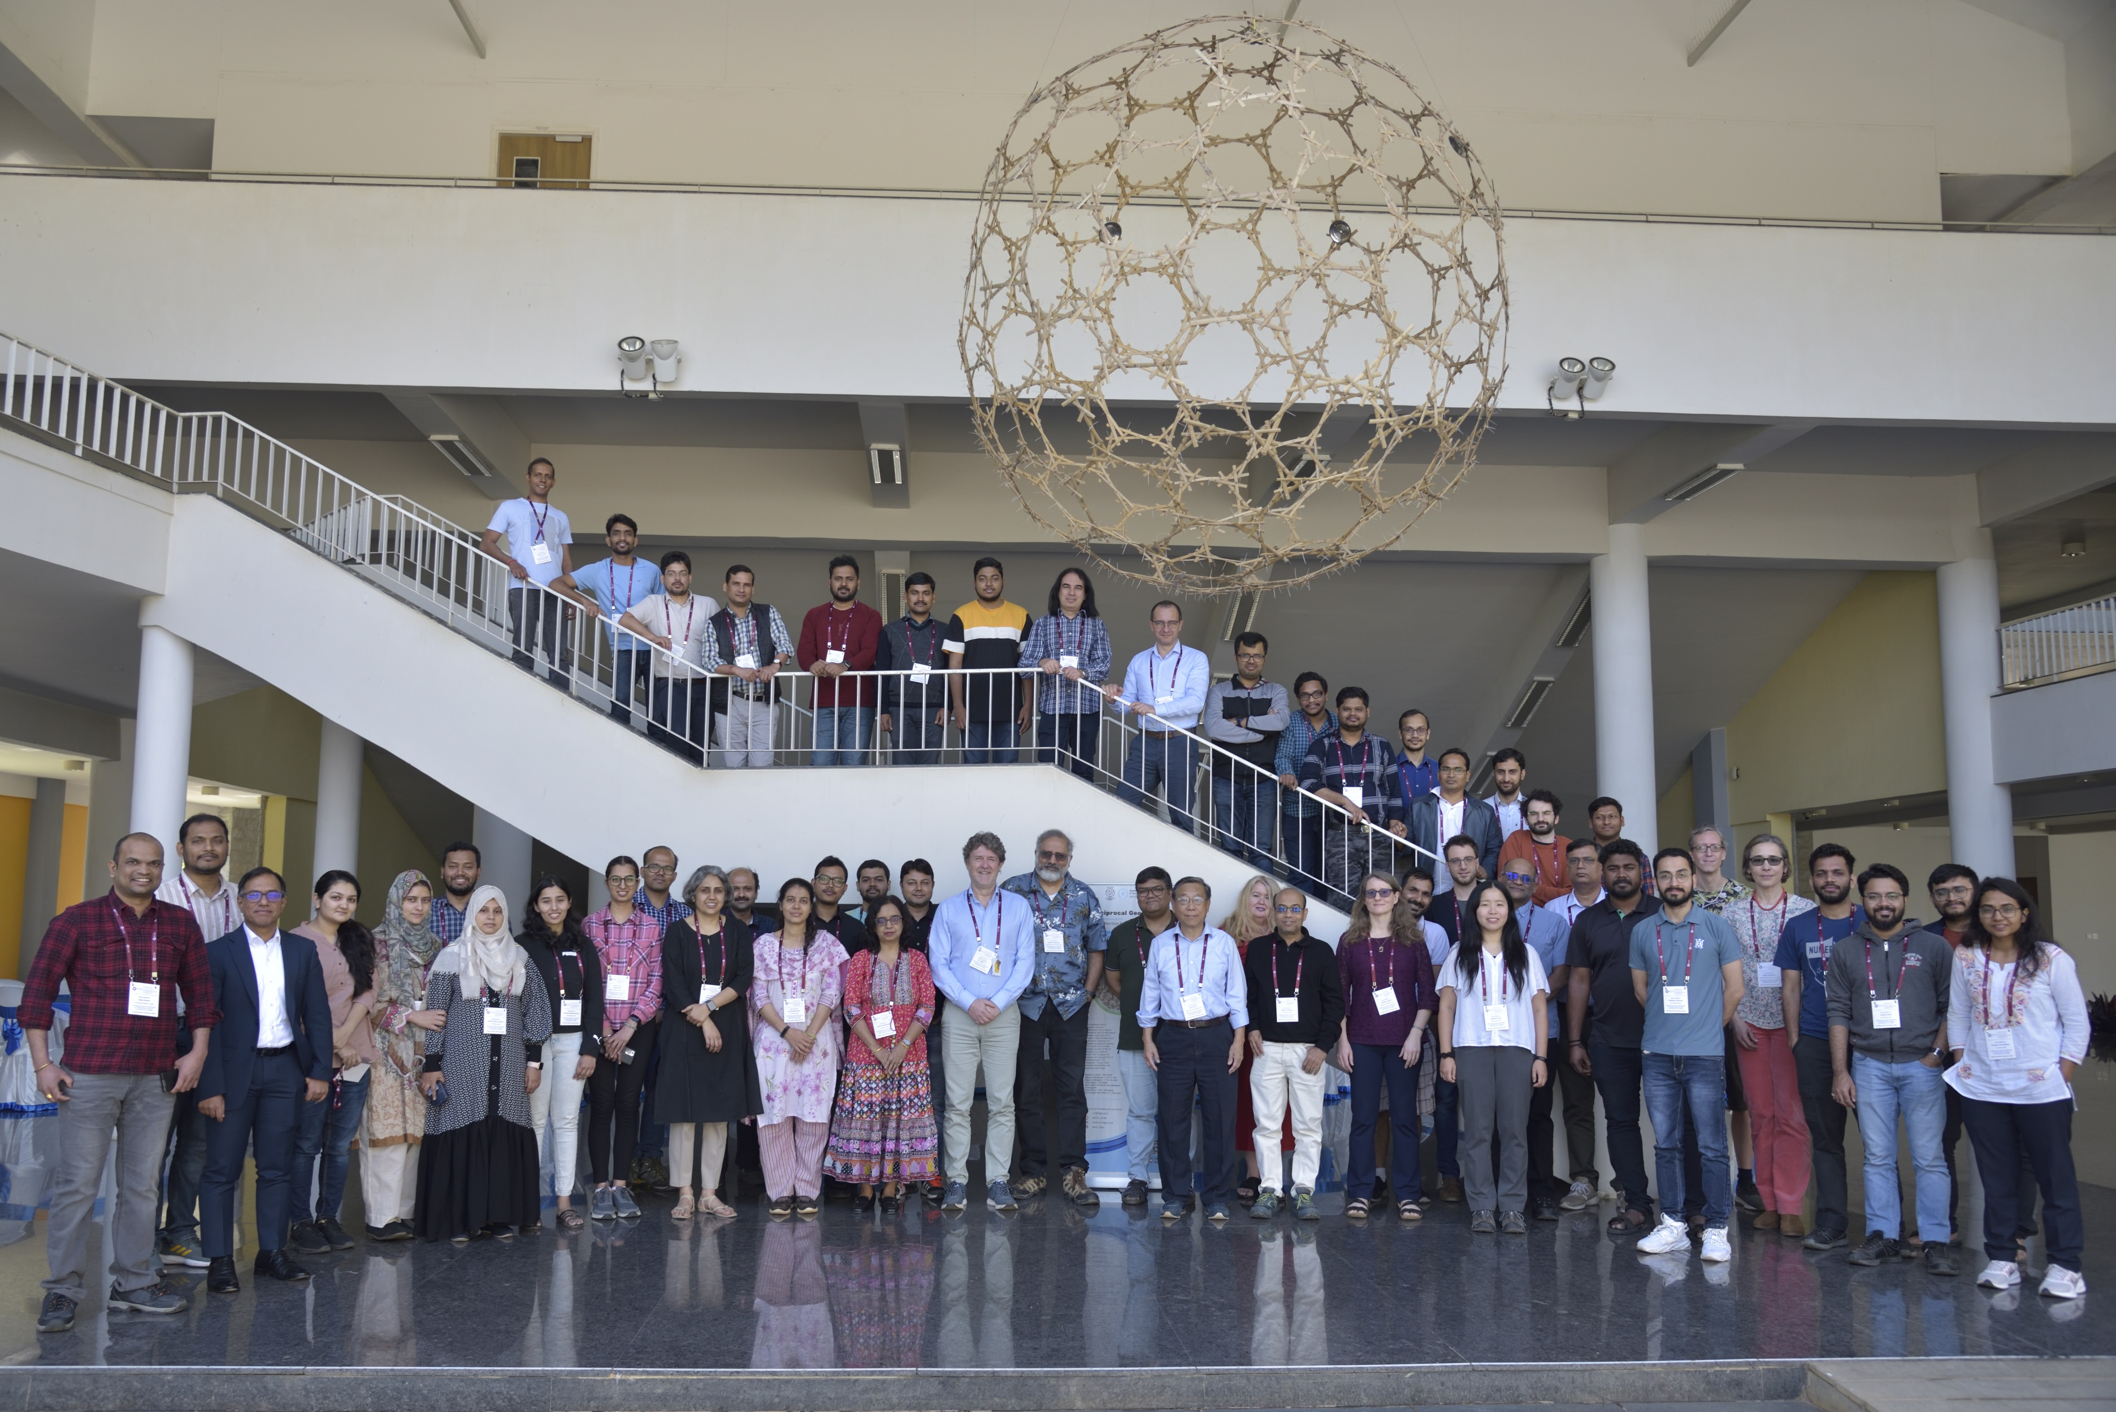
Indian Participation in the ePIC & EICUG
QCD with Electron-Ion Collider (QEIC) 1st Meeting at IIT Bombay, India (Jan 4 – 7, 2020)
International School and CFNS Workshop on Probing Hadron Structure at the Electron- Ion Collider (QEIC) III at ICTS Bangalore, India (Feb 5 - 9, 2024)
Other past and upcoming events:
QCD with Electron-Ion Collider (QEIC) II at IIT Delhi, India (Dec 18 - 20, 2022)
NHSF-India / ePIC Computing Workshop at IIT Bombay, India (May 13 -17, 2025)
CFNS – CTEQ School for QCD and EIC at IIT Bombay, India (February 8-15, 2026)

