Slide 1
EIC Accelerator Collaboration
Tatiana Pieloni, École Polytechnique Fédérale de Lausanne, Switzerland
Andrei Seryi, Jefferson Lab, USA co-chairs of EIC Accelerator Collaboration
EIC User Group meeting
14th July 2025

Slide 2
EIC Accelerator Collaboration
The EIC design, construction, and future upgrades offer exciting scientific and technical challenges, creating opportunities for closely connected worldwide accelerator R&D
The EIC Accelerator Collaboration will help realize the full potential of these opportunities
This will benefit the EIC project, collaboration partners, and the wider accelerator community. It will also help maximize the ultimate performance of the EIC facility on the long-term

Slide 3
Institutional Collaboration Board
Lin Liu | LNLS | Brazil
Oliver Kester | TRIUMF | Canada
Guillaume Olry | IJCLab | France
Pierre Vedrine | CEA Saclay | France
Qing Qin | ESRF | France
Ralph Assmann | GSI/FAIR | Germany
Lucio Rossi | INFN Milano | Italy
Roberto Cimino | INFN-LNF | Italy
Moses Chung | Pohang Accelerator Lab | South Korea
Jose Miguel Jimenez | CERN | Switzerland
Graeme Burt | Lancaster University | UK
Carsten Welsch | University of Liverpool | UK
Nik Templeton | STFC | UK
Phil Burrows | John Adams Institute | UK
Stewart Boogert | Cockcroft Institute | UK
Georg Hoffstaetter | Cornell University | United States
Jean Delayen | Old Dominion University | United States
John Power | ANL | United States
Mei Bai | SLAC | United States
Sam Posen | Fermilab | United States
Sarah Cousineau | ORNL | United States
Soren Prestemon | LBNL | United States
Young-Kee Kim | University of Chicago | United States
Yue Hao | FRIB | United States
Established the Institutional Collaboration Board: 24 members, 24 Institutes, 9 countries.
Organizing the first meeting
Gathered feedback for the EIC input to the European Strategy document & submitted
Planning to continue expanding the ICB

Slide 4
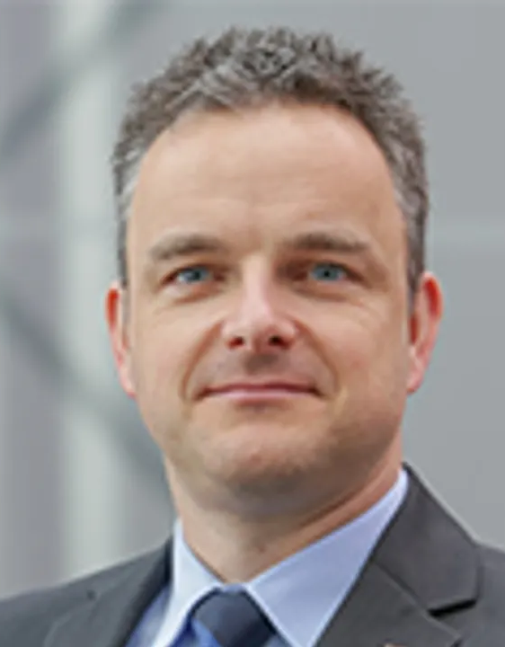
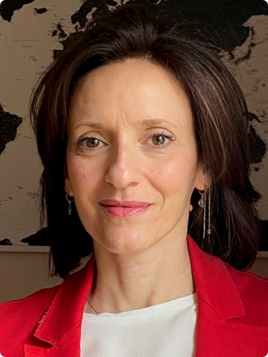
EIC Acc Collaboration international co-chair
Carsten Welsch University of Liverpool Served as the first inaugural international co-chair till Oct 2024
Tatiana Pieloni École Polytechnique Fédérale de Lausanne In Dec 2024 started serving as the the next international co-chair

Slide 5
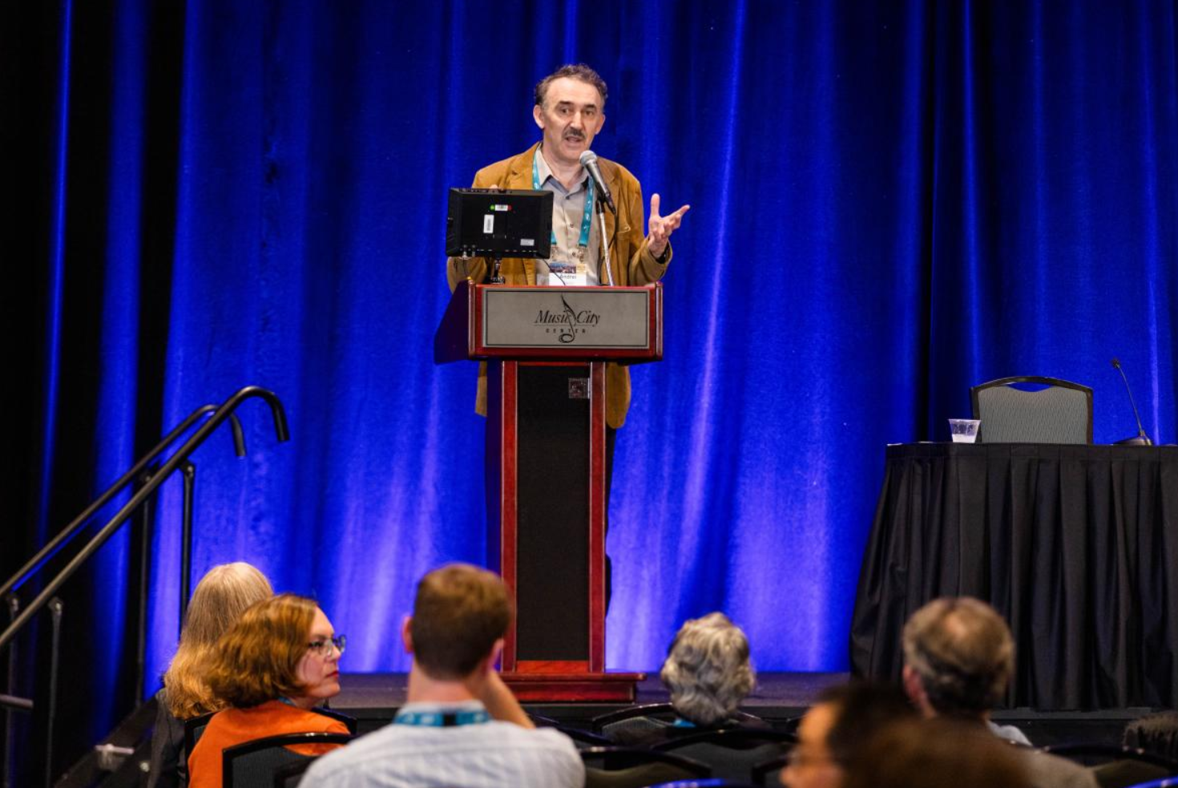
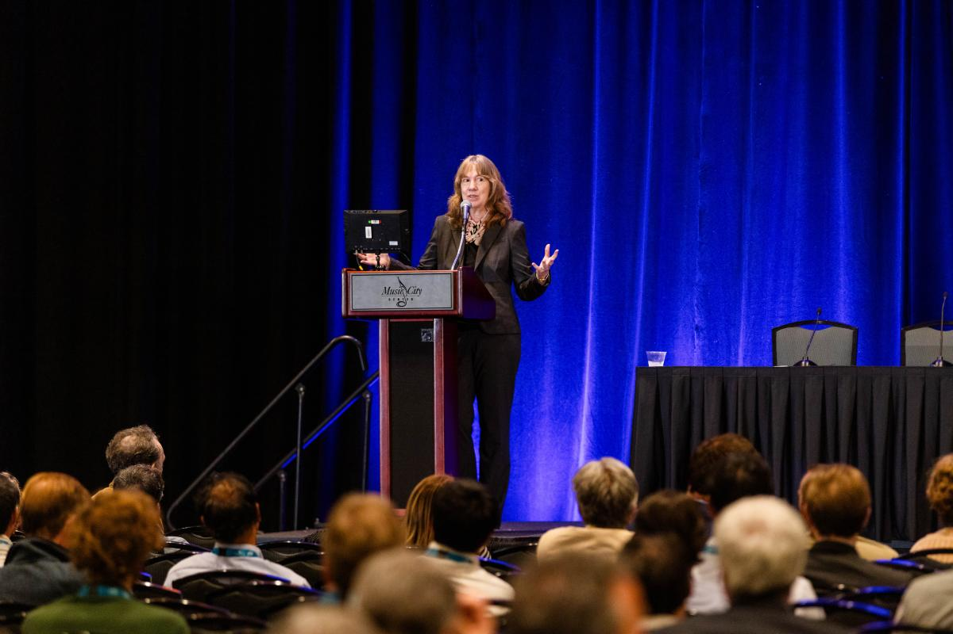
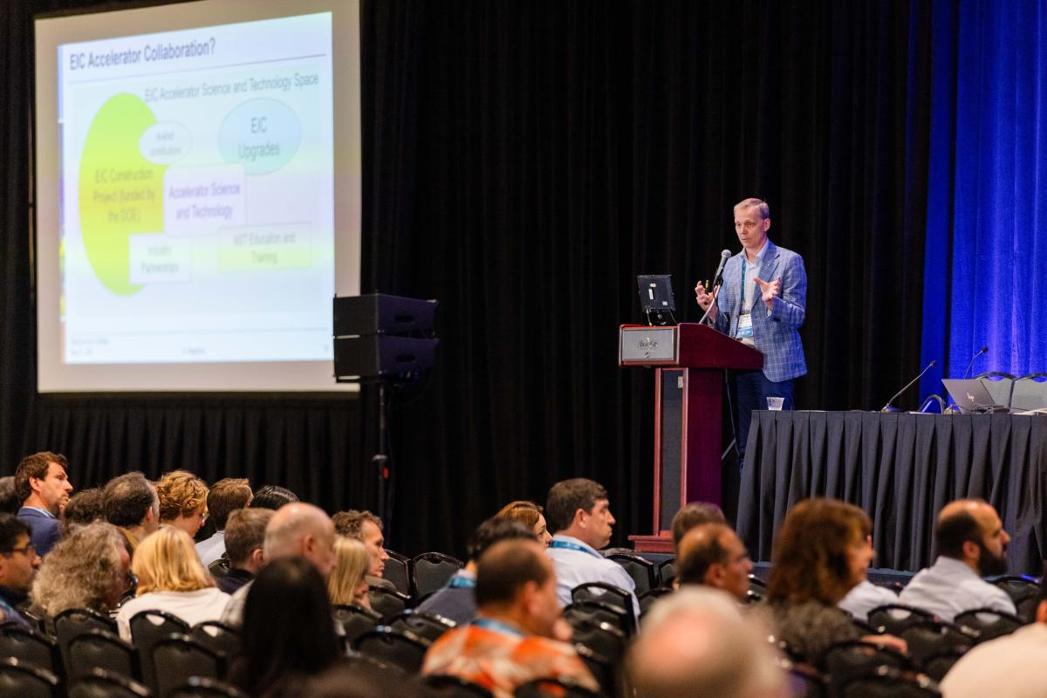
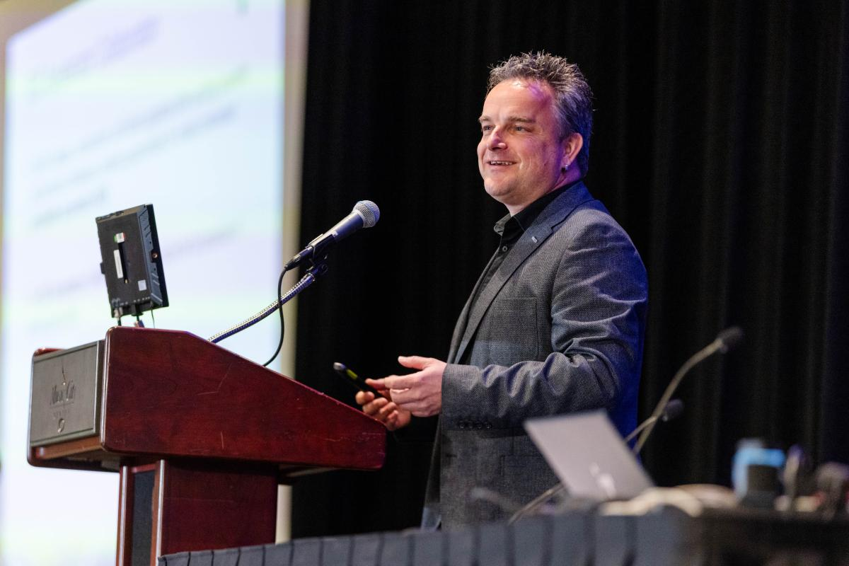
EIC-AC kick-off meeting at IPAC24
https://ipac24.org/photos-may-21-eic-collaboration-event/

Slide 6
Working Groups on key challenges
Beam-beam effects C. Montag (BNL), X. Buffat (CERN)
Polarized Beams and Polarimetry F. Rathmann (BNL), G. Hoffstaetter(Cornell)
EIC commissioning Tools Y. Hao (MSU/BNL), J.L. Vay (LBNL)
Second Interaction Region – recruiting group leaders and co-chair
High Energy Beam Cooling - recruiting group leaders and co-chair
Collimation and machine protection – group leaders identified
Injection and sources R&D – group leaders identified
Forum on EIC Synergies with Current and Future Projects - recruiting group leaders and co-chair
More WGs to come → exploring other topics and technologies of interest

Slide 7
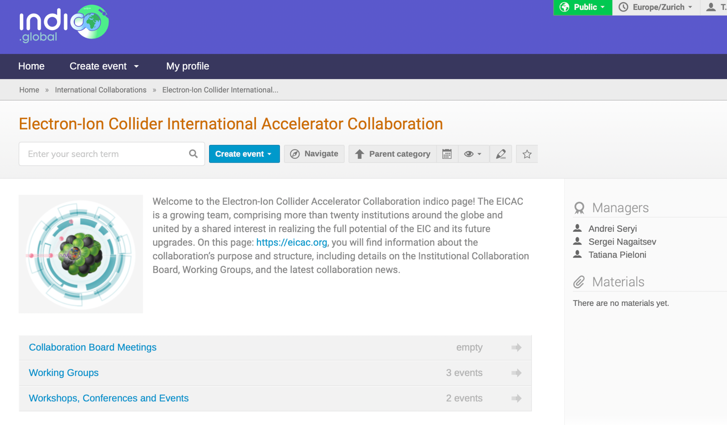
Information flow and Material Sharing
Official Webpage EICAC.org
WG meetings and material: CERN Global Indico

Slide 8
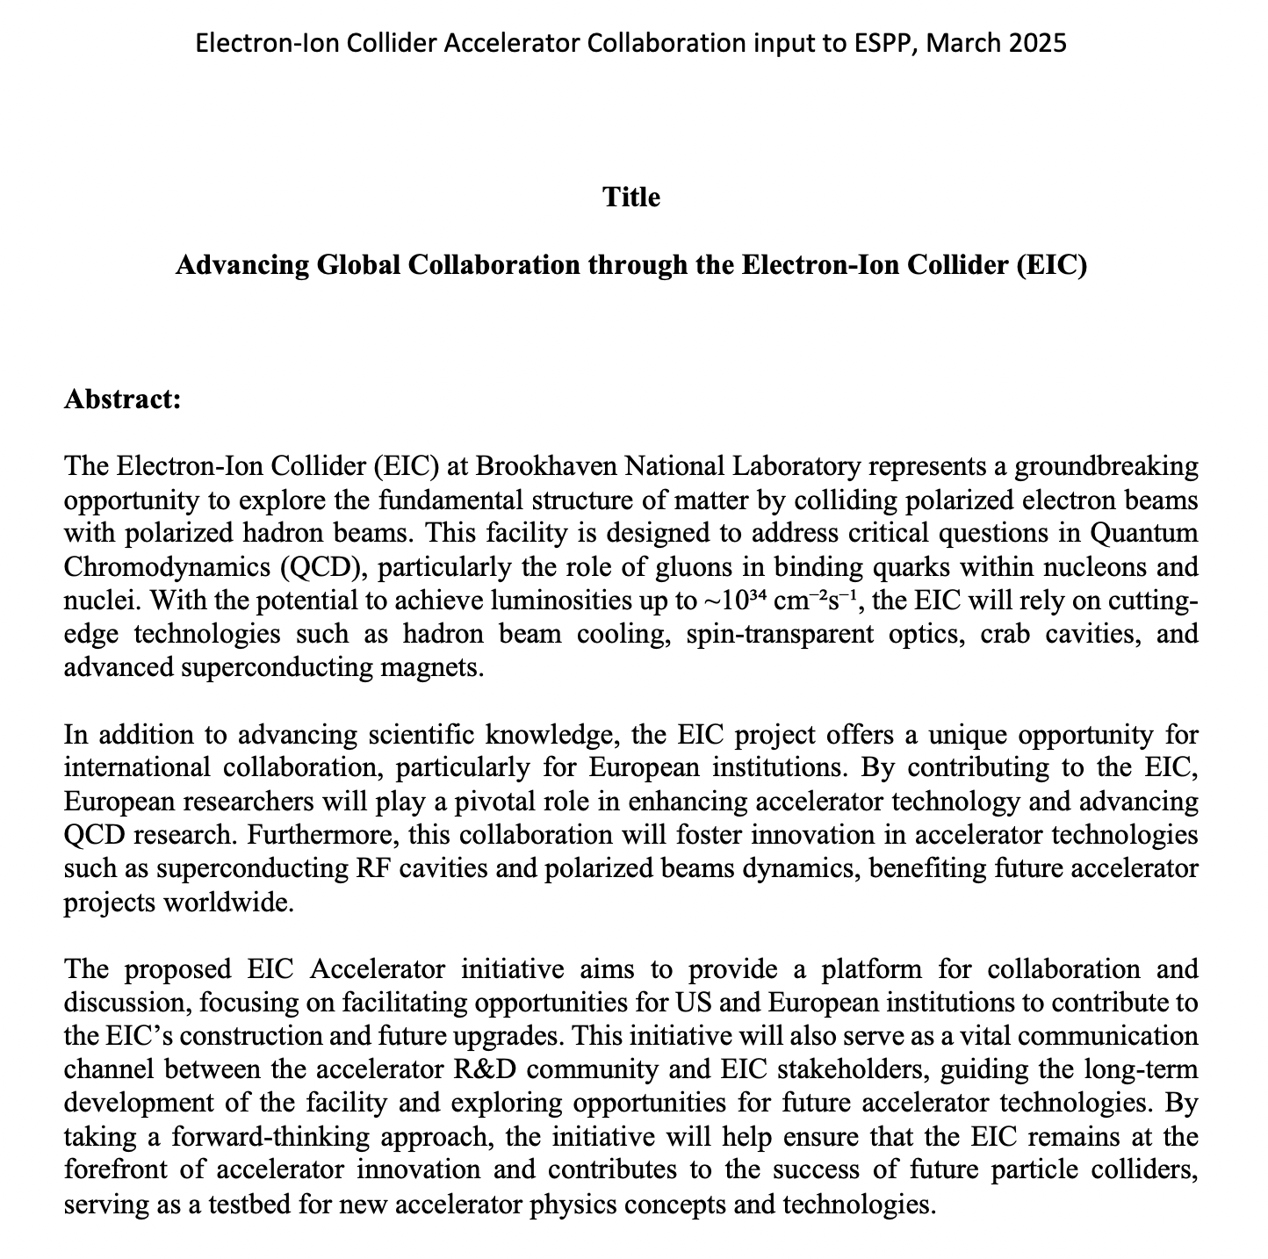
Input to European Strategy for Particle Physics
The EIC submission to ESPP highlights:
The opportunities for advancing global collaboration through the EIC
Areas of opportunity:
Scientific Research
Accelerator Technology
Educational Exchange
Prior to submission, presented at DPF/DPB forum for feedback
https://indico.cern.ch/event/1439855/contributions/6461628/

Slide 9
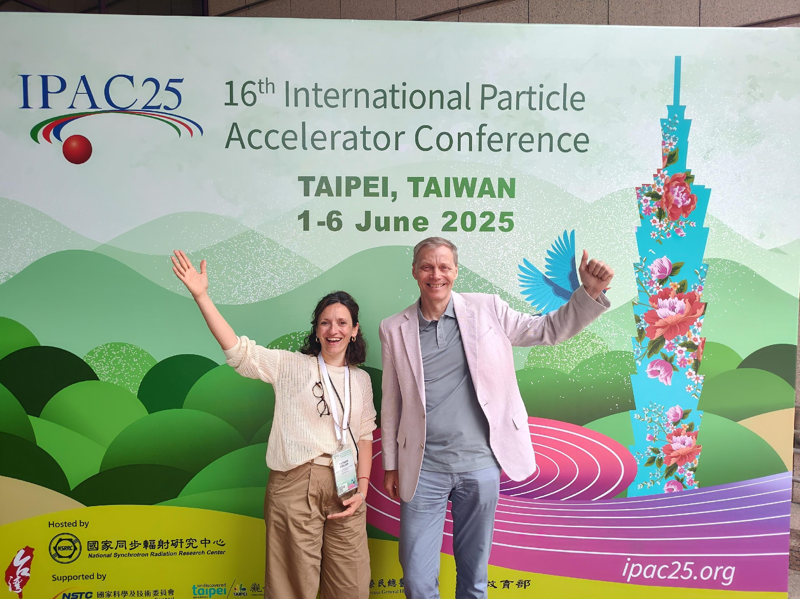
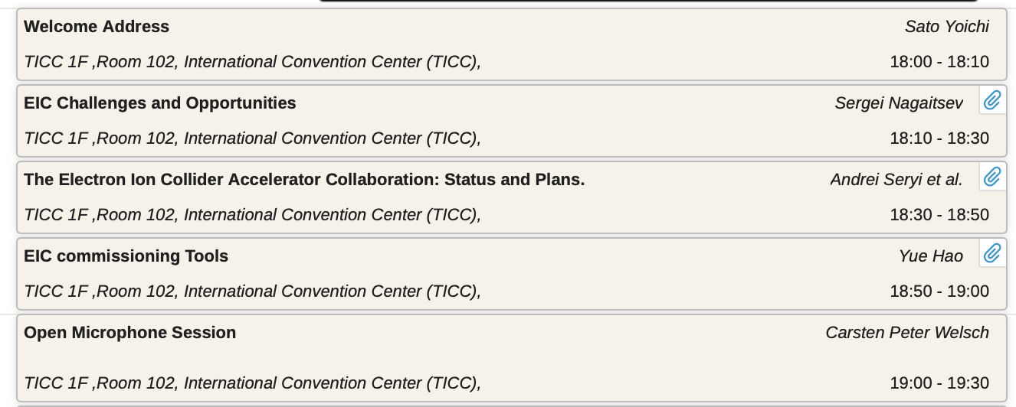
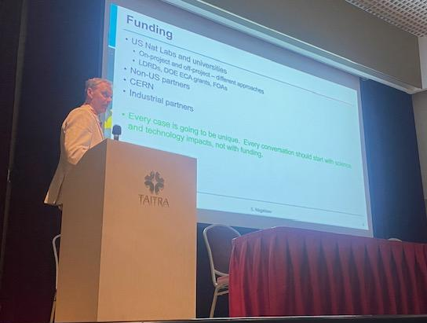
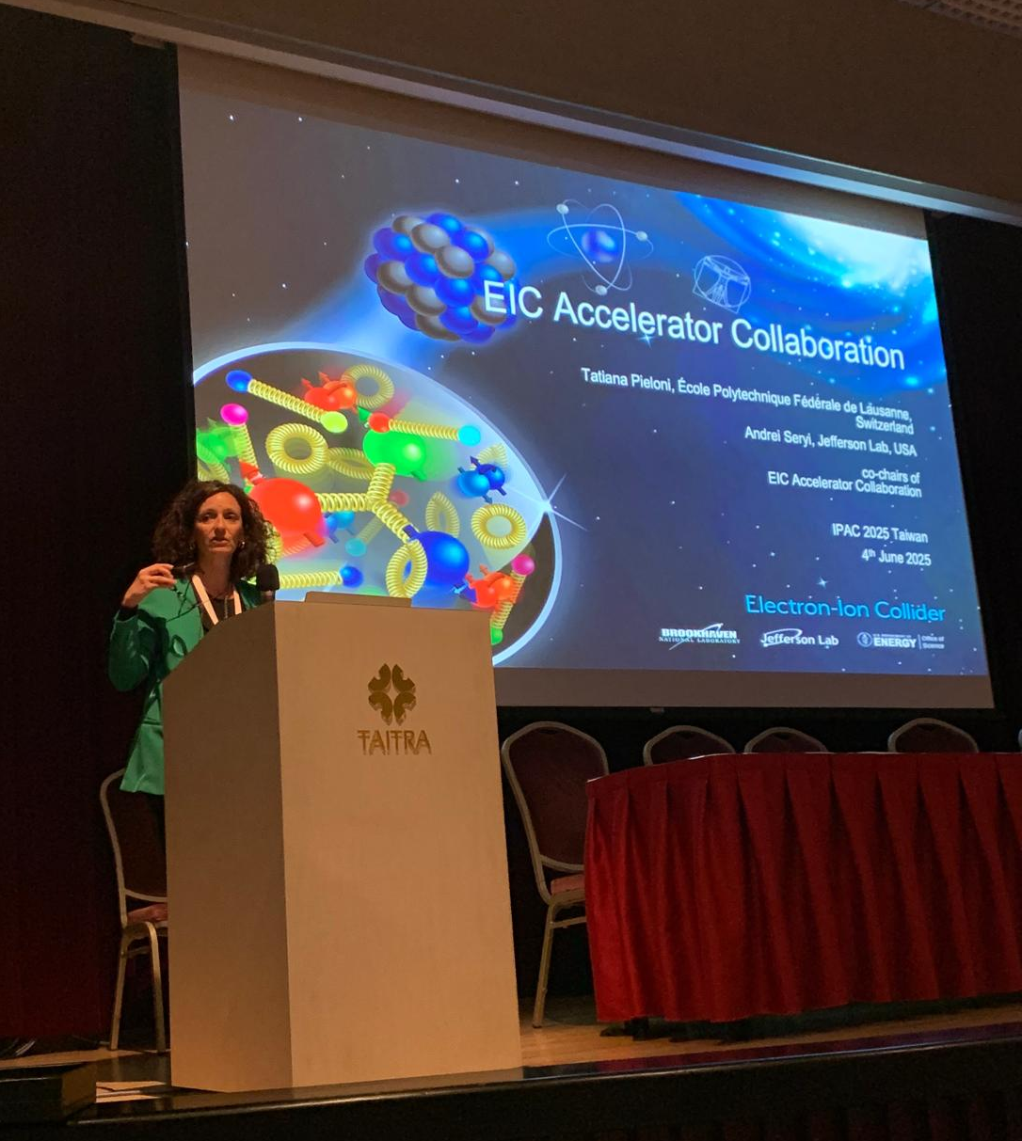
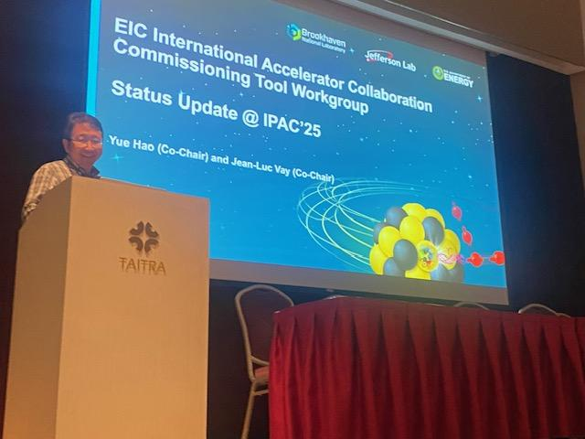
EIC-AC event at IPAC25

Slide 10
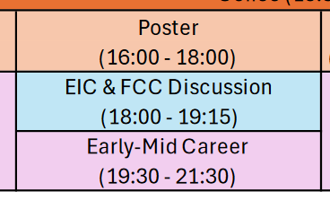
EIC-AC – FCC meeting at NAPAC 2025
EIC-AC satellite event at NAPAC 2025
Tue Aug 12, 6pm to 7:15pm
Will focus on EIC-AC updates, WG updates and EIC-FCC synergies

Slide 11
EIC Accelerator Collaboration
EIC Accelerator Collaboration missions:
Provide a discussion forum and a collaboration vehicle for the EIC accelerator-related working groups and topics;
Identify and create opportunities for US institutions to contribute to the EIC construction project;
Identify and create opportunities for In-Kind contributions to the EIC project and to future upgrades;
Identify and develop future EIC facility upgrades;
Identify and provide accelerator research and development topics and opportunities;
Communicate to EIC stakeholders on behalf of the accelerator R&D community;
Communicate to various long-range planning panels.
The EIC Accelerator Collaboration will enhance the long-term evolution and performance of the EIC, and should also help us construct the EIC more efficiently.

Slide 12
EIC-AC – conclusions and future plans
EIC Accelerator Collaboration (EIC AC) has been established
Working Groups on key technological challenges have been created
Submitted EIC AC input to the European Strategy for Particle Physics
IPAC 24 and IPAC 25 EIC-AC satellite events were successful
Preparing for EIC AC satellite meeting at NAPAC 25

