Slide 1
EIC Project Detector (== ePIC) Status
E.C. Aschenauer (BNL)
R. Ent (JLab)
Co-Associate Directors for the Experimental Program
EIC User Group & ePIC Collaboration Joint Meeting
July 14th – 18th, 2025

Slide 2


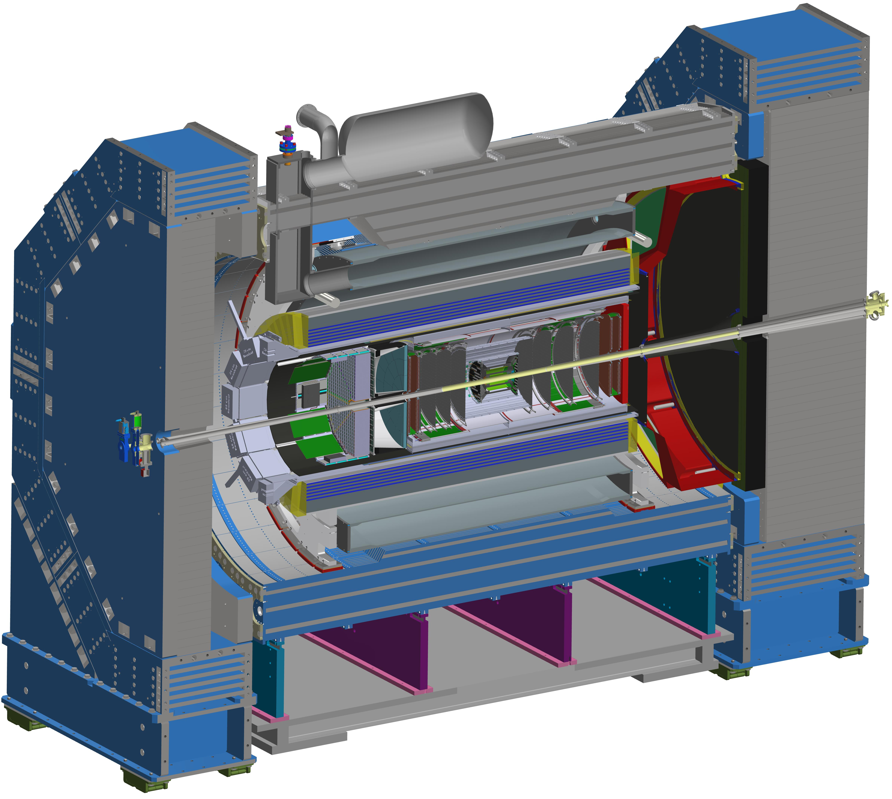
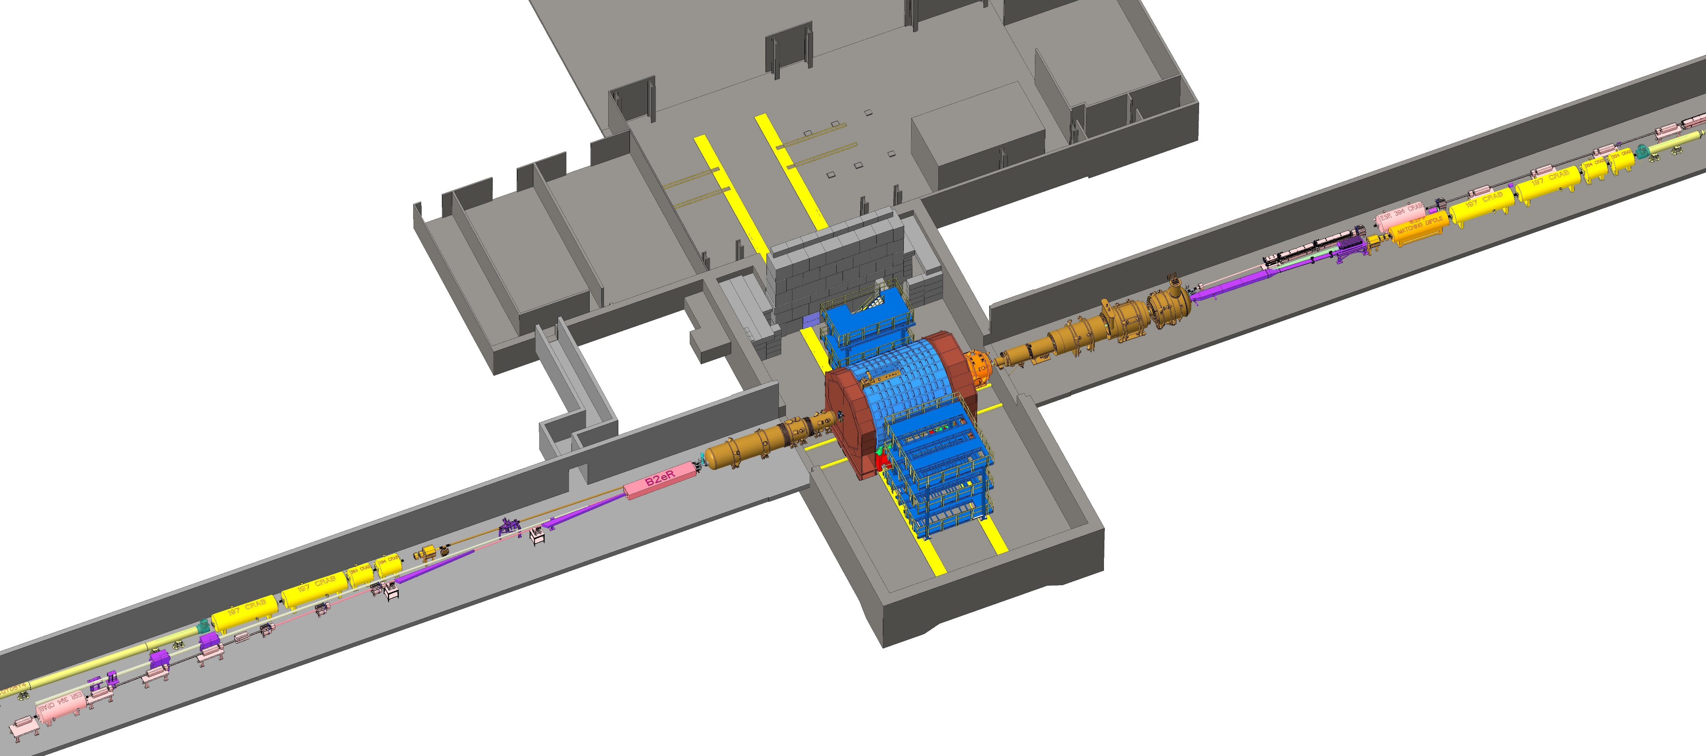
Scope Subproject: ePIC – EIC General-Purpose Detector
p/A beam
electron beam
e beam
ePIC:
26 subsystems over ± 40 m
to measure particle momenta, energy
and particle type
3 electromagnetic calorimeters
3 hadronic calorimeters
Silicon and Multi-pattern gas detectors
3 RICH detector (pfRICH, DIRC, dRICH)+ time-of-flight
7 Auxillary detectors (Si + HCal + ECals)
electron and hadron polarimetry
→ 8 world first technologies
p/A beam
Highest scientific flexibility
→ fully streaming readout electronics and data
acquisition
→ integration AI/ML capabilities from the start

Slide 3
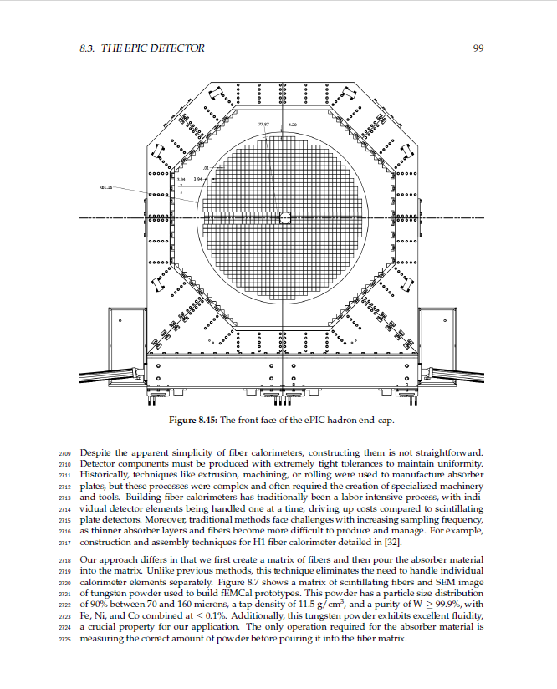
Experimental Program Progress Since CD-1
BNL and TJNAF Jointly Leading Efforts Towards Experimental Program | BNL and TJNAF Jointly Leading Process to Select Project Detector
2021 | Call for Collaboration Proposals for Detectors https://www.bnl.gov/eic/CFC.php | March 2021
 | BNL/TJNAF Proposal Evaluation Committee | Spring 2021
 | Collaboration Proposals for Detectors Submitted | December 2021
2022 | Decision on Project Detector – baseline “ECCE” | March 2022
 | Process to consolidate ECCE & ATHENA to the EIC Project Detector | Spring 2022
 | ePIC Collaboration Formed – 160 institutions | July 2022
2023 | ePIC Charter ratified & elected Leadership Team | February 2023
 | 1st Resource Review Board Meeting | April 2023
 | ePIC (Central) Detector remaining technology choices made | April 2023
2024 | ePIC Detector technical baselined | February 2024
 | Introduction of early physics planning to ePIC Collaboration | July 2024
 | Started drafting Preliminary Technical Design Report | July 2024
2025 | Passed 60% Cost-Weighted Design Maturity | January 2025
 | Detector R&D Completed (projected) | September 2025
 | Preliminary Technical Design Report completed (projected) | December 2025
Note that the host labs also separately organized ePIC computing and software reviews in Fall 2022. 2023, and 2024.
3

Slide 4

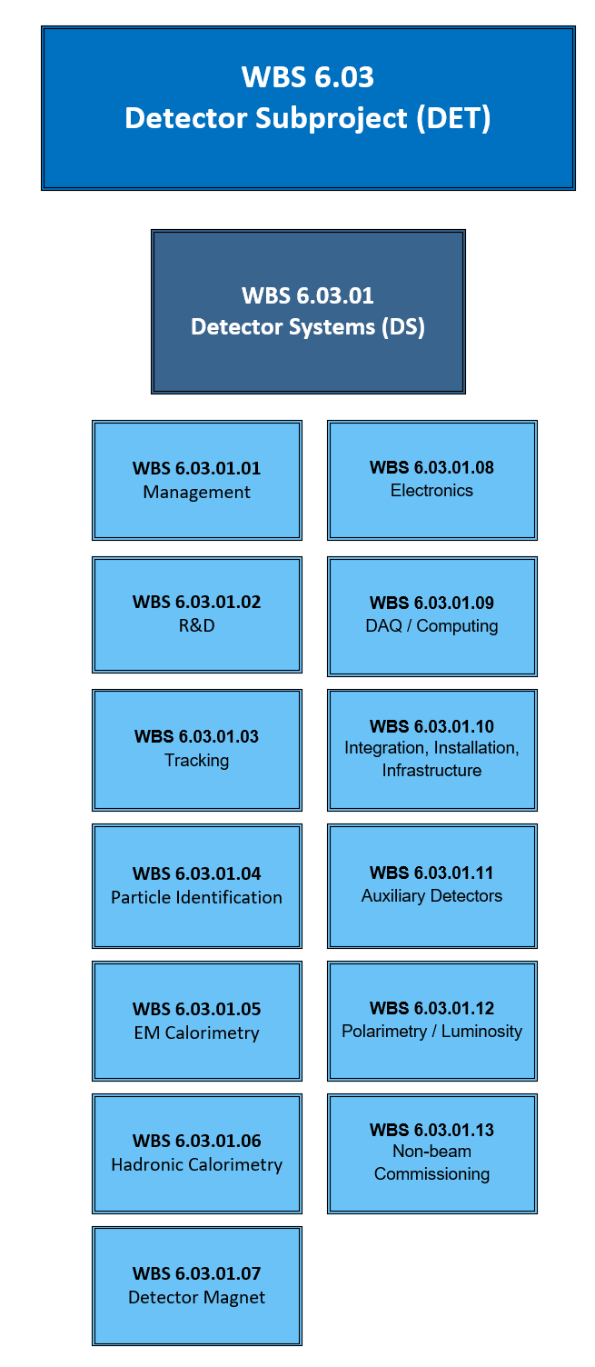
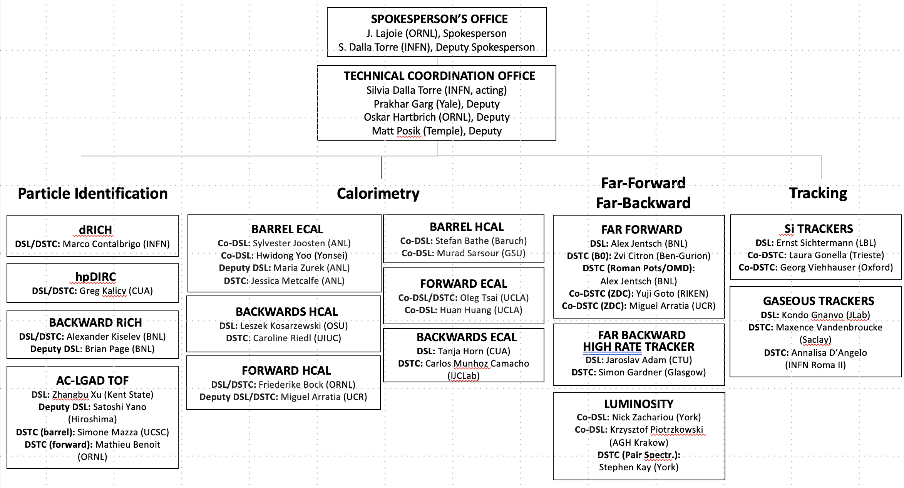
Integrating collaboration in Project WBS
Detector
Subsystem
Work Packages
will to be
integrated on L4
to WBS
DSL:
Detector Subsystem Leader
DSTC:
Detector Subsystem Technical
Coordinator
R&D is fully finished in FY2025

Slide 5
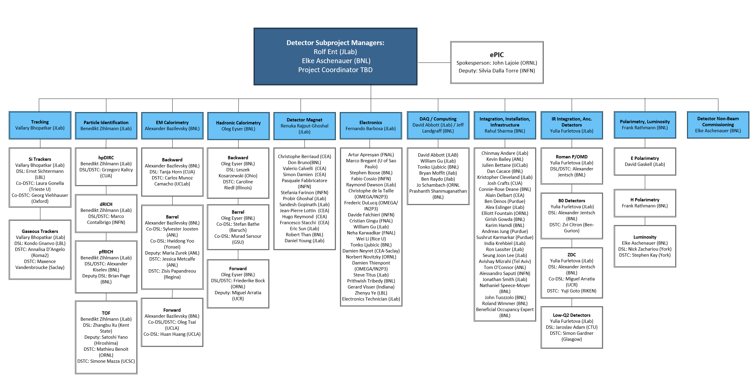




Integrating collaboration in Project Organization Structure
Detector Systems
Rolf Ent (Jlab)
Elke Aschenauer (BNL)

Slide 6
Assumptions
Approximately 30% of the detector scope is anticipated and assumed to come from non-DOE in-kind contribution and reuse of components. The work scope associated with the present best-known in-kind contributions is coded within the schedule. ​
  The identified In-kind contributions to the detector/experimental and accelerator equipment are included in the project scope and schedule but are not included in the DOE Total Project Cost (TPC).
  The remaining In-kind contributions (IKC) for the detector/experimental and accelerator systems with respect to the set of project goals for IKC are assumed but the scope is not fully defined at present.
The removal of RHIC accelerator and detector equipment (STAR and sPHENIX) is not included in the EIC Project.
  The preparation for the RHIC collider hall at IR-6 to host the EIC detector and the EIC IR magnets is included in the schedule, but the cost is covered by the BNL NPP directorate.
  The preparation for the RHIC collider hall at IR-8 to deinstall the existing sPHENIX detector at IP-8, remove STAR detector at IP-6 and allow the EIC accelerator beams top Storage Ring component removals are funded by BNL NPP Directorate.
Computing resources for simulations for scientific guidance and detector optimization and design are provided by the BNL and TJNAF computing facilities.
We assume off-project scientific labor to include scientific tasks accompanying detector construction, simulations, and high-level analysis software, and the efforts towards being ready for expedient science analysis folding in distributed computing.
We assume early beam pre-operations to start with an instrumented beam pipe only to measure beam properties and backgrounds. We assume the next stage of pre-operations with detector rolled into the experimental Hall.
The detector-specific non-beam commissioning is included in the detector scope. We assume the detector commissioning will be also supported by the international user community towards the EIC scientific program goals.

Slide 7
DOE Review Recommendations
4 in September 9-11, 2020, OPA Review, all closed
3 in January 26-29, 2021, CD-1 Review, all closed
1 in October 19-21, 2021, OPA Review, 1 in progress
  In progress: Pursue formal commitments for in kind contributions to the detector before CD-2.
None in June 28-30, 2022, FPD Status Review
2 in January 31 – February 2, 2023, OPA review, both closed
  Advance the detector integration and detector assembly planning sufficiently to mitigate risks and present at the next OPA review.
  Develop interface definitions for services for all technical options being considered and present at the next OPA review. Prioritize completing the associated R&D topics so that choices can be made as early as possible.
2 in November 14-16, 2023, OPA CD-3A review, both closed
  Proceed to CD-3A.
  Advance system engineering of detector electronics subsystems. Prioritize issues that impact space requirements within ePIC detector volume for the next review, including location of electronics as well as cooling and cables.
1 in January 7-9, 2025, OPA CD-3B review, affects infrastructure scope
  Encourage project management to strongly support the off-project addition of a new tunnel access to sector 5. ​
Only open recommendation is related to agreements. The present status is that we wait for final approval of (multi-lab) International Collective Research and Design Agreement (ICRADA) by DOE.

Slide 8
EIC as an International Facility and Agreements

Slide 9
EIC as a U.S. Based International User Facility
An EIC would be a unique facility in the world and would maintain U.S. leadership in nuclear physics.
The Scientific Foundation for an EIC was Built Over Twenty-Five Years
  Every US community report since 2002 endorsed EIC; its science is compelling, timely and fundamental
  EIC will provide a phase change in our understanding of the tiny quantum cosmos that is the nucleon and the other particles that bind and build the visible universe.
    This phase change is because we can witness how structure and interactions in a quantum world emerge from interactions of quarks and gluons – the quantum particles in an even tinier and hidden world.
There is strong and growing support for EIC in the scientific community and increasing international engagement. (>1500 members of the EIC User Group, >1000 members of the ePIC collaboration)
EIC science has worldwide endorsement (UK/STFC Infrastructure grant, Canada Long-Range Plan, NSAC Long-Range Plan, India MegaScience Vision Plan, NuPECC recommendation,…).
We plan governance of the EIC experimental program through a Resource Review Board

Slide 10

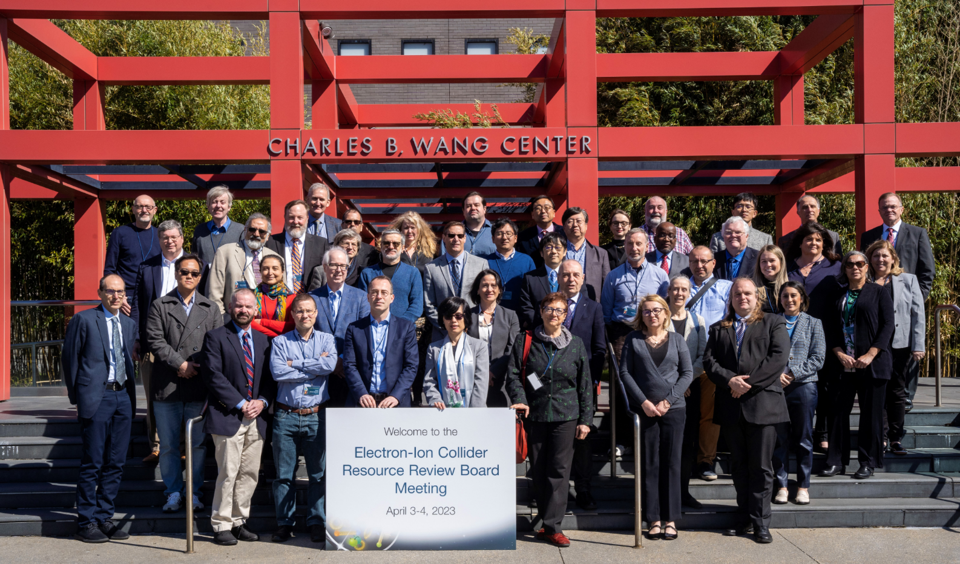
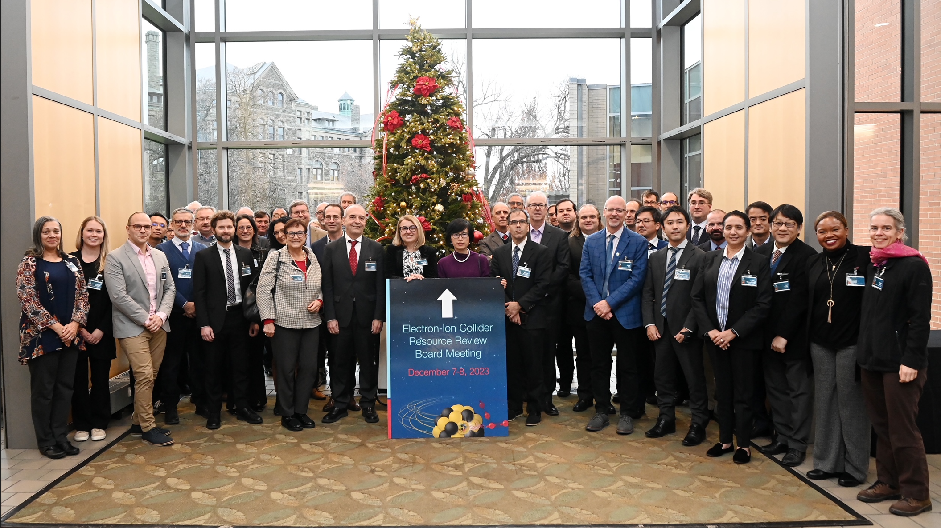
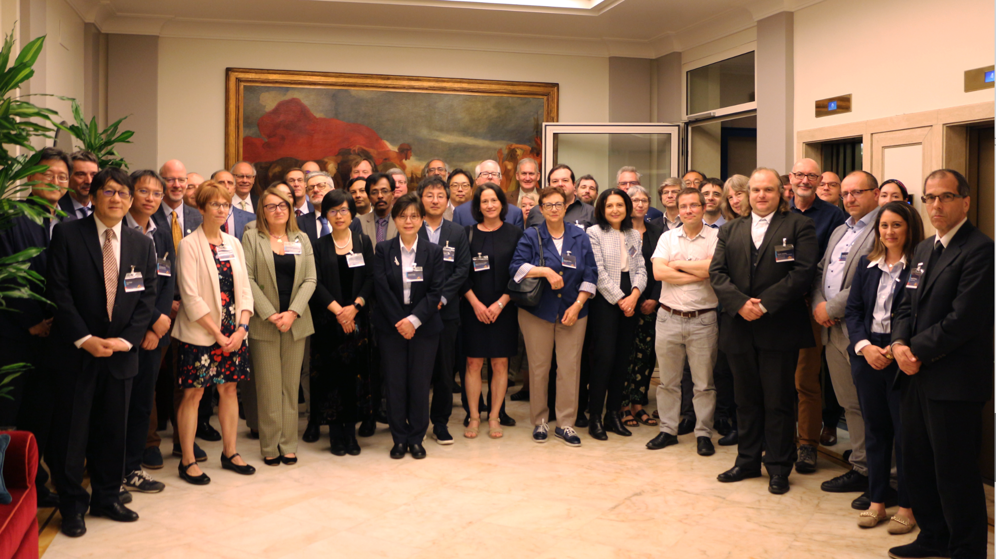
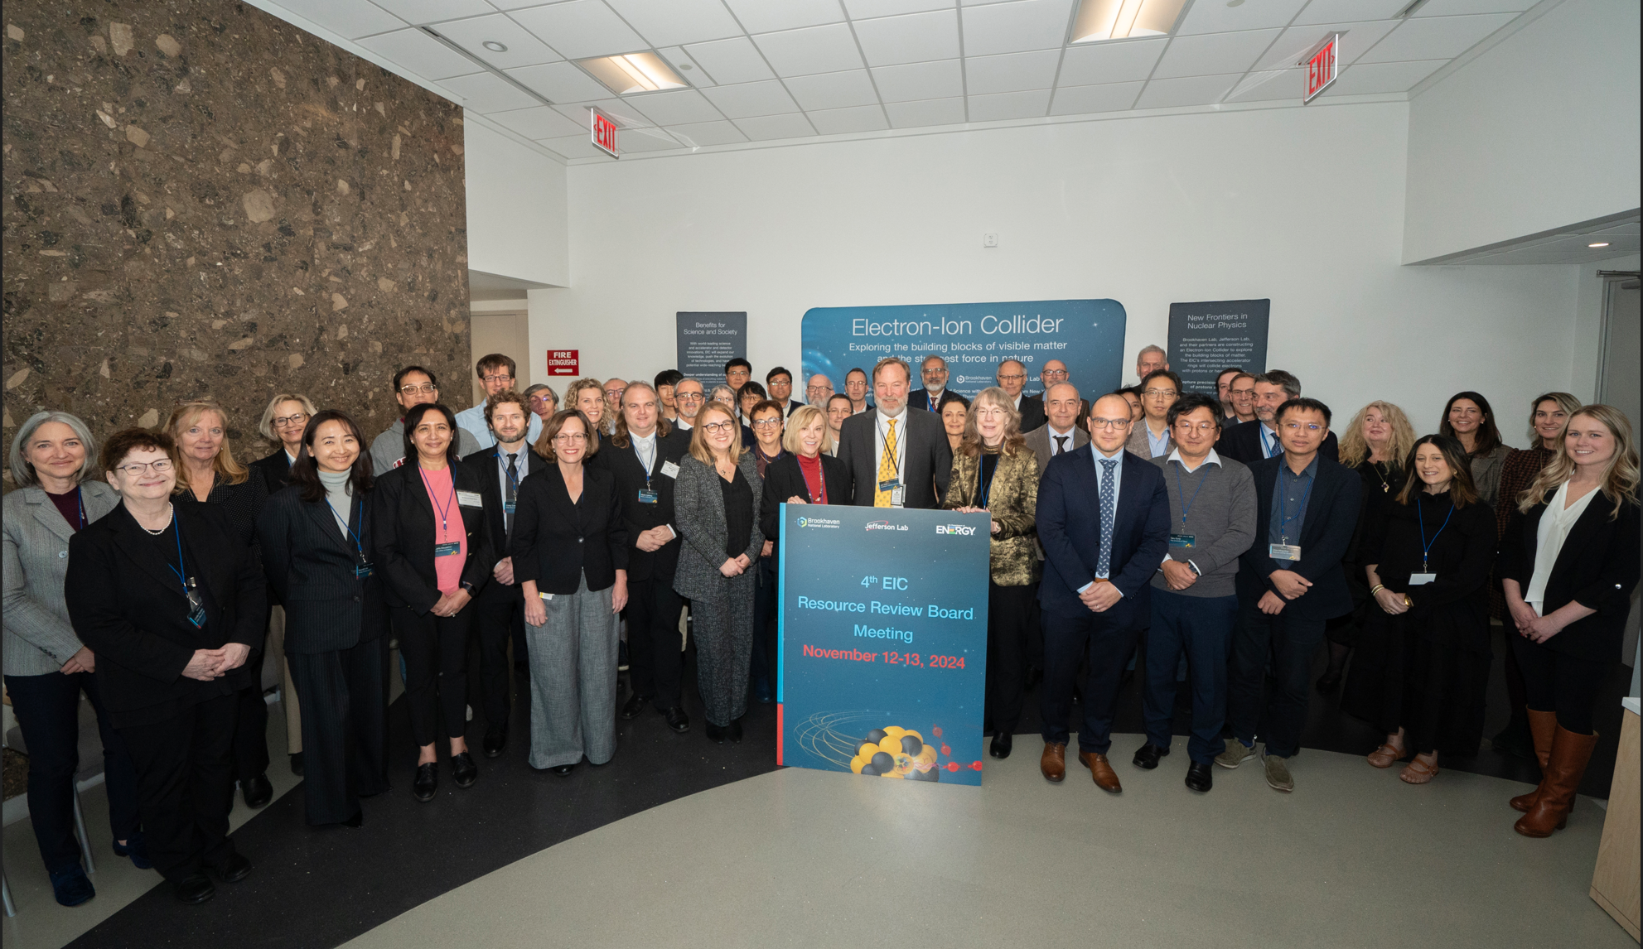
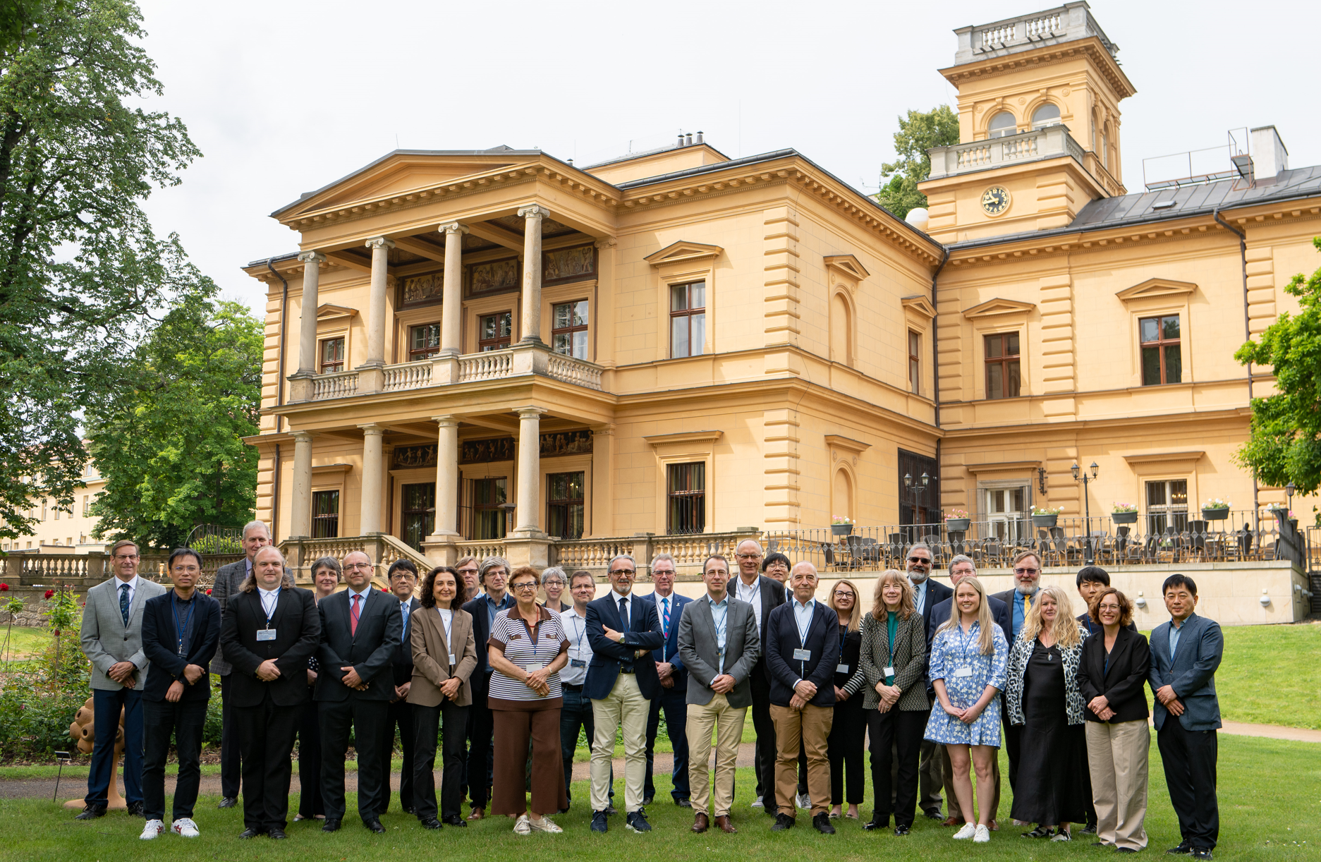
Resource Review Board (RRB) Meetings
DOE and the host labs promote the EIC as a facility “fully international in character.”
Initial RRB Co-Chairs:
Haiyan Gao (BNL) (Now: Abhay Deshpande)
Diego Bettoni (INFN) – (Will now become Franck Sabatie)
David Dean as JLab CRO is ex-officio
https://www.bnl.gov/eic-rrbmeeting/
1st RRB meeting on April 3-4, 2023 at Stony Brook University.
2nd RRB meeting on December 7 + 8 at Catholic University of America.
3rd RRB meeting on May 6 + 7 hosted by INFN/Italy in Rome
4th RRB meeting on November 7+8 2024 at BNL
5th RRB meeting on June 5+6 2025 in Prague
Future: 6th RRB meeting on November 4+5 2025 at BNL
7th RRB meeting to be hosted by Japan
The EIC-RRB provides coordination among the different funding partners during both the detector development and construction phase of the project and during the operations of the experiments that follow
The EIC-RRB shall provide oversight of resources utilized for detector construction and planning, which is the ePIC detector in the EIC project scope
The EIC-RRB will function as the body that reaches agreement on scope entailed in common projects, as appropriate, which shall be funded by members of the EIC-RRB
Strong international participation included: Armenia, Brazil, Canada, CERN, Czech Rep., France, India, Israel, Italy, Morocco, Japan, Poland, South Korea, Senegal, South Africa, Taiwan, UK

Slide 11
Path to Baseline – In-Kind Contributions (IKC)
The IKC target for the EIC detector is about 30% of the total scope approx. $100M.
The preparations of ICRADAs – First phase – has completed
The preparations of ICRADAs – Second phase – has started
Status: folding in
Reuse of components enabled by explicit design (e.g., barrel HCal, cradle, DIRC bars, ….)
In-kind contributions to PED
Likely IKC
  UK detector (UKRI/STFC)
  Italy/INFN detector
  Italy/INFN magnet
  CEA/IN2P3 detector
  Japan detector
  Korea detector
Possible IKC
  Canada detector
  Taiwan detector
  Israel Auxiliary detectors
  India detector
we would surpass this $100M goal.
This is coded in P6 in anticipation of further proposal confirmations and the signed formal agreements.
Elke and Rolf will contact partners to start work on PPDs
Agency | Scope | Status
Italy-INFN | Detector (dRICH, Si/ITS3, GEM-muRwell) | Finalizing ICRADA details
UK-STFC | Si-LAS, Low-Q2, Lumi) | Finalizing ICRADA details
France-CEA | MicroMegas, SALSA | Confirmed within CEA, ministry proposal ongoing
France-IN2P3 | EEEmCAL, RPs, ASICs | Confirmed within IJCLab/OMEGA, ministry proposal ongoing
Italy-INFN | Solenoid | Finalizing ICRADA details
France-CEA | Solenoid | Finalizing ICRADA details
Agency | Scope | Status
Korea-MSIT | Barrel EMCal, GEM-muRwell, TOF/ZDC collab. | Finalizing ICRADA details, MSIT/KBSi proposal in final stages
Japan-MEXT | Barrel TOF, streaming DAQ, ZDC | Draft ICRADA exists, MEXT proposal in final stages
Canada-CFI | Barrel EMCal readout, software | Draft ICRADA exists, CFI proposal submitted
Israel | B0 detectors | Plan to submit proposal this April, then start draft ICRADA
India | Forward EMCal, forward TOF, dRICH collab. | Plan to submit proposal this Summer
Taiwan | AC-LGAD sensors, PWO/LYSO | Pending success of Taiwan to produce sensors, prototype tests
Other?

Slide 12
CD-3A & CD-3B (Long Lead Procurements) Detector Scope

Slide 13
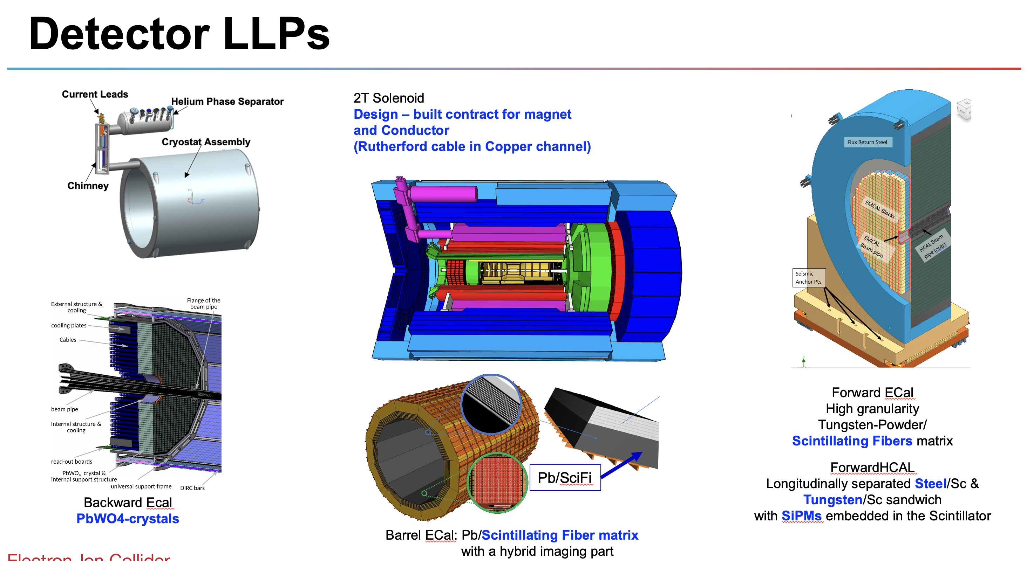
Construction has started! (CD-3A)
Detector scope is about 40% of ~ $90M in authorized CD-3A Long Lead Procurements, including 35% contingency
Lead Tungstate Crystals for the Detector Backward Electro-Magnetic (EM) Calorimeter
Scintillating Fibers for the Detector Barrel and Forward EM Calorimeters
Silicon Photomultipliers for the Detector Forward Hadronic Calorimeter
Steel and Tungsten for the Detector Forward Hadronic Calorimeter
Detector Solenoid Magnet Design and Fabrication and Conductor
PbWO4 crystals: Contract awarded 3/5/2025 (CRYTUR) -- 360 crystals delivered – quality tests completed on 250 crystals, all passed specifications.
Forward ECal: SciFi contract awarded 3/12/2025 (Luxium) -- first batch of 100 scintillating fibers did not pass specifications in quality tests; after discussions with vendor (Luxium) new batch sent and these passed.
Barrel ECal: Final evaluation scintillating fiber contract completed – two vendors Luxium and Kuraray – one of the vendors does not meet specifications, other is more expensive ~30%, price negotiations finalized → increased cost with a “Programmatic Change Request” and approval of contingency use.
SiPM: Contract awarded 11/25/2024 (Hamamatsu) → first delivery of 33K arrived
Forward HCal: All engineering test articles are finalized → contract going through different stages of approval
Conductor: Procurement working on submitting contract documents to Thomas Jefferson (DOE) Site Office; Magnet: In-kind from Italy -- INFN working on magnet tender with JLab and CEA engineers reviewing documents; Programmatic Change Request ongoing to change from DOE to in-kind scope.

Slide 14
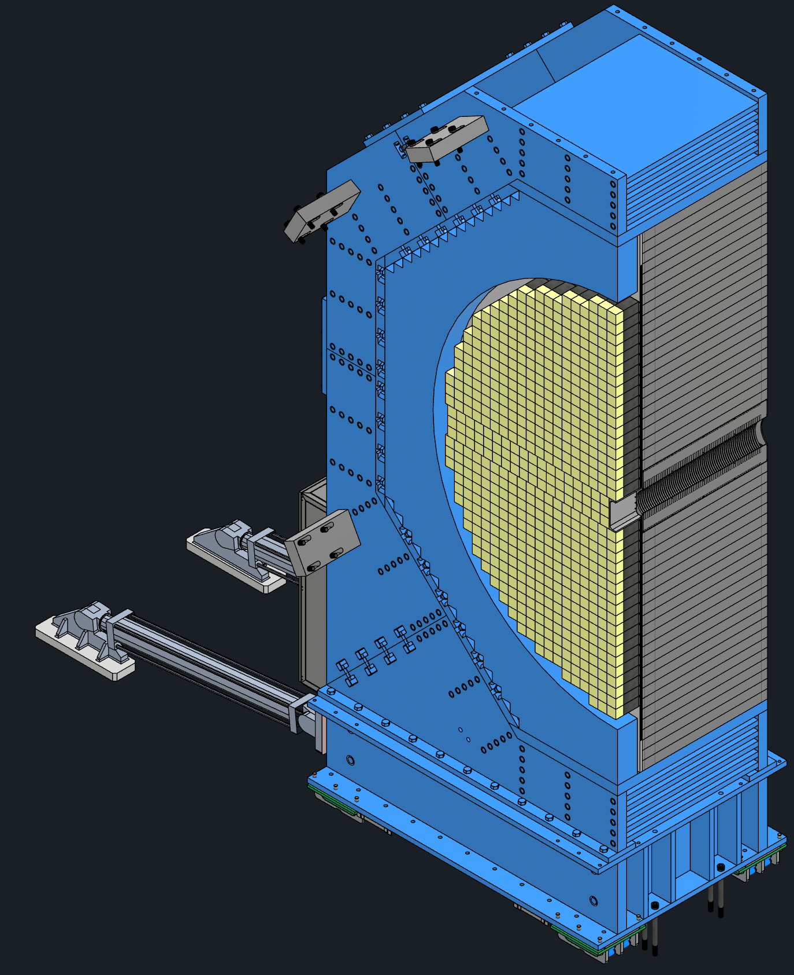
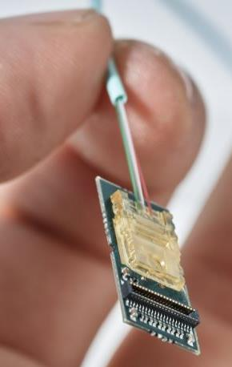
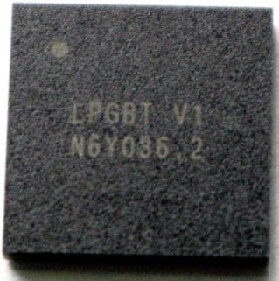
Long-Lead Procurement CD-3B Scope
The EIC Project requested authority to execute ~ $53M in LLPs, including 35% contingency during CD-3B-review January 2025.
Continuation of CD-3A Scope
WBS 6.10.05: Lead Tungstate Crystals for the Detector Backward EM Calorimeter
  1000 pieces next step to complete the 3000 needed
WBS 6.10.05: Scintillating Fibers for the Detector Barrel and Forward EM Calorimeters
  2nd phase of 4 phases → 1264 km and 1065 km, respectively out of the 4900 km and 3000 km
WBS 6.10.06: Steel Plates, machining, coating and welding of the Towers for the Detector Forward Hadronic Calorimeter
  the next 200 units out of the 1066 total 8M towers
New Items:
WBS 6.10.07: Detector Solenoid Magnet Power Supply
  Required for operation of the magnet at its design field which is required for the magnet acceptance
  Reduces schedule risk due to competing project schedules → installation accelerator vs. experimental equipment
WBS 6.10.10: Flux Return Steel for the Electron and Hadron Endcap Structures
  50% of needed magnet steel → first phase hadron endcap flux return steel
  Required for operation of the magnet at its design field which is required for the magnet acceptance
WBS 6.10.08/09: VTRx+/lpGBT for MAPS tracker, dRICH and other subsystems to ensure homogenization
  Includes 5500 Versatile Link Plus Transceivers (VTRx+) and 1500 Low Power GigaBit Transceivers (lpGBT)
  Take advantage from the planned production run by CERN, reduces cost and schedule risks as the alternative would be to develop a new design with new electronic components

Slide 15
Outlook to CD-2

Slide 16
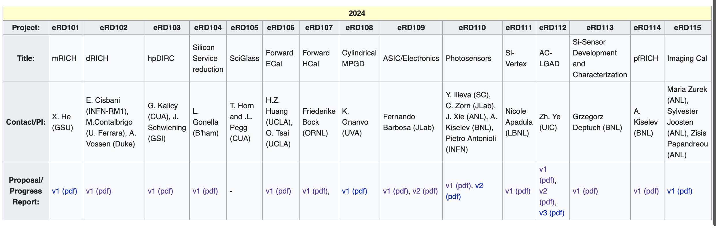





EIC Project Detector R&D Program
Projected completion: September 2025
Details: https://wiki.bnl.gov/conferences/index.php/General_Info
finished in 2023
as not ePIC
baseline technology
Projected to finish
in July
finished in 2023
as not ePIC
baseline technology
finishing
in FY25
muRWell finished
in FY24;
CYMBAL finish in CY2025
finished
in FY24 beyond INFN studies
Projected to finish
in CY25
Projected to finish
in July
finished
in FY25
finished
in FY24
finished
in FY25
finished
in FY25
finished in 2023
as technology was
very mature due to generic EIC R&D
finished
in FY25
finished in 2023
as technology is
very mature, focus on engineering design

Slide 17
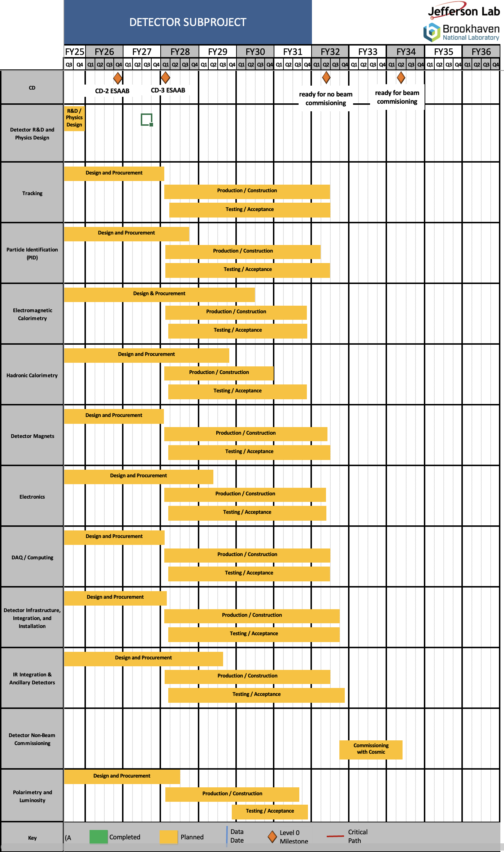
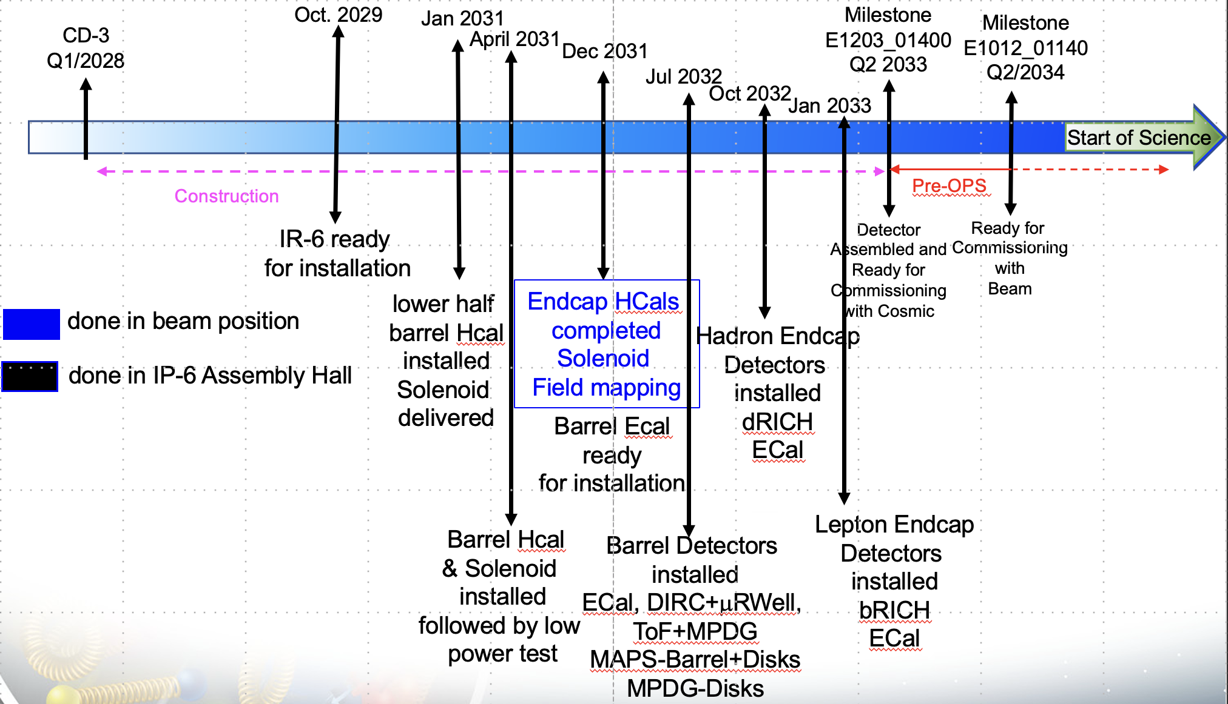
Schedule
The schedule is driven by:
  To hold the date for the CD-2 IPR of June 2026
  To keep the (inter)national user community engaged and limit the danger to lose groups
  all subdetectors need to be more or less ready at the same time to be assembled to ePIC
The schedule drivers are:
  Superconducting Solenoid → CD-3A item
  Silicon Sensors (MAPS, AC-LGAD & ASTROPIX)
  ASIC long time frames only one ASIC designed from scratch all others are modifications to existing ASICS
  Items with long production times, single vendor and complex assembly
  → CD-3A & CD-3B
  International agreements driving in-kind and MAPS design (agreement with CERN)
R&D is fully finished in FY2025

Slide 18
Risks
Overall Detector Risk summary:
We have added several risks, folding in comments from tracking reviews, off-project dependency reviews, and recent lessons learned from sister collider and collider detector experience.
Pre-mitigated high risks:
  magnet (CD-3A scope)
  accelerator/detector integration
  silicon vertex tracker delay
  delay in off-project
  integration labor
  readout electronics (CD-3B scope)
  magnet flux return steel (CD-3B scope).
Post-mitigated high risk:
  magnet delay – will stay as high until magnet low-current test to prove conductor quality.
  accelerator/detector integration – risk mitigated at end of design phase, but residual risk up to operations phase
  delay in MAPS sensors – impact of not being able to do agreements and of final assembly/integration issues
Post-mitigated moderate risks:
  backgrounds, DIRC bar reuse (or not), failure to reach $100M in-kind goal, AC-LGAD, HRPPDs, Astropix, hadron polarimetry @ EIC beam currents.

Slide 19
Detector Reviews planned for 2025
Preliminary Design Reviews (60% design maturity equivalent, called PDR, PDR2 or PDR3, pending the subsystem)
  PDR: MPGD Tracking Detectors (6.10.03.02) – Summer/Fall 2025 – Note: FDR only after completion of first engineering test articles
  PDR2: Silicon Tracking Detectors (6.10.03.01) – Fall 2025 – TBD, pending early results of ITS3 ER2
  PDR2: Cherenkov-based Particle Identification Detectors (6.10.04; pfRICH, hpDIRC, dRICH) – April 1-2, 2025
  PDR2: AC-LGAD-based Particle Identification Detectors (6.10.04; BTOF, FTOF, common systems) – November 2025
  PDR3: Barrel EM Cal (6.10.05.02) – August 28-29 (?) 2025 → Confirmed for September 17-18 to accommodate reviewers
  PDR2: Backward HCAL (6.10.06.01) – ~September 2025
  PDR: Magnet Cryogenics and infrastructure (6.10.07) – September/October 2025
  PDR3: Electronics/DAQ-computing (6.10.08. 6.10.09.01) – Confimed for September 3-4 2025 – this does not include slow controls
  PDR: DAQ-Slow Controls (6.10.09.02) – November/December 2025 – Later to ensure integration DAQ in the collider common platform
  PDR: Integration, Infrastructure and Installation (6.10.10) – September/October – everything outside GST, includes cradle, HCAL, etc.
  PDR: Integration, Infrastructure and Installation (6.10.10) – November/December 2025 – everything inside GST
  PDR3: IR Integration and Auxiliary Detectors (6.10.11) – November/December 2025 – includes 6.10.14 lumi detector
  PDR2: Polarimetry (6.10.14) – September/October 2025 – January/February 2026
Final Design Reviews (FDR):
  FDR: Final Design Review of the BABAR DIRC Bar Refurbishment for the High Performance DIRC Particle Identification Detector – April 1, 2025
  FDR: Forward EM Calorimetry (6.10.05.03) – aim for last week July (July 31?) → reconsidered and will do PDR this Fall
  FDR: Backward EM Calorimetry – → February 2026?. Barrel & Forward HCAL (6.10.05.01; 6.10.06.02; 6.10.06.03) → will do PDR this Fall
Project Reviews:
  DOE OPA CD-3B Review – January 7-9, 2025
  “Red Team” Review (acts as Director’s Review for DOE OPA Focused Status Review) – May 20-21, 2025
  DOE OPA Focused Status Review – August 5-7, 2025
Other Meetings:
  EIC International Computing Organization (EICO) – April 2–4, 2025 @BNL
  Detector R&D Day hosted by ePIC and EIC Project – April 16-17, 2025
  Technical interchange meeting with EIC Computing and Software Advisory Committee (ECSAC) – May 12, 2025
  5th RRB Meeting: June 5-6, 2025 – Prague, Czech
  10th DAC Meeting – Comprehensive look to design status and readiness for CD-2. June 11-13, 2025.
  6th RRB Meeting: November 4-5, 2025 - BNL
Issue has been dearth of mechanical engineers to start drawings

Slide 20
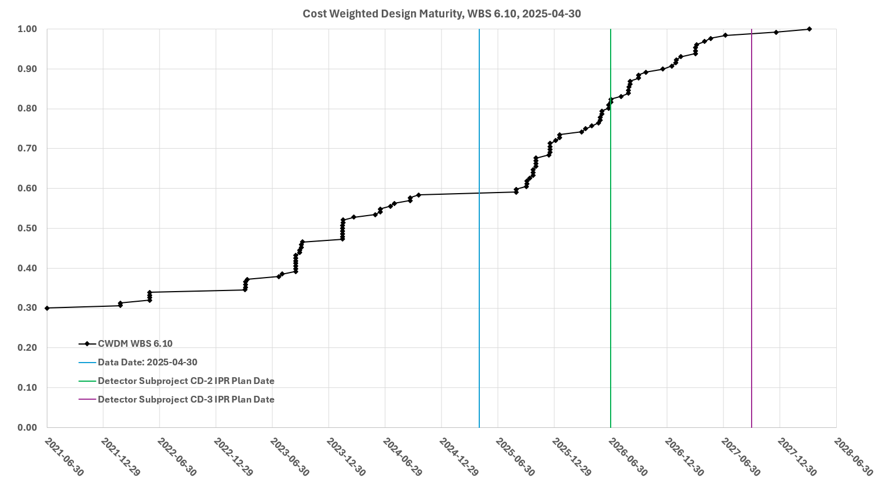
Path to Baseline – Design Maturity
Cost-weighted design maturity:
Present design maturity at 60%
Jun. 11-13: Comprehensive Design Review by DAC
Projected > 80% at end of July 1, 2026
Towards Baselining:
L3 CAMs are making updates to Basis-Of-Estimates.
Please work with L3 CAMs to create Inspection & Test Plans.
Nov. 12-14: Baseline Readiness Assessment review planned.

Slide 21
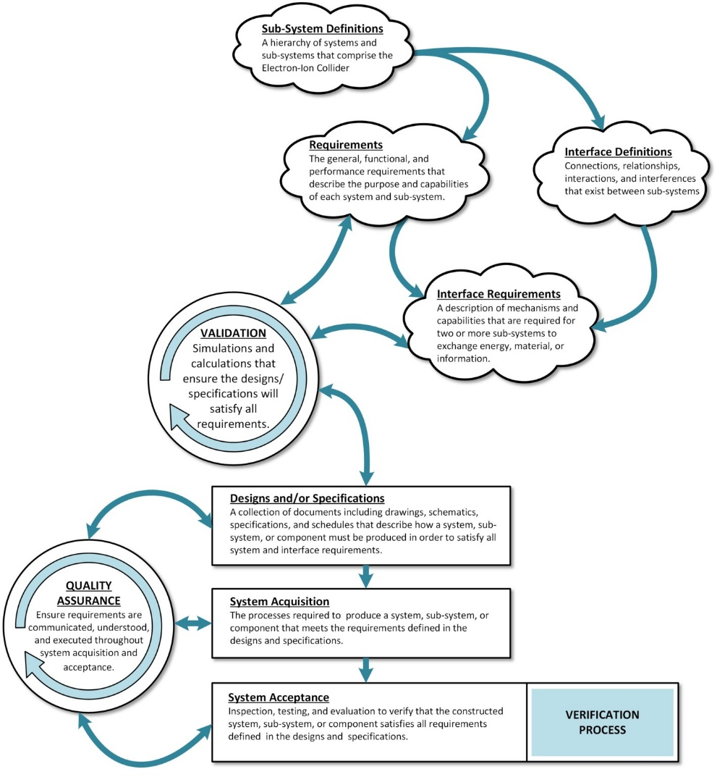
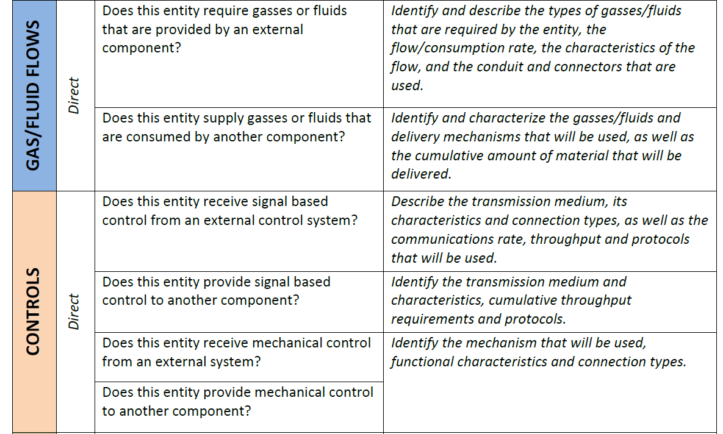
Requirements & Interfaces
Documentation: see eic.jlab.org (or eic.jlab.org/Detector)
Requirements Documents signed and posted for the collaboration
    General, functional, and performance requirements leading to design and specifications
    Validation phase completed by L2 managers.
    Routinely reviewed in all sub-system design reviews.
Interface Requirements signed and posted for the collaboration
    Interface interrogation plan has been successfully used to collect interfaces.
    Updated in 2024 to include a categorization field to collect quantitative information for the interfaces collected earlier.
    Created basic template that can be used to auto-generate all Interface Control Documents (ICDs) from the interfaces database, with minimal effort.
    Auto-generator used to produce ICDs for the Detector Magnet (CD-3A) and Endcap Steel (CD-3B).
  To develop all ICDs is the topic for this calendar year.
  Ready to baseline by late 2025.

Slide 22
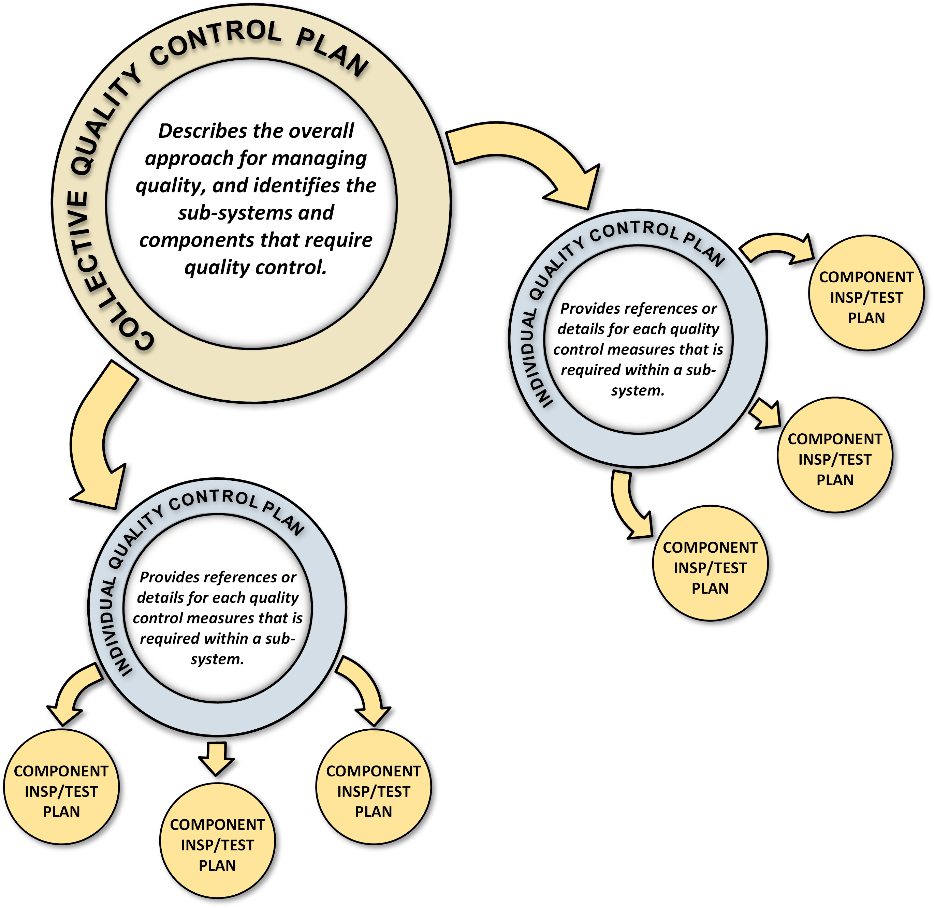
Quality Control + Installation Planning
Quality Control Documents being developed in three-tier system
    Detector 6.10 Quality Control Plan is complete
        This umbrella document includes the quality control processes for the detector sub-systems, and defines provider categories including: vendor contracts, assembly by collaboration or institutional partners, and in-house construction.
        Includes a description of the flow of requirements and quality assurance through the system acquisition process and identifies components in each sub-detector that are subject to quality control.
    Individual Quality Control Plans are in progress
        Documents are developed for each sub-detector ( ex. The 6.10.04.03 pfRICH detector) and describe the quality control for each component at various stages of the system acquisition process.
    Individual components have Inspection and test Plans (ITPs)
        ITPs currently exist for the magnet, conductor, and aerogel.
        These documents will typically be provided by ePIC collaborators.
Many quality control setups exist already!
    Aerogel test station (Temple), lead-tungstate test station, HRPPD test station (JLab, BNL, INFN), Photo-sensor test stations (BNL, Glasgow, INFN), Scintillating Fibers (UCLA, BNL, Regina), MPGD test station (CEA, JLab, UVA, FIT, Roma), Cosmic Ray hpDIRC Telescope (SBU), etc.
    Please document in Inspection and Test Plans! (see template on eic.jlab.org/Detector)
Installation Plan Document has been written to communicate detector assembly schedule and timeline.

Slide 23




ASICs – Path to Completion (all compatible with streaming readout!)
 | Status & Development Summary | Next Steps | Production | Institution
CALOROC | Interface design FY23- FY24, CALOROC1A/B designed FY24-FY25 CALOROC1A: ADC/TOT + TOA, full SRO interface CALOROC1B: Switched gain (4) + ADC + TDC, full SRO interface Tests: Oct 2025 | CALOROC2 (64 ch) – FY25-FY26 Select version and increase channels from 32 ch to 64 ch. | FY27 | OMEGA/IN2P3/IJCL, ORNL
EICROC (32x32) | EICROC0A (4x4) designed FY24-FY25, EICROC1 (32x32) FY25 EICROC0A: ADC + TOA, improved testability EICROC0B: Replaced ADC with peak sensing, Wilkinson ADC, lower power EICROC1: added full SRO interface | EICROC2 (32x32) FY26 Add Derandomizer and ZS. Digital on Top design for lower power (~1 mW/ch). | FY27 | OMEGA/IN2P3/IJCL/CEA-Saclay, AGH
FCFD (128) | Front end characterized, FCFDv1 (6 ch) FY23-FY24 characterized, FCFDv1.1 FY25 Optimized for HPK sensor characteristics | FCFDv2 (32 ch) FY25-FY26 Add ADC, TDC, interfaces from ETROC, ECON CERN. FCFDv3 (128 ch) FY26 | FY27 | FNAL
FCFD Variant (64) | FCFDv1.1 FY25 Preliminary tests with sensors | Harmonize sensor/ASIC specifications, adapt FCFD for 64 ch. | TBD | FNAL
ALCOR | ALCORv2.1 (32 ch) beam tests FY24, ALCOR v3 (64 ch) FY24-FY26 Full specification, SRO interface, BGA | ALCOR-64 – FY26 Final iteration for production | FY26 – FY27 | INFN
SALSA | SALSA0/1 FY24, SALSA2 (32 ch) designed FY23-FY25 Full SRO interface, most DSP features, Submission October 2025 | SALSA3 (64 ch) FY25-FY27 full DSP, 64 ch | FY27 – FY28 | CEA-Saclay, U Sao Paulo
ASIC production is ~1 Year: Fab, Packaging, Test. Additional information in the following slides. PED is expected to be completed in FY26.
Fab submission is imminent.
Slide courtesy Fernando Barbosa

Slide 24
ePIC Streaming Electronics, DAQ and Computing
EIC benefits tremendously from a huge effort to develop streaming-compatible ASICs!
Planning for DAQ systems (ePIC/EIC project), for computing data challenges (together with ECSJI/host labs), and for integration of AI fits seamlessly.
(International) EIC Computing Organization structure approved at last RRB
FY25 |  | FY26 |  |  |  | FY27 |  |  |  | FY28 |  |  |  | FY29 |  |  |  | FY30 |  |  |  | FY31
PicoDAQ |  |  | MicroDAQ |  |  | MiniDAQ |  |  |  |  | Full DAQ-v-1 |  |  |  |  | Production DAQ |  |  |  |  |  |  |  |  |  | DAQ
Streaming Orchestration |  |  |  |  |  |  |  |  |  |  | Streaming Challenges
AI-Empowered Streaming Data Processing |  |  |  |  |  |  |  |  |  |  | Analysis Challenges |  |  |  |  |  |  |  |  |  |  |  |  |  |  | Computing
 |  |  |  |  |  |  |  |  |  |  |  |  |  |  |  | Distributed Data Challenges
AI-Driven Autonomous Alignment and Calibration |  |  |  |  |  |  |  |  |  |  | Self-Driven ePIC Experiment |  |  |  |  |  |  |  |  |  |  |  |  |  |  | AI
Figure courtesy Markus Diefenthaler

Slide 25
Summary: Strengths & Issues/Challenges

Slide 26
Strengths & Issues/Challenges
Strengths | Critical Issues and Challenges
Requirements are well known and documented (and available to all on the web). | Integration of EIC detector and interaction region is extremely complex, so much attention to interfaces is needed.
Technical baselining of ePIC detector is complete since Spring 2024. | A complex detector with many different detector technologies; Ensure we have risk mitigation in place for those detectors that are “world’s first” or have a large (user) labor component
International interest in EIC detector is large, with many in-kind contributions confirmed and more in progress. | Formalizing interest of international EIC user community into in-kind agreements.
Good coordination between ePIC and EIC project; the ePIC collaboration is well integrated. | All detectors have institutions working on them, but many systems are workforce-hungry.
ePIC is a CERN recognized experiment | The lack of a CERN agreement for ITS3/MAPS to get access to the design, this affects progress already now. The long time to complete agreements imposes high project risk.
ePIC collaboration has started the draft TDR effort July 2024 → projected to be completed CY2025 | We are lacking behind in performance simulations critical to support the baseline design of ePIC
We have reached an overall average >60% design maturity in 2025 and will be beyond late 2025. | Accelerator & detector scope are strongly coupled, continued strong effort is needed to keep things well aligned

Slide 27


Slide 28


Slide 29
ePIC Setup at EIC Start Up
→ Initial commissioning of collider rings is with instrumented beam pipe only.
→ Subsequently, the ePIC detector rolls in for pre-ops with detector. Goal:
Central ePIC has all subsystems installed
Ancillary detectors all supports are installed, but some of the detector packages are not installed for safety reason for year 1.
ZDC and Lumi-detector are fully installed
Off-Momentum detectors should be in save position, so they can be used if beam is stable
Roman Pots will not be installed
low Q2 Tagger should be discussed
hadron and electron polarimetry will be installed from day-1 operating EIC
Hadrons
Ring Inside
Electrons
Photon
Beam
pC Hadron
Polarimeter
Rear
SC Magnets
B0 Magnets
& Detectors
Far Forward
SC Magnets
Luminosity
Monitor
Dipoles
Hadron Storage Ring
Electron Storage Ring
Low Q²
Taggers
Off Momentum
Detectors
Roman
Pots
Zero Degree
Calorimeter
Ring Outside

Slide 30
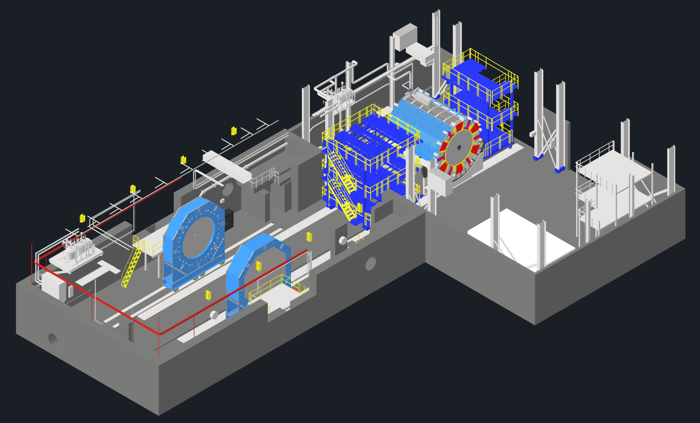
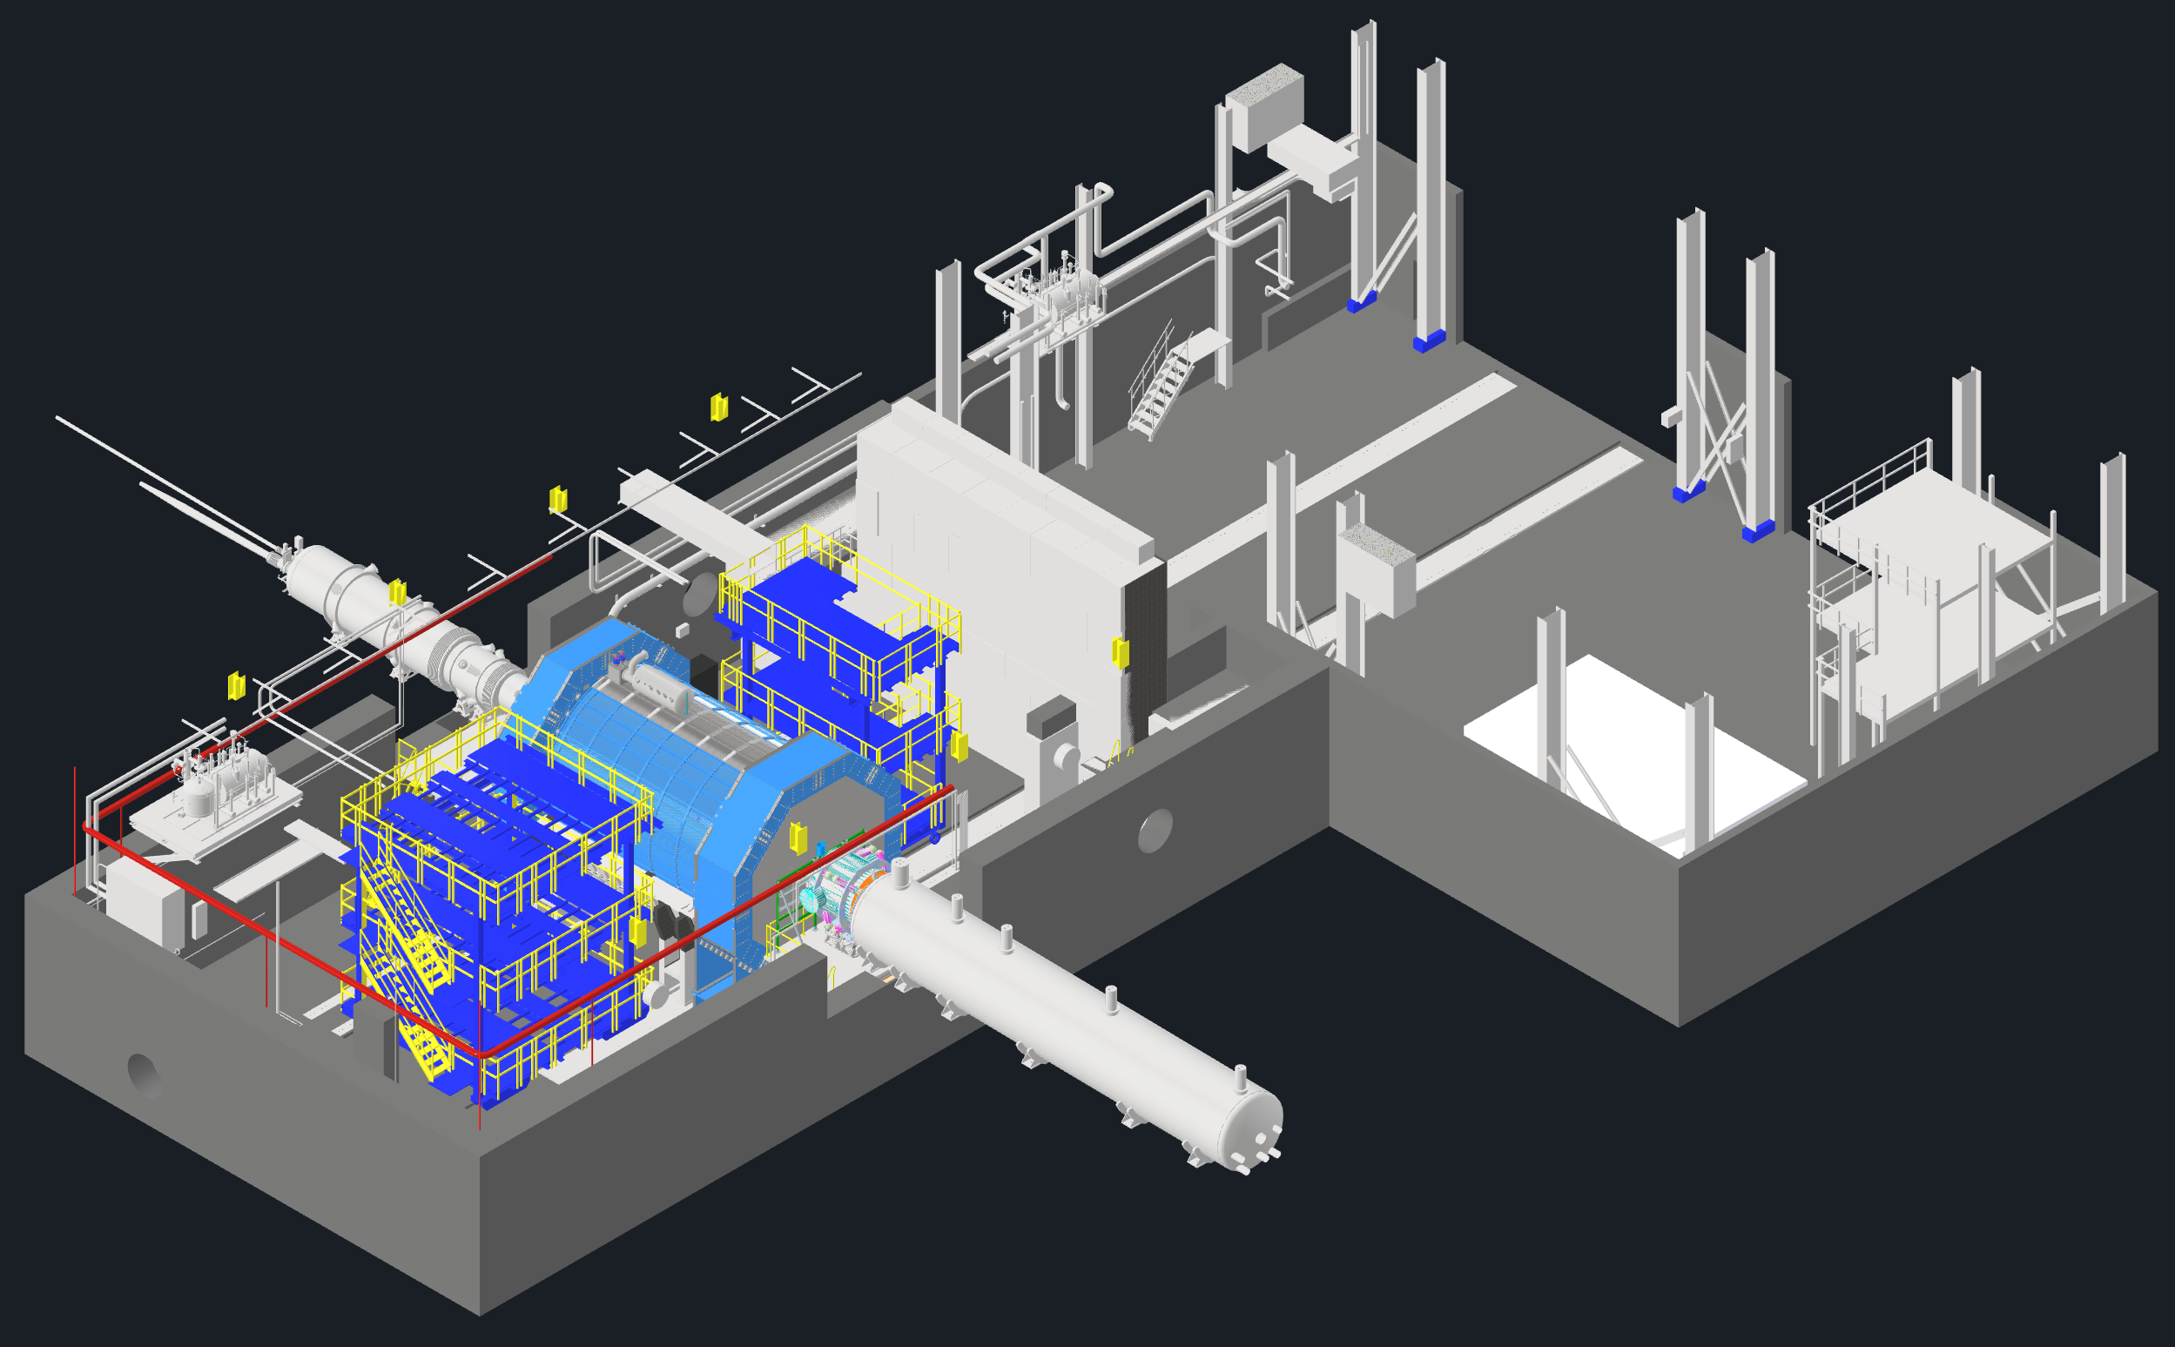
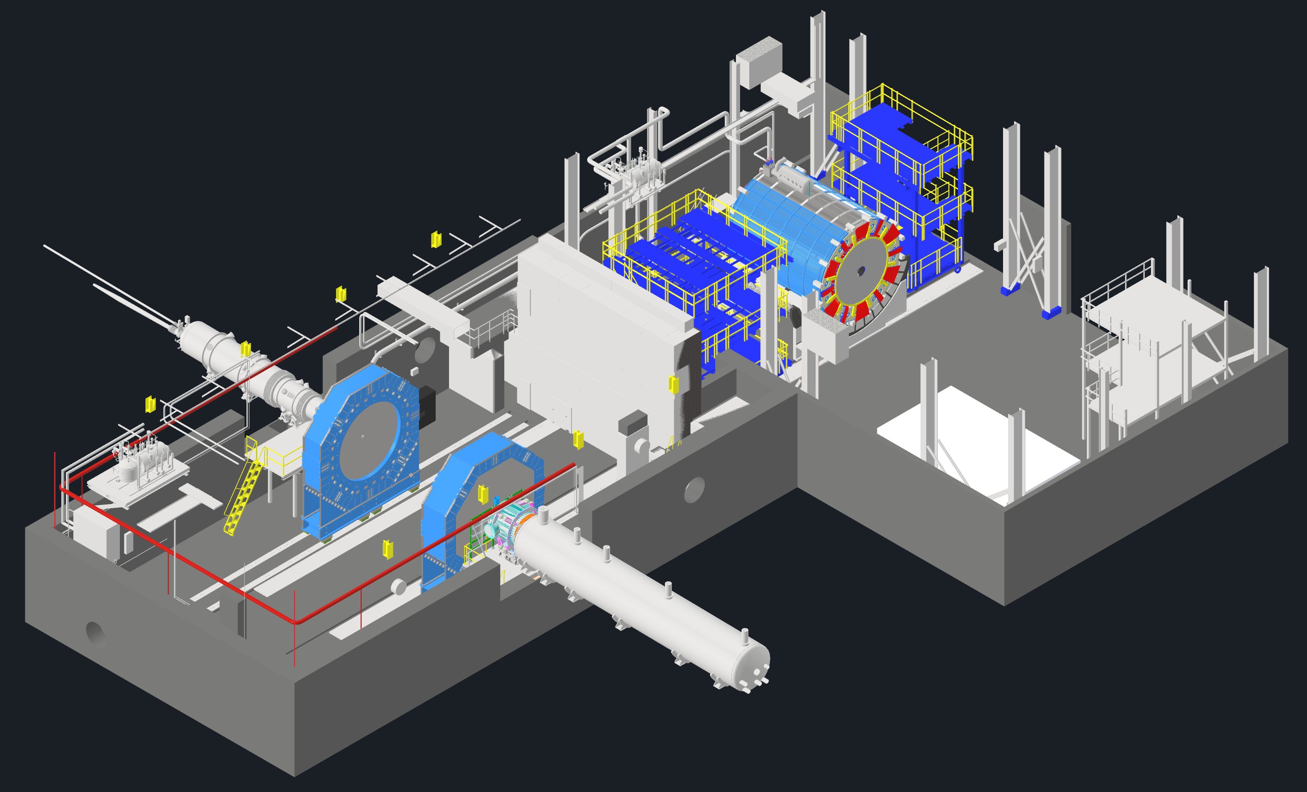
EIC - ePIC Commissioning
Q2/2033
~ CY 2034
exact dates under development
ePIC no-beam commissioning
ePIC commissioning with beam
ePIC fully assembled and Ready for Cosmic Data Taking
EIC first beam commissioning
central ePIC in assembly hall
endcap calorimeters
and beam pipe with instrumentation to have a first look on backgrounds
Luminosity detector and hadron & electron polarimeters fully installed
move central
ePIC into wide-angle hall
commission
ePIC with beam
All auxiliary detectors, but RPs and OMDs are installed
Start of Science
program
RPs and OMDs will be installed in year-2

Slide 31
Path to CD-2
2025
January
February
to
May
June
July
August
September
October
November
December
successful
CD-3B
Review
ePIC
Collaboration
Meeting
  5th RRB
  Meeting
  Prague, Czech
  DAC Meeting – Comprehensive look to design status and readiness
  for CD-2
ePIC
Collaboration
Meeting
Cost
Basis of
Estimates
vetted
and
documented
DOE
OPA
Focused
Status
Review
Flow of
requirements
from Science
requirements
to sub-detectors
to technical
requirements
to design
and
component
specifications
known
and documented
All Interface
controls
defined
Detector R&D
complete
Concepts of all
sub-detector
assembly
and
installation plans
known
Inspection and
Test Plans
for all components
that are prone
to quality control
are documented
Services
(cabling, LV, HV, cooling)
and serviceability
of sub-detectors
known and
documented
ePIC
pre-Technical
Design
Report completed
planned Baseline
Readiness
Assessment review
Nov. 12-14
6th RRB Meeting
4th - 5th BNL
sign iCRADAs
all 26 subsystems
will have a PDR
4 subsystems will
have a FDR
backward &
forward ECal
barrel & forward
HCal
Progress
design
of
individual
subsystems
and
integration
ePIC and
EIC Project
Detector R&D
Day, April
Cerenkov PID detectors
passed the 60% PDR

Slide 32
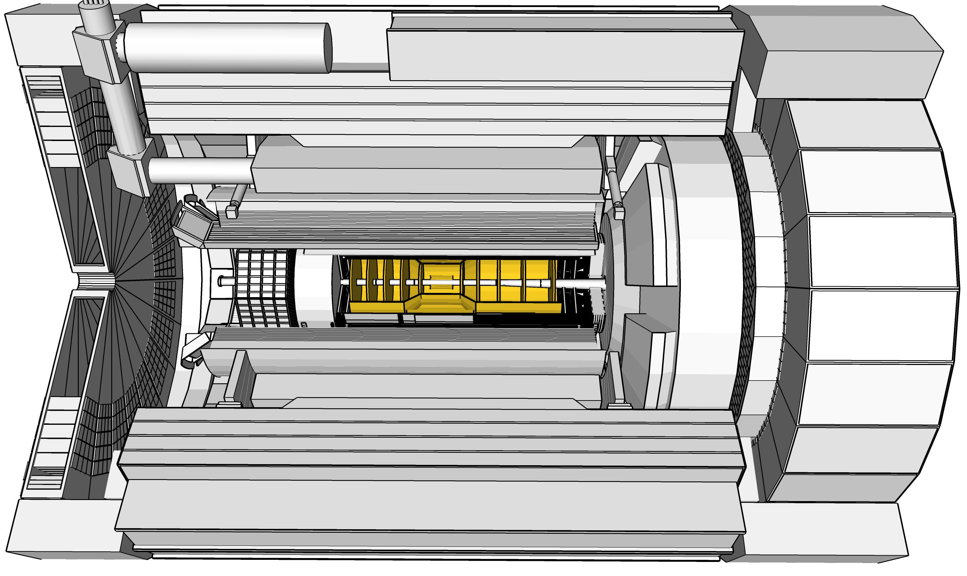
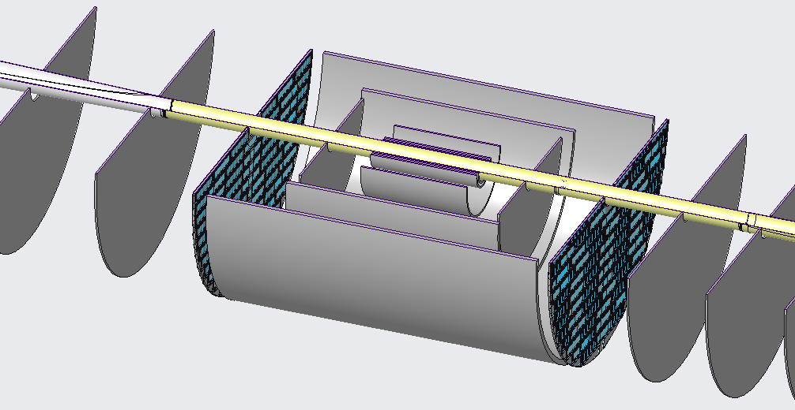
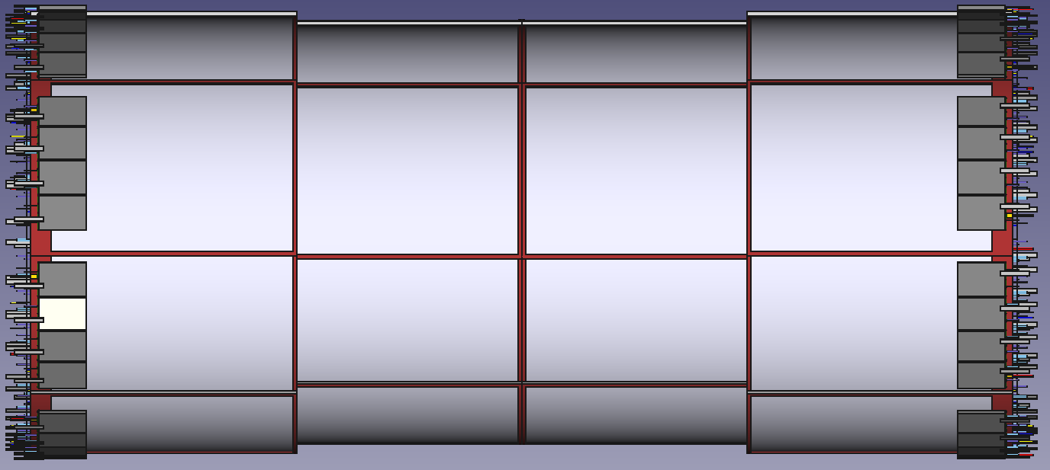
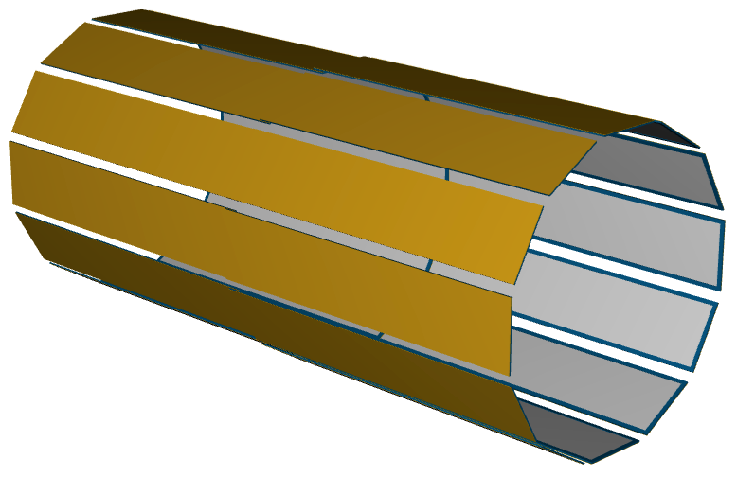
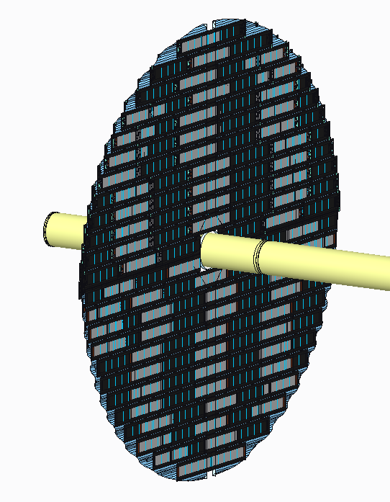
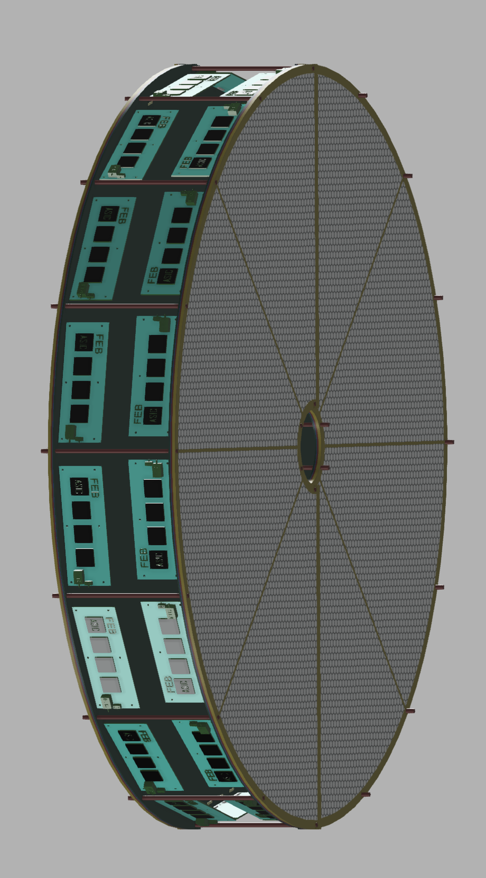

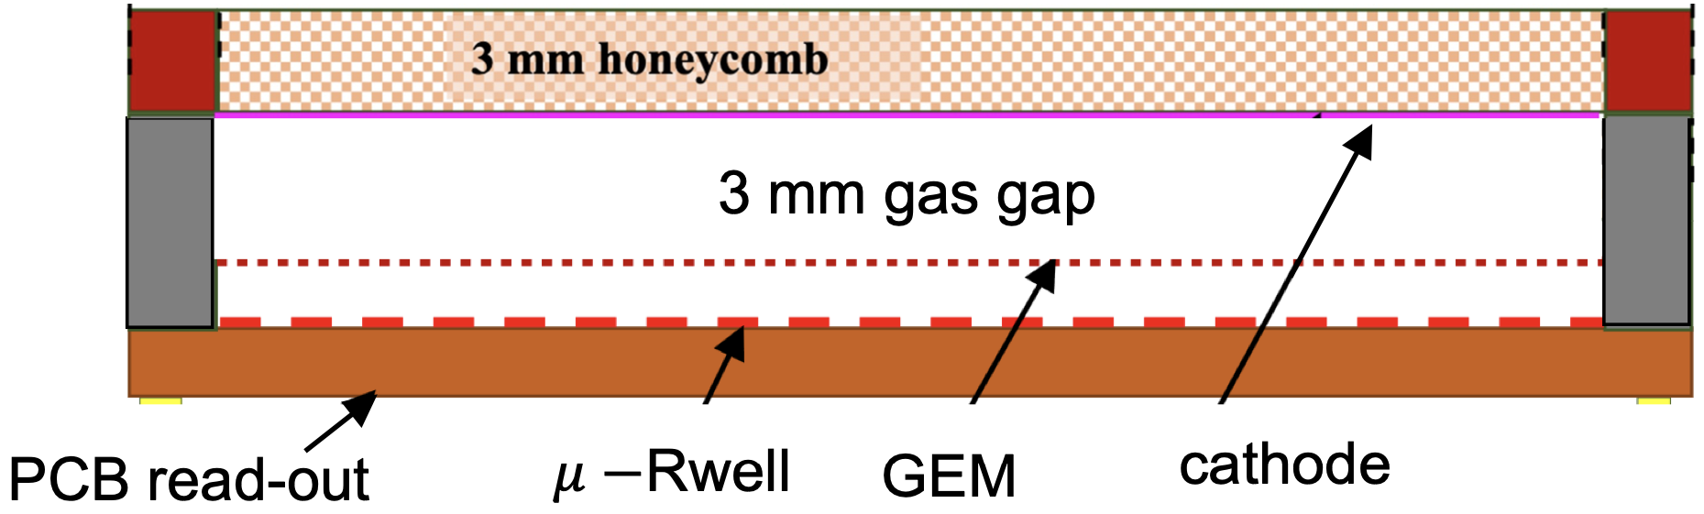
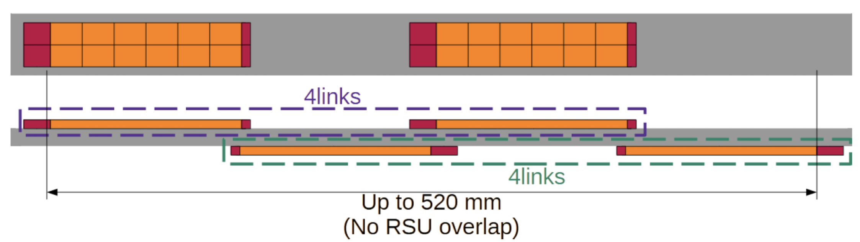
ePIC Tracking Detectors
μVertex Tracker
Barrel Tracker
Outer Barrel MPGD Tracker
EndcapTracker
MicroMegas Tracker
μRWELL Tracker
MAPS
Disks
μRWELL
Disks
Main Function
Excellent momentum 0.05%pT⊕0.5%
and spatial resolution 20μm/pT⊕ 5μm
Provide redundancy and pattern recognition for tracking
Tracking close to hpDIRC detector to improve angular and space point resolution.
Redundancy and pattern recognition for tracking
Excellent momentum 0.05 (0.10)% pT⊕1.0 (2.0)%
and spatial resolution
30μm/pT⊕ (20 – 40) μm
Provide redundancy and pattern recognition for tracking
Displaced vertex reconstruction
Proven Technology
Monolithic Active Pixel Sensor → ALICE ITS3 MOSAIX sensor (65 nm)
small pixels (~18 μm) and power consumption (<20 mW/cm²)
Cylindrical resistive Micromegas technology Used: ATLAS NSW, CLAS12, SPHENIX, MINOS& T2K TPC
EIC Large Area Sensor (LAS), modification of ITS3 sensor with 5 or 6 RSU forming staves as the basic building elements for the Outer Barrel
world’s first at
EIC Large Area Sensor (LAS), staves as the basic building elements for the MAPS disks
GEM- 𝜇Rwell hybrid configuration with increased gain
24 planar Thin-gap & double amplification (GEM & μRWELL) modules &
2D-strip readout

Slide 33
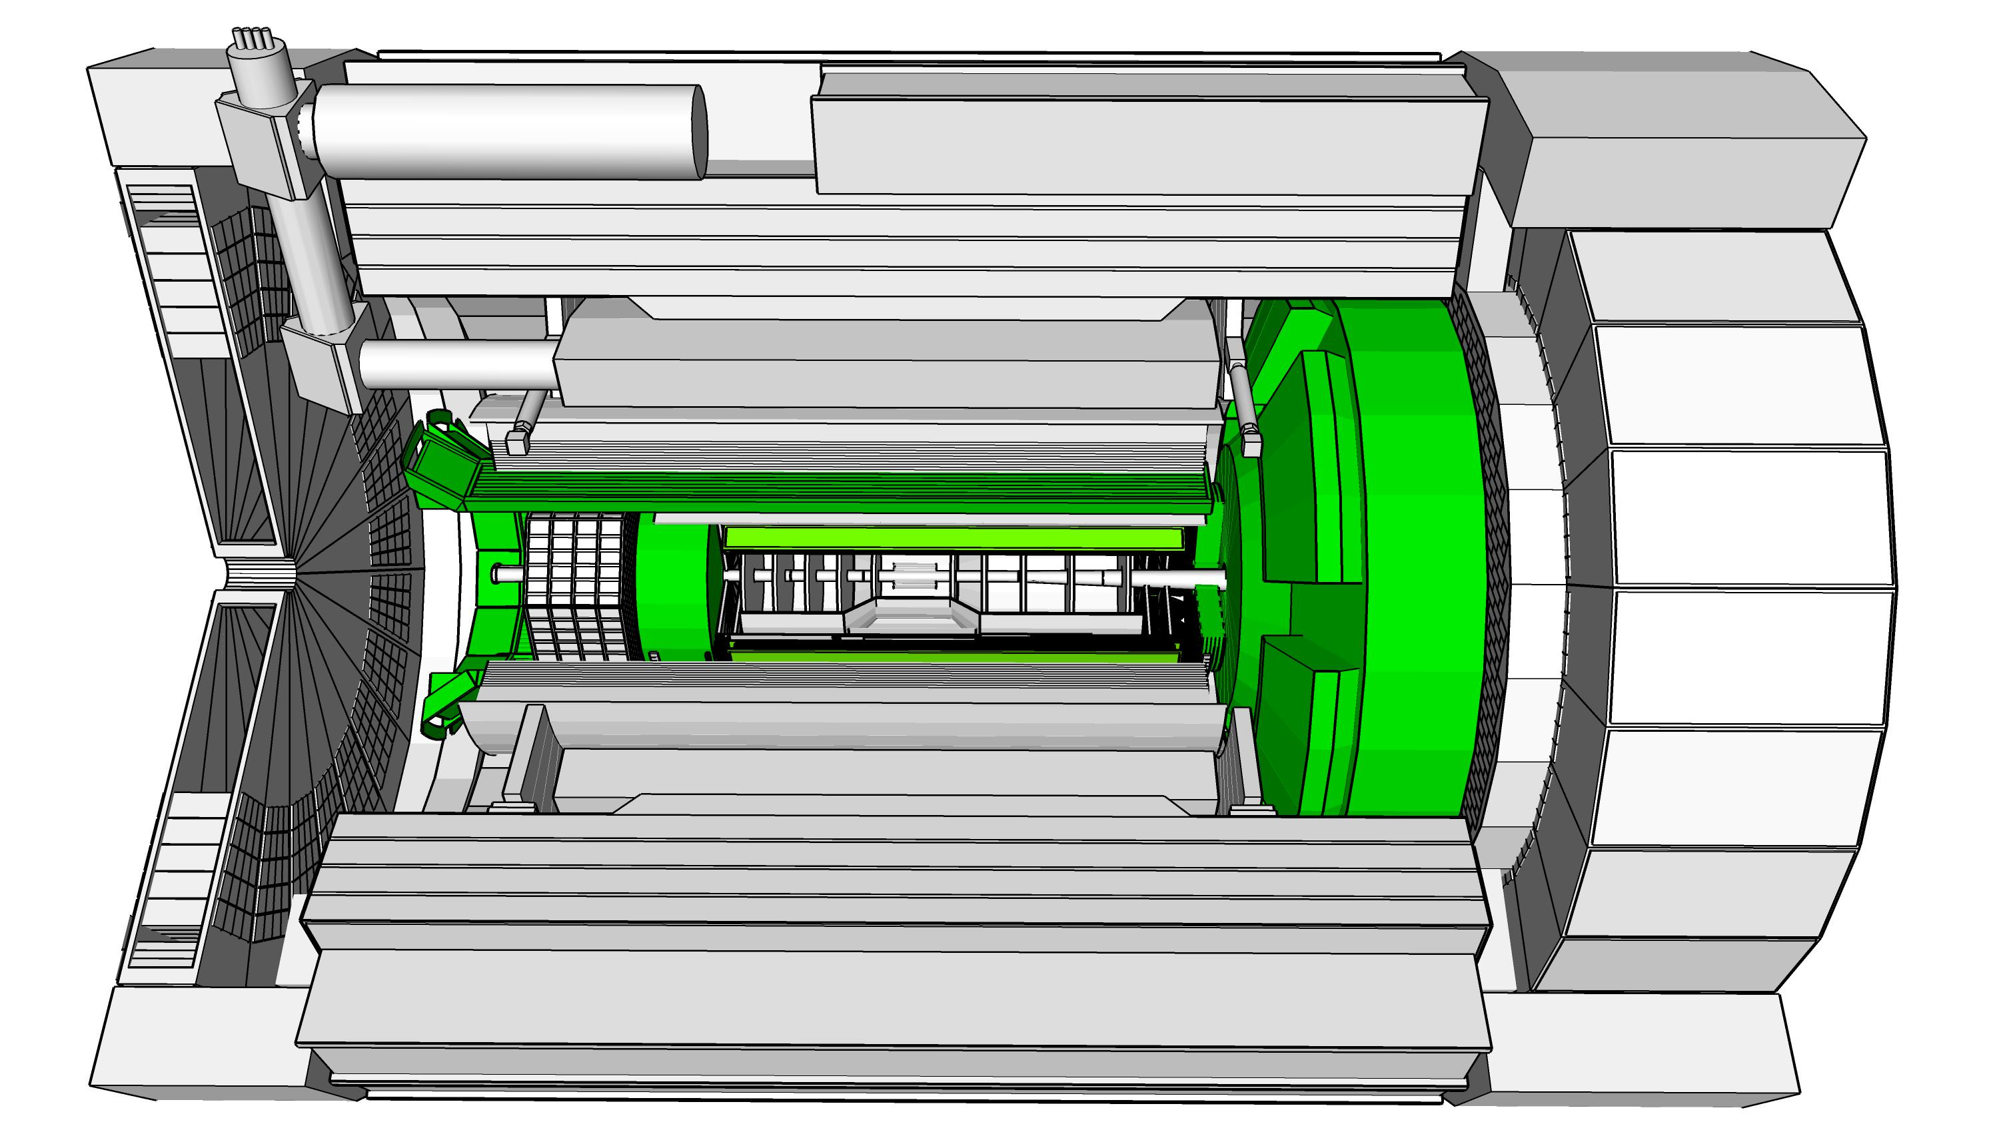
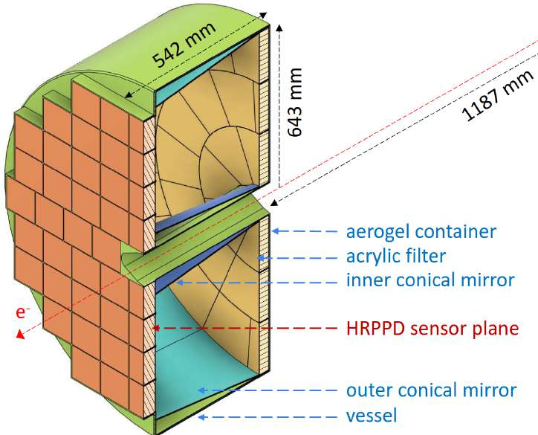
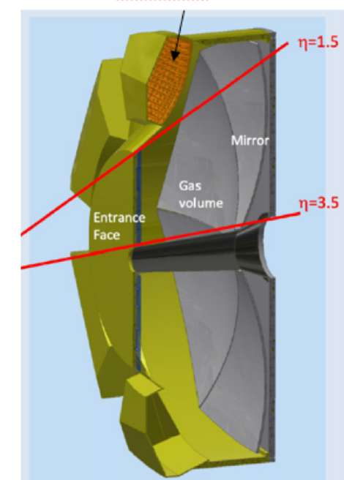
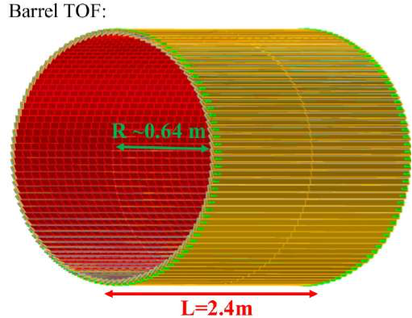
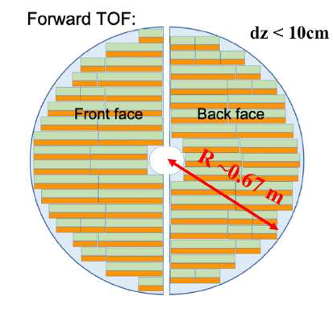
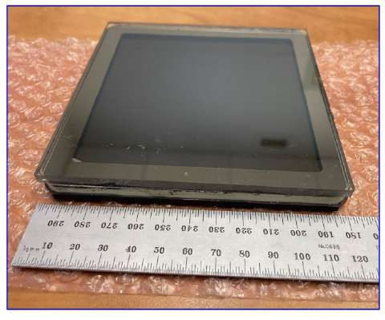
ePIC Particle Identification Detectors
Backward RICH
Barrel DIRC
Forward RICH
Time-of-Flight (Barrel, Forward)
Main Function
e, π, K, p separation
→ π/K 3σ sep. up to 9 GeV/c
and 10-20 ps timing → ToF
e, π, K, p separation
→ π/K 3σ sep. at 6 GeV/c
e, π, K, p separation
→ π/K 3σ sep. up to 50 GeV/c
e, π, K, p separation through 20-35 ps ToF
Barrel: 0.15 < p_{T} < 1.5 GeV/c
Forward: 0.15 < p_{T} < 2.5 GeV/c
Accurate space point for tracking
Proven Technology
Classical single volume proximity focusing aerogel RICH with long proximity gap (~30 cm)
High Performance DIRC
Quartz bar radiator
→ Reuse of BaBAR DIRC bars
light detection with MCP-PMTs
Fully focused
Dual Radiator RICH
Aerogel and C₂F₆ gas
Spherical Mirrors (6 Azimuthal Sectors)
Photon-Sensors tiled on spheres
world’s first at
First time use of
AC-LGAD (Low Gain Avalanche Detector)
in collider detector
Photonsensors:
HRPPDs for Time-of-Flight
First use of SiPMs as Photonsensors in a RICH

Slide 34
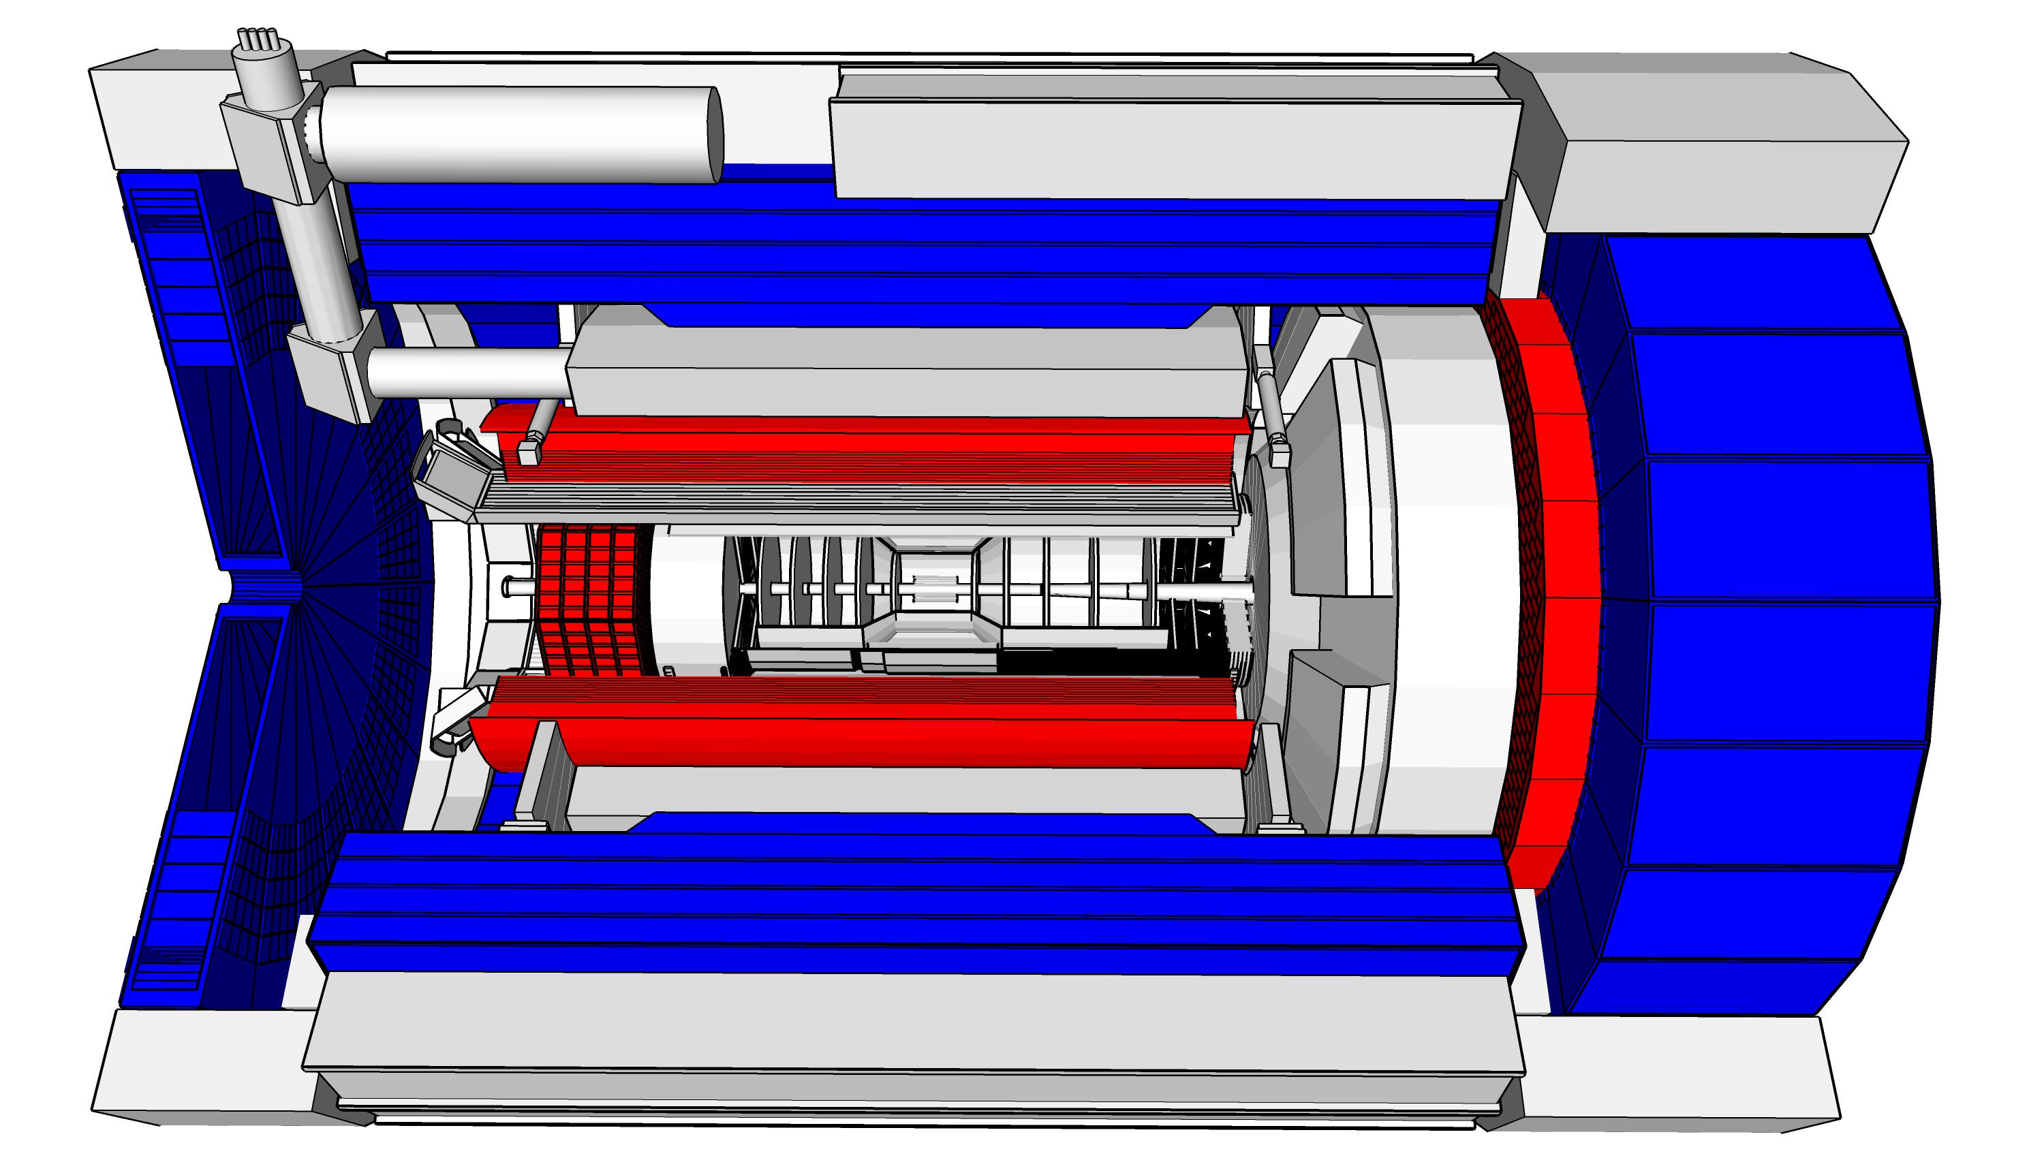
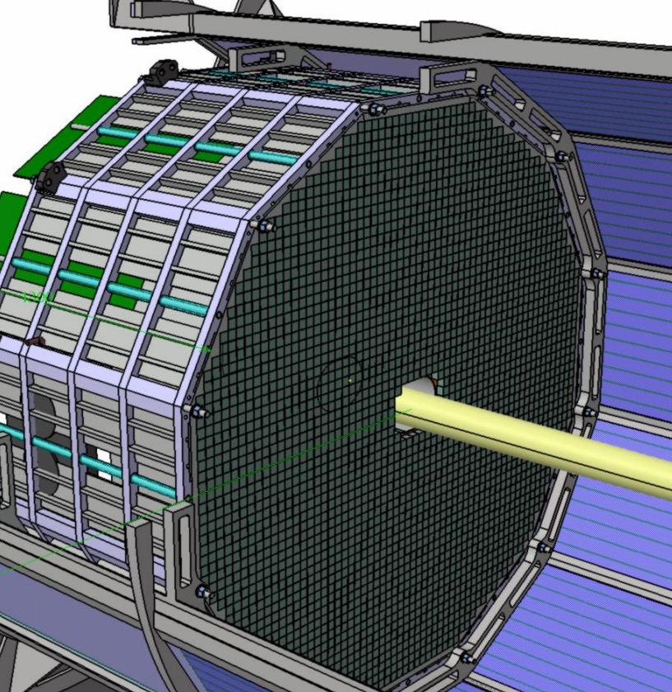
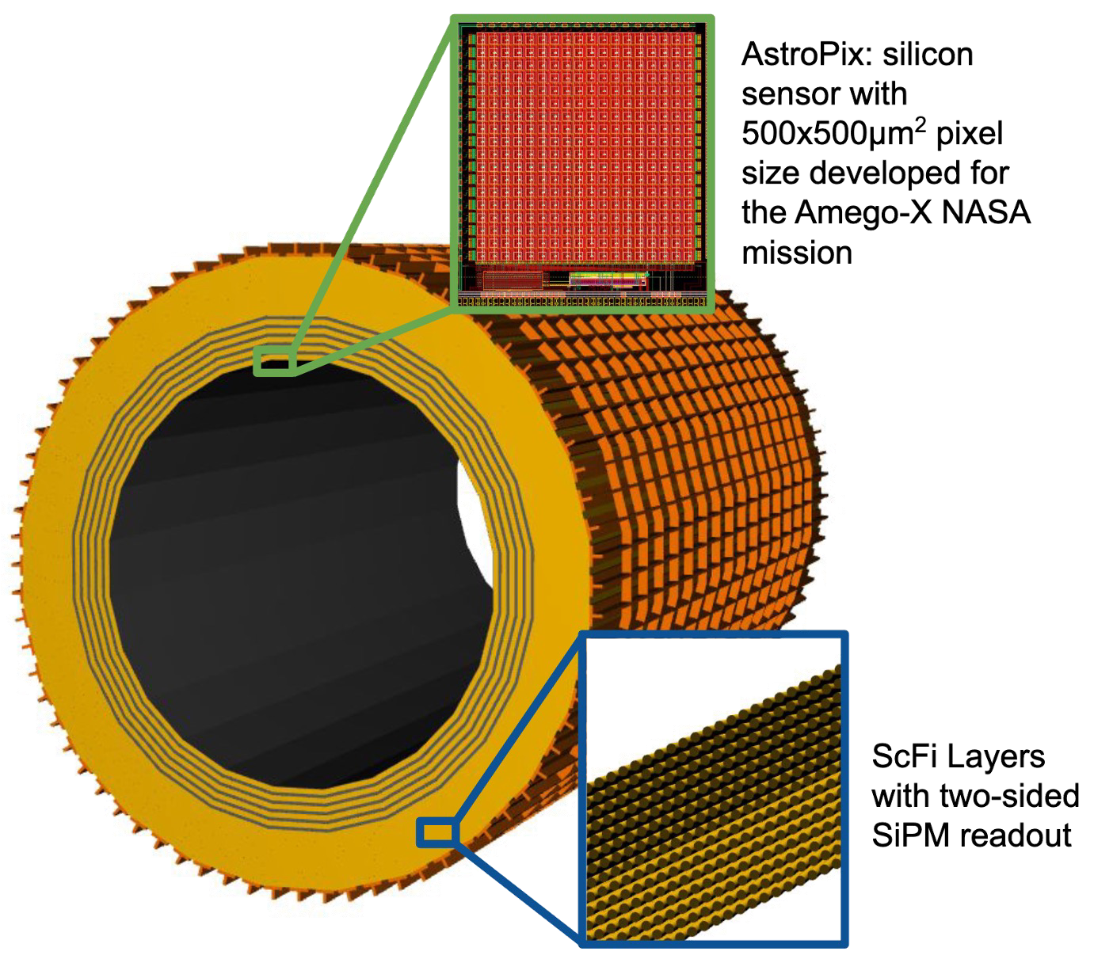
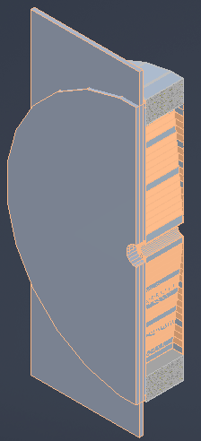
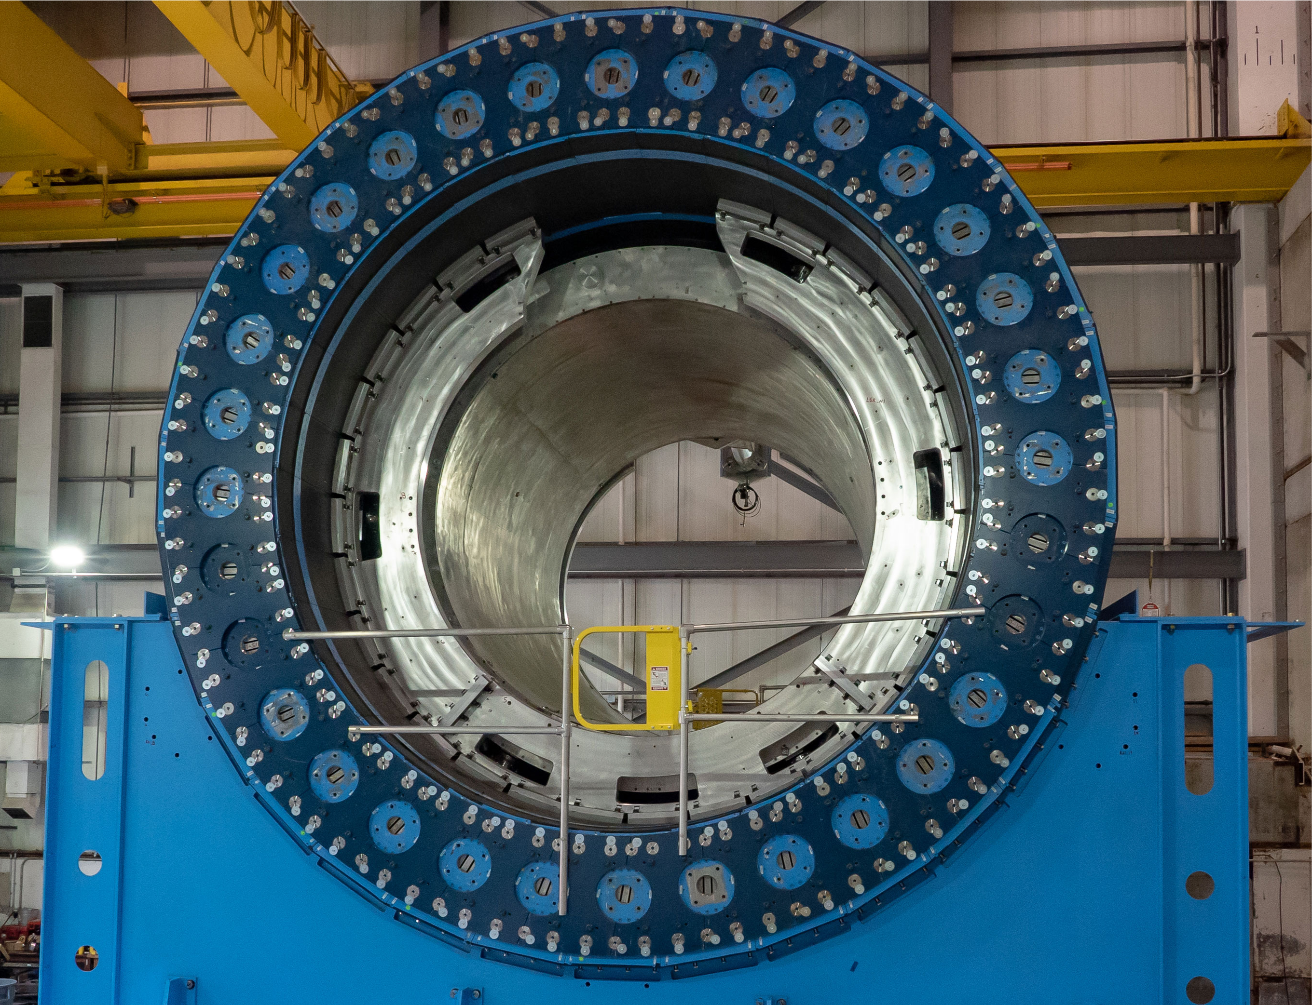
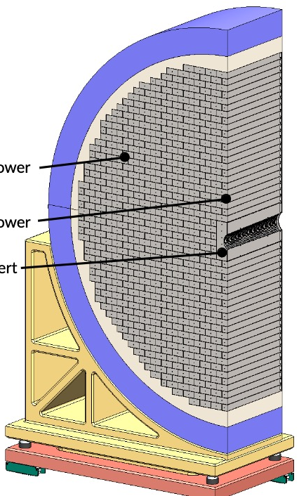
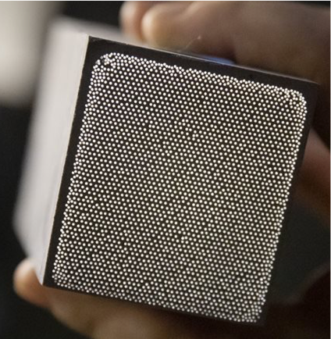
ePIC Calorimetry
Backward ECal
Barrel ECal
Forward ECal
Backward HCal
Barrel HCal
Forward HCal
Main Function
lepton and γ detection, hadronic final state characterization → π⁰, γ
separation
muon and
neutral detection
→ improved jet Energy reconstruction
muon and neutral detection
→ improved jet Energy reconstruction
scattered lepton detection
→ very high-precision
scattered lepton and γ detection, hadronic final state characterization
particle-flow measurements
Proven Technology
longitudinal segmented Steel + Scintillator SiPM-on-tile
Pioneered by CALICE analog HCal
High resolution insert next to beam-pipe
PbWO4 – crystals
→ long lead procurement
Pb/SciFi sampling part using SiPMs combined with imaging section (6 layers) interleaving Pb/SciFi with ASTROPIX
Tungsten-powder + SciFi SPACAL design
Developed through EIC R&D and applied successfully in sPHENIX
Steel + Scintillator SiPM-on-tile
Steel + Scintillator design
re-used from sPHENIX
world’s first at
first-time full-size CALICE like calorimeter in collider experiment
SiPM as Photonsensors
Use of ASTROPIX in Calorimetry

Slide 35
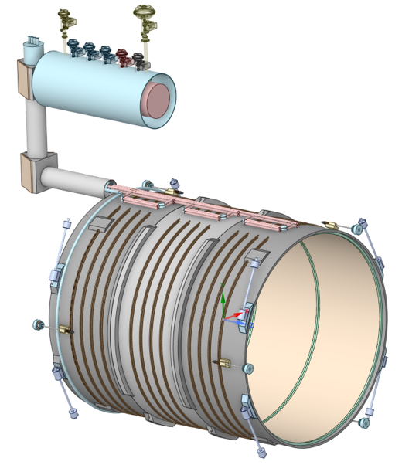
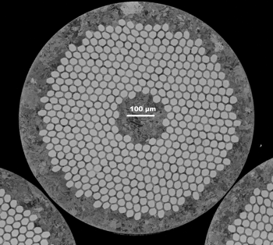
ePIC: MARCO Magnet
Coil is divided in 3 modules with 6 layers each. This is done mainly to accommodate possible conductor length.
Flux return steel layout fully defined to minimize forces and fringe fields (~10G)
B₀ | 1.5 T | 1.7 T | 2.0 T | Units
Current | 2942 | 3335 | 3924 | A
T_{op} | 4.7 | 4.7 | 4.7 | K
B_{peak} | 2.00 | 2.27 | 2.67 | T
Temp. margin | 3.06 | 2.82 | 2.45 | K
Load line margin | 59.6 | 54.2 | 46.1 | %
I / Ic(T,B_{peak}) | 17.9 | 22.1 | 29.3 | %
Dimensions in mm
Mechanical: 2D and 3D mechanical analysis done on the overall magnet assembly, coils, mandrel and tie-rods: All stresses and displacements are well within the acceptable limits.
Cryogenic: Redundant cooling system is used to ensure that thermosiphon works properly
Robust and safe operating parameters
6.10.07 Magnet – strands that are sent from Luvata to Twente for sample tests, the filaments are beautifully arranged and tests confirmed specifications – These were the final quality assurance tests before starting the long-lead procurement for conductor.
Magnet Status:
All documentation for the biding process ready
  Magnet Design Report
  Magnet Specification Document
  Magnet Acceptance Plan
  Inspection, Test Plan (ITP)
  Statement of Work – Have the draft from the RFI (Request For Information) of Spring 2023. Need to further edit to the tender package.
All documents shared with INFN and CEA/Saclay
INFN working on tender package for submission this Summer
Conductor Status:
Order of conductor samples is in place with Luvata
Conductor is similar to conductor used for 11.7 T MRI magnet at CEA, Saclay
First samples received, pass visual (electron microscope) inspection
Sent to test facility (U Twente) for sample qualification; passed specifications
Technical specifications and Statement of Work ready
Technical Production Readiness Review ready
RFP released
Vendor submitted bid; procurement worked with vendor on revised bid.
Collecting last documentation from vendor to submit to TJ Site Office approval

Slide 36

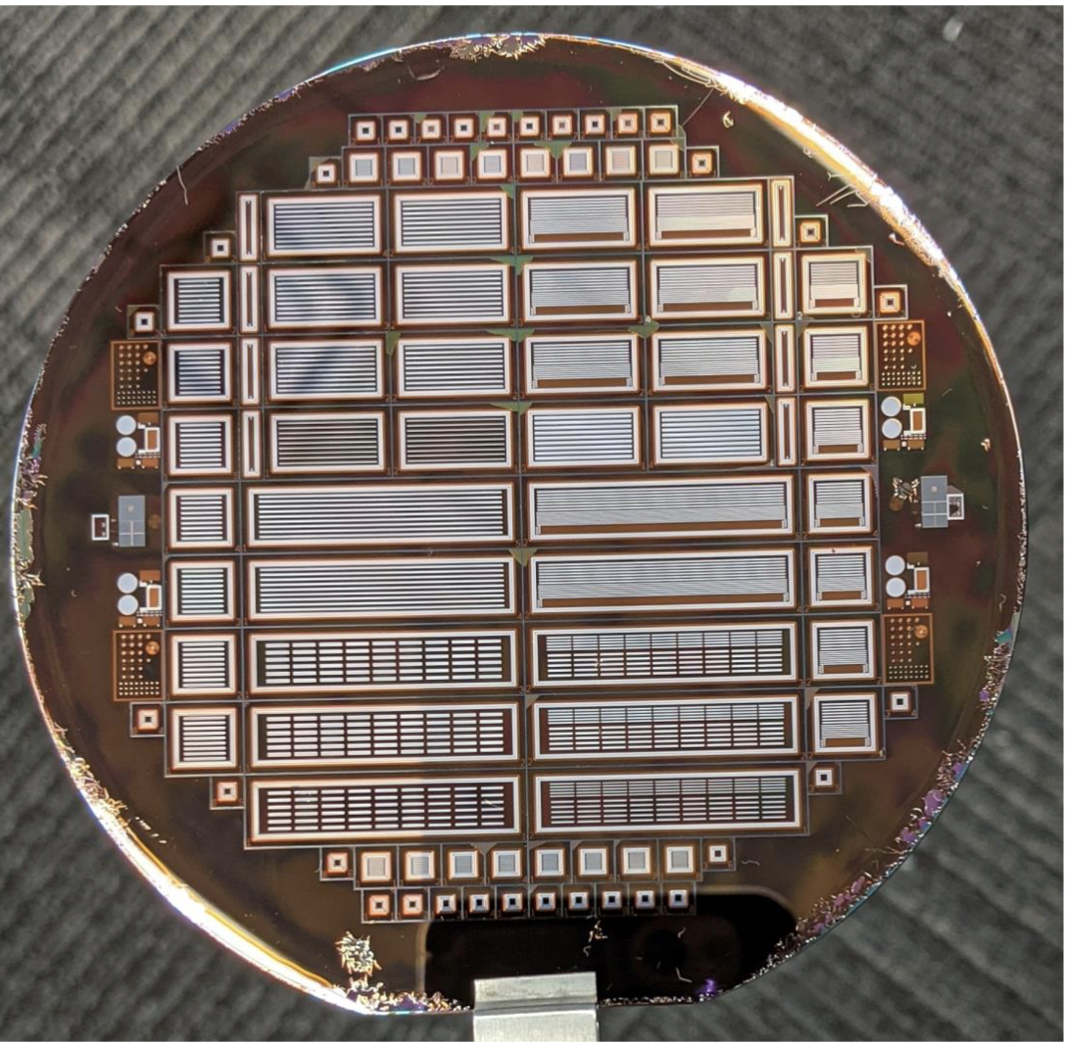
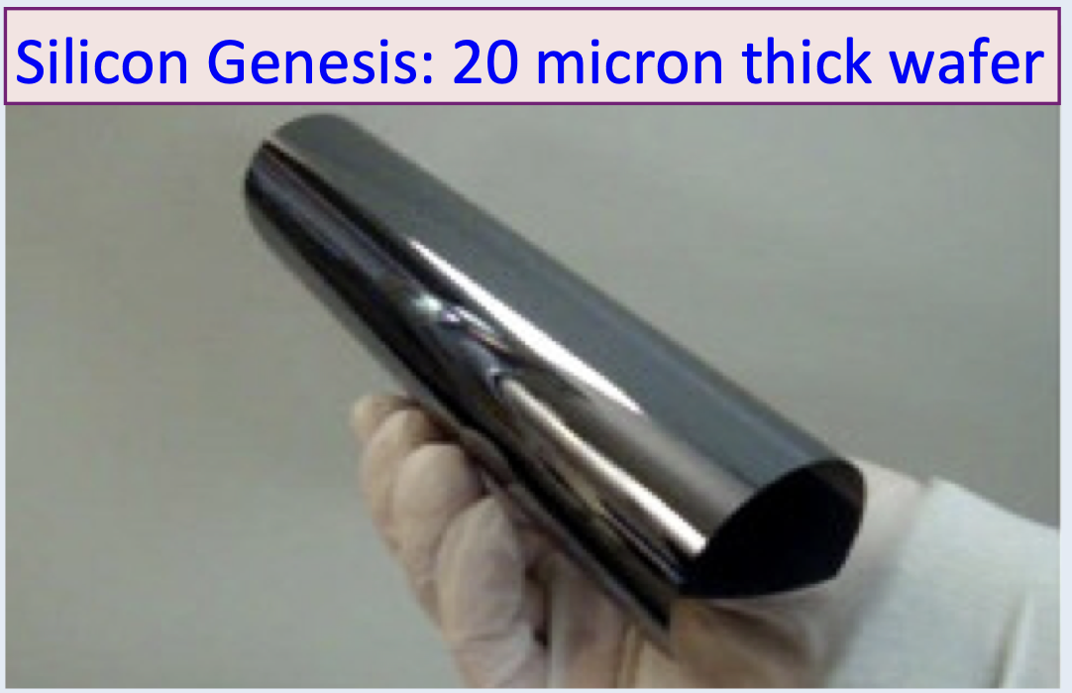


a state-of-the-Art General-Purpose Detector
Technology Highlights:
LAPPDs: New photon sensor development → Combining Timing and Photon detection
Potential Factor 5 improvement
in resolution in Time-of-Flight Positron Emission Tomography (PET)
Monolithic Active Pixel Sensor
world’s thinnest most flexible Si-Pixel detector
Development in synergy ALICE ITS3 MOSAIX sensor (65 nm), small pixels (~18 μm) and power consumption
(<20 mW/cm²)
High resolution, radiation hard
Tracker with basically no material
Critical Technology for the next generation high energy colliders.
New 2T superconducting Solenoid
→ First new large bore (2.4 m)
solenoid since LHC 15+ years
→ Conductor: Rutherford Cable
Nb-Ti strands with Copper
core
Critical to keep expertise to build large Solenoids for collider experiments
Synergy with CERN
Superconducting Magnet R&D https://indico.cern.ch/event/1162992/
AC-LGAD (AC-coupled Low Gain Avalanche Diodes)
Si-detector measuring particles in 4d
→ position and time
→ combining momentum measurement with determining the particle type
Precision:
Time 30ps, Position 10 μm and only 30 μm thick
Critical Technology for the next generation high energy colliders.
Current state of the
art PET scanner
Utilizing new
EIC Photon sensors

Slide 37





ePIC Far-Forward/Far-Backward Detectors
Main Function:
detection of forward scattered neutrons and γ
Technology:
EMCAL: 2x2x20 cm³ PbWO₄ calorimeter
Synergy with backward ECal
HCAL: Steel-SiPM-on-Tile
Synergy with forward HCal
Zero Degree Calorimeter
Main Function:
measure bunch-by-bunch luminosity through Bethe-Heitler process
Technology:
Pair-spectrometer: each with
2 tracking layers of AC-LGAD / FCFD
Synergy with Barrel-ToF
Calorimeter: Tungsten-powder + SciFi SPACAL
Synergy with forward ECal
e beam
Roman Pots and
Off-Momentum Detectors
Main Function:
detection of forward scattered protons and nuclei
Technology:
2 stations with 2 tracking layers each
AC-LGAD / EICROC ( 500x500 μm² pixel)
Synergy with forward ToF
p/A beam
B0 Magnet Spectrometer
Luminosity System
Main Function:
detection of forward scattered protons and and γ
Technology:
4 tracking layers each
AC-LGAD / EICROC ( 500x500 μm² pixel)
Synergy with forward ToF
EMCAL: 2x2x20 cm³ PbWO₄ calorimeter
Synergy with backward ECal
Low-Q2 Taggers
Main Function:
detection of scattered electrons
Technology:
2 stations with 4 tracking layers each (16x18cm²)
Si / Timepix4
Calorimeter: Tungsten-powder + SciFi SPACAL
Synergy with forward ECal

Slide 38















Central Detector Non-DOE Interest & In-Kind
In-kind contribution goal: 30% of the Detector
Barrel
Electromagnetic
Calorimeter
Dual-radiator
RICH
INFN Sezione di Bologna
Università di Bologna
INFN Sezione di Ferrara,
Università di Ferrara
INFN Sezione di Trieste
Universita di Trieste
Superconducting
Solenoid
Forward Electromagnetic
Calorimeter
Karlsruhe Institute
of Technology
Tracking
Detectors
University of Birmingham,
Daresbury Laboratory,
INFN Sezione di Bari,
Università di Bari,
Università di Foggia,
INFN Sezione di Padova,
Università di Padova,
INFN Sezione di Pavia,
INFN Sezione di Trieste,
Universita di Trieste,
Czech Technical University
in Prague,
Rutherford Appleton Laboratory
University of Liverpool,
CEA-Saclay,
Seoul National University,
INFN Sezione di Roma Tor Vergata,
Universita di Roma Tor Vergata
Yonsei University,
Gangneung-Wonju National University,
Hanyang University
Jeonbuk National University
Korea University
Kyungpook National University
University of Seoul
Pusan National University
Sungkyunkwan University
Sejong University
Hanyang University
Yonsei University
University of Regina
University of Manitoba
Backward
Electromagnetic
Calorimeter
DIRC
Time-of-Flight
GSI Helmholtzzentrum fuer Schwerionenforschung GmbH
Backward Hadronic
Calorimeter
University of Tokyo, University of Tsukuba, Hiroshima University
Kobe University, Nara Women's University, Nihon University, Shinshu University
National Central University, National Cheng Kung University
National Taiwan University, National Tsing Hua University
IJClab (Orsay)
A. Alikhanian National Laboratory, Armenia,
Charles University (CUNI), Prague
Czech Technical
University in Prague,
NPI The Czech Academy of Sciences
Data-Acquisition
Electronics

Slide 39






Far-Forward/Far-Backward Detectors Non-DOE Interest & In-kind
Zero Degree Calorimeter
IR vacuum – crucial interface for detectors
e beam
Roman Pots and
Off-Momentum Detectors
p/A beam
B0 Magnet Spectrometer
RIKEN Nishina Center
University of Glasgow
AGH University of Krakow
Ben Gurion University of the Negev
Institute of Nuclear Physics Polish Academy of Sciences (IFJ PAN)
Institute of Physics, Academia Sinica
Tel-Aviv University
Warsaw University of Technology, Faculty of Physics
University of York
Luminosity System
Low-Q2 Taggers

Slide 40
Backgrounds and Radiation Doses

Slide 41

EIC Beam Parameters
electron beam current and energy impact electron beam gas background and synchrotron radiation
→ Radiated SR power: P(kW)=88.46 E_{B}(GeV)⁴ / r(m)² I (A)
hadron beam current impacts hadron beam gas
beam energies and luminosity impact the radiation and neutron fluence

Slide 42


Beam Background Sources
Background/radiation sources : Different to hadron-hadron colliders beam related background cross-sections are larger than signal cross-section
Hadron Beam
  Low beam lifetime during injection and ramping
  → can be mitigated by collimation system → no impact on data taking
  Beam-gas scattering through Coulomb process.
  → can be mitigated by collimation system
  → see earlier talks by Zhengqiao
  Inelastic beam-gas interaction (producing showers of secondaries in the IR).
  We do not have yet any full particle tracking for hadrons
  → working on protons
  → heavy ions are especially difficult – LHC just finished full particle tracking for ions
Electron Beam
  background due to de-excitation of beam if bunches are replaced
  → can be mitigated by collimation system
  Beam-gas scattering through Coulomb and Bremsstrahlung (Bethe-Heitler) processes:
  → Elastic and inelastic beam particle scatterings on residual gas molecules and a hadron beam.
  Touschek effect:
  → Incoherent scattering of the particles in the same beam bunch.
a good vacuum is critical for all beam gas related backgrounds → need to limit how often we
break vacuum
collimation systems will minimize backgrounds, but not if the background is generated in IP-6

Slide 43
Finding Correlation between Vacuum and Beam Current
Beam Currents:
$I^{ESR}=100 mA$, $\frac{I^{ESR}}{I^{HSR}}\sim \frac{5}{2}$
Beam Dose:
$$BD=100 Ah$$
Detector Limit:
$$DL=1 MHz$$
Acceptable Beam Lifetimes:
$τ_{acc}^{ESR}\sim 10 hr$, $τ_{acc}^{HSR}\sim 3 hr$
Loop Until: $I^{ESR}<I_{nominal}^{ESR}(2.5 A)$
Initial Parameters @ 10x275 GeV
Estimate Gas Pressure:
$P^{ESR}$,$P^{HSR}$
Calculate Detector Backgrounds and Beam Lifetimes (Beam-gas, Touschek, SR, Collision, IBS, etc.):
${BG}_{i}^{ESR}$,${BG}_{j}^{HSR}$,${BG}^{COL}$, $τ_{i}^{ESR}$,$τ_{j}^{HSR}$
$$\sum{BG\sim DL}$$
AND
$$\sum{\frac{1}{τ^{ESR/HSR}}≲}\frac{1}{τ_{acc}^{ESR/HSR}}$$
NO
YES
Increase Beam Dose:
$$BD+=I^{ESR}∙∆t(1 day or 1 week)$$
$$\sum{BG>DL}$$
OR
$$\sum{\frac{1}{τ^{ESR/HSR}}>}\frac{1}{τ_{acc}^{ESR/HSR}}$$
Log: $I^{ESR}=f(\sum{∆t})$, $L_{peak}=g\left(\sum{∆t}\right)$, etc.
NO
YES
Reduce Beam Current:
$$I^{ESR}−=∆I(10 mA)$$
Increase Beam Current:
$$I^{ESR}+=∆I(10 mA)$$

Slide 44


Radiation Doses
All the information is posted at https://wiki.bnl.gov/EPIC/index.php?title=Radiation_Doses
To obtain the full radiation dose one needs to add the radiation dose due to
electron-nucleon scattering + electron beam backgrounds and hadron beam backgrounds
The figures are for an integrated lumi of 1 fb⁻¹, so one needs to scale to the total integrated luminosity
for the 15 years (5 years of commissioning and 10 years of full-lumi) as described earlier.
It is very important to have the material budget correct also along the beam pipe, like the SC magnets
Electromagnetic radiation doses
Charged hadron radiation doses

