Slide 1
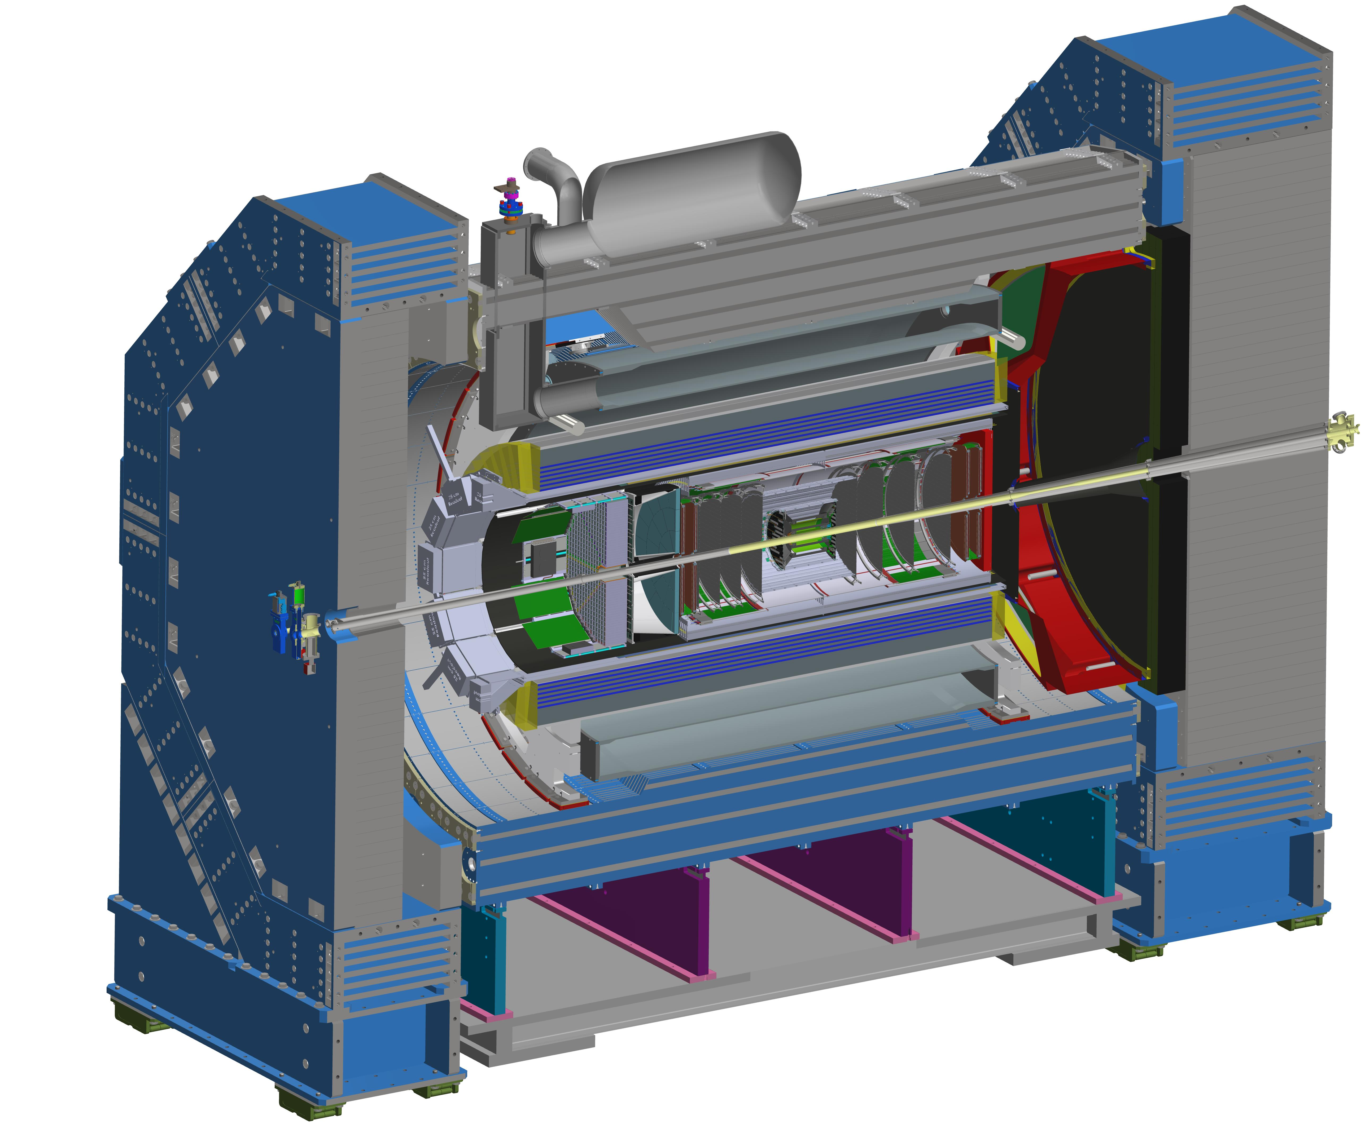

ePIC Collaboration Status
J. Lajoie, S. Dalla Torre
July 14, 2025

Slide 2
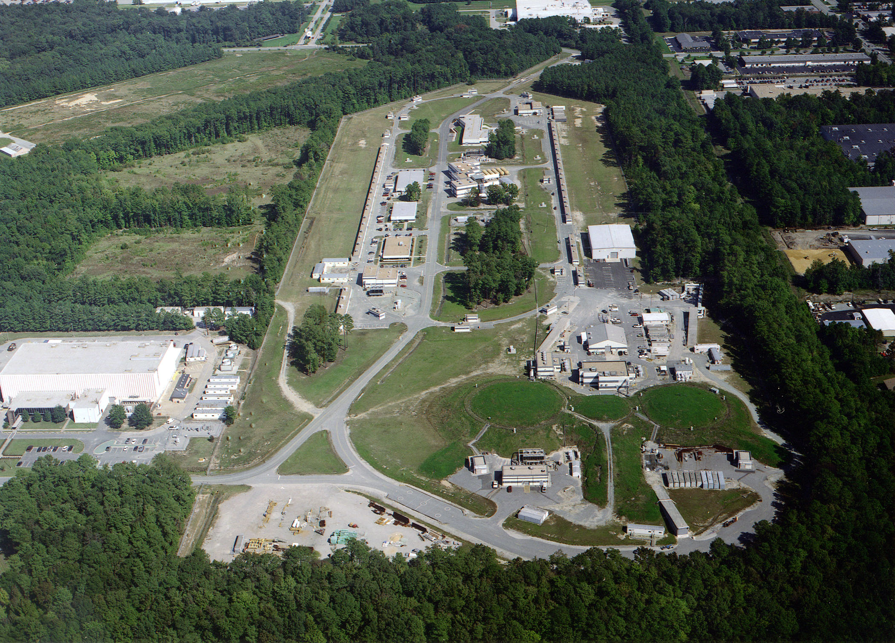

Welcome to
Many thanks to Doug Higinbotham, Sarah Crouse an the whole team at JLab!
200+ registered participants (158 in person, 64 remote, 30 students)

Slide 3


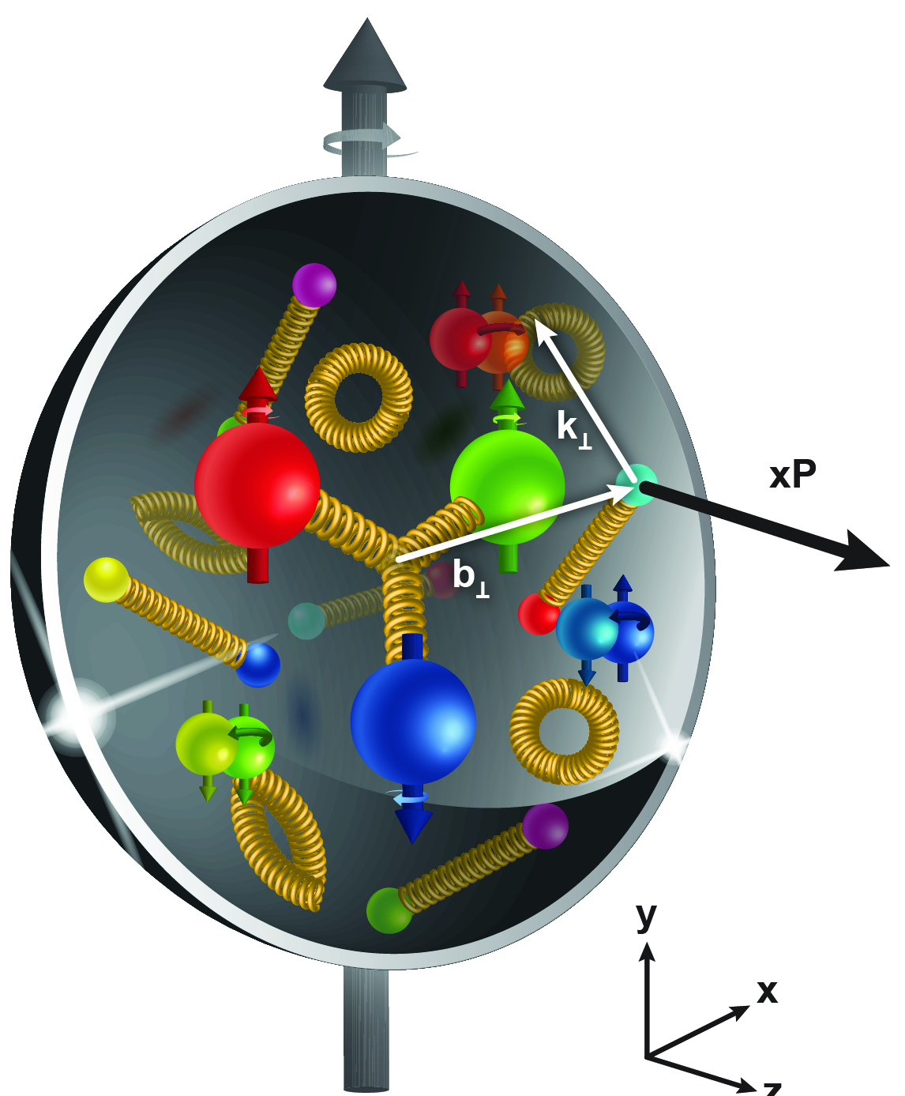
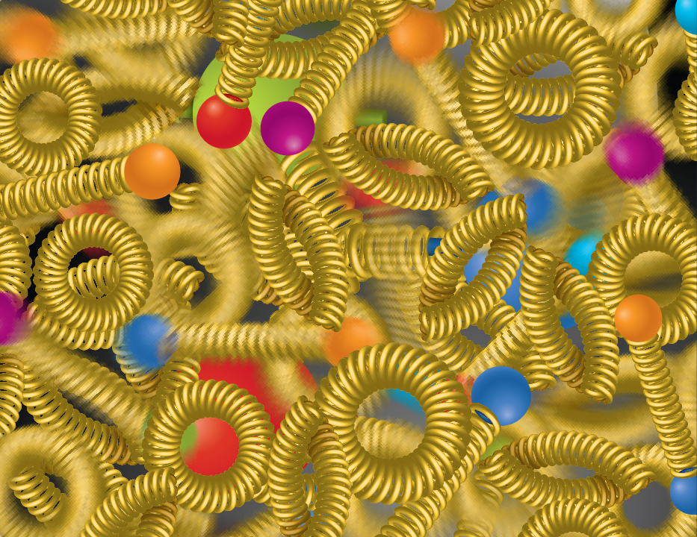
Why are the EICUG and ePIC Meeting Together?
The EIC will unravel the different contribution from the quarks, gluons and orbital angular momentum
SPIN is one of the fundamental properties of matter.
All elementary particles, but the Higgs carry spin.
Spin cannot be explained by a static picture of the proton
It is the interplay between the intrinsic properties and interactions of quarks and gluons
Does the mass of visible matter emerge from quark-gluon interactions?
Atom: Binding/Mass =
0.00000001
Nucleus: Binding/Mass =
0.01
Proton: Binding/Mass =
100
For the proton the EIC will determine an important term contributing to the proton mass, the so-called “QCD trace anomaly
How can we understand their dynamical origin in QCD?
What is the relation to Confinement
How are the quarks and gluon distributed in space and momentum inside the nucleon & nuclei?
How do the nucleon properties emerge from them and their interactions?
How do the confined hadronic states emerge from quarks and gluons?
Is the structure of a free and bound nucleon the same?
How do quarks and gluons, interact with a nuclear medium?
How do the quark-gluon interactions create nuclear binding?
What happens to the gluon density in nuclei? Does it saturate at high energy?
How many gluons can fit in a proton?
How does a dense nuclear environment affect the quarks and gluons, their correlations, and their interactions?
?
gluon
splitting
=
gluon
recombination

Slide 4
July 2025 Meeting Block Schedule
Early Career Workshop
Summer 2025 Joint EICUG/ePIC Collaboration Meeting
 | F July 11th | S | S | M July 14th | T | W | Th | F
Morning Sessions | Last part of MC4EIC | 2nd Session | 4th Session | Joint ePIC/ EICUG Plenary | Parallel/ Workfests | Parallel/ Workfests | ePIC CC Meeting | ePIC Closing Plenary
Lunch | Not Provided | Provided | Not Provided | Provided | Provided | Provided | Provided | Not Provided
Afternoon Sessions | 1st Session | 3rd Session | ( free ) | Funding Agency and Accelerator | EICUG/ Awards | Parallel/ Workfests | Parallel/ Workfests | ( free )
Many opportunities to benefit from the joint EICUG/ePIC format!
Reception
Social Event

Slide 5
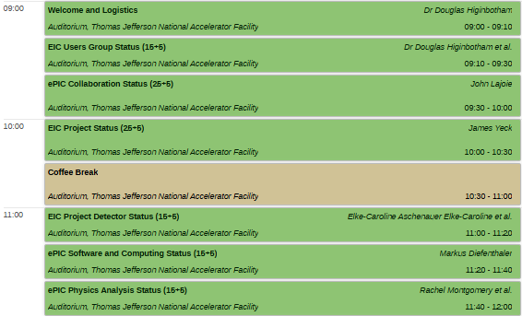
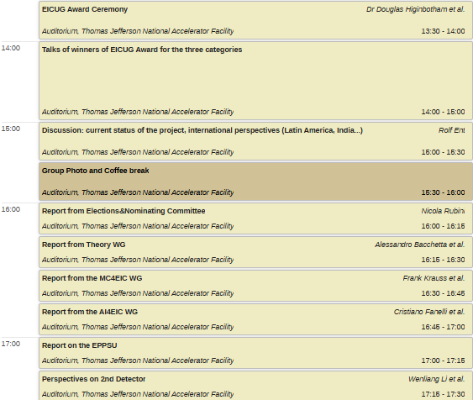
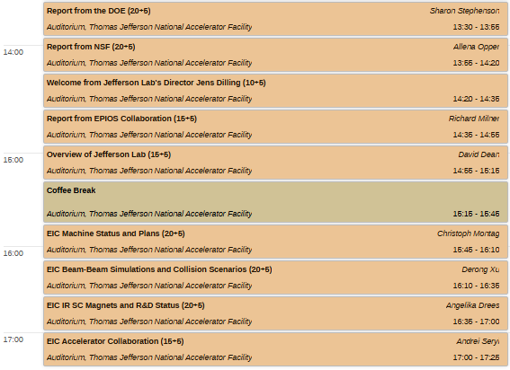
Joint Plenary and EICUG Sessions
Monday, July 14th
Tuesday Afternoon, July 15th

Slide 6

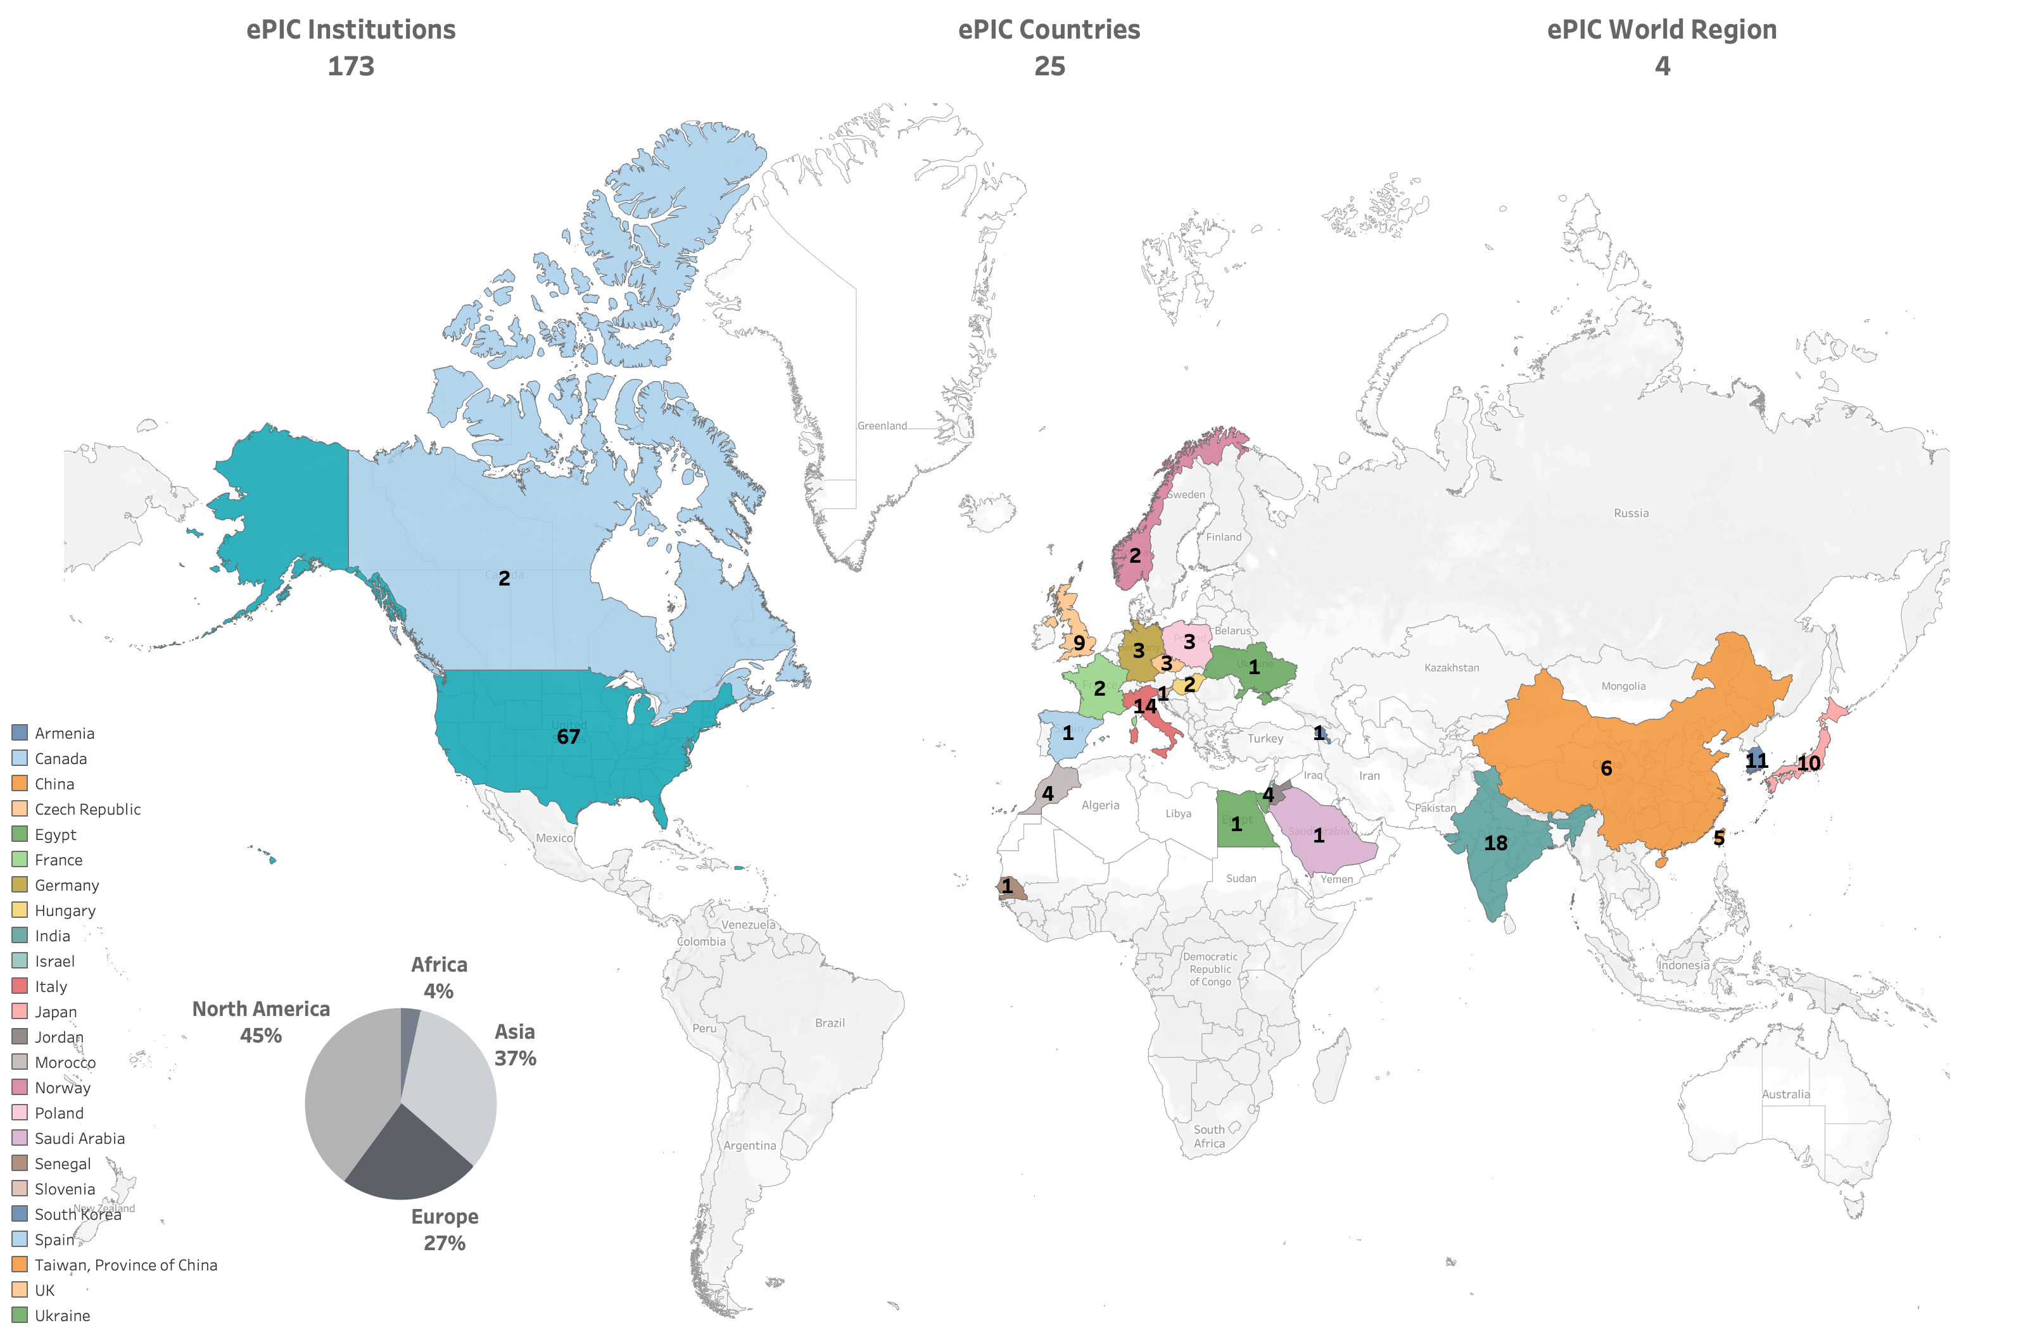
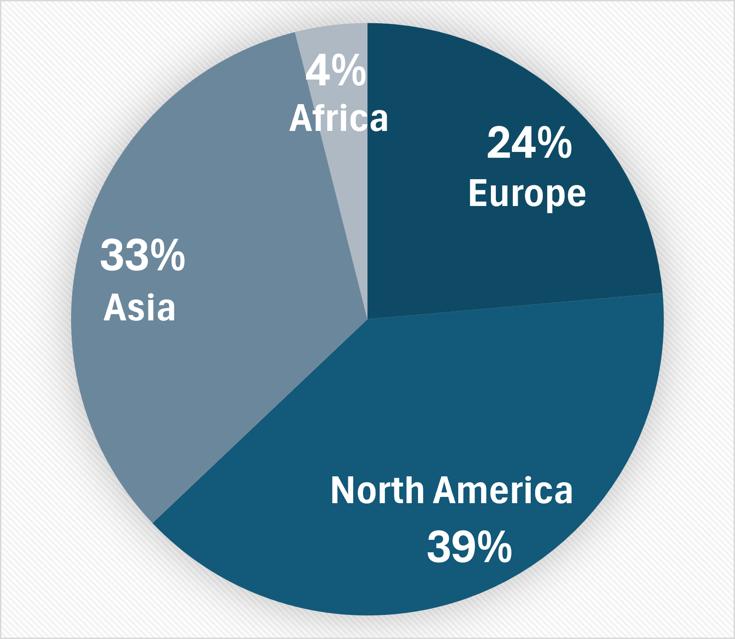
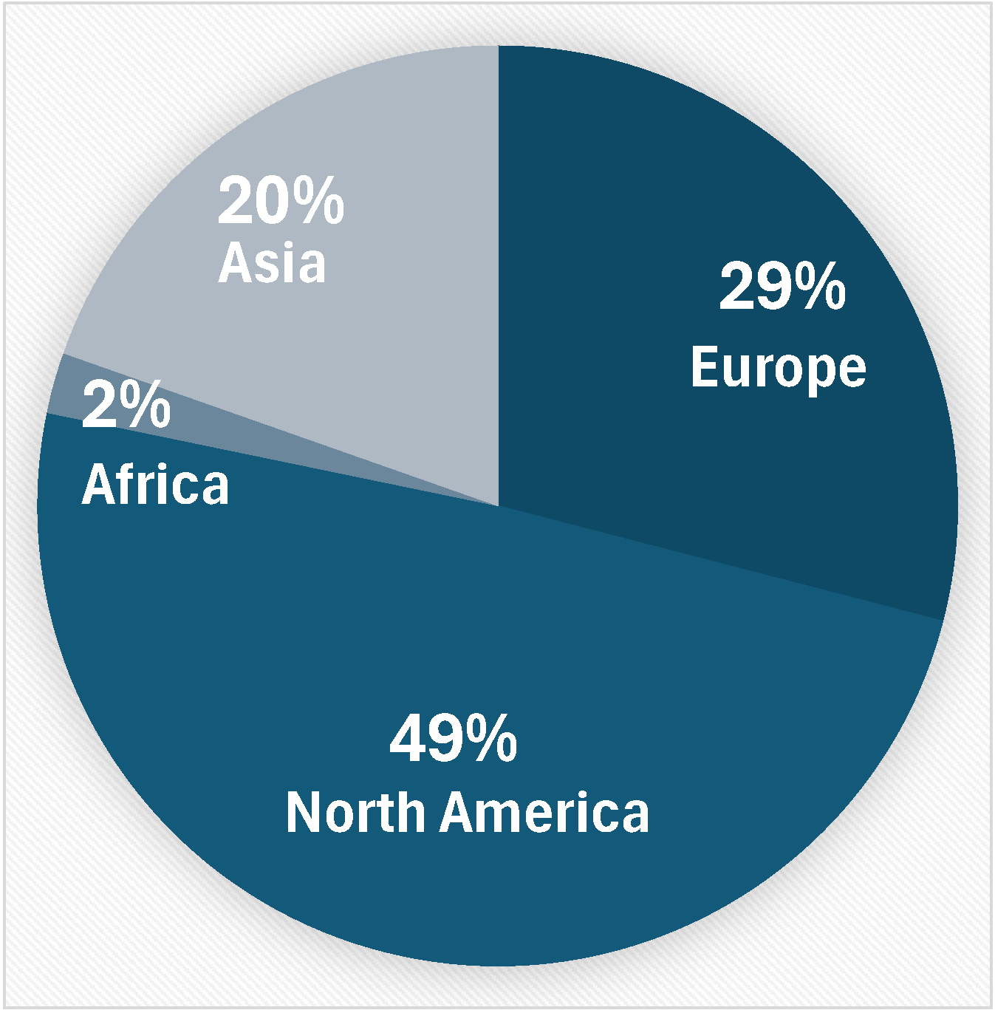
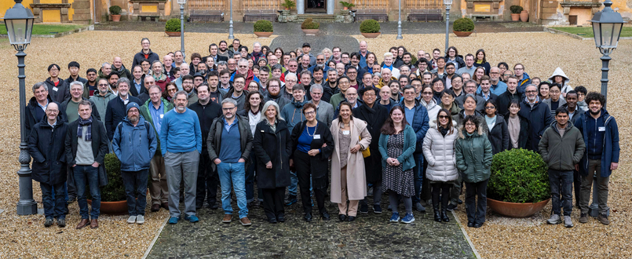
180
4
Currently:
>1050 collaborators
Institutions:
Collaborators:
Frascati – January 2025

Slide 7





New Institutions so far in 2025
Seoul National University
  CC Member Seonho Choi
Texas Southern University
  CC member Nissem Abdelrahman
Johannes Gutenberg University Mainz
  CC member Tyler Kutz
Mount Allison University
  CC member David Hornidge
University of Hawaii at Manoa
  CC member Jennifer Ott
Presentation from RCNP/Osaka in Thursday’s CC Meeting
17 new institutions added since the start of 2024!

Slide 8
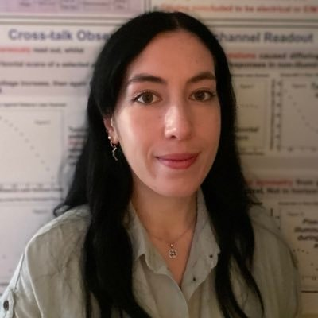
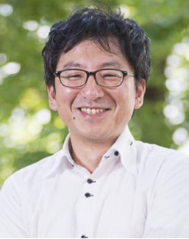

New Faces in ePIC Leadership
The Spokesperson’s Office nominated Rachel Montgomery
as a new Physics Analysis Co-Coordinator:
  Lecturer in Nuclear and Hadron Physics at University of Glasgow
  Former ePIC Diffractive and Exclusive Physics WG Convener
The Spokesperson’s Office nominated Taku Gunji as a new
Streaming Computing Model WG convener
  Associate Professor at the University of Tokyo, CNS
  SPADI Alliance member
The Spokesperson’s Office appointed John Haggerty as a new
Deputy Technical Coordinator
  sPHENIX CDR/TDR editor

Slide 9

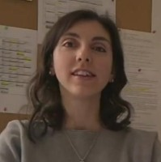

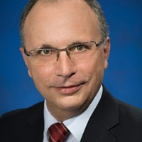
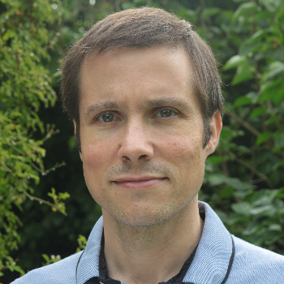
New Faces in ePIC Leadership
Renee Fatemi was elected the new vice-chair of the CC
Susanna Costanza was elected the new vice-chair of the
Code of Conduct Committee
Daniel Brandenburg was elected the new vice-chair of the Conference and Talks Committee
Carlos Munoz Camacho was elected the new vice-chair
and Eric Lancon new chair of the Membership committee.
Many thanks to the outgoing leadership:
Bernd Surrow (CC Chair)
Megan Connors (Code of Conduct)
Maria Zurek (Conference and Talks)
Pietro Antonioli and Peter Steinberg (Membership)

Slide 10
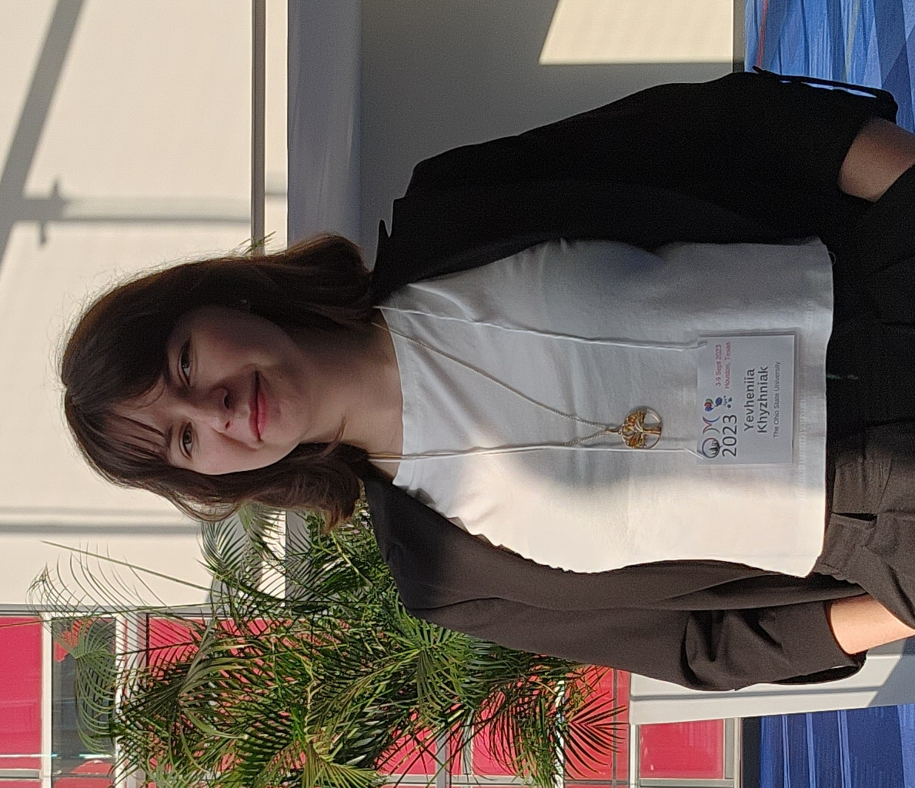
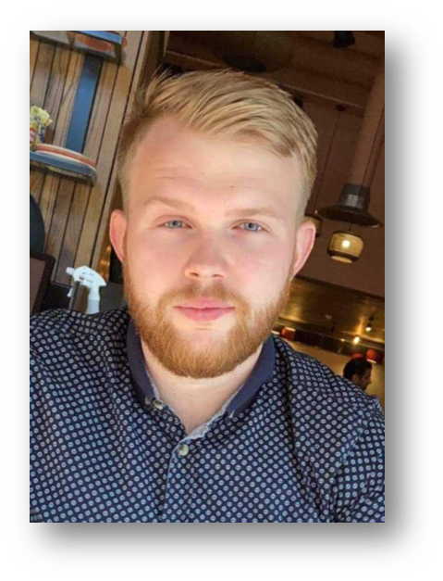
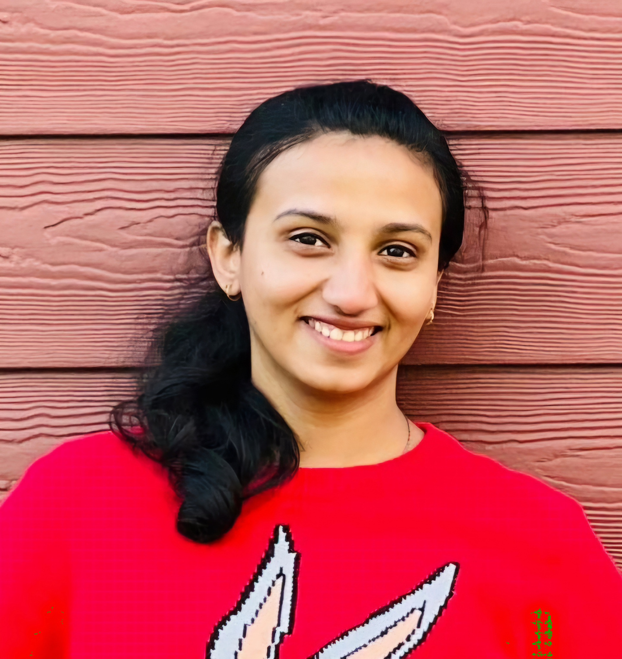
New Early-Career Members!
Many thanks to our outgoing EC representatives – Maria Stefaniak, Nicholas Schmidt, and Aranya Giri.
Yevheniia Khyzhniak
The Ohio State University
khyzhniak.1@buckeyemail.osu.edu
Gary Penman
University of Glasgow
g.penman.1@research.gla.ac.uk
Akshaya Vijay
University of Manitoba
vijaya2@myumanitoba.ca

Slide 11
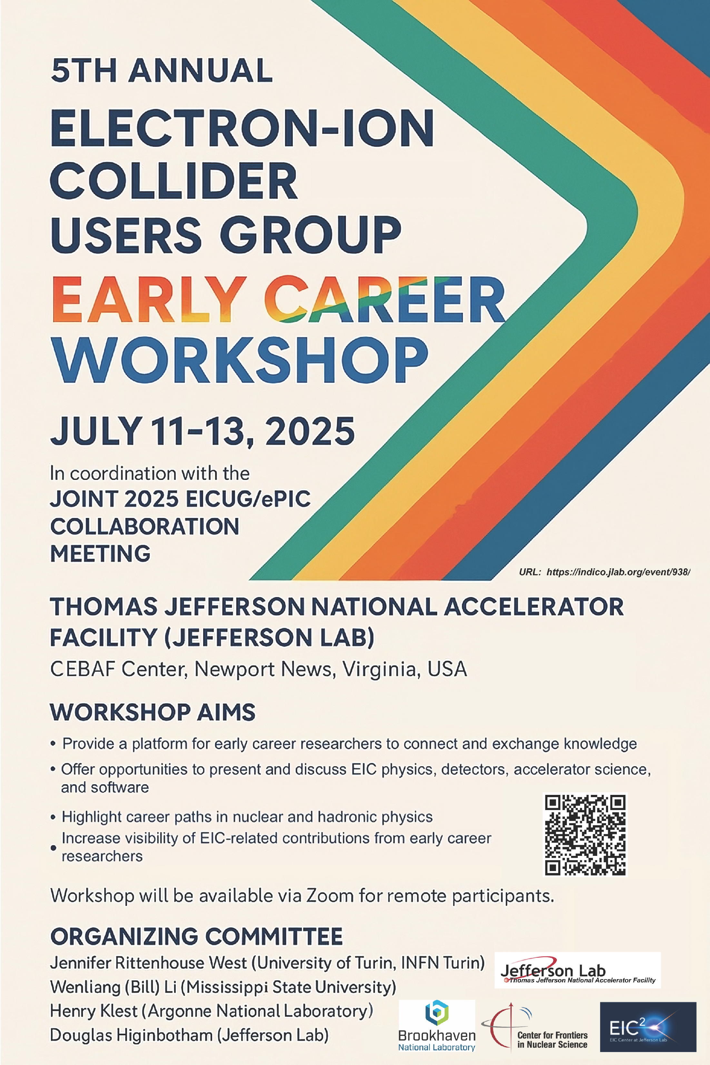
Early Career is the Future!
Fantastic turn out for the Early Career Workshop preceding this meeting!
  53 in person and 26 remote
Today’s early career scientists will be the tomorrow’s leaders when the EIC is taking data!
  Both the EICUG and ePIC are strongly committed to supporting the
  EC community

Slide 12
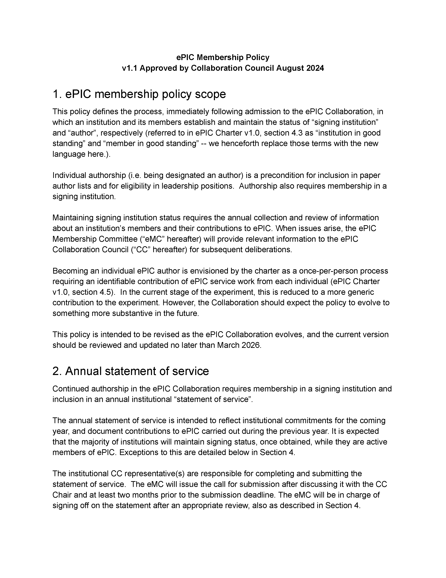
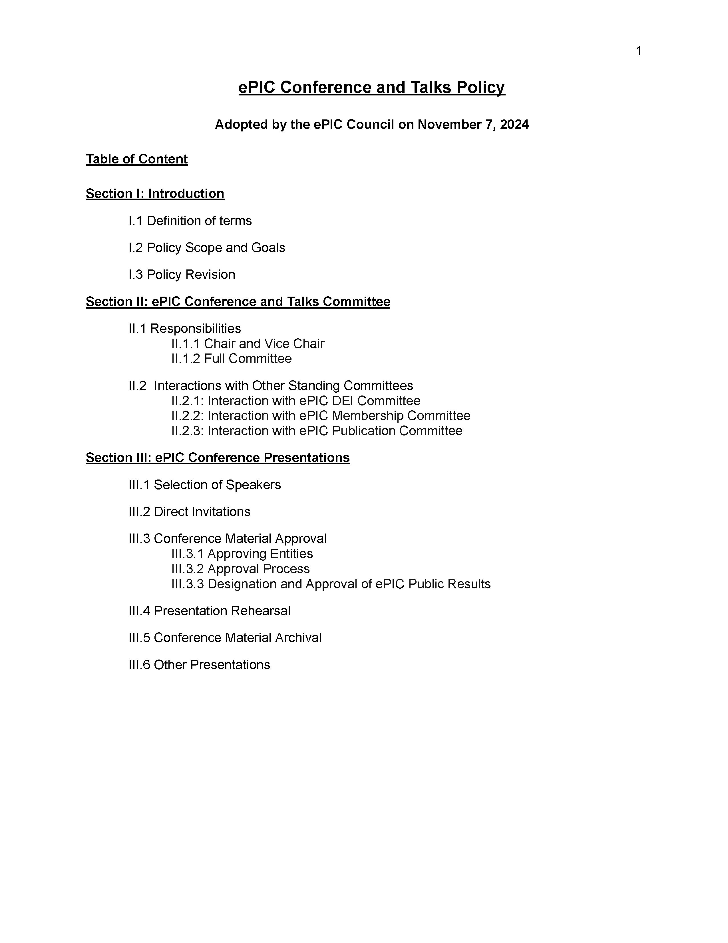
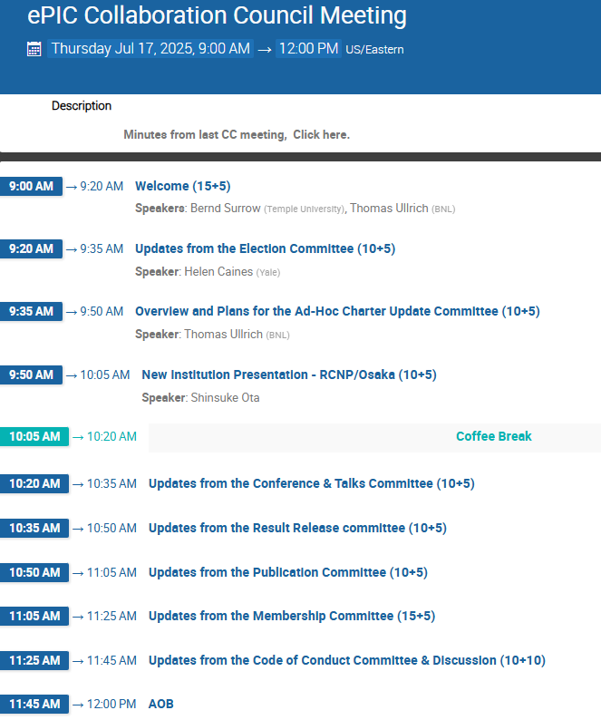
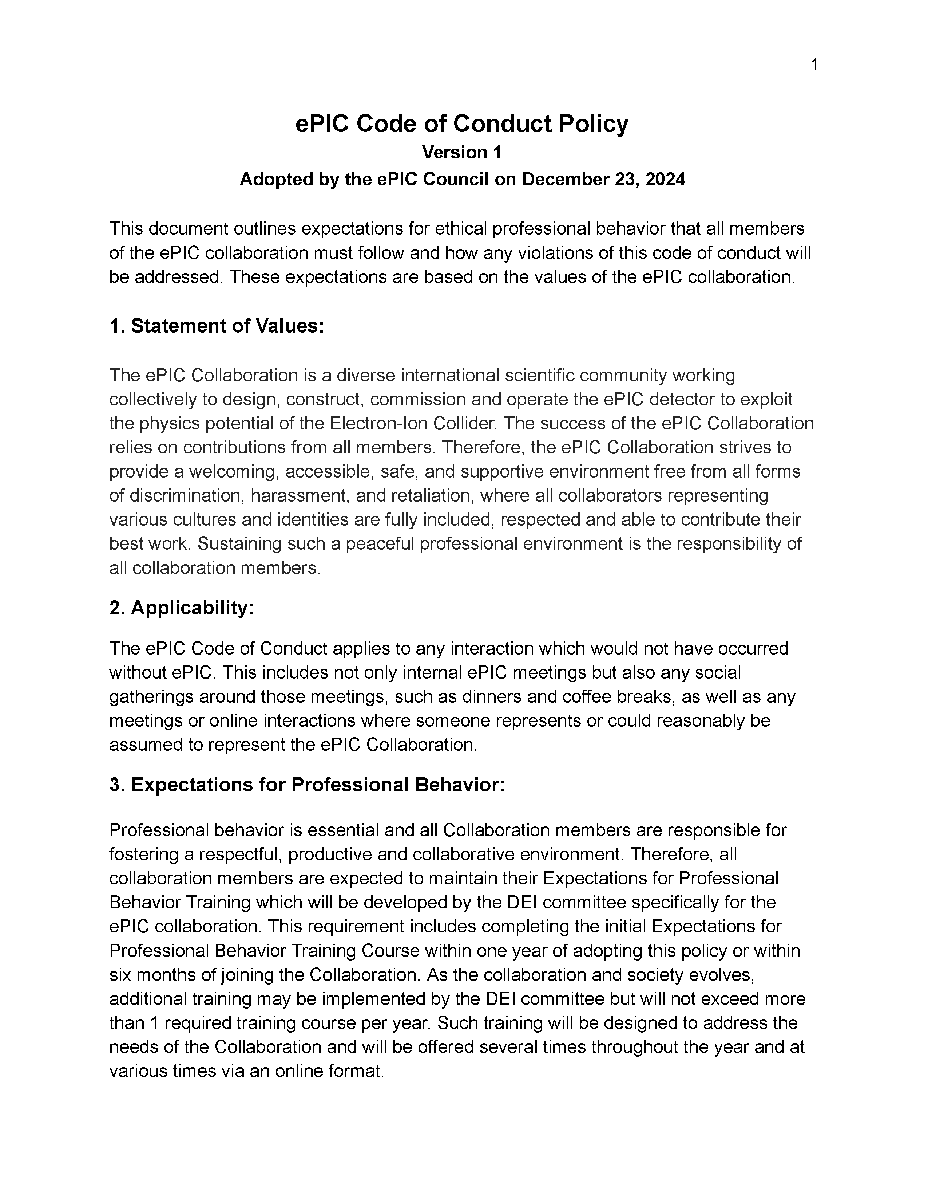
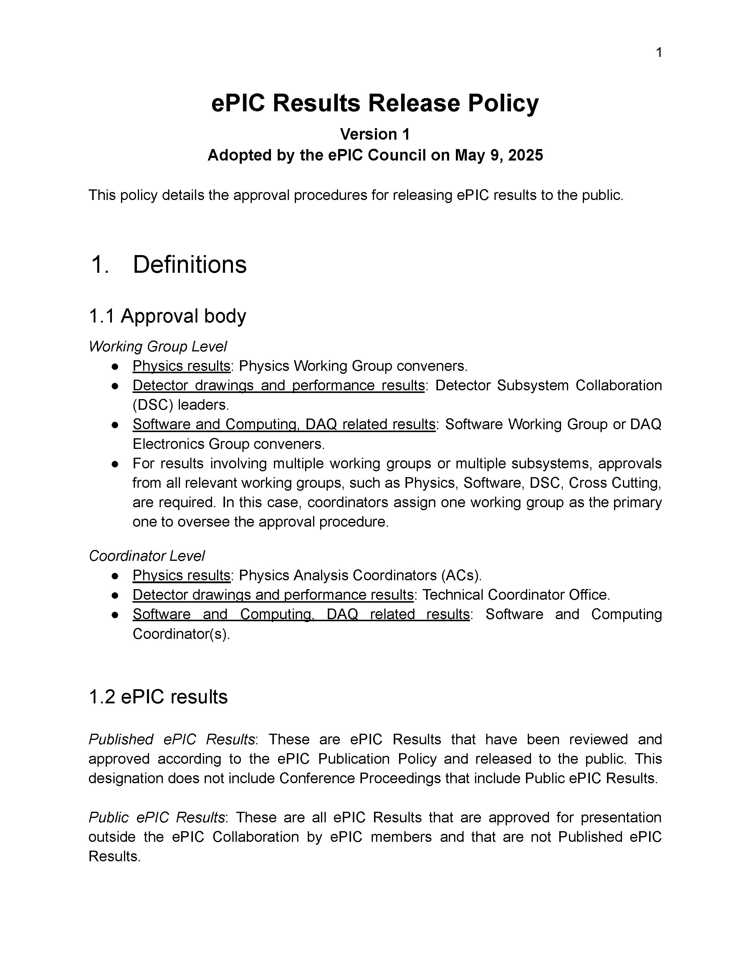
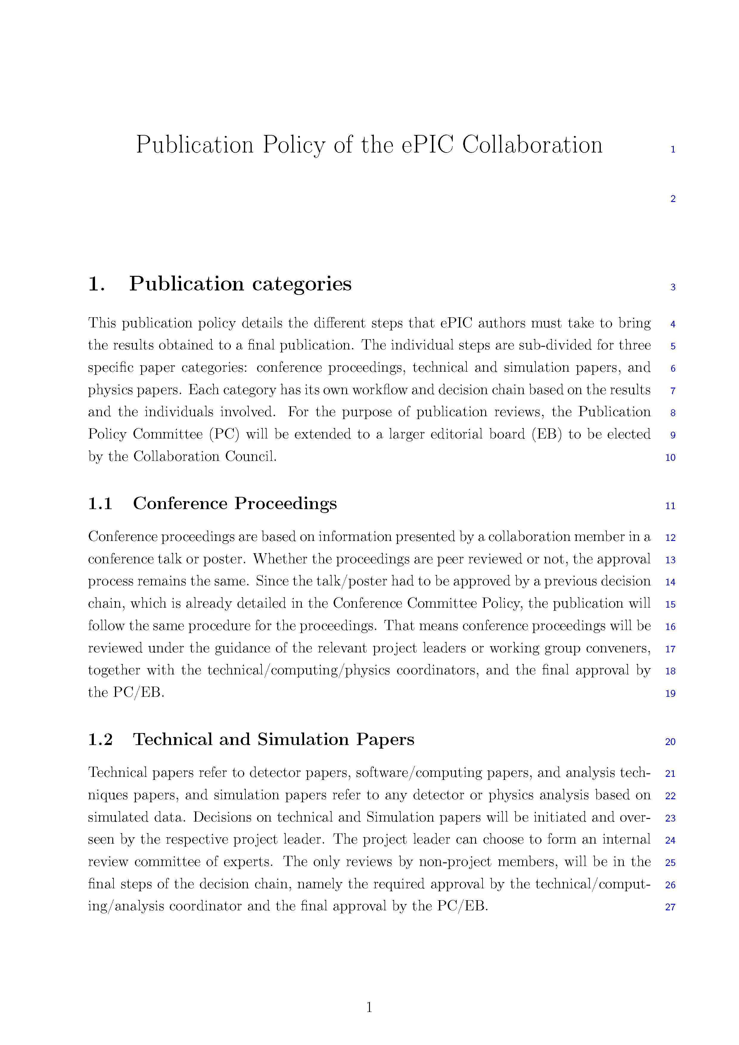
Formation of ePIC Policies
The Membership Policy was endorsed by the Collaboration Council August 2024.
The Conference and Talks Policy was endorsed by the Collaboration Council November 2024.
The Code of Conduct was endorsed by the Collaboration Council December 2024.
The Results Release Policy was endorsed by the Collaboration Council May 2025.
The Publication Policy was endorsed by the Collaboration Council in July 2025.
Important discussions in the upcoming CC Meeting on Thursday:
Election results
Discussion of charter update
Committee reports
Code of Conduct discussion

Slide 13



2025
Expect updates in the talk from Elke and Rolf
ePIC Physics preTDR and Early Science Workshop
September 2025
DOE OPA Status
5-7th August, 2025
PDR2: Polarimetry
Sept./Oct 2025
PDR: DAQ - Slow
Controls
Nov./Dec. 2025
PDR2: Cerenkov PID
April 1-2, 2025
FDR: BABAR DIRC Bar Refurbishment
ePIC Early Physics Workshop
April 24-25, 2025
10th Detector Advisory Committee
June 11-13th 2025
PDR2: Backwards HCal
~Sept. 2025
ePIC pre-TDR
V2.1
PDR3: Barrel EMCal
~August 2025
ePIC Software and
Computing Review
~Oct 2025
ePIC Software and
Computing Technical Interchange – May 12th
SVT Working Meeting
July 9-11,
2025
BIC In-Person Workshop
April 9-11,
2025
DOE IPR and ICR, 13-16th Jan. 2026
PDR: Magnet/Cryo Infrastructure
Sept./Oct. 2025
PDR3: IR Integ.
& Aux. Det
Nov./Dec. 2025
PDR3: Elec./DAQ
August 2025 (late)
Frascati
Jan 20-24,2025
EICUG/ePIC Collab. Mtg. July 14-18
ePIC Ready for Technical Baseline
Detector R&D Day (ePIC/Project)
16-17th April 2025
6th EIC RRB Meeting
Nov. 4-5th 2025
EICO
2-4th April 2025
Calorimetry
Workshop
June 5-9th, 2025
FDR: Backward & Forward EM Calorimetry, Barrel & Forward HCAL
July 2025
PDR: Integ. + Installation
(outside GST)
Nov/Dec 2025
hpDIRC Annual Meeting Jun 26th - July 2nd
PDR2: Si Tracking Detectors
Fall 2025
HSF-India/ePIC Workshop
May 13-17th, 2025
PDR2: MPGD Detectors
Summer 2025
PDR2: AC-LGAD Detectors
Fall 2025
Detector Subproject Baseline Readiness Director's Review
12-14 Nov. 2025
PDR: Integ. + Installation
(inside GST)
Nov/Dec 2025
5th EIC RRB Meeting
June 5-6th 2025
ePIC Italy Meeting
16-18 June 2025

Slide 14
Focus of this ePIC Collaboration Meeting
At the meeting in Frascati in Jan 2025 we discussed the goals and
set priorities for the collaboration in the coming year.
The main priority for the collaboration is to prepare ePIC for a technical baseline by the end of 2025
  The preTDR is the main product resulting from that priority
  Despite considerable uncertainties in 2025, our plan is to be ready
At this meeting we will take stock of our progress and prioritize and organize the remaining work to complete the ePIC technical baseline.
  There are key technical questions that remain open pending simulation results! There is an urgent need to make progress.
  Cooperation between the EIC Project and Collaboration is critical!

Slide 15
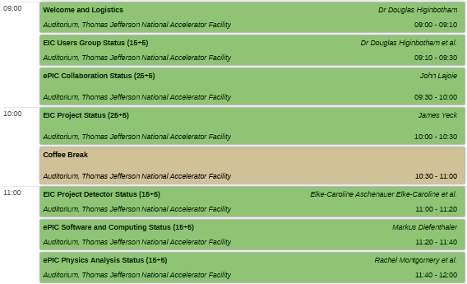
Key Things to Look For:
Monday, July 14th
Jim will update us on the EIC project plan, Elke and Rolf will give us the status of the ePIC detector portion of the project
Software and Computing Coordination and Physics Analysis Coordination will give a status update and highlight preparations to complete the preTDR in the latter half of this year.
Monday afternoon: updates from funding agencies and a collection of talks on the EIC machine status

Slide 16
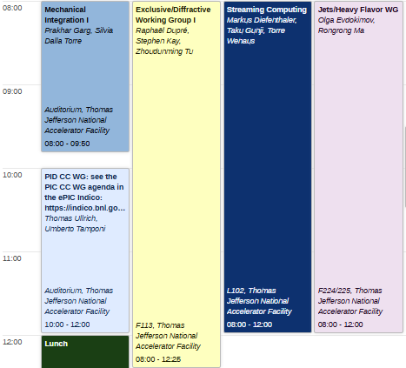
Workfests and Parallel Sessions
A critical part of ePIC collaboration meetings –
where the work gets done!
Tuesday Morning, July 15th
Integration session organized jointly by project engineers and ePIC Technical Coordination.
PID CC Working Group – organization and software status
Exclusive/Diffractive and Jets/HF Working Groups
Streaming Computing WG – calibrations, alignment and orchestration
Reception Tuesday evening following the EICUG Plenary session.

Slide 17
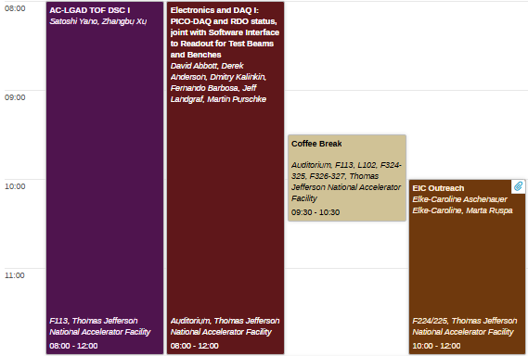
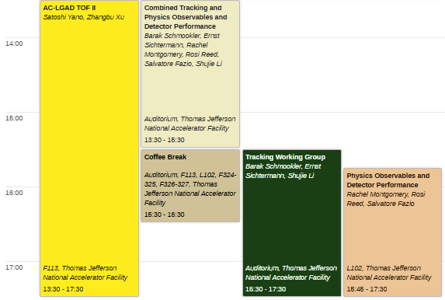
Workfests and Parallel Sessions
A critical part of ePIC collaboration meetings –
where the work gets done!
Wednesday Morning, July 16th
Wednesday Afternoon, July 16th
AC-LGAD TOF DSC
Focus on detector performance (Tracking WG and PAC’s)
Joint WG on DAQ developments
Important joint EICUG/ePIC effort on outreach.
Evening: Software Interface to Readout for Test Beams and Benches Hackathon

Slide 18
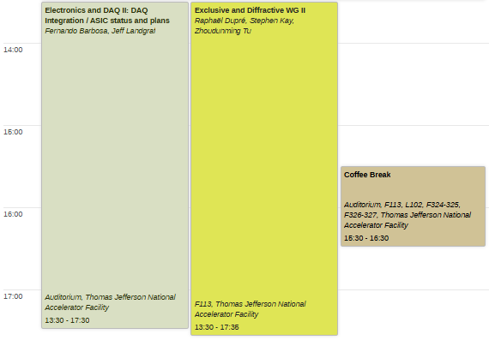
Workfests and Parallel Sessions
A critical part of ePIC collaboration meetings –
where the work gets done!
Thursday Afternoon, July 17th
Part II: Timing, data volumes and ASICS
Part II: Exclusive and Diffractive
Thursday evening social event at Traditions.

Slide 19
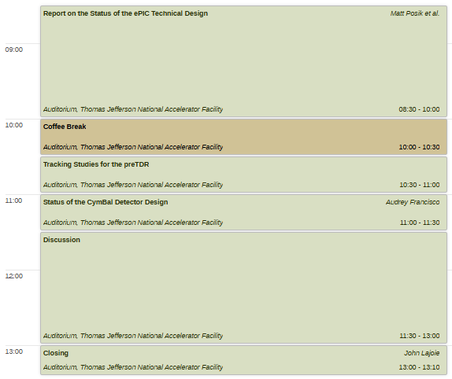
Friday Plenary Session
The intent of this session is to discuss current challenges in the ePIC technical design, with a special focus on simulation needs.
Friday, July 18th
The Technical Coordination team will present current status and challenges
Focused talks on special topics
Plenty of time for discussion! Bring your thoughts and ideas from earlier in the week! The workfests will help inform this discussion.

Slide 20
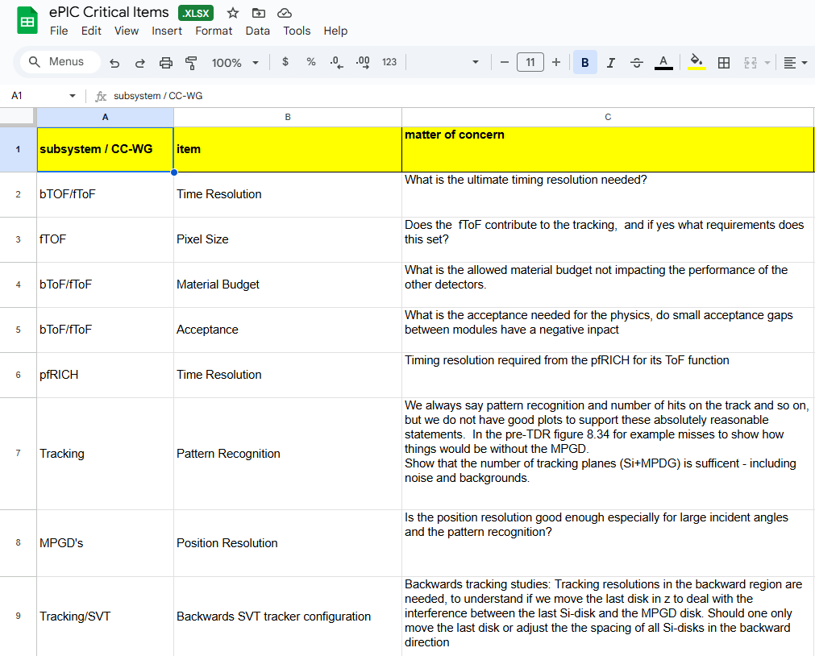
Tracking Critical Simulation Items
The Project and ePIC Leadership have been developing a list of urgent items that require simulations studies to resolve technical issues.
This is shared with the collaboration now to get people thinking about this prior to Friday’s discussion.
What is missing?
What can be combined?
What additional development is needed to enable a study?
Who can help?
Link to Spreadsheet Copy

Slide 21
The ePIC Sessions are OPEN to all who are interested.

Slide 22
Looking Forward to 2026+
ePIC faces significant challenges in the coming years:
External Challenges:
  Ensuring that international collaboration is welcome and encouraged
  Funding and support for groups working in the EIC/ePIC
  …
Internal Challenges:
  Engagement and workforce continue to be issues
  Detector integration and performance needs more effort
  After the preTDR there will still be an enormous amount of work to do to reach 90% design maturity
  …
The right approach is to make certain ePIC makes progress!

Slide 23
ePIC preTDR and Publication Plan
process design phase
writing
(TDR/notes)
Prepare
papers for
publication
structuring the
effort
preTDR v2.0
Review v2.0
(internal/external)
December 2025 pre-TDR v2.1
NIM Special
Issue
mid-2026
Mid Jan.24
Mid Mar.24
preTDR v1.0
Dec. 24
July 2025
Formation of Editorial Board
It is still our intent to publish a super-set of the material prepared for the preTDR.
  Longer articles on subsystems, physics performance, early science, etc.
  Important for collaborators to have a published product for all their hard work!
Plan to open a NIM Special Issue at the end of 2025, open for ~6 mos
  Still working to understand Open Access requirements

Slide 24
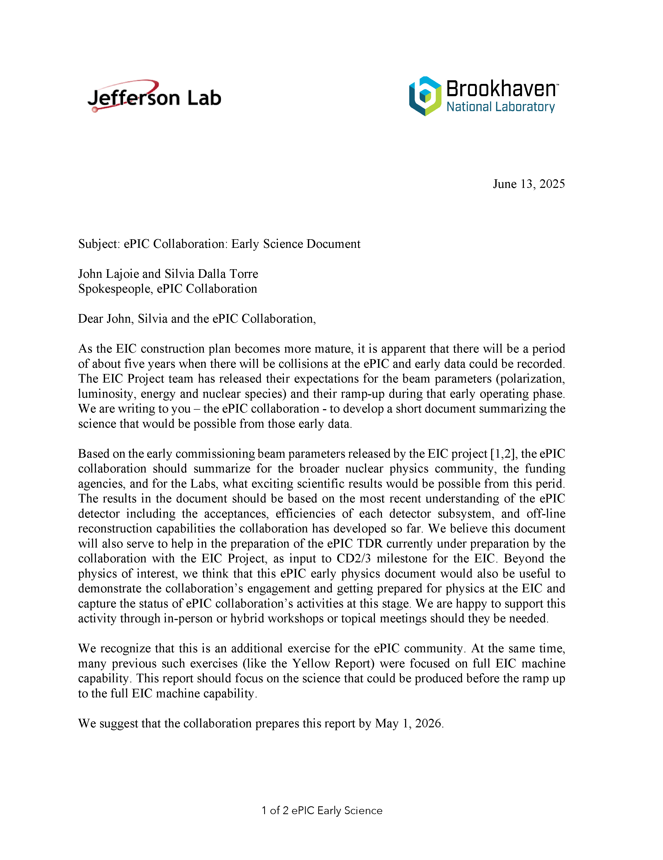
Early Science Charge
The collaboration has received a charge from Abhay Deshpande and David Dean to develop a document that summarizes EIC Early Science.
Supports the EIC project plan
Report requested by May 1, 2026
  Consistent with our publication plan
Next Early Science workshop in early 2026
Physics Analysis Readiness Workshop will be held September 17-18th in London.
More in the Physics Analysis Coordination talk.

Slide 25
The Status of the Collaboration
The ePIC Collaboration is strong, active and growing!
  International participation is key to the success of ePIC
New leaders are emerging from within the collaboration
There has been good progress on the preTDR and plans for publications
Key collaboration policies are in place
ePIC is engaged in developing the Early Science program at the EIC
The ePIC experiment is exercising its status as a CERN Recognized Experiment
  ePIC presence at CERN test beams will be greater this year
We continue to have very productive collaboration meetings with increasing engagement

Slide 26
Meeting Sticker
By request we also have a reprint of the “standard” ePIC sticker as well.
Once again, many thanks to Oskar Hartbrich for the sticker design.

Slide 27


Slide 28
ePIC Resources
Public Website - https://www.bnl.gov/eic/epic.php
Mailing Lists – https://lists.bnl.gov/mailman/listinfo
Indico Agenda - https://indico.bnl.gov/category/402/
  ePIC Software and Computing: https://indico.bnl.gov/category/435/
Wiki - https://wiki.bnl.gov/EPIC
ePIC Software Training:
  Landing Page: https://eic.github.io/documentation/landingpage.html
  Tutorials: https://eic.github.io/documentation/tutorials.html
Mattermost: https://chat.epic-eic.org
ePIC Zenodo Community: https://zenodo.org/communities/epic

Slide 29


EICUG Membership
The EICUG is a vital organization to promote the interests of the EIC community!
  Without the EICUG we would never have gotten far enough to form ePIC!
Please register your institution!
Check with your EICUG IB representative to get registered as a member
https://www.eicug.org/content/join.html

