Slide 1
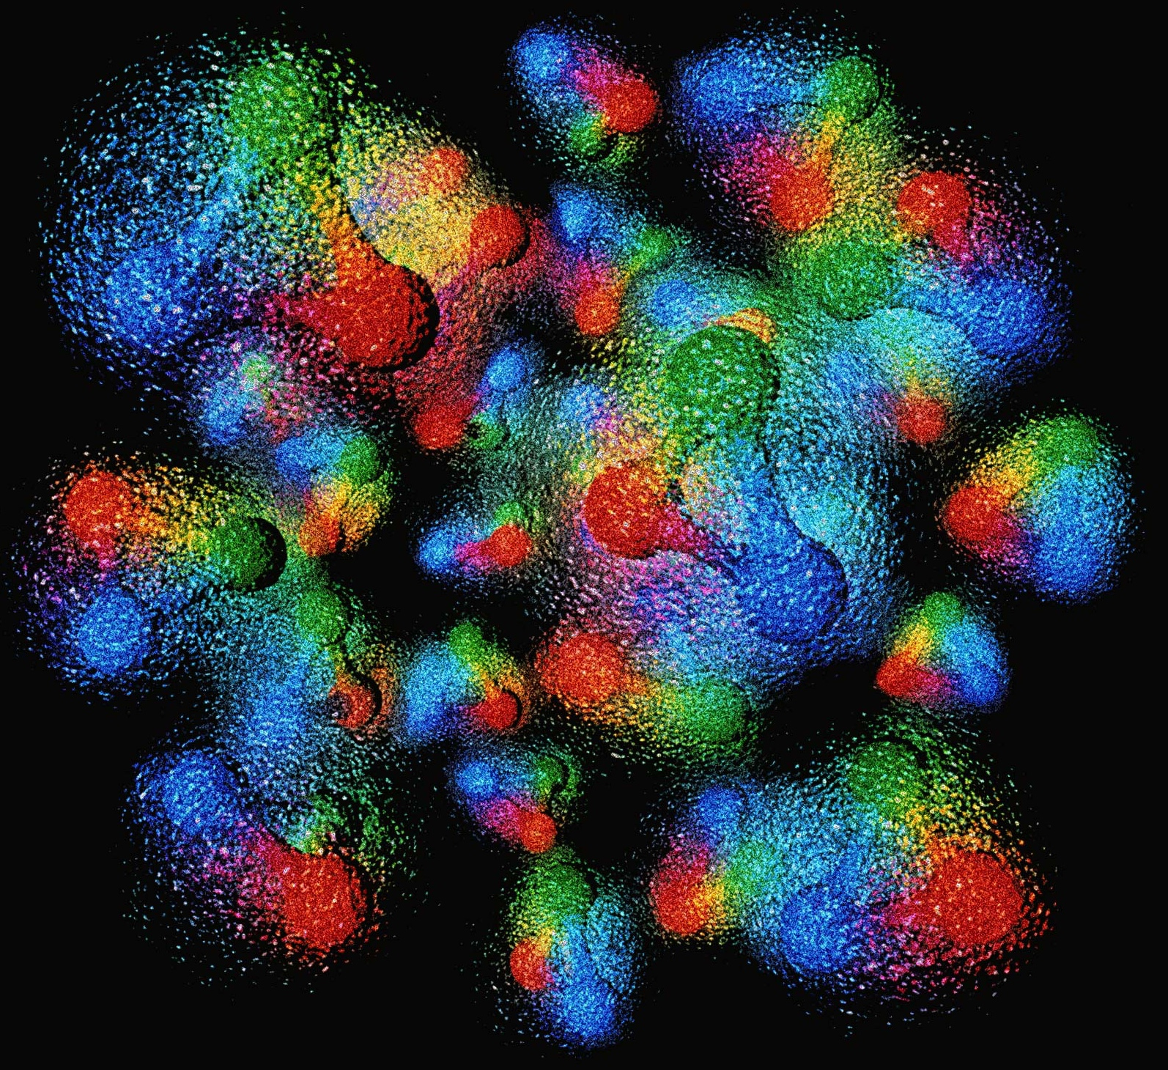
Welcome!
Or Hen (Chair)
https://www.eicug.org

Slide 2
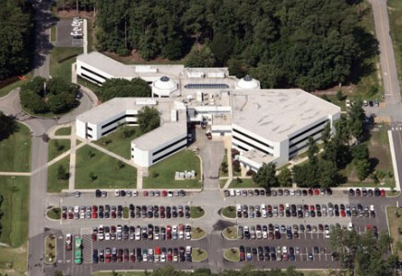
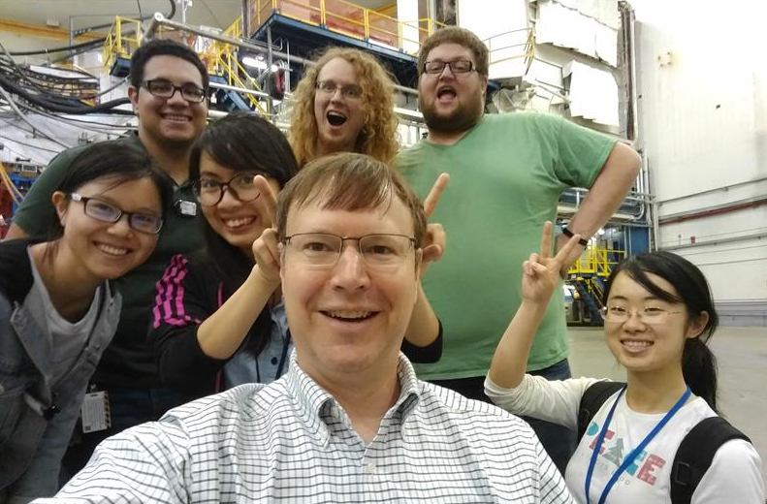
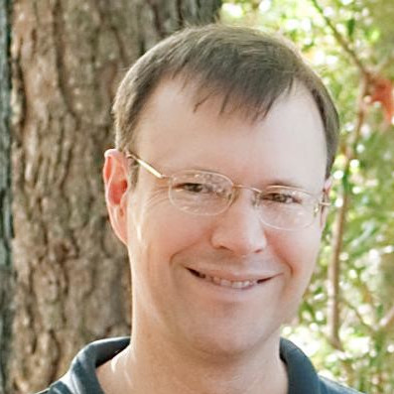
Thank you Doug & JLab Admin Staff!

Slide 3
Thank you, Steering Committee
Chair line
Chair: Or Hen (MIT, USA), term August 2024 - August 2025
Chair-elect: Douglas Higinbotham (JLab, USA), term August 2024 - August 2025
Past Chair: Marco Radici (INFN - Pavia, Italy), term August 2024 - August 2025
Regular Members
Charlotte Van Hulse (University of Alcalà, Madrid, Spain), term August 2024 - August 2027
Martha Constantinou (Temple University, USA), term August 2023 - August 2026
Alex Jentsch (Brookhaven National Laboratory, USA), term August 2023 - August 2026
International Representatives
Marta Ruspa (University of Torino and INFN-Torino, Italy), term August 2023 - August 2025
Carlos Muñoz Camacho (IJCLab, Orsay, France), term August 2024 - August 2027
Early Career Member
Henry Klest (Argonne National Laboratory, USA), term August 2024 - August 2025
Lab/EIC Project Representatives
Rolf Ent (Thomas Jefferson National Accelerator Facility, USA)
Peter Steinberg (Brookhaven National Laboratory, USA)
ePIC Representative
John Lajoie (Oak Ridge National Lab, USA)

Slide 4
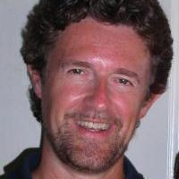
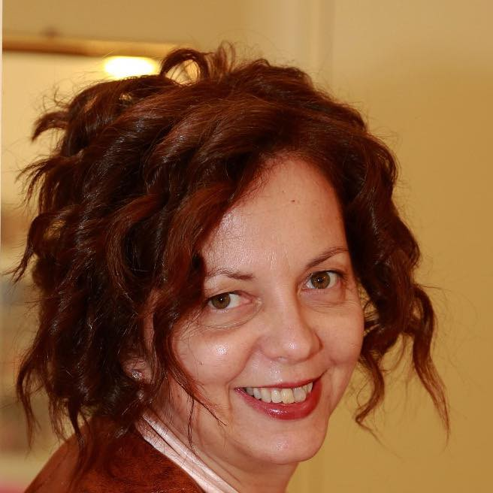
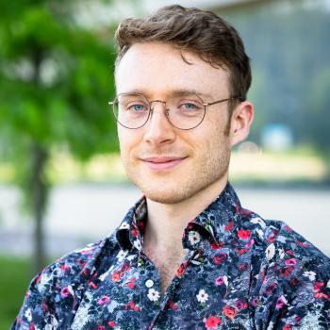
Thank you, Outgoing Members
Past Chair: Marco Radici (INFN - Pavia, Italy), term August 2024 - August 2025
Marta Ruspa (University of Torino and INFN-Torino, Italy), term August 2023 - August 2025
Henry Klest (Argonne National Laboratory, USA), term August 2024 - August 2025
Chair line
Chair: Or Hen (MIT, USA), term August 2024 - August 2025
Chair-elect: Douglas Higinbotham (JLab, USA), term August 2024 - August 2025
Past Chair: Marco Radici (INFN - Pavia, Italy), term August 2024 - August 2025
Regular Members
Charlotte Van Hulse (University of Alcalà, Madrid, Spain), term August 2024 - August 2027
Martha Constantinou (Temple University, USA), term August 2023 - August 2026
Alex Jentsch (Brookhaven National Laboratory, USA), term August 2023 - August 2026
International Representatives
Marta Ruspa (University of Torino and INFN-Torino, Italy), term August 2023 - August 2025
Carlos Muñoz Camacho (IJCLab, Orsay, France), term August 2024 - August 2027
Early Career Member
Henry Klest (Argonne National Laboratory, USA), term August 2024 - August 2025
Lab/EIC Project Representatives
Rolf Ent (Thomas Jefferson National Accelerator Facility, USA)
Peter Steinberg (Brookhaven National Laboratory, USA)
ePIC Representative
John Lajoie (Oak Ridge National Lab, USA)

Slide 5
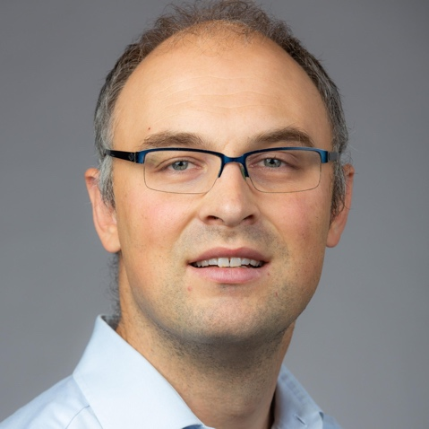
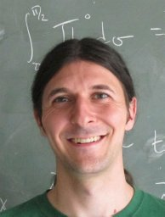
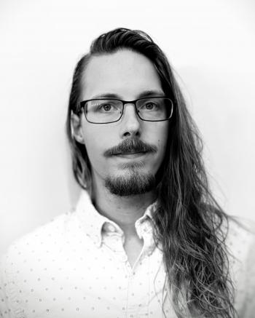
Welcome Incoming Members [Elected by over 600 users!]
Chair Elect:
Anselm Vossen
International Member:
William A. Horowitz
Early Career:
Derek Anderson

Slide 6
EICUG Moving Forward: Big Picture
Top priority: continue supporting the EIC project!
Theory community & “General” tools
ePIC
Accelerator
Advocacy
Recognize user contributions
Equally important: continue pushing for the future
Detector II and Generic R&D

Slide 7
EICUG Moving Forward: Big Picture
Top priority: continue supporting the EIC project!
Theory community & “General” tools
ePIC
Accelerator
Advocacy
Recognize user contributions
Equally important: continue pushing for the future
Detector II and Generic R&D

Slide 8
EICUG Moving Forward: Big Picture
Top priority: continue supporting the EIC project!
Theory community & “General” tools
ePIC
Accelerator
Advocacy
Recognize user contributions
Equally important: continue pushing for the future
Detector II and Generic R&D
Structure Changes: SC takes responsibility for users conduct and related issues

Slide 9
Have a great meeting!
(Or Hen, Past Chair)
https://www.eicug.org

