Slide 1
Electron Ion Collider User Group Report
Douglas Higinbotham
Jefferson Lab

Slide 2
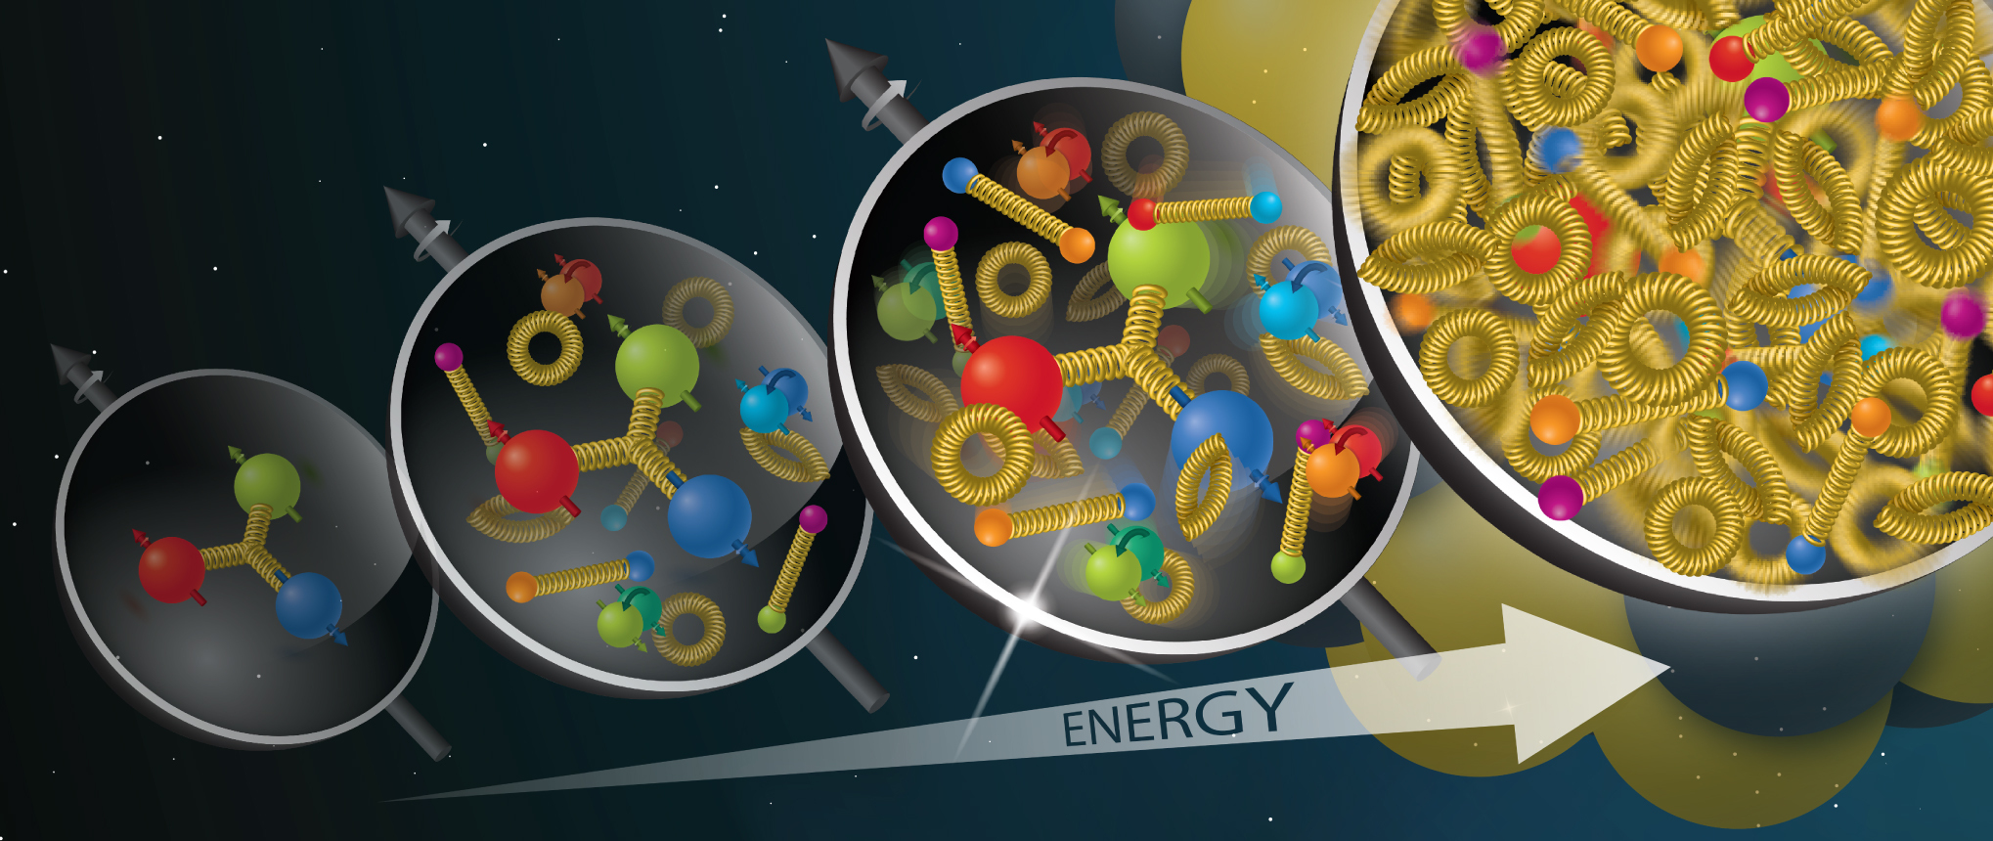
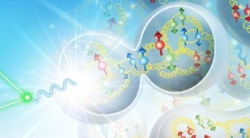
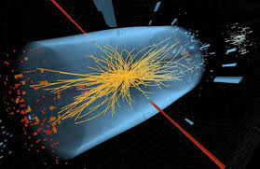
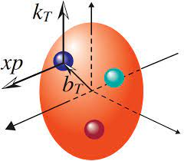
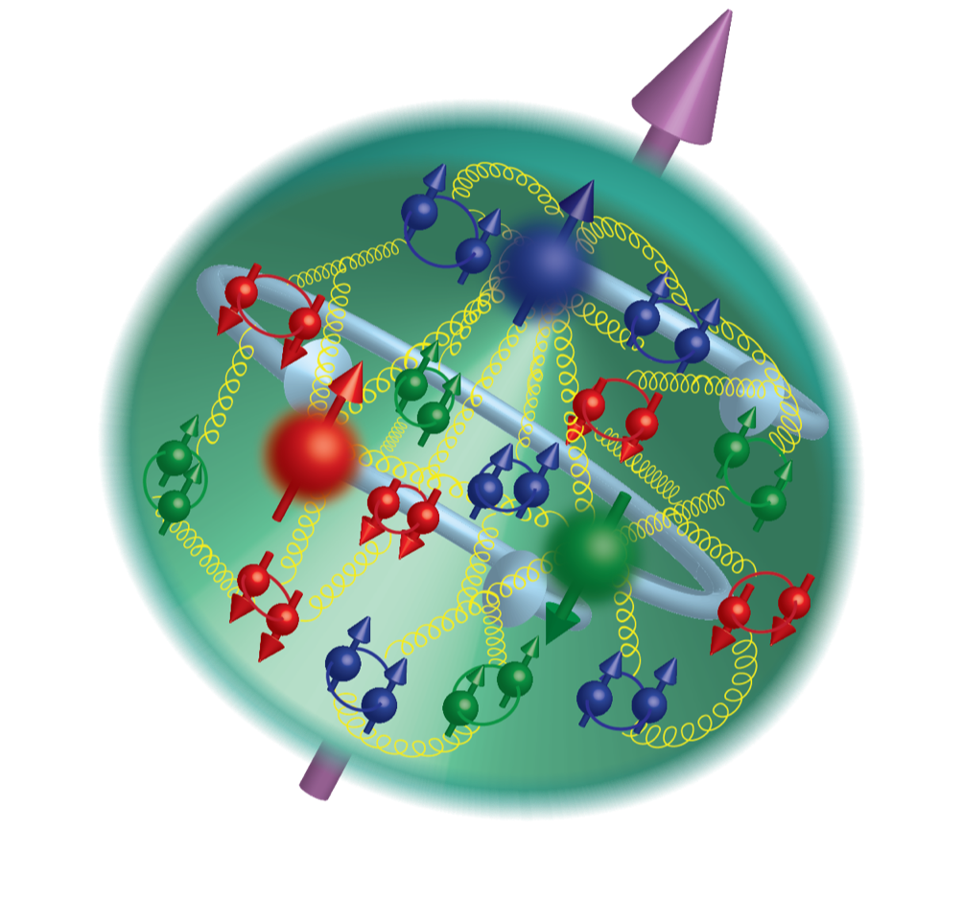
Dense Gluons
Nuclei
Cutting Edge
QCD Science
Machine
Standard Model
Femtography
Origin of Spin
Origin of Mass
2

Slide 3
Dense Gluons
Nuclei
EIC Users Group is home for the community working to realize EIC science
Experiment ⬄ Theory ⬄ Accelerator ⬄ Engineering ⬄ Computing/AI …
Cutting Edge
QCD Science
Machine
Standard Model
Femtography
Origin of Spin
Origin of Mass
3

Slide 4
Users group is inherently different from the collaboration, providing important complementarity.
Home for the full community: theory, experiment, accelerator, engineering, software, etc.
Community driven organization, independent of the DOE project
Incubator for scientific initiatives that are not a project yet, e.g. Detector II
‘low stakes’ onboarding to EIC Science and activities

Slide 5
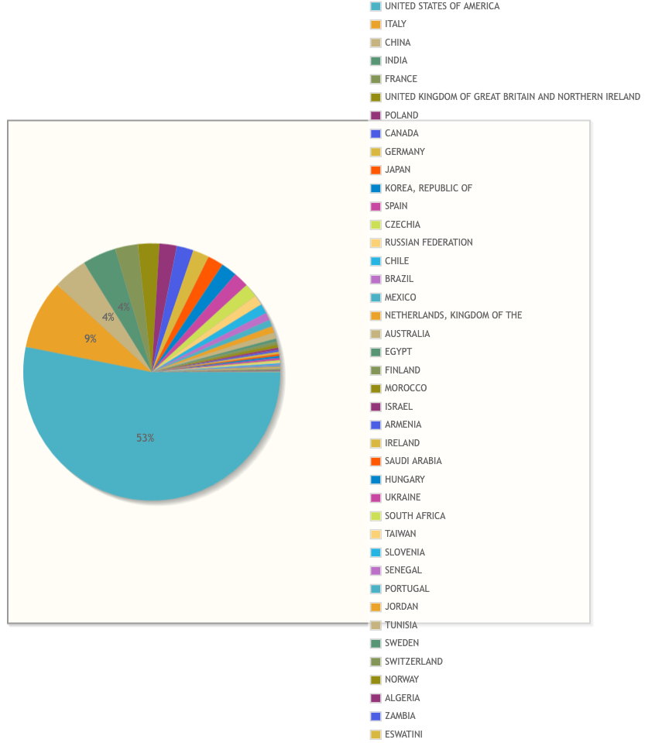
EIC User Group ( 14 July 2025 )
1556 members from 307 institutions
Experiment Scientists: 1031
Theory Scientists: 383
Accelerator Scientists: 125
Computer Scientists: 9
Support: 5
Other: 3
From 41 Countries

Slide 6
Users group led by Steering committee
Currently hosts five working groups:
Theory
Detector II
Software
MC Event Generators
Artificial Intelligence

Slide 7
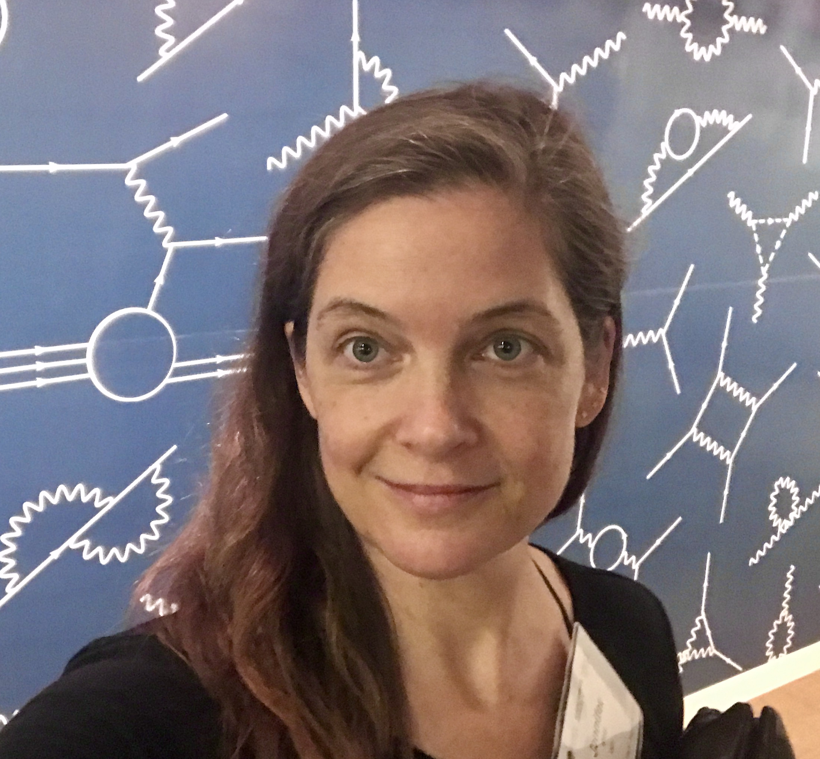
EIC Early Career Workshop (11-12 July 2025 )
Huge Thank You To The Organizers!!
Henry Klest, Wenliang Bill Li, and Jennifer Rittenhouse West
And for funding from Jefferson Lab/JSA and CFNS.
This workshop is something that Abhey, Bill and myself are extremely passionate about will continue to do what we can to enable this special workshops to continue.
The best speakers from this year's workshop will be announced tomorrow and as per your feedback those speaks will have a chance to present their work at this meeting.

Slide 8
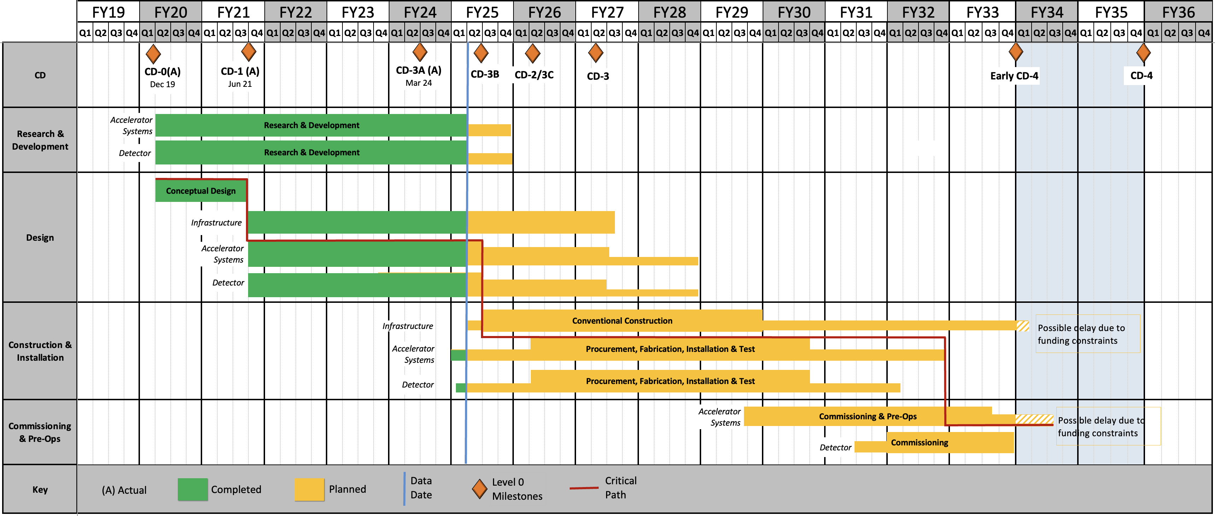
Reference Schedule from January 2025
RHIC Operations is planned for the end of CY2025
8

