Slide 1

IN CASE OF AN EMERGENCY - Auditorium
!
Locate the Nearest Exit
Exit the Building for Fire
Shelter Inside for Tornado
Wait for Further Direction
There are two doors located at the top and bottom of the Auditorium
After exiting the Auditorium, find the nearest exterior door to exit the building
After exiting the Auditorium, shelter in L102, F113, or the
F-wing hallway
JLab Security or representative will let you know when safe to resume
Notes:
CSAAPT/NCS-AAPT Fall 2024 Joint Semi-Virtual Meeting (October 19, 2024): Timetable · INDICO (Indico) (vt.edu)
JLab Webinar is inviting you to a scheduled ZoomGov meeting.
Topic: CSAAPT/NCS-AAPT Fall Joint 2024 Meeting
Time: Oct 19, 2024 08:30 AM Eastern Time (US and Canada)
Join ZoomGov Meeting
https://jlab-org.zoomgov.com/j/1619811371?pwd=pDClLPbOu22sRjwghjVPwqiwWunxtR.1
Meeting ID: 161 981 1371
Passcode: 241019
---
One tap mobile
+16692545252,,1619811371# US (San Jose)
+16469641167,,1619811371# US (US Spanish Line)
---
Dial by your location
• +1 669 254 5252 US (San Jose)
• +1 646 964 1167 US (US Spanish Line)
• +1 646 828 7666 US (New York)
• +1 551 285 1373 US (New Jersey)
• +1 669 216 1590 US (San Jose)
• +1 415 449 4000 US (US Spanish Line)
• 833 568 8864 US Toll-free
Meeting ID: 161 981 1371
Find your local number: https://jlab-org.zoomgov.com/u/adLgU6rLe
---
Join by SIP
• 1619811371@sip.zoomgov.com
---
Join by H.323
• 161.199.138.10 (US West)
• 161.199.136.10 (US East)
Meeting ID: 161 981 1371
Passcode: 241019

Slide 2
General Information
Please wear your conference badge while on site ( a JLab badge or a HSPD-12 badge is also acceptable identification)
For Monday through Thursday, we will have lunch here and we are just going to ask that we let those with dietary restrictions go first.
Tuesday evening, we will have a reception with light food (do not expect it to be dinner). [ though I was promised a baked Brei ]
Thursday evening, we will meet at Traditions Brewery (walking distance from the Mariott).
Please look through your handouts for maps, wifi passwords and the agenda.
Speakers, please upload your talks to Indico ahead of time. If you are having trouble, send your slides to John or myself and we can quickly get them added for you.
If you are session chair and need Indico admin privileges, please ask.

Slide 3
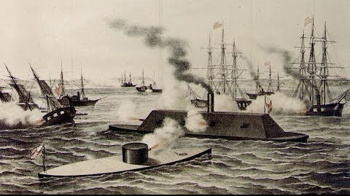
Friday Afternoon Free To Explore The Area
Highly recommend the Mariners Museum ( $1 admission ) and learn about the amazing naval history of this area.

Slide 4
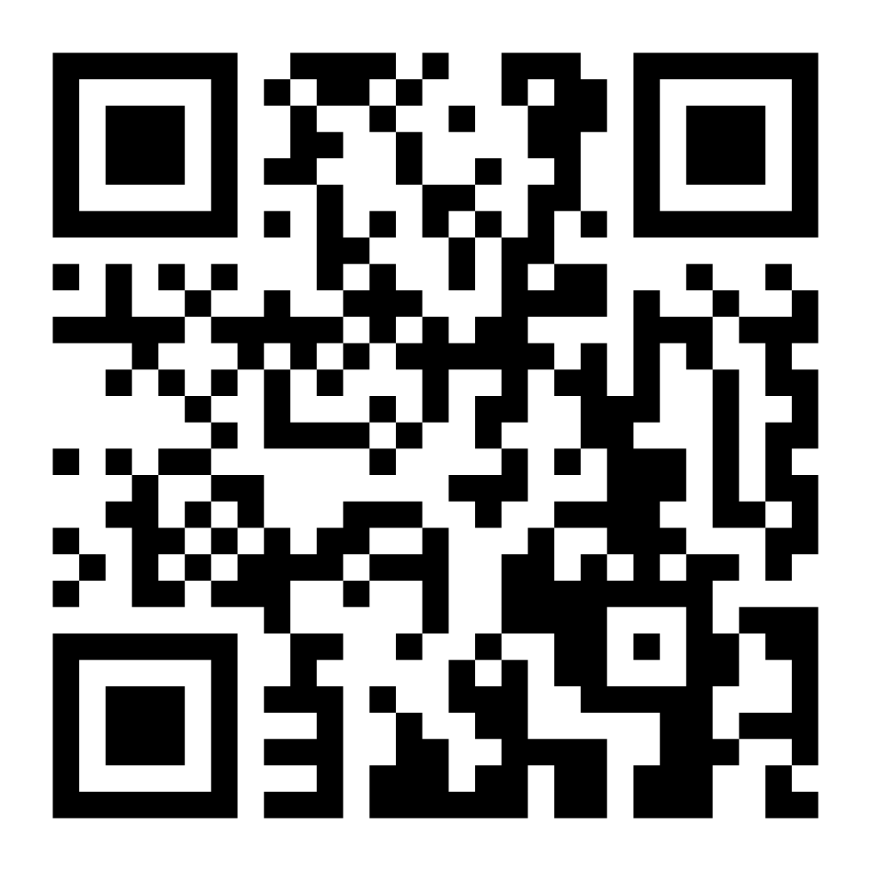
1st ePIC Poster Contest
Please Vote
Deadline: Thursday, 17th of July 6:00 pm EST
https://forms.gle/PoJchwwdi4boh3jt8

Slide 5
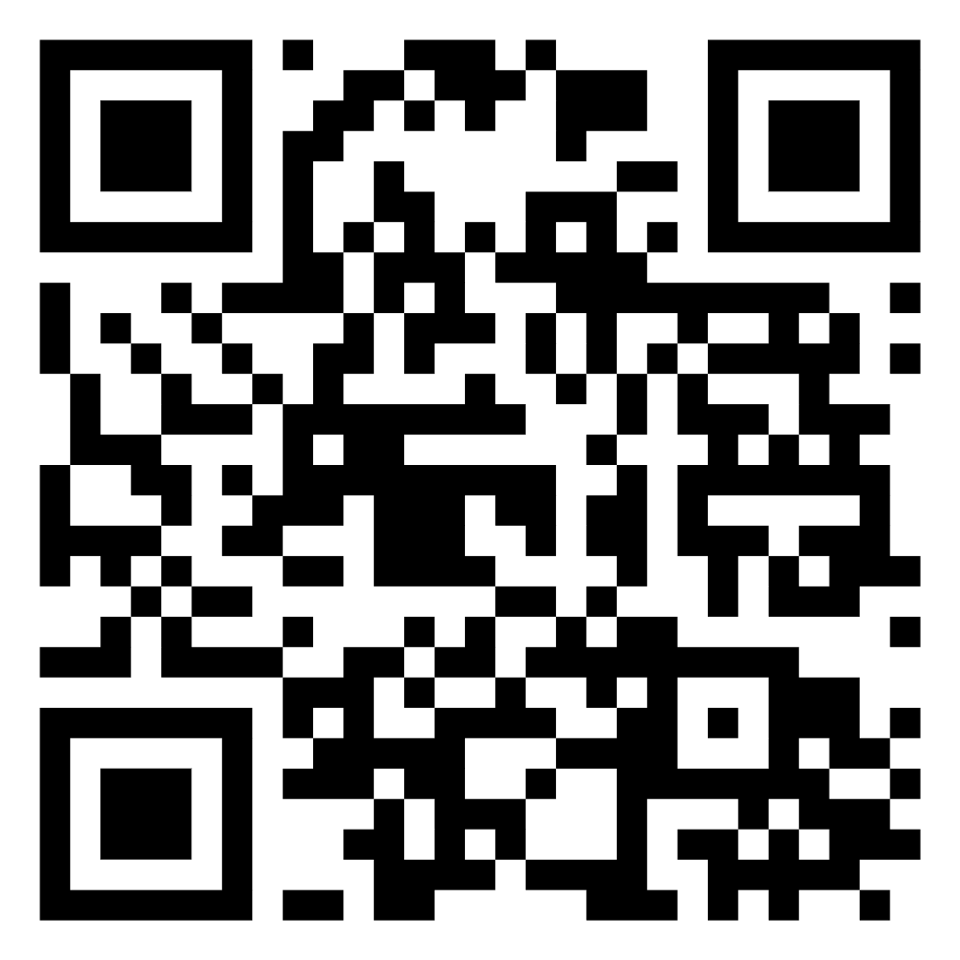
2nd ePIC Photo Contest
Please Vote
Deadline: Thursday, 17th of July 6:00 pm EST
https://forms.gle/VXgypocSAvMJ4mRq6

Slide 6
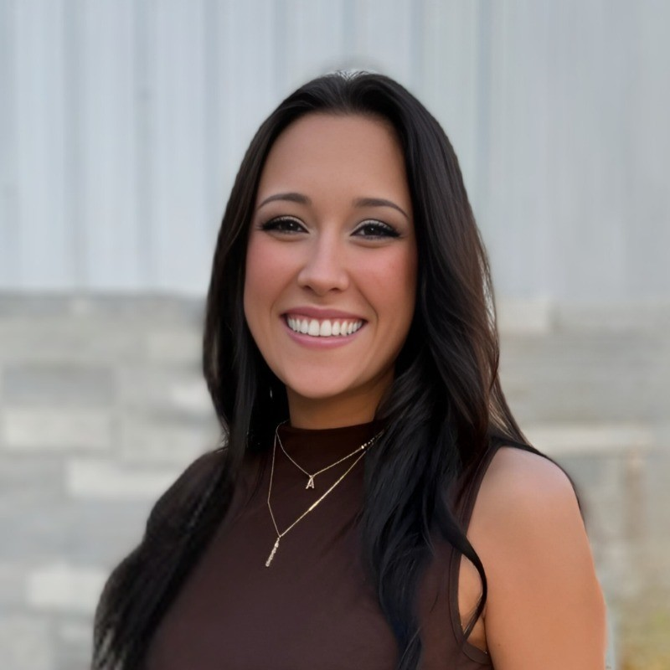
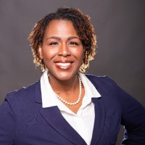
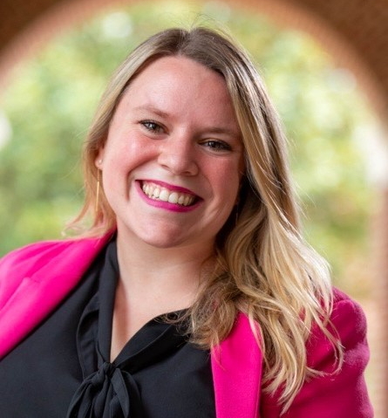
Special Thanks
Alyssa Butler
Sadie Cherry
Sarah Crouse

