Slide 1
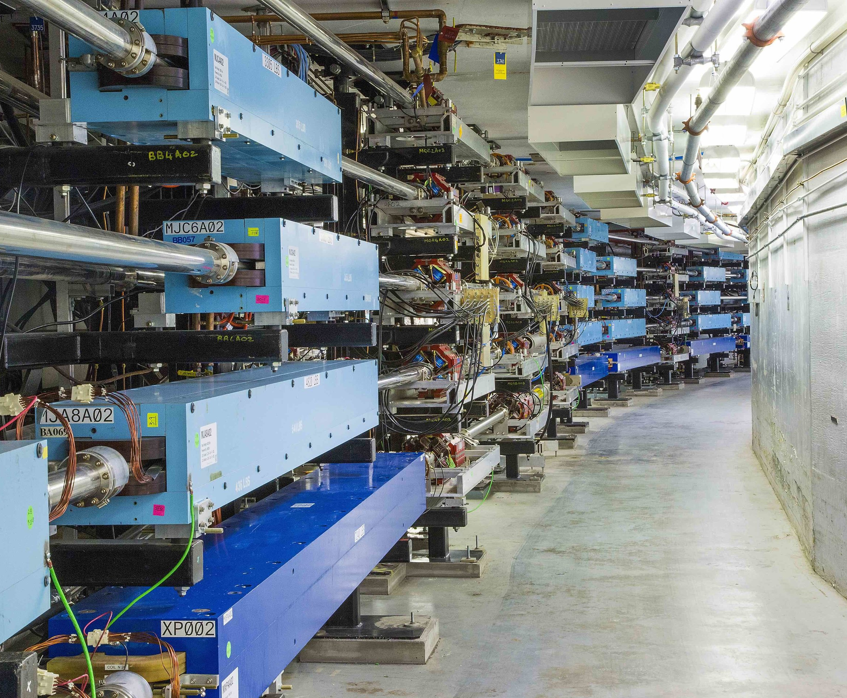
22 GeV CEBAF – Accelerator Plans
Developing a pre-conceptual design for an additional FFA* racetrack in the existing CEBAF tunnel to reach the top energy of about 22 GeV
*FFA (Fixed Field Alternating-Gradient)
Alex Bogacz
Accelerator Physics Group Leader
on behalf of the FFA@CEBAF Collaboration
Positron Working Group Workshop Jefferson Lab, March 24-26, 2025

Slide 2
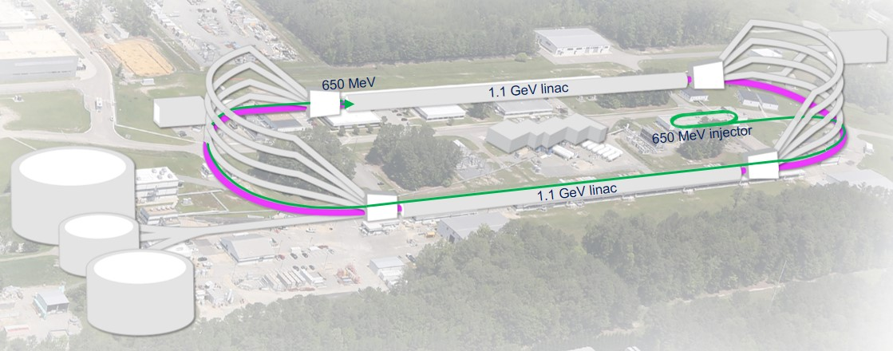

CEBAF FFA Upgrade – Baseline under Study
  The last energy upgrade was achieved by adding additional cavities, there is no more room for cavities in existing footprint (stay with 1.1 GeV per linac)
  In this upgrade, increasing (doubling) number of recirculation passes has been considered
  Remove the highest recirculation pass (Arc 9 & A) and replace them with two compact FFA arcs including time-of-flight chicanes (TOF)
  Novel permanent magnets, -like used for power and cost savings
  New 650 MeV recirculating injector
TOF
TOF
  Recirculate 4 + 6.5 times to get to 22 GeV
  Alternative staging scenario:
    4 + 5.5 passes with 1.1 GeV/linac to get to 20 GeV
    Upgrade linac energy to 1.21 GeV/linac to get to 22 GeV

Slide 3
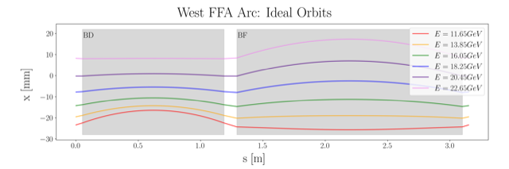
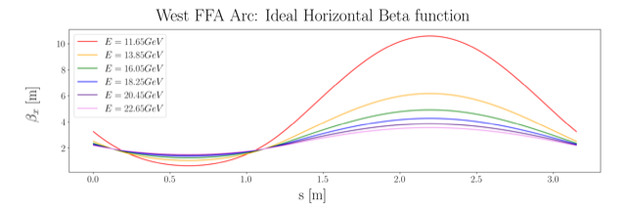
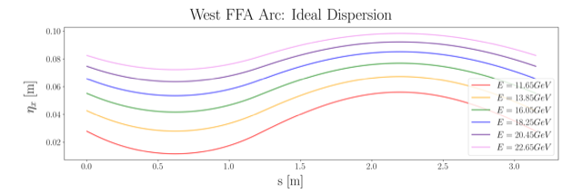
Non Scaling FFA Arc − Compact FODO Cell
orbits
Large momentum acceptance FFA cell, configured with combined function magnets capable of transporting six beams with energies spanning a factor of two
Arc composed of 75 cells, L_{cell} = 3.15 m
Closely spaced orbits for all six beams (~ 4 cm)
Low betas (~ a few m)
Extremally low dispersions (a few cm) - Virtue of combined function FFA magnets
beta functions
dispersions

Slide 4
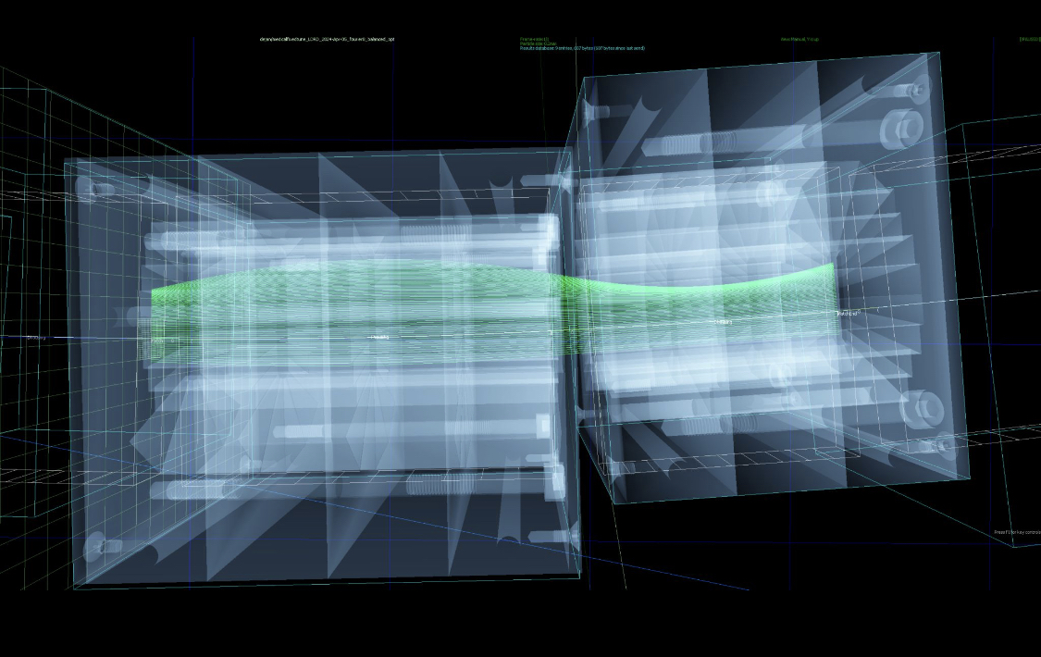
Non Scaling FFA Arc − Compact FODO Cell
Stephen Brooks
Imported a vendor's magnet mechanical design and overlaid it on the beam orbits to make sure there is clearance

Slide 5
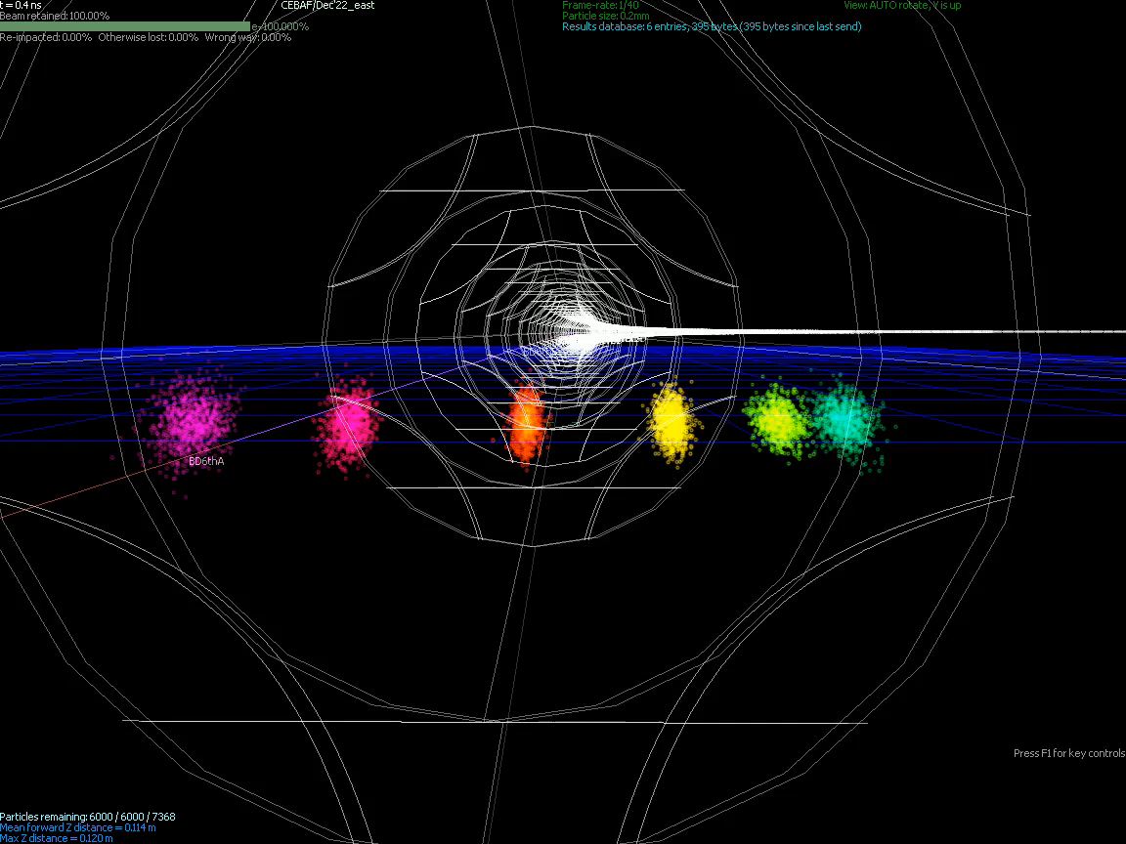
Stephen Brooks

Slide 6
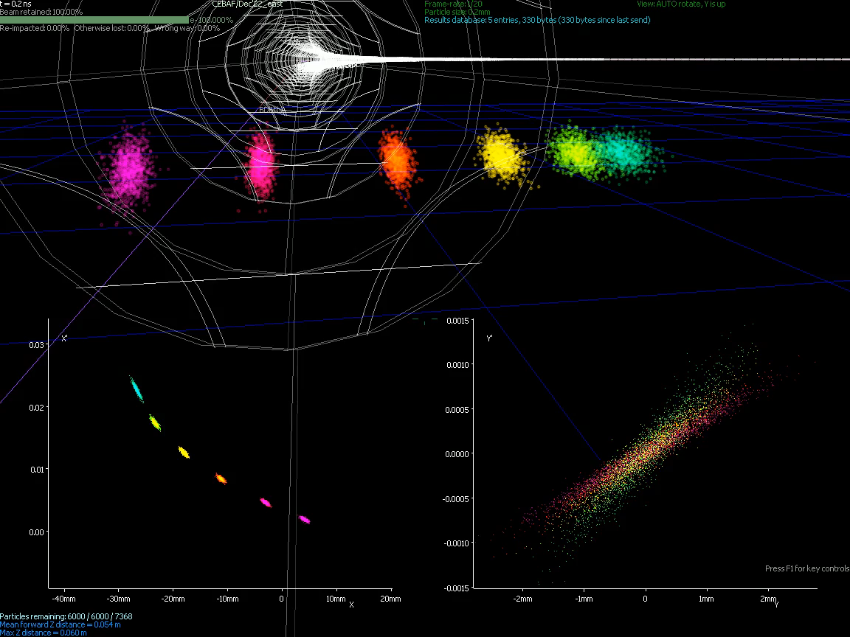
Stephen Brooks
Stephen Brooks

Slide 7
Permanent Magnet Design
Very compact compared to conventional electro magnets
Allows for accommodating 6 additional passes in CEBAF tunnel
Provides power and cost savings
Concept successfully tested at
Open mid-plane geometry
Focusing Magnet BF
G_{F}= -41.13 T/m
L_{QF}= 1.67 m
B_{F}= -0.812 T
Defocusing Magnet BD
G_{D}= 43.44 T/m
L_{BD}= 1.24 m
B_{D}= -0.593 T
12 cm
12 cm
13 cm
13 cm

Slide 8
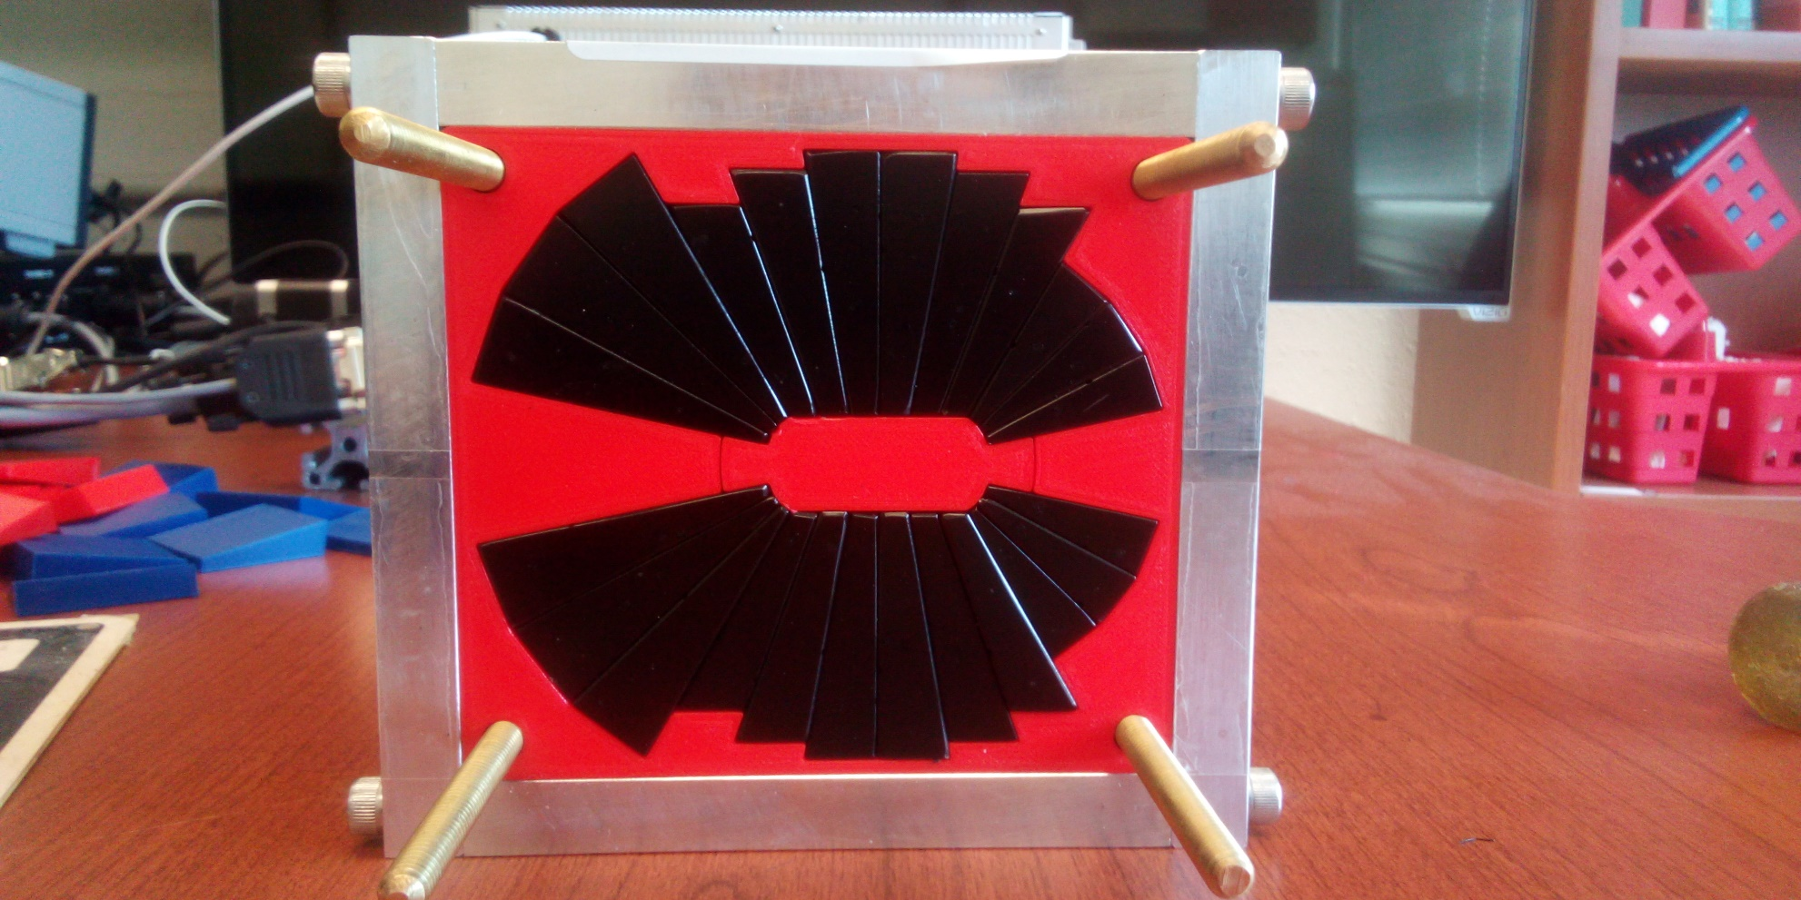
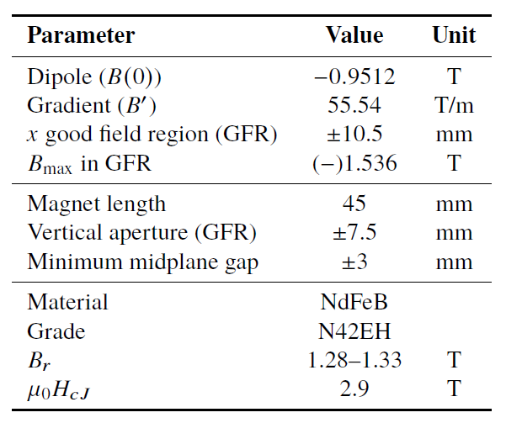

Prototype Magnet
Prototype open-midplane BF magnet successfully built and evaluated for mechanical integrity
>1.5 Tesla measured in good field region
Field accuracy of ${10}^{−3}$
Testing magnetic materials for radiation resilience at CEBAF - LDRD project started Oct. 1, 2023

Slide 9
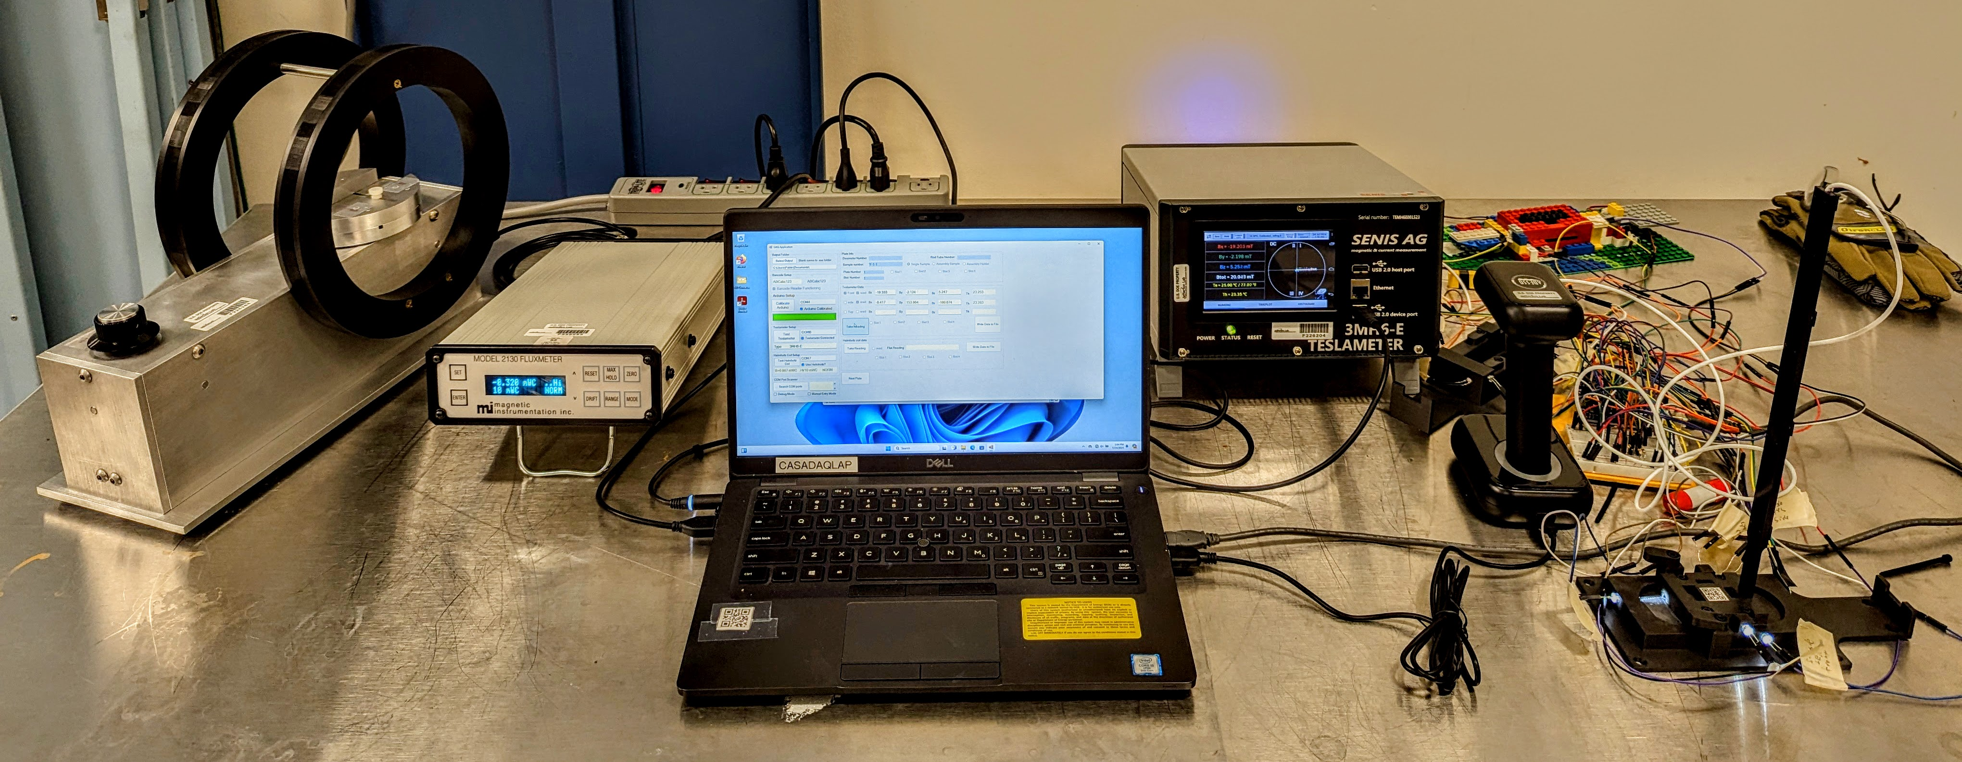
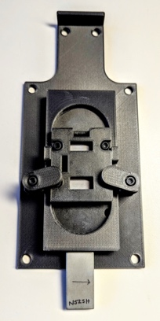
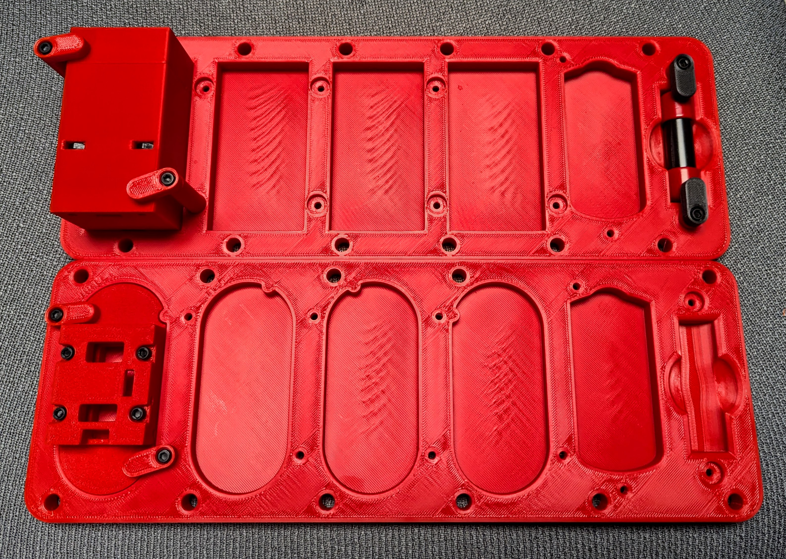
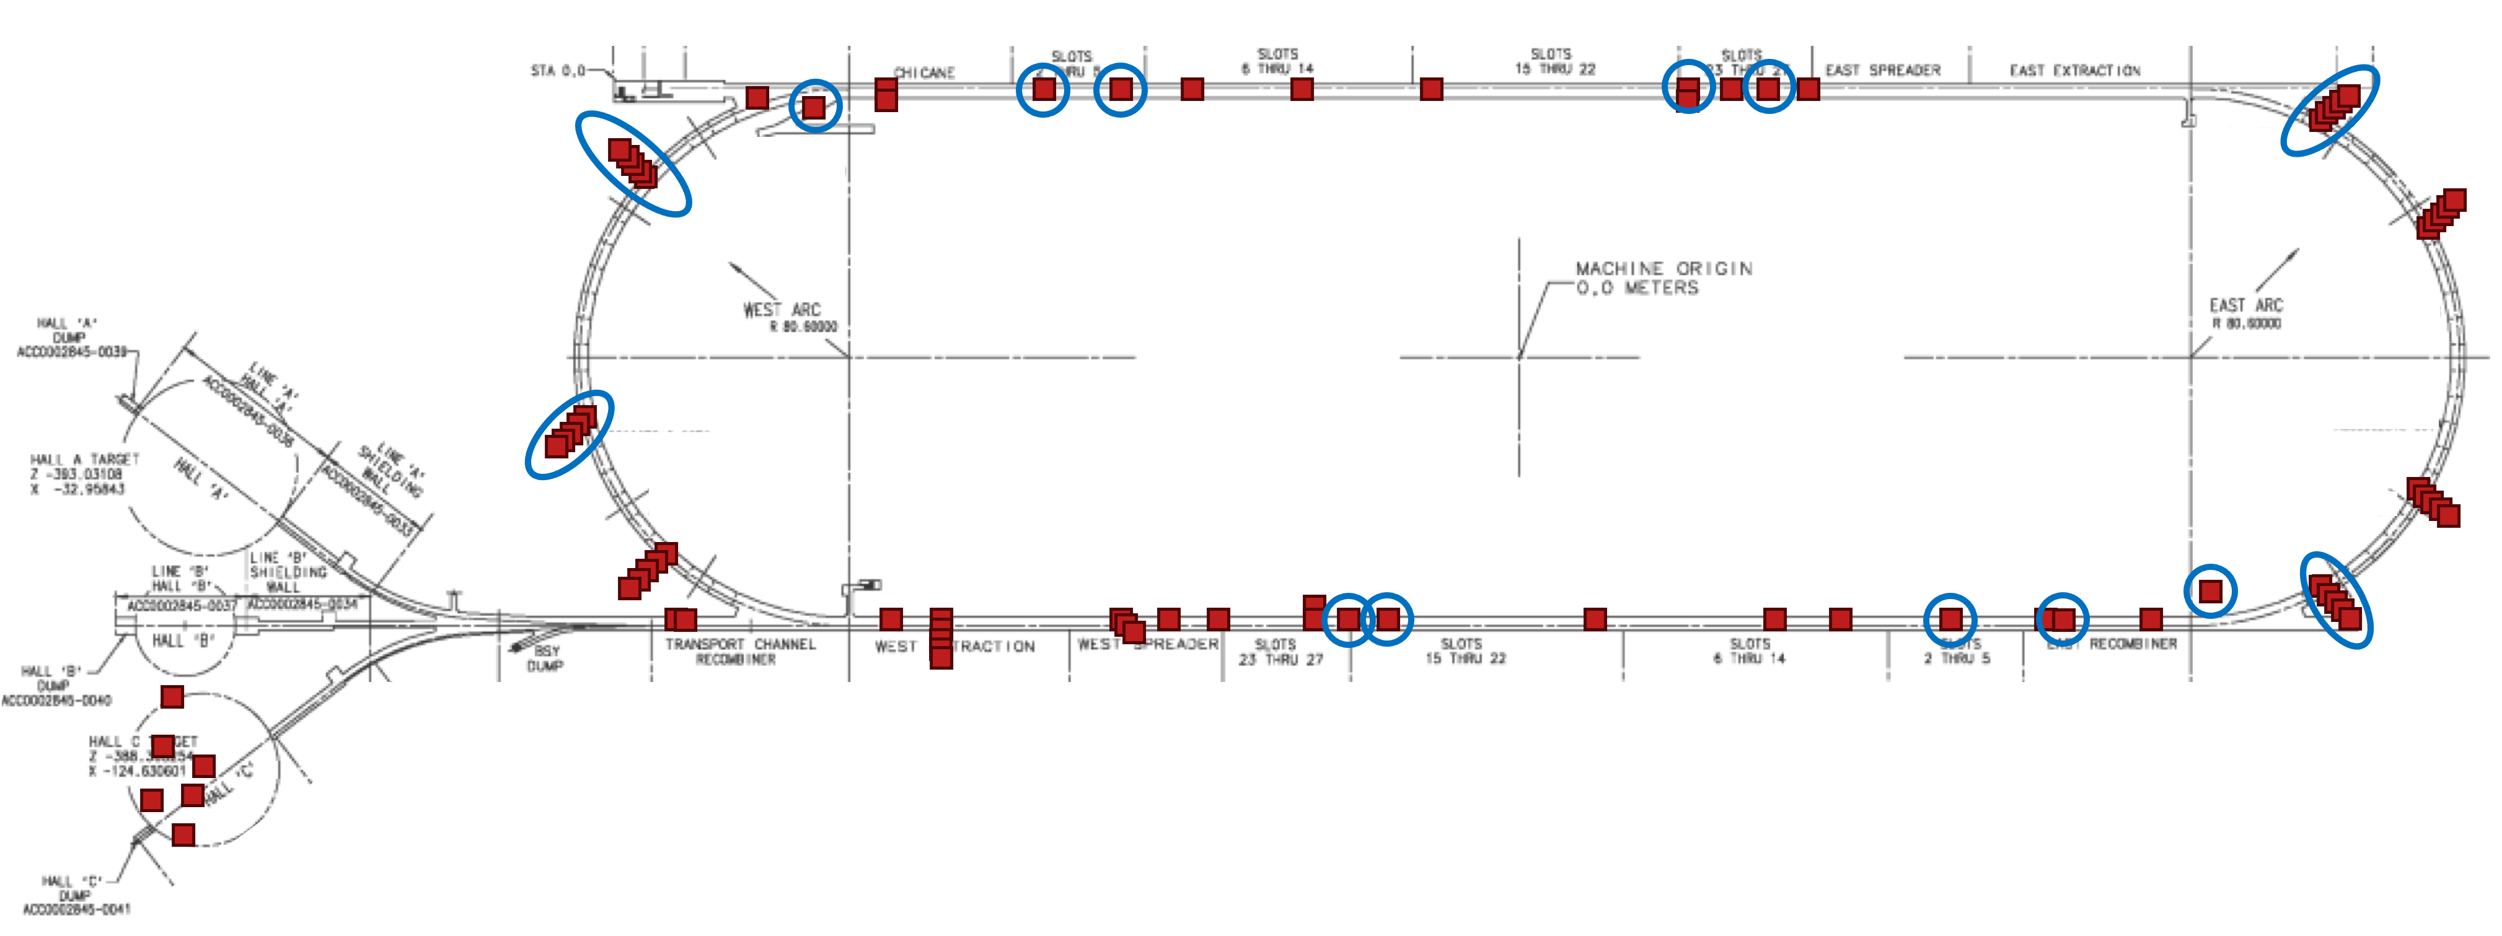
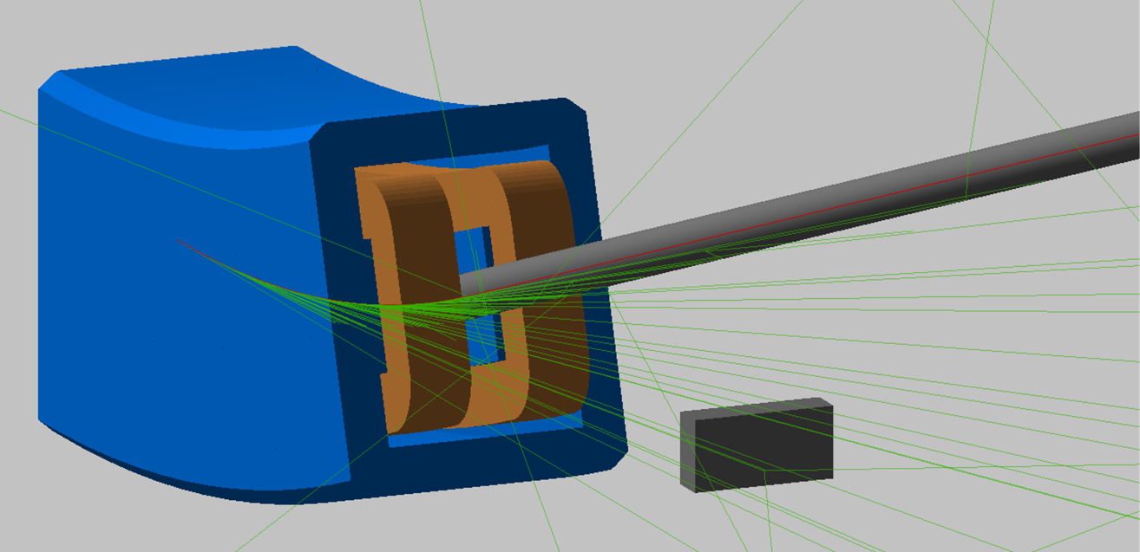
Permanent Magnet Resiliency in Real Radiation Environment
Lab Setup (Will Be Mobile)
3D Printed Mounting System
Pair Assembly Tray
Teslameter
Barcode Scanner & Arduino
Helmholtz Coil & Fluxmeter
Custom DAQ
3D Printed Reading Mount
Single Sample Tray
Single and pair assemblies placed alongside dosimetry in enclosure
In-situ reading of magnets with Teslameter and Helmholtz Coil repeatedly over time
Comparison to previous studies and our own BDSIM simulations
Extrapolation to higher energies/doses
Measurement unit
Installation map in CEBAF – 30 installation locations of varying dose and radiation type (gamma vs. neutron)
BDSIM Simulations for Dose Rates
Installed/analyzed Dosimetry
Location to install samples

Slide 10
FFA Arc Error Sensitivity Studies
Machine Errors (misalignments and field errors)
Error studies, diagnostics, correction schemes
Alex Coxe PhD thesis
6-pass Orbit Excursions in FFA Arcs
0.016
0
-0.016
Orbit Excursion (m)
0
12
s (m)
Survey (positioning) errors were taken from a normal distribution but capped at a misalignment magnitude of 0.1 mm
Field and gradient errors were capped at 1% of the intended field.
Stability of the beam dynamics not too demanding to error tolerances…

Slide 11
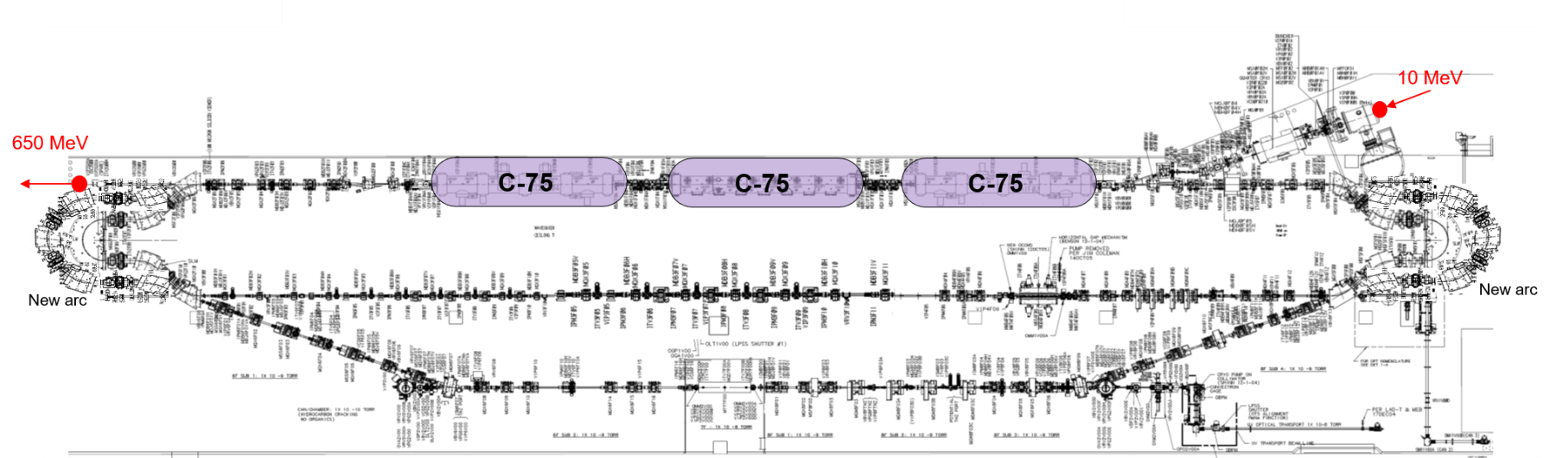
Injector Upgrade − 650 MeV Recirculating Injector
With the present 123 MeV injector, the difference in the first and final pass energies in the North Linac is too large (1:175) to effectively control the beam.
650 MeV recirculating injector (3-pass) based on LERF will allow a manageable difference in energies (1:33)

Slide 12
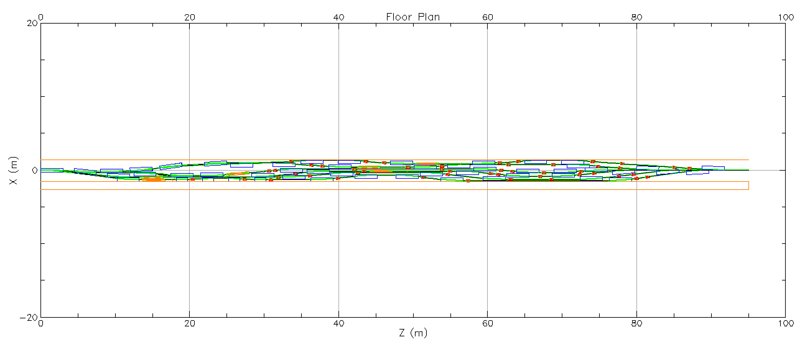
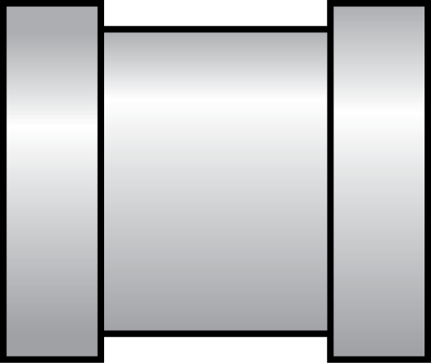
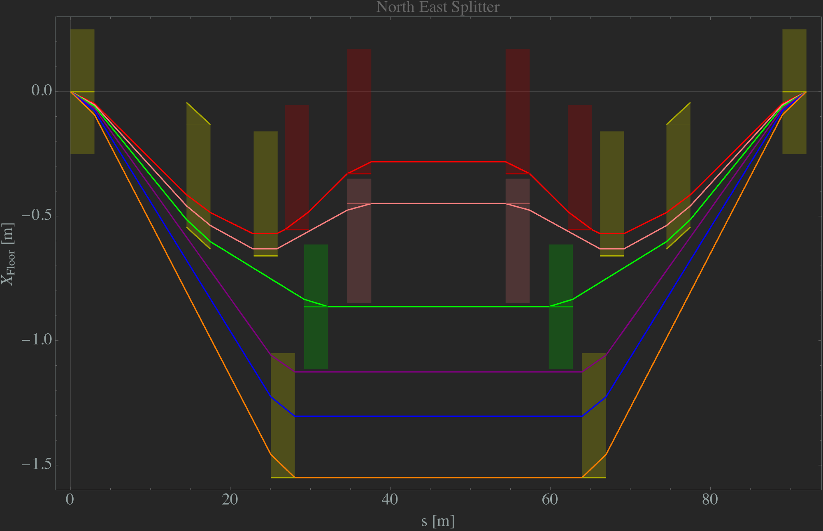
RF Separator and anti-Separator Flanking the TOF Splitter
750MHz RF separators at each ends of NE Splitter
Vertical
RF Separator
Vertical
RF Separator
Design Splitter lines to have either all even or all odd multiples of π phase advance. [2nπ or (2nπ+1)]
Now the kicks of the two RF separators can cancel out.
Design the optics of only one line of the splitter to magnify the RF kick and turn on the septa magnet in that line only.
This way we can select which beamline to extract just by turning on the proper septa and optics for the selected line.

Slide 13
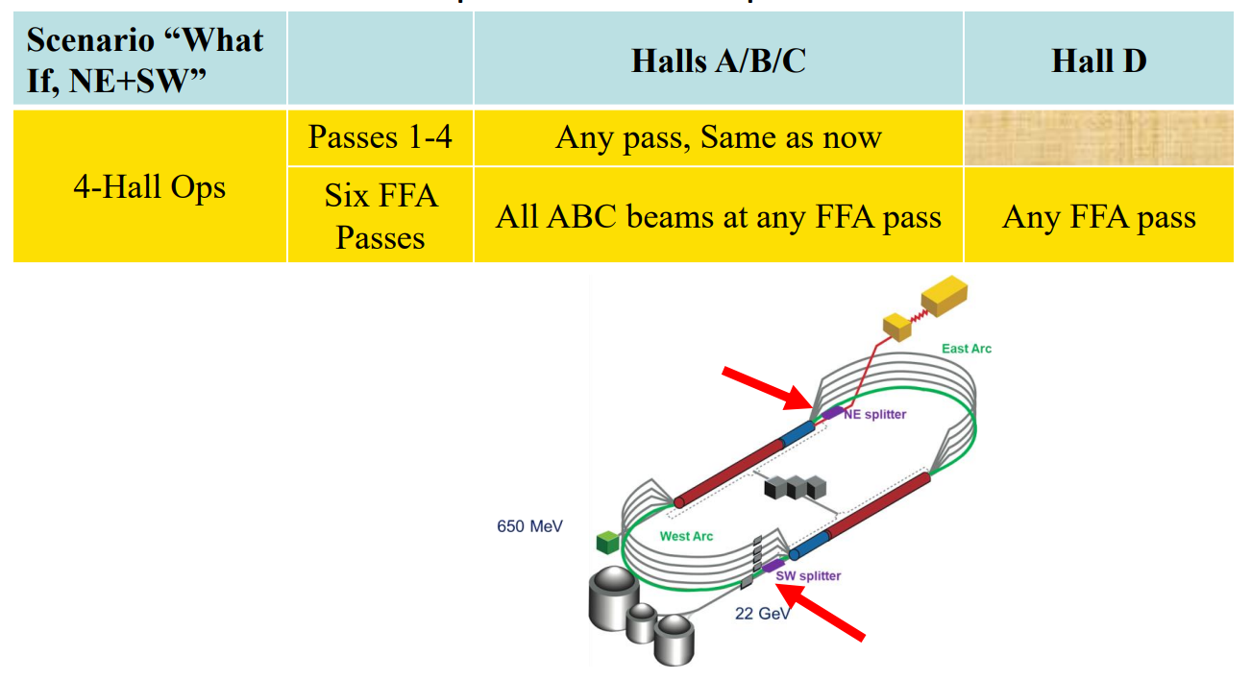
Four Hall Extraction Scheme
Two pairs of 750MHz RF separators in the NE and SW TOF Splitters

Slide 14
FFA Beam Transport Test at CEBAF
What do we want to learn?
  Proof of principle: beam transport of multiple energies
  Optics validation for FFA Cell
  Technology demonstration
What do we intend to measure?
  Orbit measurements across the aperture of FFA magnet at various energies
  Optics functions measurement
Staging
  ‘Single magnet’ test
  ‘Full Cell’ test

Slide 15
Full Length Compact FODO Cell
What if we only have one magnet?

Slide 16
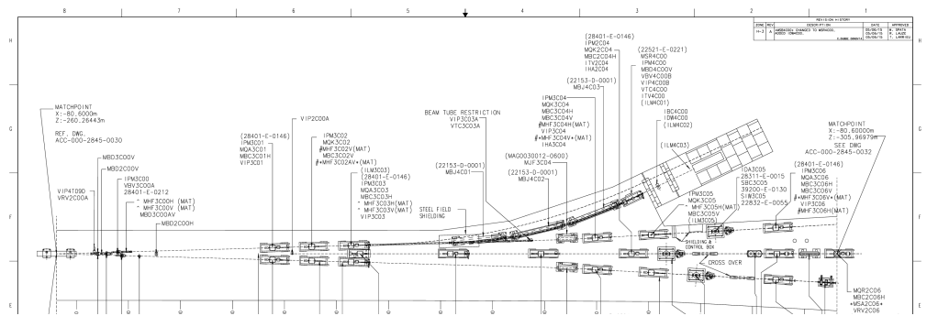
‘Single FFA magnet’ test - Possible location… BSY dump
Testing beam transport for a single FFA magnet – Probing: 4.5, 6.7, 8.9 and 11 GeV
J. Benesch et al, JLAB-TN-23-014

Slide 17
‘Single FFA magnet’ test - Possible location… BSY dump
Testing beam transport for a single FFA magnet – Probing: 4.5, 6.7, 8.9 and 11 GeV
BPM
BPM
bend
FFA magnet
bend

Slide 18
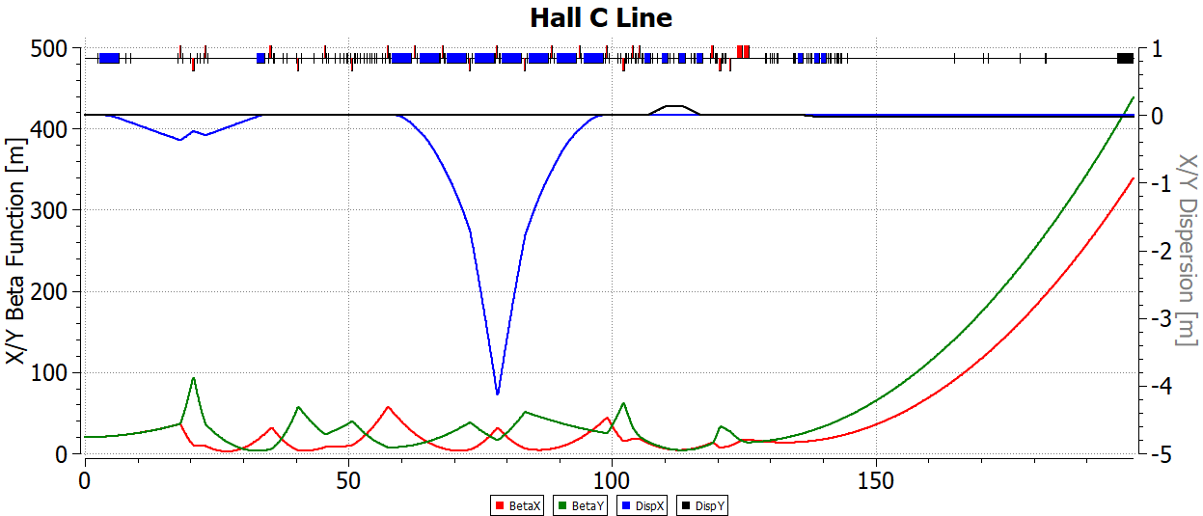
‘Full FFA Cell’ Test - Possible Location… Hall C
Testing beam optics for a single FFA cell – Possible probing of: 4.5, 6.7, 8.9 and 11 GeV beam transport
Thia Keppel, private communication, Dec. 2024

Slide 19
‘Full FFA Cell’ Test - Possible Location… Hall C
Testing beam optics for a single FFA cell – Possible probing of: 4.5, 6.7, 8.9 and 11 GeV beam transport

Slide 20
‘Full FFA Cell’ Test - Possible Location… Hall C
Testing beam optics for a single FFA cell – Possible probing of: 4.5, 6.7, 8.9 and 11 GeV beam transport
harp
FFA Cell
quad
quad
bend
bend
harp

Slide 21
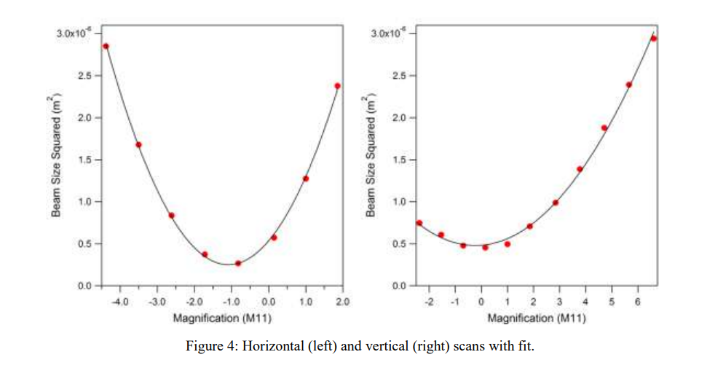
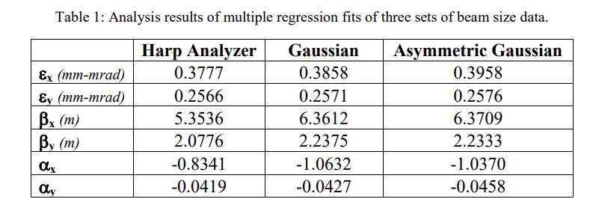
Quad scan with harps – Beam Optics measurement ( β, α, ε )

Slide 22


Energy loss, Emittance dilution and Energy spread
  Doubling the energy, while staying within current CEBAF footprint, makes the synchrotron radiation effects of paramount importance.
  Quantum nature of a ‘recoil’ effect on electrons due to photon emission makes significant impact on both the transverse and longitudinal beam dynamics, leading to cumulative emittance growth (transverse and longitudinal).
Energy loss
Emittance dilution
Natural energy spread
Maximize $ρ$, minimize H
  Cumulative emittance dilution (transverse and longitudinal) at 22 GeV (4 CEBAF + 6 FFA passes)
Projected value from the Spr/Rec contribution

Slide 23

Summary
Present Baseline (1.1 GeV per linac):
  650 MeV Recirculating Injector (additional three C-75 cryomodules)
  Recirculate 4 passes with the current CEBAF
  Plus additional 6 passes via a single FFA: 10 – 22 GeV
Non Scaling FFA Arc Architecture configured with compact FODO cells
  Beta and dispersion matching to the linacs through cell-by-cell variation (length, bend)
  Open mid-plane permanent magnet design: B-field ≤ 1 T, Gradient ≤ 50 T/m
Synchrotron Radiation impact on beam quality:
  Net transverse normalized emittance:
  Net natural energy spread: 1.5×10⁻³
  Net synchrotron radiated energy: 1 GeV
Future FFA beam transport demonstration experiments
$$ε_{N}=\text{80 }\text{mm} \text{mrad}$$

Slide 24




The FFA@CEBAF Collaboration
R. M. Bodenstein, S.A. Bogacz, K.E. Deitrick, B.R. Gamage, R. Kazimi, D. Khan, E.A. Nissen, S. Ogur, Y.R. Roblin, R. Ruber, T. Satogata, N. Sereno, A. Seryi, Jefferson Lab
J.S. Berg, S.J. Brooks, D. Trbojevic, Brookhaven National Lab
V.S. Morozov, Oak Ridge National Lab
G.H. Hoffstaetter, Cornell University

Slide 25
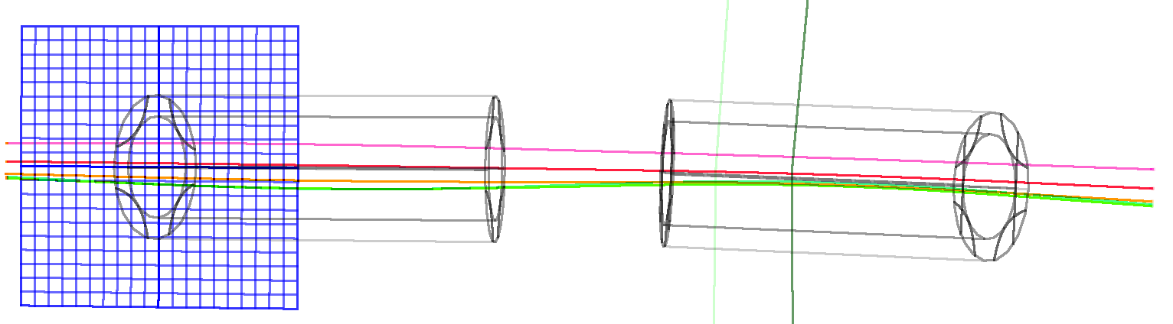

Thanks for your attention!

Slide 26
‘Single Magnet’ Test
per discussion with Joe Grames
A prototype magnet should behave exactly as one may expect, with beam going through it at one energy…. So, we are not learning much…
However, demonstrating one can tune a beam for lower energy and still have it transport at much higher energy, seems like a significant and exciting result....
Possible location in BSY dump line

