Slide 1
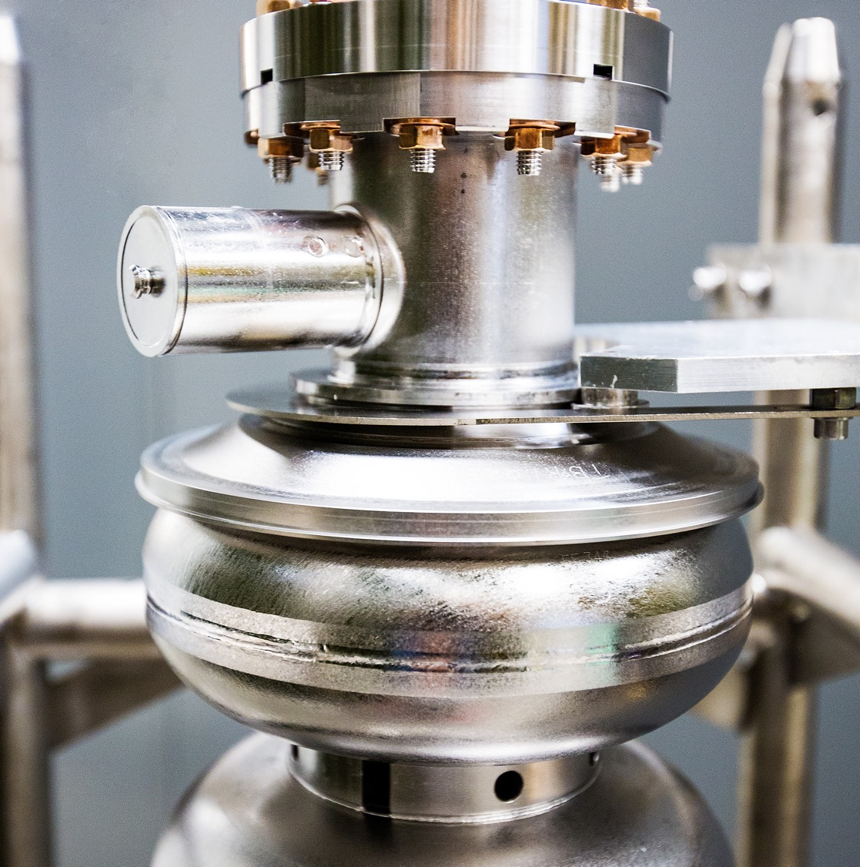

Ce⁺BAF Working Group
3-Year R&D Plan
Joe Grames, CIS Dept. Head
Positron Working Group Annual Meeting
March 24-26, 2025 @ Jefferson Lab
Notes:
Tip: Keep titles under 60 characters for readability
To change the photo: Right-click on photo and select change photo

Slide 2
Outline
J. Grames, 2025 PWG Annual Meeting, Jefferson Lab
12 GeV Ce⁺BAF Concept
Three pronged e⁺ R&D plan
Looking ahead
Preparing for PAC53

Slide 3

12 GeV Ce⁺BAF
J. Grames, 2025 PWG Annual Meeting, Jefferson Lab
Augment CEBAF 12 GeV with capability to provide either electron or positron beams, within ~shifts transition period.
Machine Parameter | Electrons | Positrons
Hall Multiplicity | 4 | 1 or more
Energy (ABC/D) | 11/12 GeV | 11/12 GeV
Beam Repetition | 249.5/499 MHz | 249.5/499/1497 MHz
Duty Factor | 100% cw | 100% cw
Unpolarized Intensity | 170 µA | > 1 µA
Polarized Intensity | 170 µA | > 50 nA
Beam Polarization | > 85% | > 60%
Fast/Slow Helicity Reversal | 1920 Hz/Yes | 1920 Hz/Yes

Slide 4

22GeV/e⁺ Upgrade Framework
J. Grames, 2025 PWG Annual Meeting, Jefferson Lab
Assumptions
  Staged approach (e⁺ then 22 GeV)
  Utilize LERF infrastructure
Ce⁺BAF Approach
  Build two new injectors (e⁻ and e⁺)
  Provide e⁻ or e⁺ on-demand
  Use CEBAF for acceleration to 12 GeV

Slide 5
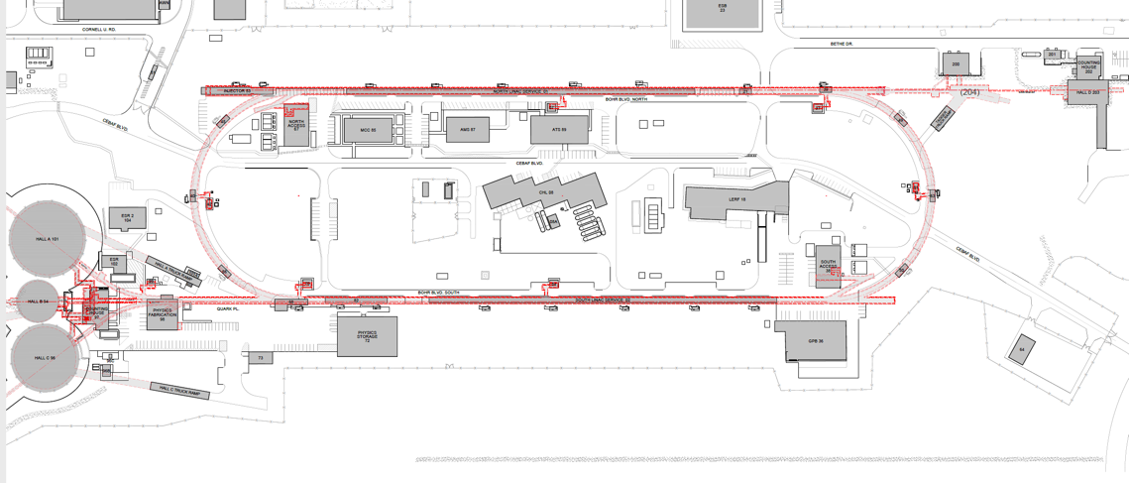
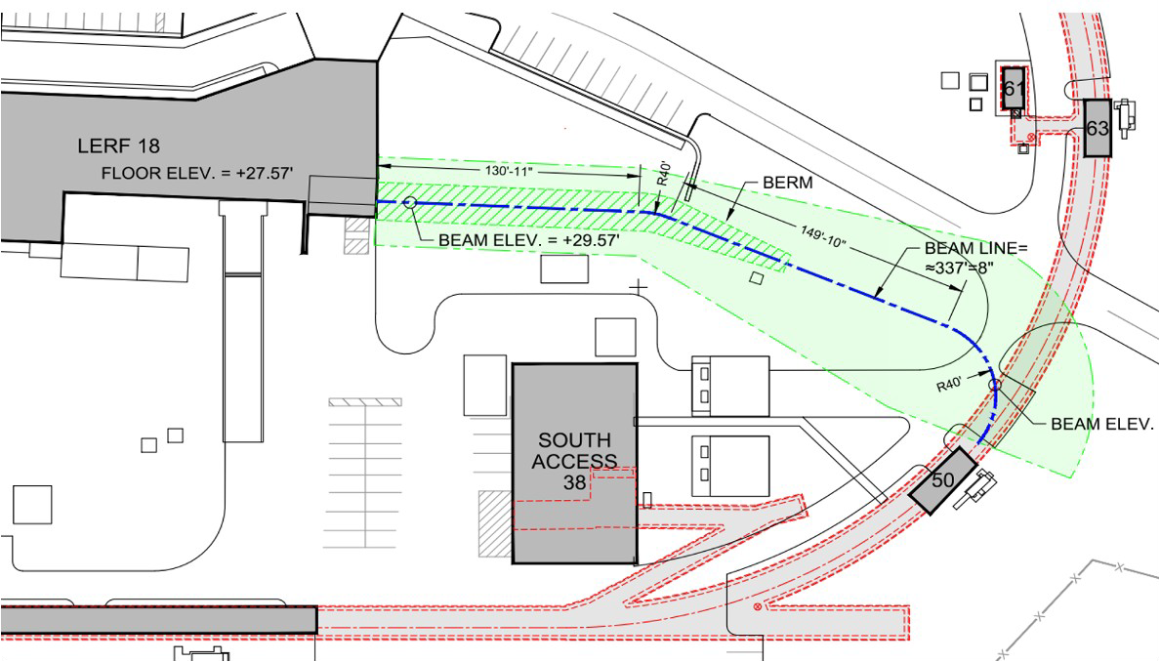
Future 12 GeV Ce⁺BAF Accelerator Complex
J. Grames, 2025 PWG Annual Meeting, Jefferson Lab
New Beamline
to CEBAF Tunnel
CEBAF Polarized
Electron Injector
123 MeV e⁺ Beam
Injected to NL
New e⁺ Injector
at LERF
123 MeV e⁺
New Transport Line
along SL and West Arc

Slide 6

3 Year e⁺ R&D Plan (FY25-FY27)
J. Grames, 2025 PWG Annual Meeting, Jefferson Lab
Conceptual Development –
evolve design & develop new ideas to prepare the pCDR
Address Critical Risk Areas – starts an experimental program to address technical risk areas
Create e⁺ testbed –
Restore LERF 100 kW & 10 MeV injector area to test prototype e+ targets & mA e- photo-guns
King Neptune Statue Virginia Beach

Slide 7
3 Year e⁺ R&D Plan (FY25-FY27)
J. Grames, 2025 PWG Annual Meeting, Jefferson Lab
Conceptual Development –
evolve design & develop new ideas to prepare the pCDR
Address Critical Risk Areas – starts an experimental program to address technical risk areas
Create e⁺ testbed –
Restore LERF 100 kW & 10 MeV injector area to test prototype e+ targets & mA e- photo-guns
King Neptune Statue Virginia Beach

Slide 8











Conceptual Development
J. Grames, 2025 PWG Annual Meeting, Jefferson Lab
A key objective of the Ce⁺BAF working group is to develop a technically sound start-to-end conceptual design which would be a basis for a pre-CDR.
JLab is supporting about 2.5 FTE spread across various Accelerator Departments (CASA, CIS, OPS, SRF-RD), Physics, and EHS&Q (RadPhys) for Ce⁺BAF R&D.
Additionally, collaborations with Universities, International Laboratories, other DOE Science Labs and DOE supported projects continue to grow and strengthen.

Slide 9
Conceptual Design – connecting to CEBAF
J. Grames, 2025 PWG Annual Meeting, Jefferson Lab
A major deliverable for FY25, colleagues from CASA and OPS completed the design of a new beamline required for injection of e⁺ into CEBAF from the LERF.
Additionally this meets a promise from last year’s workshop, to develop the capability for simulating beams to the experimental ends stations, with spin.
Reinjection finalized
Please see Salim Ogur’s presentation today at 4pm

Slide 10
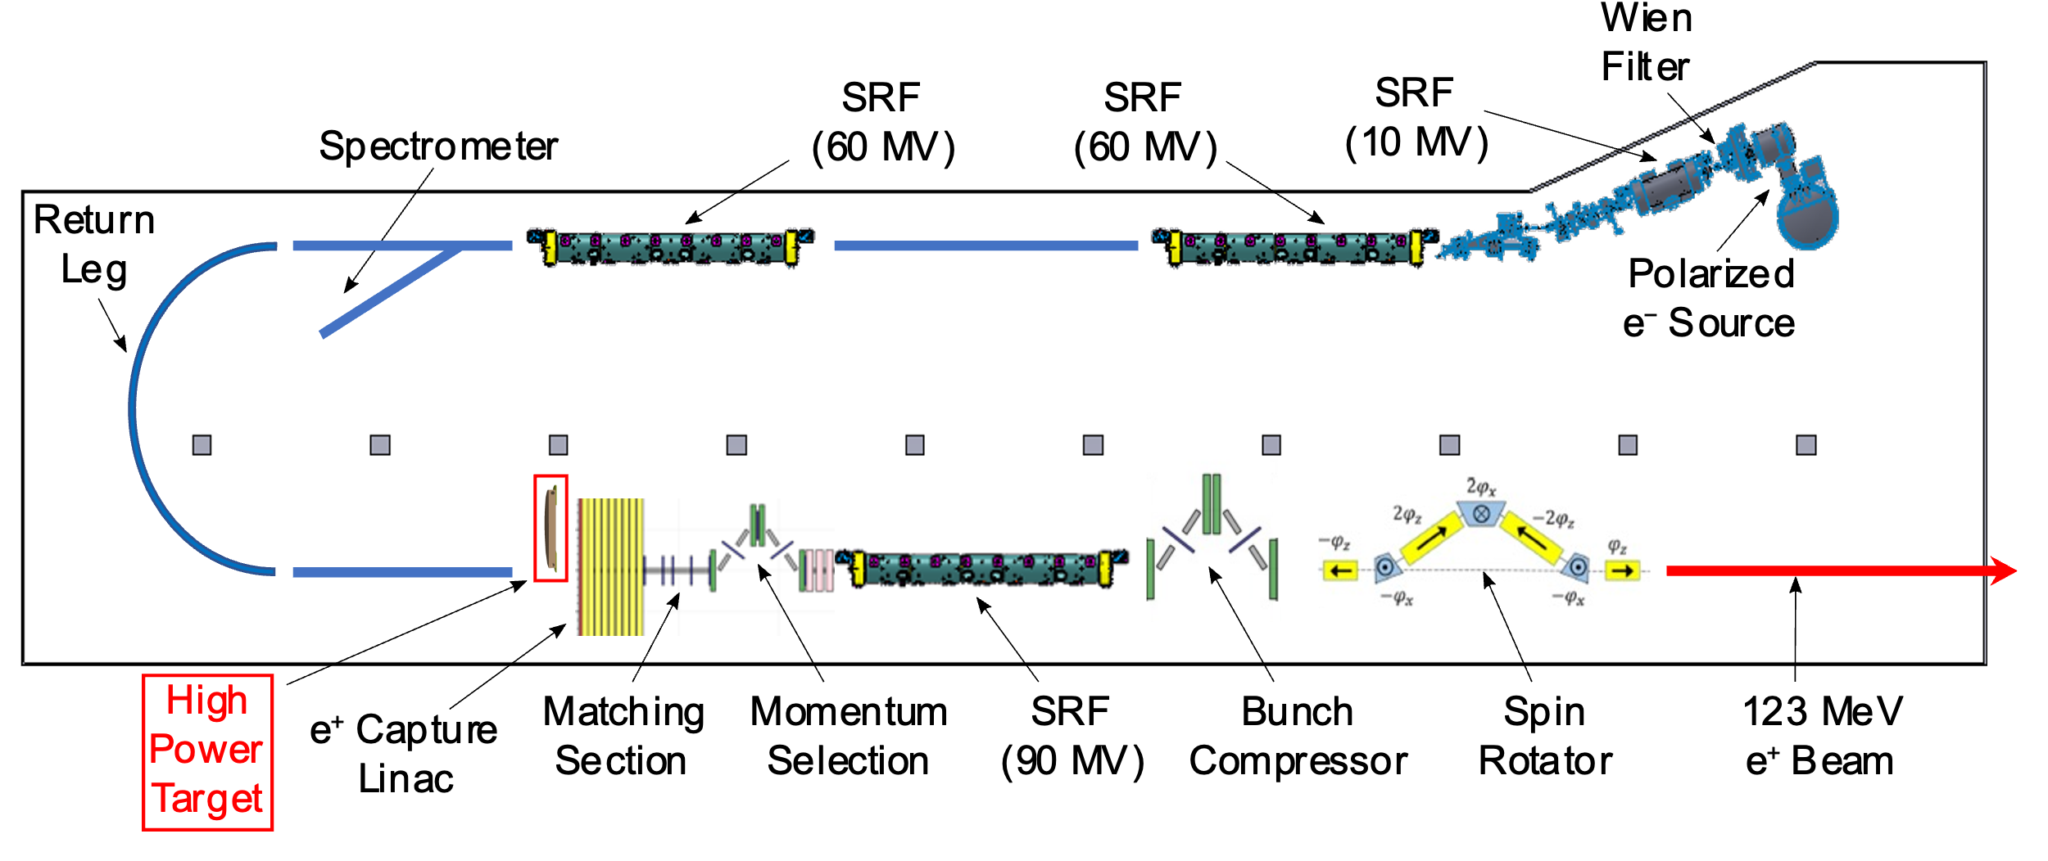
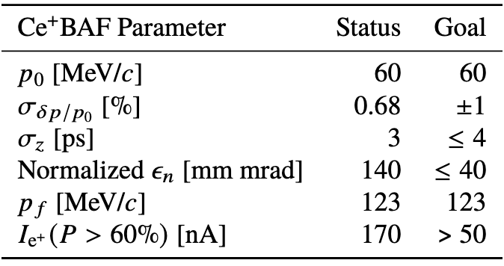
Conceptual Design – LERF injectors
J. Grames, 2025 PWG Annual Meeting, Jefferson Lab
The electron drive beam would be generated by a >1 mA spin polarized electron source, then accelerated by SRF to >100 MeV therefore creating >100 kW of power to generate the matter/antimatter in a target.
The positron secondary beam would be formed by a series of functional components to capture, define and form a bunch, with the high CW repetition rate of the drive beam.
PhD thesis of Sami Habet, preliminary concept 2023

Slide 11
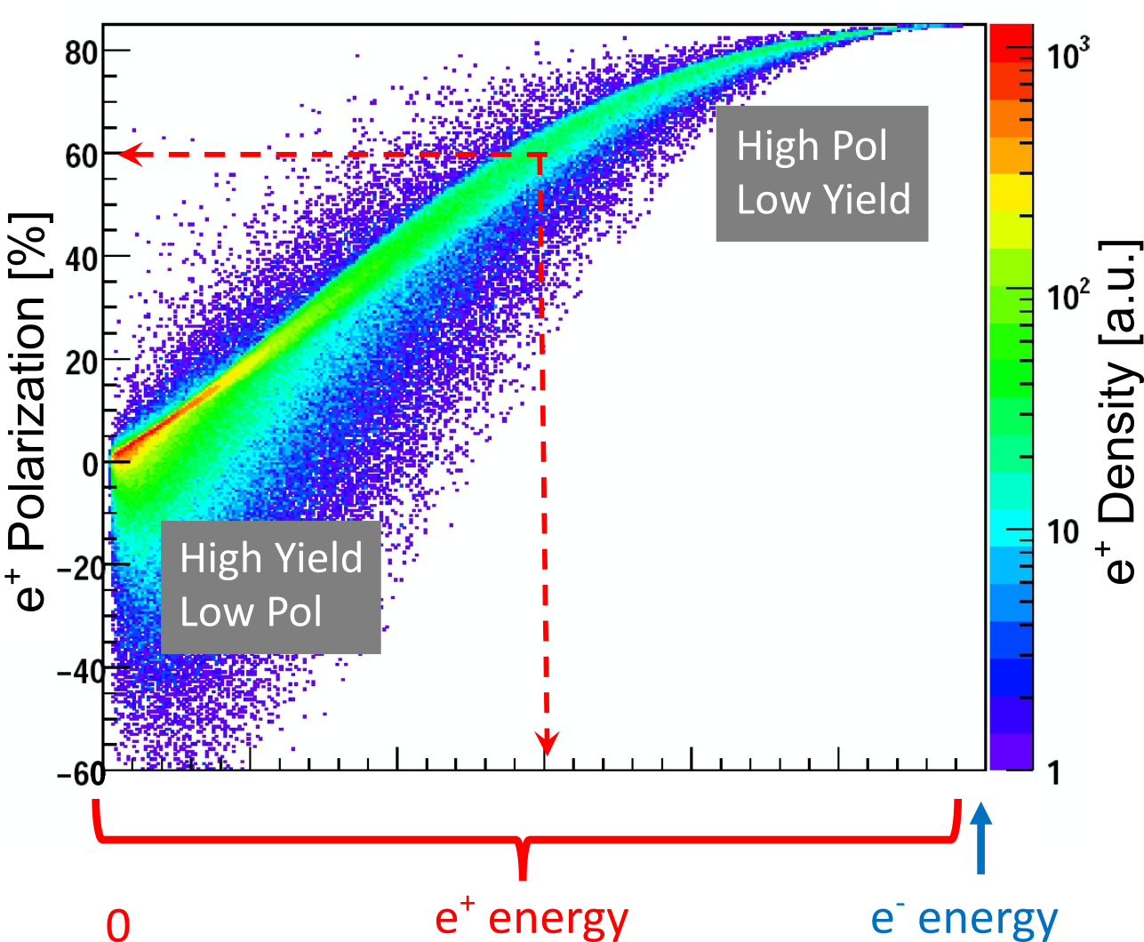
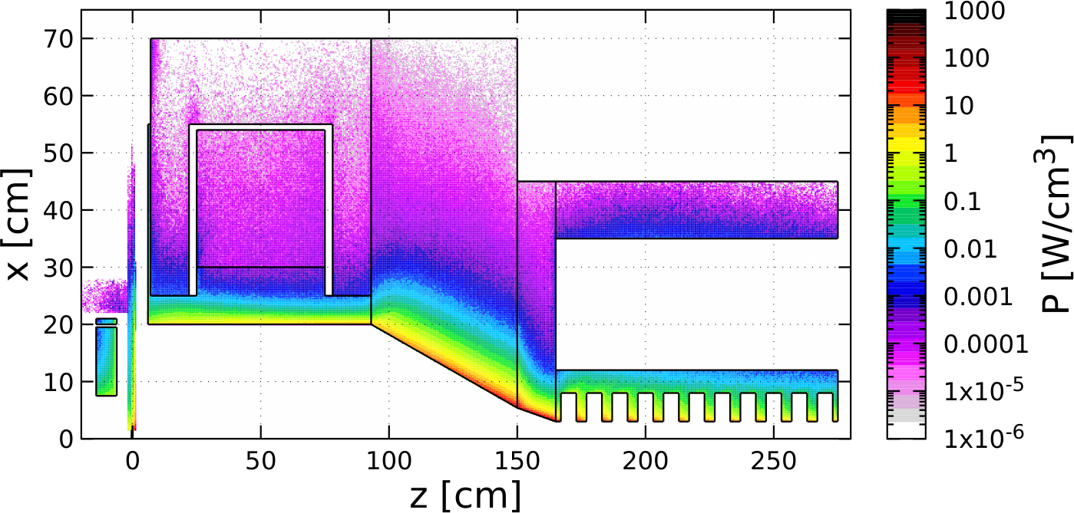

Conceptual Design – e⁺ source
J. Grames, 2025 PWG Annual Meeting, Jefferson Lab
The most critical area for Ce⁺BAF will be the e⁺ injector, where the a high fidelity CW positron beam must be formed from essentially a beam dump.
Additionally we add to this a capability to produce the e⁺ beam from two very different parts (intensity vs. polarization) of the target distribution.
At last year’s workshop significant progress was shown for managing the >100 kW of e⁻ beam power used to deliver the Watts of e⁺ beams extracted.
Steel
TZM
Cu Coil
Cu Coil
W10Cu
We decide on the working point.
W10Cu
Cu Cavity*
Compensation
Solenoid
Target

Slide 12
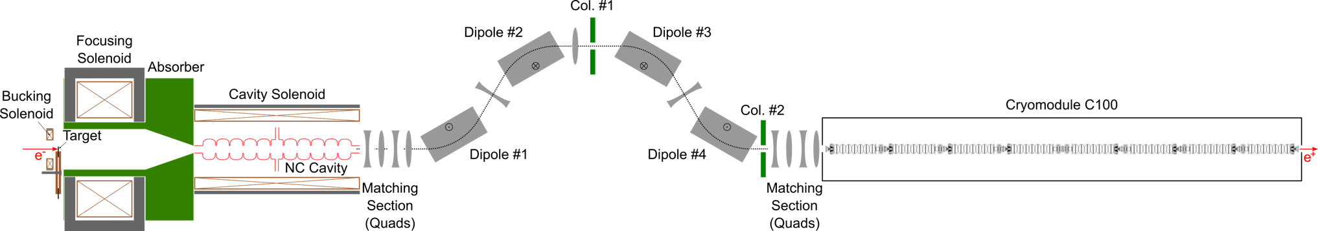
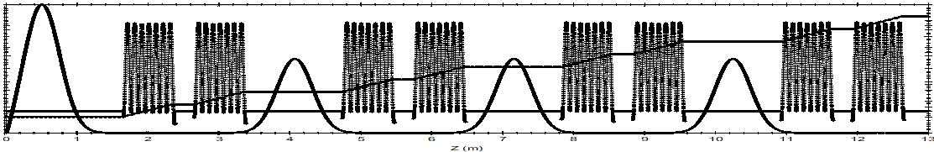
Conceptual Design – e⁺ injector at LERF
J. Grames, 2025 PWG Annual Meeting, Jefferson Lab
Colleagues from CIS, OPS, SRF, CASA are working closely together to study and optimize the trade-offs between intensity and bunch properties.
This involves generating/incorporating realistic EM fields and iteratively testing various configurations, keeping realistic engineering limits in mind.
To centralize and manage the evolving design the inaugural LDRD Strategic Hire was awarded, to create the staff scientist position of Positron Model Integrator.
Please Andriy Ushakov’s and Shaoheng Wang’s presentations today beginning at 4:30pm
SRF alternative →

Slide 13
3 Year e⁺ R&D Plan (FY25-FY27)
J. Grames, 2025 PWG Annual Meeting, Jefferson Lab
Conceptual Development –
evolve design & develop new ideas to prepare the pCDR
Address Critical Risk Areas – starts an experimental program to address technical risk areas
Create e⁺ testbed –
Restore LERF 100 kW & 10 MeV injector area to test prototype e+ targets & mA e- photo-guns
King Neptune Statue Virginia Beach

Slide 14
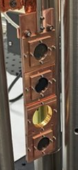
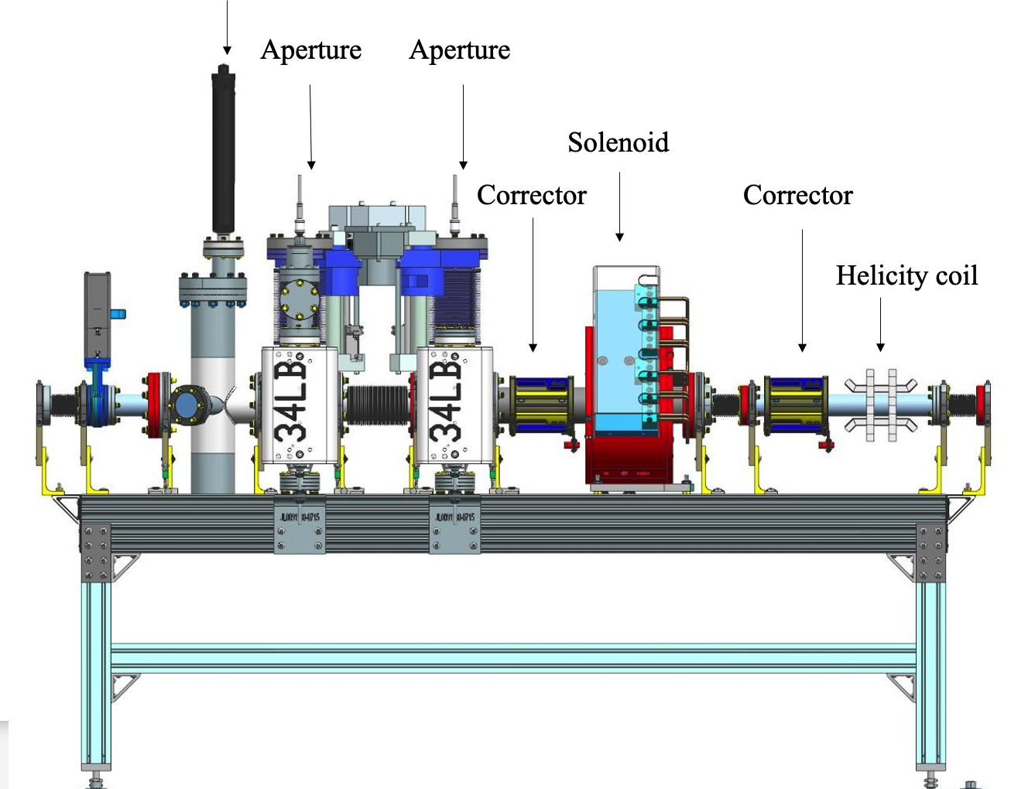
LDRD – Degraded Beams
J. Grames, 2025 PWG Annual Meeting, Jefferson Lab
The intensity of the positron beam depends on the extent of the beam size (emittance), bunch length and energy spread is collected at the target.
Therefore it is especially important to quantify the acceptance of CEBAF at injection and through the first pass, as properties continue to improve with energy.
An LDRD (FY23-FY24) funded the design and construction of an e- beam degrader to test, in conjunction with usual e- beams, these limits.
See Victor Lizarraga’s talk on Tuesday morning.

Slide 15
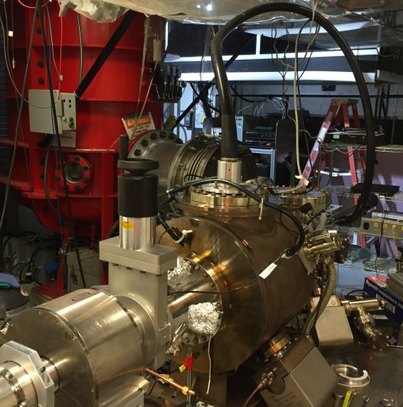
LDRD – Polarized Electron Milliampere Source
J. Grames, 2025 PWG Annual Meeting, Jefferson Lab
At CEBAF we can produce >100 uA for ~months, want to increase this capability to >1 mA for, enough necessary to provide the >100 kW of beam power
An LDRD (FY25-FY26) was awarded to use a high current photogun at the Gun Test Stand to combine and test our best practices, as a foothold to reaching a goal of >1000 C charge lifetime at >1 mA, enabling weeks of steady operation.
See Max Bruker’s talk on Tuesday morning.

Slide 16
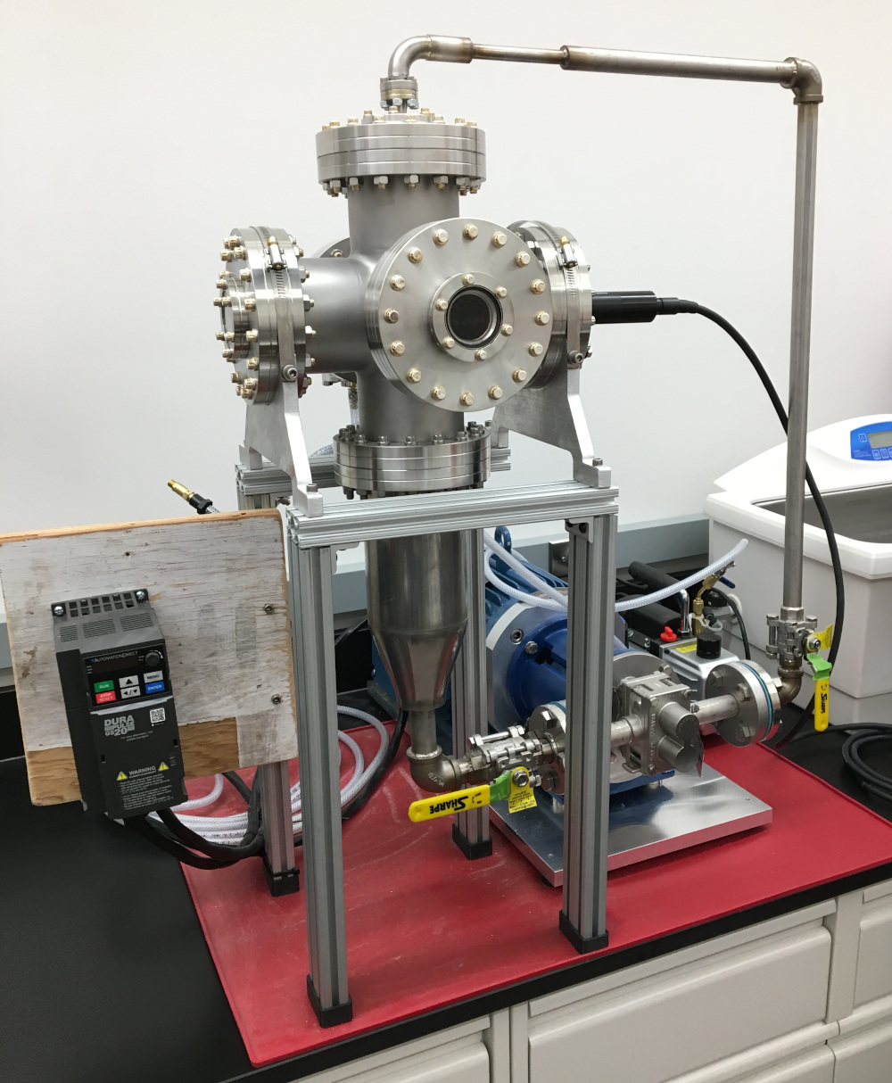
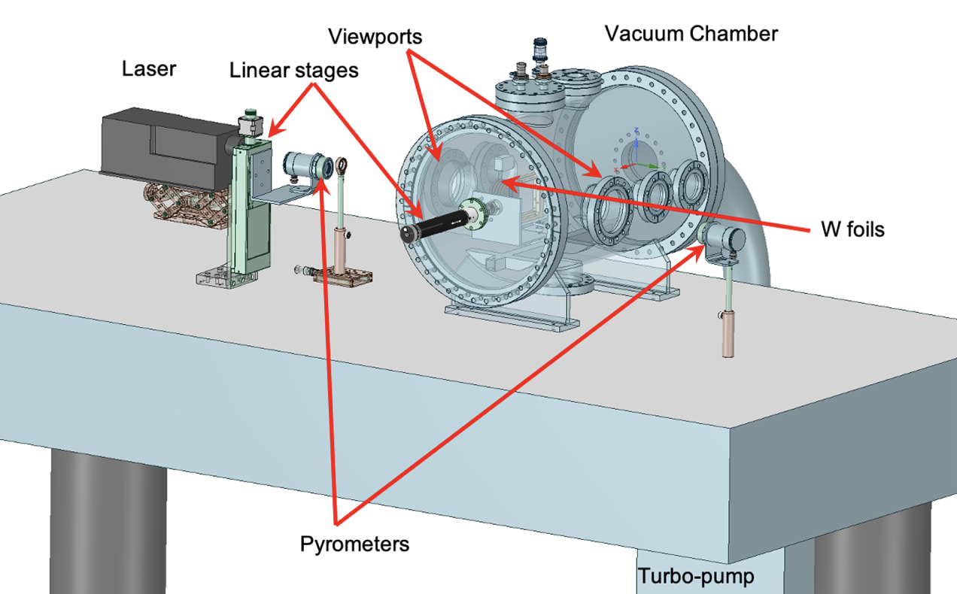
High Power Target Development
J. Grames, 2025 PWG Annual Meeting, Jefferson Lab
In our present design about 15% of the beam power (→17 kW) will be deposited in the target, which needs to be extracted through cooling.
Recognizing the challenges related to the thermal, vacuum and physical integration of the target, the DOE is funding protypes target for two alternative technologies.
A solid rotating W target will be tested using a high power LERF laser lab and another liquid jet circulating GaInSn target will be tested with >10’s kW of beam in the LERF..
Please see Silviu Covrig’s and Val Kostroun’s interesting presentations Tuesday morning.

Slide 17
3 Year e⁺ R&D Plan (FY25-FY27)
J. Grames, 2025 PWG Annual Meeting, Jefferson Lab
Conceptual Development –
evolve design & develop new ideas to prepare the pCDR
Address Critical Risk Areas – starts an experimental program to address technical risk areas
Create e⁺ testbed –
Restore LERF 100 kW & 10 MeV injector area to test prototype e+ targets & mA e- photo-guns
King Neptune Statue Virginia Beach

Slide 18
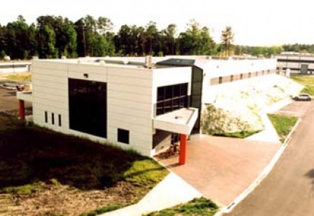
LERF – a wonderful facility for JLAB
J. Grames, 2025 PWG Annual Meeting, Jefferson Lab
The LERF previously housed a world-record mA-class ERL and FEL, creating an excellent infrastructure for SRF, shielding, and electrical/gas/cryogenic services that we need for e⁺.
Over the next few years the LERF is prescribed to several DOE mission objectives, commissioning LCLS-II and EIC CM’s and developing compact high power beams.
The Ce⁺BAF R&D working group would like to use a corner of the LERF as a testbed for e⁺ R&D.
Layout and schedule courtesy Kevin Jordan

Slide 19
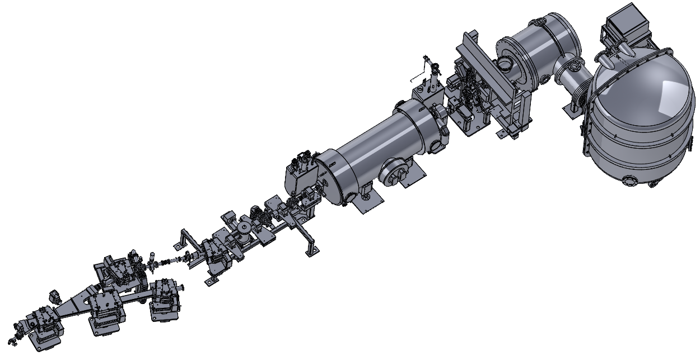
LERF – 100kW/10MeV test stand for e⁻/e⁺ sources
J. Grames, 2025 PWG Annual Meeting, Jefferson Lab
Injector beam line drawings exist, but need to first be modernized to NX CAD.
Then, modifications to incorporate the beamlines, prototype targets and a new high power dump could also happen.
In the meantime, two important activities may proceed.
Photogun (500kV/10mA)
Cryounit (10MeV/100kW)
Beamline (Magnets, RF, Diagnostics)
Irradiation of prototype targets (Shielding, Dumps, Diagnostics, Collection?)

Slide 20
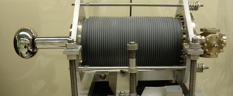
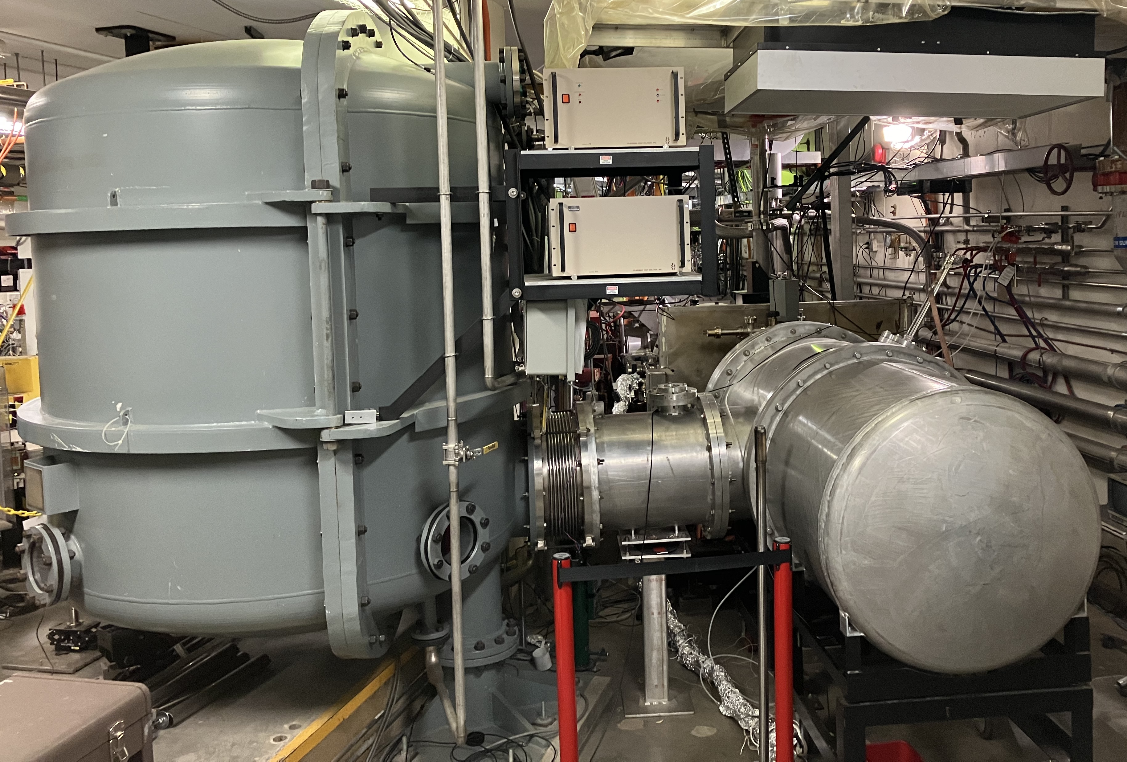
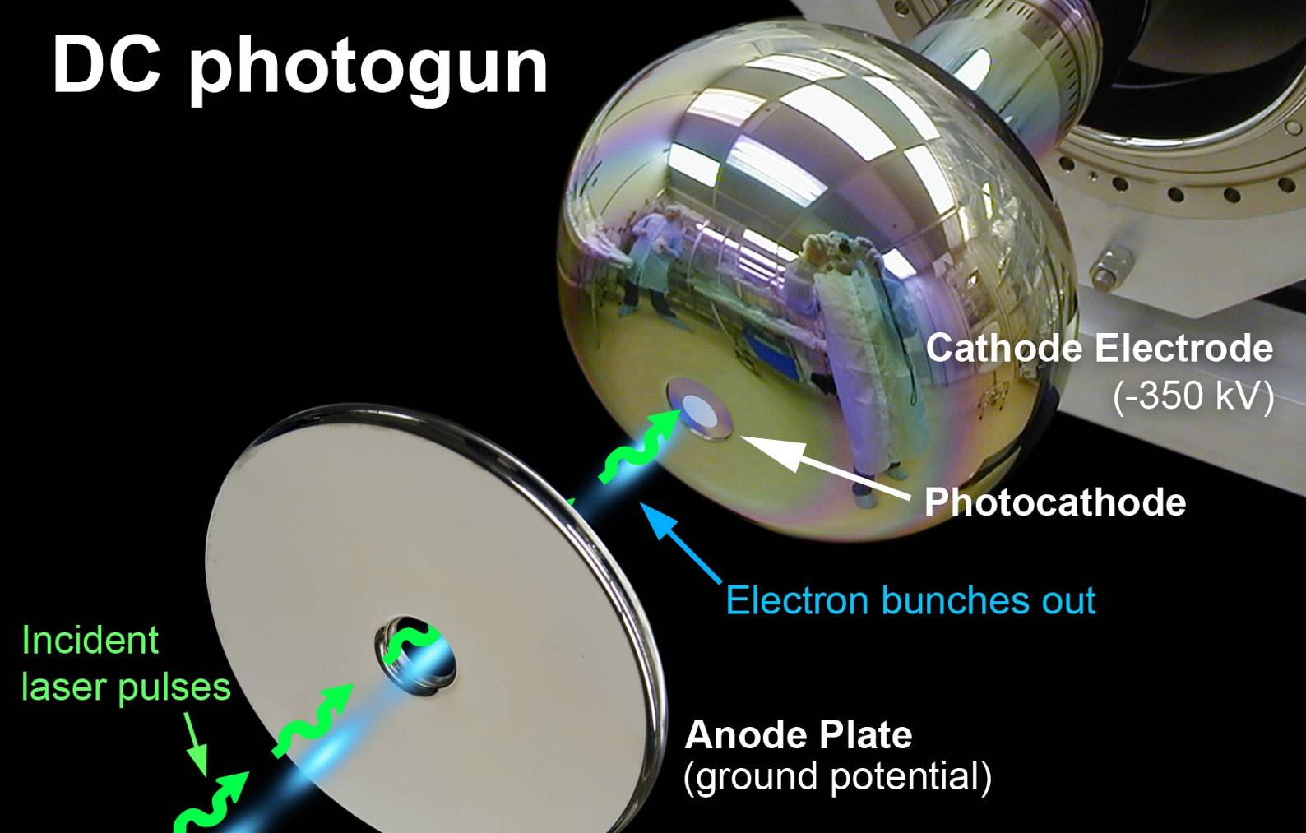
LERF – restoring the photogun
J. Grames, 2025 PWG Annual Meeting, Jefferson Lab
Photogun plan and photos courtesy Carlos Hernandez-Garcia
Perform required PM to enable the 500 kV/10 mA PS operation.
Heat clean and activate a GaAs sample in the photogun.
Restore vacuum to the drive laser light box.
HVPS
SF6 Joint
Photogun

Slide 21
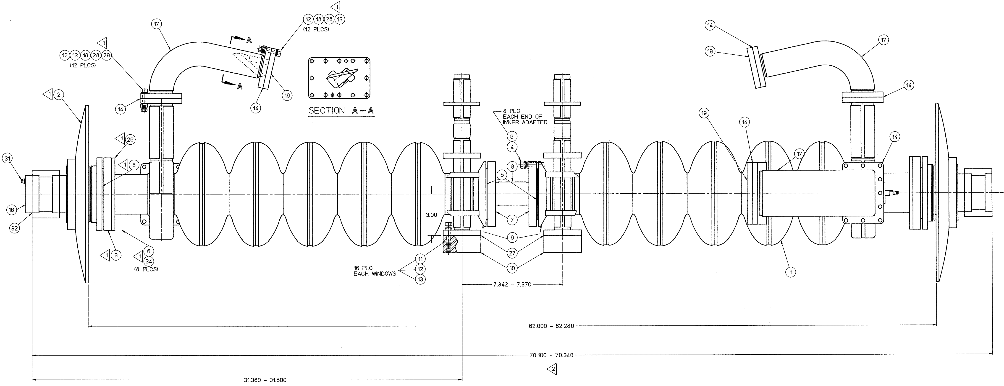
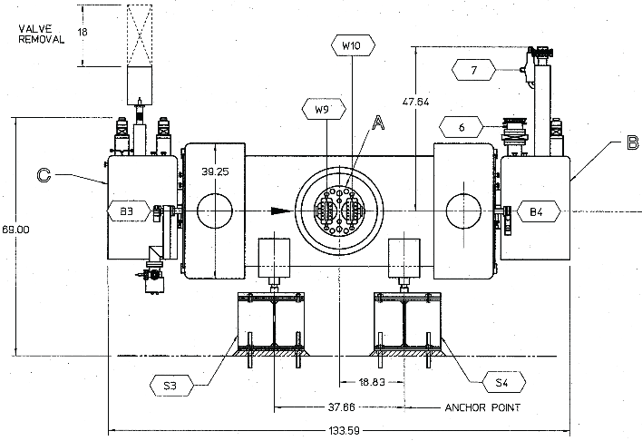
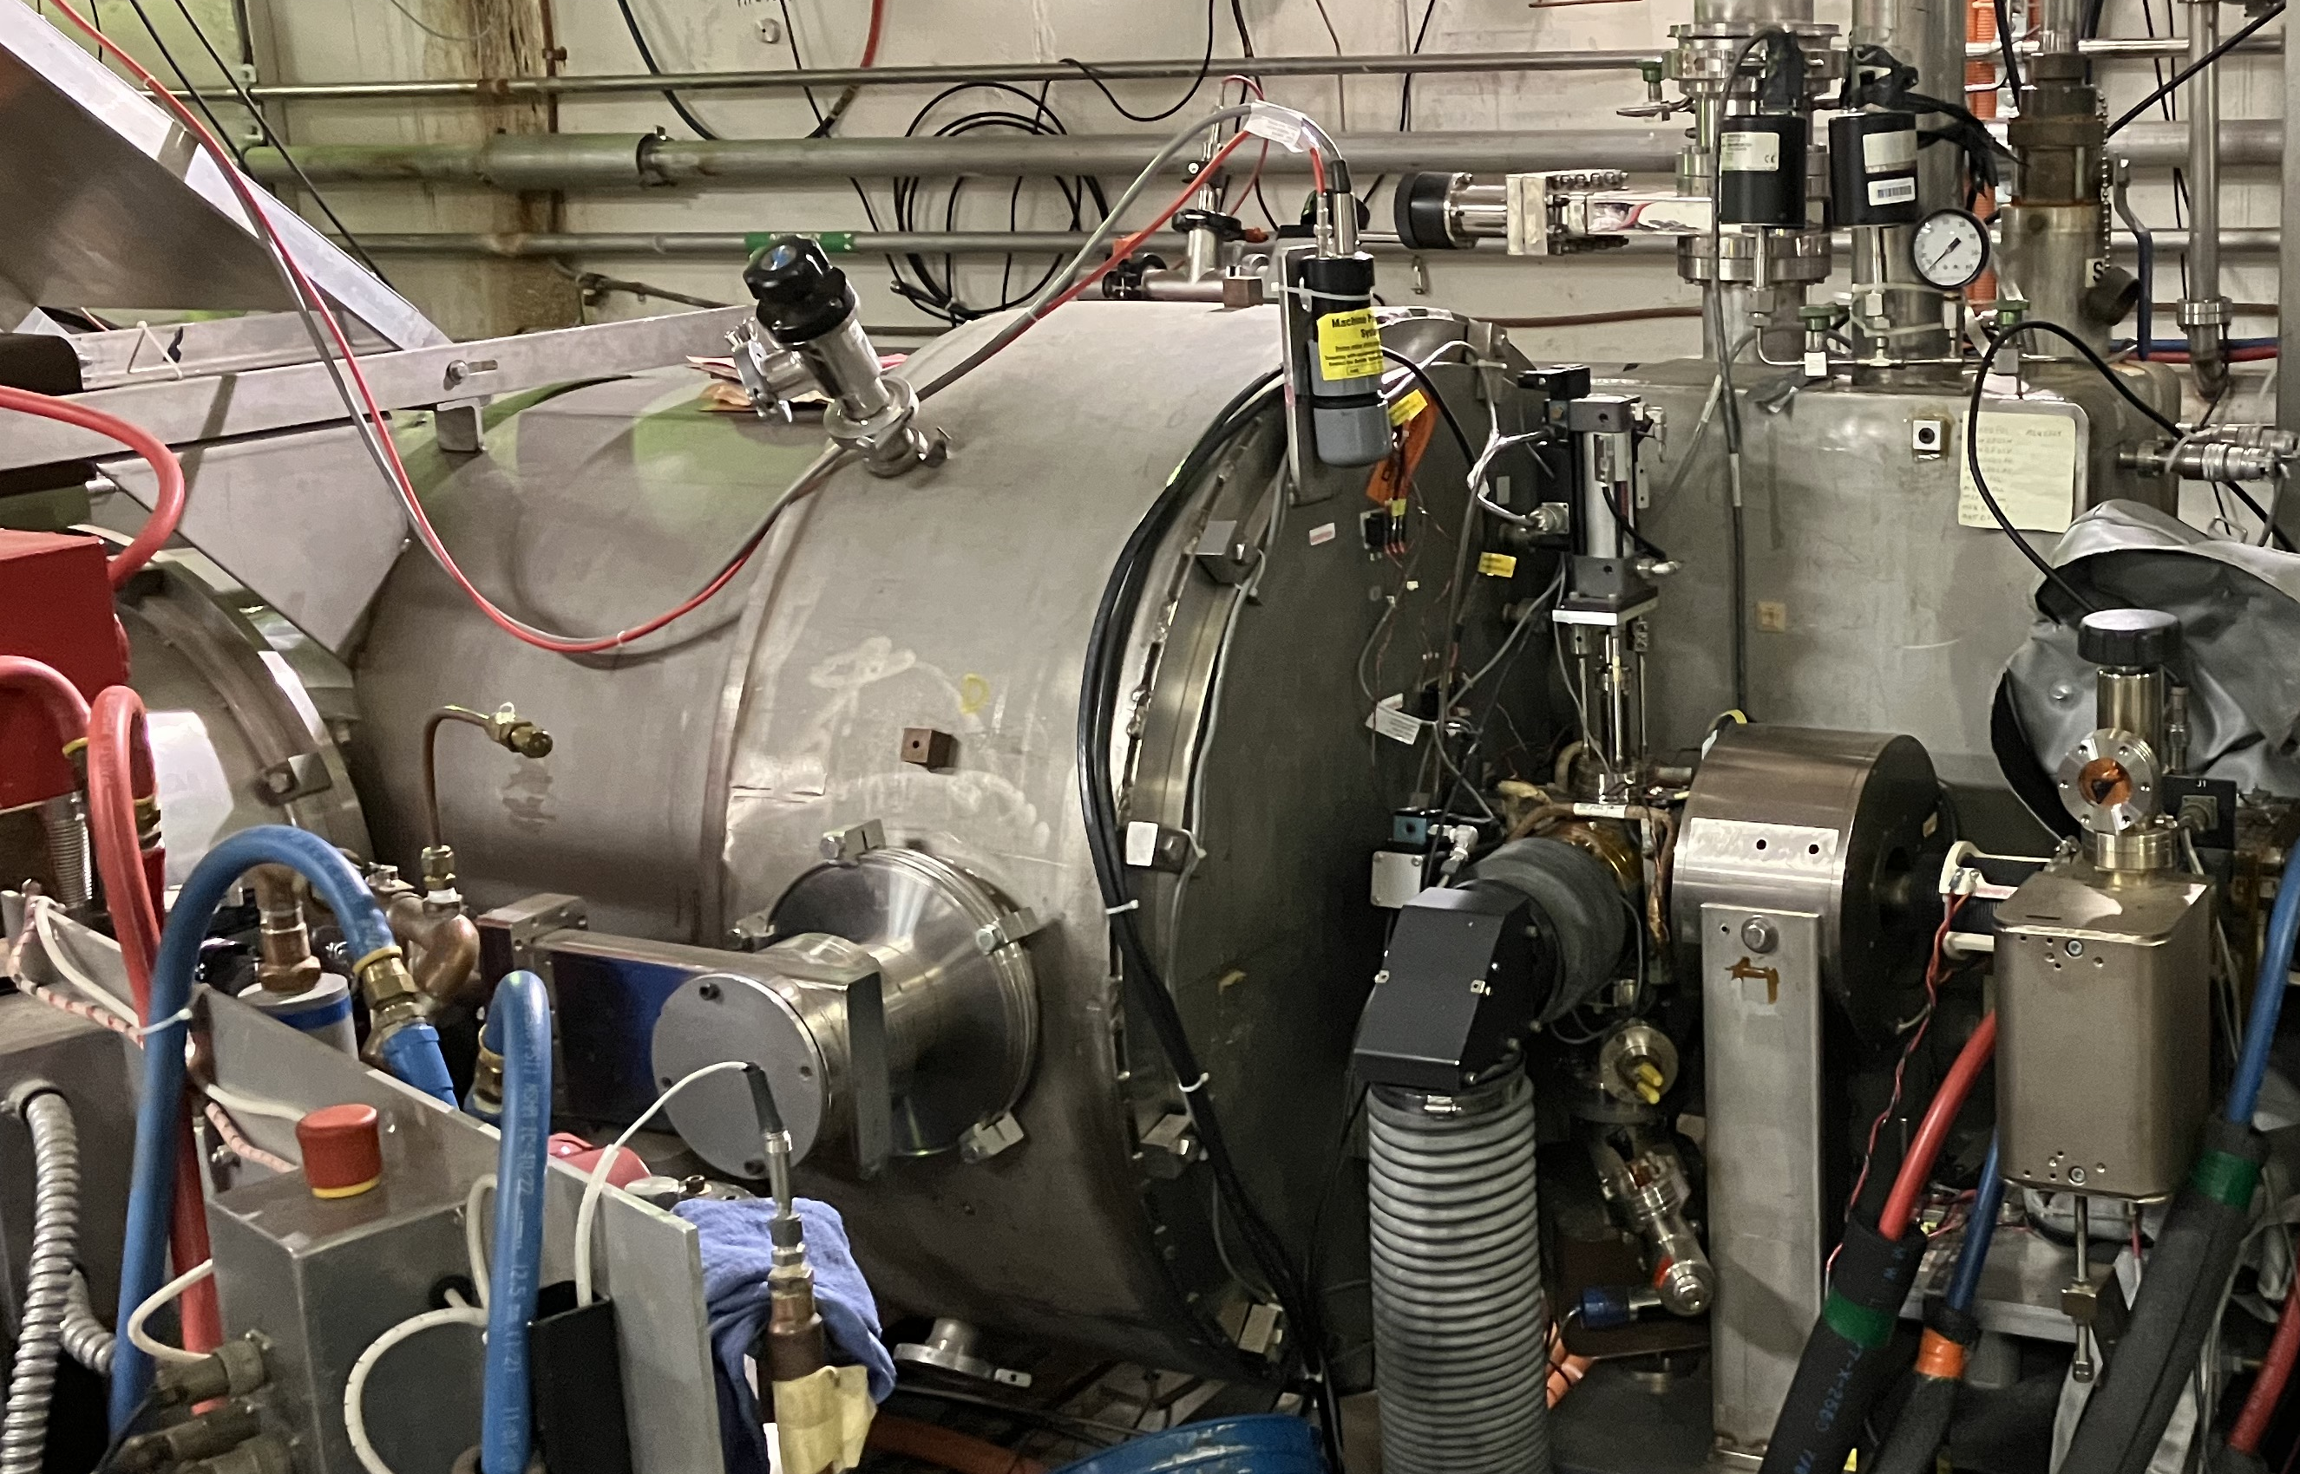
LERF – refurbishing the QCM
J. Grames, 2025 PWG Annual Meeting, Jefferson Lab
Two (2) Cornell/CEBAF-style 5-cell superconducting cavities
  Indium vacuum seals, shared liquid helium vessel
Modifications for higher power operation at 10 mA, 10 MeV
  RF windows
  Thermal anchoring of the cold RF waveguide
  Thermal anchoring of the cavity higher order mode RF dampers
  to thermal shield instead of into 2K liquid helium bath
To be refurbished
  Repair helium-to-insulation vacuum leak
  Process cavities to ensure optimal performance
Beam Direction
QCM layout and refurbishment plan courtesy Roger Ruber
OUT
IN

Slide 22
LERF – restoration plan
J. Grames, 2025 PWG Annual Meeting, Jefferson Lab
Essentially all of the CEBAF groups and resources come into play.
Most systems require PM and many require upgrades to be supported
A preliminary estimate made a year ago estimated the restoration ~$3M.
Groups are refining this estimate, with a priority given to essential scope.
The objective is bring LERF on-line by time other funding projects are maturing.

Slide 23
Has the 3-year R&D strategy been successful?
J. Grames, 2025 PWG Annual Meeting, Jefferson Lab
Oct 2024
Oct 2025
Oct 2026
Oct 2027
FY24
FY25
FY26
FY27
e+
LDRD
LDRD – Milliamp polarized photogun
LDRD – Install degrader
e+
HEP
US-Japan – e-/e+ sources
US-Japan – Advanced e-/e+ source concepts
NP-FOA High-P photocathodes MBE II
e-
Gun
NP-FOA – low carbon steel photogun
NP-FOA High-P photocathodes MOCVD II
e+
Target
SBIR-I Liquid Tgt
SBIR-II – Liquid target
NP-FOA – Spinning W target
e+
LERF
JLAB- QCM removal
JLAB - Refurbish QCM, Restore beamline/controls, Install Target/Dump
Operate high power 100kW/10MeV, test targets (liq GaInS, rot W)
JLAB - Restore GTS Photogun
PWG’24 (GWU)

Slide 24
Yes, the 3-year R&D strategy has been largely successful
J. Grames, 2025 PWG Annual Meeting, Jefferson Lab
Oct 2024
Oct 2025
Oct 2026
Oct 2027
FY24
FY25
FY26
FY27
e+
LDRD
LDRD – Milliamp polarized photogun
LDRD – Install degrader
LDRD – Strategic Hire Positron Integrator
e+
HEP
US-Japan – e-/e+ sources
US-Japan – Advanced e-/e+ source concepts
NP-FOA High-P photocathodes MBE II
e-
Gun
NP-FOA – low carbon steel photogun
NP-FOA High-P photocathodes MOCVD II
e+
Target
SBIR-I Liquid Tgt
SBIR-II – Liquid target
NP-FOA – Spinning W target
e+
LERF
JLAB - QCM removal
JLAB - Refurbish QCM, Restore beamline/controls, Install Target/Dump
Operate high power 100kW/10MeV, test targets (liq GaInS, rot W)
JLAB - Restore GTS Photogun
PWG’24 (GWU)
PWG’25 (JLAB)

Slide 25
We share out good news with our colleagues
J. Grames, 2025 PWG Annual Meeting, Jefferson Lab
2025
Mar 24-26, Positron Working Group Workshop, Jefferson Lab
Feb 25-26, 2025 - US-Japan Advanced e⁺ Source Collaboration meeting, SLAC
  J. Grames , “12 GeV Ce⁺BAF: status update”
  A. Ushakov, “Update on Simulations of Polarized Positron Beams at Ce⁺BAF”
  S. Wang, “Initial Study on the Matching and Capturing Process in a CW Positron Source Ce⁺BAF”
  S. Covrig Dusa, “JLAB Positron Target”
2024
Oct 21 - Nov 8, 2024, Hadron Physics 2030, Institut Pascal, Orsay, France
  A. Ushakov, “Positron Beams for 12 GeV CEBAF”
Oct 16-18, 2024, Advances in High-Intensity Positron Source Physics and Technologies (AHIPS2024), IJCLAB, Orsay, France
  S. Habet, “Polarized positron source design study at JLab”
  S. Ogur, “Injection Optics for 12 GeV High Polarization Positrons at Ce⁺BAF”
Sep 22-27, 2024, Workshop on Polarized Sources, Targets, and Polarimetry, JLab
  A. Ushakov, “Polarized positrons at Ce+BAF”
  V. M. Lizarraga-Rubio, “Liquid metal-based polarized positron generation benchmark using the GEANT4 toolkit”
July 15-16, 2024 Summer Hall A/C Collaboration Meeting, JLab
  A. Ushakov, “Concept of a Positron Source at Ce+BAF”
July 8-11, International Workshop on Future Linear Colliders (LCWS2024), University of Tokyo, Japan
  A. Ushakov, “Update on Ce⁺BAF Positron Activities”
  S. Wang, “Capture Cavities for the CW Polarized Positron Source Ce⁺BAF”
  S. Covrig Dusa, “CFD Simulations of High Power Positron Converter Targets”
June 10-14, Future Circular Collider (FCC) Week 2024, San Francisco
  J. Grames, “Polarized Electrons for Polarized Positron Beams”
May 19-24, 15th International Particle Accelerator Conference (IPAC'24), Nashville
  M. Bruker et al., "Toward a long-lifetime polarized photoelectron gun for the Ce+BAF positron source", MOPC52
  A. Ushakov et al., “Simulations of positron capture at Ce+BAF”, MOPC54
  S. Wang et al., “Capture cavities for the CW polarized positron source Ce+BAF”, MOPC51
  A. Sy et al., “Towards large phase space beams at the CEBAF Injector”, MOPC53
  V. Lizarraga-Rubio et al., “Computational simulations and beamline optimizations for an electron beam degrader at CEBAF”, MOPC62
  T. Lengler et al., “Radiation damage characterization of positron source materials”, TUPC81
  N. Taylor et al., “A high-power positron converter based on a recirculated liquid metal in-vacuum target”, TUPC83
April 8-12, 31st International Workshop on Deep Inelastic Scattering, Grenoble, France
  Y. Roblin, “Status of the Ce+BAF upgrade”
We are presenting our progress at some meeting every 5 weeks
Priority is given to User meetings and when possible junior scientists
We also have a good showing >6 presentations at an annual large Accelerator Conference
Meeting with our HEP colleagues is a priority too

Slide 26
Looking ahead
J. Grames, 2025 PWG Annual Meeting, Jefferson Lab
A start-to-end concept model from the LERF to the Halls at 12 GeV is becoming in reach.
We have already an outline for the technical design report and are moving with priority to provide this to lab management within 12-24 months, when needed.
The strategy for LDRD and DOE funding to address critical risk R&D has been taken seriously and is being supported next 2 years, we say thank you.
Restoration of the LERF 100kW/10MeV segment is starting to get steam, but fundamentally is throttled by resources (budget and people), we know this.
The Ce⁺BAF working group remains ambitious and excited to grow this important new capability for JLab and NP.

Slide 27
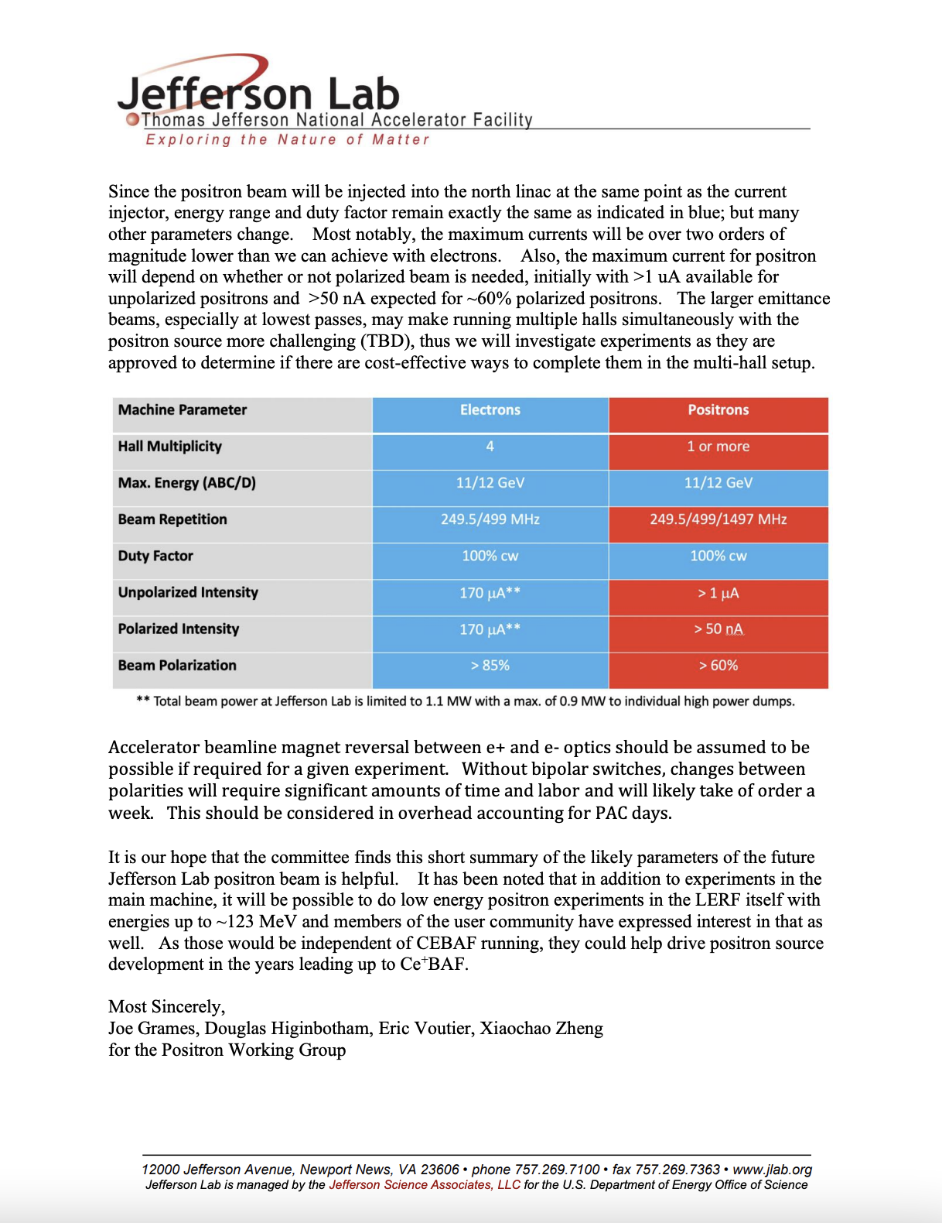
Guidance to PAC55
J. Grames, 2025 PWG Annual Meeting, Jefferson Lab
Ce⁺BAF Working Group Guidance has NOT changed.
However, we are moving rapidly in the direction to provide users particles distributions for physics simulations.
A goal for next year’s PWG annual meeting would be to update/refine the table at right.

Slide 28
QUESTIONS?
Notes:
Before sharing your presentation, confirm:
Fonts are consistent
Images meet quality standards
Charts use template colors
Footer information is current
Spell check completed
Links are working
File size is optimized

