Slide 1
A high-power positron converter based on a recirculated liquid metal in-vacuum target
V.O. Kostroun, Karl Smolenski, Joe Conway, Nick Taylor, Xelera Research LLC
and
Silviu Covrig Dusa, Jefferson National Laboratory
March 24-26, 2025
3rd Annual Workshop on Positron Beams at JLab

Slide 2
Liquid metal (LM) targets: introduction
The very large power in electron beams needed to generate positrons and the accompanying enormous power densities place stringent requirements on positron converter targets.
A possible solution to the handling of large powers are liquid metal targets, used in a number of high power applications. These include fully enclosed liquid metal targets for neutron generation, free liquid metal jets that allow extraction of pions and muons as well as other radioactive species generated in high energy particle reactions.
Liquid metal targets are conceptually very simple. The main components of the target are the nozzle, solenoid for collecting positrons, heat exchanger, and pump.

Slide 3
GaInSn prototype converter under investigation
A free surface, liquid metal jet positron converter is being investigated and built at Xelera Research LLC. The converter uses a free surface GaInSn jet as target for bremsstrahlung generated positrons. (GaInSn was selected because it is a liquid at room temperature.) Ultimately one is interested in a PbBi target that has to be heated to 150 C.
An MCNP6 calculation of positron production by a 10 MeV electron beam incident on a GaInSn target (Xo=1.727 cm) showed that a 3 mm thickness produced the largest number of positrons exiting the target.
Starting with a 3 mm × 10 mm output jet, two different nozzles were made. One with a nozzle contraction of 4 and another with a contraction of 6.6. The nozzles are each 30 mm long.
The nozzles are based on a wind tunnel nozzle design and use a fifth-order polynomial contour function. They were constructed from two halves of stainless steel and welded together.

Slide 4
Calculated positron energy distribution
(a) Positron energy distribution generated by 10 MeV electrons incident on a 3 mm thick GaInSn target, (b) angular distribution, (c) bremsstrahlung energy distribution.

Slide 5
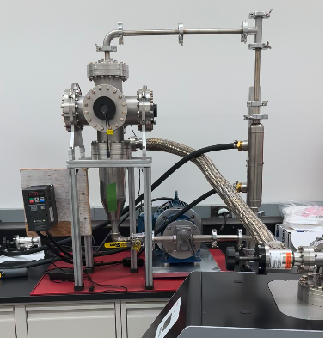
GaInSn prototype test stand
A free surface GaInSn liquid metal test stand was constructed from 304SS.
The GaInSn is pumped by a Liquiflo Model H7F Mag-Drive gear pump with speed controlled by a constant-torque variable frequency drive.

Slide 6
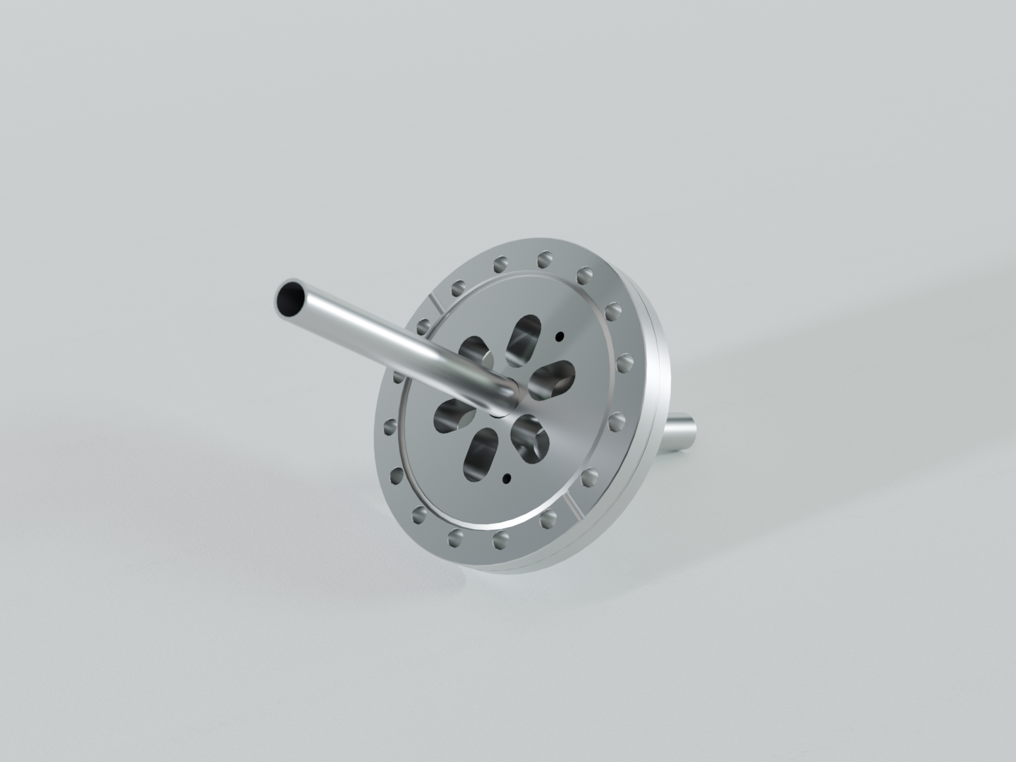
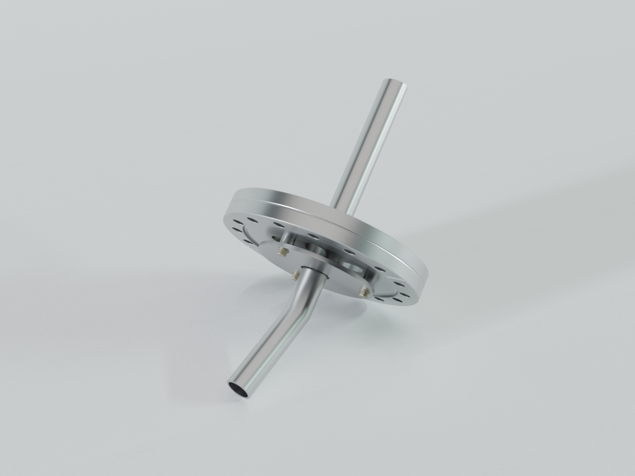
Initial observations
Initial runs were done at a poor vacuum of 127 torr and jet speed of ~8 m/s.
Serious splashing and misting were observed. The small vacuum pump used was replaced by a fore pump that evacuated the system to 30 mtorr and the misting disappeared while splashing remained.
The system was disassembled, cleaned. An anti splash guard and a 24.9 kW heat exchanger were added.

Slide 7
Before the system was tested, it was baked at 150 C for several hours and pumped out with a 300 l/s turbo-molecular pump. The vacuum was 5x10⁻⁸ torr.
On initial turn-on, the jet appeared normal, but very soon turned turbulent. All subsequent brief runs showed turbulent behavior and some splashing and the runs were terminated.

Slide 8
Conclusions
Two possible causes of the observed behavior were attributed to (a) the addition of the heat exchanger and (b) the fact that the modifications required that the system be exposed to air.
Exposure to oxygen causes a smooth oxide layer to form. The oxide skin is partially passivating and protects the liquid from further oxidation. The oxide aﬀects the fluidic properties somewhat, but since the jet behaved nicely before, under 127 torr and 30 mtorr vacua, the brief exposure to air was dismissed as the cause of the observed jet behavior.
This brought up the question as to whether or not the addition of the heat exchanger was in some way responsible for the behavior.

Slide 9
Conclusions
The volume of sections (b) through (f) was calculated and found to be 869 cm³.
The volume of GaInSn in section (a), (b) and (c) was determined to be 784 cm³. The initial amount of GaInSn, made from 5 kg of Ga, was 1,173 cm³. When the system was modified, ~200 cm³ were removed and stored in a jar, together accounting for 984 cm³ of GaInSn. A good part, or all of the missing 189 cm³ was probably in the gear pump and was not included.

Slide 10
Conclusions
The volume of the tubing and heat exchanger, sections (b) thru (f) is 869 cm³, close to the 784 cm³ volume of GaInSn present. Thus the behavior of the jet observed might be explained as follows. Initially, the liquid levels of GaInSn are as shown by the red line in the figure. As the pump is started, the liquid flows through and the jet, behaves, but eventually most of it is in the tubing and heat exchanger, and very little or none in the reservoir so that there are gaps in the flow. Speeding up the flow made things even worse.
The solution is to add more GaInSn. With 2 kg, we will get an extra 469 cm³, this plus the 200 cm³ we already have would increase the amount to 669 cm³ and should help.

Slide 11
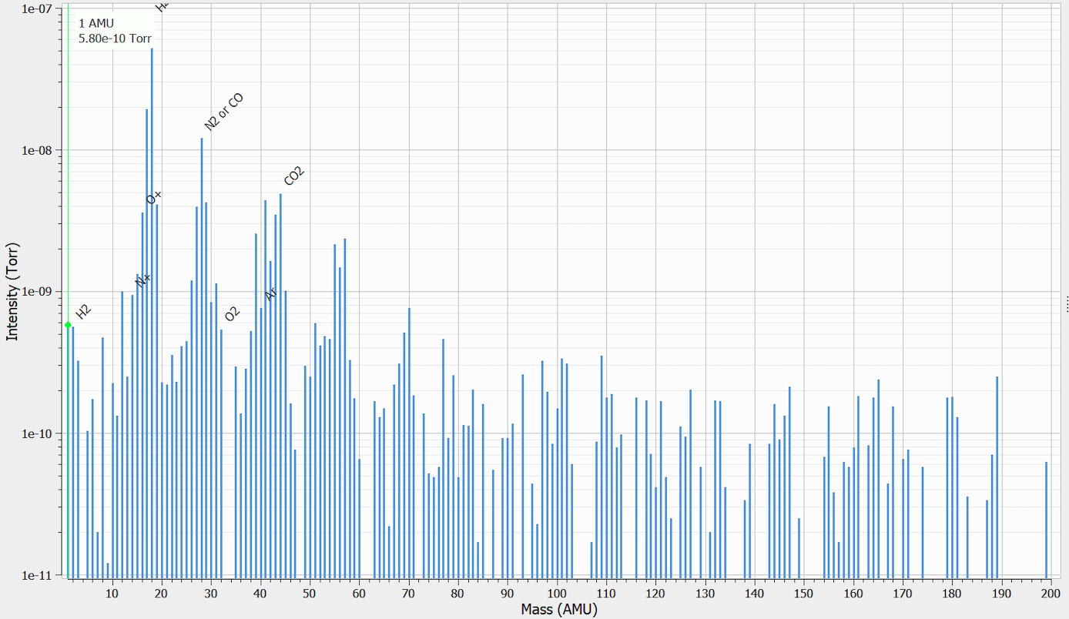
Recent results
Extra GaInSn was added via a transfer vessel.
With the vacuum of 5x10⁻⁷ torr, the system was checked using the initial 4 contraction nozzle and 6.6 contraction nozzle made inhouse.
The following results were obtained:

Slide 12
Recent results

Slide 13
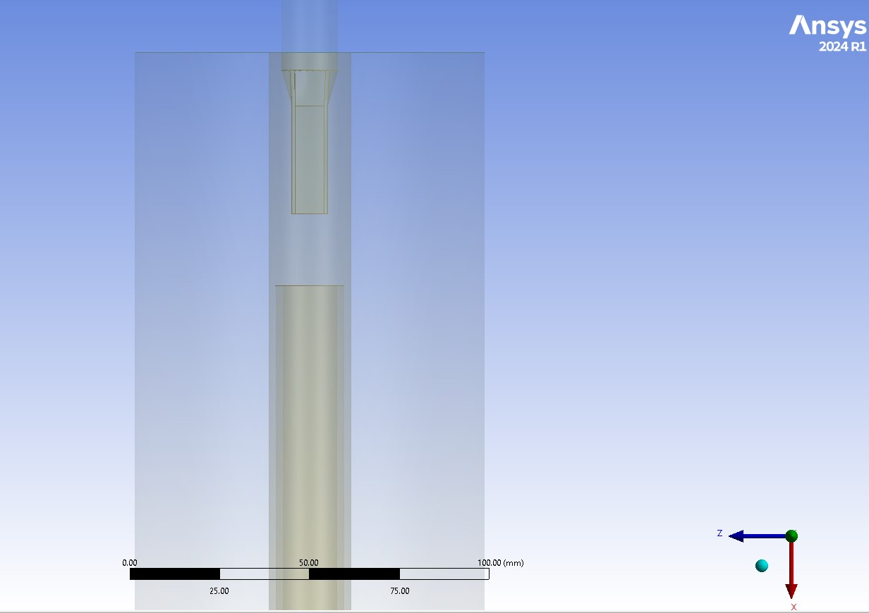
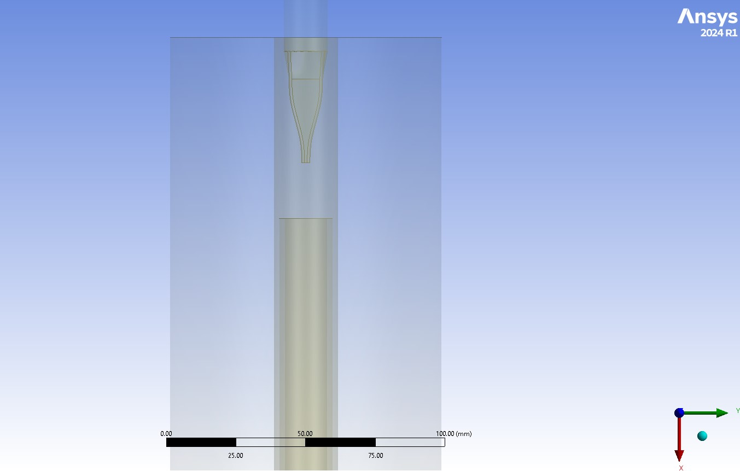
CFD nozzle simulations
CFD simulations of one of the nozzles (nozzle 2) were done by Silviu, using Fluent-ANSYS v2024R1 with a volume-of-fluid model, which is a multi-phase transport model. One phase is GaInSn and the other is air. The air fills the chamber at a pressure of 10⁻⁶ Pa (7.5 x 10⁻⁹ torr) and a density 1e-14 kg/m³. The air is not treated as an ideal gas, but rather as a constant density fluid. The liquid metal comes in at inlet at 2 m/s, 293 K and pressure sufficient to overcome the nozzle resistance. The pressure is calculated by Fluent.
CAD drawings of nozzle used in CFD calculations based on model provided by Xelera.

Slide 14
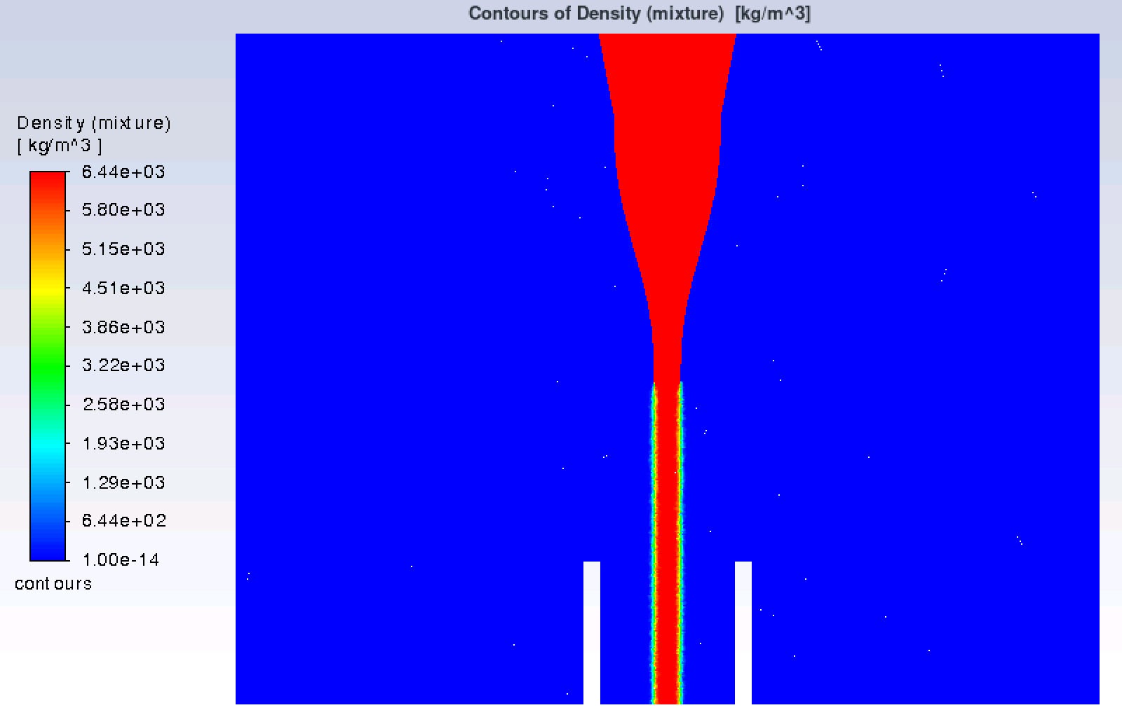
CFD nozzle simulations
Density profiles

Slide 15
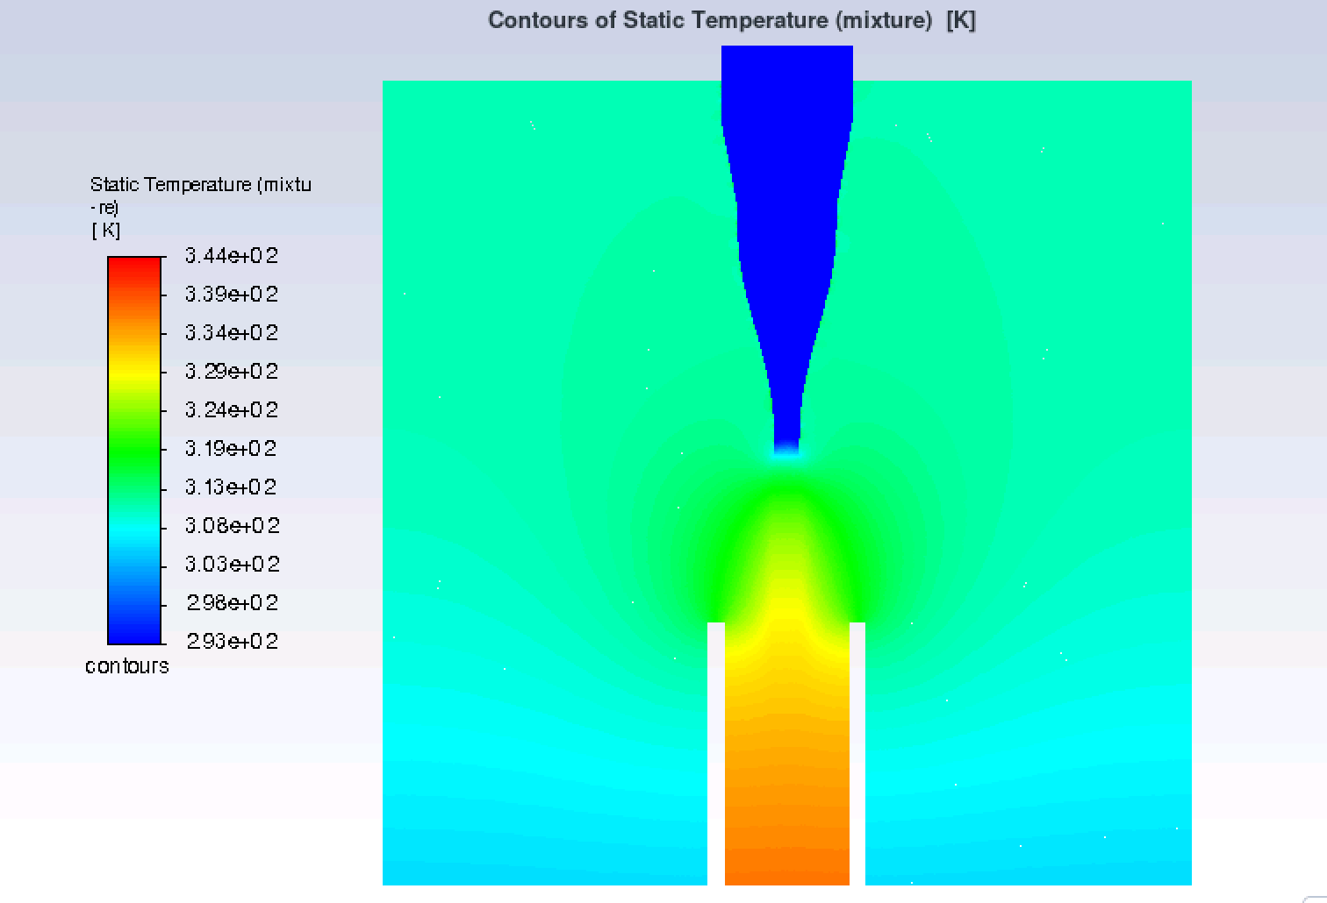
CFD nozzle simulations
Temperature profile due to 40 kW deposited by beam (distribution calculated by GEANT4)
Velocity profile, GaInSn velocity ~12.5 m/s, close to 2 m/s x 6.6

Slide 16
Radio isotope production in the GaInSn target
MCNP6 gamma dose rate in (rem/h)/mA calculated for a 10 MeV
Gaussian electron beam with σ_{x} = σ_{y} = 1mm
Suppose that radioactive nuclides are formed at a constant rate R for a time τ, after which the irradiation stops and the nuclei decay. If no radio-nuclides are present initially, the activity at time τ is given by
$A(τ)=R(1−e^{−λτ}$)
where λ=ln2/T_{1/2} , R is the saturation activity and given by Nσφ where
N is the number of target nuclides, σ is the microscopic cross section
for the pertinent reaction and φ is the flux of particles initiating the
reaction. After the irradiation is stopped,
$A\left(t\right)=R(1−e^{−λτ}$)$e^{−λt}$
The TALYS program for the simulation of nuclear reactions was used to calculate (γ,p), (γ,n) and (γ,γ’) cross sections σ(E). These were convoluted with the 10 MeV bremsstrahlung flux φ(E) produced by electrons incident on a 3 mm thick GaInSn target and integrated to give R
$R=N\int_{0}^{∞}{φ\left(E\right)σ\left(E\right)dE}$
where N is the number of targets of each specie per g.

Slide 17
Radio isotope production
At 10 MeV, MCNP6 did not register any neutrons with a reasonable number of particles.

Slide 18
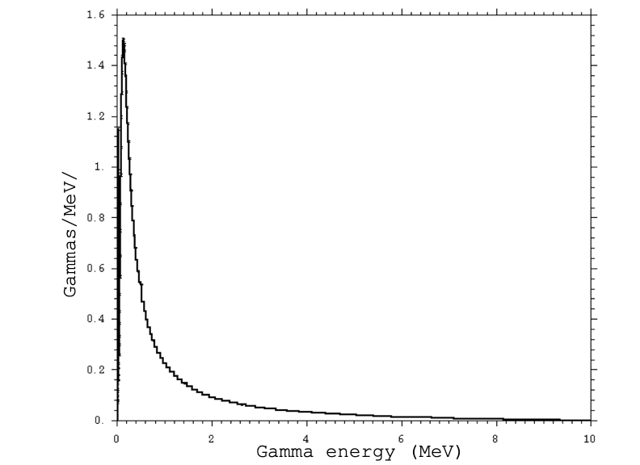
Future plans
Modify system by adding a flow meter and temperature sensors
Investigate behavior of system during several hour runs at 1.0x10⁻⁸ torr pressure (limited by KF flanges)
Design and build a positron converter that will be installed at LERF on the basis of things learned from the current system, and using it as a “template”
Investigate shielding of the converter
with lead and its placement around
the converter

