Slide 1
Discussion on the Positron Technical Design Report (TDR)
to be merged with 22 GeV TDR to generate one CEBAF upgrade roadmap

Slide 2
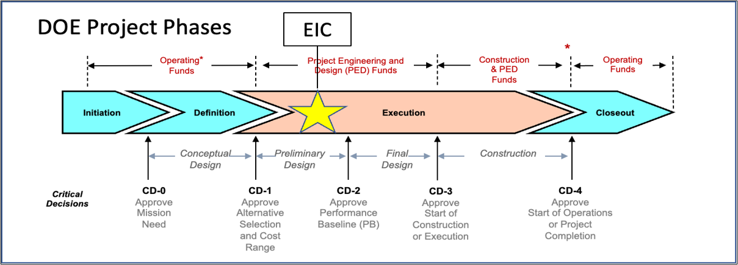
EIC Project-Critical Decisions and Plans
2019
2021
CD-2 and CD-3 in Preparation
CD-4 EF = 2034
CD-3A, Long-Lead Procurement, approved March 2024. Excellent use of IRA funding.
CD-3B, Long-Lead Procurement, approval planned for March 2025 (ESAAB)

Slide 3
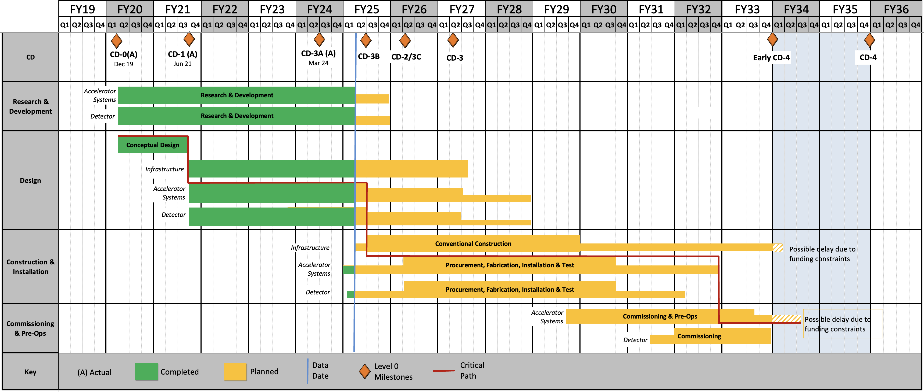
EIC Reference Schedule As Presented January 2025
RHIC Operations is planned for the end of CY2025
3

Slide 4
Notional CEBAF and EIC Efforts on One Chart
( as presented by David Dean @ the 2024 Jefferson Lab User Meeting )
Activities | Fiscal Year
 | 24 | 25 | 26 | 27 | 28 | 29 | 30 | 31 | 32 | 33 | 34 | 35 | 36 | 37 | 38 | 39 | 40 | 41 | 42
Moller (MIE, 413.3B, CD-2/3)
SoLID (LRP, Rec 4)
Positron Source (R&D)
CEBAF Upgrade preCDR/preplan
Positron Project (potential)
Transport e+
22 GeV Development (R&D)
22 GeV Project (potential)
EIC Project (V4.2, CD-1, CD-3A)
CEBAF Up

Slide 5






EIC Scientific Case Built Over Decades
2002
2007
2009
2010
2012
Gluons and the Quark Sea at High Energies
2013
NSAC
2015
Major Nuclear Physics Facilities for the Next Decade
2018
2021
2023
March 14, 2013
arXiv:2103.05419

Slide 6
Critical Decision 0 (CD-0), Approval of Mission Need
Definition: Approval of CD-0 formally establishes a project and begins the process of conceptual planning and design used to develop alternative concepts and functional requirements. Additionally, CD-0 approval allows the Program to request Project Engineering and Design funds for use in preliminary design, final design and baseline development.
DOE O 413.3B Chg 7 (LtdChg), Program and Project Management for the Acquisition of Capital Assets
Status: CurrentApproved Date: Nov 29, 2010
Goals: Make the science case so the the CEBAF Upgrade Project can be a priority for the next long-range plan & have a sufficient technical basis that DOE can approve the mission need (i.e. CD-0).

Slide 7
High Impact Documents Thus Far:
48 Citations EPJA Positron overview article: https://doi.org/10.1140/epja/s10050-021-00564-y
117 Citation EPJA 22GeV overview article: https://doi.org/10.1140/epja/s10050-024-01282-x
These two documents are often referred to as the positron and 22GeV white papers.

Slide 8
We must start getting our technical documents together in a form that could be presented to DOE. This technical document is an early and rough document but is part of setting the foundation for getting DOE to state mission need: CD-0. Goes hand-in-hand with making the science case and being a priority in the long-range plan.
EIC CD-0 was Dec. 2019 with CD-1 in June 2021.
EIC Conceptual Design Report (CDR) in 2021: https://doi.org/10.2172/1765663
EIC yellow paper came out on arXiv in 2021 with its referred publication in 2022 (has over 1k citations): https://arxiv.org/abs/2103.05419 https://doi.org/10.1016/j.nuclphysa.2022.122447
2013
2002
2007
2010
2011
2012
2013
2015
2018
Gluons and the Quark Sea at High Energies
NSAC
Major Nuclear Physics Facilities for the Next Decade

Slide 9
Discussion about our path forward….

