Slide 1
Update on Ce⁺BAF Injector Baseline Simulations
Concept of e⁺ injector
Simulation of e⁺ capture
Design of energy selection chicane
Results of start-to-end e⁺ beam tracking
A. Ushakov, J. Benesch, J. Grames, S. Ogur, V. Lizarraga-Rubio,
R. Rimmer, Y. Roblin, D. Turner, S. Wang
Jefferson Lab

Slide 2
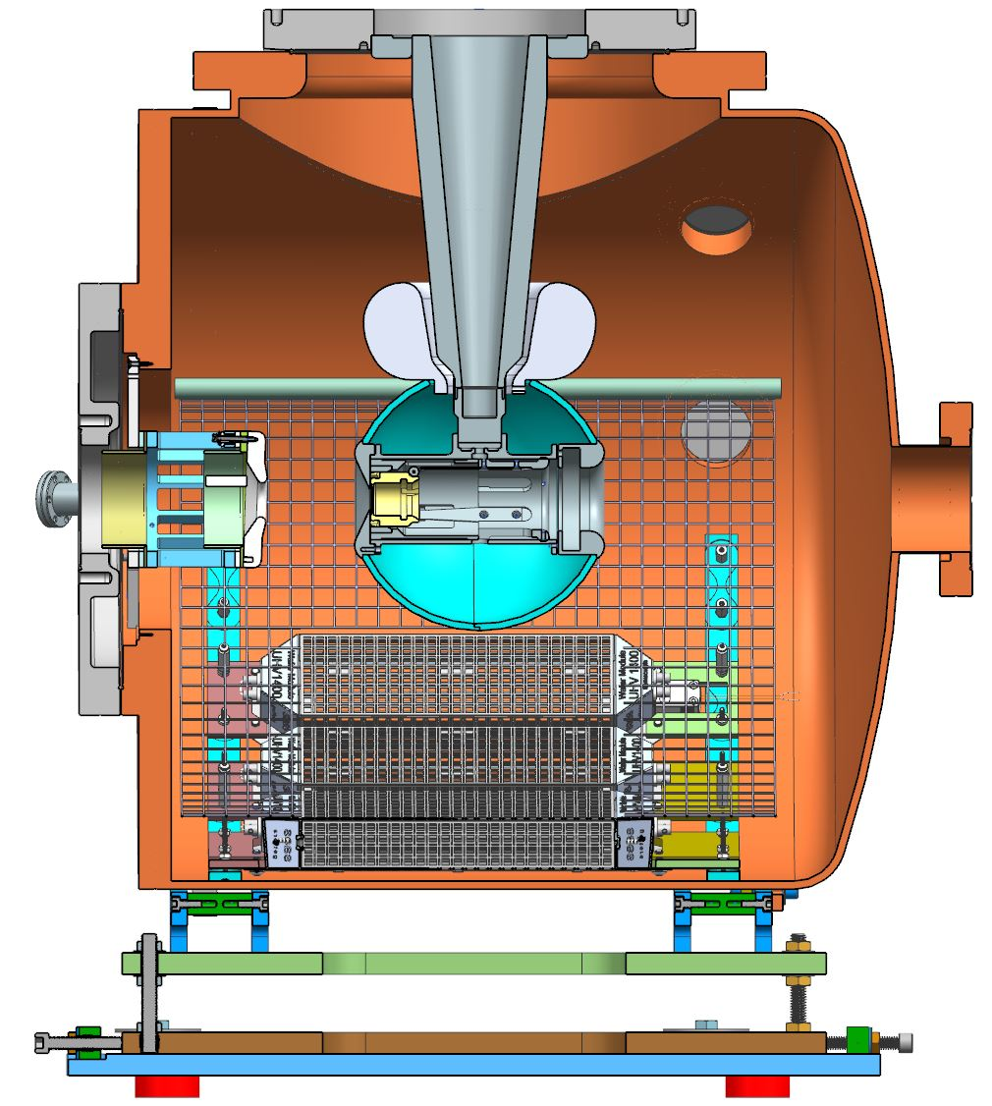
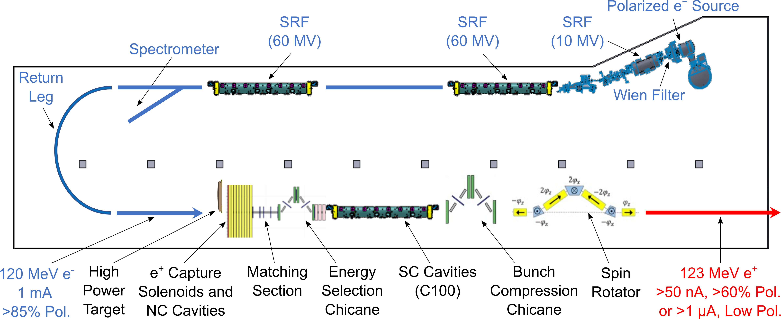
Pol. e⁺ Injector Critical Risk Areas mA e‒ Source, High Power Targets, Capture Cavity
Conceptual Development
Improve design of e⁺ injector
Develop pCDR
High current e‒ source (<10 mA @ 10 MeV)
Up to 90% polarization
Long life time
JLab LDRD “A high-intensity, polarized-beam prototype photogun for the Ce⁺BAF positron source”, PI: M. Bruker, proposal awarded, FY25-FY26
Scheme of e⁺ Injector at LERF
S. Habet, PhD Thesis, Dec 2023
 | Simul. | Goal
Energy [MeV] | 123
Current [nA] | 170 | > 50
Polarization [%] | 65 | > 60
$σ_{∆p/p}$[%] | 0.6 | < 1
$σ_{z}$ [ps] | 2 | < 4
$ε_{nx},ε_{ny}$ [m·rad] | 1.5e-3 | < 4e-5
Target Test Area

Slide 3
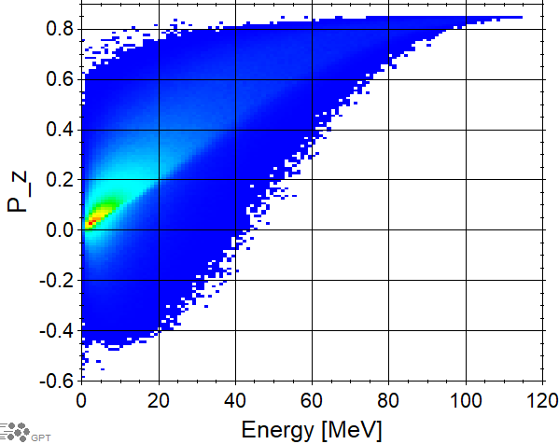
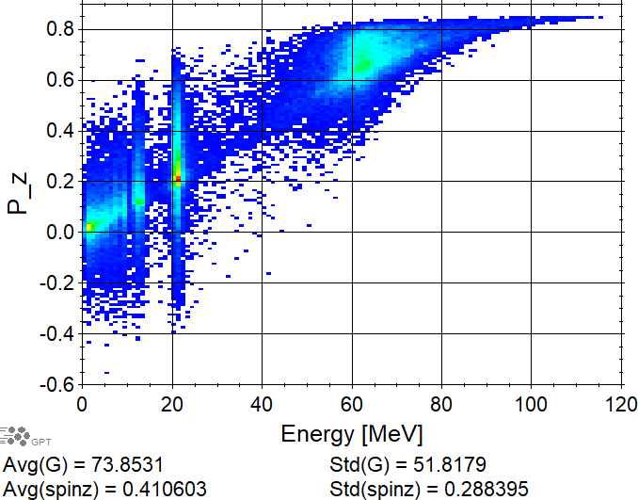
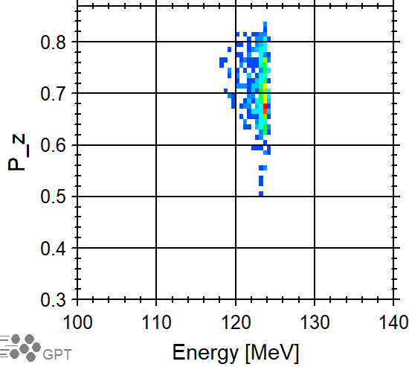
Simulation Model of e⁺ Injector
Scheme of e⁺ Injector
Start-to-end simulations (Geant4 + elegant)
e⁺ generated by 1 mA @ 120 MeV e⁻ in W target with thickness of 4 mm
Considered NC and SC focusing solenoids
NC SW standing wave capture cavity
Added quads to energy selection chicane
Added matching sections before and after chicane
e⁺ accelerated to 123 MeV in C100 cryomodule
Bunch compression is not yet implemented/studied

Slide 4
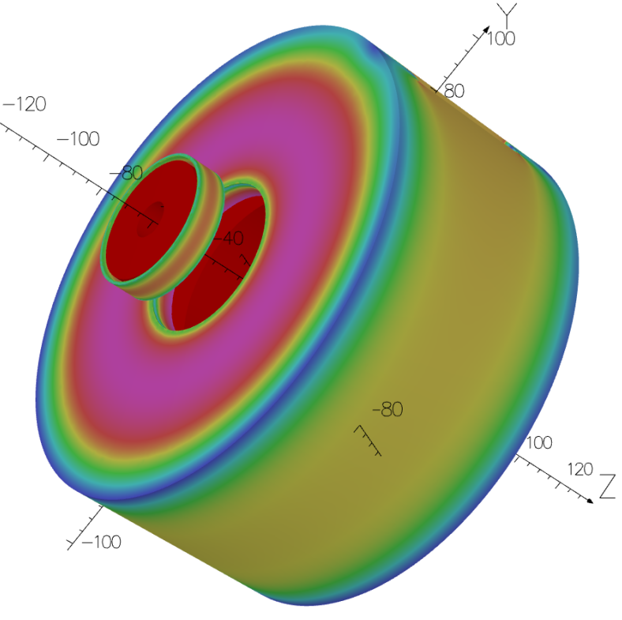
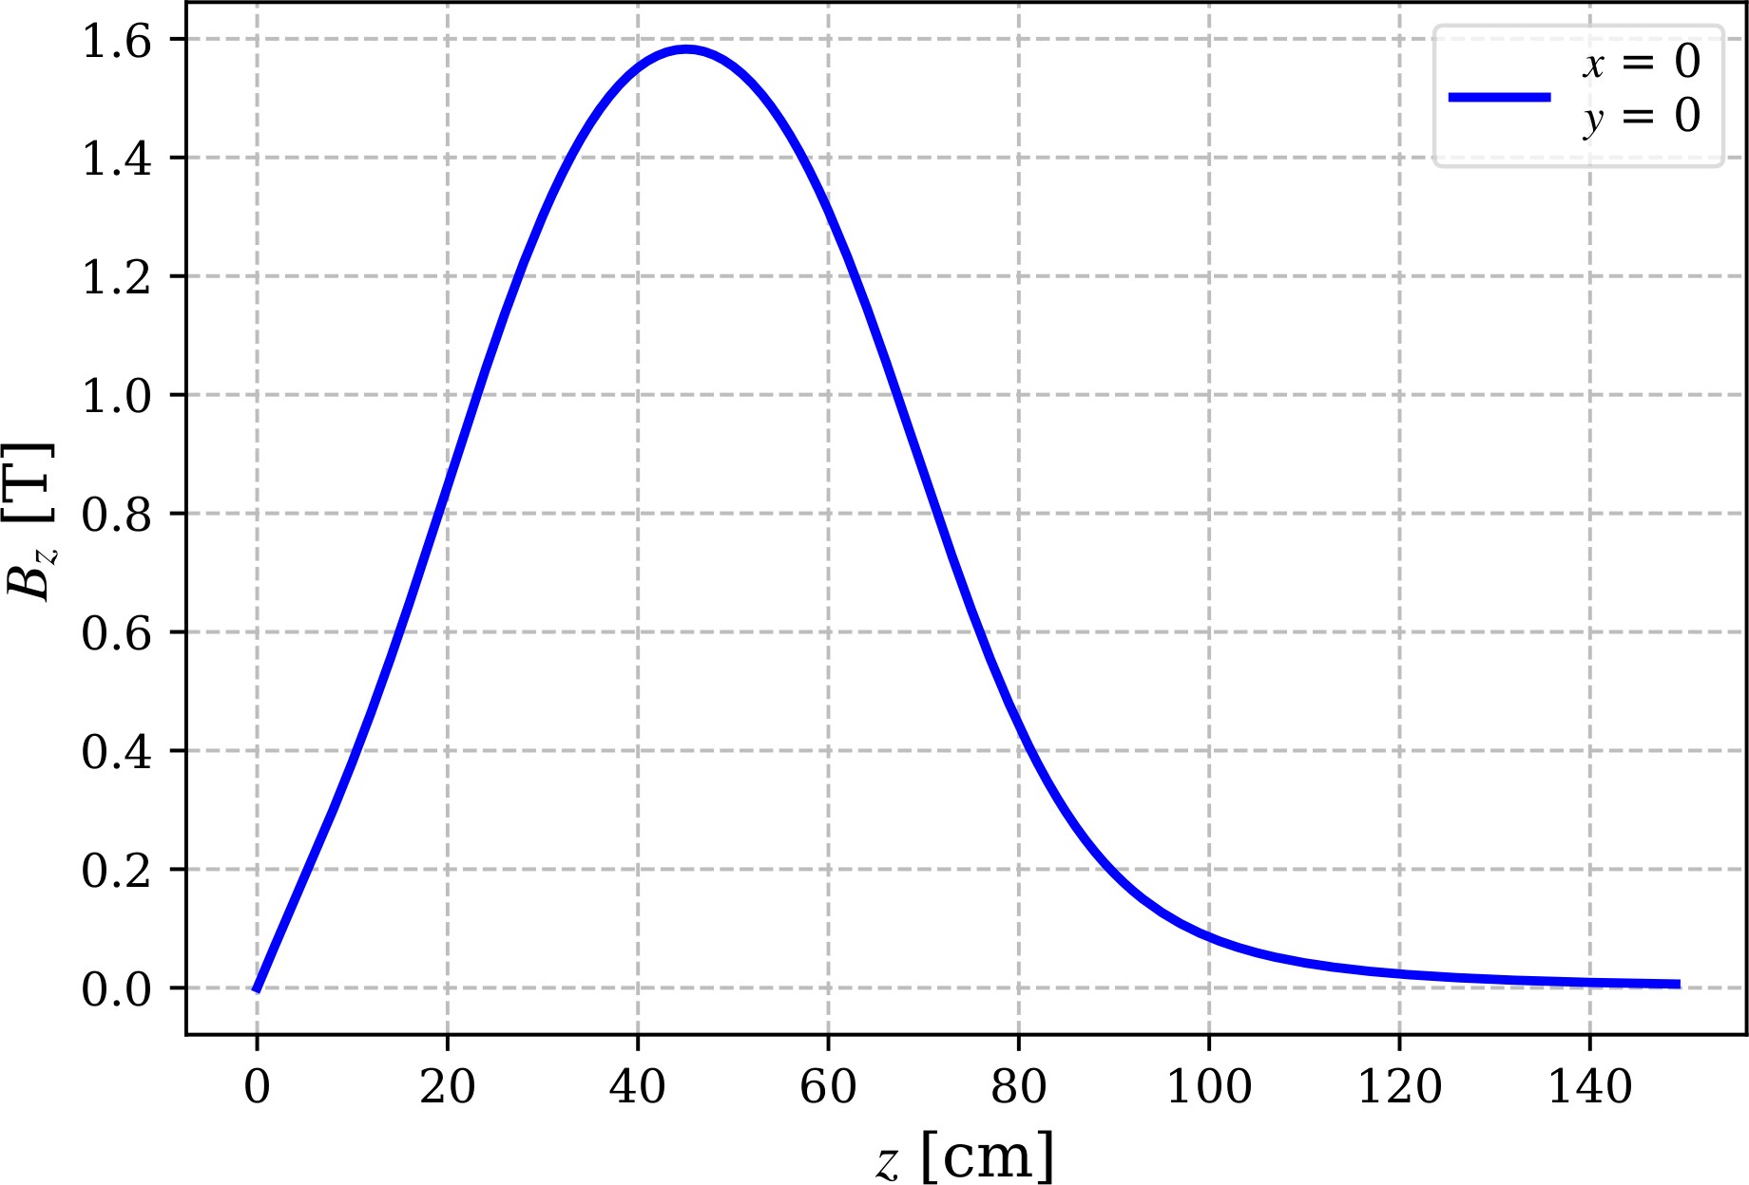
Simulation Model of e⁺ Injector
Different NC and SC options for focusing solenoid
1.6 T NC solenoid with 41 cm coil length (field map provided by Jay Benesch)
2.5 T SC solenoid with 25 cm length (simplified model, elegant)
Capture cavity: 1.497 MHz, 11 cells, 4 cm iris radius, 4 MV/m
Chicane:
Bending angle of rectangular dipoles: 0.2 rad
5 cm quad half width, 5 cm radius of beam pipe
Rectangular collimators: 1.5 cm X half width, 5 cm Y half width
Concept of Focusing and Bucking Solenoids (Jay Benesch)
Field Profile on Beam Axis
41 cm Coil Solenoid
1.24 m Target to Cavity Distance
Cavity with 4 cm Aperture Radius
Target

Slide 5
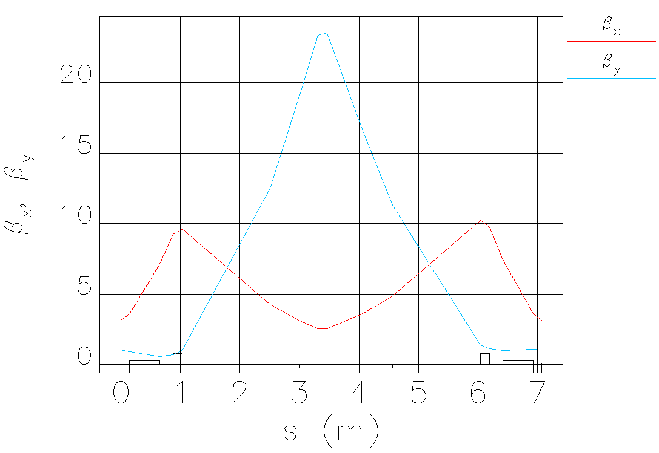
Capture with NC and SC Solenoid #1 and NC Cavity inside NC Solenoid #2
 | Target | NC Sol. #1 with 41 cm Coil |  |  | 25 cm SC Solenoid #1
γ | N_{e+} | B_{1Sol} | B_{2TW} | N_{2TW} | B_{1Sol} | B_{2TW} | N_{2TW}
Δγ/γ = ±0.1 | Target Exit |  |  | NC Cavity Exit |  |  | NC Cavity Exit
 | e⁺/10M e⁻ | T | T | e⁺/10M e⁻ | T | T | e⁺/10M e⁻
120 | 51530 | 1.615 | 0.901 | 43389 | 2.500 | 0.463 | 40189
40 | 172960 | 0.542 | 0.321 | 82840 | 0.868 | 0.130 | 60015
Steps used for design of energy selection chicane:
Calculated Twiss parameters at exit of capture cavity for 60 MeV or 20 MeV positrons
Defined chicane parameters (typically at chicane entrance beta X = 3 m, beta Y = 1 m, maximal dispersion at middle of chicane and low dispersion at start and end)
Calculated required parameters of matching section
Tracked all positrons and optimized phase of SRF for lowest energy spread and highest e⁺ current

Slide 6
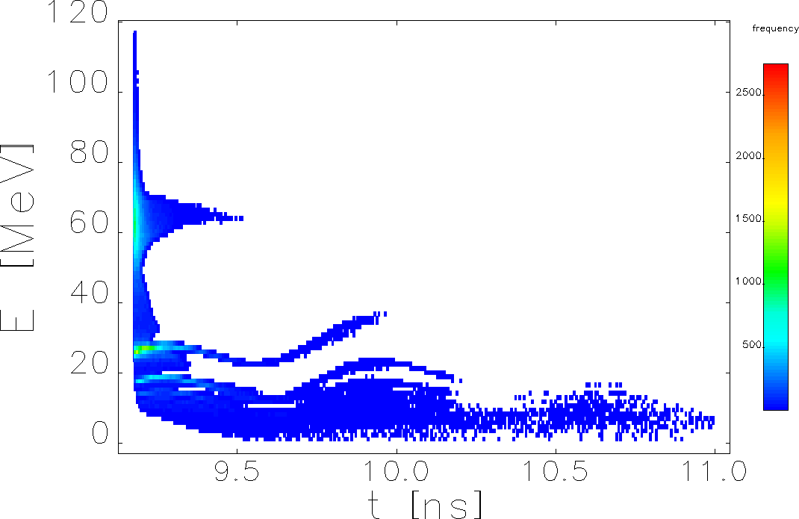
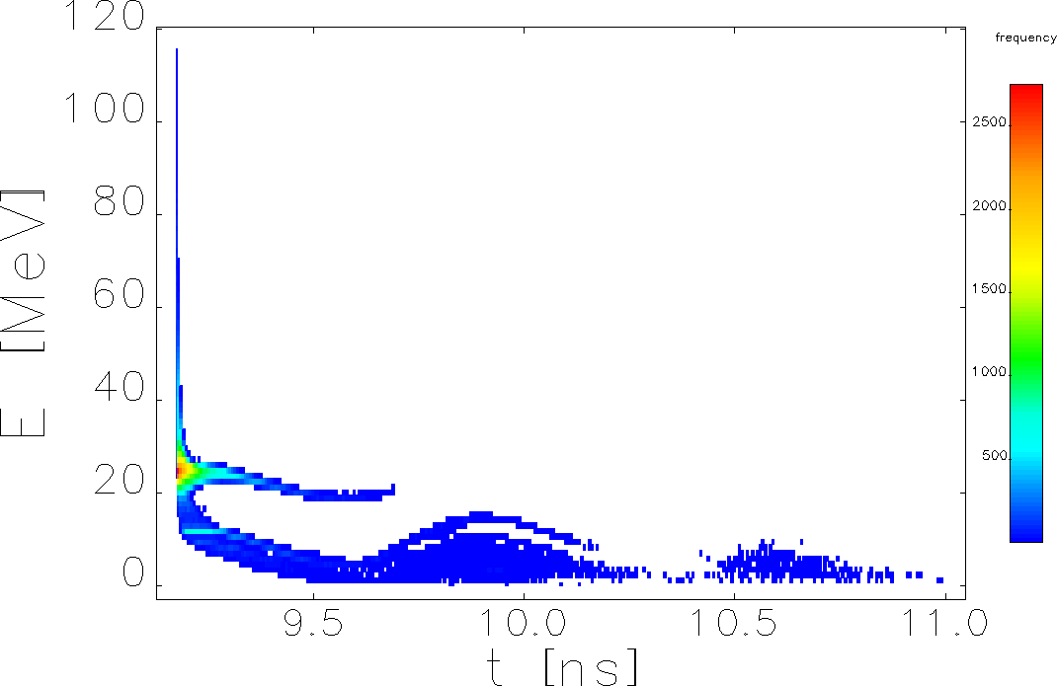
Momentum-Time Distribution at End of NC Capture Cavity (NC Solenoid)
High Polarization Mode
High Current Mode
Capture of 60 MeV e⁺ at Target
Capture of 20 MeV e⁺ at Target

Slide 7
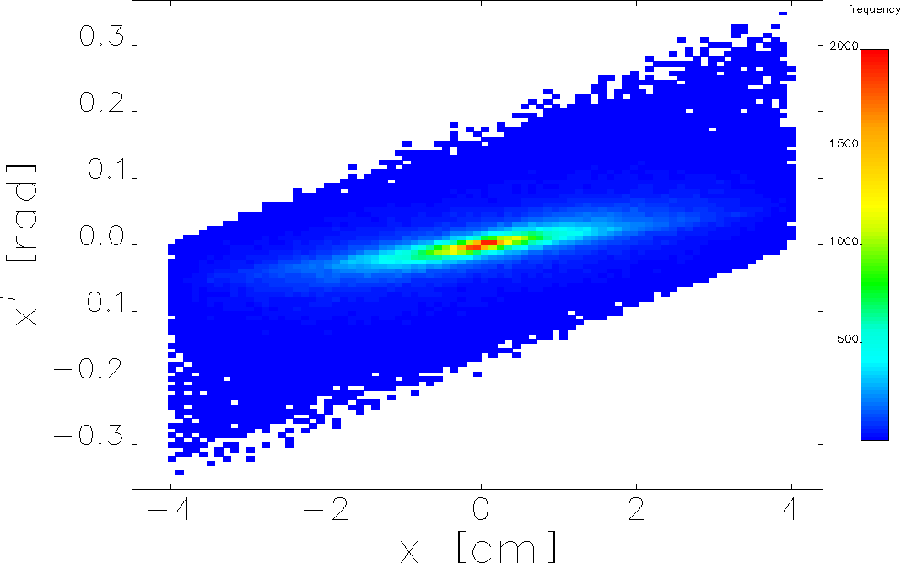
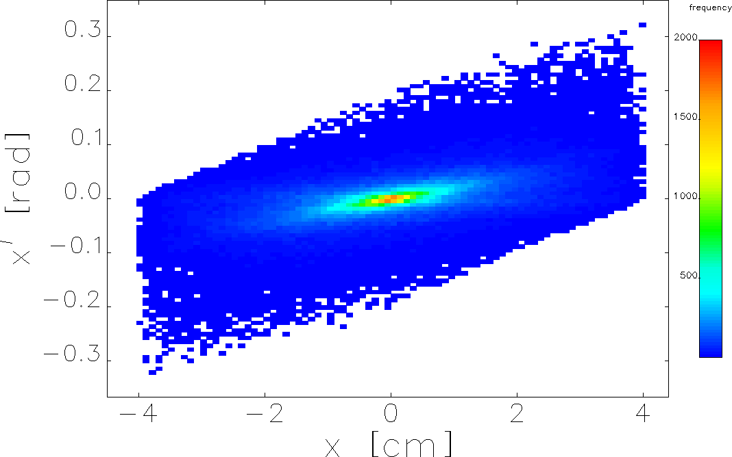
XX’ Distribution at End of NC Capture Cavity (NC Solenoid)
High Polarization Mode
High Current Mode

Slide 8
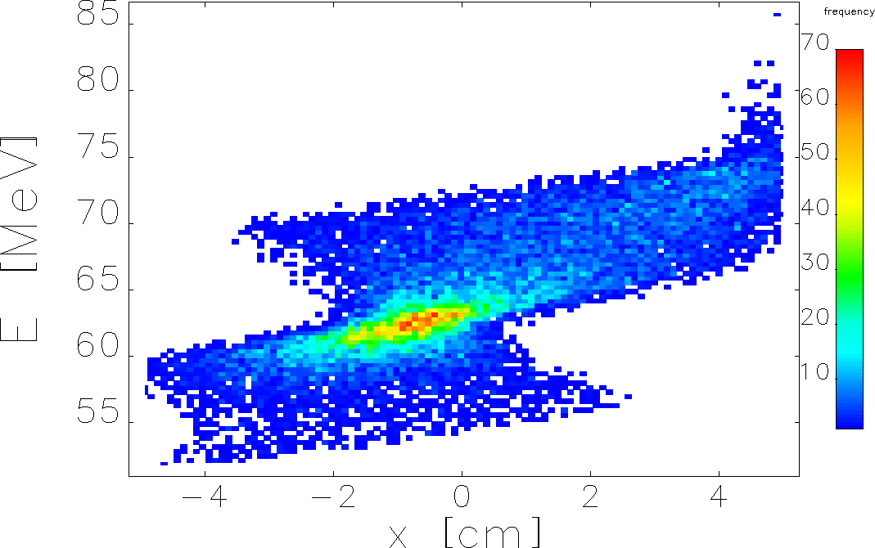
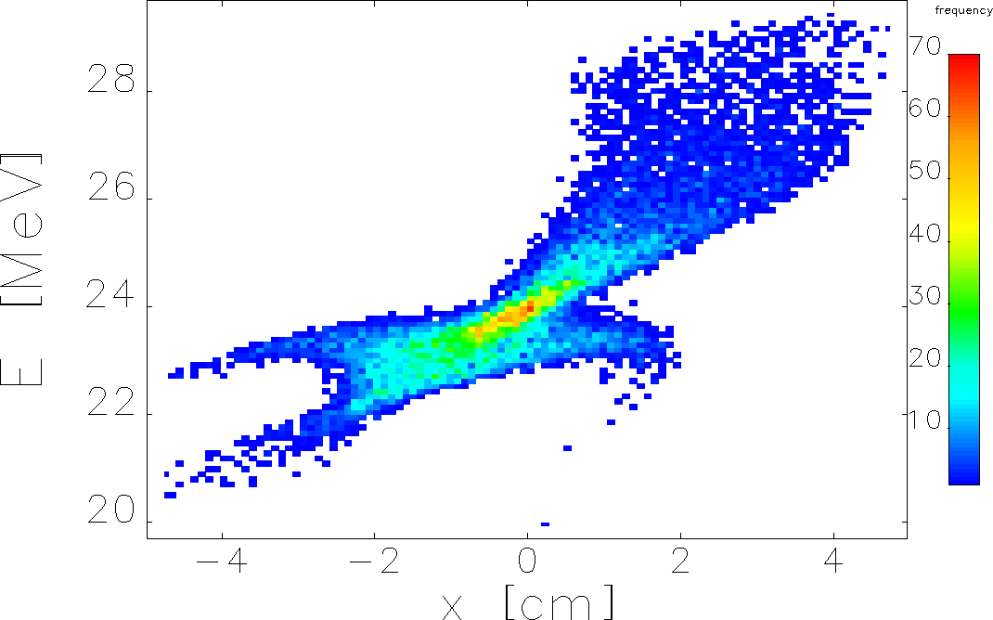
Momentum vs X before Collimator #1 (NC Solenoid)
High Polarization Mode
High Current Mode

Slide 9
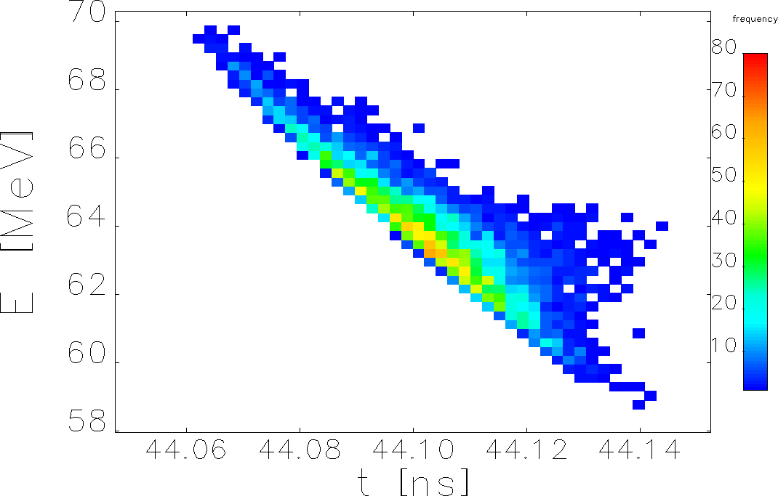
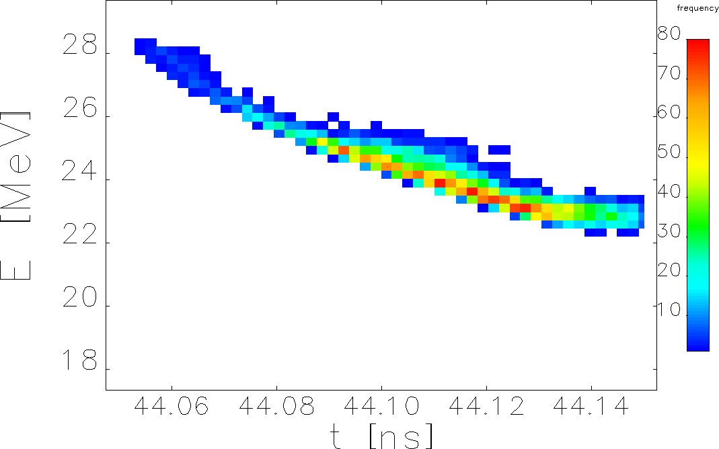
Momentum-Time Distribution before C100 (NC Solenoid)
High Polarization Mode
High Current Mode

Slide 10
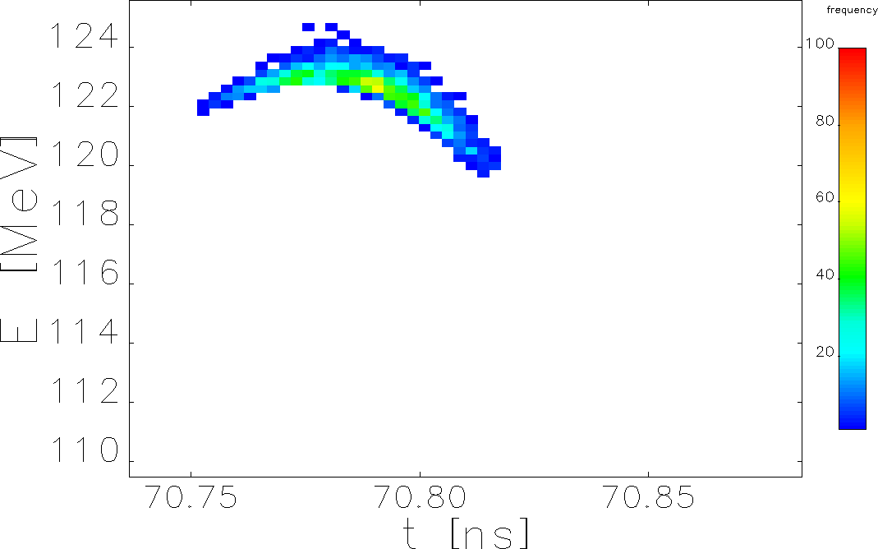
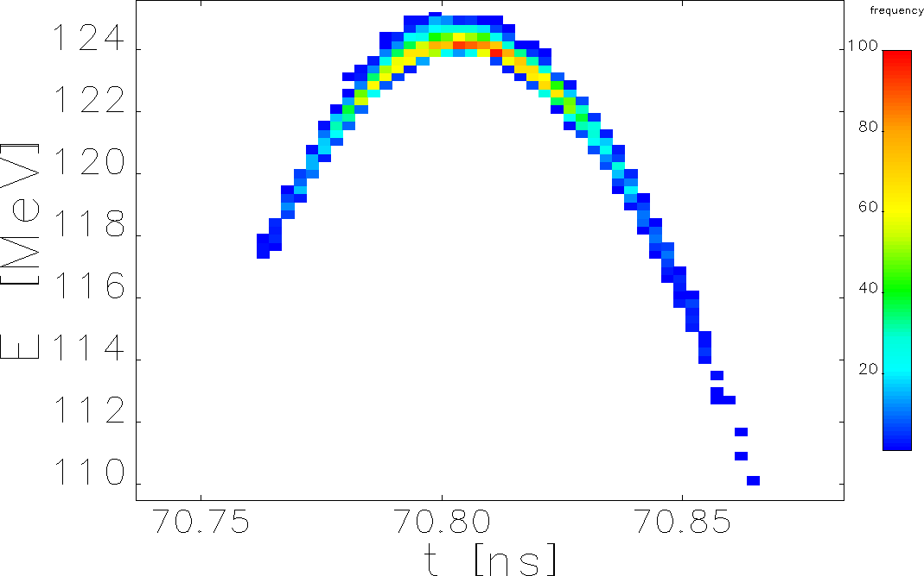
Momentum-Time Distribution after C100 (NC Solenoid)
High Polarization Mode
High Current Mode

Slide 11
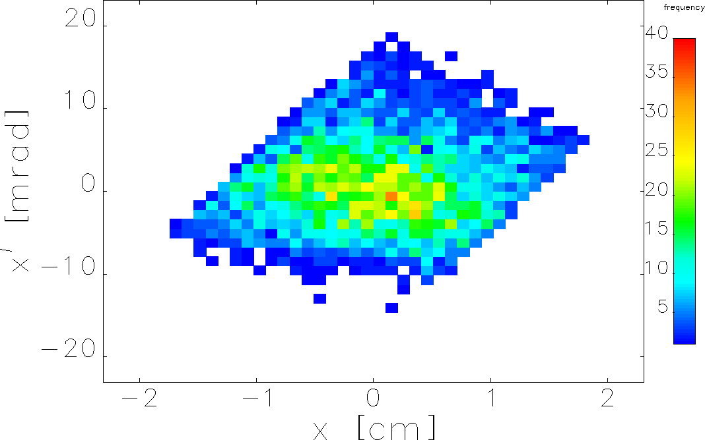
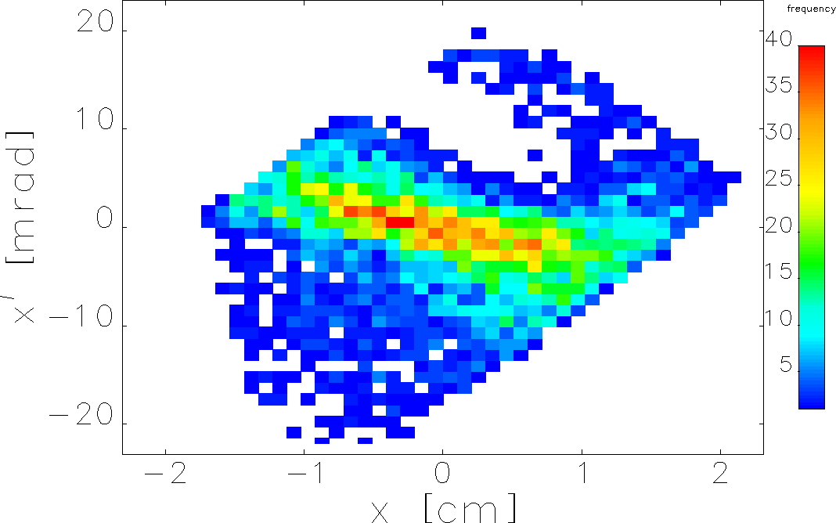
XX’ Phase Space before C100 (NC Solenoid)
High Polarization Mode
High Current Mode

Slide 12
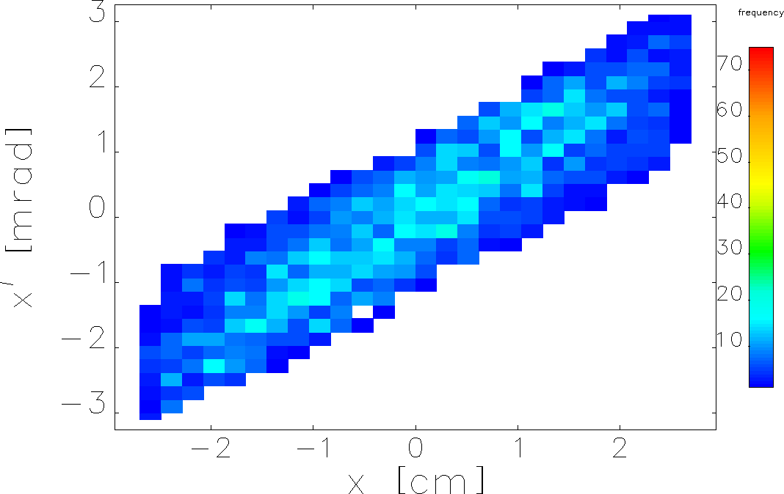
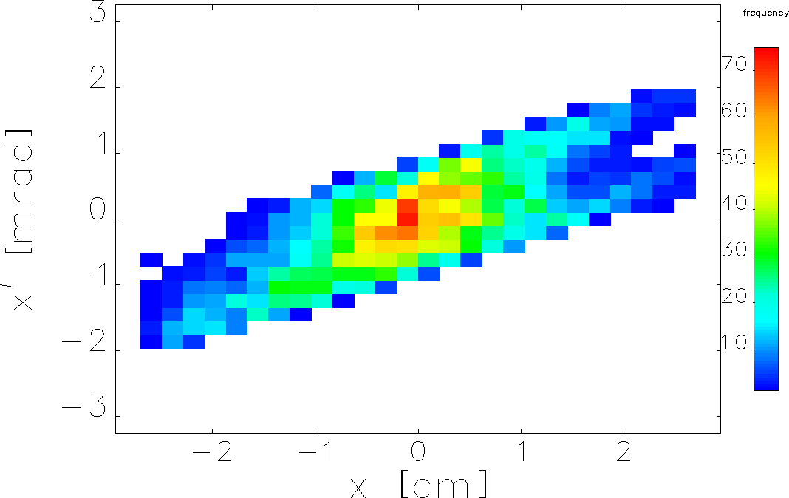
XX’ Phase Space after C100 (NC Solenoid)
High Polarization Mode
High Current Mode

Slide 13
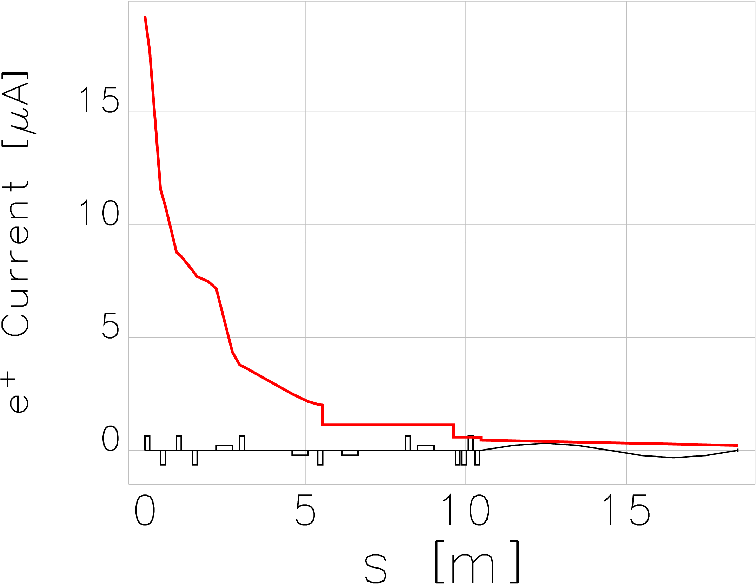
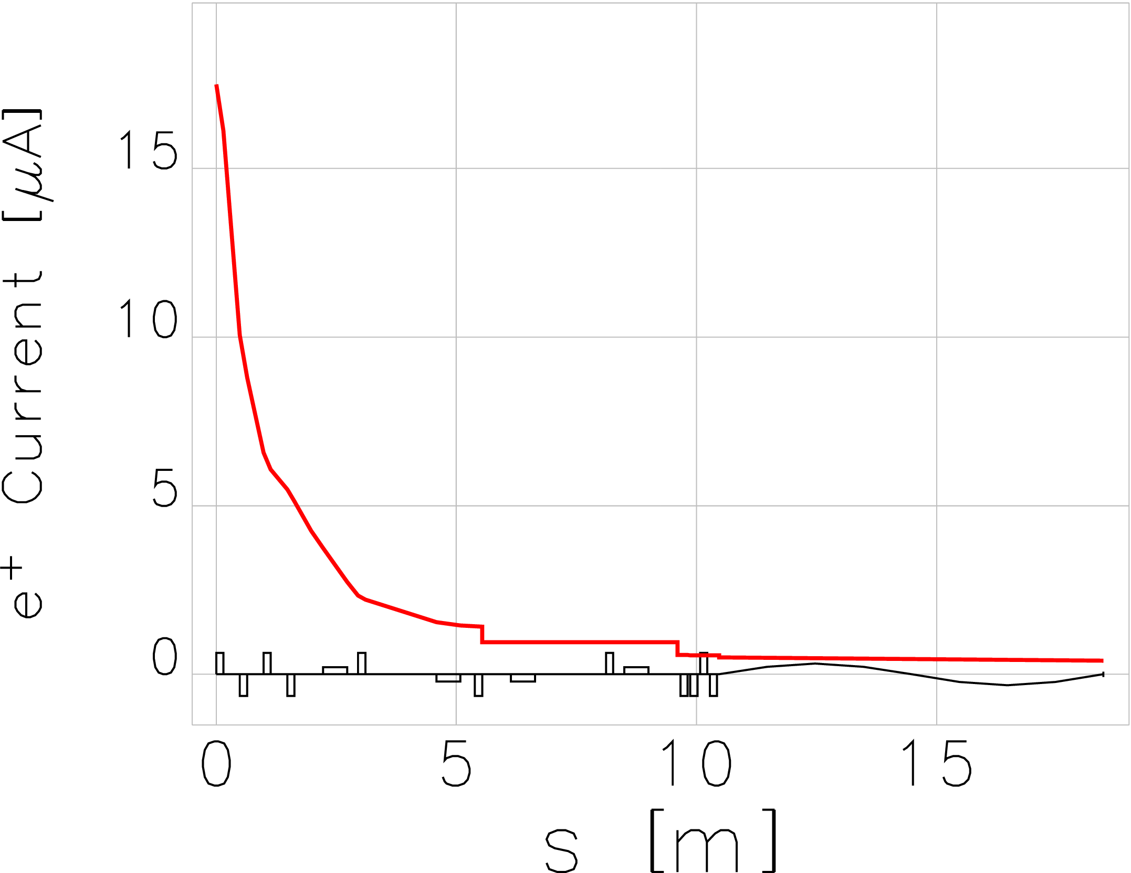
e⁺ Current along Beamline for Source with NC Solenoid and I_{e-} = 1 mA
High Polarization Mode
High Current Mode
221 nA
405 nA

Slide 14
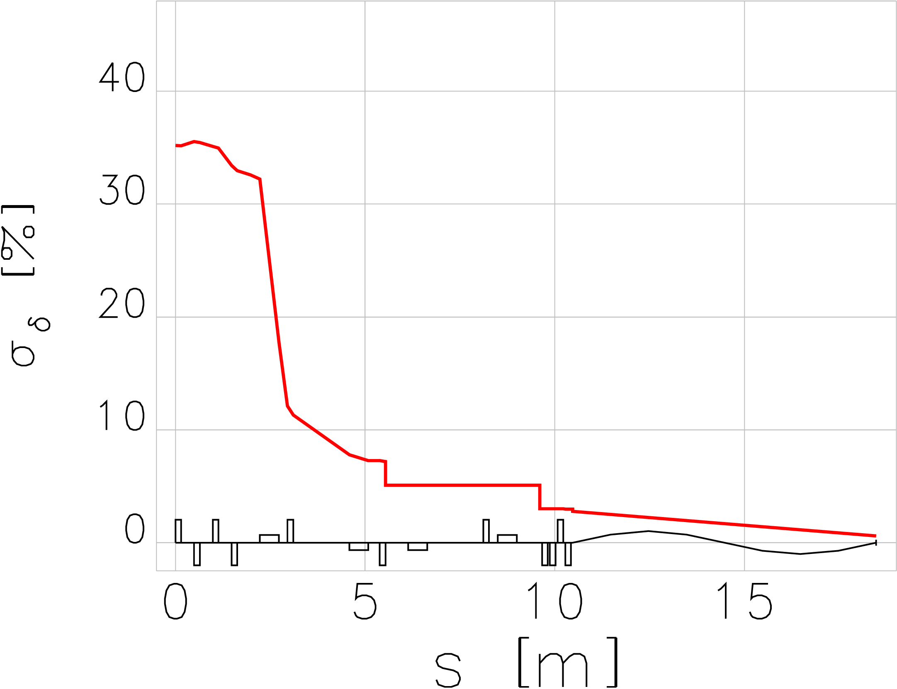
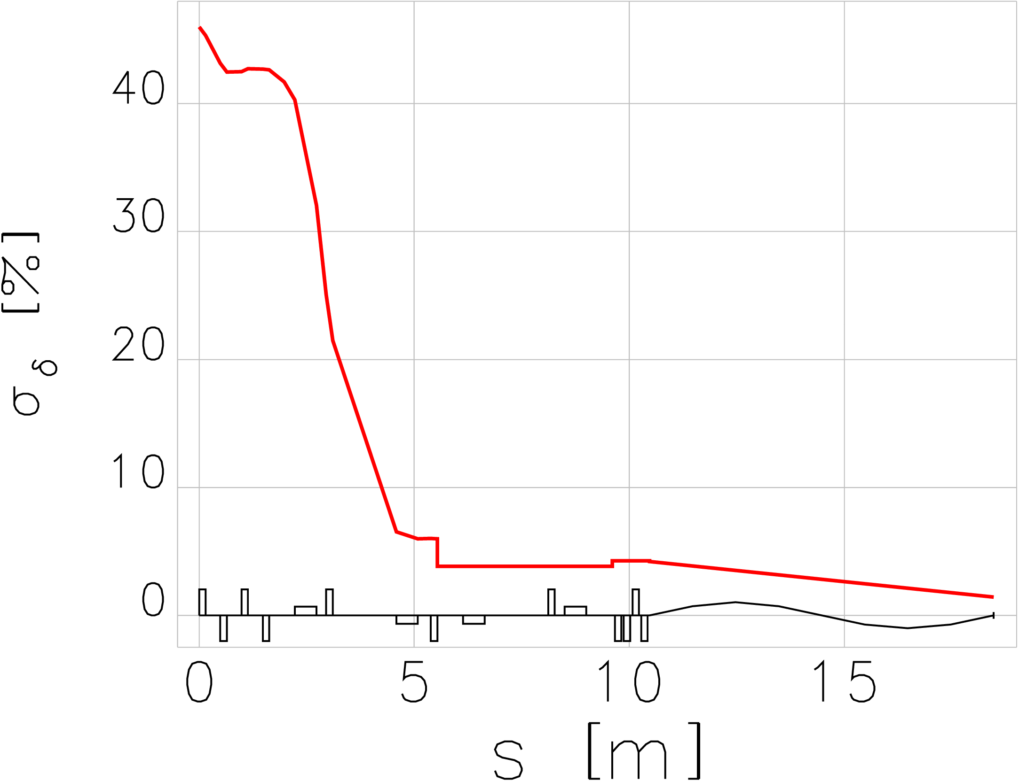
Energy Spread along Beamline (NC Solenoid)
High Polarization Mode
High Current Mode
0.6%
1.4%

Slide 15
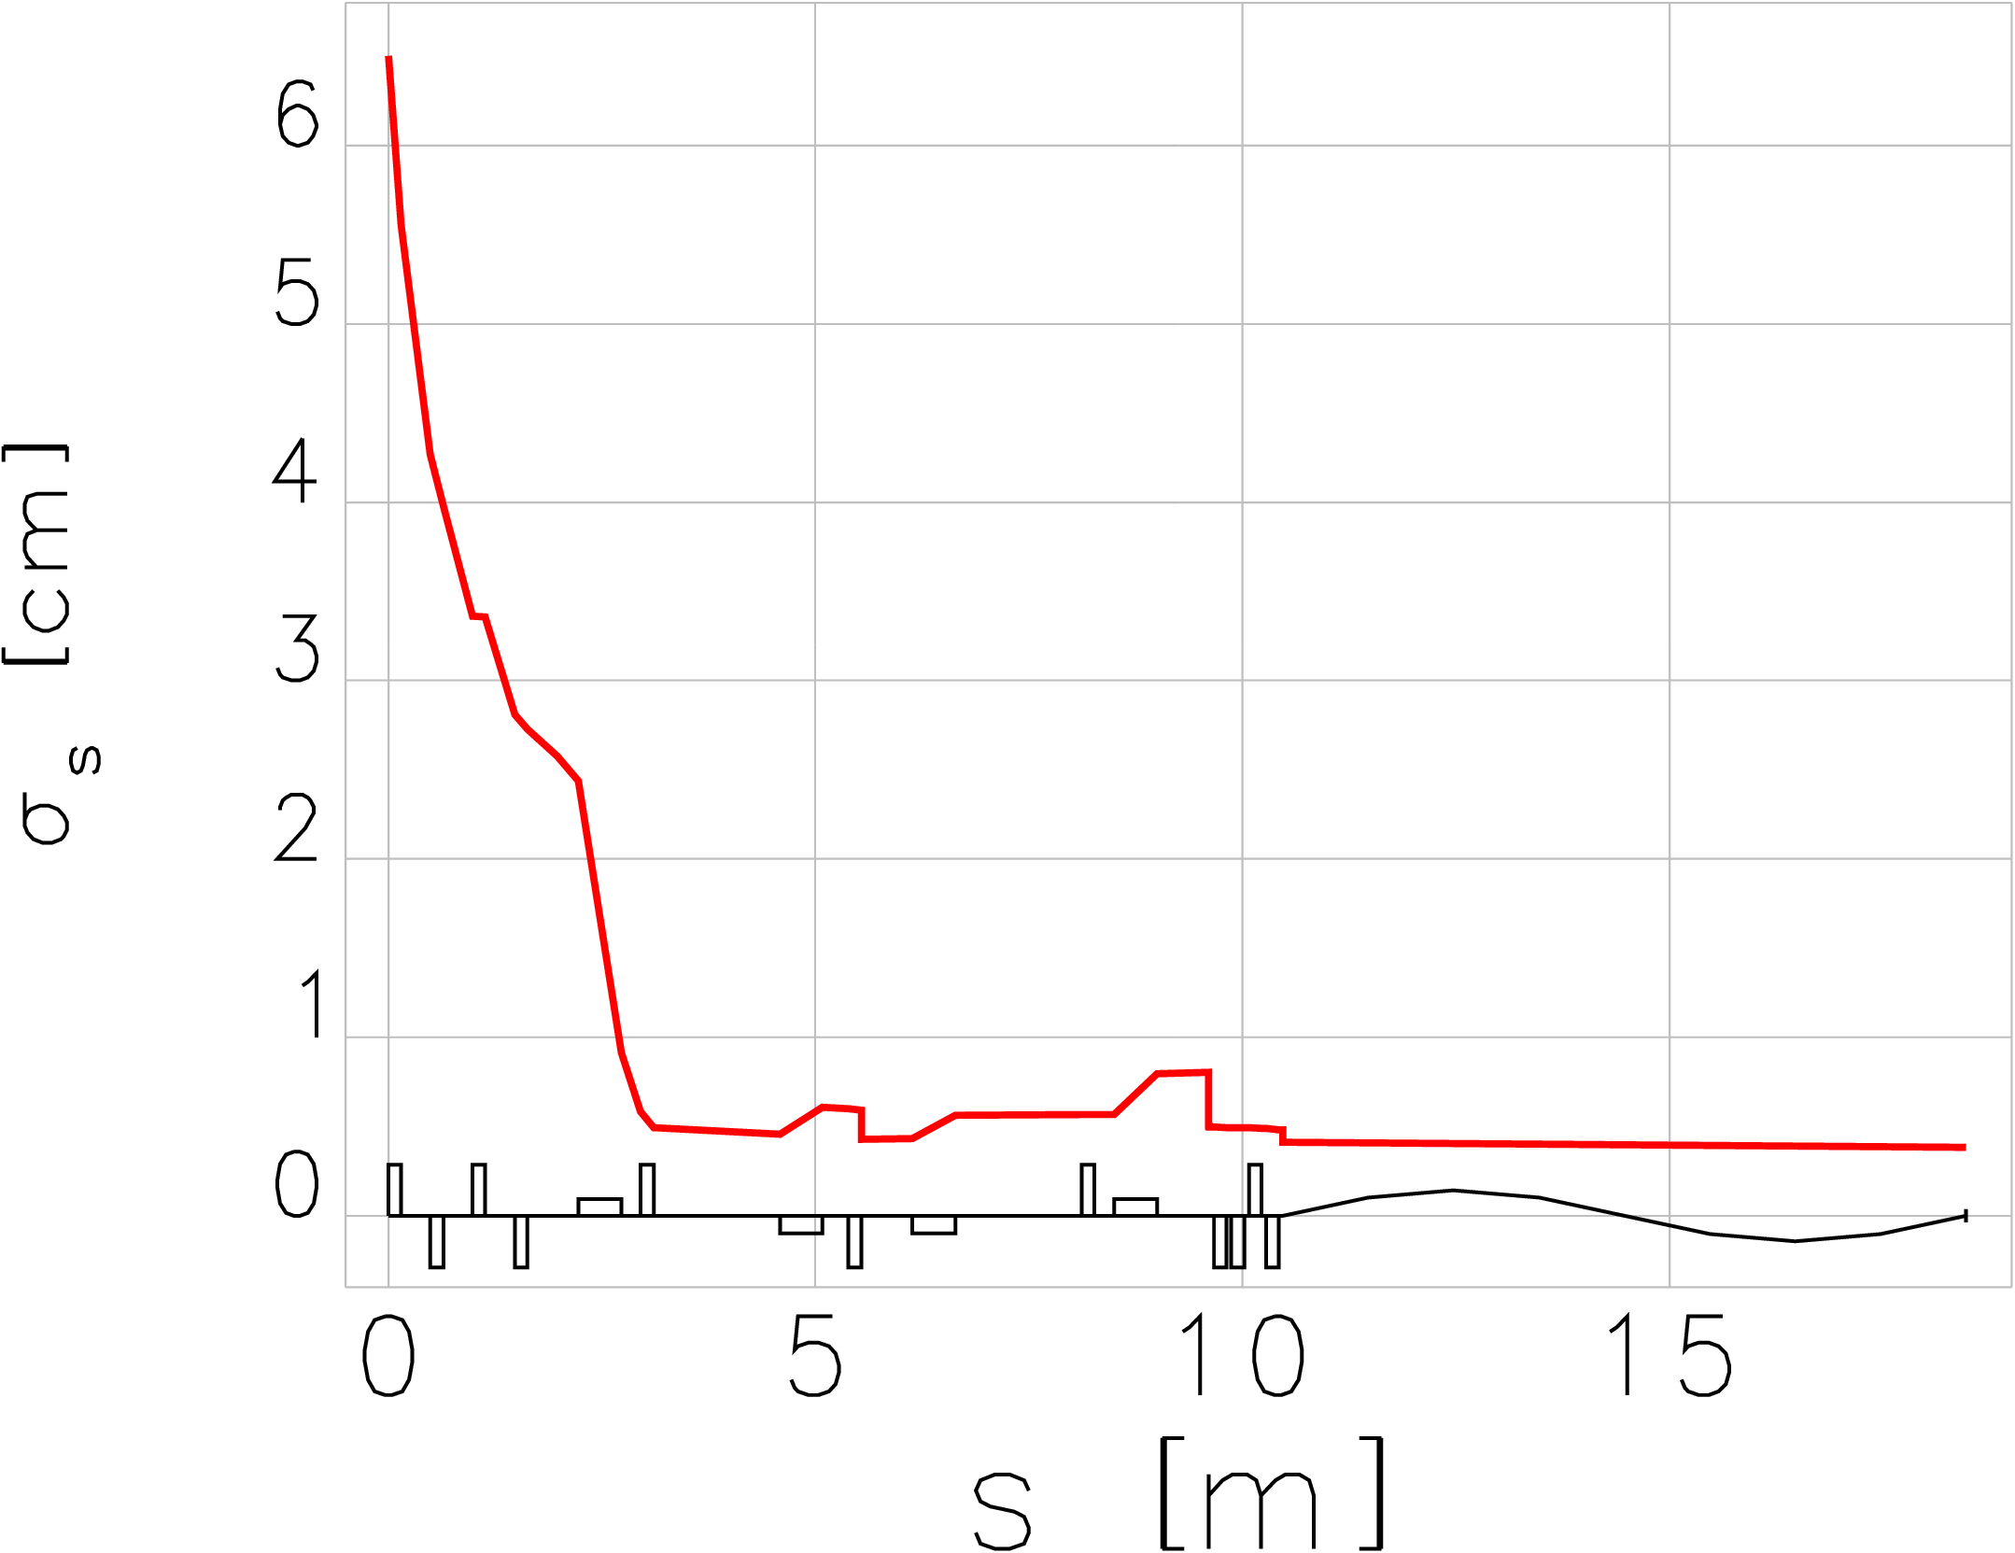
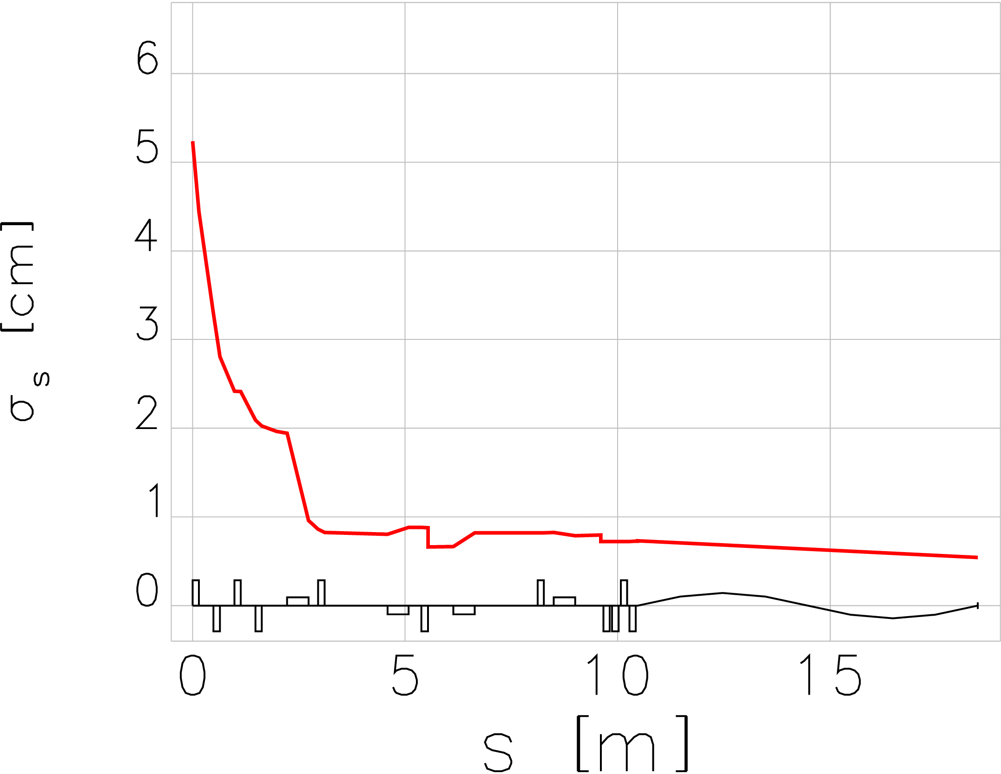
Bunch Length along Beamline (NC Solenoid)
High Polarization Mode
High Current Mode
3.8 mm
5.4 mm

Slide 16
NC and SC Solenoids for Capture of 60 MeV e⁺ (High Polarization Mode)
 | NC Sol. #1 with 41 cm Coil Length |  |  |  | SC Sol. #1 with 25 cm Length
 | B₁ = 1.615 T and B₂ = 0.9 T |  |  |  | B₁ = 2.5 T and B₂ = 0.463 T
 | e⁺ Current | dE/E | Bunch Length | Norm. Emi X | e⁺ Current | dE/E | Bunch Length | Norm. Emi X
 | [nA] | [%] | [mm] | [mm·rad] | [nA] | [%] | [mm] | [mm·rad]
NC Cavity | 19245 | 35.0 | 65.0 | 45.2 | 38494 | 31.2 | 18.2 | 82.9
Matching Section | 7483 | 32.6 | 25.8 | 25.5 | 9532 | 28.3 | 9.8 | 36.7
Chicane + Matching | 450 | 2.8 | 4.1 | 4.0 | 785 | 4.1 | 5.2 | 4.2
C100 | 221 | 0.6 | 3.8 | 1.8 | 261 | 0.8 | 5.1 | 2.2
Positions and dimensions of magnets and cavities were kept the same except for solenoid #1

Slide 17
NC and SC Solenoids for Capture of 20 MeV e⁺ (High Current Mode)
 | NC Sol. #1 with 41 cm Coil Length |  |  |  | SC Sol. #1 with 25 cm Length
 | B₁ = 0.542 T and B₂ = 0.32 T |  |  |  | B1 = 0.868 T and B2 = 0.13 T
 | e⁺ Current | dE/E | Bunch Length | Norm. Emi X | e⁺ Current | dE/E | Bunch Length | Norm. Emi X
 | [nA] | [%] | [mm] | [mm·rad] | [nA] | [%] | [mm] | [mm·rad]
NC Cavity | 17487 | 46.0 | 52.4 | 26.9 | 16756 | 35.0 | 82 | 51
Matching Section | 4258 | 41.7 | 19.6 | 6.8 | 7777 | 23.7 | 6.1 | 11
Chicane + Matching | 497 | 4.2 | 7.3 | 1.9 | 982 | 3.7 | 4.9 | 1.6
C100 | 405 | 1.4 | 5.4 | 1.1 | 659 | 1.4 | 5.1 | 1.2
Positions and dimensions of magnets and cavities were kept as for capture of 60 MeV e⁺
Field strength of magnets and cavities have been adjusted for optimal capture of 20 MeV e⁺ (highest current at the end of e⁺ beamline)

Slide 18
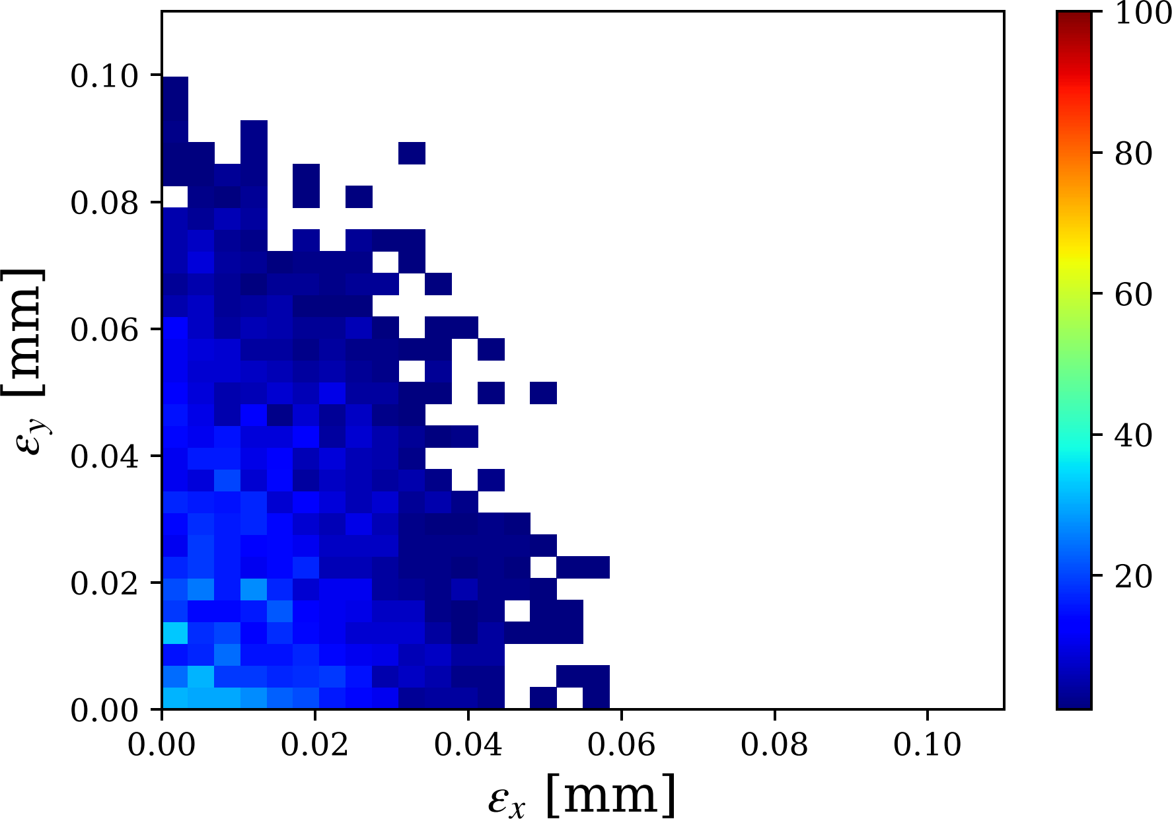
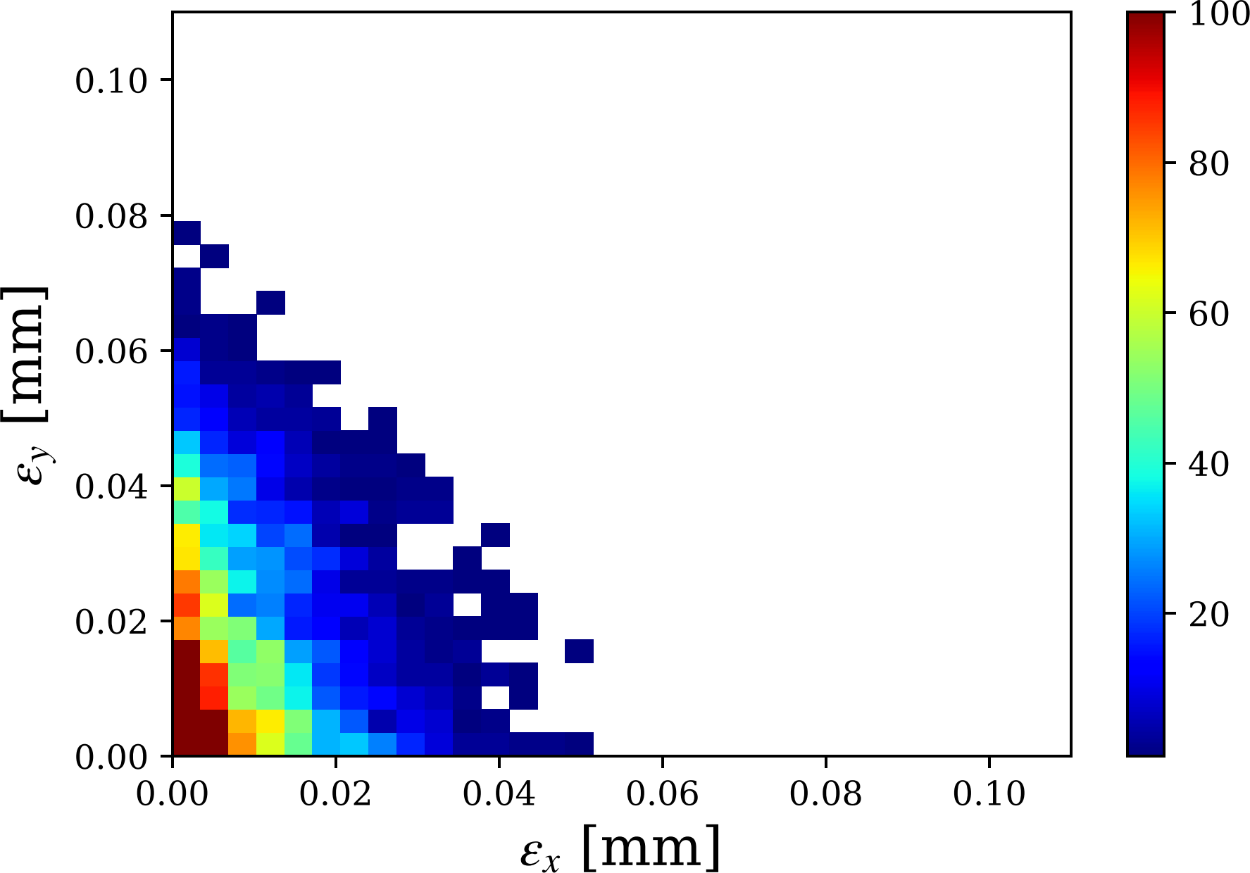
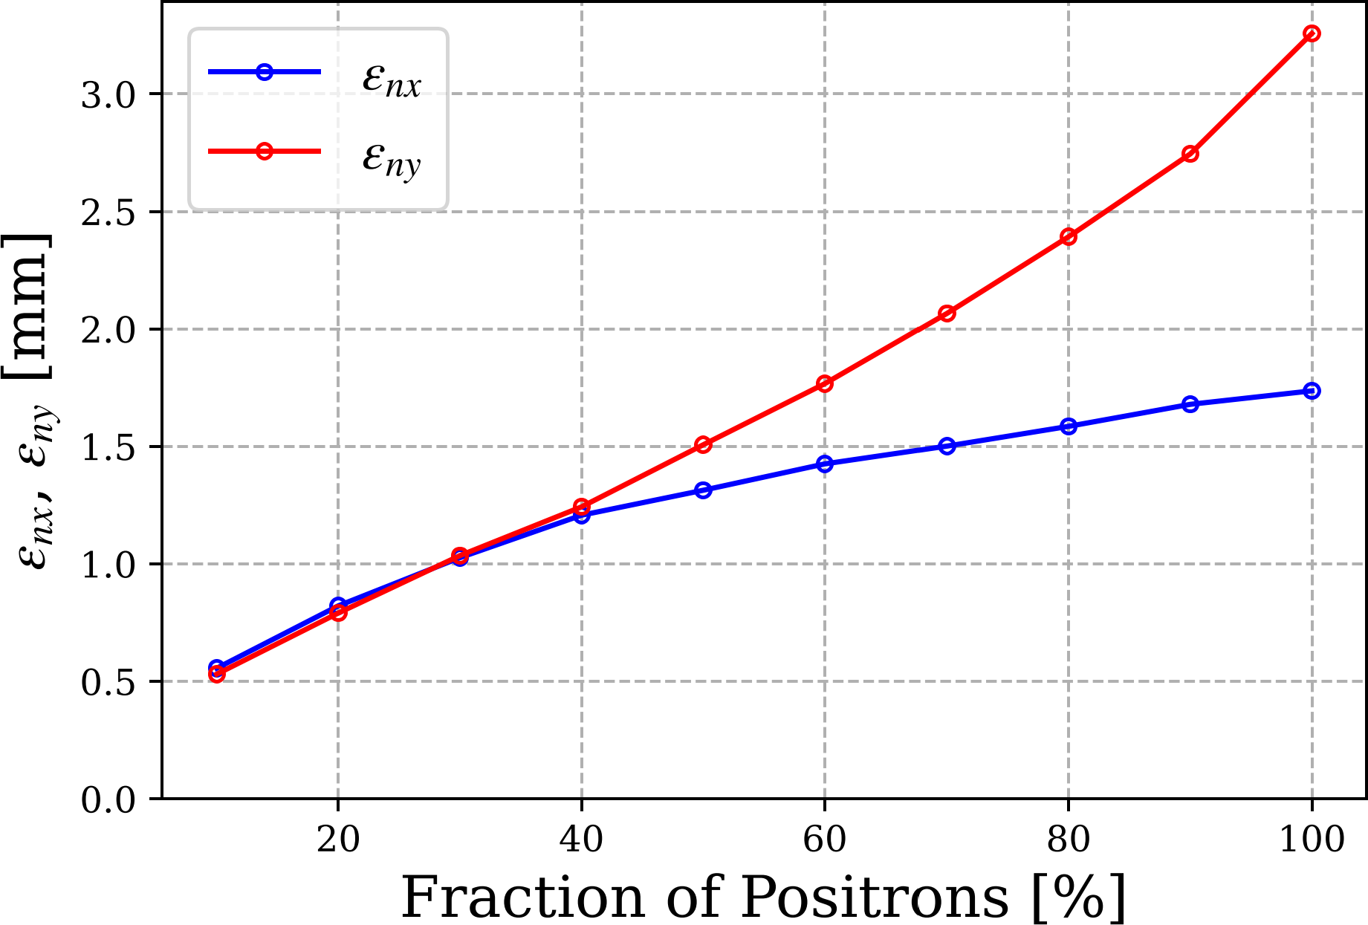
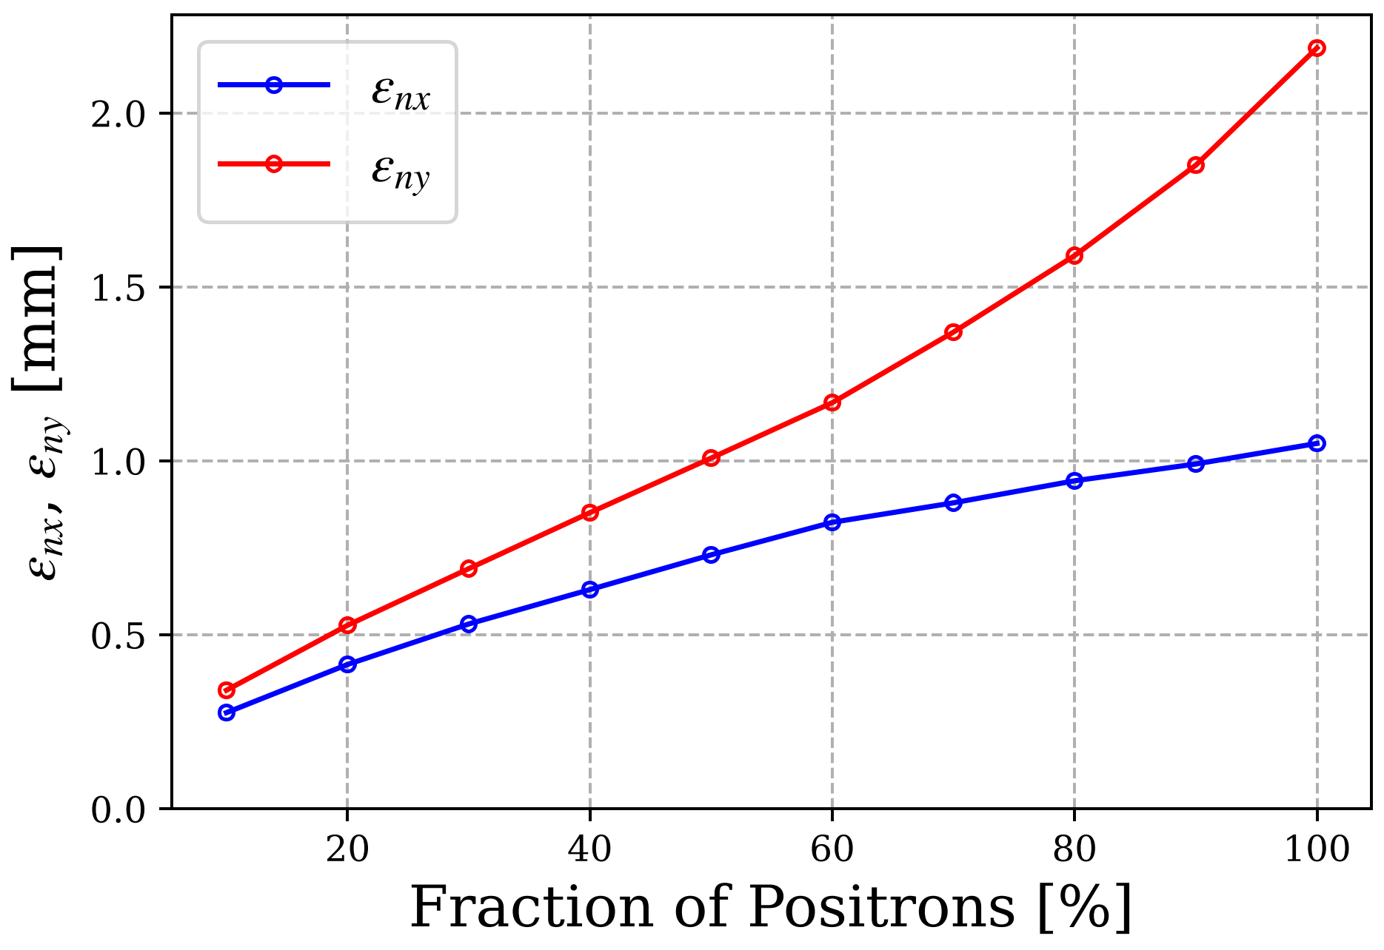
Emittance at End of e⁺ Beamline
High Polarization Mode
High Current Mode

Slide 19
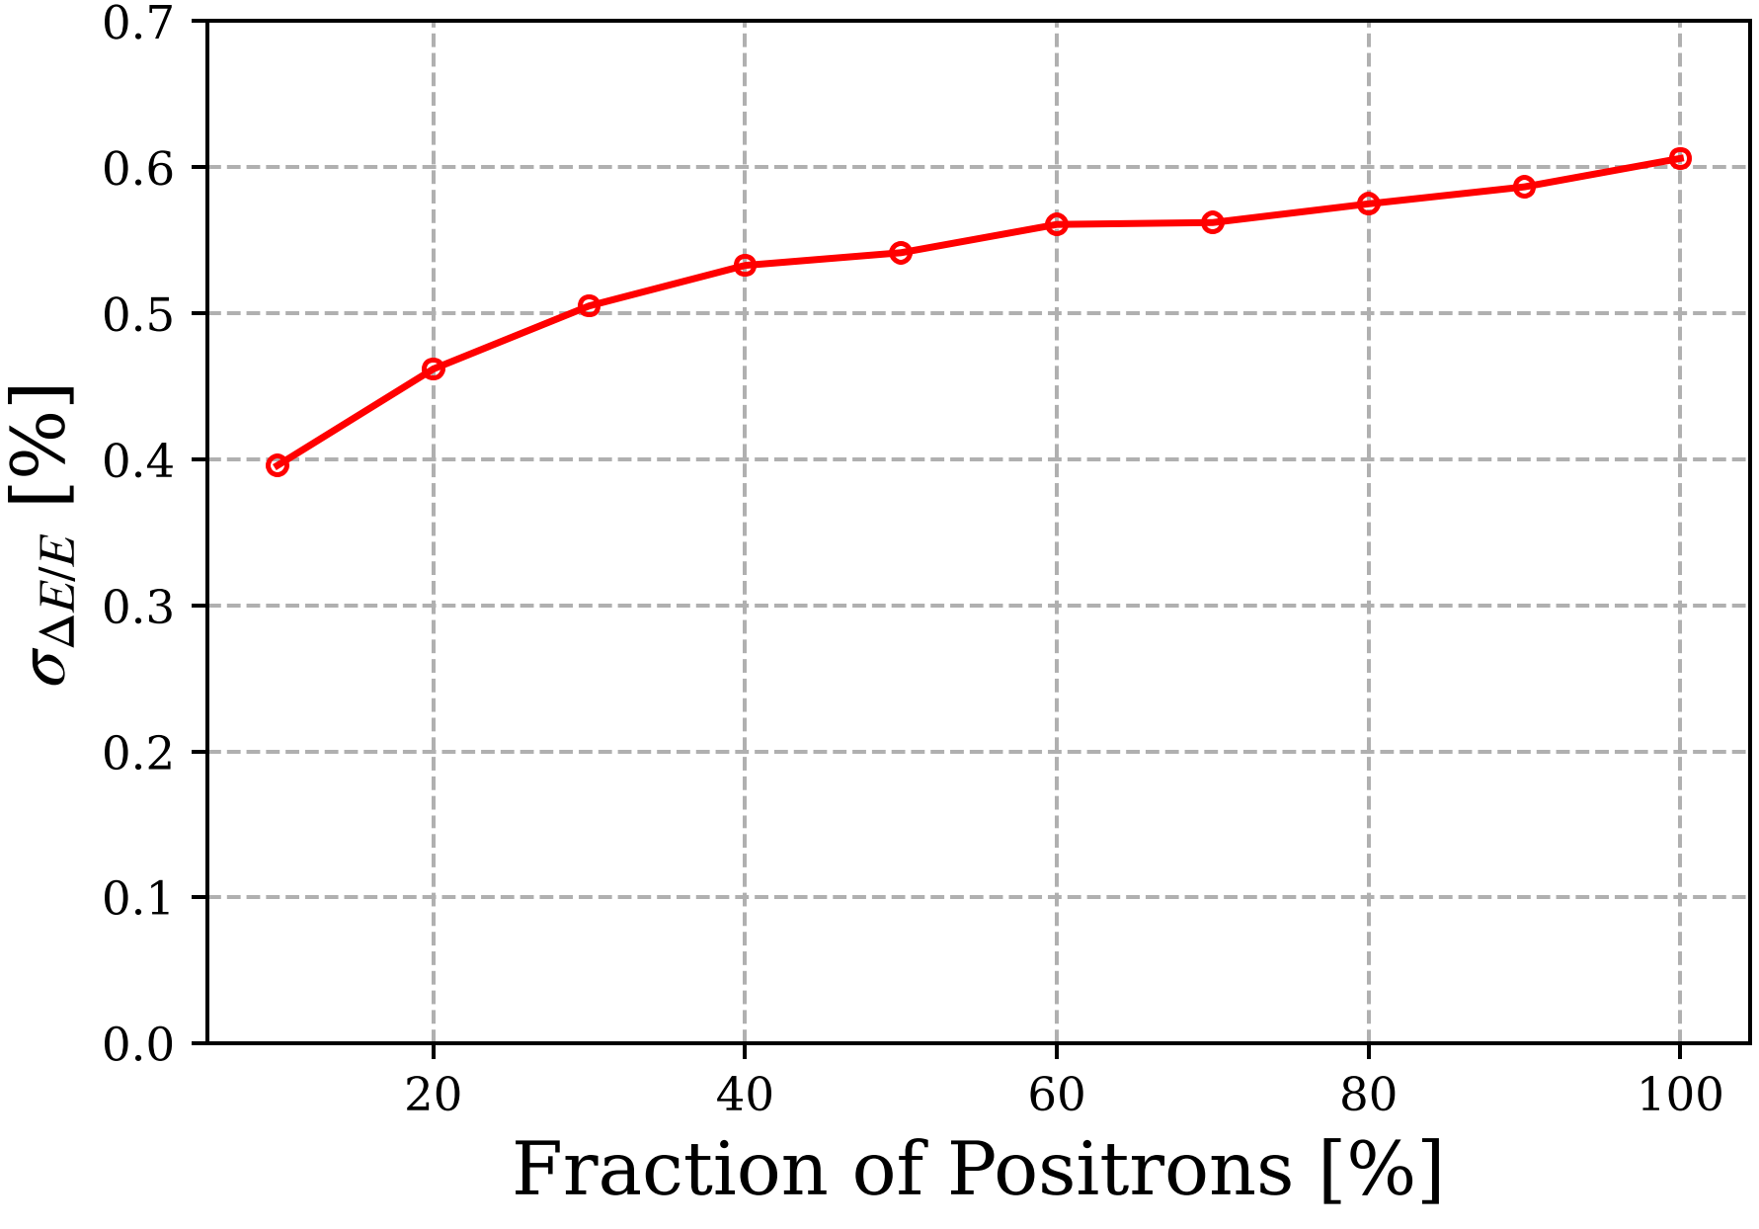
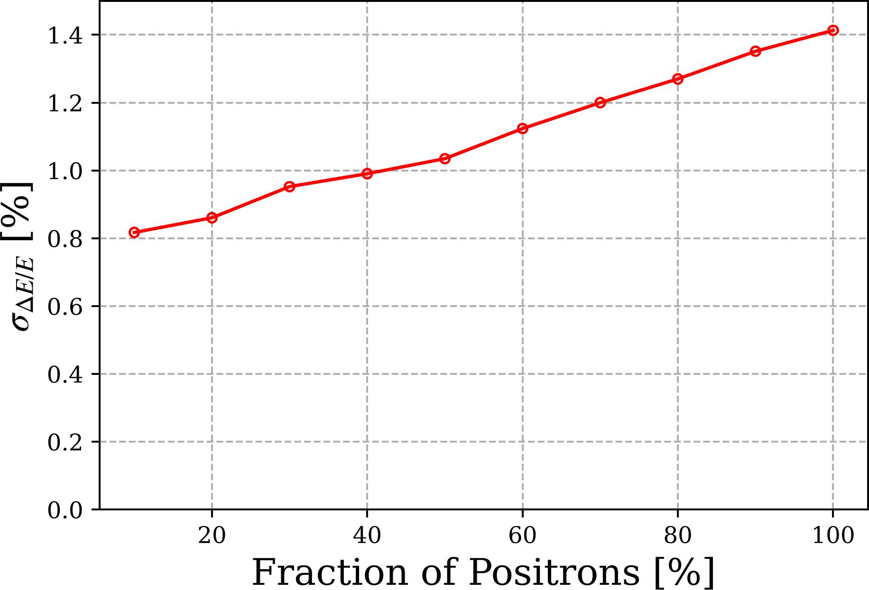
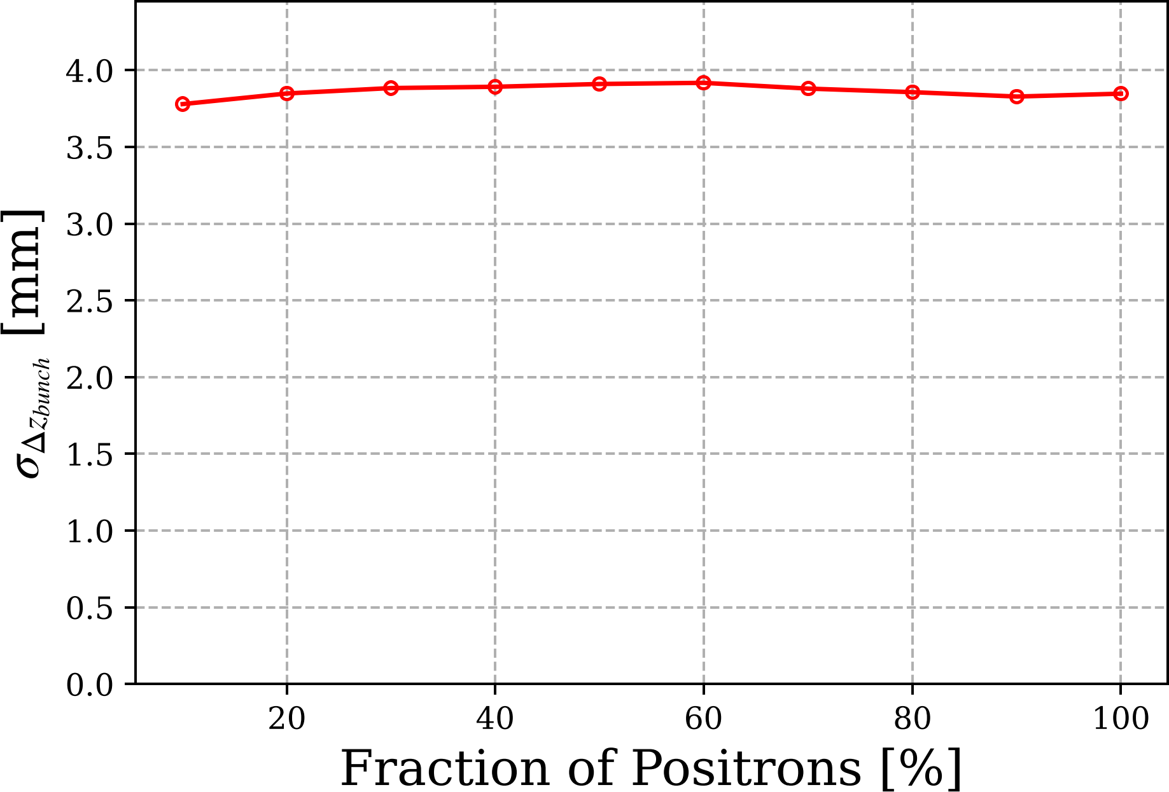
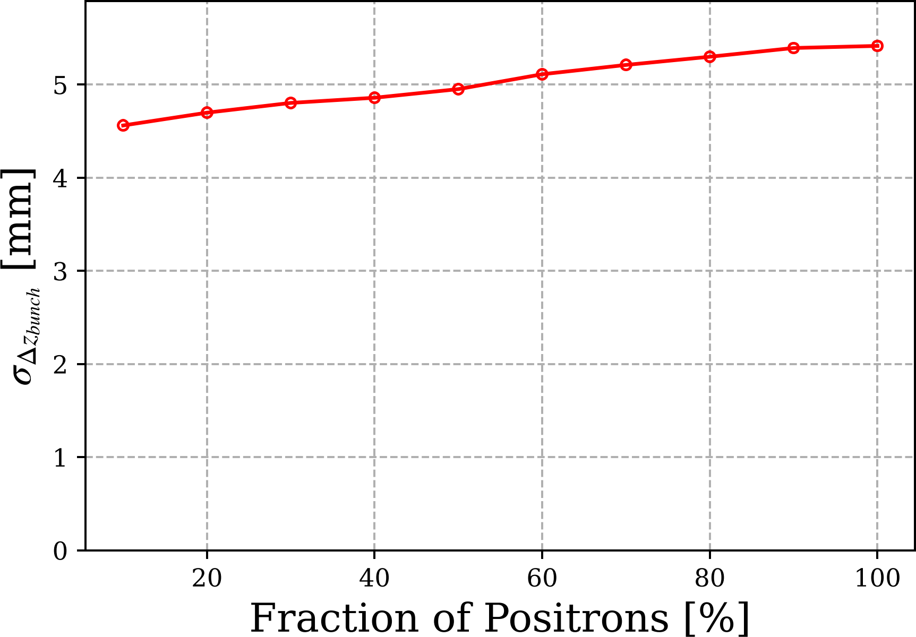
Would an Emittance Filter Help to Improve other Beam Parameters?
High Polarization Mode
High Current Mode
Polarization does not depend on emittance

Slide 20
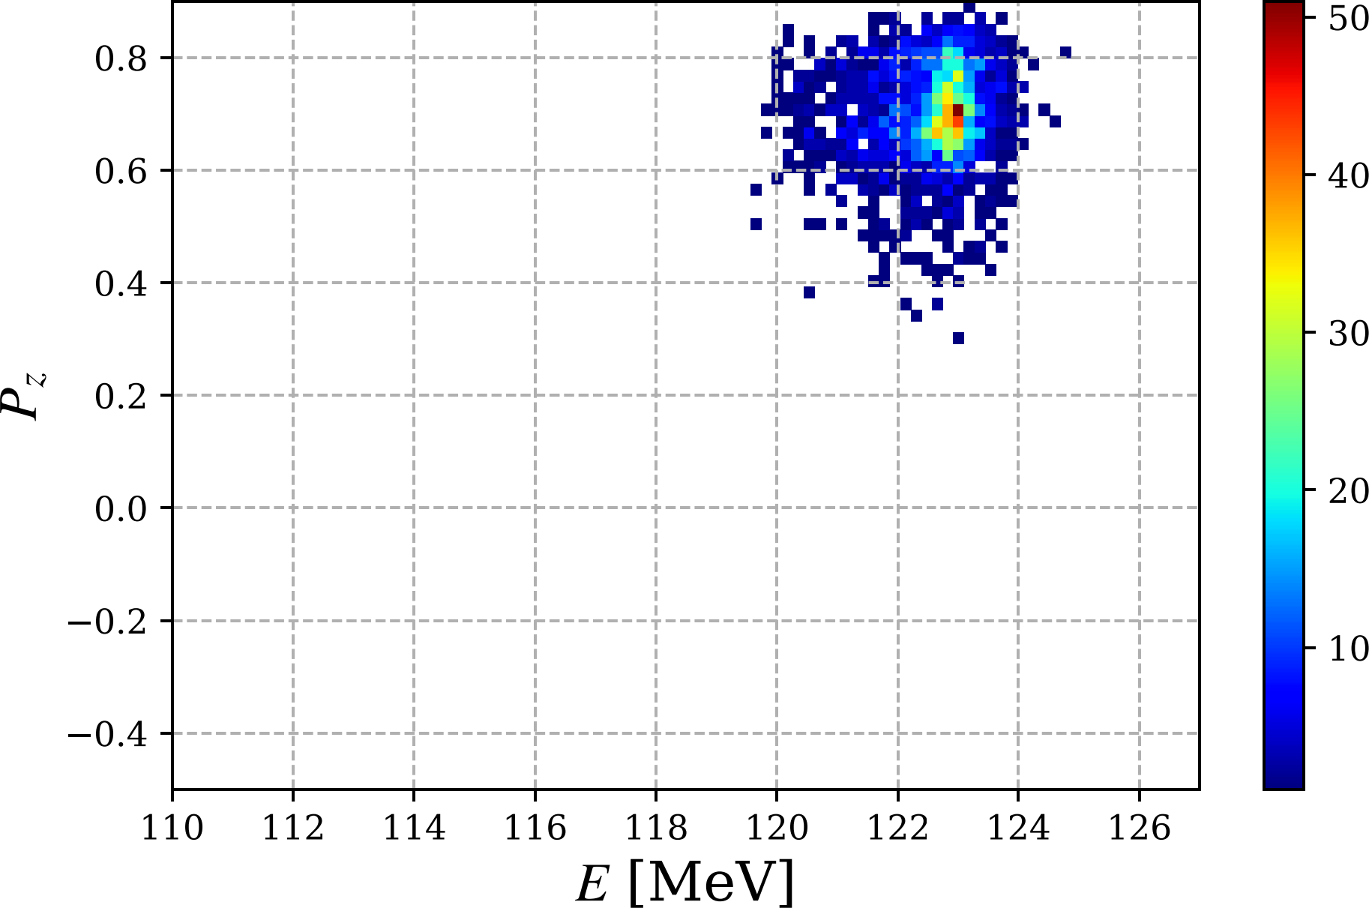
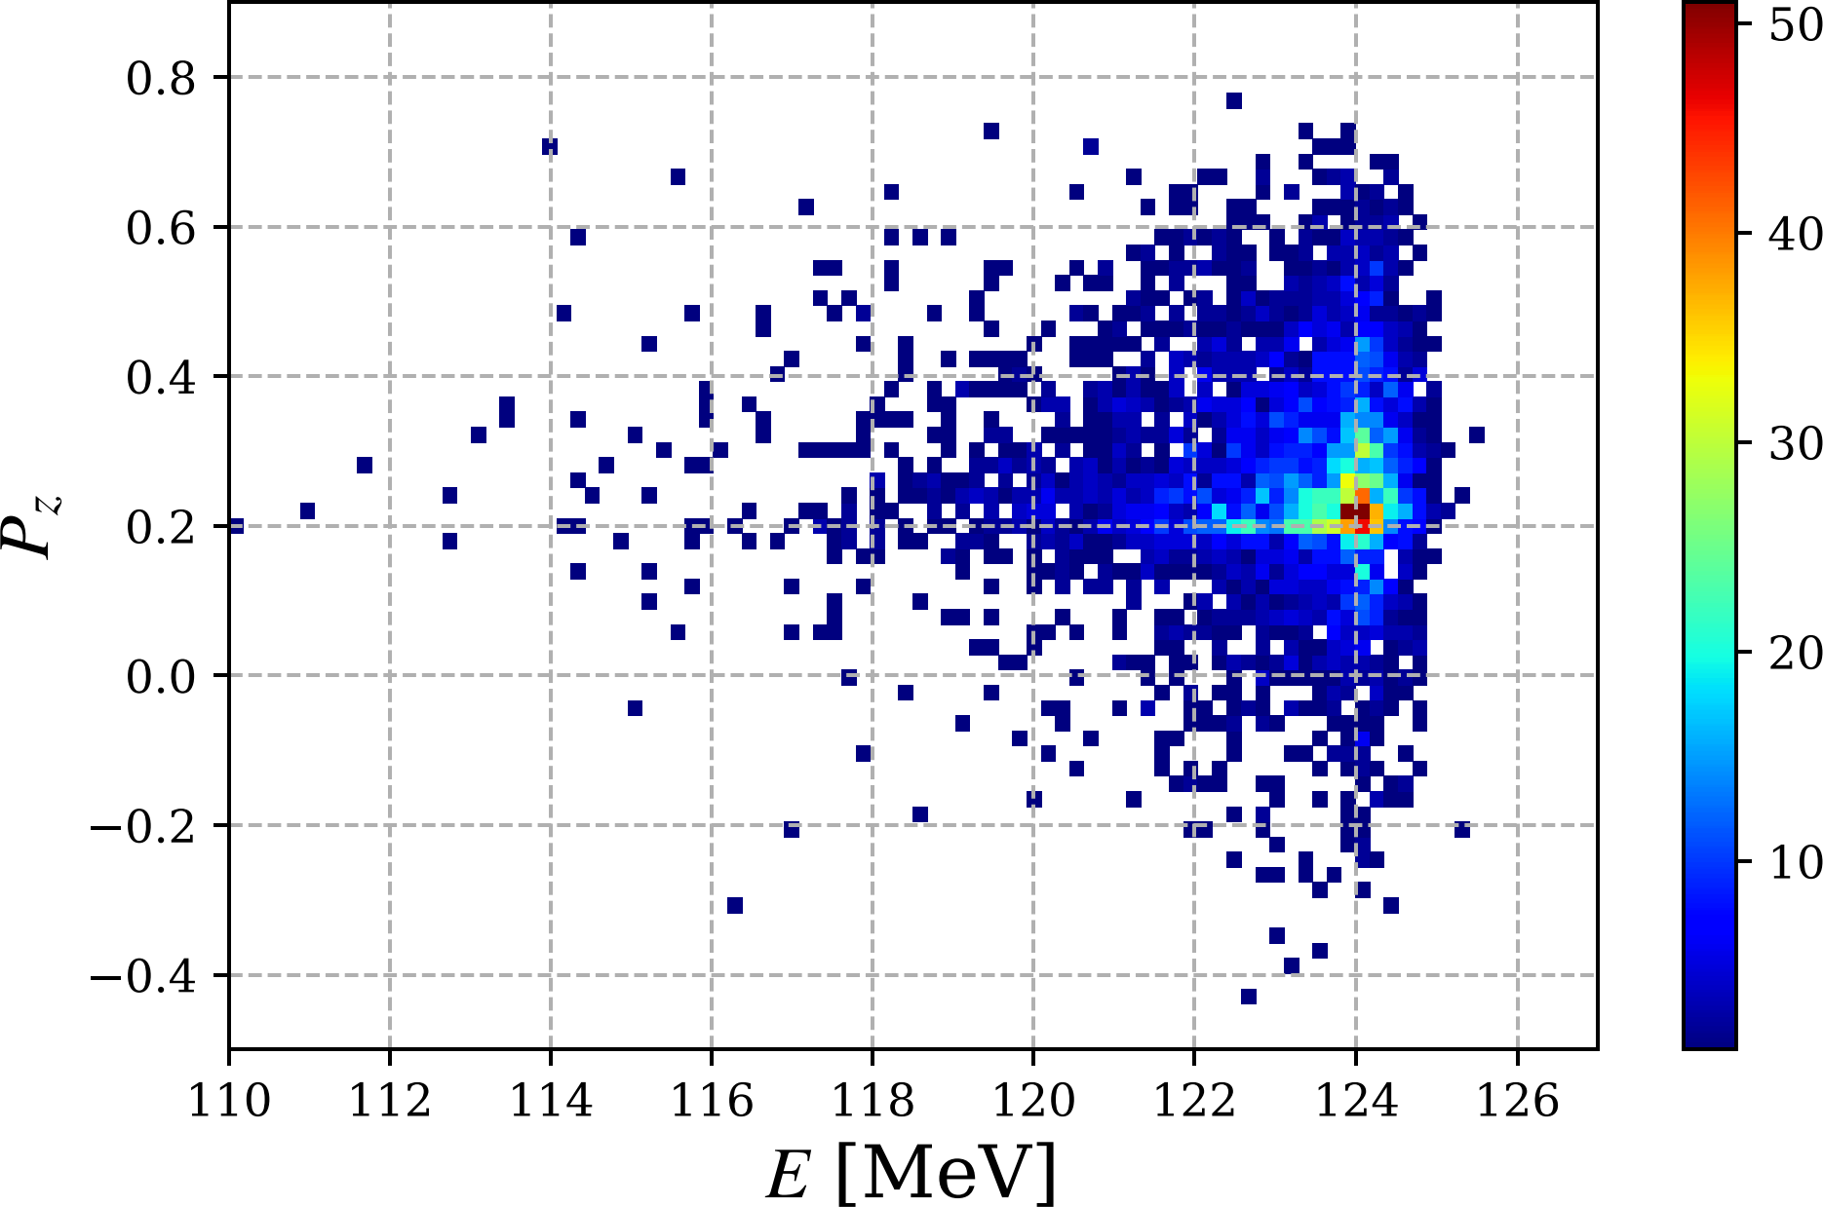
Polarization vs Energy at End of e⁺ Injector
Polarization of drive e‒ beam of 90%
High Polarization Mode
High Current Mode
$$\left\langle P_{z}\right\rangle =70.2 \%$$
$$σ_{P_{z}}=8.2 \%$$
$$\left\langle P_{z}\right\rangle =26.1 \%$$
$$σ_{P_{z}}=14.7 \%$$

Slide 21
Summary and Outlook
We are working on concept of e⁺ injector
Realistic field of capture solenoid has been used
Different capture solenoids (NC and SC) were considered
Start-to-end tracking was performed
Next steps
Continue optimization of e⁺ beamline
Design bunch compressor
Design emittance filter (beam cooling system)

Slide 22
Backup Slides

Slide 23
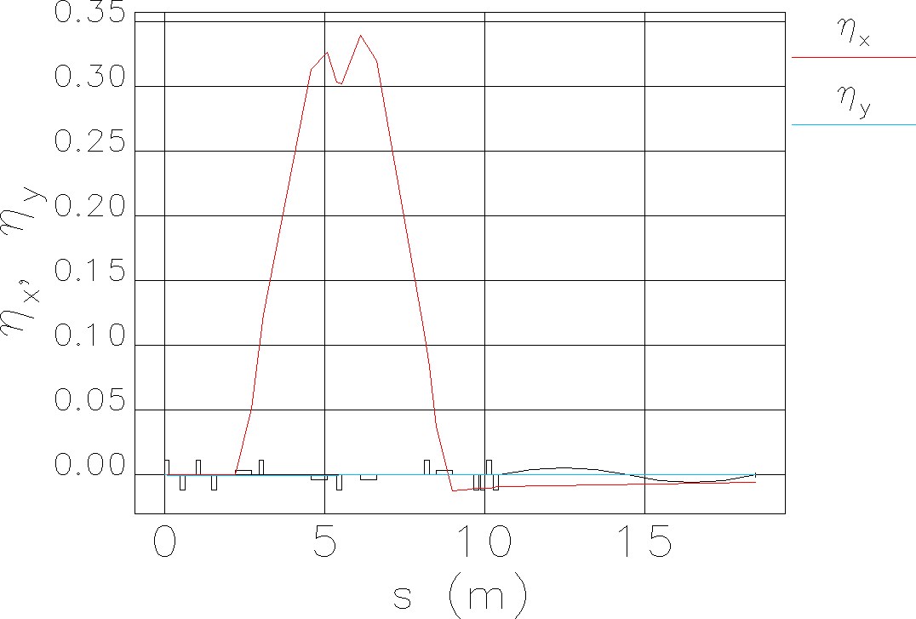
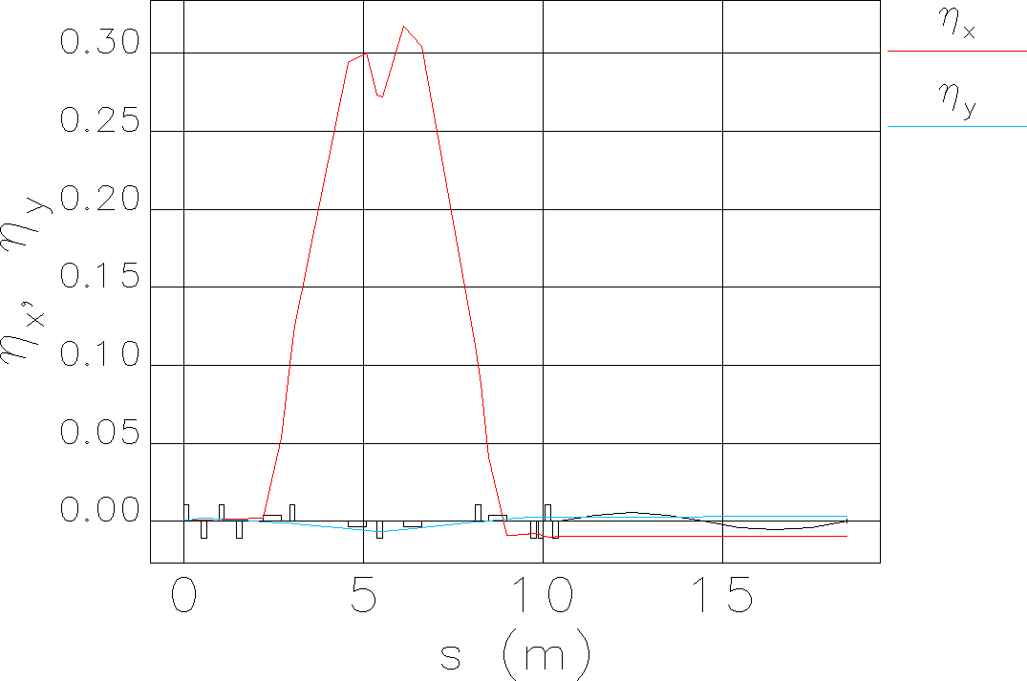
Dispersion along Beamline (NC Solenoid) and Kept Low at End
High Polarization Mode
High Current Mode
Dipole:
$$x=D\frac{Δp}{p_{0}}$$

Slide 24
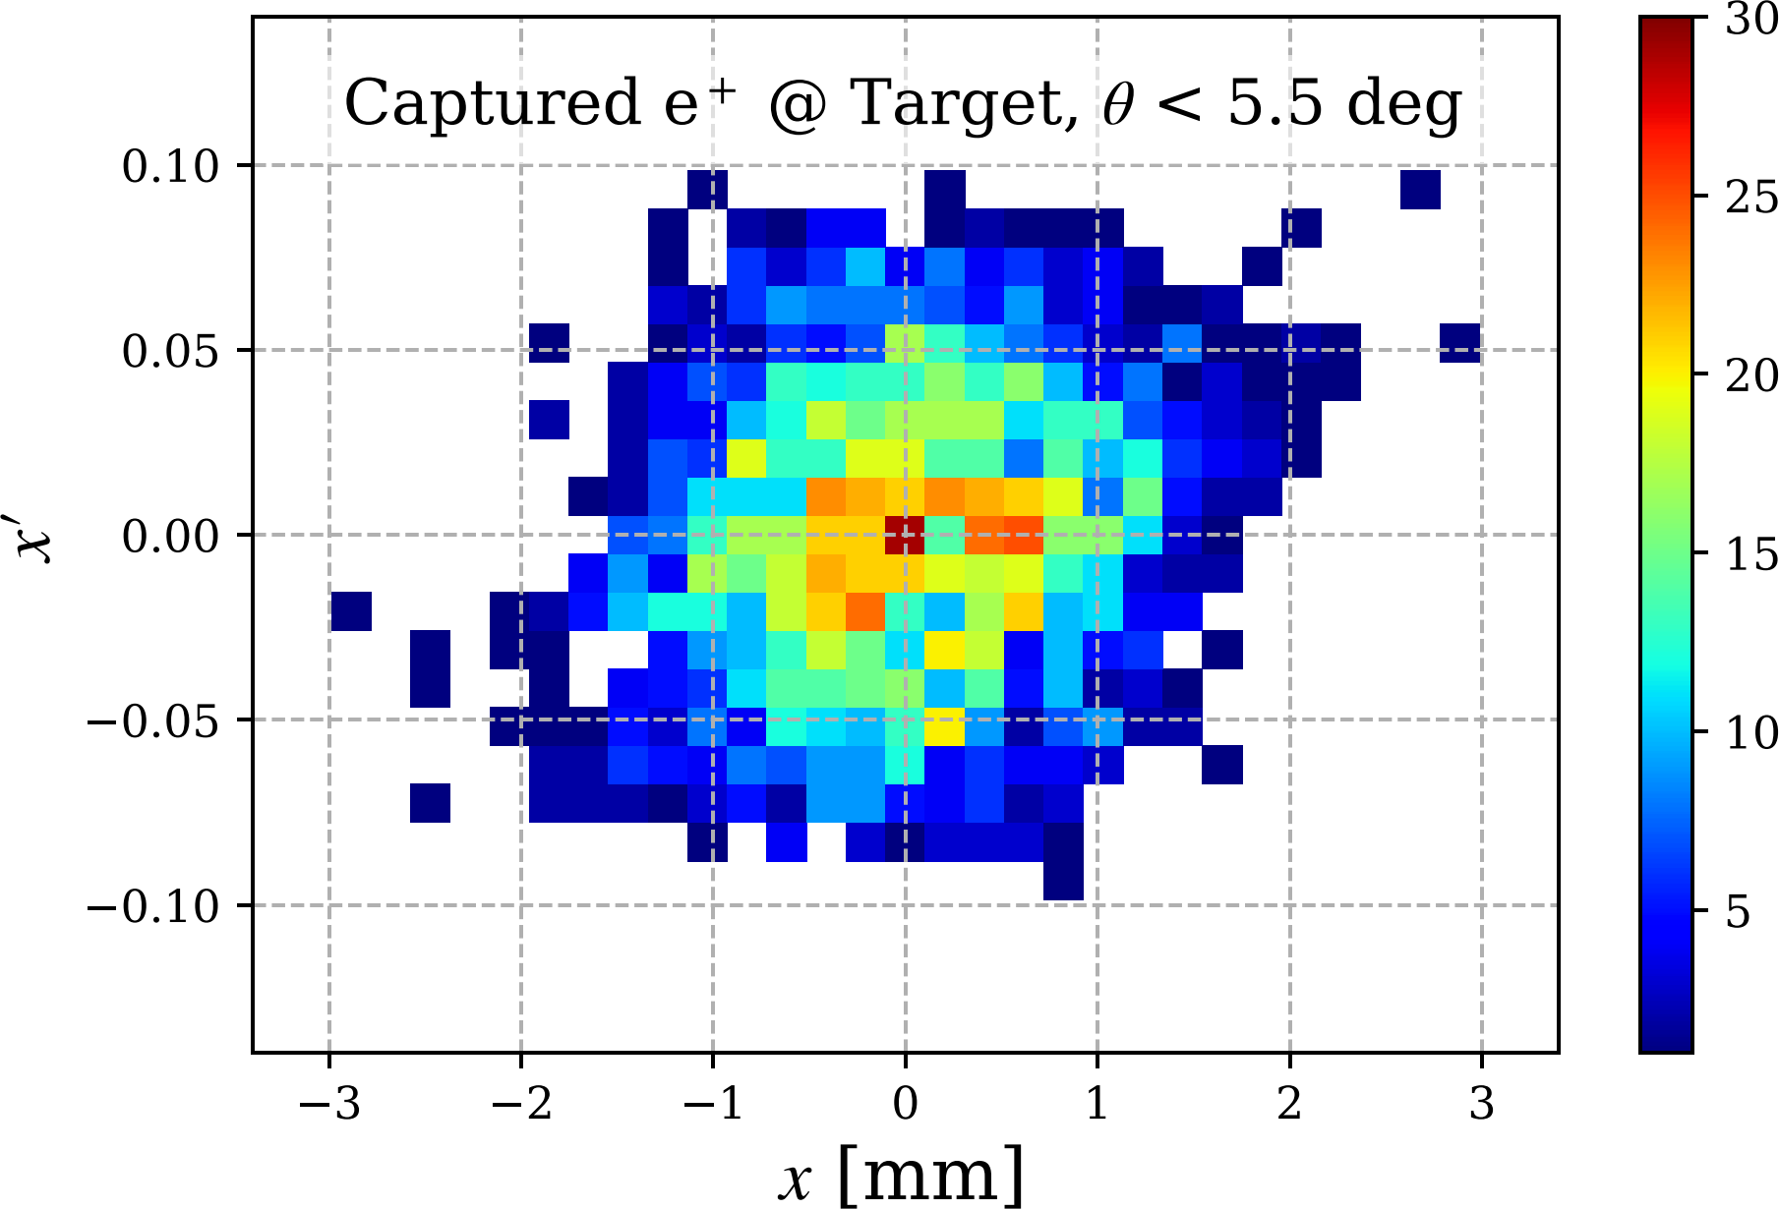
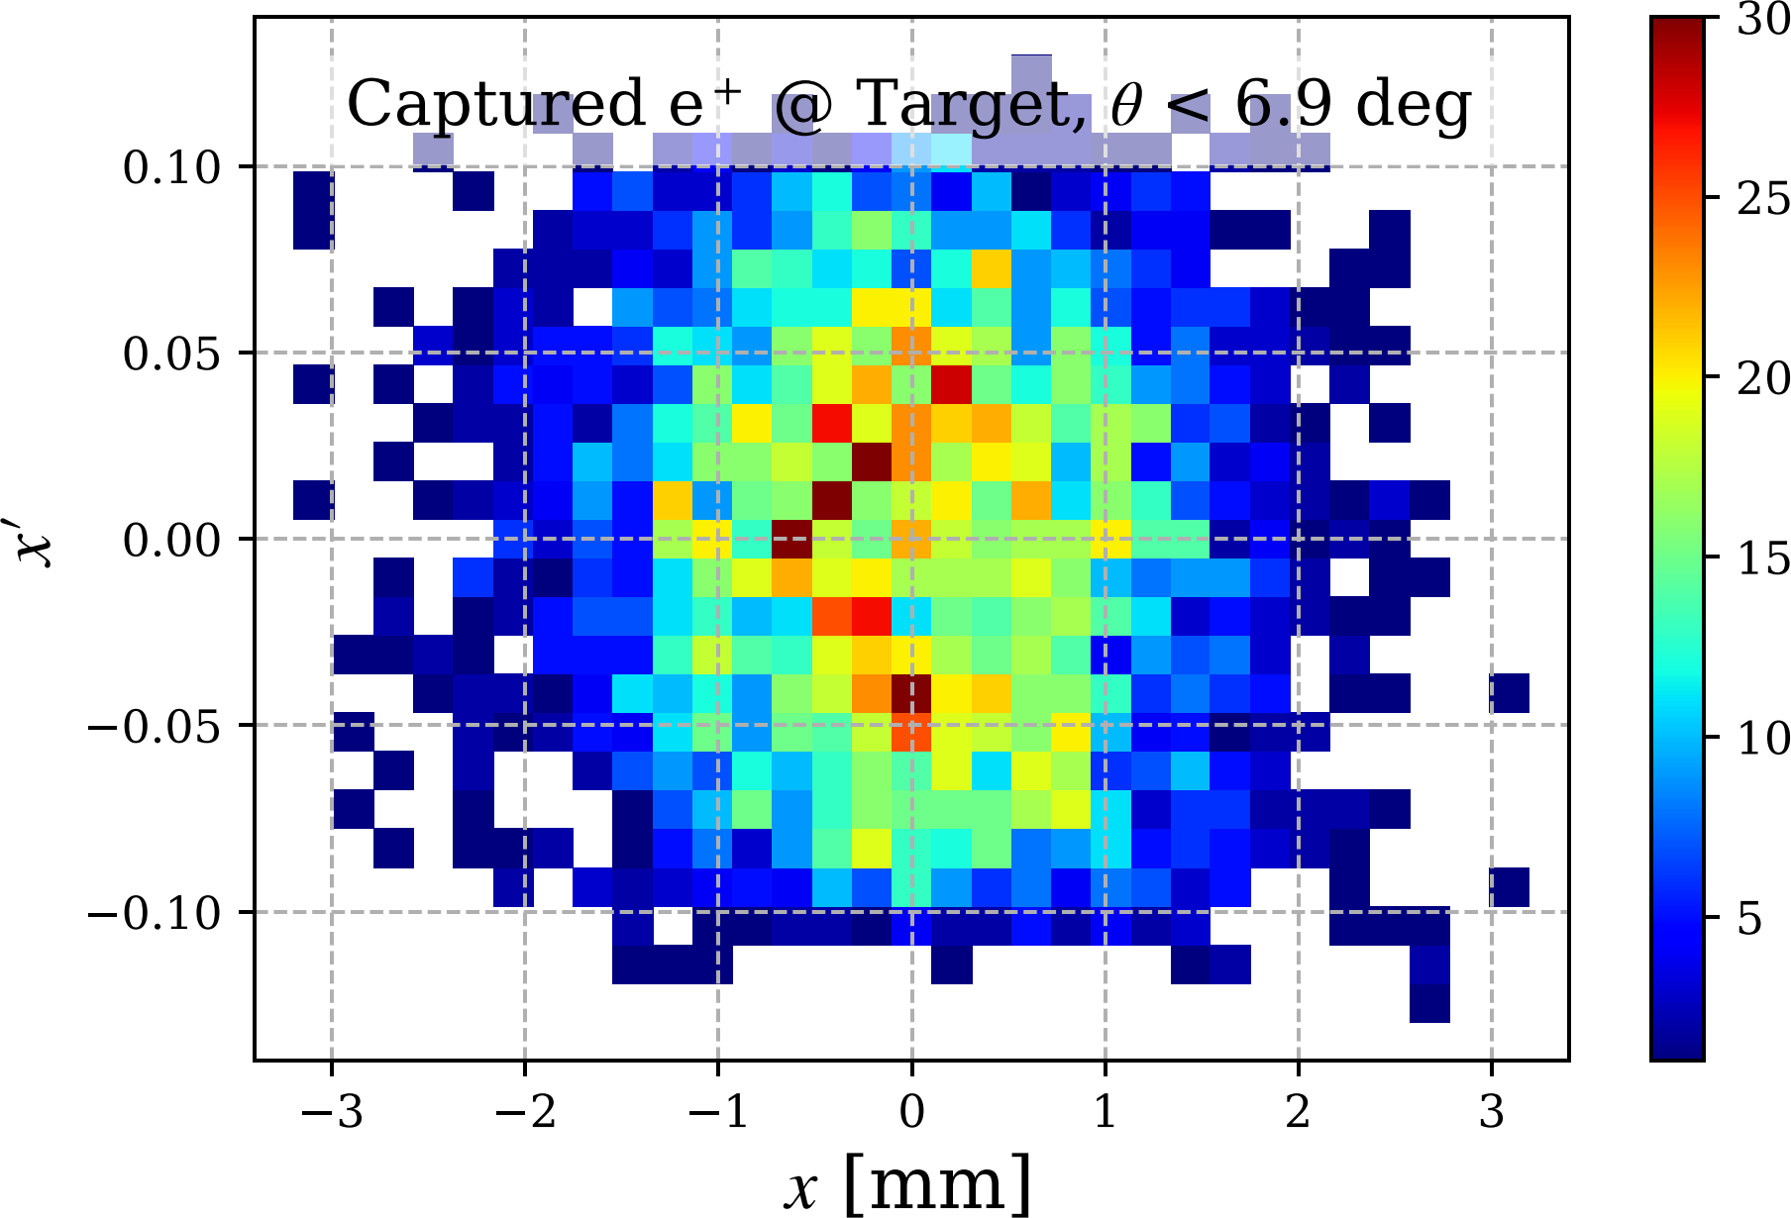
e⁺ Exiting Target Captured and Transported up to the End of C100
High Polarization Mode
High Current Mode

Slide 25
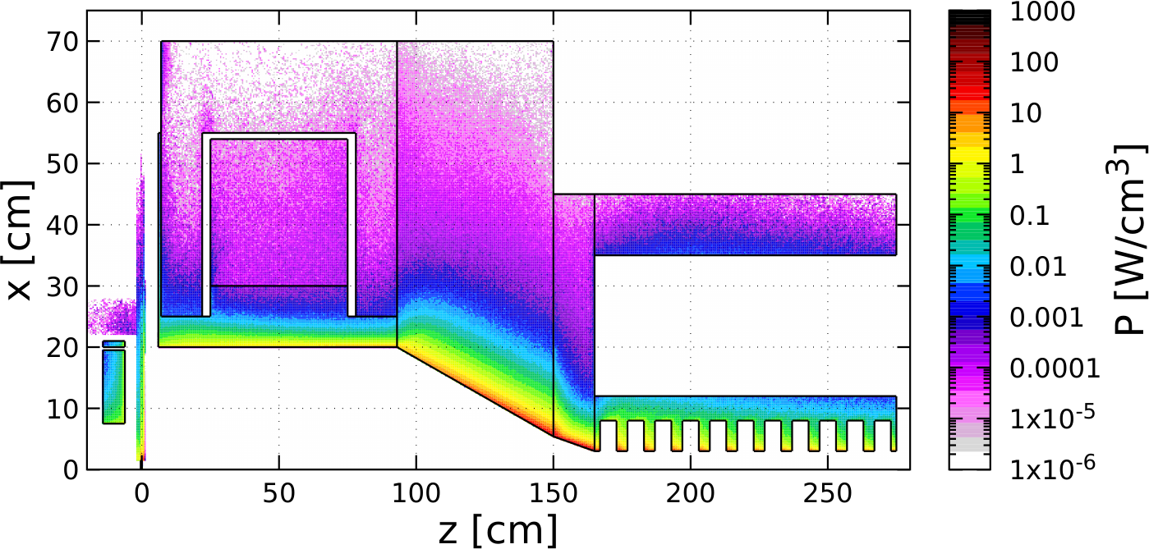
Distribution of Power Deposed by 1 mA @ 120 MeV e‒ Beam (FLUKA)
 | Power [kW]
Target | 18.11
Compensation Solenoid | 0.74
Coil of Main Solenoid | 0.02
Iron of Main Solenoid | 0.06
W10Cu Absorber inside Main Solenoid | 18.88
TZM Absorber (99.4% Mo, 0.5% Ti, 0.1% Zr) | 58.66
W10Cu Absorber upstream Cavities | 12.50
Solenoid around Cavity | 0.12
Cu Cavities | 6.50
Total Absorbed Power | 115.56 (96.3%)
Beam Power at z = 275 cm, r < 3cm | 3.20
Steel
TZM
Cu Coil
Cu Coil
W10Cu
W10Cu
Cu Cavity*
Compensation
Solenoid
Target
 | Photons | Electrons | Positrons
Yield per primary e⁻ | 0.123 | 0.029 | 0.005
Mean Energy [MeV] | 12.7 | 49.6 | 35.7
Power [kW] | 1.57 | 1.44 | 0.19
Fraction in Total Beam Power | 49.1 | 44.9 | 6.0

