Slide 1

The Capturing Scheme for CW Ce+BAF Positron Source
CW Ce+BAF positron source
QWT section
Capturing with NRF cavities
Capturing with SRF cavities
Conclusion & Outlook
Shaoheng Wang (Jefferson Lab)
on behalf of the Ce+BAF Working Group

Slide 2
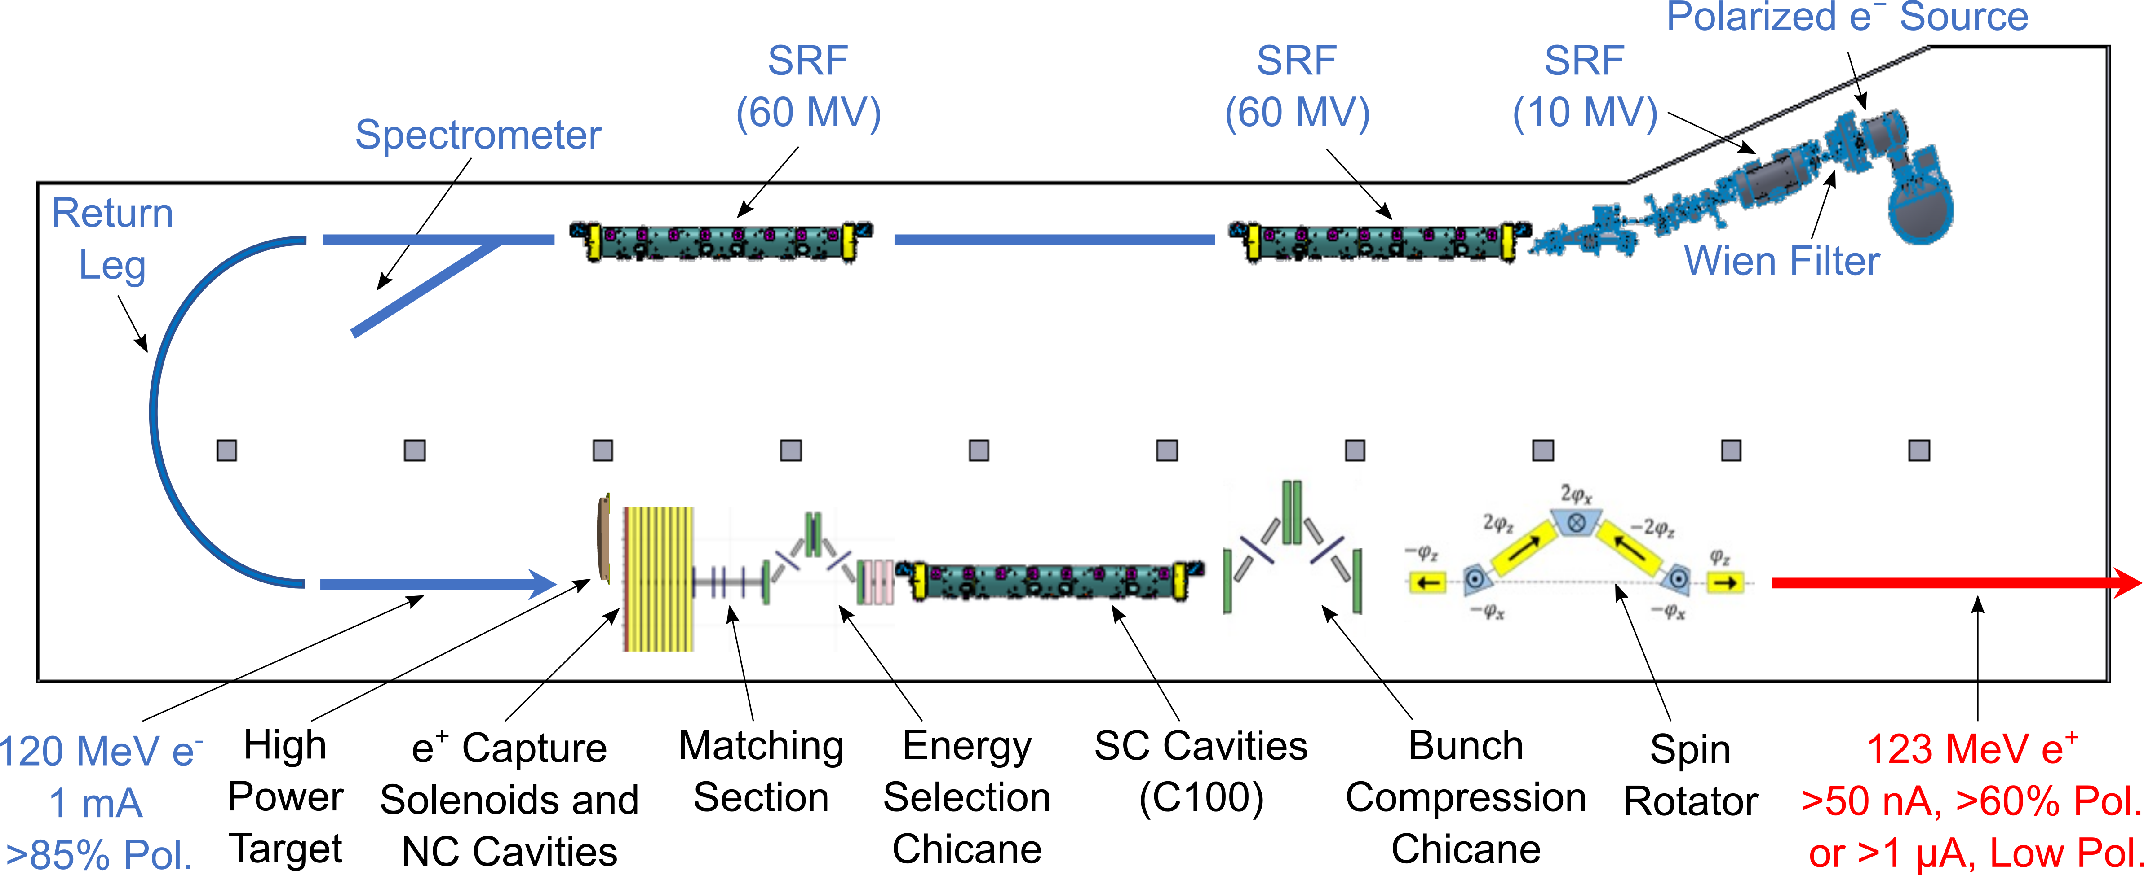
Ce+baf and Work Scope of This Study
Target Test Area
123 MeV e+
RF Cavities

Slide 3
Beginning At the Exit Plane of the Target
120 ps
The e+ distribution produced with Geant4 with 123 MeV e beam bombard on the target.
X (mm)
σ_{x} = 1.2 mm
head
tail
θ_{x} (deg)
θ_{x} (deg)
σ_{θx} = 28 deg
σ_{t} = 2 ps
time (ps)

Slide 4
When all e+ exit the target
No solenoid field is applied
The transverse size already expands 10 times just finishing the emitting process
And, with Large Energy Spread
σ_{x} = 12.9 mm
σ_{E} = 15.4 MeV
σ_{z} = 7.5 mm
tail
head

Slide 5
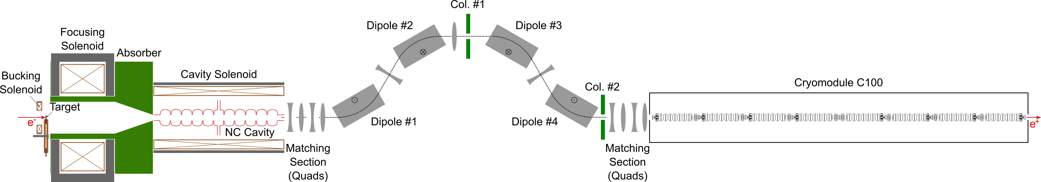
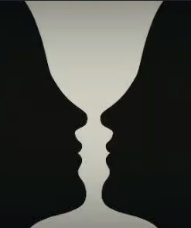
Work Scope, Continued
QWT
Section
Capture Section
CEBAF
Acceptance
The purpose is to
Capture as many as possible e+ with CEBAF acceptance.
Or, we can say, to
Minimize and appropriately distribute unacceptable e+.

Slide 6
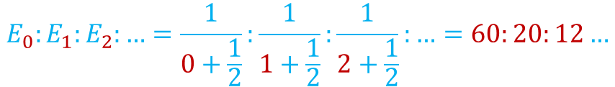


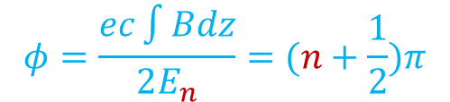

Matching Solenoid
The large angle spread e+ beam is confined by a short intensity magnetic field roduced by a solenoid.
e+ rotate in their helicoidal motion in solenoid field, e+ which have an energy such that they complete one half cycle of helix, come out of this solenoid in a direction parallel to the axis of the accelerator.
The solenoid reduces the large angular divergence of positrons by increasing the beam radius. In this way, the positron beam occupies all the geometrical acceptance at the entrance of the accelerating structures.
$$φ=\frac{ec\int{Bdz}}{2E_{n}}=(n+\frac{1}{2})π$$
Bz
π/2-phase energies:
$$E_{0}:E_{1}:E_{2}:…=\frac{1}{0+\frac{1}{2}}:\frac{1}{1+\frac{1}{2}}:\frac{1}{2+\frac{1}{2}}:…=60:20:12…$$
$$θ=2φ$$
$$θ$$
$$φ$$
Axis of
solenoid

Slide 7
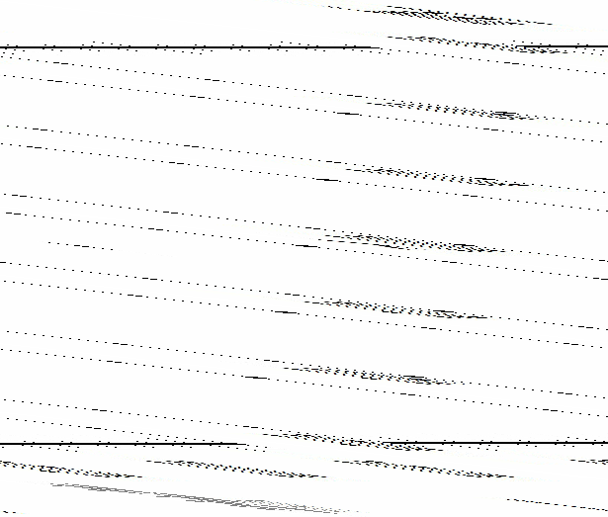
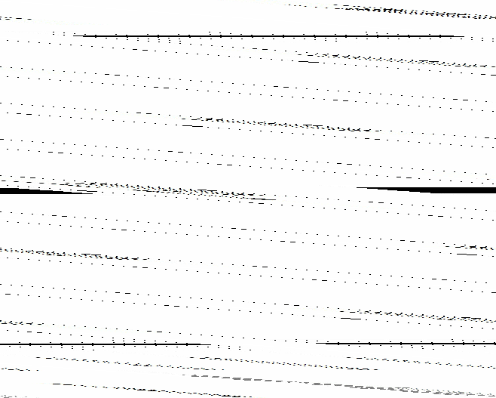
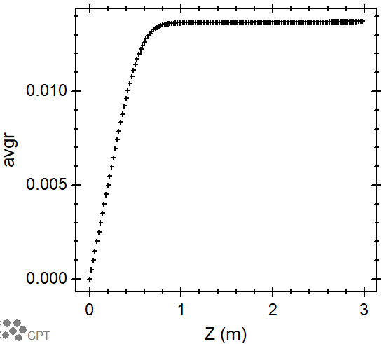
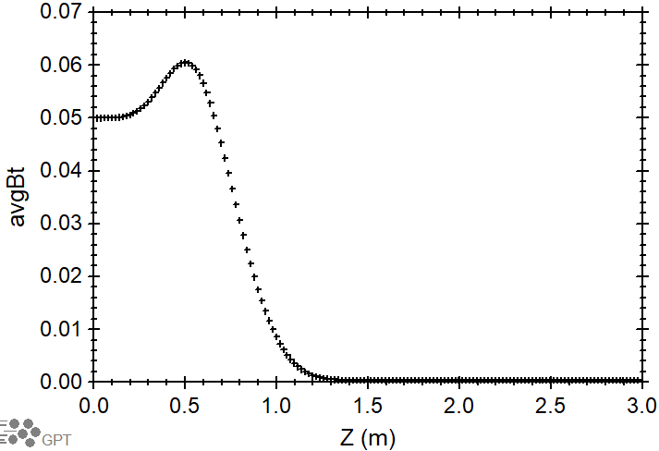
Matched Single Particle Case, Movie in (x, y) and (β_{x}, β_{y}) Spaces
Rasius (m)
β_{transverse}

Slide 8
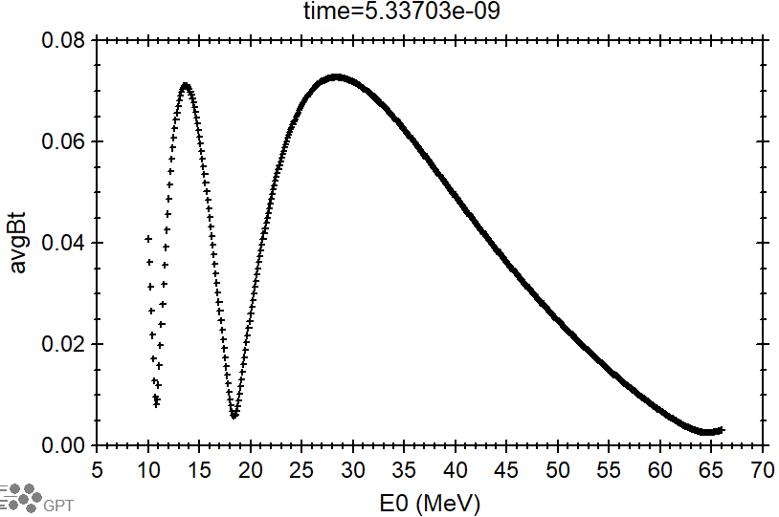
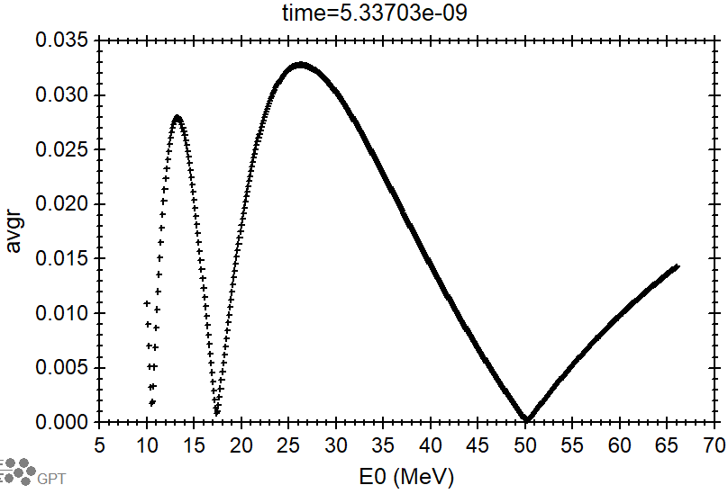
Matched Single Particle Case, Energy Scan
Beta_transverse
r

Slide 9
Harmonics Islands with Matching Solenoid Only, no Absorber
Just out of target
Time = 0.15 ns
Time = 5.5 ns
Bz
More about tail to be described later
Islands in the head

Slide 10
Harmonics Islands, continued
Time = 5.5 ns

Slide 11
Another Reason We Care Only the Head of the Bunch

Slide 12
With Absrober
The absorber is located near the exit of solenoid, e+ of energy far from E_{n} has larger radius and are removed by absorber, and the harmonic islands are carved out.
No absorber
With absorber
Time = 5.5 ns
Time = 5.5 ns
Bz
To be selected for capturing

Slide 13
Energy Selection After QWT Matching
Use
Or Or
See Andriy’s talk
solenoid
solenoid
Achromatic
Dogleg
Achromatic
Dogleg
positrons
Dipole
Dipole
19 MeV e⁺
target
target
60 MeV e⁺
Quadrupole
photons
Quadrupole
Dipole
Dipole
photons
electrons
electrons
solenoid
solenoid

Slide 14
Single Bunch Distribution When the Head Exits the QWT Region
Single e+ bunch at 5.5 ns
Physical boundary of absorber
β_{z}

Slide 15
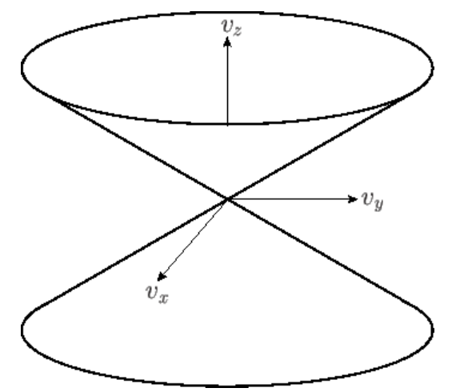
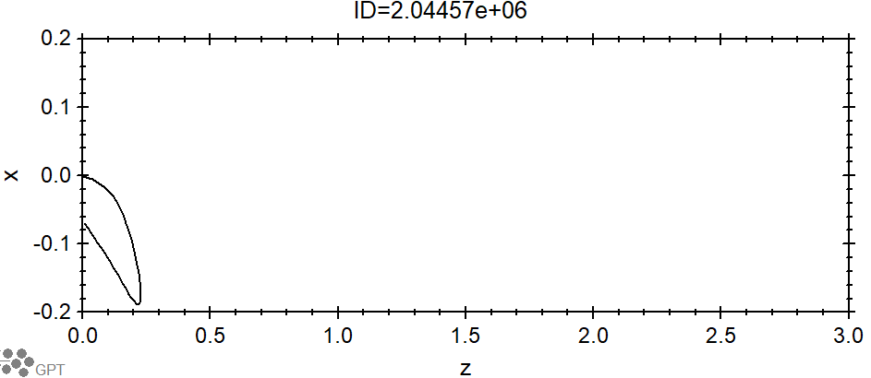
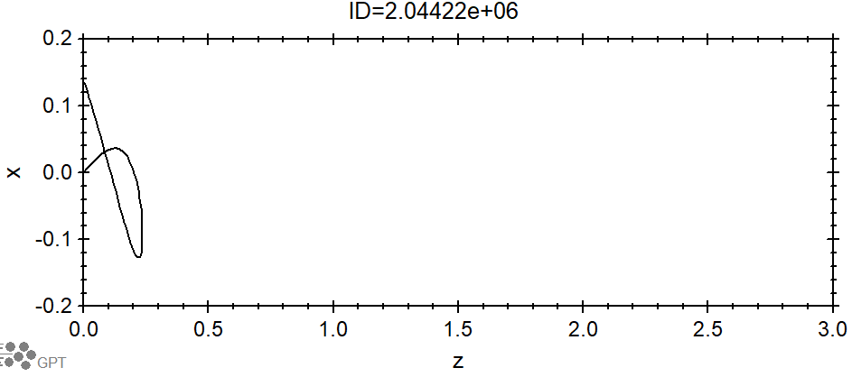
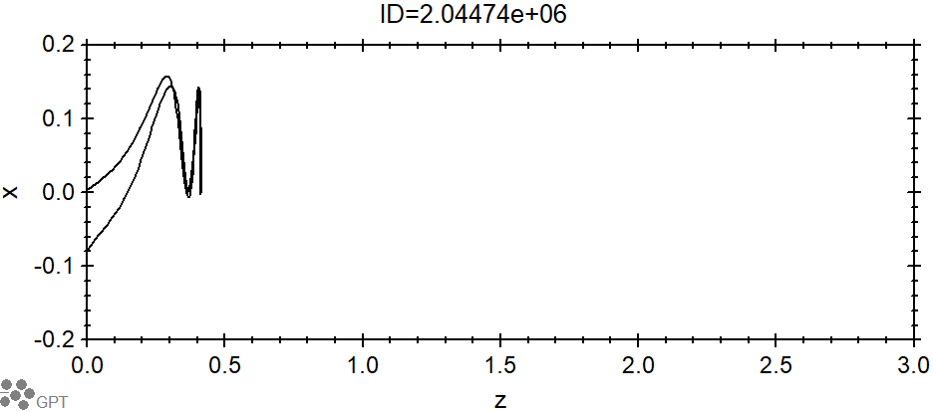
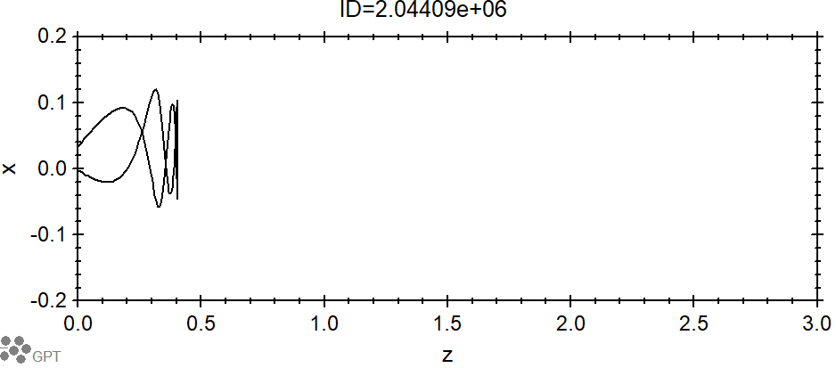
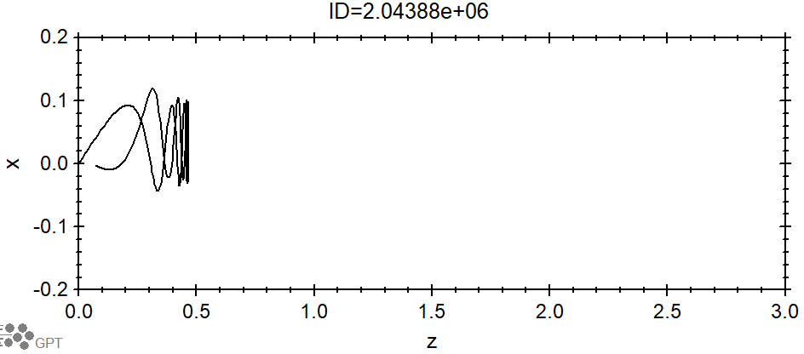
the Negative Beta Z
Magnetic mirror effect
Particles whose velocity vectors lie outside the cone are reflected by the magnetic field
Some travel a while and return to the target

Slide 16
Distribution for the CW Bunch Chrain @ 1.5 GHz in QWT Region
Physical boundary of absorber
1.5 GHz rep-rate e+ bunch chain

Slide 17
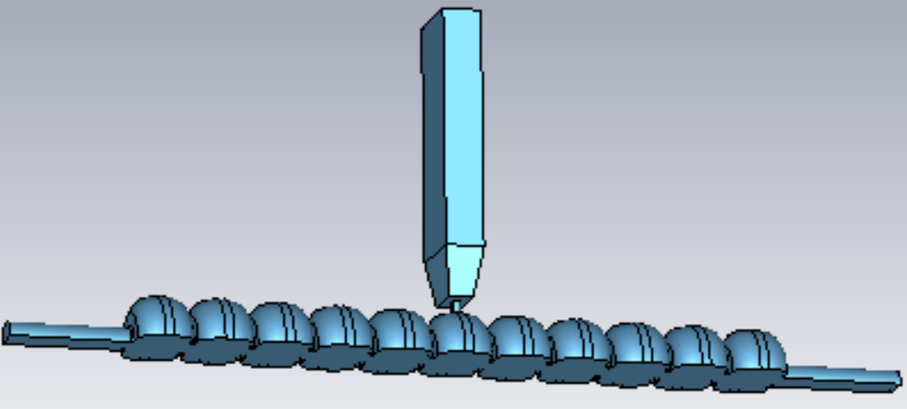
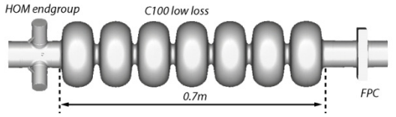
Normal Conducting and Super Conducting RF Cavities
In order to capture as much as possible e+, RF cavity and solenoid chains are used to
  Transversely decrease the e+ bunch’s emittance with adiabatic damping
  Longitudinally to manipulate the e+ phase space distribution to capture more e+
S. Wang, LCWS 24
CEBAF C100

Slide 18
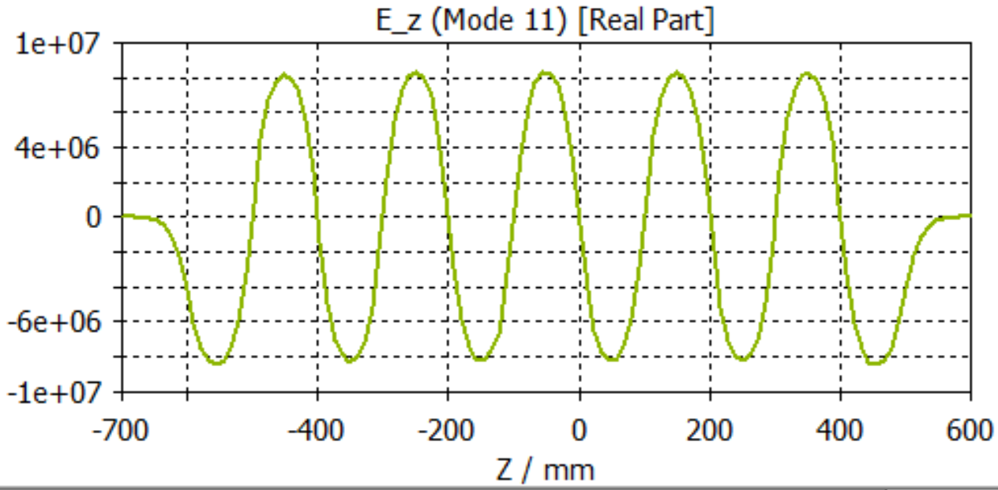
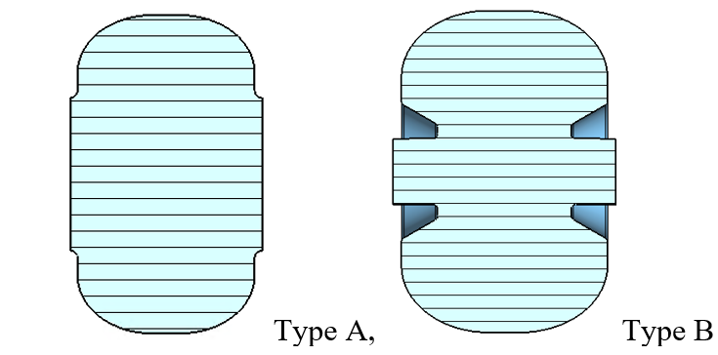
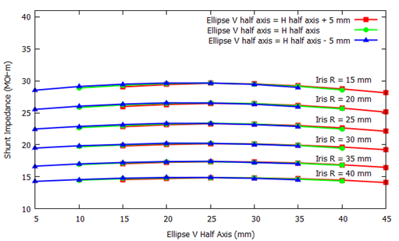
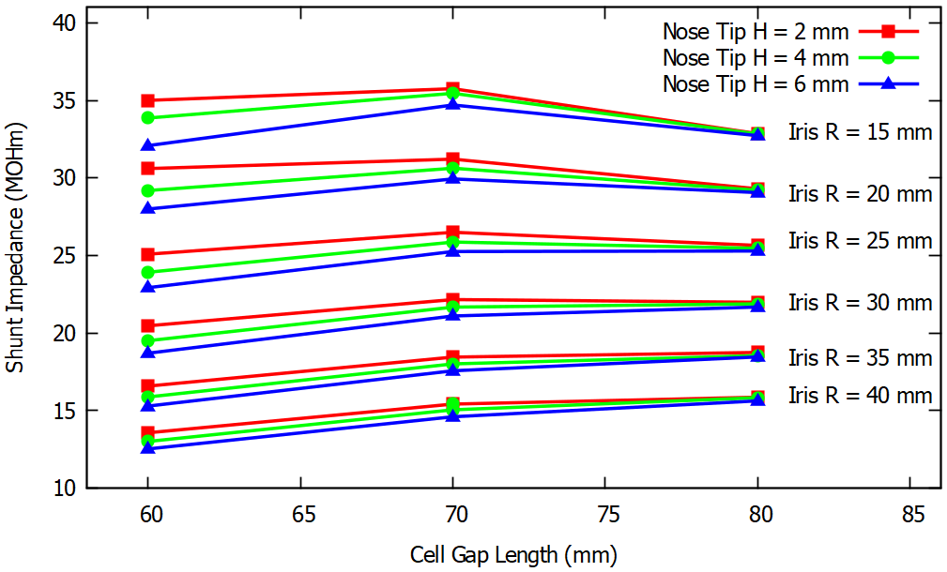
Normal Conducting RF Cavity Study
Shunt Impedance for Type A Cell
Shunt Impedance for Type B Cell

Slide 19
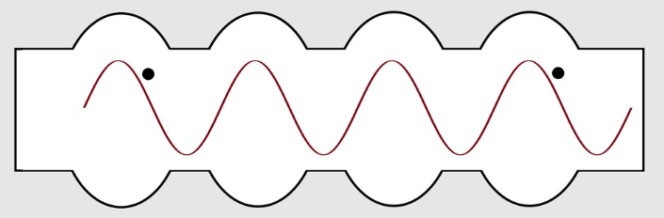









Emittance Adiabatic Damping and Acceleration
$$x^{′}=\frac{v_{x}}{v_{z}}≈\frac{v_{x}}{c}=\frac{P_{x}}{m_{0}cβγ}$$
Trace space: (x,x’,y,y’)
$${x′}_{0}$$
$$P_{x}$$
$${x′}_{1}$$
$$P_{x}$$
$$P_{z0}$$
$$P_{z1}$$
Emittance reduction factor
$$\frac{γ_{123MeV}}{γ_{60MeV}}=\frac{241.7}{118.4}=2.0$$
$$\frac{γ_{123MeV}}{γ_{19MeV}}=\frac{241.7}{38.2}=6.3$$
So 60 MeV island is chosen for first study

Slide 20
NRF Cavity and Solenoid
1 T
………………
0.12 T
With 100 kW per cavity,
case 1, For Rshunt = 15 MΩ and Riris = 40 mm, Eacc = 1.2 MV/m
case 2, For Rshunt = 25 MΩ and Riris = 25 mm, Eacc = 1.6 MV/m
Notes:
V7_NRF_1

Slide 21
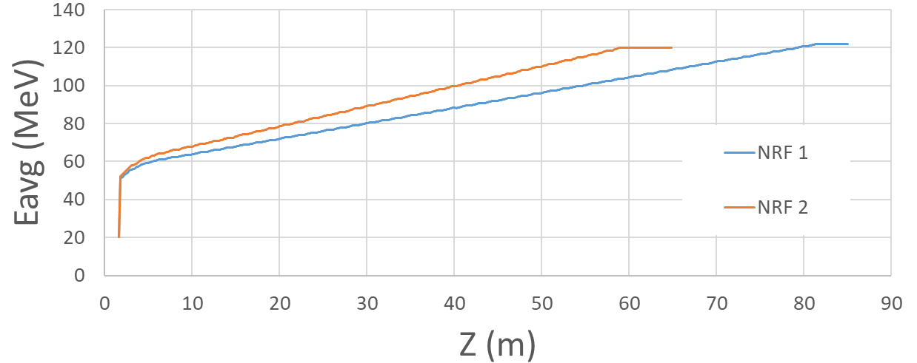
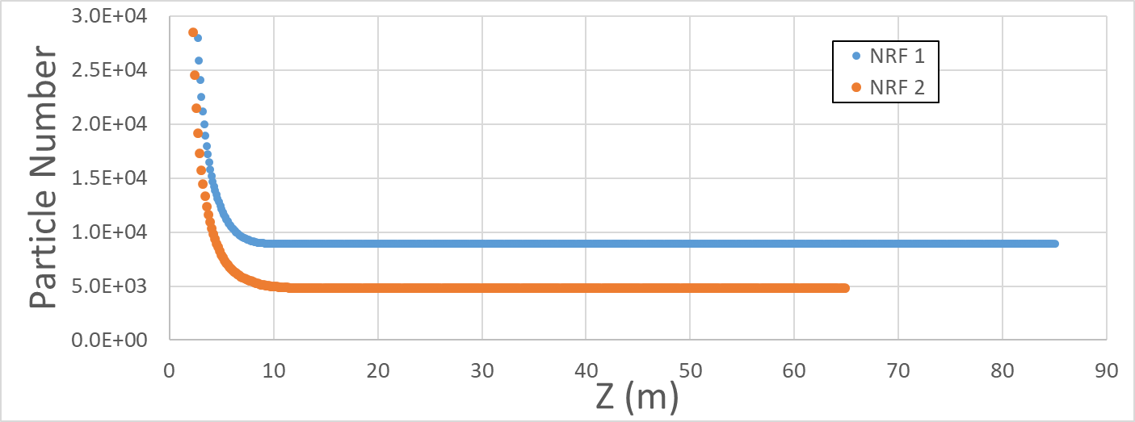
Too Many NRF Cavities and Too Much Power
36 cavities
50 cavities

Slide 22
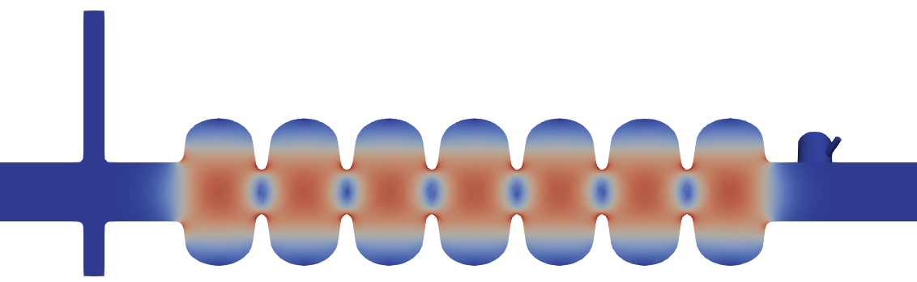
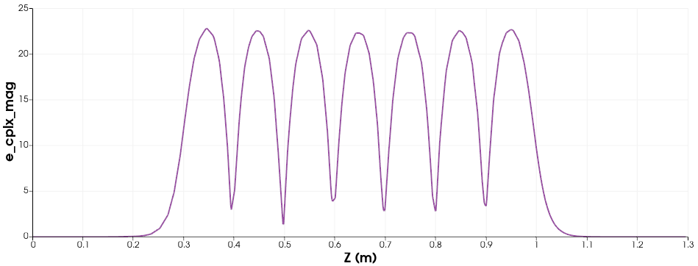
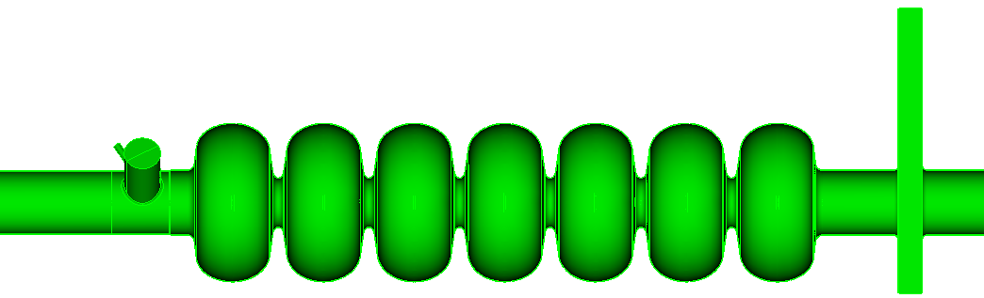
C100 Cryomodule
Iris radius = 26.5 mm

Slide 23
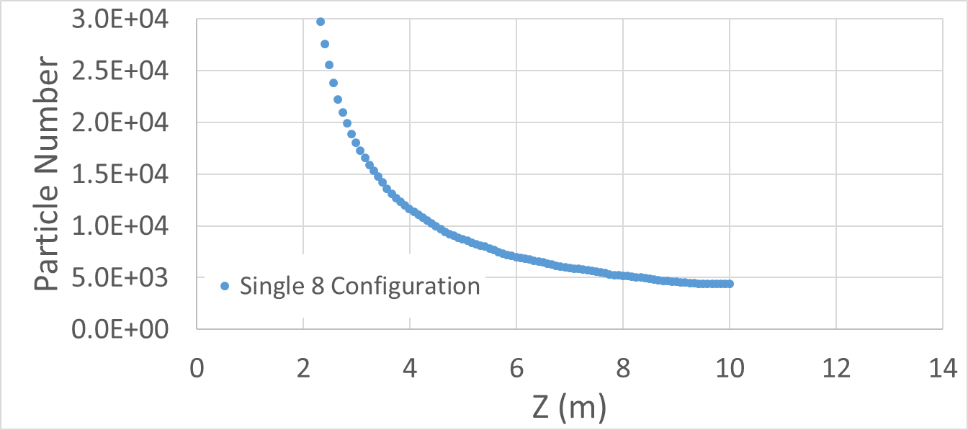
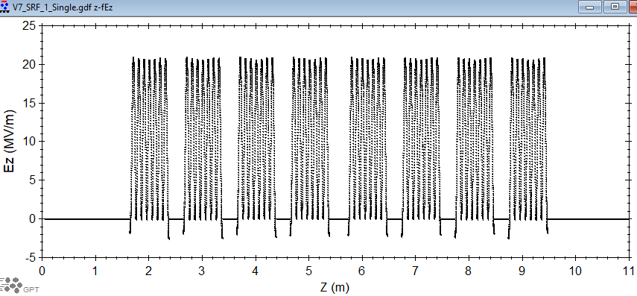
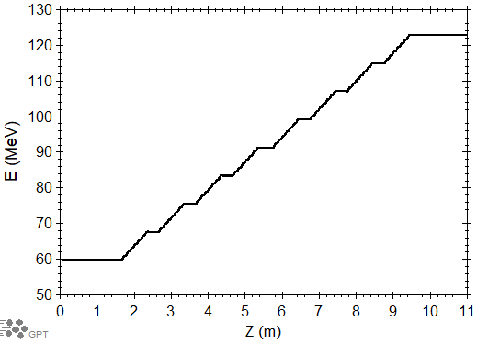
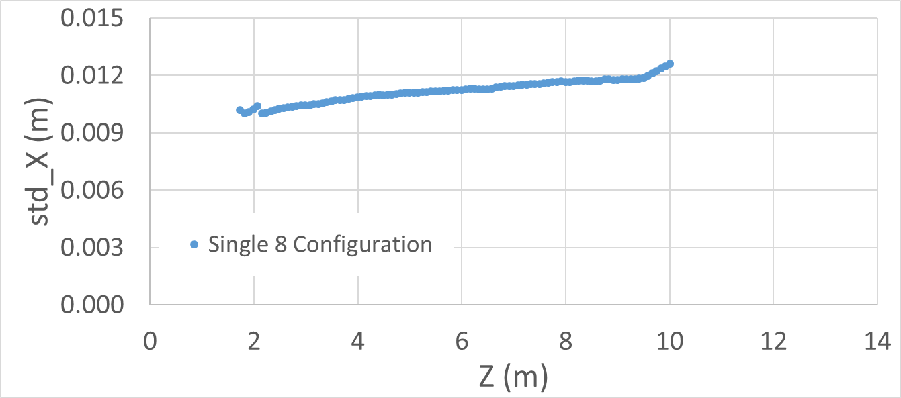
SRF, one 8-cavity cryomodule
1 T
Bz
Ez
Z (m)

Slide 24
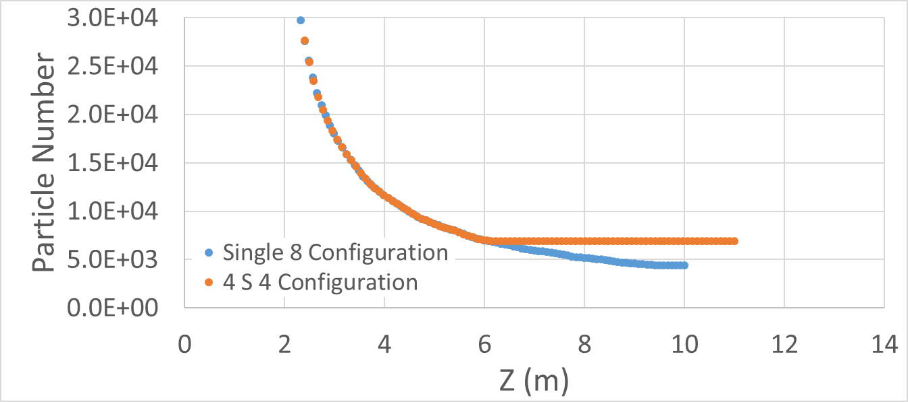
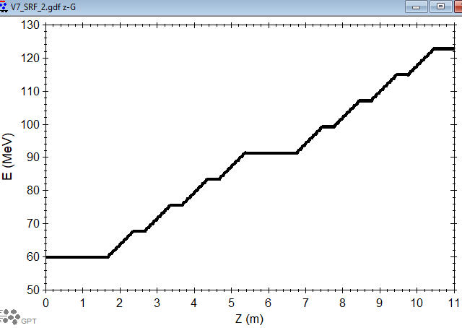
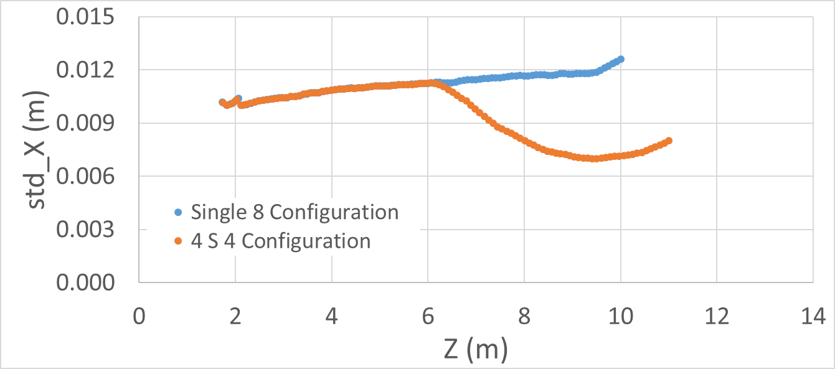
SRF, two 4-cavity cryomodule, with solenoid in between
Ez
1 T
Bz
0.6 T
157% improvement
No loss after the solenoid

Slide 25
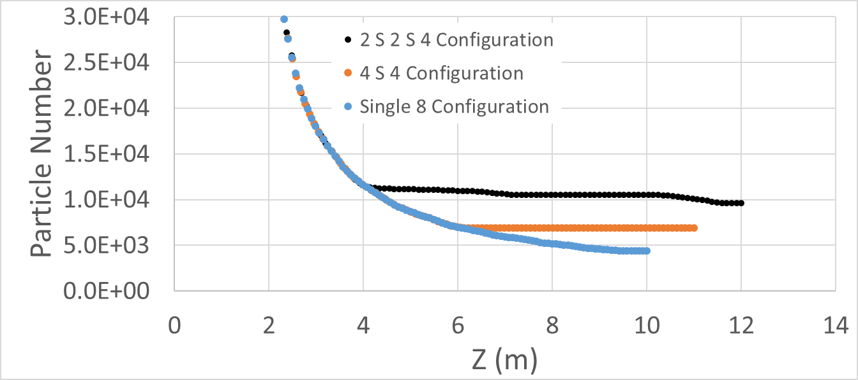
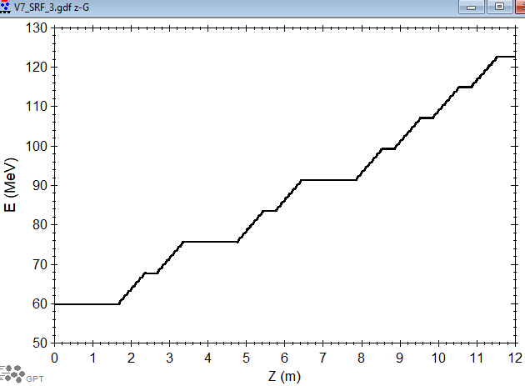
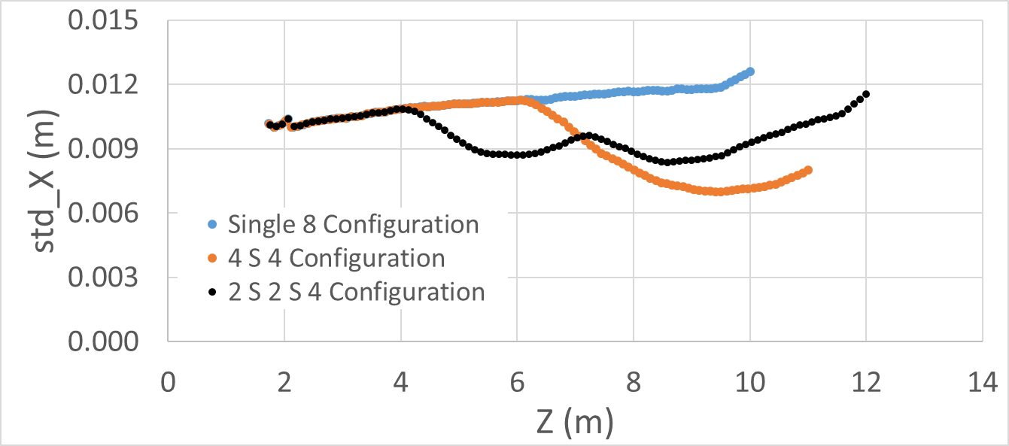
SRF, two 2-cavity cryomodule, one 4-cavity cryomodule, with solenoid in between
Ez
Bz
218% improvement
Notes:
V7_SRF_3

Slide 26
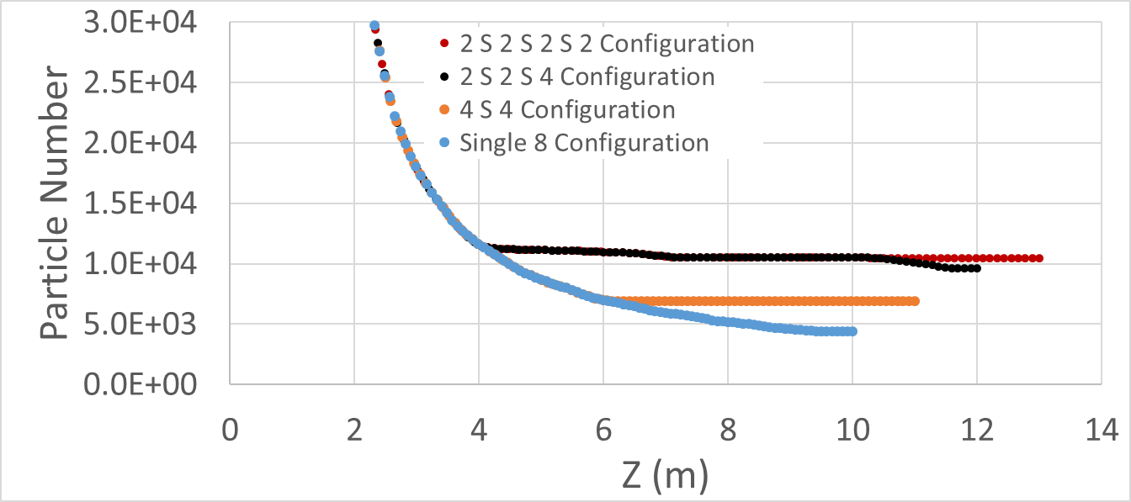
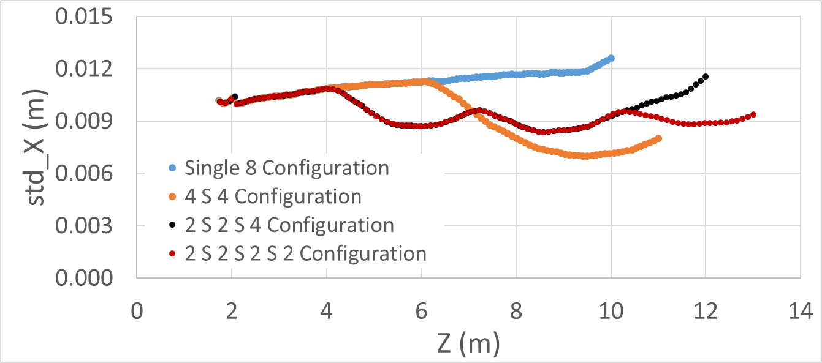
Four 2-Cavity Cryomodules
Bz
Ez
238% improvement

Slide 27
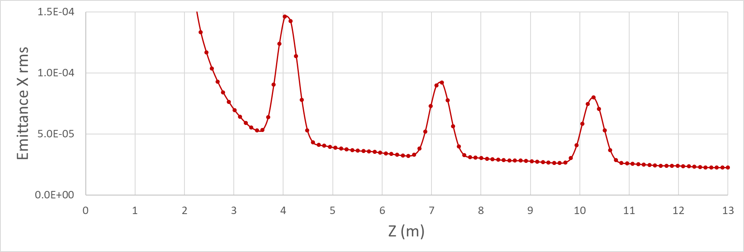
Four 2-Cavity Cryomodules, Transverse Emittance
Emittance reduction factor = 1.92

Slide 28
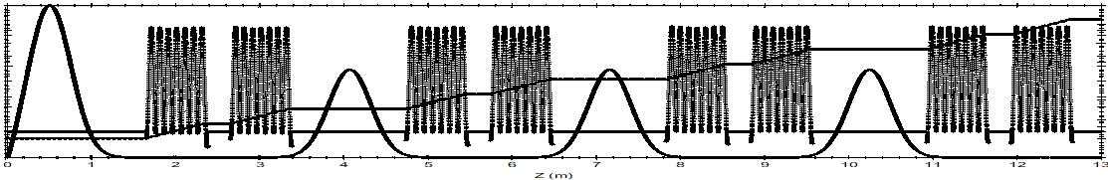
What is captured, what is not

Slide 29
Transition from QWT to SRF
The transition will include:
Energy selection
Capturable e+ selection with Bz tuning
…

Slide 30
Conclusion & Outlook
  e+ dynamics inside QWT matching section
  Comparision of NRF and SRF captring scheme
  Longitudinal capturing study
  QWT to SRF transition beamline study
  Beam loading

Slide 31












Ce⁺BAF Working Group
We would like to acknowledge members of the Ce⁺BAF Working Group, the Jefferson Lab Positron Working Group, the DOE industry partner Xelera, members of the DOE US-Japan HEP Collaboration, and collaborators at Universities and National Labs which contribute to the positron R&D effort.
T. Abe, J. Benesch, A. Bogacz, M.W. Bruker, L. Cardman, J. Conway, S. Covrig, P. Degtiarenko, Y. Enomoto,
S. Gessner, P. Ghoshal, S. Gopinath, J. Grames, J. Gubeli, C. Gulliford, S. Habet, G. Hays, C. Hernández-García,
D. Higinbotham, A. Hofler, R. Kazimi, M. Kostin, V.O. Kostroun, F. Lin, V. Lizarraga-Rubio, K. Malher,
Y. Morikawa, S. Nagaitsev, E. Nanni, S. Ogur, G. Palacios-Serrano, M. Poelker, N. Raut, B. Rimmer, Y. Roblin,
A. Seryi, K. Smolenski, M. Spata, M. Stutzman, R. Suleiman, A. Sy, N. Taylor, D. Turner, A. Ushakov,
C. Valerio-Lizarraga, E. Voutier, H. Wang, S. Wang, S. Zhang, Y. Zhang

Slide 32
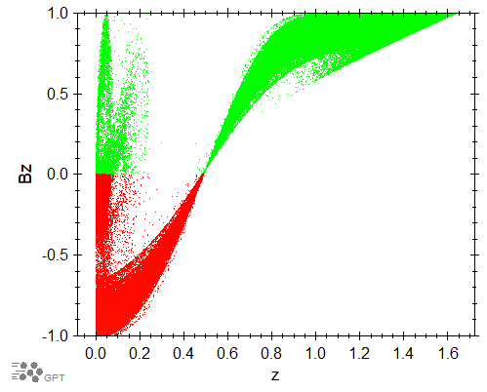
No absorber, Note the Negative Beta Z
Magnetic mirror effect
Particles whose velocity vectors lie outside the cone are reflected by the magnetic field
Some travel a while and return to the target

Slide 33
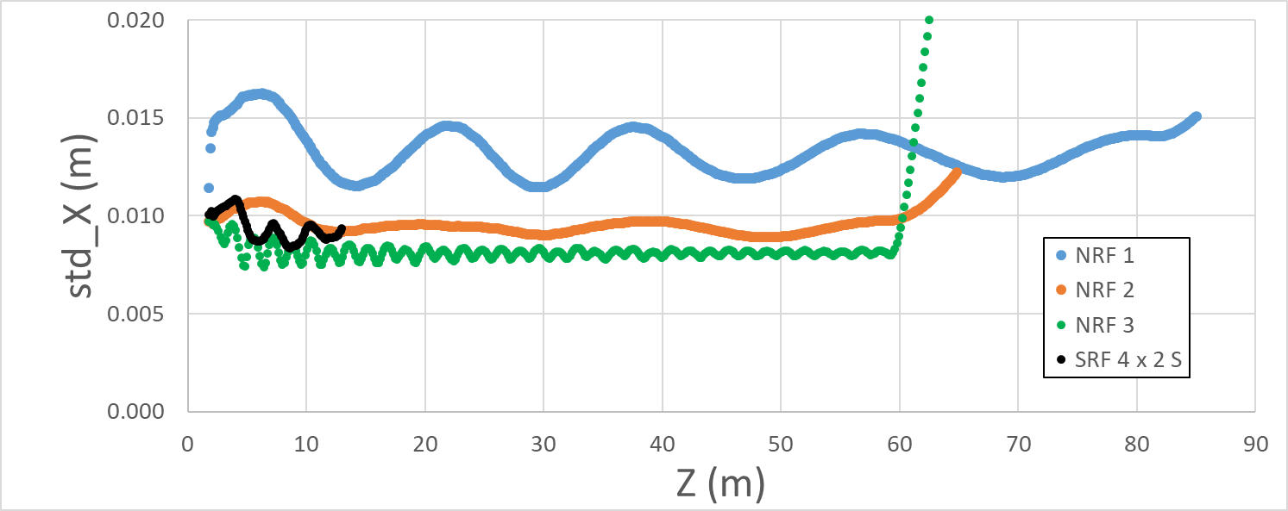
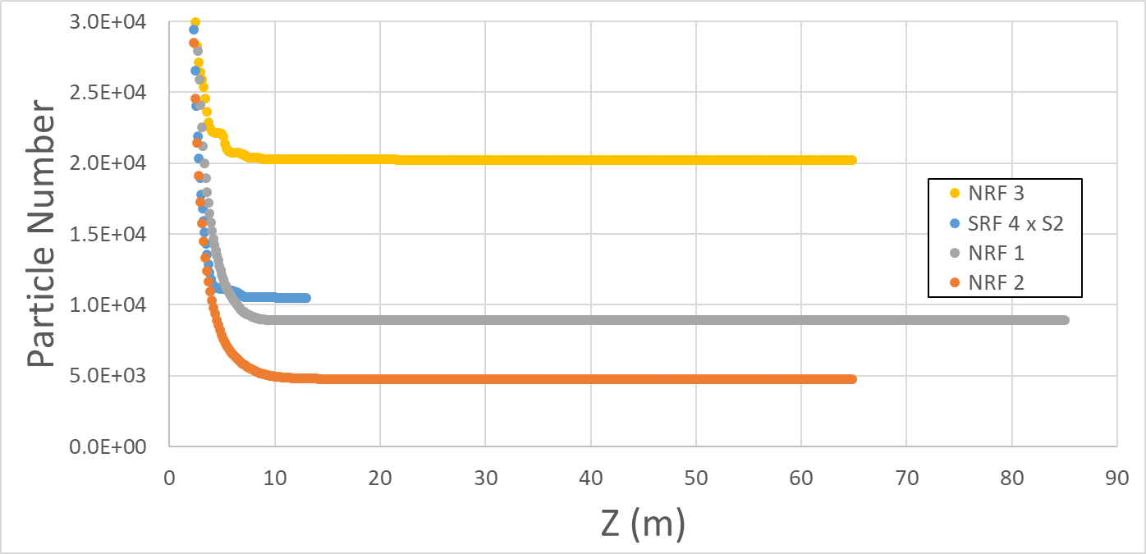
Solenoid of NRF 3 has same amplitude with that of SRF 4
Notes:
srfnode4

