Slide 1
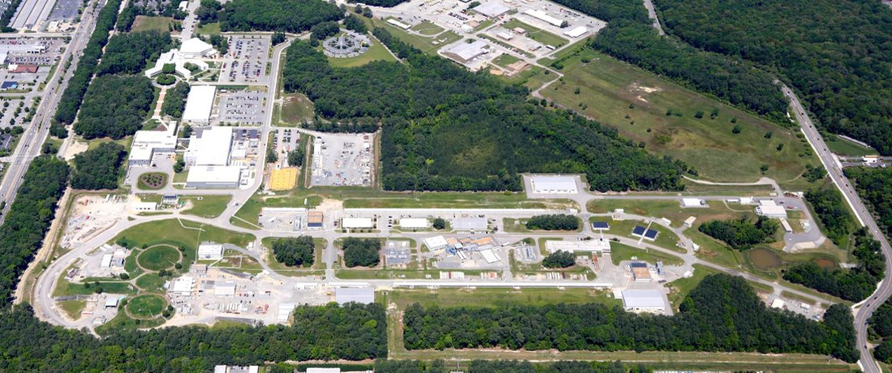
Injection of e+ from LERF to experimental halls
Salim Ogur (Jefferson Lab)​
on behalf of the Ce+BAF Working Group
24 March 2025, PWG 2025, Jefferson Lab

Slide 2












Ce⁺BAF Working Group
We would like to acknowledge members of the Ce⁺BAF Working Group, the Jefferson Lab Positron Working Group, the DOE industry partner Xelera, members of the DOE US-Japan HEP Collaboration, and collaborators at Universities and National Labs which contribute to the positron R&D effort.
T. Abe, J. Benesch, A. Bogacz, M.W. Bruker, L. Cardman, J. Conway, S. Covrig, P. Degtiarenko, Y. Enomoto,
S. Gessner, P. Ghoshal, S. Gopinath, J. Grames, J. Gubeli, C. Gulliford, S. Habet, G. Hays, C. Hernández-García,
D. Higinbotham, A. Hofler, R. Kazimi, M. Kostin, V.O. Kostroun, F. Lin, V. Lizarraga-Rubio, K. Malher,
Y. Morikawa, S. Nagaitsev, E. Nanni, S. Ogur, G. Palacios-Serrano, M. Poelker, N. Raut, B. Rimmer, Y. Roblin,
A. Seryi, K. Smolenski, M. Spata, M. Stutzman, R. Suleiman, A. Sy, N. Taylor, D. Turner, A. Ushakov,
C. Valerio-Lizarraga, E. Voutier, H. Wang, S. Wang, S. Zhang, Y. Zhang

Slide 3
Motivation
  Positron beam transport line optics design connecting LERF to the existing CEBAF
  i. which must fit into the existing CEBAF tunnel i.e. no tunnel enlargement
  ii. which would not block current CEBAF electron beam operation i.e. no hardware change in the CEBAF
  iii. that can also serve as the injector transfer line for the FFA CEBAF 22-24 GeV e-
  iv. which is being optimized for the large e+ transport, i.e. low dispersion and low beta function
Machine Parameter​ | Electrons​ | Positrons​
Hall Multiplicity​ | 4​ | 1 or 2​
Energy (ABC/D)​ | 11/12 GeV​ | 11/12 GeV​
Beam Repetition​ | 249.5/499 MHz​ | 249.5/499 MHz​
Duty Factor​ | 100% cw​ | 100% cw​
Unpolarized Intensity​ | 170 µA​ | > 1 µA​
Polarized Intensity​ | 170 µA​ | > 50 nA​
Beam Polarization​ | > 85%​ | > 60%​
Fast/Slow Helicity Reversal​ | 1920 Hz/Yes​ | 1920 Hz/Yes​

Slide 4
Outline
  1. Layout of the Positron Transport Line
  2. Positron Transport Line Optics
  3. Ce+BAF to the Experimental Halls
  Conclusion and Outlook

Slide 5

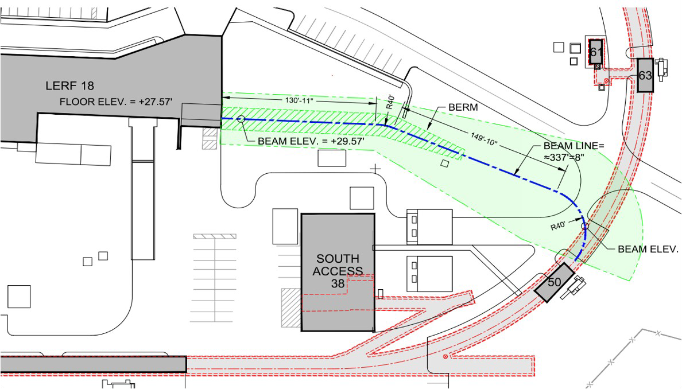
1- Positron Injector and Transport Line at CEBAF
Low Energy Recirculation Facility
West Arc
123 MeV e⁺ Beam
Injected to North Linac
New 123 MeV
e⁺ Injector at LERF
New Beamline
to CEBAF Tunnel
New Transport Line
along South Linac and West Arc

Slide 6
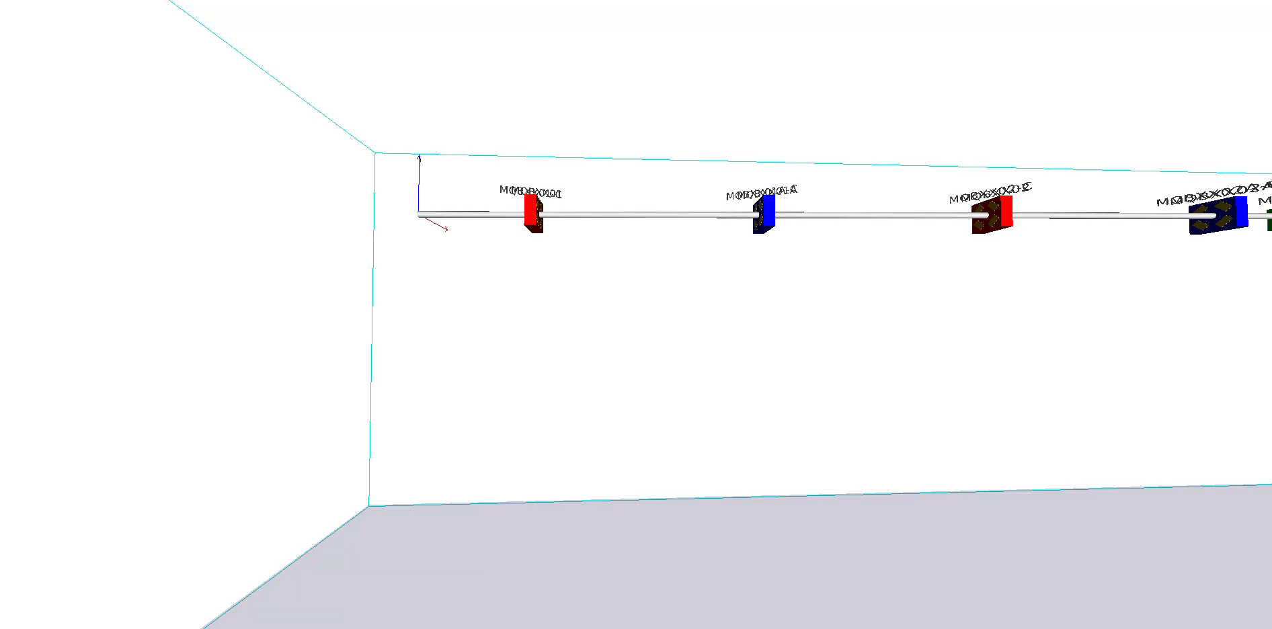
1.1 - LERF to CEBAF Tunnel
Low Energy Recirculation Facility
New Beamline
to CEBAF Tunnel

Slide 7
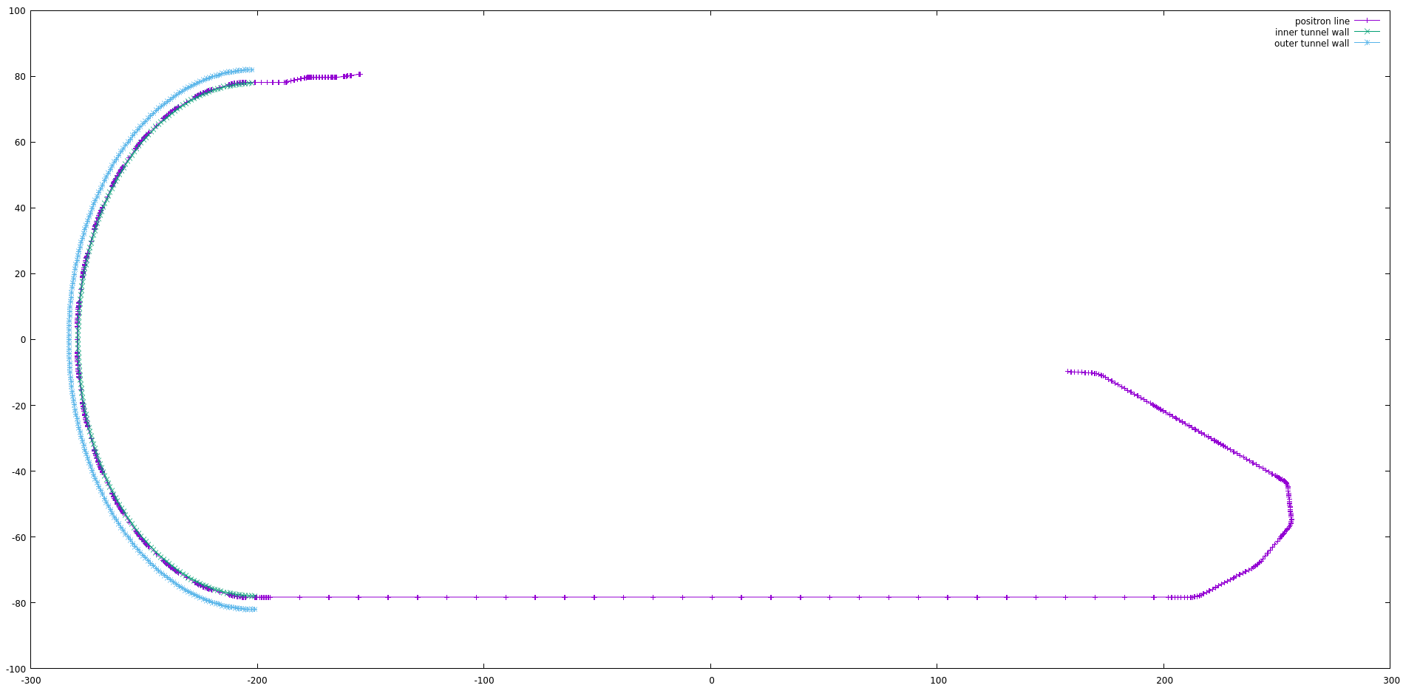
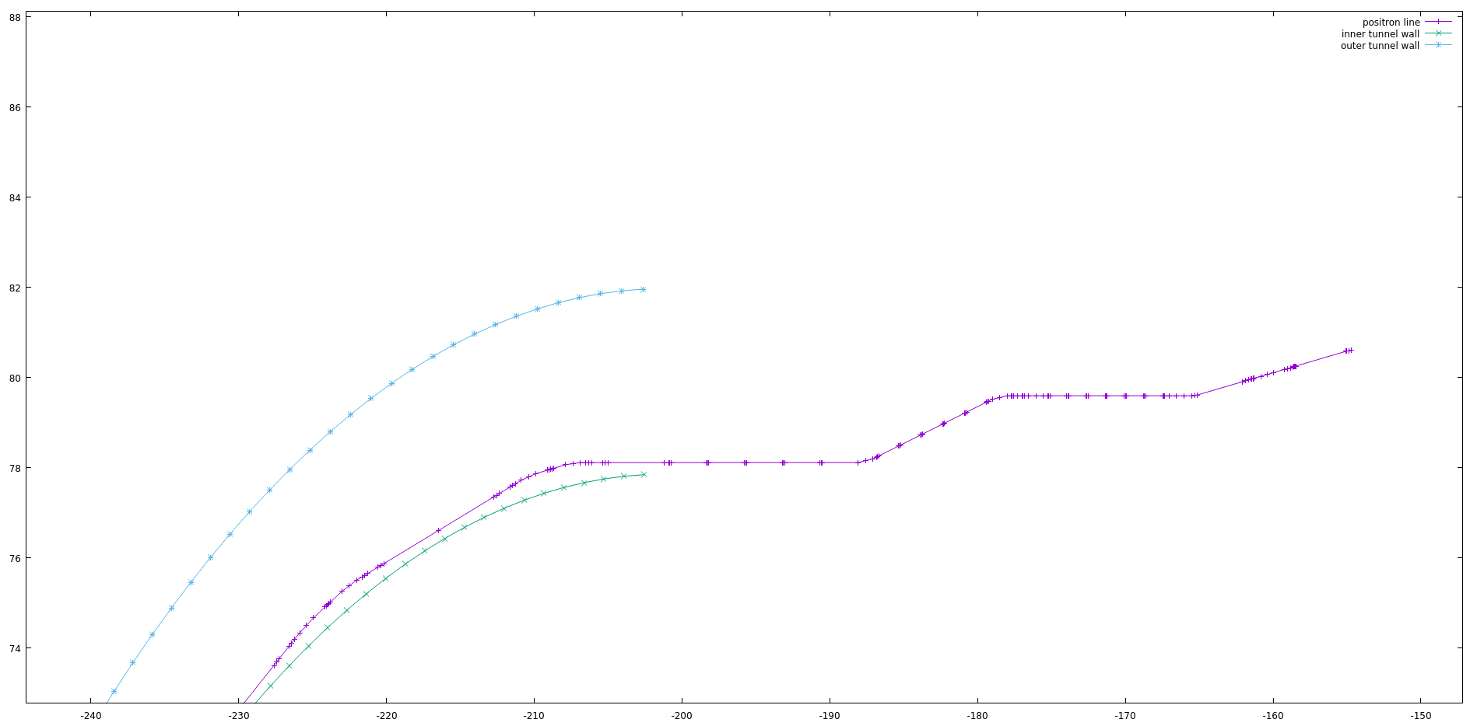
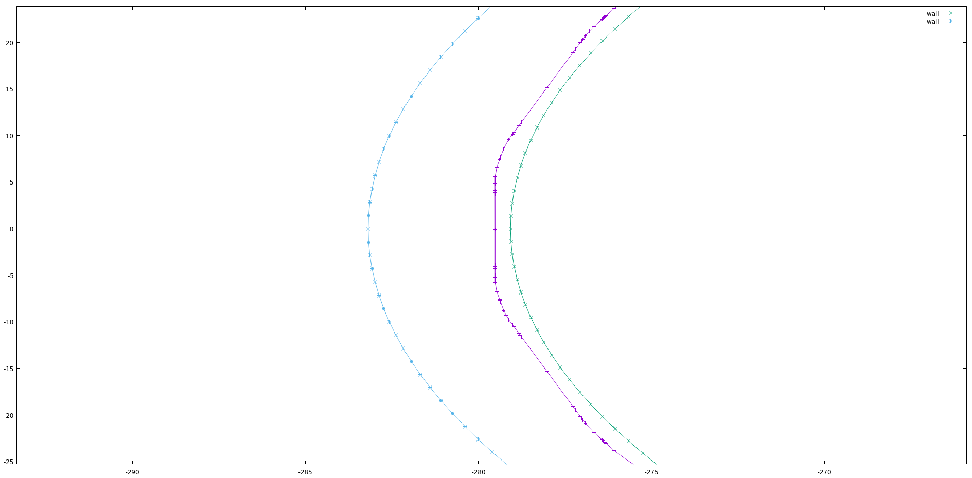
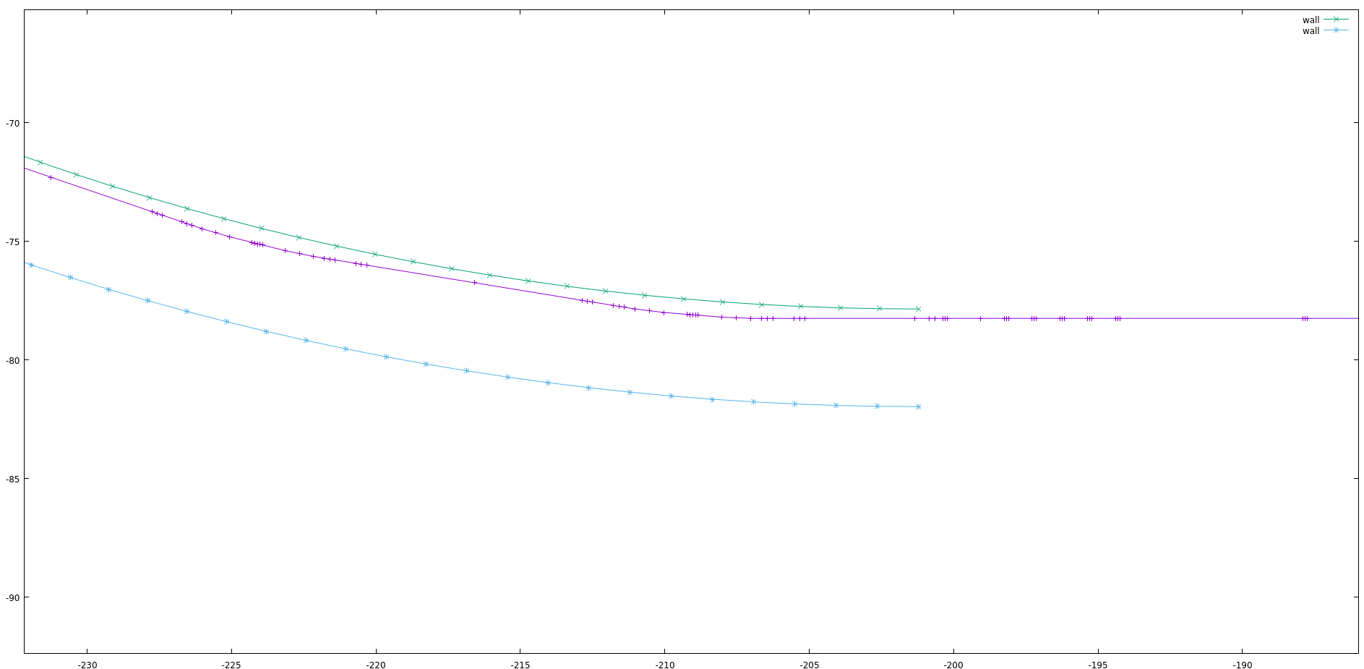
1.3 - Layout of the New LERF to NL
X [m]
Z [m]

Slide 8
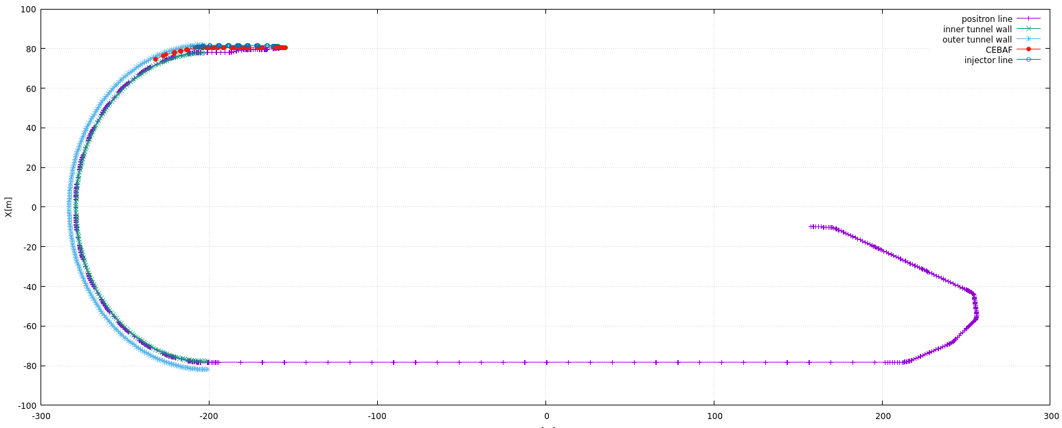
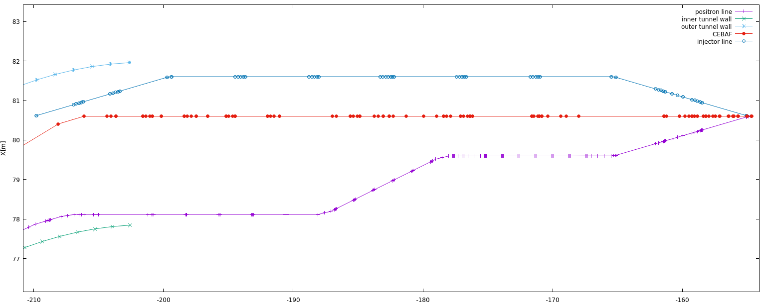
1.4 - Layout of the New LERF to NL – MERGER
Vertical Descend from the tunnel ceiling to the Linac Level

Slide 9
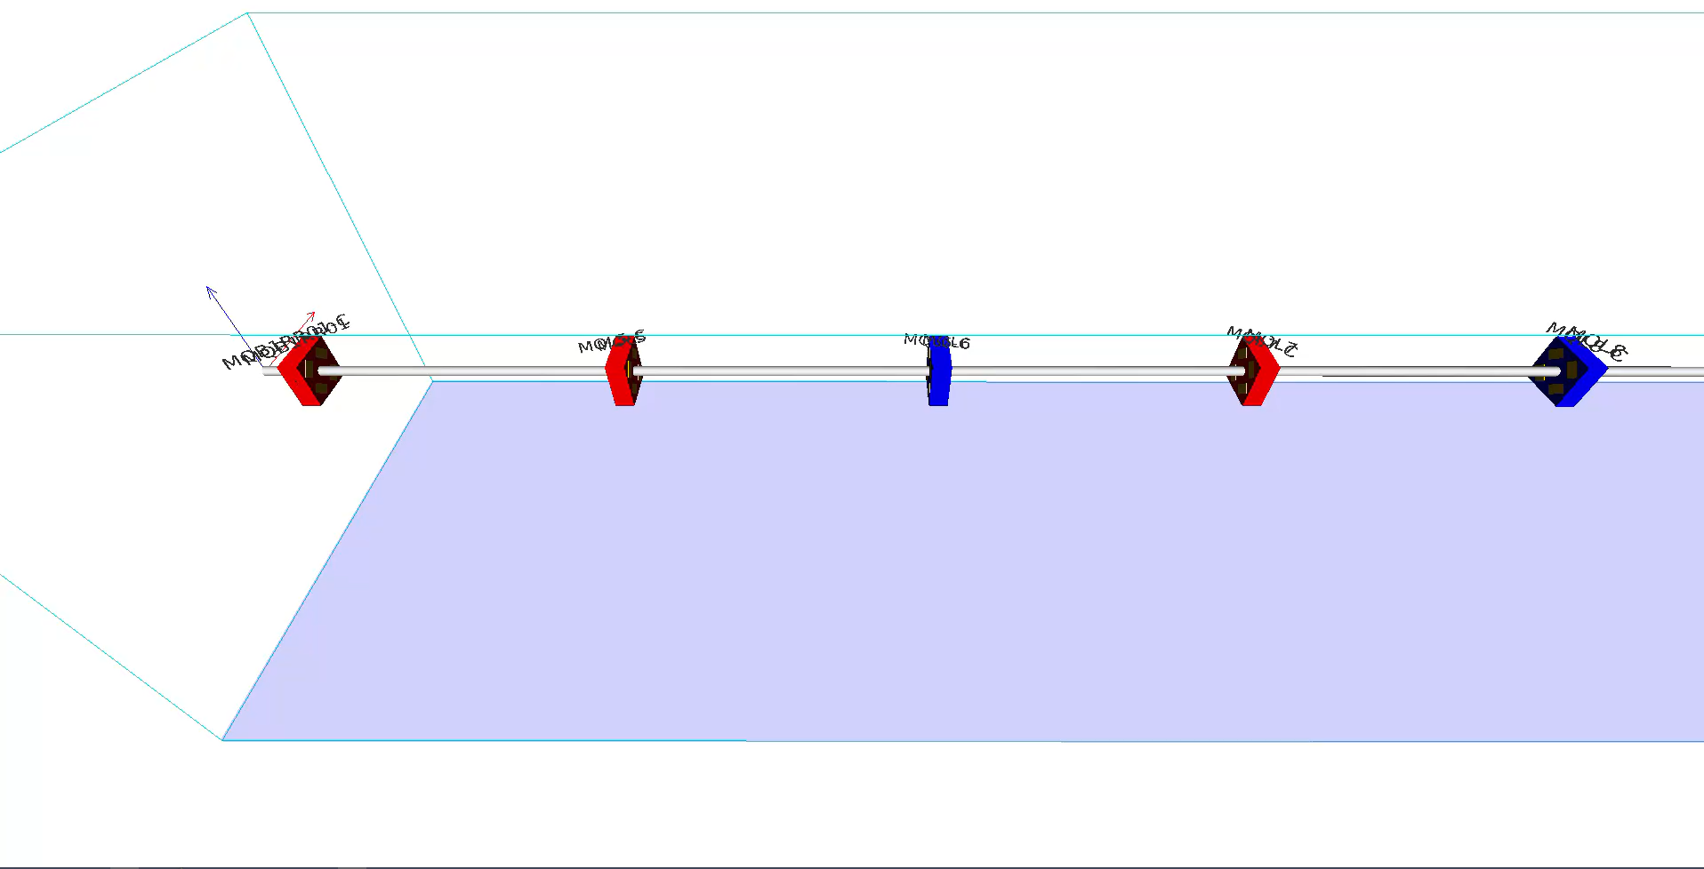
1.4 - Layout of the New LERF to NL – MERGER

Slide 10
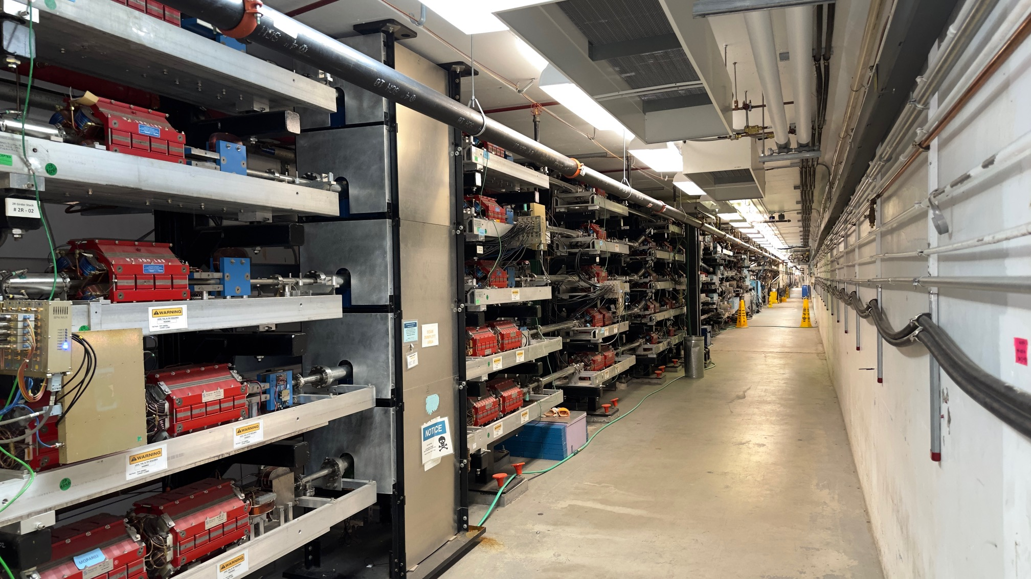
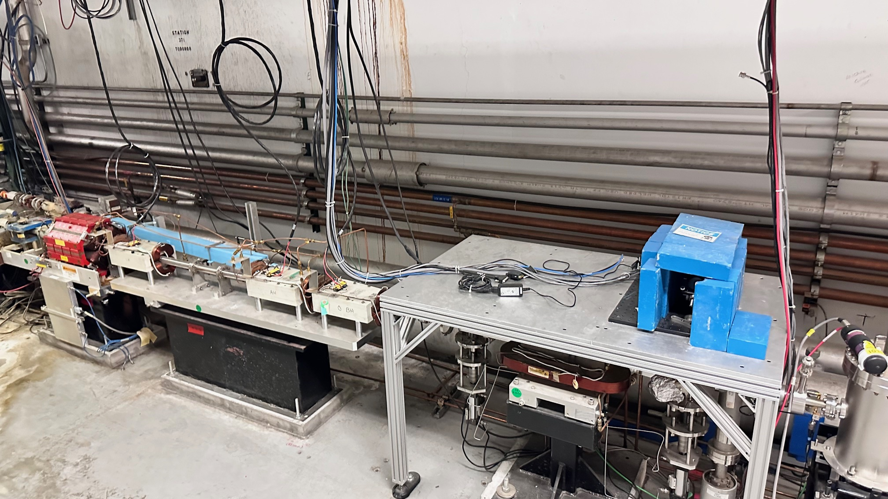
1.4 - Positron Injector and Transport Line at CEBAF - MERGER
POSITRONS
ELECTRONS
ELECTRONS
POSITRONS

Slide 11
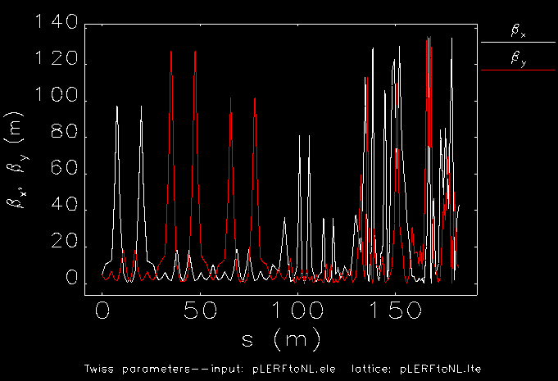
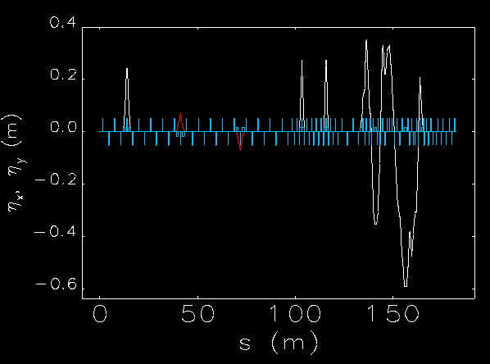
2.1 - Optics LERF Transfer Line (LTL) to East Arc
Positron generation and capture studies are ongoing, this presentation addresses the largest positron beam to be delivered without changing the existing CEBAF cryomodules. If the necessity emerges for larger cryomodule deployment as studies evolve, we may consider this option.
We use Elegant and Bmad for optics designs, yet Bmad would be used for the start-to-end tracking with spin components.

Slide 12
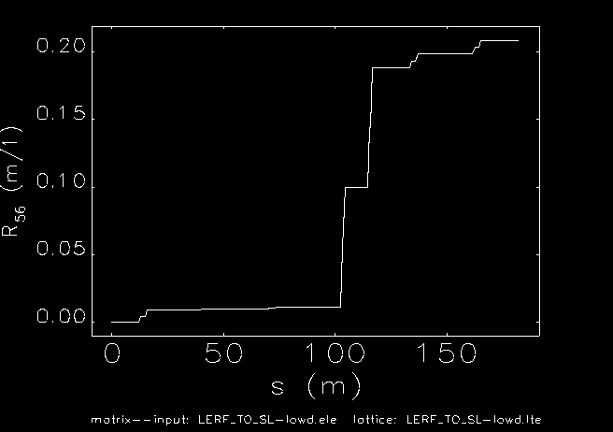
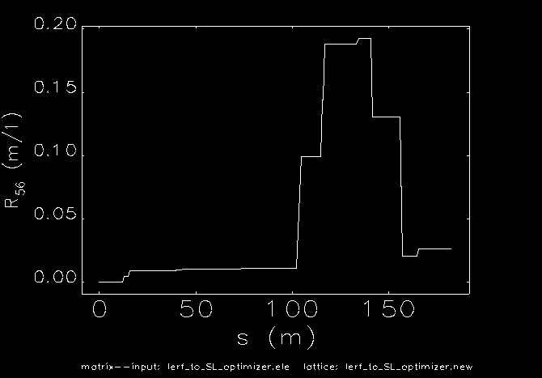
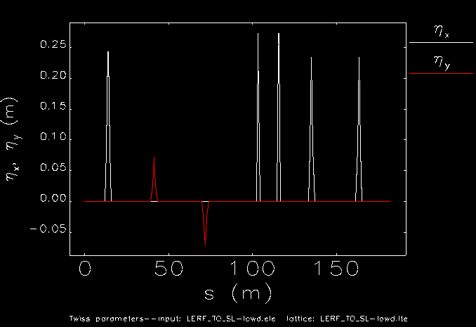
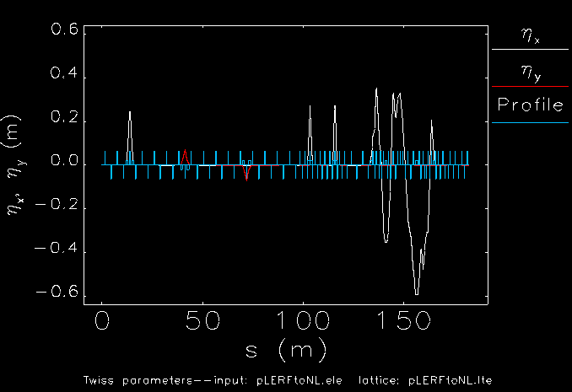
< LERF TO East ARC - R56 Options >
V 1
V 2
R56 is a matrix element which controls longitudinal beam properties (exchange between momentum spread and bunch length)
V1 R56 = 0.2083 m
V2 R56 = 0.026 m
Notes:
Use for: Introducing new topics
To change the photo: Right-click on photo and select change photo

Slide 13
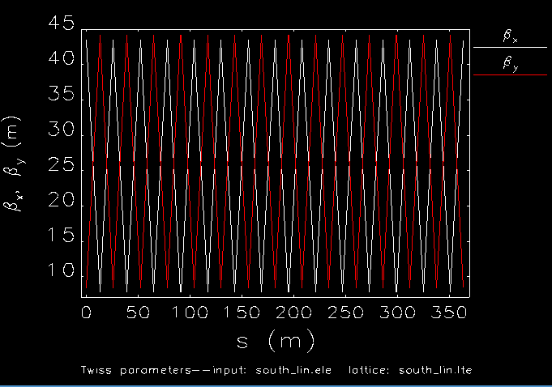
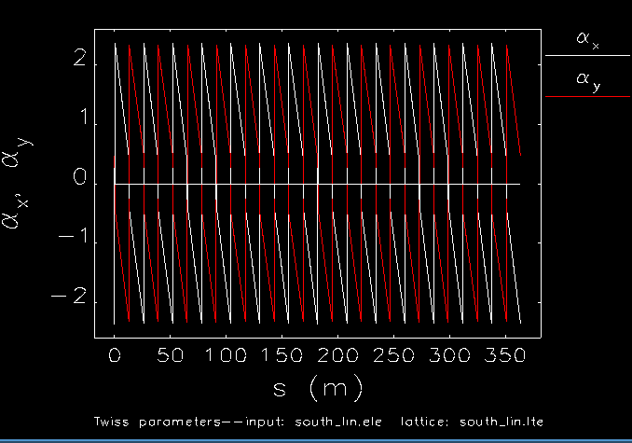


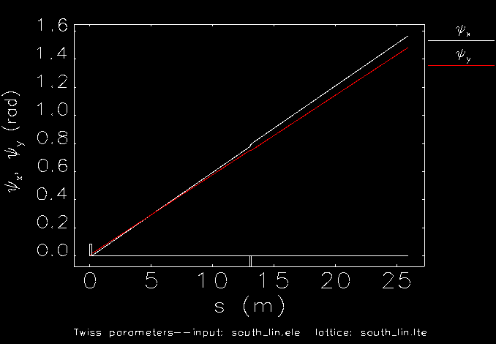
2.2 - South Transfer Line (STL)
Trace
< 2
Minimum number of quads yet providing stable optics to be deployed

Slide 14
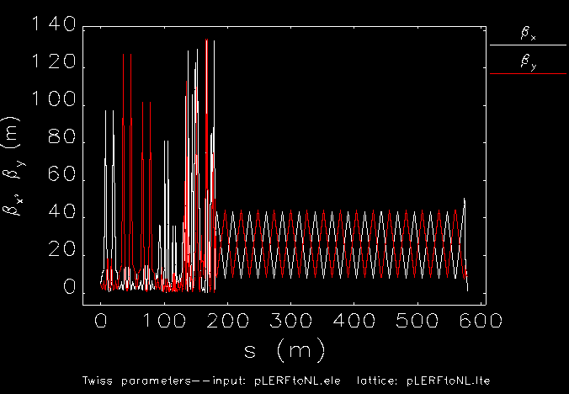
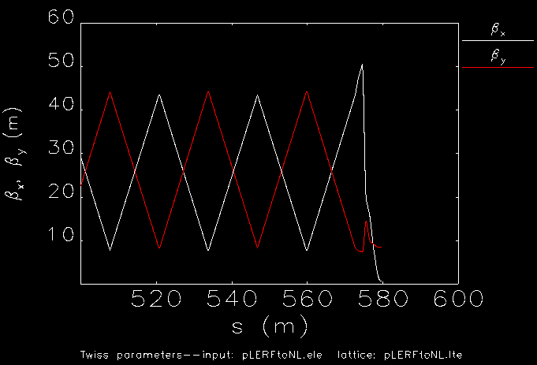
2.3 – LTL&STL Matching to New Double Bend Achromat Arc

Slide 15
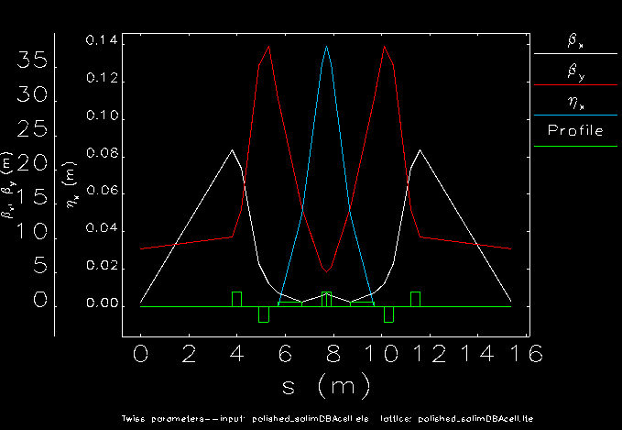
< The Double Bend Achromat Cell >
Double bend achromat cell is designed for 180 degree turn from south to north straight sections. Below 40 m beta functions with 14 cm dispersion are achieved.

Slide 16
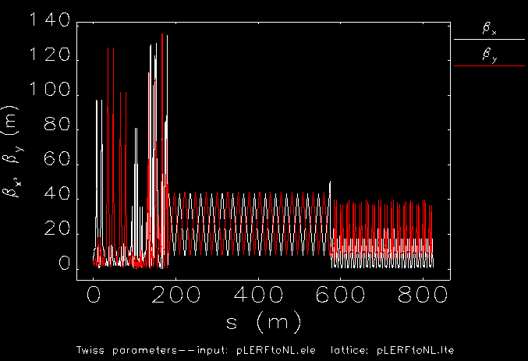
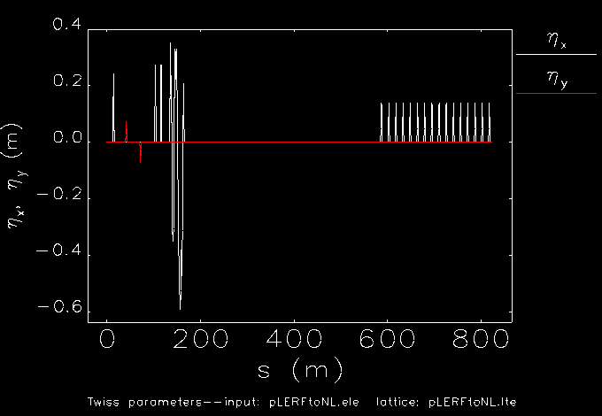
2.5- LTL+ STL + WTL
The last five quads MQL1-4 and MQB1A01 were used for fast-matching to the DBA arc. No drift length optimization.

Slide 17
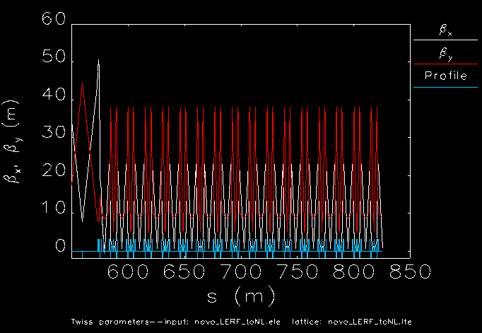
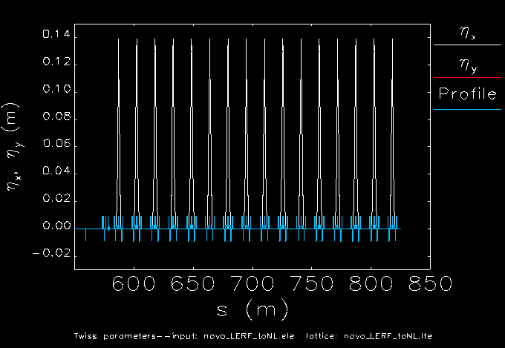
2.5- LTL+ STL + WTL (Zoomed)
DBA Arc zoomed into the stitched LERF and SL. They are all well matched resulting in NO betatron or dispersion oscillations.

Slide 18
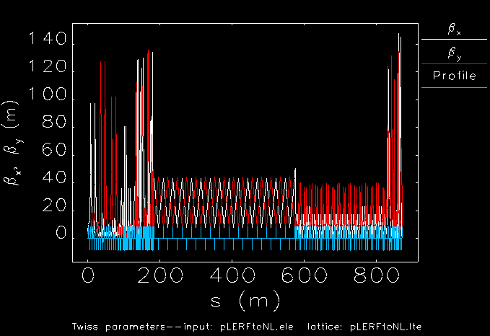
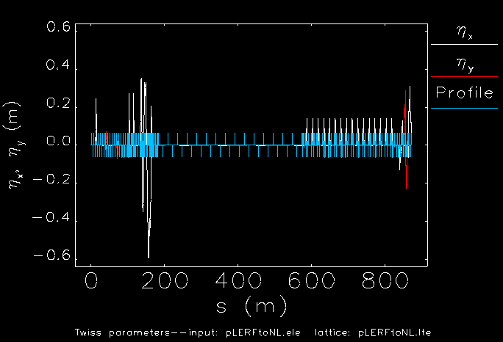
2.6 - Positron LERF to NL (ELEGANT)
Merger TL
LERF Transfer Line
(LTL)
South Transfer Line
(STL)
West Transfer Line
(WTL)
LERF TL is taken as reference for beta and dispersion function limits.

Slide 19
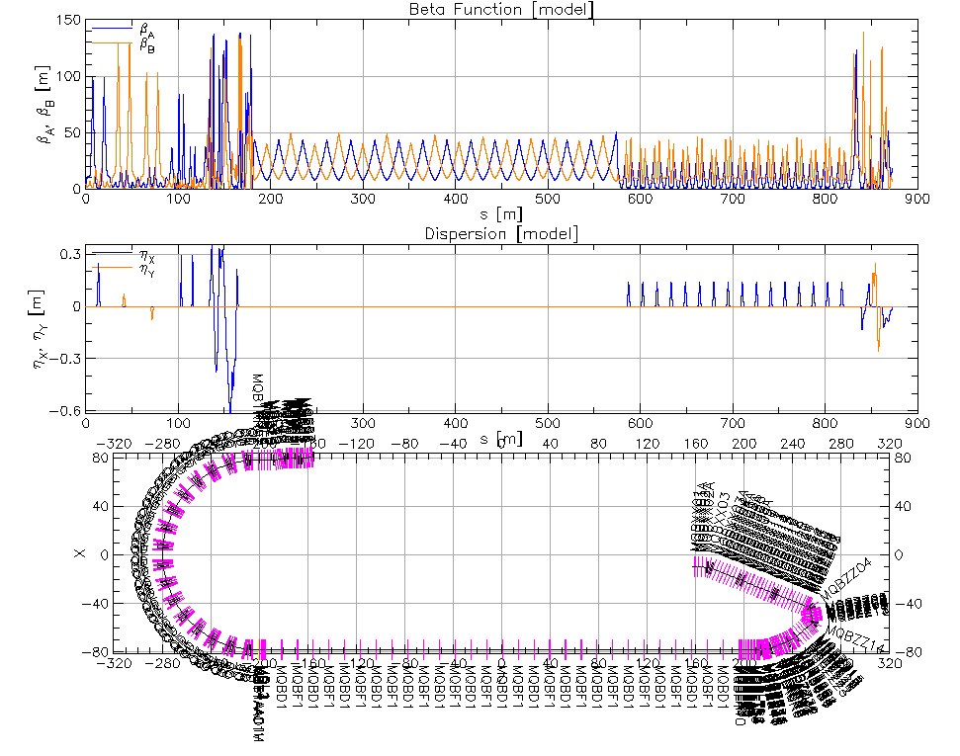
2.6.2- Benchmarking the Positron Transport Line Optics
LERF to North Linac transfer line optics design are benchmarked with Elegant and Bmad, very small discrepancies are seen and corrected.

Slide 20
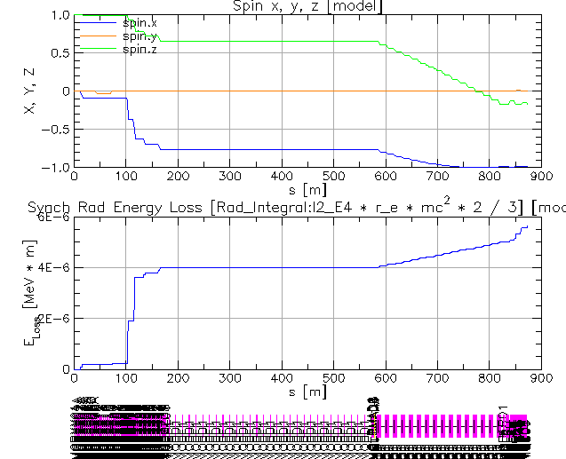
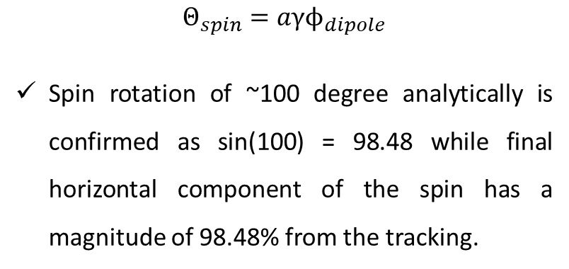
3.1 – Multiparticle Tracking with Current e+ 123 MeV Beam to the NL
Tracking with spin component giving a hypothetical spin_z=1. (PRELIMINARY)
$Θ_{spin}=aγϕ_{dipole}$
Spin rotation of ~100 degree analytically is confirmed as sin(100) = 98.48 while final horizontal component of the spin has a magnitude of 98.48% from the tracking.
Positron multi-particle beam (+spin) tracking from injector to the experiment halls (up to 11 GeV) is currently being prepared.

Slide 21
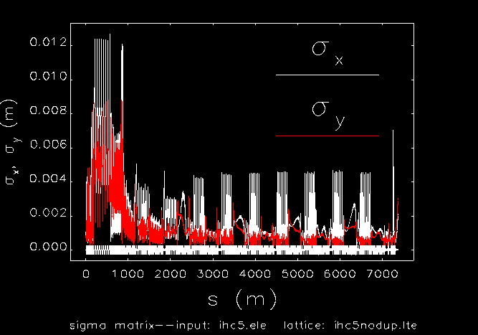
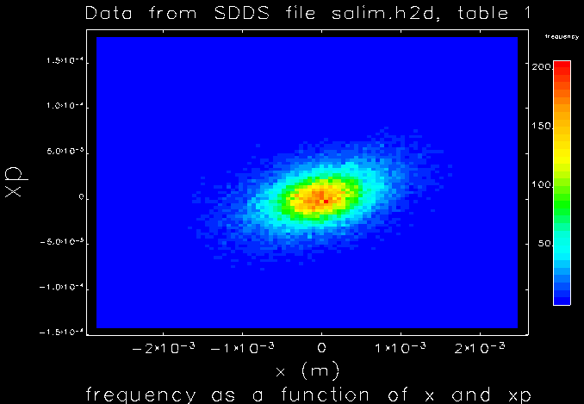
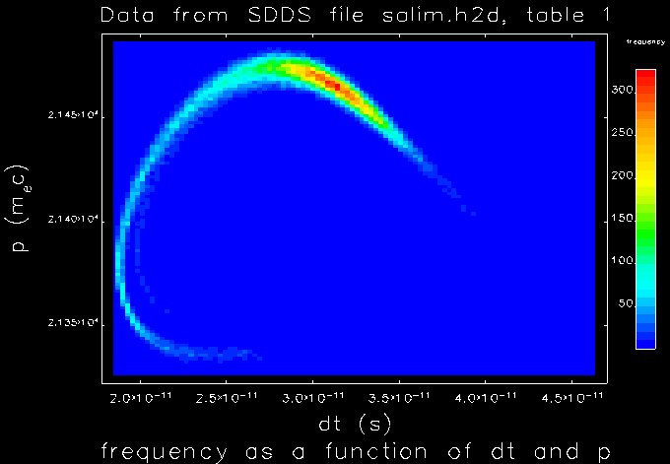
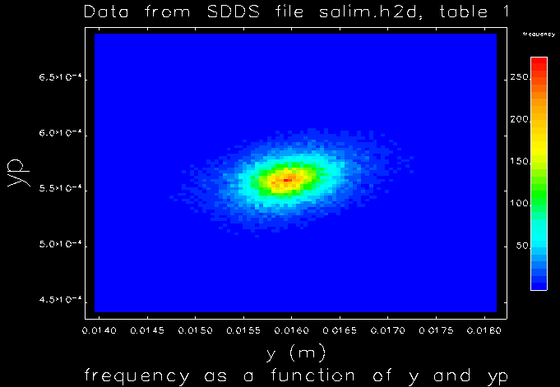
3.1 – Multiparticle Tracking with 123 MeV e+ Beam to the Hall C: 11.2 GeV
Preliminary Tracking with 100K particles to LERF to Hall C at pass 5, 2200 MeV per pass using Yves’ goal parameters on March 12, 2025.
  MA1: MAXAMP,X_MAX=0.035,Y_MAX=0.025 (LERF to NL)
  MA2: MAXAMP,X_MAX=0.025,Y_MAX=0.025 (NL to BSYA)
Transmission is 60.1% without any modification to Yves’s low-dispersion &low-R56 Ce+BAF optics.
S. Habet, PhD Thesis, Dec 2023
​ | Simul.​ | Goal​
Energy [MeV]​ | 123​
Current [nA]​ | 170​ | > 50​
Polarization [%]​ | 65​ | > 60​
[%]​ | 0.6​ | < 1​
[ps]​ | 2​ | < 4​
[m·rad]​ | 1.5e-3​ | < 4e-5​
Follow A. Ushakov’s talk on positron parameters 03.25.2025

Slide 22
Conclusion & Outlook
  Injection optics from the positron injector to the existing CEBAF is designed.
  Minimum new tunnel digging is aimed and achieved. Meanwhile, the new transport line would not block existing CEBAF operation.
  Low dispersion and low beta optics are achieved, yet subject to change as upstream (see A. Ushakov and S. Wang’s talks) and downstream optimizations are ongoing. (Also see V. Lizarraga’s talk on Degraded beam study of CEBAF)
  Preliminary positron tracking with spin components are available for experiments!

Slide 23
Back Up

Slide 24
Recirculating Injector Based on LERF (3-pass)
10 MeV + 3 × 3 × 71 MeV = 650 MeV
10 MeV
436 MeV
C-75
C-75
C-75
A. Bogacz

Slide 25
Recirculating Injector Based on LERF (3-pass)
10 MeV + 3 × 3 × 71 MeV = 650 MeV
10 MeV + 3 × 3 × 71 MeV = 650 MeV
10 MeV
650 MeV
436 MeV
C-75
C-75
C-75
C-75
C-75
C-75
New arc
New arc

