Slide 1
Detector Commissioning at ESB
Wire Chambers & Enge TOF
Liguang Tang, Hampton University/JLab
On behalf of the JLab hypernuclear collaboration
Hypernuclear Collaboration Meeting, May 15 & 16, 2025
1

Slide 2
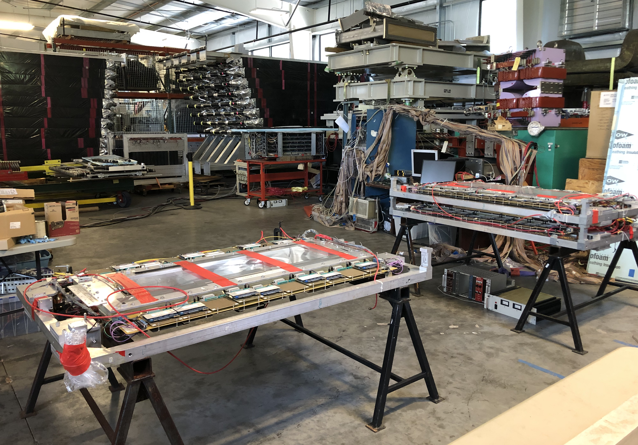
Wire Chamber Work in ESB

Slide 3
Wire Chamber Commissioning
All four sets of wire chambers are in place.
Existing gas handling system, electronics, power supplies, cables, and DAQ will be used.
E-Pass and Pre-job briefing documents are created, approved, and placed in the working area.
HV test and repair work will start on May 19, 2025. Currently we have five people involved (including three students). Full commissioning will follow when no problem found or problem resolved. We hope to complete the work by spring 2026.
Currently, we know only one HKS chamber having broken wires in the outer most wire plane (the U plane). It should be a relatively easy fix and can be done quickly.

Slide 4
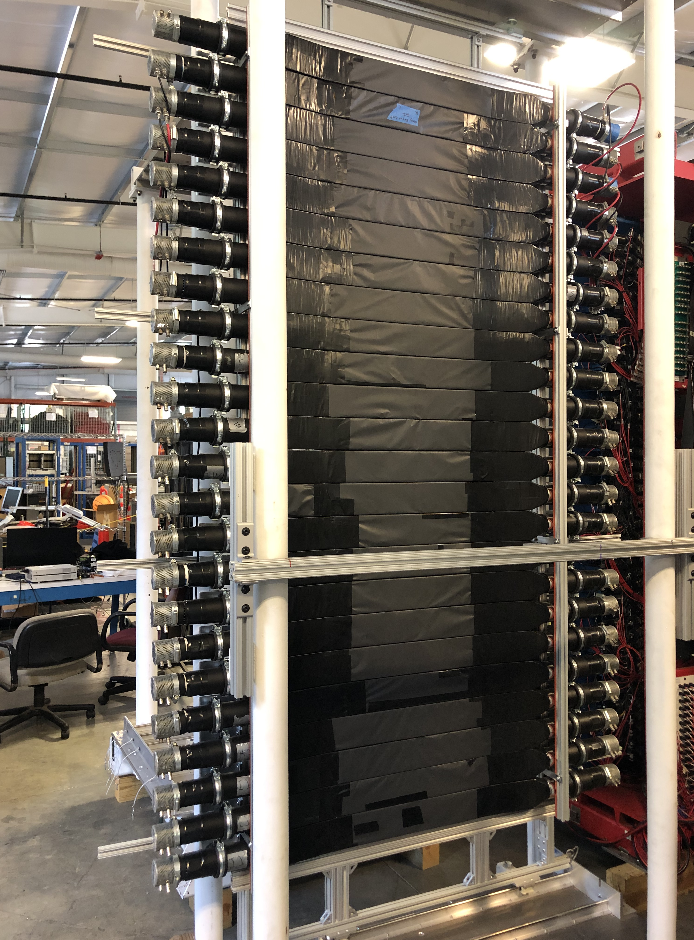
Prepare The TOF Counters For Enge
Using the existing scintillation panel used in the one of the previous Hall C experiments.
Changing the single row of 24 segments to double rows with 12 segments each.
Work can be done in parallel to the wire chamber commission.

