Slide 1
Overview Of The Hypernuclear Spectrometer System And The General Experimental Technique
Liguang Tang, Hampton University/JLab
On behalf of the JLab hypernuclear collaboration
High Precision Mass spectroscopy using the (e, e’K⁺) reaction
E12-24-004: Charge-Symmetry-Breaking in p-shell hypernuclei
E12-24-013: Isospin Dependence in the ΛNN interaction (⁴⁰_{Λ}K and ⁴⁸_{Λ}K)
E12-24-003: A dependence of the ΛNN interaction (²⁰⁸_{Λ}Tl)
E12-24-011: Triaxially deformed nucleus (²⁶Mg) probed by a Λ particle
High precision decay pion spectroscopy
E12-15-008A: Precise binding energy of ground state of light hypernucei
Hypernuclear Collaboration Meeting, May 15 & 16, 2025
1

Slide 2
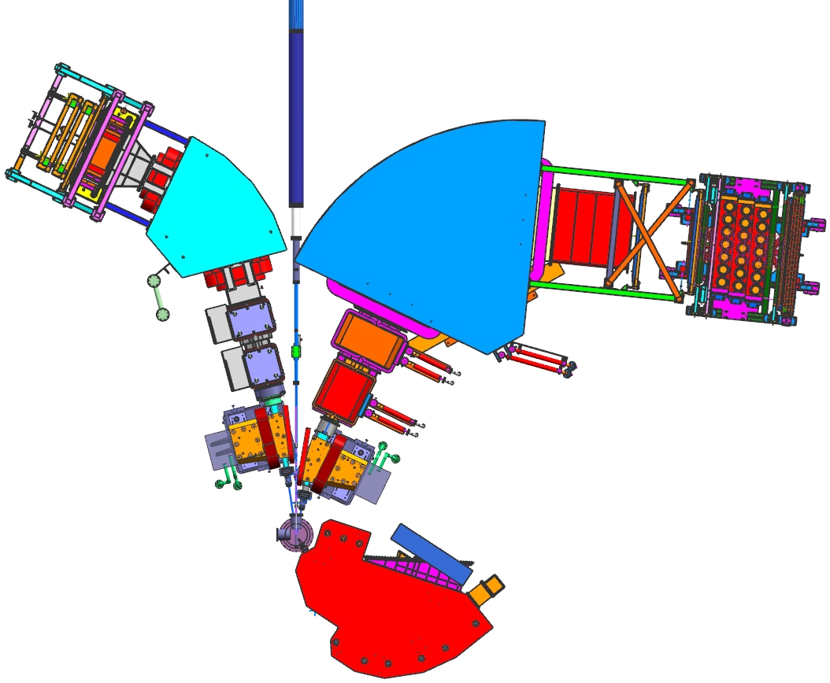
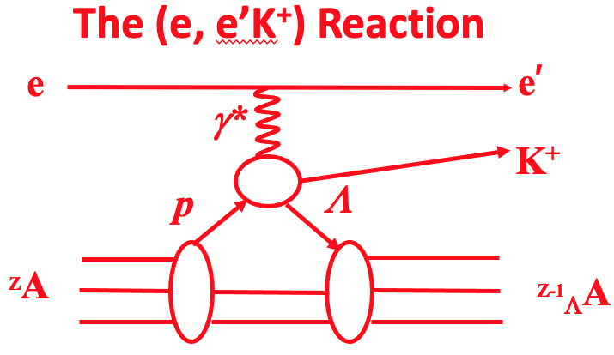
Schematic Layout of The Hypernuclear Spectrometer System
180$°$ between scattering and reaction planes (Δ$φ_{0}$)
$δθ$ is dominated by $δ$x’
HES (e’)
HKS (K⁺)
PCS Magnet
PCS Magnet
Target Chamber
⁶Li, ⁹Be, ¹¹B, ¹²C, ²⁷Al,
⁴⁰Ca, ⁴⁸Ca,
²⁰⁸Pb
Solid target only
Enge (π⁻)
New PCS magnets minimize the particles emitted @near 0$°$ to enter HES and HKS, maintaining high yield while significantly reducing accidental background
Target point: ~11 m downstream from Hall C pivot.
2

Slide 3
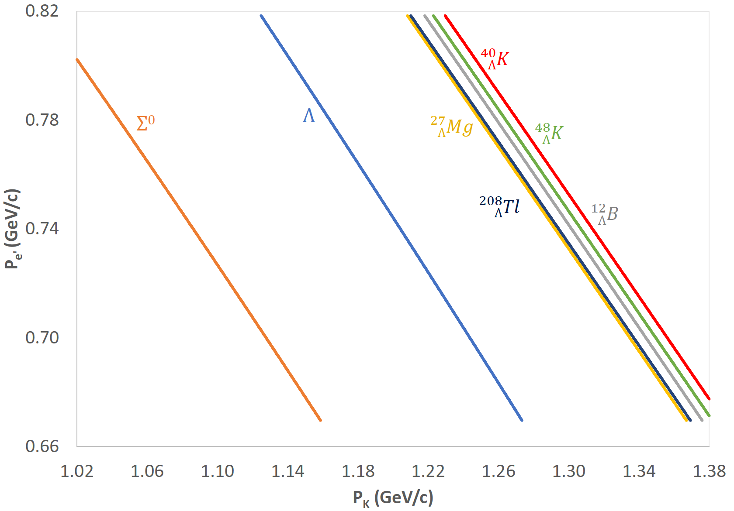
Kinematics For The (e, e’K⁺) reaction
$E_{0}$(Beam) = 2.32 GeV (two-pass beam + injector energy)
$p_{0}$(HES) = 0.744 GeV/c and $θ_{0}$ = 8.5$°$, and $p_{0}$(HKS) = 1.2 GeV/c and $θ_{0}$ $≈$ 7$°$ w.r.t. $γ^{∗}$
$∆p$(HES) = $±$10% and $∆p$(HKS) = $±$15%
No configuration change is required
3

Slide 4
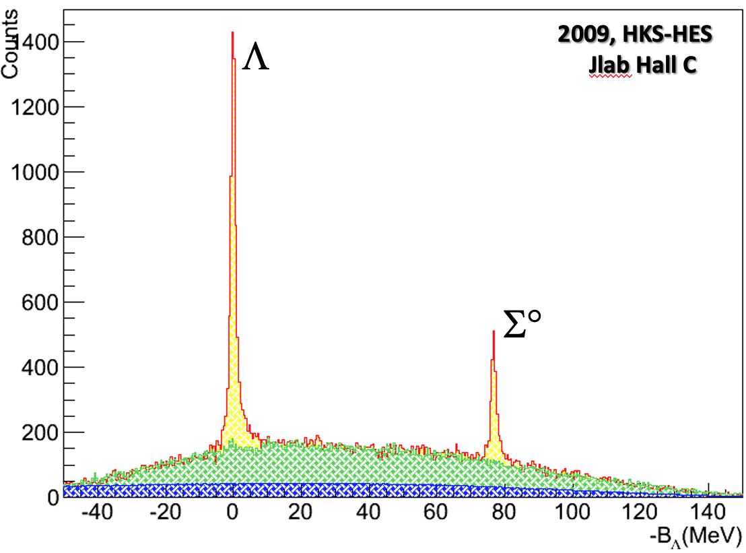
Precise Absolute Mass Calibration For The (e, e’K⁺) reaction
Goal: $δB≤± 50 keV$ and missing mass resolution $≤$ 800 $keV$ (FWHM)
E05-115, CH₂ Target
4

Slide 5
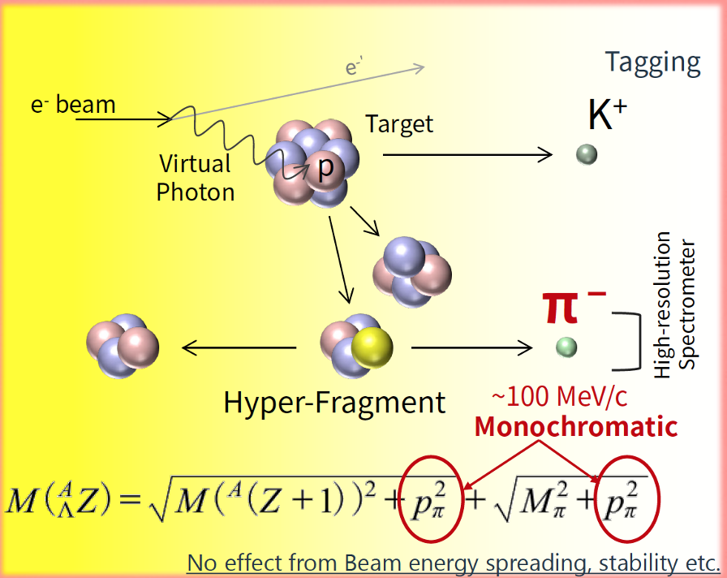
Schematic Layout of The Hypernuclear Spectrometer System
Decay pion spectroscopy from $Λ→p π^{−}$
The ($K^{+}$ & $π^{−}$) coincidence gates on $Λ$ production
HES (e’)
HKS (K⁺)
PCS Magnet
PCS Magnet
Target Chamber
⁶Li, ⁹Be, ¹¹B, ¹²C, ²⁷Al,
⁴⁰Ca, ⁴⁸Ca,
²⁰⁸Pb
Solid target only
Enge (π⁻)
5

Slide 6
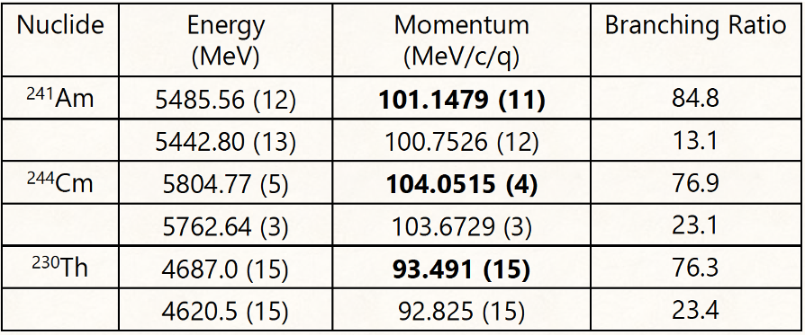
Schematic Layout of The Hypernuclear Spectrometer System
Decay pion spectroscopy from $Λ→p π^{−}$
The ($K^{+}$ & $π^{−}$) coincidence gates on $Λ$ production
HES (e’)
HKS (K⁺)
PCS Magnet
Precise momentum calibration by an Alpha source
PCS Magnet
Target Chamber
⁶Li, ⁹Be, ¹¹B, ¹²C, ²⁷Al,
⁴⁰Ca, ⁴⁸Ca,
²⁰⁸Pb
Solid target only
Enge (π⁻)
6

Slide 7
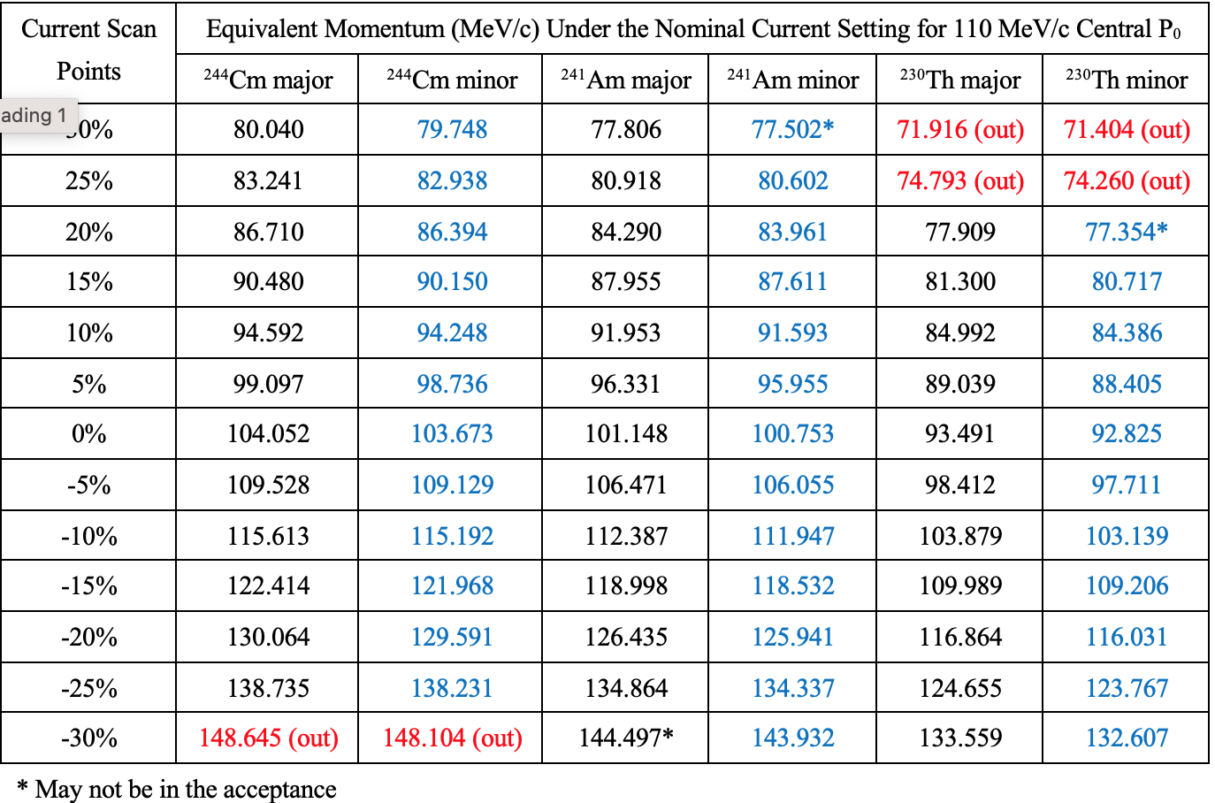
Momentum Calibration by Alpha Source – p Scan
Goal: A momentum resolution $≈$100 – 130 keV (FWHM)
7

Slide 8
Summary
Both beam energy spread (measured by SLI) and stability (controlled by FFB lock) are preferred to be at $σ≈5 × {10}^{−5}$level. The acceptable level is $σ≈8 ×{ 10}^{−5}$. This will enable us to reach the missing mass resolution at the level of $≤$600 keV (FWHM).
Hall C designers/engineers have done a great job in designing and preparing all supporting structures, platforms, shielding bunkers, cable routes and pre- and post-beam lines; evaluating and preparing PS’s and LCW; and investigating the stray field and studying beam tuning power.
Detector preparation is ongoing
We are looking forward a successful run of these five experiments.
8

