Slide 1
Simulation work on the energy resolution and Sieve Slits for the upcoming hypernuclear experiments
Ravindu Kumaragamage
Hampton University

Slide 2
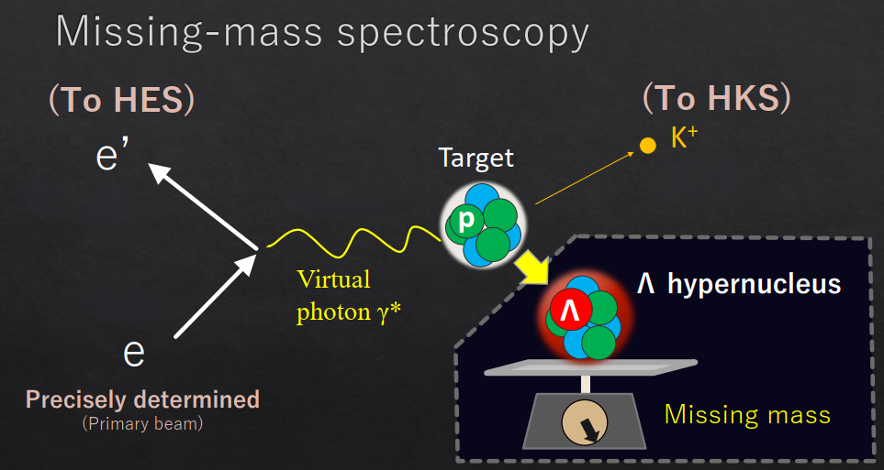
Simulation study on missing mass resolution/ energy resolution
Contributors to the Energy resolution
Beam Energy Uncertainty
Target Straggling (energy loss uncertainties in the target
from e, e', and K+)
Angular Resolutions
Scattered electron angle & Kaon angle
Momentum Resolutions
Scattered electron momentum & Kaon momentum
This simulation study is done using CERN ROOT to observe how missing mass resolution change with these variables using H-1, He-3, Li-6, Be-6, C-12, Al-27, Ca-40, Ca-48 & Pb-208 targets
Gogami, T. (2024). "Study of charge symmetry breaking in p-shell hypernuclei" [PowerPoint presentation] PAC51, Jefferson Lab, VA

Slide 3
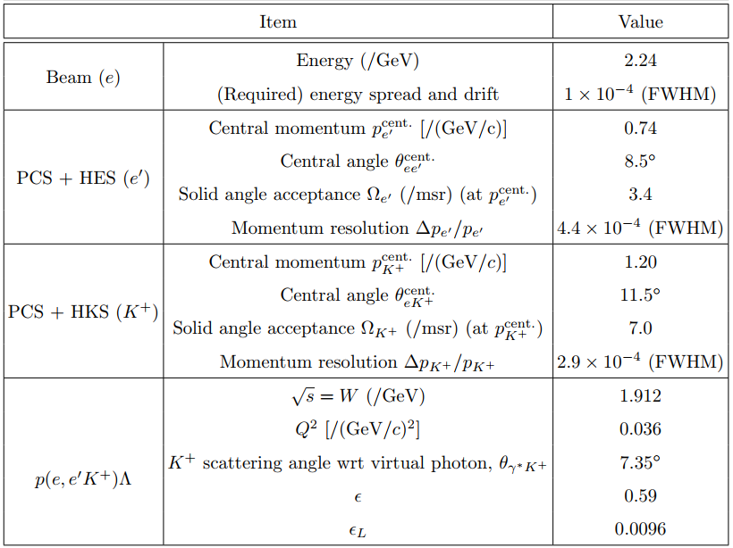
Schematic of the experimental setup at Hall C. HES and
HKS are used for detections of e′ and K+
Summary of the kinematics parameters in the experiment
Missing mass equation used in the simulation
Gogami, T. (2024). "Study of charge symmetry breaking in p-shell hypernuclei" [PowerPoint presentation] PAC51, Jefferson Lab, VA

Slide 4
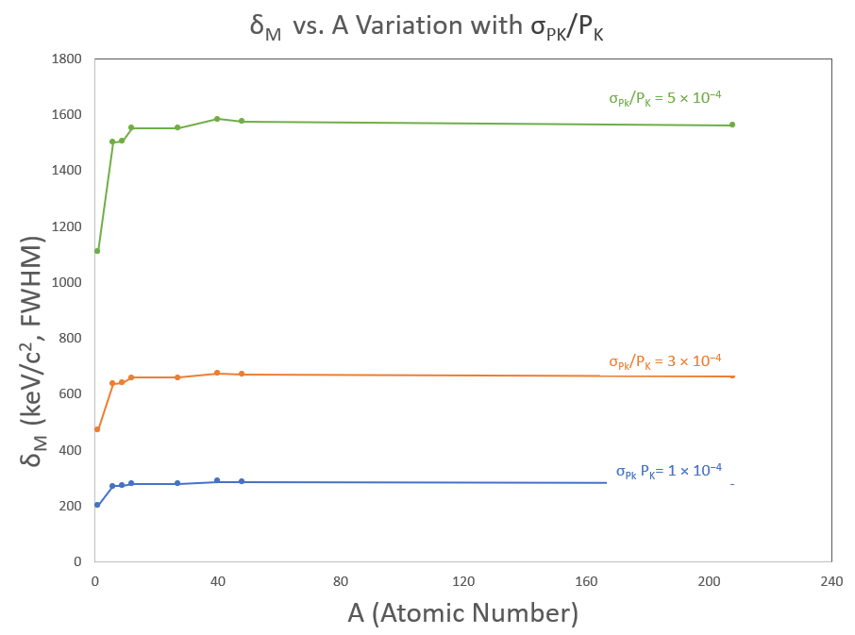
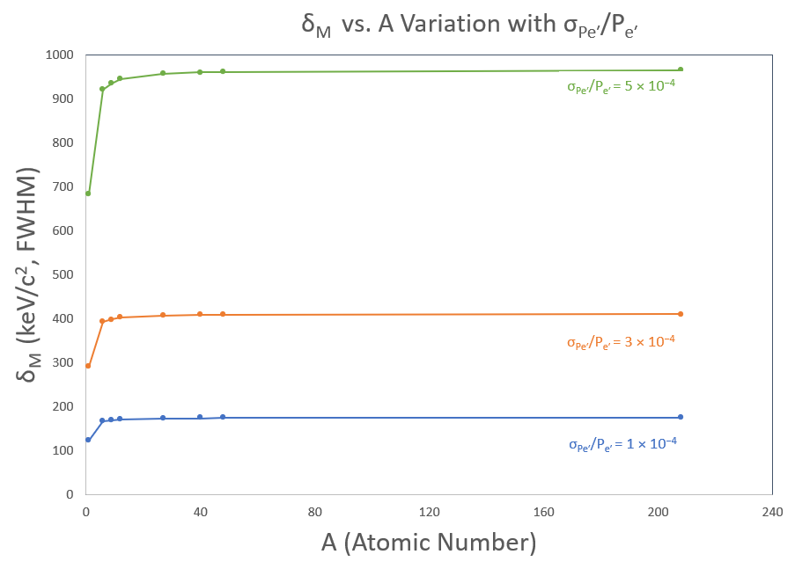
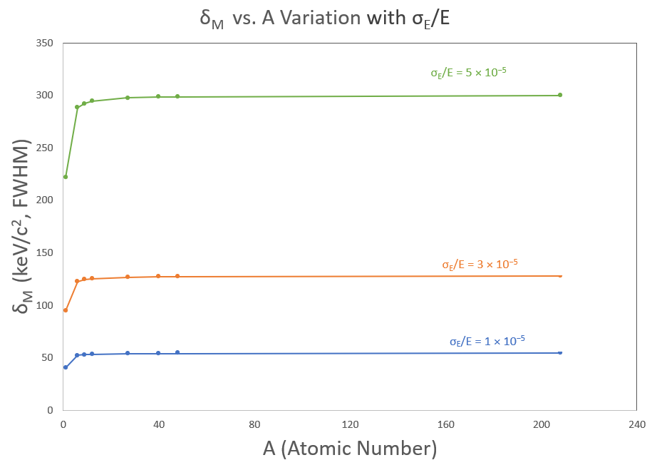
Simulation results from changing only one variable(Kaon Momentum resolution/e’ momentum resolution/Beam uncertainty)
All the other variables are set to zero to isolate the individual effect
Missing mass resolution for Kaon momentum resolution with variation of atomic number
Missing mass resolution for scattered electron momentum resolution with variation of atomic number
Missing mass resolution for beam energy uncertainty with variation of atomic number

Slide 5
observations
Heavy recoil masses have considerably higher dependence to the momentum resolutions from the measurement of the scattered electrons and the associate production of kaons and the beam.
Missing mass resolution for Kaon momentum resolution with variation of atomic number

Slide 6
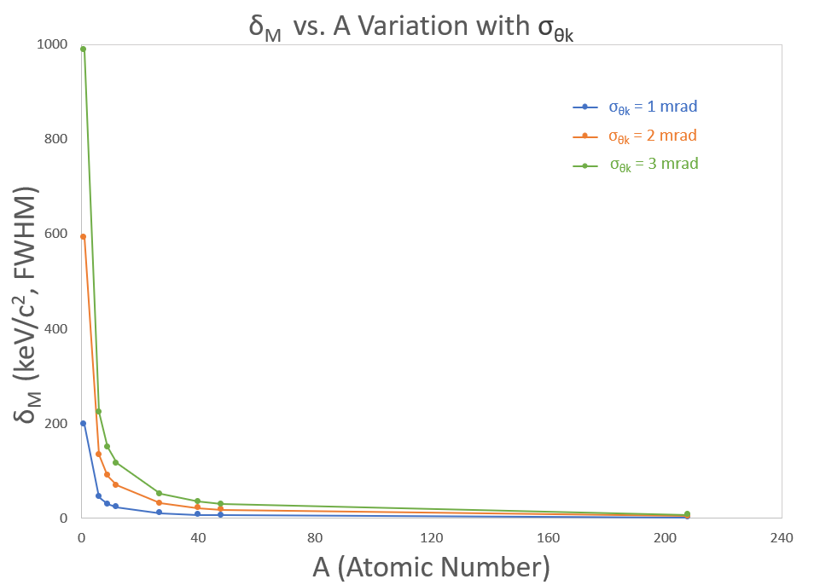
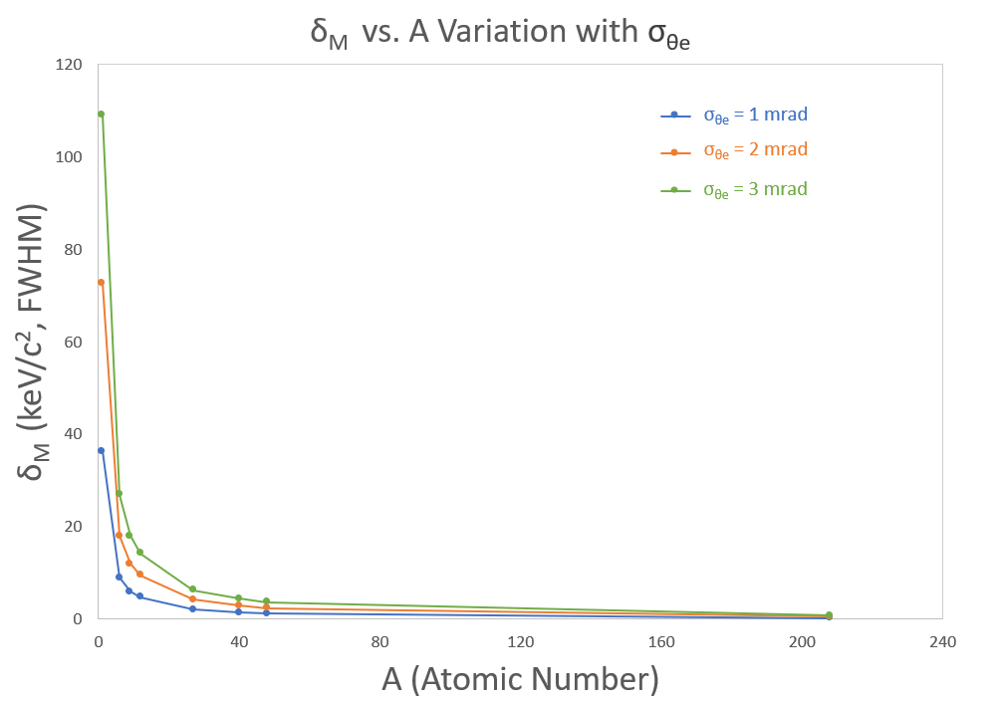
Simulation results from changing only one variable (Kaon angular resolution/e’ angular resolution)
Missing mass resolution for Kaon angular resolution with variation of atomic number
Missing mass resolution for Scattered electron angular resolution with variation of atomic number

Slide 7
observations
Heavy recoil masses are not sensitive to the angular uncertainties
light recoil masses are very sensitive to the angular uncertainties
Missing mass resolution for Kaon angular resolution with variation of atomic number

Slide 8
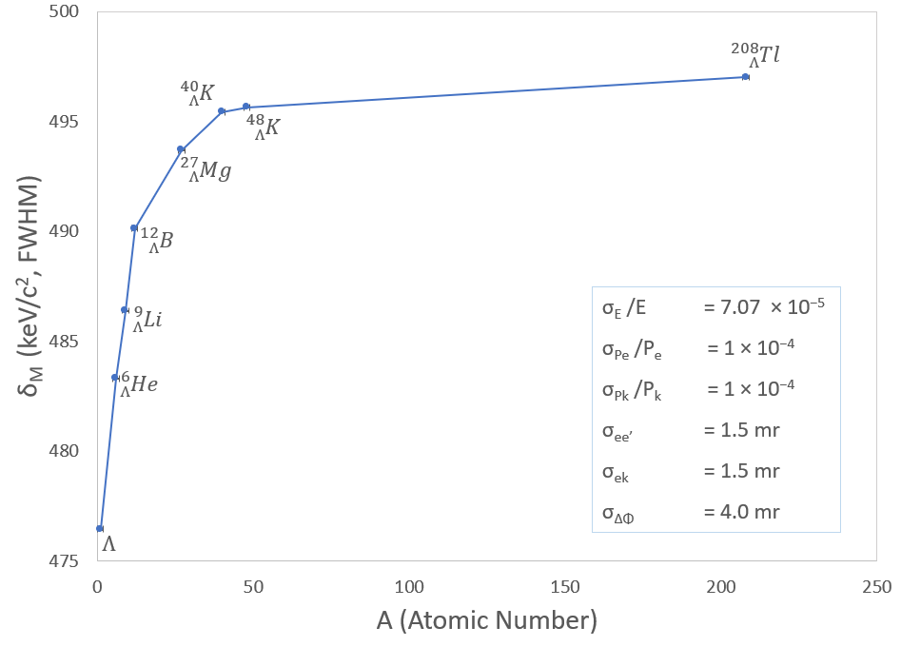
Simulation results with all the variables
Angular resolution ≤ 1.5 mrad (σ):
Minimal impact on missing mass resolution from the angular resolutions
Resolution mainly limited by beam energy & momentum of e' and K+

Slide 9
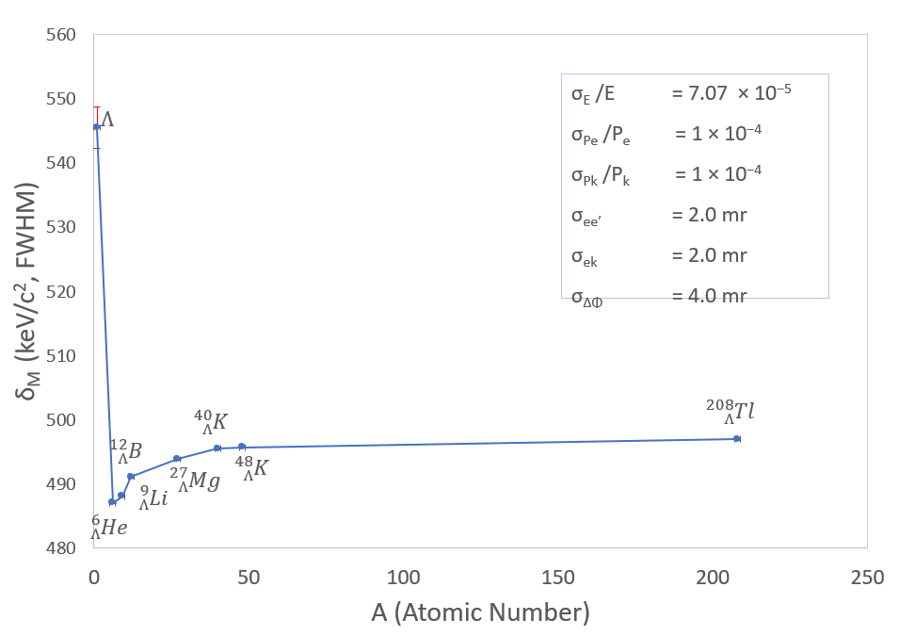
Simulation results with all the variables
Angular resolution > 2.0 mrad (σ):
Significant increase in missing mass resolution degradation, especially for light systems
Overall resolution:
Achievable missing mass resolution ~600 keV/$c^{2}$ for all hypernuclei with controlled uncertainties, which is a very good resolution
These results justify the procedures used to optimize the angular and momentum reconstruction matrices.

Slide 10
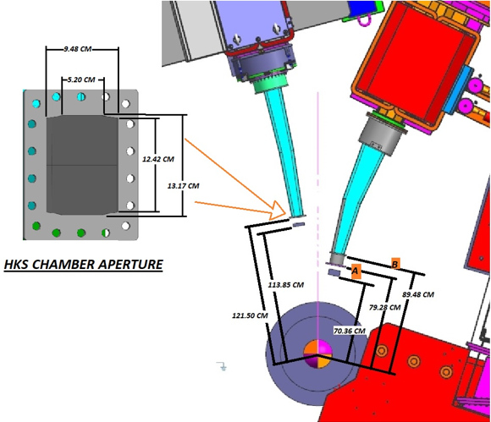
Sieve Slits
Beam Profiling: Sieve slits help shape and define the beam profile by allowing only particles passing through the slit to reach the detector.
Calibration and Alignment: They are used during calibration to ensure that the detector is properly aligned with the particle source.
Collimation: The slit acts as a collimator, filtering out particles not aligned with the desired beam direction, thereby improving measurement accuracy.
Angular Resolution: They enable the measurement of the angular distribution of particles by controlling their trajectory.

Slide 11
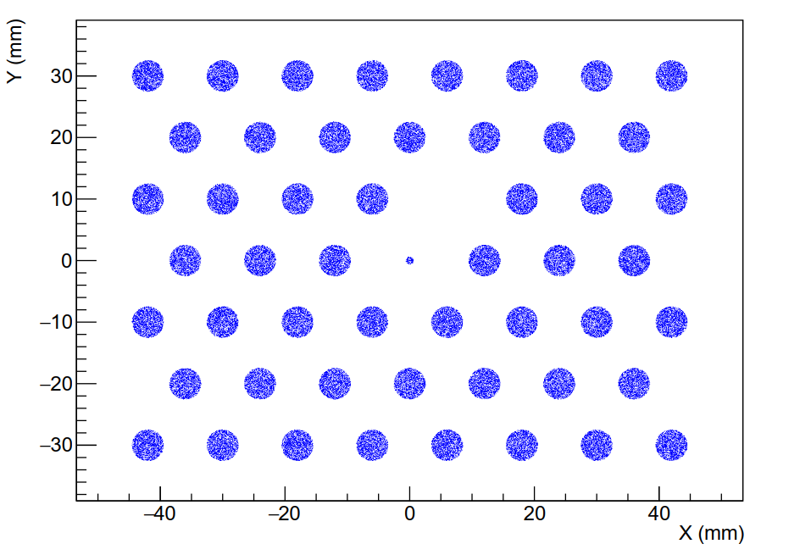
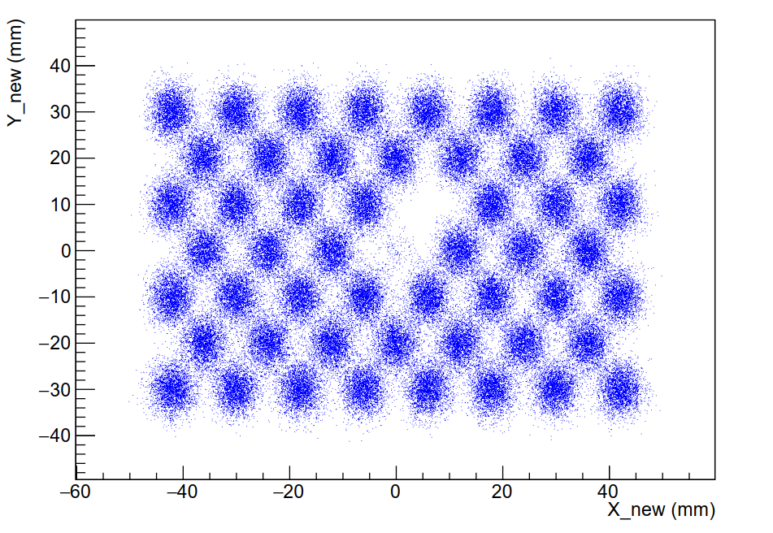
Methodology
Generate a particle beam through the sieve slit with random events
Introduce angular uncertainty with a Gaussian probability function
Reconstruct the sieve slit using the data with uncertainty

Slide 12
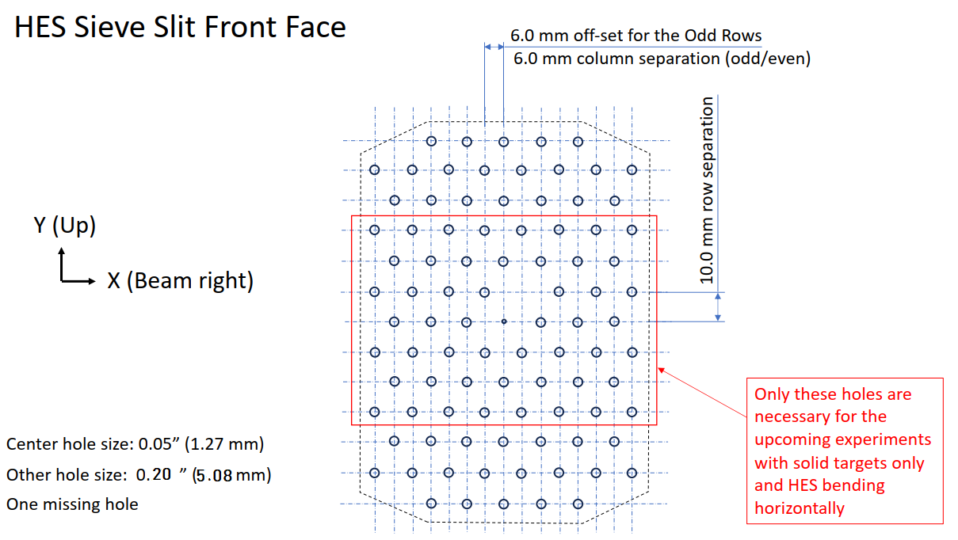
HES Sieve Slit Simulation
Generated beam data for HKS sieve slit

Slide 13
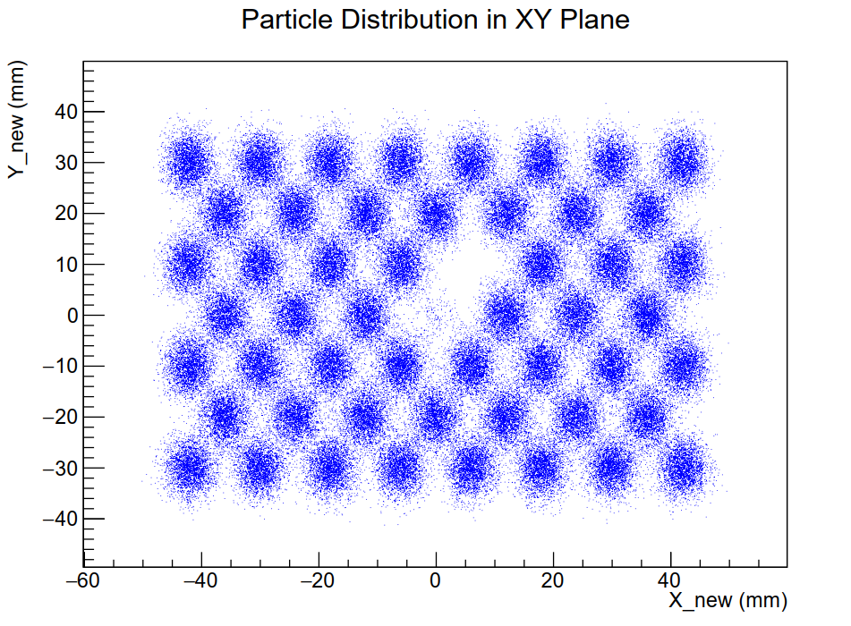
System with x’ angular uncertainty of 1.2 mr and y’ angular uncertainty of 2.0 mr

Slide 14
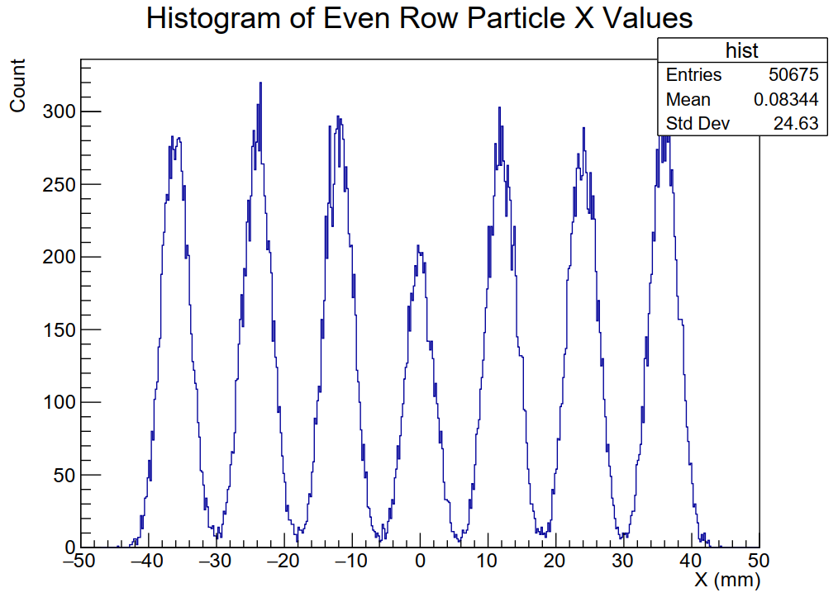
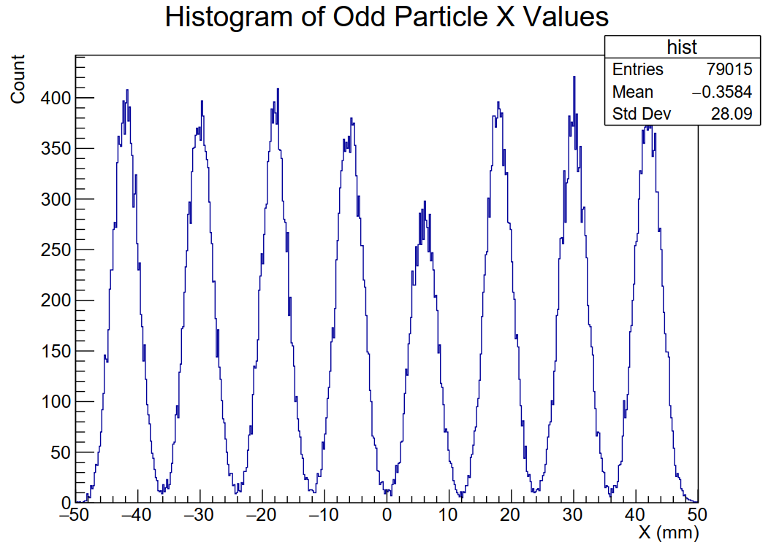
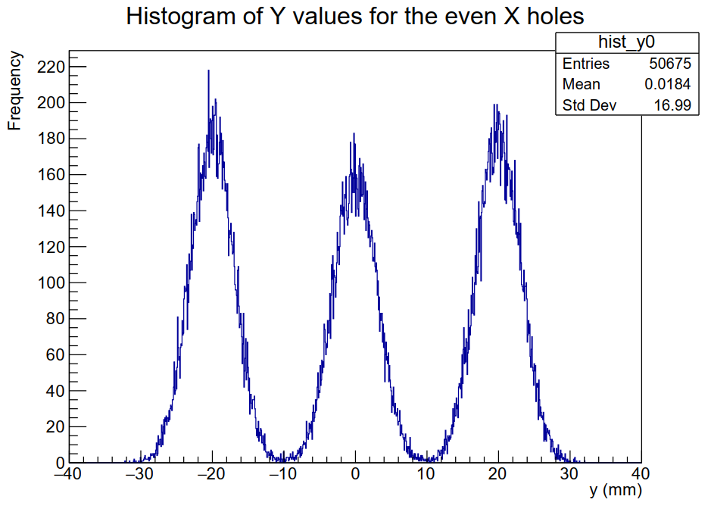
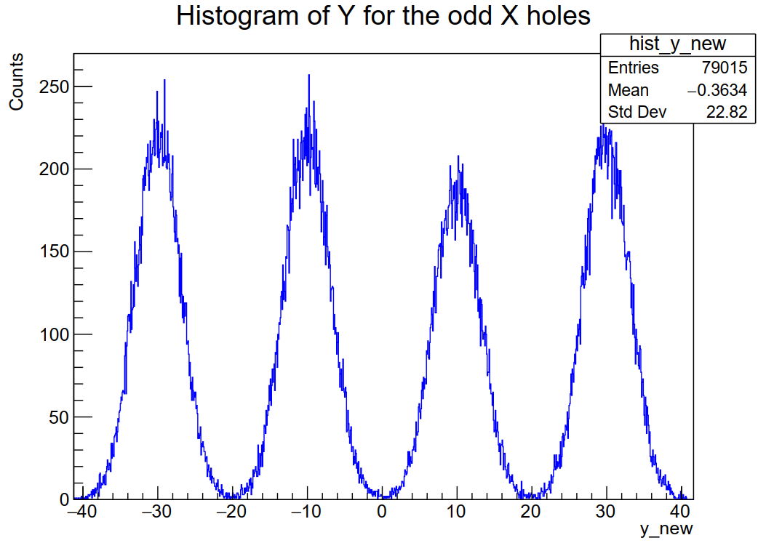

Slide 15
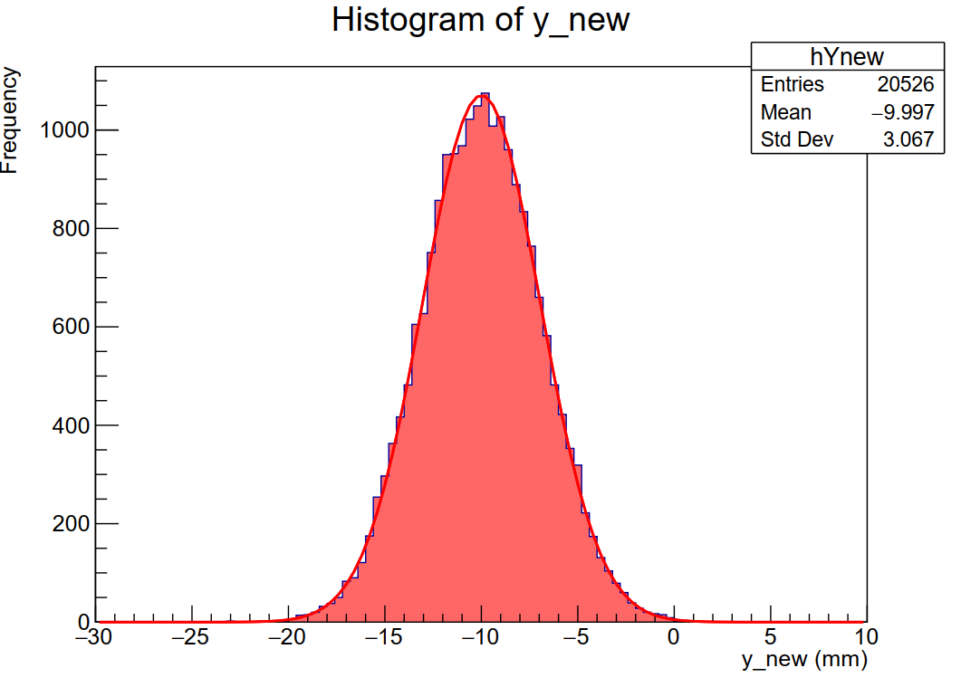
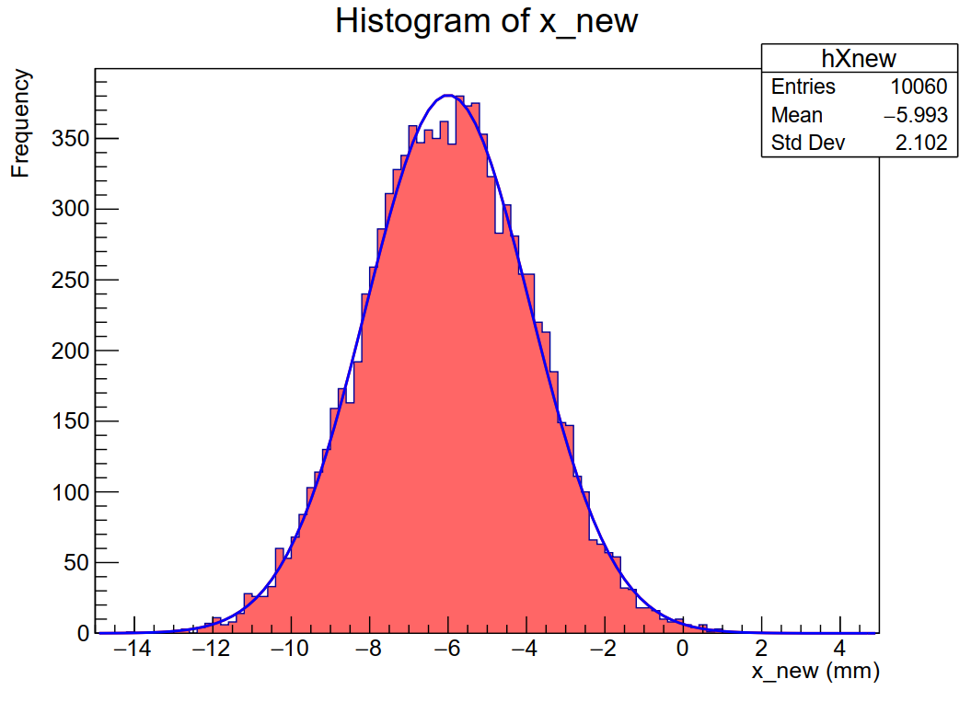

Slide 16
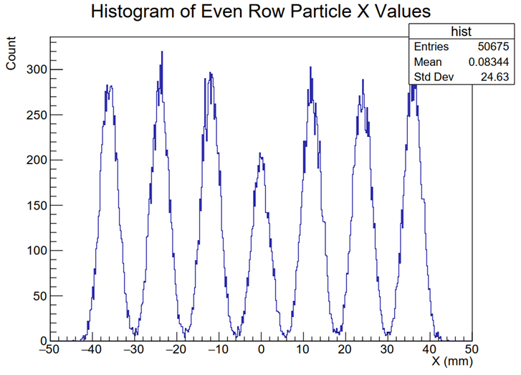
Gaussian width change with equal X’ & y’ angular uncertainties

Slide 17
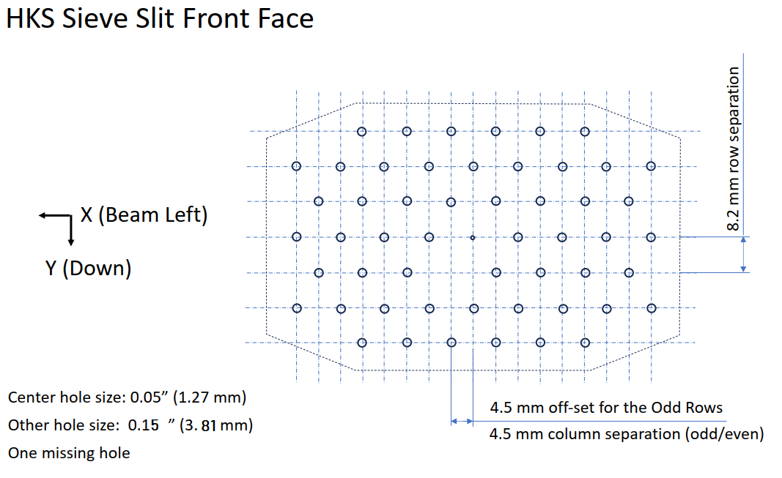
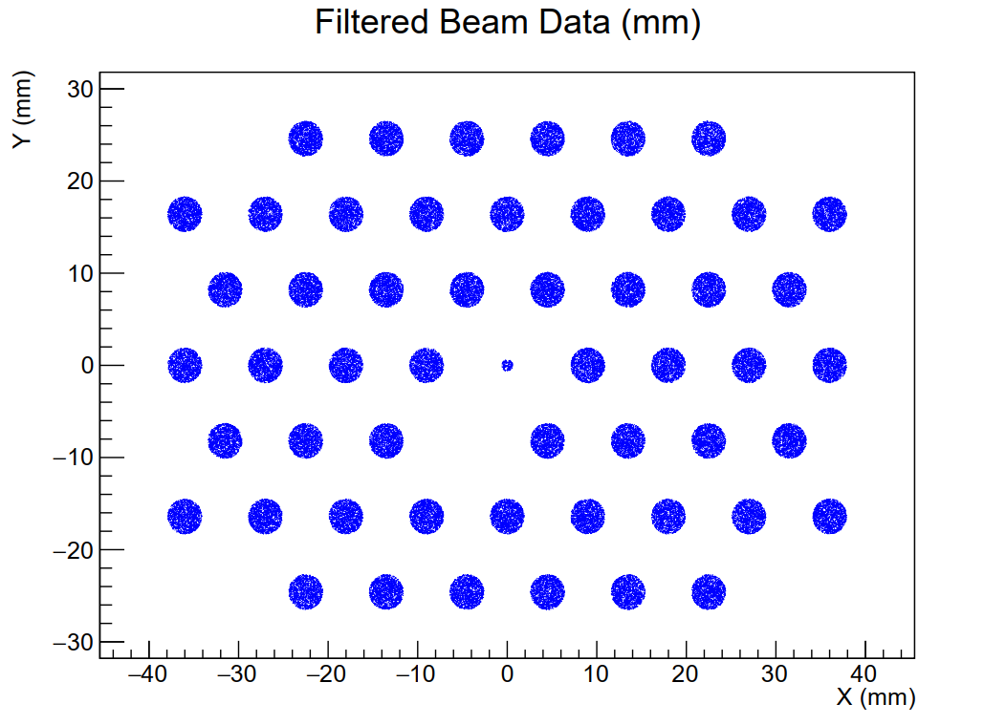
HKS sieve slit Simulation
Generated beam data for HKS sieve slit

Slide 18
Gaussian width change with equal X’ & y’ angular uncertainties

Slide 19
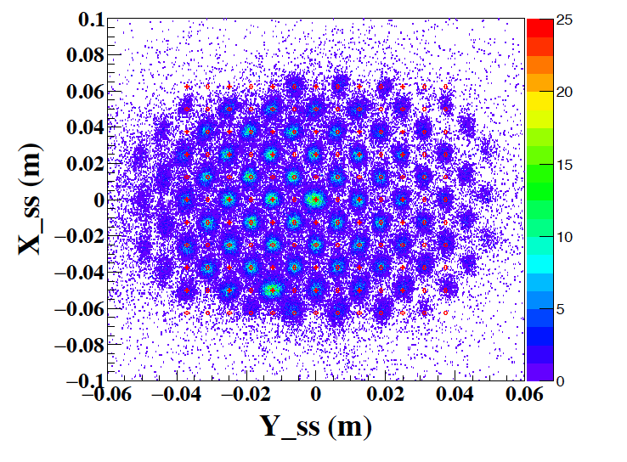
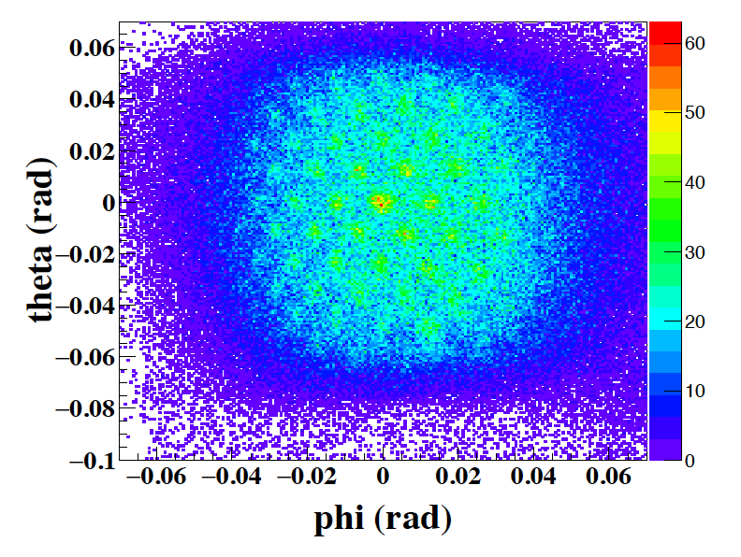
Reconstructed x' vs y' plot from the previous experiment
Reconstructed x’ vs y’ plot of HES sieve slit
Reconstructed x’ vs y’ plot of HKS sieve slit

Slide 20
Summary
Energy Resolution Study
Energy resolution of higher recoil masses depends on beam energy resolution and momentum resolutions of Kaon and e’
Energy resolution of lighter recoil masses depends on Angular resolutions of Kaon and e’
Achievable missing mass resolution ~600 keV/$c^{2}$
Sieve Slit Study
Simulations were done without considering background noise, and the Gaussian widths (sigma) of the reconstructed sieve slit peaks with respect to angular resolutions were observed.

Slide 21
Thank you!
Special thanks to my advisor Dr. Liguang Tang
Jefferson Lab Hypernuclear group members
Hampton University and Jefferson Lab
All other academic, non-academic members, students, and the world!

