Slide 1
JLab Hypernuclear Beamline Update
Hypernuclear Collaboration Meeting
Dave Gaskell
Jefferson Lab
May 15-16, 2025

Slide 2
Hypernuclear Setup in Hall C and Beam Requirements
Hypernuclear target 6.6 meters downstream of nominal target position
Key requirements:
  Successfully transport beam to dump, mitigating stray fields from magnets close to beamline
  Beam energy spread <= 3 x 10⁻⁵ (70 keV at 2.24 GeV)
  Beam position precision and stability at target: σ = 0.1 mm

Slide 3
Beam Position
Existing BPMs (3H07A/B/C) are too far from hypernuclear target to provide required precision (0.1 mm) by themselves
  Δz_{BPM-target} = 9.8/8.8/7.9 meters for existing BPMs
  Assuming σ_{x/y}=0.1 mm for each BPM, σ_{target} = 0.65 mm
Additional position monitors will be added between pivot and hypernuclear target
  Will use existing polarized target girder
  Has 2 BPMs → 3.9 and 2.2 meters from target
  Using 3H07A/B/C + new BPMs, σ_{target} = 0.11 mm
In addition to girder installation work, BPM and harp readout will require support from I&C and Accelerator Software
Reminder

Slide 4
Polarized Target Girder
M20 (3 inch) BPMs
Viewer
Superharps

Slide 5
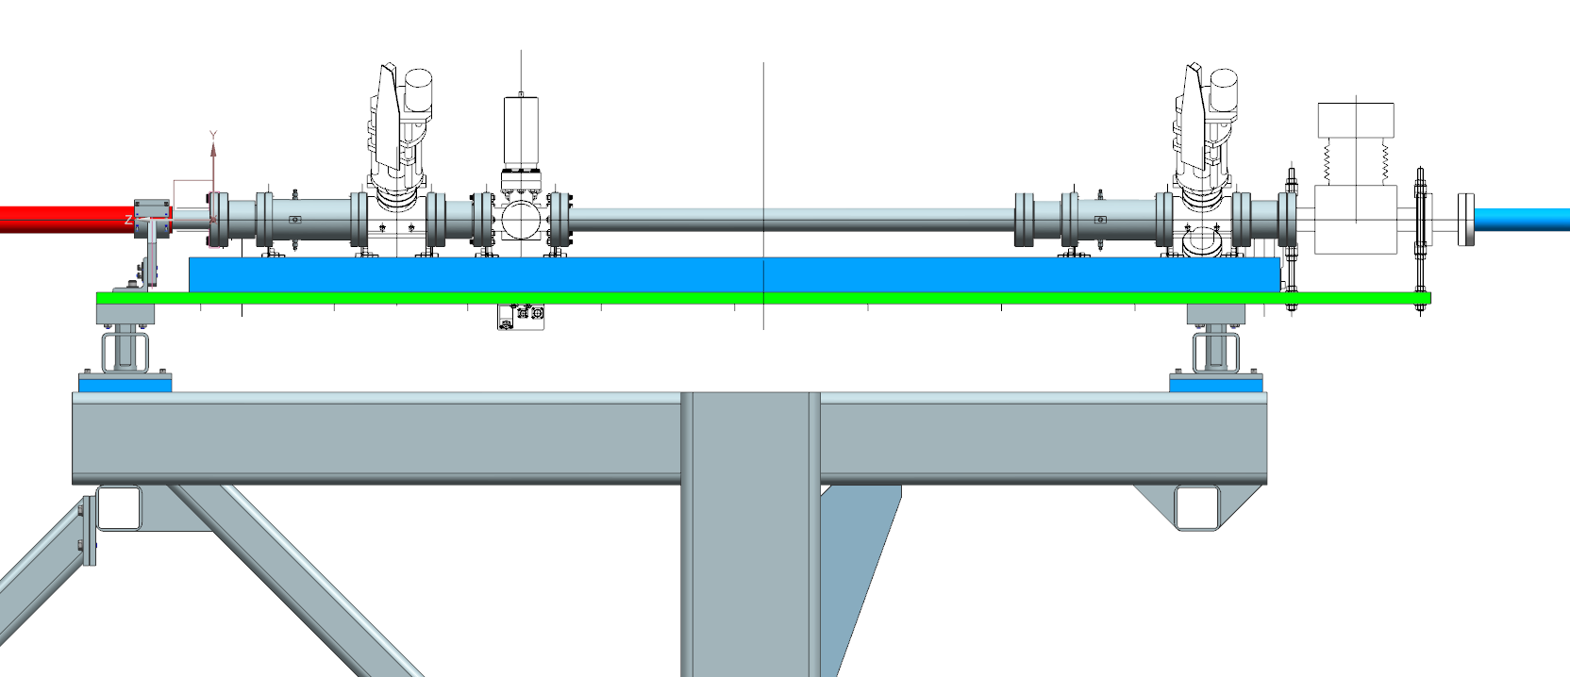
Polarized Target Girder
M20 (3 inch) BPMs
Add extra BPM?
Superharps

Slide 6
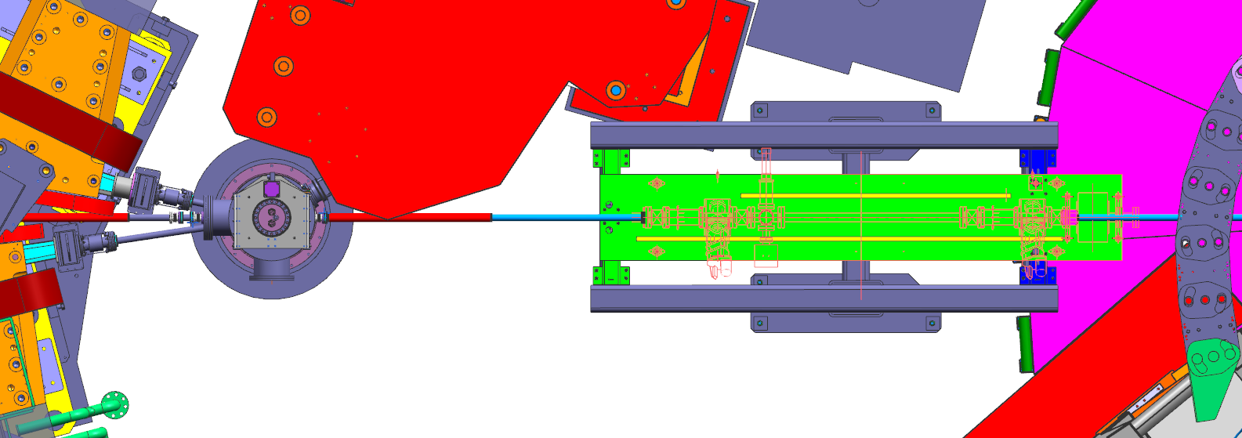
Downstream Diagnostic Girder
Hall C Pivot
Enge
Hypernuclear target
Diagnostic girder
Dean Spiers

Slide 7
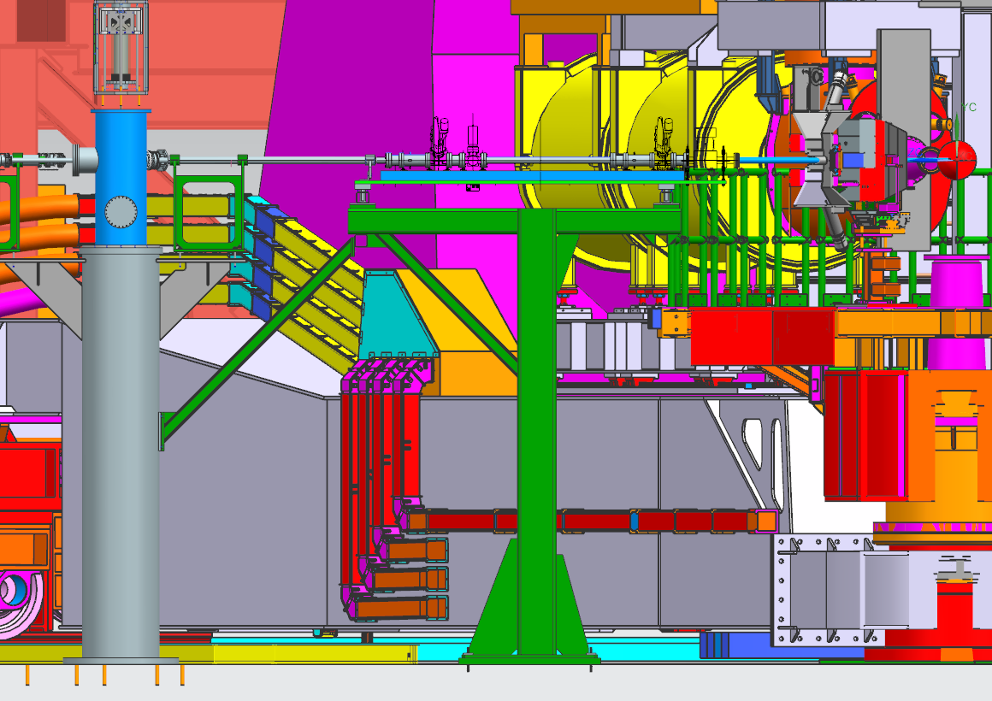
Downstream Diagnostic Girder
Dean Spiers

Slide 8
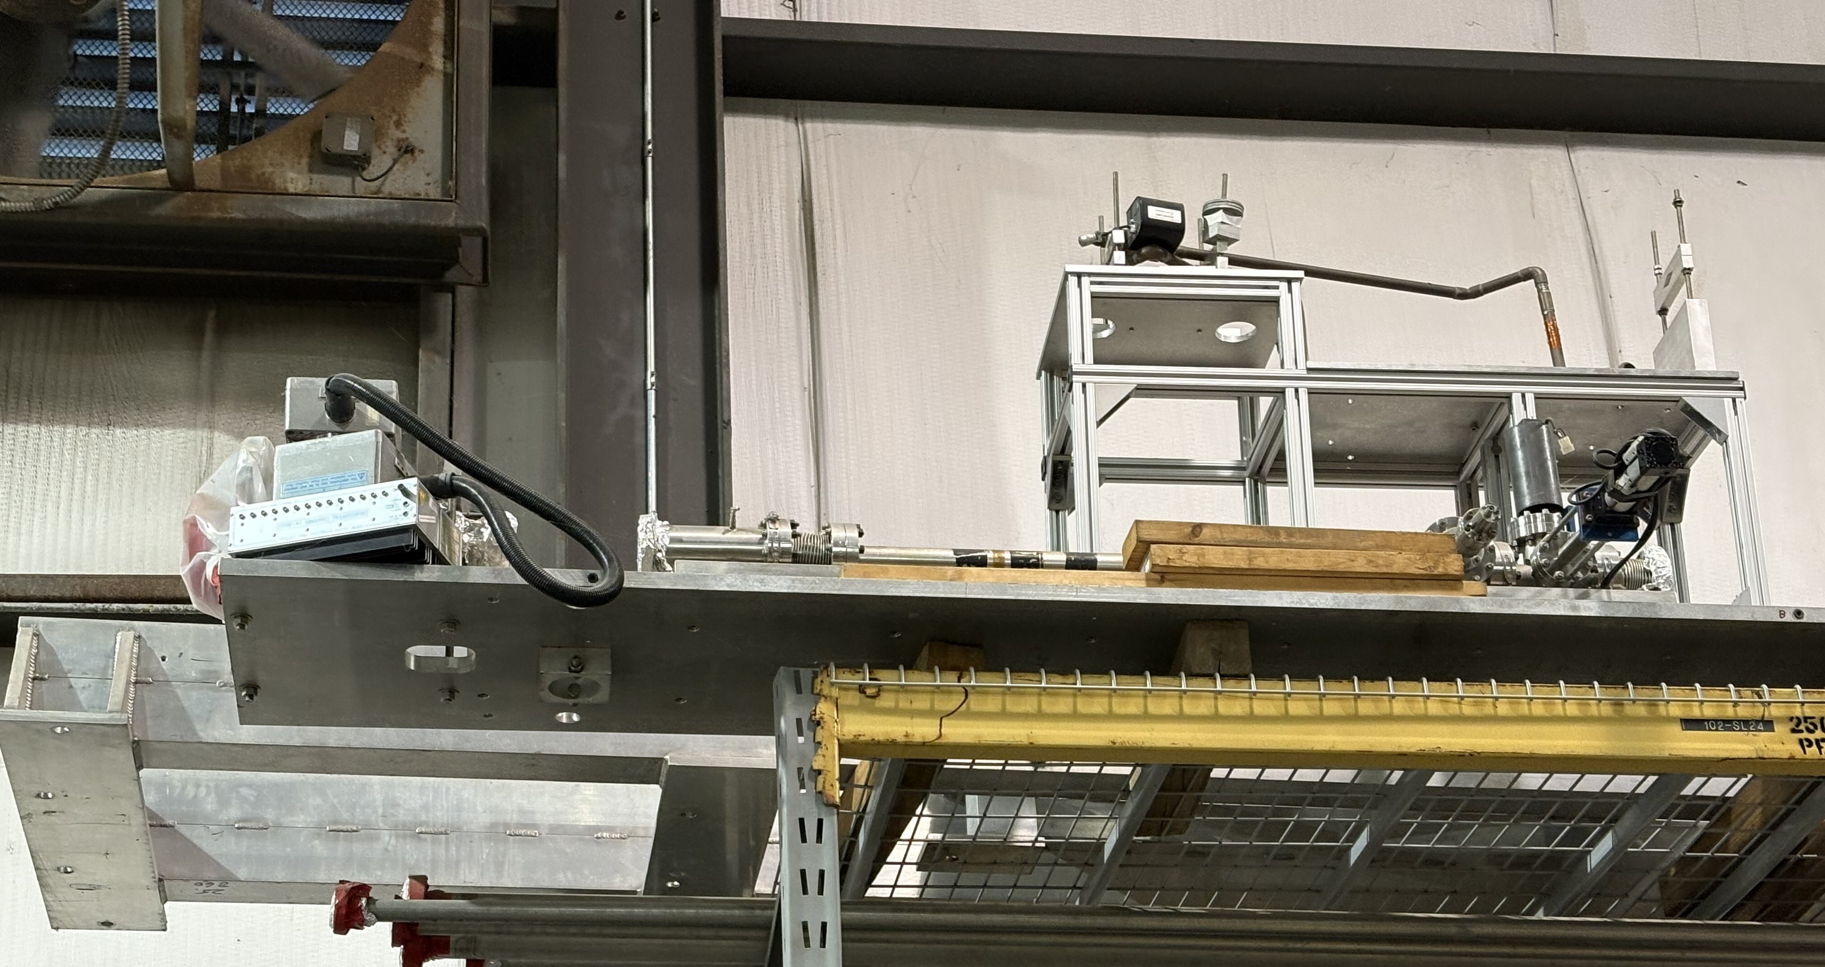
Polarized Target Girder
Polarized target girder on top shelf at the back of Physics Storage
One harp has been removed → used elsewhere in machine
→ Can’t verify from floor that both BPMs are still there
Major effort underway to clean out Physics Storage – Hall C techs will bring down girder, stage somewhere it can be worked on

Slide 9
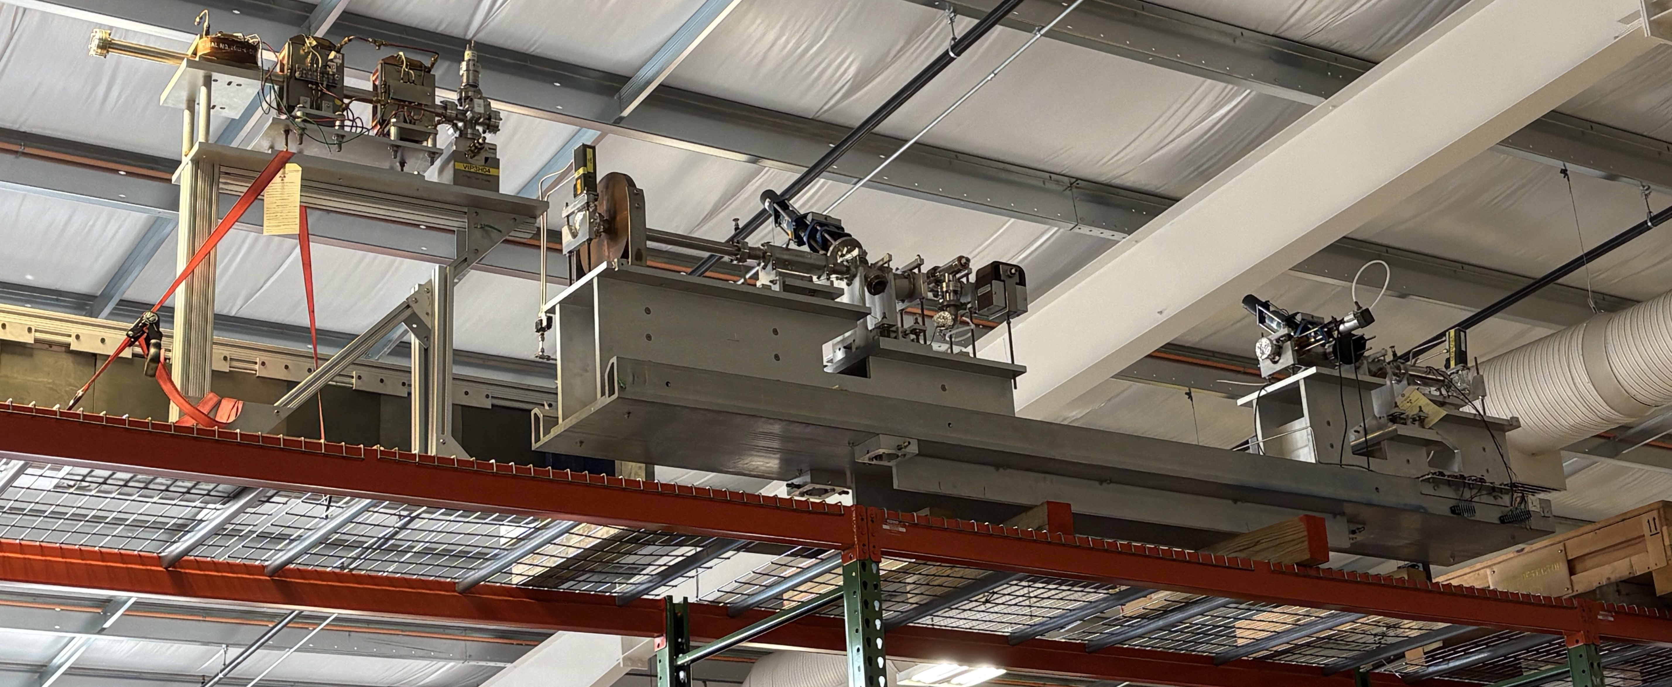
“Spare” Harps and BPMs
Girder used during Q-Weak experiment is stored in ESB → 2 harps and 2 BPMs available (and other things)

Slide 10
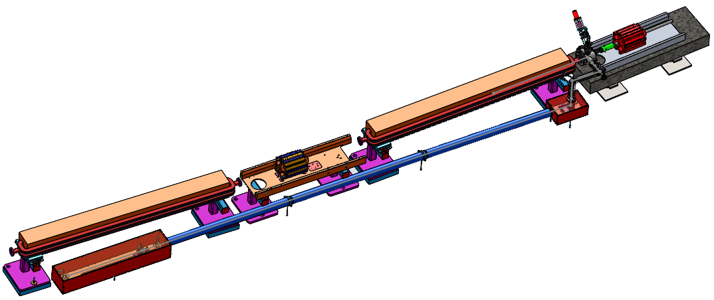
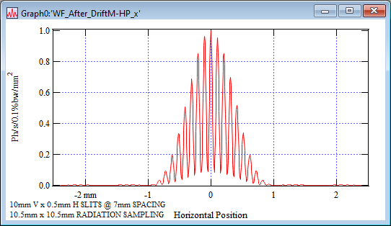
Synchrotron Light Interferometer (SLI)
Beam energy spread will be continuously monitored using new Synchrotron Radiation Interferometer
Installation in Hall C arc complete
Software needed for operation and testing in place
Low currents used during LAD have made it challenging to check out functionality
3C12 GIRDER
Joe Gubeli
TURNING MIRROR
(TW0 AXIS SERVO)
CAMERA, SLIT STAGE

Slide 11
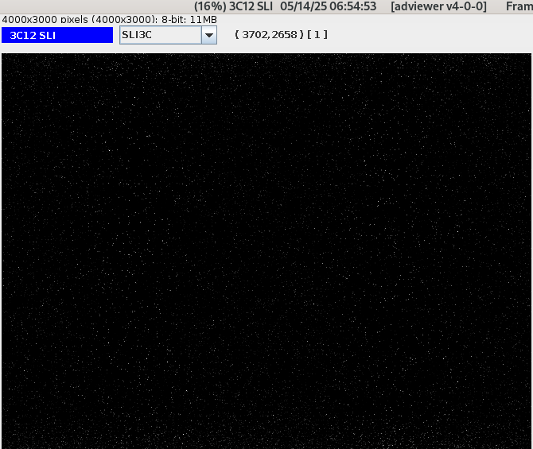
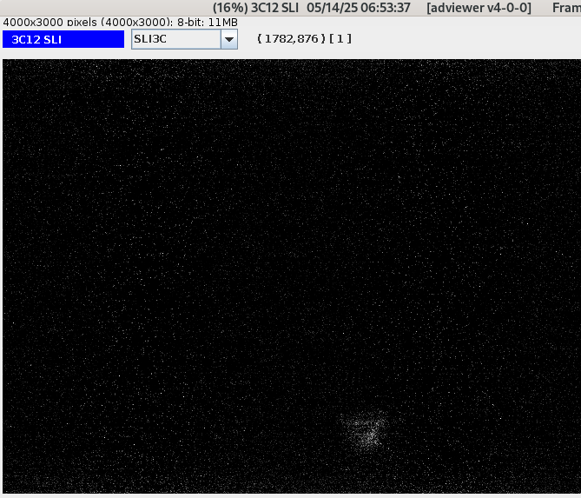
SLI at Low beam current
SLI with beam off
SLI with 0.6 uA
beam!
Joe Gubeli

Slide 12
Test Plan for Energy Width Verification
Goal is to verify required energy width (σ ~ 3 x 10⁻⁵) is achievable
Want to execute test before end of this run
  Test plan will require changing Hall C to 1 pass, setting up beam, executing test
  Will require significant time (days?) → schedule TBD
Pre-requisites
  Need energy fast-feedback working in Hall A
    Position fast-feedback recommissioned, but energy not done yet
    Needed for MOLLER too, so ample motivation to get this working
  Functioning SLI
    Difficult to check-out at low currents
    Plan to take a little time during LAD to run higher currents to test SLI

Slide 13
BPM readout
Hypernuclear experiments will require event-by-event readout of BPM information
  This has not been done in Hall C since Q-Weak experiment (2012)
  Hardware still in place → spares will become available after MOLLER installation in Hall A (switching to new technology)
  Will need additional FADC channels for readout → could “borrow” from HMS and/or SHMS

Slide 14
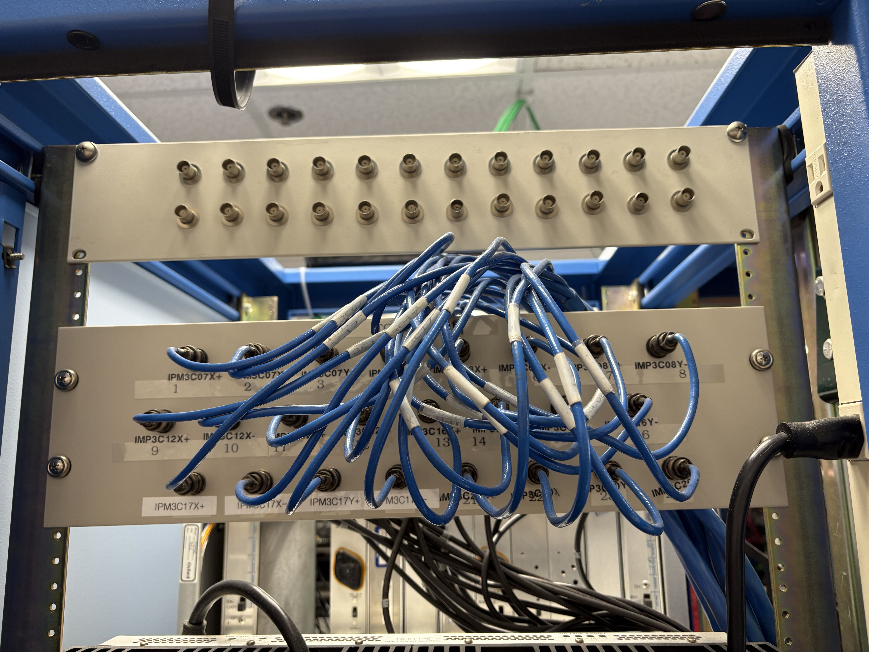
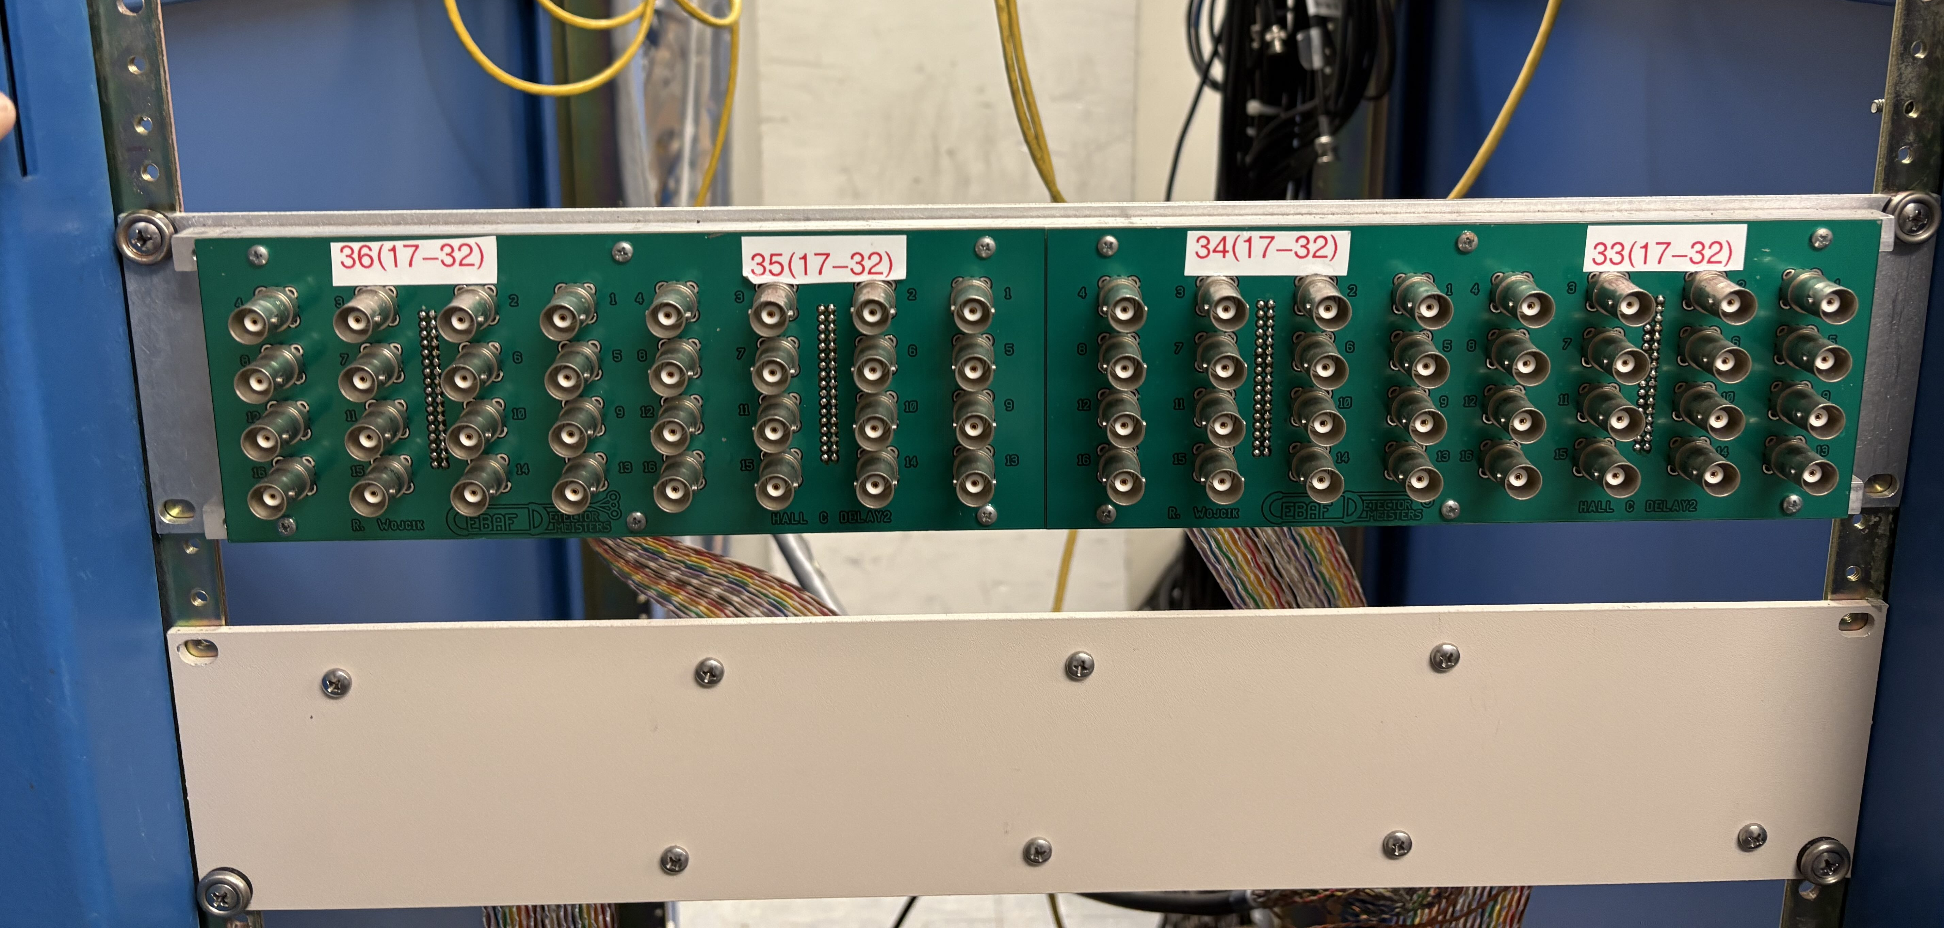
BPM readout
Located patch panels for connections from sample and hold cards
Hall BPMs on 2nd floor (”G0 cage”)
Beamline BPMs (3C12, etc.) in 1st floor electronics room in CH
Will connect a few of these signals to DAQ to make sure they’re working
Where will the BPM (and BCM) readout be? Do we need to patch the signals down to the hall, or have a dedicated crate upstairs?

Slide 15
Beamline Support
Support will be required from several groups to ensure beamline readiness
  Accelerator Operations (Hall C Ops liaison and APEL)
  Instrumentation and Controls Group (I&C)
  Accelerator Controls Software Group
  Diagnostic Development Group
  Hall C Engineering and Design
Coordination has begun, and affected groups are aware of requested support for hypernuclear beamline
Presented ERR slides to beam diagnostics meeting December 12, 2024 → no significant issues expected

Slide 16
Summary
Scope of beamline work needed for Hypernuclear running pretty well understood
  Affected groups are in the loop
Main near-term goal is to test energy width. Requirements:
  Commissioned SLI – will take some time at higher currents soon
  Energy fast feedback in Hall A (MOLLER also needs this)
  Beam time
Will connect some BPM signals to DAQ to check out signals

Slide 17
Backup

Slide 18
Beam Energy Stability: 9th Dipole
Additional information about relative beam energy can be provided using “9th dipole”
System used during previous hypernuclear experiment in Hall C
Not used for absolute beam energy measurement a la Hall A
BE magnet wired in series with Hall C arc magnets
NMR probe placed at fixed position in dipole
BE magnet still in place in BSY service building – needs modest amount of work to revive
Re-cable magnet leads
Locate and install NMR
Implement remote NMR readout

Slide 19
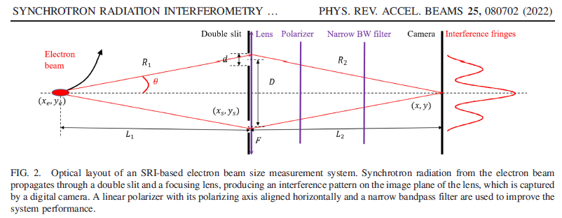
MEASURING THE BEAM SIZE [NON-INVASIVE]
SYNCHROTRON RADIATION INTERFEROMETER
Joe Gubeli

Slide 20
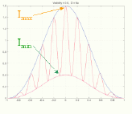
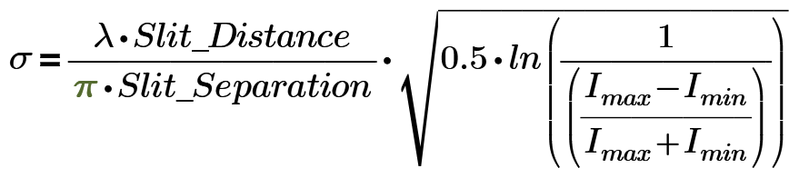
SYNCHROTRON RADIATION WORKSHOP (SRW) SIMULATIONS
TYPICAL FULL CAMERA FRAME
TYPICAL ZOOMED IN CAMERA IMAGE
HORIZONTAL SLICE THROUGH IMAGE CENTER
Joe Gubeli

