Slide 1
Double DVCS with CLAS12 in Hall-B
S. Stepanyan
CLAS Collaboration meeting
Jefferson Lab, March 4-7, 2025
Notes:
----- Meeting Notes (9/27/11 07:19) ---
Many thanks to organizers for invitation to participate in the conference and give this talk on GPD program at JLAB.

Slide 2
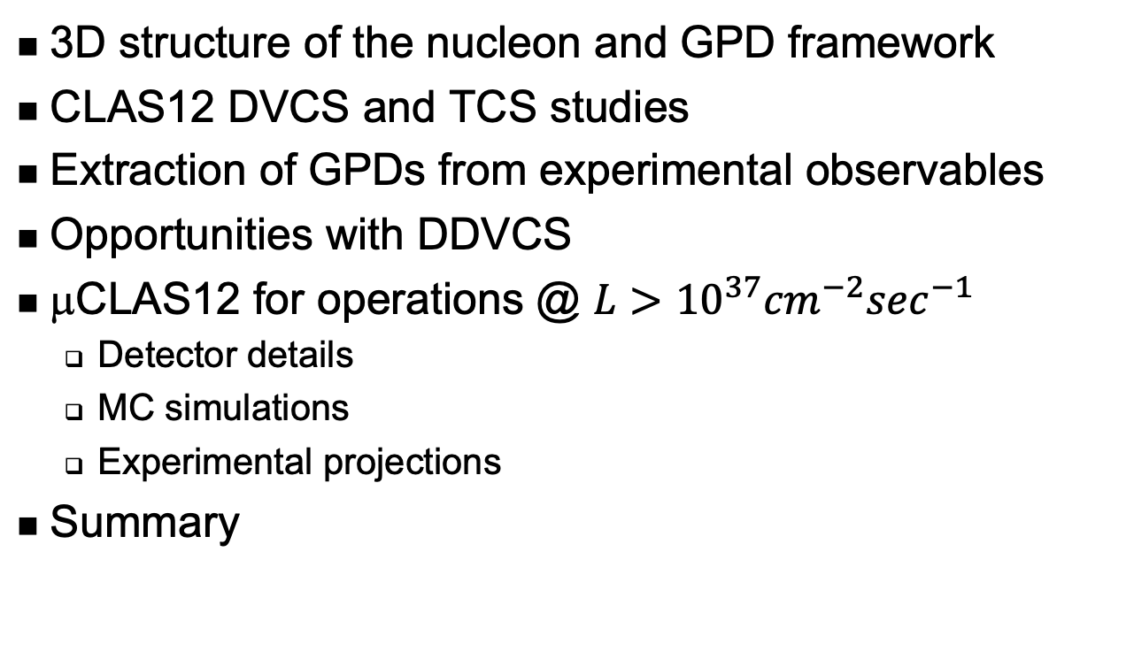
Outline
3D structure of the nucleon and GPD framework
CLAS12 DVCS and TCS studies
Extraction of GPDs from experimental observables
Opportunities with DDVCS
μCLAS12 for operations @ $L>{10}^{37}{cm}^{−2}\sec^{−1}$
  Detector details
  MC simulations
  Experimental projections
Summary

Slide 3
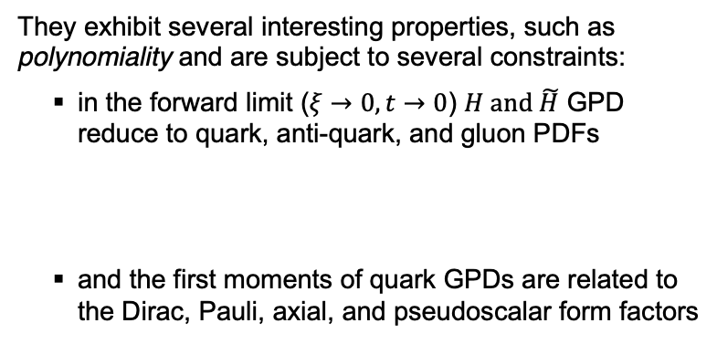
3-D Structure of the Nucleon
The formalism of Generalized Parton Distributions (GPDs) laid the path towards 3-D imaging (femtography) of the nucleon’s partonic structure and determination of nucleons’ fundamental properties using deep exclusive reactions.
The femtography is the major thrust of the CLAS12 science program.
GPDs describe the correlation of quark/antiquark transverse spatial and longitudinal momentum, and the quark angular momentum distributions.
They exhibit several interesting properties, such as polynomiality and are subject to several constraints:
  in the forward limit ($ξ→0, t→0$) $H and \tilde{H}$ GPD reduce to quark, anti-quark, and gluon PDFs
  and the first moments of quark GPDs are related to the Dirac, Pauli, axial, and pseudoscalar form factors
At leading-twist, there are four chiral-even (parton helicity-conserving) GPDs:

Slide 4
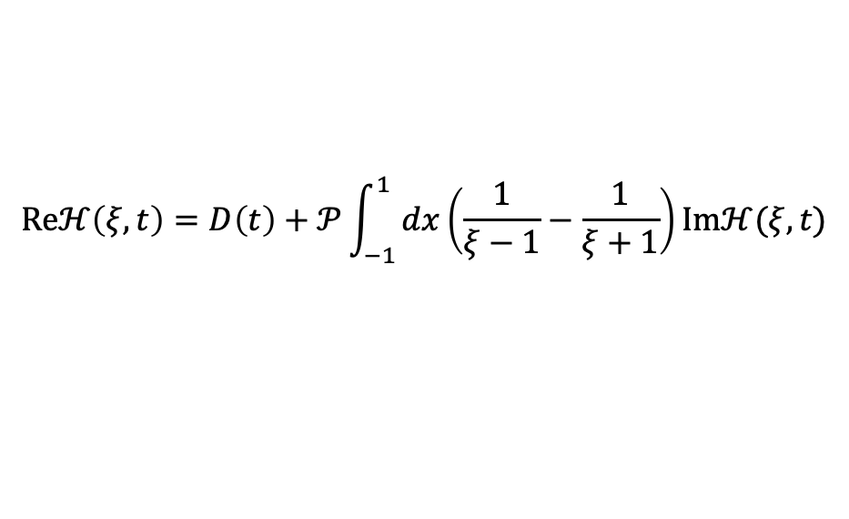
Nucleon EMT FF, GFF and GPDs
The QCD EMT of the nucleon:
The Mellin moments of GPDs linked to the EMT FF -
and the nucleon spin -
Ji, Phys. Rev. Lett 77 / Phys. Rev. D 55, 1997.
The D-term characterizes the distribution of forces inside the nucleon and can be inferred from the GPD dispersion relation.
$$Reℋ\left(ξ,t\right)=D\left(t\right)+𝒫\int_{−1}^{1}{dx\left(\frac{1}{ξ−1}−\frac{1}{ξ+1}\right)}Imℋ(ξ,t)$$

Slide 5
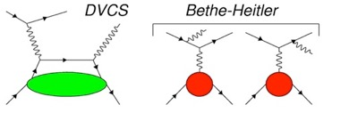
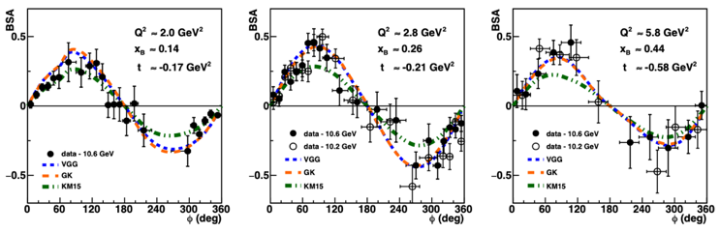
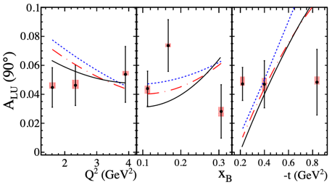




Accessing GPDs experimentally – DVCS
$$ep→e^{′}p^{′}γ=σ_{BH}{+σ}_{DVCS}{+σ}_{Int}$$
+
Over the years, CLAS experiments have provided a large set of data on beam helicity, longitudinal targets, and double spin asymmetries.
$A_{LU}∝Imℋ(\tilde{ℋ}, ℰ)$
$A_{LL}∝Re\tilde{ℋ}(ℋ$)
$A_{UL}∝Im\tilde{ℋ}(ℋ$)
CLAS12 will provide significantly more data on the proton and neutron targets and will add asymmetries on the transversely polarized target.
The quest is on, and the first data have already provided
G. Christiaens et al. (CLAS Collaboration) Phys. Rev. Lett. 130, 211902
A. Hobart et al. (CLAS Collaboration) Phys. Rev. Lett. 133, 211903 (2024).

Slide 6
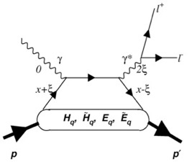
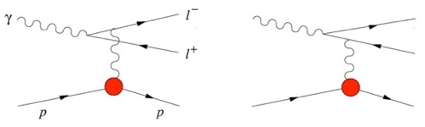
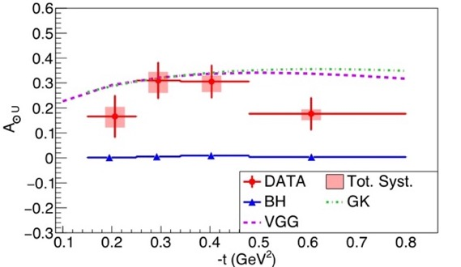
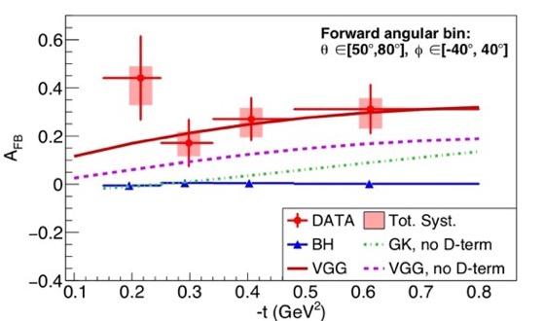
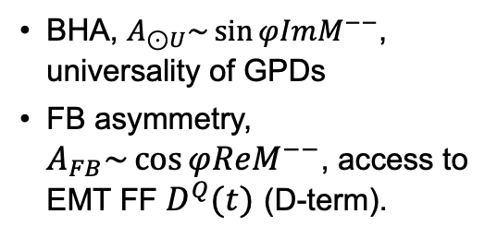
TCS with CLAS12
Bethe-Heitler (BH)
TCS
BHA, $A_{⊙U}\sim \sin{φImM^{−−}}$, universality of GPDs
FB asymmetry, $A_{FB}\sim \cos{φReM^{−−}}$, access to EMT FF $D^{Q}(t)$ (D-term).
+
P. Chatagnon, et al. (CLAS Collaboration),"Phys. Rev. Lett. 127, 262501 (2021).

Slide 7
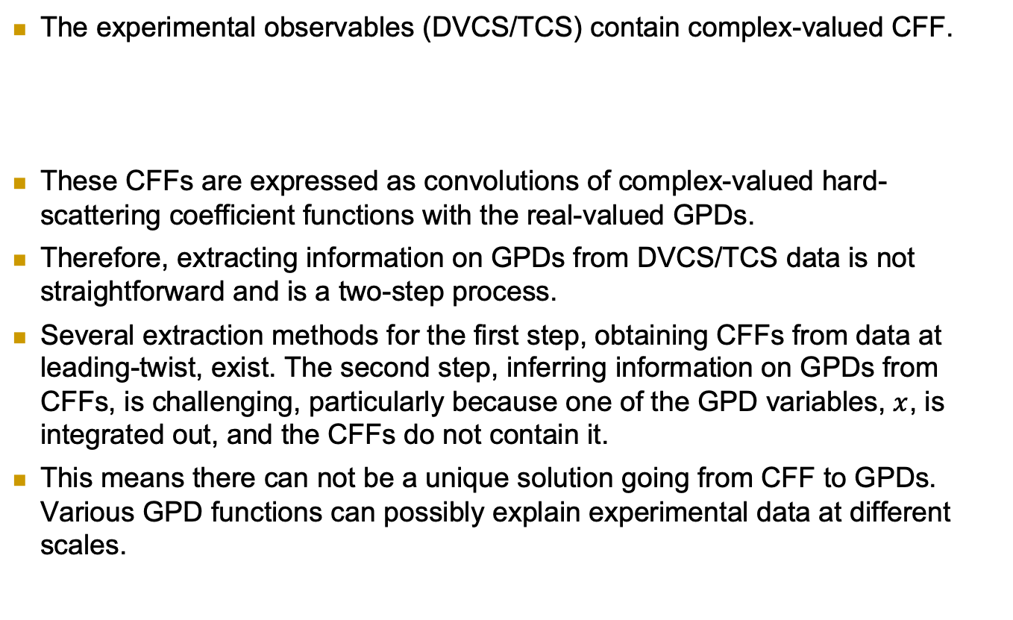
Extracting information on GPDs
The experimental observables (DVCS/TCS) contain complex-valued CFF.
These CFFs are expressed as convolutions of complex-valued hard-scattering coefficient functions with the real-valued GPDs.
Therefore, extracting information on GPDs from DVCS/TCS data is not straightforward and is a two-step process.
Several extraction methods for the first step, obtaining CFFs from data at leading-twist, exist. The second step, inferring information on GPDs from CFFs, is challenging, particularly because one of the GPD variables, $x$, is integrated out, and the CFFs do not contain it.
This means there can not be a unique solution going from CFF to GPDs. Various GPD functions can possibly explain experimental data at different scales.

Slide 8
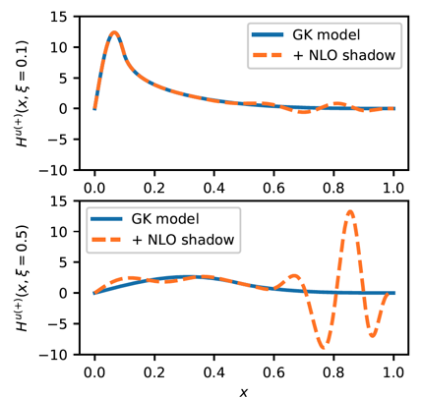
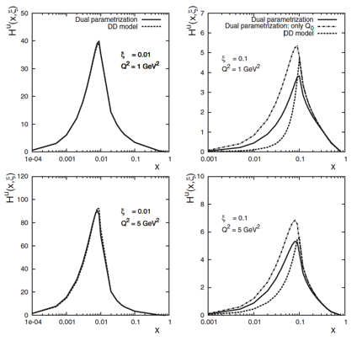
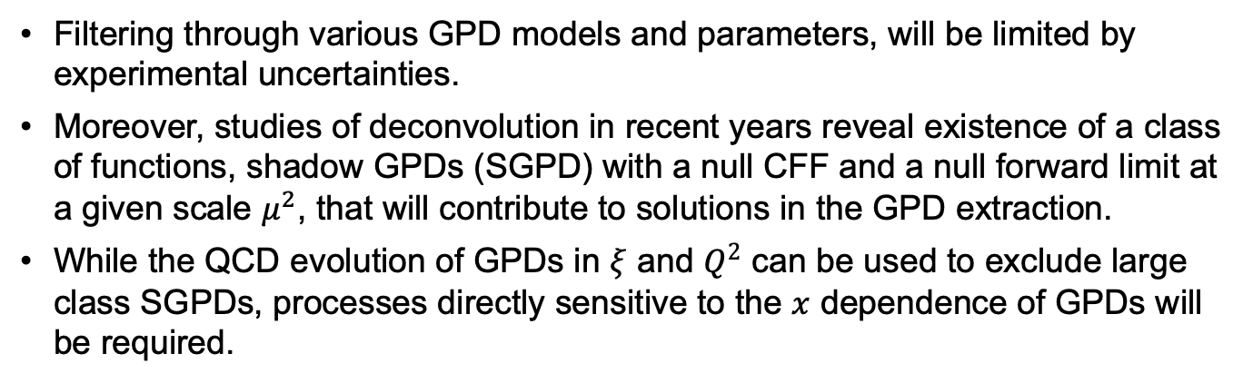
Models of GPDs and SGPDs
Filtering through various GPD models and parameters, will be limited by experimental uncertainties.
Moreover, studies of deconvolution in recent years reveal existence of a class of functions, shadow GPDs (SGPD) with a null CFF and a null forward limit at a given scale $μ^{2}$, that will contribute to solutions in the GPD extraction.
While the QCD evolution of GPDs in $ξ$ and $Q^{2}$ can be used to exclude large class SGPDs, processes directly sensitive to the $x$ dependence of GPDs will be required.
V. Bertone, H. Dutrieux, C. Mezrag, H. Moutarde, and P. Sznajder, Phys. Rev. D 103, 114019 (2021)
V. Guzey and T. Teckentrup, Phys. Rev. D 74, 054027 (2006)

Slide 9
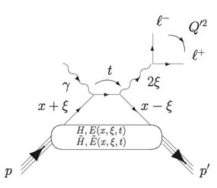
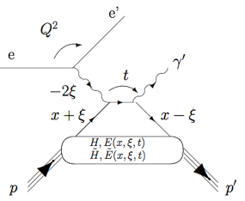
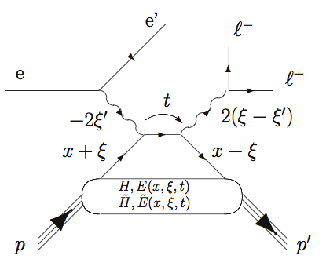

Closing the loop on virtual Compton scattering
First experimental measurement with CLAS12 PRL 127, 262501 (2021)
Started in 2001, PRL 87, 182002.
Now is the flagship physics program
TCS
Hard scale is defined by time-like photons
Hard scale is defined by space-like photon
DVCS
JLAB Flagship program – accessing GPDs through measurements of beam/target asymmetries and the cross sections of Compton processes (TCS and DVCS)
Access to the Re-part of the Compton amplitude
Jefferson Lab at the luminosity frontier is the only place in the world DDVCS can be measured!
μCLAS12 in Hall B and SoLID in Hall A are the two proposed facilities capable of carrying out such measurements.
DDVCS
Both space-like and time-like photons can set the hard scale
σ-DDVCS is three orders of magnitude smaller than σ-DVCS

Slide 10
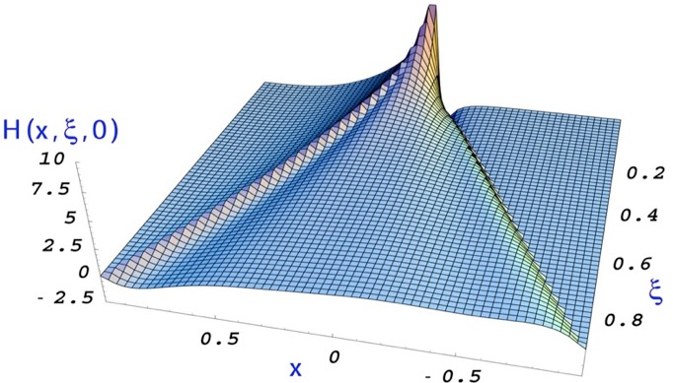
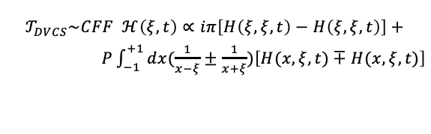
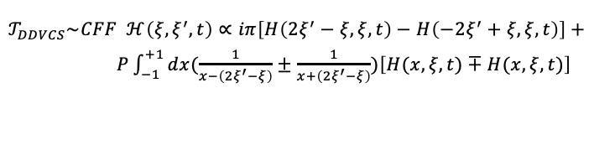
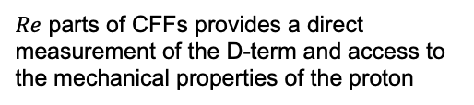


CFFs and GPDs in Virtual Compton Scattering
$$𝒯_{DVCS}\sim CFF ℋ\left(ξ, t\right)∝iπ\left[H\left(ξ,ξ,t\right)−H\left(ξ,ξ,t\right)\right]+$$
$P\int_{−1}^{+1}{dx(\frac{1}{x−ξ}±\frac{1}{x+ξ})\left[H(x,ξ,t)∓H(x,ξ,t)\right]}$
Q²<Q^{’2}
Q²>Q^{’2}
(the same for TCS)
x=-𝜉
x=𝜉
$$𝒯_{DDVCS}\sim CFF ℋ\left(ξ,ξ^{′},t\right)∝iπ\left[H\left(2ξ^{′}−ξ,ξ,t\right)−H\left(−2ξ^{′}+ξ,ξ,t\right)\right]+$$
$P\int_{−1}^{+1}{dx(\frac{1}{x−\left(2ξ^{′}−ξ\right)}±\frac{1}{x+\left(2ξ^{′}−ξ\right)})\left[H(x,ξ,t)∓H(x,ξ,t)\right]}$
Spin asymmetries (Im, $x=ξ$)
HERMES, CLAS, Hall A, JLAB12, COMPASS
Angular asymmetry in TCS (|Re|) JLAB12
Charge asymmetry in DVCS (|Re|) HERMES, COMPASS, JLAB12
DVCS Cross sections (|Re|²) H1, Hall A, JLAB12, COMPASS
DDVCS (Im, $x≠ξ$) – JLAB12 at L ≥ 10³⁷ cm⁻² sec⁻¹
$Re$ parts of CFFs provides a direct measurement of the D-term and access to the mechanical properties of the proton
Notes:
----- Meeting Notes (9/27/11 11:46) -----
so far the most promising way to access GPDs experimentally is through deeply virtual Compton scattering
DVCS is measured together with BH process, DVCS observables are spin and charge asymmetries and cross sections
----- Meeting Notes (9/27/11 12:09) -----
existing and a future programs will measure spin asymmetries and cross sections, there is one measurement on BCA (Hermes), important for direct access to the real part of CFF

Slide 11
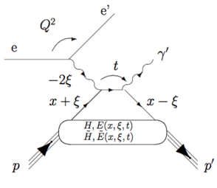
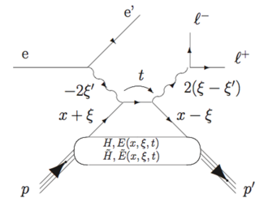
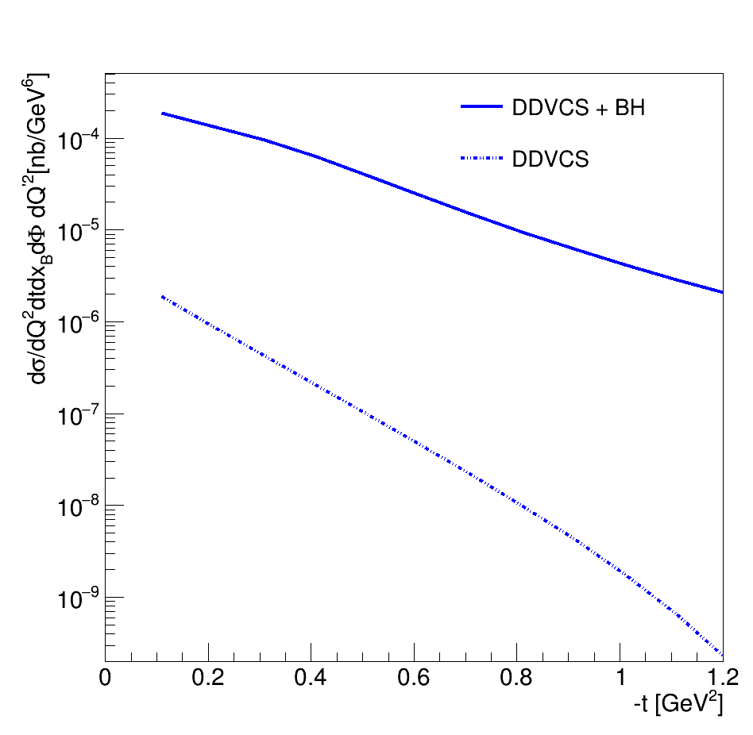
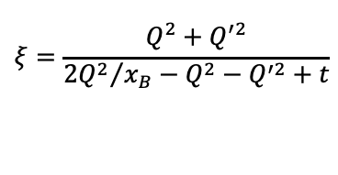




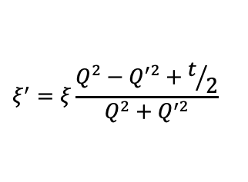
DVCS and DDVCS cross sections
$$Q^{′2}≡M^{2}={(l^{+}−l^{−})}^{2}$$
$$Q^{2}=−q^{2}={(e−e^{′})}^{2}$$
$$ξ=\frac{Q^{2}+Q^{′2}}{{{2Q}^{2}}/{x_{B}}−Q^{2}−Q^{′2}+t}$$
$$x_{B}=\frac{Q^{2}}{2pq}$$
$$t={(p−p^{′})}^{2}$$
$$ξ^{′}=ξ\frac{Q^{2}−Q^{′2}+t/2}{Q^{2}+Q^{′2}}$$
$$E=10.6 GeV; Q^{2}=2.75 GeV^{2}; x_{B}=0.15; Q^{′2}=1.4 GeV^{2}$$
Cross sections from R. Paremuzyan, VGG code

Slide 12
Proposal following LOI in 2016

Slide 13
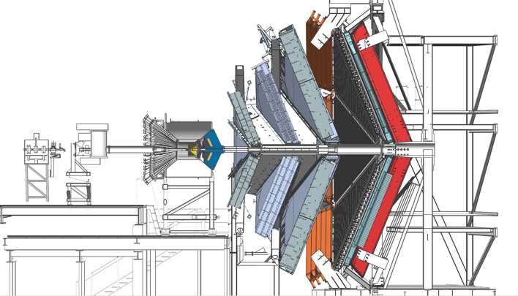
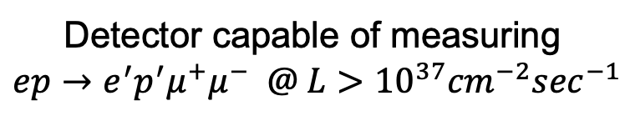
High luminosity CLAS12 for DDVCS
Two main challenges in DDVCS measurements:
The cross-section is four orders of magnitude smaller than that of DVCS;
Ambiguities and anti-symmetrization issues with the decay leptons of the outgoing virtual photon and the incoming-scattered lepton.
Di-muon electroproduction using upgraded CLAS12 will overcome these challenges.
μCLAS12
A simple concept:
Remove HTCC and block the CLAS12 forward with a W-shield and PbWO₄ calorimeter to prevent flooding of DC by EM background;
Scattered electrons will be detected in the calorimeter, while shield will work as pion filter, as most of charged pions will shower and will not reach to the forward tracking system;
Remove CVT, instead use a high rate MPGDs for central and forward (in front of the calorimeter) tracking
Shield
Trackers
Calorimeter
Detector capable of measuring
$$ep→e^{′}p^{′}μ^{+}μ^{−} @ L>{10}^{37}{cm}^{−2}\sec^{−1}$$

Slide 14
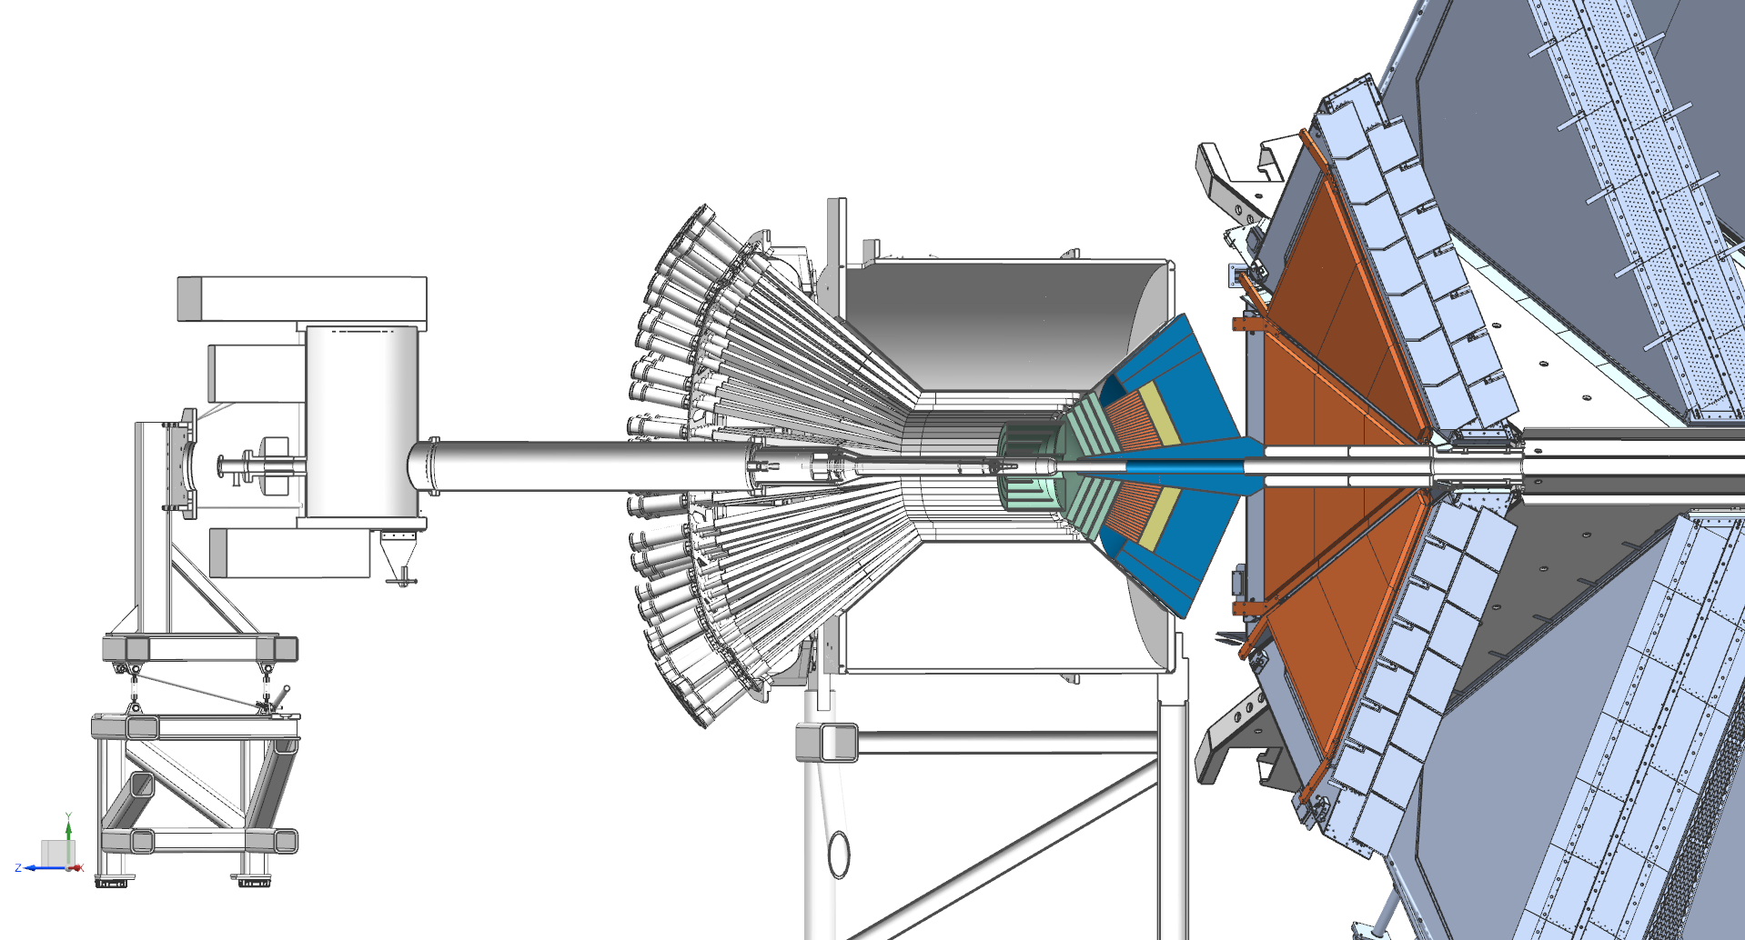
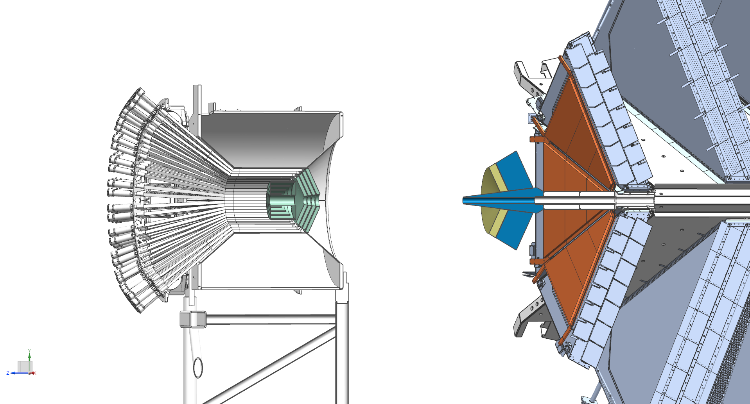
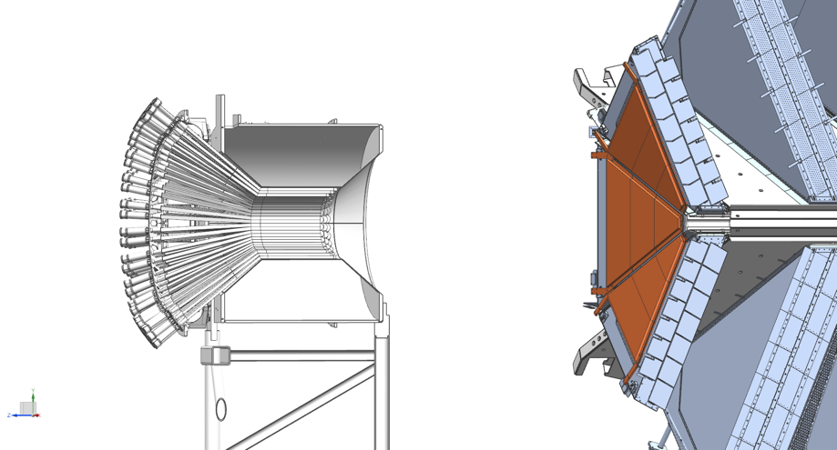
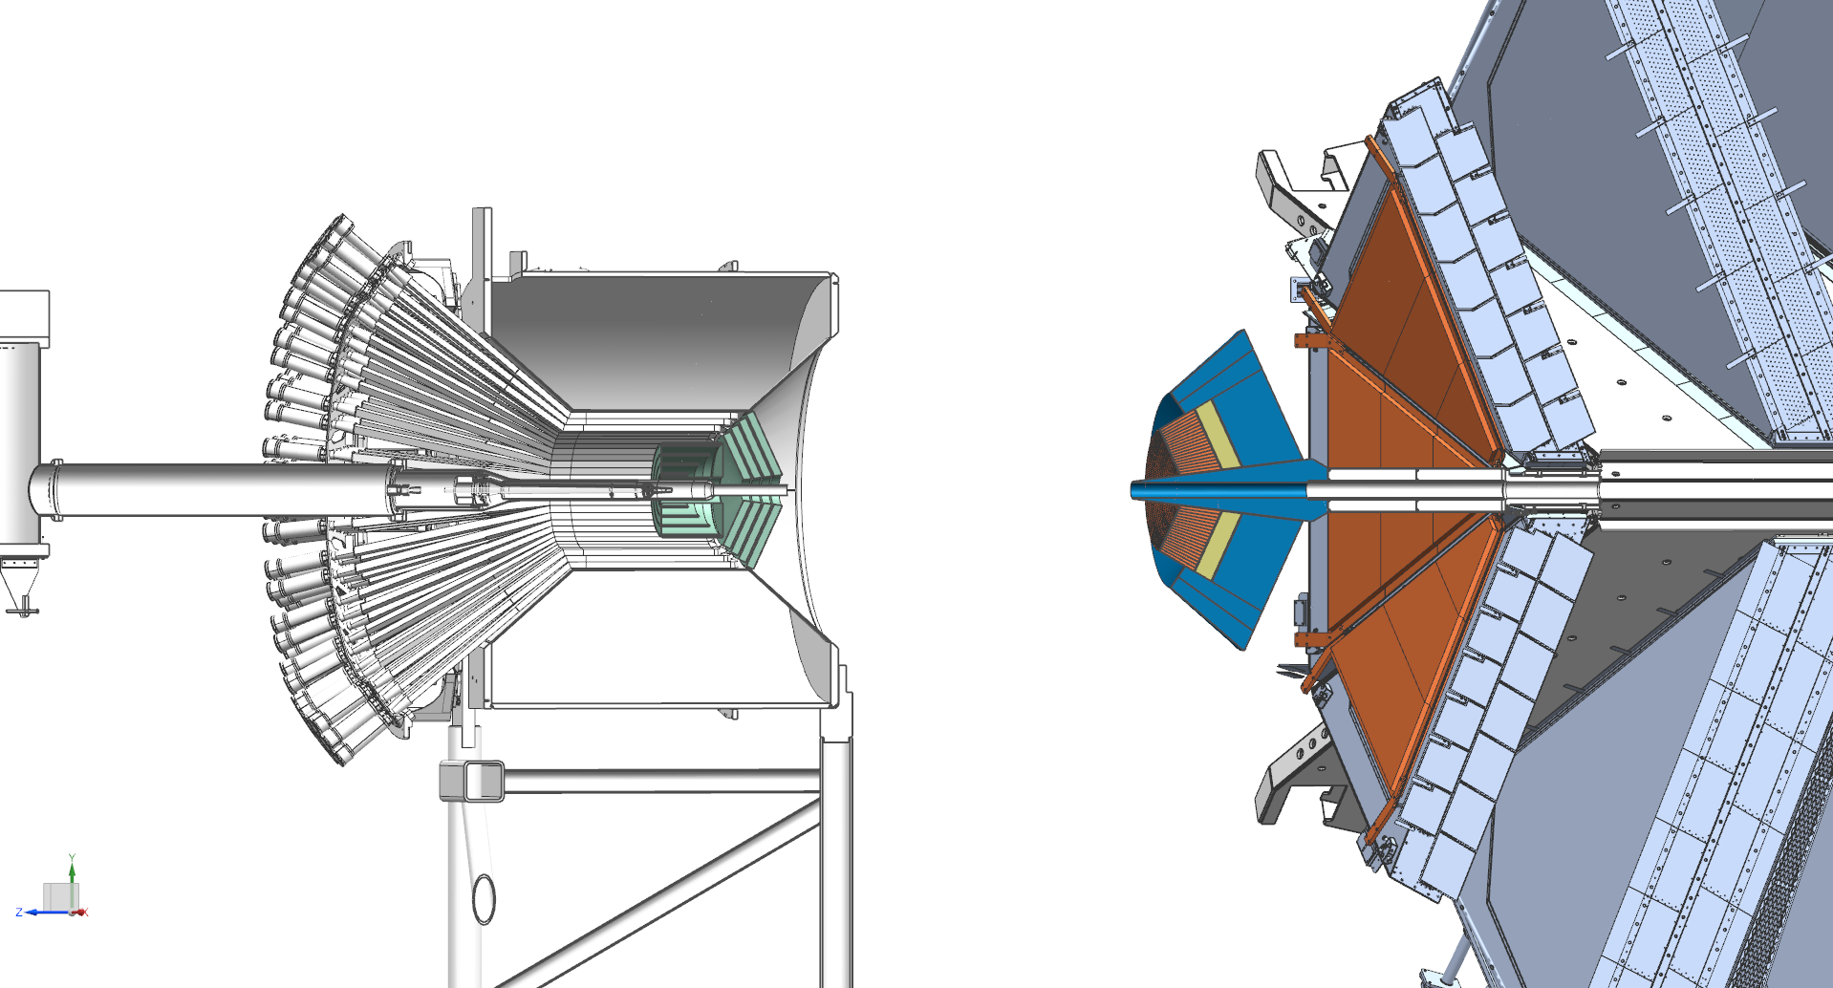
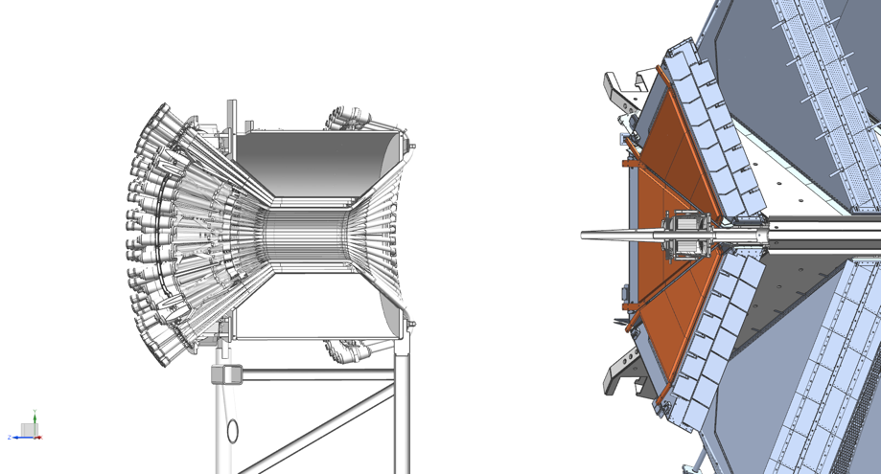
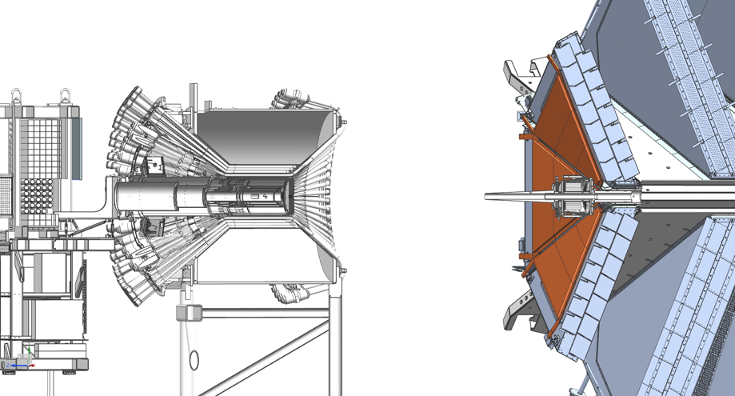
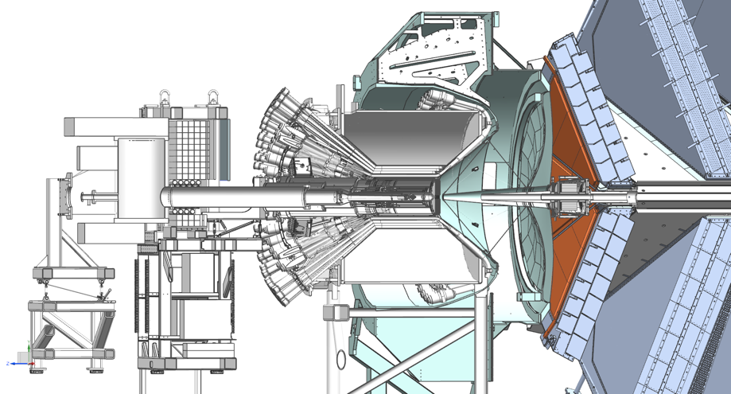
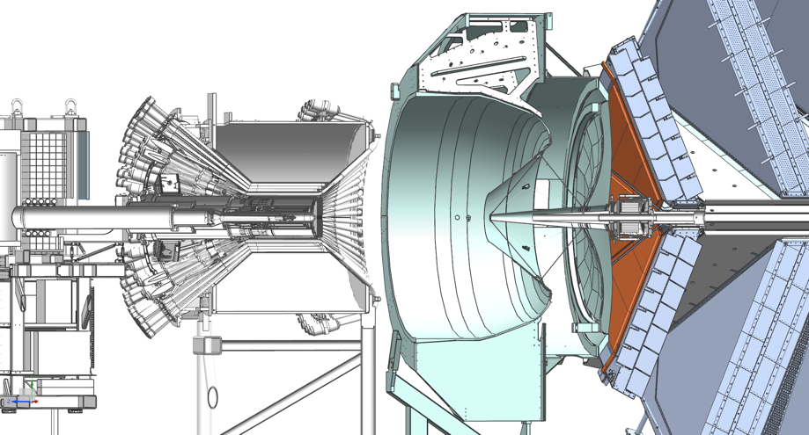
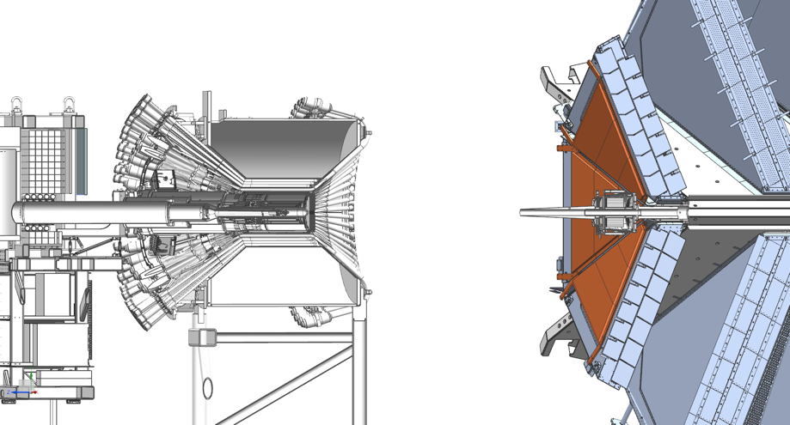
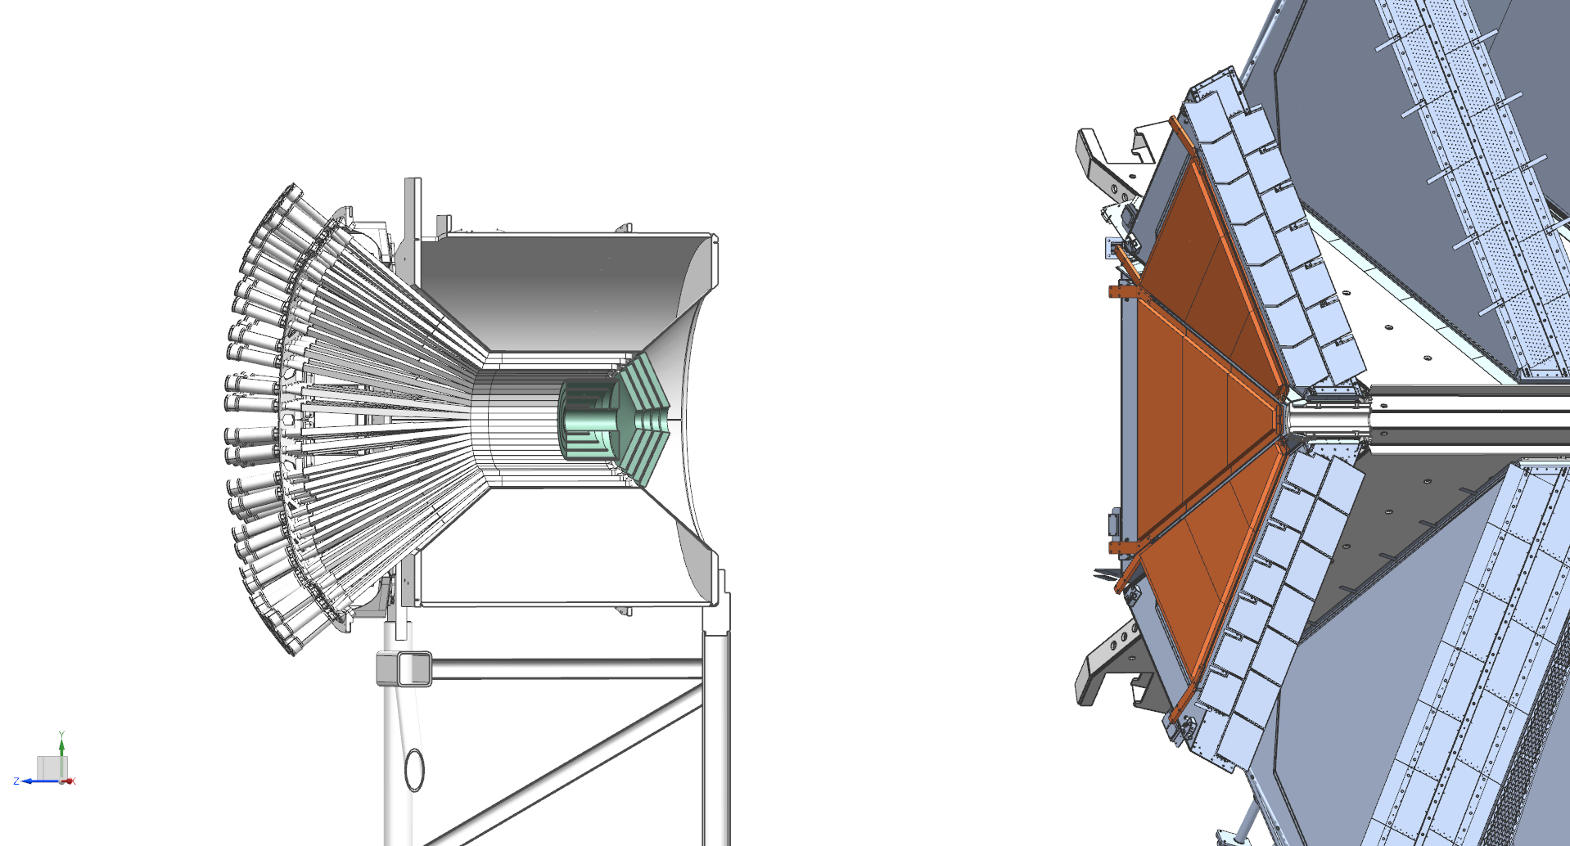
Convert CLAS12 FD into a μ-spectrometer
Starting from CLAS12 with μRWELL

Slide 15
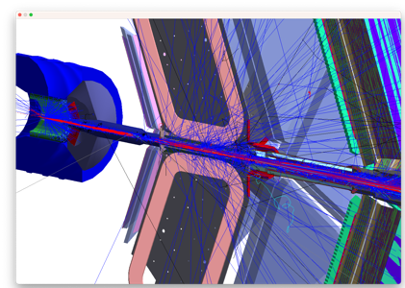
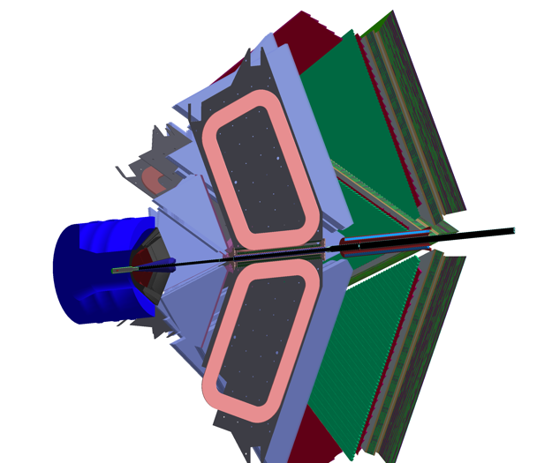
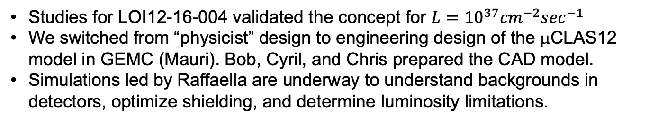

GEANT4 model
Studies for LOI12-16-004 validated the concept for $L={10}^{37}{cm}^{−2}\sec^{−1}$
We switched from “physicist” design to engineering design of the μCLAS12 model in GEMC (Mauri). Bob, Cyril, and Chris prepared the CAD model.
Simulations led by Raffaella are underway to understand backgrounds in detectors, optimize shielding, and determine luminosity limitations.
Shielding is the simple extension of the existing CLAS12 W-pipe.
ECal
FTOF
DC
Cylindrical recoil detector should be added
At ${10}^{36} {cm}^{−2} \sec^{−1}$, 1.4% occupancy in R3.

Slide 16
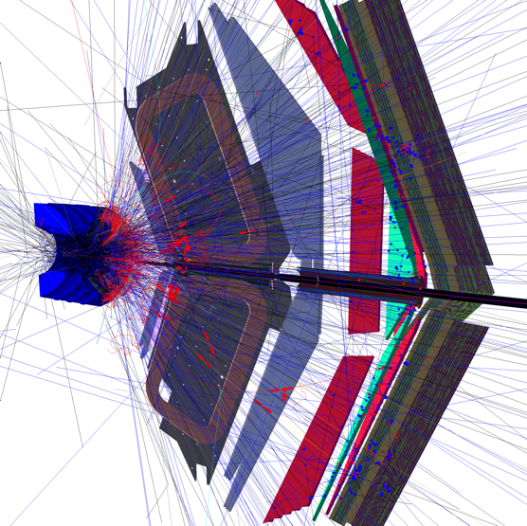
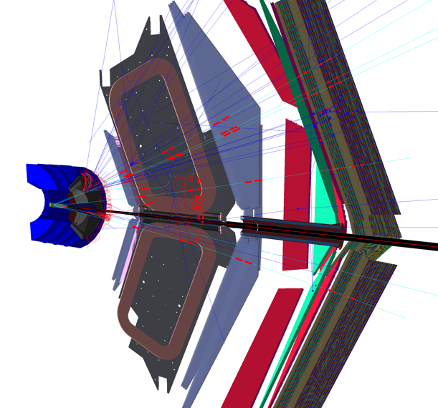
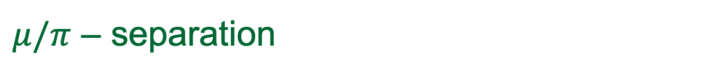


$μ/π$ – separation
From Mauri
6 GeV $π^{+}$
6 GeV $μ^{+}$
ECal
Most pions will shower in the calorimeter/shielding and will not reach drift chambers, much less the ECal.
Conversely, muons will lose some energy in the calorimeter/shielding but will reach drift chambers and Ecal. Ecal is where muons are IDed.

Slide 17
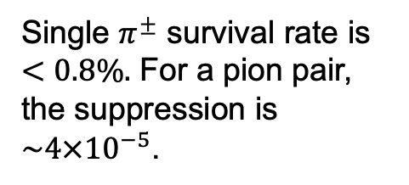
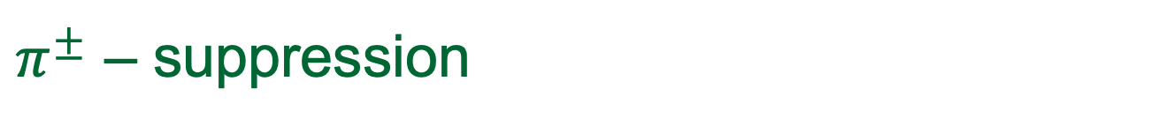


$π^{±}$ – suppression
Studies done by Rafo
MIP⁻
$$← π^{+}$$
MIP⁺
Generated with GEANT particle gun, uniform in momentum and angle
MIP⁺
$$← π^{−}$$
Single $π^{±}$ survival rate is $<0.8\%.$ For a pion pair, the suppression is ${\sim 4×10}^{−5}$.
MIP⁻

Slide 18
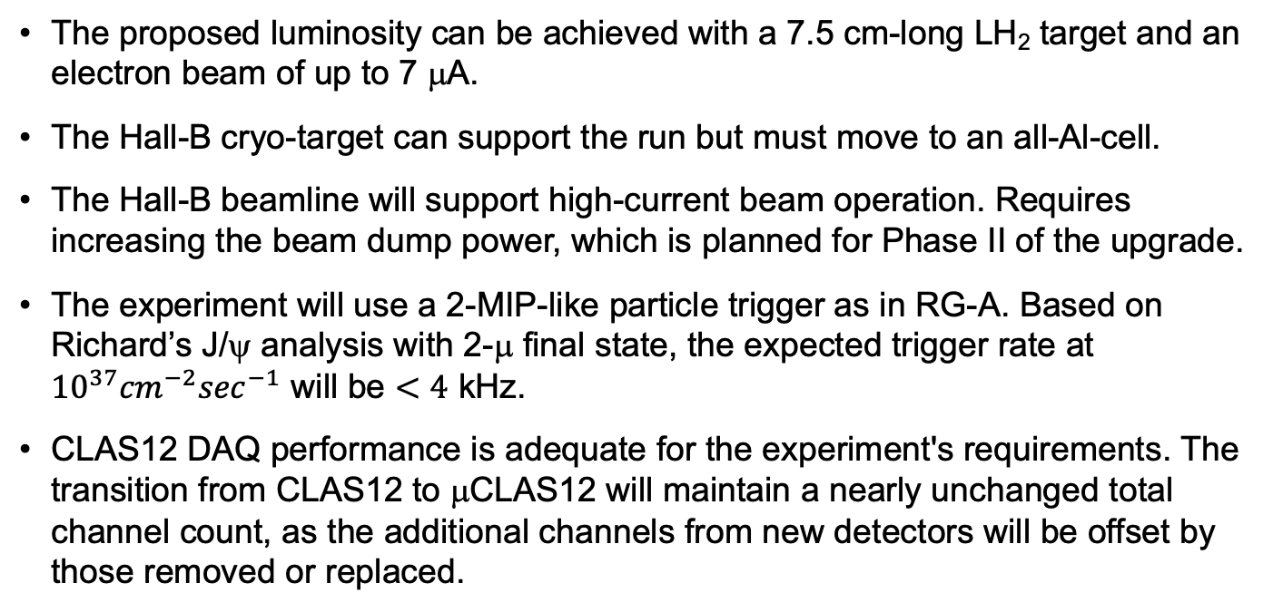
Beam, target, DAQ and trigger
The proposed luminosity can be achieved with a 7.5 cm-long LH₂ target and an electron beam of up to 7 μA.
The Hall-B cryo-target can support the run but must move to an all-Al-cell.
The Hall-B beamline will support high-current beam operation. Requires increasing the beam dump power, which is planned for Phase II of the upgrade.
The experiment will use a 2-MIP-like particle trigger as in RG-A. Based on Richard’s J/ψ analysis with 2-μ final state, the expected trigger rate at ${10}^{37}{cm}^{−2}\sec^{−1}$ will be $<4$ kHz.
CLAS12 DAQ performance is adequate for the experiment's requirements. The transition from CLAS12 to μCLAS12 will maintain a nearly unchanged total channel count, as the additional channels from new detectors will be offset by those removed or replaced.

Slide 19
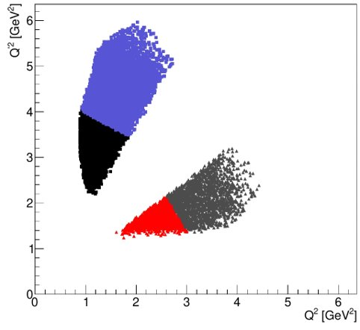
Kinematical coverage for DDVCS
R. Paremuzyan
Studies with GRAPE event generator, BH only. The electrons will be detected in the PbWO₄ calorimeter and the muon pairs in the CLAS12 FD.
The whole region is measured simultaneously, covering the space-like and time-like regions.
Bin(0,1)
Bin(0,0)
Bin(1,1)​
Bin(1,0)​

Slide 20
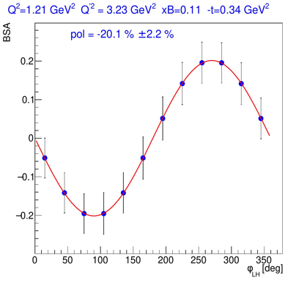






Projections DDVCS: 200 days @ ${10}^{37}{cm}^{−2}\sec^{−1}$
The time-like region, $Q^{2}<Q^{′2}$
The space-like region, $Q^{2}>Q^{′2}$

Slide 21





J/ψ near-threshold production
$$ep→e^{′}p^{′}J/ψ→e^{′}μ^{+}μ^{−}(p^{′})$$
Studies are led by Pierre, the expected number of J/ψ from the model is 45k. It is consistent with Mariana’s analysis of RG-A with electron in FT.

Slide 22

Summary
We propose studying DDVCS in the electroproduction of muon pairs using modified CLAS12.
Double DVCS allows mapping of GPDs in the $x$-space, and μCLAS12 is one of the unique places this reaction can be studied.
With 200 days of beam time, we can measure BSA in space-like and time-like regions of phase space.
Data will be accumulated using a two-MIP-like particle trigger in the CLAS12 forward detector and will be suitable for high-statistics studies of TCS and near-threshold J/ψ production.
The proposal is open to all members of the collaboration, just let me know if you want to participate.

Slide 23


Slide 24



Slide 25


Integrated luminosity $1.5∙{10}^{41}$ cm⁻² sec⁻¹
Final states:
$ep→e^{′}e^{+}e^{−}\left(p^{′}\right)$
$ep→$ $e^{′}{p′e}^{+}{(e}^{−})$
$ep→e^{′}e^{+}e^{−}p′$
About little over third is from a).

Slide 26


CLAS12 ECal for muon ID
The rate of RG-A 2-MIP trigger at a luminosity of $\sim 0.6∙{10}^{35}$ cm⁻² sec⁻¹ was about 3 kHz.
In Richard’s analysis, only 1% of triggered pairs were identified as muon n-pairs. With a pion-pair survival rate of $5∙{10}^{−5}$ , the expected trigger rate from pion pairs is 60 Hz.
The rate of “true” muon-pair trigger will be 5 kHz.

