Slide 1
Antibaryon Electroproduction off Protons at CLAS12
CLAS12 Collaboration
Leonel Martinez 3/6/25

Slide 2
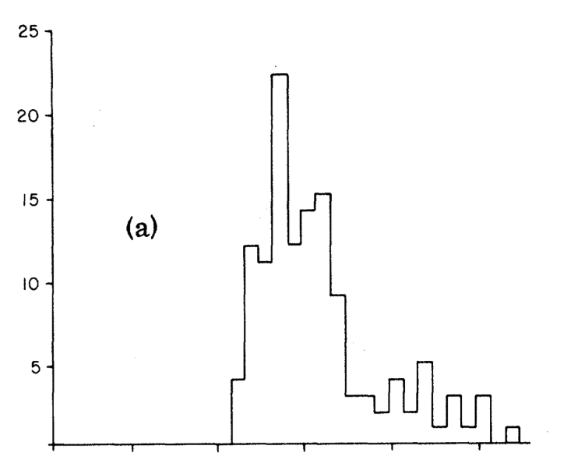
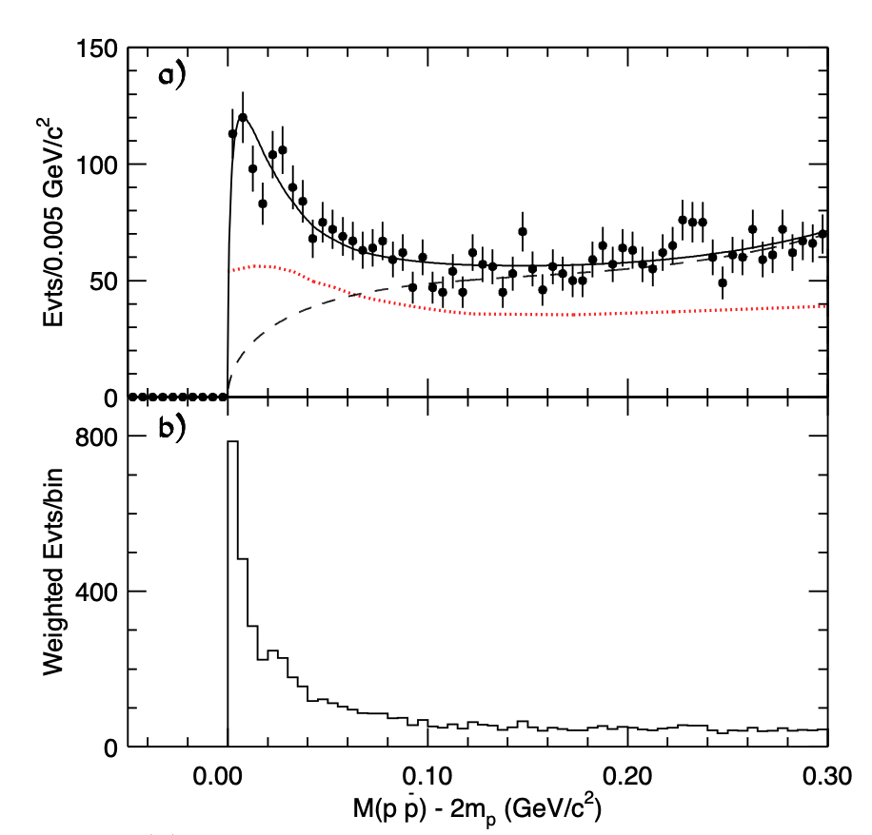
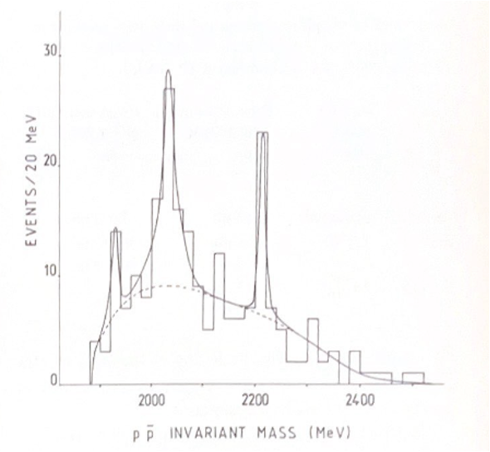
History
$p\overline{p}$ system has long been used to search for intermediate resonances
Evidence for narrow resonances has been inconclusive
Low statistic experiments (pre 1990’s)
BES-II[1] found near mass threshold resonance
$M(p\overline{p})=1.832GeV$
$Γ<76MeV/c^{2}$
BES-III[2] extracted quantum numbers
$0^{−+}$
$M(p\overline{p})$ from the reaction $ep→epp\overline{p}$
BES-II: a) $M(p\overline{p})−2m_{p}$, dashed curve is background from $J/ψ→π^{0}p\overline{p}$. b) Events weighted by $|{\overset{⃗}{p}}_{p}^{RF}|/2$
[1]Bai, J. Z., et al. “Observation of a Near-Threshold Enhancement in Th P Pbar Mass Spectrum from Radiative J/Psi-->gamma P Pbar Decays.” arXiv.Org, 7 Mar. 2003, arxiv.org/abs/hep-ex/0303006v1.
[2] Ablikim, M, et al. “Spin-Parity Analysis of Ppbar Mass Threshold Structure in J/PSI and Psi’ Radiative Decays.” arXiv.Org, 5 Dec. 2011, arxiv.org/abs/1112.0942.
$M(p\overline{p})$ from the reaction $π^{−}p→π^{−}pp\overline{p}$

Slide 3
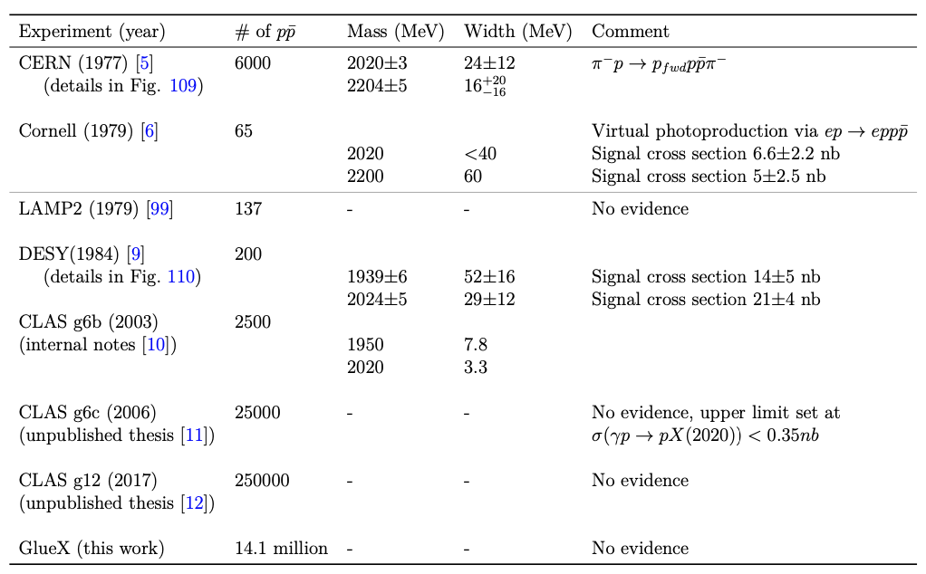
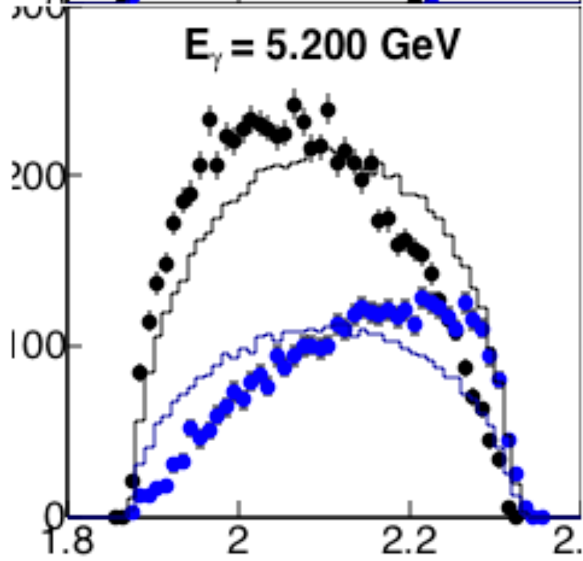
Previous $γp$ Analyses
$γp→pp\overline{p}$
Recent high statistics photoproduction experiments have found no evidence of narrow resonances
CLAS g12 (Will Phelps)[3]
Glue-X (Hao Li)[4]
Focused on cross section extraction
High cross section needed for resonance extraction
Various experiments and their results on whether an intermediate resonance was detected.
[3] Phelps, Will. “Antibaryon Photoproduction Using CLAS at Jefferson Lab.” Florida International University, 2017.
[4] Li, Hao. “Baryon–Antibaryon Photoproduction Oﬀ the Proton.” Carnegie Mellon University, 2023.
Differential cross section as a function of the invariant mass of either $M(p\overline{p})$ or $M(pp)$.

Slide 4
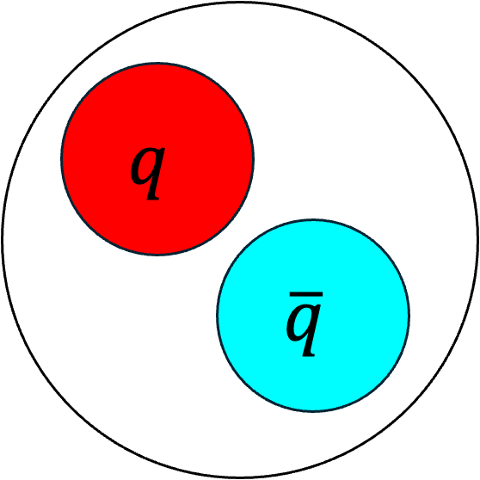
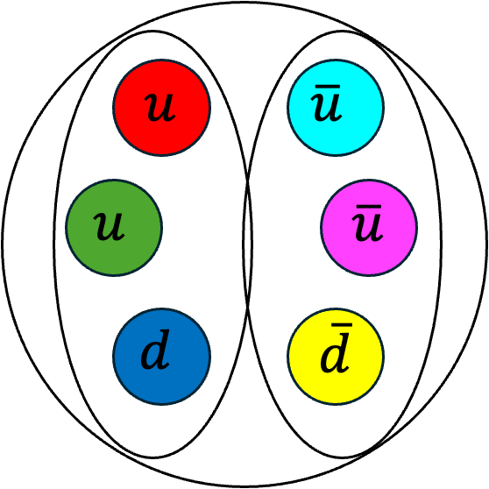
Motivation
Narrow resonances have conflicting evidence
Potential wide resonances
Production mechanism of $p\overline{p}$ remains unclear
$p\overline{p}$ is a prime candidate to look for potential intermediate exotic states
Glueballs[5]
Tetraquarks[6]: $qq\overline{q}\overline{q}$
Baryonium[6]: Bound $N\overline{N}$
Intermediate Mesons
$$q$$
$$\overline{q}$$
$$q$$
$$\overline{q}$$
[5] Gutsche, Thomas, et al. “Search for the Glueball Content of Hadrons in Gamma P Interactions at Gluex.” arXiv.Org, 17 Aug. 2016, arxiv.org/abs/1605.01035.
[6] Olsen, Stephen Lars. “A New Hadron Spectroscopy.” arXiv.Org, 28 Nov. 2014, arxiv.org/abs/1411.7738.

Slide 5
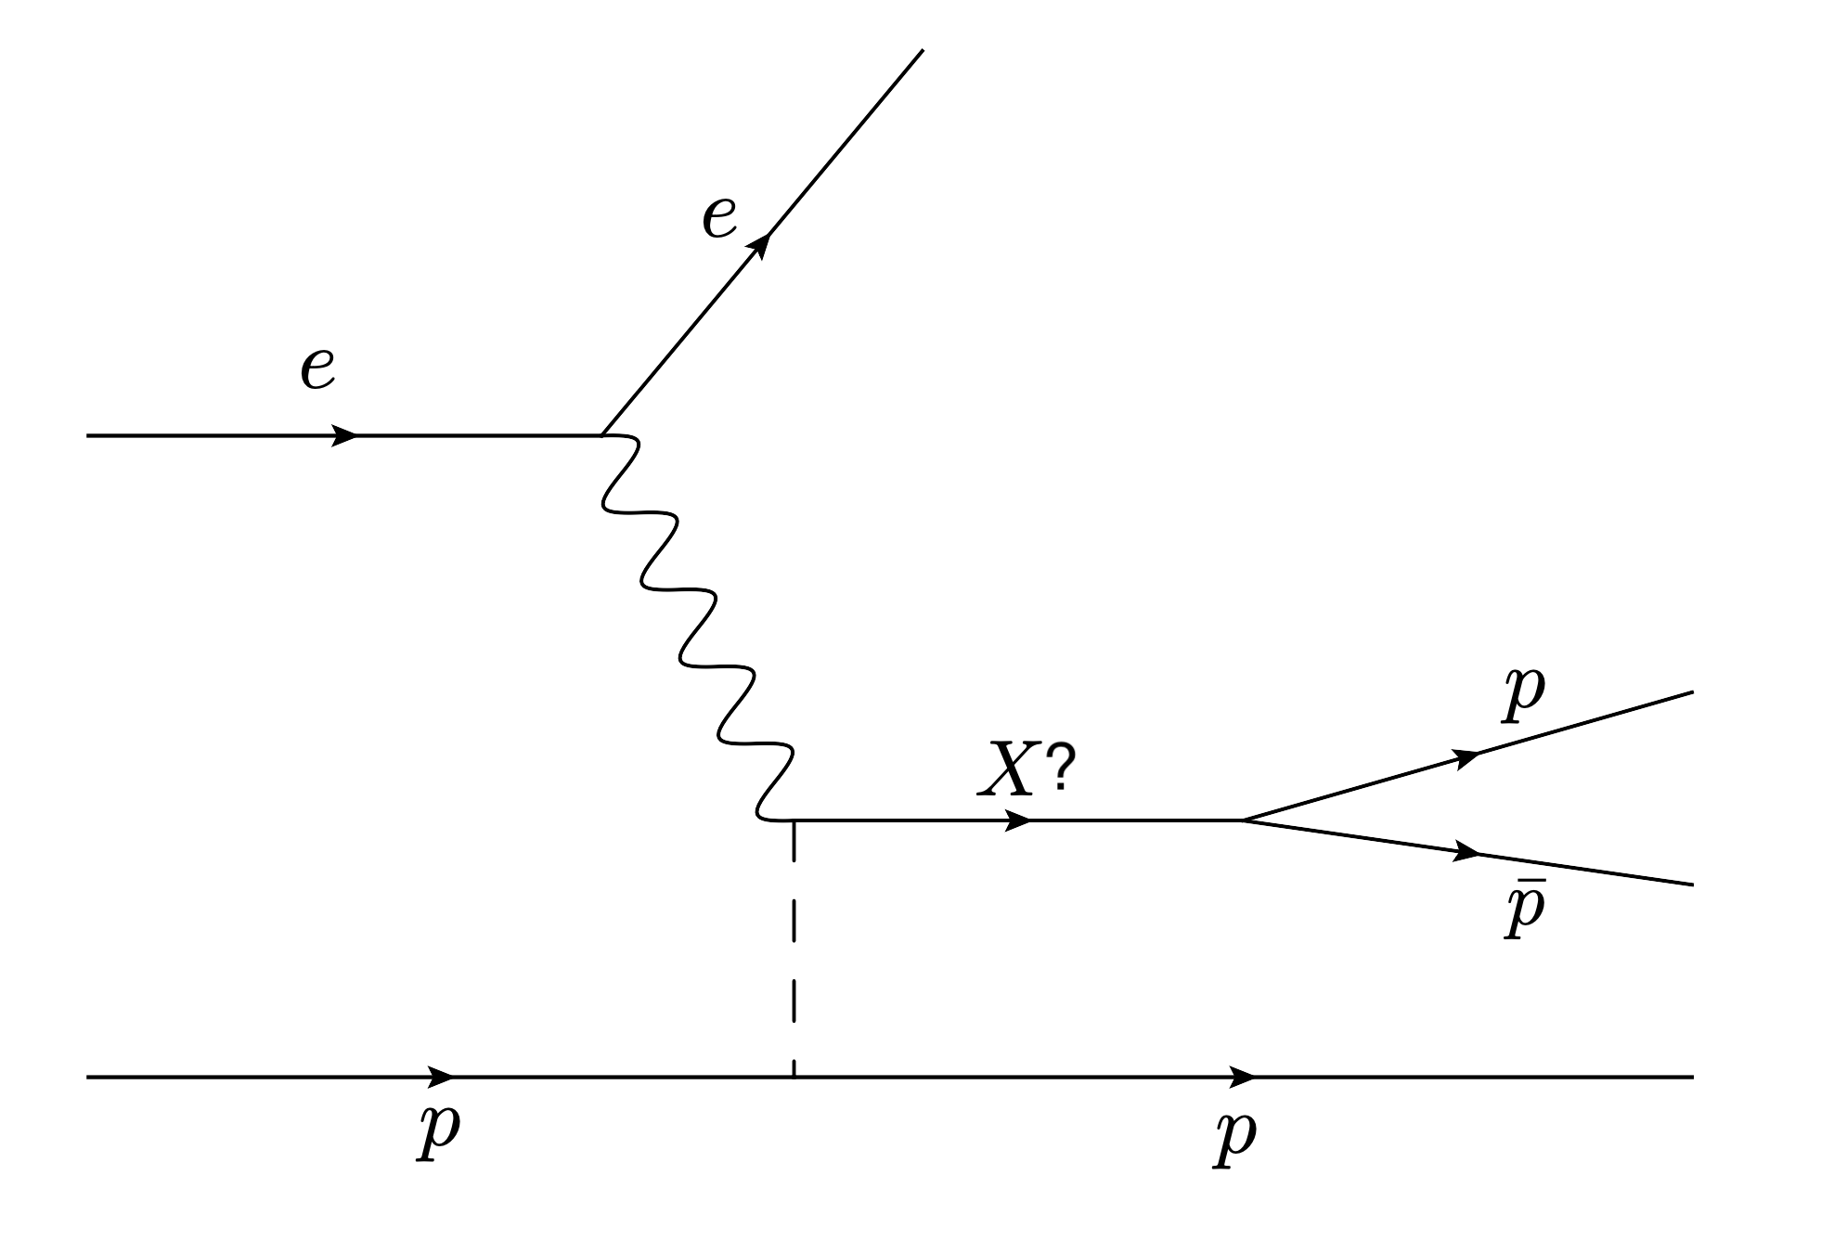
Reaction and Data
Looking into three reactions
$ep→epp\overline{p}$
$ep→eppπ^{−}\overline{n}$
$ep→ep\overline{p}π^{+}n$
Using RG-A Spring 2019 dataset
Requiring an electron in either the Forward Detector (eFD) or the Forward Tagger (eFT)
Electron beam energy at 10.2 GeV
A possible Feynman Diagram

Slide 6
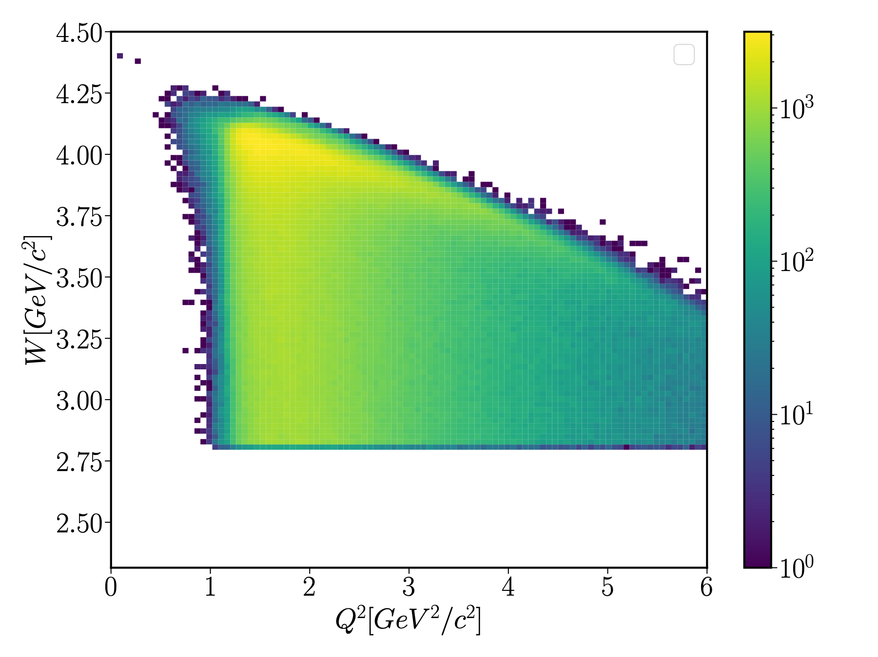
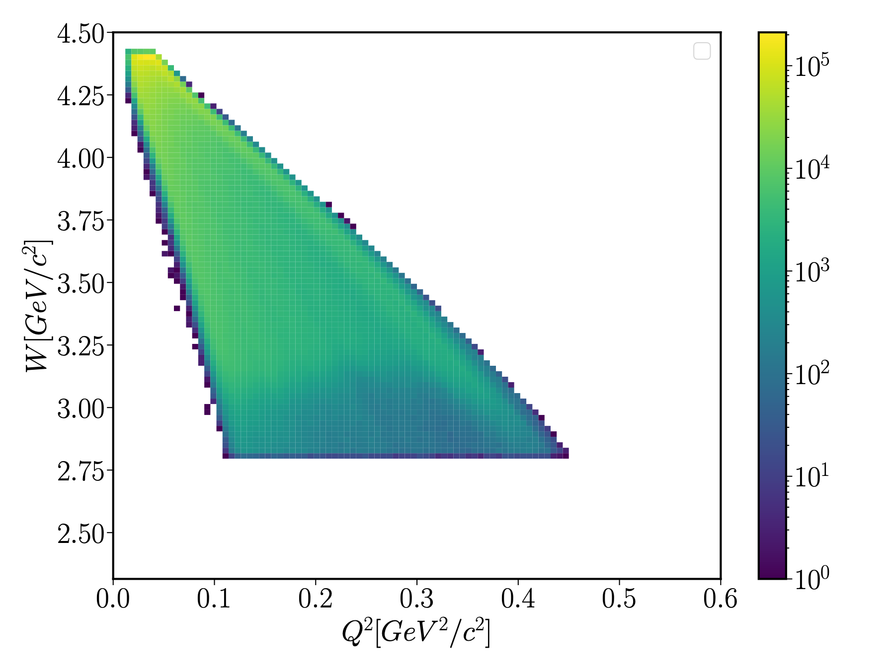
$Q^{2}$ and $W$ Distributions
Forward Detector
$W≥3m_{p}$
$Q^{2}$ Ranges for Forward Detector and Forward Tagger
Forward Detector: $Q^{2}∈[0.6,6]$
Forward Tagger: $Q^{2}∈[0,0.6]$
Forward Tagger

Slide 7
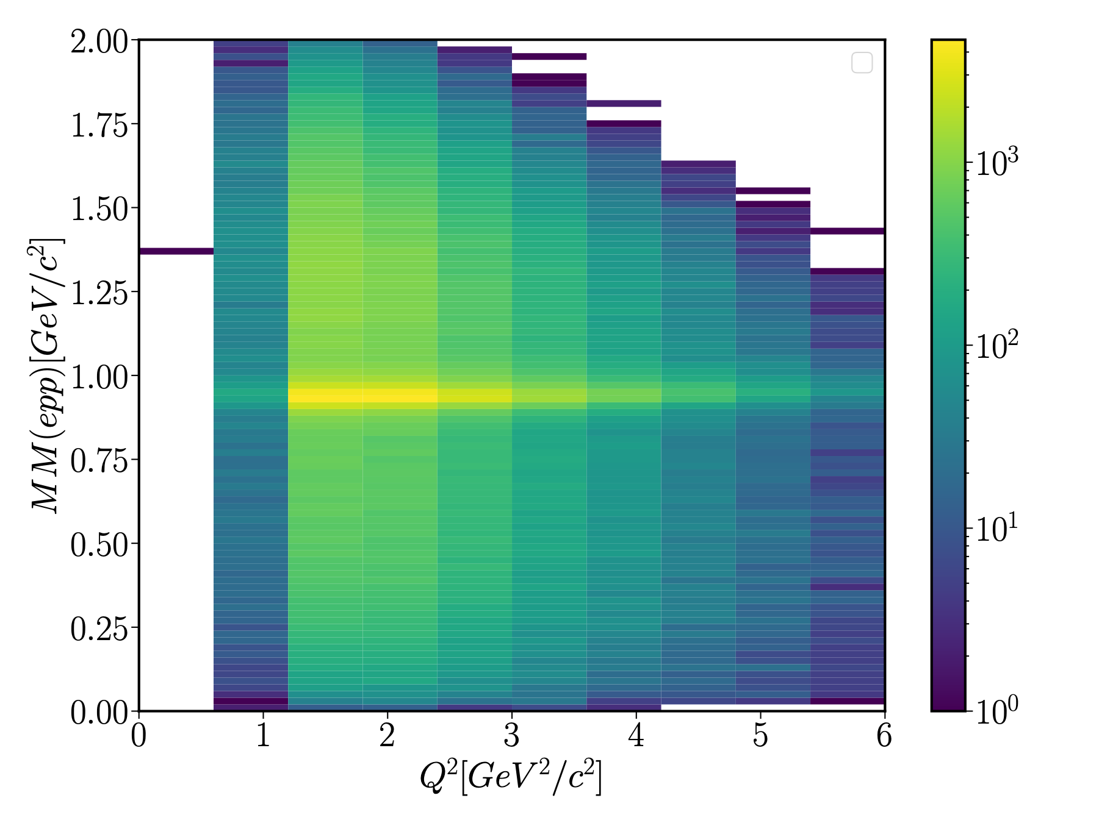
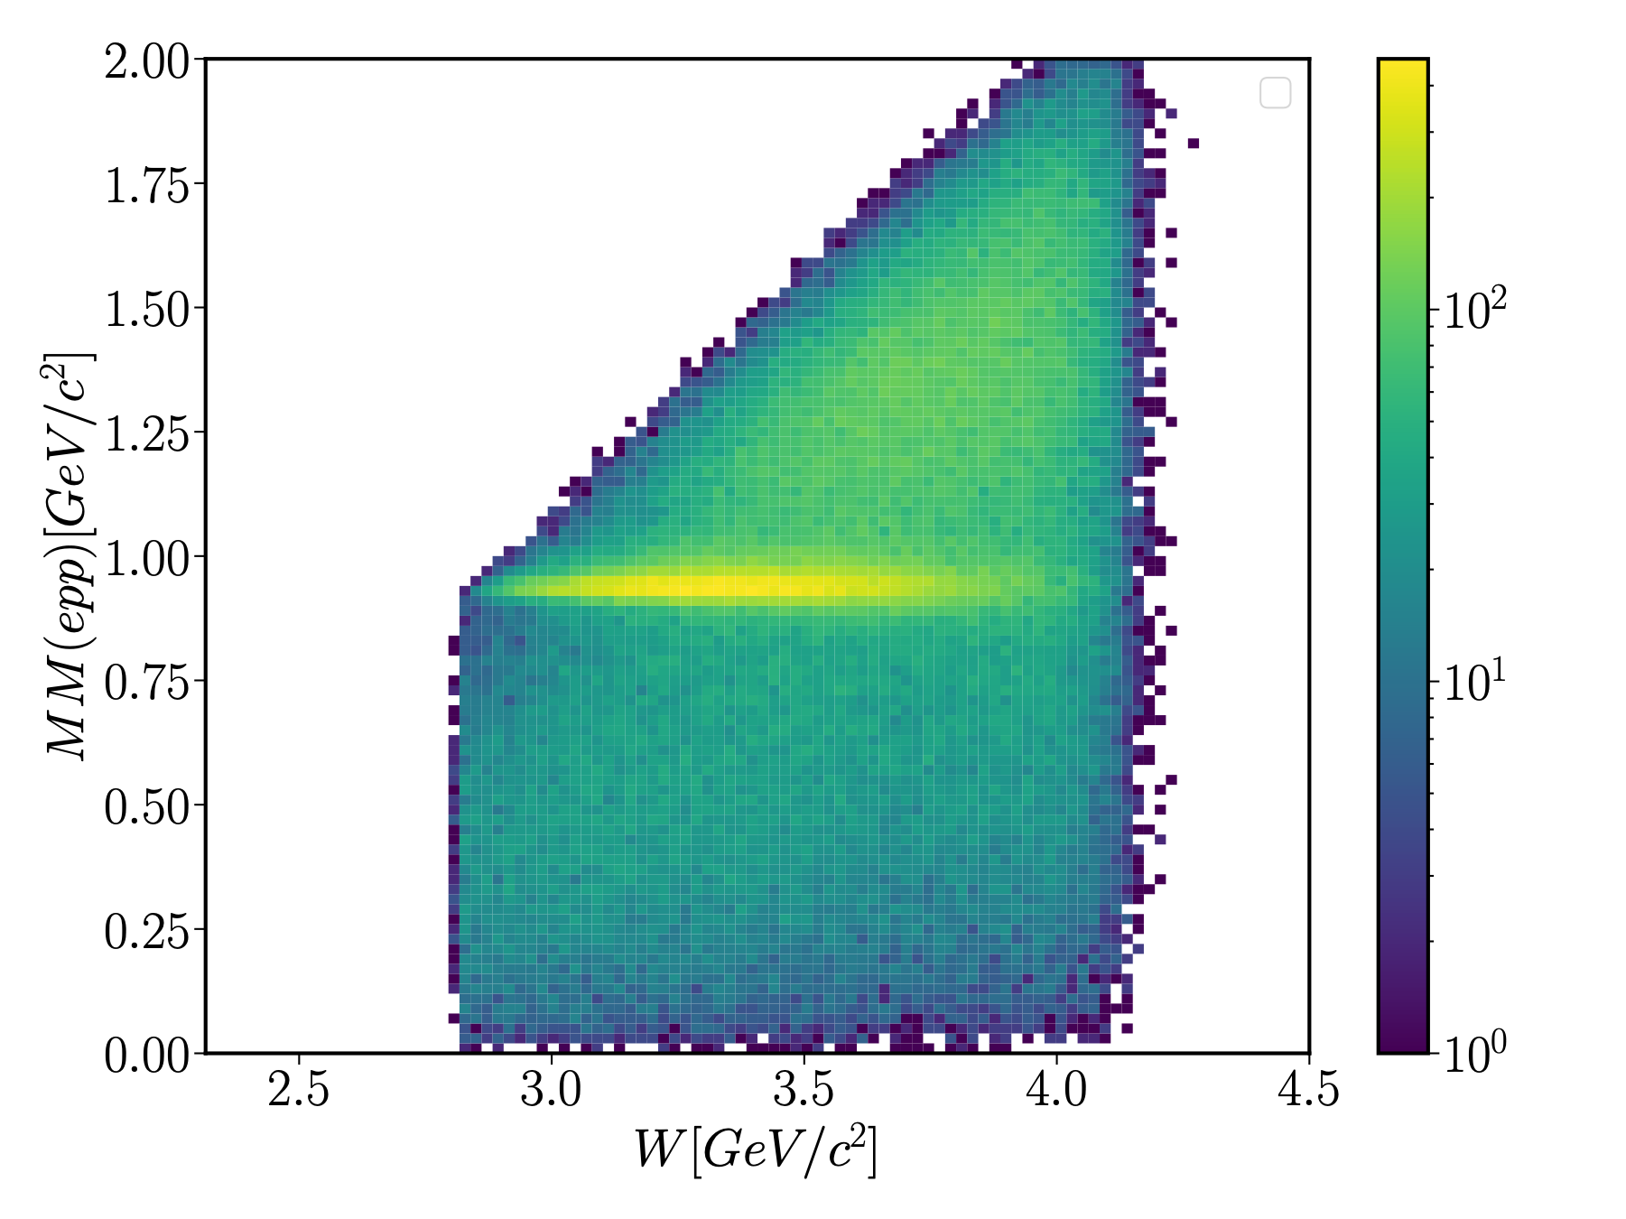
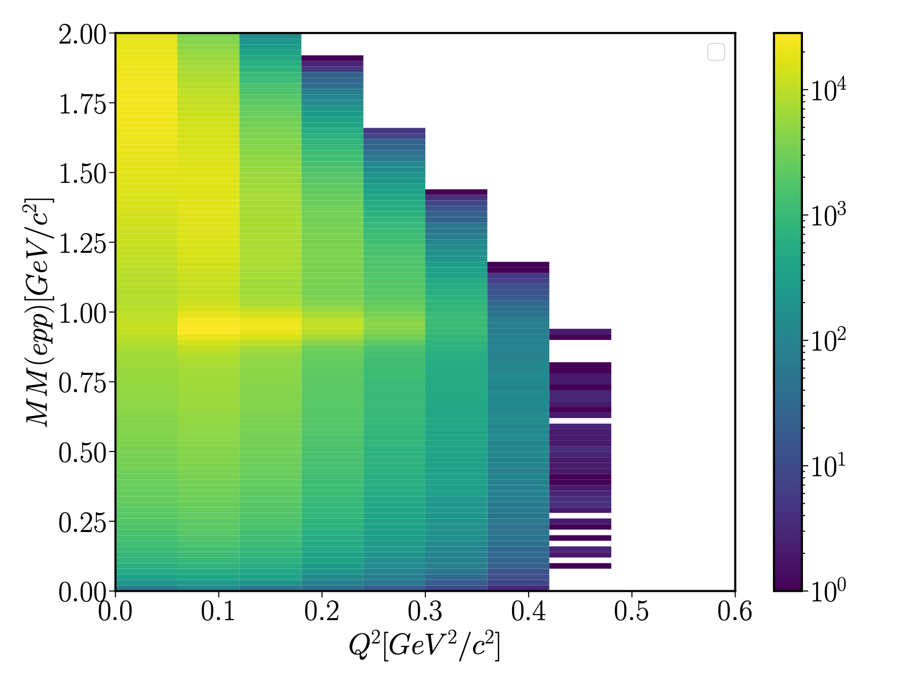
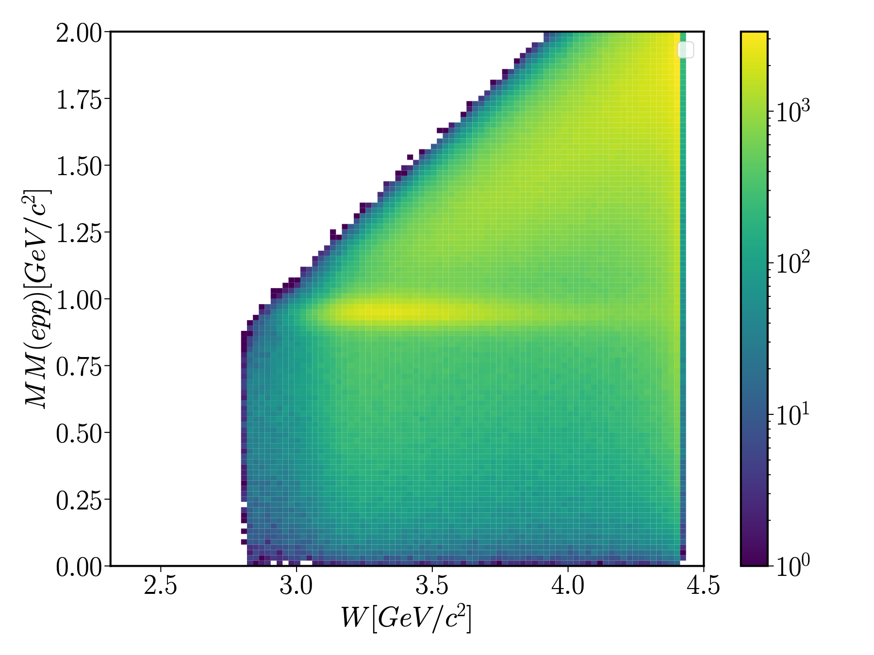
Kinematic Range
Forward Detector
Momentum transfer
$Q^{2}=−(p_{beam}−p_{e})^{2}$
Final State Hadronic Invariant Mass
$W^{2}=(p_{beam}+p_{target}−p_{e})^{2}$
Clear signal band shown
Forward Tagger

Slide 8
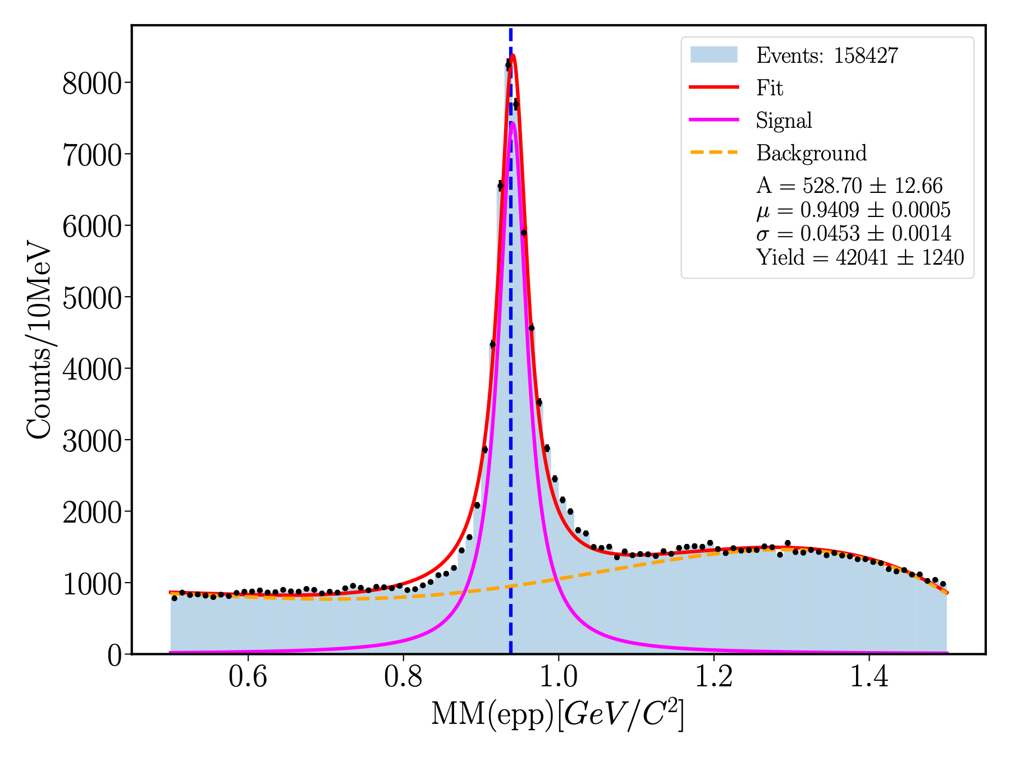
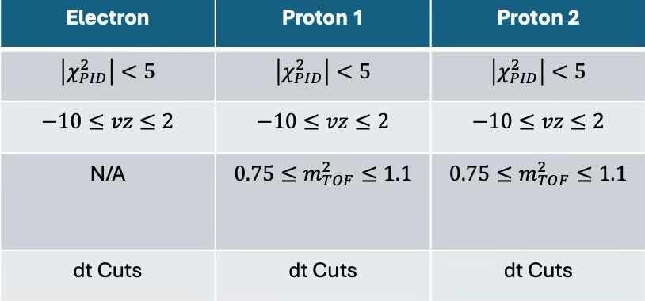
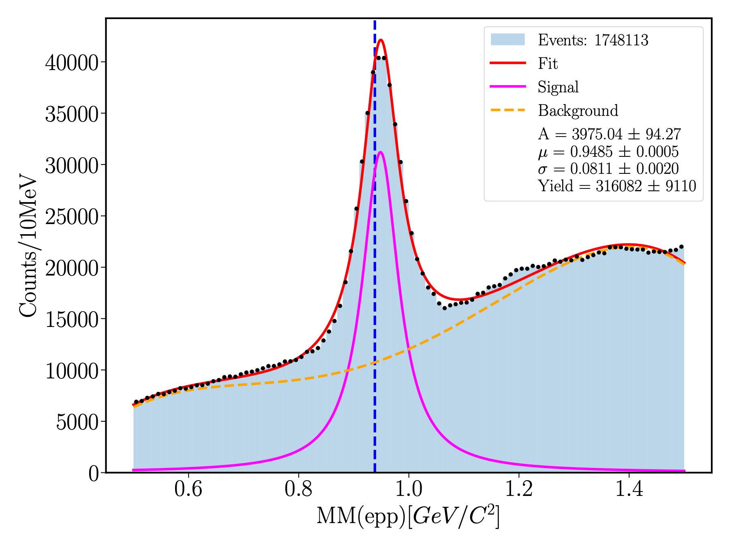
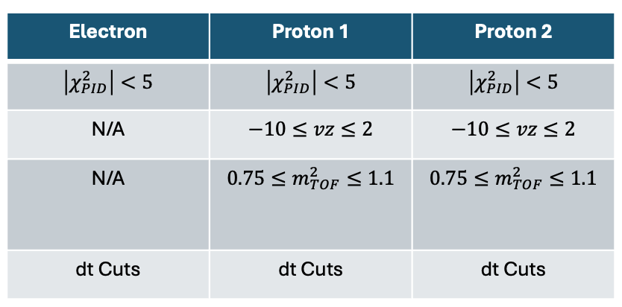
Available Statistics
Forward Detector
Missing mass technique used
$ep→epp(X)$
Cuts applied
Timing
Particle Identification
Particle Counter
Kinematic ($W≥3m_{p}$)
Missing mass distribution off of $epp$ for the recoil electron detected in the Forward Detector.
Forward Tagger
Missing mass distribution off of $epp$ for the recoil electron detected in the Forward Tagger

Slide 9
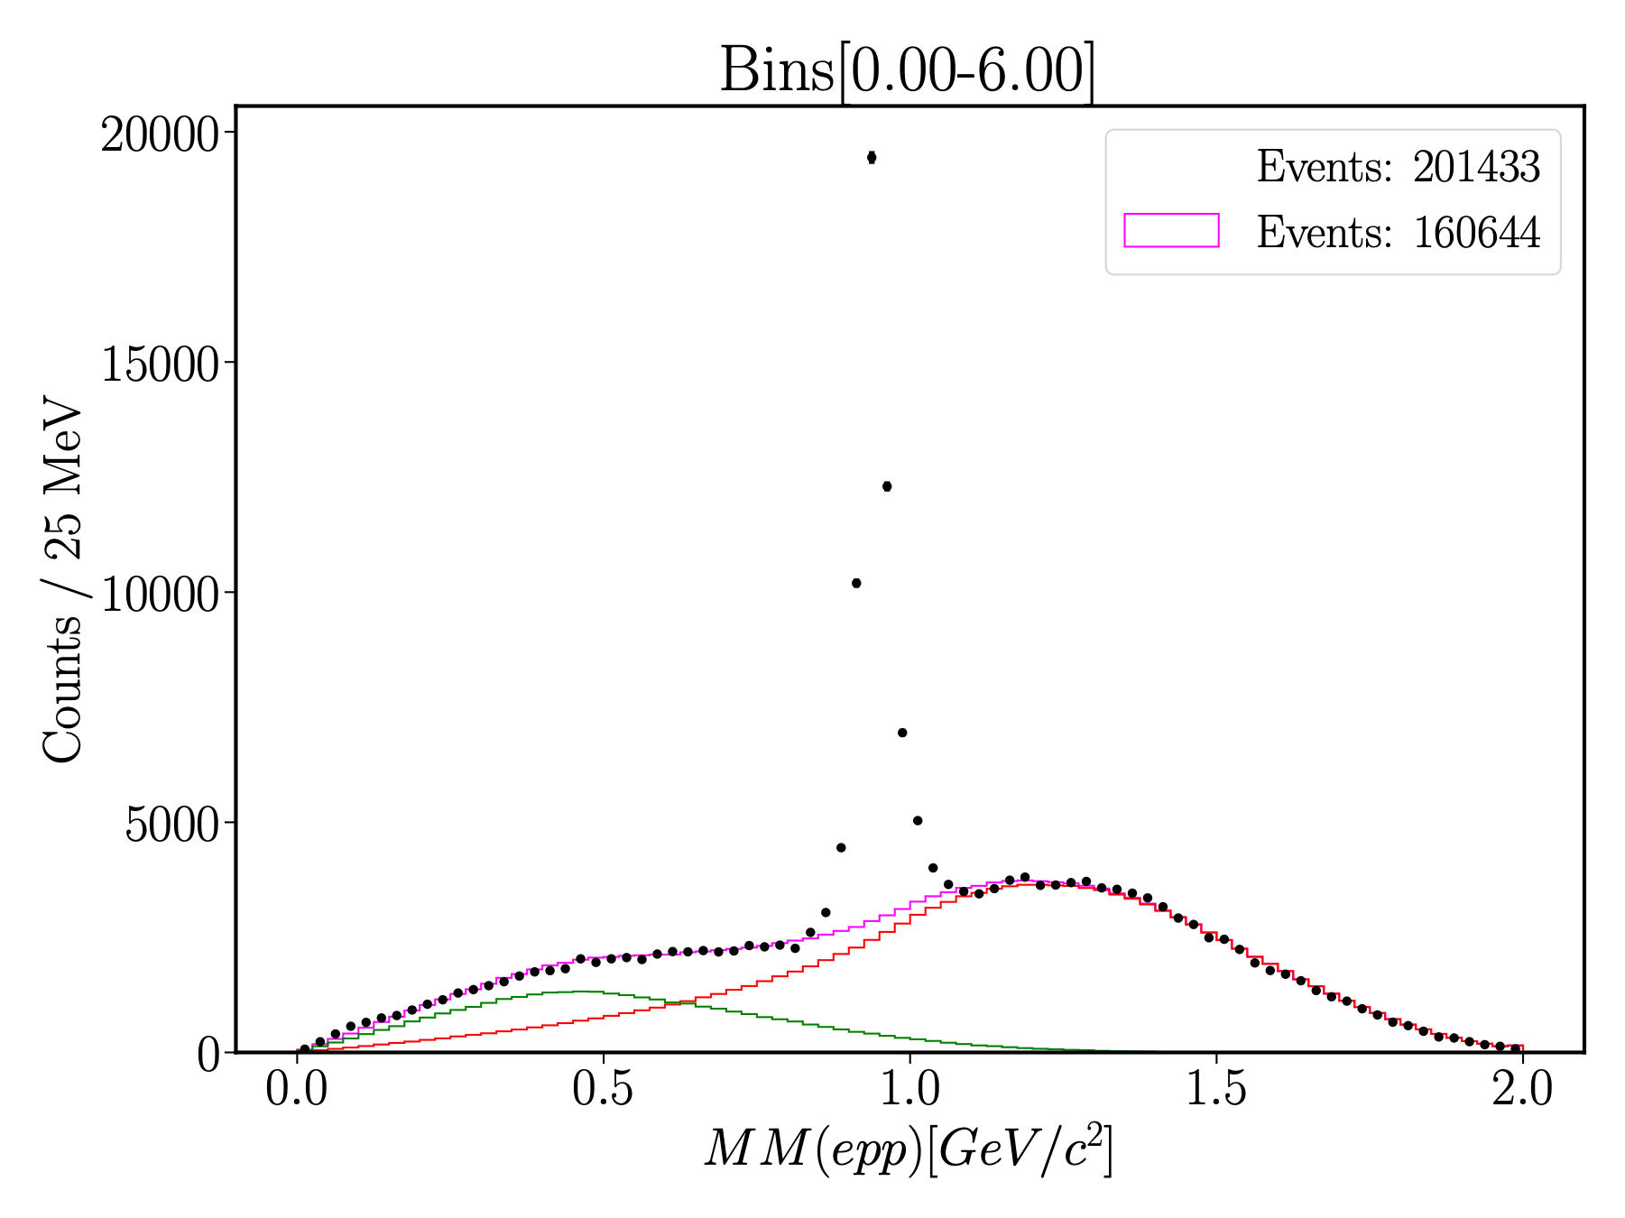
FD Uncorrelated Background
$φ$ Angle Randomization to break the correlation in the final state
$p_{T}^{x}=|p_{T}|cos(φ_{1}+δ_{1})$
$p_{T}^{y}=|p_{T}|sin(φ_{1}+δ_{1})$
Mimic the uncorrelated background in the reaction
Data-driven background estimation
$$θ_{2}$$
$$θ_{1}$$
$$φ_{2}$$
$$φ_{1}$$

Slide 10
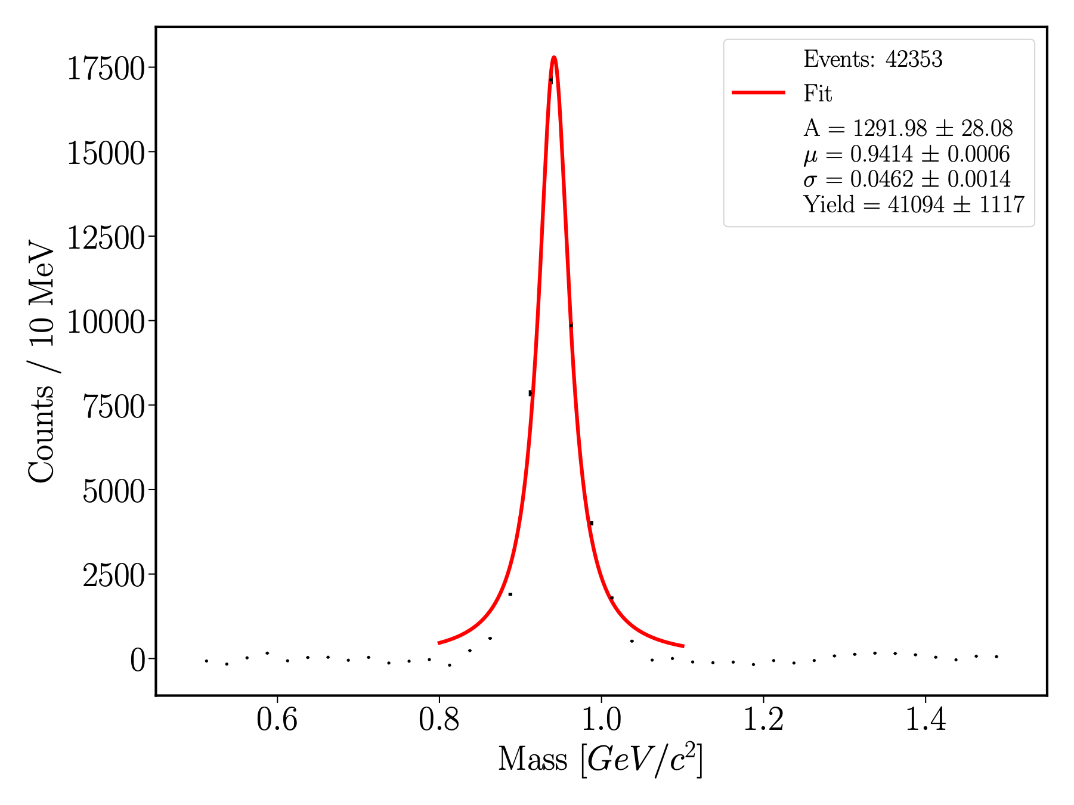
Background Subtraction
Subtracting the background found by $φ$ Angle Randomization
Uncorrelated background removed
Lorentzian to extract yield
Drawback: Symmetric distribution on an antisymmetric signal peak
Radiative corrections needed

Slide 11
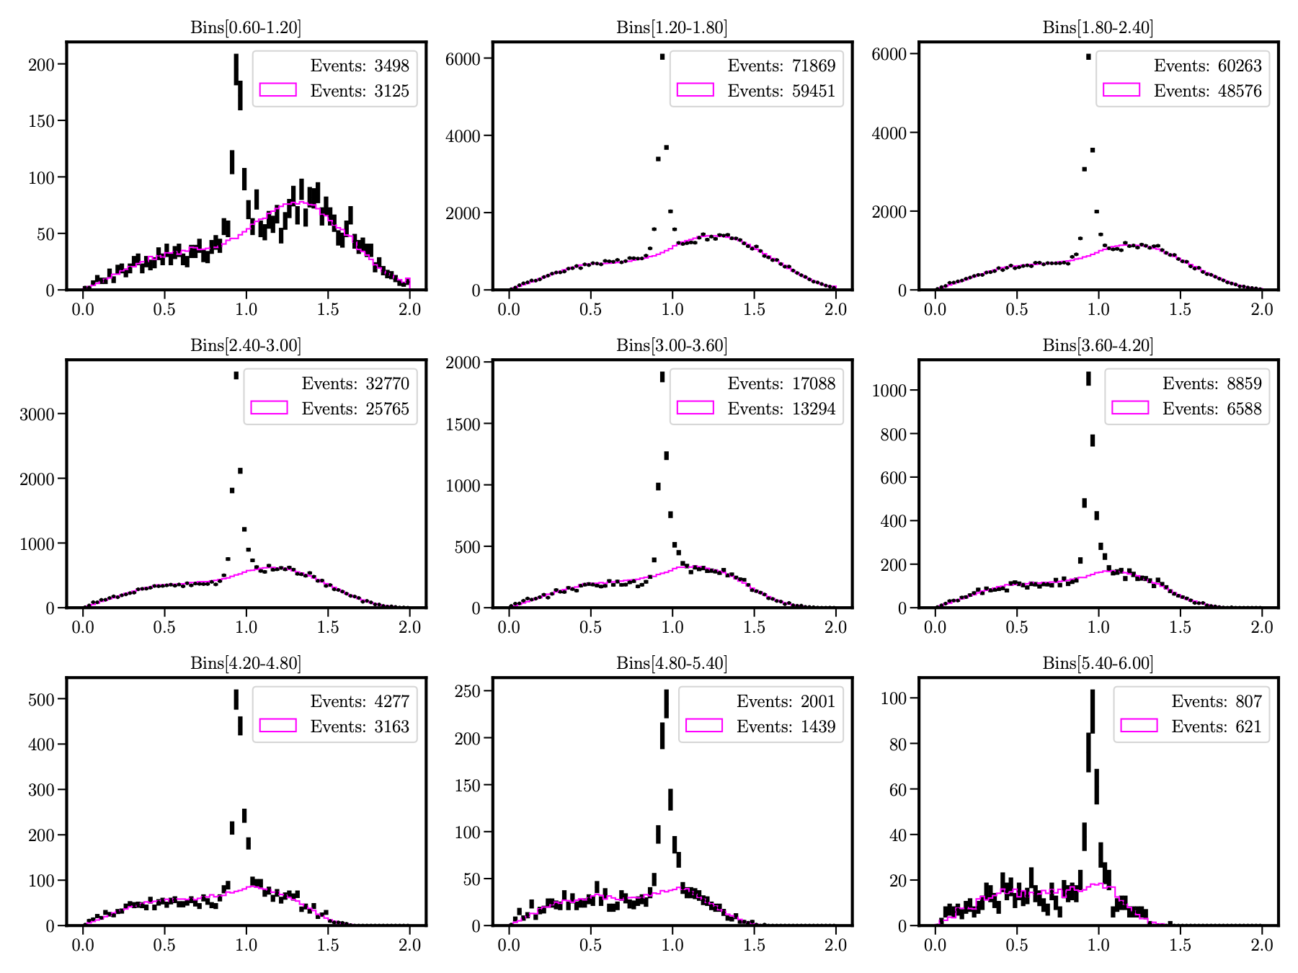
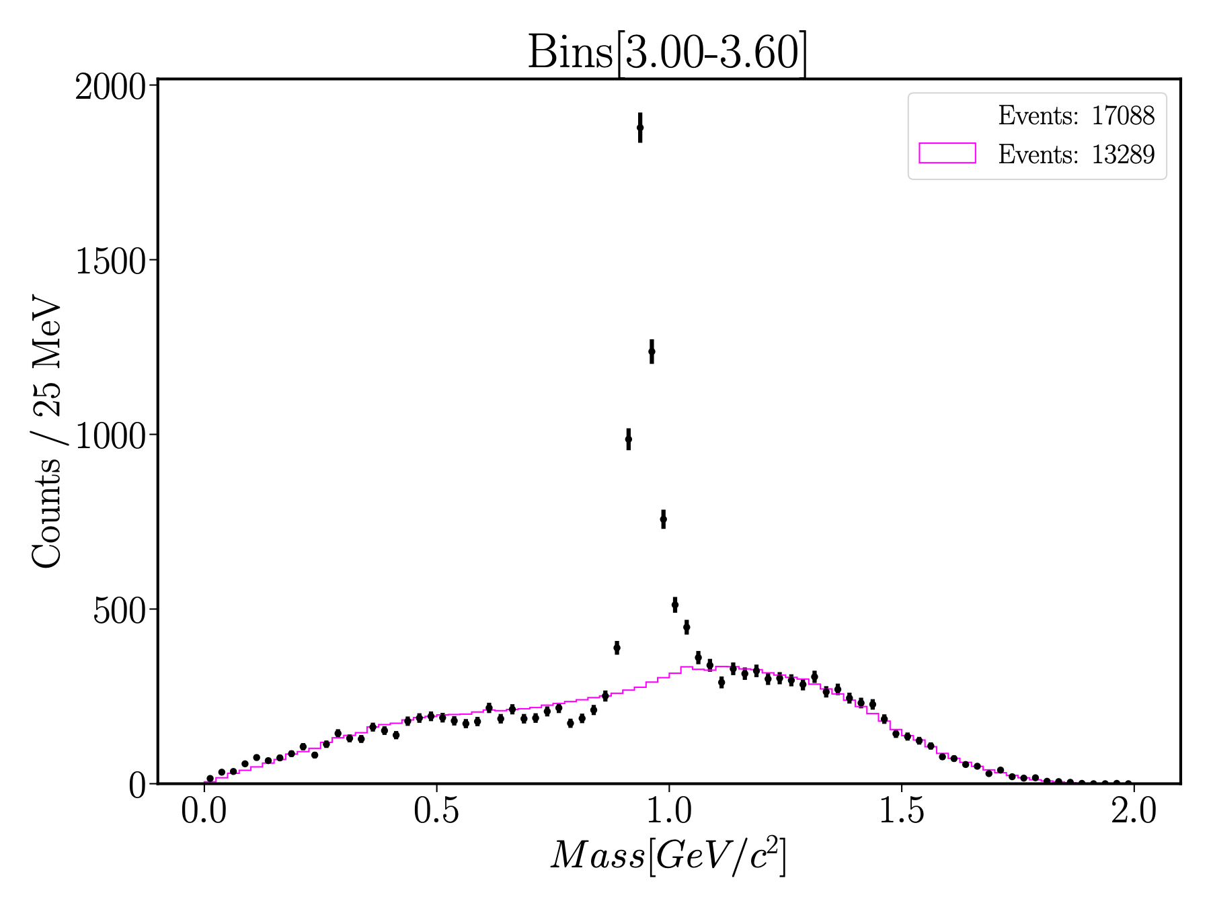
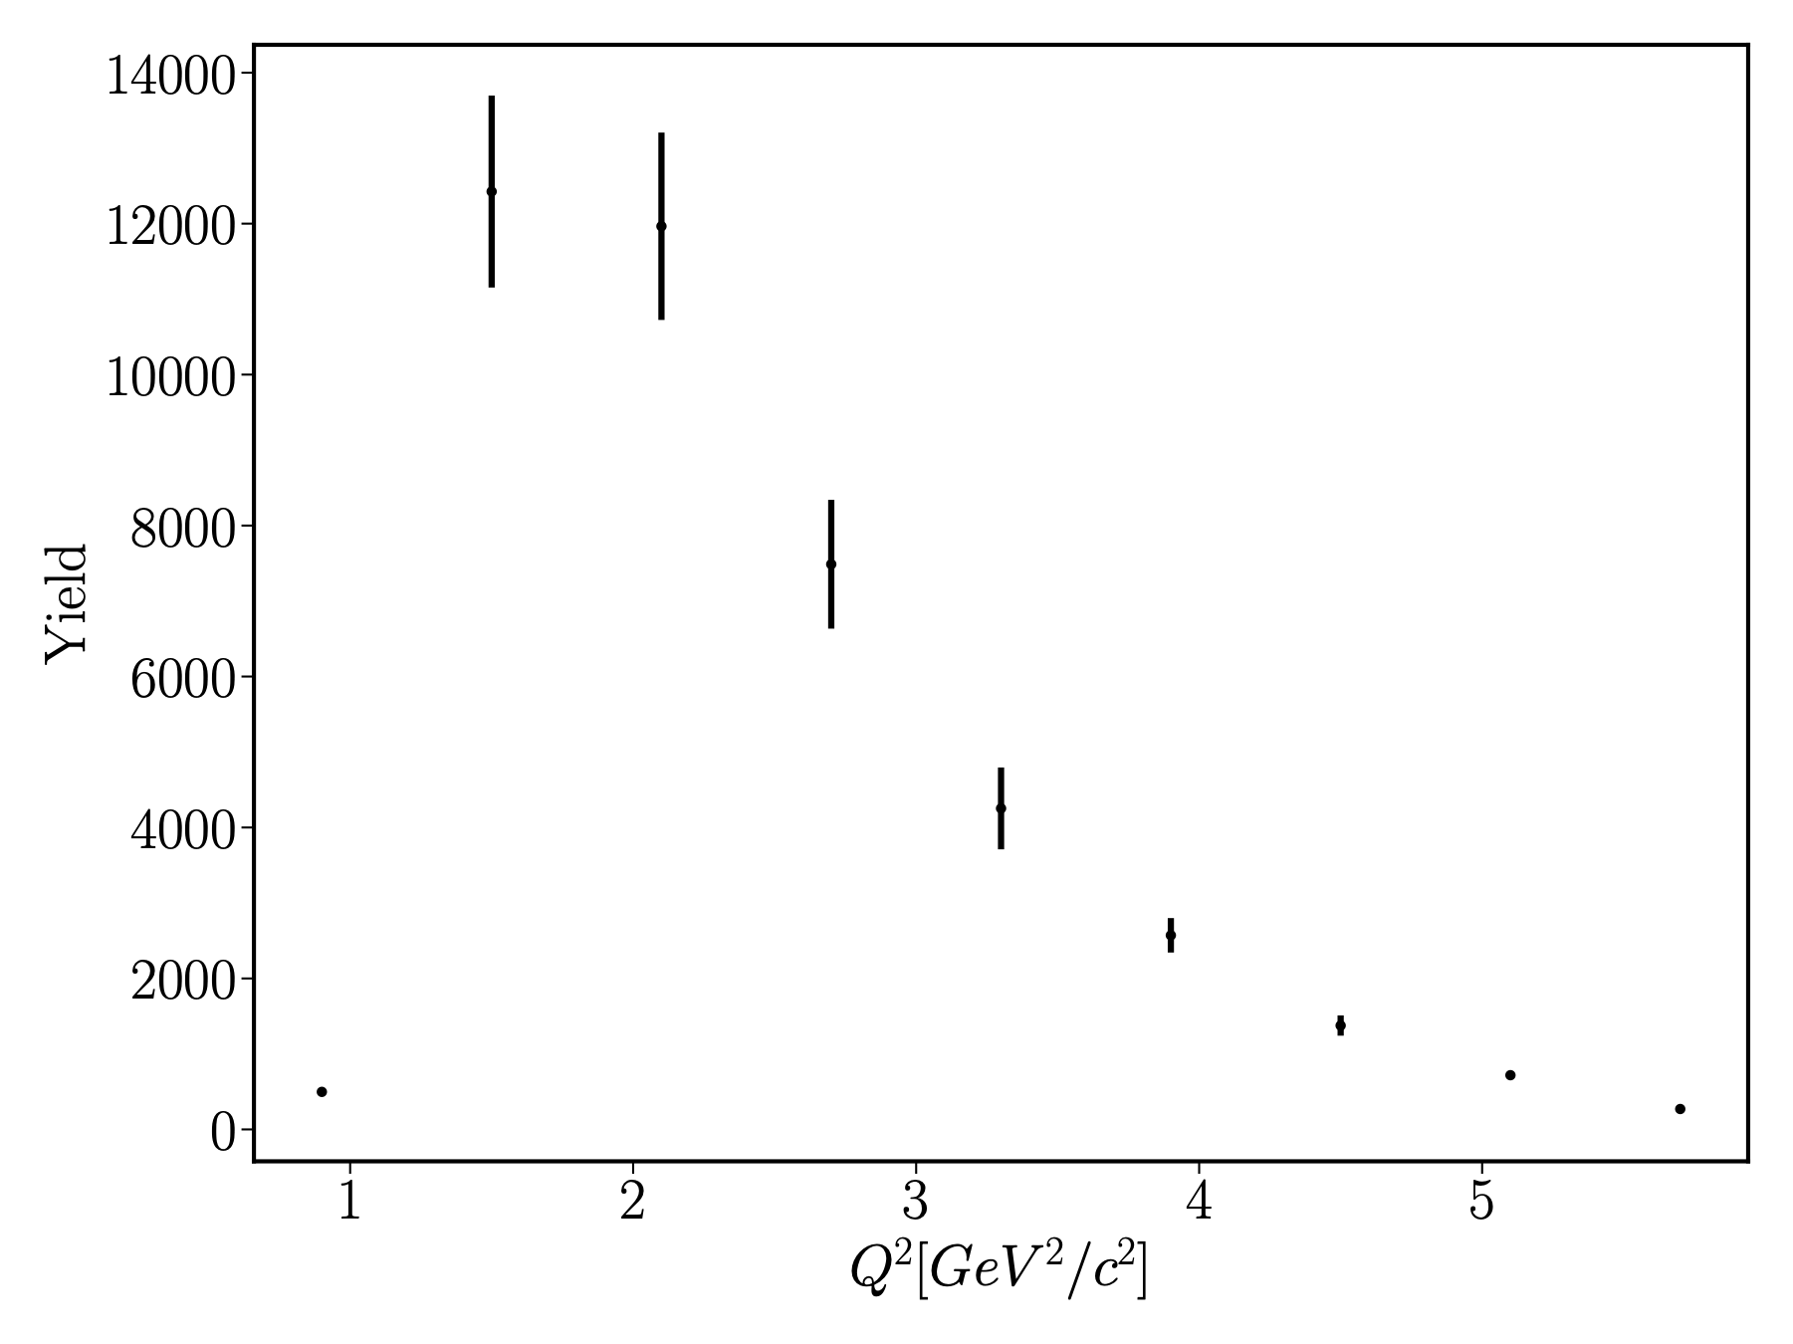
$Q^{2}$ Bins
Binning Missing Mass distribution by $Q^{2}$
$Q^{2}∈[0.6,6]$ with 9 equally spaced bins
Can extract yield by subtracting background and fitting signal peak

Slide 12
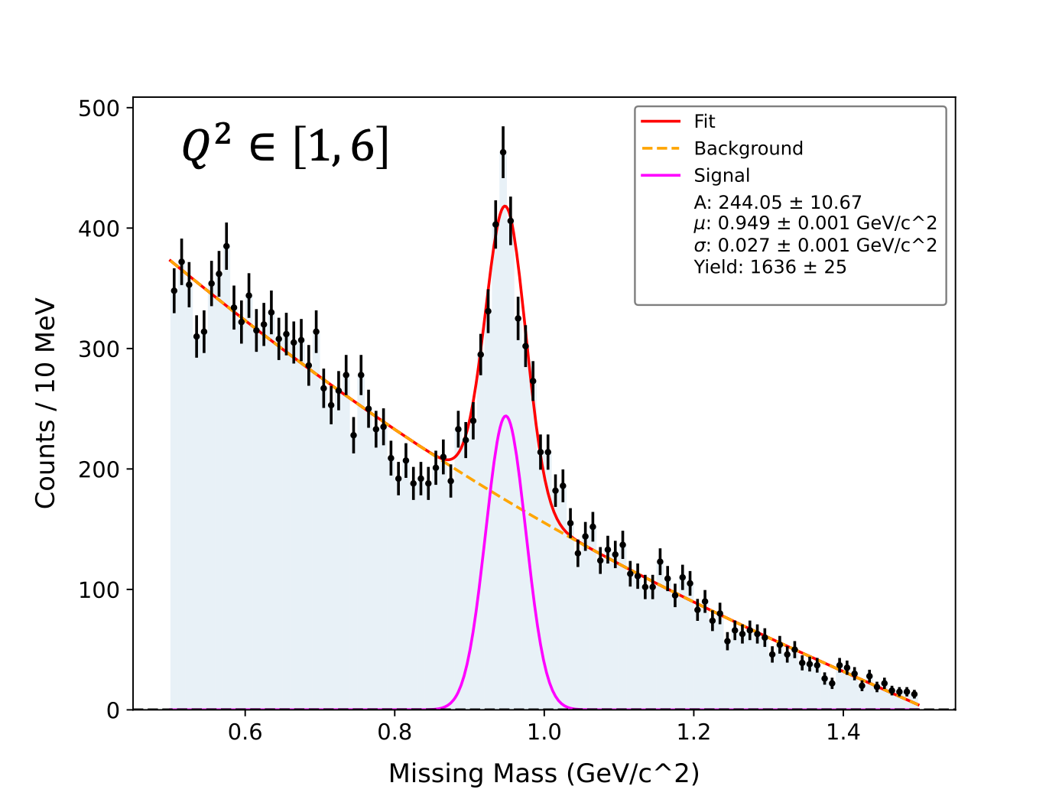
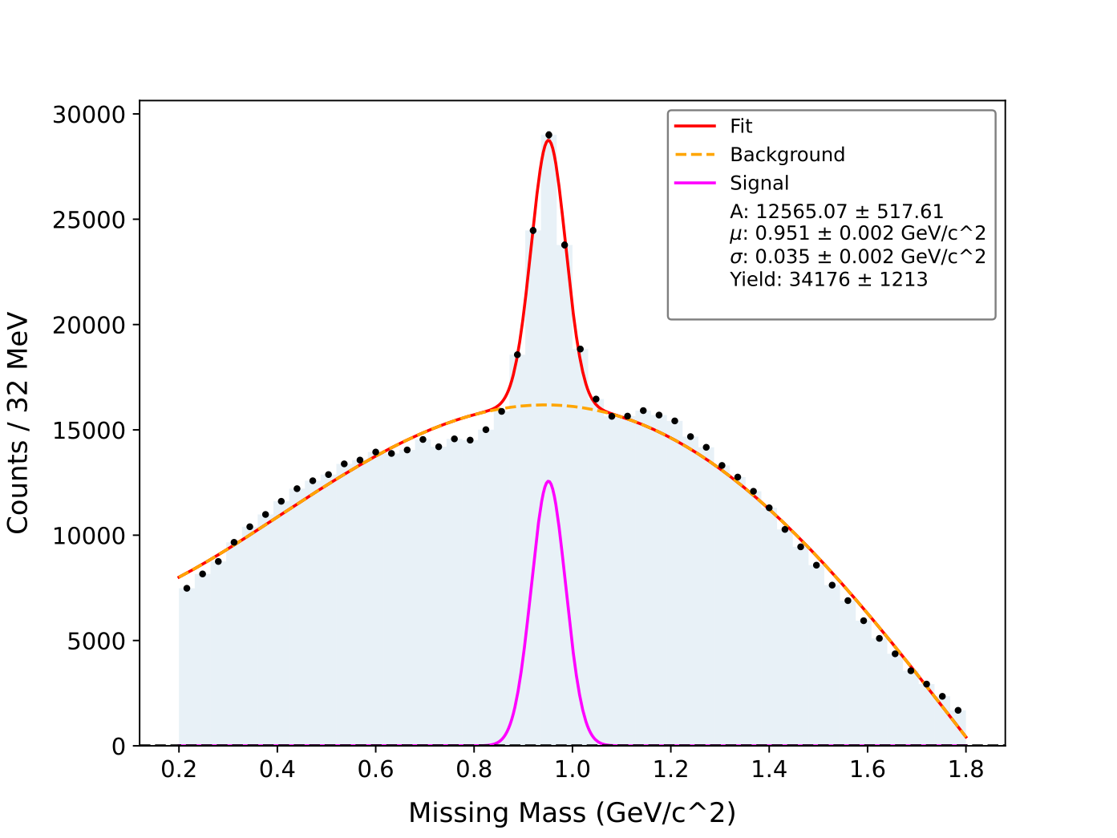
Other reaction $ep→eppπ^{−}(\overline{n})$
Forward Detector
$ep→eppπ^{−}(\overline{n})$
Being looked at by an undergraduate student: Alexander Lohr
Relative statistics between different experiments
CLAS g12 Photoproduction: 1200 Events
CLAS12 Electroproduction: 36000 Events
Forward Tagger
$$ep$$
$$γp$$
$$\frac{Y_{\overline{n}}}{Y_{\overline{p}}}$$
$$10\%$$
$$0.52\%$$

Slide 13
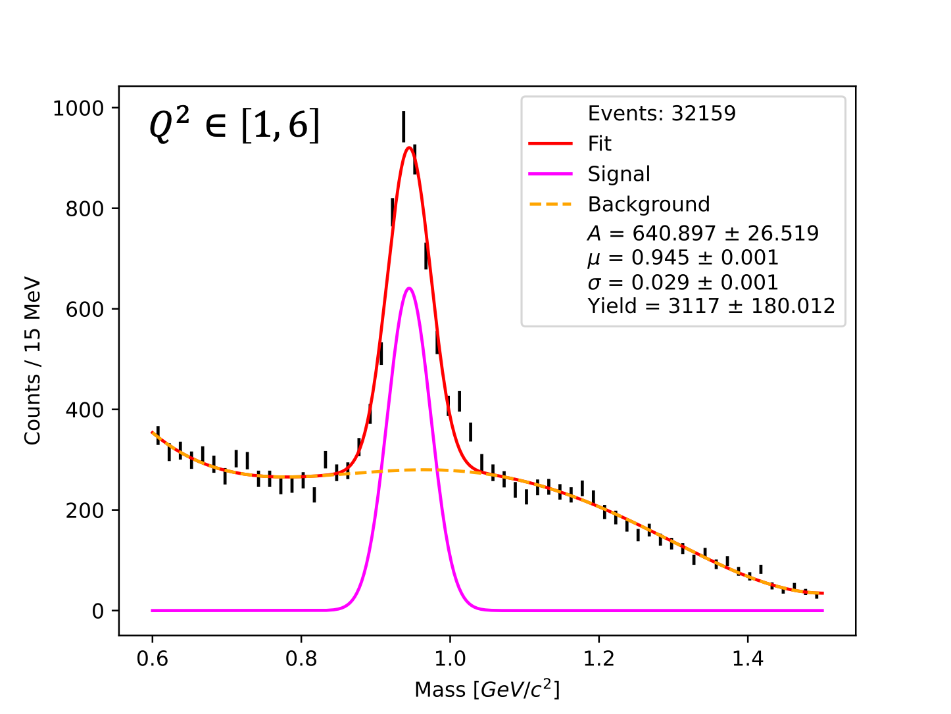
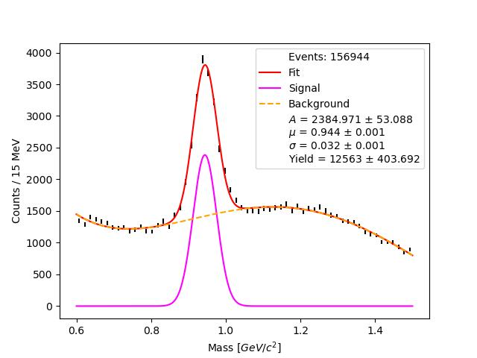
Other reaction $ep→ep\overline{p}π^{+}(n)$
Forward Detector
$ep→ep\overline{p}π^{+}(n)$
Being looked at by an undergraduate student: Edward Morell
Relative statistics between different experiments?
CLAS g12 Photoproduction: 1200 Events
CLAS12 Electroproduction: 15000 Events
Forward Tagger
$$ep$$
$$γp$$
$$\frac{Y_{n}}{Y_{\overline{p}}}$$
$$4\%$$
$$0.52\%$$

Slide 14
Outlook
First time high statistics cross section extraction of $p\overline{p}$ in electroproduction (Immediate goal)
Simulations are underway
Amplitude Analysis
Combinatorial background studies
Two identical fermions in the final state
Compare Mixed Events and $φ$ Angle Randomization
Supported by: DE-SC0013620, This work was supported by the US Department of Energy Office of Science, Office of Nuclear Physics, under contract no. DE-SC0013620
Thank you!

