Slide 1
Polarizing ³He via MEOP at High Magnetic Fields for CLAS12
Pushpa Pandey
Massachusetts Institute of Technology
On behalf of CLAS12 Polarized ³He Collaboration
CLAS Collaboration
March 4, 2025

Slide 2
Outline
Polarized ³He for Nuclear Physics
Polarization tests:
Metastable Exchange Optical Pumping (MEOP)
Physics Goals for CLAS12
Design
Results so far
Next Steps

Slide 3
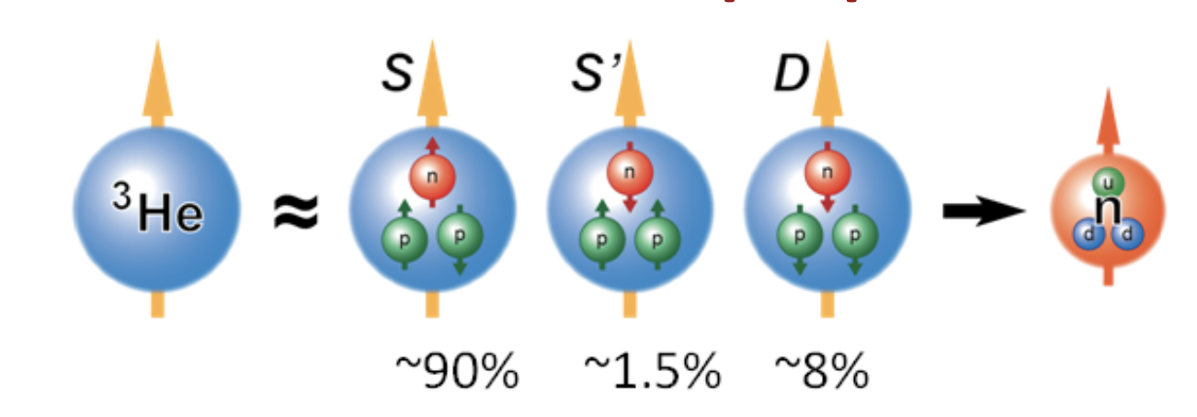
Polarized ³He
Why Polarized ³He ?
Neutron spin structure study
Polarized spin asymmetries: ³He is a good surrogate for a neutron.
Crucial cross-check against measurements on “~n” from ND₃
Total luminosity: long cells and higher beam current
Facilities involved for successful polarized ³He targets in
lepton scattering experiments: SLAC, HERMES, MIT-Bates, JLab 6 and 12 GeV (Hall A & C)
Emerging possibilities for polarized ³He at CLAS12:
Recent advancements in high-field metastability exchange optical pumping (MEOP) techniques
Collaborative efforts by MIT and BNL to develop a polarized ³He ion source for the Electron-Ion Collider (EIC)

Slide 4
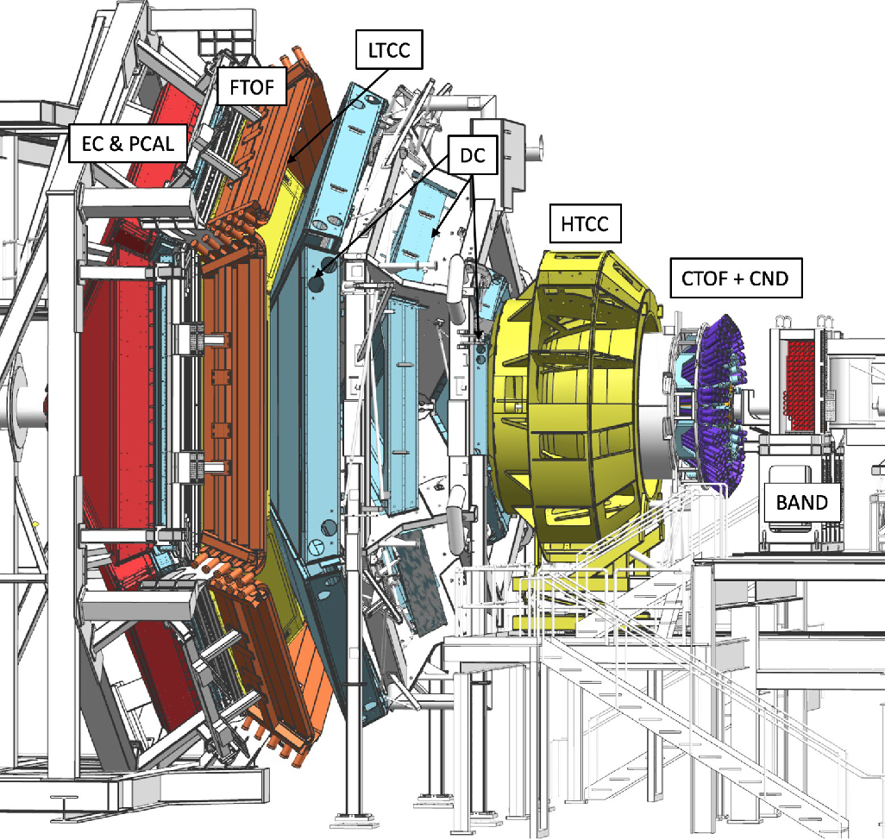
Polarized ³He Target for CLAS12
CEBAF Large Acceptance Spectrometer for Jefferson Lab’s 12 GeV upgrade
High luminosity electron scattering
Multi-particle final state response
5 T solenoid in interaction region
Proposal to PAC48: A program of spin-dependent electron scattering using a polarized ³He target in CLAS12
P_{T} -dependence of the longitudinal spin structure function F_LL of the neutron
Nuclear corrections to SIDIS
Novel target needed for standard configuration

Slide 5
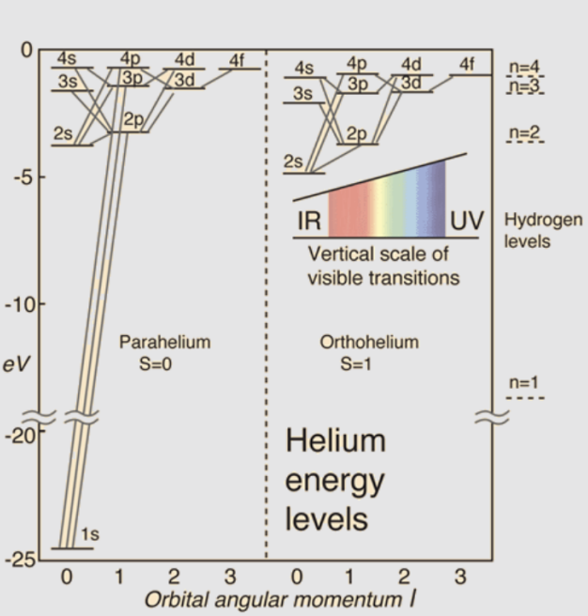
Optical Pumping
Energy to first excited electronic state is 20 eV!
This corresponds to a wavelength of around 60 nm, not practical for driving polarizing transitions.
We have to optically pump other electronic states, then transfer to the helium nucleus.
Polarization of Gas via Optical Pumping
Spin-exchange: Evaporate Alkalis into the Gas, Pump Them
Metastability-exchange: Excite Electrons to 2S, Pump Them

Slide 6
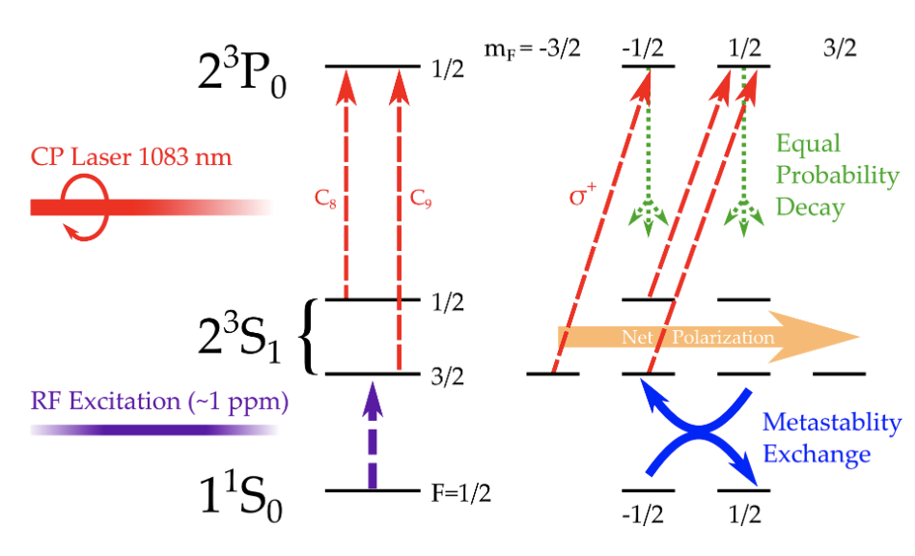
Metastability Exchange Optical Pumping
Discharge excites atoms to the 2³S1 state
Optically pump Metastable State ³He
Laser drives transition and induces polarization on metastables.
Collisions between 2³S1 state and ground state atoms polarize the nuclei
High field MEOP is attractive since it doesn’t require exchange of gases

Slide 7
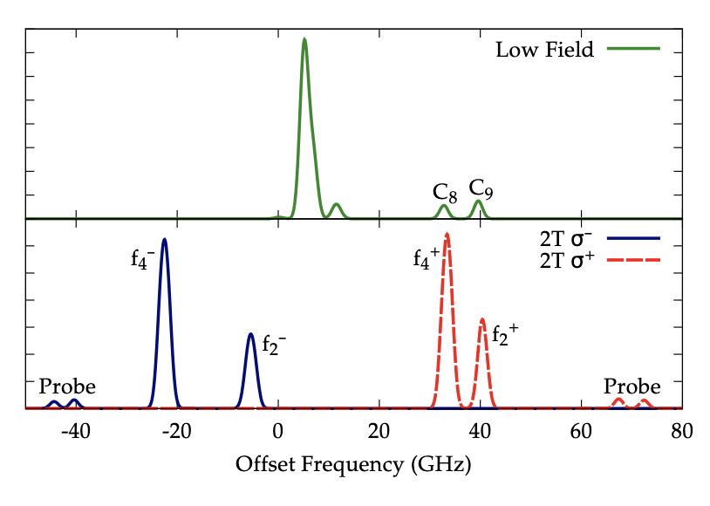
³He Transitions
Absorption spectrum of ³He at low magnetic field and 2 T, showing the separation of degenerate Zeeman states with increasing field. Pumping transitions are labeled by name, as are lines useful for probes.

Slide 8
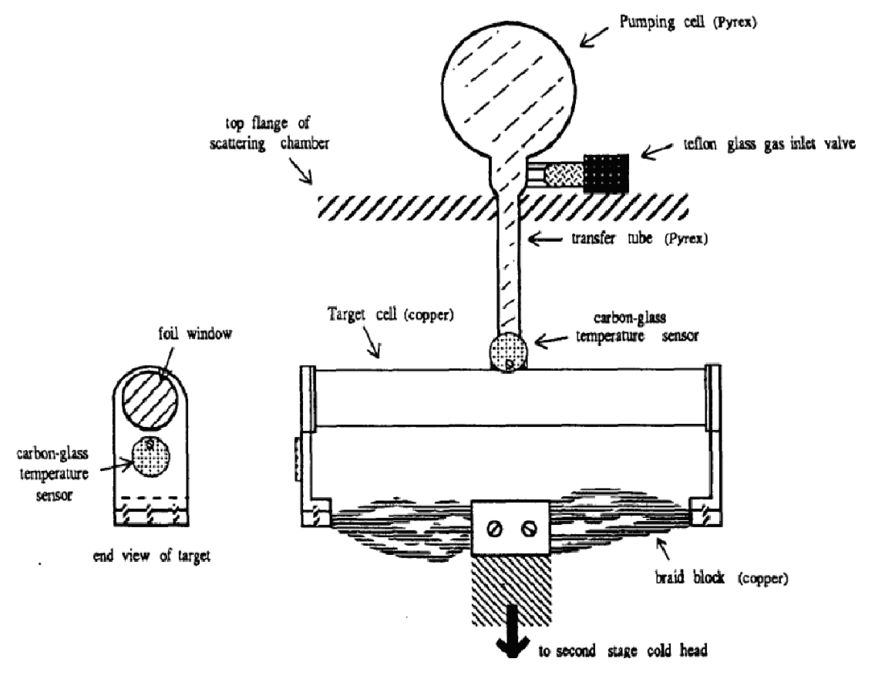
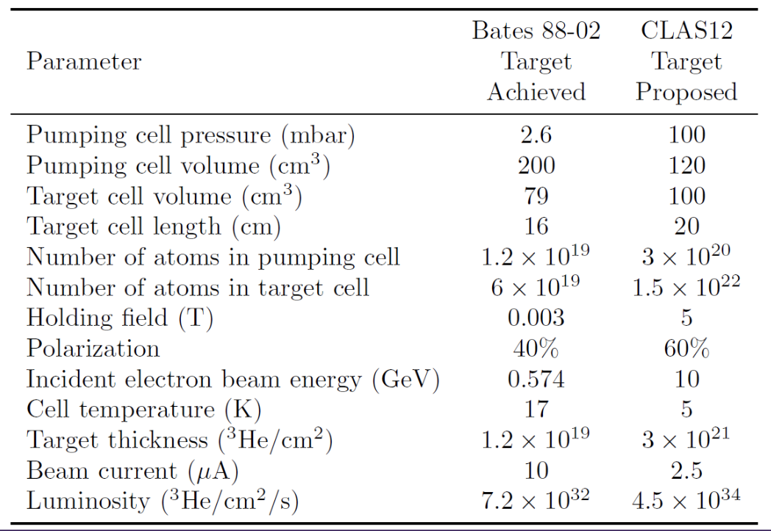
Double Cell CryoTarget Bates 88-02

Slide 9
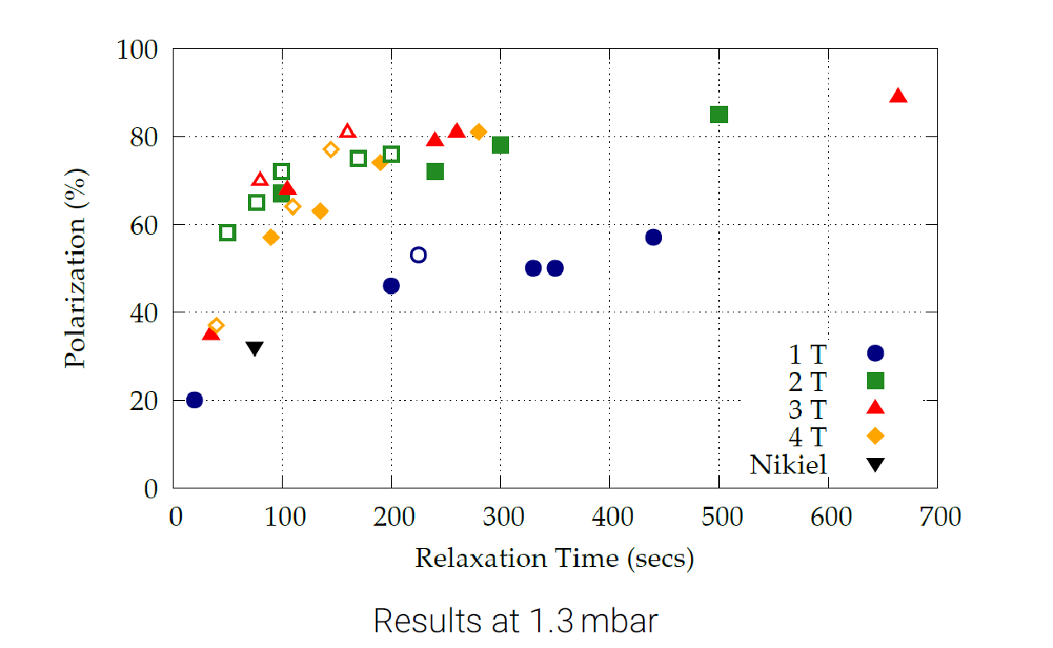
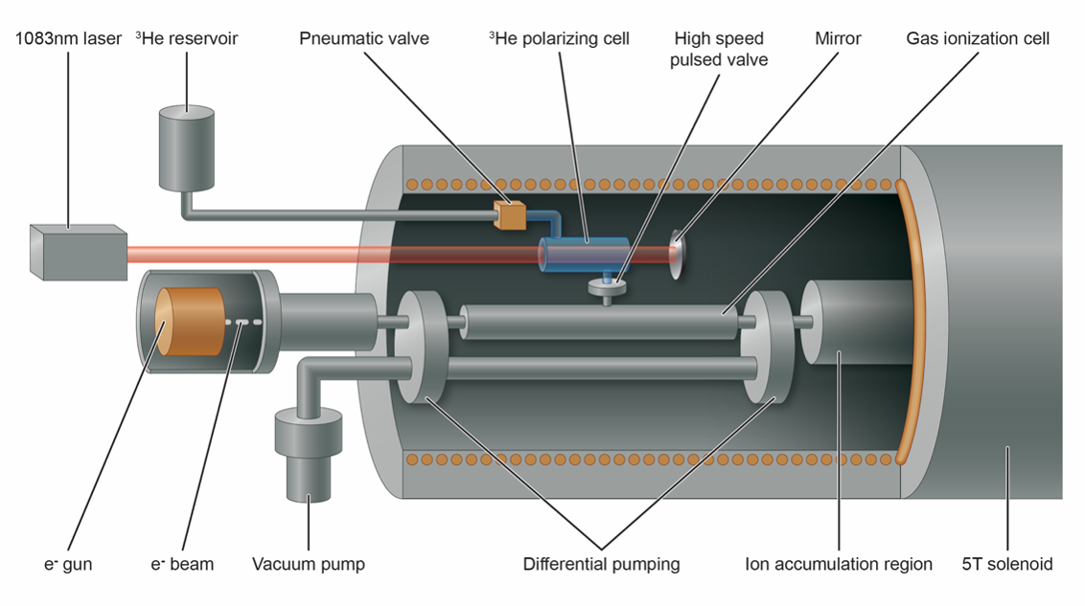
High Field MEOP for EIC
High field MEOP already being applied for nuclear physics
BNL’s Electron Beam Ion Source: 5 T
MEOP tests between 2 to 4 T gave nearly 90% at 1.3 mbar (Maxwell et al., NIM A 959, 2020)

Slide 10
New Target for CLAS12
Combining two technologies: double-cell polarized ³He target (Maxwell, Milner, NIM A, 2021.)
CLAS12’s 5 T solenoid standard configuration
5.4 amg, comparable to SEOP
High Field MEOP
High magnetic field (5 T)
Polarization ~ 60%
Higher pressure (100 times) compared to typical low field MEOP (100 mbar vs 1 mbar)
Double-Cell Cryo Target
Polarize ³He using MEOP at room temp (300 K)
Diffuse transfer to 5 K target cell
Density increase by 60 times

Slide 11
Target Conceptual Design
293 K Pumping Cell:
Volume: 200 cm³ borosilicate glass
MEOP achieving 60% polarization
Annular cylindrical shape
5 K Target Cell:
Volume: 100 cm³, 20 cm long aluminum cell
Cooled by LHe heat exchanger
Luminosity: 2.7×10³⁴ nuc/cm²/s at 0.5 μA

Slide 12
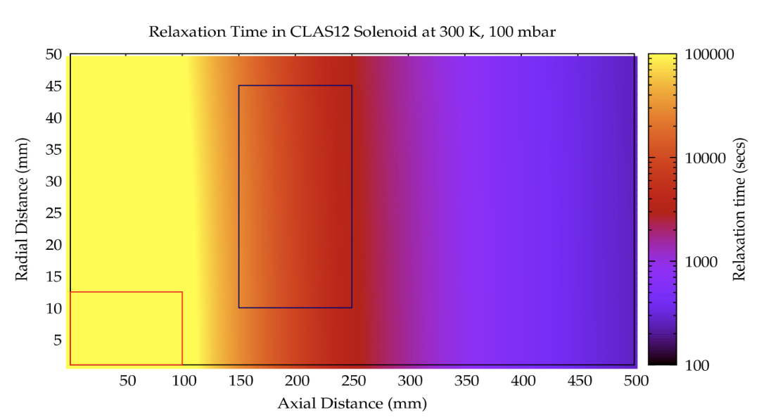
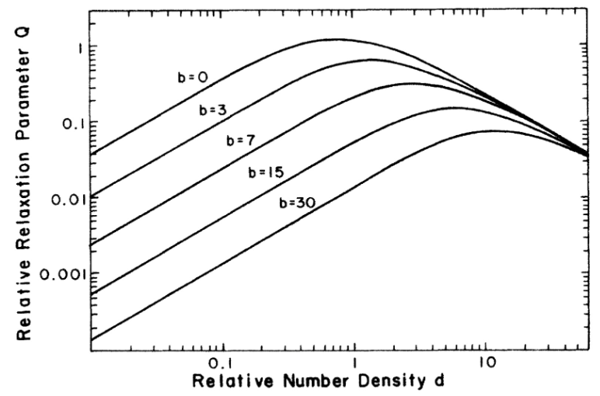
Depolarization Mechanisms
Wall Relaxation:
Borosilicate glass
Aluminum with coating
Field Gradient:
Relaxation time around the pumping region: 10⁴ seconds
Ionizing Radiation:
Formation of 3He2+molecules
Suppressed with higher magnetic fields

Slide 13
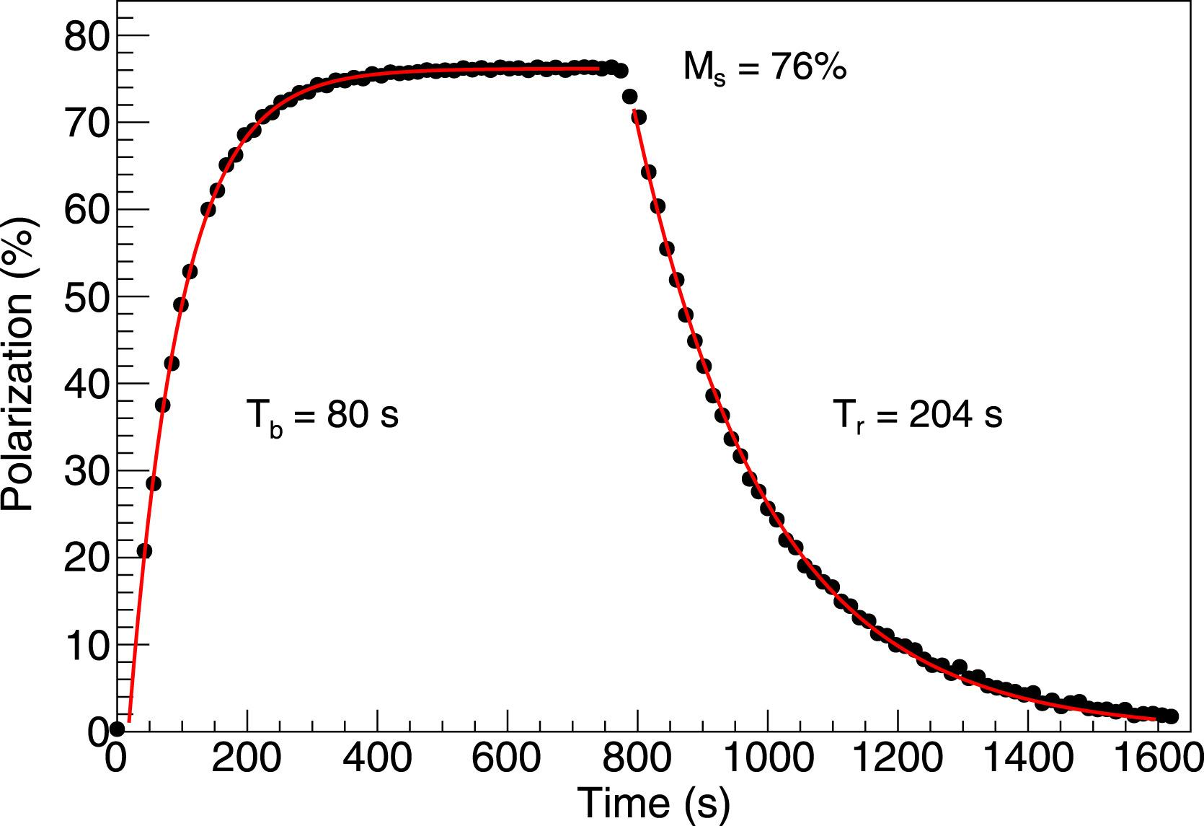
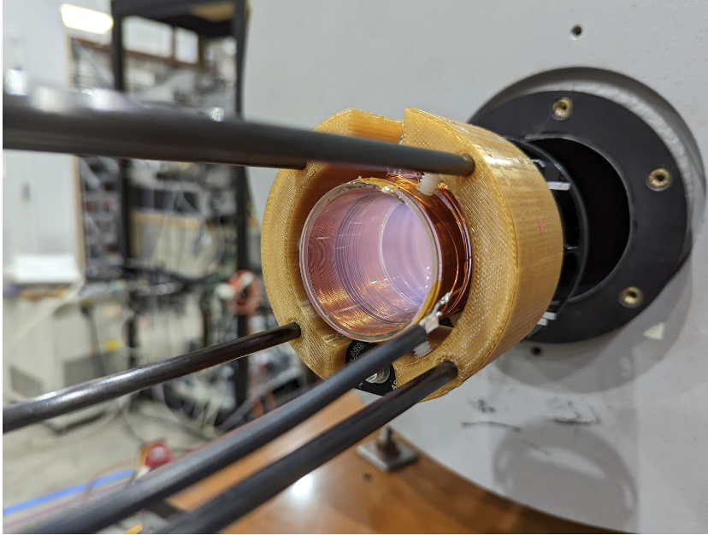
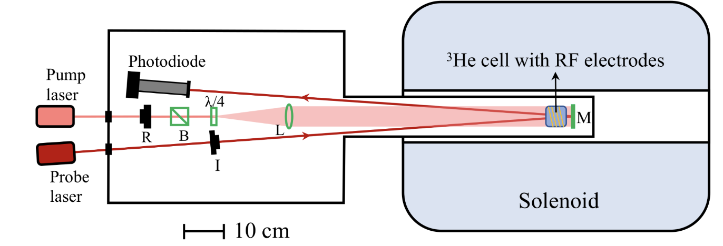
First Development (High Field) (Season 1)
High-field tests
1 torr Sealed ³He cell
4T warm-bore solenoid
1083 nm probe laser
76 % nuclear polarization with 1400 seconds relaxation time
X. Li, NIM A, 1057, 168792 (2023)
X. Li, J. Maxwell, D. Nguyen

Slide 14
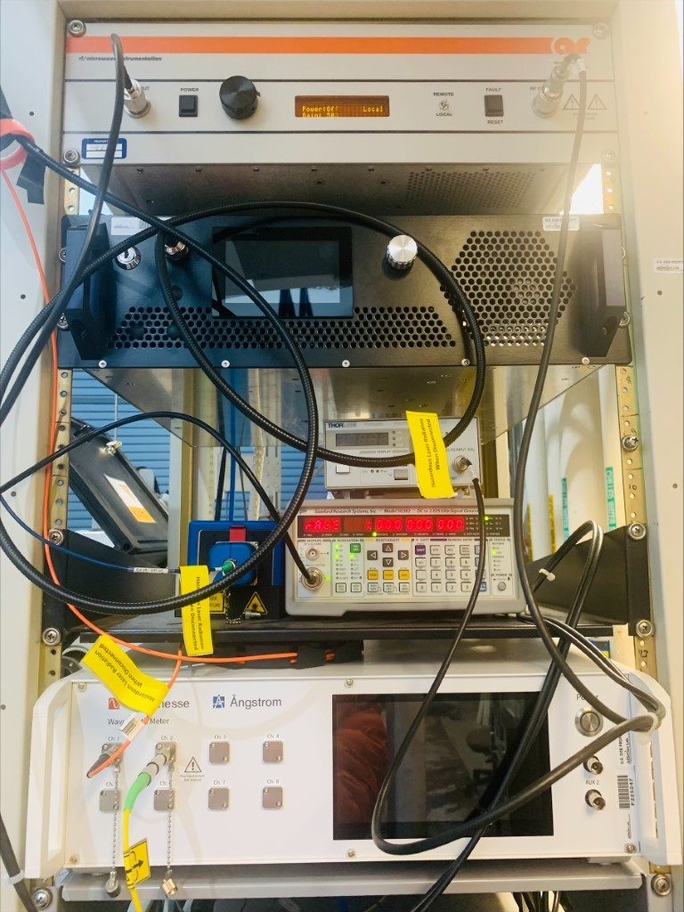
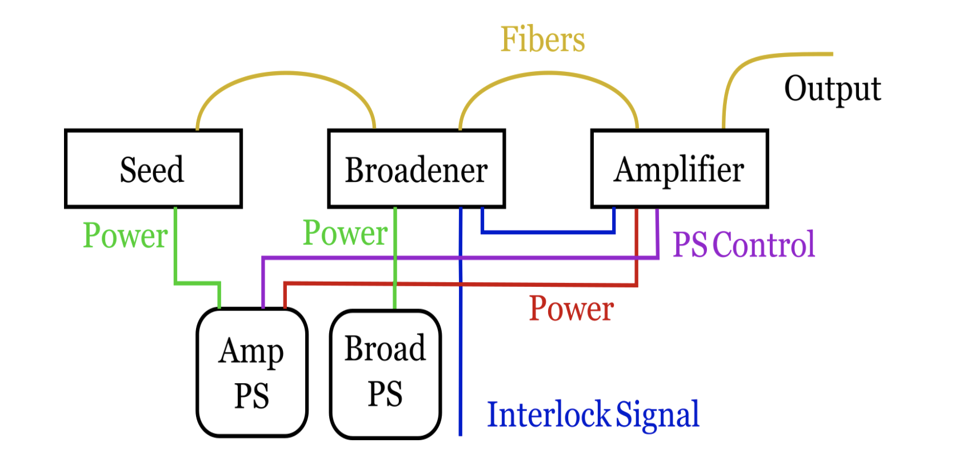
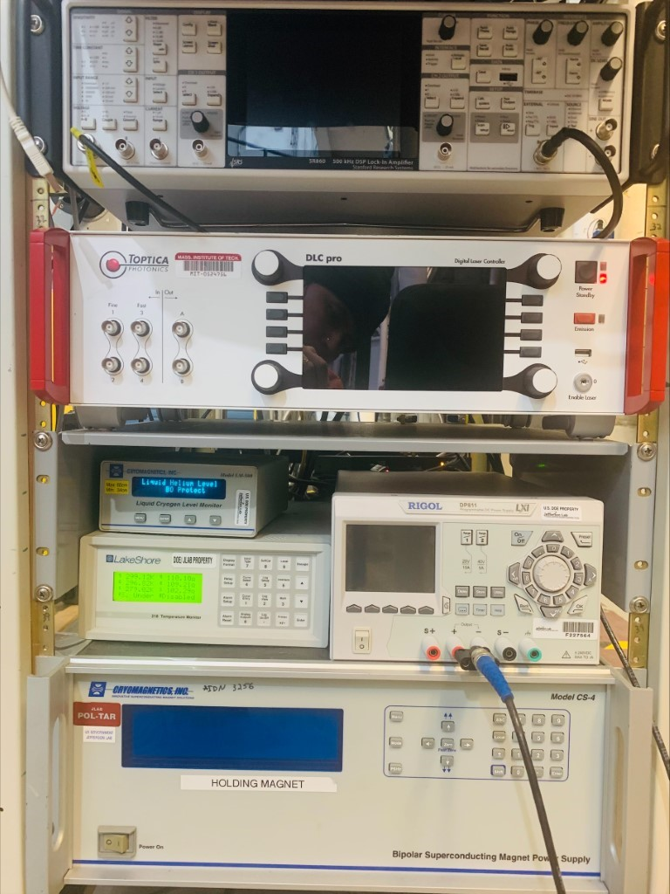
MEOP Apparatus (Electronics)(Season 2)
Rf (25 W)
Pump Laser(0.1 -10)W
Photodiode Amplifier
Signal Generator
Wavelength Meter
Lock-In Amp
Probe Laser (70 mW)
New laser system (Azurlight):
Three modules in the pumping laser system: a low-power seed laser, a broadener to expand the laser line wavelength to cover our pumping lines, and an amplifier to increase the power of the broadened
laser light to anywhere from 0.1 to 10 W.

Slide 15
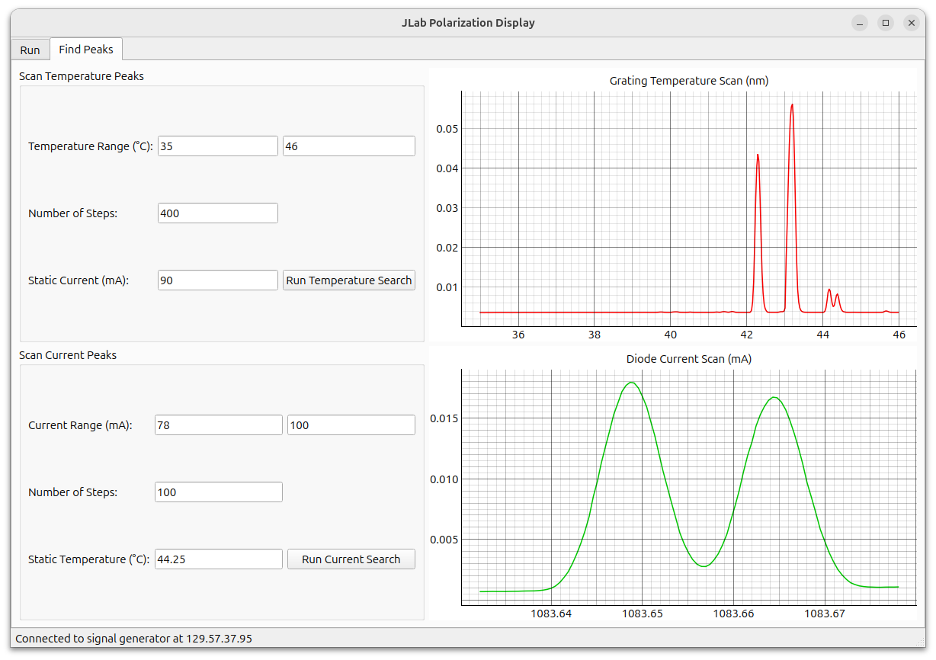
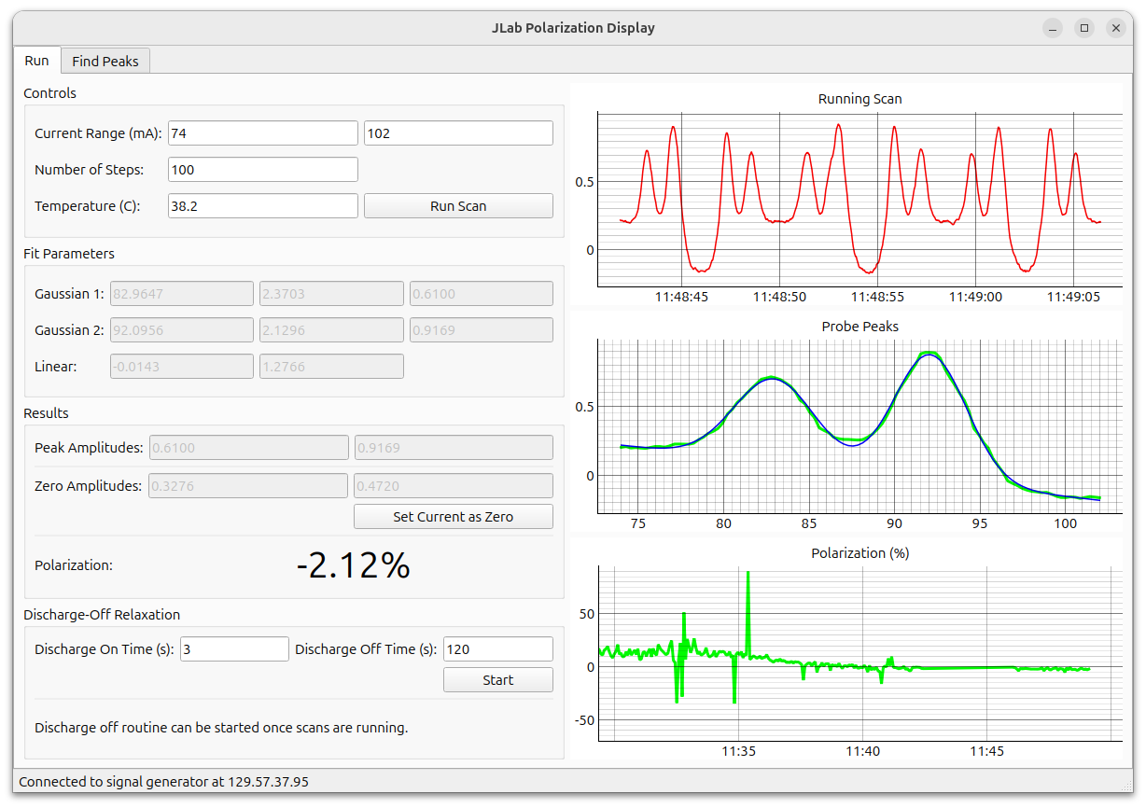
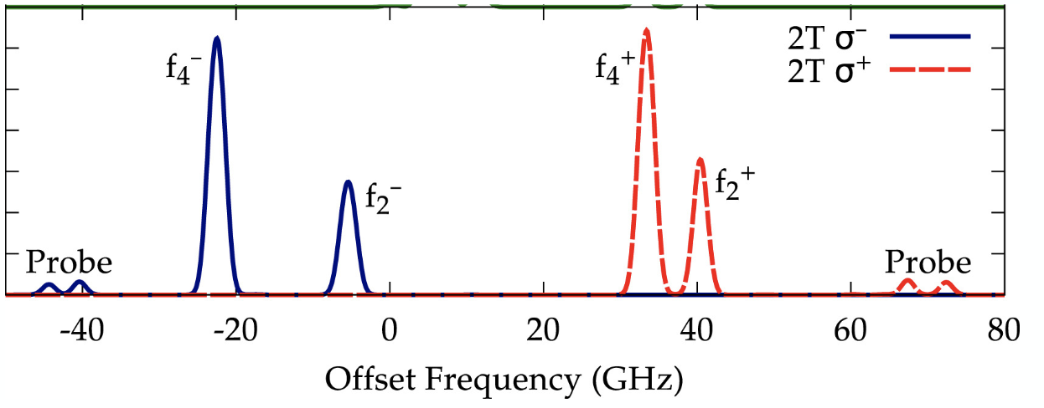
MEOP Software
J. Maxwell
Peak Type | Probe QWP | PumpQWP
f2- | 𝞂ᐩ | 𝛔−
f4- | 𝛔− | 𝛔−
f2+ | 𝛔− | 𝞂ᐩ
f4+ | 𝞂ᐩ | 𝞂ᐩ

Slide 16
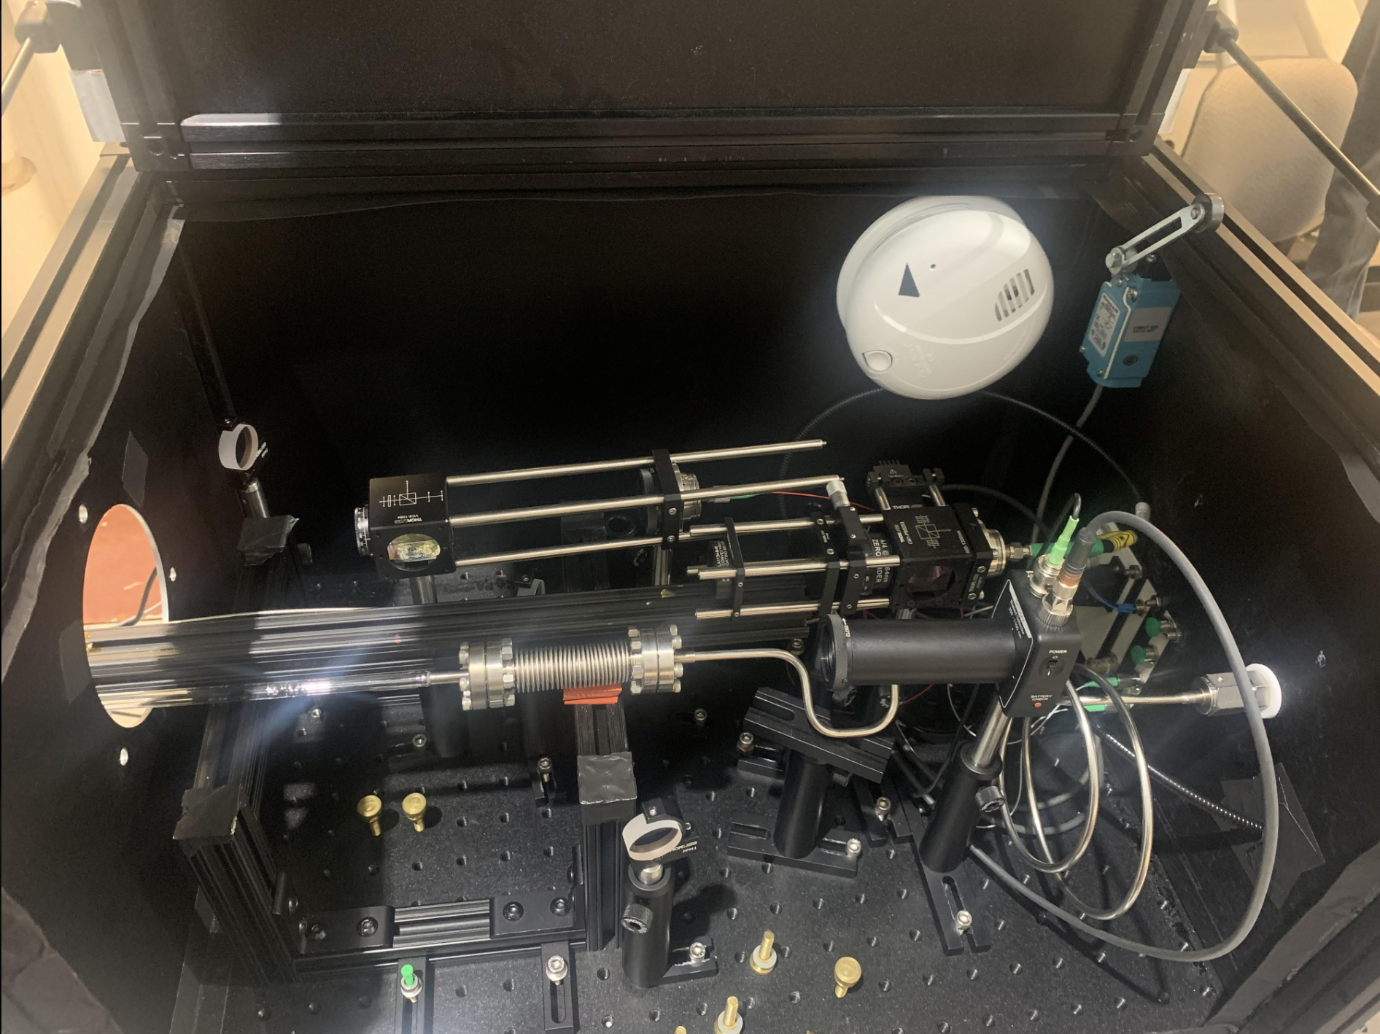
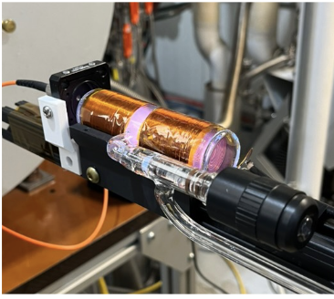
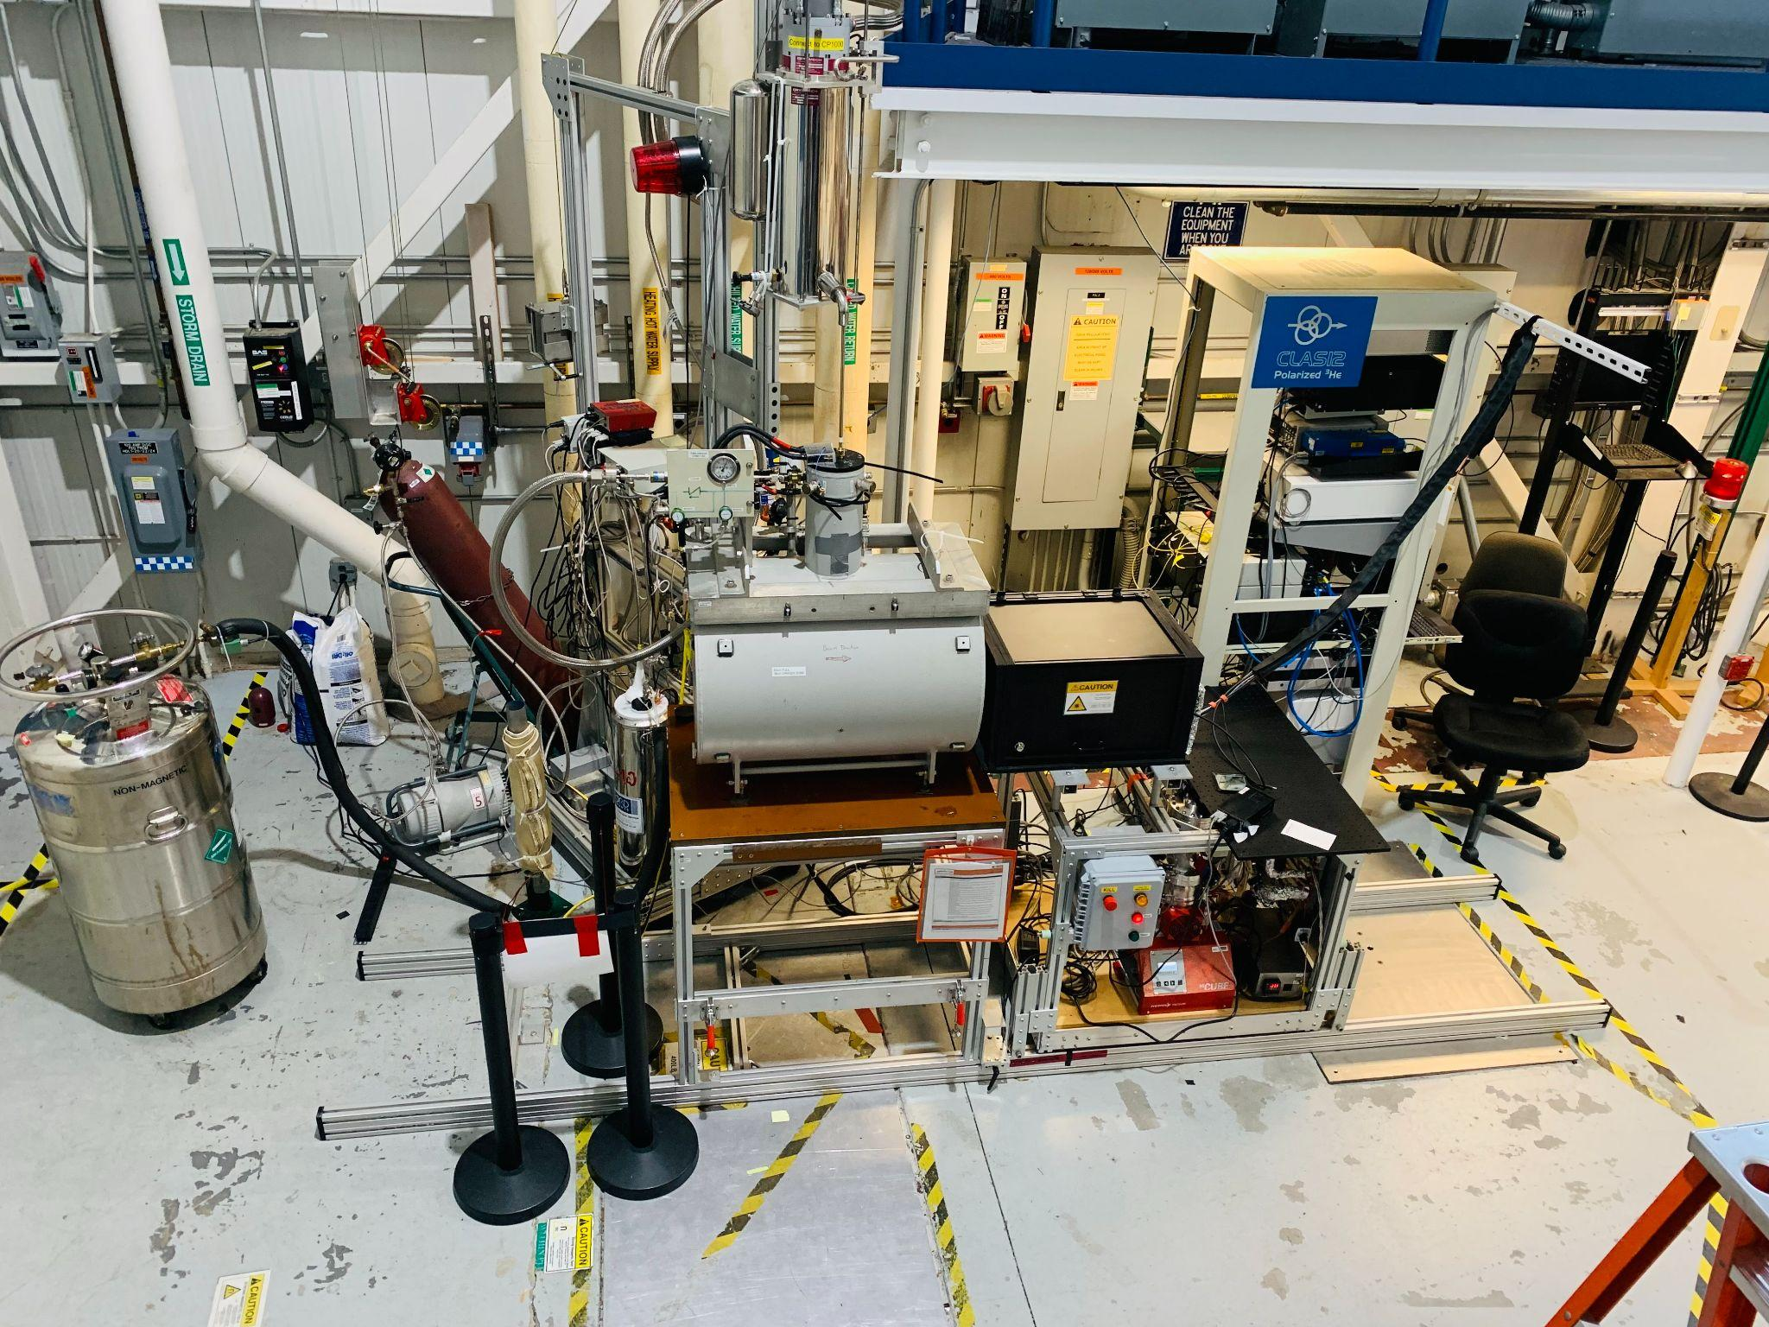
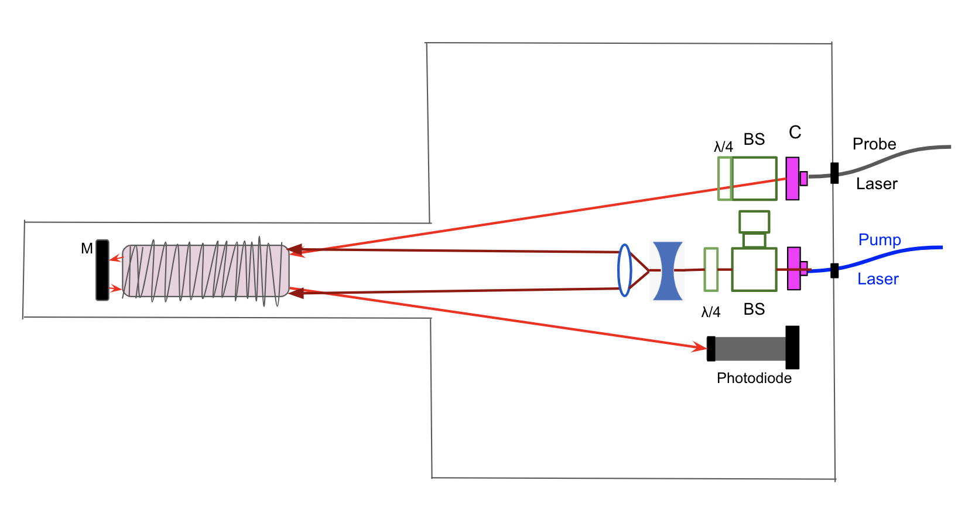
Target Development Lab (Season 2)
Fillable ³He cell at various mbars
FROST Magnet provides 1-5T magnetic field
Tested with various magnetic field and the cell pressure
Added qwp for probe as well
B-Field

Slide 17
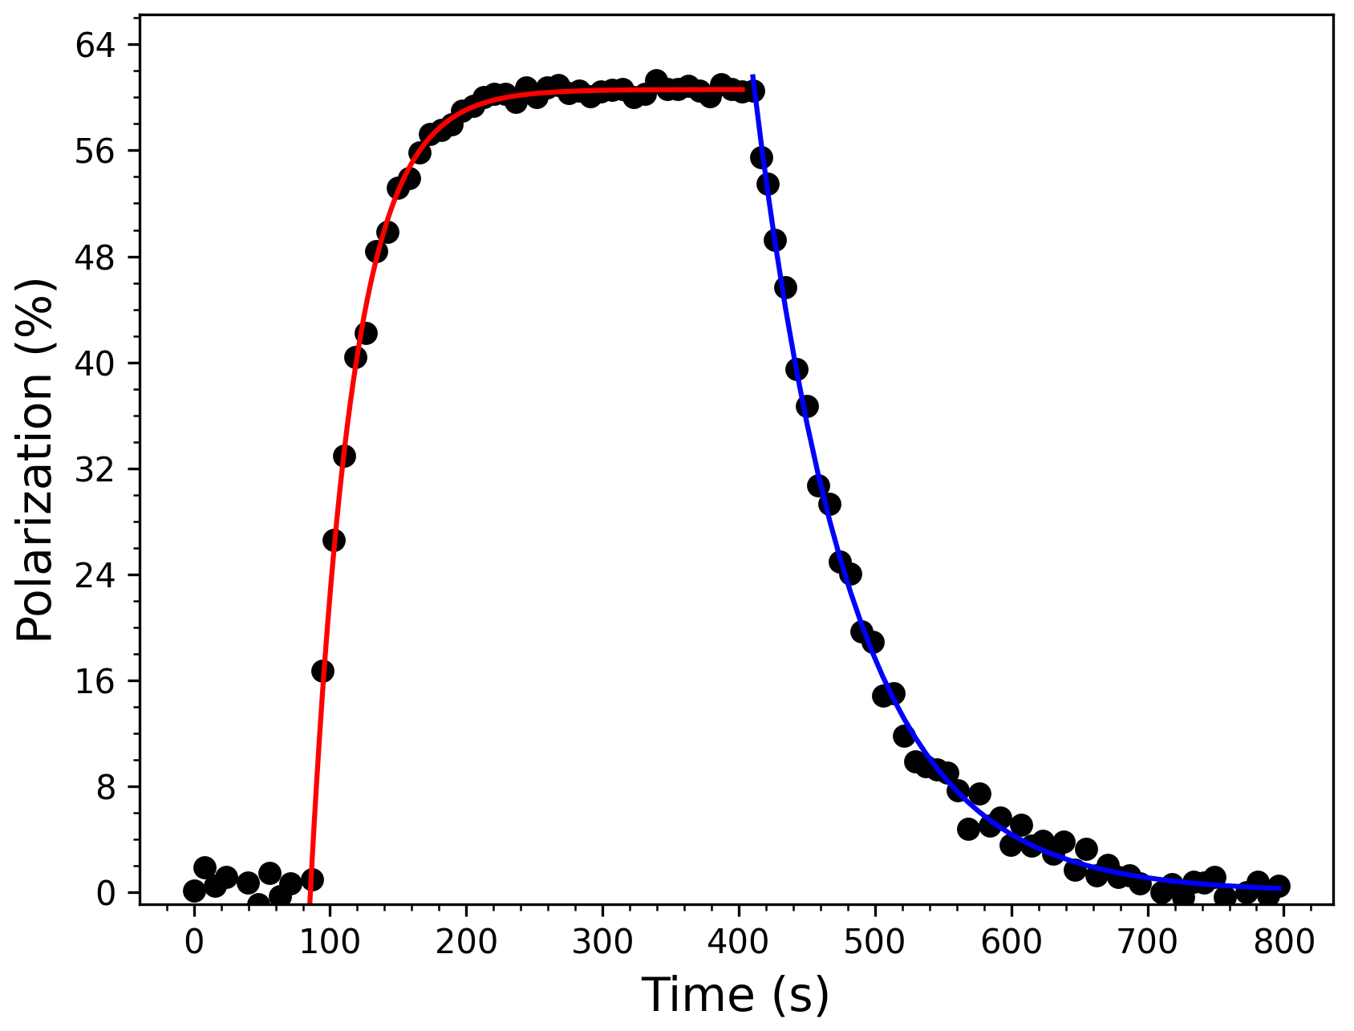
Polarization Tests (Sealed Cell Vs Fillable Cell)
Mₛ = 60 %
Tᵣ = 75 s
Tb = 31 s
1 torr, 2T, f4-
This talk: 1 mbar, 2T, f4+
BNL result with the same sealed cell~89% in 2015
X. Li, NIM A, 1057, 168792 (2023)

Slide 18
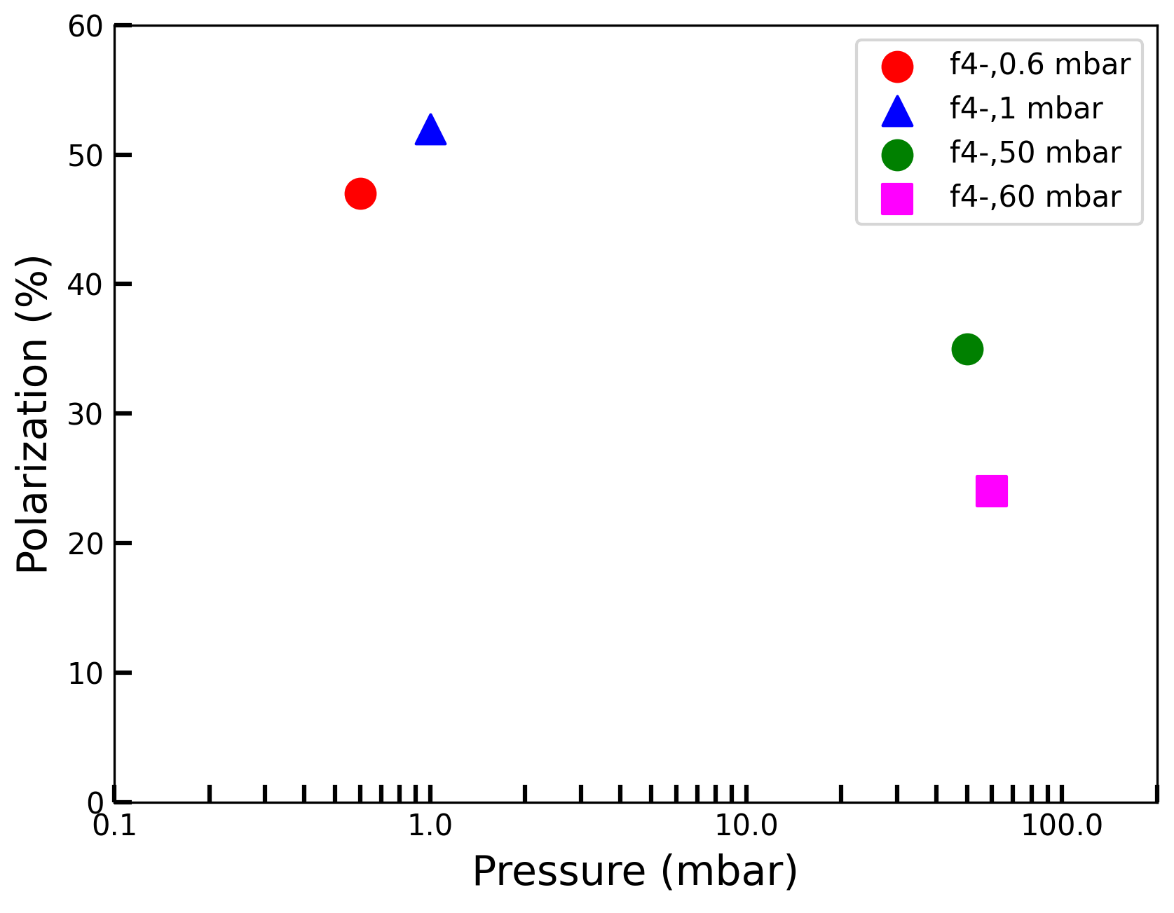
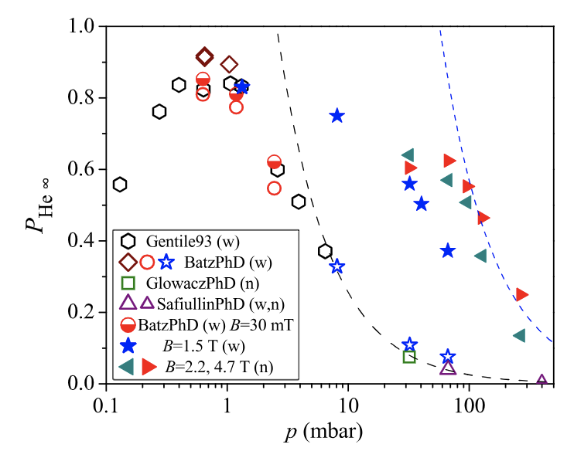
First Results in Pressure vs KBL Results
2T
Preliminary
T. R. Gentile et. al., Rev. Mod. Phys. 89, 045004 (2017)
High pressure tests need high enough RF power, high discharge amplitude

Slide 19
Hunting Down the Missing Polarization
Hiccups:
Shorter relaxation and steady state polarization drops as relaxation time goes up
Filled cell is longer (10 cm) and thinner (2 cm diameter)
Uses viton O-rings
Curvature makes it difficult to get laser in-edge, where the discharge is
Could be due to the depolarization mechanisms
Possible solutions:
Check with brand new sealed cell
New fillable cell setup without O-rings

Slide 20
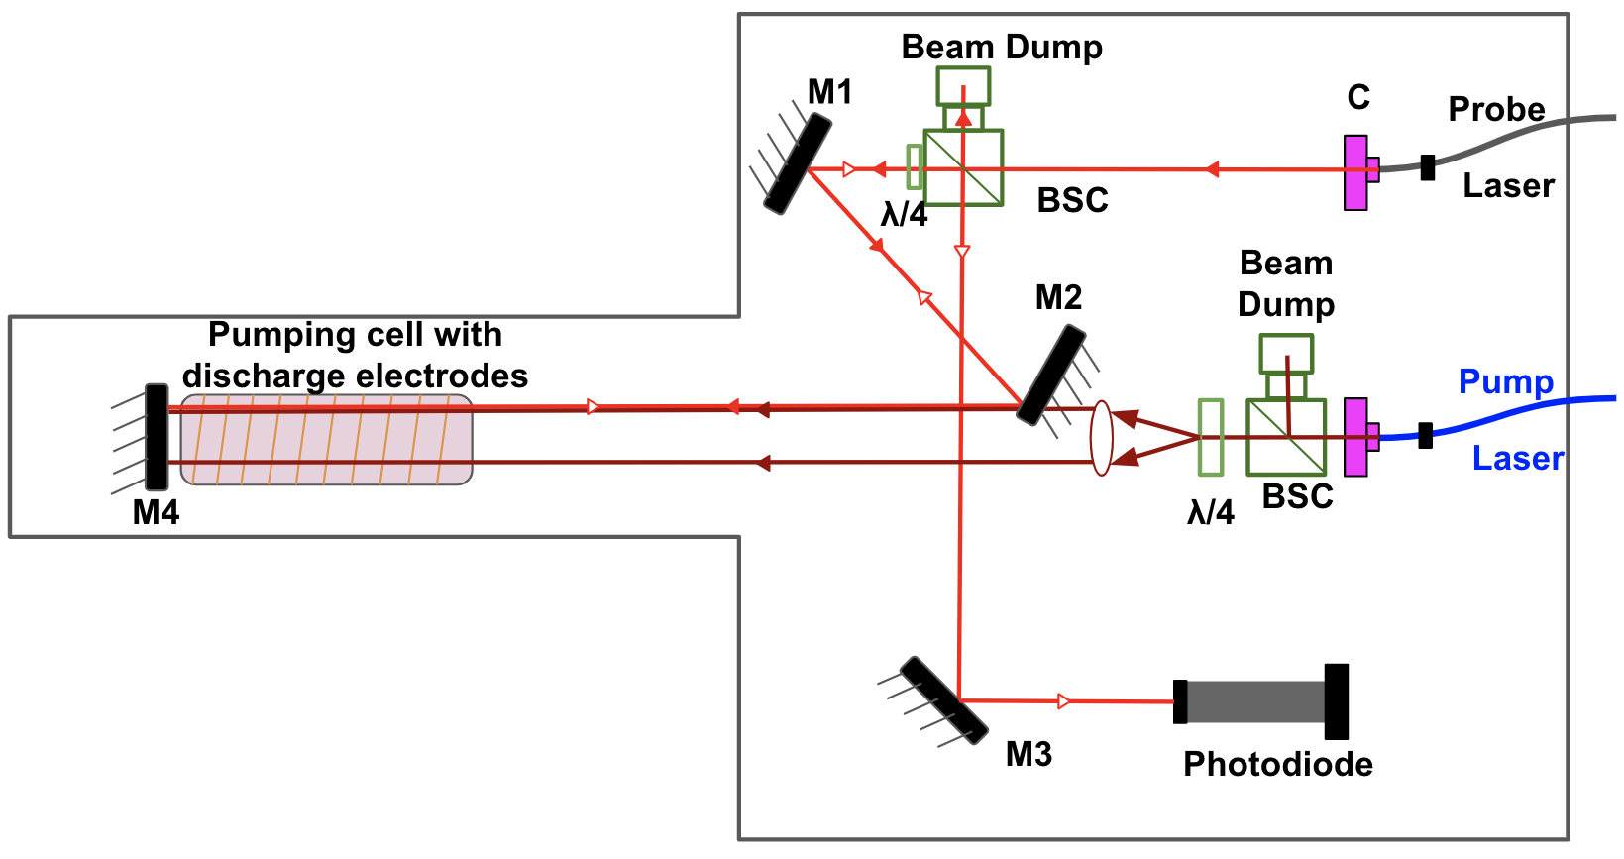
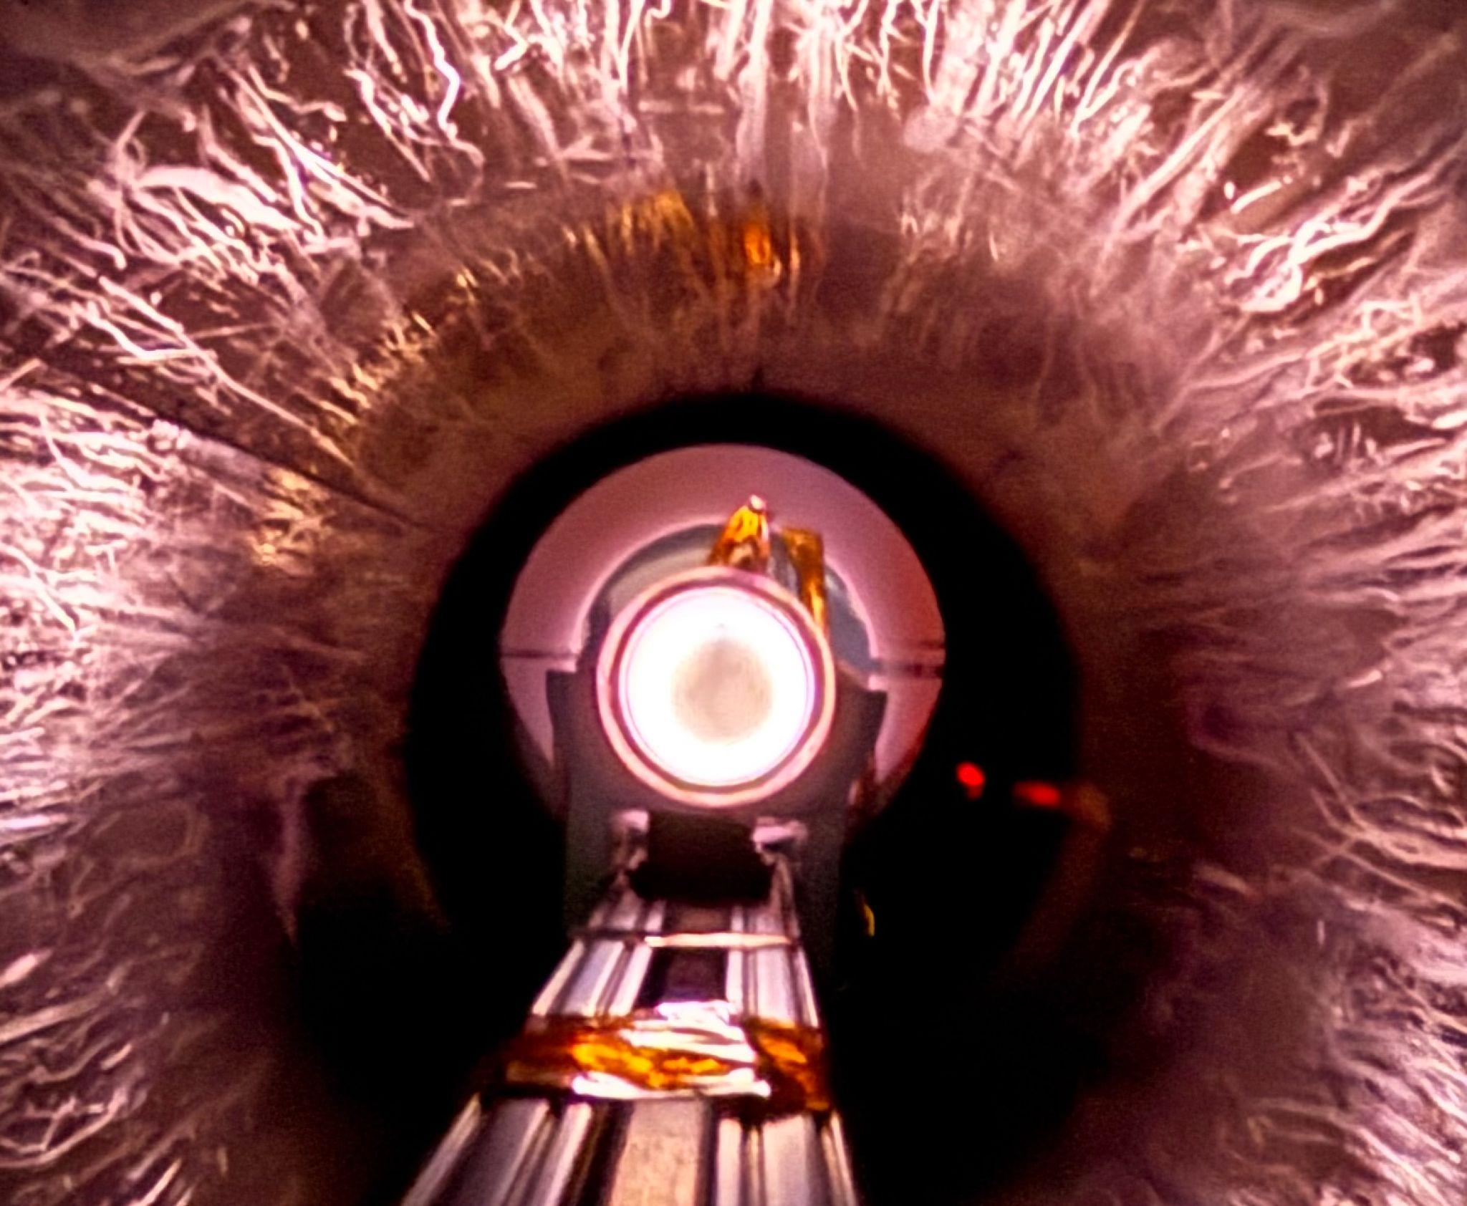
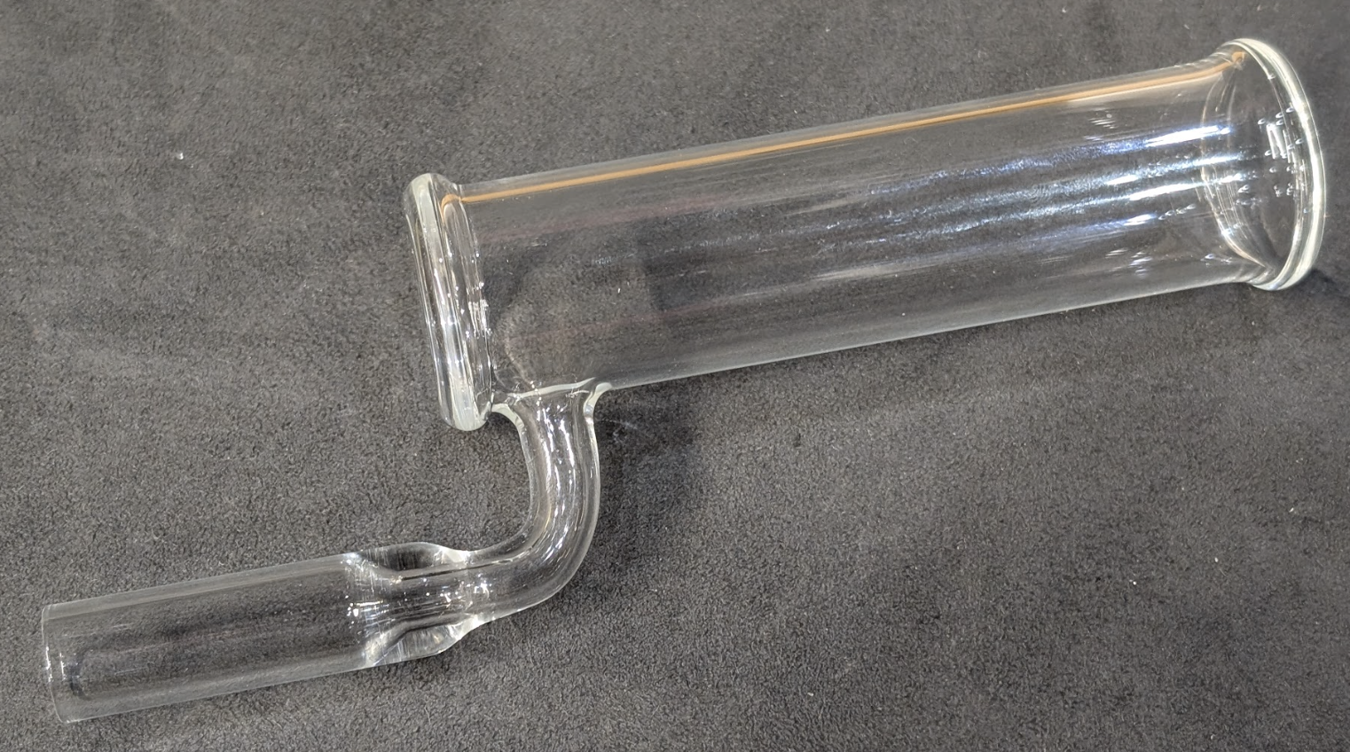
Polarization Tests (Season 3 Reforms)
Brand new 1.2 mbar smaller radius sealed cell
Added 3 additional mirrors for beam profile matching

Slide 21
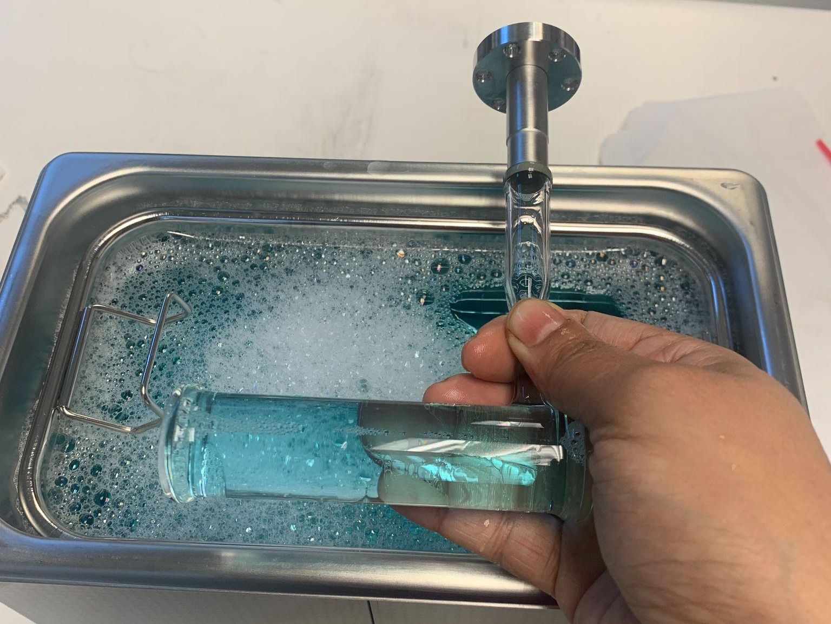
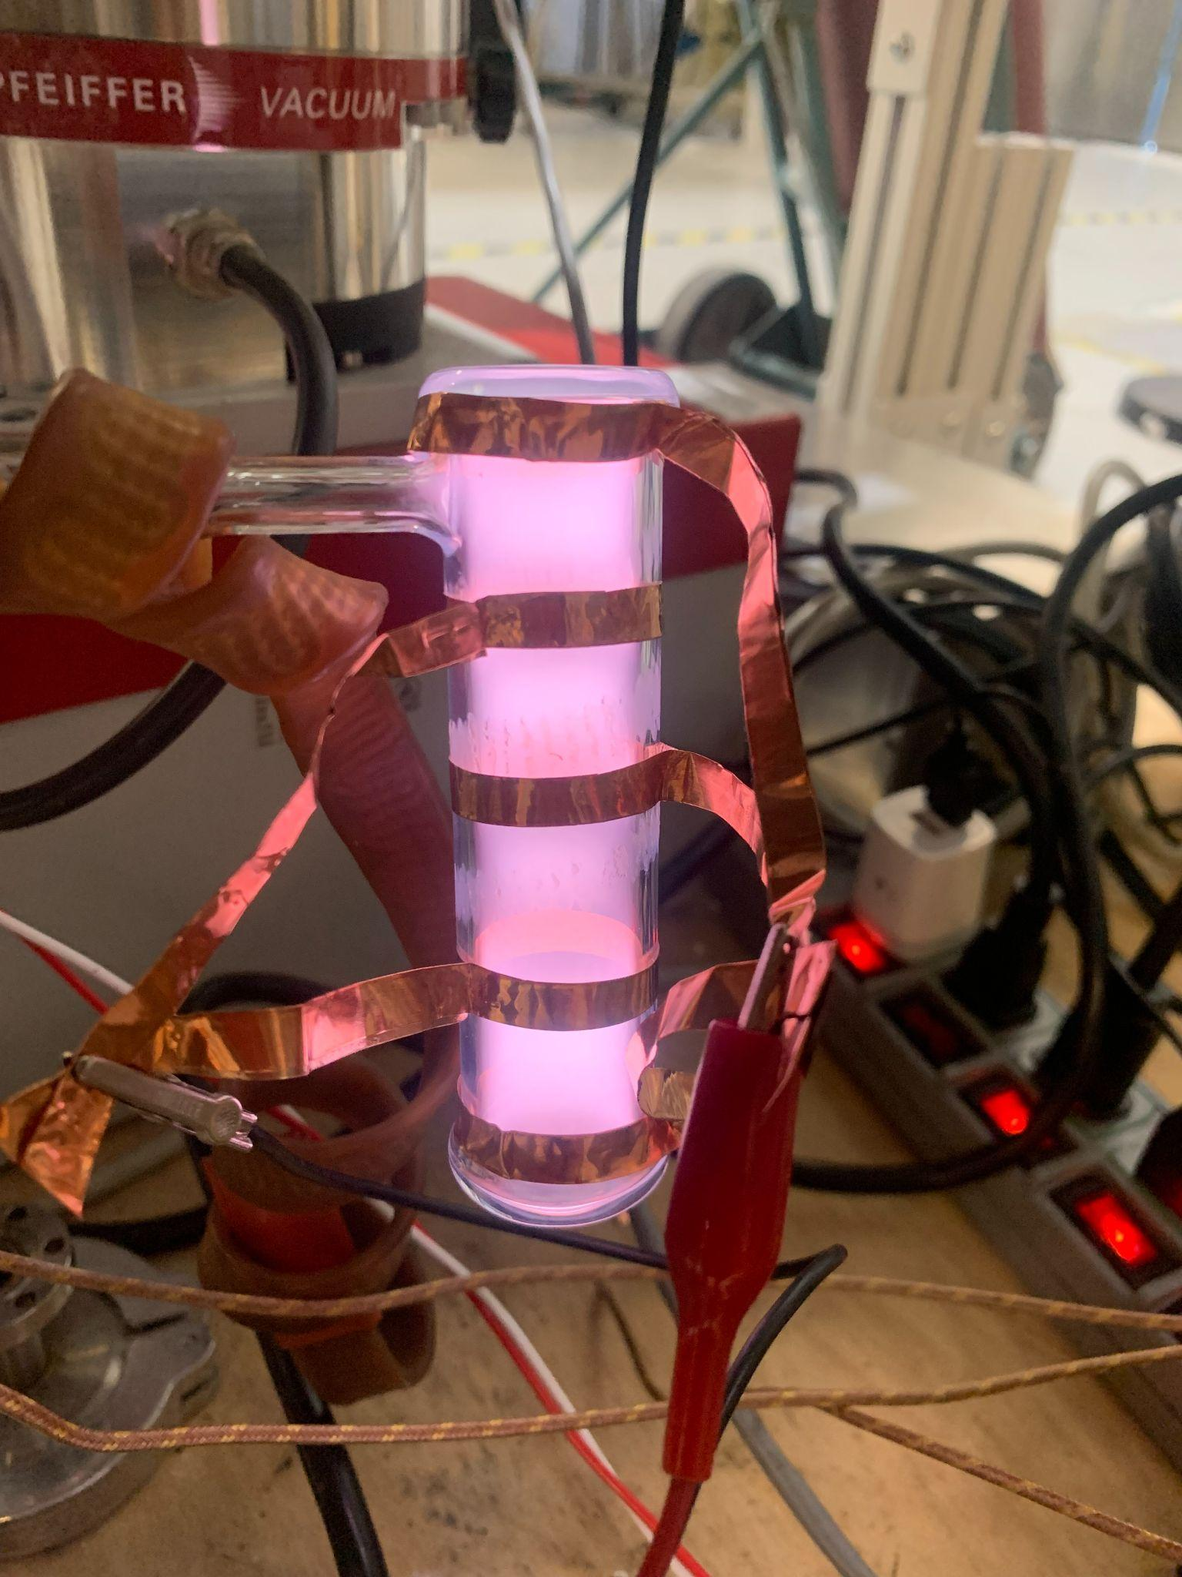
Sealed Cell Readiness
Shipped to Finkinbeiner Inc. in Waltham, MA, for sealing off.
Ultrasonic bath cleaning with detergent, hot water, and series of alcohols wash, baking at 200 C, pump and purge until the spectrum looks clean

Slide 22
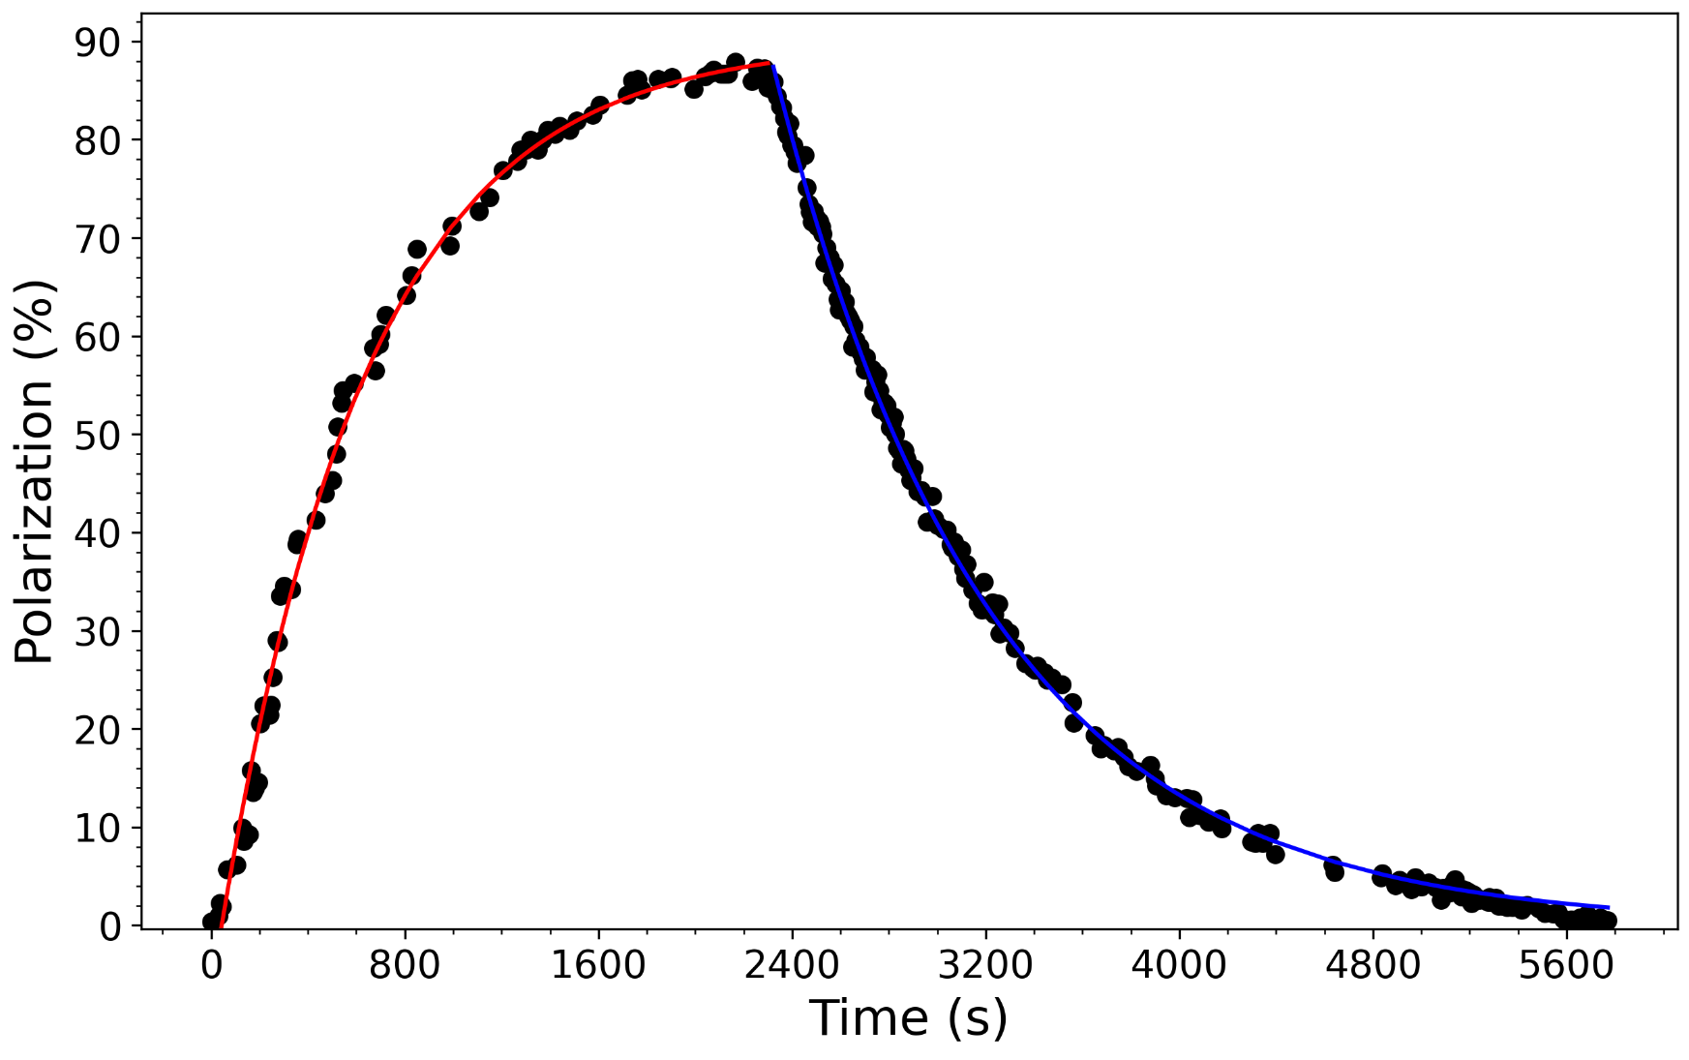
Polarization Tests (Depolarization diagnostics tests)
First measurement of ³He polarization using MEOP at 5 T
Mₛ = 85 %
f4+ 5 T
Tb = 504 s
Tᵣ = 898 s
Ready for NIM A

Slide 23
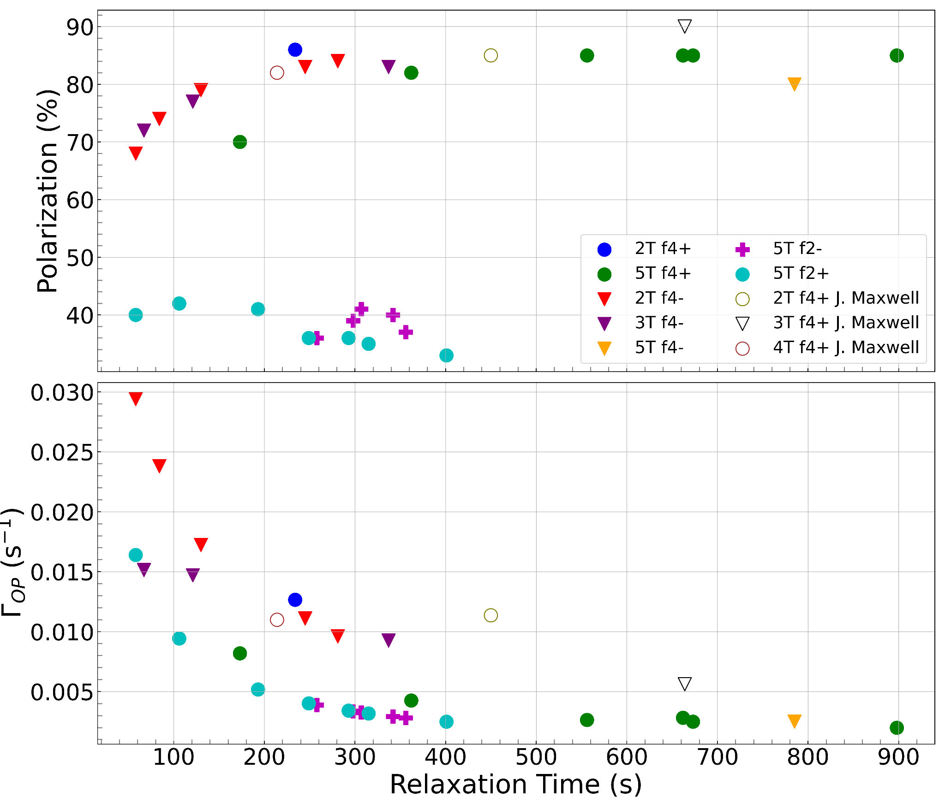
Polarization Tests (Season 3)
Ready for NIM A

Slide 24
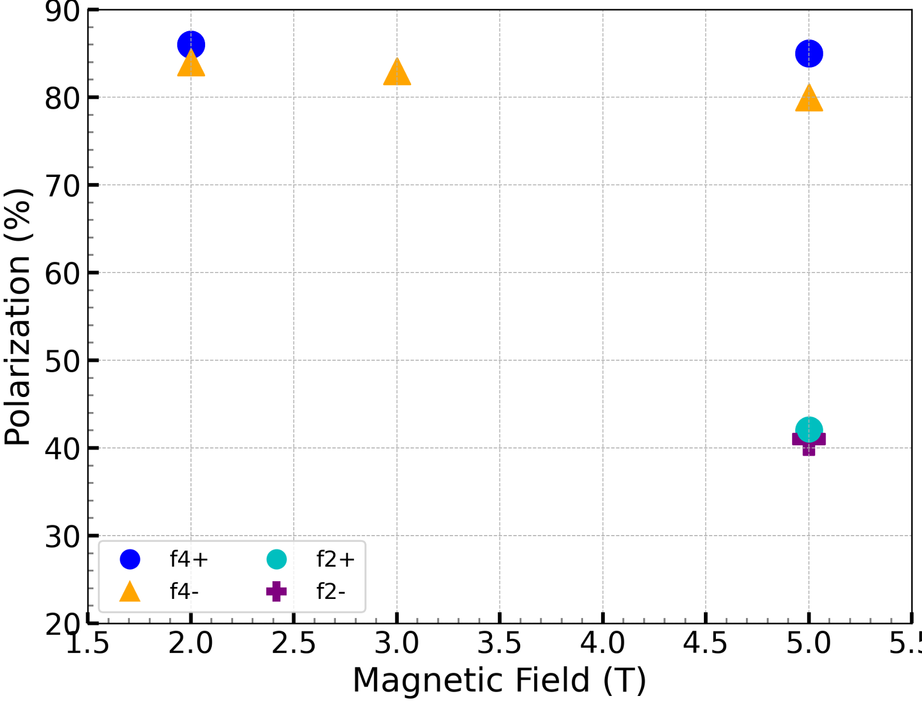
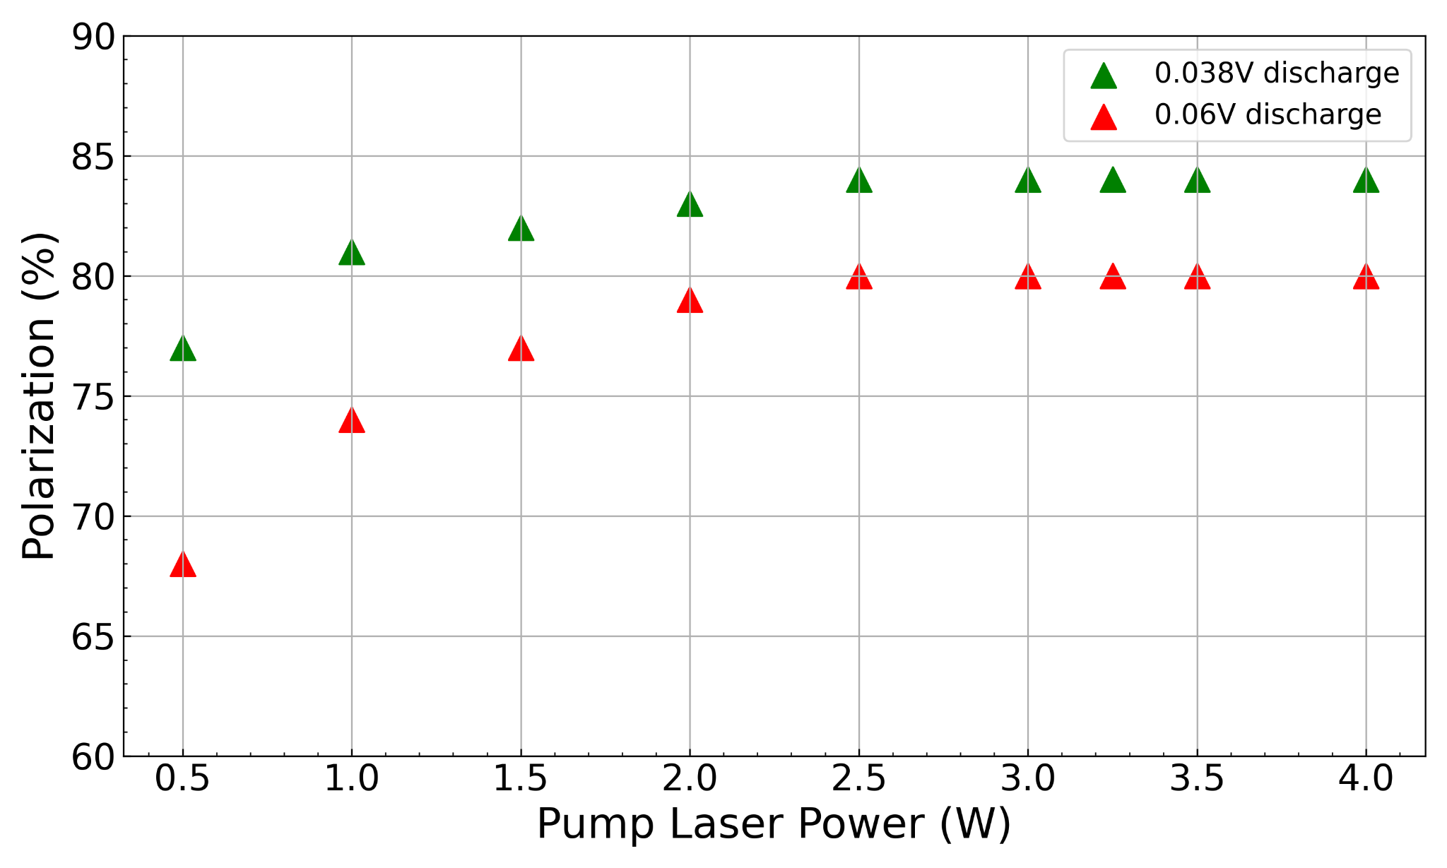
Polarization Tests (Season 3)
Ready for NIM A

Slide 25
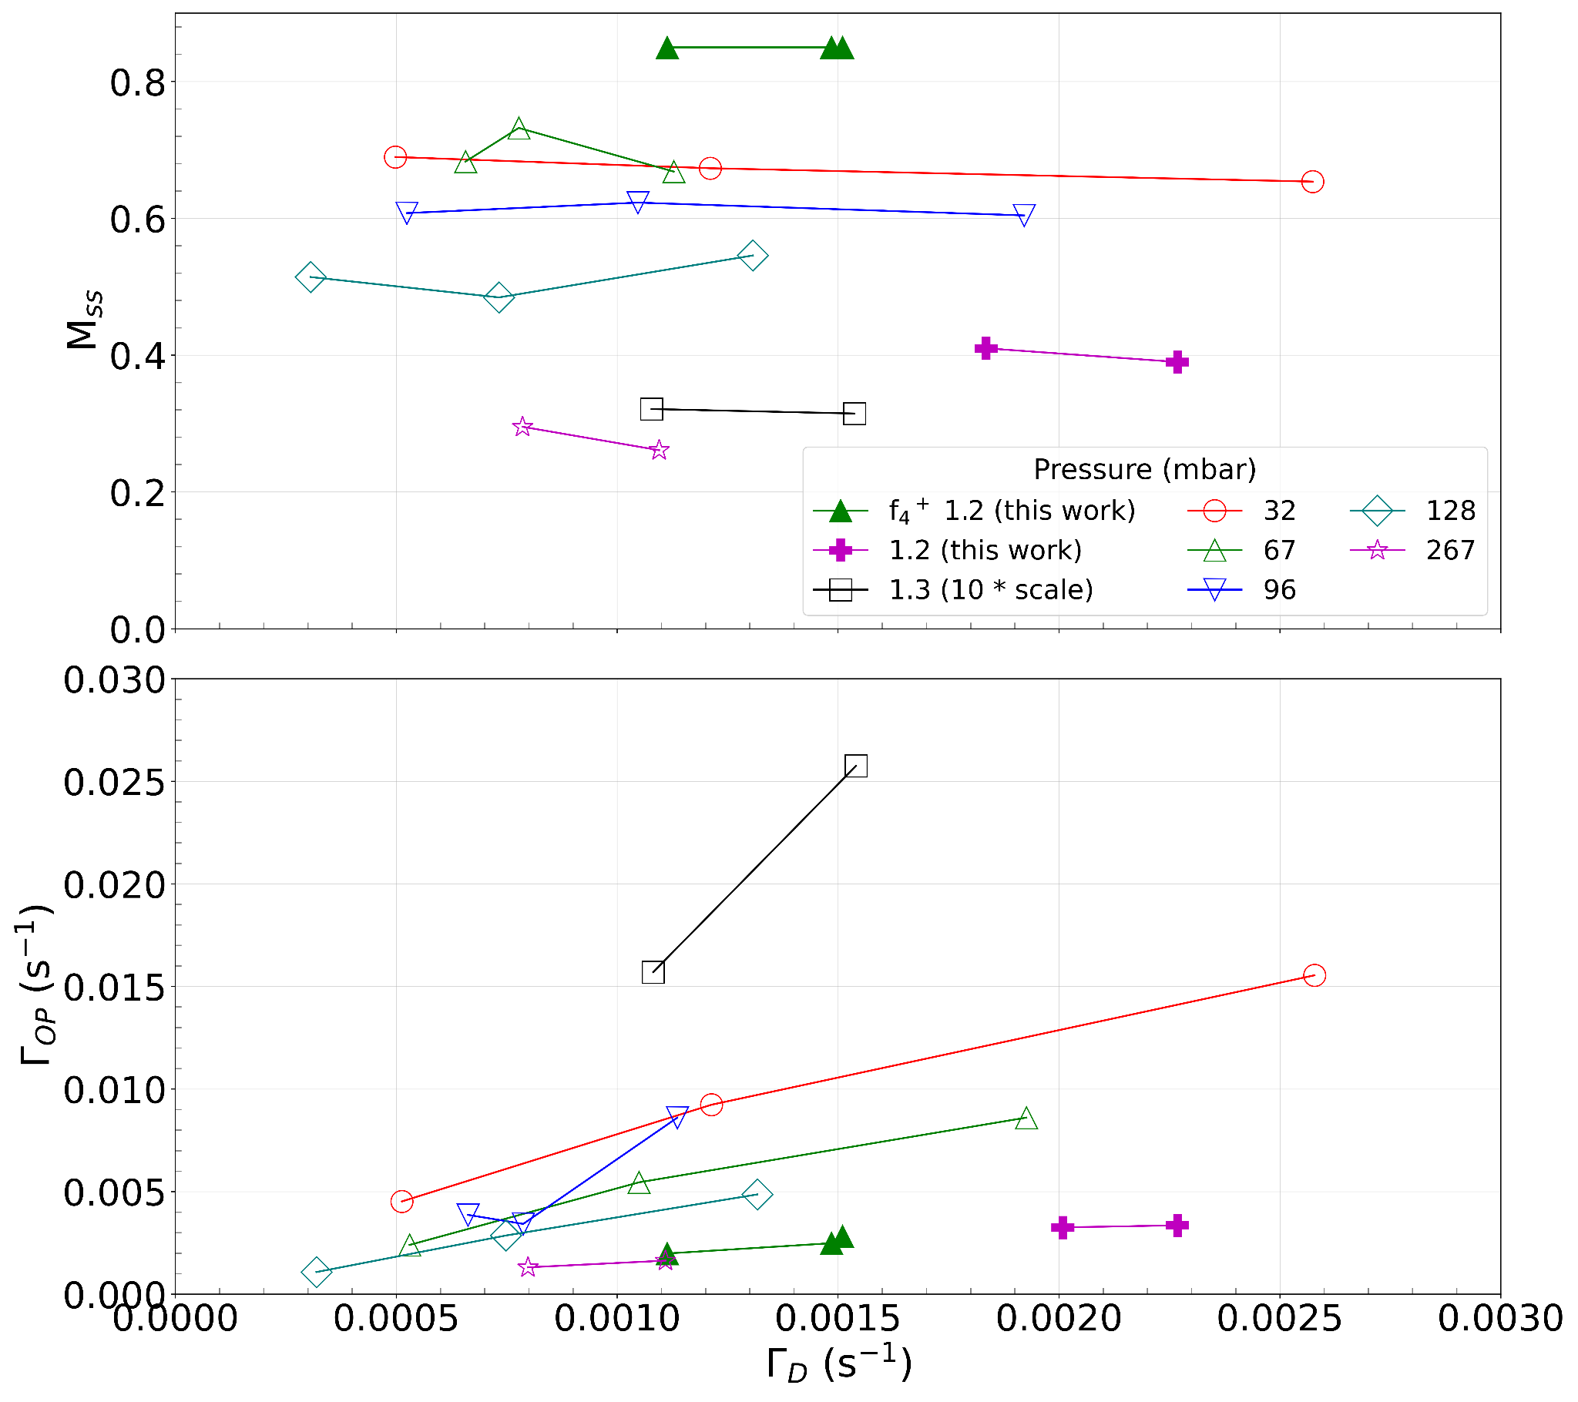
Polarization Tests (Season 3)
Our results with the f₂⁻ line at 1.2 mbar closely align with the performance of Nikiel et al.'s higher-pressure cell, particularly in terms of maximum steady-state polarization, as well as pumping and relaxation rates.
Nikiel’s results: 4.7 T, different pressures sealed cell, f₂⁻ line
Ready for NIM A
Nikiel et al., The European Physical Journal D 67 (9) (2013)

Slide 26
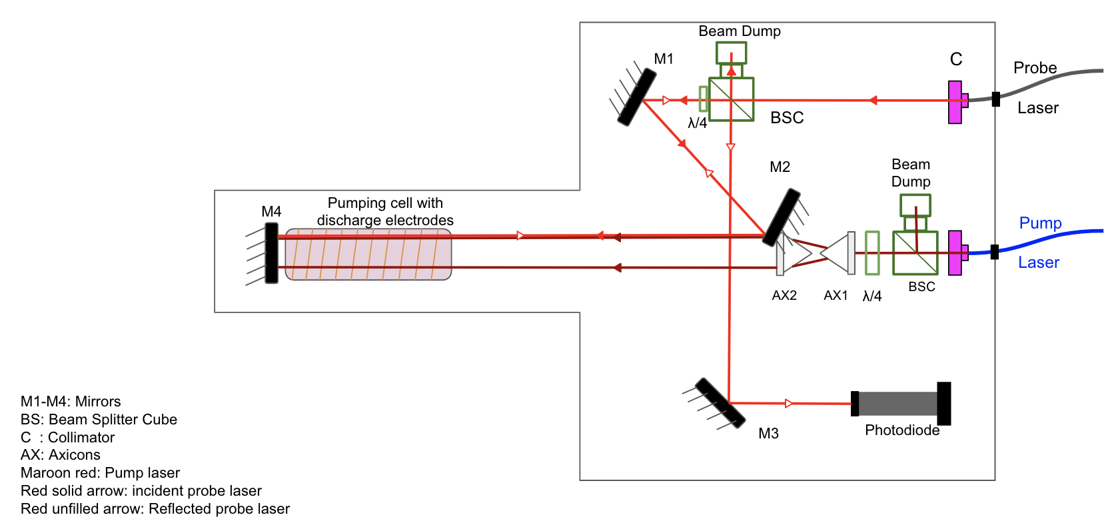
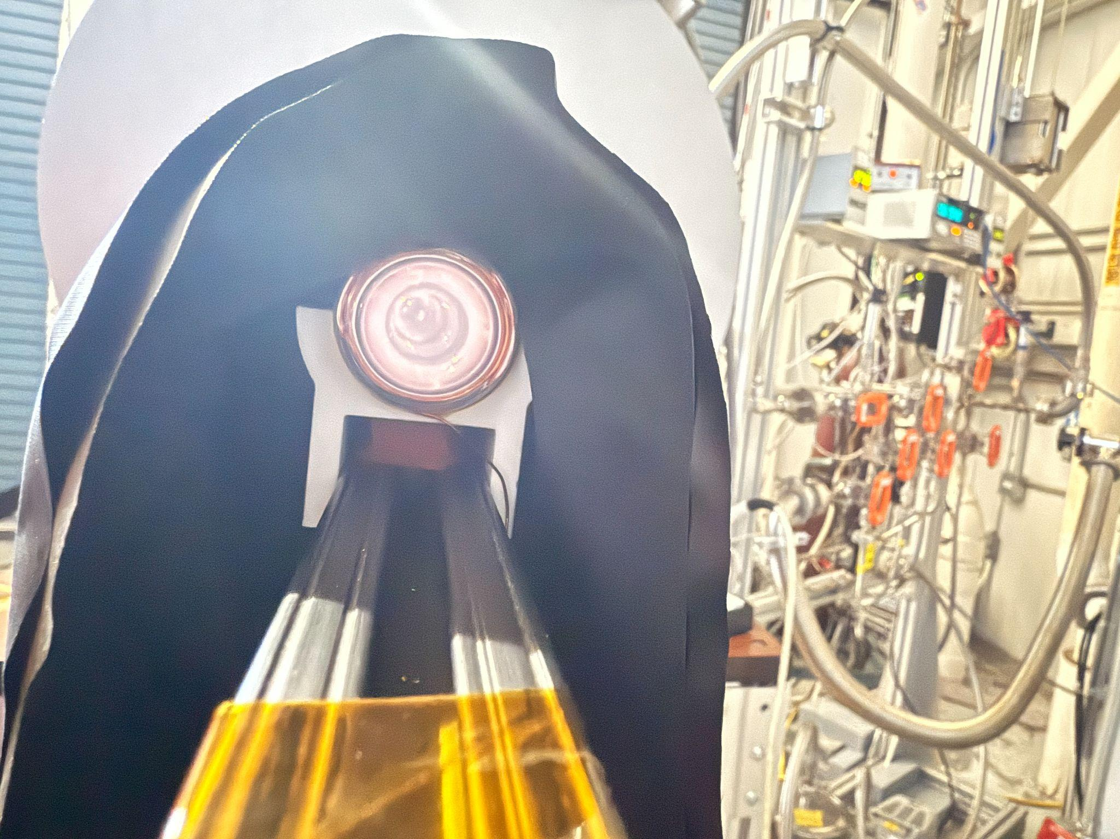
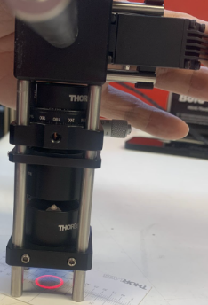
High Pressure Optics Set Up (Season 4) NEXT
100 mbar sealed cell tests with a new smaller radius cell that ~fits with axicons
Axicon enables beam profile matching
discharge distribution
Install Mechanical chopper

Slide 27
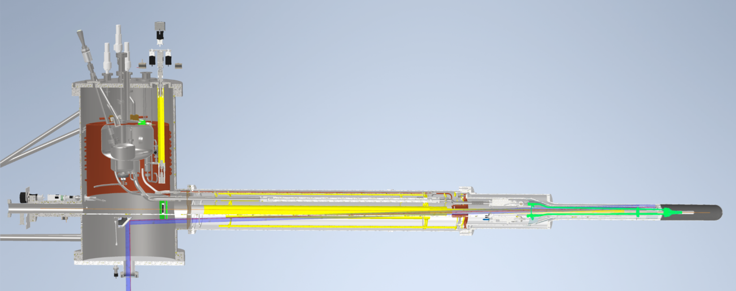
Double Cell Design

Slide 28
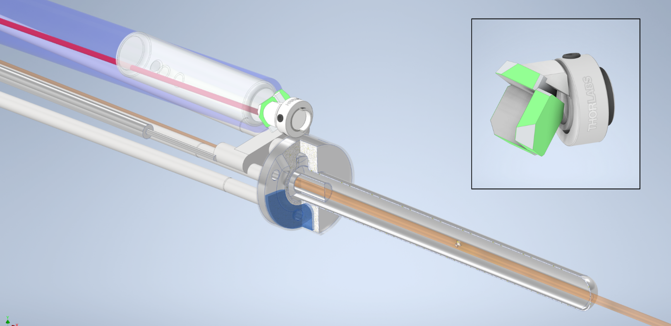
Double Cell Design

Slide 29
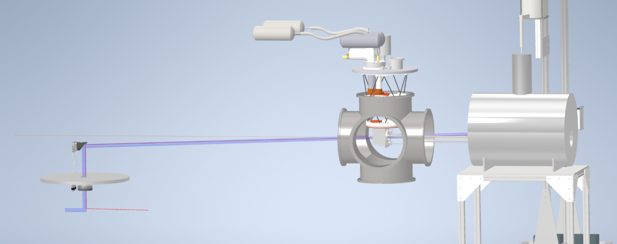
Double Cryogenic Cell Test Stand

Slide 30
Tentative Schedule
First High-field Polarization at JLab: April 2022
Paper on Systematic Studies of High Field Polarization at 1.3 mbar up to 4T: October 2023
Lab Moved from EEL to Test Lab: December 2023
New Laser to Allow Tests to 5T: February 2024
Tests of Fillable Cell for Variable Pressures: September 2024
New Sealed Cell at 1.2 mbar to 5T, Polarized to 85%: December 2024
Paper on Results to 5T in Preparation: February 2025
Looking Forward: Projected Schedule
Tests on 100 mbar Sealed Cell: March 2025
New Fillable Cell Tests: May 2025
Fabrication of Double Cryogenic Cell Test Stand: Summer 2025
Tests of Double Cryogenic Cell: Fall 2025
Ready for opportunistic run: Summer 2026

Slide 31
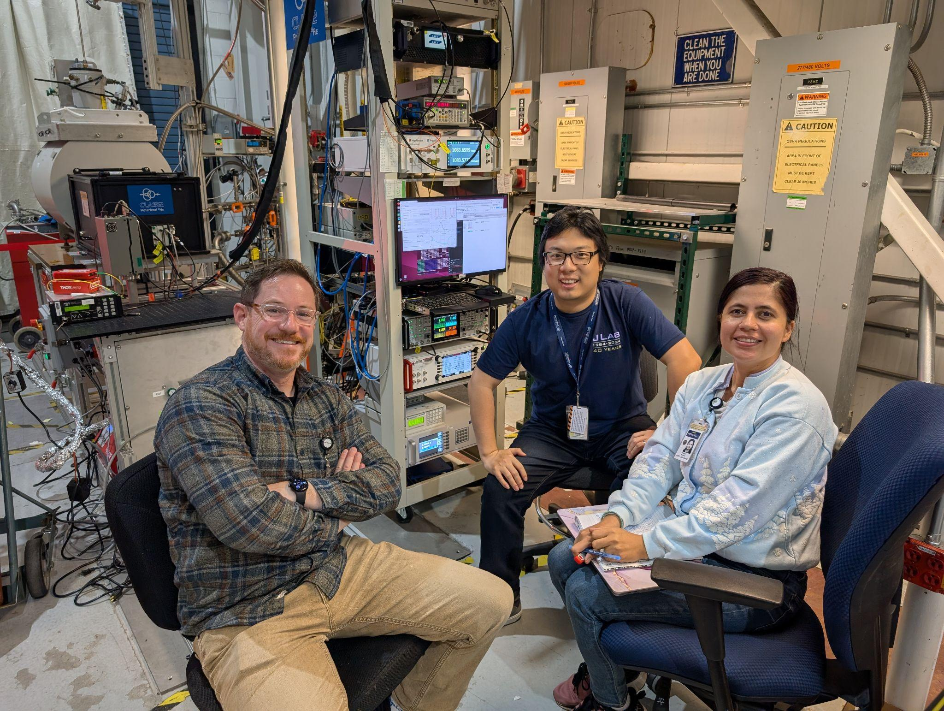
Acknowledgments
CLAS12 Polarized ³He collaboration:
MIT : R. Milner, P. Pandey
JLab: H. Avakian, C. Keith, J. Maxwell, J. Brock
UTK: D. Nguyen, H. Lu
Shandong U.: X. Li
Supported by:
This material is based upon work supported by the U.S. Department of Energy, Office of Science, Office of Nuclear Physics under contract DEAC05-06OR23177.
Thank you for your attention !

Slide 32
Back Up

Slide 33
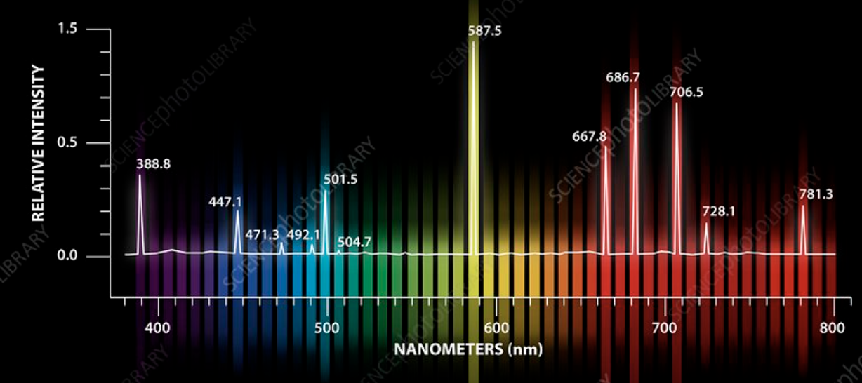
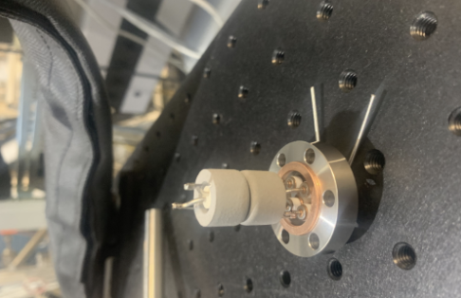
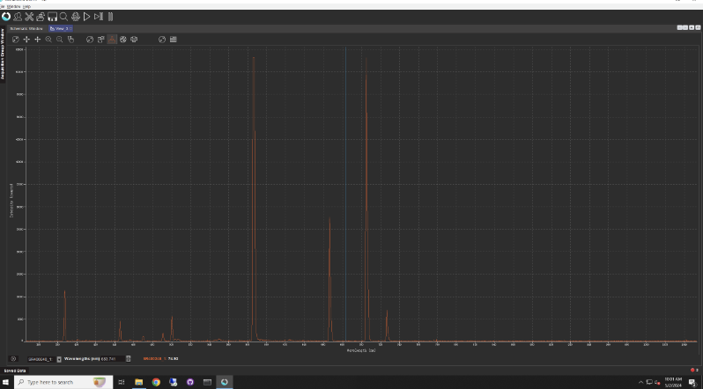
Gas Purity
Baked the cell, and the helium path to cell for about 2 weeks before the use.
Getter takes care of gas purity, but needs re-activation when purity gets worse

Slide 34
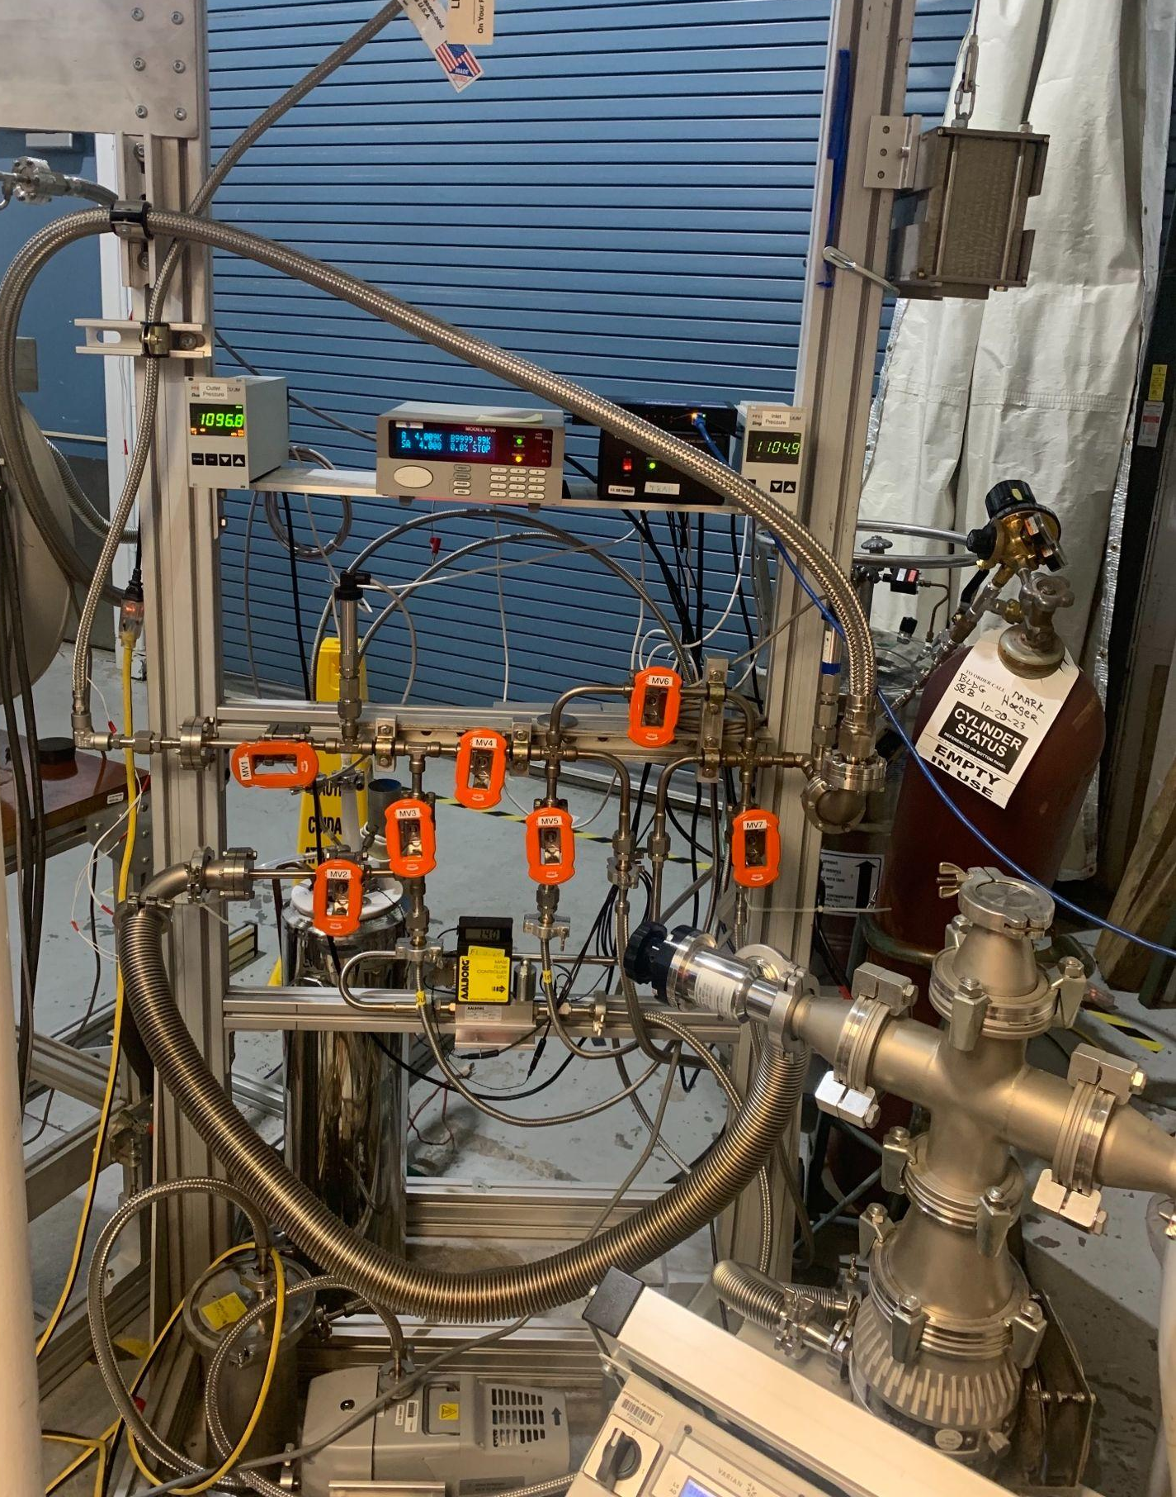
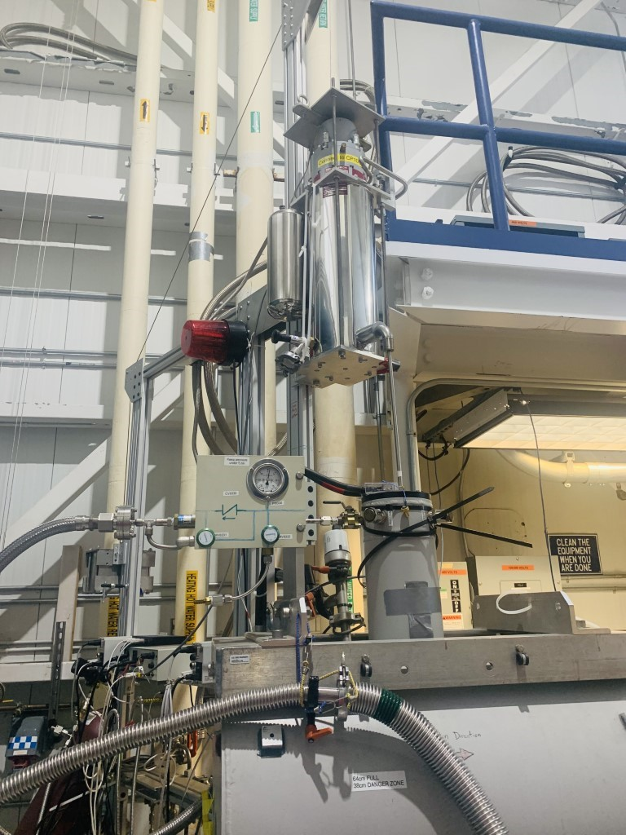
Magnet Re-liquefier
Back to the reliquifier
Reliquifier
⁴He gas
back from the magnet
⁴He gas into the reliquifier
Liquified ⁴He
Into the magnet
ByPasses
Warm gas out from the magnet back to the inlet for recirculation (reliquifying)
⁴He gas inlet
LN2 trap
To produce the field, warm bore magnet has to be cooled by liquefier
To the pumps

Slide 35
