Slide 1
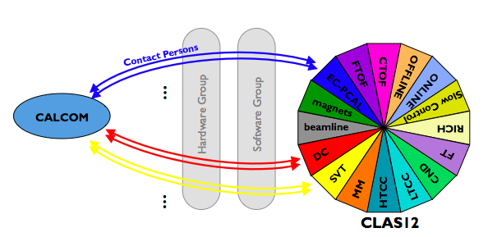
Topics:
Calibration activities: RG-A, C, D, E, K
DC calibration suite update
“Online” calibrations + commissioning: RG-L
Summary

Slide 2
Active Run Groups in Calibration Mode – March 2025
# | Run Group | Dataset | Conditions | Run Range | Stage
1 | RG-A | Spr18 | LH2 6.4, 10.6 GeV, inbending+outbending (+ 2.2 GeV zero-field from engineering run) | 3029 - 4325 | Cooking
2 | RG-C | Spr23 | Polarized NH3, ND3, 10.5 GeV, inbending; FT-On/FT-Off | 16843 - 17811 | Cooking
3 | RG-D | F23 | LD2, C, Cu, Sn 10.6 GeV inbending+outbending | 18329 - 19130 | Cooking
4 | RG-E | Spr24 | LD2, C, Cu, Al, Sn, Pb 10.5 GeV | 20015 – 20525 | Calibrating
5 | RG-K | Spr24 | LH2 6.4, 8.5 GeV outbending | 19200 - 19893 | Calibrating
 | Analysis Coordinator | Chef
RG-A | Timothy Hayward | Nick Trotta
RG-C | Silvia Niccolai | Li Xu
RG-D | Lamiaa El Fassi | Mathieu Ouillon
RG-E | Hayk Hakobyan | Antonio Radic
RG-K | Annalisa D’Angelo | Lucilla Lanza
RG-L | Mohammad Hattawy | Mathieu Ouillon, Noémie Pilleux
Five different datasets are being calibrated in parallel
+
RG-L/ALERT upcoming
2

Slide 3
Calibration Timeline: June 2024 - January 2025
November 8, 2024
RG
A
C
D
E
K
L
June July August September October November December January
Spr18 pass-2 calibration
pass-1 review
F22 pass-1 calibration
F22 pass-1 review
Spr23 pass-1 calibration
Spr23 pass-1 review
calib review
alignment
pass-1 review
pass-1 calibration
alignment
pass-1 calibration
pass-1 calibration
calib review
alignment
pass-1 calibration
pass-1 calibration
calib review
online calib
3

Slide 4
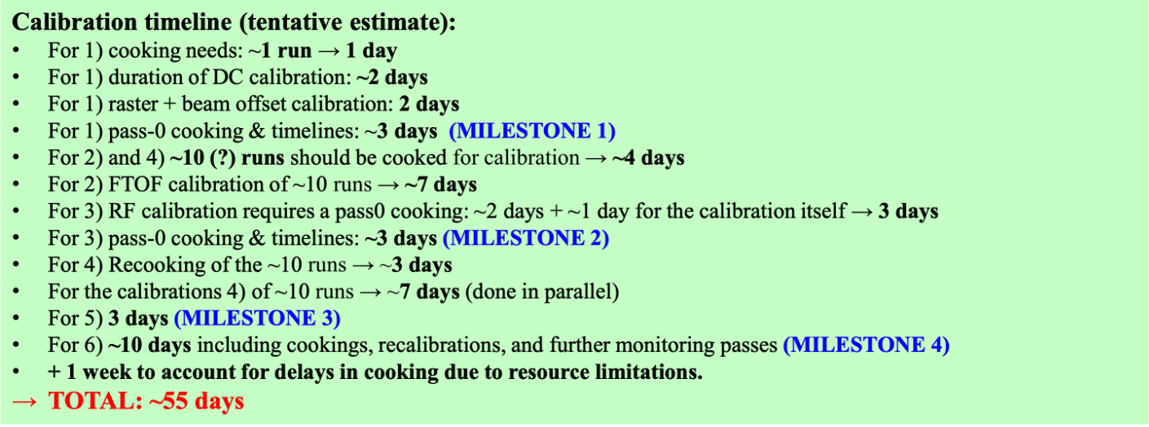
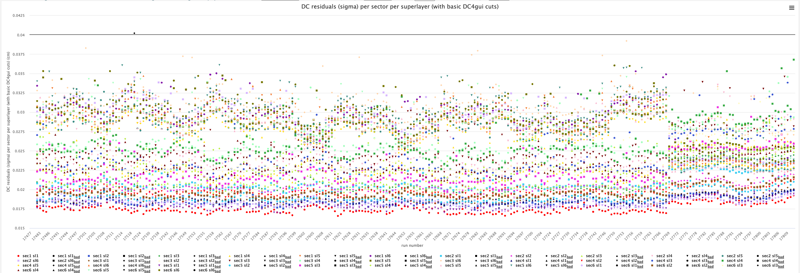
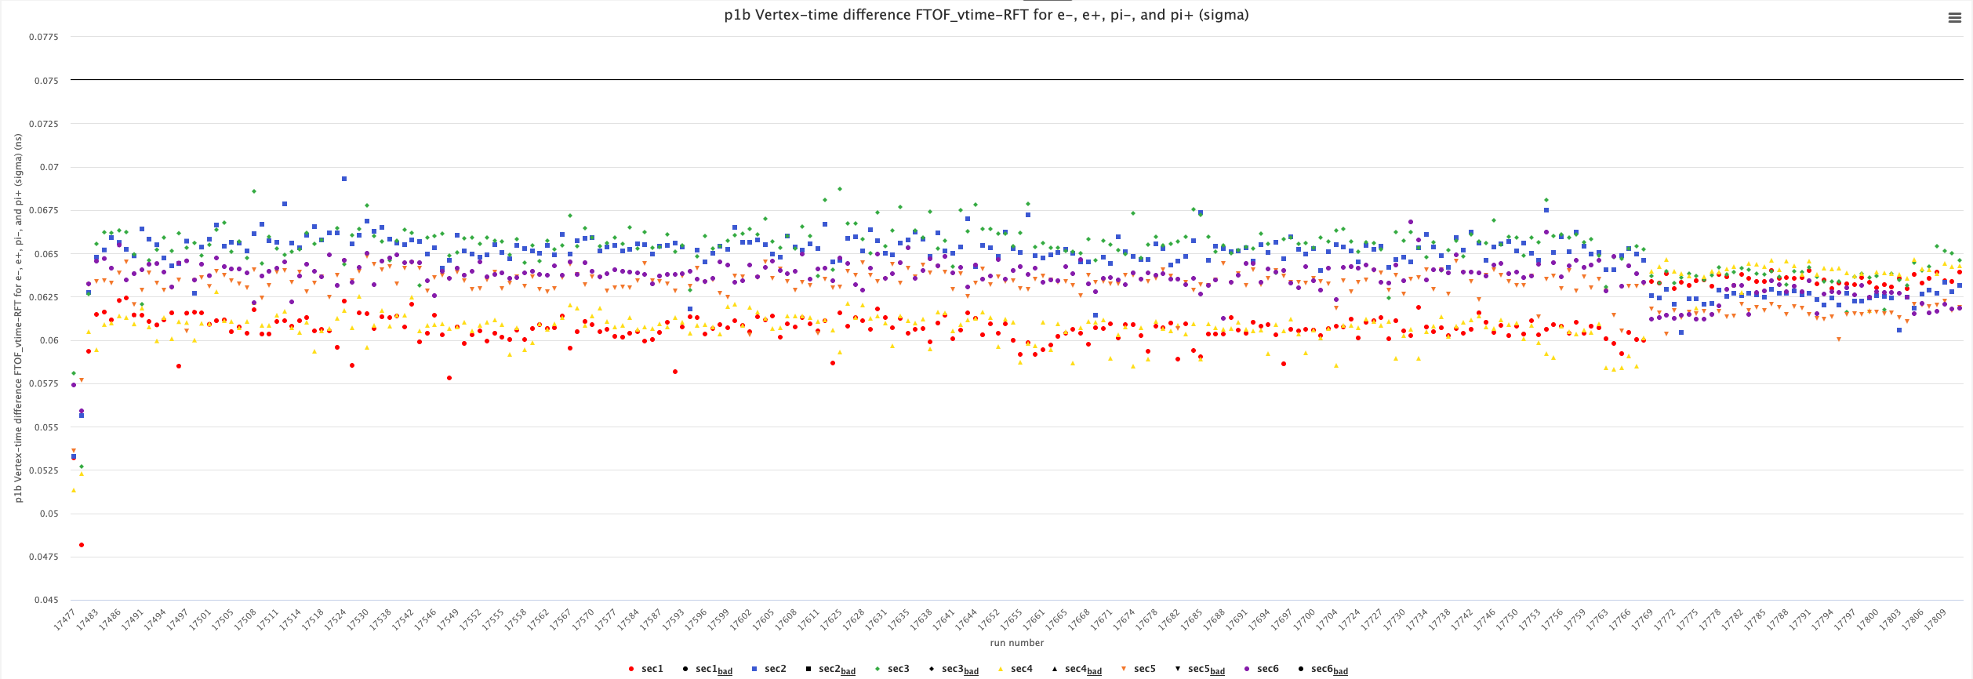
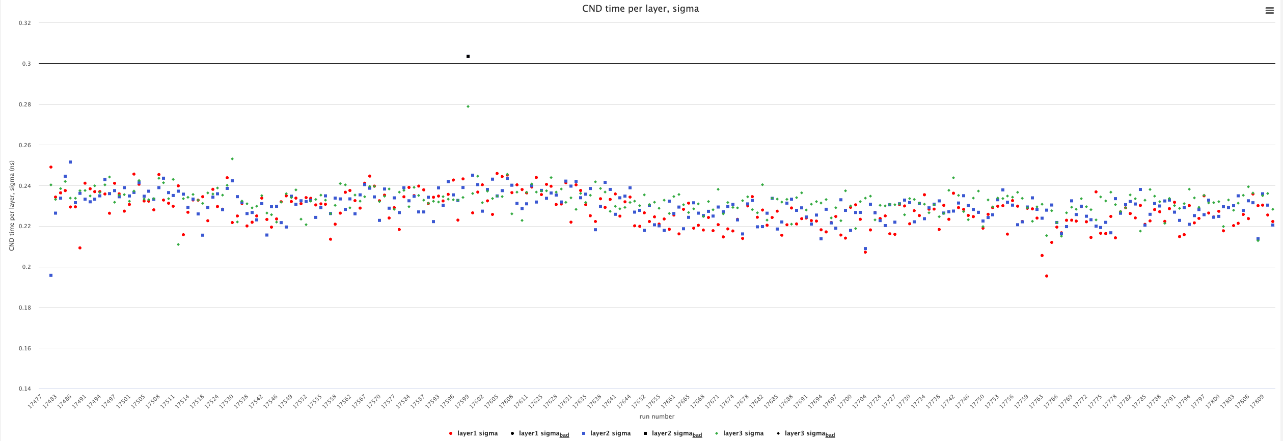
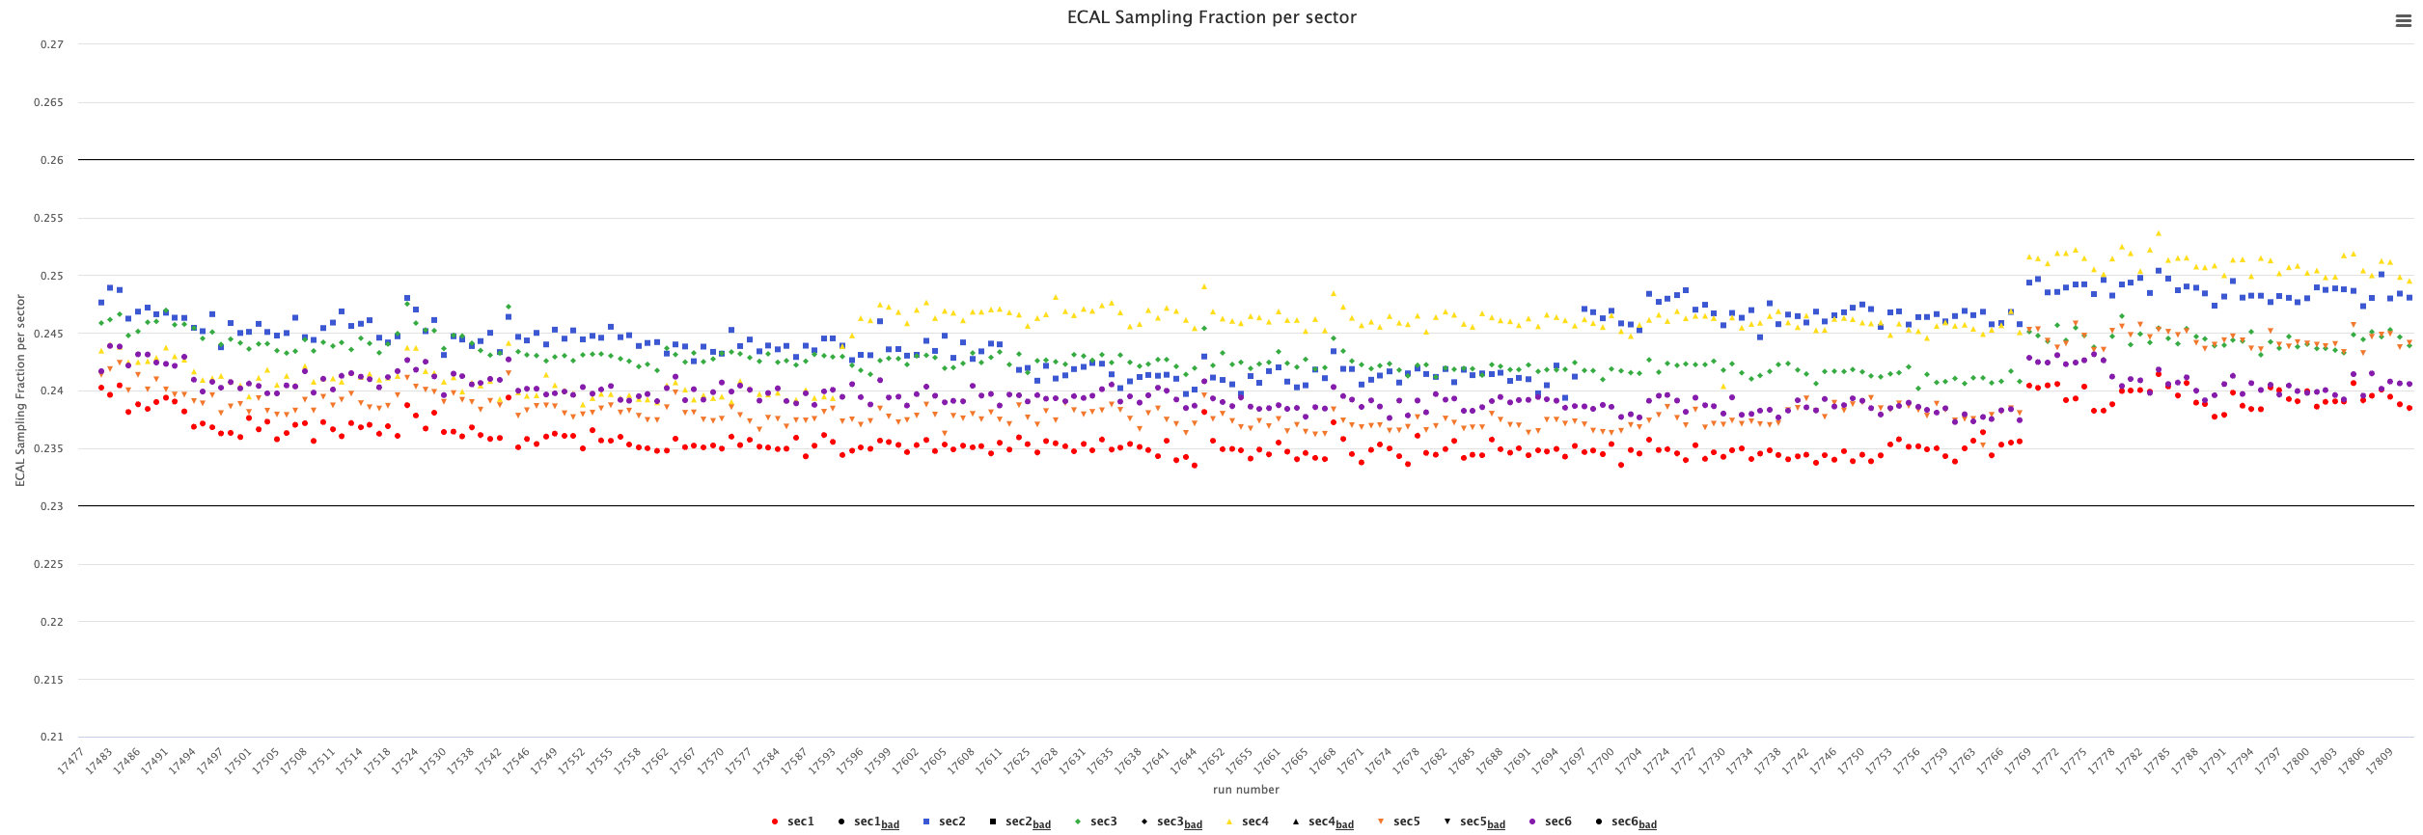
RG-C Spr23 - Status
[1] RG-C Spr23 – Pass-1 calibration review May 17, 2024
Timeline:
Original calibration window:
Apr. 15 – Jul. 15, 2024
Updated calibration window:
Jul. 1 – Nov. 30, 2024
Start delayed 2.5 months to finish RG-C F22 work
2 week delay due to computing resources
1 month delay due to beam offset/CVT position studies
2 week delay due to FT-Cal calibrations
2 week delay due to efficiency characterization
2 week delay due to manpower availability
Pass-1 review: Feb. 19, 2025
Cooking: Feb. 27 – XXX, 2025
400 μm
75 ps
DC
FTOF
300 ps
0.23-0.26
CND
ECAL
4

Slide 5
RG-A Spr18 - Status
[2] RG-A Spr18 – Pass-1 calibration review Dec. 1, 2023
Timeline:
Original calibration window:
Jan. 8 – Jun. 21, 2024 (included alignment tasks)
Updated calibration window:
Jun. 1 – Aug. 31, 2024 (after completion of alignment)
3 months delay to finish/investigate alignment
1 month delay due to beam offset calibrations
1 month delay due to need for additional calibration iterations
1 month delay due to DC calibration studies
1 month delay due to cooking issues
1 month delay due to manpower availability
Pass-1 review: Feb. 26, 2025
Cooking: TBD
 | Run range | Beam | Torus | Solenoid
1 | 3000-3069 | 6.4 GeV | -100% | -100%
2 | 3070-3087 | 6.4 GeV | -75% | -100%
3 | 3097-3105 | 6.4 GeV | 75% | -100%
4 | 3131-3293 | 10.6 GeV | 100% | -100%
5 | 3304-3551 | 10.6 GeV | -100% | -100%
6 | 3698-3817 | 10.6 GeV | -100% | -100%
7 | 3819-3834 | 6.4 GeV | 75% | -100%
8 | 3839-3853 | 6.4 GeV | 100% | -100%
9 | 3855-3857 | 6.4 GeV | 100% | -50%
10 | 3862-3987 | 10.6 GeV | 100% | -100%
11 | 4001-4325 | 10.6 GeV | -100% | -100%
Note: DC HV was reduced for this run compared to F18 settings; “massive” version of FMT installed
5

Slide 6
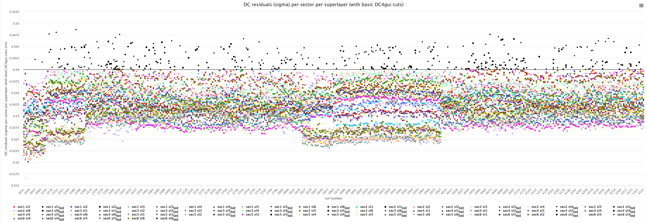
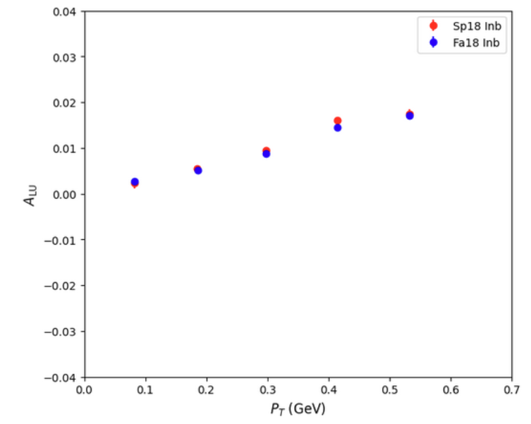
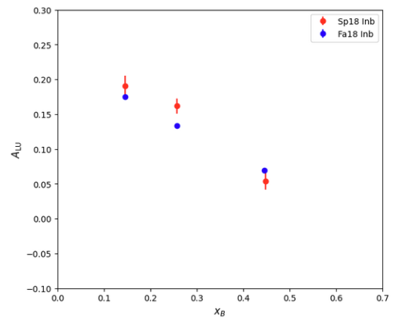
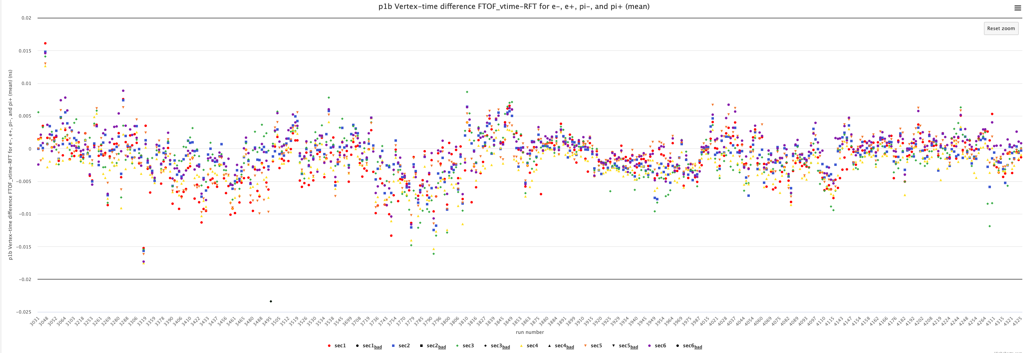
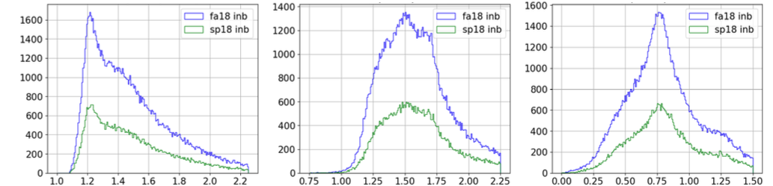
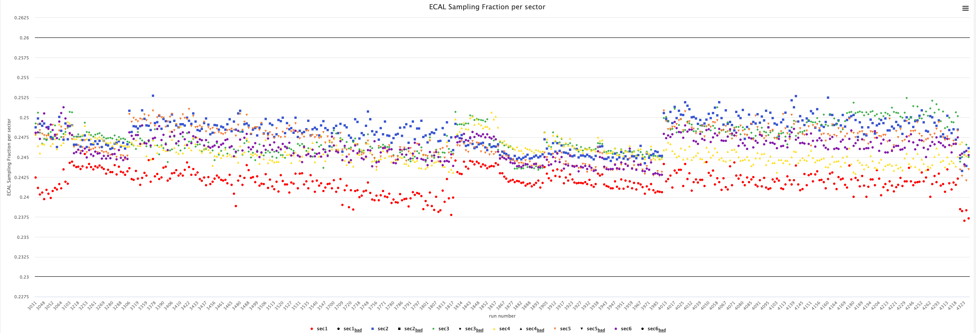
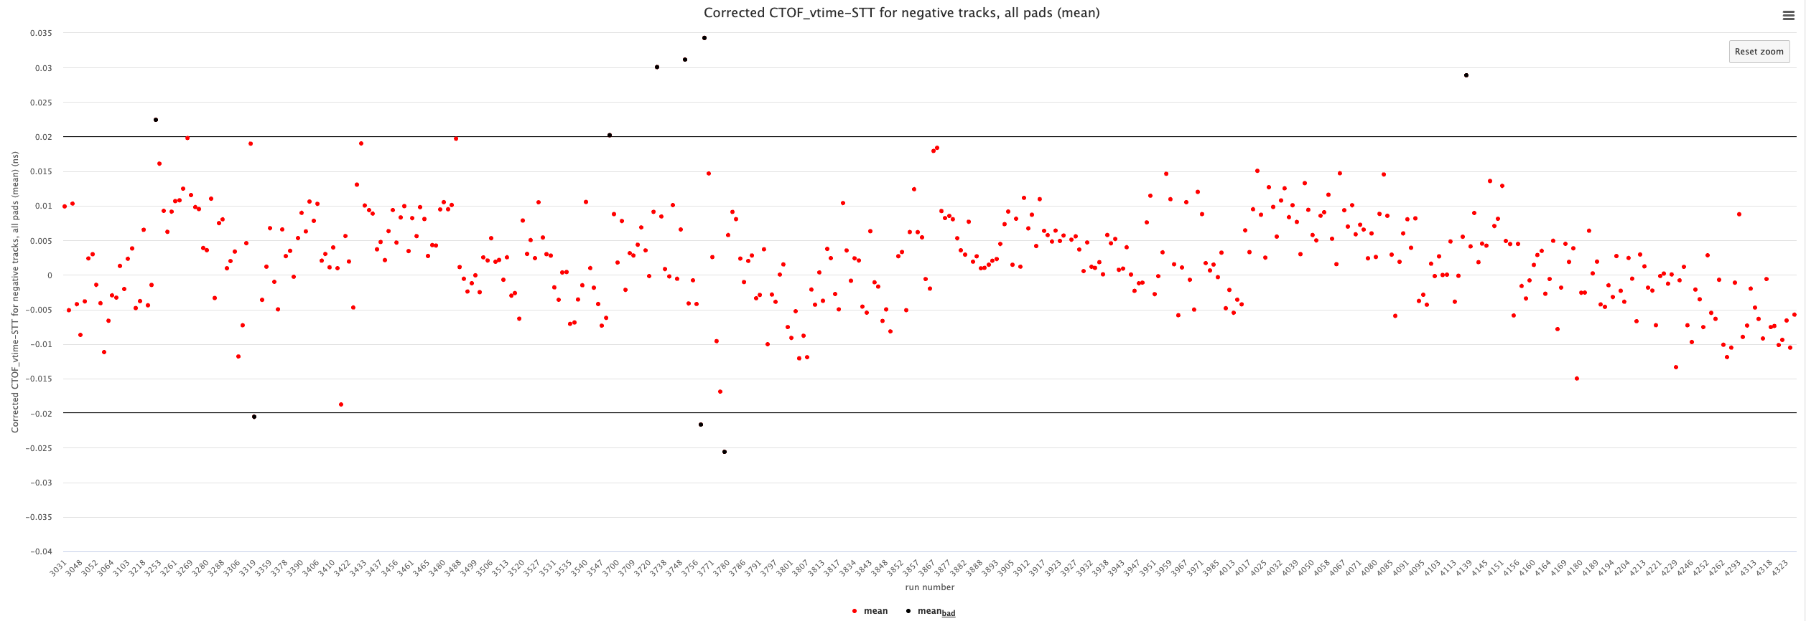
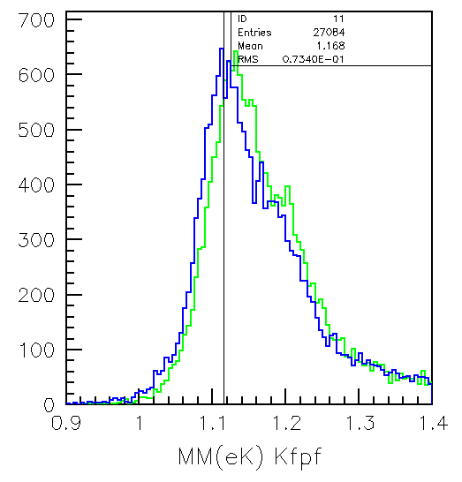
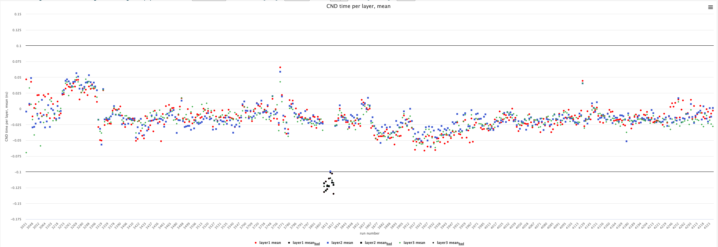
DC
400 μm
RG-A Spr18 - Status
A_{LU}
A_{LU}
FTOF
±20 ps
e′π⁺X SIDIS
DVCS
p_{T} (GeV)
x_{B}
ECAL
0.23-0.26
ep → e′p′π⁻X
ep → e′π⁺π⁻X
ep → e′p′π⁺X
CTOF
±20 ps
M (GeV)
M (GeV)
M (GeV)
CND
±100 ps
MM(e′K⁺) (GeV)
6

Slide 7
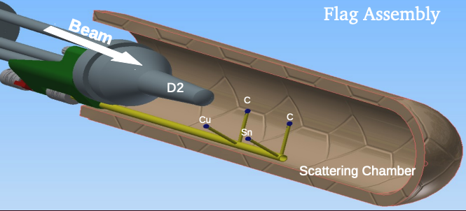
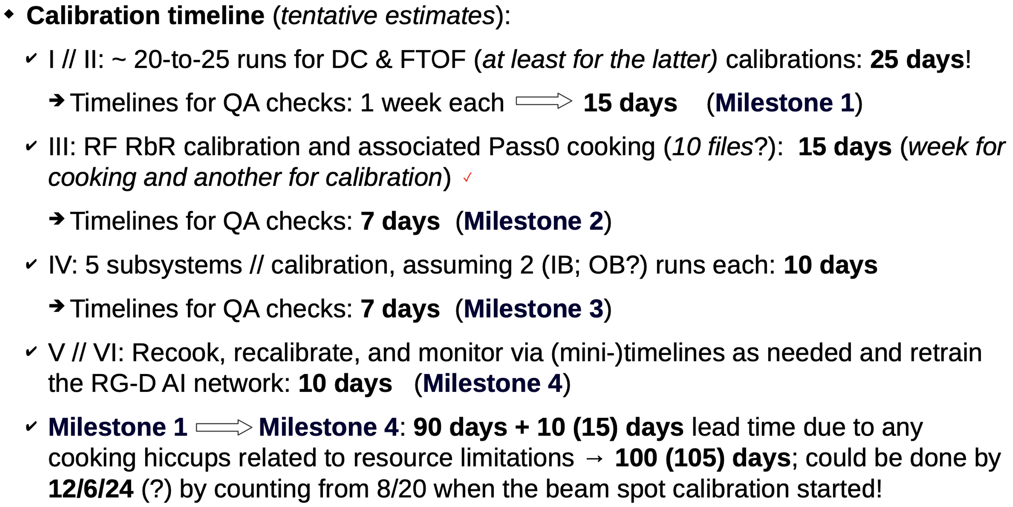
RG-D F23 - Status
[3] RG-D F23 – Pass-1 calibration review Sep. 20, 2024
Timeline:
DC alignment:
Initial alignment in Oct. 2023 – completed re-work in June 2024 - 5-month delay to original schedule
Updated calibration window:
Aug. 26 - Dec. 20, 2024
1 month delay due to DC time offset calibration
2 month delay due to DC time-to-distance calibration
Pass-1 review: TBD
Cooking: TBD
Target | Schedule
LD₂ | 3
⁶³Cu/¹¹⁸Sn | 8
LD₂ | 3
¹²C/¹²C | 7
LD₂ | 2
⁶³Cu/¹¹⁸Sn | 9
LD₂ | 3
¹²C/¹²C | 7
LD₂ | 3
⁶³Cu/¹¹⁸Sn | 11
7

Slide 8
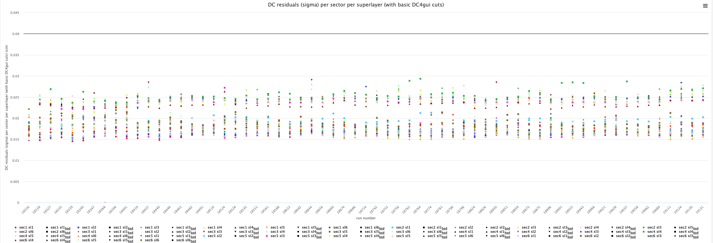
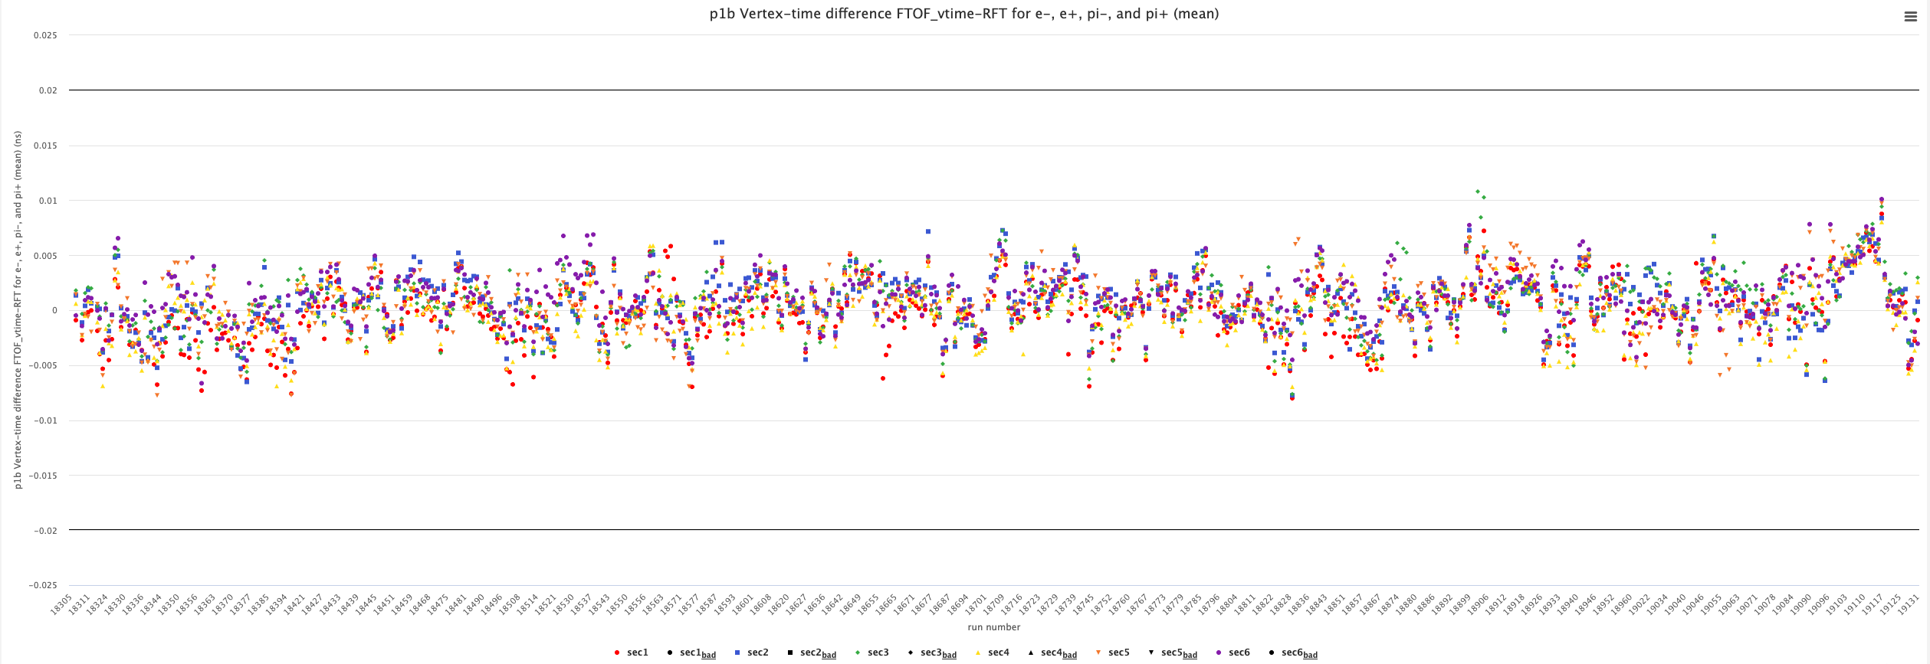
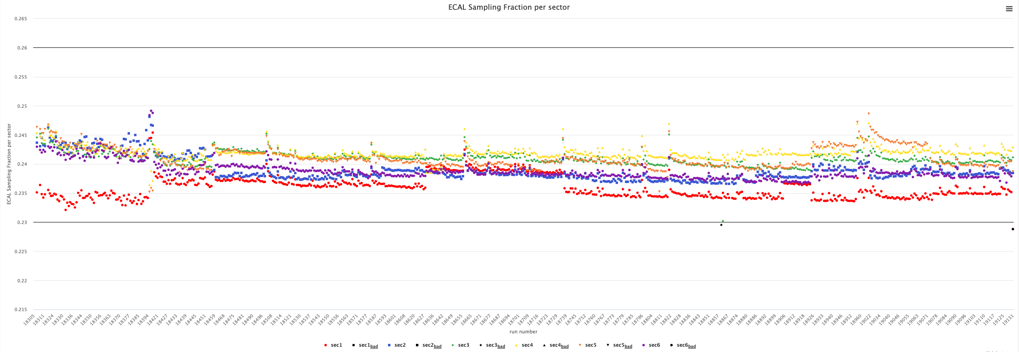
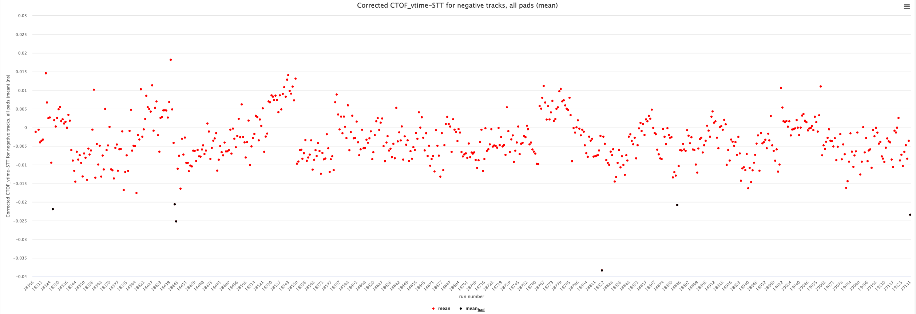
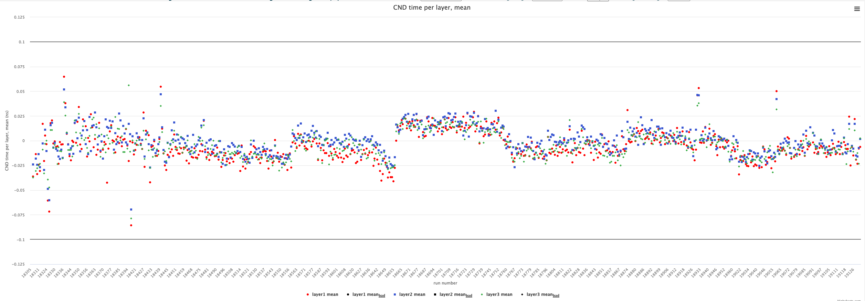
RG-D F23 - Status
DC
400 μm
Where do things stand?
CALCOM “ready for calibration” review complete
DC alignment/CVT alignment complete
Beam offset calibration complete
Calibrations complete: CND, CTOF, ECAL, FTOF, HTCC, LTCC, RICH, RF, BAND
DC calibrations – first dataset with new suite and protocols – impressive results closer to best achievable
Remaining work:
Hardware status tables mostly filled
AI network training for DC (to be checked)
Physics validation and ancillary information checks
Pass-1 cooking review by Apr. 2025
FTOF
±20 ps
ECAL
0.23-0.26
CTOF
±20 ps
CND
±100 ps
8

Slide 9
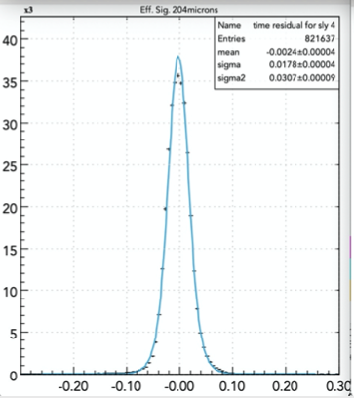
DC Calibration Suite
SL1 SL2 SL3 SL4 SL5 SL6
Before
178 μm
196 μm 204 μm 241 μm 229 μm 301 μm 310 μm
After
R2 space residual (mm)
150 μm 152 μm 209 μm 202 μm 141 μm 143 μm
time (ns) vs. DOCA
Δtime (ns) vs. DOCA
space residual (mm)
Recent improvements in the DC calibration suite:
Improve algorithmic approach to account for time-walk correction
Improve B-field dependent parameterization for R2
Add improved metrics for calibration convergence
Improve event selection + fitting approach
Veronique Ziegler/Florian Hauenstein
9

Slide 10
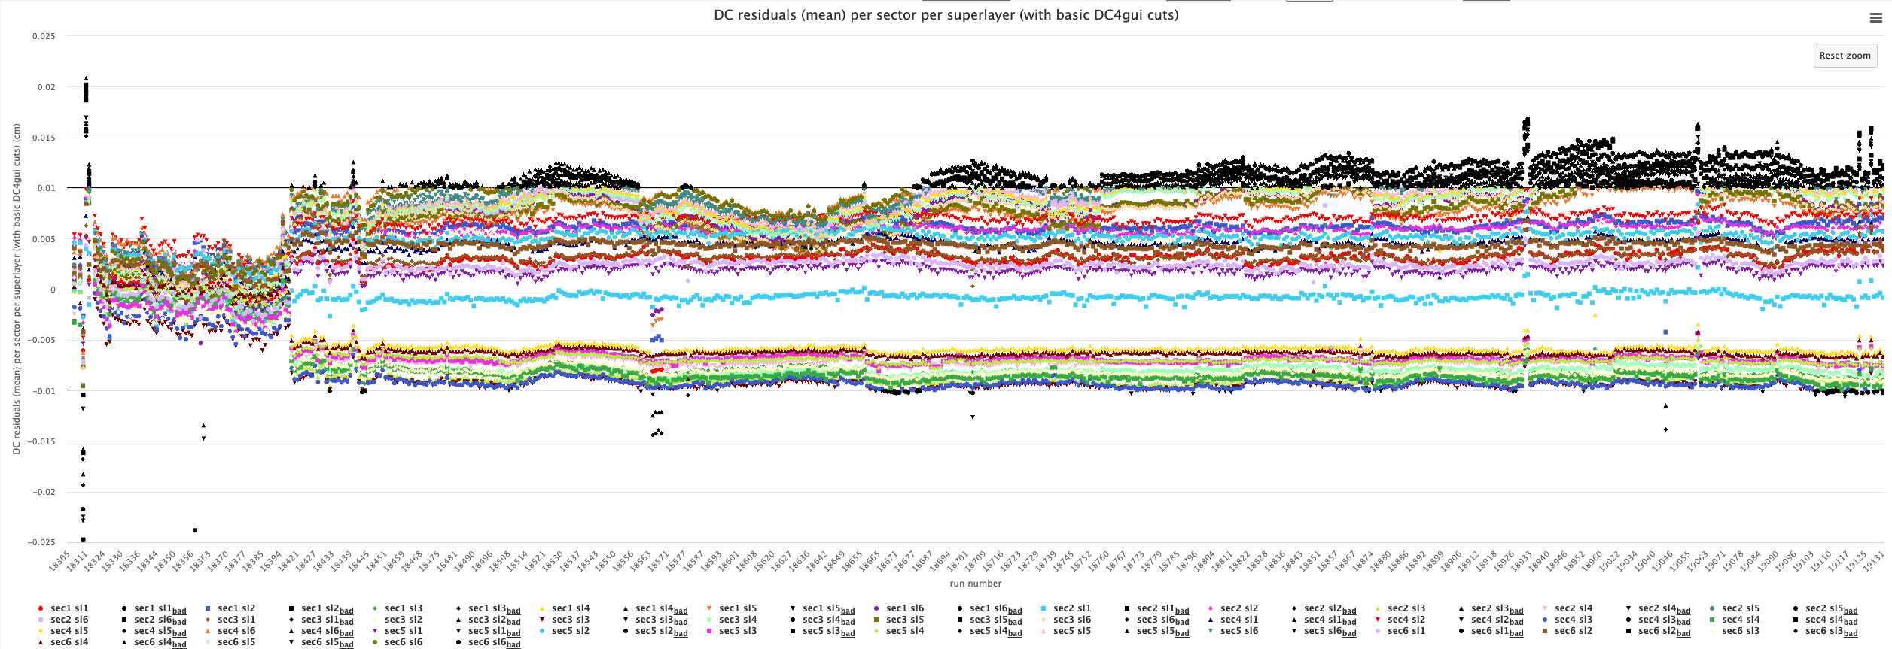
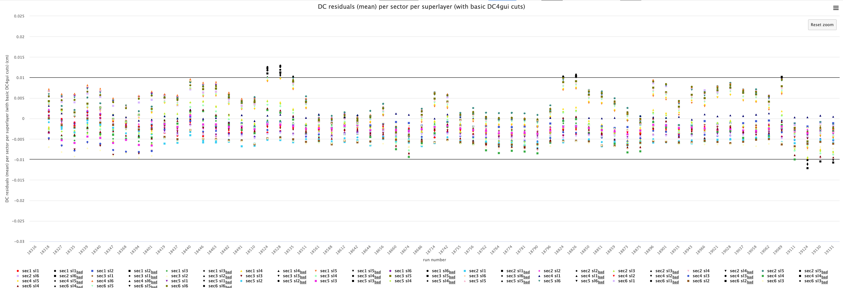
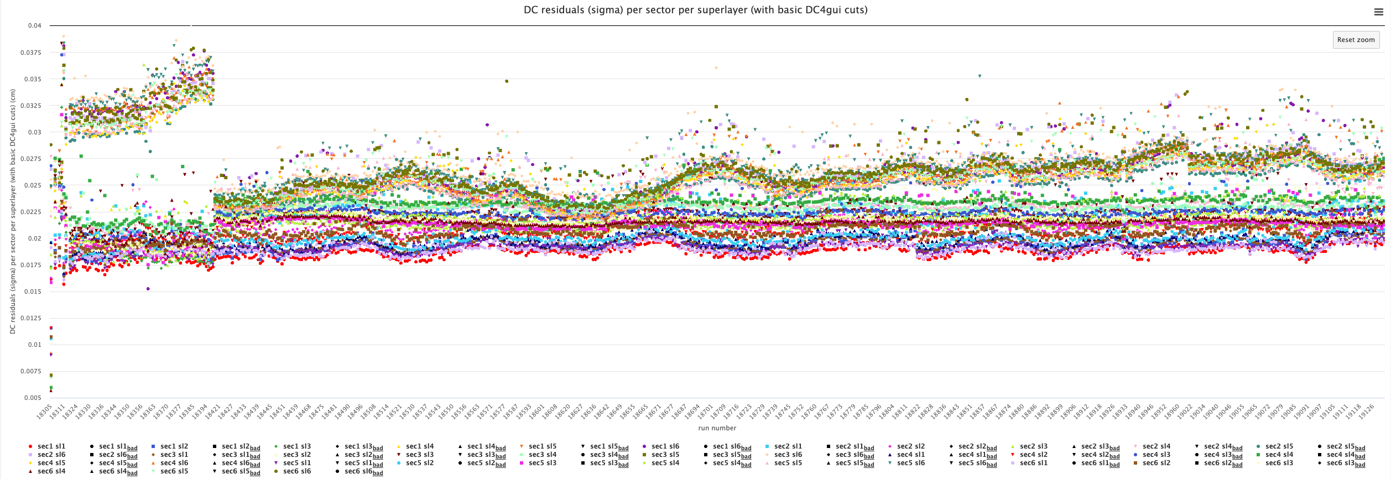
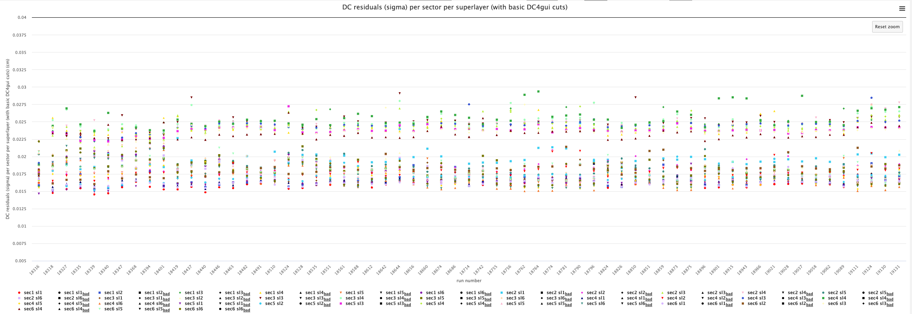
DC Calibration Suite
RG-D calibration
MEAN
MEAN
±100 μm
WIDTH
400 μm
WIDTH
10

Slide 11
DC Calibration Suite
RG-D calibration
Pressure dependence remains – still to be understood
11

Slide 12
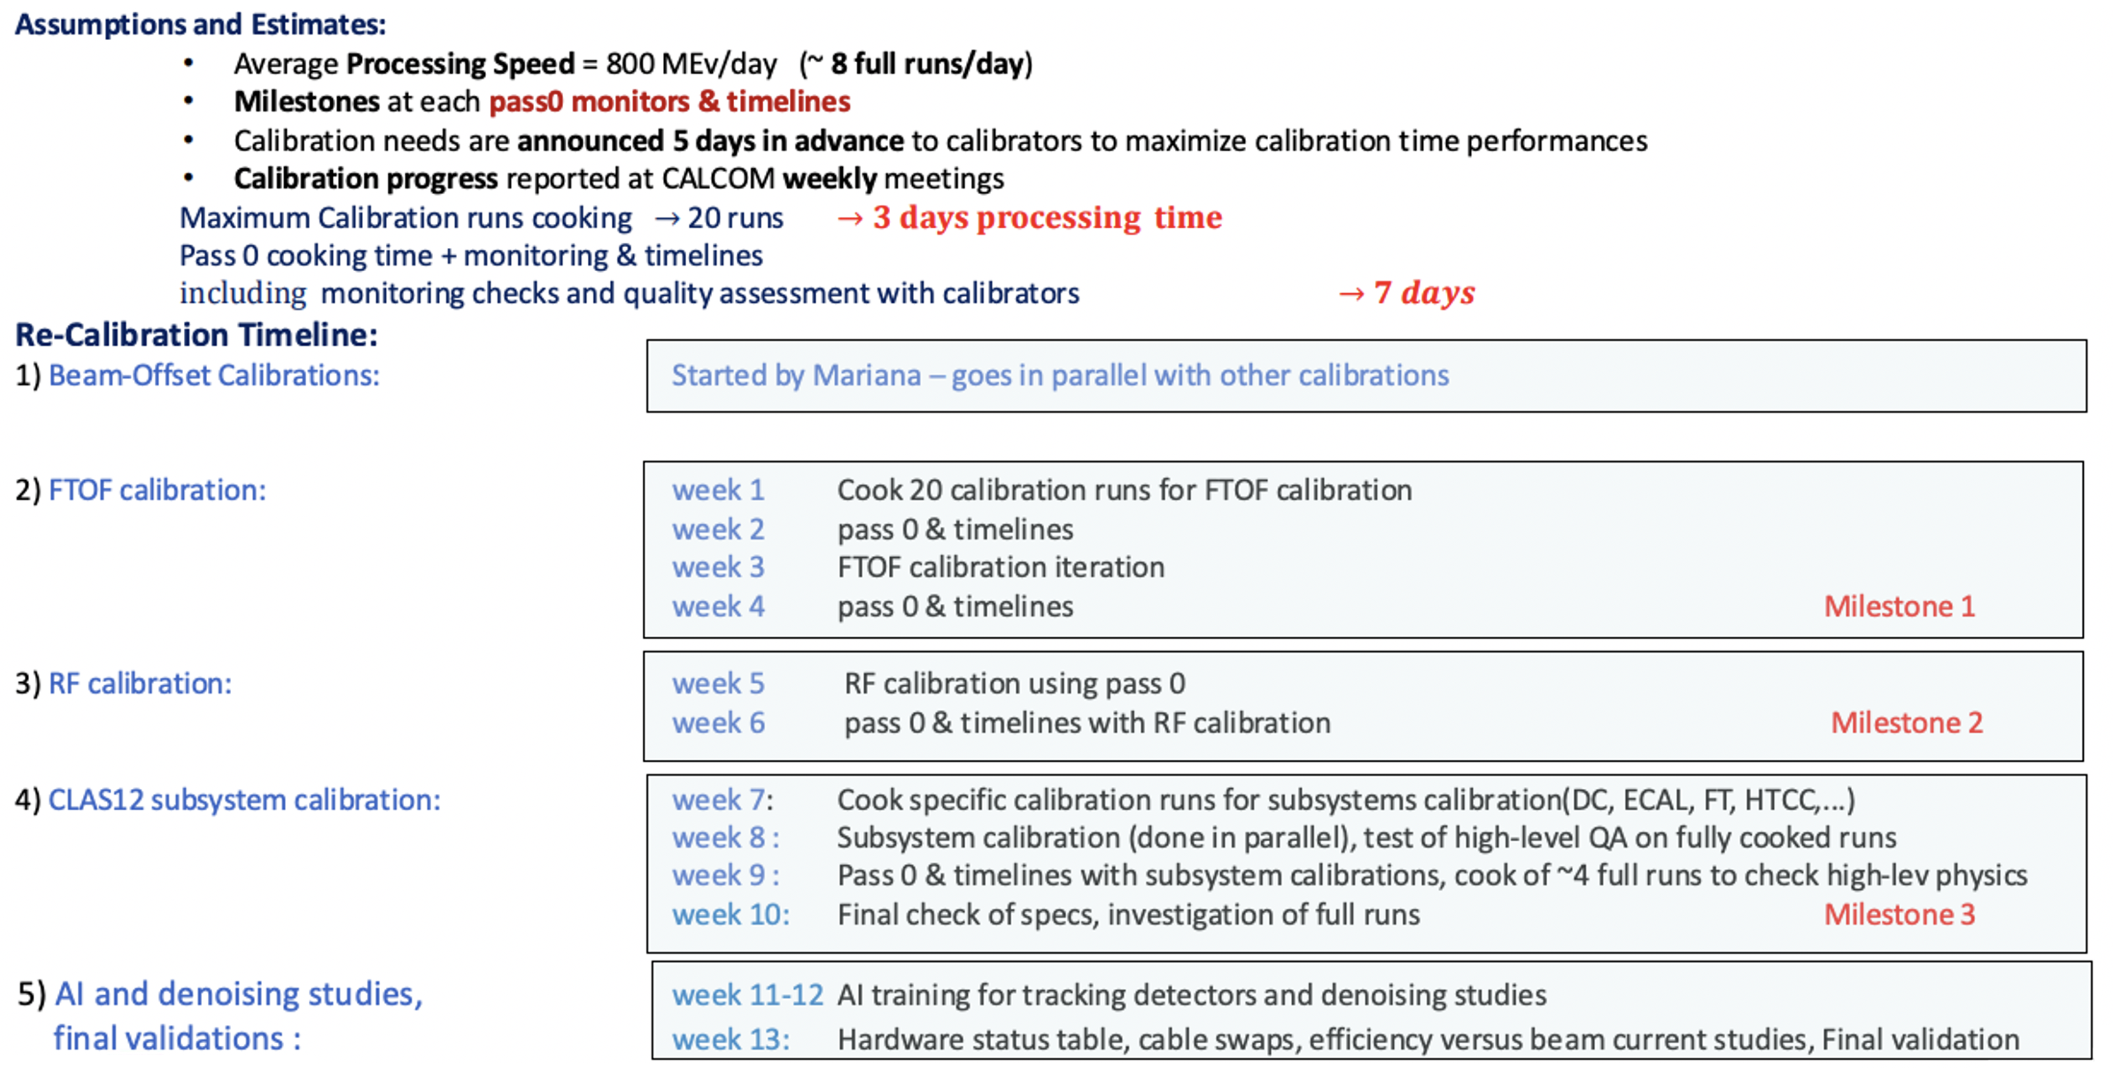
RG-K Spr24 - Status
[4] RG-K Spr24 – Pass-1 calibration review Oct. 11, 2024
Where do things stand?
CALCOM “ready for calibration” review complete
DC alignment/CVT alignment complete
Beam offset calibration complete
1st/2nd rounds of subsystem calibrations performed – some final “clean-up” remains
Remaining work:
DC calibrations (using lessons learned from RG-D)
Hardware status tables
AI network training for DC
Physics validation and ancillary information checks
Detailed study of DC resolution vs. HV
Pass-1 cooking review by Apr/May 2025
Timeline:
Original calibration window:
Oct. 15, 2024 – Feb. 7, 2025
2 month delay to start DC calibrations
Pass-1 review: TBD
Cooking: TBD
12

Slide 13
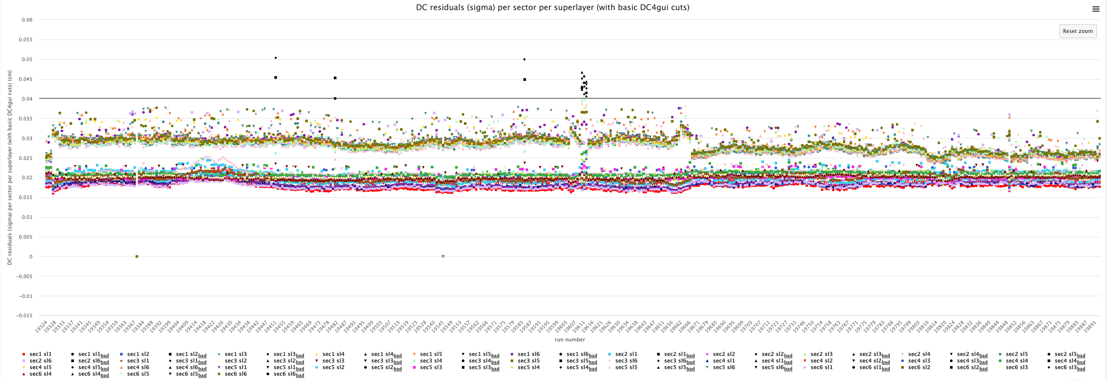
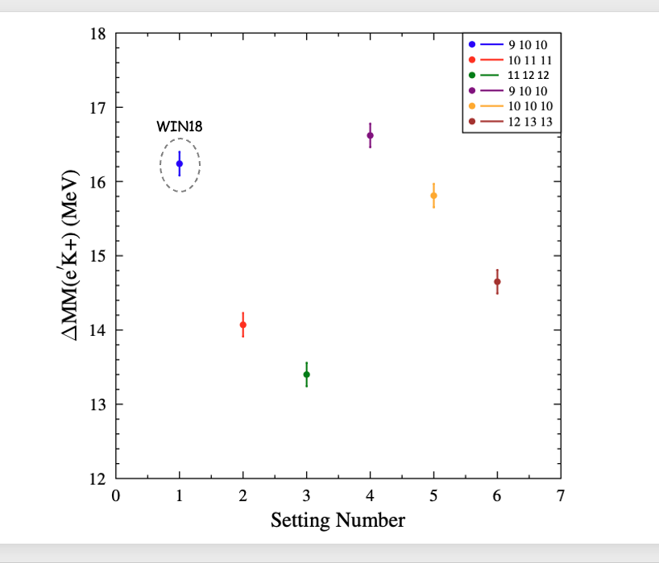
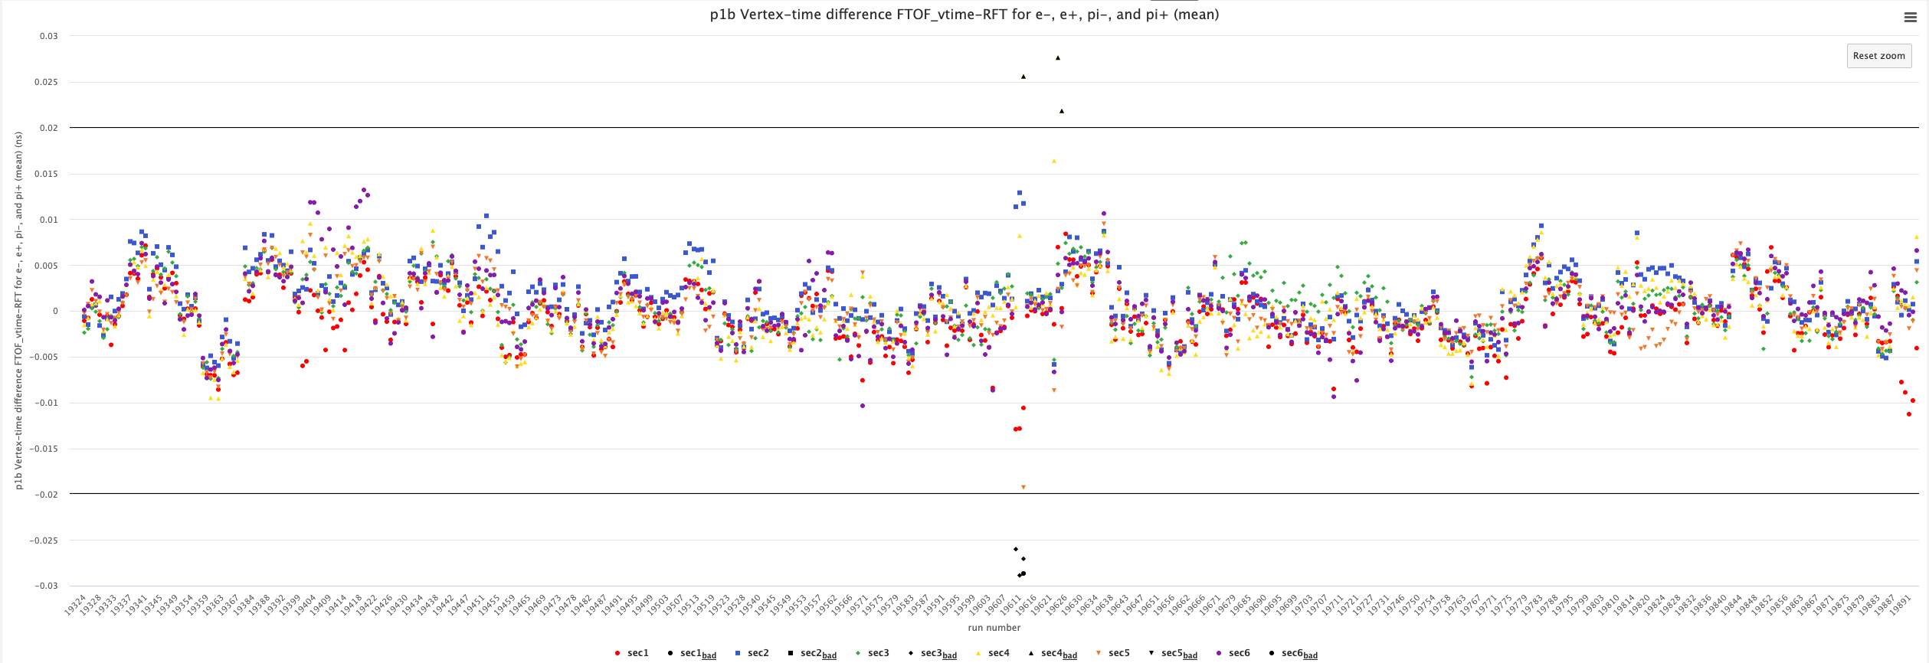
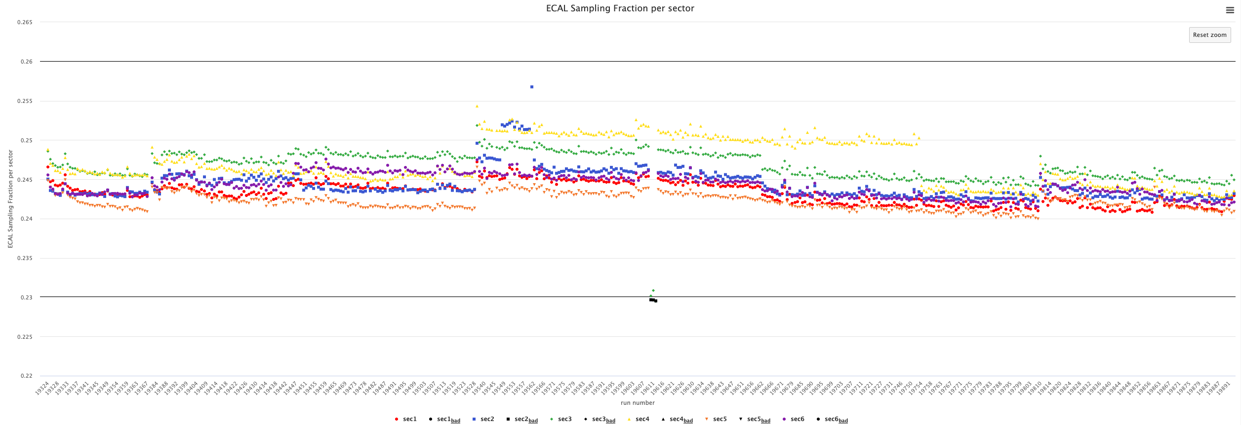
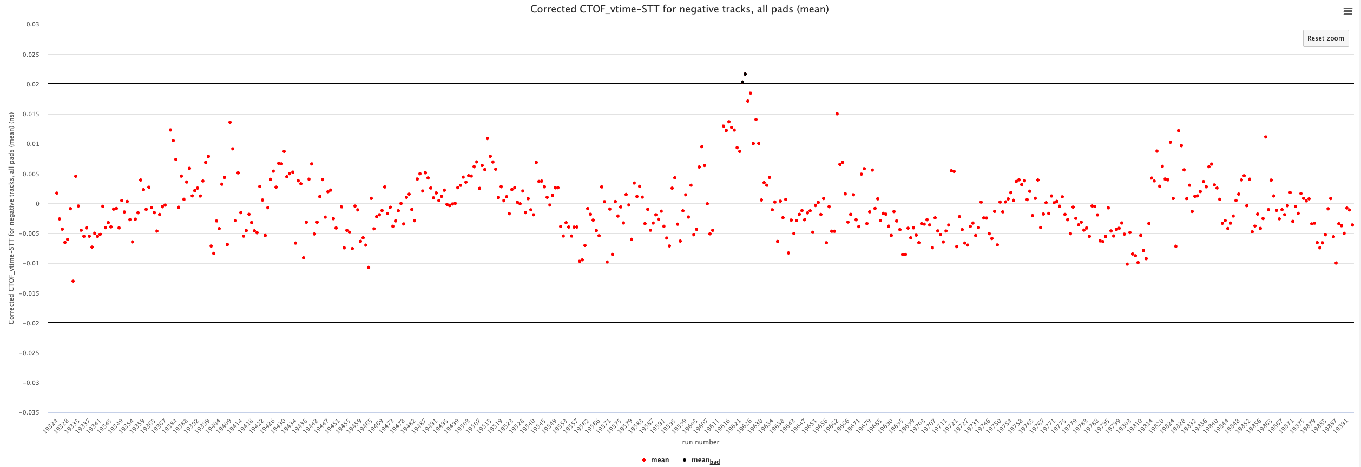
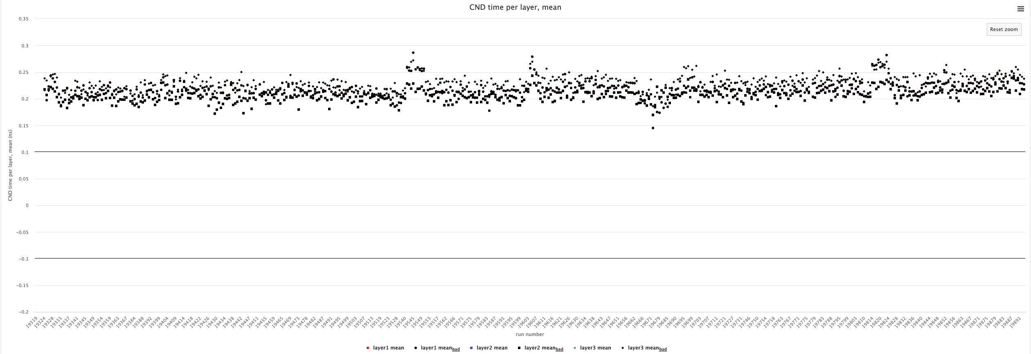
DC
400 μm
RG-K Spr24 - Status
“online” studies
FTOF
±20 ps
SPR24
ECAL
“offline” studies
0.23-0.26
CTOF
±20 ps
CND
RG-D
Note:
DC calibrations now getting underway
Change from RG-D is that sector-dependent calibrations will be used (Veronique Ziegler)
±100 ps
13

Slide 14
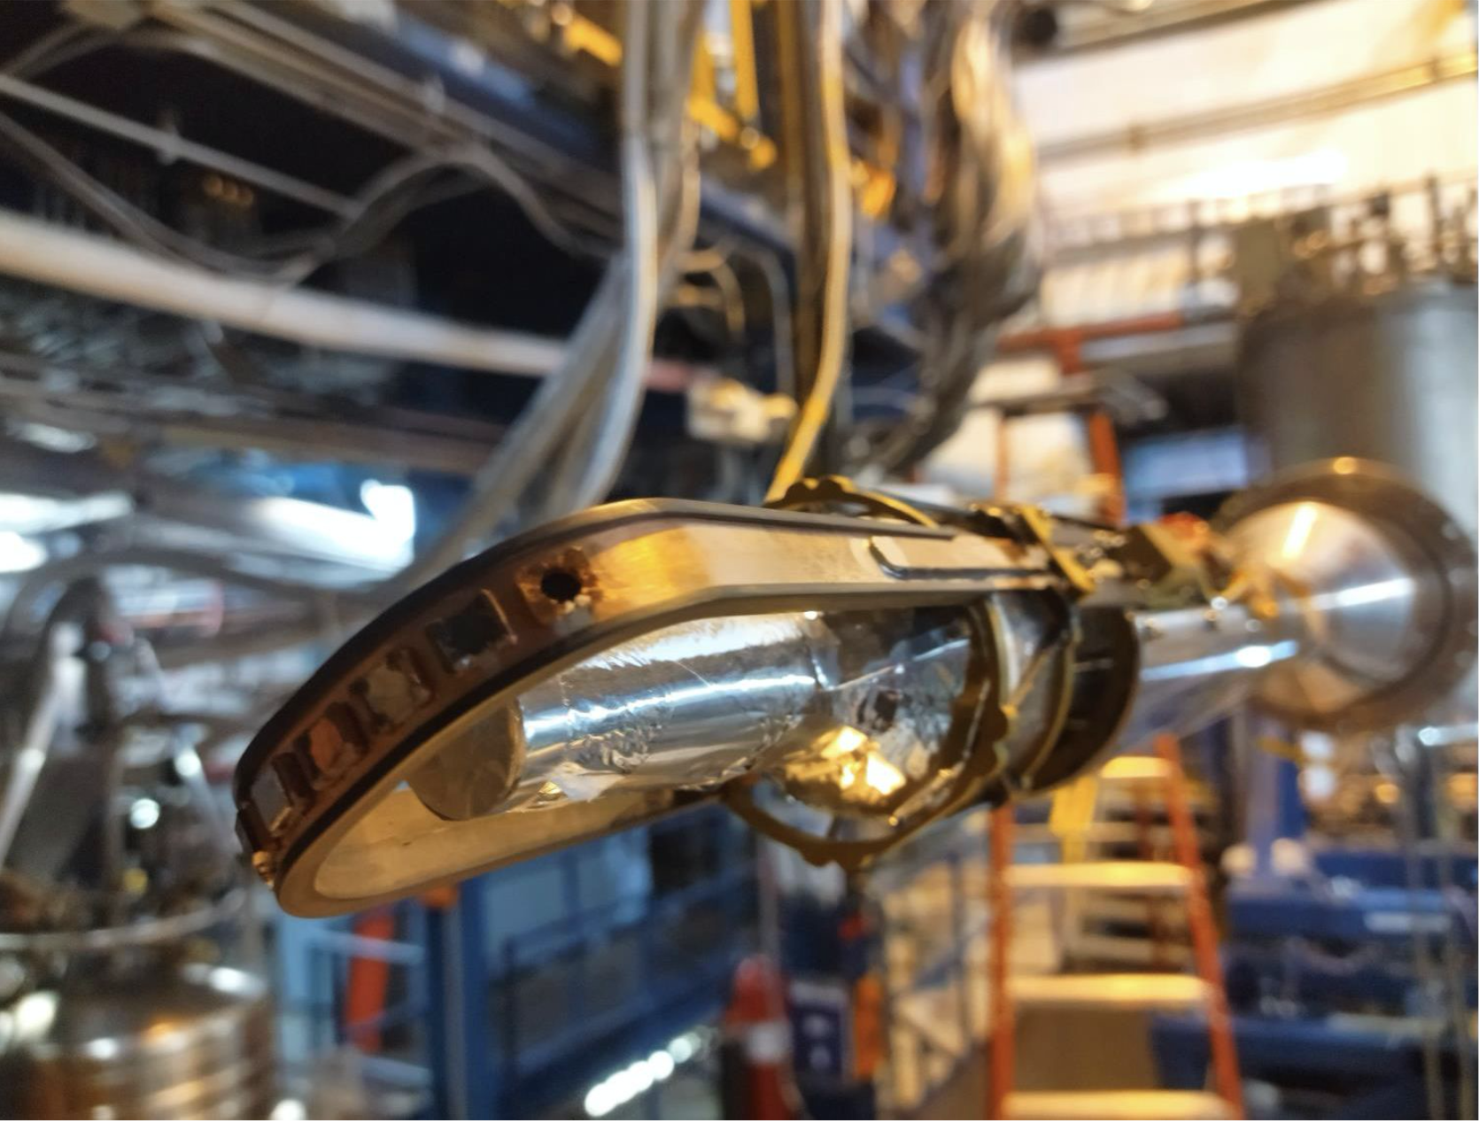
RG-E Spr24 - Status
[5] RG-E Spr24 – Pass-1 Calibration review Jan. 31, 2025
Remaining work:
DC calibrations – getting underway
Hardware status tables
AI network training for DC
Physics validation and ancillary information checks
Pass-1 cooking review by May/Jun 2025
Where do things stand?
CALCOM “ready for calibration” review complete
DC alignment/CVT alignment complete
Beam offset calibration complete
RF, FTOF calibrations complete
Subsystem calibrations in progress
14

Slide 15
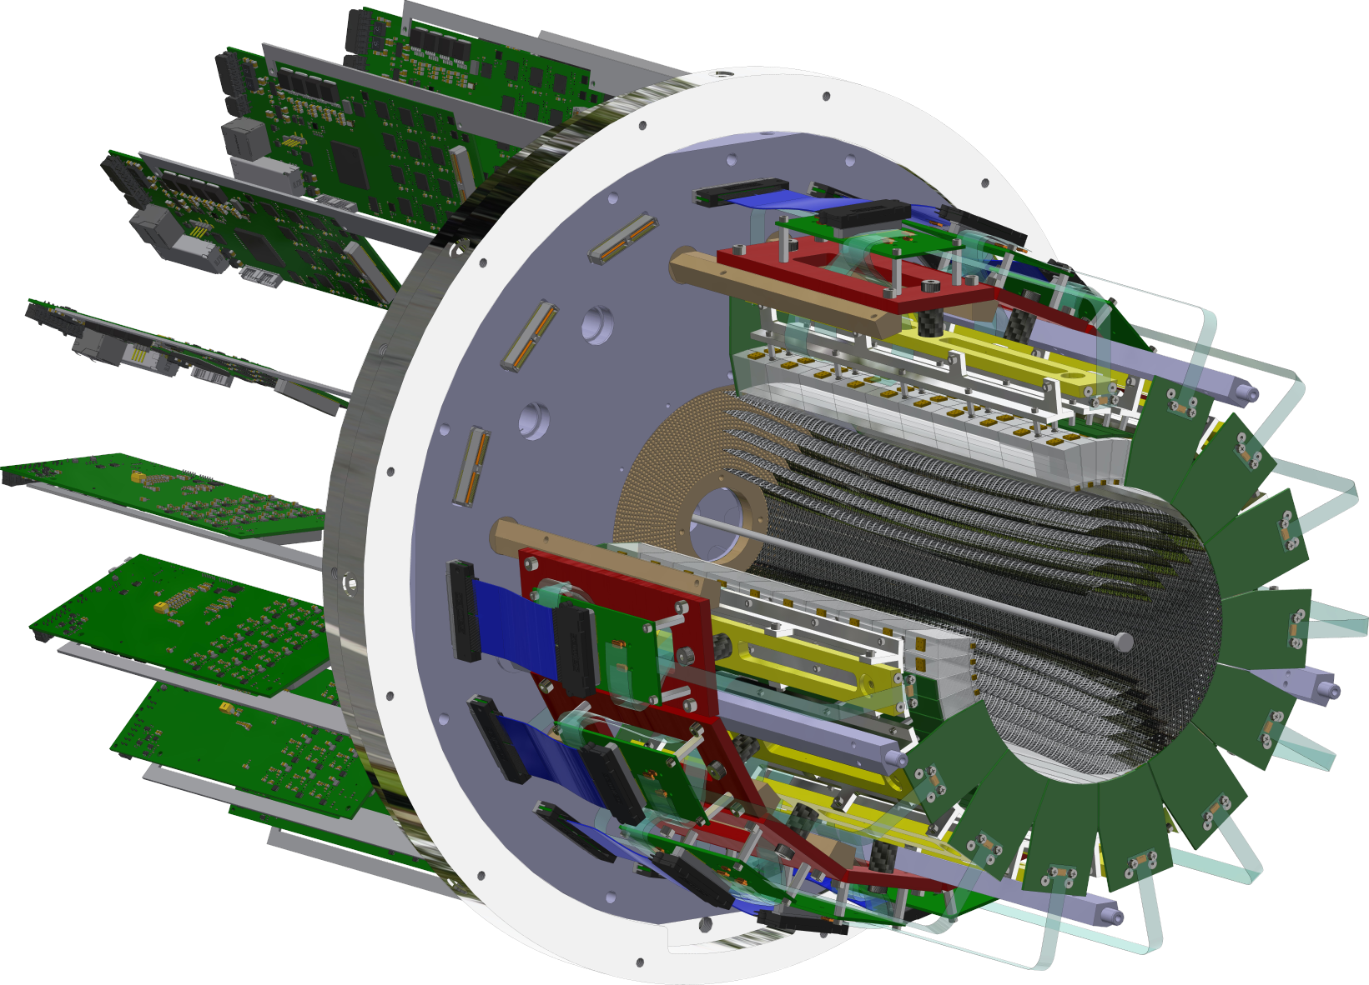
RG-L Spr25 - Status
[6] RG-L – Online calibration
RG-L (ALERT) – Mar. 24 – Sep. 7, 2025:
Initial commissioning key to verify ALERT detectors (AHDC, ATOF) are working and data is sensible for physics running
Setup online pass-0 monitoring to cook data/update timelines daily
Complete initial calibration of Forward Detector subsystems following standard protocols
Test AHDC and ATOF calibration suites with beam data to continue development, validation, and procedures
Configurations:
1-pass commissioning (7 days)
5-pass production (100+ days)
3-pass production for extension (37 days)
Analysis Coordinator (Mohammad Hattawy)
Chefs (Mathieu Ouillon, Noémie Pilleux)
Goal: complete all pass-1 calibrations within 6 months of the end of the run
15

Slide 16
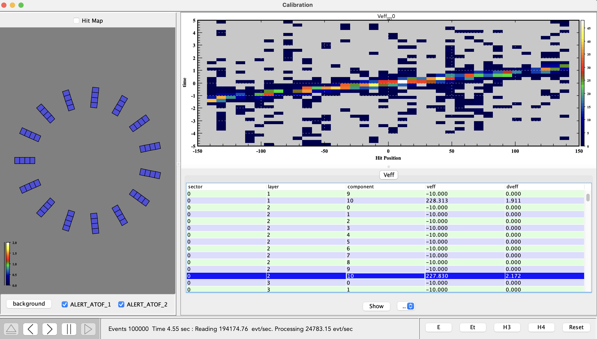
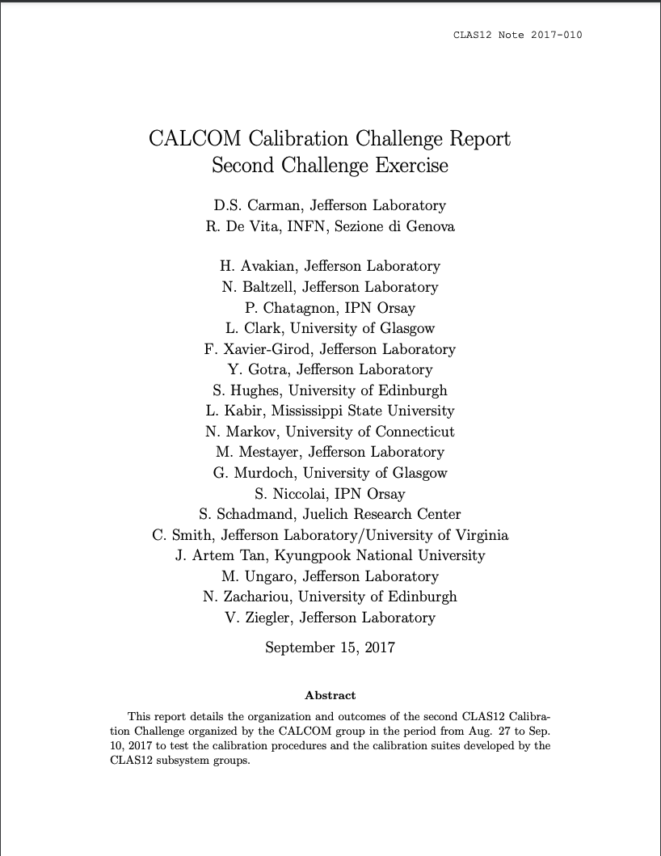
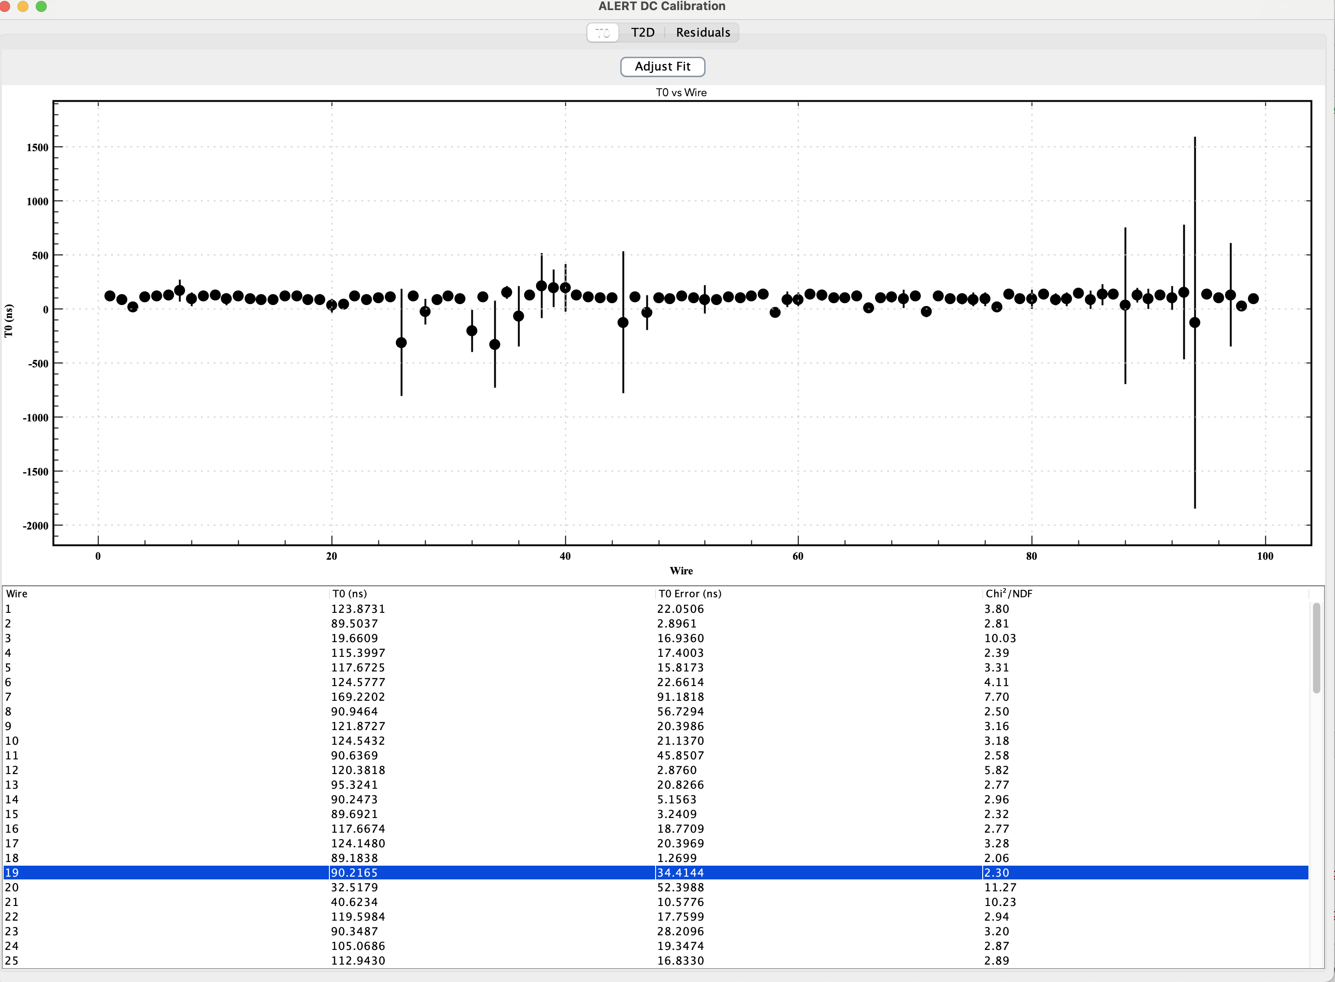
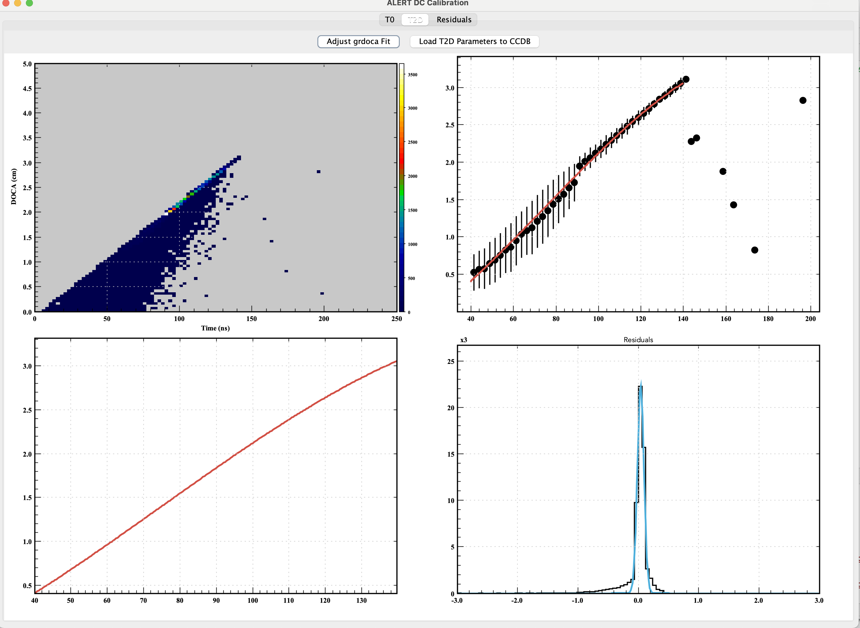
RG-L Spr25 – Calibration Challenge
ATOF
ATOF:
Time offsets
Attenuation length
Effective velocity
Time walk
Paddle-to-paddle
AHDC:
Time offsets
Time-to-distance
CLAS12-Note 2017-10
AHDC
Goals:
test calibration suites on pseudo-data generated with distorted calibration constants
verify extracted constants are consistent with original ones
verify resulting resolutions are consistent with expected
verify HW status from knocked-out channels
16

Slide 17
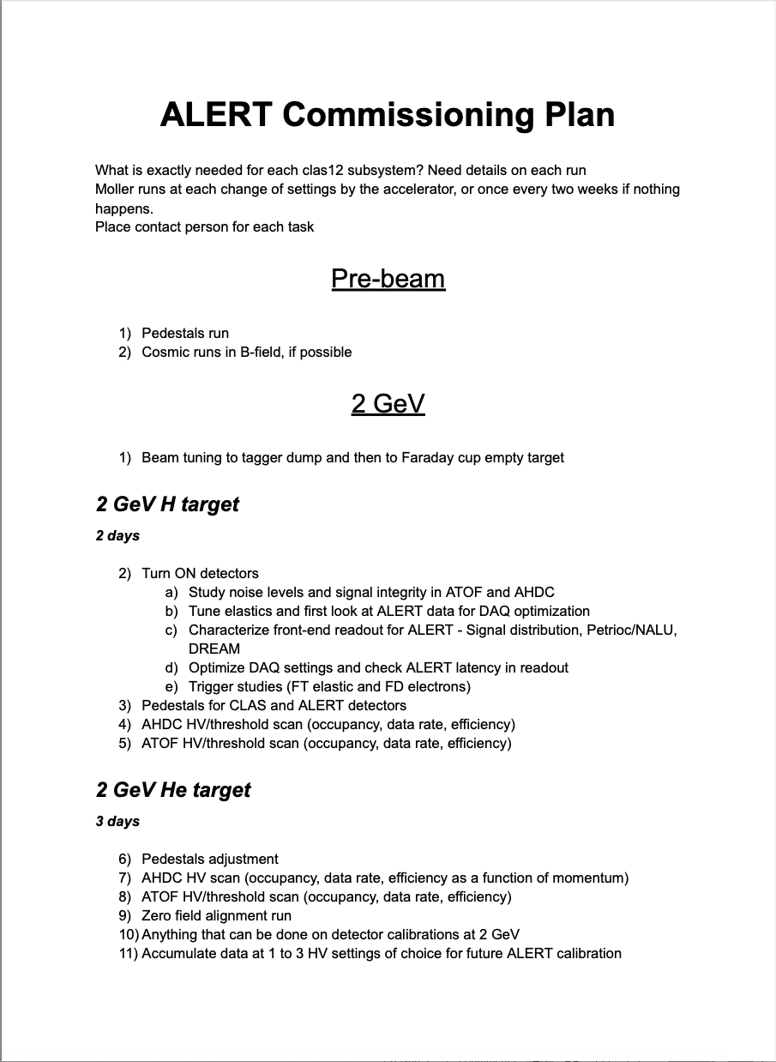
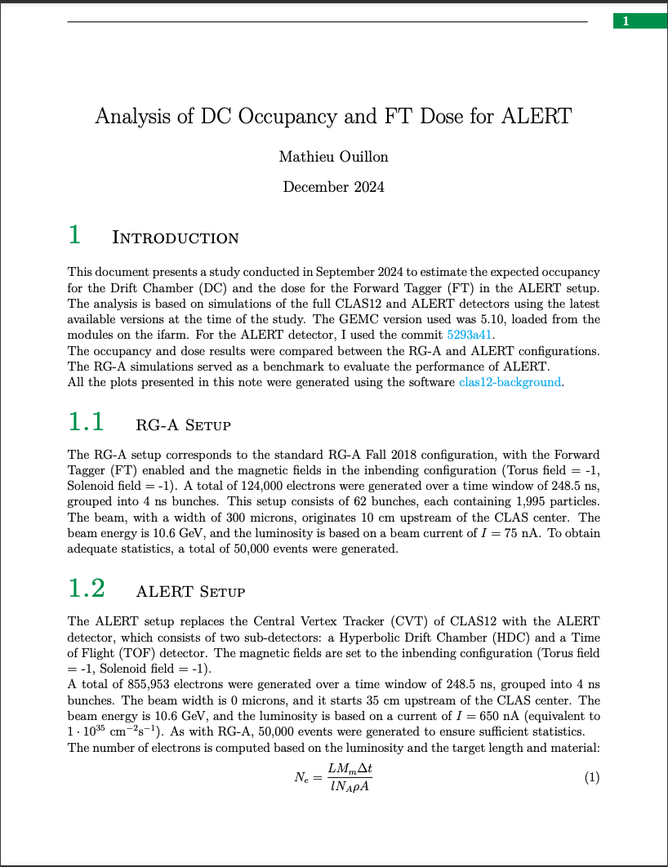
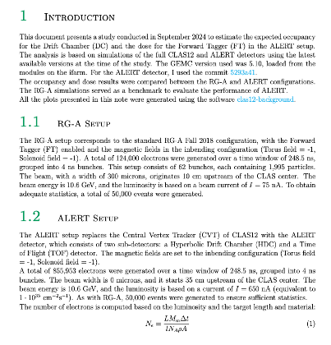
RG-L Spr25 – Commissioning Plan
Calibration Plans for CTOF and CND
in ALERT Run
Florian Hauenstein, Mohammad Hattawy
February 2025
17

Slide 18
Calibration Timeline: February – September 2025
February 28, 2025
RG
A
C
D
E
K
L
February March April May June July August September
pass-1 review
pass-1 review
pass-1 calibration
pass-1 review
pass-1 calibration
pass-1 review
pass-1 calibration
pass-1 review
online calibration
calib review
18

Slide 19
Summary
CALCOM has been overseeing the detector calibrations of the different CLAS12 datasets:
Completed: RG-A, RG-C
Current focus: RG-D, E, K
On the near-term horizon: RG-L
CALCOM is a critical service-work committee for the CLAS Collaboration:
Lots of folks are part of this work: CALCOM, coordinators, chefs, timeline crew,
subsystem leaders, calibrators, alignment team, Software Group, data validators, …
Notes:
Beginning work to calibration tools for improved speed/quality
Calibration task force – see talk by Raffaella De Vita
Discussion of upcoming pass-3 (DC tracking + AI for CVT tracking)
Plans to be discussed
But they always come back!
19

Slide 20
Backup Slides

Slide 21
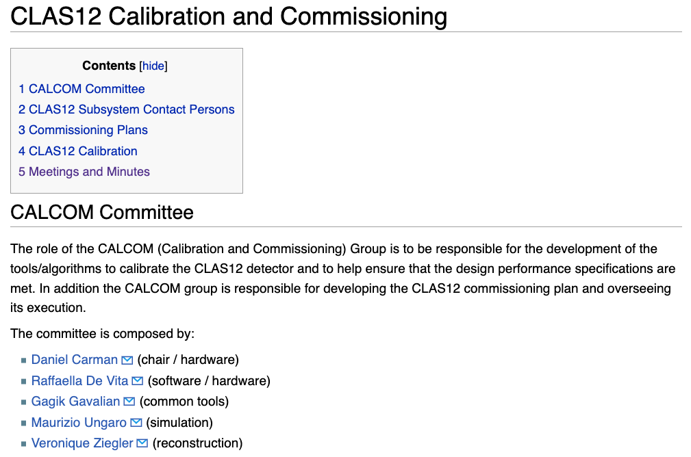
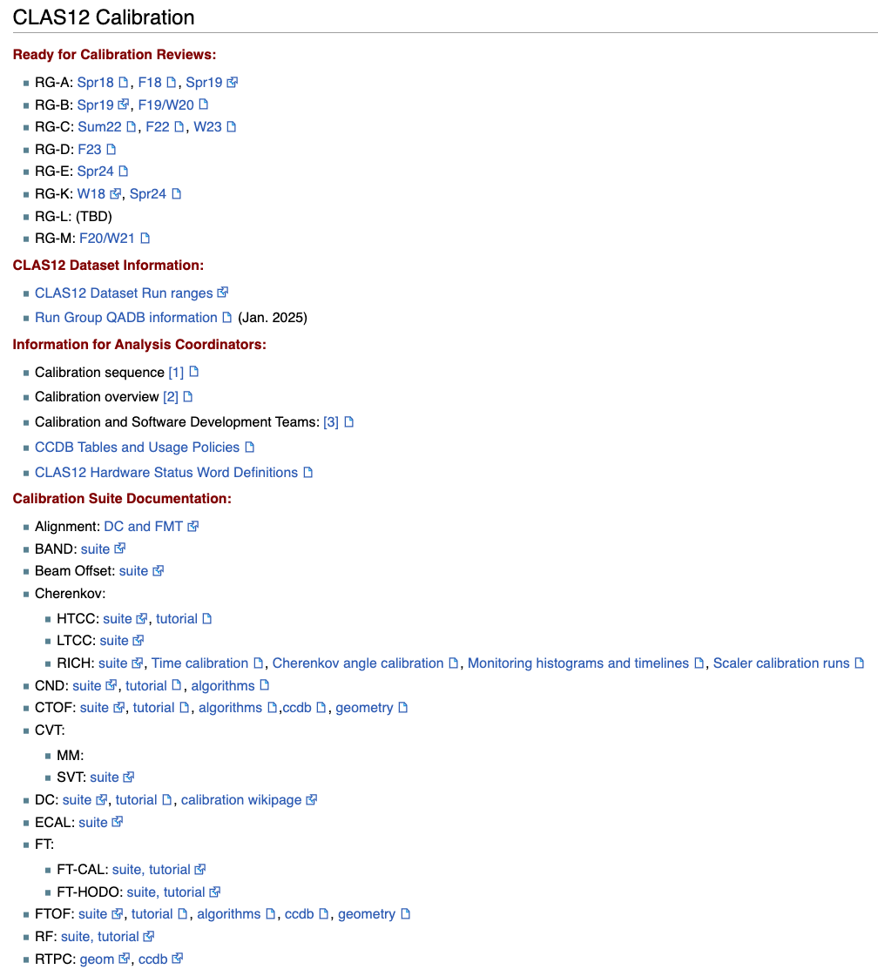
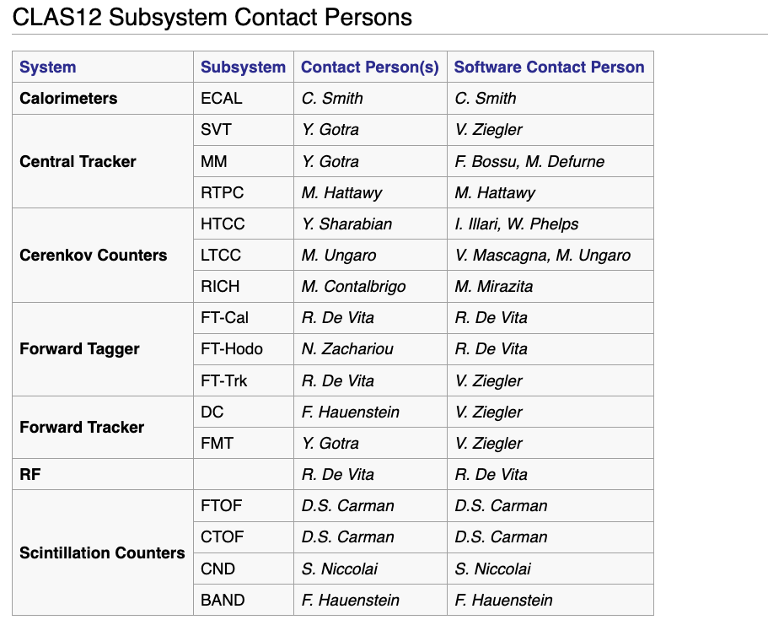
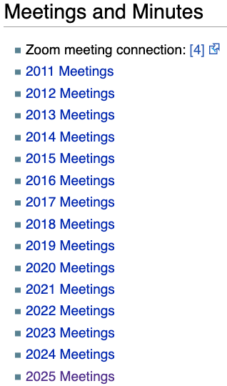
clas12_calcom@jlab.org
Fridays @ 10 a.m.
https://clasweb.jlab.org/wiki/index.php/CLAS12_Calibration_and_Commissioning
21

Slide 22
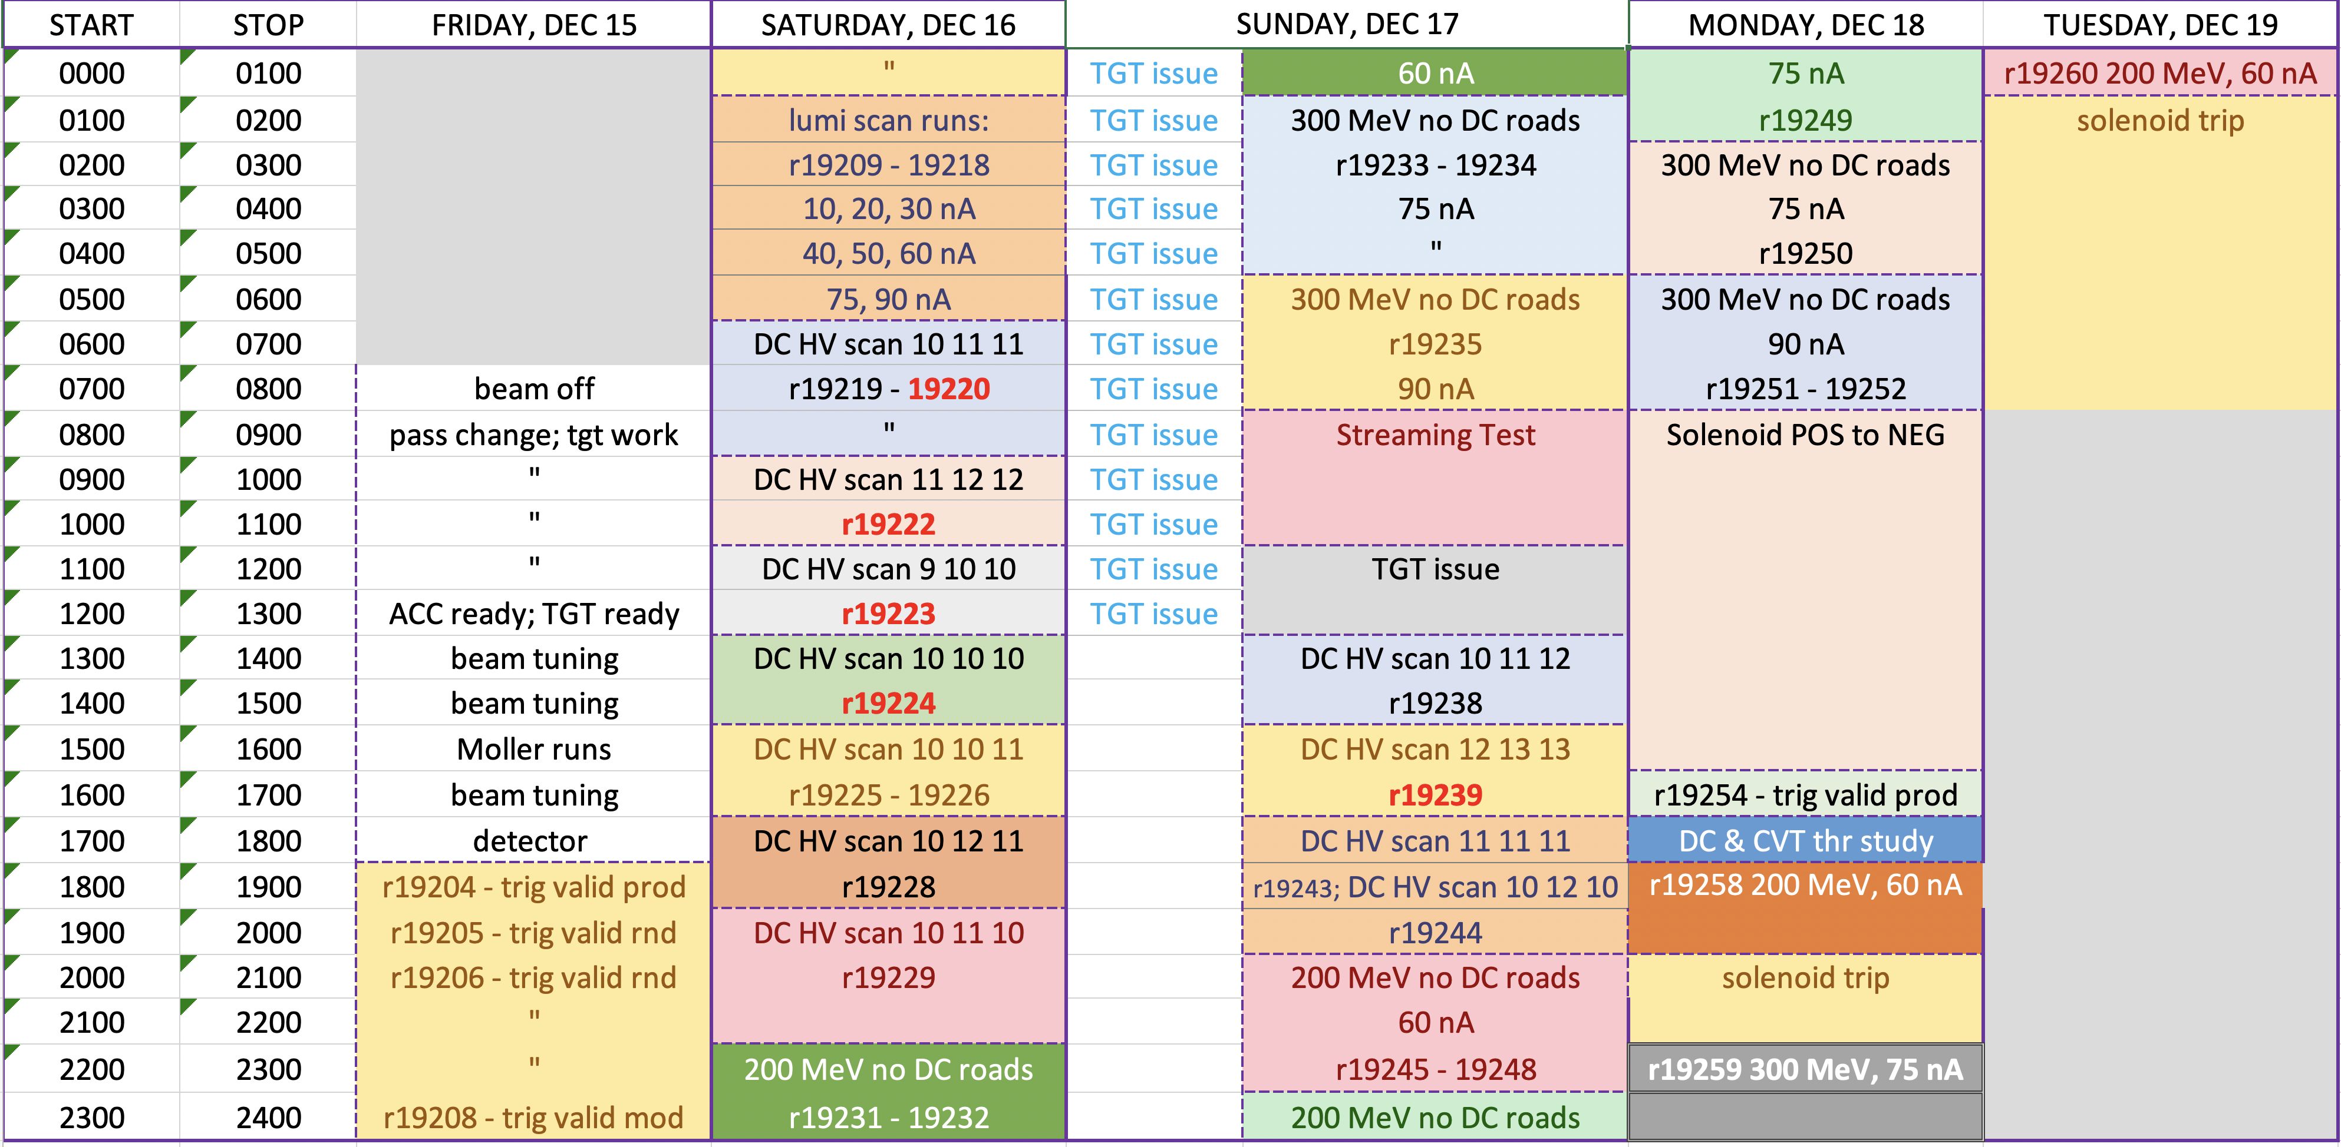
RG-K Commissioning Run – Dec. 2023
Run Number | R1 DC HV Setting | R2 DC HV Setting | R3 DC HV Setting
19220 | 10 | 11 | 11
19222 | 11 | 12 | 12
19223 | 9 | 10 | 10
19224 | 10 | 10 | 10
19225 | 10 | 10 | 11
19226 | 10 | 10 | 11
19228 | 10 | 12 | 11
19229 | 10 | 11 | 10
19238 | 10 | 11 | 12
19239 | 12 | 13 | 13
19243 | 11 | 11 | 11
19244 | 10 | 12 | 10
History of HV settings for (R1, R2, R3):
(8, 10, 9) : RG-A Spr18
(8, 9, 9) : RG-A F18 (early)
(9, 10, 10) : RG-A F18, RG-A/B Spr19
(10, 10, 10) : RG-M, RG-C
(10, 11, 11) : RG-D, RG-E
(11, 12, 12) : RG-K Spr24 (1)
(10, 12, 11) : RG-K Spr24 (2)
22

Slide 23
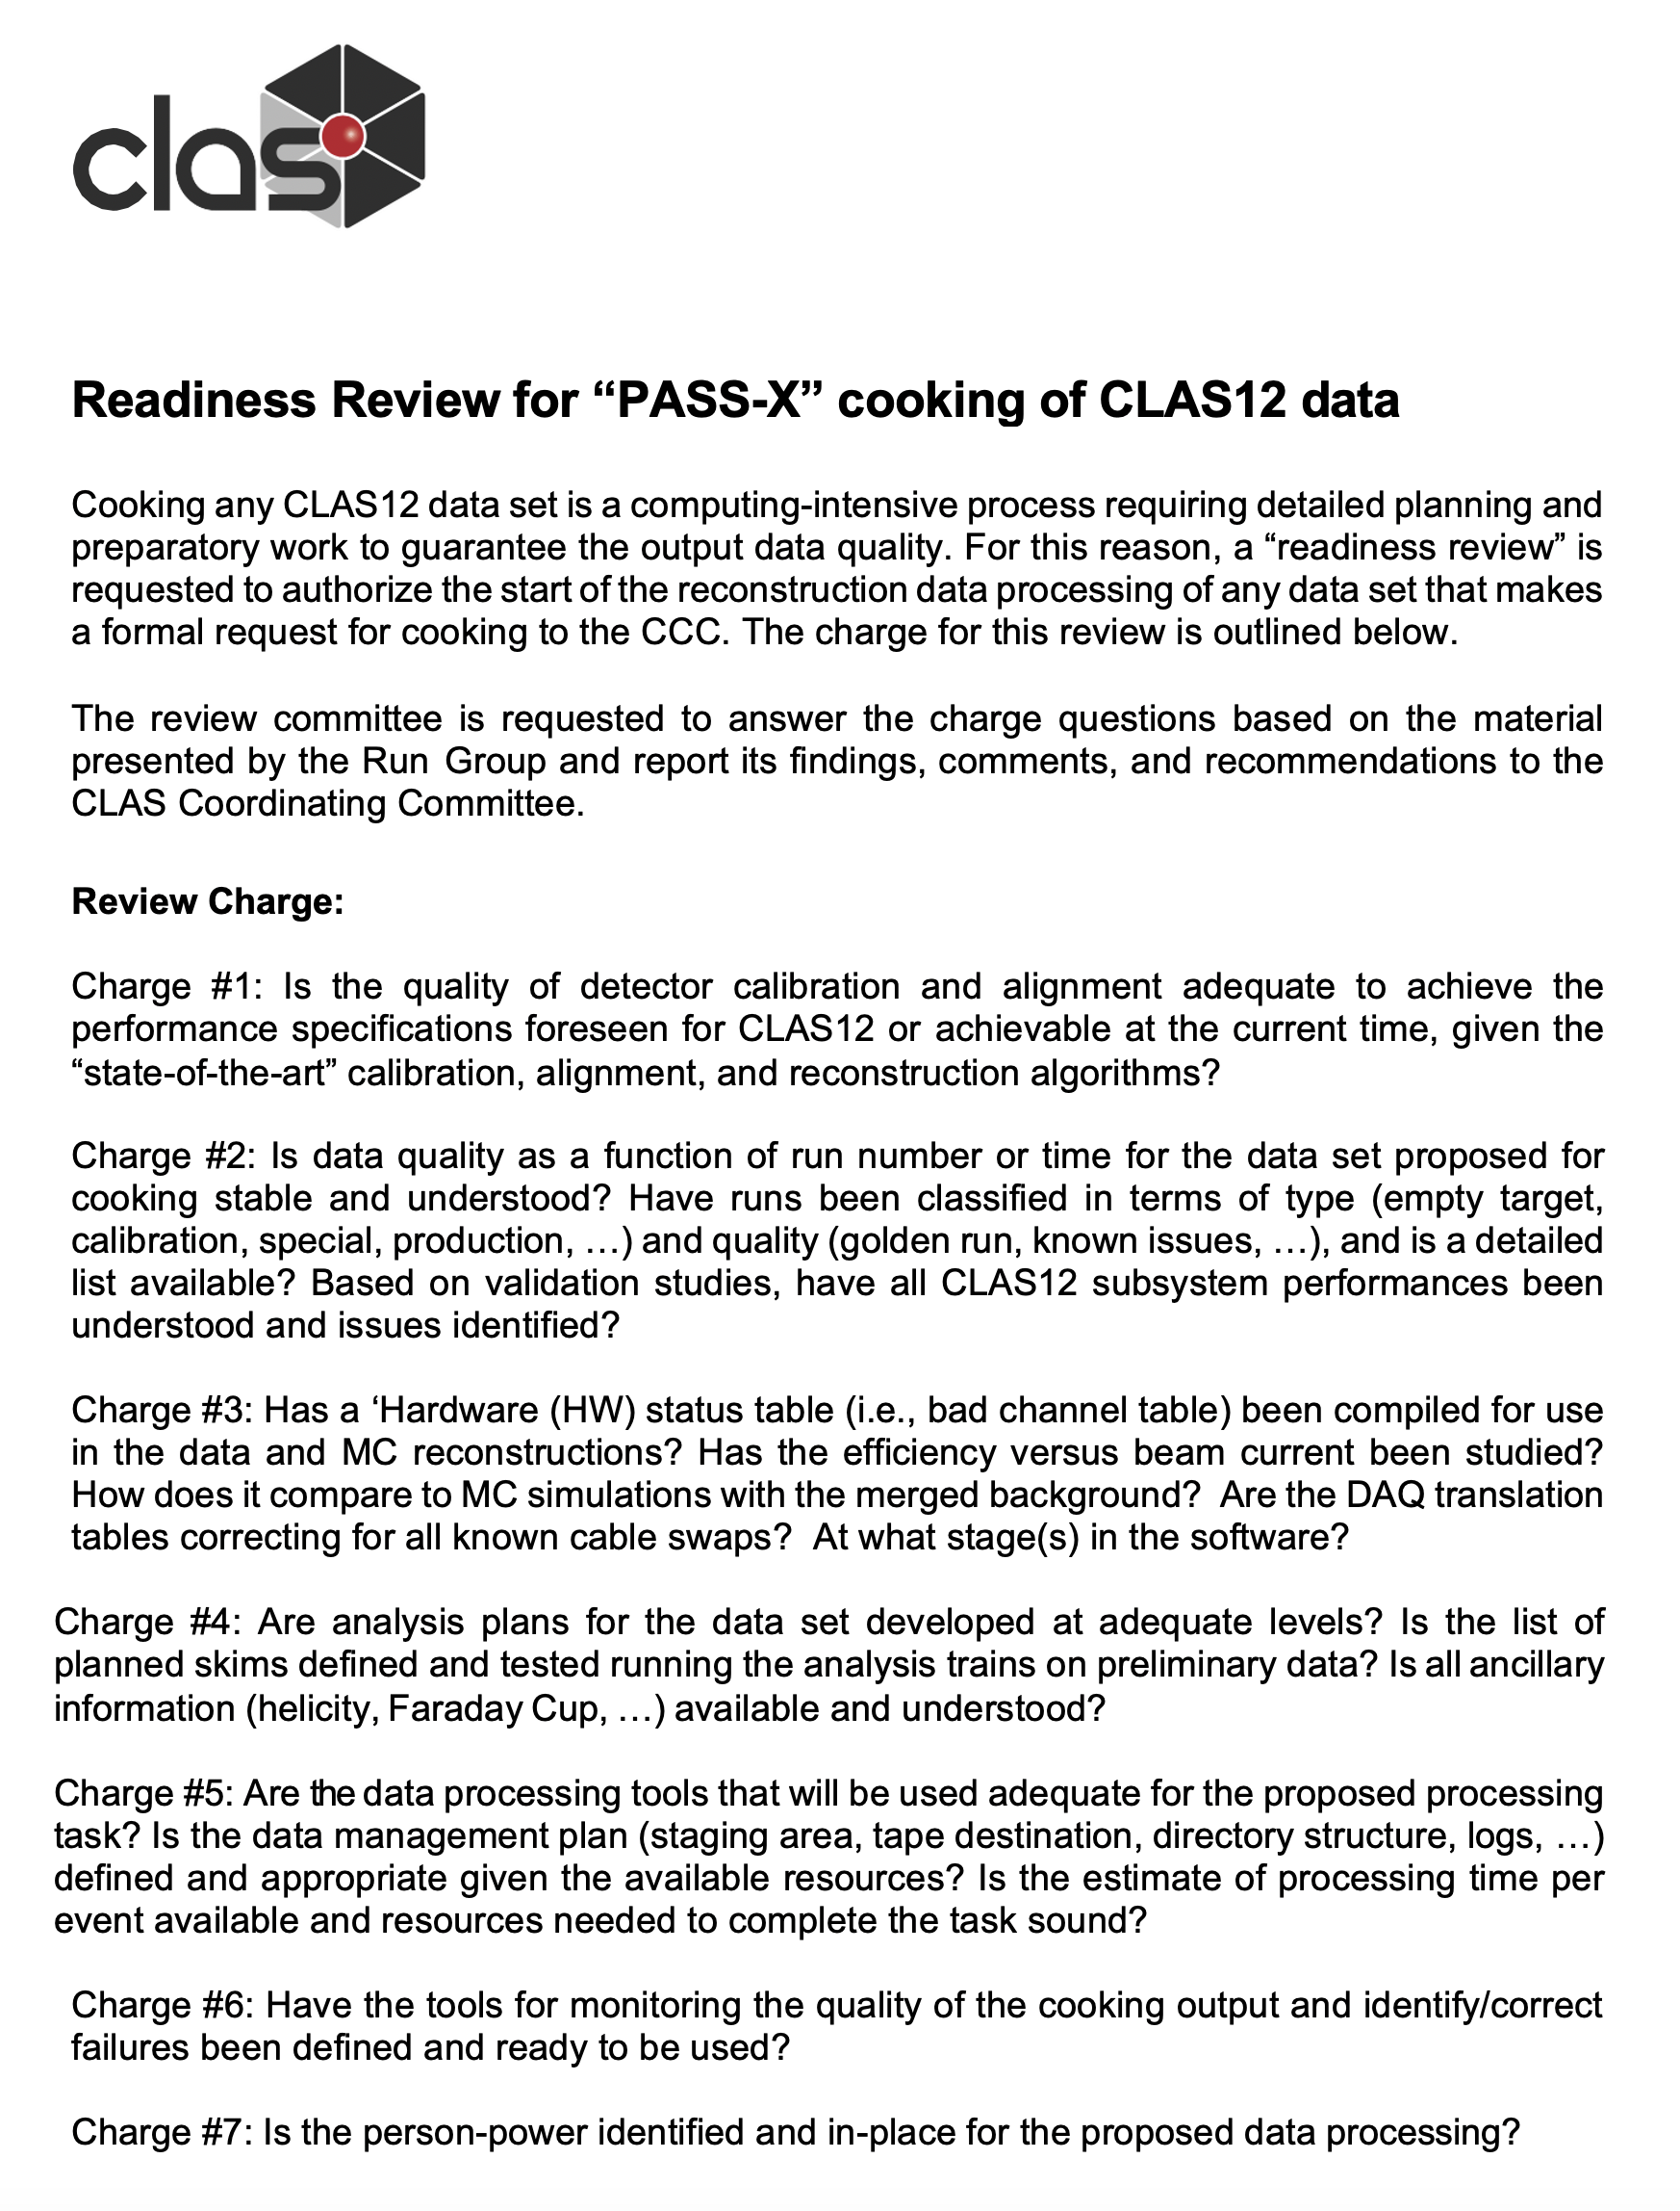
Pass-X Readiness Reviews
Committee: Marco Battaglieri (chair), Nathan Baltzell, Marco Mirazita, Cole Smith, Larry Weinstein
Role: Final review of calibration quality, status tables, software and scripting before recommendation to CCC to approve production cooking (see the generic review charge).
Reviews:
RG-B Spr19: Oct. 28, 2022
RG-M 21/22: May 23, 2023
RG-A Spr19: May 31, 2023
RG-K W18: Aug. 16, 2023
RG-A F18: Sep. 22, 2023
Notes:
The calibration quality for all subsystems should meet the defined QA specifications for all datasets to allow for minimal systematics when combining data taking years apart.
The calibration QA specifications are well defined and the Run Groups are held to the same standards.
The committee prepares their report for delivery to the CCC to give approval to start data processing.
RG-B F19/W20: Nov. 1, 2023
RG-C Sum22: Jan. 26, 2024
RG-C F22: Aug. 28, 2024
RG-C Spr23: Feb. 19, 2025
RG-A Spr18: Feb. 26, 2025
10 reviews completed since Oct. 2022
23

