Slide 1
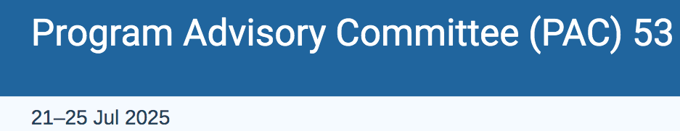
Measurements of SSAs in exclusive production of hadrons with transversely polarized target*
Harut Avakian (JLab)
  Hard scattering processes: 3D structure of nucleon
  Exclusive hadron production (ep→e’pρ⁰,e’pπ⁰, e’nπ⁺..)
    What we learned from unpolarized and longitudinally polarized target measurements
    What we can learn from transverse target measurements
  Summary
*) RGH extension proposal (C12-11-111A)

Slide 2
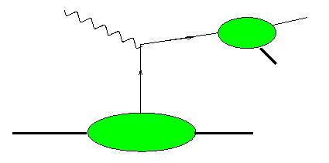
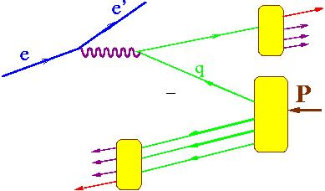
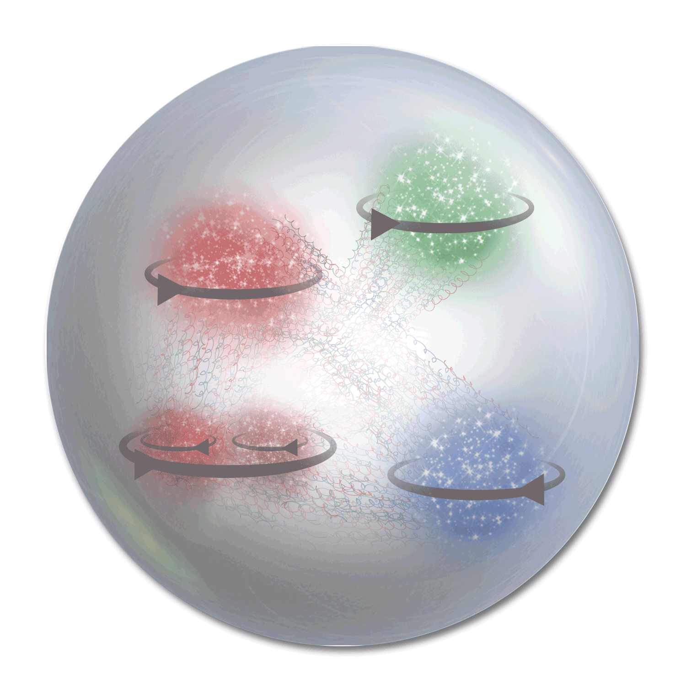
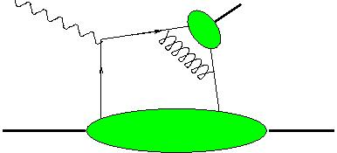


3D PDFs: Electroproduction of hadrons
Study
γ∗_{Τ}
h
Current Fragmentation Region (CFR)
x,Q²,z,P_{T},φ,φ_{S}
~1/Q⁴
TMD-FF
x_{F}>0
N
X
Flavor and polarization dependence of transverse momentum distributions
h
TMD-PDF
γ∗_{L}
DA
π,ρ,Κ.
x,Q²,t,φ,φ_{S} +φ,θ
~1/Q⁶
h
N
N,Δ,Λ,..
Flavor and polarization dependence of transverse space distributions
GPD
x_{F}<0
γ∗_{L/T}
h
Target Fragmentation Region (TFR)
X
N
correlations and entanglement of CFR and TFR, controlling CFR, allowing access to GPDs and GTMDs
N,Δ,Λ,..
Semi-exclusive production (Guo-Yuan)
Different non-perturbative objects may be involved with several independent variables involved
Cross contributions make studies based on a given set of assumptions challenging

Slide 3

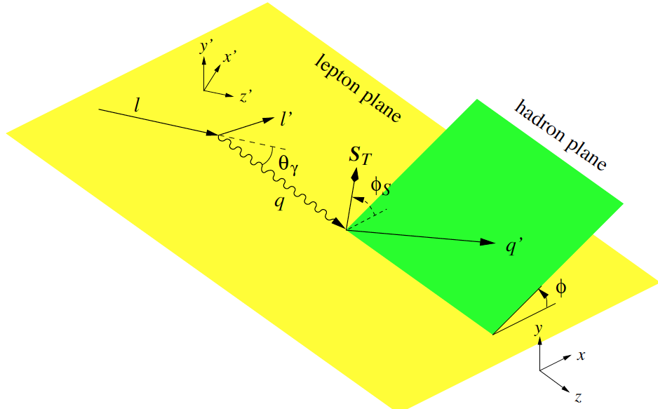
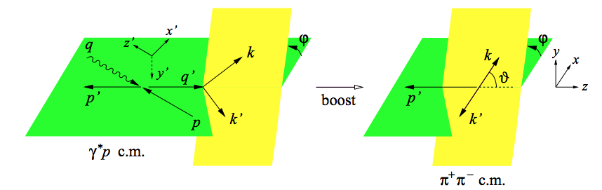
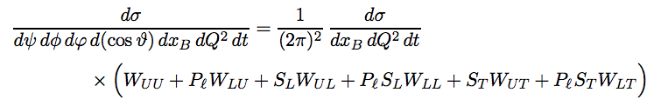
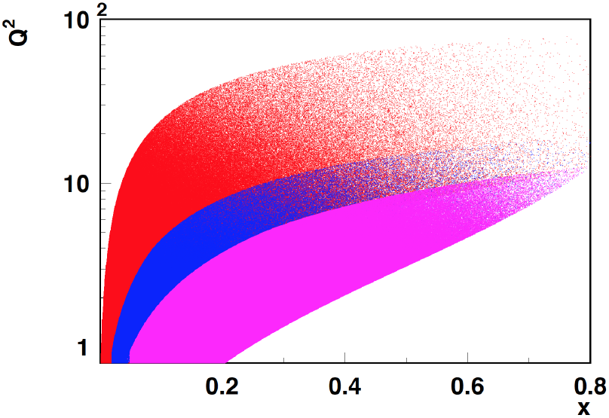
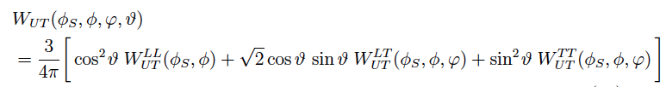

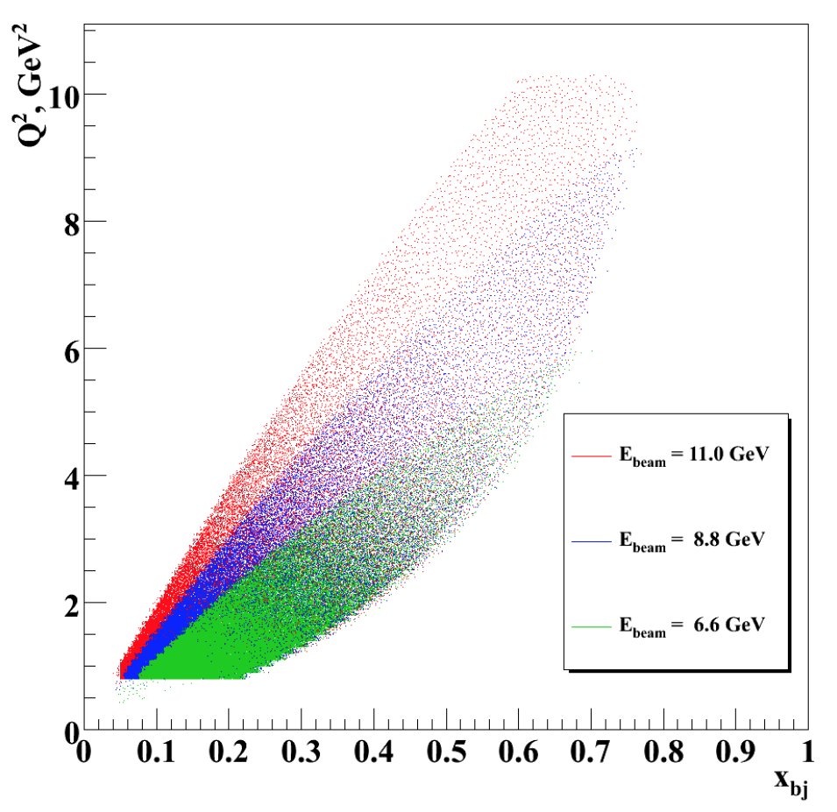

Polarized Leptoproduction of VMs
Diehl: 0704.1565 (36?)
COMPASS
HERMES/JLab22
JLab12
JLab7/9/11
helicity amplitudes/SDMEs provide access to non-perturbative structure (GPDs)
Notes:
helicity amplitudes T_mu\nu depend on Q^2,x,t obey parity relations. SDMES T*T*

Slide 4
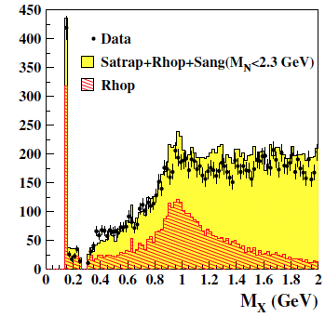
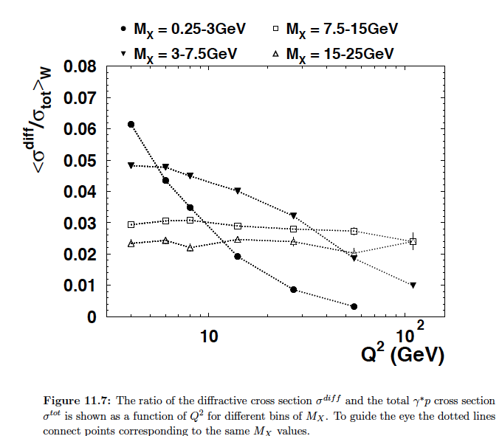
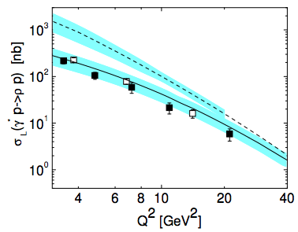
Exclusive processes: longitudinal rho at ZEUS
ZEUS diffraction 1/Q⁶ at low M_X
~20-30% of DDIS comes from rho
1/Q⁶ theory misses ~70-80% at low Q²
Kroll&Goloskokov
hep-ph/0611290
Departure from 1/Q⁶ attributed to large power corrections → expected to be more significant at lower CM energies!!

Slide 5
Exclusive measurements with major impact
Measurements of Q²-dependence of exclusive rho at HERA
Main result: Cross section drops as ~1/Q⁴, L/T ratio increases slowly with Q²
Longitudinal photons start to dominate at very large Q² (low statistics, practically impossible multidimensional measurements )
Conclusion: Large power corrections to Leading Twist, complicating interpretation within GPD based phenomenology
Challenges: Separating exclusive from semi-exclusive, and longitudinal from transverse
Measurements of exclusive rho at HERMES and COMPASS
Main result: Extraction of SDMEs, small SSAs observed for polarized and unpolarized targets for rho, longitudinal photons start to dominate at very large Q² (low statistics, practically impossible multidimensional measurements )
Challenges: Separating exclusive from semi-exclusive, and longitudinal from transverse
Consequence→
Exclusive ρ meson studies have been left on the sidelines of 3D structure investigations
No reliable MC simulations with polarization degrees of freedom available for exclusive hadrons, and VMs in particular

Slide 6


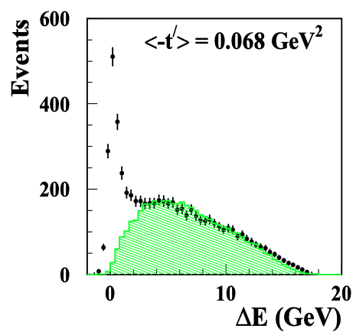
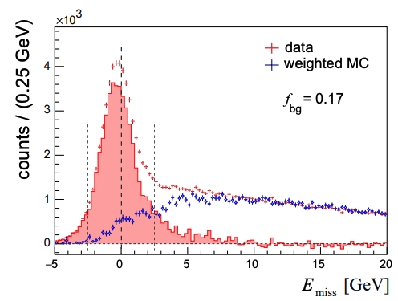
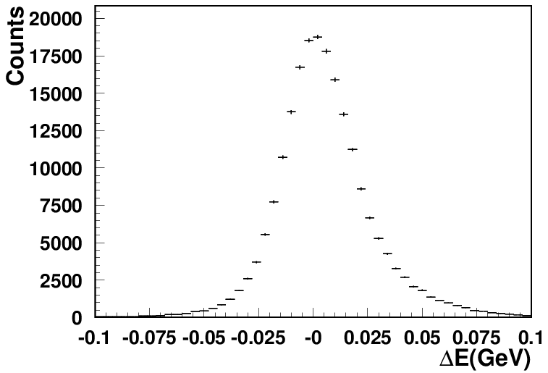
Measuring exclusive processed at higher energies
Exclusivity condition defined by the missing Energy:
CLAS12 (width <0.1GeV)
HERMES(width ~0.6GeV)
COMPASS(width ~2GeV)
~20% of data
Guarantying the “exclusivity” requires good resolutions (gets worse at higher energies)
Subtraction procedure relays on normalization, based on exclusive limit of LUND-MC
All distributions have tails, indicating the RC may not be negligible
Extraction of SDMEs, will require validation in the multi-D space (significant samples)

Slide 7
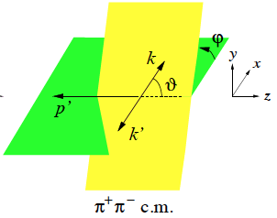
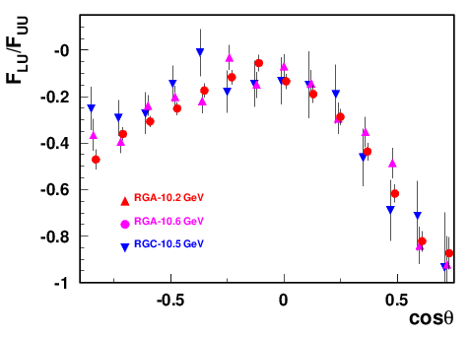
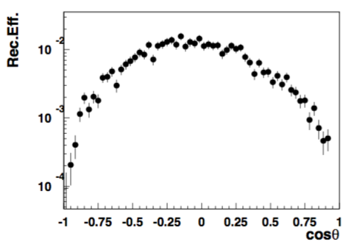
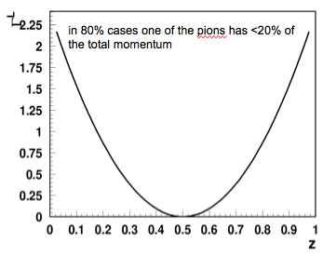

What we know about the longitudinal rho
longitudinal ρ→ source of info on γ∗_{L}
Has huge SSAs (negative for beam SSA)
CLAS12
ρ⁰_{T}
ρ⁰_{L}
CLAS12 PRELIMINARY
1 bin in ZEUS
Very challenging to measure
asymmetric decays hard to detect and identify
Interference of γ_{T}*→ρ_{L} and γ_{L}*→ρ_{L}
← measured 0 at HERMES/COMPASS
→Needed for L/T separation

Slide 8
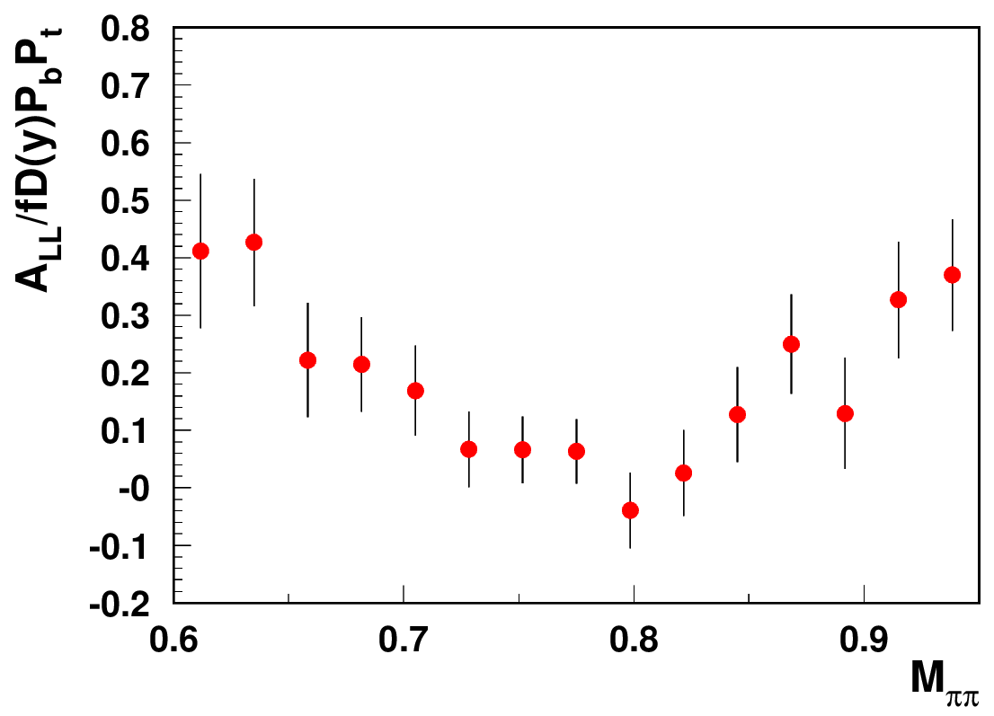
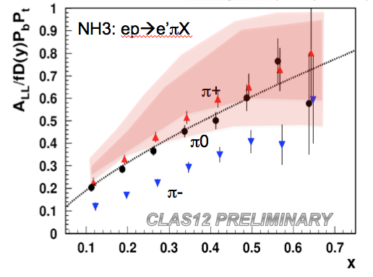
Studies of ρ⁰ impact with longitudinally polarized NH₃ target
A.Bongallino (theory bands)
CLAS12 Preliminary
ep->e’p’π⁺π⁻
Need clear separation of hydrogen from NH₃
and “diffractive” exclusive ρ0s from exclusive π+π−
Exclusive rho, dominated by longitudinal photons introduces dilution to A₁ at lower x&Q² suppressing π+ DSA (decrease seem to be inconsistent with theory)
DSA is P-even, SSA is P-odd
longitudinal photon cross section is P-odd
→ contribution appears only in the SSA, a P-odd observable, and does not appear in DSA(→significant dilution in DSA)

Slide 9
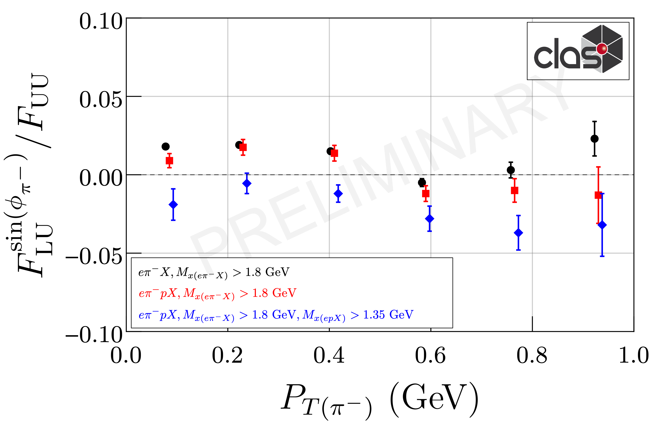
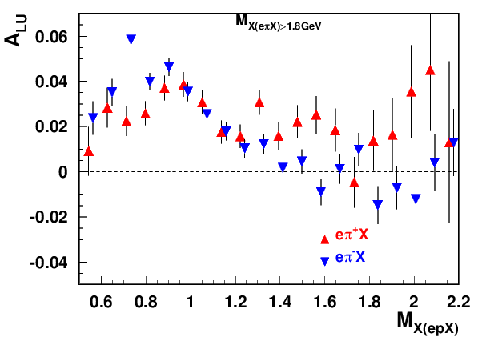
Exclusive ρ contributions to π: P_{T}-dependence
“ρ-free” SIDIS
0.1<P_{T}<0.3, 0.4<z<0.6
Can change the pion SSAs, in particular at small PT
The same sign and size of π+ and π- SSA indicates the rho0 may not be properly subtracted(require detailed MC studies, which require proper SDMEs)
While VM contributions are ~20% in multiplicities in SSA they can be >100%
Detection of the target proton introduces much smaller bias on the inclusive charged pion SSA, than the exclusive rho contributions

Slide 10
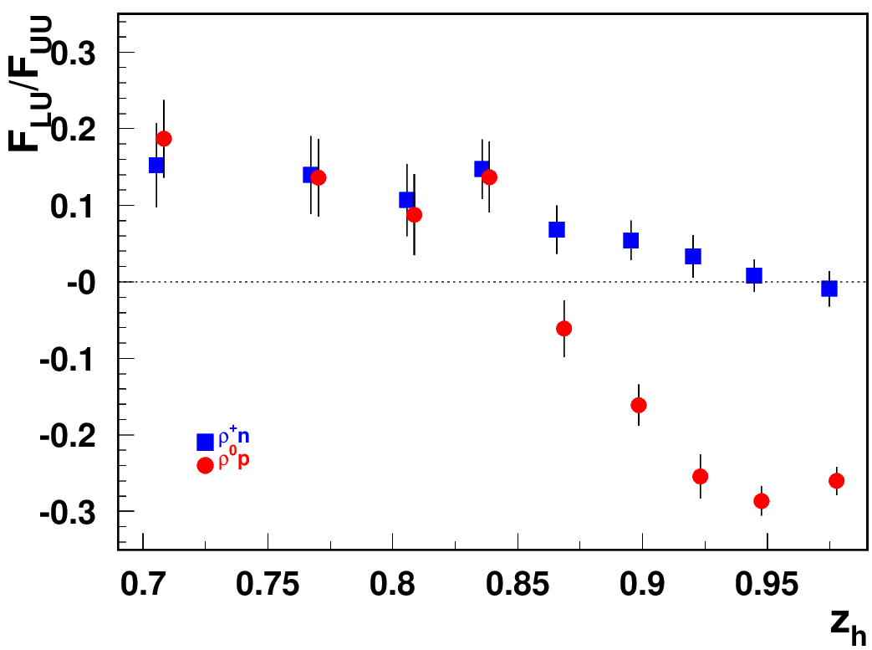
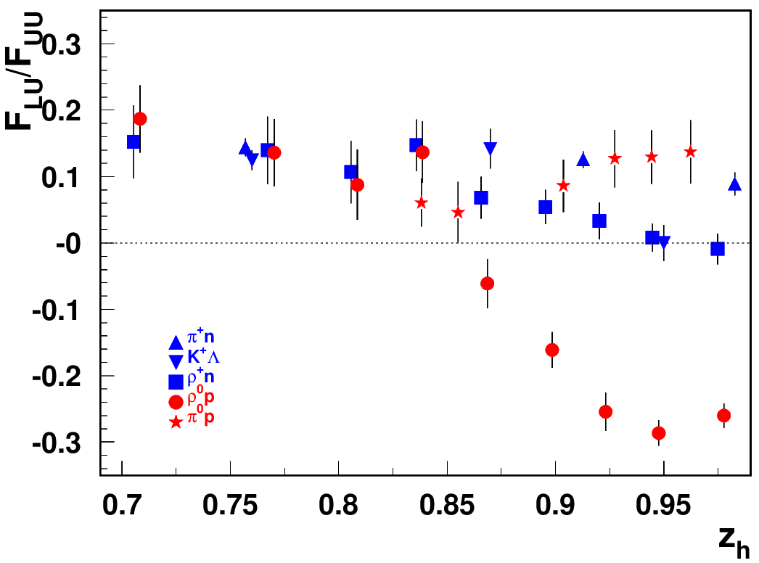
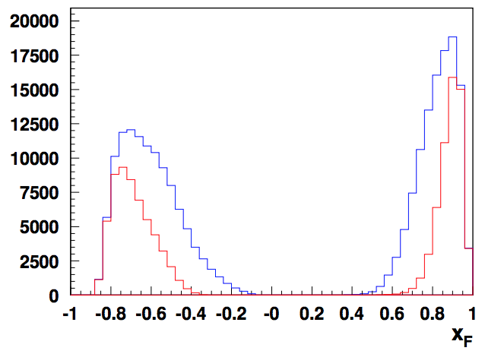
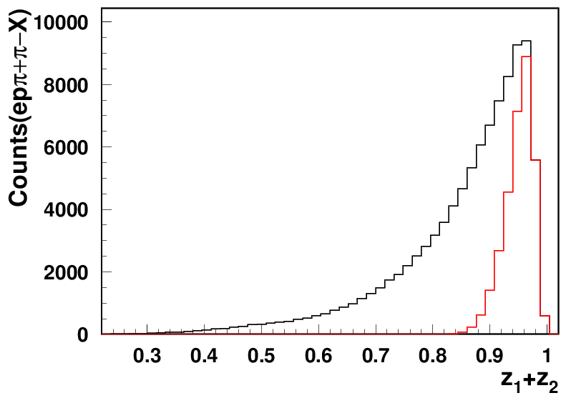
“diffractive” VMs: rapidity gap
G.Matousek (Duke) & N.Trotta (UCONN)
Beam SSA for exclusive states
ep→e’pρ⁰
ρ⁰
p
t<1
ρ⁰_{T}
t<0.5
Significant rapidity gap between protons (backward) and rho (forward)
ρ⁰_{L}
all exclusive ρ
longitudinal ρ
ρ⁰_{L} and ρ⁰_{T} →2 different particles!!!
Identify kinematics of “diffractive” ρ⁰ by comparison with ρ⁺

Slide 11





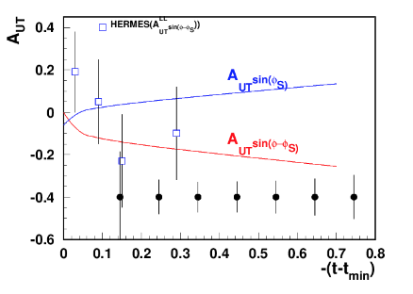
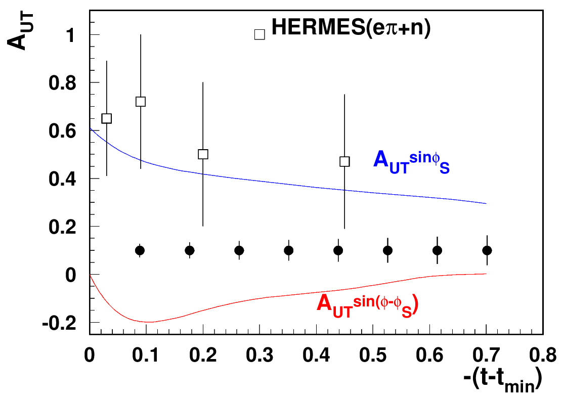
CLAS12 A_{UT}: exclusive hadrons with RGH
Significant transverse asymmetries predicted for exclusive π+
GK:ArXiv:1310.1472
exclusive (ep→e’pρ⁰)
suppressed
enhanced
RGH(100 days)
RGH(100 days)
Sivers SSA (GPD-E) or exclusive rho
predictions from Goloskokov&Kroll
GK:ArXiv:0906.0460
Exclusive processes help in understanding of longitudinal photon contributions
CLAS12, best positioned for measurements of exclusive processes, requiring combination of high statistics, good resolution and multiple observables

Slide 12
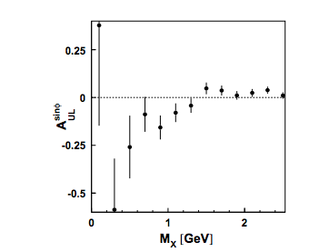
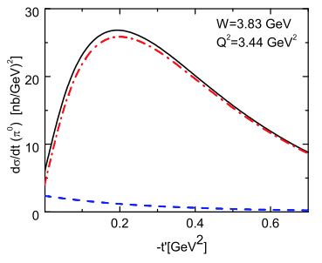

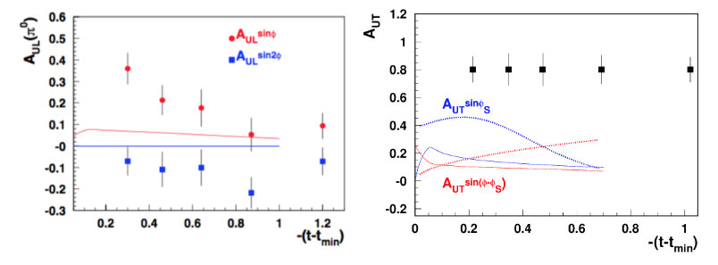
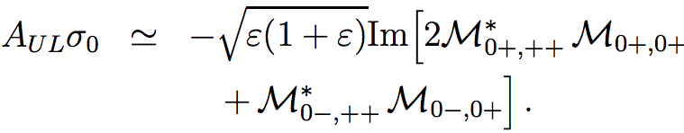
CLAS12 A_{UT}:exclusive π⁰
GK:ArXiv:1106.4897
HERMES
Significant transverse asymmetries predicted for exclusive π0
longitudinal
exclusive π+
longitudinal
enhanced
suppressed
Sort out large E~ (needed to explain HERMES A_{UL})

Slide 13
summary
Exclusive hadron production data accumulated by CLAS12 allowing detailed studies of variety of contributions, critical for providing adequate data for QCD based phenomenology for 3D studies (TMDs and GPDs/GTMDs?)
First data from longitudinally polarized target, confirms importance of sorting out longitudinal photon contributions in general, and the impact of longitudinal ρ⁰s, in particular.
Multidimensional measurements with high resolution, critical for separation of exclusive from semi-exclusive, with separation of different dynamical contributions to certain exclusive processes, validation by measurements of Q²-dependence are critical for proper interpretation of the data
Cross contributions from different polarized SFs due to angle of virtual photon with target polarization direction makes measurements with transversely polarized targets critical for disentangling spin and flavor dependence of 3D PDFs with well-controlled systematics.
Measurements of exclusive hadron production with transversely polarized target will provide important input for GPD based phenomenology, also providing a critical input for pion SIDIS phenomenology

Slide 14
Support slides

Slide 15
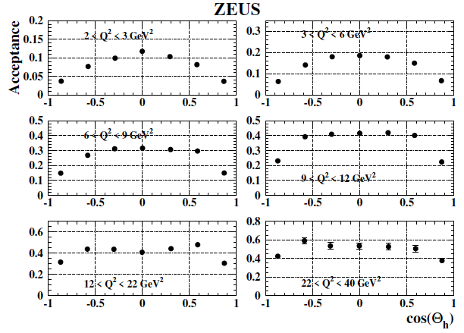
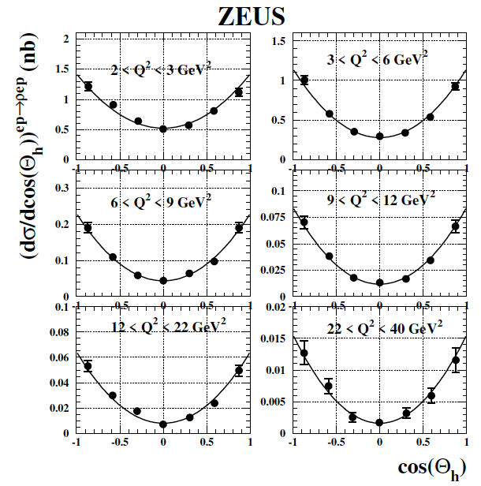
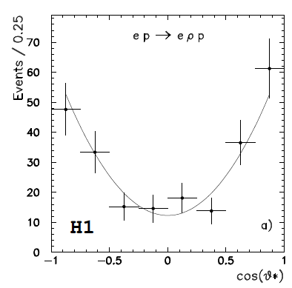
Measurements of exclusive VMs at ZEUS and H1
ZEUS rho (0708.1478)
<100K events
hep-ex/9602007
Proper acceptance account requires fine multidimensional binning, high statistics
7-bins with acceptance at |cosθ|>0.8 reducing ~2 times (integrated over t?)

Slide 16
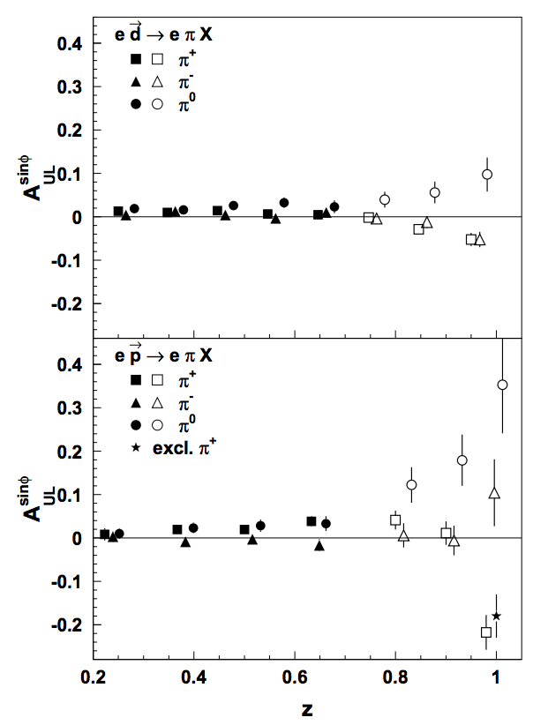
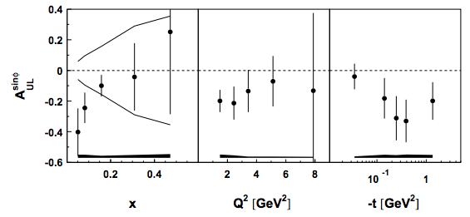
HERMES A_{UL}:”exclusive” pions
https://arxiv.org/pdf/hep-ex/0212039
https://arxiv.org/pdf/hep-ex/0112022
same sign for π+ and π- (ρ?)
SSA significant at small x, low Q² and relatively large t

Slide 17
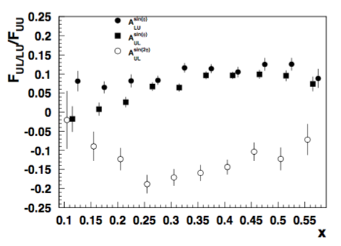

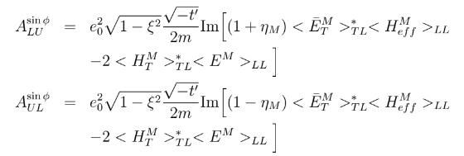
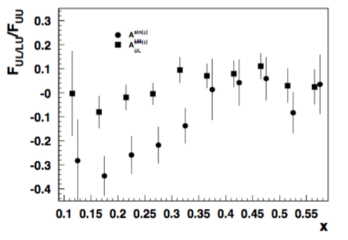
x-dependence of A_{LU} vs A_{UL}
ALU and AUL converge at large x→ large t_{min}
ep→e’π⁺n
ep→e’ρ⁰p
common term, likely dominates at large x
AUL and ALU diverge at low x, indicating additional contribution (~E_{T}-bar) being significant at low x (to be cross checked)

Slide 18
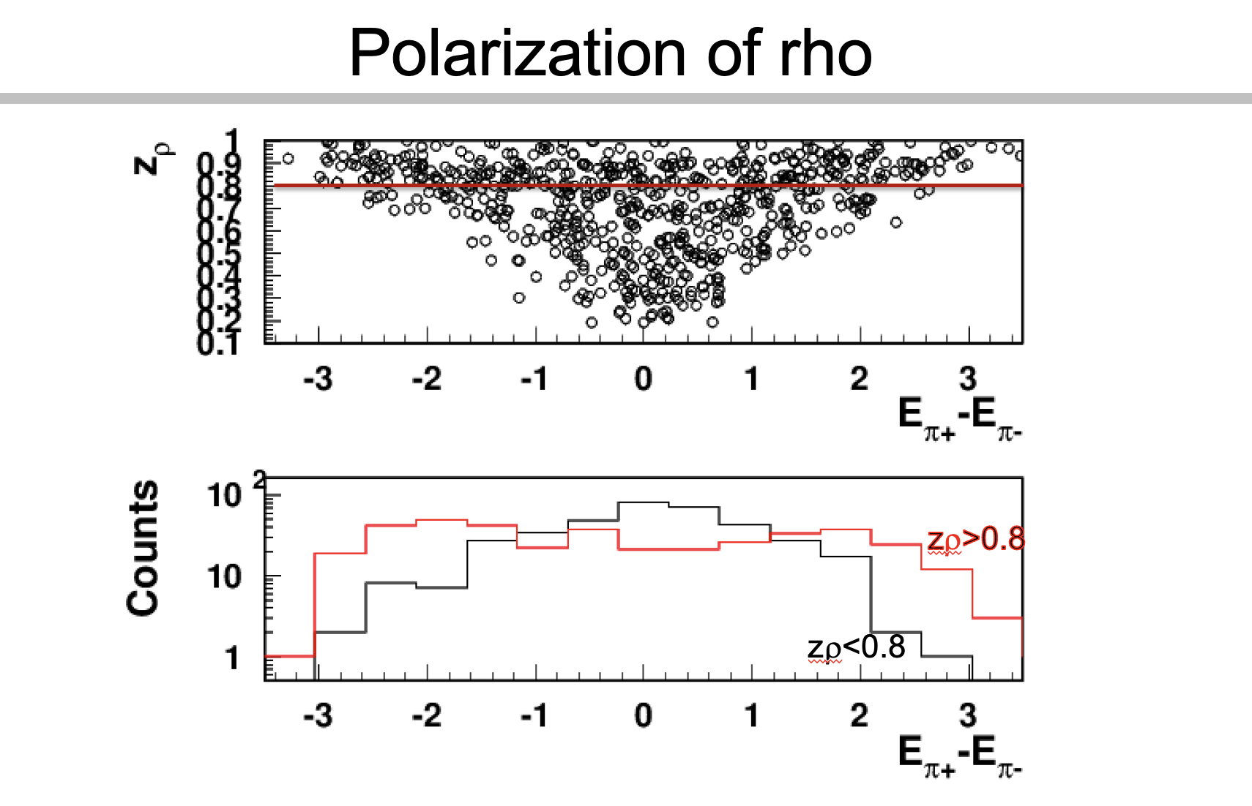
Studies of ρ⁰ impact with longitudinally polarized NH₃ target
CLAS12 Preliminary
ep->e’p’π⁺π⁻
Need clear separation of hydrogen from NH₃
and “diffractive” exclusive ρ0s from exclusive π+π−
DSA is P-even, SSA is P-odd
longitudinal photon cross section is P-odd
→ contribution appears only in the SSA, a P-odd observable, and does not appear in DSA(→significant dilution in DSA)
At large z (small t) the shapes of distributions (getting asymmetric) clearly indicate dominance of longitudinal rho

Slide 19
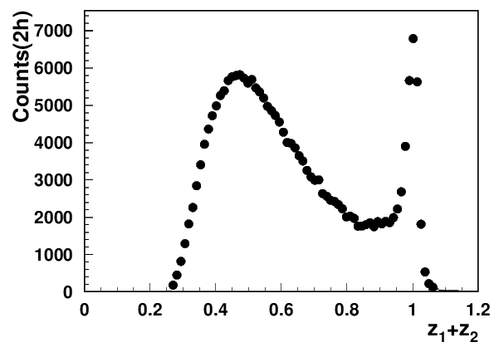
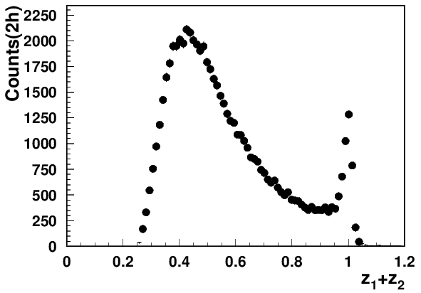
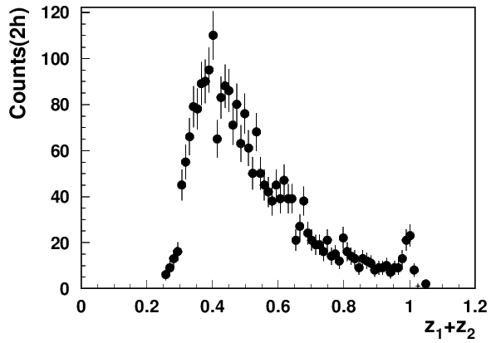
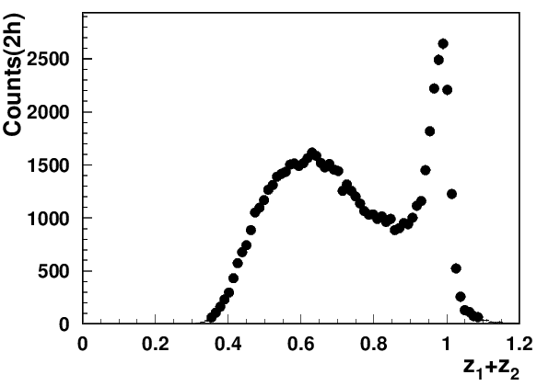
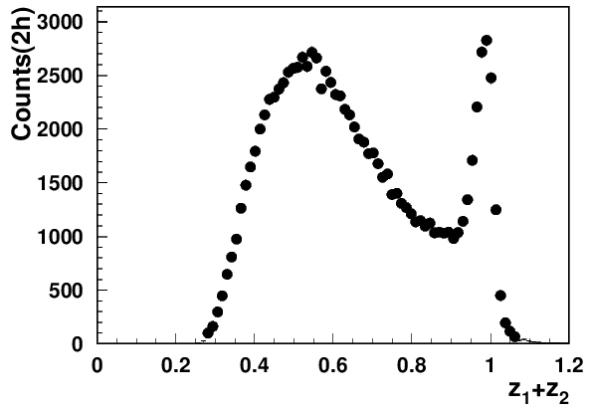
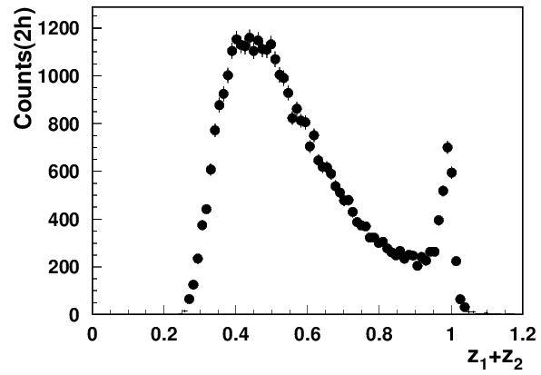





Exclusive dihadrons from CLAS12
Q²=2 GeV²
Q²=3 GeV²
Q²=4 GeV²
x=0.2
Q²=2 GeV²
Q²=3 GeV²
Q²=4 GeV²
Q²=5 GeV²
GK: arXiv:0708.3569
x=0.3
Q²=2 GeV²
Q²=3 GeV²
Q²=4 GeV²
Q²=5 GeV²
x=0.4
at lower x need higher z
The exclusive rho contributions in SIDIS (multiplicity) drop with Q² (~1/Q²)
At large z=z₁+z₂ the transverse photon contributions to ρ_{L} suppressed
Notes:
Lorenz invariant amplitudes

Slide 20


Addressing PAC/theory comments
What exactly are identified so far sources of “factorization breakdown” in SIDIS and where is the evidence that “few GeV” matters?
COMPASS 2h
CLAS12
Q²=2 GeV²
x=0.2
2) Diffractive VMs (ρ⁰)
CLAS12 measurements indicate the 2hadron exclusive sample is dominated by “diffractive rho0”produced at very small t
JLab provides possibility of detailed studies of those rhos, crucial for interpretation in terms of TMDs of SIDIS data in general, and for EIC in particular.
Estimated ~20% contributions from rho to charged pion SIDIS, consistent with ~10% of diffractive DIS in inclusive DIS
indication: most longitudinally polarized ρ⁰
note: higher the Q² lower is ε
Studies of exclusive processes require high resolution and multidimensional measurements !!!

Slide 21









“ρ-free SIDIS” free: target proton bias
ep→e’ππX
ep→e’pππX
+ x_{Fproton}<0
ep→e’pππX
+ x_{Fproton}<0
+ M_{X}(epX)>1.05 GeV
x=0.3(0.25<x<0.35)
Q²=2 GeV²
Q²=3 GeV²
Q²=4 GeV²
While the detected proton introduces slight difference in the kinematic distributions, the cut on the proton missing mass makes significant impact (clear at large z).
Notes:
Lorenz invariant amplitudes

Slide 22



DIS kinematical coverage and observables
ν=E-E’
z=E_{h}/ν
CLAS12
p┴
P_{hT} = p┴ +z k┴
EIC
x-slices to study Q²-dependence

Slide 23





A₁ x-dependence for ep→e’π⁰X vs ep→e’π+π−X
0.3<z<0.8, y<0.75
CLAS12 PRELIMINARY
CLAS12 PRELIMINARY
the line x^{0.72}(DIS)
DSA extracted for ep→e’π⁰X (filled) and ep→e’π+π−X for 0.3<z<0.8(empty circles) consistent
No contributions from exclusive ep→e’ρ⁰X
Consistent with simple fit to world data (no major Q²-dependence)

Slide 24


DSAs: comparing different processes
0.28<x<0.32, 0.3<z<0.8, y<0.75
A. Bongallino(ep→e’π+X)
ep→e’π+X
the DIS line x^{0.72}
CLAS12 PRELIMINARY
DSA for ep→e’π+X vs ep→e’π0X and ep→e’π−π+X consistent
No major Q²-dependence apart from for ep→e’π+X

Slide 25
Myths on 3D structure studies
1. Lower center of mass experiments have major problems with factorization due to all kinds of corrections (mixing CFR & TFR, power corrections, target mass corrections,…..)
2. Exclusive processes can be studied at higher energies, which lack proper resolutions needed for separation for different dynamical contributions, statistics for multidimensional measurements,…
→L/T separation can be performed at higher energies using exclusive VMs
3. 3D structure can be studied without involving polarization degrees of freedom
4. Non perturbative QCD effects in valence region can be studied at very large Q² or very high P_{T}, where the multidimensional measurements are practically impossible
3D structure can be studied in 1D measurements
6. Medium modifications could be understood without understanding the dynamical contributions with proton and neutron (deuteron/He3) targets
Notes:
What are some common misconceptions in the field of 3D hadron structure?

Slide 26

Theory-Experiment-Phenomenology
theory
…........
Fragmentation Function
→ probability to produce π+
…........
most significant
increases at higher energies
γ*_{L} and γ*_{T} → different dynamics
Notes:
lN\rightarrow l^\prime \omegaX

Slide 27



Single pion Double Spin Asymmetries
A.Bungallino (theory band for pi0)
1810.07054
NH3: ep→e’πX
HERMES(p)
π+
π0
π-
CLAS12 PRELIMINARY
z
Double spin asymmetries for ep→eπ+X seem to decrease at large z and effect more significant at low x
The ep→eπ+X drops faster at low x than ep→eπ⁰X (consistent with DIS fit)
Note: →exclusive rho contributions more significant at large z and low x

Slide 28



Myth#1: Separating target fragmentation at JLab
3) Separating Target Fragmentation Region TFR from Current fragmentation region (CFR)
F. Benmokhtar & Duquesne U.
“ρ-free” SIDIS
ep→e’pX
Major difference only for protons at small t!
With beams in polarized SIDIS typically always polarized, beam SSA can serve as a tool to separate
kinematical regions (CFR/TFR)
dynamical contributions
cut on M_{X} eliminate exclusive VMs
Negative sign of the SSA (plateau) defines the TFR dominance

Slide 29

impact of rho : multiplicities in SIDIS
G.Matousek (Duke) & N.Trotta (UCONN)
0.18<x<0.22
0.5<z0.7
Q²=2 GeV²
total eπ+X
Estimated ~20% contributions from rho, mainly show up at low P_{T} in SIDIS
The “diffractive” rho will bias extractions of TMDs, unless properly subtracted in multidimensional space of SIDIS measurements.
Notes:
Lorenz invariant amplitudes

Slide 30






L/T separation in exclusive rho production at high energies
COMPASS: 2210.16932
more precisely
assuming →
SCHC
To evaluate need measurements of sinΦ and cosΦ moments, both very significant . The beam SSA sinΦ modulation inaccessible already at COMPASS/HERMES (suppressed as 1-ε)
The measurement of r₀₀⁸ require measurement of beam SSA ~

Slide 31




CLAS12 RGC experiment with longitudinally polarized target
CLAS12
Electroproduction on longitudinally polarized NH3 and ND3
NH3
C
E12-06-109, E12-06-119, E12-07-107, E12-09-009
Subtracting carbon data from NH3 (nice neutron peak)
Dynamic Nuclear Polarization (DNP)
Notes:
5 mm Radial Clearance inside the SVT
The actual time for swapping the Target Cell is ~15 min
The Target Cell is comprised of a 50 mm long perforated PCTFE (polytetrefluoroethylene) cylinder with a wall thickness of 0.5 mm and sealed with 20 μm thick Al foil beam windows upstream and downstream. These cells are made in two diameters, 15 and 20 mm. The cell is supported in the bath my an Al frame with a removable foil window upstream and fixed foil down stream.
NH₃, ND₃, CH₂, CD₂, C, Empty and Optical Targets

Slide 32

Reports

