Slide 1
Revealing the Transition Region of QCD with the Proton’s g₂ Structure Function
-
C12-24-002
Jefferson Lab PAC 53
7/24/2025
David Ruth, Jian-Ping Chen, Nathaly Santiesteban, Karl Slifer

Slide 2
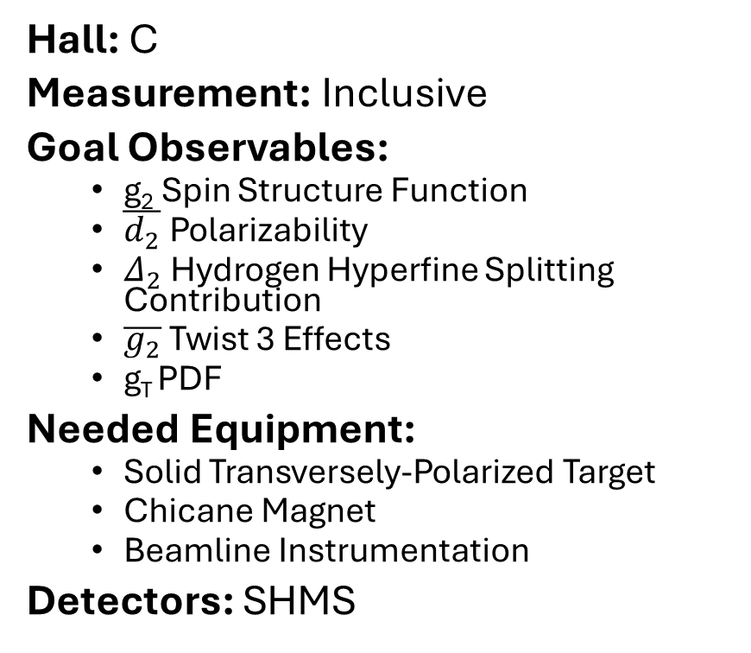
Experiment Overview
Hall: C
Measurement: Inclusive
Goal Observables:
  g₂ Spin Structure Function
  $\overline{d_{2}}$ Polarizability
  $Δ_{2}$ Hydrogen Hyperfine Splitting Contribution
  $\overline{g_{2}}$ Twist 3 Effects
  g_{T} PDF
Needed Equipment:
  Solid Transversely-Polarized Target
  Chicane Magnet
  Beamline Instrumentation
Detectors: SHMS
Beam Current: 85 nA
Beam Energies: 4.4 GeV, 8.8 GeV
Target Material: NH₃ (Ammonia)
Q² Range: 0.22 – 2.2 GeV²
W Range: 1078 – 2400 MeV
Requested Days: 26
Current Status: C2 (Conditional Approval)
PAC52 Report Conditions:
  “The impact of this new setup on the detector resolution and its subsequent effect on the physics results has not been thoroughly addressed. A full Monte Carlo simulation of the new setup and detector is needed.” (✅ Complete)

Slide 3
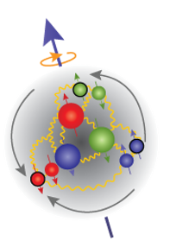
QCD

Slide 4
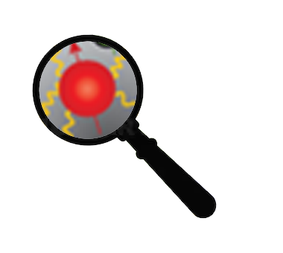
QCD
Low
Q²
High
Partons Combine to Form Nucleon
Confinement
Effective Theories: χPT
Can’t use Twist Approx.
Individual Partons
Asymptotic Freedom
Perturbative QCD
Leading Twist

Slide 5
QCD
?
Low
Q²
High
Partons Combine to Form Nucleon
Confinement
Effective Theories: χPT
Can’t use Twist Approx.
Quark/Gluon Correlations
Lattice QCD
Higher Twists
Individual Partons
Asymptotic Freedom
Perturbative QCD
Leading Twist

Slide 6

How to study QCD and higher twist in the transition region?
In unpolarized systems, F₁ / F₂ structure functions describe quark-gluon distribution:
In a spin-½ polarized system, g₁/g₂ describe the spin distribution :
Nucleon Spin Structure
Quark-Gluon Correlations

Slide 7
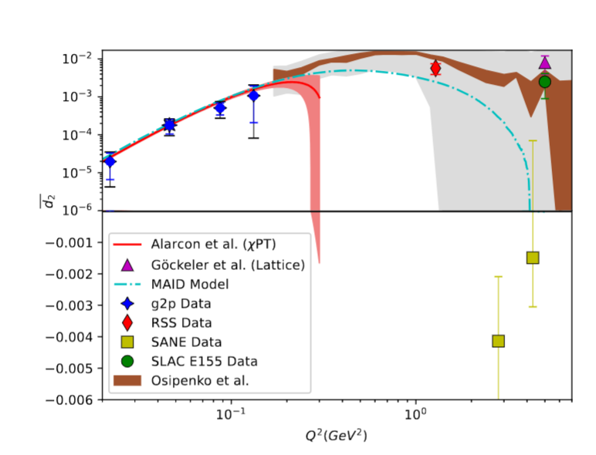
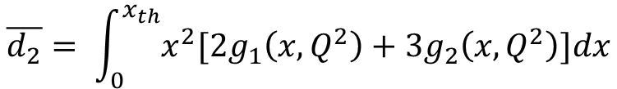
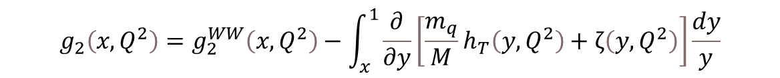
g₂ Structure Function enables direct tests of QCD and higher twist
Higher Twist:
Benchmarking (Lattice) QCD:
Small
B-Field
$$g_{2}\left(x,Q^{2}\right)=g_{2}^{WW}\left(x,Q^{2}\right)−\int_{x}^{1}{\frac{∂}{∂y}\left[\frac{m_{q}}{M}h_{T}\left(y,Q^{2}\right)+ζ\left(y,Q^{2}\right)\right]\frac{dy}{y}}$$
Proton
Proton
Twist-3
Function of g₁
Weighted integrals (moments) of the spin structure functions can be directly calculated by effective theories:
Polarizabilities describe nucleon’s ensemble response to an external field
$$\overline{d_{2}}= \int_{0}^{x_{th}}{x^{2}[{2g}_{1}\left(x,Q^{2}\right)+{3g}_{2}\left(x,Q^{2}\right)]dx}$$

Slide 8
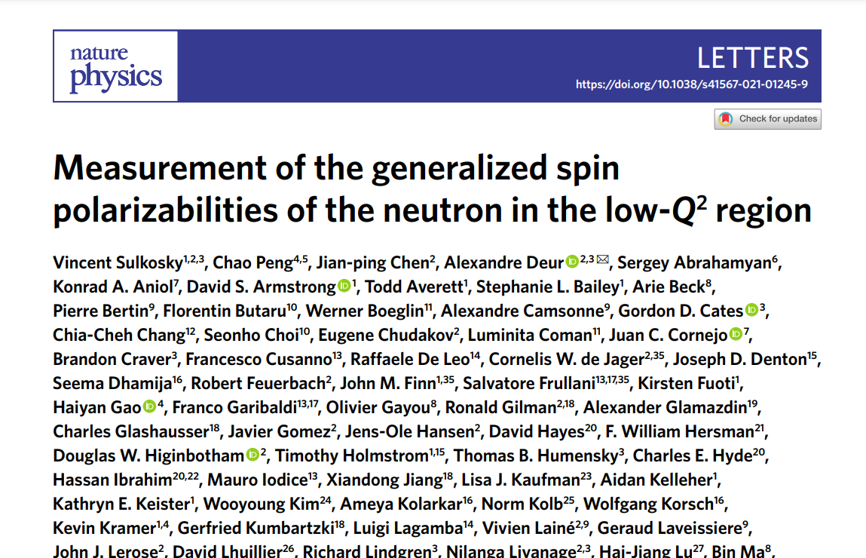
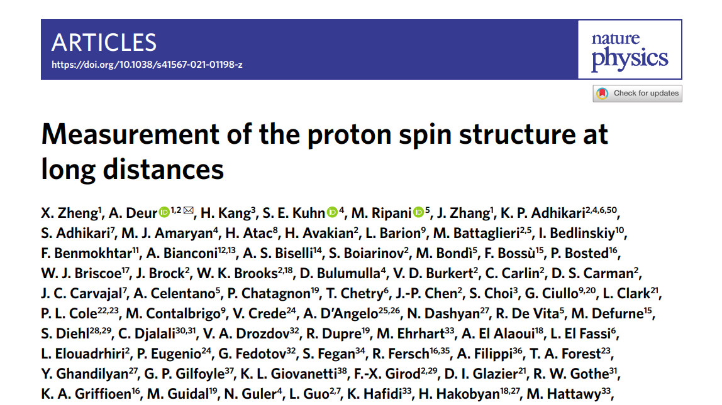
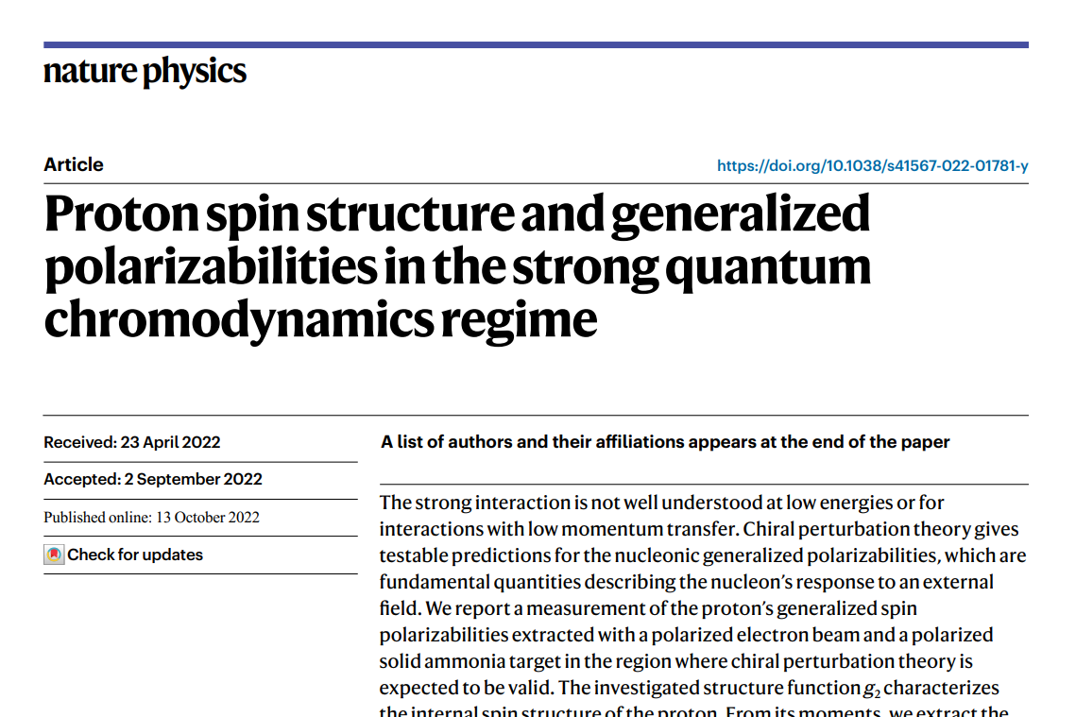
Recent Successful JLab Program
Highly successful program to measure SSF
Three different experiments published recent SSF results in Nature Physics
2007 JLab Review: DOE Milestone to “measure g₁ and g₂ over an enlarged range of x and Q²”

Slide 9
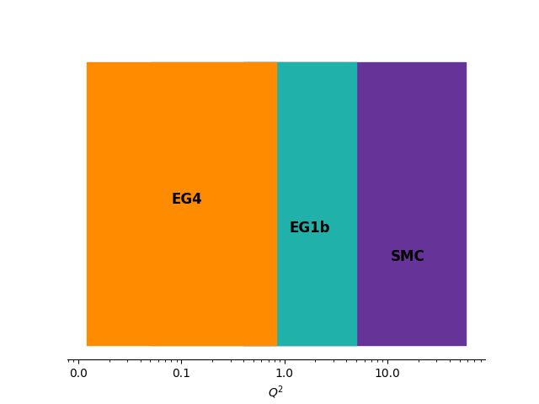
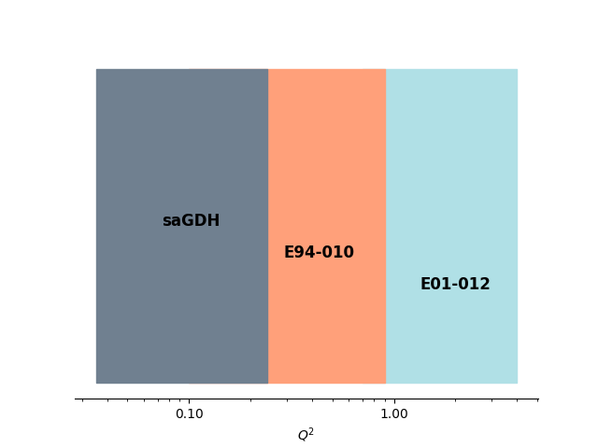
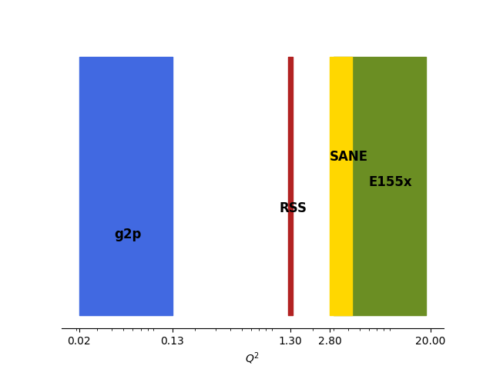
Proton
Neutron
g₁
g₂

Slide 10
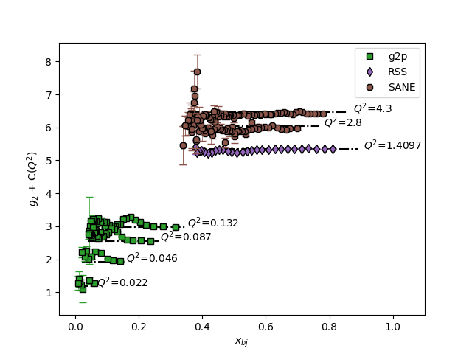
Transition Region g₂ has Strong scientific motivation:
Needed as a Benchmark for Lattice QCD
Unique Sensitivity to Twist-3 Effects
Builds on 3 previous Hall A/C Successful measurements with near identical setup, plus:
Much higher rates than the higher Q² experiments
Smaller out-of-plane angle than the low Q² data
g₂
This
Proposal

Slide 11
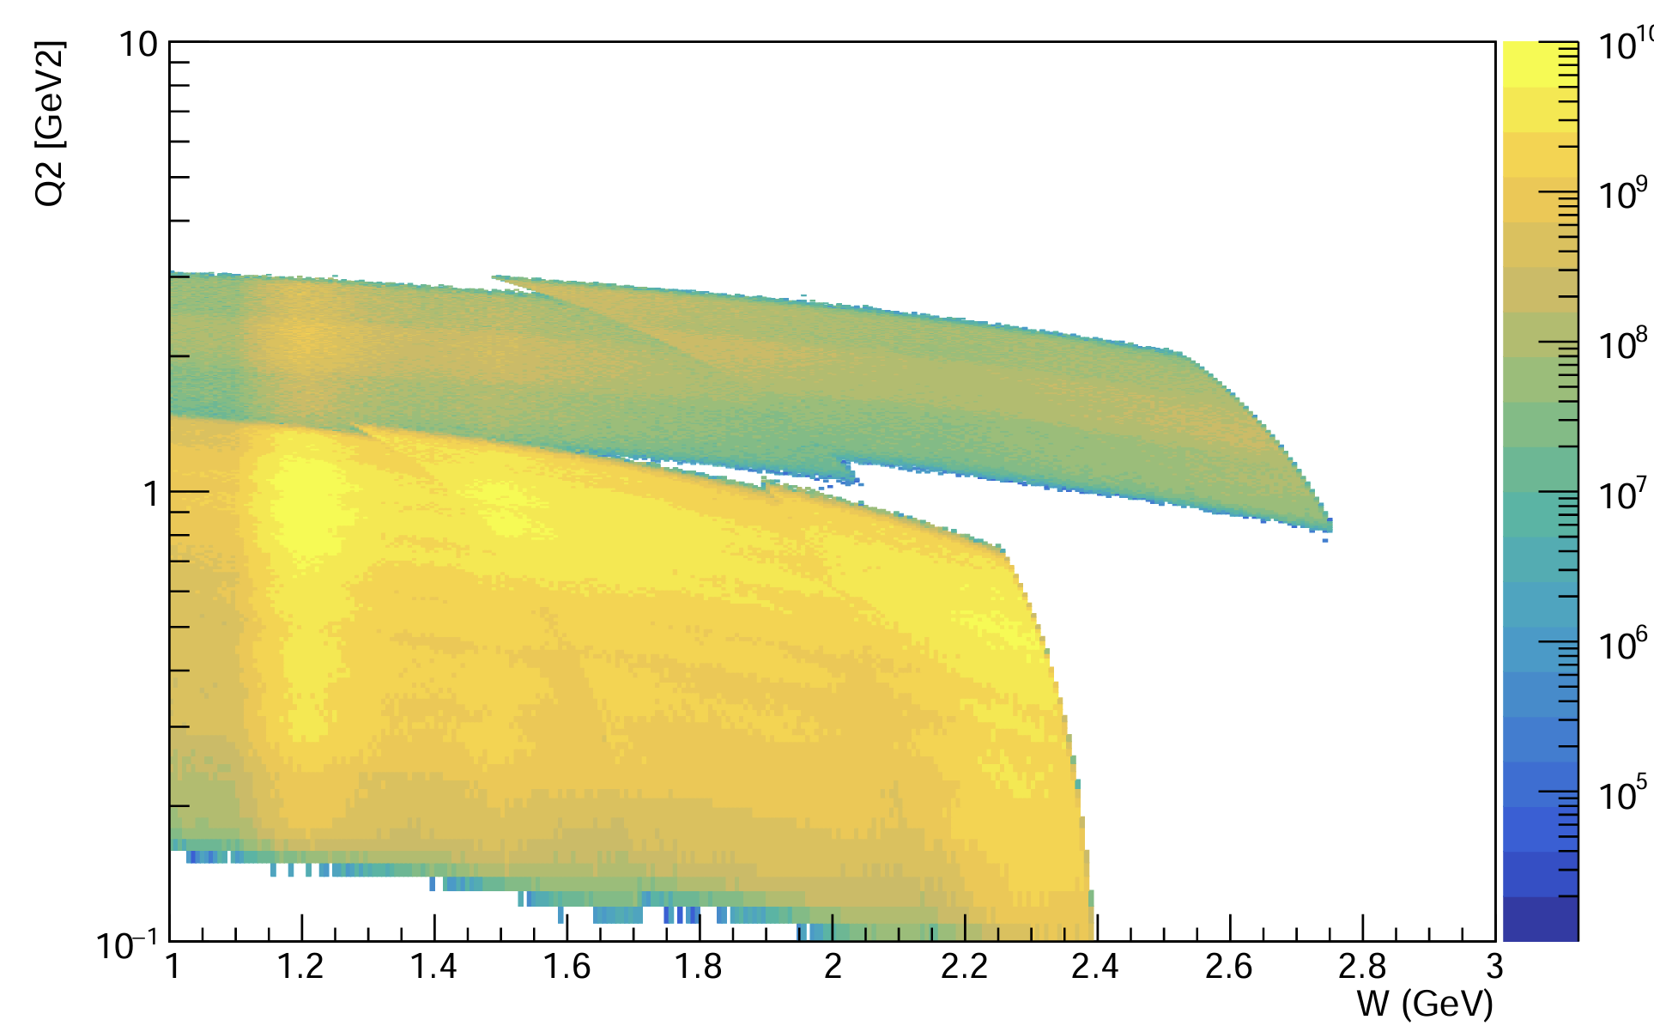
Proposed Experiment
How:
Hall C
Transversely Polarized NH₃ Target
SHMS Detector
Polarized Beam:
  85 nA Current
  4.4 + 8.8 GeV Beam Energies
8.8 GeV Beam
4.4 GeV Beam
Let’s measure proton g₂ in the resonance region across the missing part of the transition regime
Full order of magnitude in Q² : 0.2 GeV² - 2.2 GeV²
First ever transition region measurement of the proton’s g₂ structure function -- extract moments and higher twist effects

Slide 12
Experimental Setup
SHMS
Moller
Polarimeter
Fast Raster
Slow
Raster
Slow
Raster
Chicane
1
Chicane
2
BPMs/Harps
5T Transverse
Target
BCMs
Dump
Standard equipment package, plus:
5T polarized target
Chicane Magnet
Low current beamline configuration
Slow Raster
Nearly identical to the successful setup for previous Hall A/C experiments RSS, EG4, g2p

Slide 13
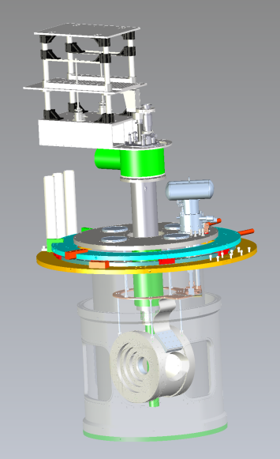
Polarized Target
NH₃ (Ammonia) target
Transversely Polarized with Dynamic Nuclear Polarization (DNP)
Since previous experiments:
  New Target Group magnet more optimized for transverse running!
  Needs installation w/ UVA PT fridge & scattering chamber
  Collaboration will send students & work together with Target Group on this project

Slide 14
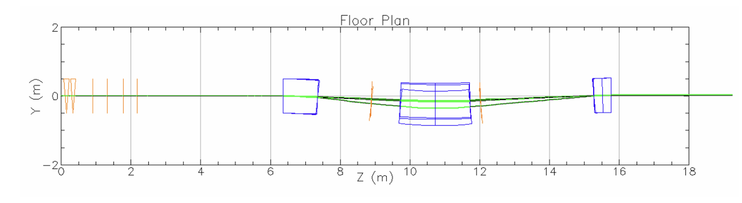
Chicane Magnet
See R. Bodenstein, JLAB-TN-25-023
Transverse target field needs pre-bending of the beam
Chicane design (J. Benesch) replaces two existing 1m dipoles
Further BMAD optimization performed by R. Bodenstein
Chicane is needed for SoLID + any experiment with transverse PT
Allows beam to cleanly reach hall dump – no local dump needed!

Slide 15
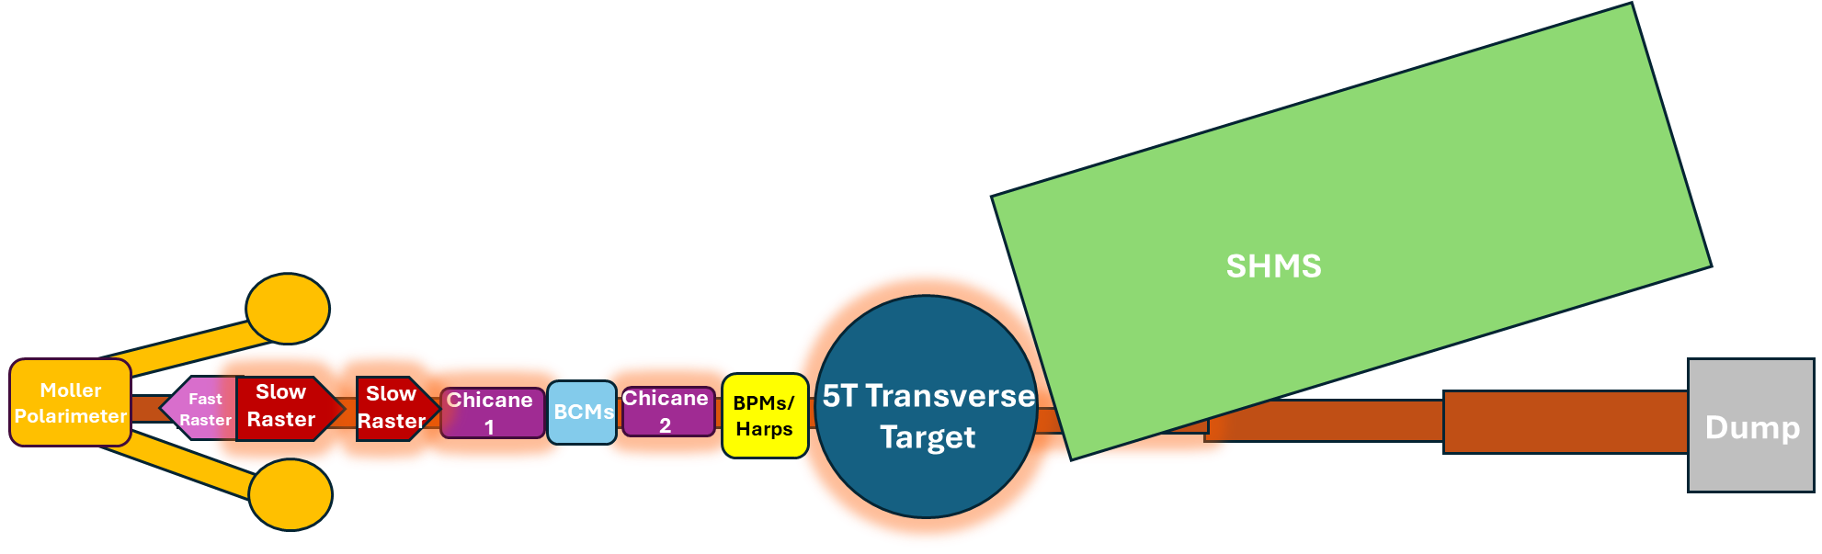
Simulation Study
✅
✅
✅
✅
Monte-Carlo simulation performed with all effects included & accounted for:
  Raster
  Chicane
  Target Field
  Spectrometer Optics
  Multiple Scattering
  Radiative Effects
  Ionization Energy Loss
  Particle Decay
Chicane optimization: BMAD and Optim
Standard Hall C analysis cuts
Systematic impact on observable now included
z
All following plots are for the worst case kinematic setting at the lowest Q².
Target field/chicane effects are smaller for all other settings.
Thanks to Jefferson Lab Staff Scientists
Dave Gaskell, Jay Benesch, and Ryan Bodenstein for their help!

Slide 16
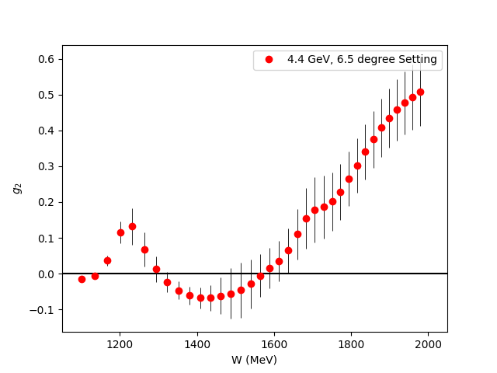
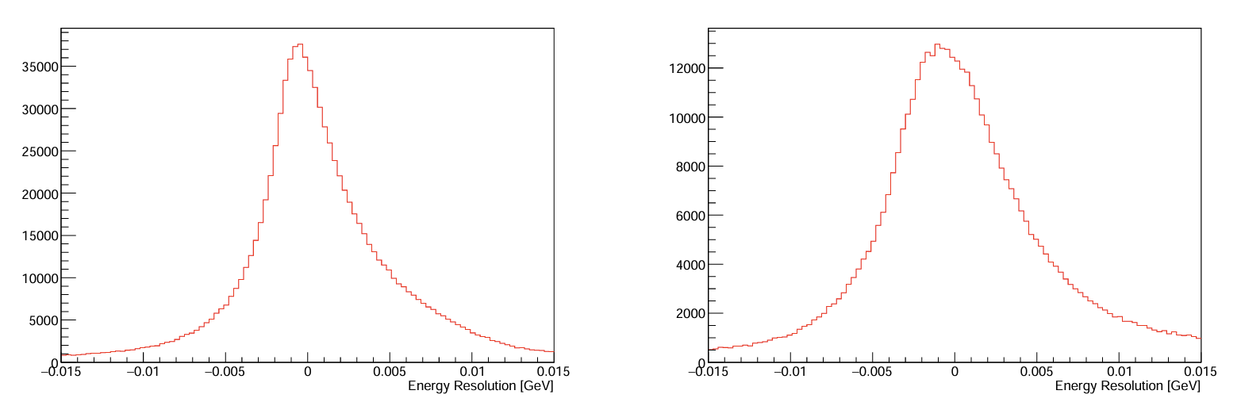
Resolutions
Without Target Field/Chicane
With Target Field/Chicane
Planned Bin Size: > 30 MeV
Resolution w/ Target: 10-20 MeV
There should be no issue resolving the resonances of g₂p

Slide 17
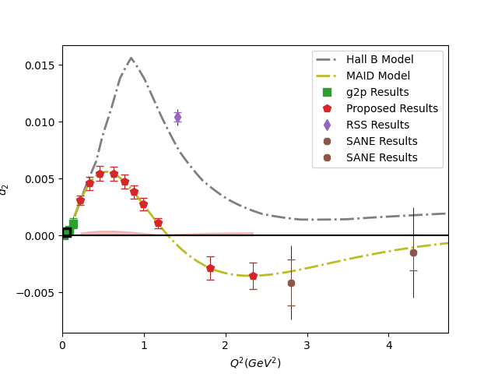
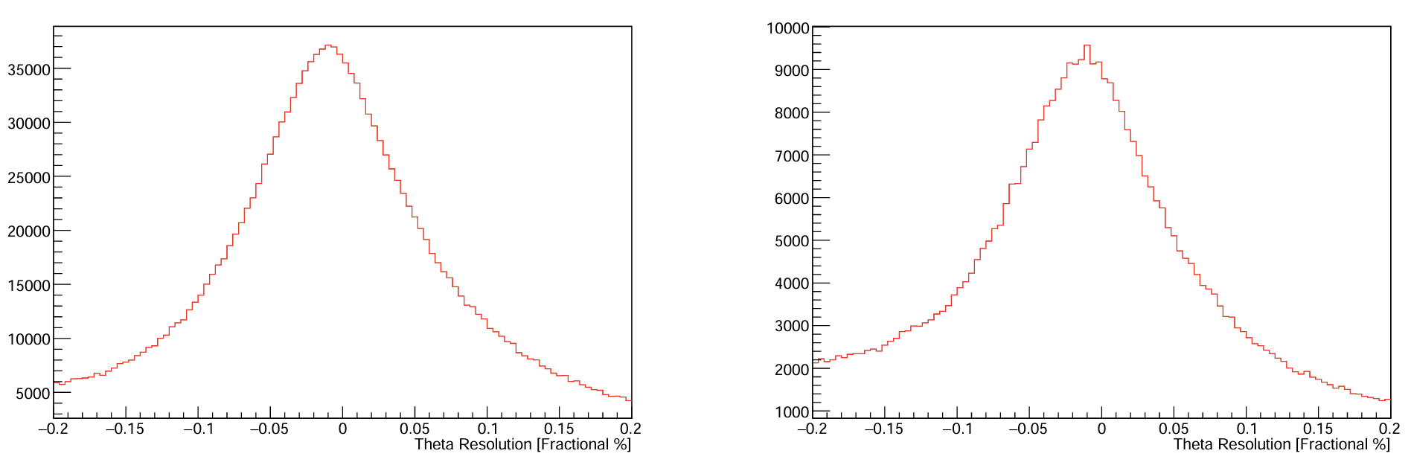
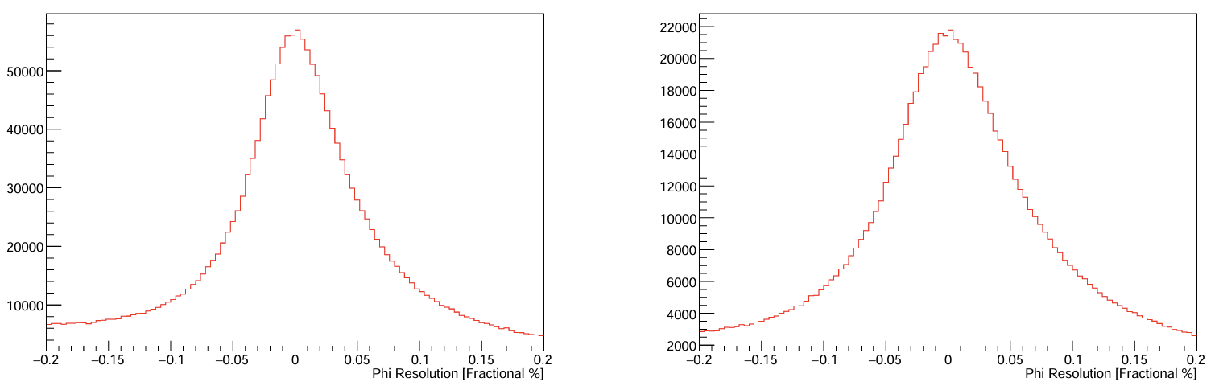




Resolutions
$$θ$$
$$θ$$
$$φ$$
$$φ$$
Without Target Field/Chicane
With Target Field/Chicane
Planned Scattering Angle Bin Size: ~1.0 - 2.5º
Resolution w/ Target: ~0.96º
There should be no issue resolving the features of the moments

Slide 18
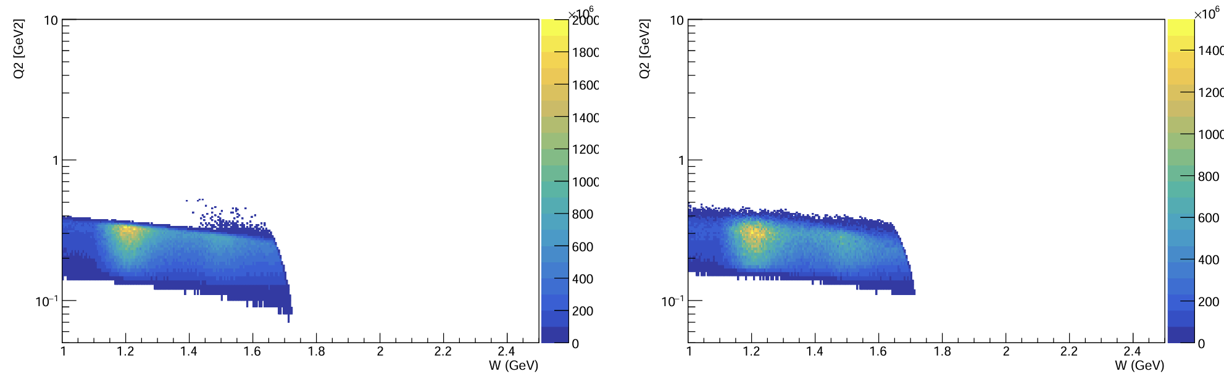
Impact on Coverage
Without Target Field/Chicane
With Target Field/Chicane
Effects on the kinematic coverage are small and well-understood

Slide 19
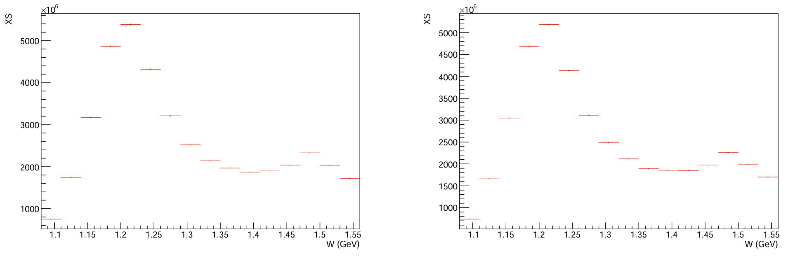
Systematic Impact
Truth
Reconstructed
Around a 2% or less effect from the resolution on the XS
Included in new systematics calculation

Slide 20
Simulation Conclusions
PAC52 Conditional: “The impact of this new setup on the detector resolution and its subsequent effect on the physics results has not been thoroughly addressed. A full Monte Carlo simulation of the new setup and detector is needed.”
(✅ Complete)
Resolutions enlarged by the target field =
2% syst. uncertainty contribution
We have fulfilled PAC52’s condition and the impact of the target and chicane is now well understood and accounted for

Slide 21
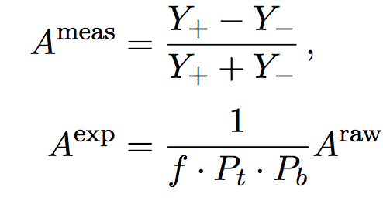
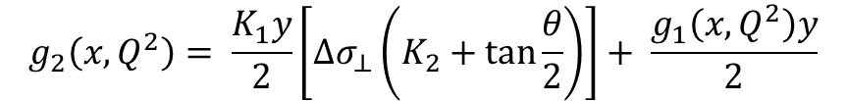


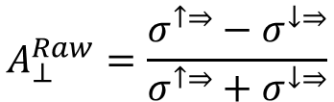
g₂ Extraction Method
Measure Asymmetry and Cross Section:
Form Polarized XS Difference:
Extract g₂
$$A_{⊥}^{Raw}=\frac{σ^{↑⇒}−σ^{↓⇒}}{σ^{↑⇒}+σ^{↓⇒}}$$
$$\frac{d2σ}{dΩdE′}=\frac{(ps)N}{N_{in}ρ(LT)ε_{det}}\frac{f}{ΔΩΔE′ΔZ}$$
Spin-Dependent Effects
Unpolarized
Scattering
$${∆σ}_{⊥} =2A_{⊥}^{exp}σ_{0}$$
Input from
Hall B Data
$$g_{2}\left(x,Q^{2}\right)= \frac{K_{1}y}{2}\left[Δσ_{⊥}\left(K_{2}+\tan{\frac{θ}{2}}\right)\right]+ \frac{g_{1}\left(x,Q^{2}\right)y}{2}$$

Slide 22
Beam Time Required
Source | Time (PAC Days)
Q² = 0.22 GeV² | 0.1
Q² = 0.33 GeV² | 0.2
Q² = 0.46 GeV² | 0.3
Q² = 0.62 GeV² | 0.8
Q² = 0.77 GeV² | 1.1
Q² = 0.89 GeV² | 1.8
Q² = 1.03 GeV² | 2.3
Q² = 1.25 GeV² | 4.6
Q² = 1.84 GeV² | 0.9
Q² = 2.2 GeV² | 0.9
Total Physics Days | 13
Overhead Days | 13
Only
26 Days
To measure 10 Q² settings of g₂ with high precision…
covering a full order of magnitude of the transition region!

Slide 23
Projected Systematics
Source | %
Acceptance | 4-6
Packing Fraction | 3
Charge Determination | 1
Tracking Efficiency | 1
PID Efficiencies | < 1
Software Cut Efficiency | < 1
Resolution/Simulation | < 2
Energy | 0.5
Deadtime | < 1
XS Total | 5-7
Target Polarization | 5
Beam Polarization | 3
Radiative Corrections | 3
Parallel Contribution | 2
Const Q² Adjustment | < 1
S.F. Total | 8.5-9.8
Dominating systematics are target polarization and acceptance

Slide 24
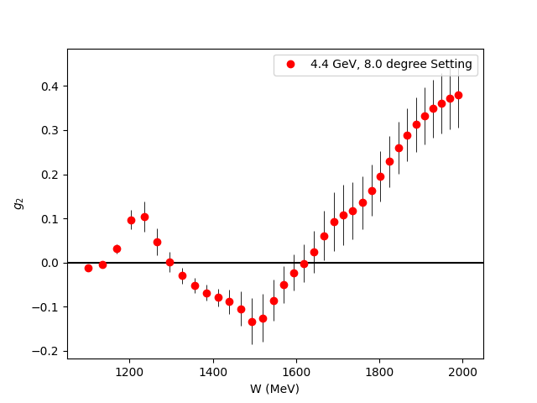
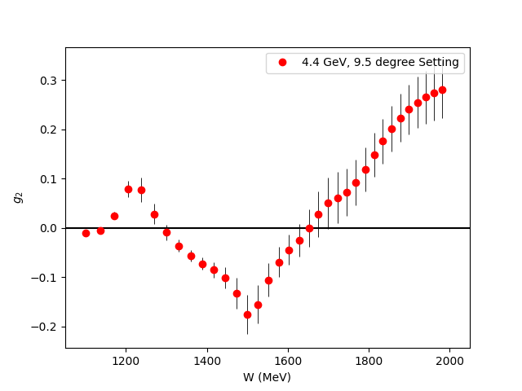
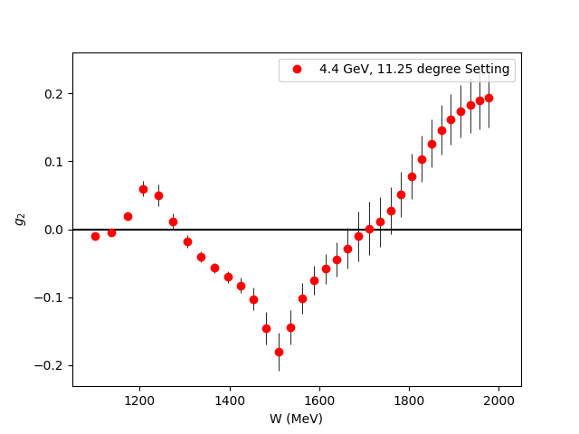
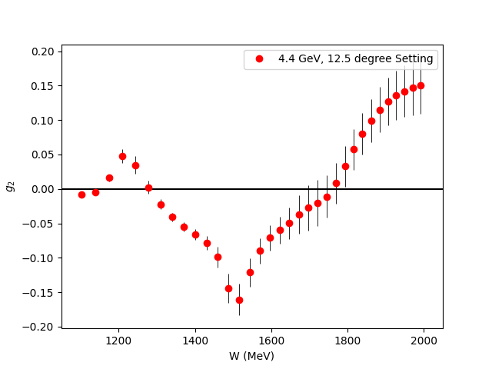
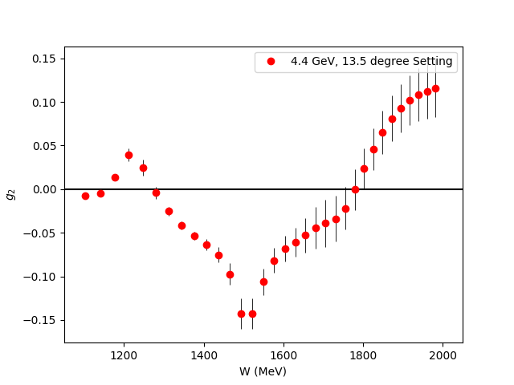
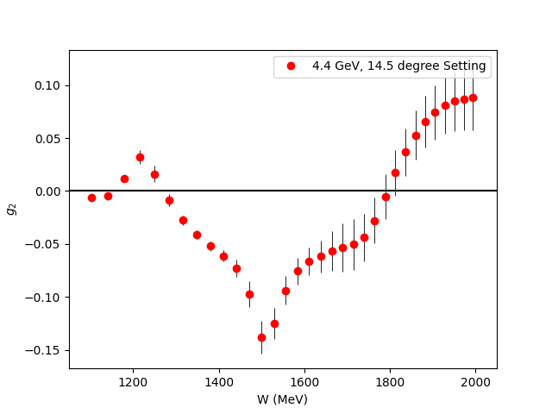
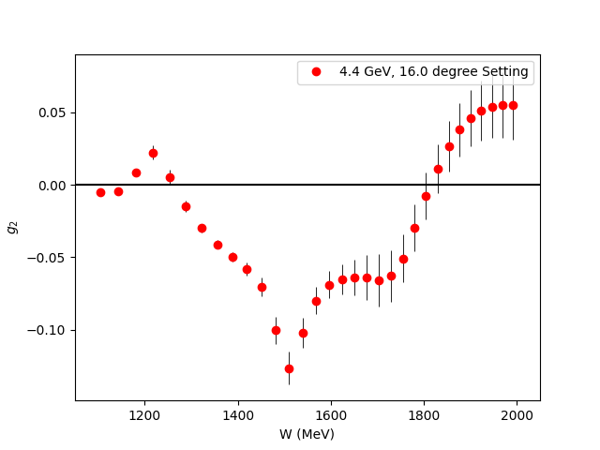
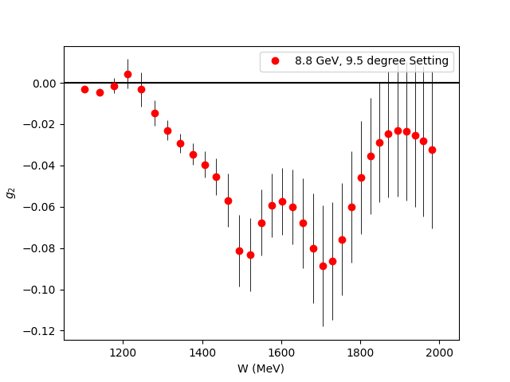
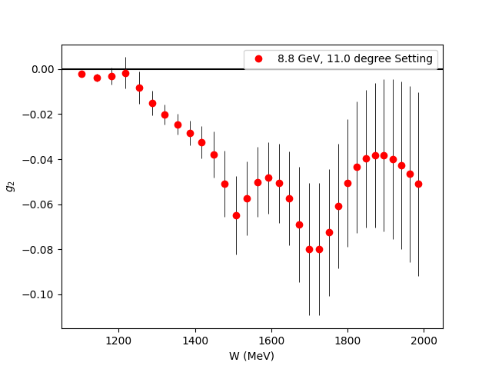
Projected g₂ Uncertainties
Fills the last major Q² spectrum gap for the nucleon spin structure functions
Covers almost the entire transition region

Slide 25
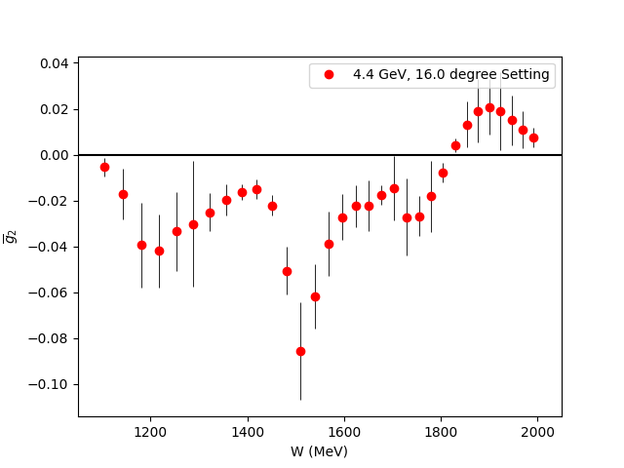


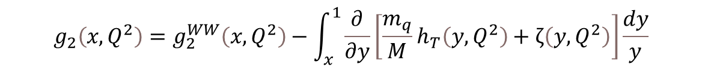
$\overline{g_{2}}$ (Twist 3 Extraction)
Small
$$g_{2}\left(x,Q^{2}\right)=g_{2}^{WW}\left(x,Q^{2}\right)−\int_{x}^{1}{\frac{∂}{∂y}\left[\frac{m_{q}}{M}h_{T}\left(y,Q^{2}\right)+ζ\left(y,Q^{2}\right)\right]\frac{dy}{y}}$$
$\overline{g_{2}}$ (Twist-3)
Utilize CLAS Hall B Results
for g₁ in same regime
Direct extraction of Twist 3 effects
in the regime they contribute most significantly
First ever extraction of this quantity for the proton!

Slide 26

Projected $\overline{d_{2}}$ Uncertainties
Can benchmark Lattice QCD in the regime where Perturbative QCD starts failing
New Lattice calculations expected in next few years!

Slide 27
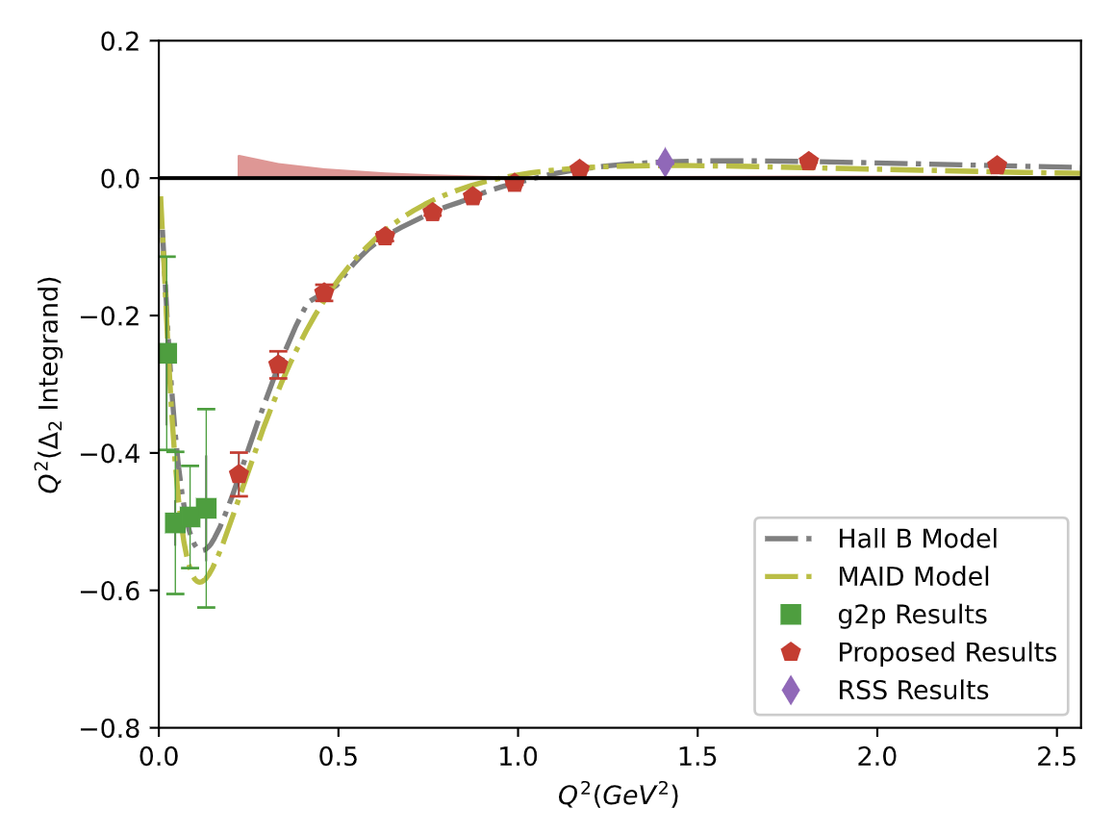
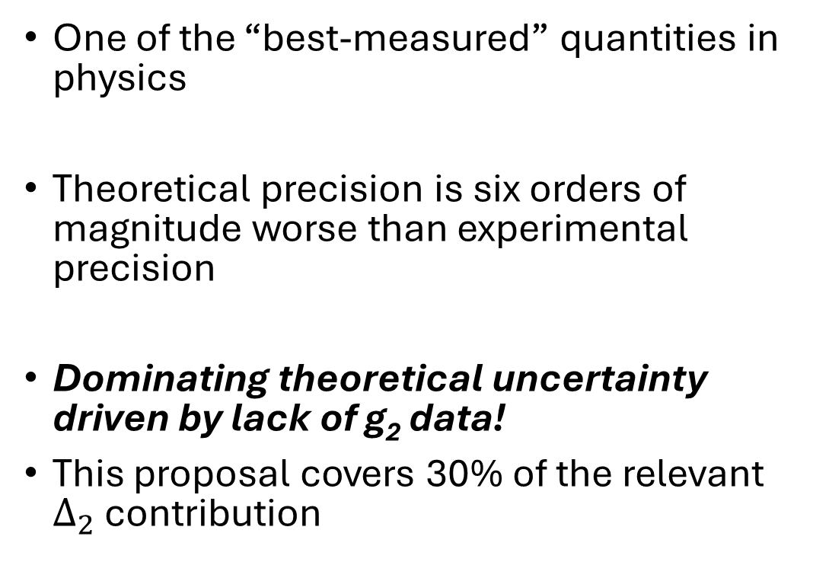
Hydrogen Hyperfine Splitting Impact
One of the “best-measured” quantities in physics
Theoretical precision is six orders of magnitude worse than experimental precision
Dominating theoretical uncertainty driven by lack of g₂ data!
This proposal covers 30% of the relevant $Δ_{2}$ contribution

Slide 28
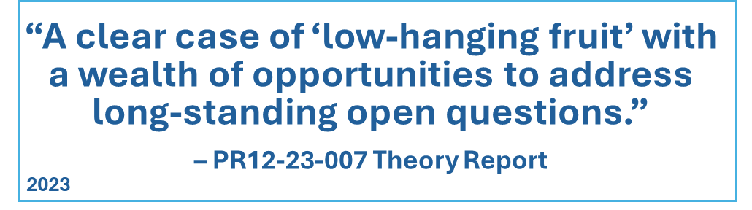
What do the theorists have to say…?

Slide 29
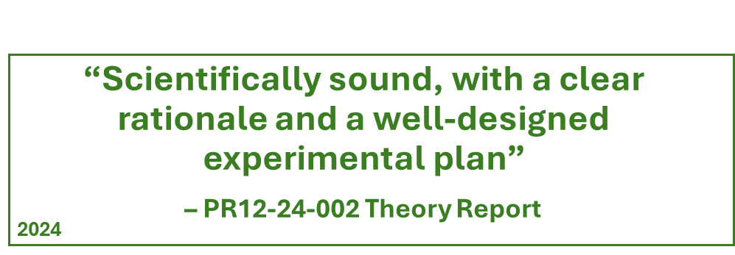
What do the theorists have to say…?

Slide 30
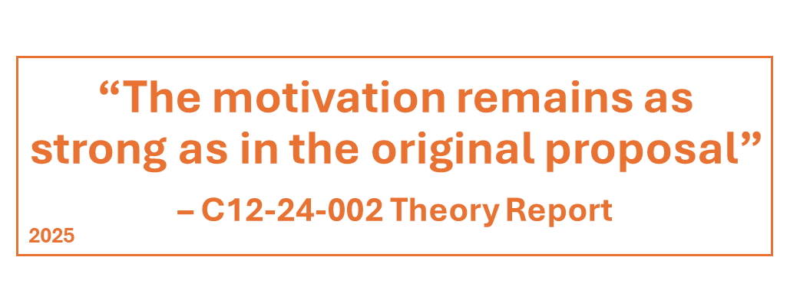
What do the theorists have to say…?

Slide 31
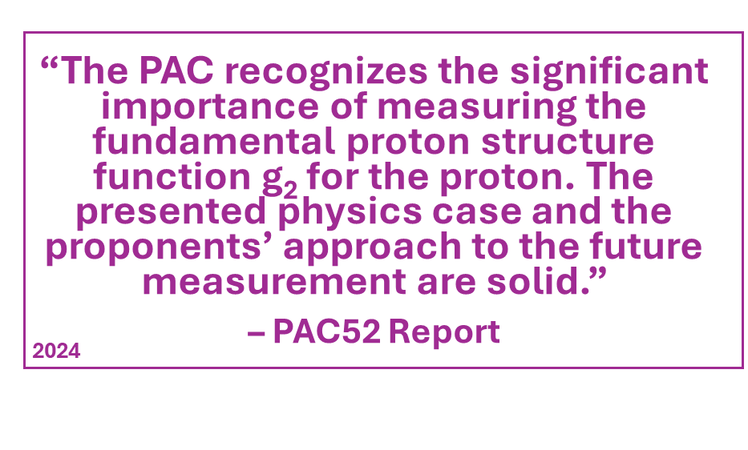
PAC Status

Slide 32
PAC Status
Conditional Requirements:
“The impact of this new setup on the detector resolution and its subsequent effect on the physics results has not been thoroughly addressed. A full Monte Carlo simulation of the new setup and detector is needed.”
– PAC52 Report

Slide 33
PAC Report / Conditional Status
Conditional Requirements:
✅
“In our view, this requirement has been fulfilled in great detail. The effects of the chicane and the transverse target field on the resolution of the SHMS and the experimental observables are fully understood and quantified. ”
-PAC53 Readers
(Prof. Alexandra Gade & Prof. Bernhard Ketzer)
“The impact of this new setup on the detector resolution and its subsequent effect on the physics results has not been thoroughly addressed. A full Monte Carlo simulation of the new setup and detector is needed.”
– PAC52 Report

Slide 34
Summary
All of PAC52 Conditional Requirements fulfilled ✅
Target field impact extensively quantified with simulation ✅
Significant and novel physics goals:
  Study higher twist (interaction-dependent effects)
  Test Lattice QCD
  Study hydrogen hyperfine splitting
  Extract other polarizabilities and moments
Collaboration is ready to get to work on helping to prepare the equipment✅
Let’s make it happen!

Slide 35
Backup Slides

Slide 36
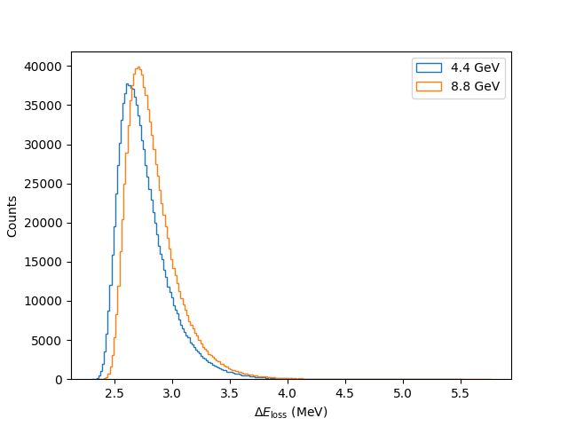
TAC/Reader Questions Summary
Is the downstream beampipe interaction due to low energy tails/multiple scattering a concern?
  No, we calculated this interaction to be small and the detector is shielded against these backgrounds
Is a local beam dump an option?
  We investigated this option in the proposal’s first iteration and it is a worse option due to open questions about small detector angles and heat load from the high energy beam.
How long to check the low current BCM linearity?
  Dr. Mack (BCM Expert) will help us check and obtain a <1% nonlinearity with a few days of work and an RF signal generator.
Is the wrong luminosity included in the rates calculation and will you exceed the DAQ rate limit?
  No, there was just an unclear sentence in the proposal. The correct rate was used and we will not exceed the DAQ limit.
Ionization

Slide 37
TAC/Reader Questions Summary
Can the polarized target be commissioned in time?
  Yes, there is a significant amount of work to be done by the Target Group, but they have no doubts it can be done in time and the collaboration will help however we can.
Overhead for a T.E. should be 4 hours, not 2.25
  Fixed, does not increase PAC days request
What do the planned statistics mean in the context of model uncertainties?
  The primary goal of the statistics is to check theory directly, but the data will also hugely improve the phenomenological models, which are almost unconstrained in this region.
Are some events lost in the simulation when the target field is added?
  Yes, some events are smeared outside the analysis cuts. This never effects more than 5% of events at most, and is not a significant impact on the statistics.

Slide 38
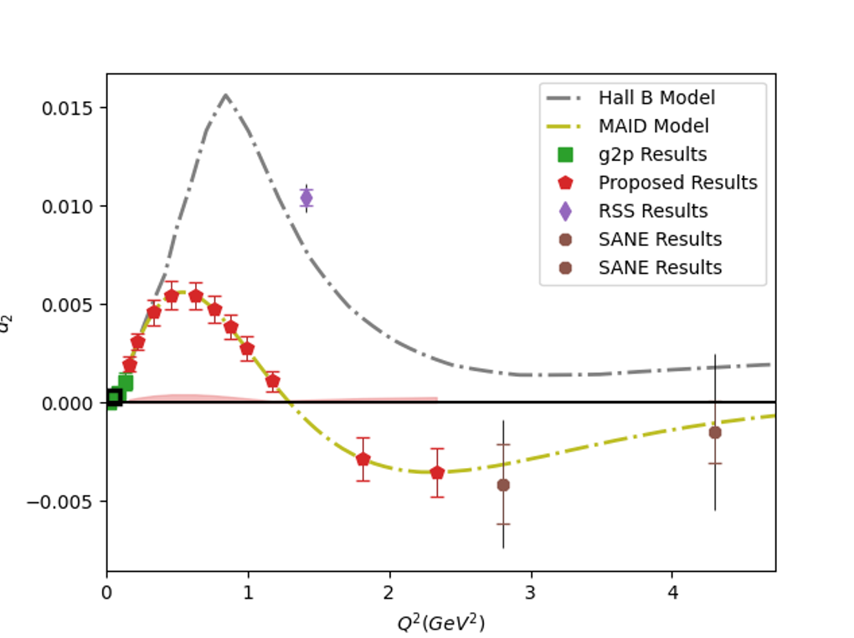
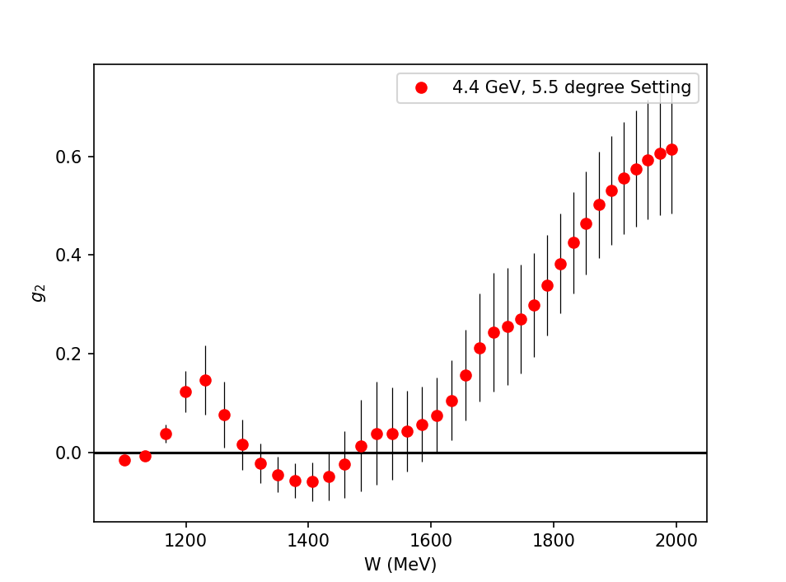
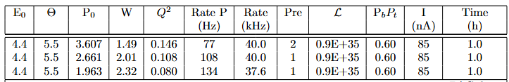
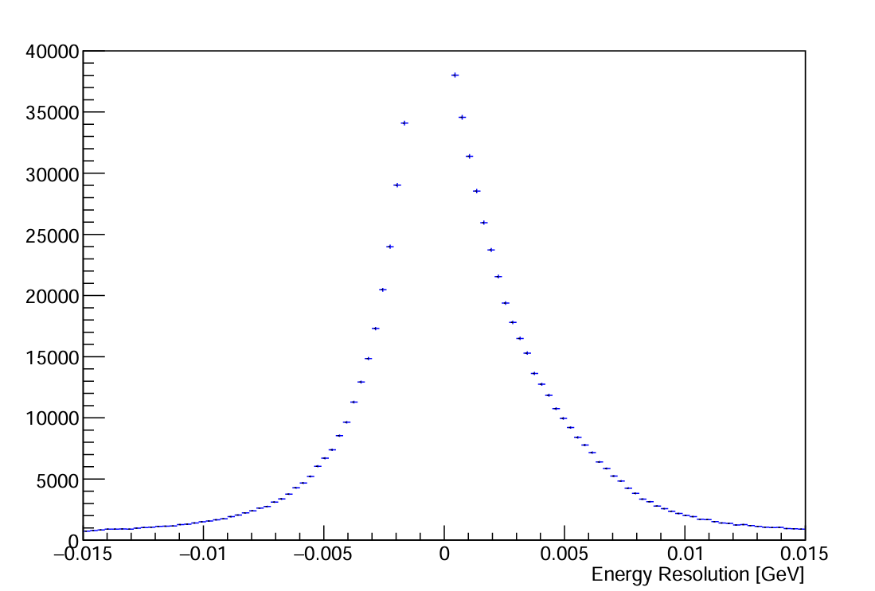
Option: Going Lower in Q²
Reader Question: B. Ketzer
What if we add a kinematic setting at the minimum Scattering Angle of SHMS (5.5 deg)?
Q² = 0.16 GeV²
3 additional hours running + 5 additional hours overhead
Would exceed DAQ rate limit and need a prescale factor
Impact on resolutions in simulation seems similar to that shown for 6.5 deg setting
We would need 1 additional PAC day to safely add this setting (total 27 days)
Creates more continuous coverage by connecting more closely to g2p results at low Q²

Slide 39
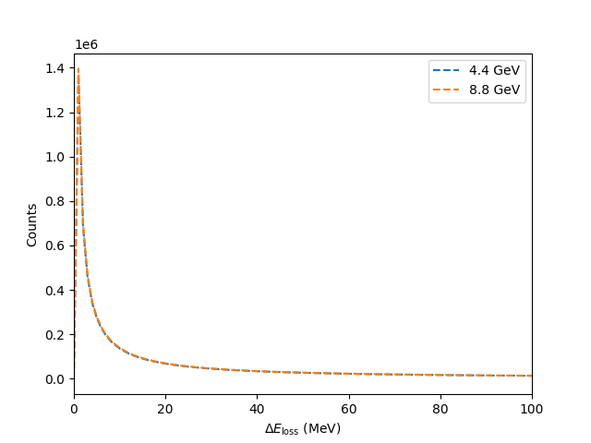

Downstream Beam Pipe
A few TAC questions about beam interaction with downstream beam pipe
A small fraction of the post-target beam [O(1) nA] interacts with pipe
No consequential background:
  Out of line of sight of SHMS electron acceptance
  SHMS has shielded detector hut explicitly to remove these backgrounds!
  Any residue is removed by cutting on Z_{target}
No radiological hazard:
  Beam current is already low
  Only a small fraction of the beam actually interacts with beampipe
Ionization
Bremsstrahlung
M. Roy E12-06-121 Thesis

Slide 40

Local Beam Dump
Proposal originally featured Local Dump
Unknown if higher beam energy will crack steel on old dump
A helium bag would be needed
Small SHMS angles would need to dump beam into Q1 steel
Using the Chicane gives a much cleaner measurement

Slide 41

BCM Linearity
Beam Charge Asymmetry dQ/Q: 0.1% or better with charge feedback
Dr. Dave Mack can demonstrate the nonlinearity is not worse than 1% with RF Signal Generator
This results in 0.01% False Physics Asymmetry (or better)

Slide 42




Hyperfine Contribution
Running Integral from $\int_{Q_{min}^{2}}^{∞}{dQ^{2}}$
$$Δ_{2}=−24M_{p}^{2}\int_{0}^{∞}{\frac{dQ^{2}}{Q^{4}}}\int_{0}^{x_{th}}{\tilde{β_{2}}\left(x , Q^{2}\right)g_{2}\left(x , Q^{2}\right)dx}$$
The leading error in theoretical calculations of the hydrogen HFS comes from these spin-structure function dependent integrals!
The subject of an ongoing tension between theory and experiment
The transition region accounts for ~30% of the integral!
Running Integral
$Q_{min}^{2}$ (GeV²)

Slide 43




Hydrogen Hyperfine Splitting Impact
$$Δ_{2}=−24M_{p}^{2}\int_{0}^{∞}{\frac{dQ^{2}}{Q^{4}}}\int_{0}^{x_{th}}{\tilde{β_{2}}\left(x , Q^{2}\right)g_{2}\left(x , Q^{2}\right)dx}$$
Transition region accounts for 30% of $Δ_{2}$
These results can cut the error in this region to $1/6$ of the current error
$Δ_{pol}={c(Δ}_{1}+Δ_{2})$ accounts for 81% of the current two-photon Hyperfine Splitting uncertainty
Opportunity to study or maybe eliminate a long-standing tension between theory and experiment for $Δ_{pol}$!
Ruth
et al. ‘24
$$Δ_{pol}$$

Slide 44

“Color Polarizability” d₂
$$\overline{d_{2}}= \int_{0}^{x_{th}}{x^{2}[{2g}_{1}\left(x,Q^{2}\right)+{3g}_{2}\left(x,Q^{2}\right)]dx}$$
At high Q²: color polarizability / “color Lorentz force”
Interesting differences in existing data motivate further study
Upcoming lattice predictions in this region need experimental benchmark!

Slide 45



Running Integrals as % Total Value ($\int_{x_{min}}^{1}{dx}$)
Running Integral (% Total)
Running Integral (% Total)
$\overline{d_{2}}$
$Δ_{2}$
x_{min}
x_{min}
Integrals are saturated in the measured region (flat slope)
Therefore, the low-x regime is irrelevant to these integrals

Slide 46



Projected $Γ_{2}$ Uncertainties
Having data in the regime where twist-2 assumption fails helps us better understand the small-x regime
If B.C. Sum Rule is followed, then we directly measure how the low-x part transitions from $g_{2}^{WW}$into a more complex form!

Slide 47


Dynamical Mass Generation
A. Accardi & A. Bacchetta, PLB 2017
g₂ can also directly probe dynamical mass generation in QCD!
Strong theory interest in this aspect
Will coordinate with global QCD analysis groups (JAM/CJ collaborations at JLab) to optimally use data

Slide 48
Rates Table
E₀ (GeV) | Scattering Angle (deg) | P₀ (GeV) | Target Q² (GeV²) | Proton Rate (Hz) | Rate (kHz) | Time (h)
4.4 | 6.5 | 3.607 | 0.22 | 77 | 40.0 | 1
 |  | 2.661 |  | 65 | 25.1 | 1
 |  | 1.963 |  | 69 | 18.9 | 1
 | 8 | 3.607 | 0.33 | 41 | 21.4 | 1.3
 |  | 2.661 |  | 28 | 11.5 | 1.9
 |  | 1.963 |  | 30 | 8.3 | 1.8
 | 9.5 | 3.607 | 0.46 | 18 | 9.1 | 2.3
 |  | 2.661 |  | 14 | 5.9 | 3.0
 |  | 1.963 |  | 15 | 4.3 | 2.8
 | 11.2 | 3.607 | 0.62 | 7 | 3.7 | 6.0
 |  | 2.661 |  | 6 | 3.0 | 6.5
 |  | 1.963 |  | 7 | 2.2 | 5.9
 | 12.5 | 3.607 | 0.765 | 4 | 2.0 | 9.1
 |  | 2.661 |  | 4 | 1.9 | 8.5
 |  | 1.963 |  | 4 | 1.5 | 7.6
 | 13.5 | 3.607 | 0.892 | 2 | 1.3 | 16.5
 |  | 2.661 |  | 3 | 1.3 | 13.7
 |  | 1.963 |  | 3 | 1.1 | 12.1
 | 14.5 | 3.607 | 1.028 | 1 | 0.8 | 23.2
 |  | 2.661 |  | 2 | 1.0 | 17.4
 |  | 1.963 |  | 2 | 0.8 | 14.9
 | 16 | 3.607 | 1.250 | 0 | 0.4 | 50.8
 |  | 2.661 |  | 1 | 0.6 | 32.7
 |  | 1.963 |  | 1 | 0.5 | 26.6
8.8 | 11 | 7.213 | 2.3 | 0 | 0.5 | 33.3
 |  | 5.321 |  | 0 | 0.8 | 19.0
 | 14 | 7.213 | 3.44 | 0 | 0.1 | 101.8
 |  | 5.321 |  | 0 | 0.2 | 31.6
Total PAC Days:
13.0

Slide 49
Overhead
Overhead | Number | Time Per (hr) | (hr)
Target Anneal | 26 | 2.0 | 52.0
Beamline Survey | 10 | 8.0 | 80.0
Target Swap | 2 | 4.0 | 8.0
Target T.E. | 6 | 4 | 24.0
Target Field Ramp | 10 | 1.0 | 10.0
Carbon, Dummy, Empty runs | 28 | 0.5 | 14.0
Pass Change | 2 | 4.0 | 8.0
Momentum Change | 28 | 0.5 | 14.0
Moller Measurement | 10(+1 shift) | 4.0(+8.0) | 48.0
Pair-Symmetric Background | 2 | 4.0 | 8.0
Optics Calibration | 2 | 16.0 | 32.0
BCM Calibration | 2 | 4.0 | 8.0
Total: 12.7 Overhead Days (305.5)

Slide 50


Burkhardt-Cottingham Sum Rule
$Γ_{2}= \int_{0}^{x_{th}}{g_{2}\left(x,Q^{2}\right)dx}$ = 0
“Superconvergence” Sum Rule for an amplitude whose imaginary part is g₂
Assuming convergent dispersion relations for g₂(𝜈) and 𝜈g₂(𝜈), arises naturally from subtraction of VVCS amplitudes:
  $Im S_{2}\left(ν,Q^{2}\right)= \frac{2π}{ν^{2}M}g_{2}(x,Q^{2})$
  $S_{2}\left(ν,Q^{2}\right)=\frac{2}{π}\int_{ν_{th}}^{∞}{\frac{ν Im S_{2}}{ν^{′2}−ν^{2}}dν^{′}}$
  $νS_{2}\left(ν,Q^{2}\right)=\frac{2}{π}\int_{ν_{th}}^{∞}{\frac{ν^{′}Im S_{2}}{ν^{′2}−ν^{2}}dν^{′}}$
B.C. Integral converges to 0 in both QED and Perturbative QCD, and follows from Wandzura-Wilczek relation (Altarelli et al [1994], R. L. Jaffe [1990 Review])

Slide 51
Reliability of the Chicane
Chicane is a new installation, not a refurbishment of the old chicane
Design is fundamentally similar to numerous similar projects by the JLab staff, nothing untested or uncertain about it
Dr. Benesch is the longest serving member of the TAC and has designed resistive and superconducting magnets since 1976
Staff scientists are very confident that chicane will be carefully built and tested and will work well, but will need some time to commission

Slide 52




Collaboration
Jian-Ping Chen
Nathaly Santiesteban
Karl Slifer
David Ruth
Polarized Target
Experts
g2p Analysis
SANE Analysis
RSS Analysis
W. Armstrong
J. Maxwell
Z.E. Meziani
M. Jones
K. Slifer, A. Arora, M. Farooq, N. Santiesteban, H. Chinchay, Z. Wolters, O. Olokunboyo, A. Zec, E. Long, J.P. Chen, D. Ruth, C. Keith, J. Maxwell. D. Meekins, J. Brock, D. Keller, I. Fernando, S. Covrig Dusa
D. Ruth
J.P. Chen
K. Slifer
K. Slifer
M. Jones
O. Rondon
Notes:
.

