Slide 1
  Dispersive effects in unpolarized inclusive elastic electron/positron-nucleus scattering
  (JLab PAC53 Proposal)
Paul Guèye
Facility for Rare Isotope Beams
Michigan State University
John Arrington
Lawrence Berkeley Lab
Andrei Afanasev
George Washington University

Slide 2
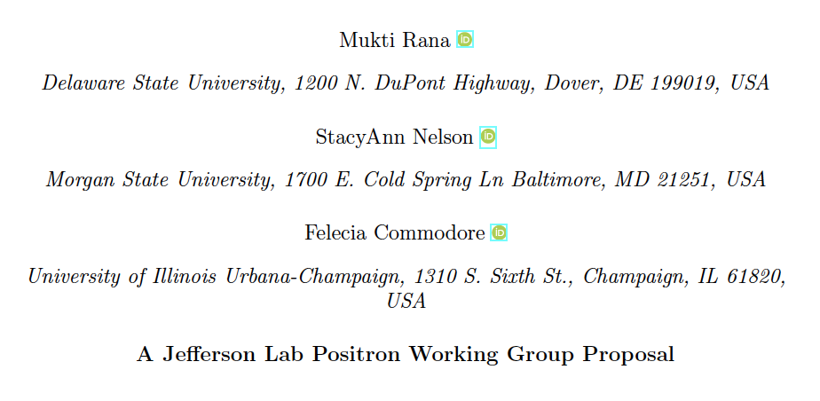
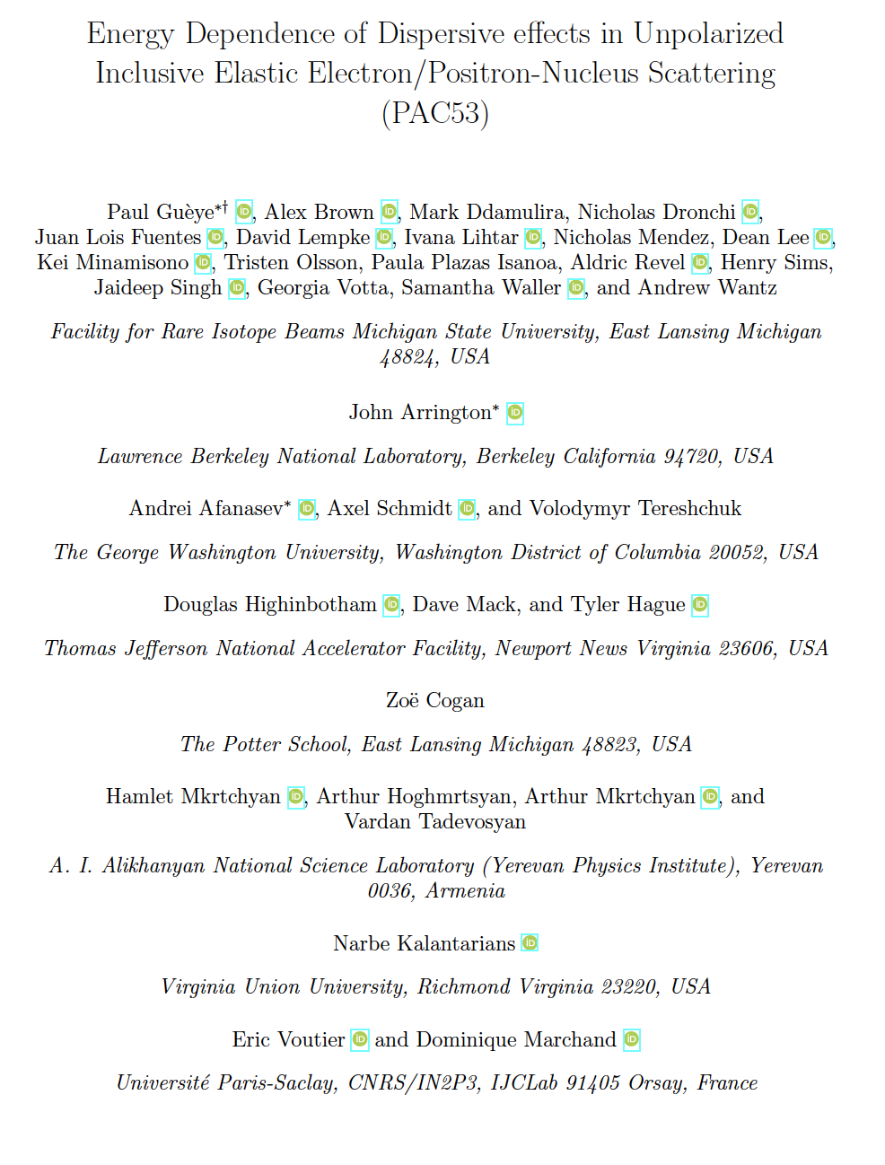
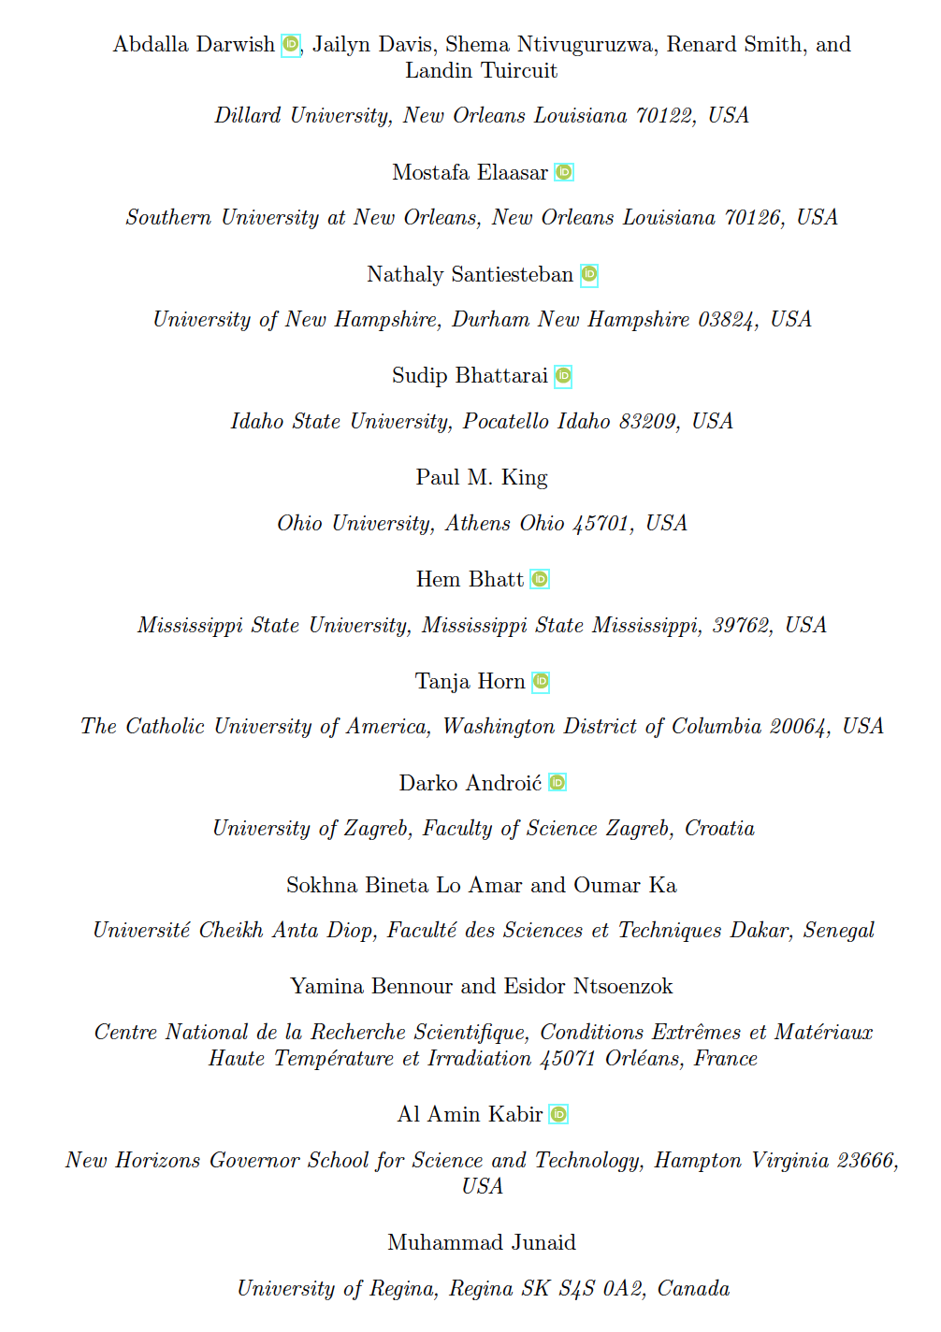
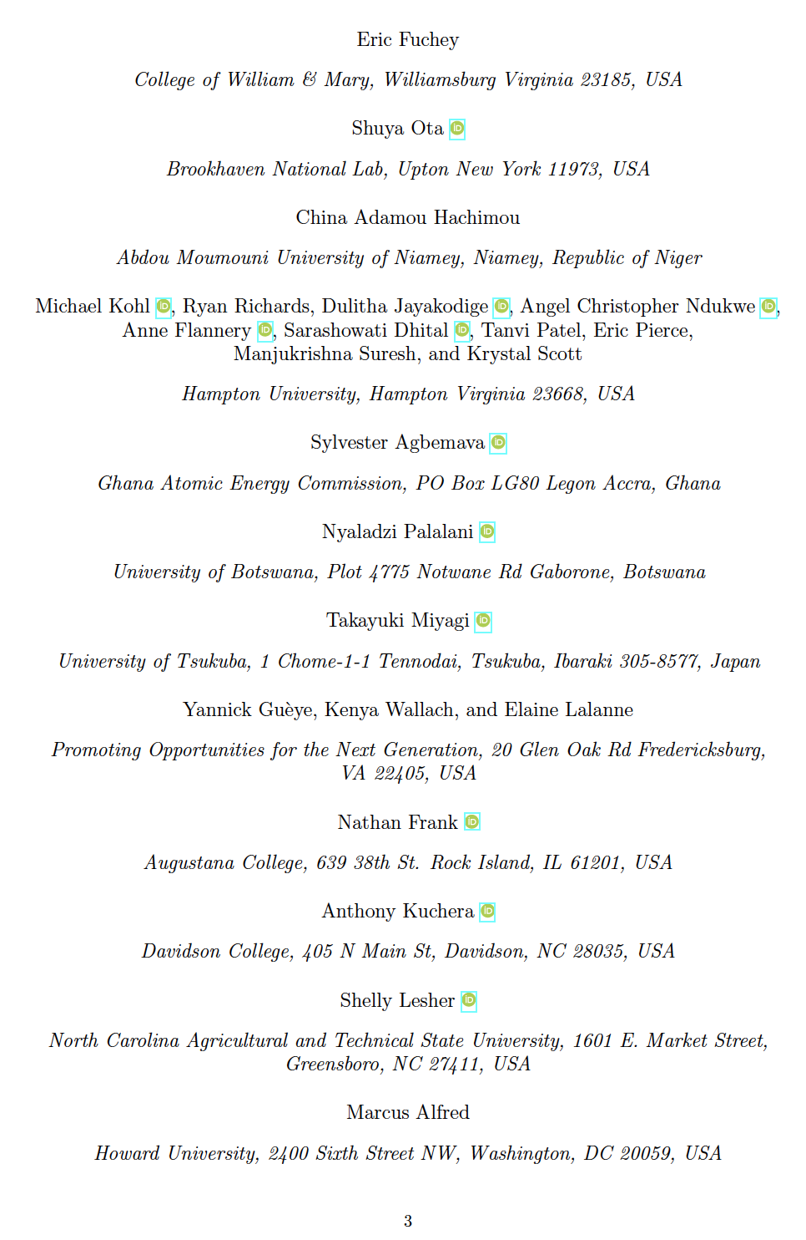
Collaborators
53 participants → 80 participants
26 institutions → 35 institutions

Slide 3
Outline
Background on e± scattering
Physics Goals
  Direct
    Nuclear charge radii
    Rare isotopes & nuclear structure
    Neutron skin puzzle & single spin asymmetries
  Indirect
    Coulomb Sum Rule
    Electron dipole moment
PAC53 proposal PR12+25-013
Summary

Slide 4
Outline
Background on e± scattering
Physics Goals
  Direct
    Nuclear charge radii
    Rare isotopes & nuclear structure
    Neutron skin puzzle & single spin asymmetries
  Indirect
    Coulomb Sum Rule
    Electron dipole moment
PAC53 proposal PR12+25-013
Summary

Slide 5
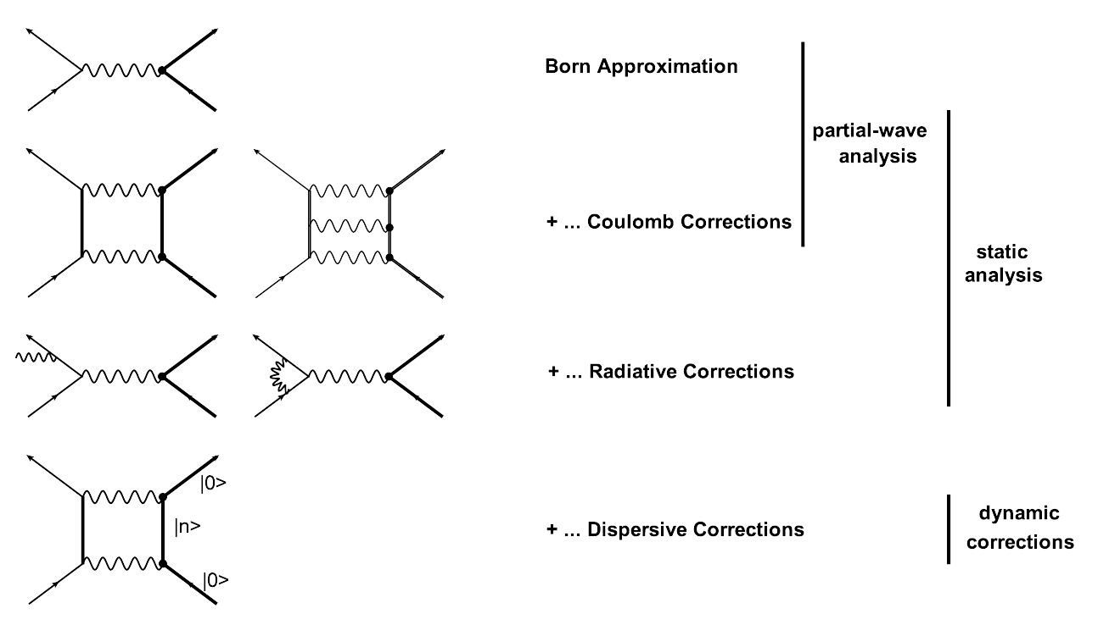
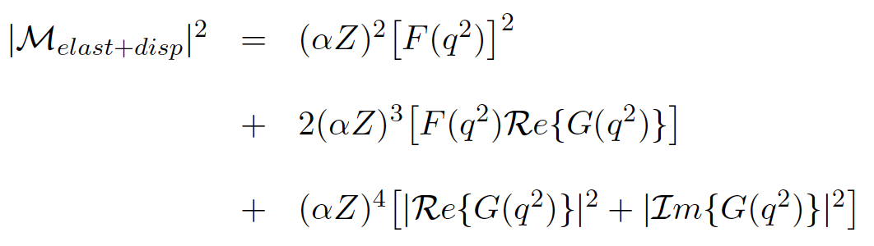

Background: Electron Elastic Scattering
comparison e⁺/e⁻

Slide 6
Background: Electron Elastic Scattering
minimum of diffraction
F(q²) = 0
P. Guèye et al., EPJ A56(5) 2020
10.1140/epja/s10050-020-00135-7
comparison e⁺/e⁻

Slide 7
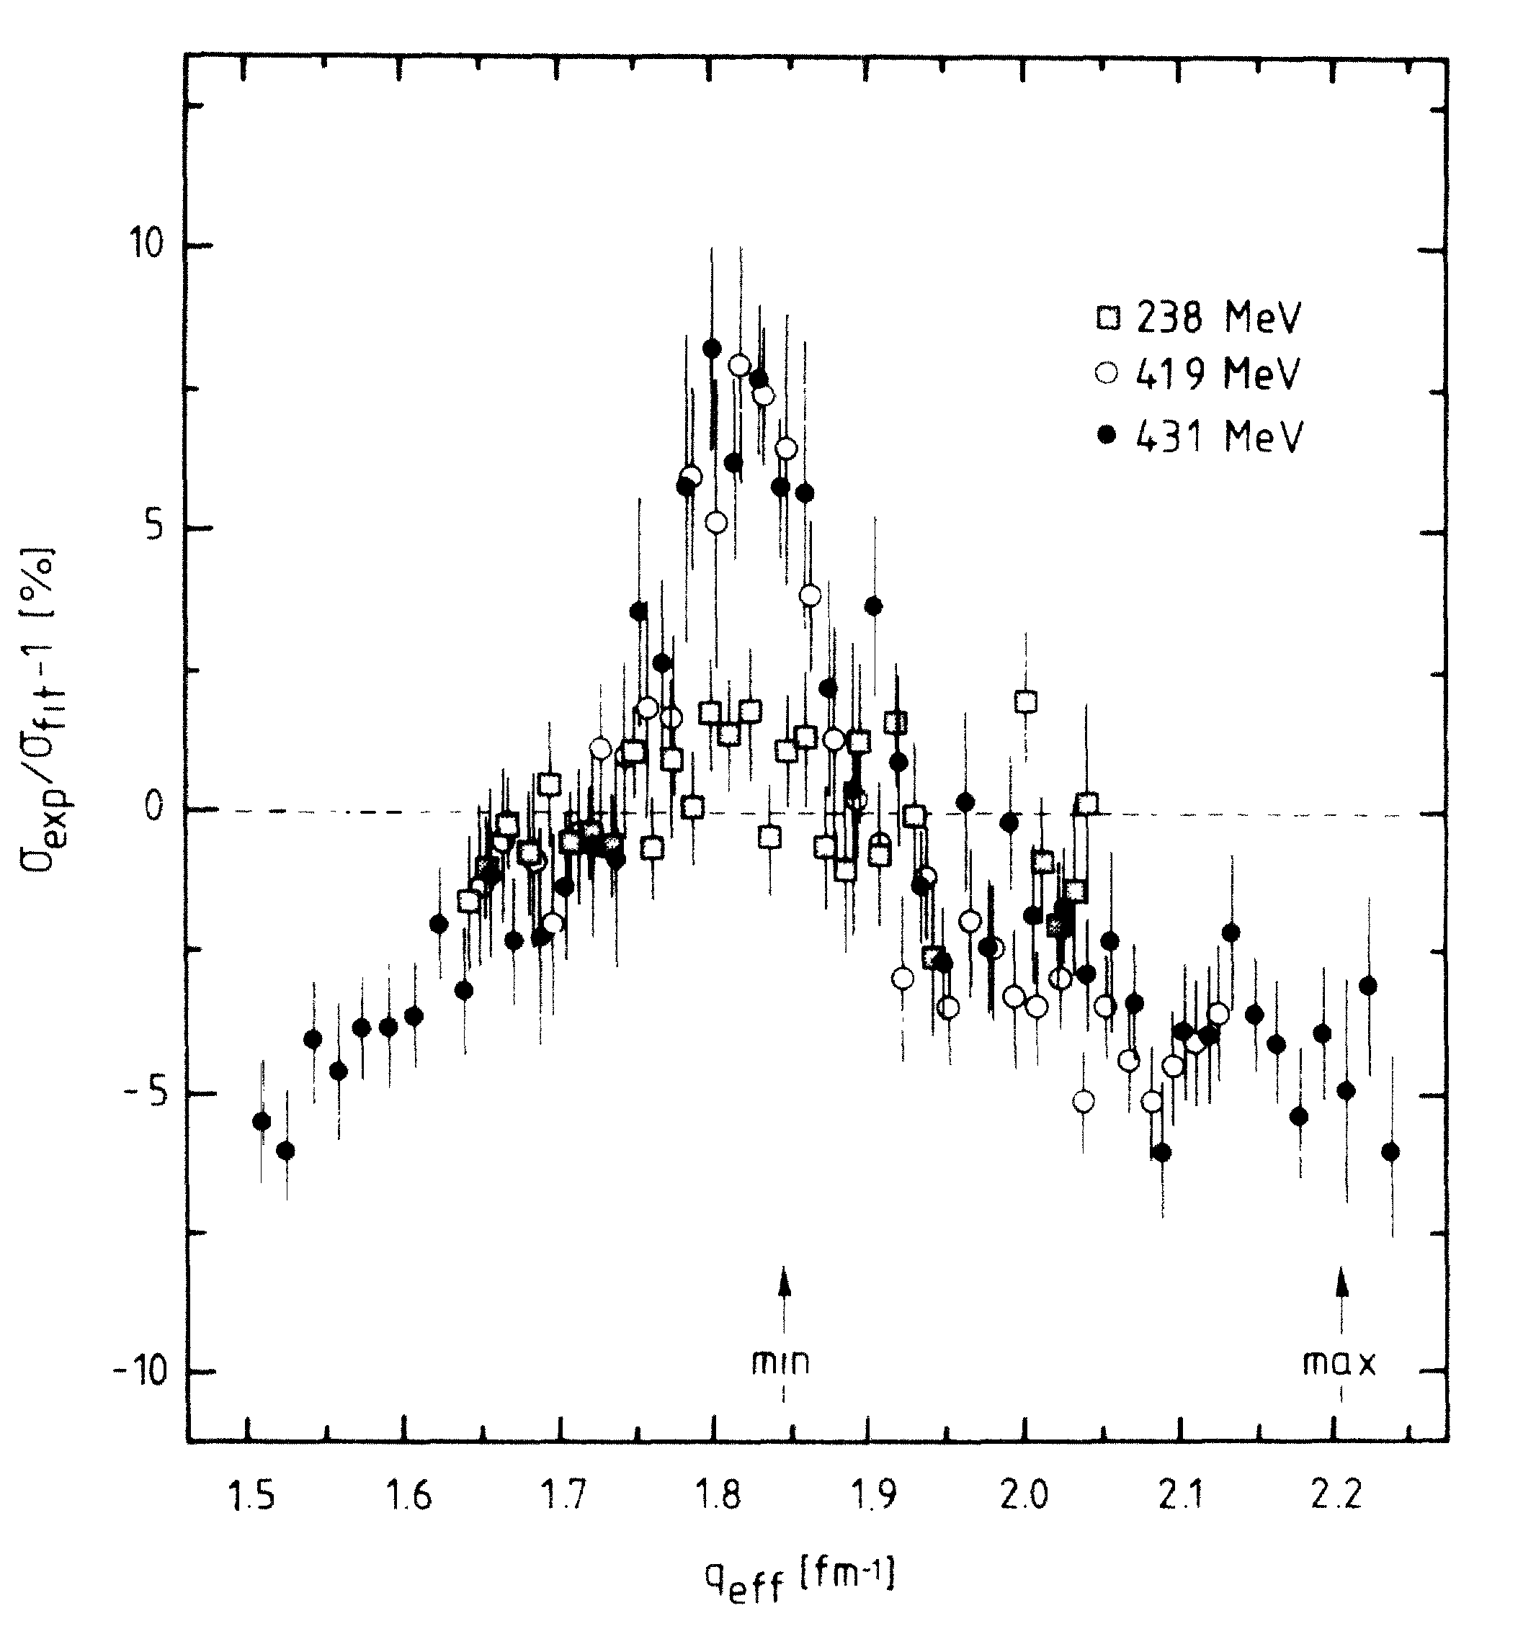
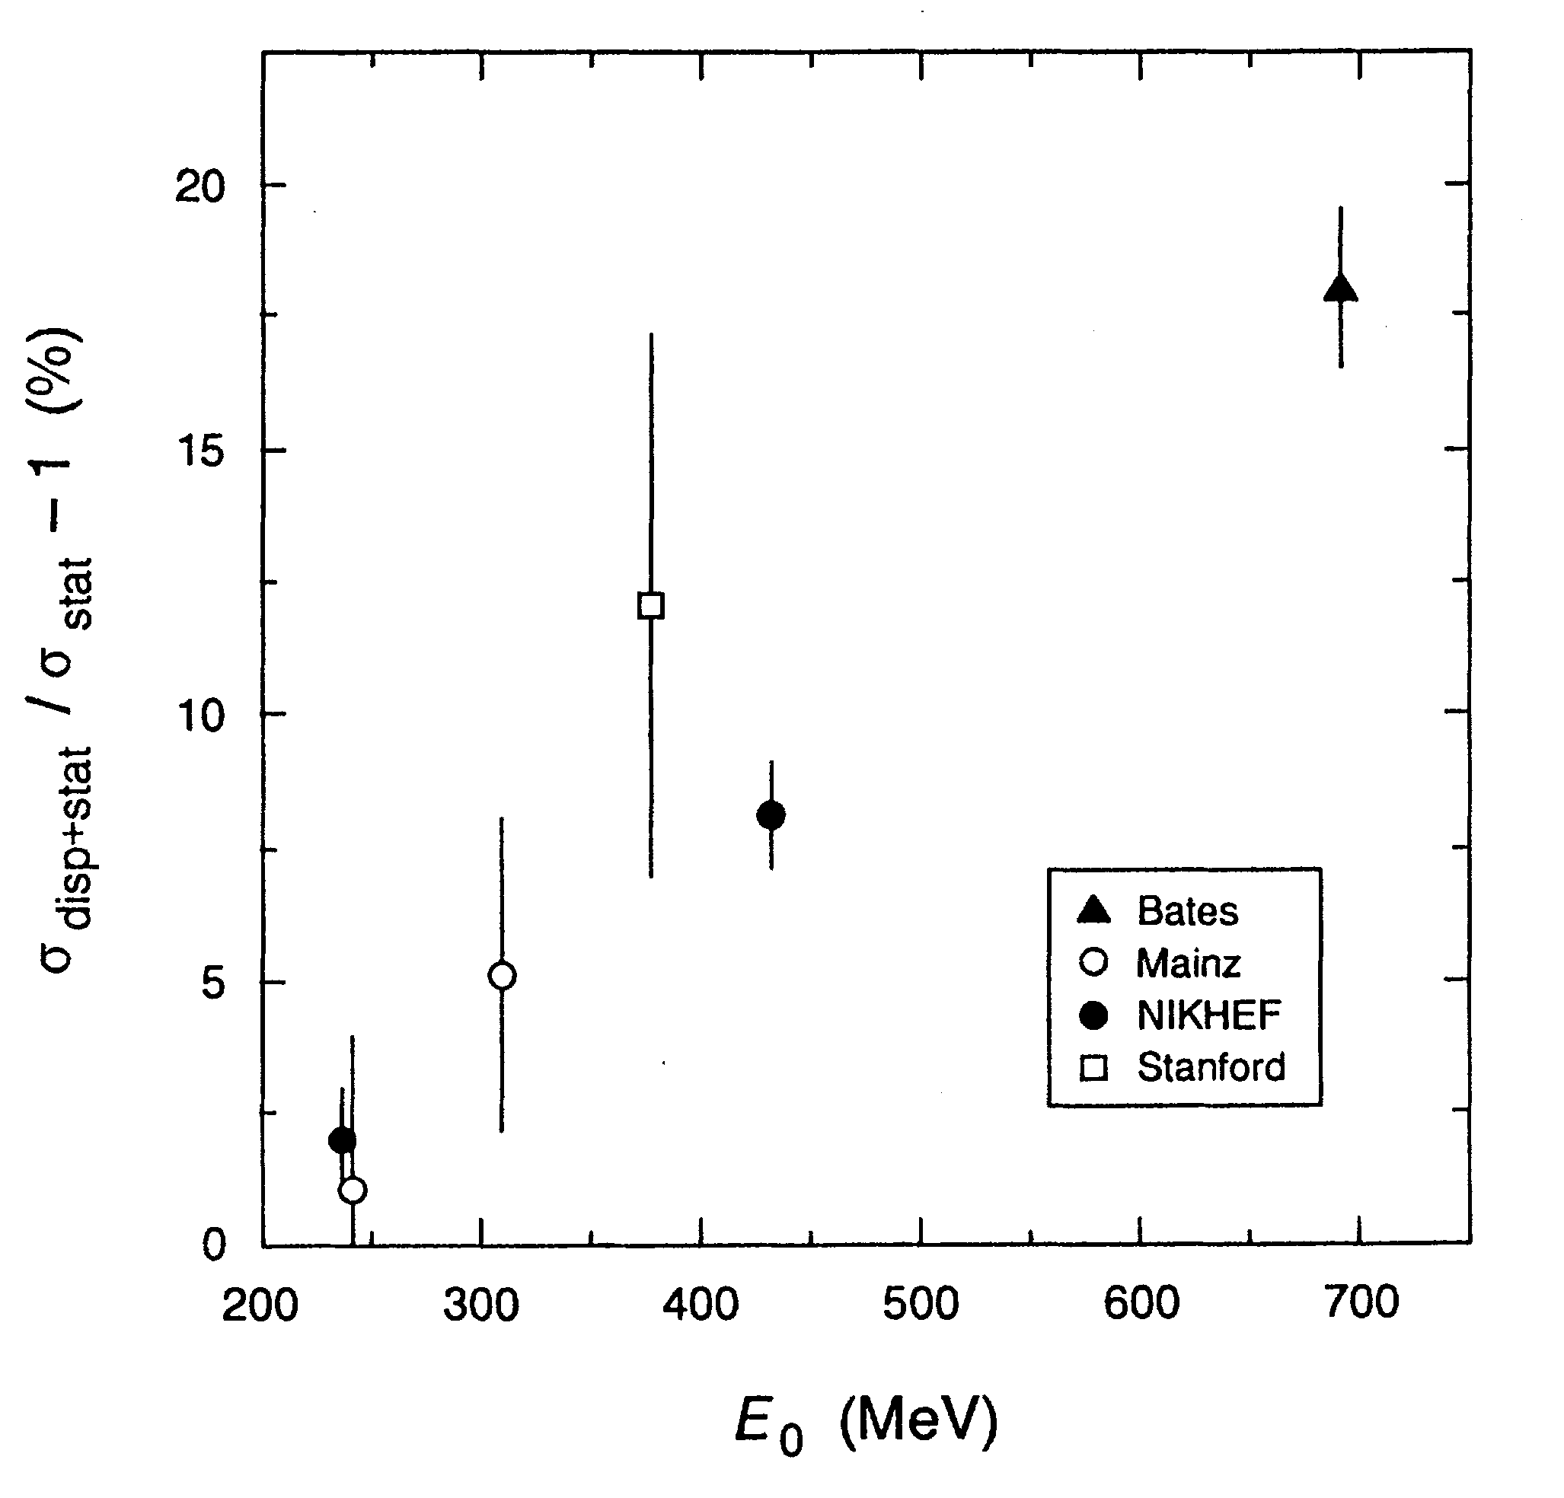
Background: e± Experiments at NIKHEF [1]
Nationaal Instituut voor Kernfysica en Hoge Energie-Fysic (NIKHEF)
[The Netherlands]
E. Offerman et al., PRL 57 (13) 1986
E. Offerman et al., PRC 44 (3) 1991
Comparison to static charge density
  Fourier-Bessel parameterization
  Reuter et al., PRC 26 (806) 1982
  L. Cardman et al., Nuc. Phys. A216 806 (1973)
E_{beam} = 238, 243, 419 & 431 MeV
Phase 1 (1986):
  <5% for 1.5 < q (fm⁻¹) < 2.3
Phase 2 (1991):
  1st minimum of ¹²C
  Energy dependence
Effect on ¹²C charge radius (rms)
  2.471 → 2.478: 0.28%

Slide 8
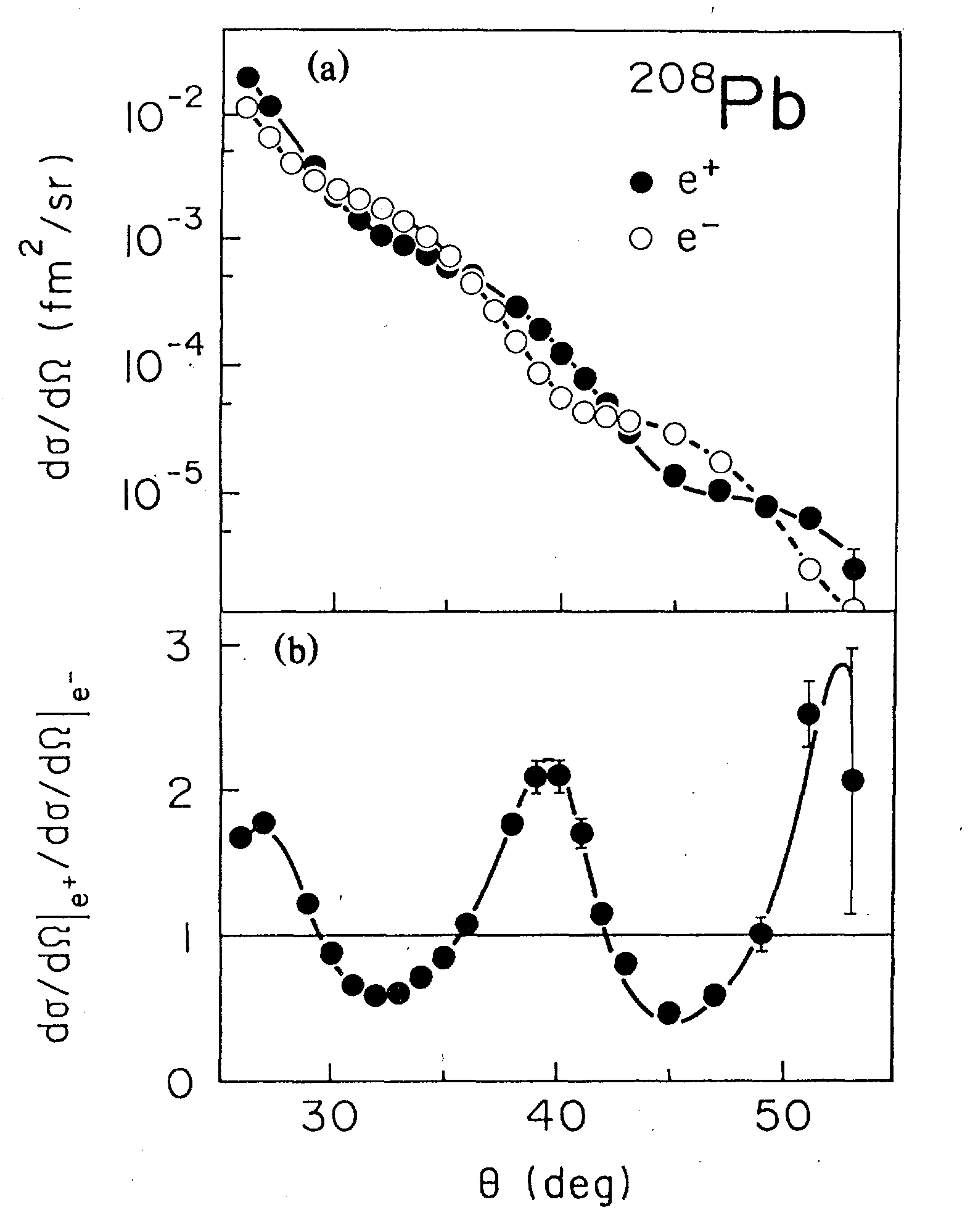
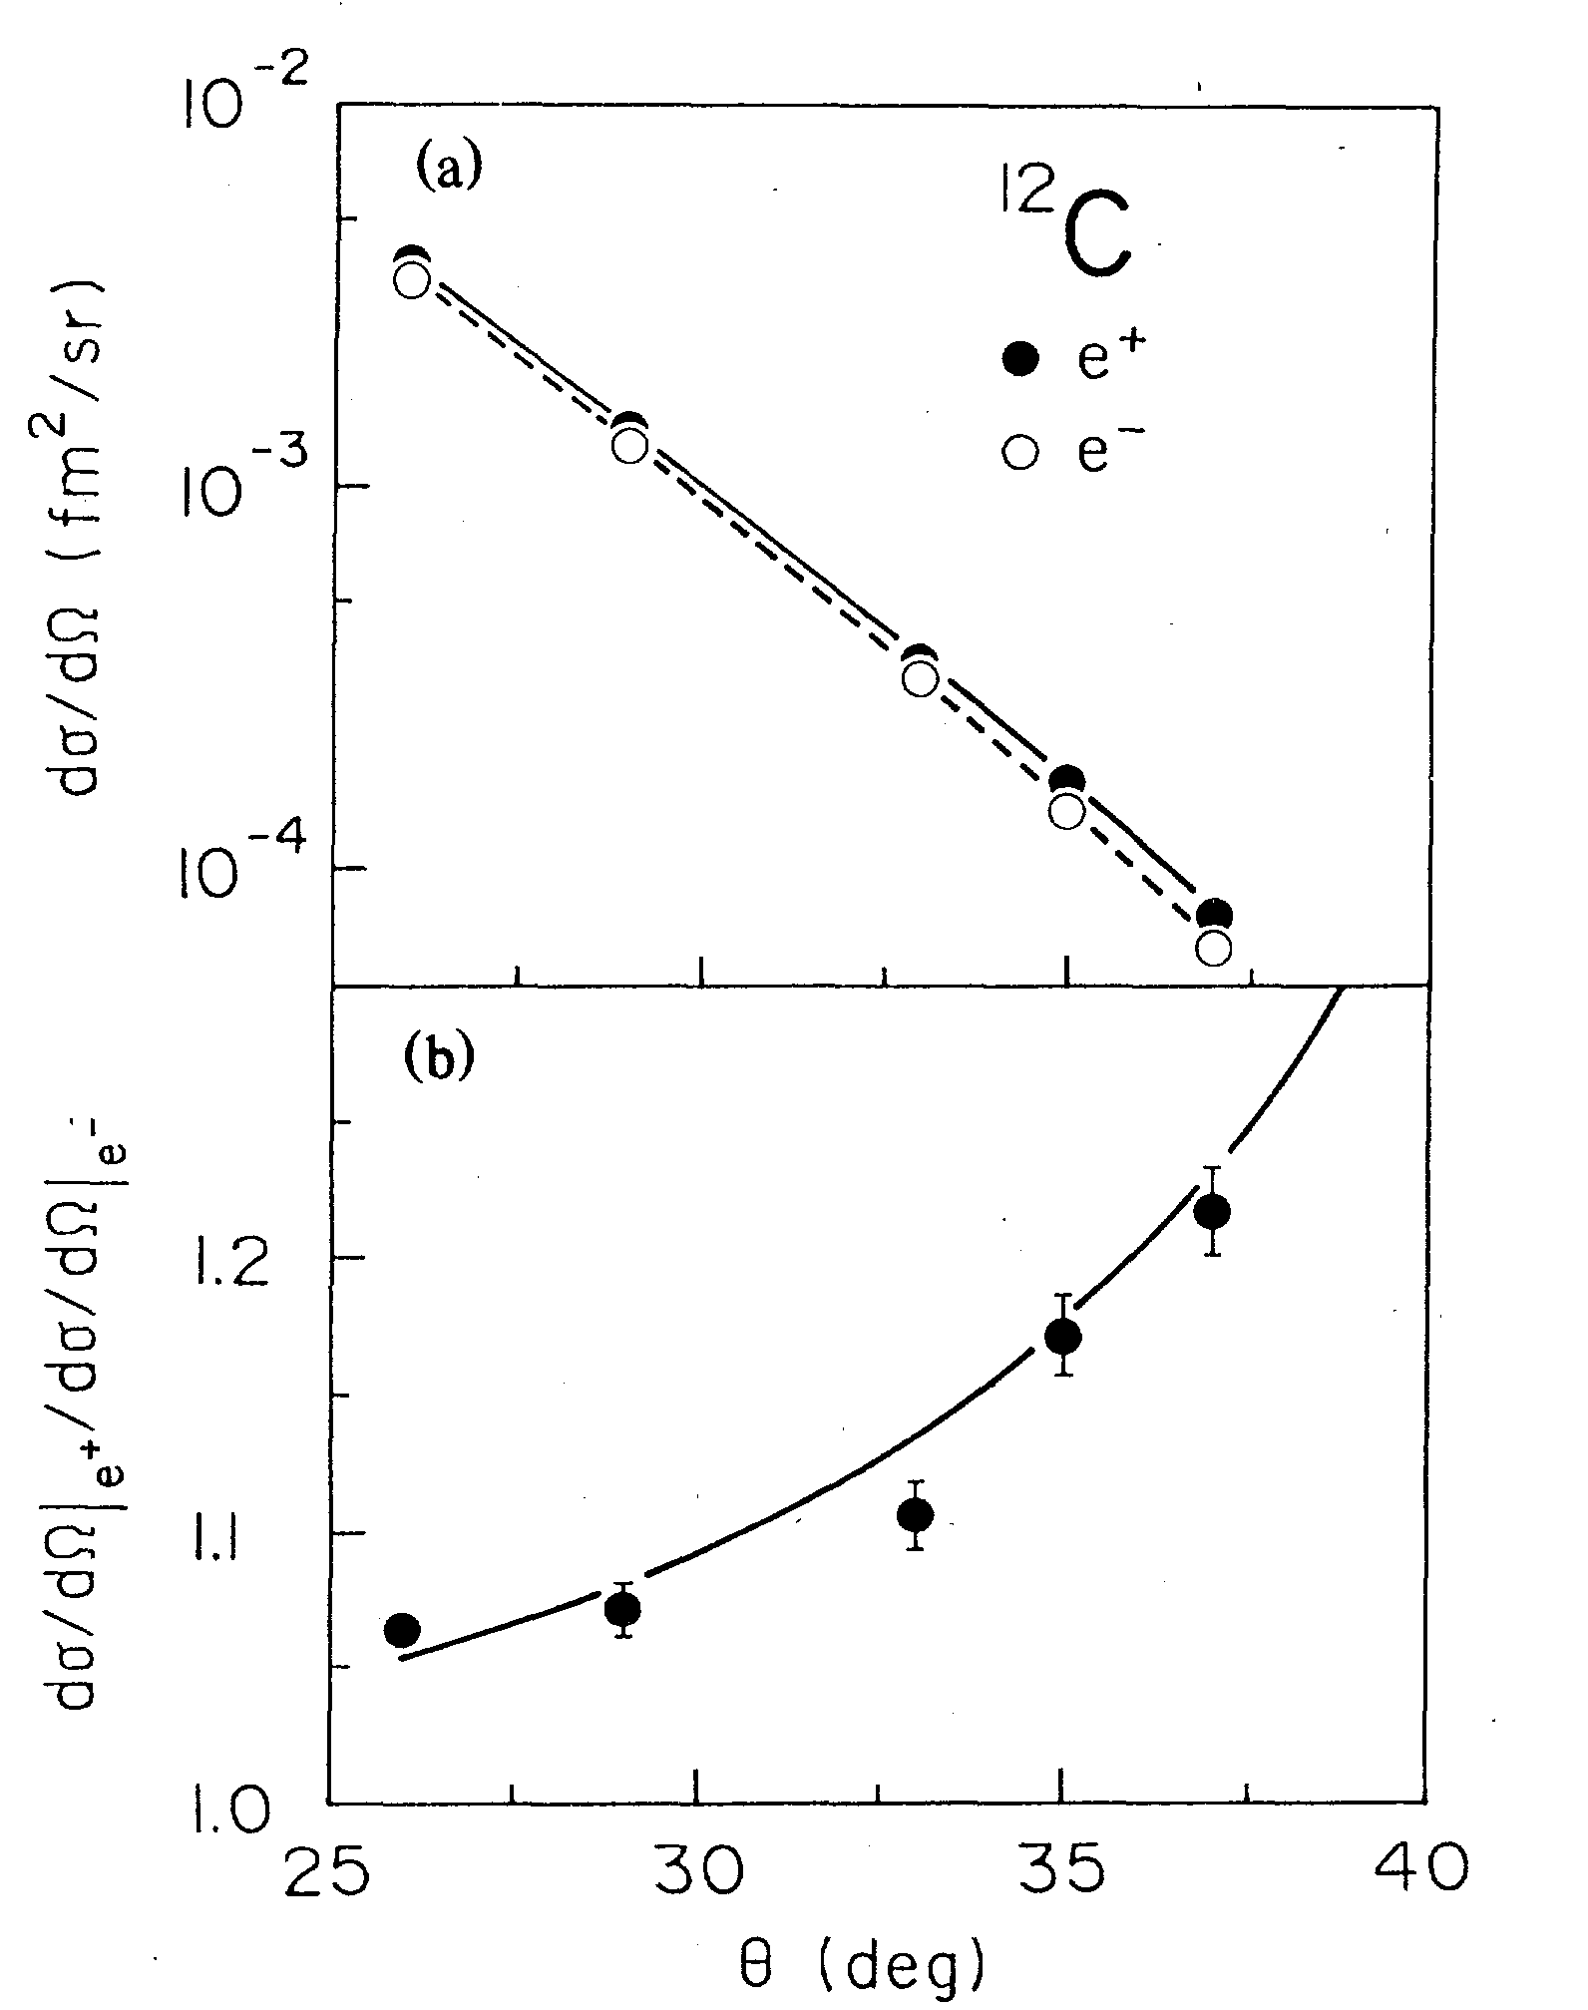
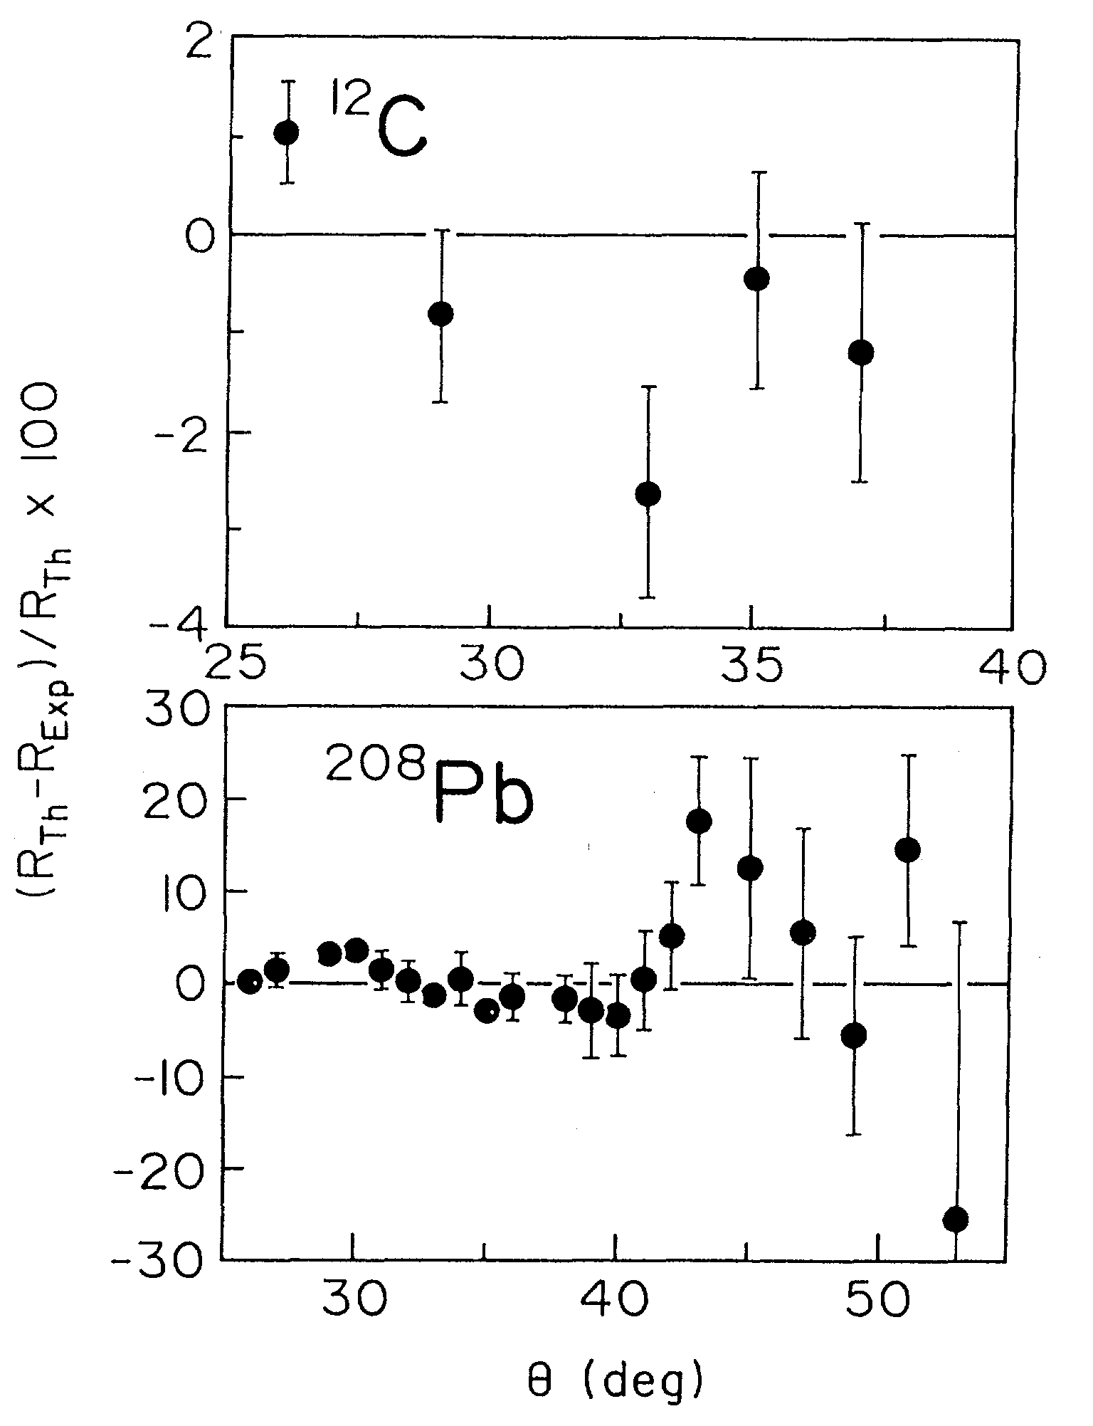
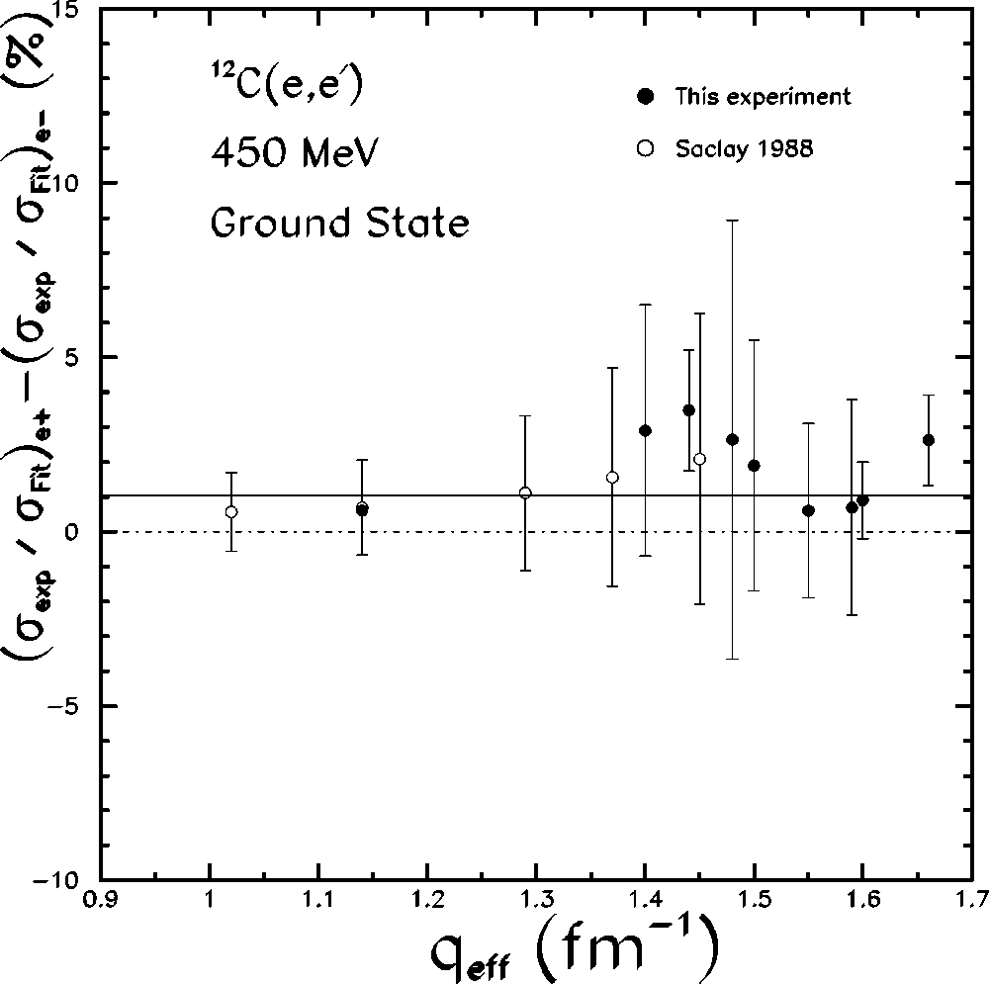
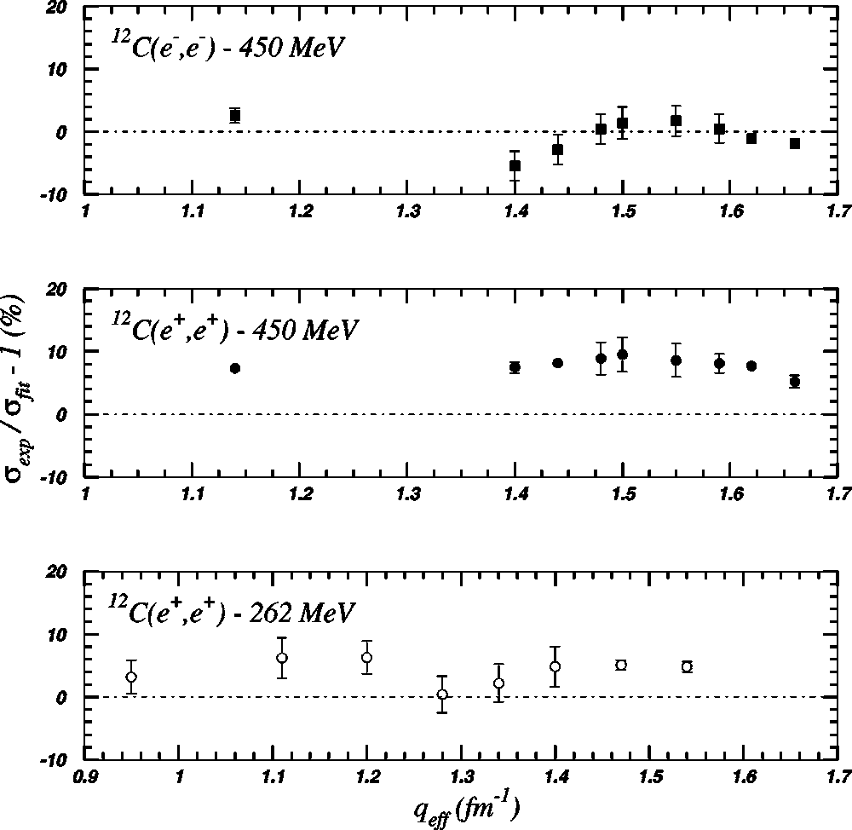
Background: e± Experiments at ALS [2]
Accélérateur Linéaire de Saclay (ALS)
[France]
Coulomb Effect
V. Breton et al., PRL 66 (5) 1991
P. Gueye et al., PRC 57 (5) 1998
P. Gueye et al., PRC 63
(051303) 2001
Comparison to static charge density
  E_{beam} = 450 MeV; I = 20 nA
  <2% for 1 < q (fm⁻¹) < 1.5
Ground state & 1st excited state of ¹²C
  E_{beam} = 262 & 450 MeV; I = 30 nA
  <2% for 0.95 < q (fm⁻¹) < 1.66

Slide 9
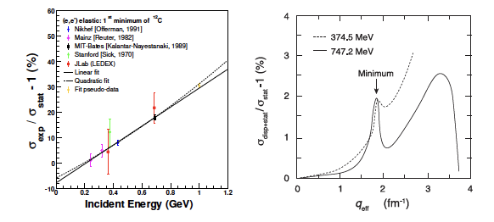
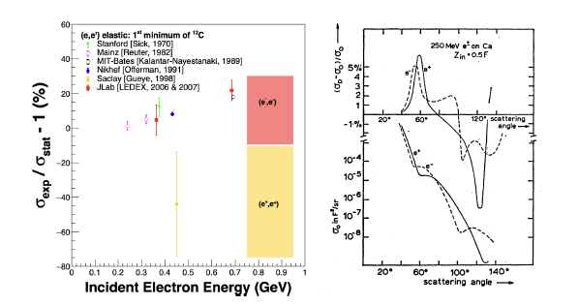
Status on Experiments vs. Theory
(Note: no updated theoretical work!)
Energy dependence
  J. Friar & M. Rosen, Ann. Phys., 87:289 (1974)
  Theory : no
  Experiment : yes!
Sign between e⁻ & e⁺ in ¹²C minimum
  G. Rawitscher, Phys. Rev., 151:846 (1966)
  Theory : positive
  Experiment : negative!

Slide 10
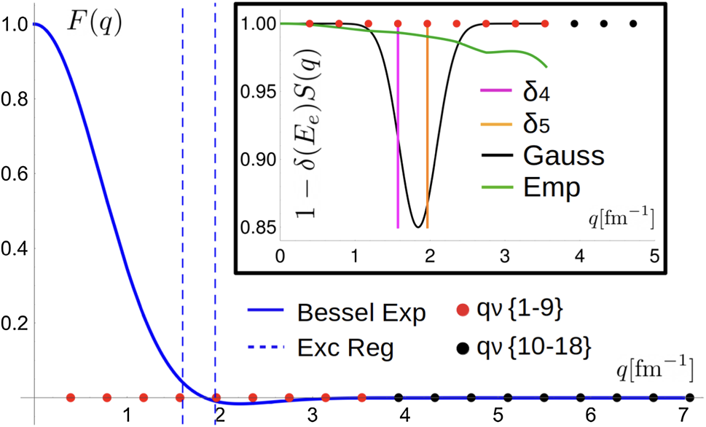
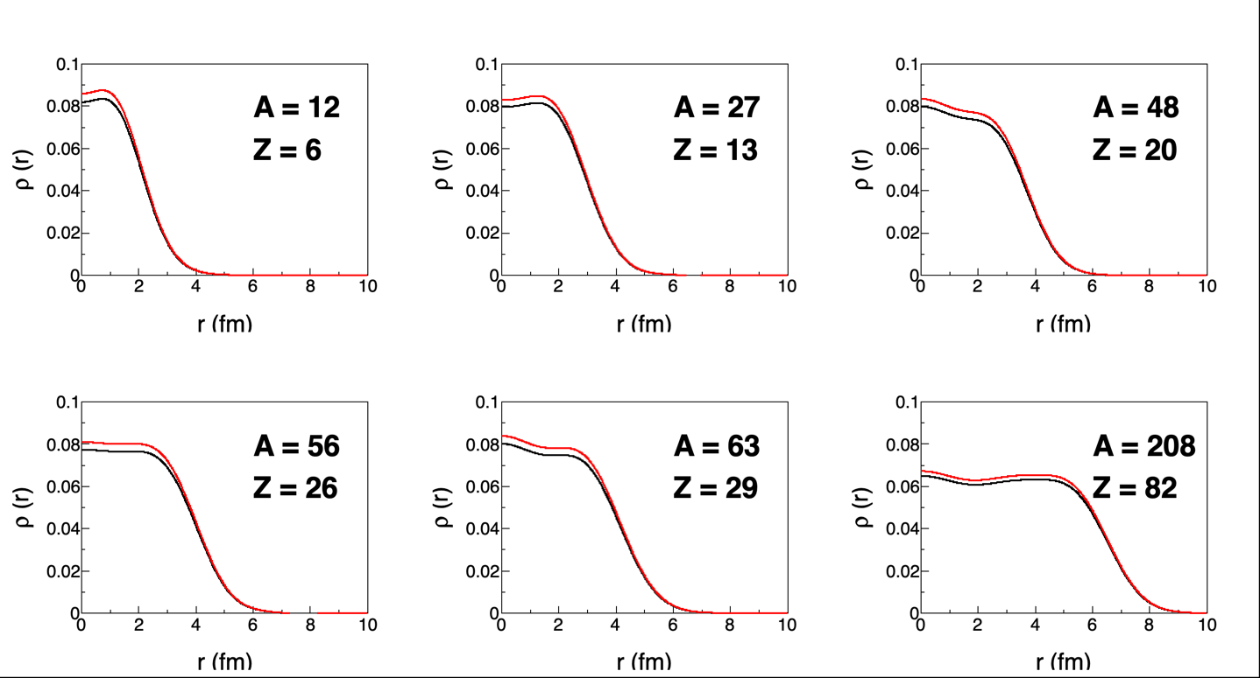
Physics I: Charge Radii and IAEA Recommendation [1]
P. Guèye et al., EPJ A56(5) 2020
F(q) = 1 - 0.00833q
¹²C
 | ¹²C | ²⁷Al | ⁴⁸Ca | ⁵⁶Fe | ⁶³Cu | ²⁰⁸Pb
ρ_{disp}(r)/ρ(r) [%] | 4.91 | 4.11 | 4.58 | 4.65 | 4.65 | 3.49

Slide 11
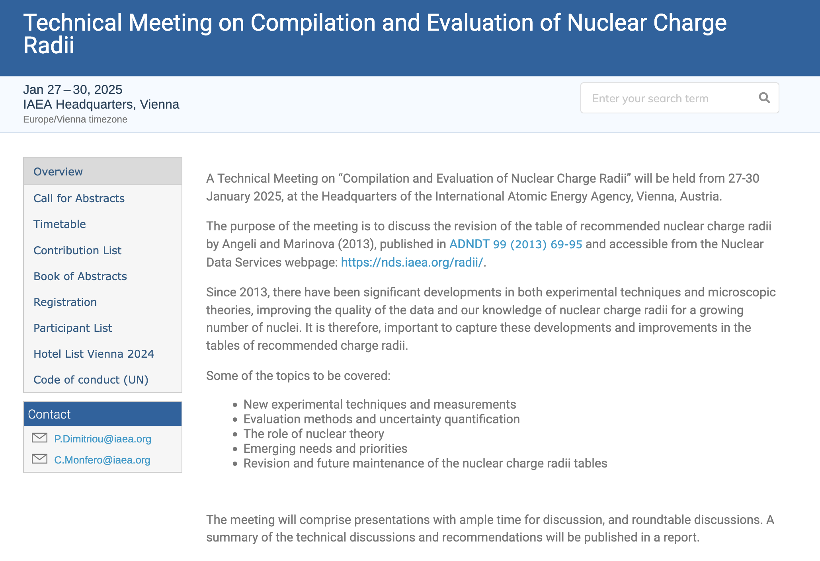
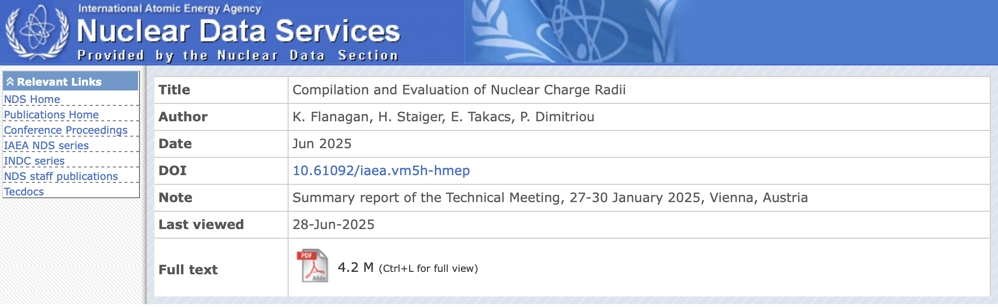
Physics I: Charge Radii and IAEA Recommendation [2]
IAEA Technical Meeting
  Compilation and Evaluation of Nuclear Charge Radii
  January 27-30, 2025; 20 participants
  https://conferences.iaea.org/event/401
https://nds.iaea.org/publications/indc/indc-nds-0918/

Slide 12
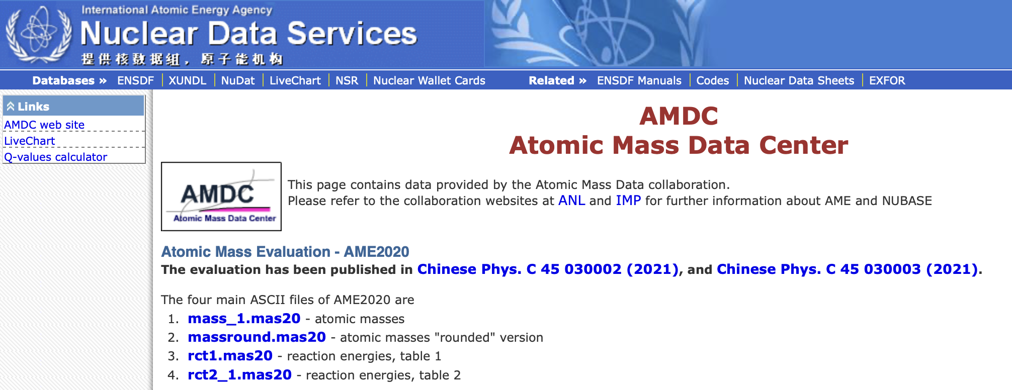
Physics I: Charge Radii and IAEA Recommendation [3]
Outcomes
  More accurate compilation of rms charge nuclear radii
    Angeli, I. & Marinova, K. P
      Atom. Data Nucl. Data Table, 99, 69 (2013)
    Large uncertainties: mainly theory
    Need guidance for experiments
    Dispersive effects not accounted for in past compilations!
  Best practices to extract precise RMS nuclear charge radii?
    Stable : electron scattering (deVries, 1987!), muon spectroscopy and laser spectroscopy
    Unstable : laser spectroscopy (ref. nuclei), electron (SCRIT @ RIKEN and ULQ2 @ Tohoku Univ.)
    Standardize : e.g., Barrett moments from μ-spectroscopy (accuracy: ≤0.1%)
  Need to get there
    Both experimental and theoretical sides
  Regular charge nuclear radii compilation “à la” AMDC

Slide 13


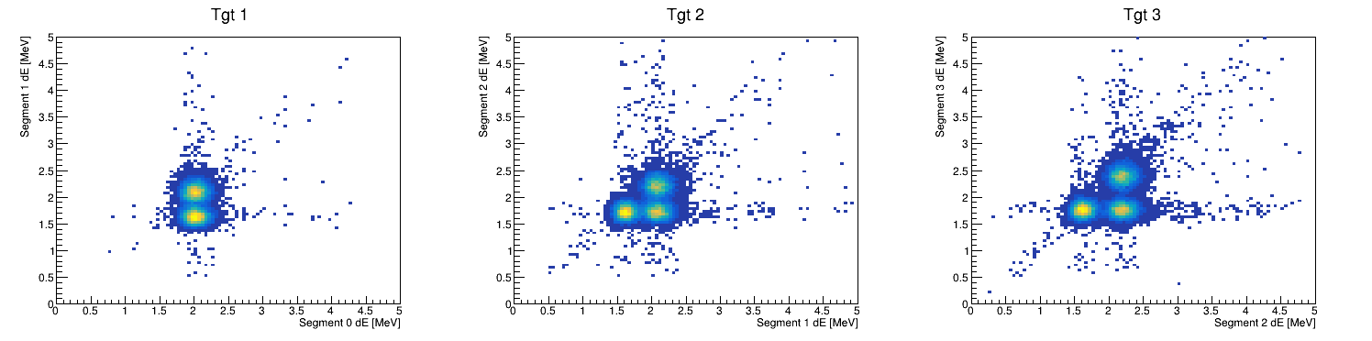
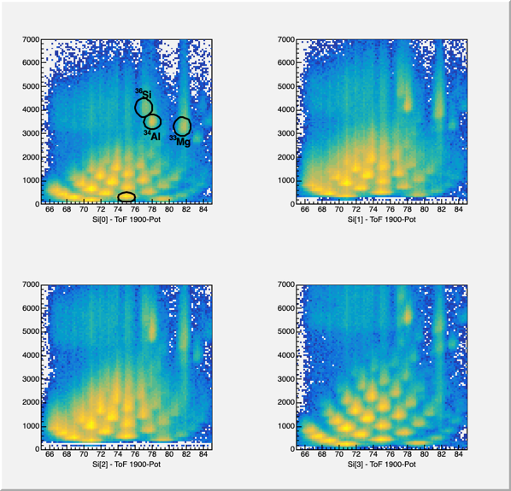
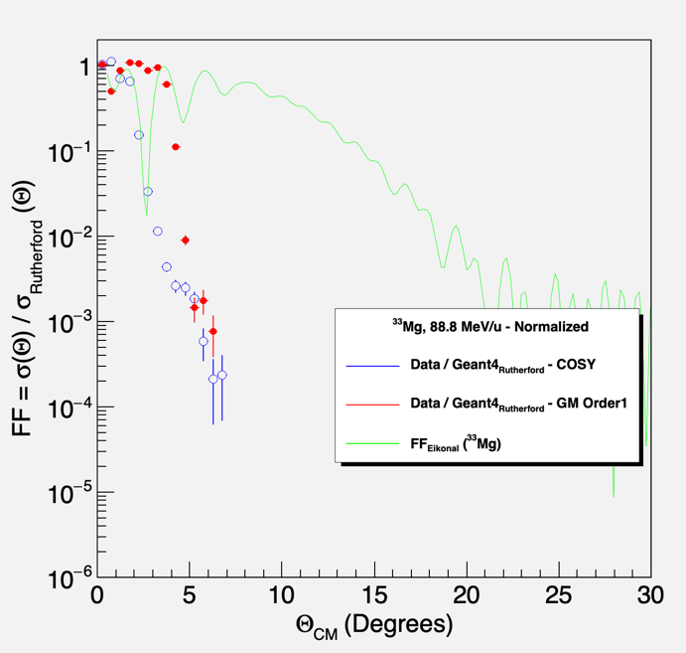
Physics II: Rare Isotopes and Nuclear Structure [1]
T. Redpath et al., NIM A, 977 (2020) 164284
Extension to rare isotopes
  MoNA Collaboration/PING Program
    Si-Be segmented target (4 Si + 3 Be)
  Rutherford scattering kit (PING)
    Elastic scattering of rare isotopes?
  Preliminary results for matter radii
    Impact from charge radii
    Sensitivity to neutron distribution?
Graduate student
  Paula Plazas Isanoa (MSU, Fall 2024)
  Joint thesis project
    Laser spectroscopy (BECOLA)
    Matter radii (MoNA Collaboration)
Undergraduate student
  Makaila Parks (Spelman College, PING2024)
  PING2020-2025 cohorts
Unreacted beam
Unreacted beam
Unreacted beam
PHY-2012040
PHY-2310078
Reaction fragments
Reaction fragments from tgt 1 (left), tgt 2 (right)
Reaction fragments from tgt 1 (left), tgt 2 (right)
  Pierre Capel
  Institut für Kernphysik
  Johannes Gutenberg-Universität Mainz

Slide 14
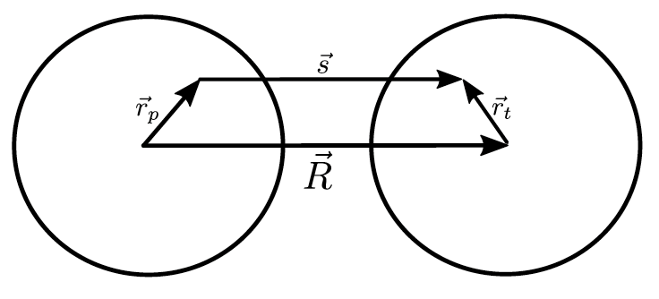
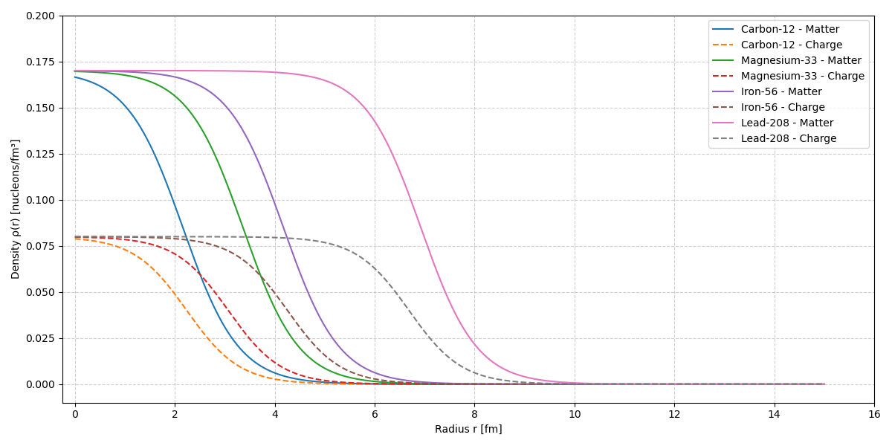
Physics II: Rare Isotopes and Nuclear Structure [2]
Double-folding model
  Optical potential to describe two colliding ions obtained by
    Averaging an appropriate N-N interaction over the matter distributions
    Similar approach as treatment of the Coulomb interaction
  Two components: real (Coulomb) and imaginary (nuclear)
  Use two-Fermi parameter distribution
Application to ⁹Be(^{A}X, ^{A}X’) at 88.8 MeV/u (³³Mg)
G. Satchler, W. Love, Phys. Rep. 55(3) (1979) 183–254
L. Chamon et al., Comp. Phys. Com. 267 (2021) 108061
PHY-2012040
PHY-2310078
 | ρ₀ | R₀ (fm) | a (fm)
Charge | 0.08 protons/fm³ | 1.76Z1/3 − 0.96 fm | 0.53
Matter | 0.17 nucleons/fm³ | 1.31A1/3 − 0.84 fm | 0.56
  Makaila Parks
  (Spelman, Undergrad student)

Slide 15
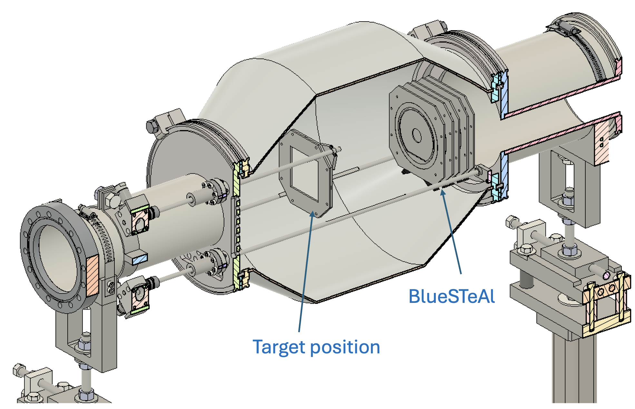
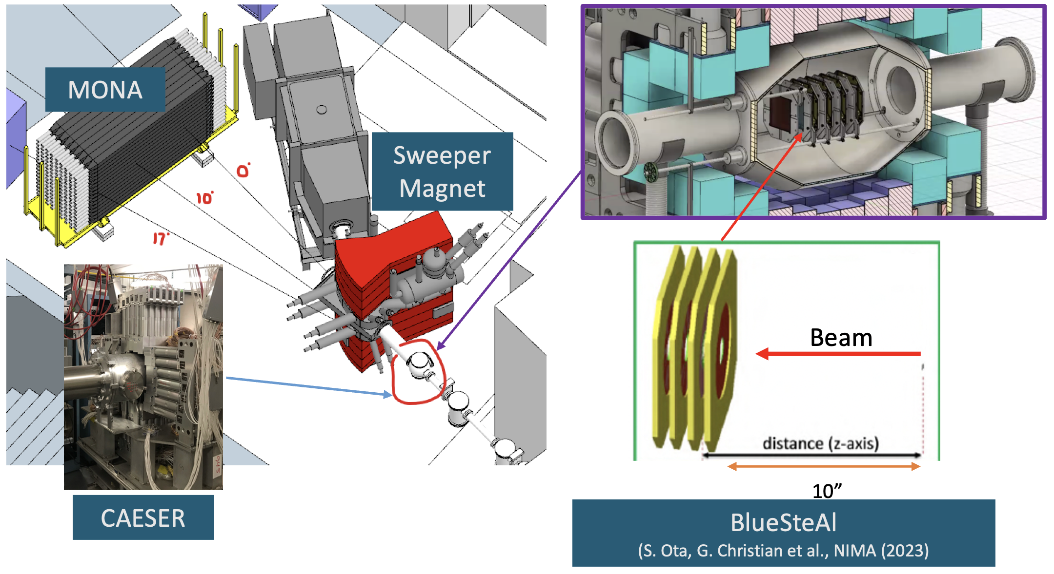
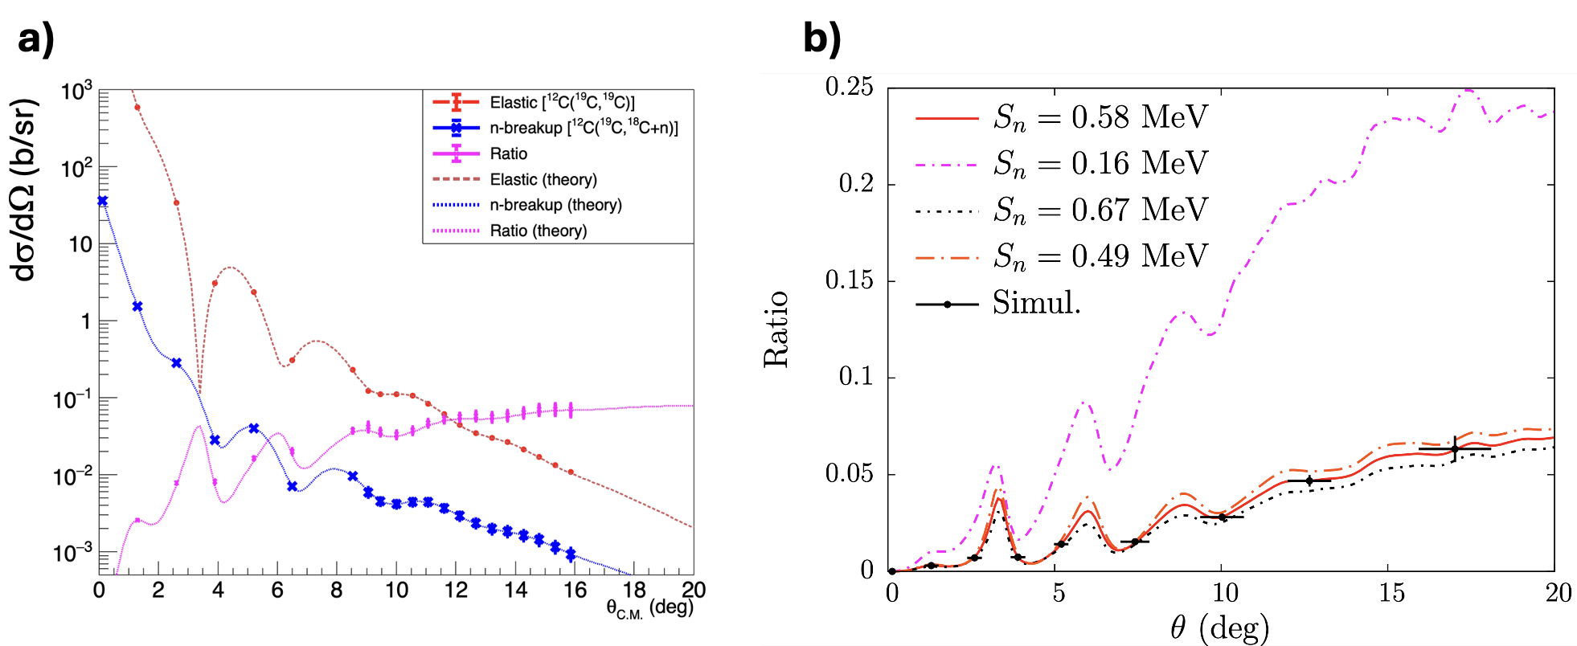
Physics II: Rare Isotopes and Nuclear Structure [3]
FRIB PAC3 proposal
  PR25076: spokespersons are S. Ota (BNL), P. Capel (JHUM) & P. Guèye (FRIB)
  Establish a complete picture of the halo nucleus ¹⁹C using a novel technique: the ratio method
S. Ota et al., Phys. Rev. Lett. 134, 212501 (2025)

Slide 16
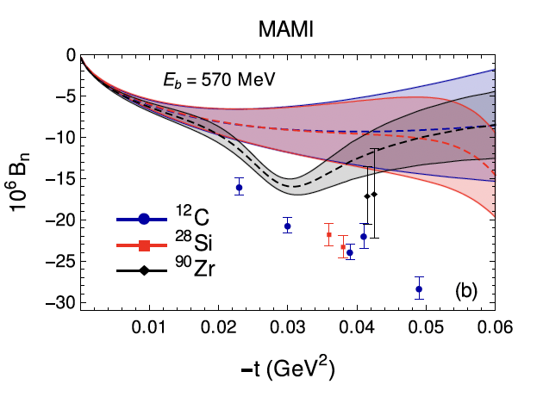
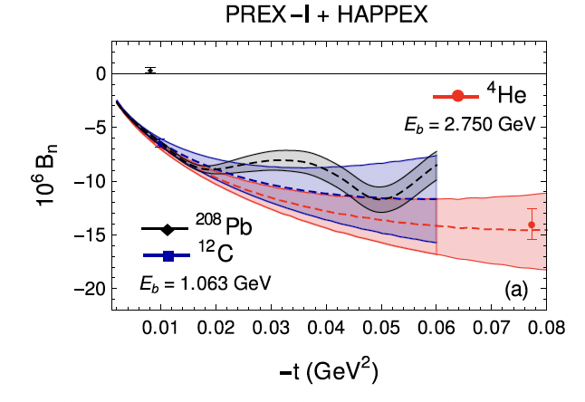
Physics II: Neutron skin puzzle and single spin asymmetries
Coulomb potential
  ²⁰⁸Pb charge radius: 0.07% effect [5.5012(13) fm → 5.5053(13) fm]
Single spin asymmetries (SSA)
  PV experiments measurements near diffraction minima
  Beam-normal SSA conserves parity
    But 0 in the first Born (1-𝛾) approximation
  Past JLab experiments on SSA on nuclear targets [1, 2]
    Unambiguous evidence of effects beyond the Born approximation
    Coulomb distortions are insufficient
    Excitation of nuclei during the scattering process (BNSSA) [3]
      Played a defining role!
      Light nuclei: OK
      ²⁰⁸Pb : not satisfactory
Guèye et al., EPJ A56(5) 2020
[1] Abrahamyan et al., Phys. Rev. Lett., 109(19):192501, 2012
[2] Adhikari et al., Phys. Rev. Lett., 128(14):142501, 2022
[3] Abrahamyan et al., Phys. Rev. C103(6):064316, 2021

Slide 17
PR12+25-013: Overview [1]
LOI12-23-015 (PAC51)
  Polarization (no!), theory, simulation
Collaborators
  53 participants → 80 participants
  26 institutions → 35 institutions
Endorsement
  Positron Working Group
Main goals
  Measure unpolarized A(e±,e±) cross section
  Map dispersive effects
    Energy dependence
      0.7 GeV – 4.24 GeV
    Atomic mass dependence
      8 targets
      ¹²C, ²⁷Al, ⁴⁸Ca, ⁵⁶Fe, ⁶³Cu, ¹⁹⁶Pt, ²⁰⁸Pb, ²⁰⁹Bi
Experiment (Hall C)
  Phase 1: qualitative measurements
    Compare A(e⁻,e⁻) with theory
    A. Afanasev group at GWU
  Phase 2: absolute direct measurements
    Compare A(e±,e±) cross sections
Physics
  Nuclear charge radii
  Rare isotopes & nuclear structure
  Neutron skin puzzle & single spin asymmetry
  Coulomb Sum Rule
  Electron dipole moment

Slide 18
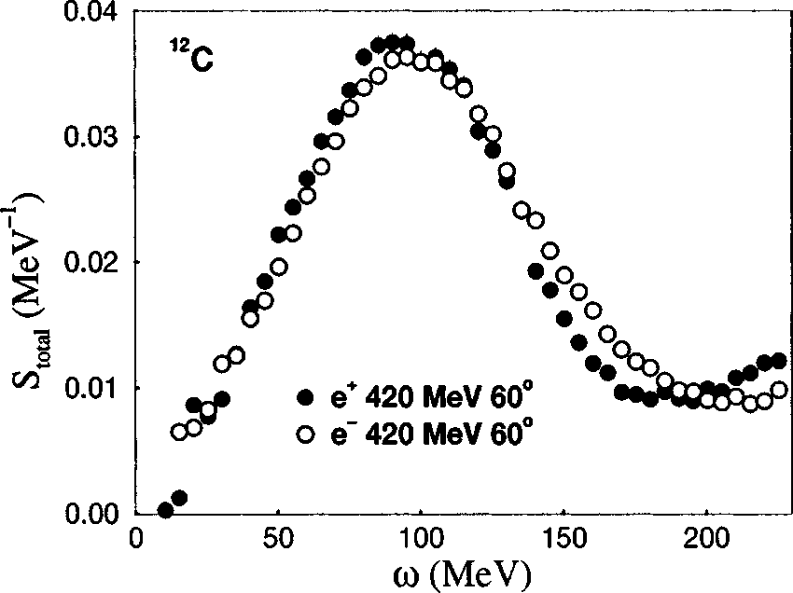
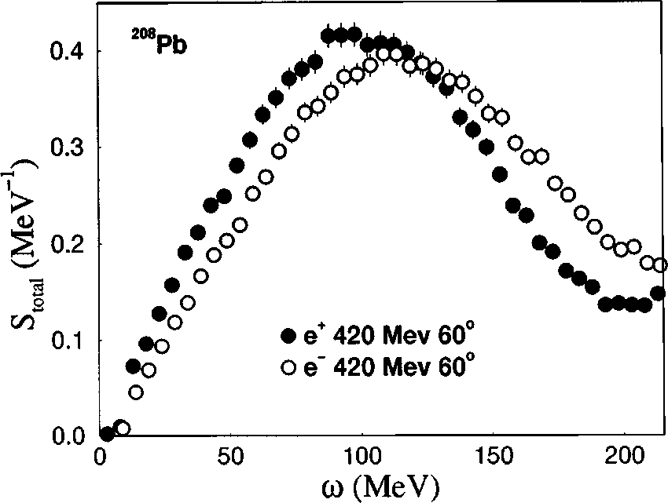
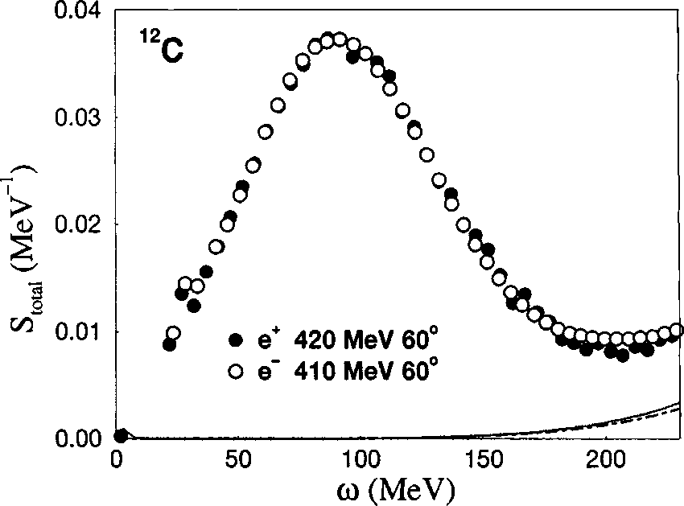
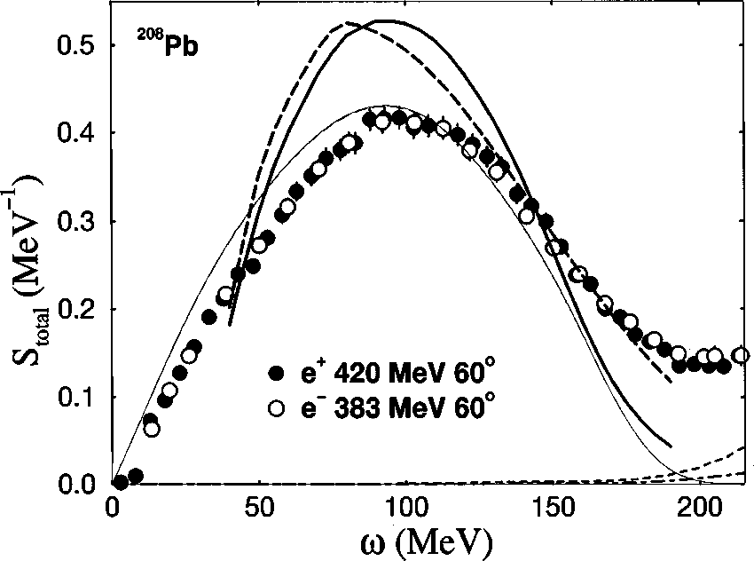
PR12+25-013: LEDEX And Charge Distributions [1]
Guèye et al., Phys. Rev. C60 044308 (1999)
E. Offerman et al., PRL 57 (13) 1986
Effective Momentum Approximation (EMA)

Slide 19
PR12+25-013: LEDEX And Charge Distributions [1]
OR

Slide 20
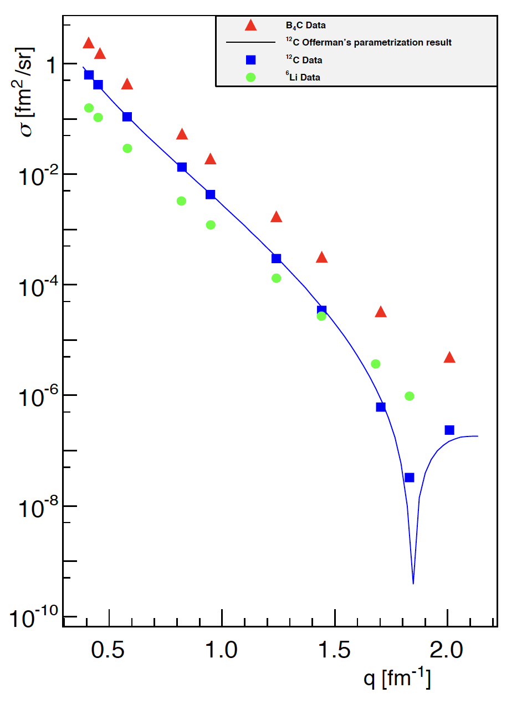
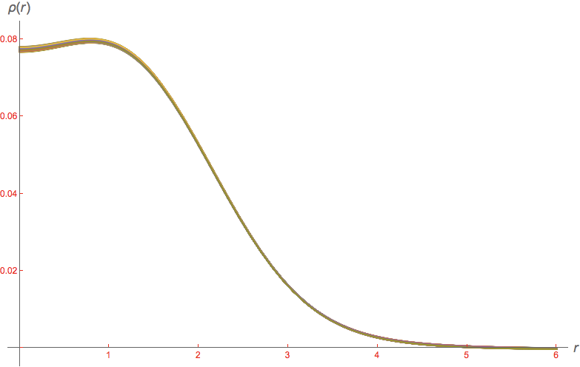
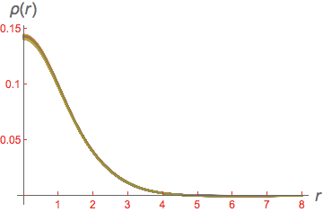
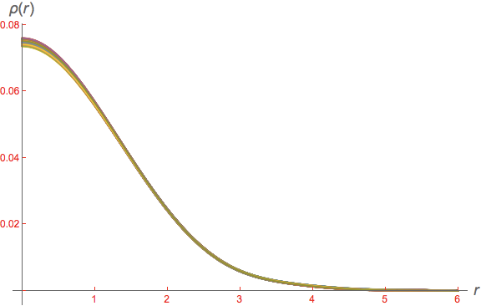
PR12+25-013: LEDEX And Charge Distributions [2]
A. Kabir, PhD thesis, Kent State University (2015)
¹²C
¹⁰B
LEDEX experiment (Hall A)
E_{beam}: 362 MeV, 685 MeV
Radii (rms)
  ¹²C: 2.450 ± 0.090 fm (3.67%)
  ¹⁰B: 2.425 ± 0.122 fm (5.03%)
  ⁶Li : 2.519 ± 0.048 fm (1.91%)
⁶Li

Slide 21
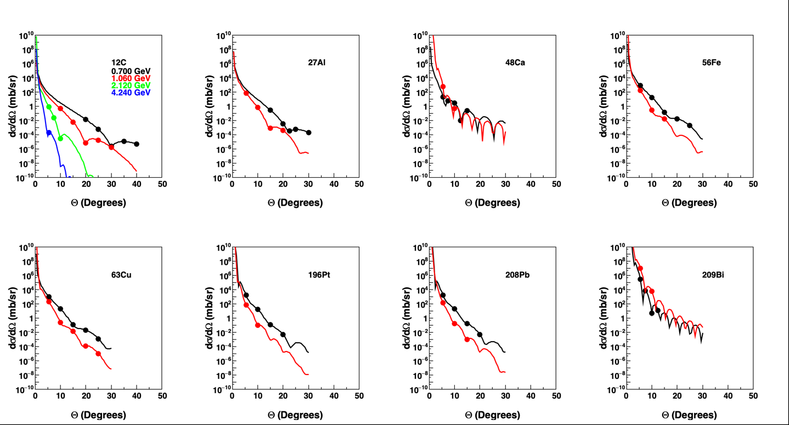
PR12+25-013: Phase 1
Zoë Cogan, high school, PING program
Energy dependence only for 12C
Kinematics
  Large set!
  67 points
Optimization
  SHMS/HMS
  Same Θ_{e’}

Slide 22
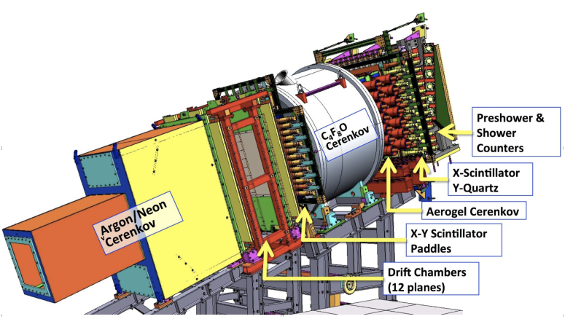
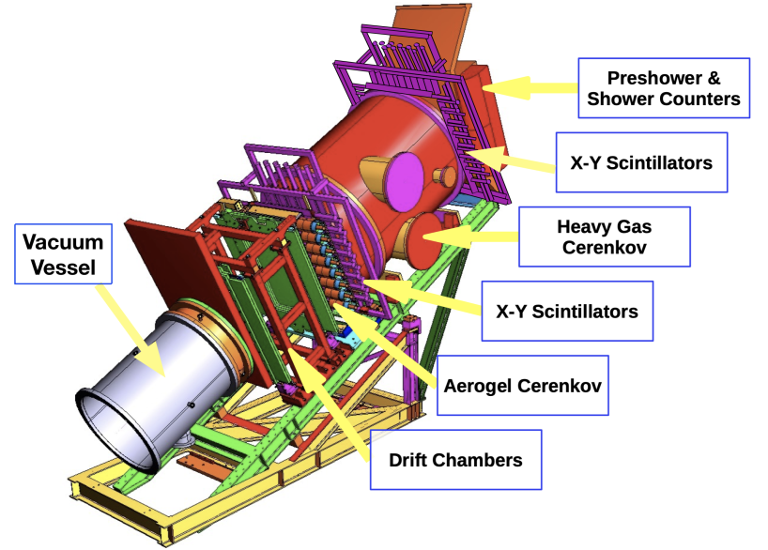
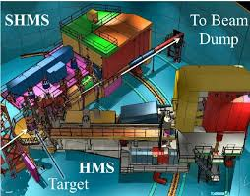
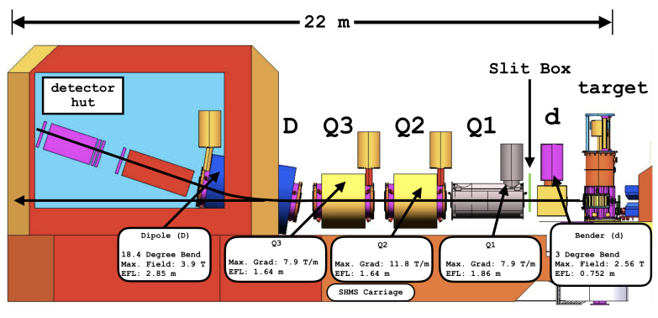
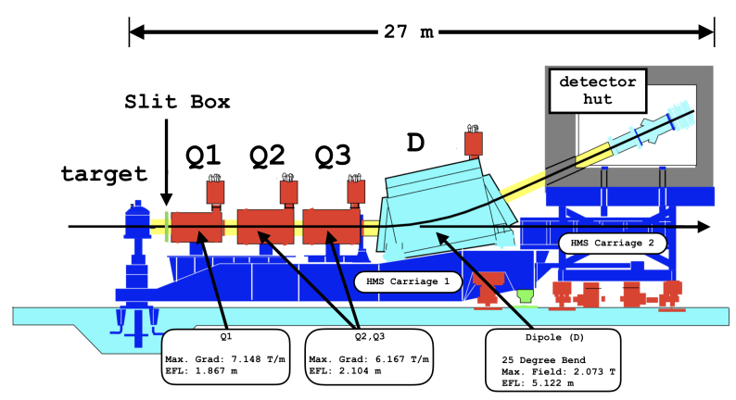
Hall C [1]
SHMS
HMS
Credits:
Hall C detector design group

Slide 23
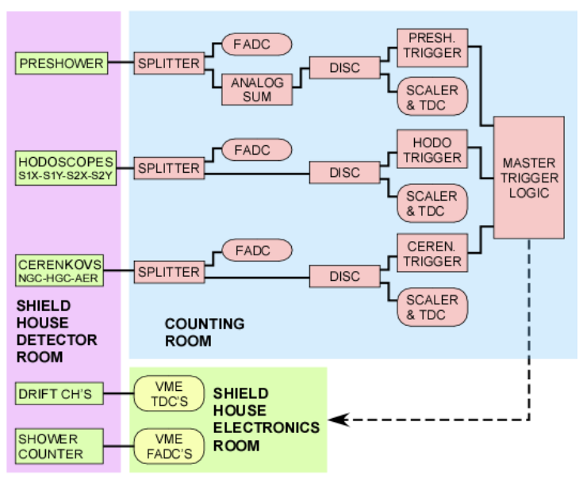
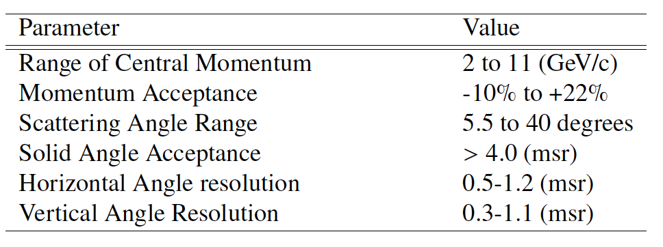
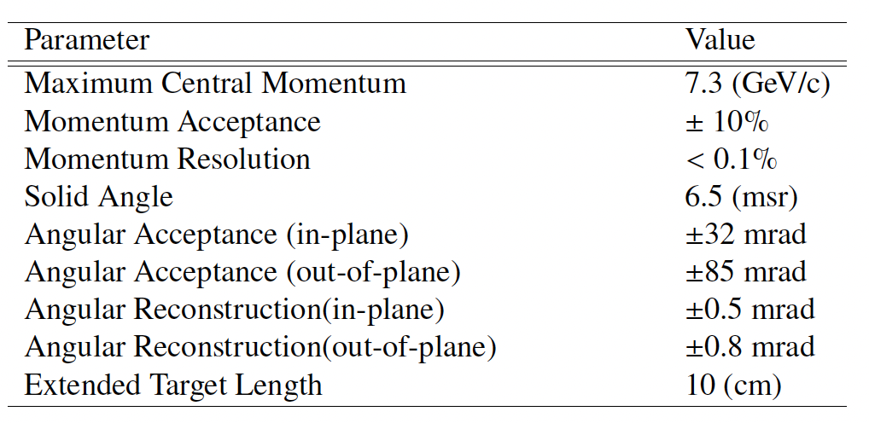
Hall C [2]
SHMS
HMS
Standard configuration
  Could use HMS at large angles to minimize experiment time
Trigger
  Phase 1: ELREAL (e⁻) that has a PID cut and high efficiency
  Phase 2: ELREAL or ELCLEAN (e⁺: developed with higher PID cut to handle the pi⁺ contribution)

Slide 24
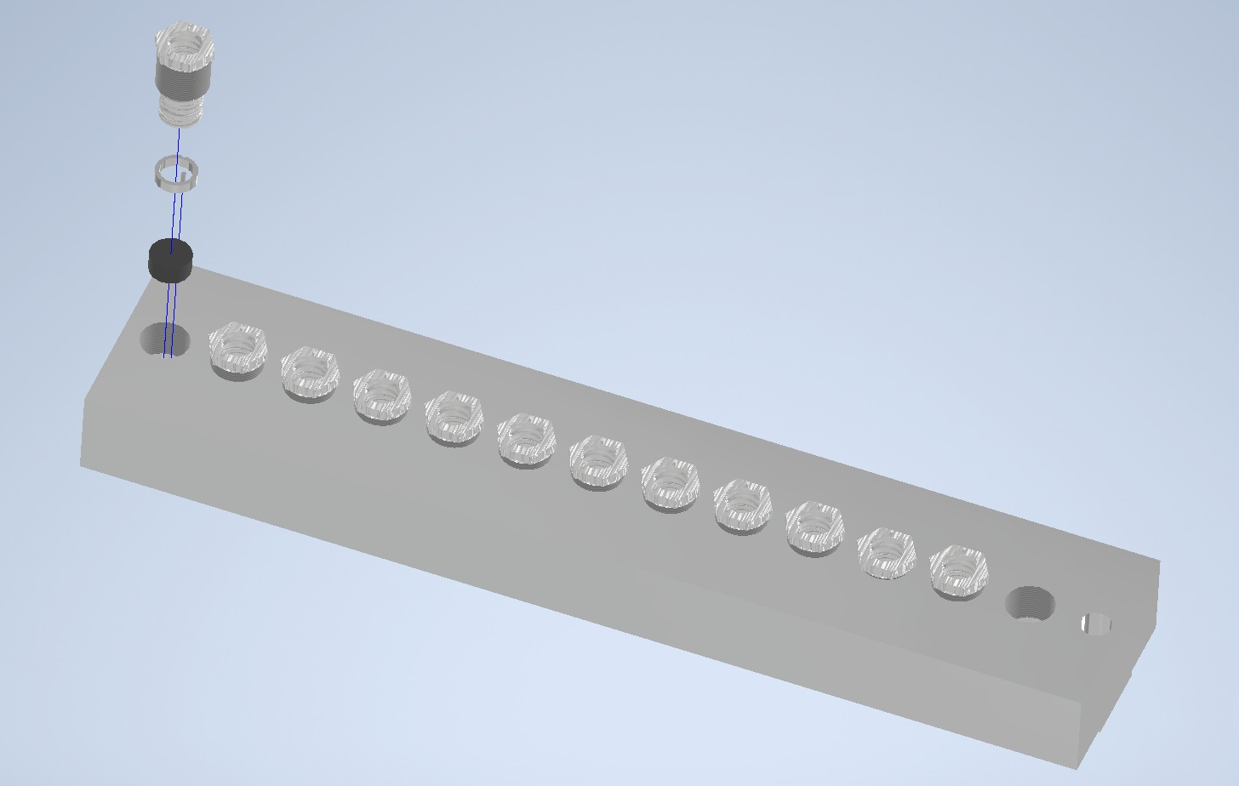
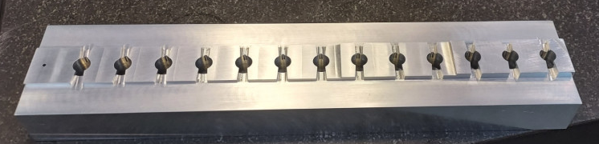
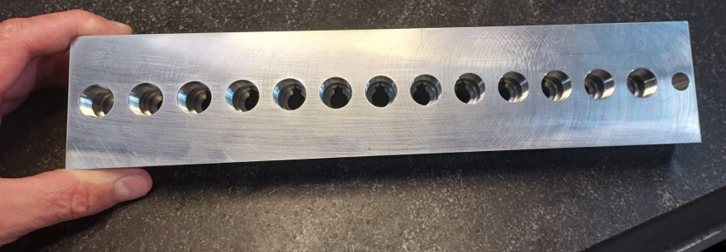
PR12+25-013 (PAC53): Target (TAC Review)
Target purity
  >99%
LH₂ for calibration
  No. Using ¹²C
Target ladder (J. Arrington)
  Will use the 13 target ladder developed for x>1 experiment
  Used : ¹²C, ²⁷Al, ⁴⁸Ca, ⁵⁶Fe, ⁶³Cu
  New : ¹⁹⁶Pt, ²⁰⁸Pb, ²⁰⁹Bi
Special cooling for Ca & Pb (D. Meekins)
  Was able to handle the significant power load on the targets (>200 W)
  It is cooled by conduction thru normal cryotarget connections
Heat dissipation for high current: could lower I_{beam} by x100
  ΔN/N: 0.1% (10⁶ events) to 1% (10⁴ events) → (Δσ/σ)_{stat}: 1.7% to 1.98%
        Courtesy: Dave Meekins

Slide 25


PR12+25-013: Kinematics (revised) [4]
* : prescale
**: prescale + small collimator
SIMC Simulation (in-house MC/fortran)
  Beam resolution
  Target: straggling + radiative corrections
  SHMS: resolution and detector efficiencies

Slide 26



PR12+25-013: Overview [5]
Statistics (rev)
Phase 1: ~1%
Phase 2: ~4-6%

Slide 27
PR12+25-013 (PAC53): Theory Review [2]
Comment 2
  The discussion of the nuclear structure effects in Sec.2 refers to some old empirical models... It would be helpful to connect the discussion of TPE corrections with these modern approaches. E.g., what is the role of 2-body currents near the diffractive minimum of the charge form factor?
  The model of the nuclear charge distribution of Refs.[27,28] quoted in Sec.2.2.1 refers to an idealized “static” distribution ... The discussion of the impact could be formulated in terms of systematic approaches accounting for relativistic corrections (e.g. magnetic currents) and interaction effects.
  The nuclear electric and magnetic form factor can be used to benchmark nuclear few body calculations with EFT interactions and current operators (2-body currents). It would be interesting to discuss the impact of the proposed measurements in this context.
New collaborators (theory)
  D. Lee (MSU): Nuclear Lattice Effective Field Theory (NLEFT)
  A. Brown (MSU): Shell Model; Skyrme Energy Density Functional (SKX-EDF)
  T. Miyagi (U. Tsukuba): Valence-Space In-Medium Similarity Renormalization Group (VS-IMSRG)
  Will provide clean data for comparison with any theoretical model

Slide 28
PR12+25-013 (PAC53): Theory Review [3]
Comment 3
  The proposal refers to “inclusive elastic” scattering, without specifying how exactly the elastic signal is to be identified. The analysis assumes that the electron/positron-nucleus scattering process is elastic, i.e., that the final nucleus is in its ground state. The scattering process can also leave the nucleus in a low-level excited state, which then decays through low-energy photon emission or nuclear decay. If the excitation energy is low enough, such processes will be experimentally indistinguishable from elastic scattering; however, they could have a significant effect on the size of the extracted “dispersive” TPE effects. The contributions from this effect should be estimated, especially for the heavier nuclei.
Contributions from excited states and TPE
  Standard analysis procedure: subtract Coulomb and radiative corrections
    TPE (e.g., Coulomb corrections) are included within the EMA framework
  Contribution from excited states
    Can exclude1st excited state: spectrometer resolution <10⁻⁴
      Beam resolution + SHMS resolution + straggling in target + radiative corrections + detector resolutions
      Study radiative tail region (excitation energy cut)

Slide 29
Contribution From Excited States
Units of MeV | ¹²C | ²⁷Al | ⁴⁸Ca | ⁵⁶Fe | ⁶³Cu | ¹⁹⁶Pt | ²⁰⁸Pb | ²⁰⁹Bi
1st Excited State | 4.443 | 0.844 | 3.832 | 0.847 | 0.670 | 0.356 | 2.615 | 0.986

Slide 30


700 MeV

Slide 31


1060 MeV

Slide 32

2120 MeV & 4240 MeV

Slide 33
Theory Review
“This is a well motivated experiment that could have significant impact”
First ever comprehensive study and energy dependence of dispersive effects
  Measure elastic inclusive cross section in Hall C at ~1-2% level
Two phases
  Phase 1: qualitative measurements – 20 days
    Compare A(e⁻,e⁻) with theory
    A. Afanasev group at GWU
  Phase 2: absolute direct measurements – 33 days
    Compare A(e±,e±) cross sections
Physics
  Nuclear charge radii
  Neutron skin puzzle & single spin asymmetries
  Coulomb Sum Rule
  Rare isotopes & nuclear structure
  Electron dipole moment (possible sensitivity)

Slide 34
Thank You!

Slide 35







Physics: Coulomb Sum Rule
J. Morgenstern & Z. Meziani.
EPJ, A17, 451–455, (2003)
J. A. Tostevin and A. Gade
Phys. Rev. C 103, 054610 (2021)
M. Paolone, JLab e05-110; CSR quenching?
Hall A/C Collaboration (January 2022)
P. Guèye et al., EPJ A56(5) 2020
22% in ¹²C!

Slide 36
Physics: EDM Search [1]
Collaboration with Jaideep Singh @ MSU
Need: nuclei with spin >0
  Four electromagnetic form factors [1]
    F₁ (charge) and F₂ (anomalous magnetic moment)
      Experimentally measured
      F₂ lead to 2-photon exchange puzzle [2]
    F₃ (electron dipole moment)
      No non-zero measured but possible [3,4]
    F₄ (Zeldovich anapole moment)
      No experimental evidence
      Through coupling to off-shell photons (virtual exchanged between 2 fermions) [1]
      PV through F4 competes with PV through Z0: very hard to disentangle!
      [1] M. Nowakowski, E. A. Paschos and J. M. Rodríguez, Eur. J. Phys. 26 545–560 (2005)
      [2] Bosted P. E., Phys. Rev. C51 409–11 (1995)
        [3] Commins E. D., Advances in At., Mol. and Opt. Phys., 40 1–55 (1999)
        [4] Regan B. C. et al., Phys. Rev. Lett. 88 071805 (2002)

Slide 37
Physics: EDM Search [2]
Goal
  Constrain EDMs from electron scattering data in a model independent way
  Note on small Z: theory predicts that they are immeasurably small
    No one have even tried to measure them!
  Experimental verification
    Experimental limits even if crude
  Would need polarized experiments
Targets
  Spin 0 :¹²C, ⁴⁸Ca, ⁵⁶Fe, ¹⁹⁶Pt, ²⁰⁸Pb
  Non-spin 0: ²⁷Al (5/2), ⁶³Cu (3/2), ²⁰⁹Bi (9/2)

