Slide 1
Experiment Readiness Review
Jefferson Lab PAC July 21 – 25, 2025
Patrizia Rossi

Slide 2
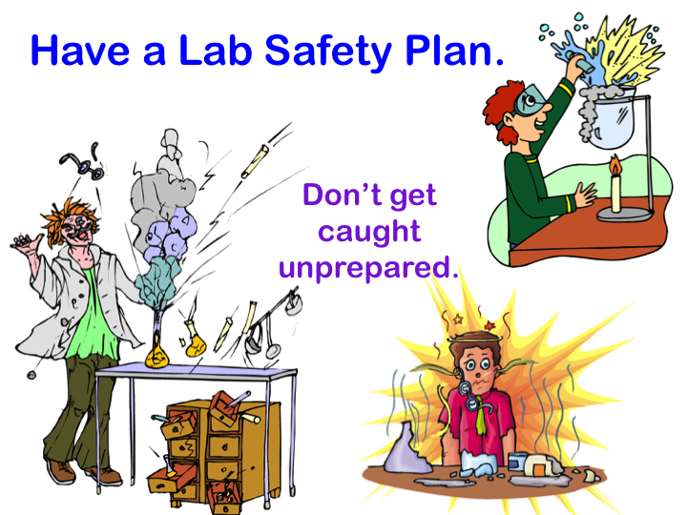
Experiment Readiness Review (ERR)
ERRs are standalone reviews required prior to delivery of any beam to the halls
Objective of the ERR is a safe, efficient and effective operation of the experiment
Operation will not result in injury to personnel and/or damage the equipment
  Automatic protection measures of personnel & equipment are in place during abnormal situations
Equipment performs as expected - no wasted beam time nor it interferes with other experiments
  Operating instructions & boundaries are defined as well as responsible staff
Experiment is successful in achieving its goals
Have an Experiment Safe & Efficient Plan !!
Don’t get caught unprepared
DECOMMISSIONING
2

Slide 3
From Proposal to Data: The Experiment Lifecycle
PROPOSAL PHASE
Submitting Proposals
TAC & PAC Process
PAC recommendations -> Director’s Decision
Approval
Conditional Approval
  C1 –pending technical review, no return to PAC
  C2 – pending further review by future PAC
DECOMMISSIONING
3

Slide 4
From Proposal to Data: The Experiment Lifecycle
PROPOSAL PHASE
Submitting Proposals
TAC & PAC Process
PAC recommendatios -> Director’s Decision
Approval
Conditional Approval
  C1 –pending technical review, no return to PAC
  C2 – pending further review by future PAC
⬇
PRELIM. PLANNING PHASE
Exp. Description and Requirements
Exp. Readiness Review Calendar
RESOURCE AVAILABILITY
– Stage I: resources need to be identified/obtained
– Stage II: resources are essentially available
This is a Laboratory issue - not for PAC
DECOMMISSIONING
4

Slide 5
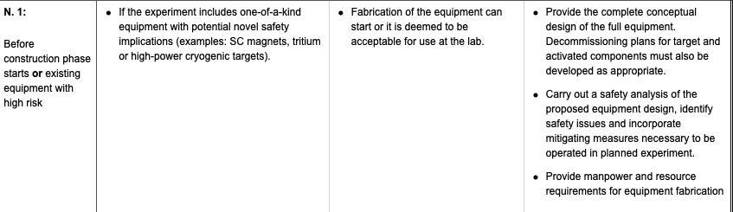
From Proposal to Data: The Experiment Lifecycle
PROPOSAL PHASE
Submitting Proposals
TAC & PAC Process
PAC recommendatios -> Director’s Decision
Approval
Conditional Approval
  C1 –pending technical review, no return to PAC
  C2 – pending further review by future PAC
⬇
PRELIM. PLANNING PHASE
Exp. Description and Requirements
Exp. Readiness Review Calendar
RESOURCE AVAILABILITY
⬇
DESIGN PHASE
ERR N.1
DECOMMISSIONING
5

Slide 6
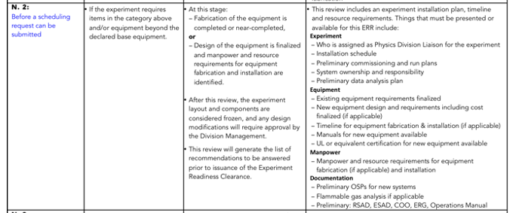
From Proposal to Data: The Experiment Lifecycle
PROPOSAL PHASE
Submitting Proposals
TAC & PAC Process
PAC recommendatios -> Director’s Decision
Approval
Conditional Approval
  C1 –pending technical review, no return to PAC
  C2 – pending further review by future PAC
⬇
PRELIM. PLANNING PHASE
Exp. Description and Requirements
Exp. Readiness Review Calendar
RESOURCE AVAILABILITY
⬇
DESIGN PHASE
ERR N.1
Before construction phase starts or existing equipment with high risk
⬇
ERR N.2
CONSTRUCTION PHASE
DECOMMISSIONING
6

Slide 7
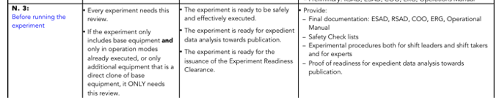
From Proposal to Data: The Experiment Lifecycle
PROPOSAL PHASE
Submitting Proposals
TAC & PAC Process
PAC recommendatios -> Director’s Decision
Approval
Conditional Approval
  C1 –pending technical review, no return to PAC
  C2 – pending further review by future PAC
⬇
PRELIM. PLANNING PHASE
Exp. Description and Requirements
Exp. Readiness Review Calendar
RESOURCE AVAILABILITY
⬇
DESIGN PHASE
ERR N.1
Before construction phase starts or existing equipment with high risk
⬇
CONSTRUCTION PHASE
ERR N.2
Before a scheduling request can be submitted
SCHEDULING OF EXPERIMENT
by JLab
⬇
⬇
ERR N.3
EQUIPMENT INSTALLATION
DECOMMISSIONING
RUN THE EXPERIMENT
7

Slide 8
From Proposal to Data: The Experiment Lifecycle
PROPOSAL PHASE
Submitting Proposals
TAC & PAC Process
PAC recommendatios -> Director’s Decision
Approval
Conditional Approval
  C1 –pending technical review, no return to PAC
  C2 – pending further review by future PAC
⬇
PRELIM. PLANNING PHASE
Exp. Description and Requirements
Exp. Readiness Review Calendar
RESOURCE AVAILABILITY
⬇
DESIGN PHASE
ERR N.1
Before construction phase starts or existing equipment with high risk
⬇
CONSTRUCTION PHASE
ERR N.2
Before a scheduling request can be submitted
SCHEDULING OF EXPERIMENT
by JLab
⬇
⬇
EQUIPMENT INSTALLATION
ERR N.3
Before running the experiment
Hall Leader requests approval for running the experiment
Readiness Certificate is issued by the Physics Division
DECOMMISSIONING
RUN THE EXPERIMENT
https://www.jlab.org/physics/experiment_process/np-pfx-chart
8

Slide 9
Conclusions
The ERR process has been used effectively since the start of the 12 GeV experimental program. 59 ERRs have been conducted, covering 89 experiments and over 12 additional major pieces of equipment such as the tritium target and new superconducting magnets have been reviewed.
The model seems to work well, with very good communication, coordination, and cooperation amongst multiple divisions, and roles and responsibilities well defined (work coordinator, physics liaison, accelerator liaison, engineering coordinator).
  The ERR process is a credited control procedure and addresses the Accelerator Safety Envelope compliance.

