Slide 1

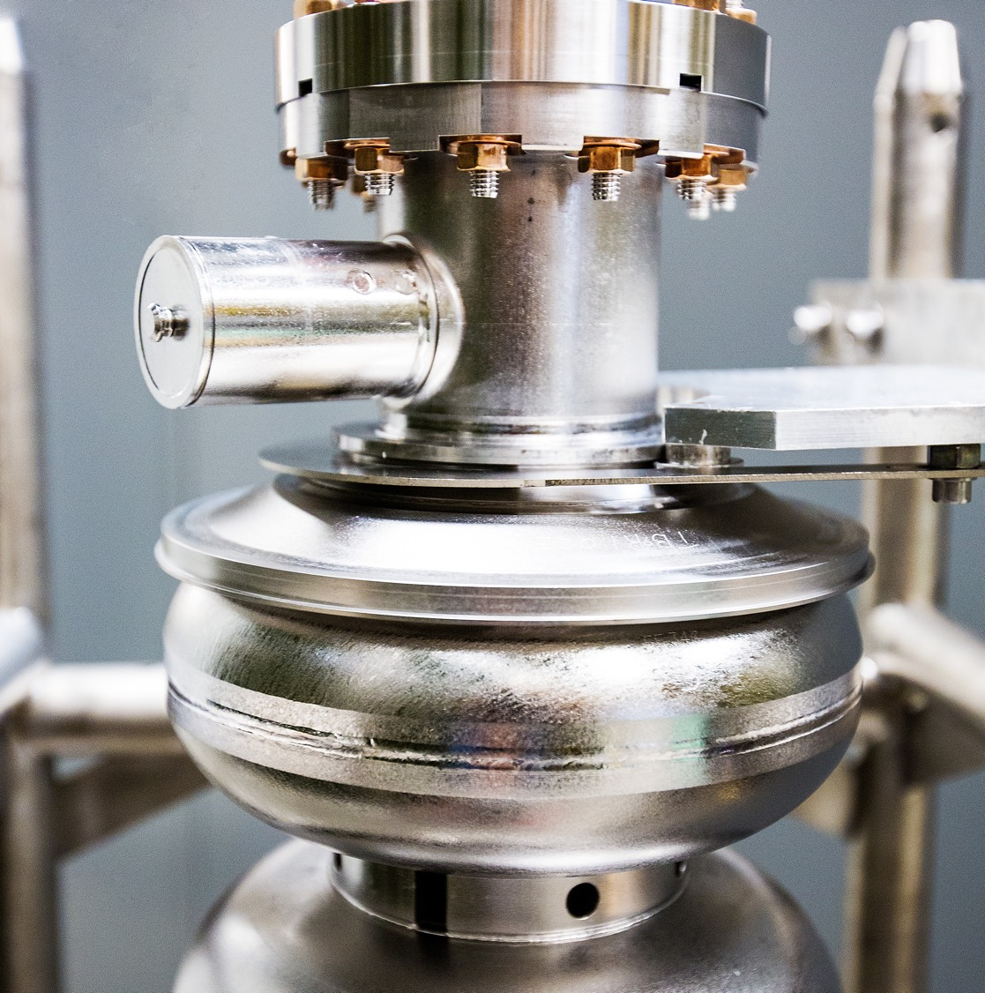
Nuclear Physics
Experiment Scheduling
21 July 2025
Douglas Weadon Higinbotham, Ph.D.
Notes:
Tip: Keep titles under 60 characters for readability
To change the photo: Right-click on photo and select change photo

Slide 2
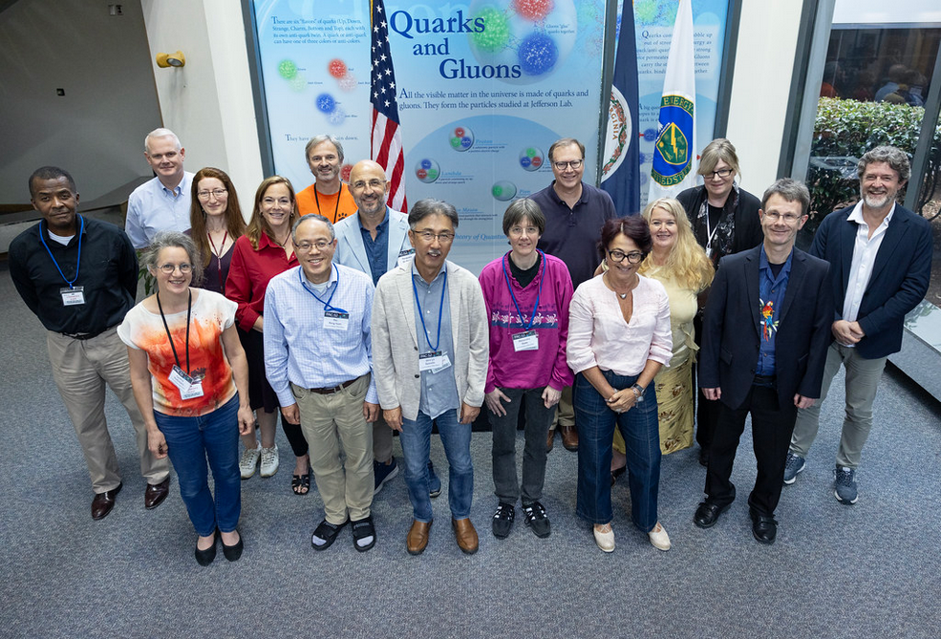
CEBAF Experiment Life Cycle
Proposal for a new experiment
Review of the proposal and reviews by our Program Advisory Committee (PAC)
High Impact Science Approved
Experimental Readiness Reviews: part of our accelerator accredited controls
Scheduling & Running the Experiment
Analyzing the data
Publications and Theses
Typically, a ten-year process, with many experiments at each one of the stages at any give time.
Photo of Jefferson Lab’s 52nd Program Advisory Committee.
Notes:
Guidelines: 6-8 bullets per slide; Use sentence fragments for bullets
To change the photo: Right-click on photo and select change photo

Slide 3
Nuclear Physics Experiment Scheduling (NPES) Committee
The advice from our Program Advisory Committee is used to help set priorities and guide our making a schedule with up to four halls running at the same time.
Different halls can run different passes of the CEBAF accelerator, require very different currents (from 10 nA to 100 uA) and many experiments require longitudinal polarization. This all needs to be done within the limits of what CEBAF can deliver (e.g. 1.1 MW total power).
Often schedules get built around a flagship measurement such as GEP-V or MOLLER and then the committee works hard to deliver the best technically ready experiments in support of the mission of the lab.
The current NPES committee members are Eugene Chudakov, David Dean, Joe Grames, Douglas Higinbotham (Co-Chair), Mark Jones, Cynthia Keppel, Eduard Pozdeyev (Co-Chair), Patrizia Rossi, and Mike Spata, with valuable input provided from both accelerator and physics division support groups as well as facilities and engineering teams.
After final review by the NPES committee, the schedule goes to the Jefferson Lab Director Jens Dilling for final approval and then is posted online and emailed to our user community.
Notes:
Guidelines: 6-8 bullets per slide; Use sentence fragments for bullets
To change the photo: Right-click on photo and select change photo

Slide 4
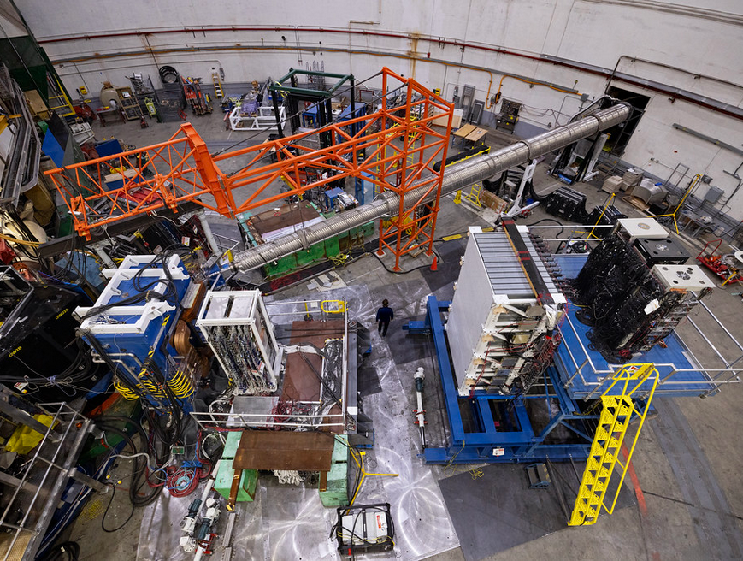
DETAILED SCHEDULE
For every day of CEBAF running we have a detailed schedule for each of the experimental halls.
Each morning the schedule is reviewed with the hall run coordinators along with the program deputy, head of accelerator operations and myself for physics division.
As needed to ensure the experiments are getting the data they need, we make minor changes to the plan and those changes are reflected on a white-board at MCC.
Most important is good communication between the halls and the accelerator.
Photo of experimental Hall A. Our hall for major installation experiments like GEP-V (shown) and MOLLER.
Notes:
Guidelines: 6-8 bullets per slide; Use sentence fragments for bullets
To change the photo: Right-click on photo and select change photo

Slide 5
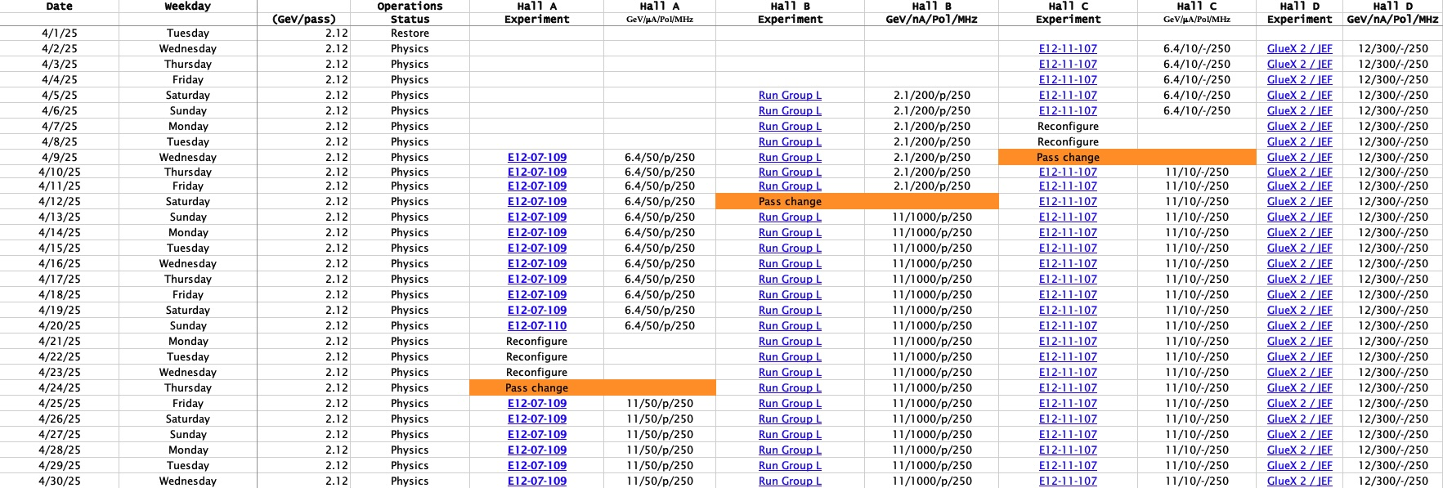
As a previous lesson learned, we try to stagger the initial start of beam to the halls.

Slide 6
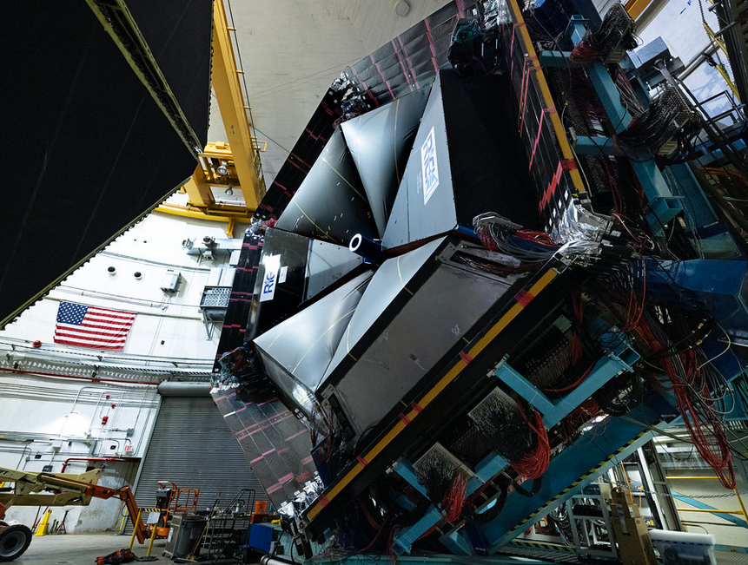
TWO YEAR SCHEDULE
The scheduling memo that is approved by Kim and made by the NPES committee has the plan for the current fiscal year and a tentative plan for the next fiscal.
As budgets are uncertain, we of course adjust these plans as needed; but we do try to stick with them as much as possible. For example, when an experiment runs can be particularly important for the doctorial students and postdoctoral scientists and for a 413.3B project such as MOLLER can be important for a project milestone.
Photo of experimental Hall B. This large acceptance spectrometer, CLAS12, is ideal of multiparticle final-states as well as for searches over large areas of phase space.
Notes:
Guidelines: 6-8 bullets per slide; Use sentence fragments for bullets
To change the photo: Right-click on photo and select change photo

Slide 7
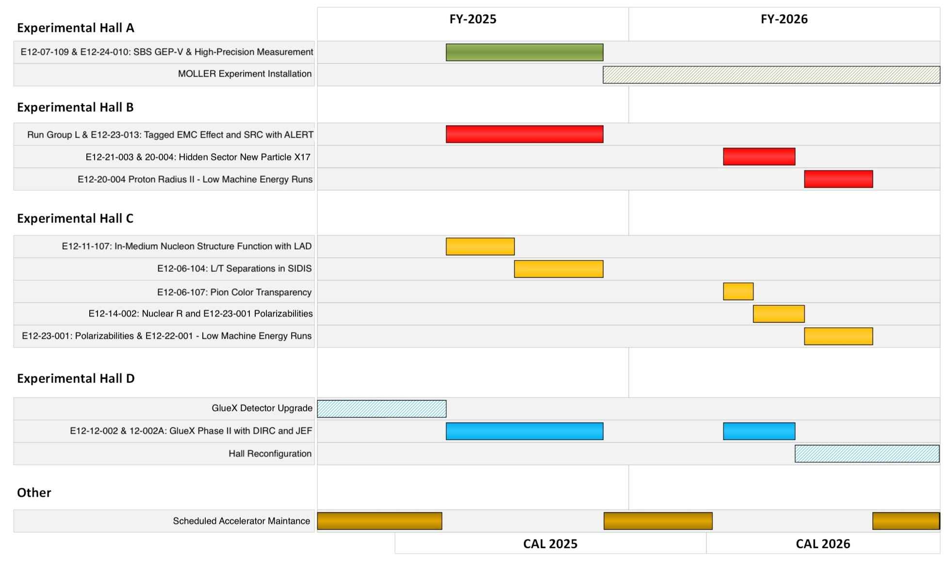
NOTE: New Version Coming With Next Scheduling Memo
Also see detailed xls file at: https://www.jlab.org/physics/experiments/schedule

Slide 8
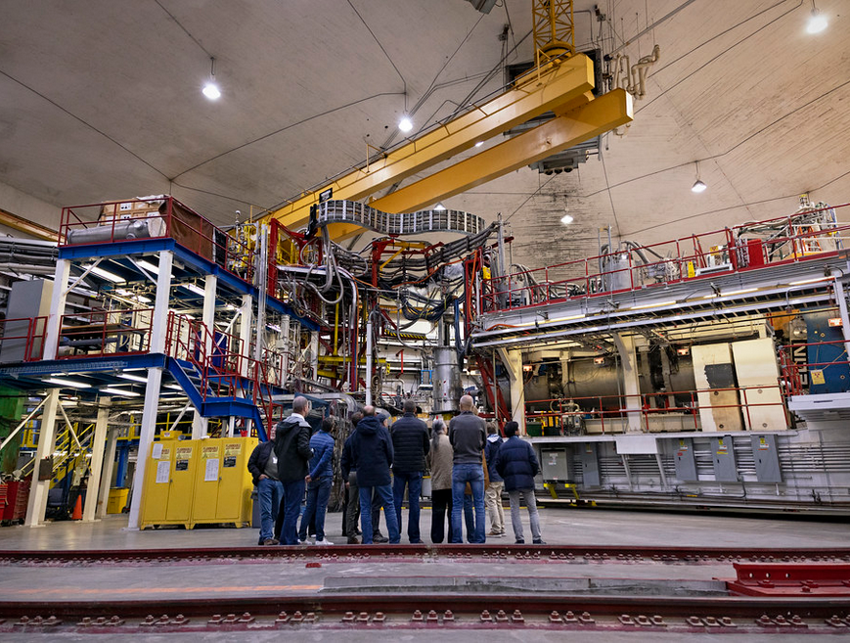
LONG TERM SCHEDULE
Along with the formal two-year schedule that is approved by Kim, we are also always looking forward at least five years.
Unlike the short-term schedule, which tends to only get minor changes in the sequence or timing of experiments, the long-term schedule tends to see more dramatic shifts as priorities and/or funding profiles change.
While only the MOLLER experiment is a 413.3B project, all our experiments require a lot of planning, resource management and often an enabling piece of equipment. For example, the current experiment in Hall B has the ALERT detector system installed, in Hall C the new LAD detector and in Hall D an upgraded calorimeter.
Photo of experimental Hall C. This high luminosity hall is equipped with a pair of spectrometers for high precision experiments with space for large ancillary detectors.
Notes:
Guidelines: 6-8 bullets per slide; Use sentence fragments for bullets
To change the photo: Right-click on photo and select change photo

Slide 9
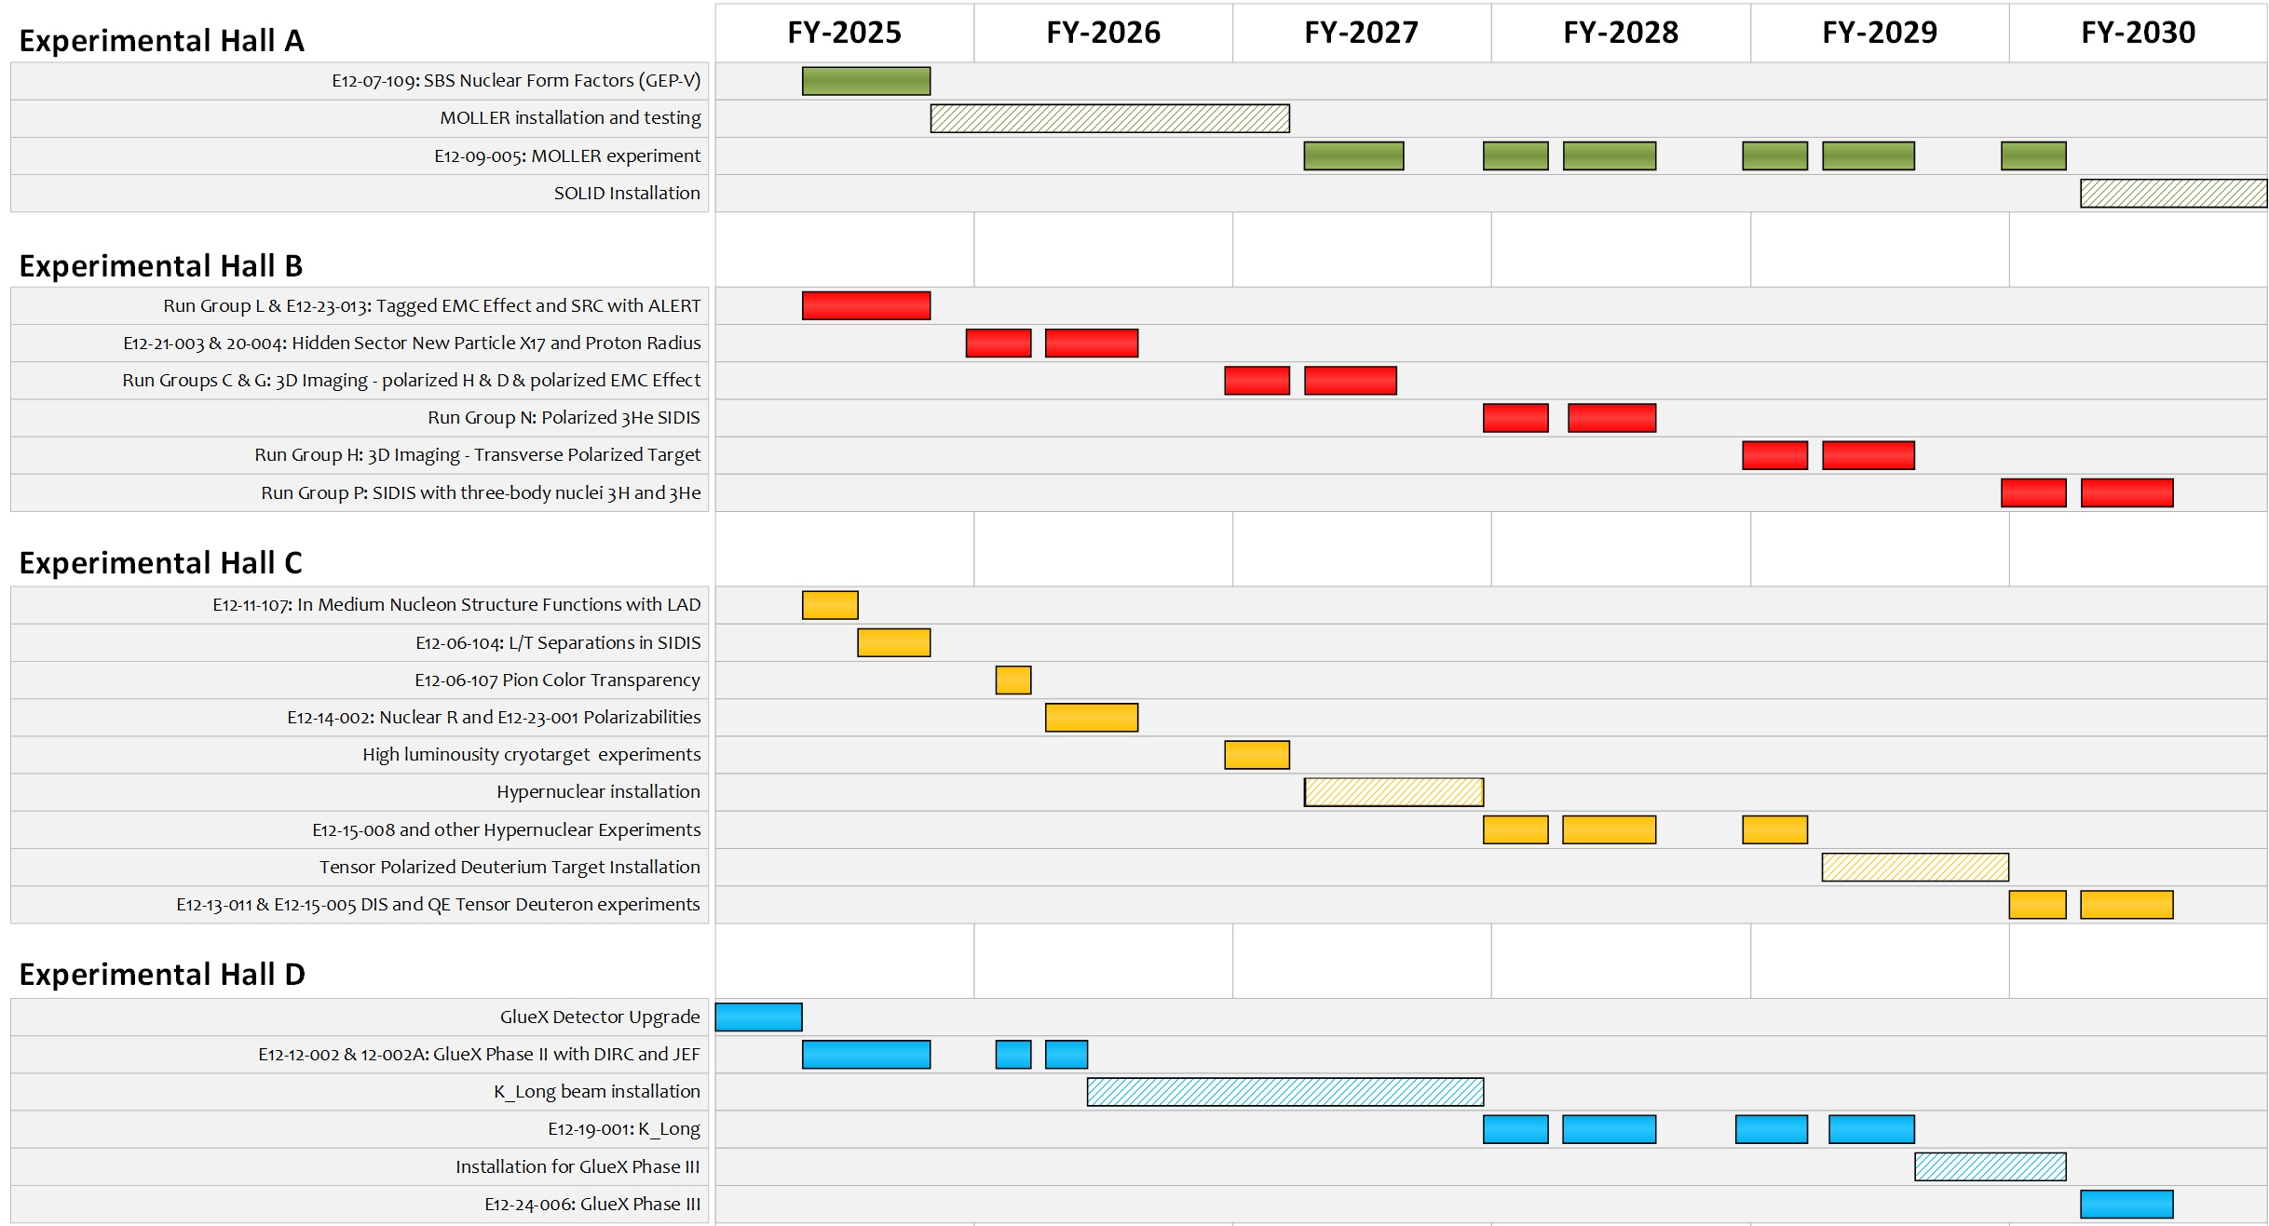
Next major installation

Slide 10
Summary
A lot of effort goes into the planning of each of the Jefferson Lab experiments with a decade of time typically required to go from an approved PAC proposal to final publications.
At all stages, we try to have good communication with our amazing user community, from the long-term schedules down to the day-by-day.
Overall, we are all working hard to get the best possible science done while also making sure the Ph.D. students are getting the data they need for their dissertations.
The schedules, especially the long-term one, are regularly updated and we look forward to the input from PAC53 to keep Jefferson Lab’s nuclear physics program world class and highest-possible impact.
Notes:
Before sharing your presentation, confirm:
Fonts are consistent
Images meet quality standards
Charts use template colors
Footer information is current
Spell check completed
Links are working
File size is optimized

