Slide 1
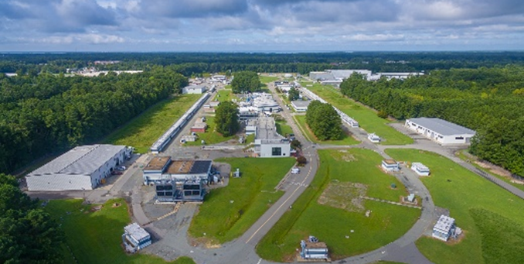
PAC53 Introduction, Charge, and Future Initiatives
Cynthia Keppel
PAC53
July 21-25, 2025

Slide 2
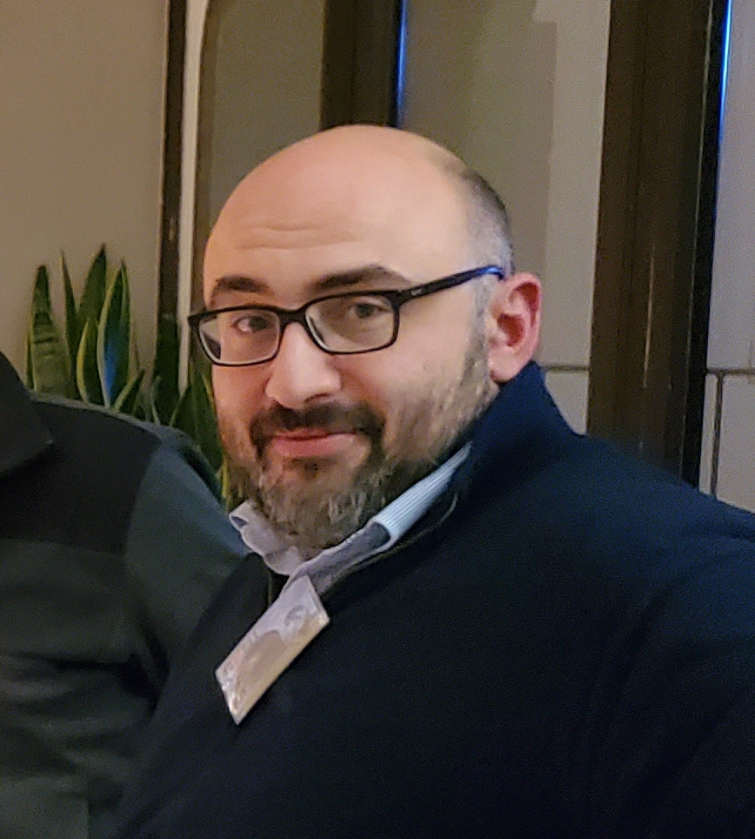

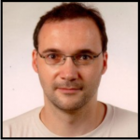


Welcome PAC members!!
MANY, MANY, MANY THANKS!!!! Serving on the PAC is critical and greatly appreciated work. Your expert input is absolutely essential to the success of the Jefferson Lab program.
Committee Member Changes for PAC53
- New Chair Pasquale DiNezza (INFN)
- Elke Aschenauer, Keith Baker, Shin’ya Sawada, Concettina Sfienti, Feng Yuan have rotated off.
- Welcome to Bakur Parsamyan (CERN, INFN), Bernhard Ketzer (University of Bonn), Chris Polly (Fermilab), Peter Schweitzer (University of Connecticut) and Hirokazu Tamura (Tohoku University).

Slide 3
Approved PAC Days by Physics Topic
Background….
Topic | Hall A | Hall B | Hall C | Hall D |  | Total
The hadron spectra as probes of QCD (Baryon and meson spectroscopy) |  | 219 | 11 | 740 |  | 970
The transverse structure of hadrons (Elastic and transition Form Factors) | 154.5 | 110 | 316 | 25 |  | 605.5
The longitudinal structure of hadrons (Unpolarized and polarized Parton Distribution Functions) | 80 | 230 | 252 | 33 |  | 595
The 3D structure of hadrons (Generalized Parton Distributions and Transverse Momentum Distributions) | 321 | 872 | 377 |  |  | 1570
Hadrons and cold nuclear matter (Medium modification of nucleons, quark hadronization, N-N correlations, hypernuclear spectroscopy) | 226.5 | 322 | 491.3 | 15 |  | 1054.8
Tests of the Standard Model and Fundamental Symmetries | 513 | 307 | 9 | 79 |  | 908
Total | 1295 | 2060 | 1456.3 | 892 |  | 5703.3
Reference: https://misportal.jlab.org/ul/ul_office/ExperimentDB/rptApprovedExperimentsByHallAndTopicDays.cfm

Slide 4
Number of Approved Experiments by Physics Topic
Topic | Hall A | Hall B | Hall C | Hall D |  | Total
The hadron spectra as probes of QCD (Baryon and meson spectroscopy) |  | 6 | 1 | 4 |  | 11
The transverse structure of hadrons (Elastic and transition Form Factors) | 8 | 6 | 7 | 1 |  | 22
The longitudinal structure of hadrons (Unpolarized and polarized Parton Distribution Functions) | 5 | 5 | 8 | 1 |  | 19
The 3D structure of hadrons (Generalized Parton Distributions and Transverse Momentum Distributions) | 10 | 14 | 10 |  |  | 34
Hadrons and cold nuclear matter (Medium modification of nucleons, quark hadronization, N-N correlations, hypernuclear spectroscopy) | 10 | 12 | 16 | 2 |  | 40
Tests of the Standard Model and Fundamental Symmetries | 3 | 3 | 1 | 1 |  | 8
Total | 36 | 46 | 43 | 9 |  | 134
Reference: https://misportal.jlab.org/ul/ul_office/ExperimentDB/rptApprovedExperimentsByHallAndTopic.cfm

Slide 5
Status of Fully Approved Experiments
 | Full Completed | Partially Completed | Approved (Not Yet Run) | Total Approved Number of Experiments
Hall A | 13 | 1 | 14 | 28
Hall B | 6 | 14 | 8 | 28
Hall C | 12 | 7 | 24 | 43
Hall D | 4 | 1 | 3 | 8
Total | 35 | 23 | 49 | 107
12 GeV era, see https://misportal.jlab.org/mis/physics/experiments/searchProposals.cfm
Fully approved
  Conditional not included (positrons and other)
  Run groups and SoLID included
Finishing 2 more this month (one each in B,C)
Some longer experiments split into distinct run periods where a fraction of the data is collected and analyzed prior to a final full run (i.e. partially completed).

Slide 6
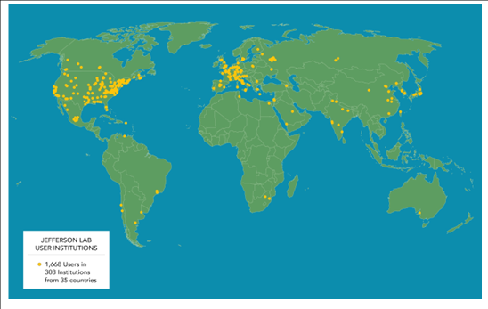
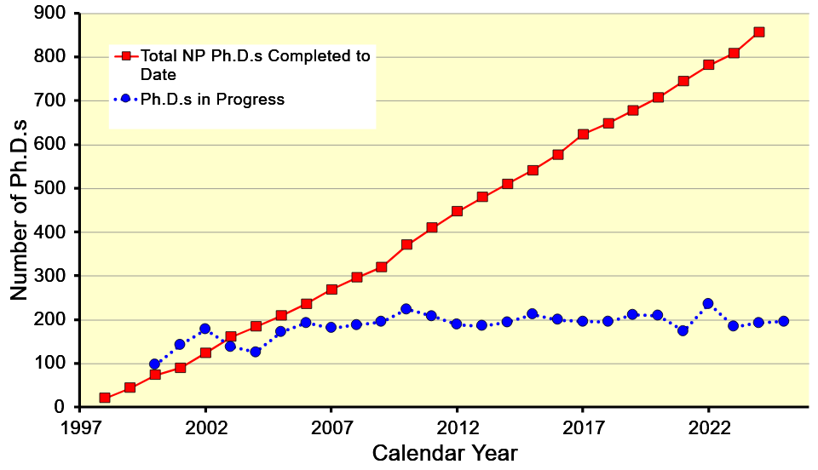
User Driven Science
PAC 53
New Proposals | 13
Conditional | 2
Run Group | 2
Letters of Intent | 2
Jeopardy | 2
TOTAL | 21
International community
200+ users on site on average
~1/3 of US nuclear physics PhDs

Slide 7
PAC53 CHarge
Review new proposals, previously conditionally approved proposals, jeopardy proposals, and letters of intent for experiments that will utilize CEBAF and provide advice on their scientific merit, technical feasibility and resource requirements.
Identify proposals that represent high quality physics within the range of scientific importance represented by the previously approved proposals and recommend for approval.
Also provide a recommendation for scientific rating for experiments newly recommended for approval, and on continued approval and scientific rating for worthy jeopardy proposals.
Identify other proposals with physics that have the potential for falling into this category pending clarification of scientific and/or technical issues and recommend for conditional approval. Provide comments on technical and scientific issues that should be addressed by the proponents prior to review at a future PAC.
  C1 – Approval (with grade and time allocation) pending technical review, no need to return to PAC
  C2 – Approval pending further review by future PAC

Slide 8
Jeopardy
Policy
Finalized after discussion with UGBOD in September 2016
Rationale
To ensure the relevancy of experiments which haven’t run within a five year window of time, the Jefferson Lab Program Advisory Committee is asked to review experiments in a jeopardy process to ensure the experiments are still world class and can reject, defer, approve or adjust the letter grade of the experiment as deemed appropriate.
Approach
Use normal yearly PAC in ~4 year cycle of Halls to address all presently approved proposals that have not been scheduled. This PAC 53 focuses on Hall D.
Started in 2019, now steady state - proposals that have been approved for 4 years or more but are not scheduled will be considered in Jeopardy.
  Changed to “not completed” instead of “not scheduled”
  Does not speak to projected long term schedule – use near term NPES
  New beam time or significant resource requests must be submitted as full proposals
  Major changes to configurations should come back as new proposals

Slide 9
Jeopardy issues
Is there any new information that would affect the scientific importance or impact of the Experiment since it was originally proposed?
2) If the Experiment has already received a portion of its allocated beam time and/or is on the presently published near term NPES schedule, the spokespersons should provide an analysis of the existing data set, the projected result for any additional time on the published schedule, and the projected result for the complete data set including all remaining unscheduled time. The goal is to show the physics impact of the respective data sets.
3) What is the status of the collaboration in terms of institutes, committed staff, and prospective students?
4) Should the remaining beam time allocation and experiment grade be reconsidered?

Slide 10
Proposals with Parallel/GROUP Running
Parallel running procedure (in equal time, conditions)
  Intent is to encourage proposals of “run groups”
– Only a brief summary needed for additions to existing run group or experiment
- These run in parallel with previously approved or conditionally approved proposals, so they are considered already approved (or conditional) and are presented by approved collaboration or Hall leadership
– The PAC will provide a written comment for each of these in the report.
- Summary is different from collaboration endorsement – should speak only to impact on approved experiment/group, science remains with PAC

Slide 11
Reminder about letters of intent
Letters of Intent will be given the same “rights” to their scientific ideas as are currently afforded to deferred experiments, i.e.:
  LOI has established a claim to a physics measurement that lasts for the next two successive PAC meetings.

Slide 12
Policy on Equipment Availability
Categories for resource availability:
– Stage I: resources need to be identified/obtained
– Stage II: resources are essentially available
This will be considered a Laboratory issue
(i.e. not for PAC) – addressed by Experimental Readiness Review process

Slide 13

PAC Report
Draft report text must be complete before closeout on Friday. We will review the draft text Friday afternoon before the closeout.
Pamela Cole will assemble the draft text into a report for a final round of edits by email during the 2 weeks following the PAC meeting.

Slide 14
Role of User Chair and Chair elect on PAC
Monitor communications between PAC and spokespersons – identify issues.
Monitor PAC meeting proceedings for conflicts of interest.
Monitor PAC meeting proceedings to identify issues of fairness and ethical behavior.
Participate in all scientific discussions to provide additional expertise (except where there is a conflict of interest).
Should not vote on grading.

Slide 15
SOme last noteS
PAC 52 Final Report noted:
As in previous years, the PAC received several proposals aiming at studying short-range correlations in nuclei. This document the continued interest in this physics. The committee feels that it may be beneficial for the lab to organize a forum (for instance a working group or a series of meetings) that would join interested experimental groups and theorists, with the aim of developing a strategy to bring this important field forward, regarding key measurements, observables, and their theoretical interpretation.
  User-organized (and lab management attended) inclusive workshops held
  Focus on engagement of younger scientist community
  Results to be reported at this meeting (also reported at recent User Group meeting)
The agenda is available on indico here:
https://indico.jlab.org/event/923/timetable/#20250721
Groups of open session talks ”sandwiched” between Executive Summary discussions
  Open sessions end Thursday lunch
  Close-out (draft report complete) Friday at 2:00 pm
  Reception tonight
  PAC dinner Wednesday – more information to come!

Slide 16

Thank you AGAIN!
Questions?
Please feel free/encouraged to discuss any suggestions informally with me, Doug, Patrizia, Pam.
We will also meet with Pasquale after this meeting to obtain feedback
  This year we have created a LaTeX template/outline to help with the proposal process.
  Simplified coversheets
  Requiring systematic uncertainty evaluation, table of beam/target condition request,…

