Slide 1

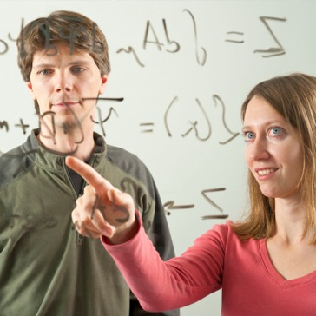
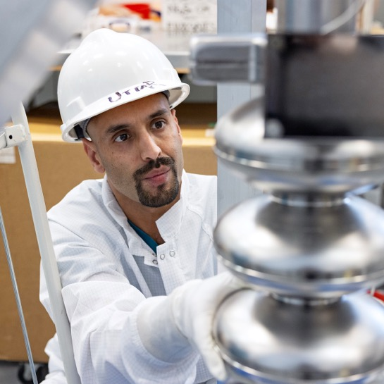
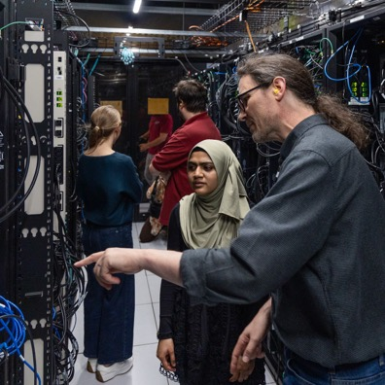


Welcome
Jefferson Lab’s 53rd Program Advisory Committee Meeting
Jens Dilling, Lab Director
21 July 2025

