Slide 1
FFA@CEBAF Permanent Magnet Resiliency in Real Radiation Environment
FY25 Q1 Update
Ryan Bodenstein
Team: Kirsten Deitrick, Edith Nissen, Randika Gamage
2025/01/21

Slide 2
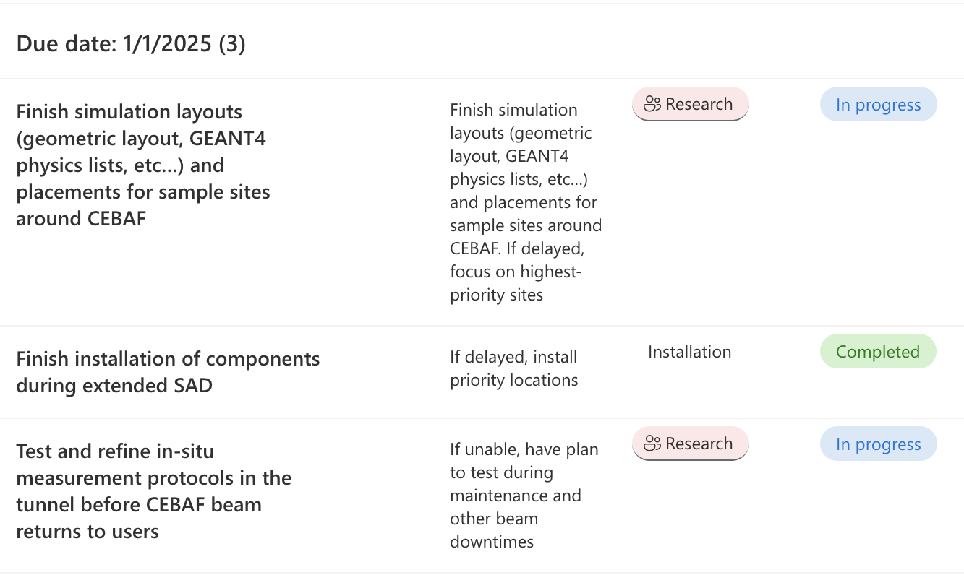
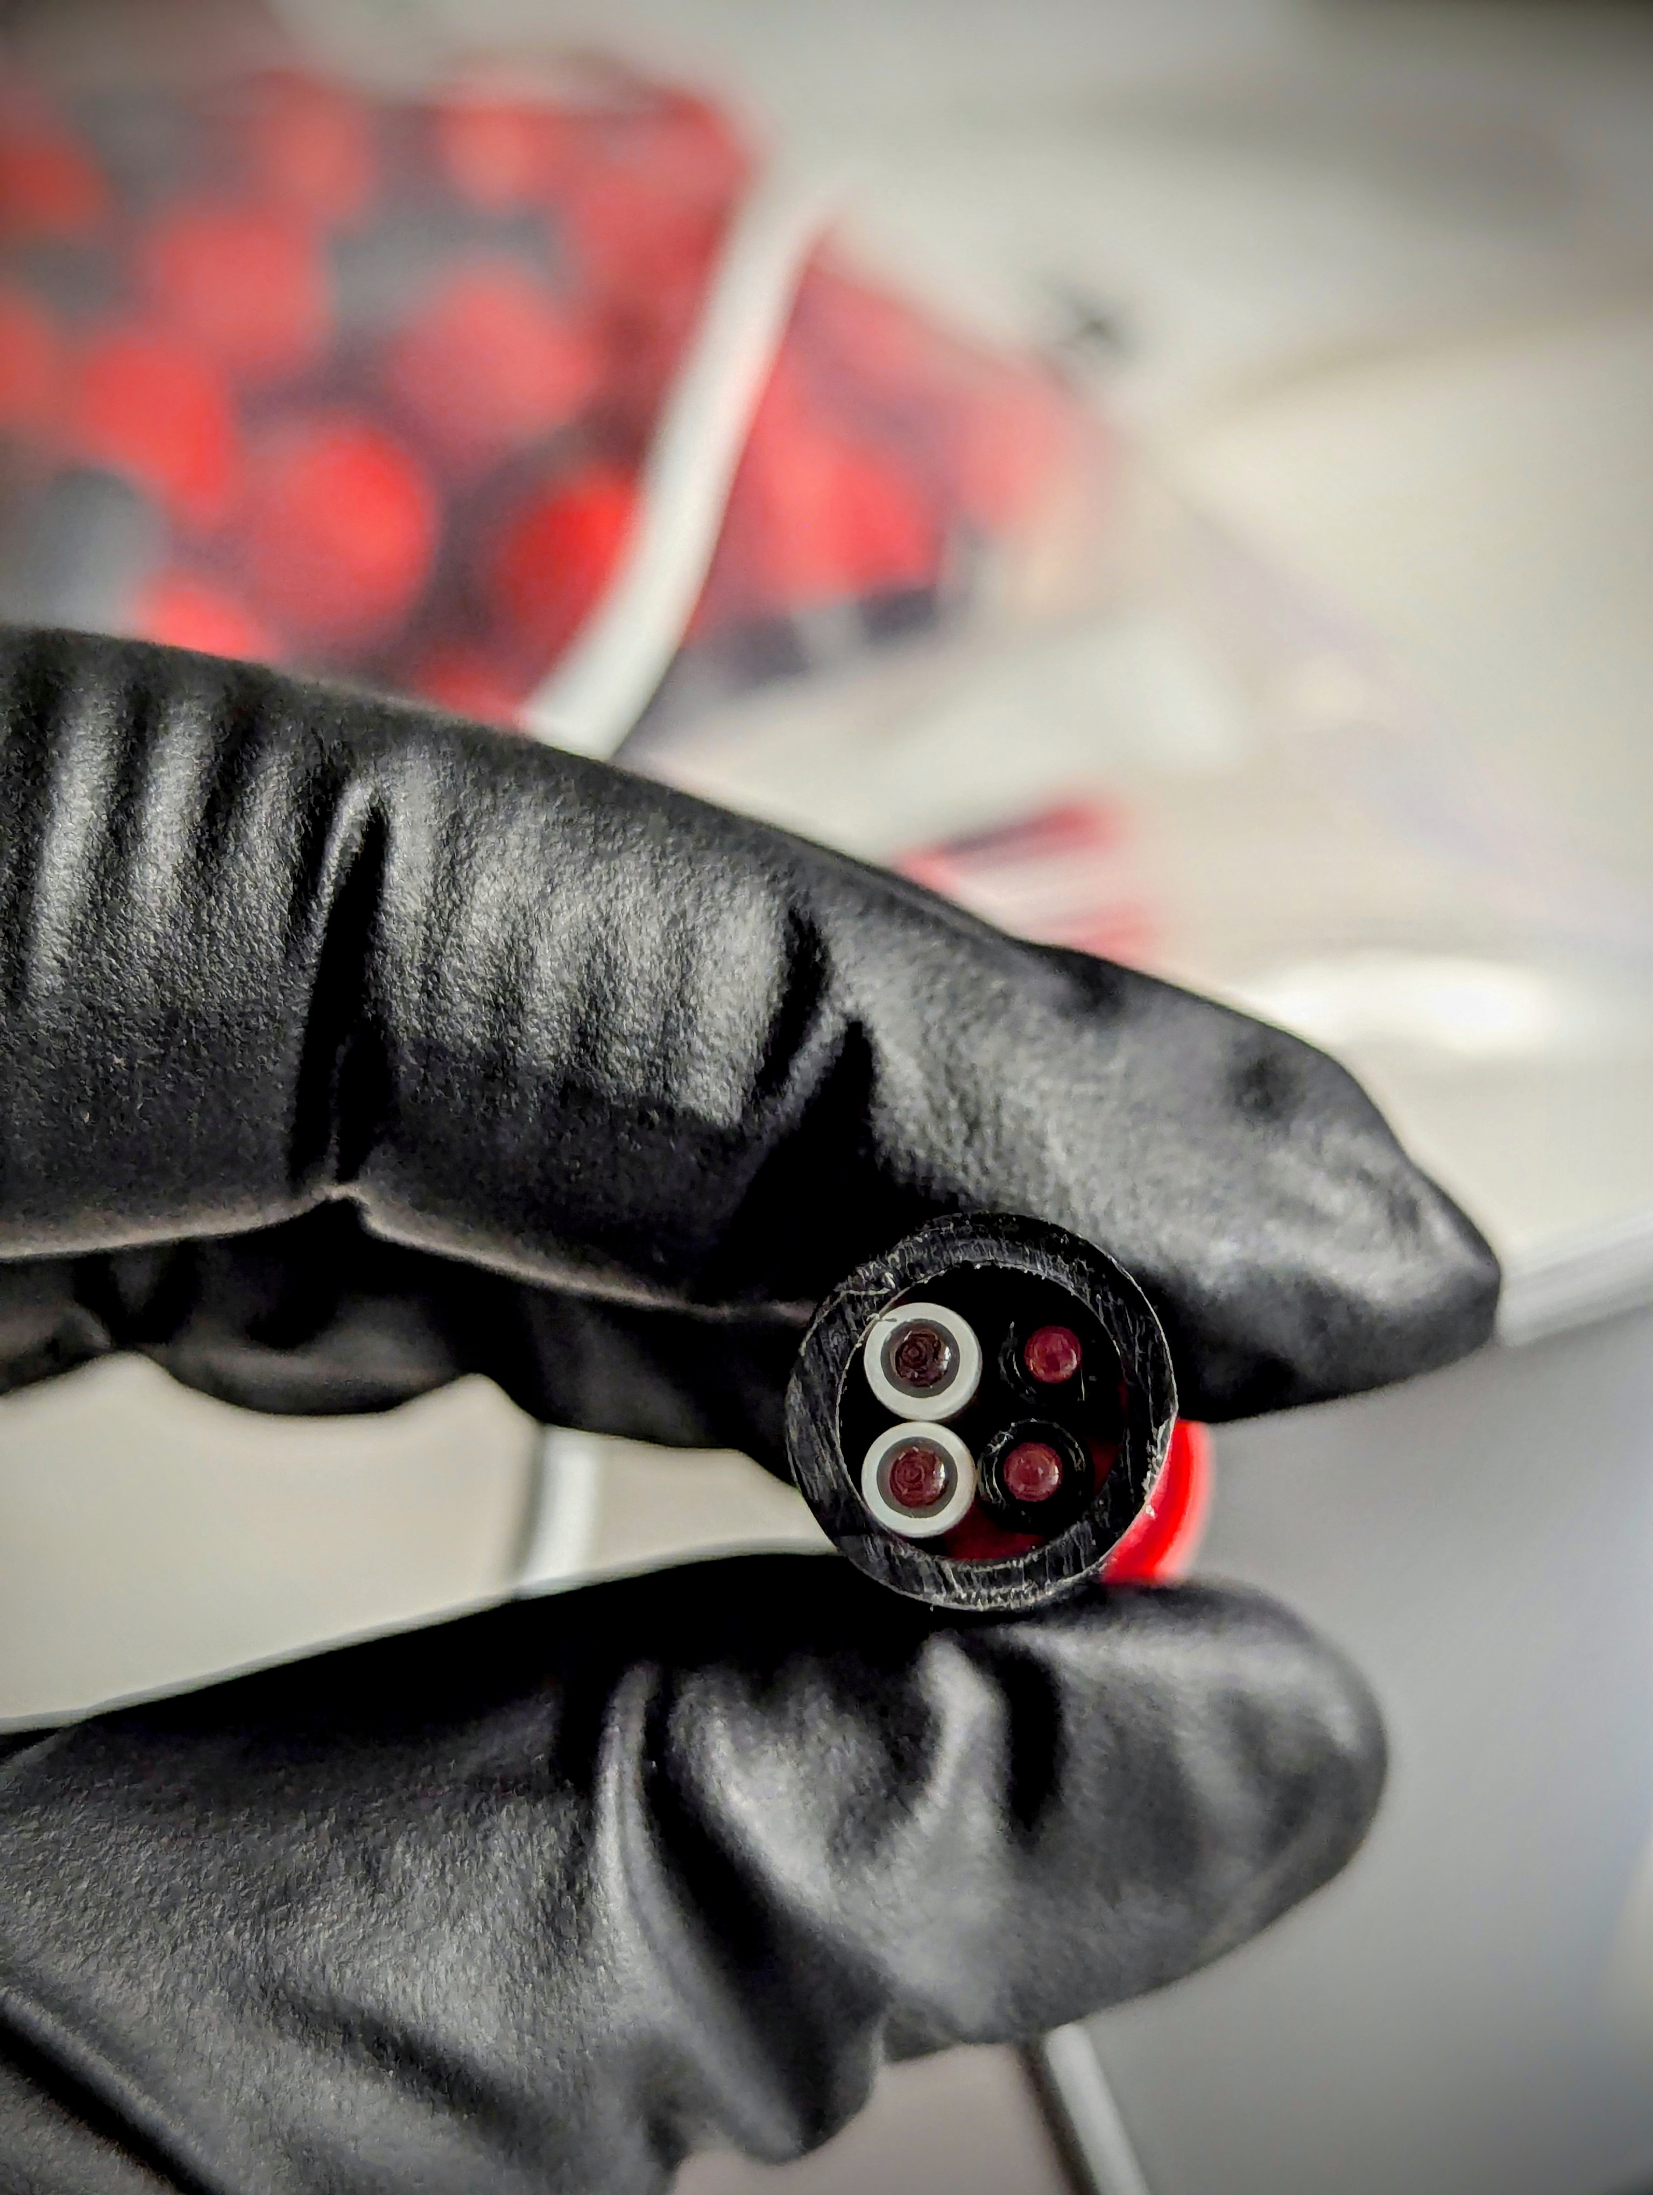
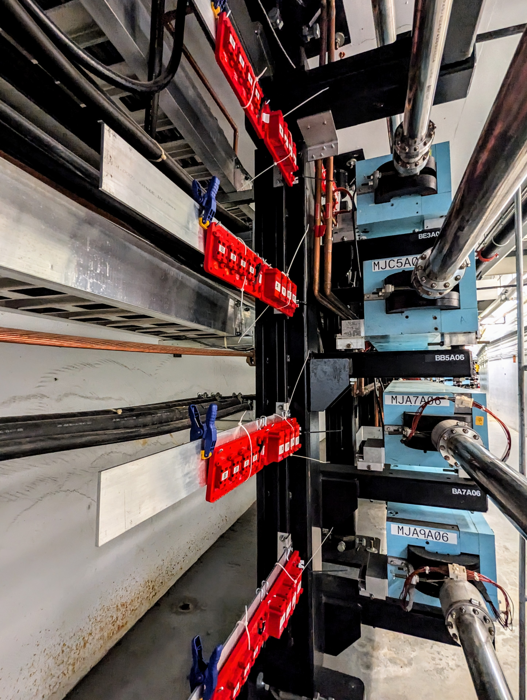
Path to Completion
Tracking quarterly milestones, documenting as we progress
Some delays due to late deliveries, work-pauses (and associated re-prioritizations), SAM schedule, complications with access/installations/data, etc…
Orders all placed, procurement slow
Samples installed in tunnel
Possible Delays
One investigator was “tied up” with visa delays – some work completed, but behind
Broken Hall probe
Frequent stand-downs and work pauses impacting work
Publication Outlook
Possible collab with Cockcroft Institute – talks ongoing
JLAAC Presentation?
Contributions to workshops/conferences (IPAC, FFA, etc…)
Journal papers:
Hoping for two: simulation work + full results

Slide 3
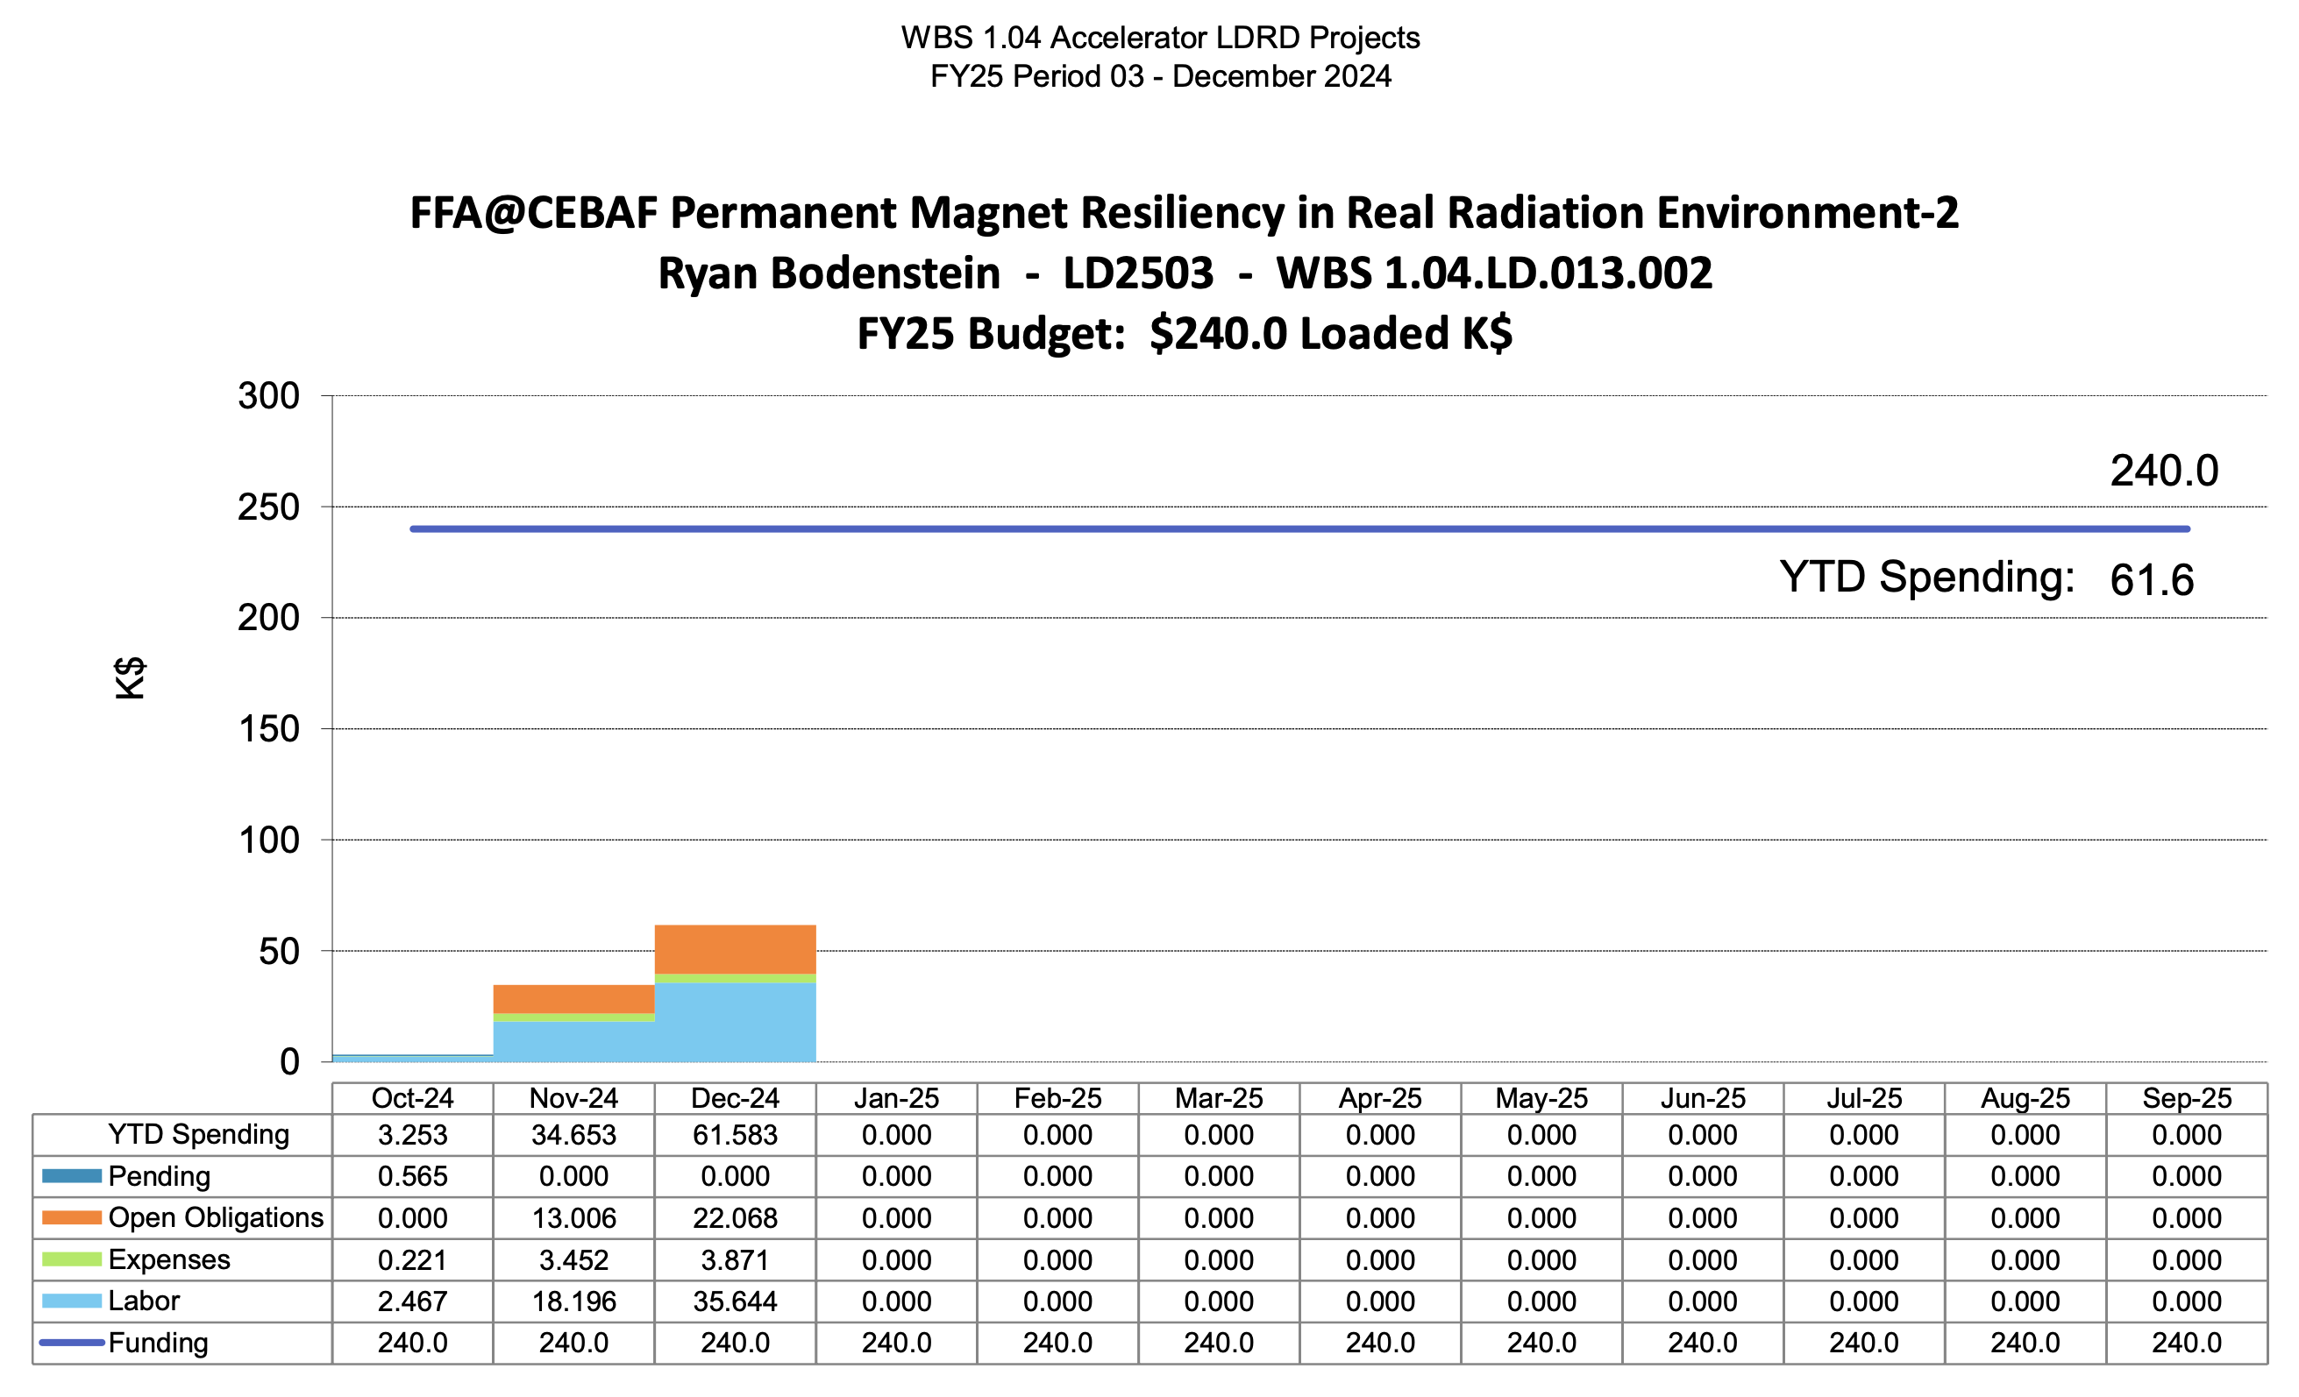
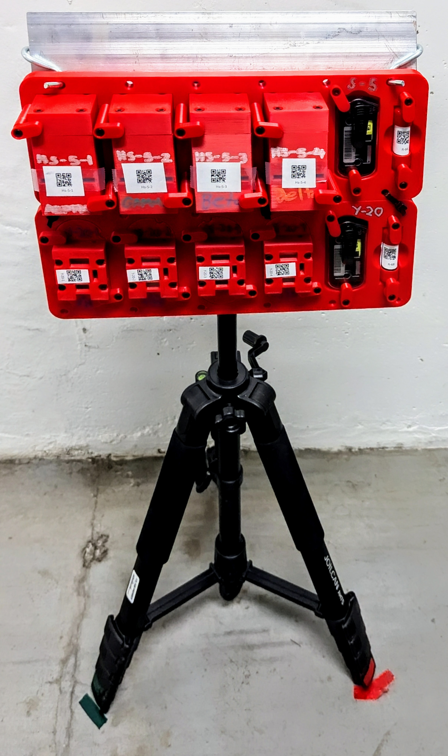
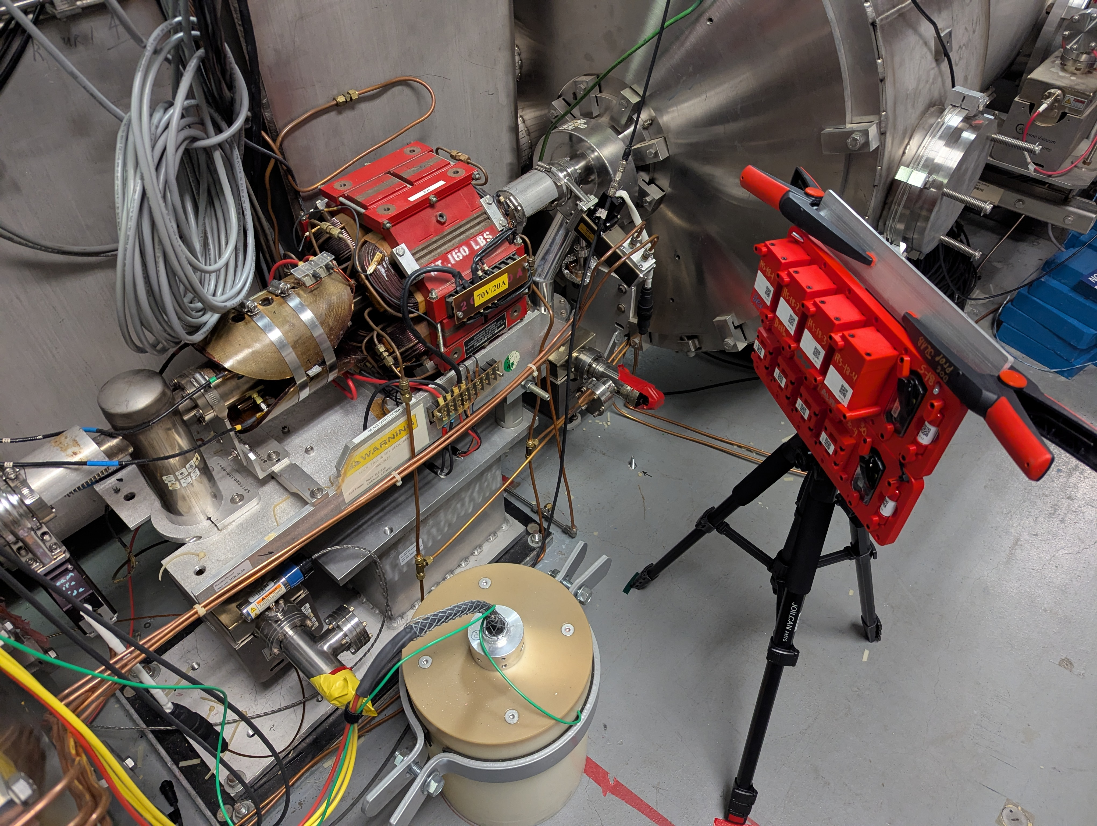
Q1 was challenging, but still making strong progress:
Simulations being re-prioritized:
Delays due to complications and personnel
Re-focusing efforts for integrated dose first, then will expand as needed
Hall probe broken
Temporary fix ongoing, ordered replacement
Delays persist from work pause, SAM, and late funding notification:
”Hired” operators to adjust and assemble magnets
Procurement slow, delayed arrival of equipment, such as dosimetry, replacement probe, etc…
Needed to use machine shop more than expected
Mount arms and adjusting Hall probe holder
2/3 of samples installed in tunnel
30 locations, two plates per site (instead of 3)
Now for the good:
Samples installed!
Dosimetry set
Talks of future collaboration with international scientists
Assemblies field-mapped, and simulations show lack of interaction with beam

