Slide 1
Update on High Q work at FNAL
A. Grassellino for the FNAL High Q group
TTC working group
26 Feb 2015

Slide 2
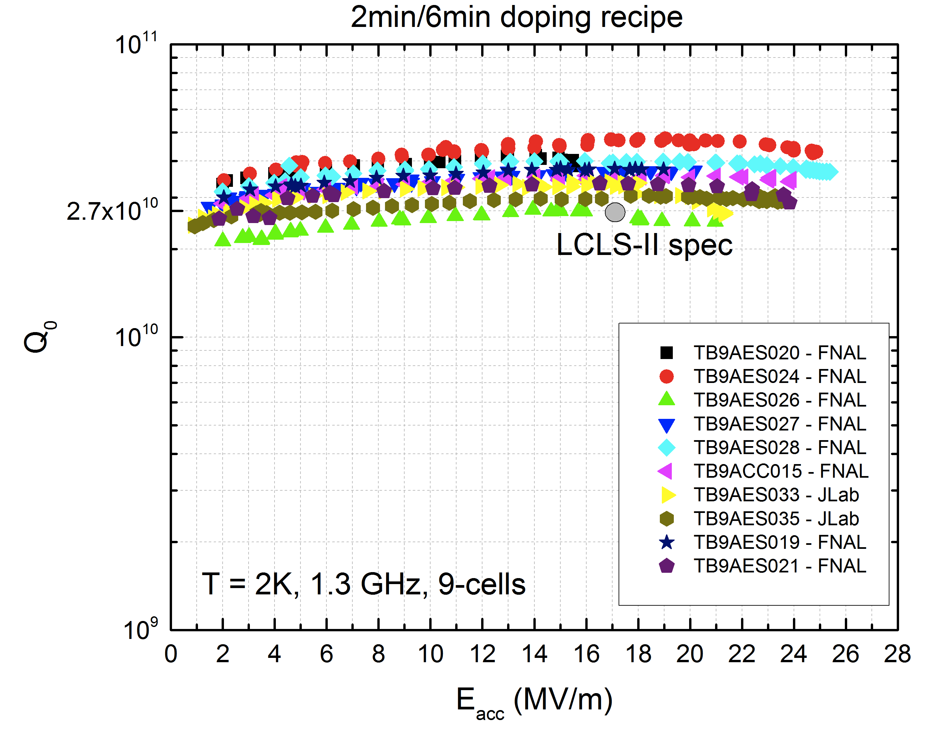
FNAL + Jlab Nine Cell 2.0K Results for LCLS-2, doping recipe 2/6

Slide 3
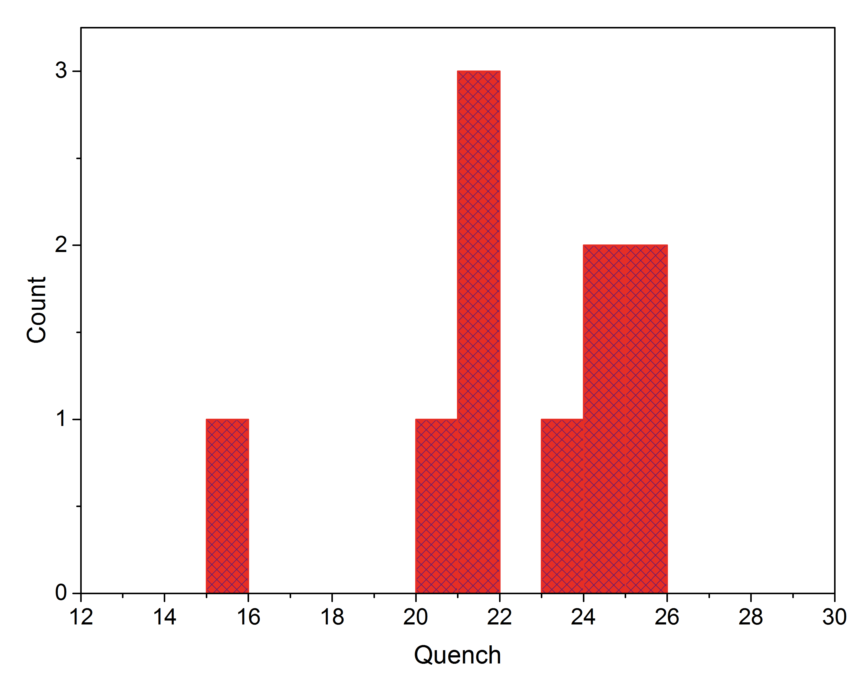
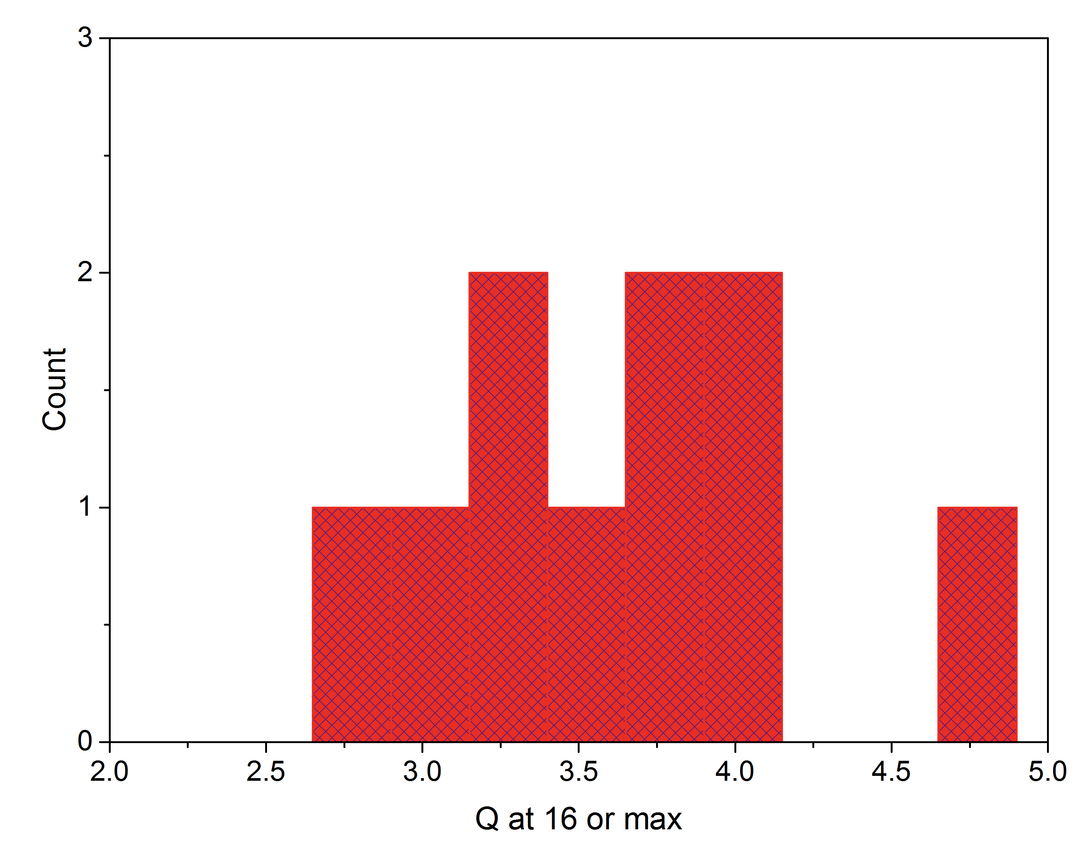
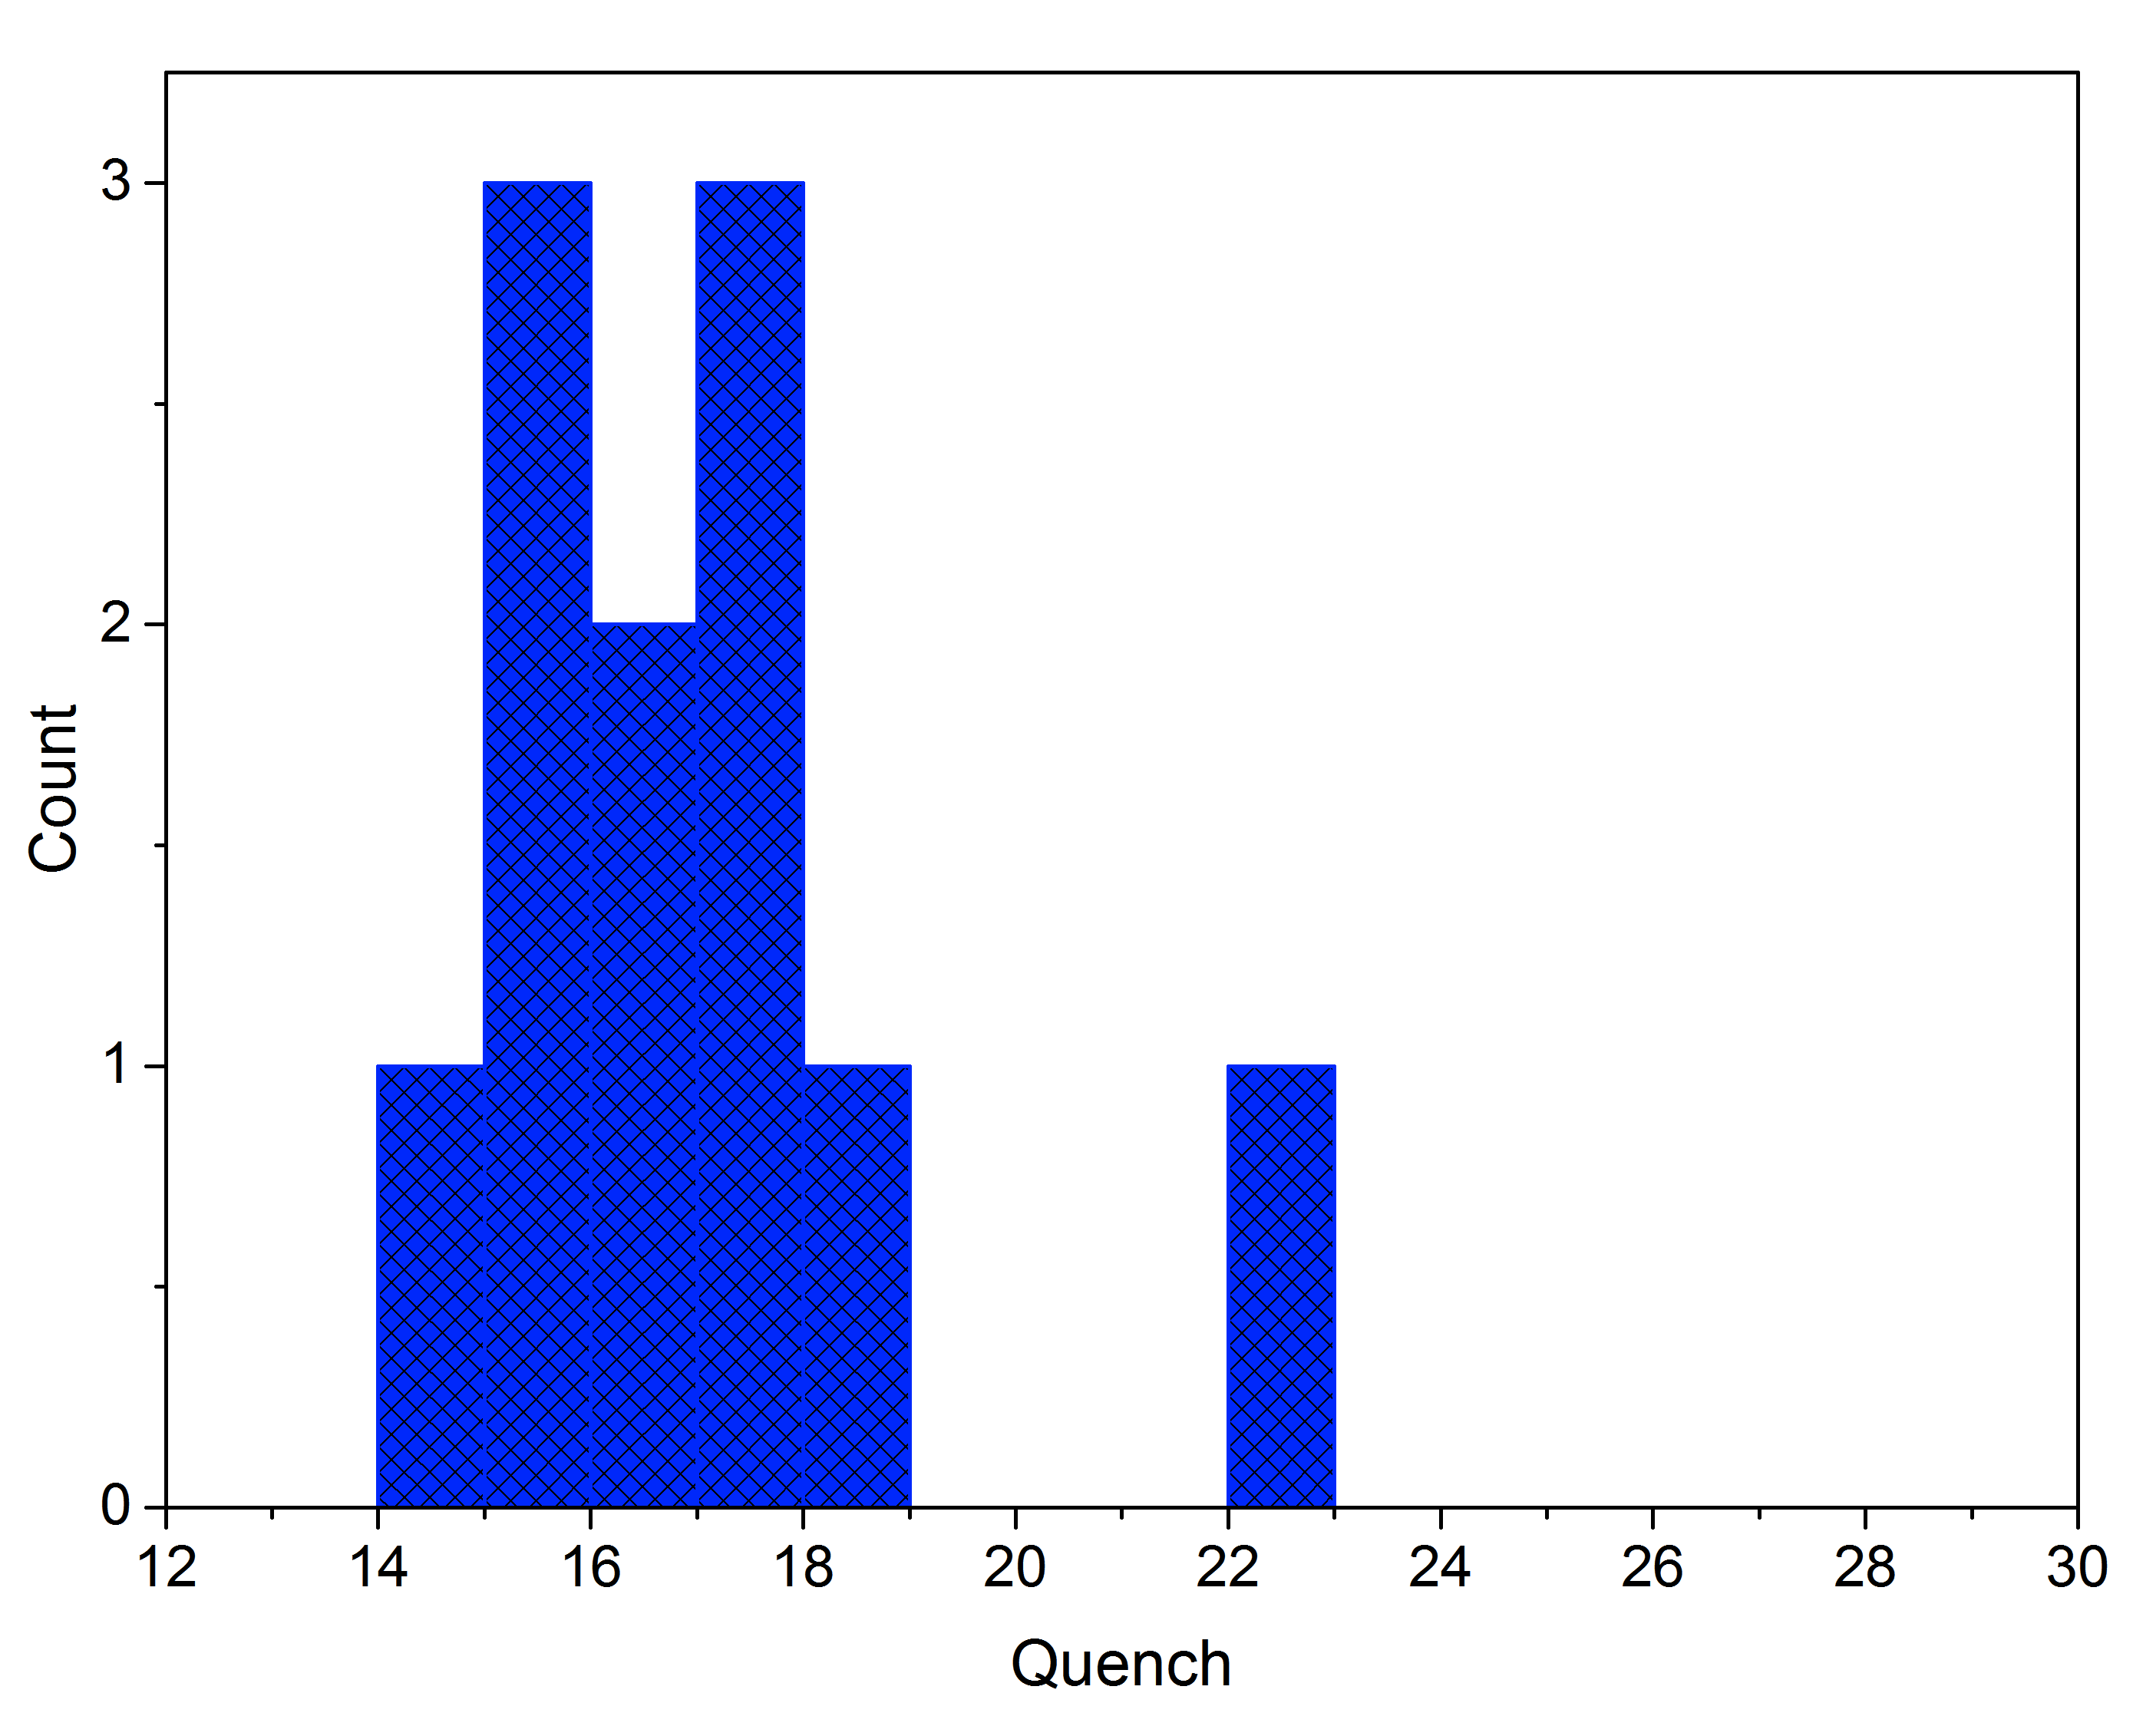
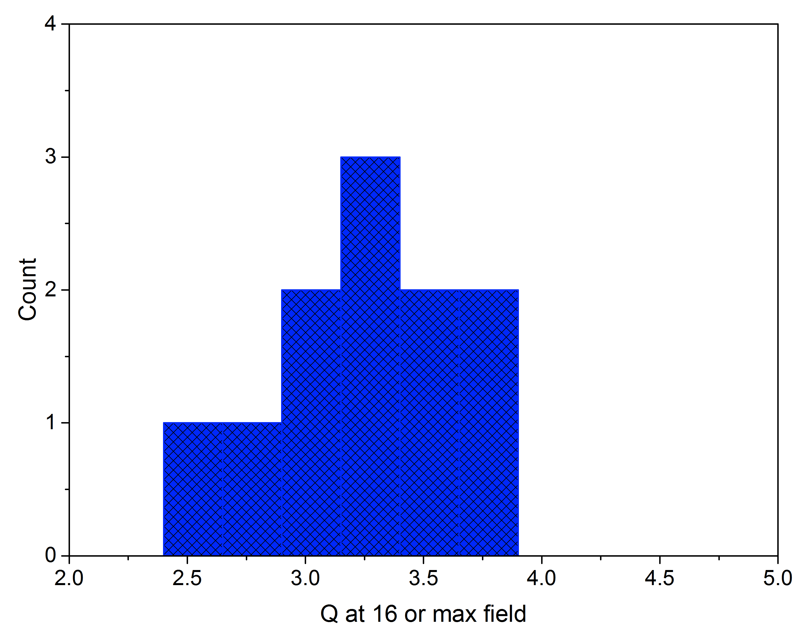
Q and quench field distribution for the two recipes
16 MV/m
2.7e10
Recipe 2/6
(FNAL/Jlab)
<Q>=3.6e10
<E_{max}>=22.2 MV/m
E_{max}median=22.8MV/m
Recipe 20/30
(Cornell/Jlab/FNAL)
<Q>=3.24e10
<E_{max}>=16.3 MV/m
E_{max}median=16.5MV/m

Slide 4
FNAL PROTOTYPE CRYOMODULE-status
 | First pass | Second pass | Q (2K, 16MV/m) | Quench [MV/m] | Status
TB9AES021 | OK |  | 3.35E10 | 24 | DRESSED – in HTS – completed –to VTS
TB9AES027 | OK |  | 3.6e10 | 21 | DRESSED – VTS, then HTS (this week)
TB9AES028 |  | OK | 4e10 | 25.5 | Lined up for dressing
TB9AES020 |  | Low quench | 4.1e10 | 15 | Optical inspection/replica
TB9AES024 | OK |  | 4.75e10 | 25 | Lined up for CM
TB9AES019 | OK |  | 3.75 | 20 | Lined up for CM
TB9ACC015 | OK | OK | 3.5e10 | 24 | Lined up for CM (needs transition rings)
TB9AES026 | OK |  | 2.75e10 | 21.5 | Lined up for CM

Slide 5
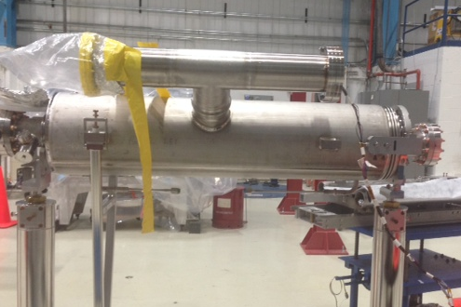
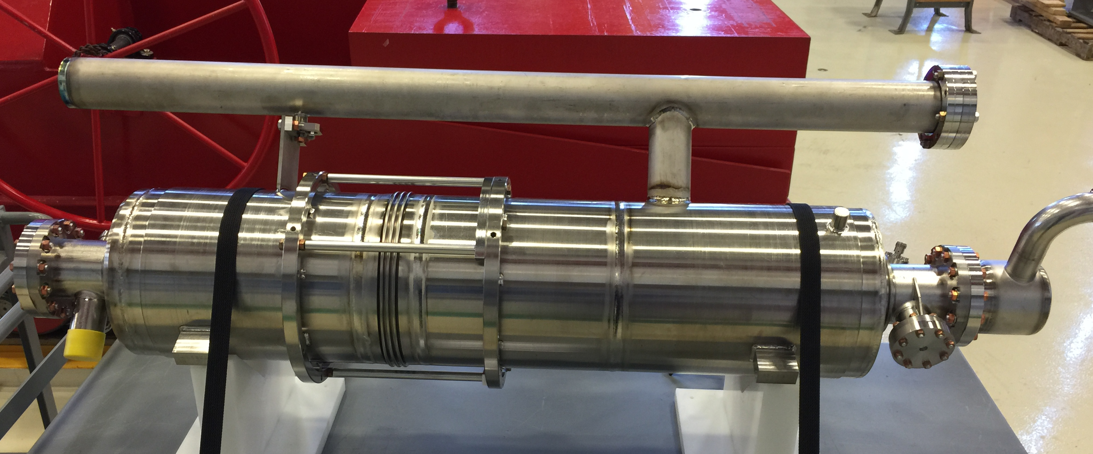
Cooling studies in ILC style vs LCLS-2 style vessel
Vessel was modified to create left-right cooling symmetry and have larger chimney for CW
Thermocurrent induced fields appear however larger with new LCLS-2 vessel! Despite perfect left-right symmetry
Yet, lowering the starting temperature where no thermocurrent induced fields are present, always worsens Q
ILC style
LCLS-2 style

Slide 6
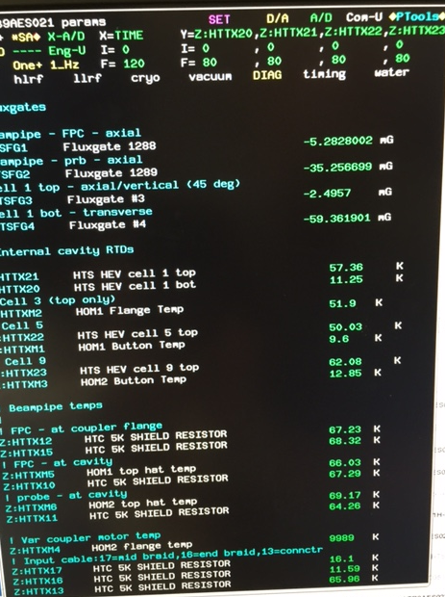
Large TC induced fields at cooldown despite perfect left-right cooling symmetry
No clear correlation with performance (see next slides)

Slide 7
TB9AES021 test completed
Cavity is now warming up and heading to VTS for cross-comparison of VTS-HTS performance ‘dressed’ – important for qualification purposes
Results: best Q = 2.3e10 at 16 MV/m, 2K, quench ~23 MV/m, for cooldown from >70K, worse Q ~ 1.9e10 for cooldown from 35K
  30% degradation from VT
  Residual resistance 3.5→6 nΩ, BCS resistance 4.5 →5.5 nΩ (in agreement with Cornell observations)
  1.7 nΩ difference to target Q = 2.7e10
  Q always improving with fast cooling from higher starting temperature
Latest test with one layer shield showed no difference from two shield configuration
Heating at top of cell 1 responsible for performance degradation – we attribute to ‘flux pile up’ at top of cell 1

Slide 8
Comparison from 60 and 100K cooldowns (T=2K)
Q
A. Grassellino et al, “Cooling Studies of N Doped Nine Cell Cav-
ities Dressed in Different Helium Jackets”, in preparation
Eacc [MV/m]

Slide 9
Comparison from 35, 60, 80, 100K cooldowns
Up to 100 mGauss TC induced fields
Q
No TC induced fields
Eacc [MV/m]

Slide 10
Q penalized by end cell; Q > 2.7e10 and rising with field in pi/9 mode

Slide 11
New paper on arxiv – evidence for equatorial heating in VTS and HTS via flux lines concentration
Now available at http://arxiv.org/abs/1502.07291

Slide 12
Mattia and Martina new paper – important findings and considerations

Slide 13
Mattia and Martina’s new paper – interesting discovery

Slide 14
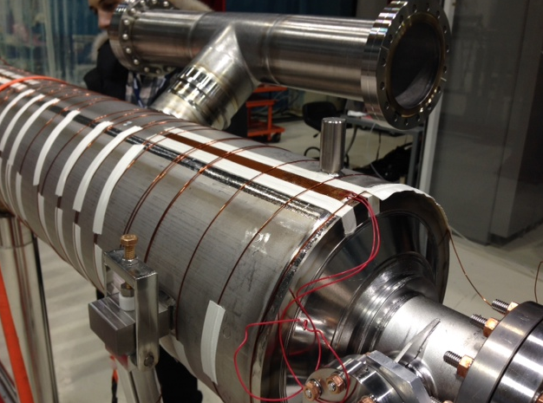
Hole in mag shielding above invar rod support

Slide 15
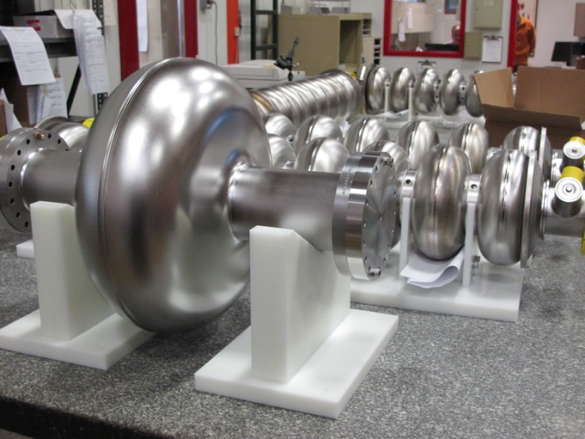
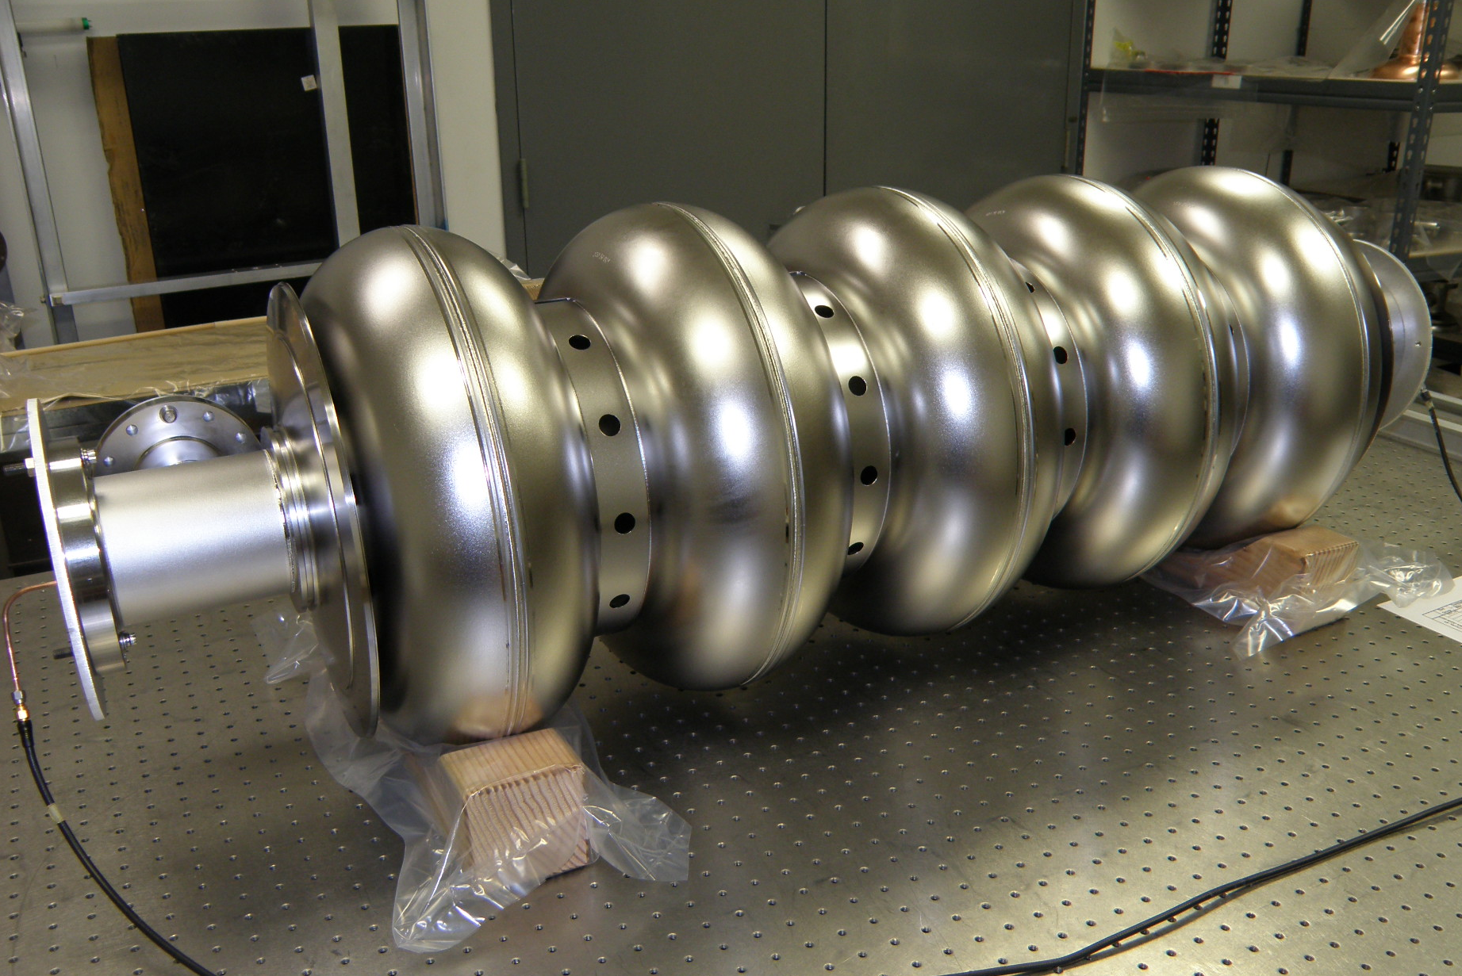
650 MHz (beta=0.9) cavities
Currently Available Cavities:
1-Cell 650 MHz
6 from AES
6 from PAVAC
5-Cell 650 MHz
4 from AES
5 from PAVAC

Slide 16
Integration of SRF R&D and PIP-II
First impact of high Q

Slide 17
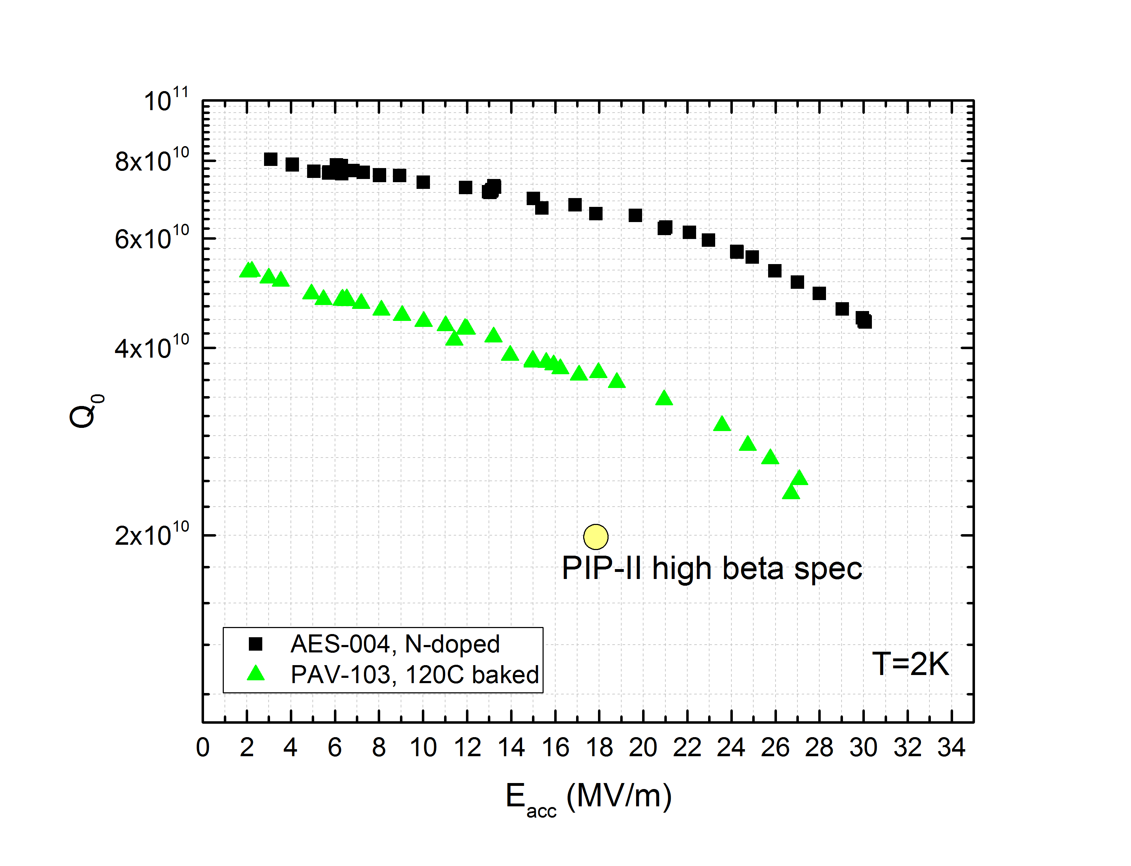
Results – highlights – 120C bake vs N doping – 7e10 at 2K, 17 MV/m – world record! Other useful applications eg FCC
Applying N doping to 650 MHz (beta=0.9) leads to Q far exceeding specs
High duty factor operation may be possible even with the existing (limited) capacity cryoplant
1-cell

Slide 18
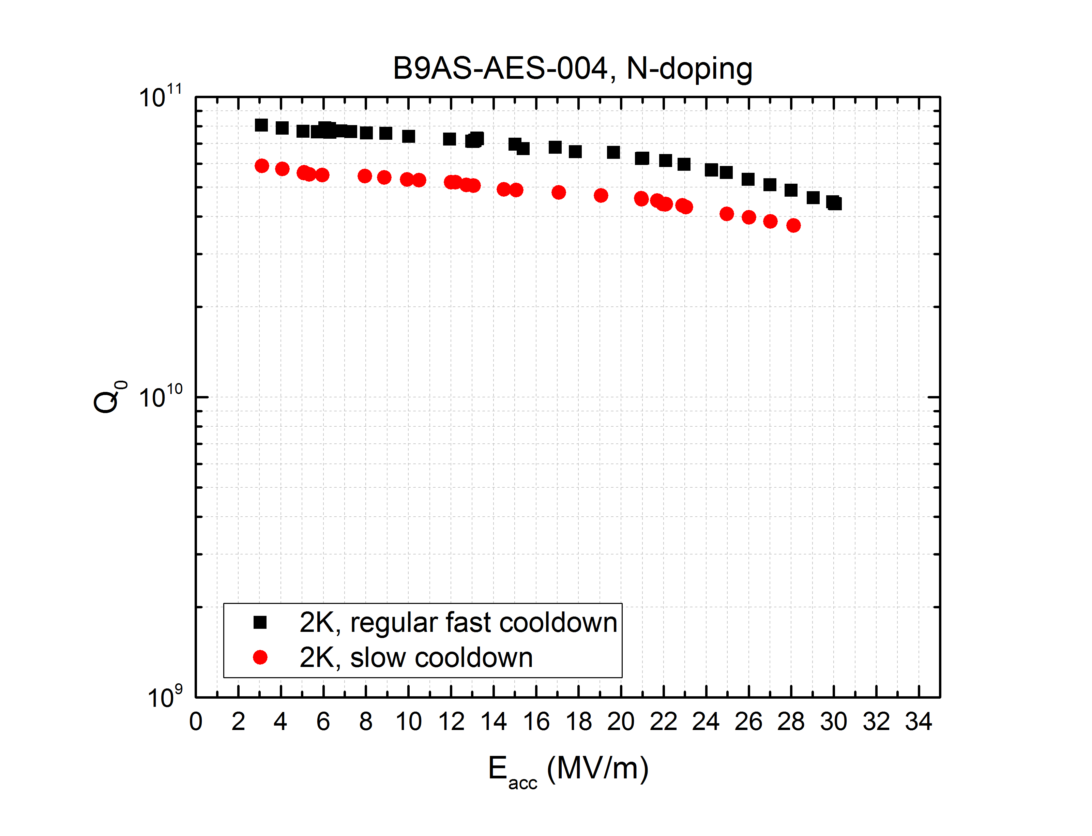
Results – cooling studies – fast vs slow cooling
Good news: 650 MHz cavities appear to be less sensitive to fast/slow cooldown impact on trapped flux
T=2K
Full cryomodule implementation of high Q cavities should be less challenging than for LCLS-II
1-cell

Slide 19
Last but not least….FNAL embarking in Nb3Sn effort
FNAL team now even stronger! Sam Posen has recently joined FNAL as Associate scientist
LDRD funded for Nb3Sn
Sam already at work on it!

