Slide 2
Nb films
Sergio Calatroni for the new CERN SRF & films team

Slide 3
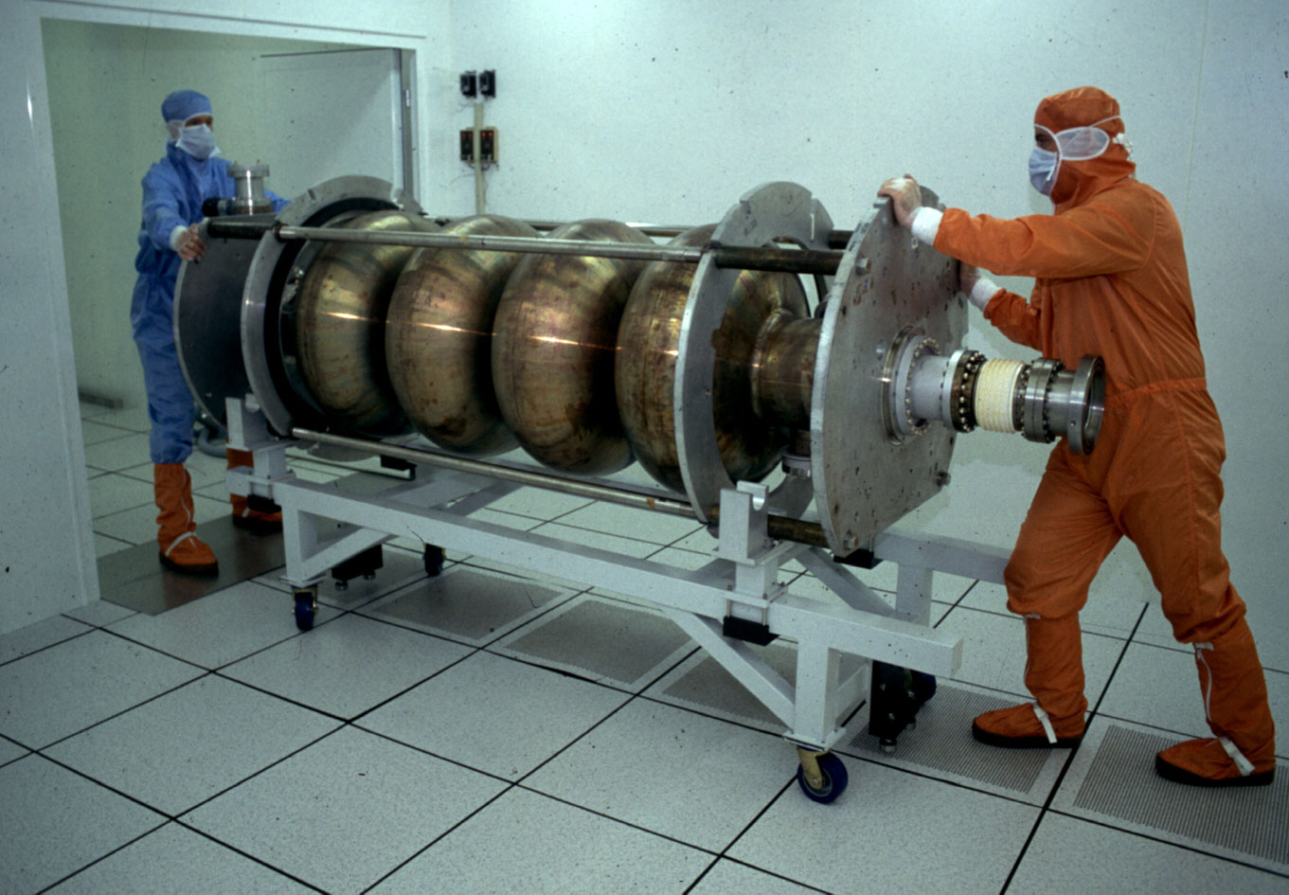
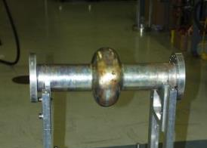
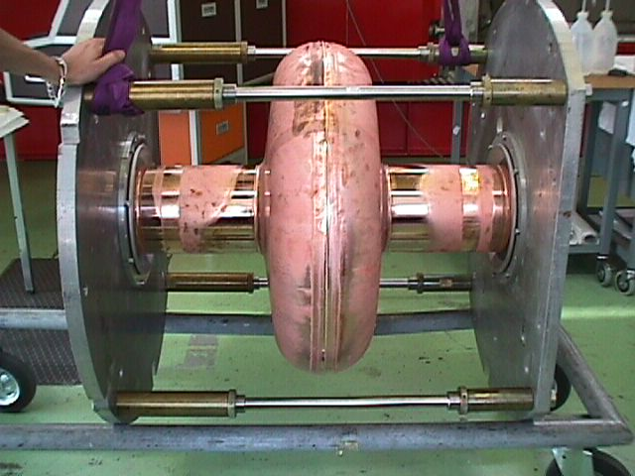
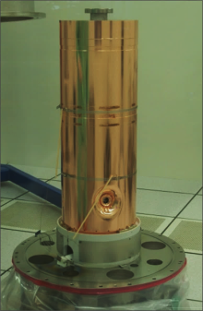
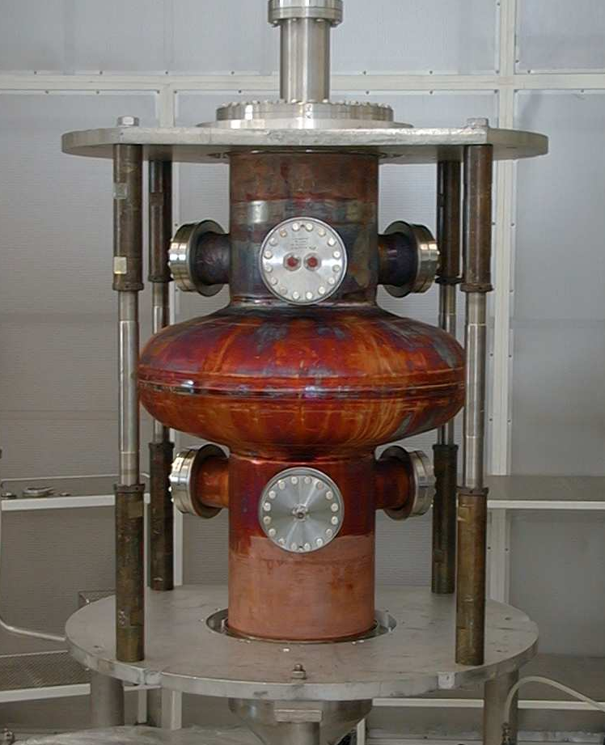
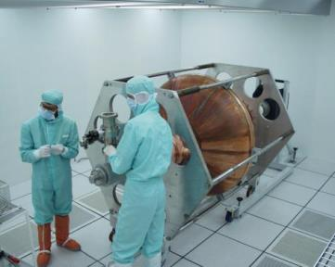
SC Nb coatings for RF cavities @ CERN
1.5 GHz
Low-β
LEP200
200 MHz
HIE-ISOLDE
LHC

Slide 4

A short history of Nb/Cu at CERN
LEP 200: 288 4-cell 352 MHz Nb/Cu cavities
LHC: 16 monocell 400 MHz Nb/Cu cavities
HIE-ISOLDE: 20 QWR 101 MHz Nb/Cu (phase 1+2)
R&D: 200 MHz, 400 MHz, 500 MHz, 1.3/1.5 GHz, β=1 elliptical and β= 0.48…0.85 elliptical, QPR resonator…
CERN activities in the field stopped circa 2000, and resumed a few years ago because of HIE-ISOLDE
This is known, and so what? Let’s see a few old slides

Slide 5
BCS resistance at zero RF field, 4.2 K, 1.5 GHz
900
R_{BCS} at 4.2 K
Nb bulk: ~900 nΩ
Nb films: ~400 nΩ
R_{BCS} at 1.7 K
Nb bulk: ~2.5 nΩ
Nb films: ~1.5 nΩ
850
Nb bulk
800
750
700
650
600
R_{BCS} (4.2K) [nΩ]
550
500
450
400
Mean free path measured by RF frequency shift.
350
1
2
5
10
20
1+πξ₀/2
Please! Do such measurement for Nb bulk for N₂ and like treatments!
Question: What would be the RF field dependent BCS for films (new measurement techniques unavailable 10 years ago)

Slide 6
Effect of external magnetic field
Losses due to trapped external magnetic field at 1.7 K R_{fl} = (R_{fl}⁰ + R_{fl}¹ H_{RF}) H_{ext}
The minimum values are obtained using Kr as sputter gas: R_{fl}⁰ = 3nΩ/G ; R_{fl}¹ = 0.4 nΩ/G/mT
Triangles: bulk Nb
Squares: coatings on oxide-free copper
Circles: coatings on oxidized copper
(a)
(b)
100
10
R_{fl}⁰[nΩ/G]
R_{fl}¹[nΩ/G/mT]
10
1
1
1+πξ₀/2
10
1
10
1+πξ₀/2
Note: This intrinsic values apply for full trapping, without fancy cool-down techniques for flux expulsion

Slide 7

High-Q, High field cavities
3 nOhm
Coatings performed using krypton
Fully EP (and EP only) substrates
Measurement at 1.7 K
Question:
Why can’t bulk niobium cavities be as good as coated ones ?
…. At low field….

Slide 8
Remainder of film properties
RRR (on quartz) : 27±4 (mfp = RRR * 2.7 nm)
H₂ content: ~0.1 % atomic (TDS on Cu, non-epi and epi)
Coating angle of incidence < 30 degrees
(best coating temperature 150 °C)
µ-SR measurements in agreement with RF-measured mfp
Things can be tricky, though (next: old slides again)
(on Cu) | non-epitaxial | epitaxial
RRR | 11.5 ± 0.1 | 28.9 ± 0.9
Tc | 9.51 ± 0.01 K | 9.27 ± 0.09 K
Grain size | 110 ± 20 nm | >1 µm
Orientation | (110) | (211)(200)(110)
Strain Δa⊥/a ⊥ | 0.636 ± 0.096 % | 0.466 ± 0.093 %
Much more data from JLAB, AASC,
…

Slide 9
Films as a bulk – Hydrogen becomes a problem!
~5 µm grain size, RRR ≅ 55
~1 µm grain size, RRR ≅ 28
0.1 µm grain size, RRR ≅ 11
There are more differences between these Nb/Cu films than those listed, this is just a basis for reflection
H₂ content is ~ 0.1 at. % for sputtered Nb/Cu films (in niobium bulk it is
0.02 at.%) and it is picked up from vacuum system during deposition.
A possible solution: high-temperature annealing, but it does not work with copper cavities. Proposal (L. Hand, W. Frisken): molybdenum cavities.

Slide 10
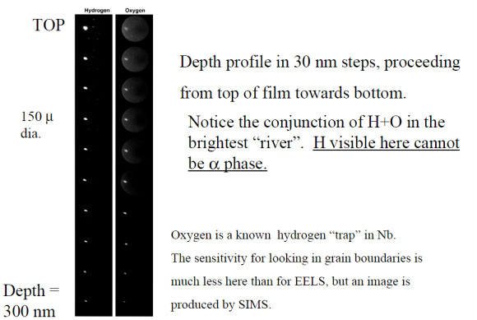
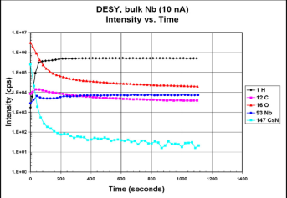
Film as a bulk – H₂ measurements
There are new results on measurements of H₂ content by measuring the lattice parameter and the total impurity content
See TuP16
From: L. Hand, Cornell U. – W. Frisken, York U.

Slide 11
The future
Time is ripe for restarting R&D
CERN management strongly supports this, also within FCC project
Focus on high-Q, not (only) high-field
We are reviewing internally our goals, resources, means and tools
Collaboration is the new mantra
Many possible items of study have been suggested
More can be discussed

Slide 12
R&D lines
Structure (film defects, Hc1 and so on)
  HIPIMS
  High-temperature treatments & coatings
  (Substrate preparation)
  ….
Hydrogen
  High-temperature treatments & coatings
  Doping ?
  ….
New materials
  Nb₃Sn by sputtering
  ….
Anything else?
  Please suggest and we may consider how to proceed

