Slide 1
JLAB CLAS12 SRO
Sergey Boyarinov, Ben Raydo
Feb 12, 2025

Slide 2
Hall B Streaming DAQ Diagram
Trigger Supervisor
TCP Servers
TCP Clients
250MHZ CLOCK, SYNCRESET
TRIGGER_IN, BUSY_OUT
Circular
Buffer
output thread
Event Builder1
EVIO file
Circular
Buffer
Event Builder2
EVIO file
TCP Clients
TCP Servers
output thread
FADC board
10GBit
input thread
Circular
Buffer
Circular
Buffer
Event Builder3
EVIO file
FADC board
output thread
FADC board
FADC board
input thread
Circular
Buffer
round-robin
Circular
Buffer
Event Builder4
EVIO file
FADC board
VTP-1
output thread
FADC board
Circular
Buffer
…………………
input thread
Circular
Buffer
Event Builder5
EVIO file
FADC board
output thread
FADC board
input thread
Circular
Buffer
EVIO file
…………………
…………………
…………………
Frame Routing Thread
Circular
Buffer
output thread
Event Builder6
DCRB board
input thread
Circular
Buffer
Circular
Buffer
Event Builder7
EVIO file
DCRB board
output thread
DCRB board
VTP-NN
Circular
Buffer
Event Builder8
EVIO file
DCRB board
input thread
Circular
Buffer
output thread
DCRB board
EVIO file
DCRB board
input thread
Circular
Buffer
Circular
Buffer
output thread
Event Builder9
DCRB board
input thread
Circular
Buffer
Event BuilderN
EVIO file
DCRB board
Circular
Buffer
output thread
VXS CRATES
FRAME ROUTERS (shown one, can be as many
as needed, all running using the same scheduler)
DATA PROCESSORS/
EVENT BUILDERS

Slide 3
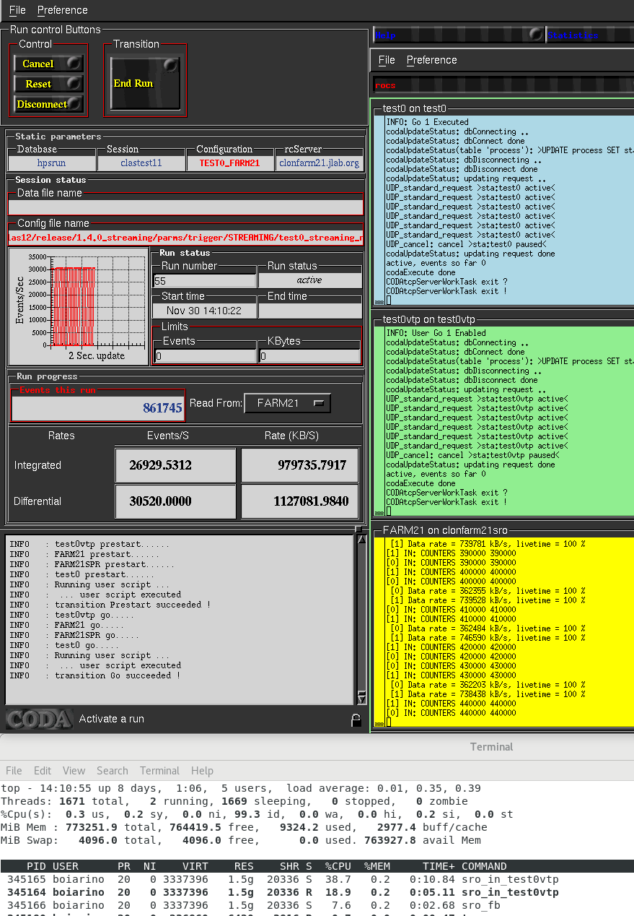
CPU usage on clonfarm21: FADC noise test, 2 streams
Performance tests are using
front-end noise, since it can
deliver much higher data rate
then real data. On that particular
machine, all threads are adequate
to stream data without any frame
losses
Component Data Rate CPU usage
(Mbyte/s) (per core)
--------------------------------------------------------
InputThread 360 19%
InputThread 740 38%
FrameRouter 1100 8%

Slide 4
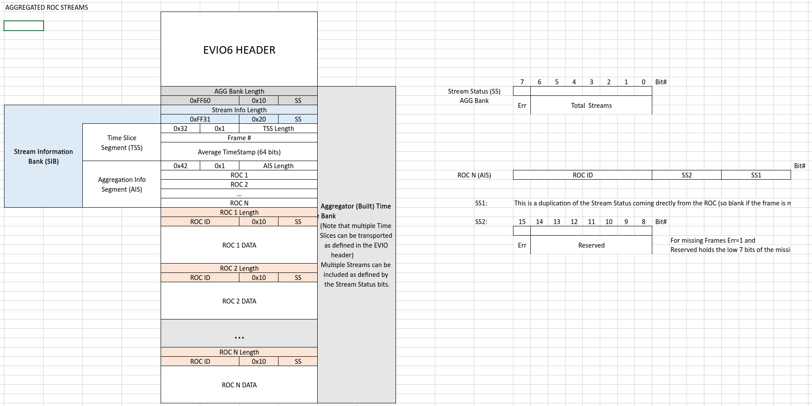
Streaming Data Format
Following is the streaming data format recommended by JLAB DAQ Group
(David Abbott / Carl Timmer). Hall B adopted that format for current development.
Shown data structure is suitable for raw streaming data only. In case of online data
processing, we will try to stick with existing data banks used in triggered daq operation.

Slide 5
CLAS12 streaming network/computing- current status
VTP (DC51)
VTP (FT1)
VTP (DC52)
VTP (FT2)
2x400GBit
Not used
VTP (DC53)
VTP (FT3)
Sector 5
VTP (ECAL)
Clonfarm21
RHEL9 server
128 core
768G mem
VTP (PCAL)
VTP (FTOF)
10GBit
to CLAS12
network
VTP (ECAL)
200GBit
Arista 7050 switch
10/25/40/50/100G
28 ports for VTPs
2x10GBit
TCP/IP Links
Sector 3
VTP (PCAL)
VTP (FTOF)
2x100GBit to Computer Center
VTP (ECAL)
VTP (PCAL)
18 crates are currently connected to streaming daq: ECAL/PCAL/FTOF/LTCC from 3 sectors, DC from 2 sectors, and FT. It allows to develop data processing components using realistic cosmic and beam data. Performance tests can be performed with overall bandwidth up to 36x10GBit/sec
Sector 2
VTP (FTOF)
VTP (DC21)
VTP (DC22)
VTP (DC23)

Slide 6
CLAS12 streaming network/computing- plan for 2025
VTP (DC61)
VTP (FT1)
100GBit to CLAS12 network
VTP (DC62)
Every VTP
has 2x10GBit
TCP/IP Links
VTP (FT2)
Sec6
VTP (DC63)
VTP (FT3)
VTP (ECAL1)
VTP (PCAL1)
VTP (FTOF1)
Clonfarm21
RHEL9 server
128 core
768G mem
Clondaq2
RHEL9 server
32 core
386G mem
107T SSD
Sec5
Arista 7050CX3 switch
40/100G 32 ports
2x400GBit
Sec4
4x100GBit
Sec3
200GBit
Arista 7050DX4 switch
40/100/400G 32 ports
Sec2
2x400GBit to Computer Center
VTP (ECAL1)
VTP (PCAL1)
39 crates will be connected to streaming daq: ECAL/PCAL/FTOF/LTCC from 6 sectors, DC from 6 sectors, and FT. Performance tests can be performed with overall bandwidth up to 78x10GBit/sec – more then 50GByte/s expected for entire CLAS12 in streaming mode
Sec1
VTP (FTOF1)
VTP (DC11)
VTP (DC12)
VTP (DC13)

Slide 7
Conclusion
CLAS12 operates using triggered DAQ with typical event rate up to 30kHz, and will continue to operate same way through high luminosity upgrade, reaching event rate up to 100kHz
In the same time, CLAS12 readout system being upgraded and eventually will become fully compatible with streaming DAQ mode
Data processing solutions for the future streaming operation being developed and tested as part of current operation

